Slide 1
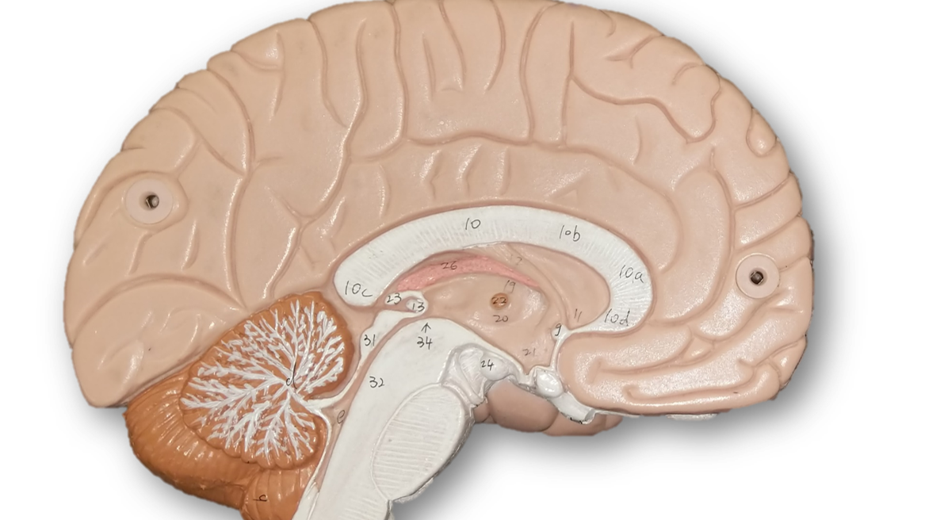
Quiz #4
Human anatomy

Slide 2
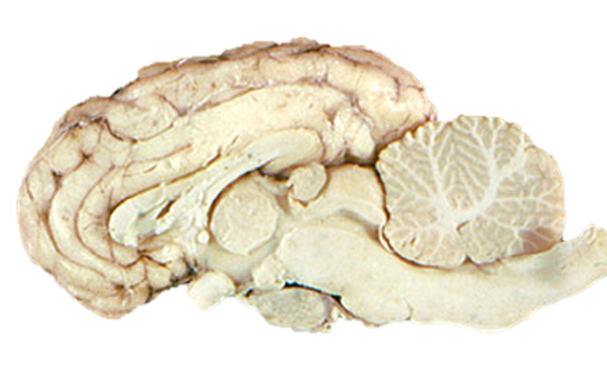
Identify the Structure
Question #1

Slide 3
Identify the Structure
Question #2

Slide 4
Identify the Structure
Question #3

Slide 5
Identify the Structure
Question #4

Slide 6
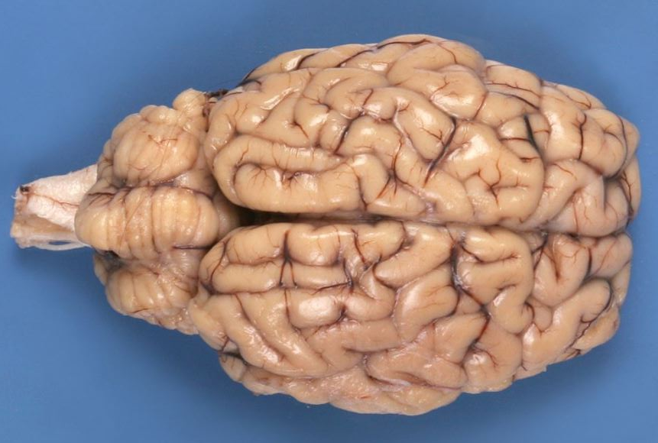
Identify the Structure
Question #5

Slide 7
Identify the FISSURE
Question #6

Slide 8
Identify the LOBE
Question #7

Slide 9
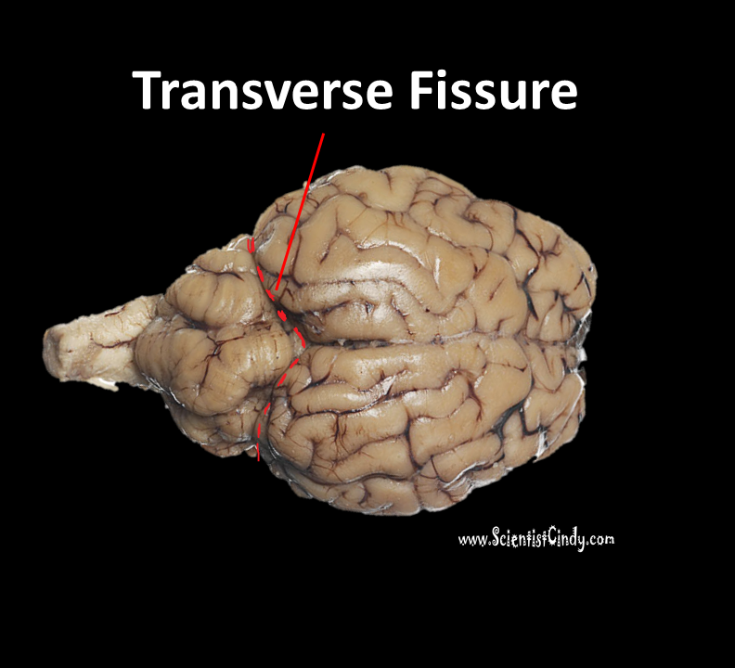
Identify the FISSURE
Question #8

Slide 10
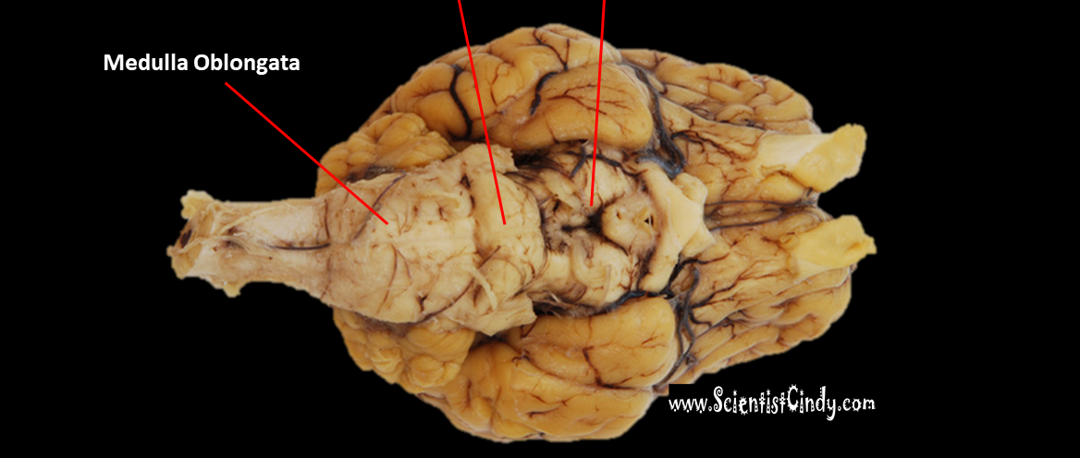
Identify the STRUCTURE
Question #9
???????????

Slide 11
Identify the STRUCTURE
Question #10
???????????

