Slide 1
Sensory Physiology
Chapter 10

Slide 4
Proprioception
Proprioception is defined as the awareness of…
Body movement in space
Body’s position in space
Proprioception is sensed by specialized sensory receptors in the muscles and joints called proprioceptors.

Slide 5
Receptors can be divided into four major groups
Receptors can be divided into four major groups, based on the type of stimulus to which they are most sensitive.
Chemoreceptors respond to chemical ligands that bind to the receptor (taste and smell, for example).
Mechanoreceptors respond to various forms of mechanical energy, including pressure, vibration, gravity, acceleration, and sound (hearing, for example).
Thermoreceptors respond to temperature.
Photoreceptors for vision respond to light.

Slide 7
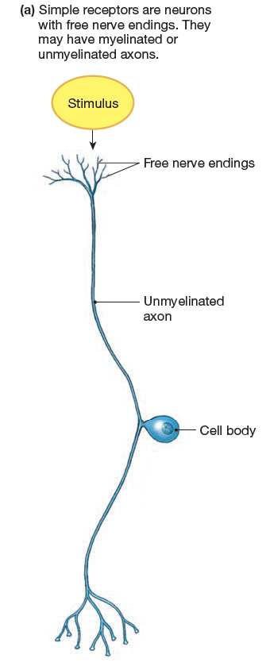
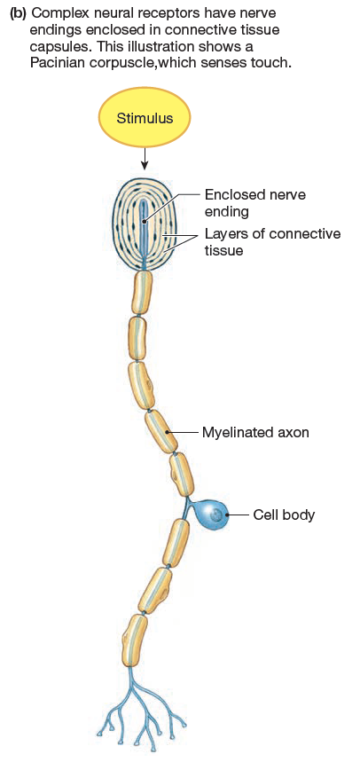
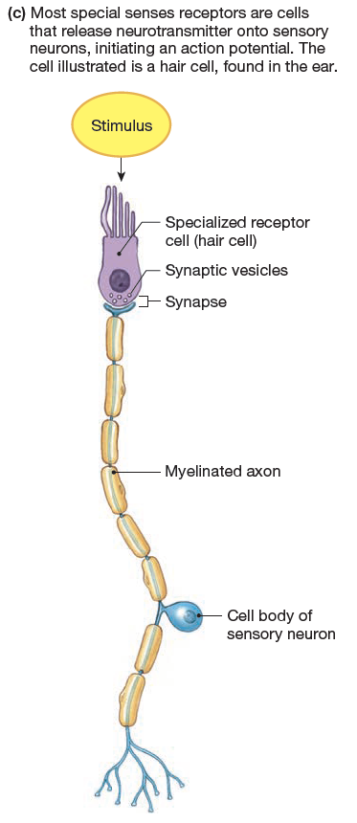

Slide 8
Sensory Transduction Converts Stimuli into Graded Potentials
Transduction - Sensory receptors convert physical stimuli, such as light or heat, into electrical signals.
The minimum amount/strength of a stimulus required to activate a receptor is known as the threshold.

Slide 9
The CNS Integrates Sensory Information
Sensory information from much of the body enters the spinal cord and travels through ascending pathways to the brain.
Some sensory information goes directly into the brain stem via the cranial nerves.
Sensory information that initiates visceral reflexes is integrated in the brain stem or spinal cord and usually does not reach conscious perception.

Slide 10
perceptual threshold
Perceptual threshold is the level of stimulus intensity necessary for you to be aware of a particular sensation.
Your brain tends to filter out and ignore some stimuli.
habituation – the decreased perception of a stimulus
This is accomplished by inhibitory modulation – this diminishes a suprathreshold stimulus until it is below the perceptual threshold.

Slide 11
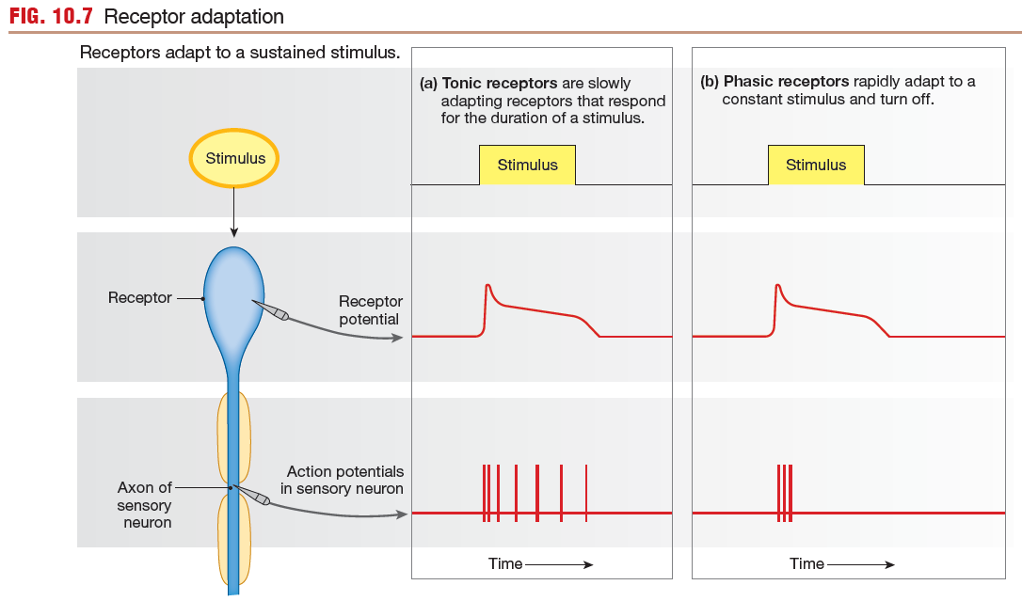

Slide 12
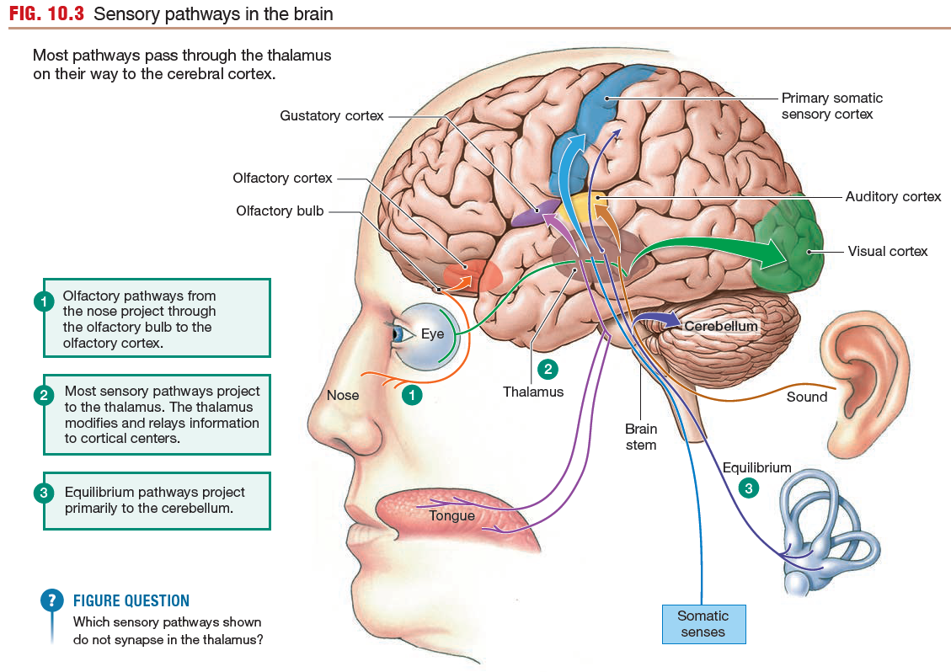
Sensory Pathways

Slide 13
The CNS must distinguish 4 properties of a stimulus
The CNS must distinguish four properties of a stimulus:
Modality
Location
Intensity
Duration

Slide 14
Sensory Modality
The modality of a stimulus is indicated by which sensory neurons are activated and by where the pathways of the activated neurons terminate in the brain.
Each receptor type is most sensitive to a particular modality of stimulus.

Slide 15
Location of the Stimulus
The location of a stimulus is coded according to which receptive fields are activated.
The sensory regions of the cerebrum are highly organized with respect to incoming signals, and input from adjacent sensory receptors is processed in adjacent regions of the cortex.
This arrangement preserves the topographical organization of receptors on the skin, eye, or other regions in the processing centers of the brain.

Slide 16
Intensity of the Stimulus
The intensity of a stimulus cannot be directly calculated from a single sensory neuron action potential because a single action potential is “all-or-none.” Instead, stimulus intensity is coded in two types of information: the number of receptors activated and the frequency of action potentials coming from those receptors, called frequency coding.
As a stimulus increases in intensity, additional receptors are activated.
As stimulus intensity increases, the receptor potential amplitude (strength) increases in proportion, and the frequency of action potentials in the primary sensory neuron increases, up to a maximum rate.

Slide 17
Duration of the Stimulus
The duration of a stimulus is coded by the duration of action potentials in the sensory neuron.
In general, a longer stimulus generates a longer series of action potentials in the primary sensory neuron.
However, if a stimulus persists, some receptors adapt, or cease to respond.

Slide 18
Receptor Response to continuous stimulation
Receptors fall into one of two classes, depending on how they adapt to continuous stimulation.
Tonic receptors are slowly adapting receptors that fire rapidly when first activated, then slow and maintain their firing

Slide 19
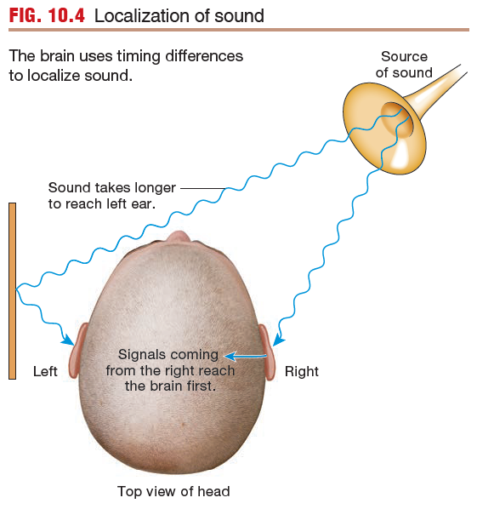

Slide 20
Specificity of Sensory Pathways
Each receptor is most sensitive to a particular type of stimulus.
A stimulus above threshold initiates action potentials in a sensory neuron that projects to the CNS.
Stimulus intensity and duration are coded in the pattern of action potentials reaching the CNS.
Stimulus location and modality are coded according to which receptors are activated.
Each sensory pathway projects to a specific region of the cerebral cortex dedicated to a particular receptive field. The brain can then tell the origin of each incoming signal.

Slide 21
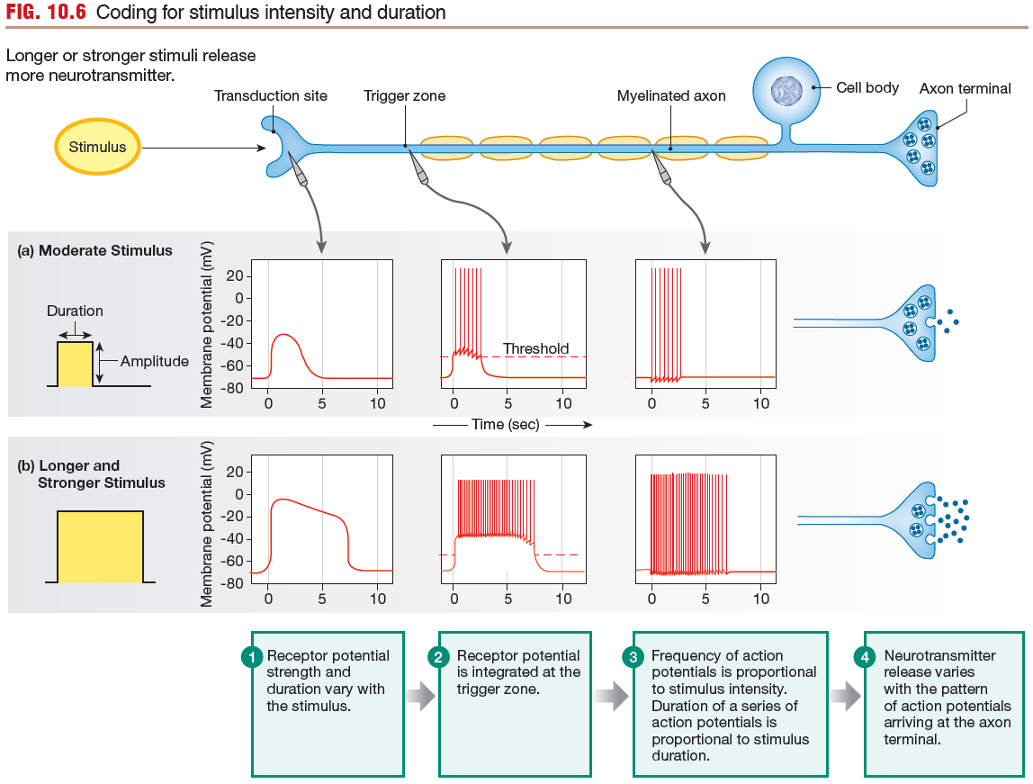

Slide 22
4 Somatosensory Modalities
There are four somatosensory modalities:
Touch
Proprioception
Temperature
Nociception (pain and itch)

Slide 23
Pathways for Somatic Perception
Pathways for Somatic Perception Project to the Cortex and Cerebellum
Receptors for the somatic senses are found both in the skin and in the viscera.
Receptor activation triggers action potentials in the associated primary sensory neuron.

Slide 24
Pathways for Somatic Perception
Primary sensory neurons in the peripheral nervous system are pseudounipolar neurons whose nerve cell bodies lie in the dorsal root ganglia alongside the spinal cord.
Their axon terminals synapse in the CNS onto interneurons that serve as the secondary sensory neurons.

Slide 26
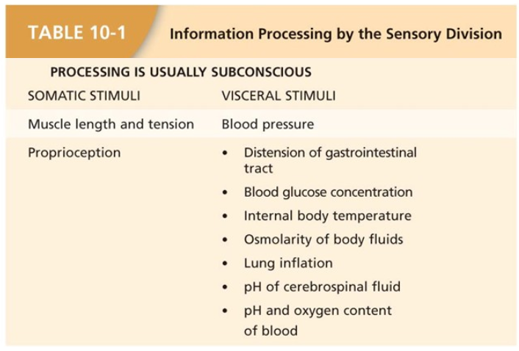

Slide 29
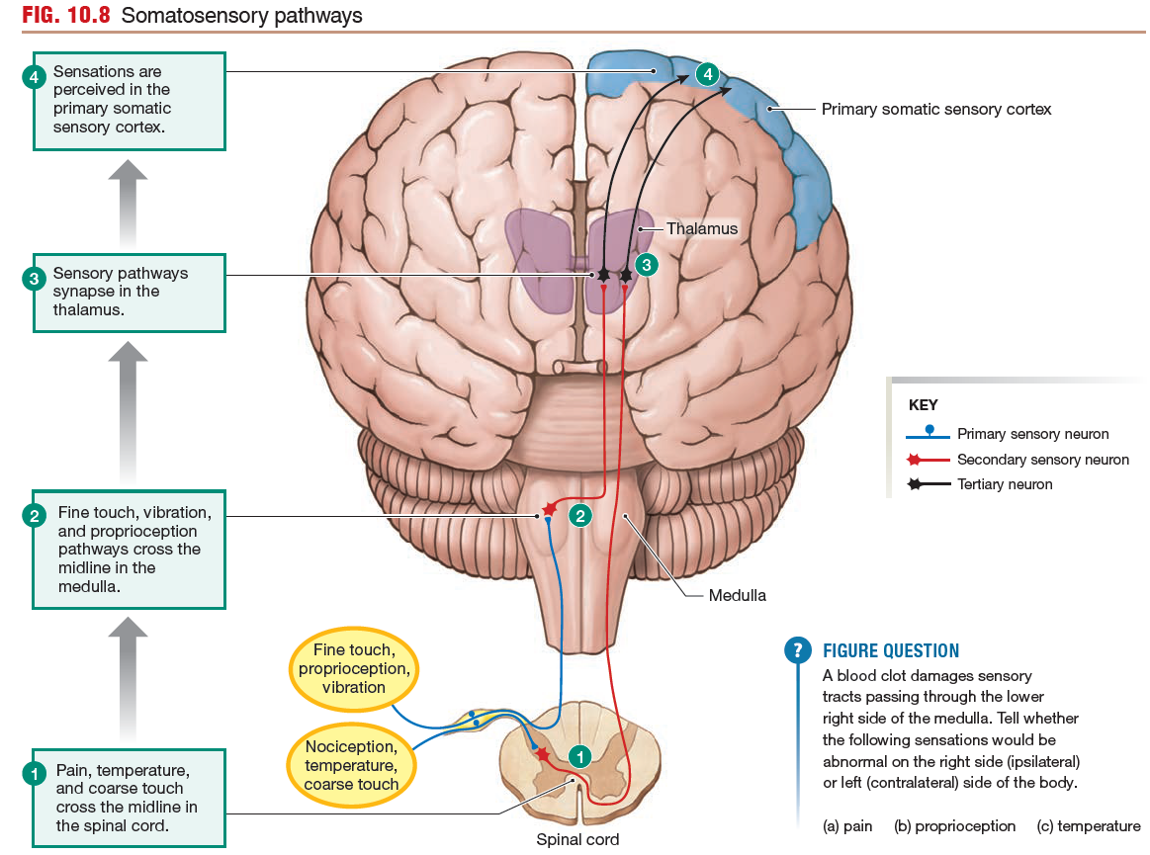

Slide 30
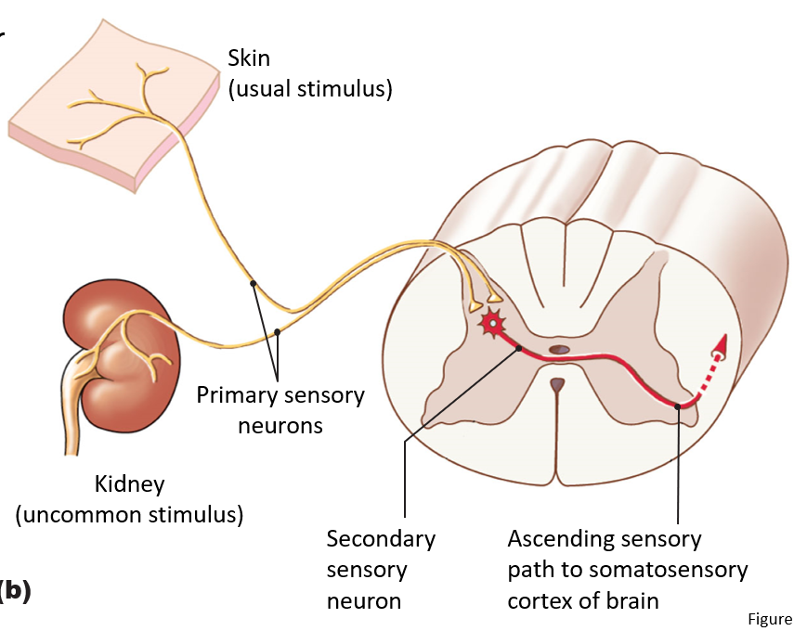
Sensory Receptors are known as Primary Sensory Neurons

Slide 31
Primary and Secondary Neurons
Neurons associated with receptors for nociception, temperature, and coarse touch synapse onto their secondary neurons shortly after entering the spinal cord.
In contrast, most fine touch, vibration, and proprioceptive neurons have very long axons that project up the spinal cord all the way to the medulla.

Slide 32
All secondary sensory neurons cross the midline of the body at some point, so that sensations from the left side of the body are processed in the right hemisphere of the brain and vice versa.

Slide 33
The secondary neurons for nociception, temperature, and coarse touch cross the midline in the spinal cord, then ascend to the brain.
Fine touch, vibration, and proprioceptive neurons cross the midline in the medulla.

Slide 34
tertiary sensory neurons
All secondary sensory neurons synapse onto tertiary sensory neurons located in the thalamus, which in turn project to the somatosensory region of the cerebral cortex.
In addition, many sensory pathways send branches to the cerebellum so that it can use the information to coordinate balance and movement.

Slide 35
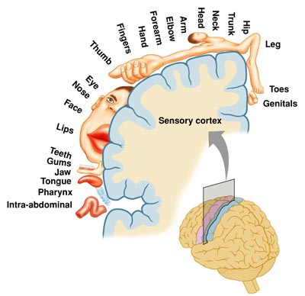
The somatosensory cortex
The somatosensory cortex is the part of the brain that recognizes where ascending sensory tracts originate.
Each sensory tract has a corresponding region of the cortex, its sensory field.
All sensory pathways for the left hand terminate in one area, all pathways for the left foot terminate in another area, and so on.

Slide 36
The somatosensory cortex
Within the cortical region for a particular body part, columns of neurons are devoted to particular types of receptors.
For example, a cortical column activated by cold receptors in the left hand may be found next to a column activated by pressure receptors in the skin of the left hand.
This columnar arrangement creates a highly organized structure that maintains the association between specific receptors and the sensory modality they transmit.

Slide 37
Phantom Limb Syndrome
In contrast, if a person loses a finger or limb, the portion of the somatosensory cortex devoted to the missing structure begins to be taken over by sensory fields of adjacent structures.
Reorganization of the somatosensory cortex “map” is an example of the remarkable plasticity of the brain.
Unfortunately, sometimes the reorganization is not perfect and can result in sensory sensations, including pain, that the brain interprets as being located in the missing limb (phantom limb pain).

Slide 38
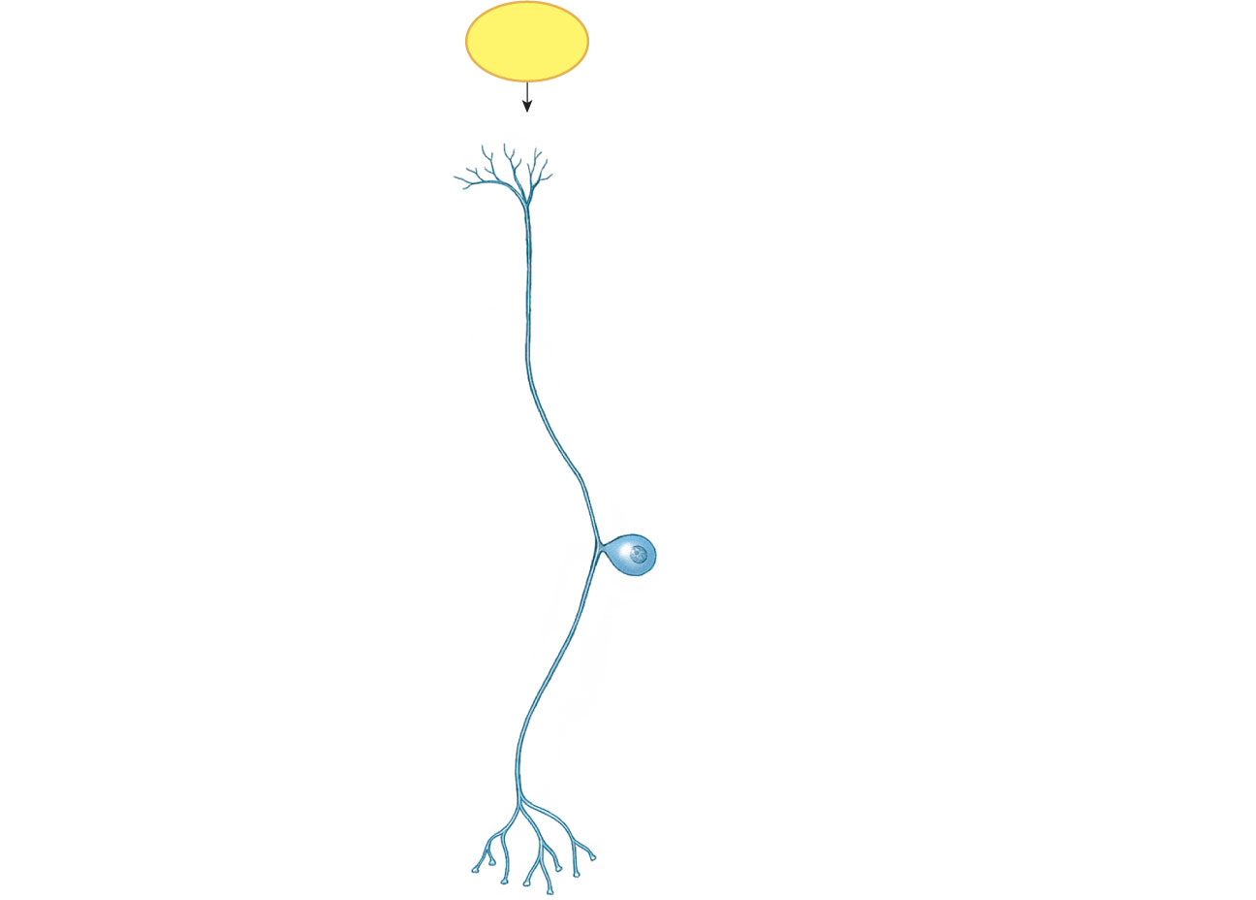
Somatosensory Receptors
Stimulus
Free nerve endings
Unmyelinated axon
Cell body
Figure 10-1a

Slide 39
Somatosensory Receptors
Stimulus
Enclosed nerve ending
Layers of connective tissue
Myelinated axon
Cell body
(b)
Figure 10-1b

Slide 40
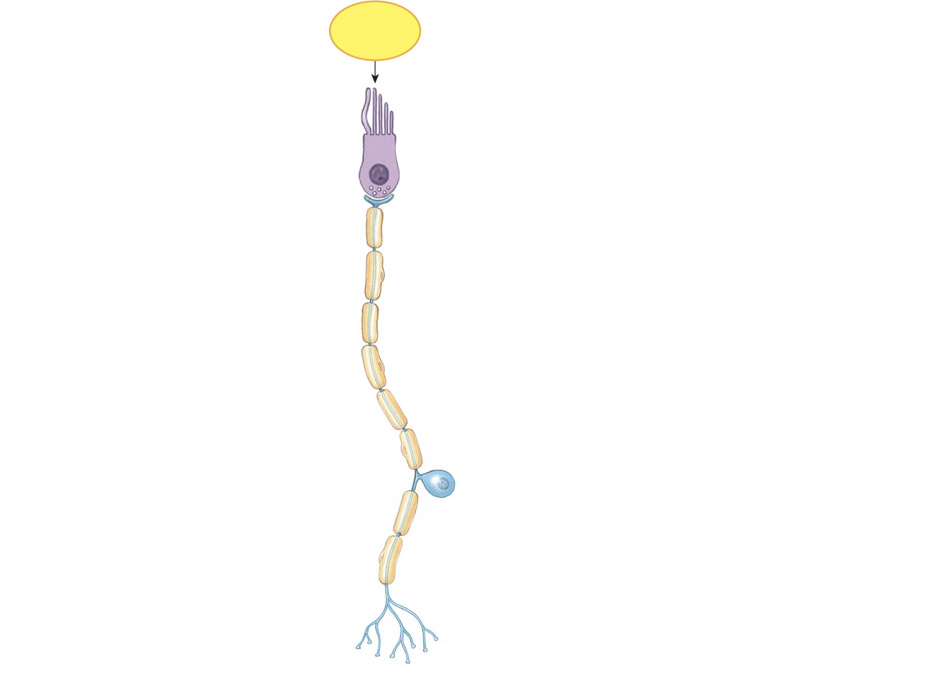
Somatosensory Receptors
Stimulus
Specialized receptor cell (hair cell)
Synaptic vesicles
Synapse
Myelinated axon
Cell body of sensory neuron
(c)
Figure 10-1c

Slide 41
Sensory Transduction
Stimulus energy converted into information processed by CNS
Ion channels or second messengers initiate membrane potential change
Adequate stimulus: Preferred form of stimulus
Threshold: Minimum stimulus
Receptor potential: Change in sensory receptor membrane potential

Slide 42
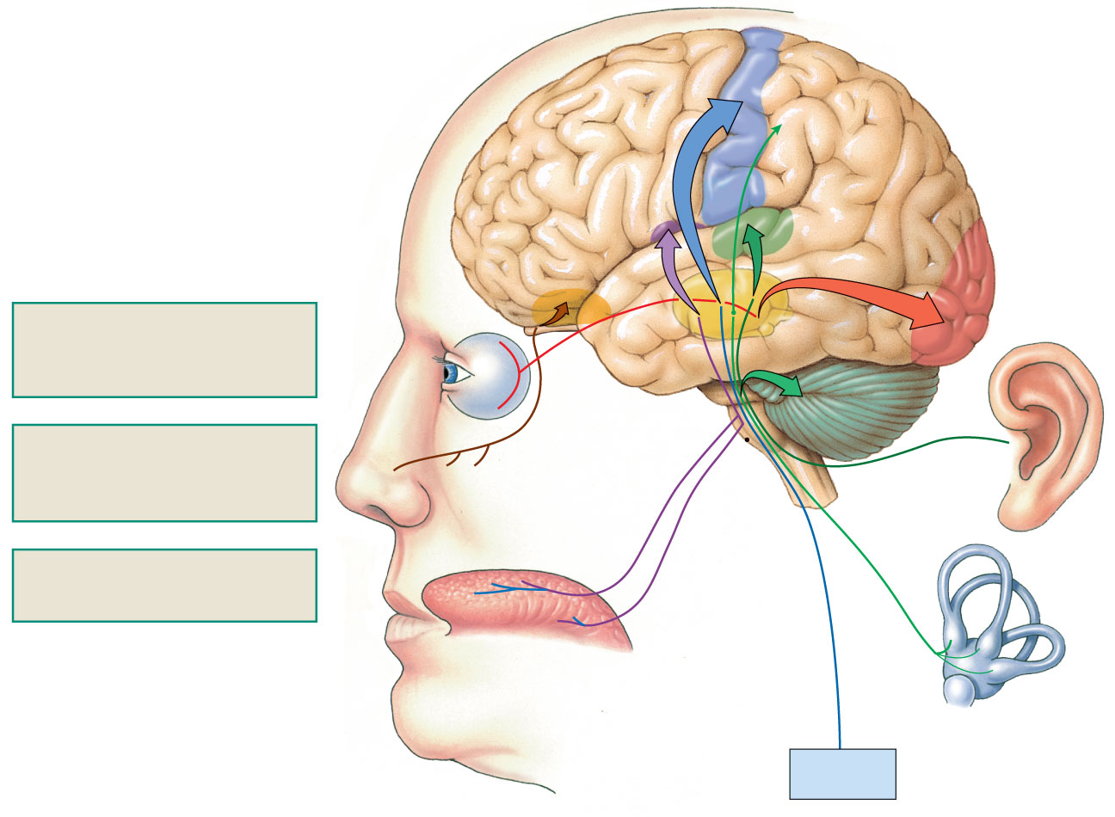
Sensory Pathways
Gustatory cortex
Primary somatic sensory cortex
Olfactory cortex
Olfactory bulb
Auditory cortex
Visual cortex
1
Olfactory pathways from the nose project through the olfactory bulb to the olfactory cortex.
Eye
2
Cerebellum
2
Most sensory pathways project to the thalamus. The thalamus modifies and relays information to cortical centers.
Nose
1
Thalamus
Sound
Brain stem
Equilibrium
3
Equilibrium pathways project primarily to the cerebellum.
3
Tongue
Somatic senses
Figure 10-4

Slide 43
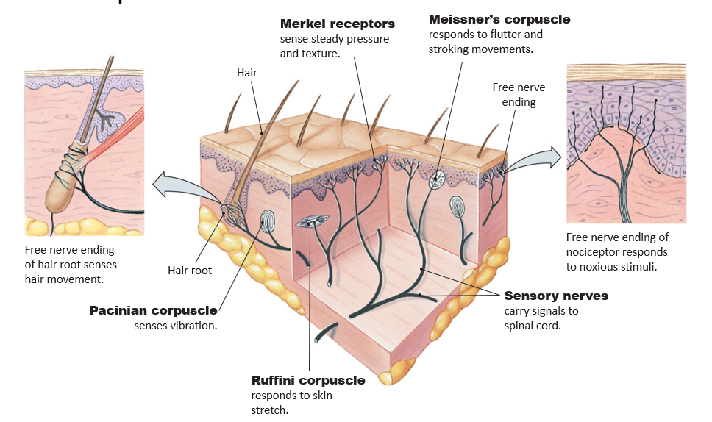
Touch Receptors in the Skin

Slide 44
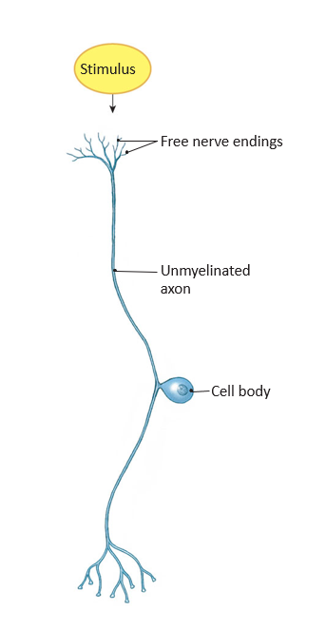
Temperature Receptors
Free nerve endings
Terminate in subcutaneous layers
Cold receptors
Lower than body temperature (37 °C)
Warm receptors
Above body temperature to about 45°C
Pain receptors activated above 45°C

Slide 45
Nociceptors (Pain Receptors)
Free nerve ending
Respond to strong stimulus that may damage tissue
Modulated by local chemicals
Substance P is secreted by primary sensory neurons
Mediate inflammatory response
Inflammatory pain

Slide 46
Nociceptors Pathways
Reflexive protective response
Integrated in spinal cord
Withdrawal reflex
Ascending pathway to cerebral cortex
Becomes conscious sensation (pain or itch)

Slide 47
Nociceptors: Pain and Itch
Itch
Histamine activates C fibers causing itch
Pain
Subjective perception
Fast pain
Sharp and localized—by Aβ fibers
Slow pain
More diffuse—by C fibers

Slide 48
Pain
Analgesic drugs
Aspirin
Inhibits prostaglandins and slows transmission of pain to site of injury

Slide 49
Touch Receptors Respond to Many Different Stimuli
Touch receptors are among the most common receptors in the body.
These receptors respond to many forms of physical contact, such as stretch, steady pressure, fluttering or stroking movement, vibration, and texture.
They are found both in the skin and in deeper regions of the body.

Slide 51
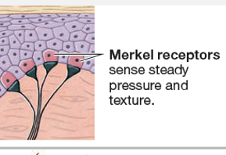
Merkel receptors
Merkel receptors are an example of nonneural sensors in the somatic senses.
The Merkel receptor consists of a Merkel cell that synapses onto a primary sensory neuron.
Merkel receptors are found in the greatest density in the fingertips and are responsible for the high sensitivity of tactile reception in these areas.

Slide 52
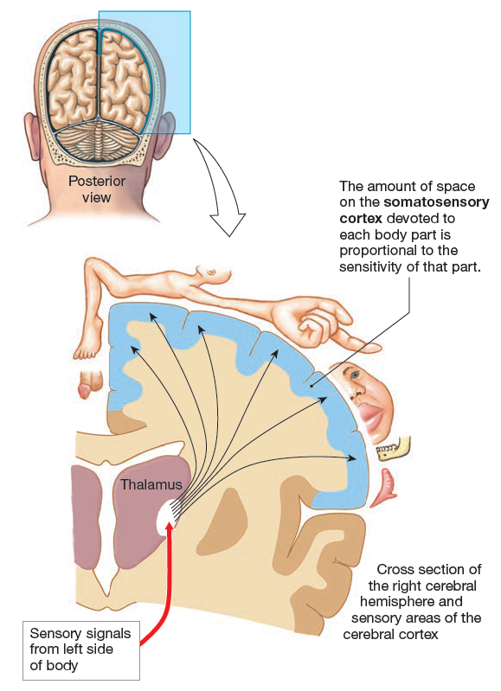
Each body part is represented next to the area of the sensory
cortex that processes stimuli for that body part.

Slide 53
Skin Receptors

Slide 54
Nociceptors Initiate Protective Responses
Nociceptors are neurons with free nerve endings that respond to a variety of strong noxious stimuli (chemical, mechanical, or thermal) that cause or have the potential to cause tissue damage.
Nociceptors are found in the skin, joints, muscles, bones and various internal organs, but not in the central nervous system.
Activation of nociceptor pathways initiates adaptive, protective responses.

Slide 55
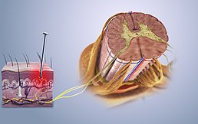
Nociception
Pain is a subjective perception, the brain’s interpretation of sensory information transmitted along pathways that begin at nociceptors.
Pain is highly individual and multi-dimensional, and may vary with a person’s emotional state.
The discussion here is limited to the sensory processing of nociception.

Slide 56
Nociception
Afferent signals from nociceptors are carried to the CNS in two types of primary sensory fibers:
A delta fibers and C fibers.

Slide 57
Fast Pain and Slow Pain
Fast pain is experienced as sharp and localized. It is rapidly transmitted to the CNS by the small, myelinated Ad fibers.
Slow pain, is described as duller and more diffuse, is carried on small, unmyelinated C fibers.

Slide 58
Fast Pain and Slow Pain
The timing distinction between the two is most obvious when the stimulus originates far from the CNS, such as when you stub your toe.
You first experience a quick stabbing sensation (fast pain), followed shortly by a dull throbbing (slow pain).

Slide 59
Itch (pruritus)
Itch (pruritus) comes only from nociceptors in the skin and is characteristic of many rashes and other skin conditions.

Slide 60
Nociceptor Pathways
Protective nociceptor reflexes begin with activation of the neuron’s free nerve endings.
Ion channels responding to a variety of chemical, mechanical, and thermal stimuli create graded potentials that trigger action potentials if the stimulus is strong enough.
Local chemicals released upon tissue injury include K+, histamine, and prostaglandins released from damaged cells; serotonin released from platelets activated by tissue damage; and the peptide substance P, which is secreted by primary sensory neurons.

Slide 61
nociceptors
The primary sensory neurons from nociceptors terminate in the dorsal horn of the spinal cord..
Nociceptor activation can follow two pathways:
reflexive protective responses that are integrated at the level of the spinal cord (spinal reflexes
ascending pathways to the cerebral cortex that become conscious sensation (pain or itch).
The primary nociceptor neurons synapse onto interneurons for spinal reflex responses or onto secondary sensory neurons that project to the brain.

Slide 62
Nociception
Nociception responses integrated in the spinal cord initiate rapid unconscious protective reflexes that automatically remove a stimulated area from the source of the stimulus.
For example, if you accidentally touch a hot stove, an automatic withdrawal reflex causes you to pull back your hand even before you are aware of the heat.

Slide 63
Somatosensory Pathways
The secondary sensory neurons cross the body’s midline in the spinal cord and ascend to the thalamus and sensory areas of the cortex.
The pathways also send branches to the limbic system and hypothalamus. As a result, pain may be accompanied by emotional distress (suffering) and a variety of autonomic reactions, such as nausea, vomiting, or sweating.
Pain can be felt in skeletal muscles (deep somatic pain) as well as in the skin.
Muscle pain during exercise is associated with the onset of anaerobic metabolism and is often perceived as a burning sensation in the muscle (as in “go for the burn!”).
Some investigators have suggested that the exercise-induced metabolite responsible for the burning sensation is K+, known to enhance the pain response. Muscle pain from ischemia (lack of adequate blood flow that reduces oxygen supply) also occurs during myocardial infarction (heart attack).

Slide 64
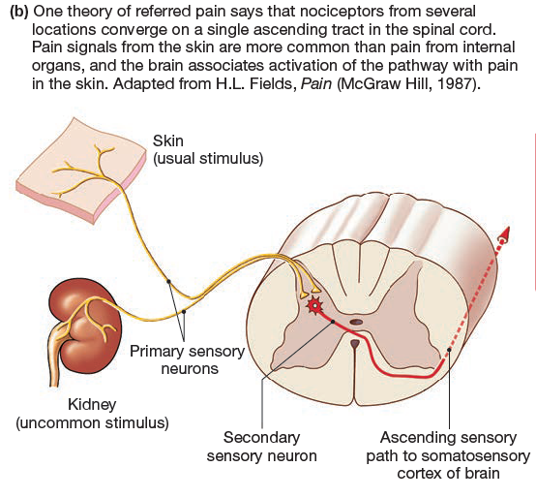

Slide 65
referred pain
Pain in the heart and other internal organs (visceral pain) is often poorly localized and may be felt in areas far removed from the site of the stimulus.
For example, the pain of cardiac ischemia may be felt in the neck and down the left shoulder and arm.
This referred pain apparently occurs because visceral and somatic sensory pain inputs converge on a single ascending tract (Fig. 10.11b).
According to this model, when painful stimuli arise in visceral receptors, the brain is unable to distinguish visceral signals from the more common signals arising from somatic receptors.
As a result, it interprets the pain as coming from the somatic regions rather than the viscera.

Slide 66
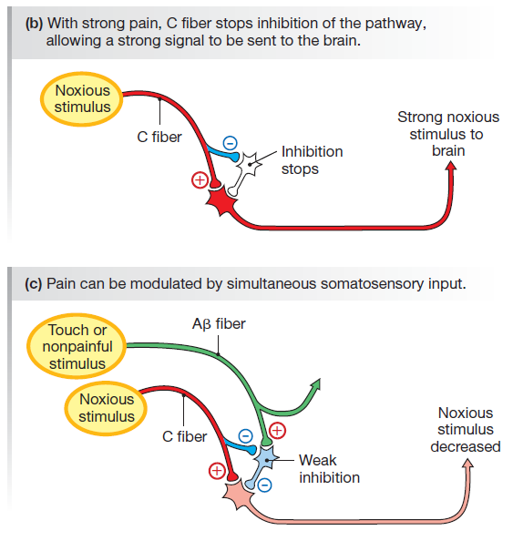
Pain Modulation
In the gate control theory of pain modulation, Ab fibers carrying sensory information about mechanical stimuli help block pain transmission
The Ab fibers synapse on the inhibitory interneurons and enhance the interneuron’s inhibitory activity.
If simultaneous stimuli reach the inhibitory neuron from the Ab and C fibers, the integrated response is partial inhibition of the ascending pain pathway so that pain perceived by the brain is lessened.
The gate control theory explains why rubbing a bumped elbow or shin lessens your pain: the tactile stimulus of rubbing activates Ab fibers and helps decrease the sensation of pain.

Slide 67
Chemoreception: Smell and Taste
The five special senses—smell, taste, hearing, equilibrium, and vision—are concentrated in the head region.
Smell and taste are both forms of chemoreception, one of the oldest senses from an evolutionary perspective.

Slide 68
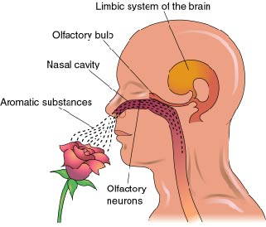
Olfaction
Olfaction allows us to discriminate among millions of different odors. Even so, our noses are not nearly as sensitive as those of many other animals whose survival depends on olfactory cues.
The olfactory bulb, the extension of the forebrain that receives input from the primary olfactory neurons, is much better developed in vertebrates whose survival is more closely linked to chemical monitoring of their environment.

Slide 69
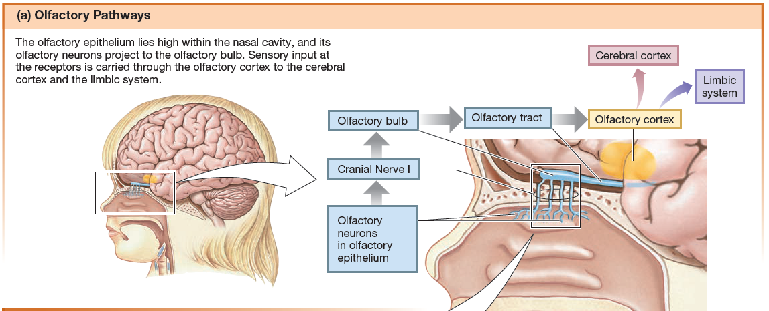

Slide 70
Olfactory Pathways
The human olfactory system consists of an olfactory epithelium lining the nasal cavity, with embedded primary sensory neurons called olfactory sensory neurons.
Axons of the olfactory sensory neurons form the olfactory nerve, or cranial nerve I.
The olfactory nerve synapses with secondary sensory neurons in the olfactory bulb.
Secondary and higher-order neurons project from the olfactory bulb through the olfactory tract to the olfactory cortex .
The olfactory tract, unlike most other sensory pathways, bypasses the thalamus.

Slide 71
Olfactory Pathways
Ascending pathways from the olfactory bulb also lead to the amygdala and hippocampus, parts of the limbic system involved with emotion and memory.
The link between smell, memory, and emotion is one amazing aspect of olfaction.
A special cologne or the aroma of food can trigger memories and create a wave of nostalgia for the time, place, or people with whom the aroma is associated.

Slide 72
The Olfactory Epithelium
Olfactory sensory neurons in humans are concentrated in a patch of olfactory epithelium high in the nasal cavity.
Olfactory sensory neurons have a single dendrite that extends down from the cell body to the surface of the olfactory epithelium, and a single axon that extends up to the olfactory bulb.
Olfactory sensory neurons, unlike other neurons in the body, have very short lives, with a turnover time of about two months.
Stem cells in the basal layer of the olfactory epithelium are continuously dividing to create new neurons.

Slide 74
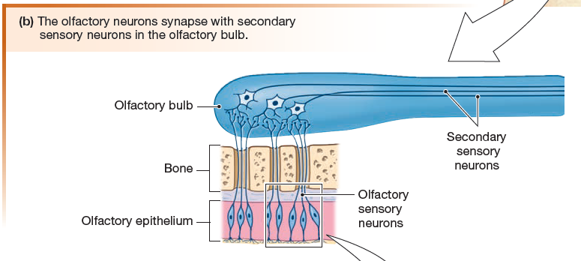

Slide 75
Olfactory Signal Transduction
The surface of the olfactory epithelium is composed of the knobby terminals of the olfactory sensory neuron dendrites, each knob branching into multiple nonmotile cilia (Fig.
10.13c).
The cilia are embedded in a layer of mucus that is produced by olfactory (Bowman’s) glands in the epithelium and basal lamina.
Odorant molecules must first dissolve in and penetrate the mucus before they can bind to an olfactory receptor protein on the olfactory cilia.
Each olfactory receptor is sensitive to a limited range of odorants.

Slide 76
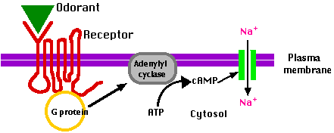
Olfactory Signal Transduction
Olfactory receptors are G protein-linked membrane receptors
The combination of most odorant molecules with their olfactory receptors activates a special G protein, Golf , which in turn increases intracellular cAMP.
The increase in cAMP concentration opens cAMP-gated cation channels, depolarizing the cell.
If the graded receptor potential that results is strong enough, it triggers an action potential that travels along the sensory neuron’s axon to the olfactory bulb.

Slide 77
Taste
Our sense of taste, or gustation, is closely linked to olfaction. Much of what we call the taste of food is actually the aroma.
Taste is currently believed to be a combination of five sensations:
Sweet
sour (acid)
Salty
bitter,
umami, a taste associated with the amino acid glutamate and some nucleotides.
Umami, a name derived from the Japanese word for “deliciousness,” is a basic taste that enhances the flavor of foods.
This Photo by Unknown Author is licensed under CC BY

Slide 78
Taste
Each of the five currently recognized taste sensations is associated with a physiological process.
Sour taste is triggered by the presence of H+
Salty by the presence of Na+.
Sweet and umami are associated with nutritious food.
Bitter taste is recognized by the body as a warning of possibly toxic components. If something tastes bitter, our first reaction is often to spit it out.

Slide 79
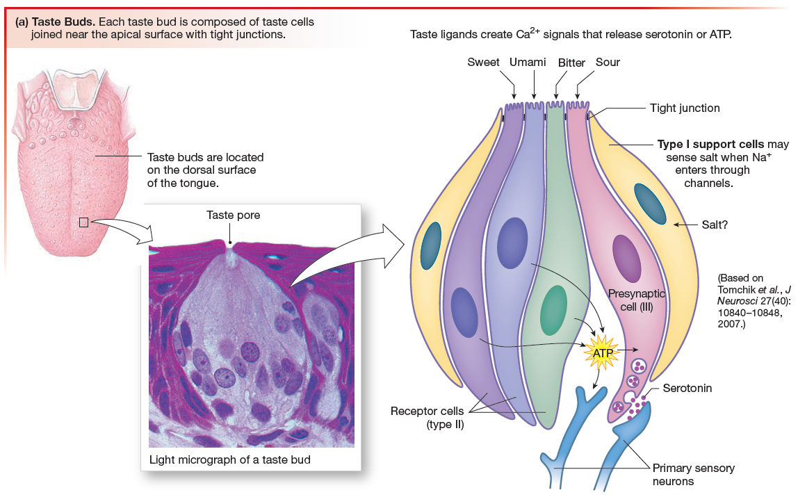
Taste Buds and Taste
The receptors for taste are located primarily on taste buds clustered together on the surface of the tongue.
One taste bud is composed of 50–150 taste receptor cells (TRCs), along with support cells and regenerative basal cells.
Taste receptors are also scattered through other regions of the oral cavity, such as the palate.

Slide 80
Gustation (Taste)
For a substance (tastant) to be tasted, it must first dissolve in the saliva and mucus of the mouth.
Dissolved taste ligands then interact with an apical membrane protein (receptor or channel) on the taste receptor cell.
Interaction of the taste ligand with a membrane protein initiates a signal transduction cascade that ends with release of chemical messenger molecules from the TRC.

Slide 81
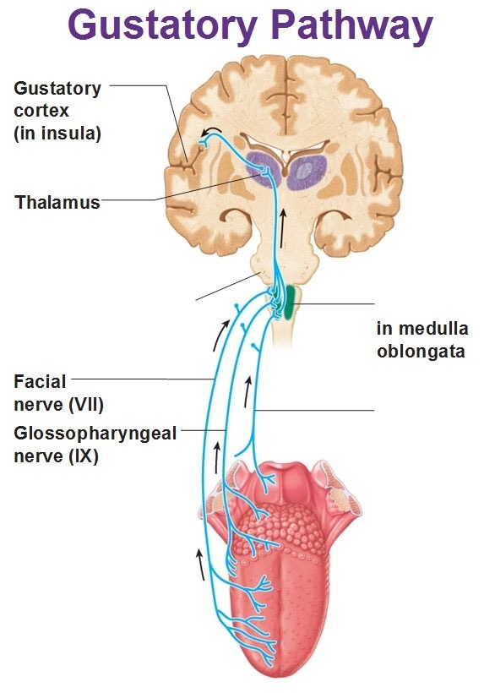
Gustation (Taste)
Chemical signals released from taste receptor cells activate primary sensory neurons (gustatory neurons) whose axons synapse in the medulla.

Slide 82
Gustation (Taste)
Sensory information then passes through the thalamus to the gustatory cortex located in the deep cortical region called the insula

Slide 83
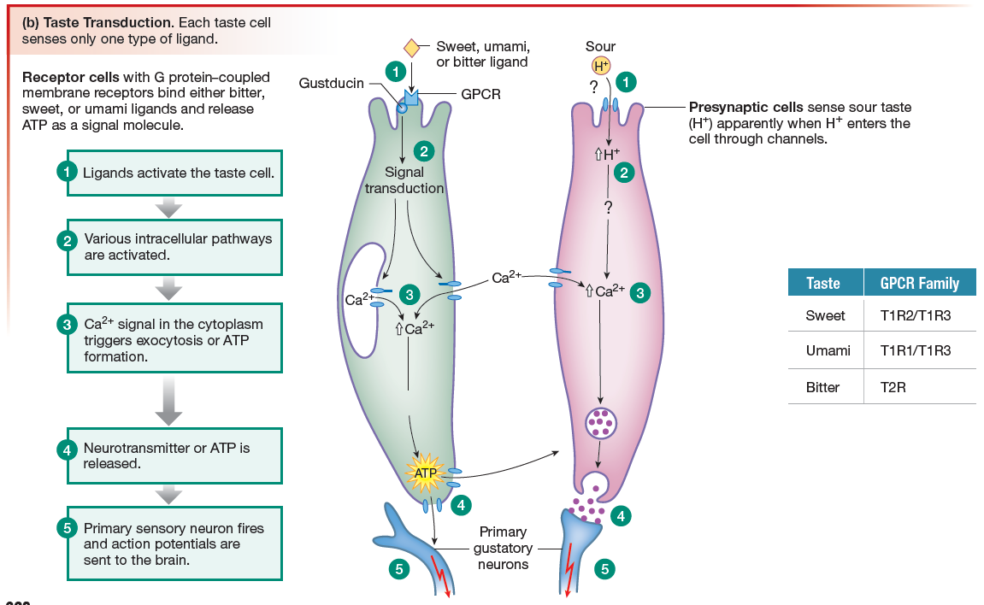
Taste Transduction Uses Receptors and Channels
Sweet, bitter, and umami tastes are associated with activation of G protein-coupled receptors.
Salty and sour transduction mechanisms both appear to be mediated by ion channels.

Slide 86
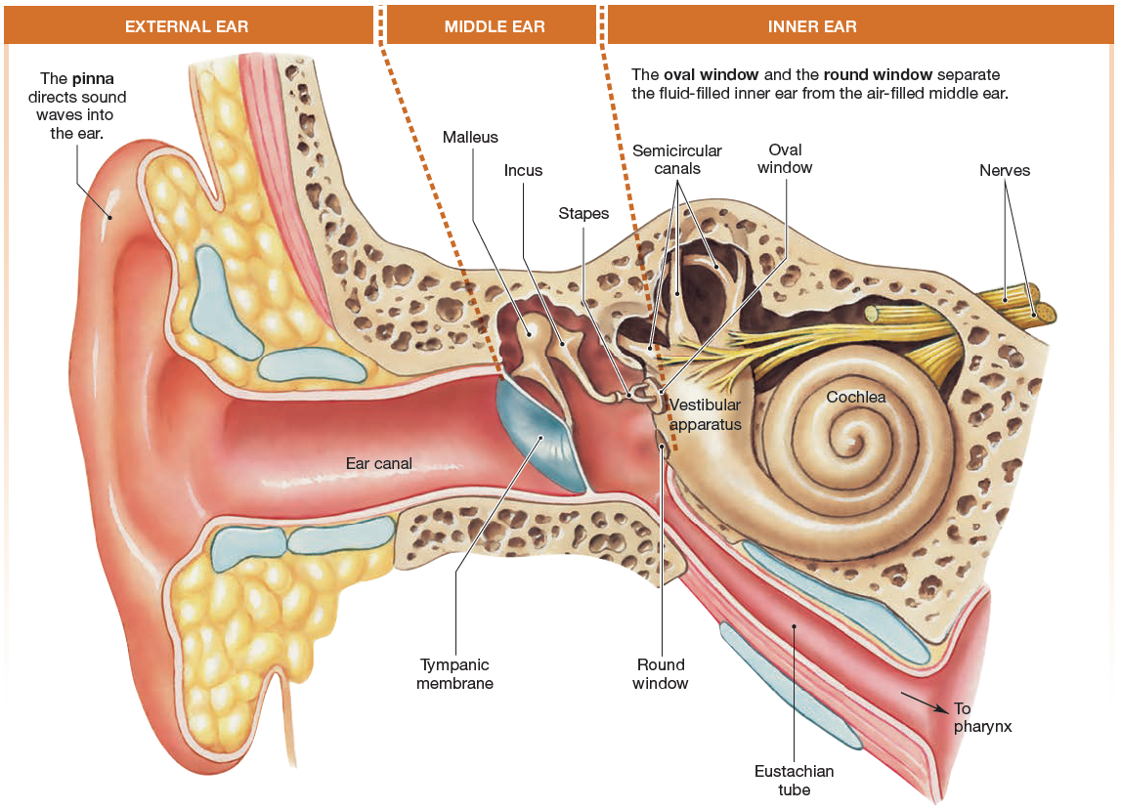
The Ear: Hearing
The ear is a sense organ that is specialized for two distinct functions: hearing and equilibrium.
The ear is divided into external, middle, and inner sections

Slide 87
The Ear: Equilibrium
The vestibule / vestibular apparatus lies within the inner ear.
The vestibule / vestibular apparatus is the primary sensor for equilibrium.

Slide 88
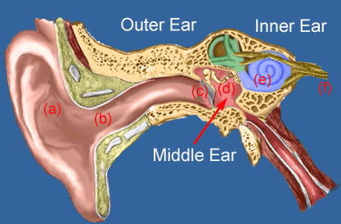
The structures of the external ear
The external ear consists of the outer ear, or pinna, and the ear canal.
The ear canal (external auditory meatus) ends at the tympanic membrane, or eardrum.

Slide 89
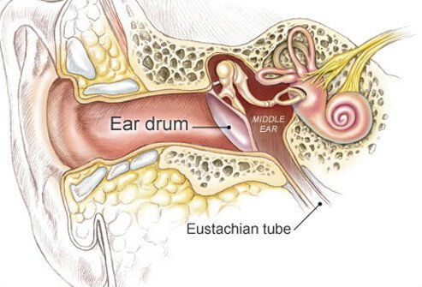
The tympanic membrane
The tympanic membrane is a thin membrane that separates the external ear from the middle ear.

Slide 90
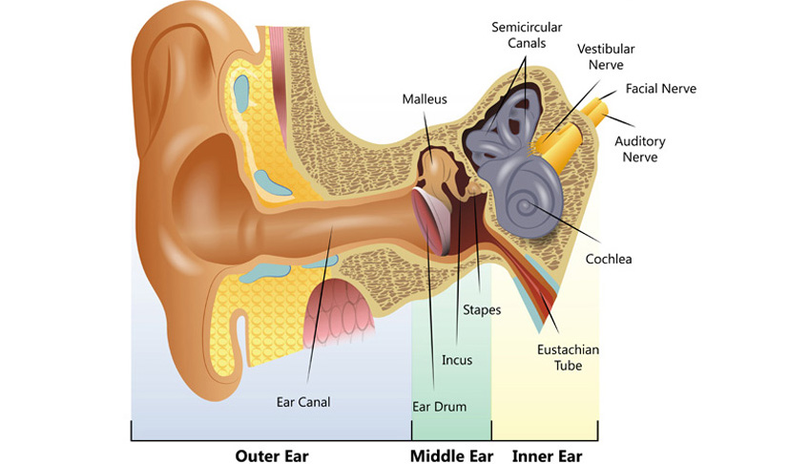
The middle ear
The middle ear is an air-filled cavity that connects with the Eustachian tube, and houses the 3 ear bones;
The malleus (hammer)
The incus (anvil)
The stapes (stirrup)

Slide 91
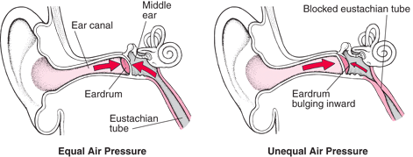
The Eustachian Tube
The Eustachian tube connects the middle ear to the pharynx (the throat)
The Eustachian tube is normally collapsed, sealing off the middle ear, but it opens transiently to allow middle ear pressure to equilibrate with atmospheric pressure during chewing, swallowing, and yawning.
The Eustachian tube acts to equalize pressure in the ear.

Slide 92
Ossicles (Tiny bones of the middle ear)
Three small bones of the middle ear conduct sound from the external environment to the inner ear:
The malleus (hammer)
The incus (anvil)
The stapes (stirrup)
The three bones are connected to one another with the biological equivalent of hinges.

Slide 93
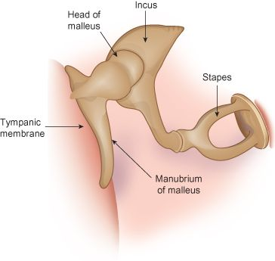
Ossicles (Tiny bones of the middle ear)
One end of the malleus is attached to the tympanic membrane.
The malleus connects to the incus which then connects to the stapes.
The stapes is attached to the oval window which is a thin membrane that separates the middle ear from the inner ear.
Oval Window

Slide 94
The inner ear
The inner ear consists of two major sensory structures.
The vestibular apparatus
The cochlea

Slide 95
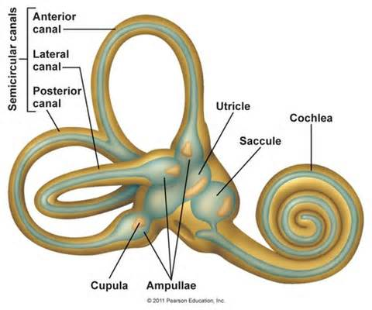
The vestibular apparatus
The vestibular apparatus (vestibule) contains the semicircular canals that function as the sensory transducer for our sense of equilibrium.

Slide 96
The cochlea
The cochlea of the inner ear contains sensory receptors for hearing.
On external view the cochlea is a membranous tube that lies coiled like a snail shell within a bony cavity.
Two membranous disks, the oval window (to which the stapes is attached) and the round window, separate the liquid-filled cochlea from the air-filled middle ear.

Slide 97
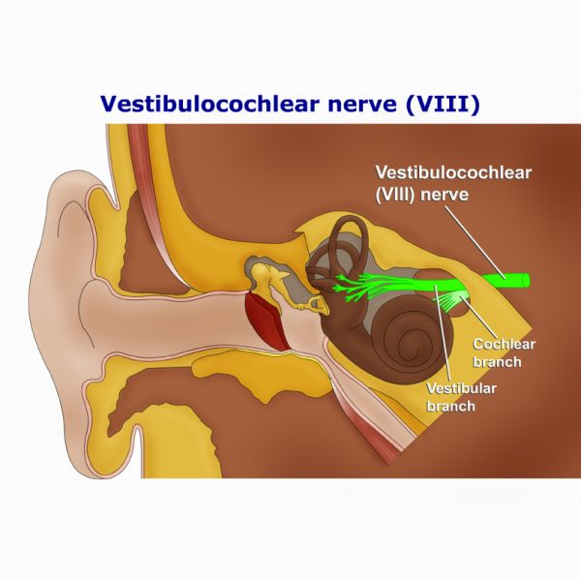
The Vestibulocochlear Nerve
The vestibulocochlear nerve (cranial nerve VII) has 2 branches:
The cochlear nerve
The vestibular nerve
The branches of cranial nerve VIII, the vestibulocochlear nerve, lead from the inner ear to the brain.

Slide 98
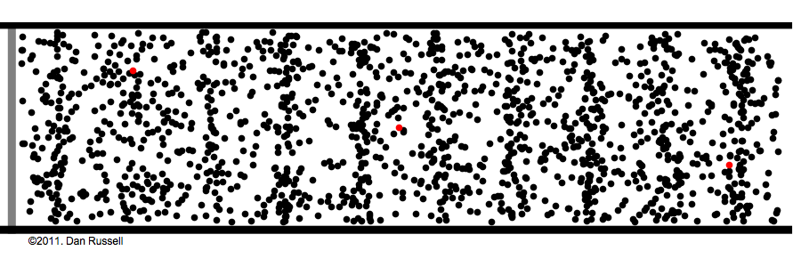
Hearing (Perception of Sound)
Hearing is our perception of the energy carried by sound waves, which are pressure waves with alternating peaks of compressed air and valleys in which the air molecules are farther apart.
The classic question about hearing is, “If a tree falls in the forest with no one to hear, does it make a noise?” The physiological answer is no, because noise, like pain, is a perception that results from the brain’s processing of sensory information.

Slide 99
What is Sound?
Sound is the brain’s interpretation of the frequency, amplitude, and duration of sound waves that reach our ears.

Slide 100
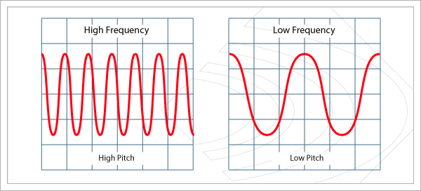
Frequency (pitch) of Sound Stimuli
Our brains translate frequency of sound waves (the number of wave peaks that pass a given point each second) into the pitch of a sound.
Low-frequency waves are perceived as low-pitched sounds, such as the rumble of distant thunder.
High-frequency waves create high-pitched sounds, such as the screech of fingernails on a blackboard.

Slide 101
Frequency (pitch) of Sound Stimuli
Sound wave frequency is measured in waves per second, or hertz (Hz).
The average human ear can hear sounds over the frequency range of 20–20,000 Hz.

Slide 102
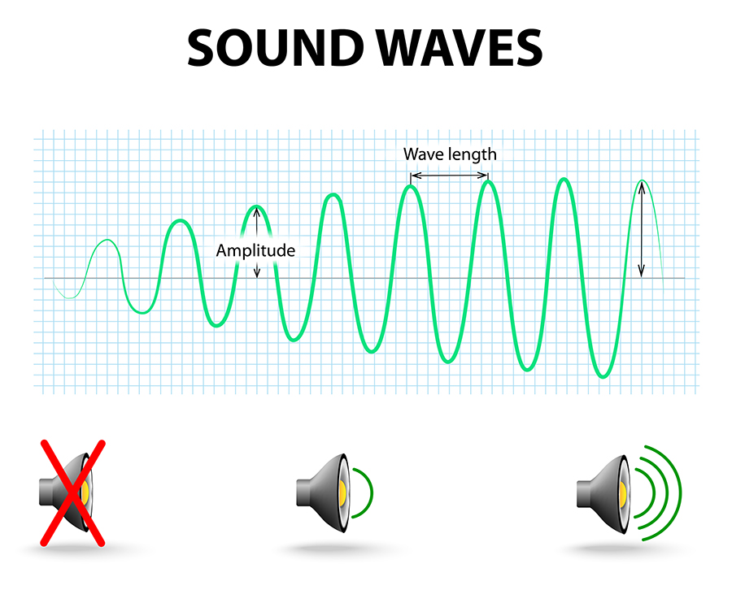
Amplitude (loudness) of Sound Stimuli
Loudness is our interpretation of sound intensity and is influenced by the sensitivity of an individual’s ear.
The intensity of a sound wave is a function of the amplitude of the sound wave.

Slide 103
Amplitude (loudness) of Sound Stimuli
Intensity is measured on a logarithmic scale in units called decibels (dB).
Normal conversation has a typical noise level of about 60 dB.
Sounds of 80 dB or more can damage the sensitive hearing receptors of the ear, resulting in hearing loss. The amount of damage depends on the duration and frequency of the noise as well as its intensity.

Slide 104
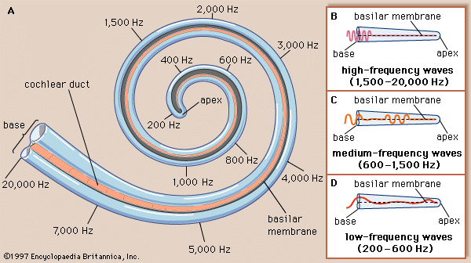

Slide 105
Sound Transduction
Sound Transduction Is a Multistep Process
Hearing is a complex sense that involves multiple transductions.
Energy from sound waves in the air becomes mechanical vibrations, then fluid waves in the cochlea.
The fluid waves open ion channels in hair cells, the sensory receptors for hearing.
Ion flow into hair cells creates electrical signals that release neurotransmitter which in turn triggers action potentials in the primary auditory neurons.

Slide 106
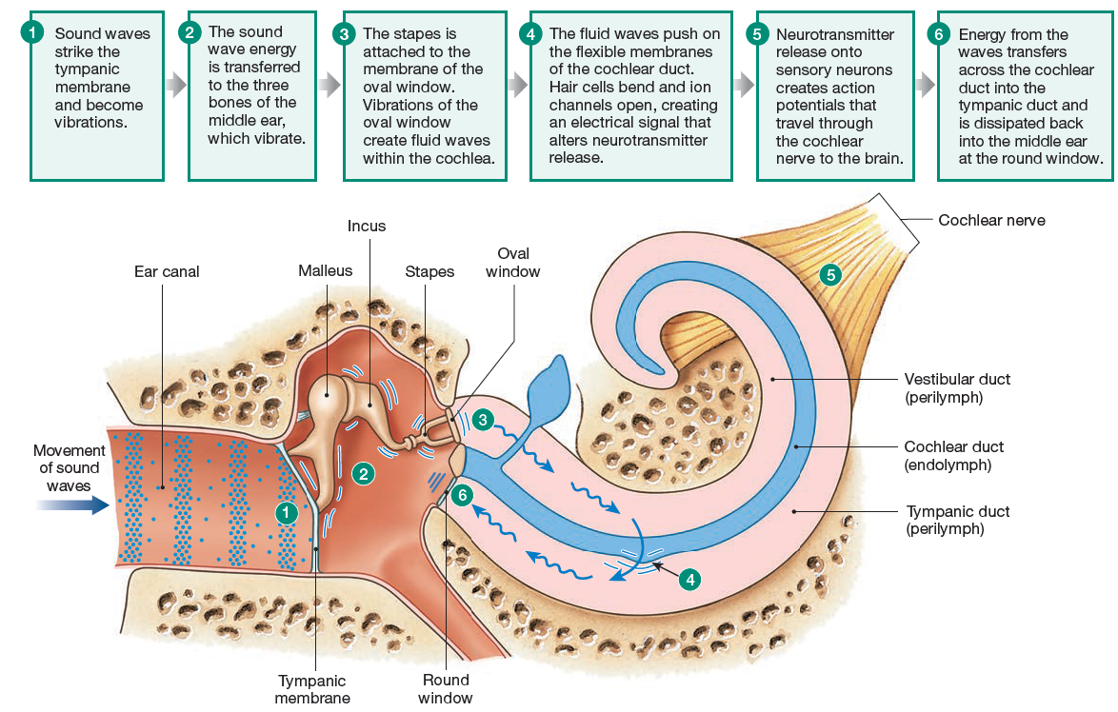

Slide 107
Sound Transduction
Sound transduction steps
Sound waves striking the outer ear are directed down the ear canal until they hit the tympanic membrane and cause it to vibrate (first transduction).
The tympanic membrane vibrations are transferred to the malleus, the incus, and the stapes, which then amplify the signal.
As the stapes vibrates, it pulls and pushes on the thin tissue of the oval window, creating fluid waves within the cochlea.

Slide 108
Sound Transduction
Sound transduction steps
Vibrations at the oval window create waves in the fluid-filled channels of the cochlea (second transduction).
As waves move through the cochlea, they push on the flexible membranes of the cochlear duct and bend sensory hair cells inside the duct.
Movement of the cochlear duct opens or closes ion channels on hair cell membranes, creating electrical signals (third transduction).
These electrical signals alter neurotransmitter release (fourth transduction).

Slide 109
Sound Transduction
Sound transduction steps
Neurotransmitter binding to the primary auditory neurons initiates action potentials that send coded information about sound through the cochlear branch of the vestibulocochlear nerve (cranial nerve VIII) and the brain.

Slide 110
Sound Transduction
Sound transduction steps
The wave energy dissipates back into the air of the middle ear at the round window.

Slide 111
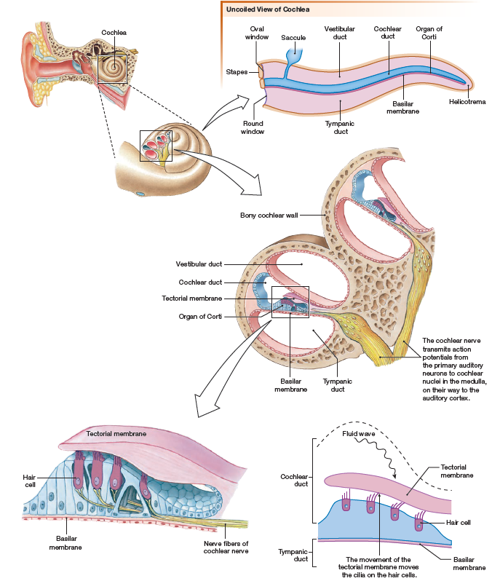
The Organ of Corti
The cochlear duct contains the organ of Corti, composed of four rows of hair cell receptors plus support cells.
The organ of Corti sits on the basilar membrane and is partially covered by the tectorial membrane
The basilar membrane and the tectorial membrane are both flexible tissues that move in response to fluid waves passing through the vestibular duct.
As the waves travel through the cochlea, they displace basilar and tectorial membranes, creating up-and-down oscillations that bend the hair cells.

Slide 112
The Organ of Corti
Hair cells are nonneural receptor cells. The apical surface of each hair cell is modified into 50–100 stiffened cilia known as stereocilia, arranged in ascending height.

Slide 113
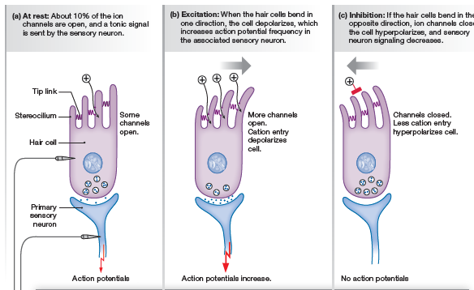

Slide 114
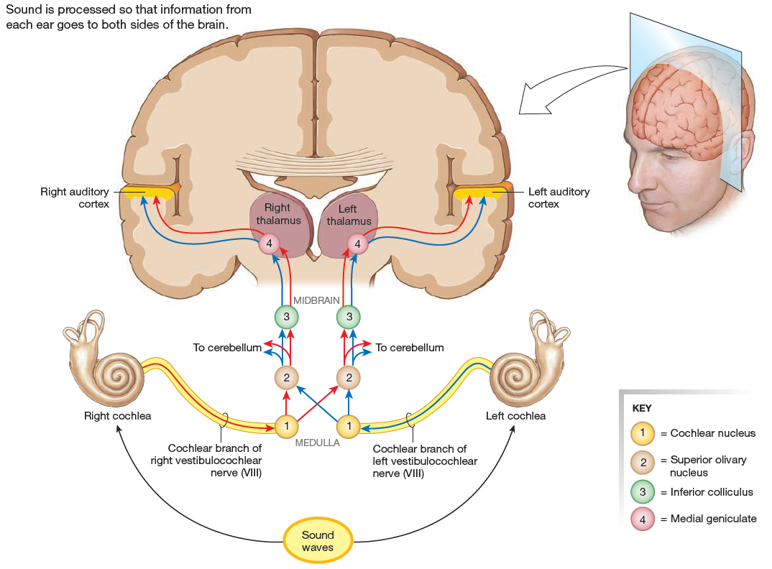
Auditory Pathways
Auditory Pathways Project to the Auditory Cortex
Once the cochlea transforms sound waves into electrical signals, sensory neurons transfer this information to the brain.
The cochlear (auditory) nerve is a branch of cranial nerve VIII, the vestibulocochlear nerve.
Primary auditory neurons project from the cochlea to cochlear nuclei in the medulla oblongata.

Slide 115
Auditory Pathways
From the medulla, secondary sensory neurons project to two higher nuclei, one ipsilateral (on the same side of the body) and one contralateral (on the opposite side).
Splitting sound signals between two ascending tracts means that each side of the brain gets information from both ears.
These ascending tracts then synapse in nuclei in the midbrain and thalamus before projecting to the auditory cortex.

Slide 117
The Ear: Equilibrium
Equilibrium is a state of balance, whether the word is used to describe ion concentrations in body fluids or the position of the body in space.
The special sense of equilibrium has two components:
a dynamic (changing) component that tells us about our movement through space
a static (unchanging) component that tells us if our head is not in its normal upright position.

Slide 118
The Ear: Equilibrium
Sensory information from the inner ear combined with signals from joint and muscle proprioceptors tell our brain where body parts are in relation to one another and to the environment.
Visual information also plays an important role in equilibrium.

Slide 119
The Vestibular Apparatus Provides Information about Movement and Position
The vestibular apparatus, also called the membranous labyrinth, is an intricate series of interconnected fluid-filled chambers.
In humans, the vestibular apparatus consists of two saclike otolith organs—the saccule and the utricle— along with three semicircular canals that connect to the utricle at their bases.

Slide 120
The Vestibular Apparatus Provides Information about Movement and Position
The otolith organs tell us about linear acceleration and head position.
The three semicircular canals sense rotational acceleration in various directions.

Slide 121
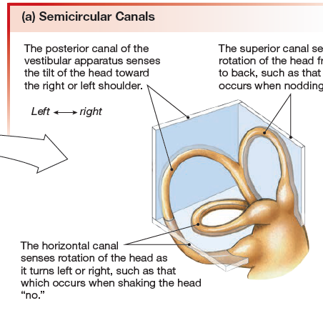
The Semicircular Canals
The Semicircular Canals Sense Rotational Acceleration
The three semicircular canals of the vestibular apparatus monitor rotational acceleration.
They are oriented at right angles to one another.
The horizontal canal monitors rotations that we associate with spinning or turning, such as an ice skater’s spin or shaking your head left and right to say “no.”
The posterior canal monitors left-to-right rotation, such as the rotation when you tilt your head toward your shoulders or perform a cartwheel.
The superior canal is sensitive to forward and back rotation, such as nodding your head front to back or doing a somersault.

Slide 122
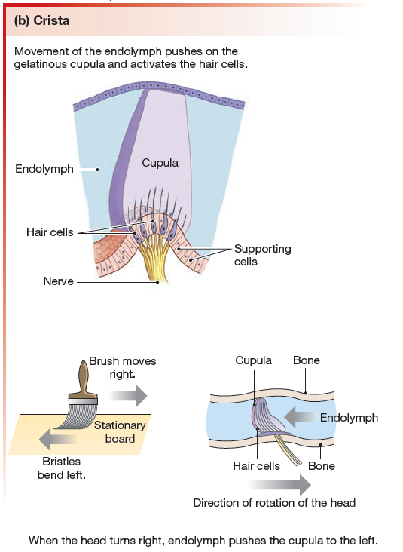
Semicircular canals
At one end of each canal is an enlarged chamber, the ampulla, which contains a sensory structure known as a crista.
The crista consists of hair cells in liquid.
As the head turns, the membranous walls of the labyrinth move, but the fluid within the labyrinth cannot keep up because of inertia.
In the ampullae, the drag of endolymph bends the cupula and its hair cells in the direction opposite to the direction in which the head is turning.

Slide 123
The Eye and Vision
The pupil is an opening through which light can pass into the interior of the eye.
Pupil size varies with the contraction and relaxation of a ring of smooth pupillary muscle.
The pupil appears as the black spot inside the colored ring of pigment known as the iris. The pigments and other components of the iris determine eye color.

Slide 124
Acceleration and Head Position
The two otolith organs, the utricle and saccule are arranged to sense linear forces.
Their sensory structures, called maculae, consist of hair cells, a gelatinous mass known as the otolith membrane, and calcium carbonate and protein particles called otoliths.

Slide 125
The hair cell cilia are embedded in the otolith membrane and otoliths bind to matrix proteins on the surface of the membrane
If gravity or acceleration cause the otoliths to slide forward or back, the gelatinous otolith membrane slides with them, bending the hair cell cilia and setting off a signal.

Slide 126
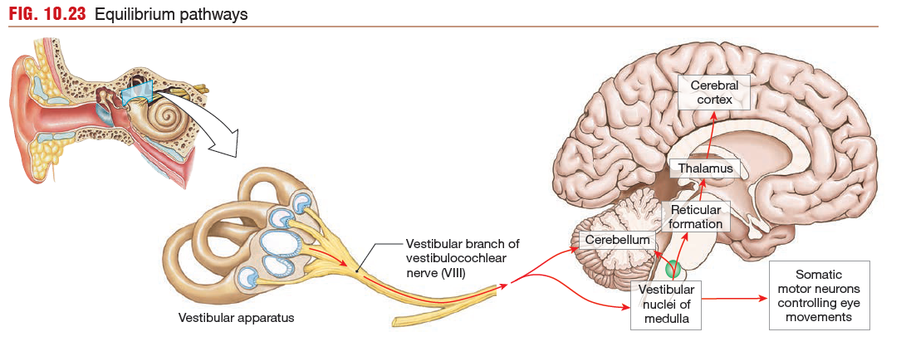

Slide 127
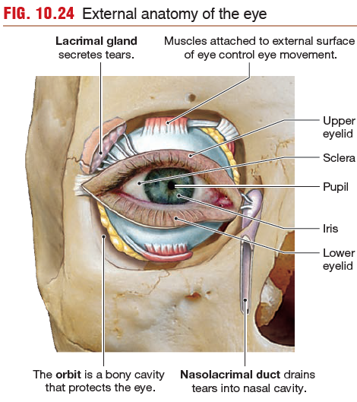

Slide 128
The Eye and Vision
The eye itself is a hollow sphere divided into two compartments (chambers) separated by a lens.
The lens, suspended by ligaments called zonules, is a transparent disk that focuses light.
The anterior chamber in front of the lens is filled with aqueous humor
Behind the lens is a much larger chamber, the vitreous chamber, filled mostly with the vitreous body that helps maintain the shape of the eyeball.
The outer wall of the eyeball, the sclera, is composed of connective tissue.

Slide 129
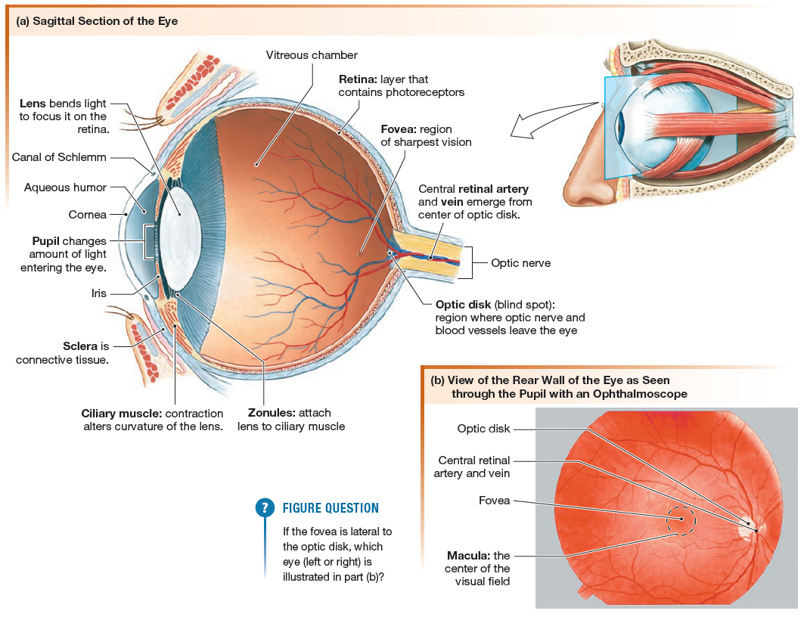

Slide 130
the Cornea
Light Enters the Eye through the Cornea
In the first step of the visual pathway, light from the environment enters the anterior surface of the eye through the cornea.

Slide 131
The Pupil
First, the amount of light that reaches photoreceptors is modulated by changes in the size of the pupil.
The pupil constricts in light through the actions of the circular pupillary sphincter muscles.
In the dark, the opening of the pupil dilates to 8 mm, a 28-fold increase in pupil area.
Dilation occurs in the dark when radial dilator muscles lying perpendicular to the circular sphincter muscles contract under the influence of sympathetic neurons.

Slide 132
The Lens
Light is focused onto the retina by changes in the shape of the lens.
After passing through the opening of the pupil, light strikes the lens, which has two convex surfaces.
The cornea and lens

Slide 133
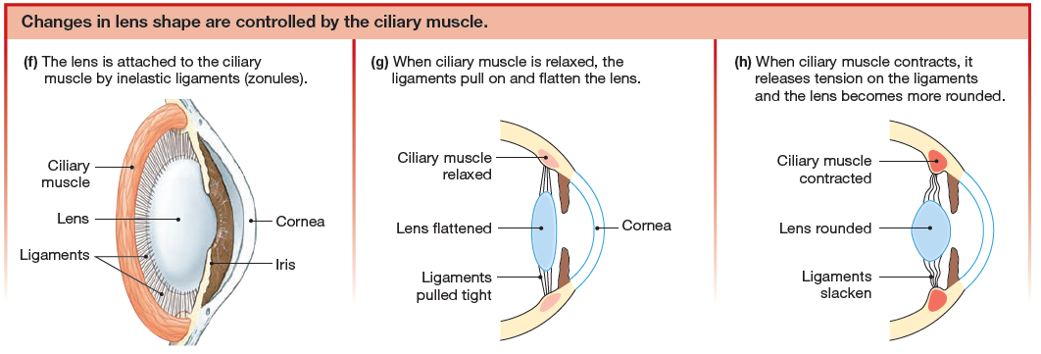

Slide 138
Phototransduction is the process by which animals convert light energy into electrical signals.
In humans, phototransduction takes place when light hits the retina, the sensory organ of the eye
Photoreceptors are the neurons that convert light energy

Slide 139
The fovea and the macula immediately surrounding it are the areas of most acute vision, and they form the center of the visual field.

Slide 140
Sensory information about light passes from the photoreceptors to bipolar neurons, then to a layer of ganglion cells.
The axons of ganglion cells form the optic nerve, which leaves the eye at the optic disk. Because the optic disk has no photoreceptors, images projected onto this region cannot be seen, creating what is called the eye’s blind spot.

Slide 142
The optic nerves from the retina go to the optic chiasm in the brain, where some of the fibers cross to the opposite side.
After synapsing in the lateral geniculate body (lateral geniculate nucleus) of the thalamus, the vision neurons of the tract terminate in the occipital lobe at the visual cortex.
Collateral pathways go from the thalamus to the midbrain, where they synapse with efferent neurons of cranial nerve III that control the diameter of the pupils.

Slide 143
Photoreceptors Transduce Light into Electrical Signals
There are two main types of photoreceptors in the eye: rods and cones.
Rods function well in low light and are used in night vision, when objects are seen in black and white rather than in color.
Cones are responsible for high-acuity vision and color vision during the daytime, when light levels are higher.
The fovea, which is the region of sharpest vision, has a very high density of cones.

Slide 145
Rods and Cones
Light-sensitive visual pigments are bound to the disk membranes in outer segments of photoreceptors. These visual pigments are transducers that convert light energy into a change in membrane potential. Rods have one type of visual pigment, rhodopsin.

Slide 146
Cones
Cones have three different pigments that are closely related to rhodopsin.
The visual pigments of cones are excited by different wavelengths of light, allowing us to see in color. White light is a combination of colors, as demonstrated when you separate white light by passing it through a prism. The eye contains cones for red, green, and blue light.
Each cone type is stimulated by a range of light wavelengths but is most sensitive to a particular wavelength.
Red, green, and blue are the three primary colors that make the colors of visible light, just as red, blue, and yellow are the three primary colors that make different colors of paint.
The color of any object we are looking at depends on the wavelengths of light reflected by the object.
Green leaves reflect green light, and bananas reflect yellow light.
White objects reflect most wavelengths.
Black objects absorb most wavelengths, which is one reason they heat up in sunlight while white objects stay cool.

Slide 150
Ganglion Cells
Bipolar cells synapse with ganglion cells, the next neurons in the pathway.
Each ganglion cell receives information from a particular area of the retina and are known as visual receptive fields.

Slide 151
Ganglion Cells
The receptive field of a ganglion cell near the fovea is quite small.
Only a few photoreceptors are associated with each ganglion cell, and so visual acuity is greatest in these areas. At the edge of the retina, multiple photoreceptors converging onto a single ganglion cell results in vision that is not as sharp.

Slide 152
Ganglion Cell Receptive Fields
There are two types of ganglion cell receptive fields.
on-center/off-surround fields
off-center/on-surround fields

Slide 153
Ganglion Cell Receptive Fields
In an on-center/off-surround field, the associated ganglion cell responds most strongly when light is brightest in the center of the field.
If light is brightest in the off-surround region of the field, the on-center/off-surround field ganglion cell is inhibited and stops firing action potentials.
The reverse happens with off-center/on-surround fields.

Slide 154
Processing Beyond the Retina
The axons of ganglion cells merged together to make up the optic nerve.
Ganglion cells fire action potentials that travel down their axons or down the optic nerve to the CNS.
The optic nerves from each eye approaches the optic chiasm where they enter the brain.

Slide 155
Visual Fields
The left visual field of each eye is projected to the visual cortex on the right side of the brain.
The right visual field is projected to the left visual cortex.

Slide 156
Visual Fields
Objects seen by both eyes fall within the binocular zone and are perceived in three dimensions (as having depth).
Objects seen with only one eye fall outside the binocular zone and are perceived in only two dimensions (no depth perception).

Slide 157
the binocular zone
The central portion of the visual field, where left and right sides of each eye’s visual field overlap, is the binocular zone.
The two eyes have slightly different views of objects in this region, and the brain processes and integrates the two views to create a 3-dimensional image.

Slide 158
Visual Pathways
From the optic chiasm, most projections go to the lateral geniculate body of the thalamus, where the optic fibers synapse onto neurons leading to the visual cortex in the occipital lobe.

