Slide 1
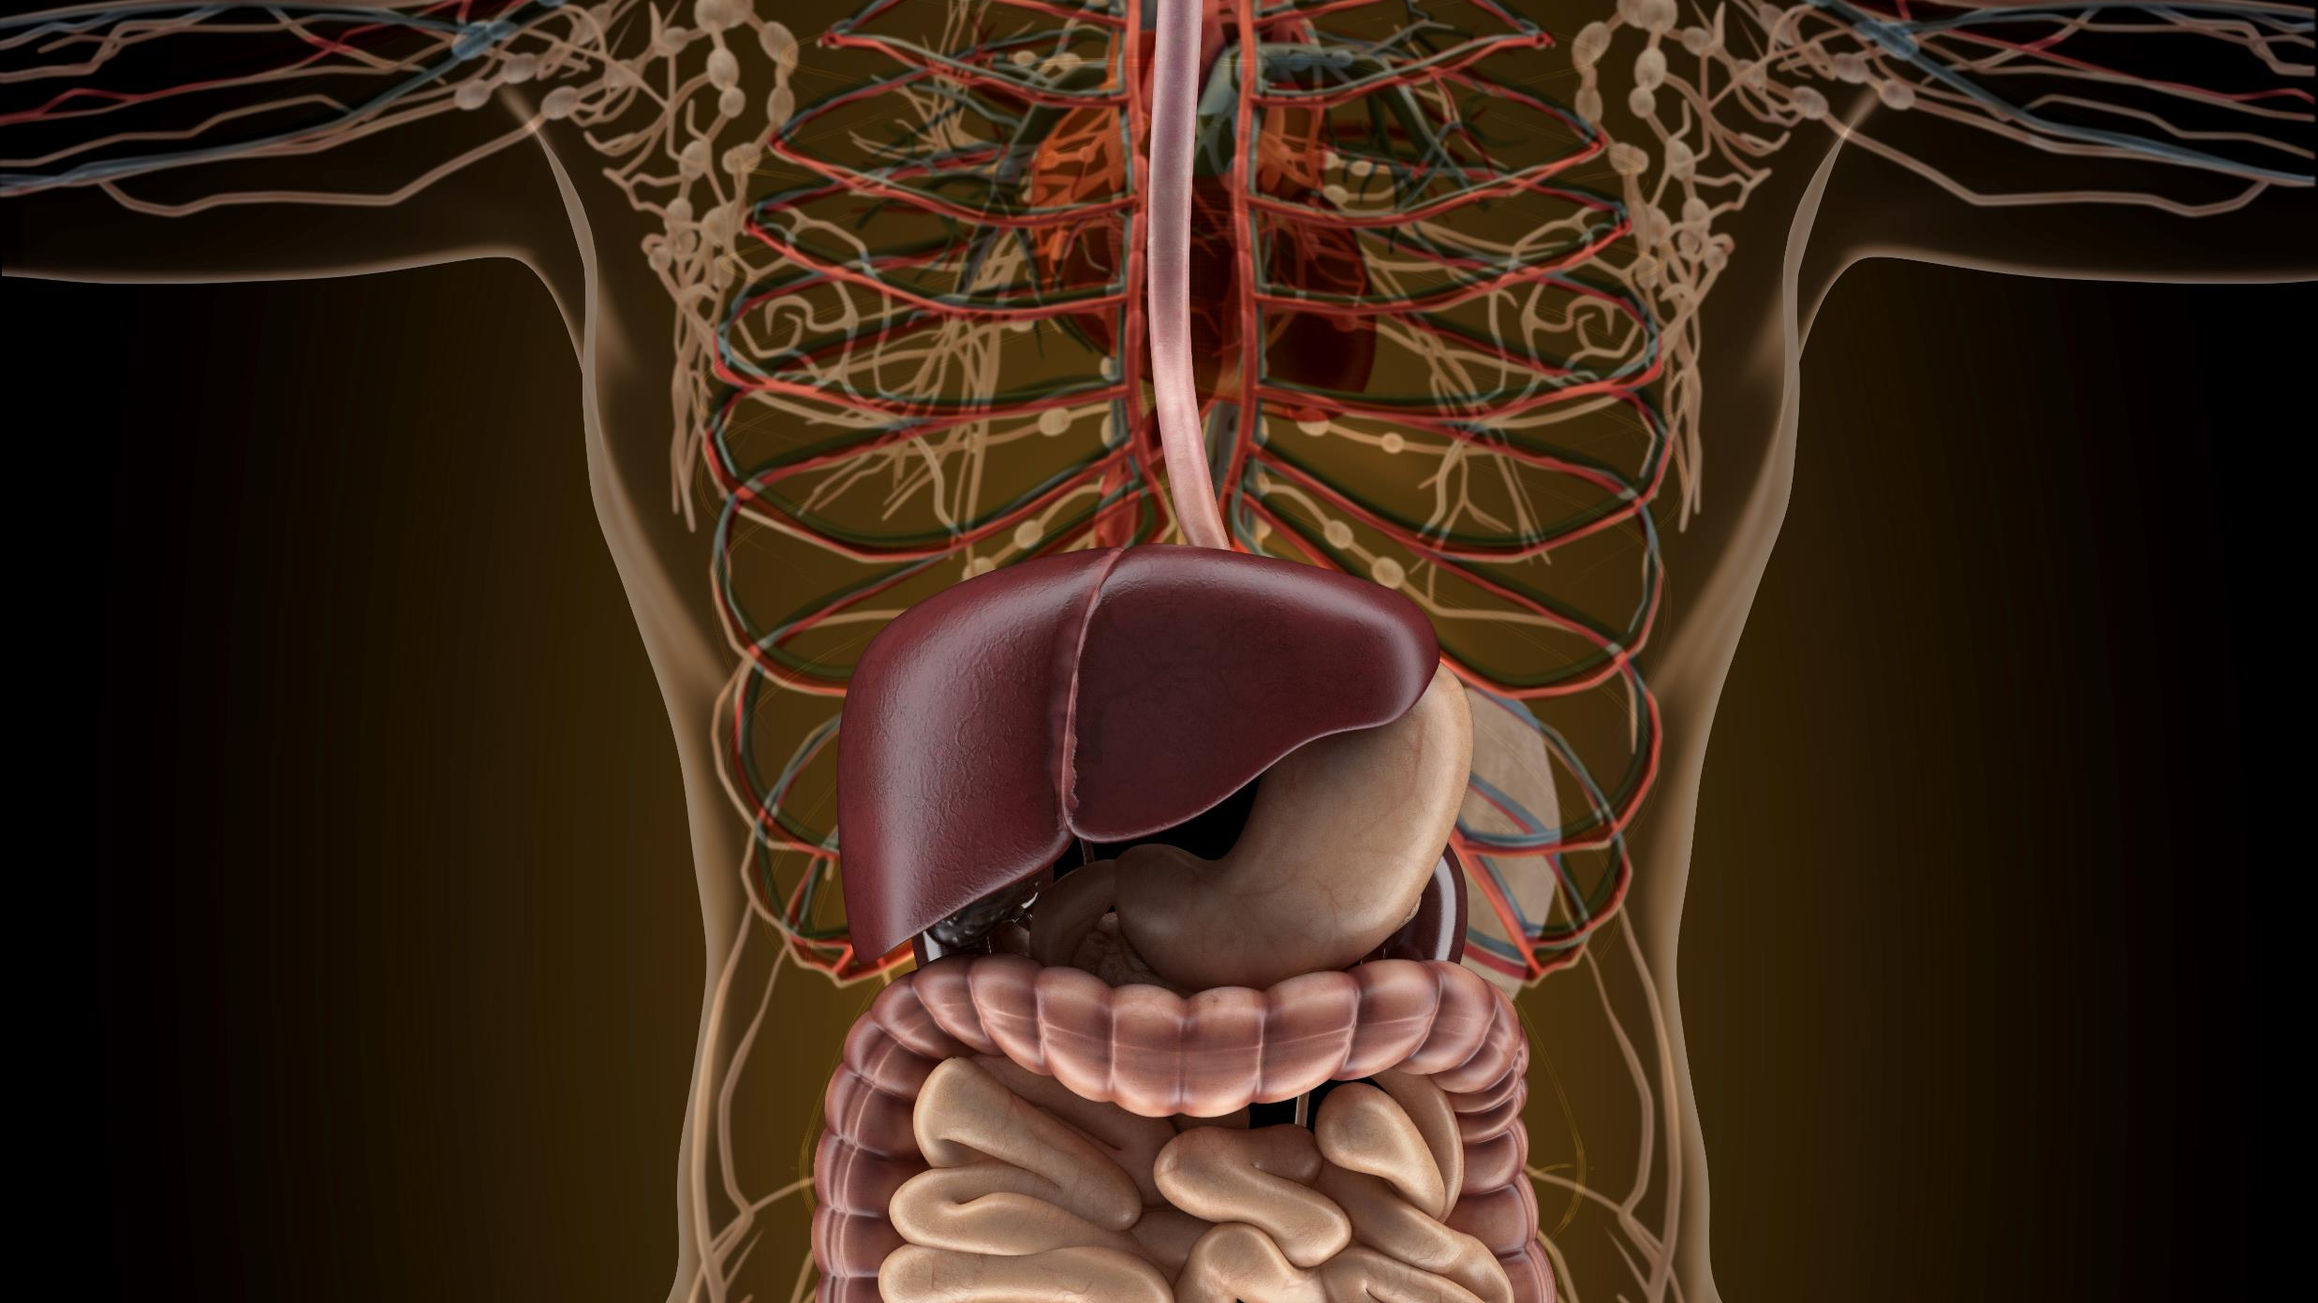
The Digestive System
By Scientist Cindy

Slide 2
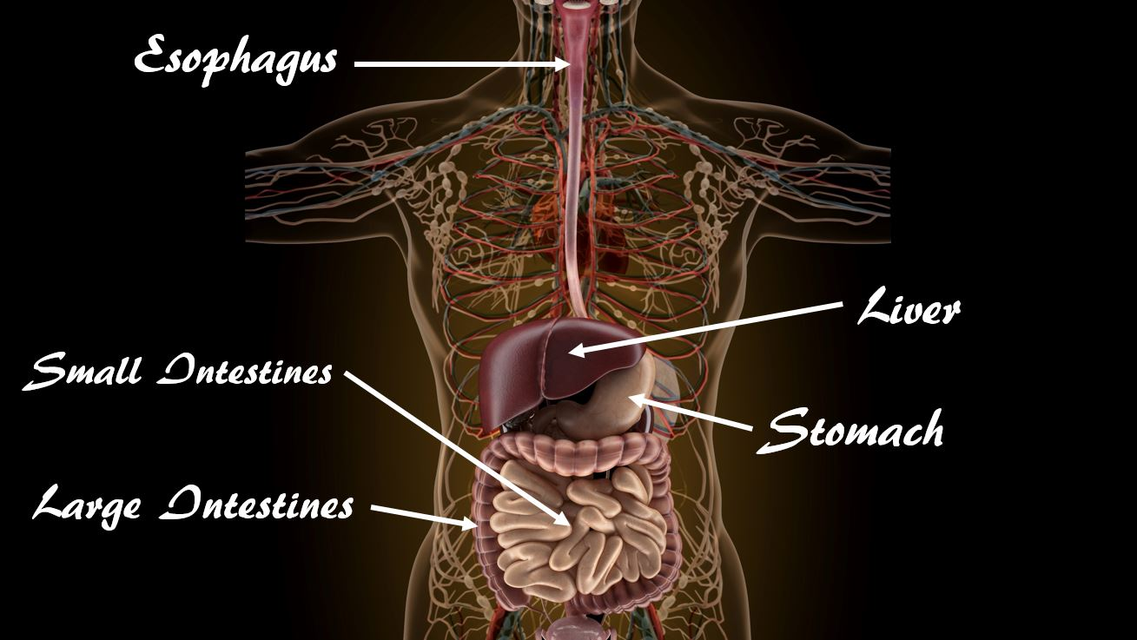
FUNCTIONS OF THE DIGESTIVE SYSTEM
2 functions of the digestive system :
Digestion
Absorption
The Gastrointestinal System is responsible for
the breakdown and absorption of various foods and liquids needed to sustain life.

Slide 3
FUNCTIONS OF THE DIGESTIVE SYSTEM
During digestion, two main processes occur at the same time;
Mechanical Digestion
Chemical Digestion

Slide 4
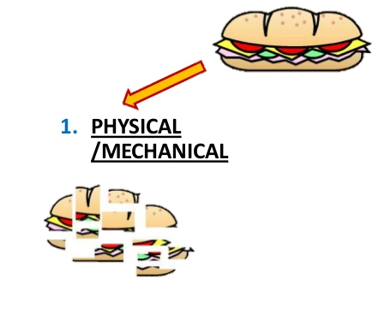
Mechanical Digestion:
Mechanical Digestion: larger pieces of food get broken down into smaller pieces while being prepared for chemical digestion.
Mechanical digestion starts in the mouth and continues into the stomach.

Slide 5
Chemical Digestion:
Chemical Digestion: starts in the mouth and continues into the intestines.
Several different enzymes break down macromolecules into smaller molecules that can be absorbed.

Slide 6
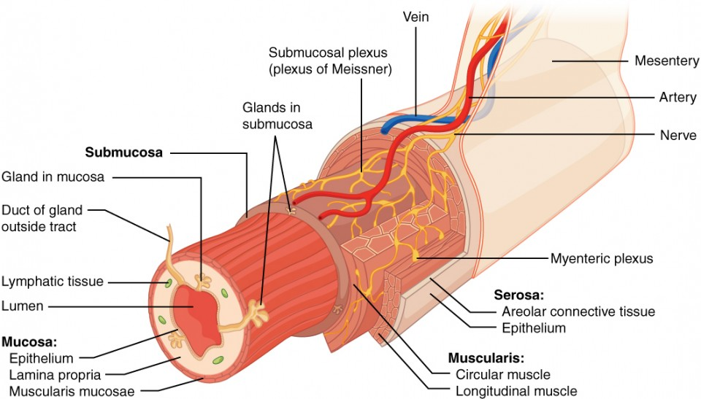
Tunics
The GI tract is composed of four layers also known as Tunics.
From the inside out they are called:
Mucosa
Submucosa
Muscularis
Serosa

Slide 7
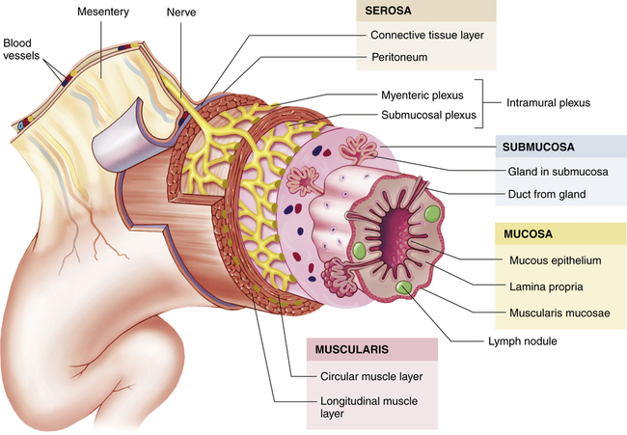
Mucosa:
The mucosa is the absorptive and secretory layer.
It is composed of simple epithelium cells and a thin connective tissue.
Has goblet cells that secrete mucus.
Has Villi and Micro Villi.

Slide 8
Submucosa:
The submucosa is relatively thick, highly vascular, and serves the mucosa.
The absorbed elements that pass through the mucosa are picked up from the blood vessels of the submucosa.
The submucosa also has glands and nerve plexuses.

Slide 9
Muscularis:
The muscularis is responsible for segmental contractions and peristaltic movement in the GI tract.
The muscularis is composed of two layers of muscle:
an inner circular layer of smooth muscle
outer longitudinal layer of smooth muscle.
These muscles cause food to move and churn with digestive enzymes down the GI tract.

Slide 10
Serosa:
The last layer is a protective layer.
It is composed of avascular connective tissue and simple squamous epithelium.
It secretes lubricating serous fluid.
This is the visible layer on the outside of the organs.

Slide 11
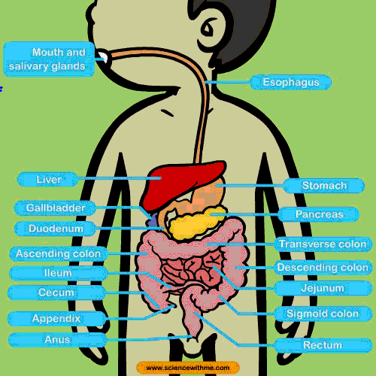
The GI Tract
The GI tract includes
The Mouth
The Esophagus
The Stomach
The Small Intestine (Duodenum, Jejunum, Ileum)
The Large Intestine (Colon)
Rectum
Anus

Slide 12
Accessory Organs
1. Salivary glands
2. Tongue
3. Teeth
4. Liver
5. Gallbladder
6. Pancreas
7. Vermiform appendix

Slide 13
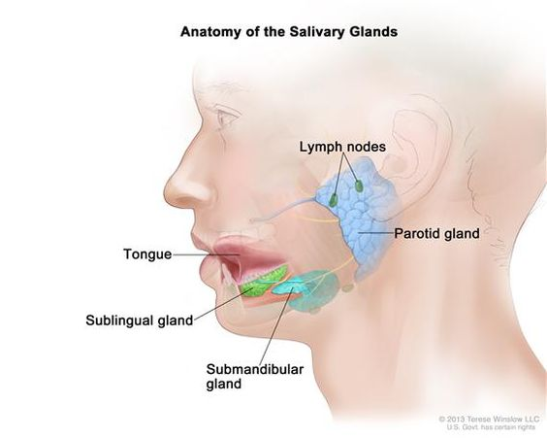
Salivary glands
The 3 salivary glands –
Parotid Gland
Submandibular Gland
Sublingual Gland
The Salivary Glands are exocrine glands that produce saliva which begins the process of digestion with amylase, and moistens the food creating a bolus.

Slide 14
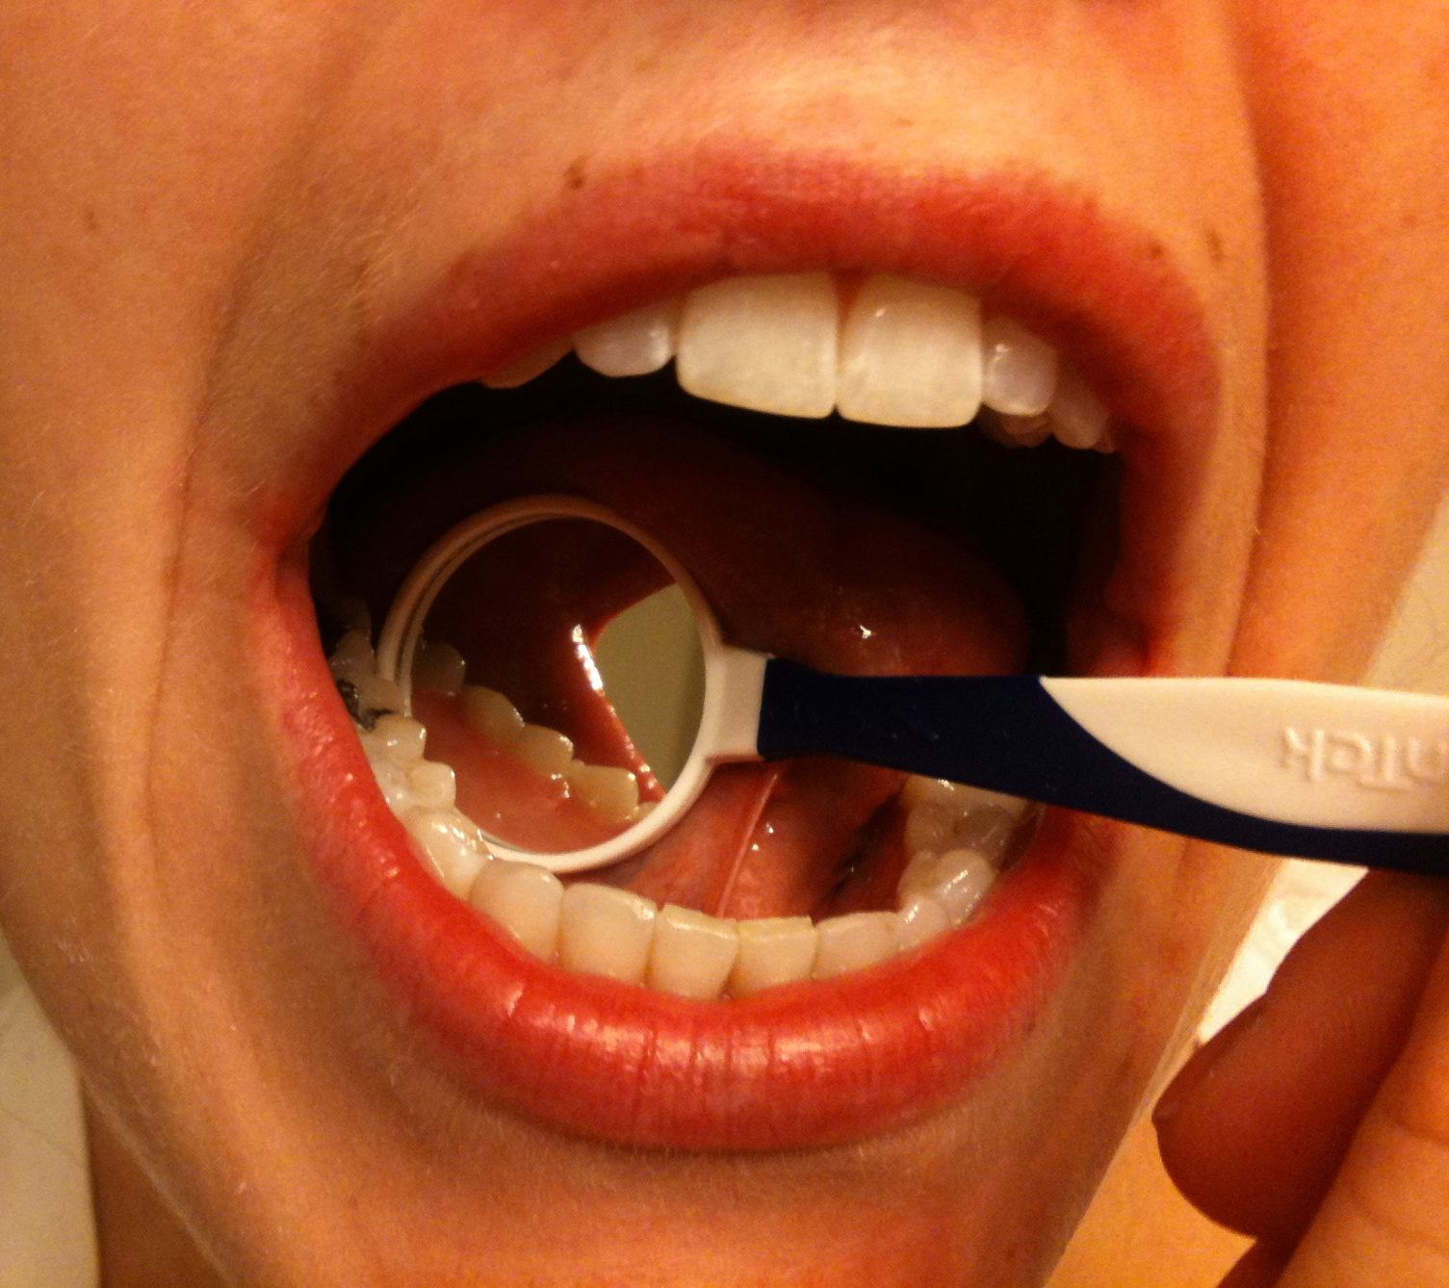
Tongue and Teeth
Tongue
Manipulates food for chewing/swallowing
Main taste organ, covered in taste buds
Teeth
For chewing food up
This Photo by Unknown Author is licensed under CC BY-SA-NC

Slide 15
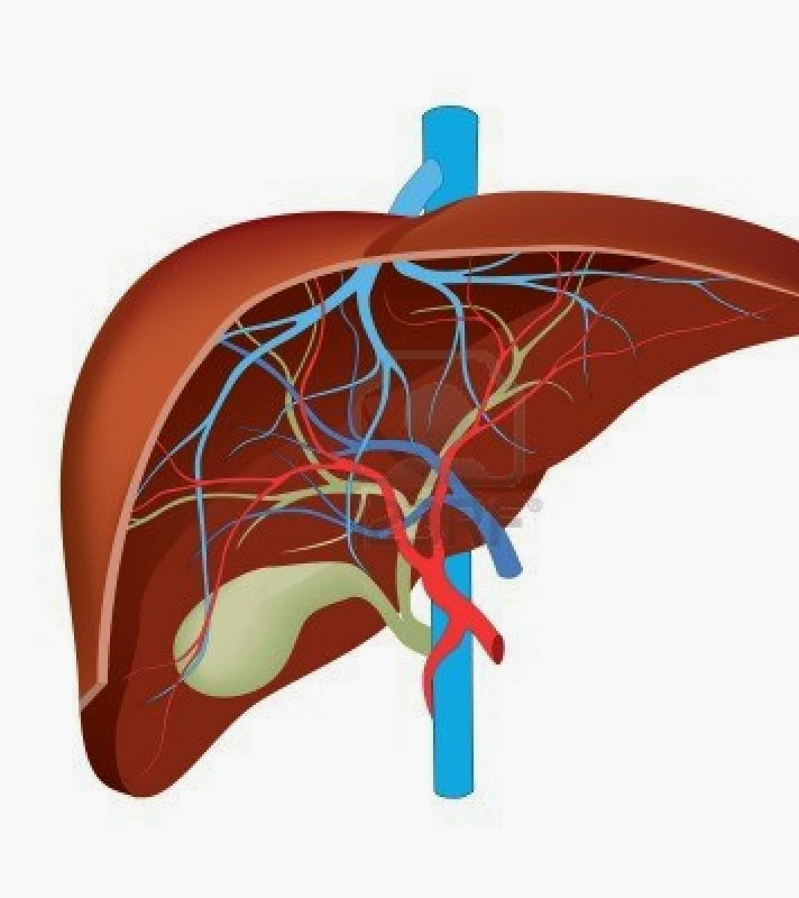
Liver
Produces and excretes bile required for emulsifying fats.
Some of the bile drains directly into the duodenum and some is stored in the gall bladder.
Helps metabolize proteins, lipids, and carbohydrates.
Urea is formed in liver from amino acids and compounds of ammonia.
Breaks down insulin and other hormones.
Produces coagulation factors.

Slide 16
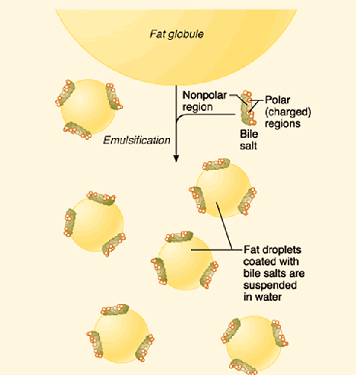
Liver
The liver produces and excretes bile required for emulsifying fats.
Some of the bile drains directly into the duodenum and some is stored in the gall bladder.

Slide 17
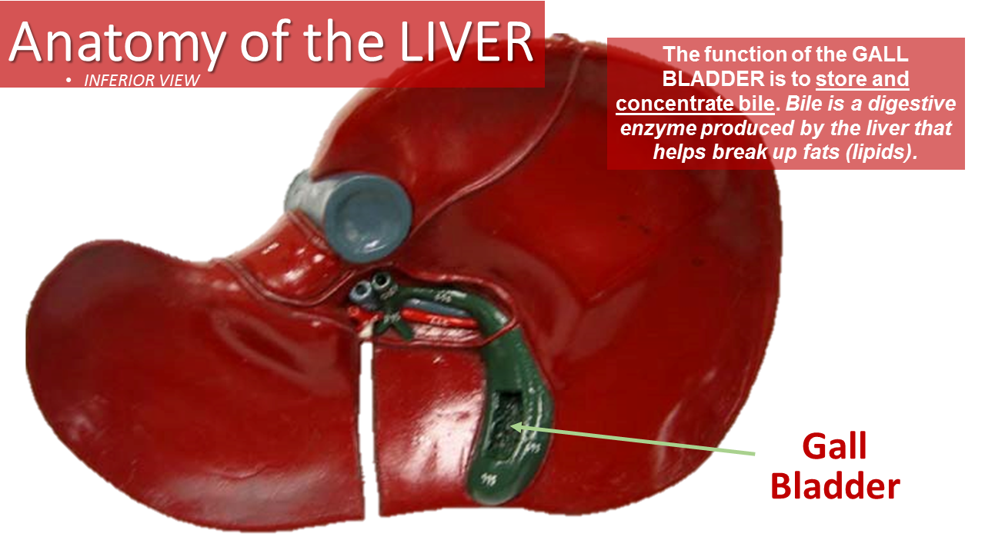
Gallbladder
FUNCTION:
Bile storage – Stores and Concentrated Biles from the Liver

Slide 18
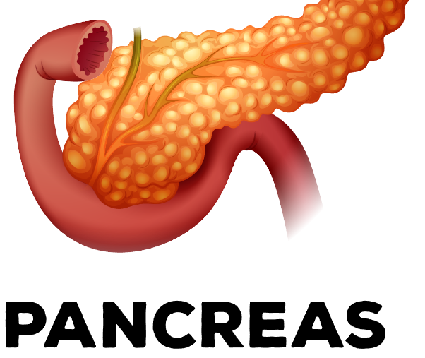
Pancreas
Exocrine functions: Digestive enzyme secretion.
Trypsinogen – Trypsin: digests protein.
Chymotypsinogen – Chymotrypsin: digests proteins.
Carboxypeptidases: digests proteins.
Lipase-lipid: digests fats.
Amylase: digests carbohydrates.

Slide 19
Pancreas
Endocrine functions: Hormone secretion.
Somatostatin: inhibits insulin in response to the body is getting too much glucose.
Glucagon: stimulates the stored glycogen in the liver to convert to glucose. Produced if the body does not have enough glucose.
Insulin: made in the beta cells of the Islets of Langerhans of the pancreas. Insulin is a hormone that regulates blood glucose.

Slide 20
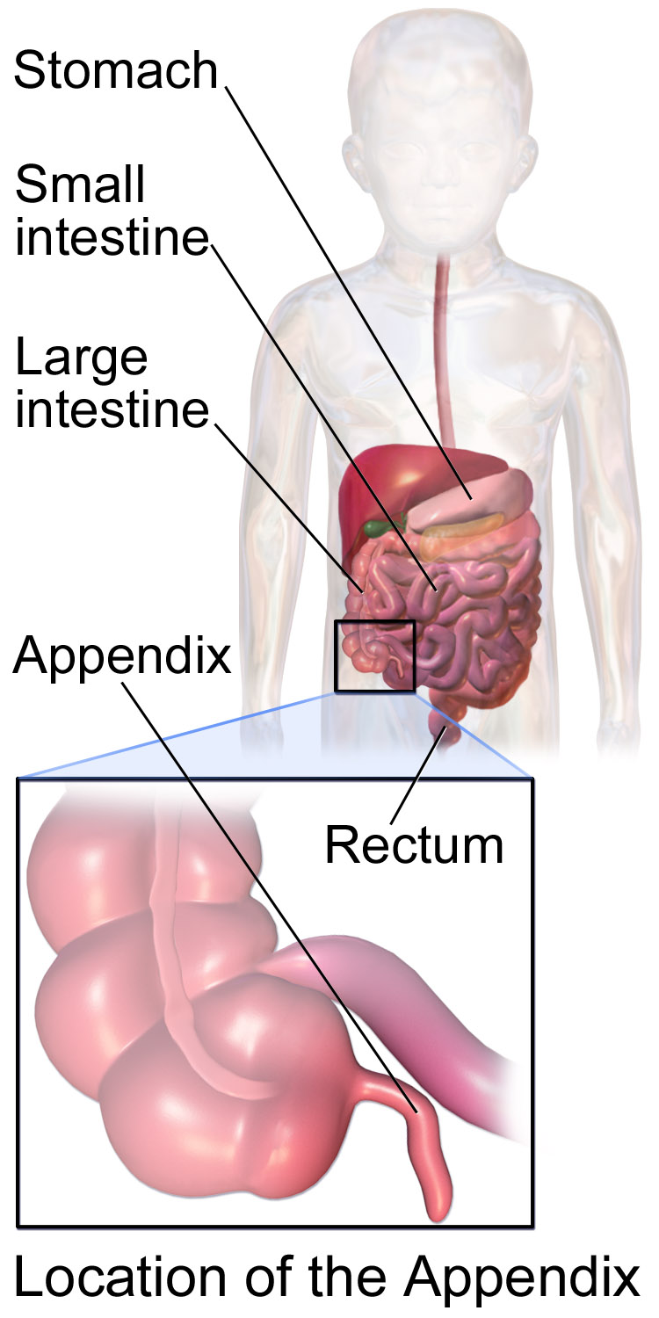
Vermiform Appendix
There are a few theories on what the appendix does.
Vestigal organ
Immune function
Helps maintain gut flora

Slide 21
The gastrointestinal tract
The gastrointestinal tract, is also called the digestive tract, alimentary canal, or gut
It is the system of organs that
takes in food
digests it
expels waste

Slide 22
The alimentary canal
The alimentary canal is the long tube of organs that runs from the mouth (where the food enters) to the anus (where indigestible waste leaves).

Slide 23
2 Processes of Digestion
During digestion two main processes occur at the same time:
Mechanical Digestion:
larger pieces of food get broken down into smaller pieces while being prepared for chemical digestion.
Mechanical digestion starts in the mouth and continues in to the stomach.
Chemical Digestion:
several different enzymes break down macromolecules into smaller molecules that can be more efficiently absorbed.
Chemical digestion starts with saliva and continues into the intestines.

Slide 24
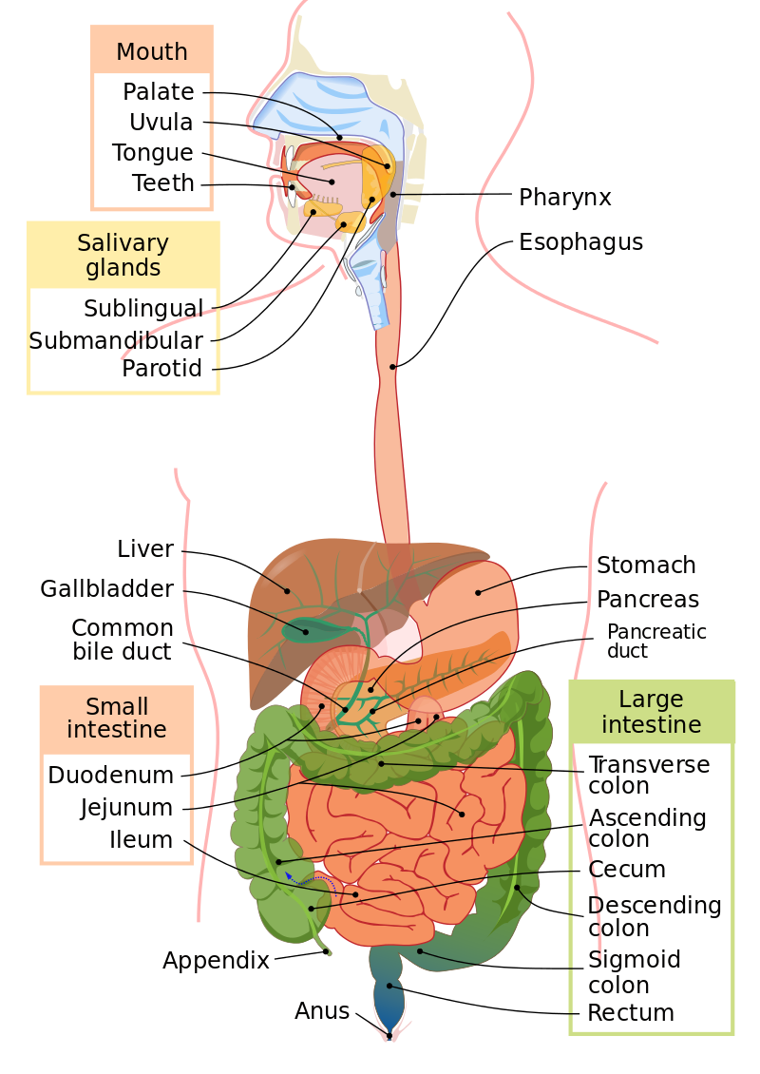
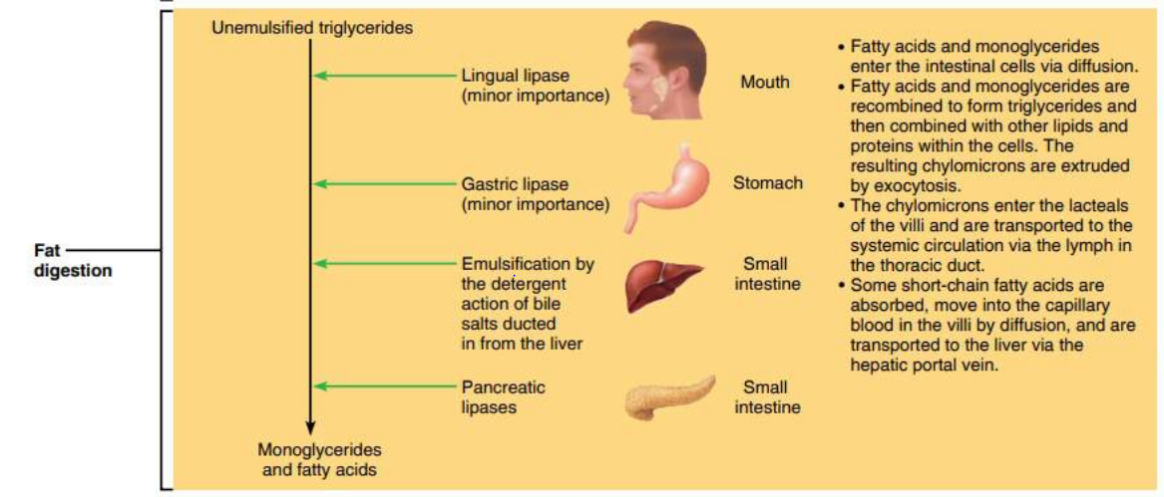
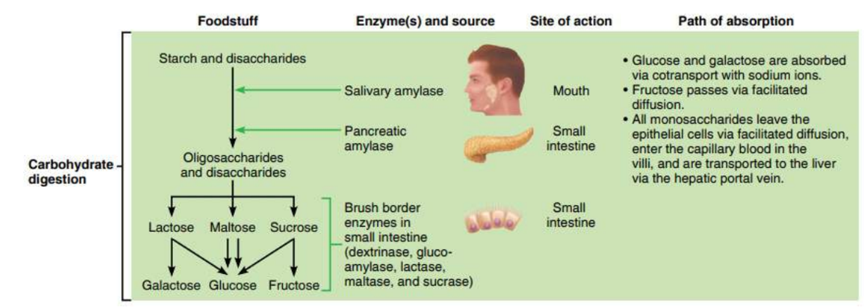
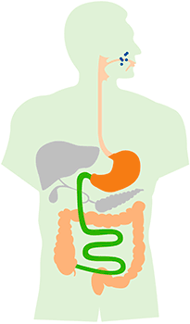
The average adult digestive tract is about thirty feet (30') long.
While in the digestive tract the food is really passing through the body rather than being in the body.
The smooth muscles of the tubular digestive organs move the food efficiently along as it is broken down into absorb-able atoms and molecules.
During absorption, the nutrients that come from food (such as proteins, fats, carbohydrates, vitamins, and minerals) pass through the wall of the small intestine and into the bloodstream and lymph.
In this way nutrients can be distributed throughout the rest of the body.
In the large intestine there is re absorption of water and absorption of some minerals as feces are formed.
The parts of the food that the body passes out through the anus is known as feces.

Slide 25
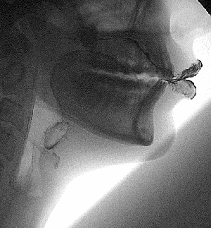
Mastication
Digestion begins in the mouth.
Saliva moistens the food while
Teeth chew it up and make it easier to swallow.
Amylase, which is the digestive enzyme found in saliva, starts to break down starch into simpler sugars before the food even leaves the mouth.

Slide 26
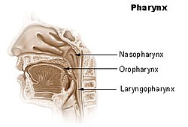
The Pharynx (Throat) (Nasopharynx, Oropharynx, Laryngopharynx)
Swallowing your food happens when the muscles in your tongue and mouth move the food into your oropharynx, then on to the laryngopharynx.
The pharynx is a common passageway for air (in the respiratory system) and for food (in the digestive system).

Slide 27
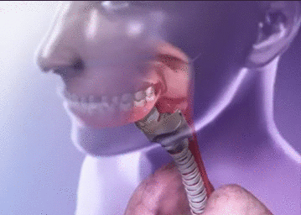
THE EPIGLOTTIS
A small flap of skin called the epiglottis closes over the pharynx to prevent food from entering the trachea and thus choking.
For swallowing to happen correctly a combination of 25 muscles must all work together at the same time.

Slide 28
ENZYME SUMMARY
Enzyme | Produced In | Site of Release | pH Level
Carbohydrate Digestion:
Salivary amylase | Salivary glands | Mouth | Neutral
Pancreatic amylase | Pancreas | Small intestine | Basic
Maltase | Small intestine | Small intestine | Basic
Protein Digestion:
Pepsin | Gastric glands | Stomach | Acidic
Trypsin | Pancreas | Small intestine | Basic
Peptidases | Small intestine | Small intestine | Basic
Nucleic Acid Digestion:
Nuclease | Pancreas | Small intestine | Basic
Nucleosidases | Pancreas | Small intestine | Basic
Fat Digestion:
Lipase | Pancreas | Small intestine | Basic

Slide 29
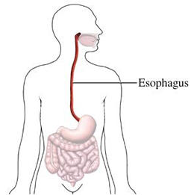
ESOPHAGUS
The esophagus is the muscular tube through which food passes from the pharynx (throat) to the stomach.
This is where the second stage of digestion is initiated (the first stage is in the mouth with teeth and tongue masticating food and mixing it with saliva).

Slide 30
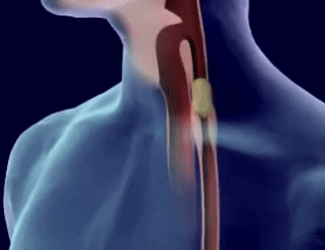
peristalsis
After passing through the throat, the food moves into the esophagus and is pushed down into the stomach by the process of peristalsis.
peristalsis is the involuntary wavelike muscle contractions that occur along the G.I. tract.
peristalsis is how food is pushed through the G.I. tract
The esophagus is lined with mucus membranes, and uses peristaltic action to move swallowed food down to the stomach.

Slide 31
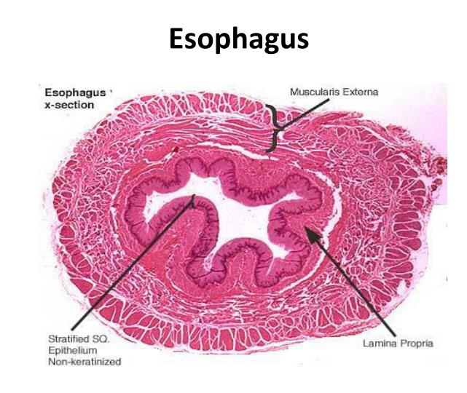
Histology of the Esophagus
The esophagus is lined by a stratified squamous epithelium.
rapidly turned over
serves as a protective layer
effect due to the high volume transit of food, saliva, and mucus into the stomach.
The lamina propria of the esophagus is sparse.
The mucus secreting glands are located in the submucosa, and are connective structures called papillae.
The muscularis propria of the esophagus consists of striated muscle in the upper third (superior) part of the esophagus.
The middle third consists of a combination of smooth muscle and striated muscle, and the bottom (inferior) third is only smooth muscle.

Slide 32
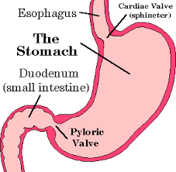
CARDIAC SPHINCTER
This part of the esophagus is called the lower esophageal sphincter a.k.a. the cardiac sphincter.
This aids in keeping food down and not being regurgitated.

Slide 34
The stomach
The stomach is a thick walled organ that lies between the esophagus and the first part of the small intestine (the duodenum).
It is on the left side of the abdominal cavity.
The fundus of the stomach lying against the diaphragm.

Slide 35
The stomach
A mucous membrane lines the stomach which contains glands (chief cells) that secrete gastric juices.
The gastric glands begin secreting before food enters the stomach due to the parasympathetic impulses of the vagus nerve.

Slide 36
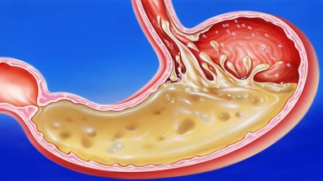
The stomach
The secretion of gastric juices occurs in three phases:
Cephalic
Gastric
Intestinal
The cephalic phase is activated by the smell and taste of food and swallowing.
The gastric phase is activated by the chemical effects of food and the distension of the stomach.
The intestinal phase blocks the effect of the cephalic and gastric phases.

Slide 37
The stomach
This Photo by Unknown Author is licensed under CC BY-SA-NC
Gastric juice also contains an enzyme named pepsin, which digests proteins.
Hydrochloric acid causes the stomach to maintain a pH of about 2 (acidic).
Acid helps kill off bacteria that comes into the digestive system.
It may cause or compound damage to the stomach wall or its layer of mucus, causing a peptic ulcer.

Slide 38
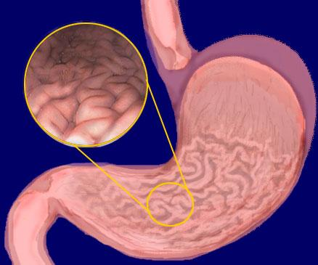
The stomach
On the inside of the stomach there are folds of skin call the gastric rugae.
Gastric rugae make the stomach very extendable, especially after a very big meal.

Slide 39
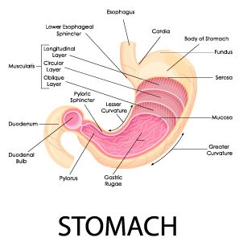
The stomach
The stomach is divided into four sections, each of which has different cells and functions.
1) Cardiac region, where the contents of the esophagus empty into the stomach,
2) Fundus, formed by the upper curvature of the organ,
3) Body, the main central region, and
4) Pylorus or atrium, the lower section of the organ that facilitates emptying the contents into the small intestine.

Slide 41
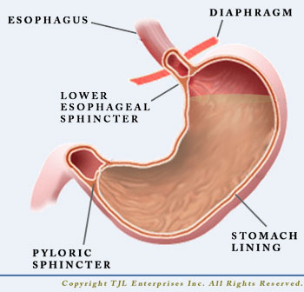
Stomach Sphincters
Two smooth muscle valves, or sphincters, keep the contents of the stomach contained.
1) Cardiac or esophageal sphincter
2) Pyloric sphincter

Slide 42
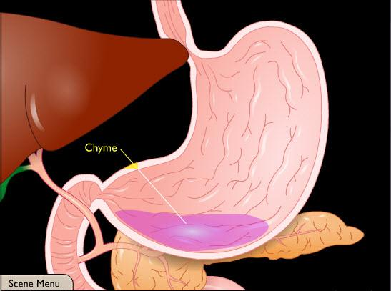
Chyme
After receiving the bolus (chewed food) the stomach undergoes smooth muscular contractions (peristalsis) mixed and churned with gastric juices the bolus is transformed into a semi-liquid substance called chyme.

Slide 43
Digestion in the stomach
Stomach muscles mix up the food with enzymes and acids to make smaller digestible pieces.
The pyloric sphincter, a walnut shaped muscular tube at the stomach outlet, keeps chyme in the stomach until it reaches the right consistency to pass into the small intestine.
The food leaves the stomach in small squirts rather than all at once.

Slide 44
Digestion in the stomach
Water, alcohol, salt, and simple sugars can be absorbed directly through the stomach wall.
However, most substances in our food need a little more digestion and must travel into the intestines before they can be absorbed.

Slide 45
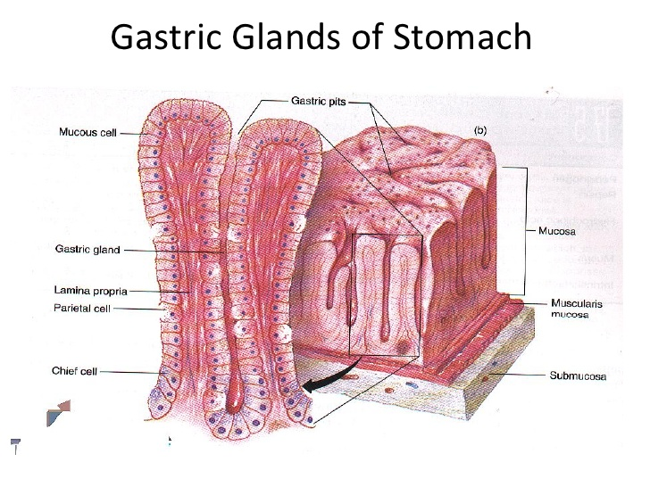
Gastric Glands
There are many different gastric glands and they secret many different chemicals.
Parietal cells secrete hydrochloric acid and intrinsic factor
Chief cells secrete pepsinogen
Goblet cells secrete mucus
Argentaffin cells secrete serotonin and histamine
G cells secrete the hormone gastrin.

Slide 46
Histology of the human stomach
the first main layer is the mucosa.
This consists of an epithelium, the lamina propria underneath, and a thin bit of smooth muscle called the muscularis mucosa.
The submucosa lies under this and consists of fibrous connective tissue, separating the mucosa from the next layer, the muscularis externa.
The muscularis in the stomach differs from that of other GI organs in that it has three layers of muscle instead of two. Under these muscle layers is the adventitia, layers of connective tissue continuous with the omenta.
The epithelium of the stomach forms deep pits, called fundic or oxyntic glands.
Different types of cells are at different locations down the pits. The cells at the base of these pits are chief cells, responsible for production of pepsinogen, an inactive precursor of pepsin, which degrades proteins. The secretion of pepsinogen prevents self-digestion of the stomach cells.

Slide 47
Histology of the human stomach
Further up the pits, parietal cells produce gastric acid and a vital substance, intrinsic factor.
The functions of gastric acid
kills most of the bacteria in food,
stimulates hunger
activates pepsinogen into pepsin
denatures the complex protein molecule as a precursor to protein digestion through enzyme action in the stomach and small intestines.

Slide 48
Histology of the human stomach
Near the top of the pits, closest to the contents of the stomach, there are mucous-producing cells called goblet cells that help protect the stomach from self-digestion.
The muscularis externa is made up of three layers of smooth muscle.
.

Slide 49
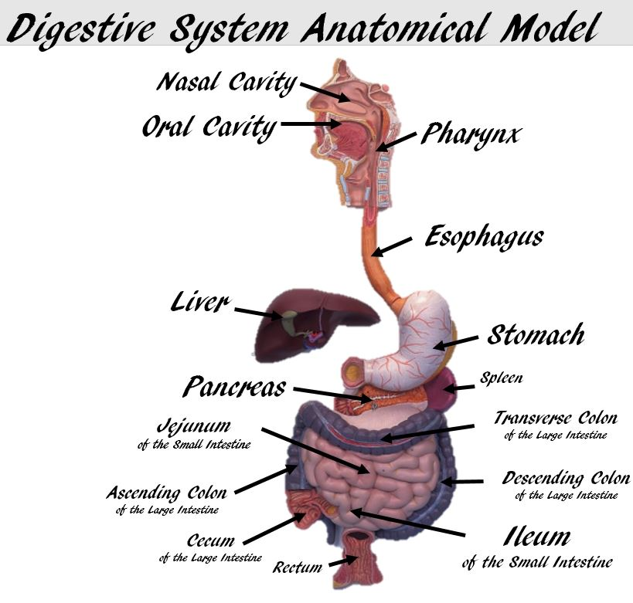
Control of secretion and motility
The movement and the flow of chemicals into the stomach are controlled by both the nervous system and by the various digestive system hormones.
The hormone gastrin causes an increase in the secretion of HCL, pepsinogen and intrinsic factor from parietal cells in the stomach. It also causes increased motility in the stomach. Gastrin is released by G-cells into the stomach. It is inhibited by pH normally less than 4 (high acid), as well as the hormone somatostatin.

Slide 50
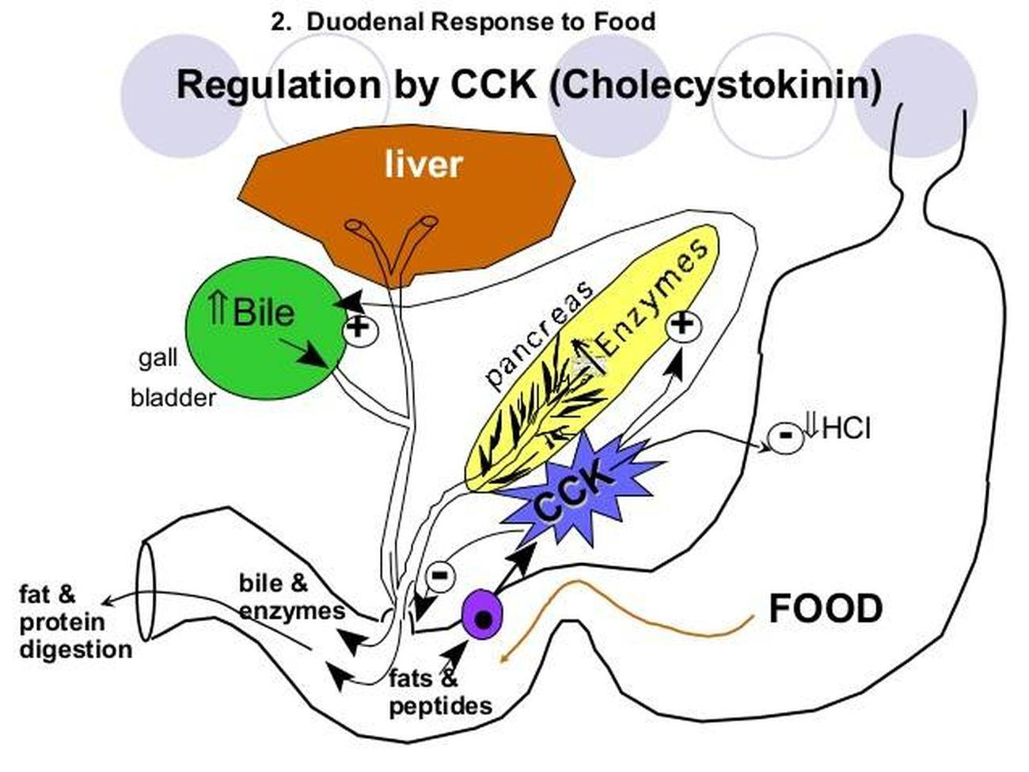
Cholecystokinin (CCK)
Cholecystokinin (CCK) has most effect on the gall bladder, but it also decreases gastric emptying.

Slide 51
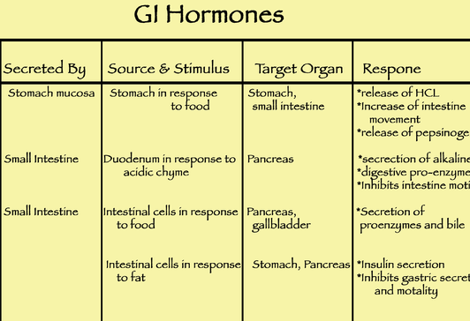
secretin
Secretin is a hormone released into the bloodstream by the duodenum (especially in response to acidity) to stimulate secretion by the liver and pancreas.

Slide 52
GASTRIN
Gastrin is a hormone that is produced by ‘G’ cells in the lining of the stomach and upper small intestine.
During a meal, gastrin stimulates the stomach to release gastric acid.
Gastric Acid –
breaks down protein
absorbs certain vitamins
kills harmful bacteria
Stimulates the release of bile from the gallbladder
Stimulates the release of pancreatic enzymes from the pancreas
Stimulates expansion of the stomach lining
Increases muscle contractions of the gut

Slide 53
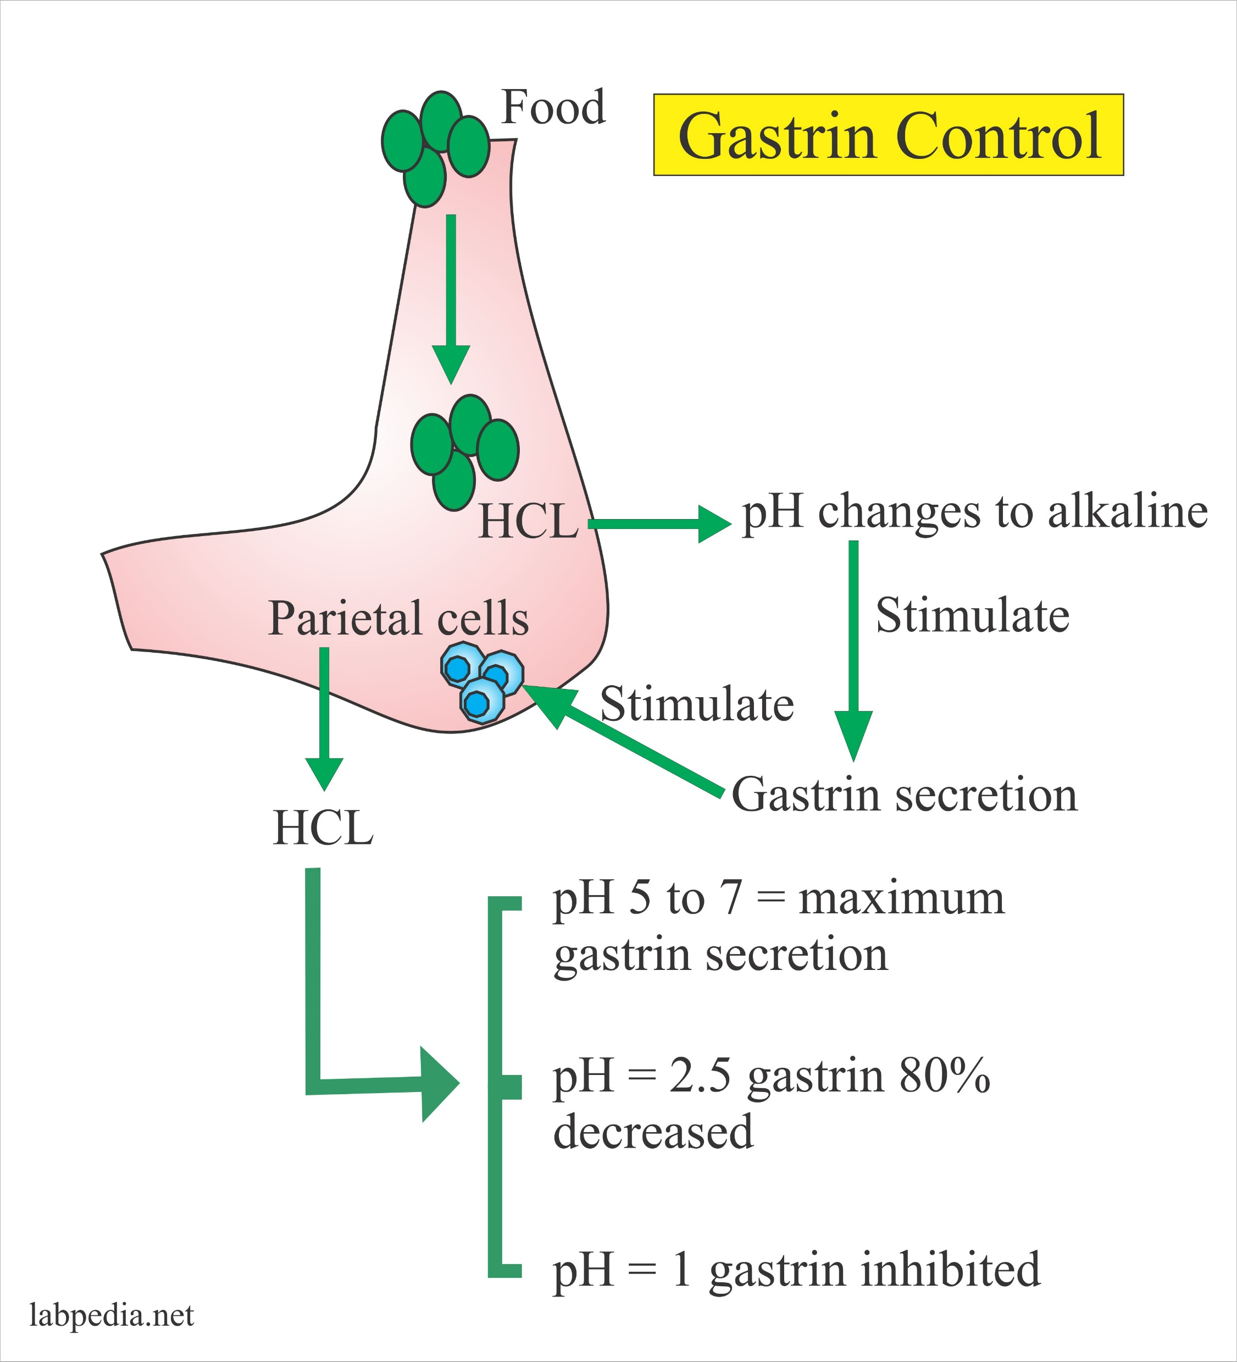
How is gastrin controlled?
Before a meal, the anticipation of eating stimulates the release of Gastrin.
During a meal, Gastrin release is stimulated by stretch receptors in the stomach wall.
the hormone somatostatin inhibits or slows the production and release of gastrin.
Somatostatin is released when the stomach empties at the end of a meal or when pH gets too low.

Slide 54
Small Intestines
The small intestine is the site where most of the chemical and mechanical digestion is carried out.
Tiny projections called villi line the small intestine which absorbs digested food into the capillaries.
Most of the food absorption takes place in the jejunum and the ileum.

Slide 55
Small Intestines
The functions of a small intestine is, the digestion of proteins into peptides and amino acids principally occurs in the stomach but some also occurs in the small intestine.
Peptides are degraded into amino acids; lipids (fats) are degraded into fatty acids and glycerol; and carbohydrates are degraded into simple sugars.

Slide 56
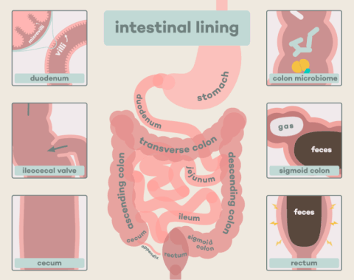
The three main sections of the small intestine are the duodenum, the jejunum, the ileum.
The duodenum
In anatomy of the digestive system, the duodenum is a hollow jointed tube connecting the stomach to the jejunum. It is the first and shortest part of the small intestine. It begins with the duodenal bulb and ends at the ligament of Treitz. The duodenum is almost entirely retro peritoneal. The duodenum is also where the bile and pancreatic juices enter the intestine.
The jejunum
The jejunum is a part of the small bowel, located between the distal end of duodenum and the proximal part of ileum. The jejunum and the ileum are suspended by an extensive mesentery giving the bowel great mobility within the abdomen. The inner surface of the jejunum, its mucous membrane, is covered in projections called villi, which increase the surface area of tissue available to absorb nutrients from the gut contents. It is different from the ileum due to fewer goblet cells and generally lacks Peyer's patches.
The ileum
Its function is to absorb vitamin B12 and bile salts. The wall itself is made up of folds, each of which has many tiny finger-like projections known as villi, on its surface. In turn, the epithelial cells which line these villi possess even larger numbers of micro villi. The cells that line the ileum contain the protease and carbohydrate enzymes responsible for the final stages of protein and carbohydrate digestion. These enzymes are present in the cytoplasm of the epithelial cells. The villi contain large numbers of capillaries which take the amino acids and glucose produced by digestion to the hepatic portal vein and the liver.
The terminal ileum continues to absorb bile salts, and is also crucial in the absorption of fat-soluble vitamins (Vitamin A, D, E and K). For fat-soluble vitamin absorption to occur, bile acids must be present.

Slide 57
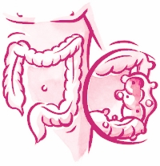
The large intestine (colon)
The large intestine (colon) extends from the end of the ileum to the anus. It is about 5 feet long, being one-fifth of the whole extent of the intestinal canal.
It's caliber is largest at the commencement at the cecum, and gradually diminishes as far as the rectum, where there is a dilatation of considerable size just above the anal canal.
This Photo by Unknown Author is licensed under CC BY-SA

Slide 58
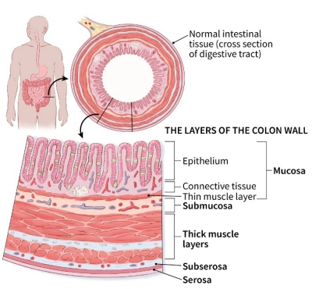
It differs from the small intestine in by the greater caliber, more fixed position, sacculated form, and in possessing certain appendages to its external coat, the appendices epiploicæ.
Further, its longitudinal muscular fibers do not form a continuous layer around the gut, but are arranged in three longitudinal bands or tæniæ.

Slide 59
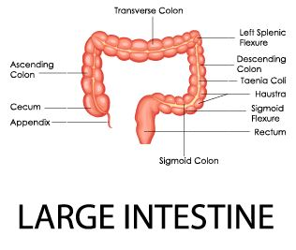
The large intestine
The large intestine is divided into the cecum, ascending colon, transverse colon, the descending, sigmoid colon (flexure) rectum, and anal canal.

Slide 60
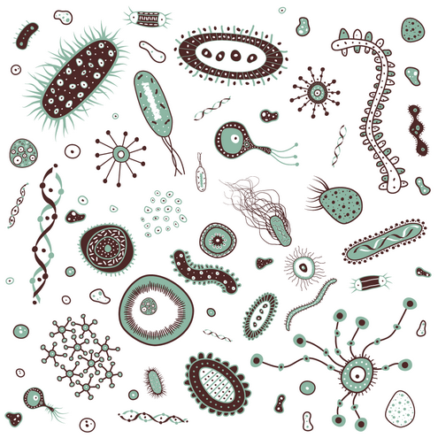
BENEFICIAL BACTERIA
There are many beneficial bacteria but some of the most common and important are Lactobacillus Acidophilus and various species of Bifidobacterium. These are available as "probiotics" from many sources.
synthesize vitamins, like B12, biotin, and vitamin K
breakdown toxins
stop proliferation of harmful organisms
stimulate the immune system
produce short chain fatty acids (SCFAs) that are required for the health of colon cells and help prevent colon cancer.

Slide 61
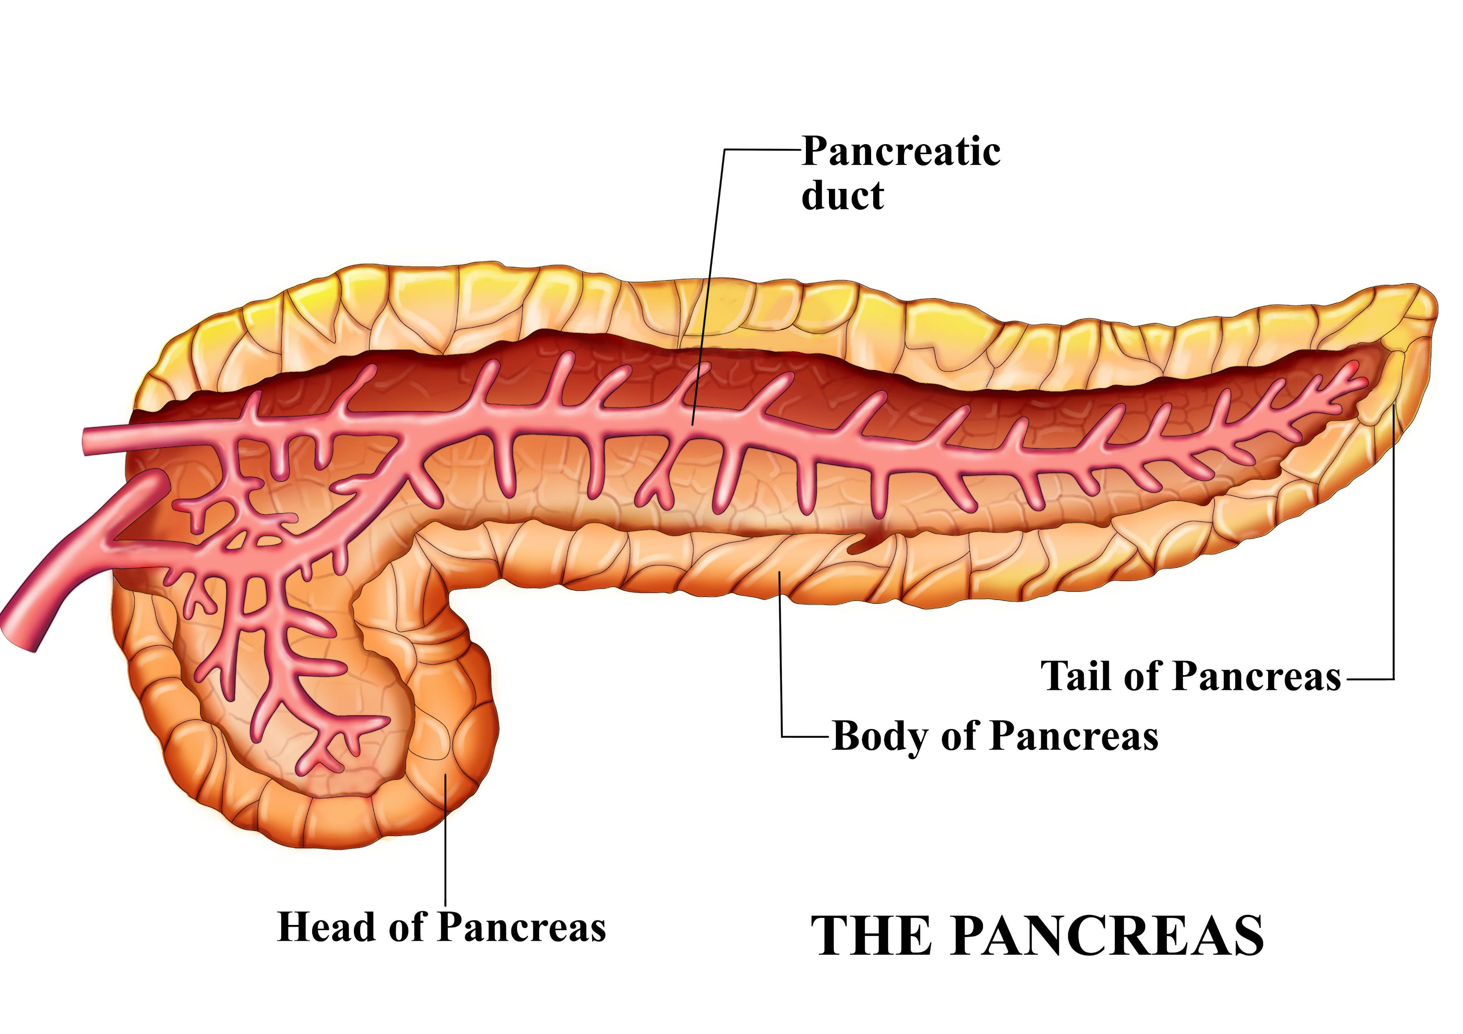
Pancreas
The Pancreas Has 3 regions:
the head
the body
The tail
The function of the pancreas is to:
produce enzymes that break down digestible foods (exocrine pancreas)
secrete hormones that affect carbohydrates metabolism (endocrine pancreas).

Slide 62
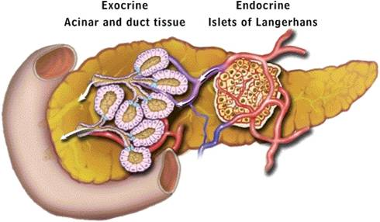
Exocrine Function of the Pancreas
The pancreas contain exocrine cells.
These exocrine cells contain ducts.
These exocrine cells contain precursor digestive enzymes (mainly trypsinogen, chymotrypsinogen, pancreatic lipase, and amylase).
These granules are termed zymogen granules (zymogen referring to the inactive precursor enzymes.)
It is important to synthesize inactive enzymes in the pancreas to avoid auto degradation, which can lead to pancreatitis.

Slide 63
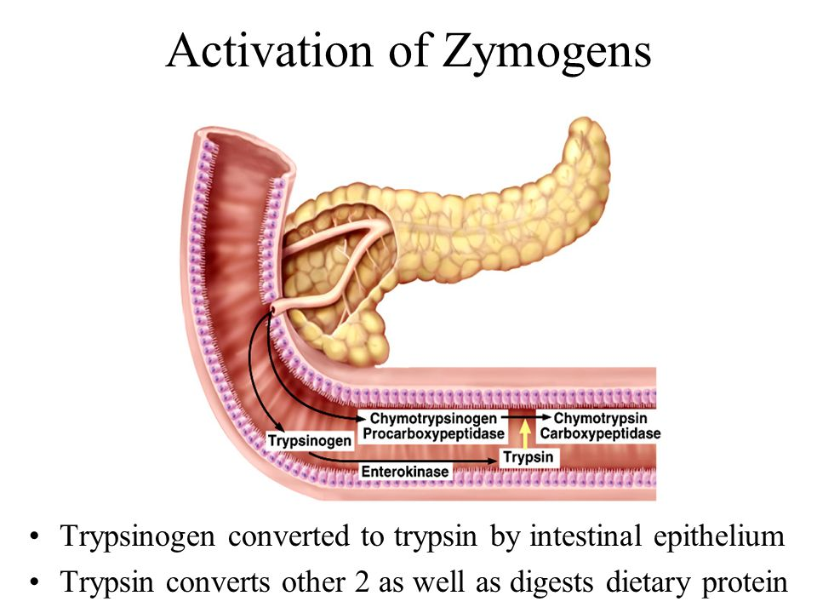
zymogens: trypsinogen and chymotrypsinogen.
The pancreas creates the zymogens: trypsinogen and chymotrypsinogen.
These zymogens are inactivated forms of trypsin and chymotrypsin.
trypsinogen reacts with enterokinase present in the intestines to form trypsin.
trypsin functions to activate trypsinogen and chymotrypsinogen to their active forms.

Slide 64
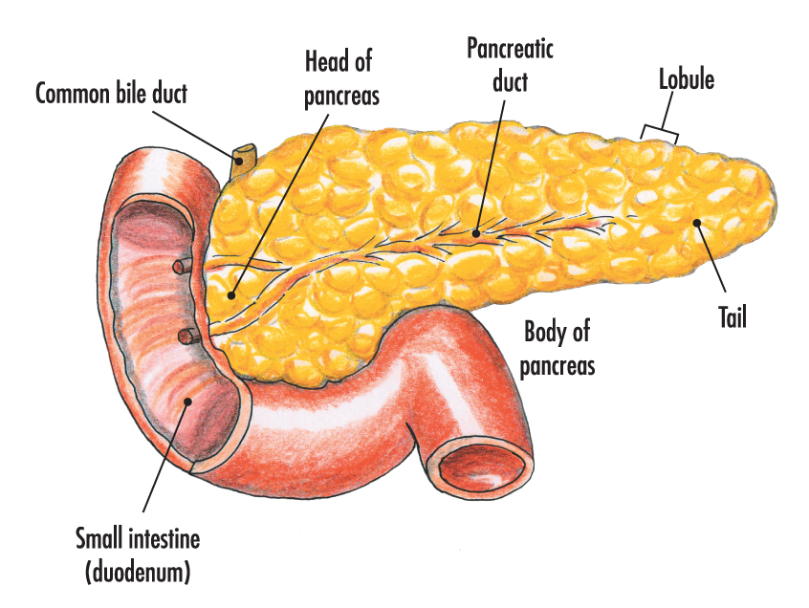
zymogens: trypsinogen and chymotrypsinogen.
Pancreatic secretions accumulate in intralobular ducts that drain the main pancreatic duct, which drains directly into the duodenum.
This Photo by Unknown Author is licensed under CC BY-NC-ND

Slide 66
Endocrine Cells of the Pancrease
The endocrine cells of the pancreas are located in the islets of Langerhans.
They are:
Insulin-producing beta cells (50-80% of the islet cells)
Glucagon-releasing alpha cells (15-20%)
Somatostatin-producing delta cells (3-10%)
Pancreatic polypeptide-containing PP cells (remaining %)

Slide 67
Liver
The liver plays a major role in metabolism and has a number of functions in the body including
Glycogen storage
Plasma protein synthesis
Drug detoxification
Bile production
Regulates a wide variety of high-volume biochemical reactions

Slide 68
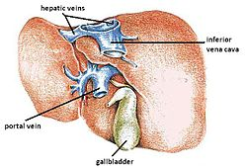
The liver
The liver is considered both an ORGAN and a GLAND.
The liver is supplied by two main blood vessels on its right lobe:
the hepatic artery
The hepatic artery normally comes off the celiac trunk.
the portal vein
The portal vein brings venous blood from the spleen, pancreas, and small intestine, so that the liver can process the nutrients and byproducts of food digestion.
The hepatic veins drain directly into the inferior vena cava.

Slide 69
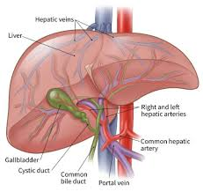
The liver
The liver is considered both an ORGAN and a GLAND.
The liver is supplied by two main blood vessels on its right lobe:
the hepatic artery
The hepatic artery normally comes off the celiac trunk.
the portal vein
The portal vein brings venous blood from the spleen, pancreas, and small intestine, so that the liver can process the nutrients and byproducts of food digestion.
The hepatic veins drain directly into the inferior vena cava.

Slide 70
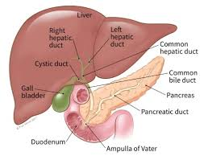
Ductal System
The bile produced in the liver is collected in bile canaliculi, which merge from bile ducts.
These eventually drain into the right and left hepatic ducts.
The right and left hepatic ducts merge to form the common hepatic duct.

Slide 71
Ductal System
The cystic duct (from the gallbladder) joins with the common hepatic duct to form the common bile duct.
Bile can either drain directly into the duodenum via the common bile duct or be temporarily stored in the gallbladder via the cystic duct.
The common bile duct and the pancreatic duct enter the duodenum together at the ampulla of Vater.
The branching's of the bile ducts resemble those of a tree, and indeed term "biliary tree" is commonly used in this setting.

Slide 72
The various functions of the liver are carried out by the liver cells or hepatocytes.
The liver produces and excretes bile, required for dissolving fats.
Some of the bile drains directly into the duodenum, and some is stored in the gallbladder.

Slide 73
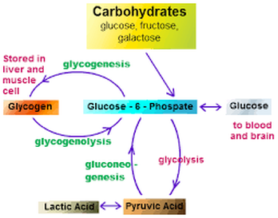
carbohydrate metabolism
The liver performs several roles in carbohydrate metabolism:
Gluconeogenesis (the formation of glucose from certain amino acids, lactate or glycerol)
Glycogenolysis (the formation of glucose from glycogen)
Glycogenesis (the formation of glycogen from glucose)

Slide 74
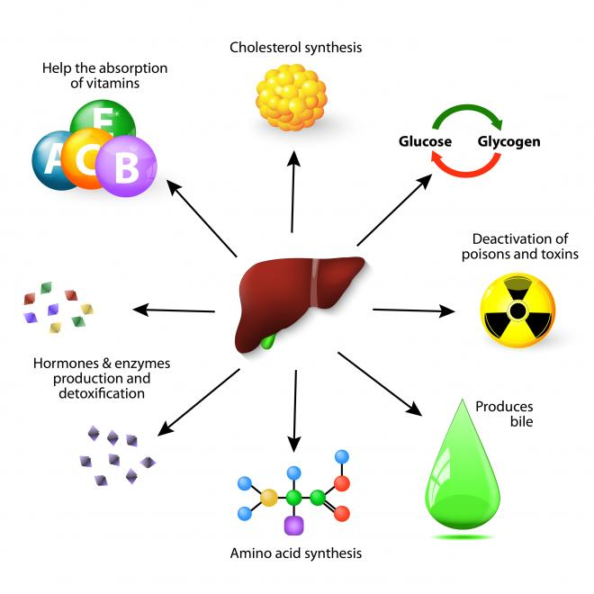
The breakdown of insulin and other hormones

Slide 75
The liver is responsible for protein metabolism.
The liver also performs several roles in lipid metabolism:
Cholesterol synthesis
Production of triglycerides (fats)
Breaks down hemoglobin
Breaks down toxic substances
Drug metabolism
Converts ammonia to urea
Stores glucose in the form of glycogen

Slide 76
Gallbladder
The gallbladder stores bile, which is released when food containing fat enters the digestive tract.
The release of bile from the gallbladder stimulates the secretion of cholecystokinin (CCK).
The bile emulsifies fats and neutralizes acids in partly digested food.
After being stored in the gallbladder, the bile becomes more concentrated than when it left the liver, increasing its potency and intensifying its effect on fats.

Slide 77
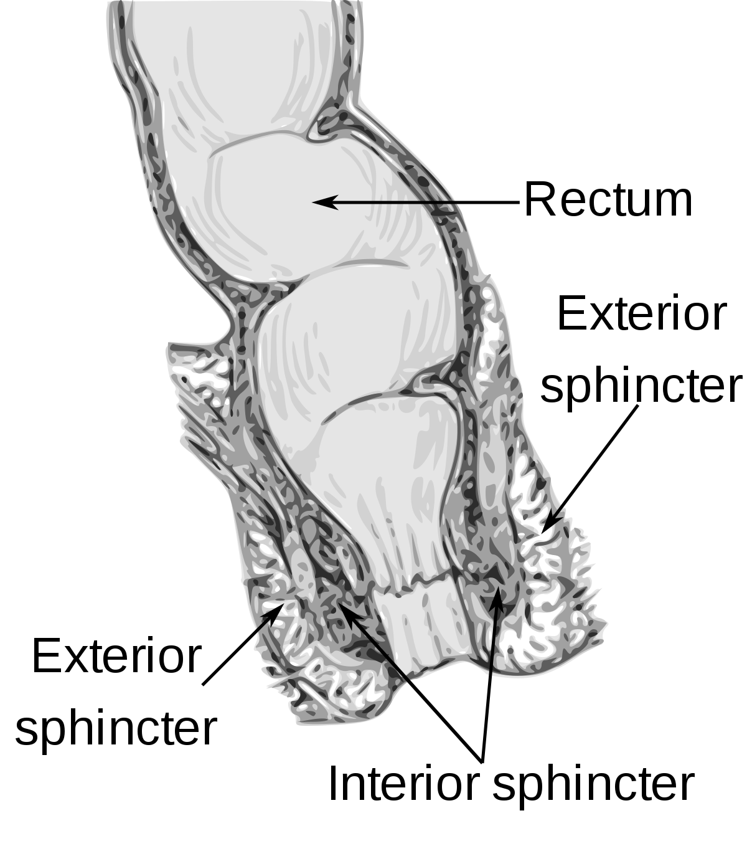
Anus
The Anus has two anal sphincters
Internal Anal Sphincter
External Anal Sphincter
These hold the anus closed until defecation occurs.
The internal sphincter - consists of smooth muscle and its action is involuntary
The external sphincter The other consists of striated muscle and its action is voluntary.

