Slide 1
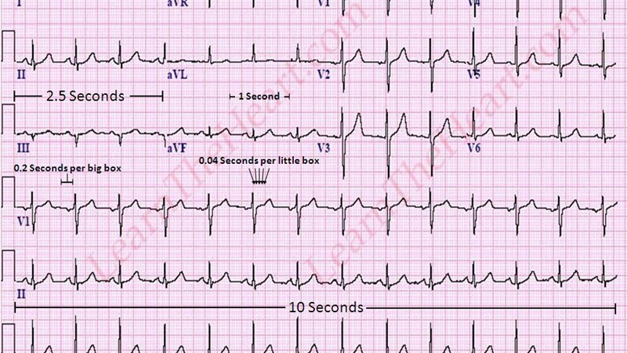
Cardiovascular Laboratory
Adapted from The McGill Physiology Virtual Lab

Slide 2
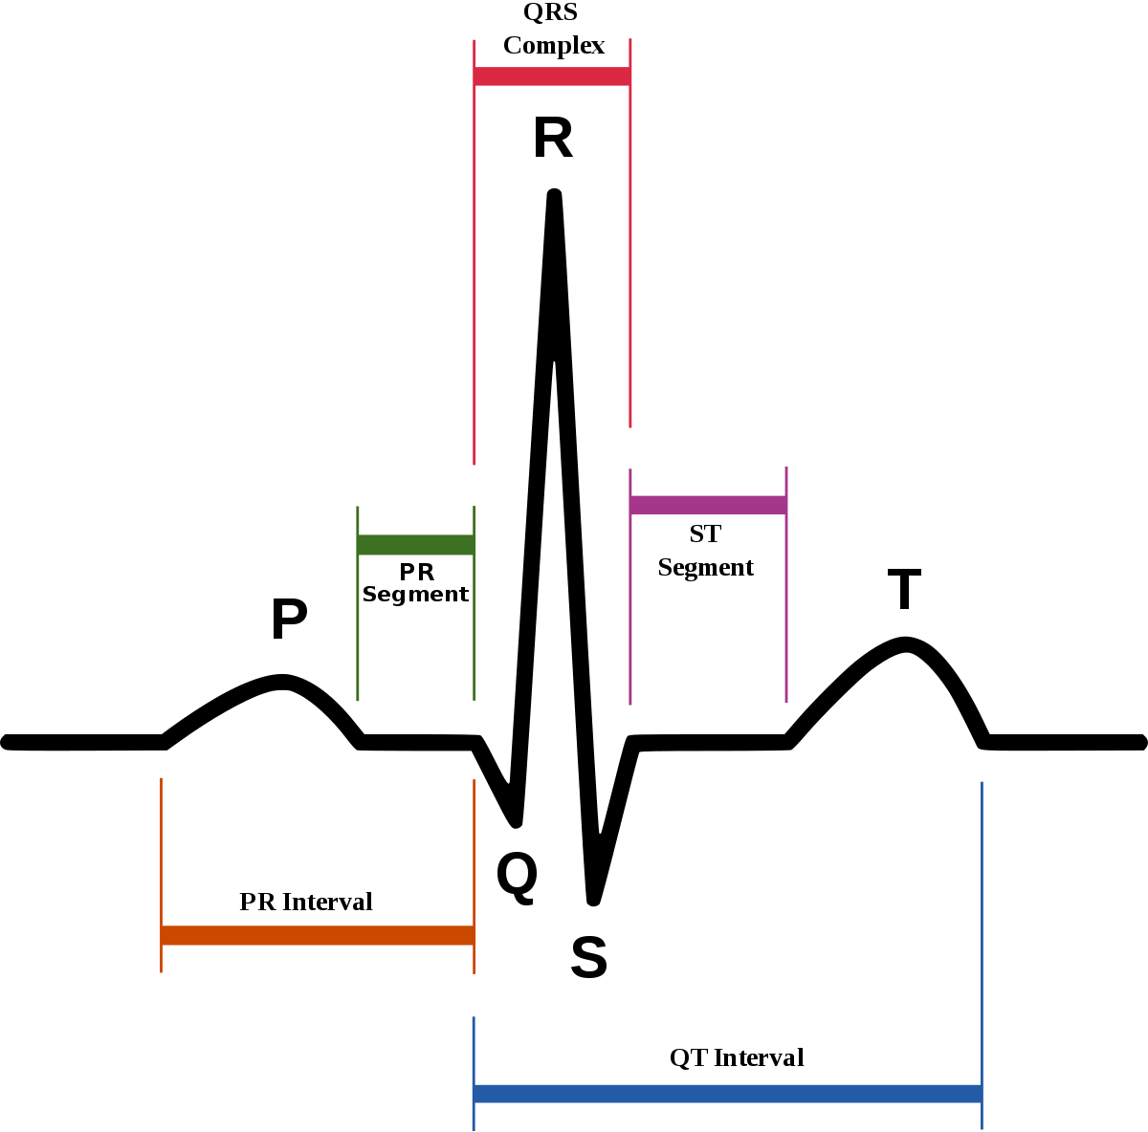
ECG> Introduction
The electrocardiograph (abbreviated ECG or EKG) is a device that picks up electrical activity originating in the heart from the surface of the body. In the clinic, the ECG is one of the most commonly used diagnostic machines. The recording produced by the electrocardiograph is called an electrocardiogram, also abbreviated ECG or EKG.

Slide 3
Electrocardiogram Waveform
The figure to the right shows a typical ECG.
Three characteristic features of the waveform are easily identified:
the P wave, the QRS complex, and the T wave.

Slide 4
Electrocardiogram Waveform
The P wave is associated with the activation of the atria, the QRS complex with the activation of the ventricles, and the T wave with repolarization of the ventricles.

Slide 5
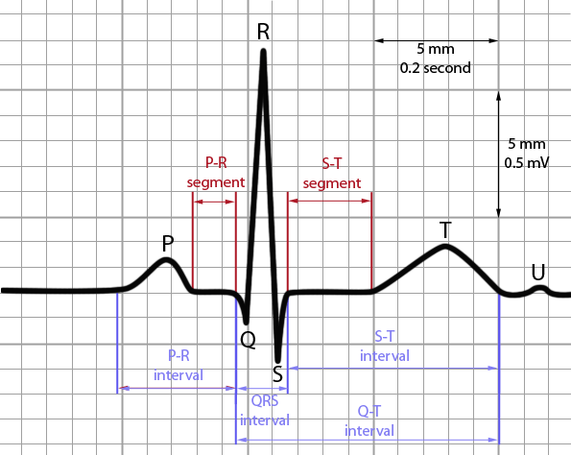
Electrocardiogram Intervals
The P-R interval is the time from the beginning of the P wave to the start of the QRS complex.
The QRS interval or duration or width is the time from the beginning to the end of the QRS complex.
The QT interval is the time from the beginning of the QRS complex to the end of the T wave.
The RR interval is the time from the peak of one R wave to that of the following R wave.

Slide 6
ECG> Setup - Practical Points
To ensure that the recording technique is uniform and to reduce the number of variables influencing the tracing, the following points must be kept in mind: there must be effective contact between electrode and skin
The subject should lie flat on their back; lying on side or sitting up alters the heart's electrical axis.

Slide 7
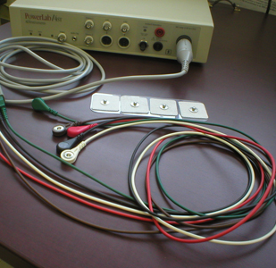
ECG> Setup - Equipment
The ECG signal will be recorded through the PowerLab data acquisition system, which contains an isolated input amplifier (BioAmp).
A five-lead patient cable is connected to the input of the BioAmp. Here, only three leads will be used.

Slide 8
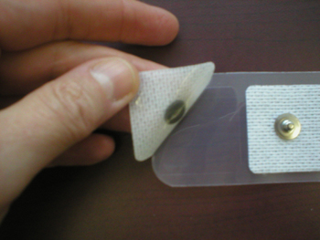
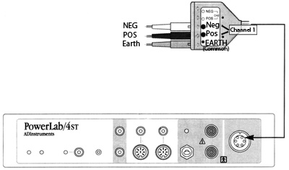
Four disposable electrodes and alcohol pads are also required.

Slide 9
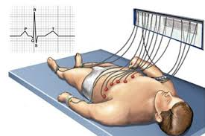
Procedure
The subject should lie flat on his/her back on a bench or cot, with hands at their sides.

Slide 10
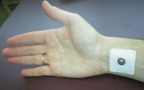
Procedure
The inner aspect of the right forearm just above the wrist is rubbed briskly with alcohol.
The disposable electrode is then placed onto the cleansed area.

Slide 11
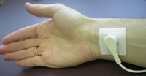
Procedure
The electrodes are placed in the same way for the left arm, and then for both legs, attaching the electrodes a few inches above the subject's ankle.

Slide 12
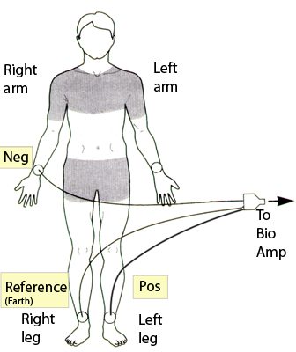
Procedure
Depending on the lead orientation, the appropriate leads of the patient cable are snapped on the electrodes.
For example, the following connections are made in order to record from Lead II:
NEG (white plug) to the right arm
POS (black plug) to the left leg
Earth (green plug, Common or reference) to the right leg

Slide 13
The Three Standard Bipolar Limb Leads
The LL electrode is taken to the + terminal of the BioAmp, and the RA electrode is taken to the - terminal of the BioAmp. Thus the output called Lead II is the difference in the potentials appearing on the left leg and the right arm:
Lead II = (V_{LL} - V_{RL}) - (V_{RA} - V_{RL}) = V_{LL} - V_{RA} Remember that the potential measured at the right leg (VRL) is used as the reference potential

Slide 14
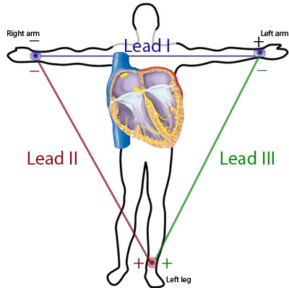
The Three Standard Bipolar Limb Leads
Lead I = (VLA - VRL) - (VRA - VRL) = VLA - VRA Lead II = (VLL - VRL) - (VRA - VRL) = VLL - VRA Lead III = (VLL - VRL) - (VLA - VRL) = VLL - VLA
The figure shows a diagrammatic representation of the Einthoven Triangle Hypothesis.
In Einthoven's triangle, the heart may be considered to lie at the center of an equilateral triangle and the corners of the triangles are the effective sensing points - the right arm, left arm and left leg electrodes.

Slide 15
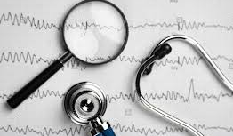
ECG> Basics
In brief, you need to understand and remember:
the depolarization and repolarization sequence in the heart
the fact that when a wavefront of depolarization travels towards the + electrode and away from the electrode attached to the - terminal, a positive-going deflection will result.
the voltage recorded along a particular lead axis at a particular time is obtained by taking a projection onto that axis of the vector representing the magnitude and direction of depolarization at that time.
Einthoven's law: a complex in lead II is equal to the sum of the corresponding complexes in leads I and III.

Slide 16
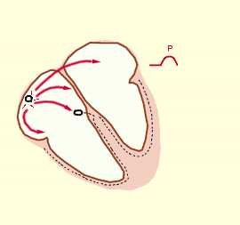
Activation of the Heart and the ECG
The drawings to the right in the table below show the main stages of activation of the heart, as well as the ECG recorded in lead II at those stages.

Slide 17
Activation of the Heart and the ECG
The electrical activity of the heart originates in the sino-atrial node.
The impulse then rapidly spreads through the right atrium to the atrioventricular node.
It also spreads through the atrial muscle directly from the right atrium to the left atrium.
The P-wave is generated by activation of the muscle of both atria.

Slide 18
Activation of the Heart and the ECG
The impulse travels very slowly through the AV node, then very quickly through the bundle of His, then the bundle branches, the Purkinje network, and finally the ventricular muscle..

Slide 19
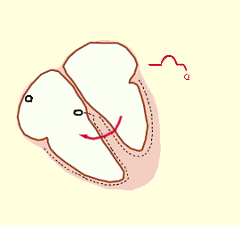
Activation of the Heart and the ECG
The first area of the ventricular muscle to be activated is the interventricular septum, which activates from left to right.
This generates the Q-wave.

Slide 20
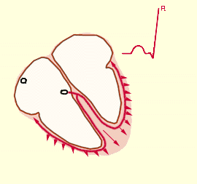
Activation of the Heart and the ECG
Next, the left and right ventricular free walls, which form the bulk of the muscle of both ventricles, gets activated, with the endocardial surface being activated before the epicardial surface.
This generates the R-wave.

Slide 21
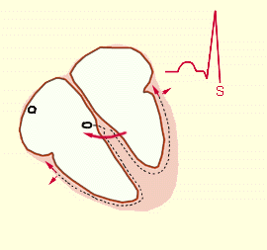
Activation of the Heart and the ECG
A few small areas of the ventricles are activated at a rather late stage.
This generates the S-wave.

Slide 22
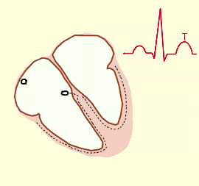
Activation of the Heart and the ECG
Finally, the ventricular muscle repolarizes.
This generates the T-wave.

Slide 23
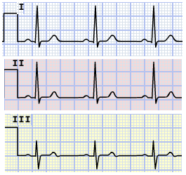
Cardiac axis
The cardiac axis refers to the mean direction of the wave of ventricular depolarization in the frontal plane, measured from a zero reference point.
The mean QRS axis is obtained from measurements of the heights of the QRS waves in the 3 leads.

Slide 24
Cardiac axis
In the example to the right, notice that there are tall R waves in leads I and II, and that in lead III, the R and the S waves are of equal size and opposite direction.

Slide 25
COMMON MISCONCEPTIONS ABOUT THE ECG
The PR interval is NOT in general measured from the P wave to the R wave.
It is rather defined to be the time from the beginning of the P-wave to the beginning of the QRS complex.
Thus the PR interval is measured from the beginning of the P-wave to the beginning of the R-wave only if the first deflection in the QRS complex happens to be an R-wave (i.e. no Q-wave present).

Slide 26
COMMON MISCONCEPTIONS ABOUT THE ECG
Similarly, the QT interval is NOT in general measured from the Q-wave to the T-wave.
It is rather defined as the time from the beginning of the QRS complex to the end of the T-wave.

Slide 27
COMMON MISCONCEPTIONS ABOUT THE ECG
The P-wave (QRS complex) is NOT generated by the contraction of the atria (ventricles).
It is generated by electrical activity (more specifically depolarization or activation) of the muscle.

Slide 28
COMMON MISCONCEPTIONS ABOUT THE ECG
Purkinje fibre cells are NOT nerve cells.
Rather, they are specialized cardiac muscle cells.
The sinoatrial node, atrioventricular node, bundle of His, and bundle branches are also made up of specialized cardiac muscle cells.

Slide 29
THE FOLLOWING STATEMENTS ARE TRUE:
One does NOT see any deflection on the ECG during the time that the sinoatrial node is being depolarized.
The depolarization of the atrioventricular node and the His-Purkinje system also does not generate any electrical activity that is detectable in the ECG.

Slide 30
THE FOLLOWING STATEMENTS ARE TRUE:
One does not necessarily see a Q-wave or an R-wave or an S-wave in each lead that one examines.
Indeed, in some individuals with perfectly normal hearts, there is no Q-wave present in any of the three leads I-III.
Other normal individuals have no S-waves in any of the three leads.

Slide 31
1) Inspecting the ECG
While displaying Lead II, the P-wave, the QRS-complex, and the T-wave are identified.
In the chart program, experiment with different settings for the time scale and the voltage scale so that, e.g. the waveform is not too big or small in amplitude.

Slide 32
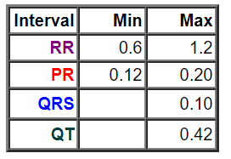
2) Identifying Waves and Intervals
The time scale is set to an appropriate value for displaying the overall shape of the P-QRS-T waveform.
The various complexes and intervals are examined.
The RR, PR, QRS and QT intervals are measured, and compared to the normal ranges given in the table to the right (in seconds).

Slide 33
3) Effect of Lead Placement
The white (Neg) electrode on the right arm is moved from its position on the wrist to a new position somewhere above the elbow.

Slide 34
3) Effect of Lead Placement
After returning the white electrode to its original position, the subject extends the right arm outwards and holds it horizontally in mid-air away from the body.

Slide 35
3) Effect of Lead Placement
The above ECG trace appears very noisy, because the recording is also picking up the EMG activity from the muscles used in extending the arm outwards.

Slide 36
4) Effect of Respiration
In sinus arrhythmia, the heart rate varies with the phase of respiration.
The heart rate typically increases during inspiration and decreases during expiration.
Therefore, as observed, the R-R interval is longer during expiration.
These changes are mediated through vagal reflexes.
Sinus arrhythmia is more common in young healthy athletes.

Slide 37
5) The Timing of the Heart Sounds
One member of the group listens with the stethoscope to the subject's heartbeat to determine where the two well-separated heart sounds fall on the ECG trace.

Slide 38
5) The Timing of the Heart Sounds
The first heart sound S₁ is due to the closure of the mitral and tricuspid valves at the start of ventricular systole. The second heart sound S₂ is due to the closure of the aortic and pulmonary valves.

Slide 39
6) Changes in Morphology with Leads
The three following leads were recorded in one particular individual.
There is no guarantee that the ECG recorded by your group will be similar to those three traces, since there is large inter-individual variability in the ECG.

Slide 40
6) Changes in Morphology with Leads
Recall that the R wave is due to the activation (depolarization) of the major portion of the ventricles. From the sample data above, it is evident that the lead whose axis is most parallel to the direction of the subject's ventricular depolarization is lead II. (The R wave is largest in lead II.) The R wave is very small in lead I. We can therefore conclude that for this subject the direction of ventricular depolarization is more close to being perpendicular to lead I.

Slide 41
ECG> Cardiac Arrhythmias
1) Sinus Tachycardia
Sinus tachycardia occurs in adults when impulses originate at the SA node at a rate greater than 100 per minute . It may or may not be clinically significant, and is not in itself indicative of cardiac disease. (For example, sinus tachycardia may be associated with fever or exercise.)

Slide 42
ECG> Cardiac Arrhythmias
2) Sinus Bradycardia
Sinus bradycardia occurs when impulses originate at the SA node at a rate of less than 60 per minute. Sinus bradycardia is not necessarily indicative of cardiac disease and is often seen in athletes and during sleep.

Slide 43
ECG> Cardiac Arrhythmias
3) Atrioventricular (AV) block
Partial AV block occurs when AV node damage prevents some atrial impulses from being transmitted to the ventricles. In the particular case illustrated, every second P wave is not followed by QRS and T waves, producing 2:1 AV block. It is said that there are "dropped beats" of the ventricles.

Slide 44
ECG> Cardiac Arrhythmias
3) Atrioventricular (AV) block
Complete AV block: When the condition that is causing poor conduction in the AV node becomes severe, there is a complete block of the impulses from the atria to the ventricles. In that case, a subsidiary pacemaker can arise in the ventricles, which then paces the ventricular muscle. There is then no synchronization between atrial and ventricular electrical activity. The ventricles have "escaped" from atrial control, and are beating at their own natural rate, which is typically much less than the sinus rate.

Slide 45
ECG> Cardiac Arrhythmias
4) Premature Contractions A premature contraction occurs when the heart contracts prior to the time when normal contraction is expected. Some premature contractions are due to ectopic foci in the heart, which emit abnormal impulses at abnormal times during the cardiac rhythm. The ectopic focus can be situated anywhere in the heart. In the case of a premature contraction, the PR interval is often shorter for the premature beat than for the normal sinus beat.

Slide 46
ECG> Cardiac Arrhythmias
5) Ventricular Fibrillation
In ventricular fibrillation, multiple impulses are simultaneously traveling in different directions through the ventricles. If left untreated, ventricular fibrillation results in death within about 2-4 minutes. Although electric shock can initiate ventricular fibrillation, a very strong electrical current passed through the ventricles for a short period of time can actually stop fibrillation ("defibrillation"). The defibrillation shock stimulates all parts of the ventricles simultaneously and puts them in the same state of refractoriness, allowing the S-A node or some other part of the heart to become the pacemaker when the heart starts to beat again.

