Slide 1
Electromyography
Virtual Lab

Slide 2
What is an EMG?
The recording of electrical spikes representing action potentials in the muscle fibers is called an electromyogram (EMG).
An EMG uses recording electrodes to "listen" to the electrical activity of a muscle during voluntary contractions.
You can use the EMG to examine changes in electrical activity as force is increased voluntarily.

Slide 3
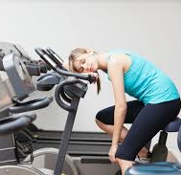
EMGs during Muscle Fatigue
You're at your local gym, getting your pump on and lifting dumbbells. You're feeling strong and decide to try a 30 lb curl. 1 rep, 2 rep, 3 rep....Ugh... why is it getting so hard to lift?
In this muscle fatigue lab we will introduce you to some more in depth muscle physiology and why your muscles get tired.

Slide 4
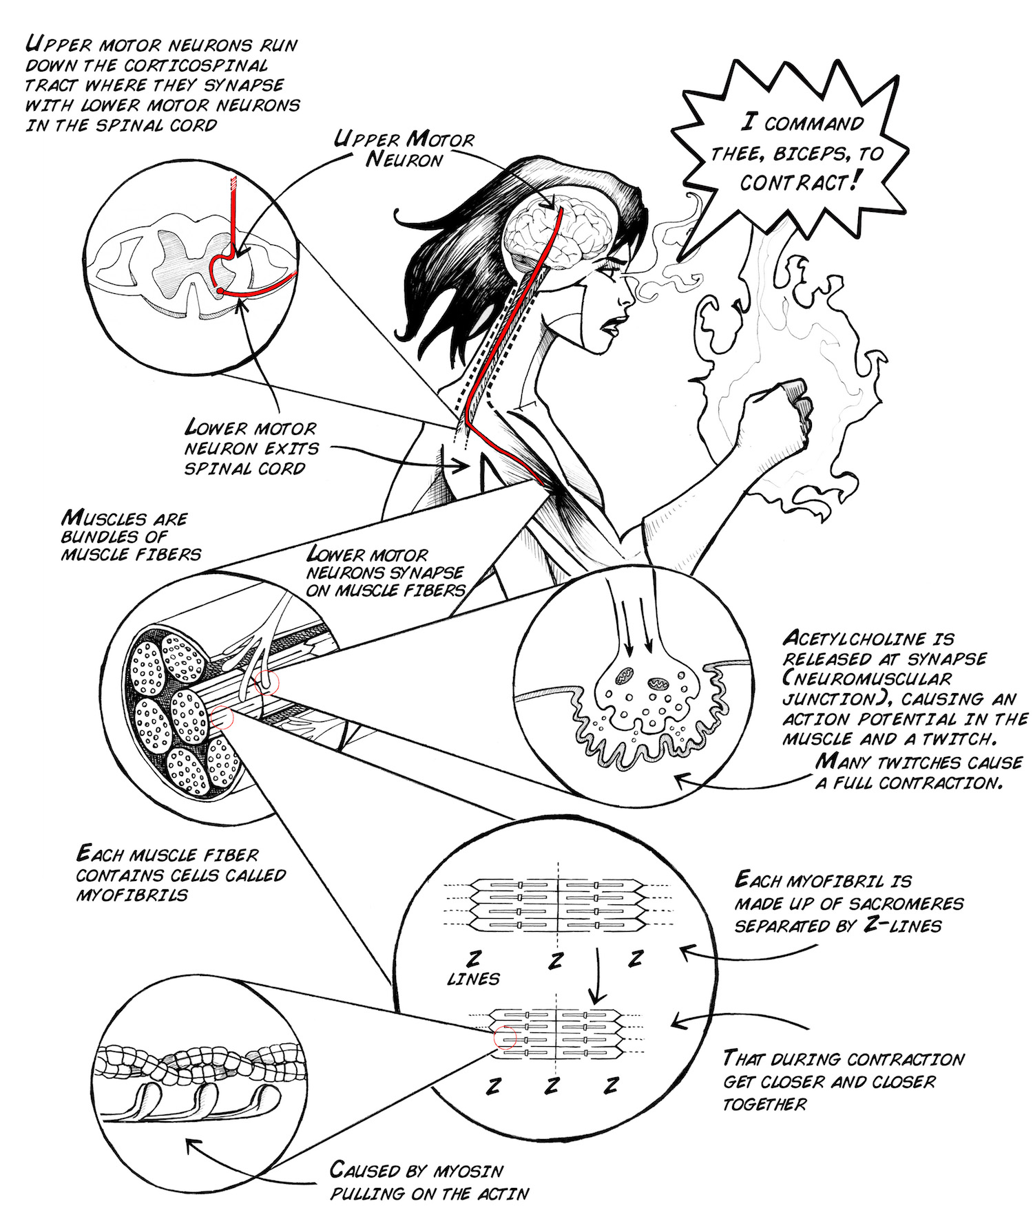
Background
In order to make voluntary actions such as lifting a soldering iron or kicking a soccer ball, you use your skeletal muscles!
Your skeletal muscles allow you to do all the wonderful movements with which you pass your days.

Slide 5
Background
Your muscles contract and enable movement by sliding microscopic actin and myosin protein filaments across each other, with a full support cast of other players including proteins (troponin and tropomyosin), ions (Na⁺, K⁺, Ca²⁺), energy carriers (ATP), and blood circulation to deliver O₂ and remove CO₂.

Slide 6
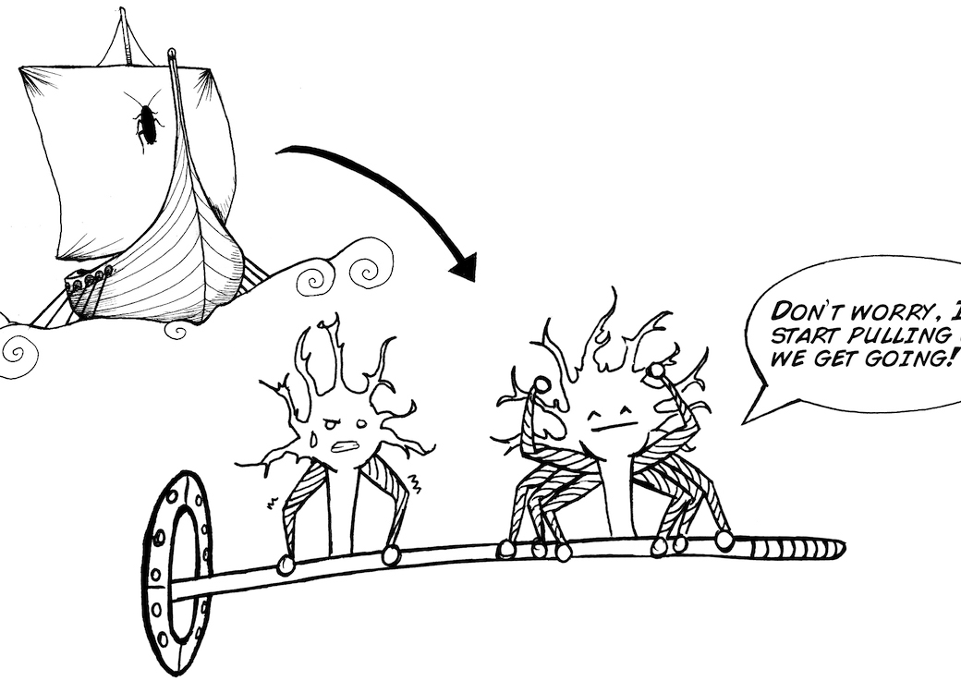
Motor Units
Each of your muscles is subdivided into functional groups of muscle fibers called motor units.
A motor unit is a motor neuron and all of the muscle fibers it innervates.

Slide 7
Motor Units
To achieve great things, like lifting a heavy weight, motor units join together in a systematic way to supply the force required to achieve strength.
This teamwork among motor units is called "Orderly Recruitment" by scientists, and as stated before, motor units with the smallest number of muscle fibers begin contracting first during a movement, followed by the motor units with the largest number of fibers afterward, to allow for a smooth, strong muscle contraction.

Slide 8
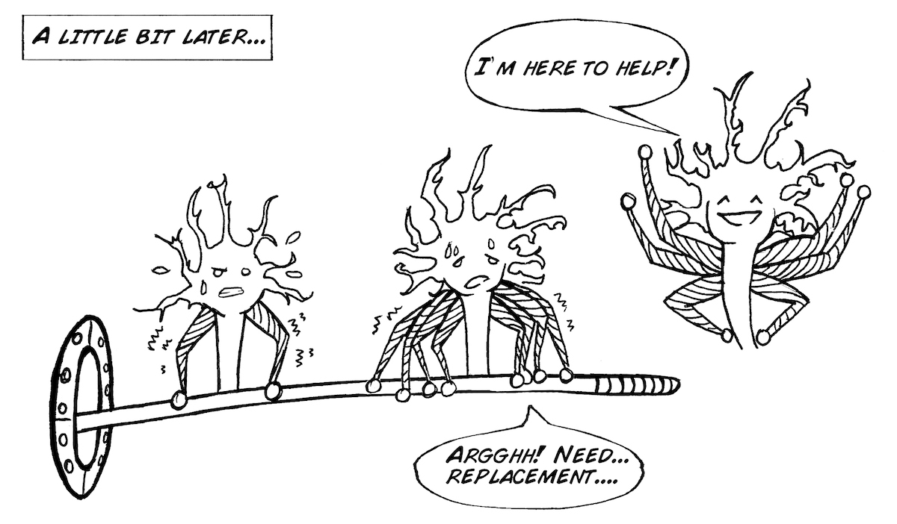
Muscle Recruitment
In addition, a motor unit can be recruited to replace an already active motor unit that is experiencing fatigue.
So...how does this all relate to your muscles getting tired?

Slide 9
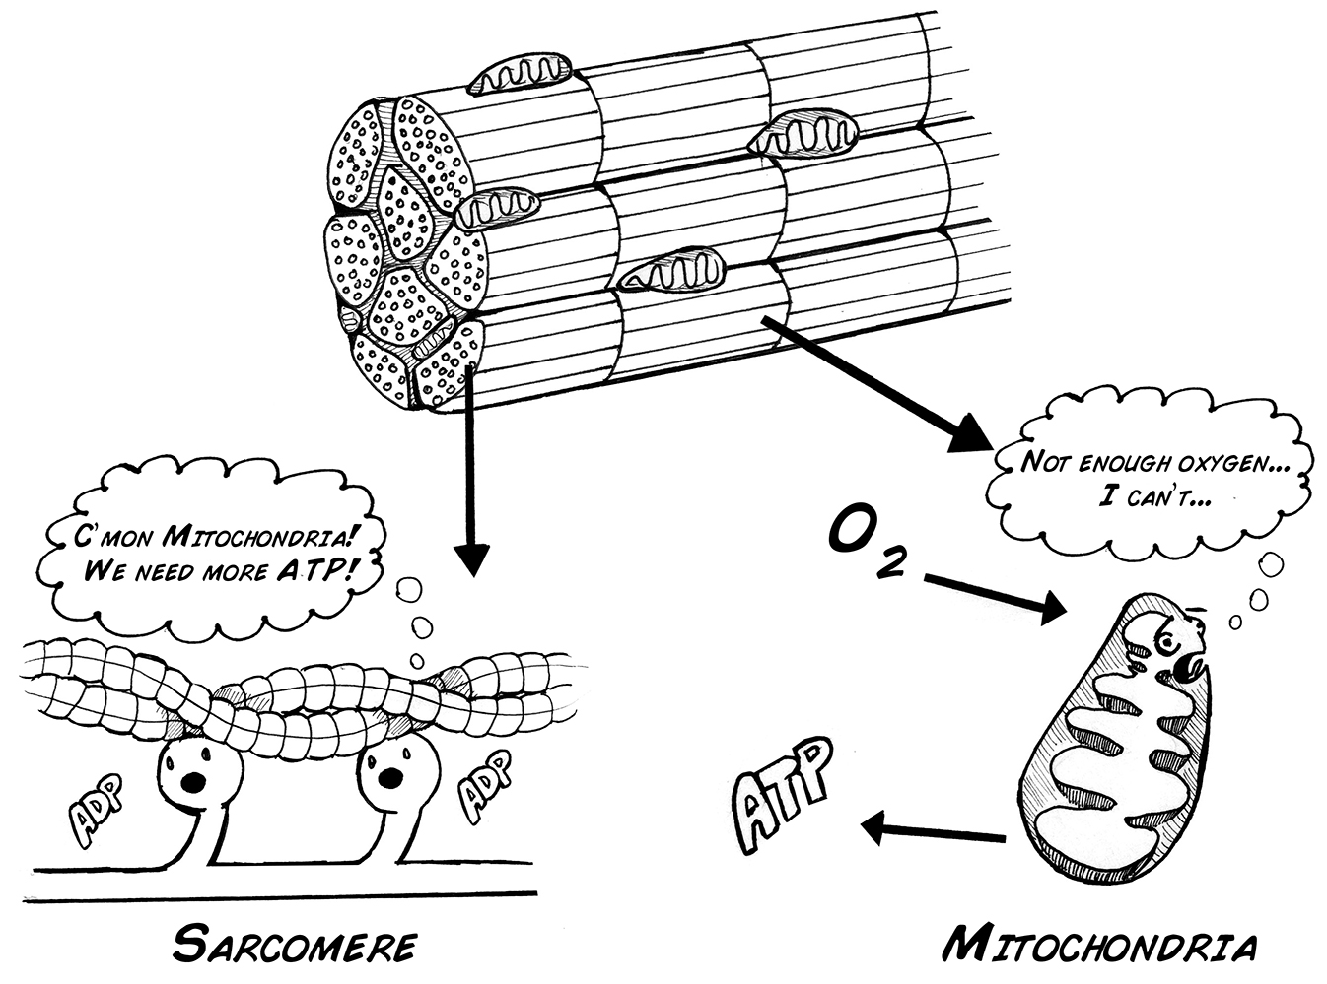
Fatigue
If such O₂ isn't available as an electron acceptor , the Krebs cycle and electron transport chain cannot operate, and the muscle must gain ATP from other sources.
For example, for rapid, intense activity, phosphocreatine (synthesized from amino acids) can serve as a phosphate donor to allow ATP formation.
This is called anaerobic contraction, meaning "not using oxygen."

Slide 10
Fatigue
However, anaerobic contraction can lead to build-up of metabolites and waste products, and a significant increase in the acidity (decreased pH) inside the muscle cell, which can interfere with the many biochemical reactions necessary for the actin and myosin to produce force and slide against each other.
This chemical change is thought to be the cause of the "stinging" or burning sensation you feel in your muscles as you become fatigued (such as in arm wrestling or in the last few reps of a difficult weight lifting set).

Slide 11
Fatigue
We can observe the effects of these fatigue processes, albeit indirectly, by examining the amplitude of the EMG signal during a muscle contraction.
As fatigue progresses,
1) the firing rate of motor neurons drops, which in turn drops the number of action potentials the muscles themselves then fire, leading to a reduction in strength
2) muscles can often also continue generating action potentials due to neural drive, but the muscle is unable to contract due to molecular fatigue events in the muscle fibers, which in turn leads to a reduction in strength

Slide 12
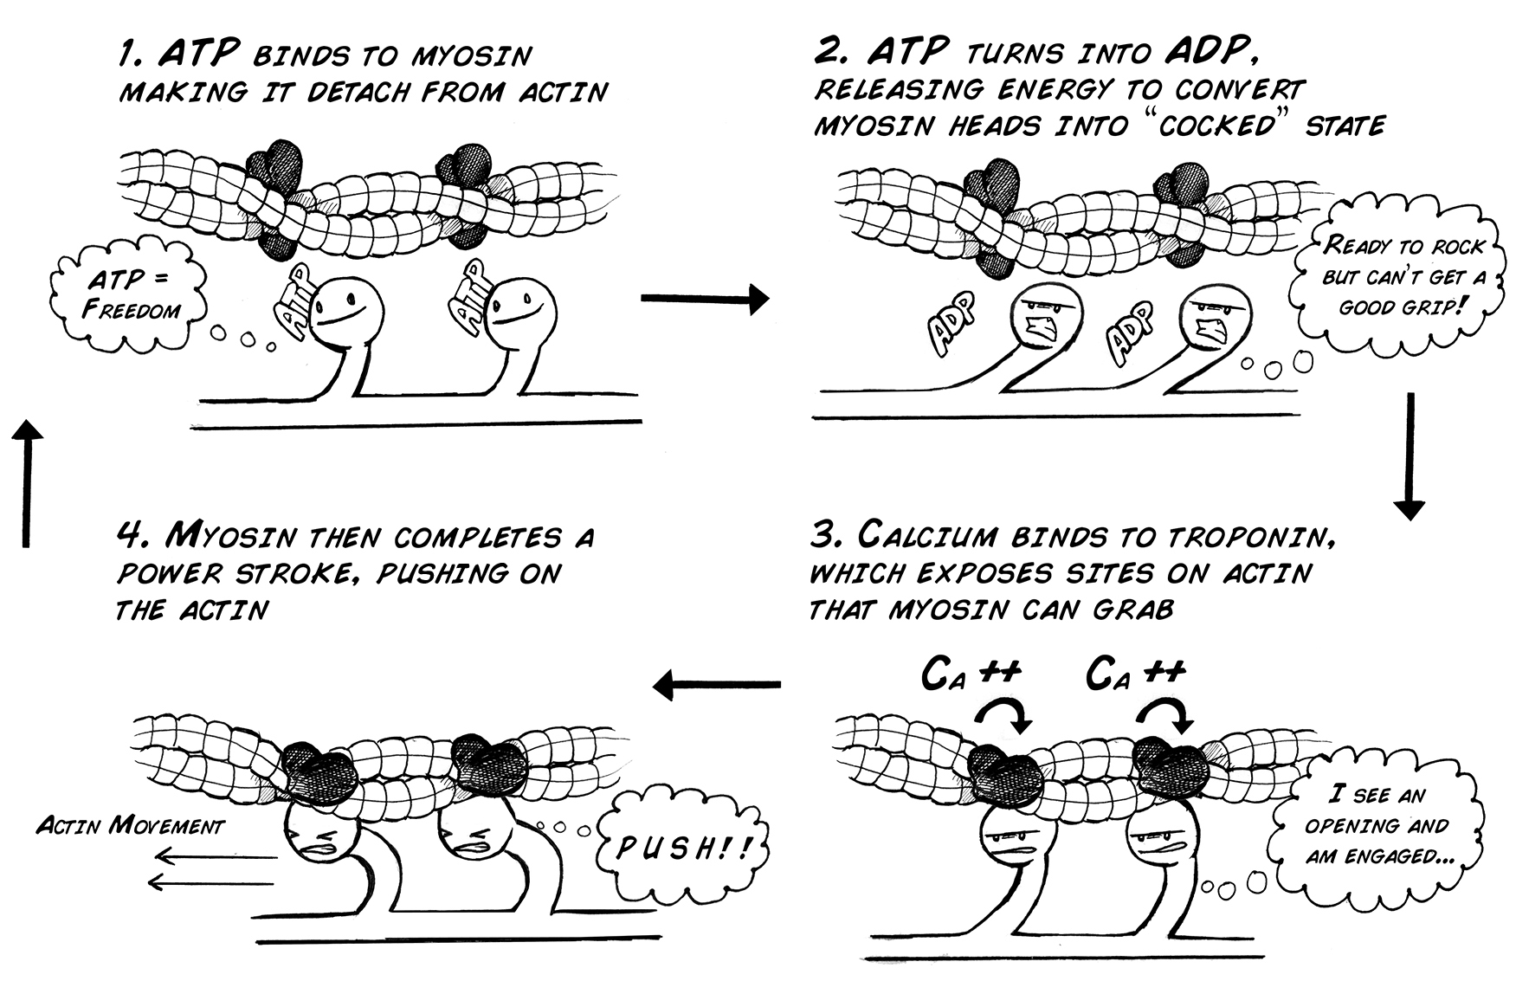
The Sliding Filament Model
When a muscle cell fires an action potential due to a motor neuron command, this causes a release of calcium (Ca²⁺) inside the muscle fiber from the sarcoplasmic reticulum.
The Ca²⁺ then flows into the area where the actin and myosin is (the sarcomere), initiating a complex cellular reaction with ATP that allows the myosin to pull on the actin.
The movement of myosin pulling on actin in the sarcomeres is called a "sliding filament model" and consists of 4 steps.

Slide 13
The Sliding Filament Model
As long as calcium and ATP are available, the actin and myosin will continue pulling on each other and the twitching will continue.
Note that the calcium is rapidly transported back into the sarcoplasmic reticulum where the process must be initiated again by the muscle firing an action potential to cause another twitch.
The summing together of many of these incredibly tiny "pulling events" produces a twitch (a very tiny, very fast force).
When many twitches occur in a row, the twitches sum together and produce a larger force.
ATP is continually provided in the muscle by breaking down glucose.

Slide 14
The Sliding Filament Model
If glucose isn't available, fatty acids can be used to make pyruvate and keep the Krebs cycle and the oxidative phosphorylation pathway operating.
As long as oxygen (O₂) is present and can be readily transported to the muscle cell, the oxidative phosphorylation pathway can produce ATP at incredible rates.
This is called aerobic contraction, meaning "using oxygen."

Slide 15
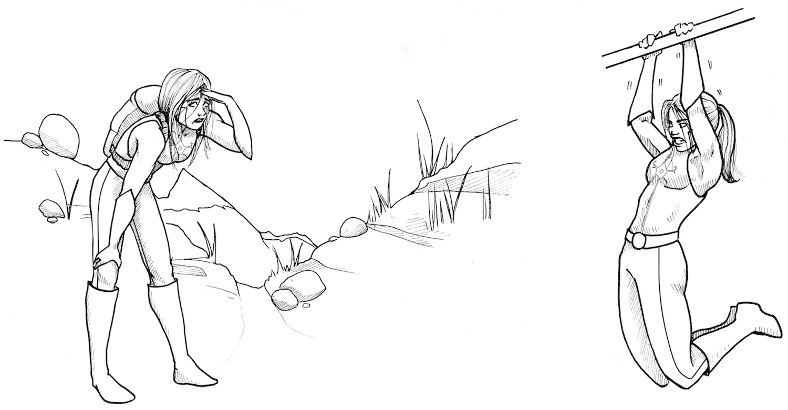
…how does this all relate to your muscles getting tired?
Muscle Fatigue occurs when the muscle experiences a reduction in its ability to produce force and accomplish the desired movement. The factors that explain fatigue are complex and after more than 100 years of investigation are still a topic of active research.
For example, short term fatigue (failure to lift a heavy weight, do more push-ups, etc.) is different than long term fatigue such as as a marathon run, a 100 mile bicycle ride, or a full-day hike through the Rocky Mountains of Colorado.

Slide 16
Why Fatigue Happens
We do understand though some of the basic reasons that muscles become fatigued during high intensity exercise, most notably that the demand for oxygen can be greater than the supply.
The blood flow to the muscle can be reduced because of 1) muscles intensely contracting can reduce blood flow and thus oxygen availability, or 2) the muscle is simply working so intensely that there literally is not enough oxygen to meet demand (a sprint at top speed).

Slide 17
Why Fatigue Happens
If such O₂ isn't available as an electron acceptor , the Krebs cycle and electron transport chain cannot operate, and the muscle must gain ATP from other sources.
For example, for rapid, intense activity, phosphocreatine (synthesized from amino acids) can serve as a phosphate donor to allow ATP formation.
This is called anaerobic contraction, meaning "not using oxygen."

Slide 18
“Feel the BURN!”
However, anaerobic contraction can lead to build-up of metabolites and waste products, and a significant increase in the acidity (decreased pH) inside the muscle cell, which can interfere with the many biochemical reactions necessary for the actin and myosin to produce force and slide against each other.
This chemical change is thought to be the cause of the "stinging" or burning sensation you feel in your muscles as you become fatigued (such as in arm wrestling or in the last few reps of a difficult weight lifting set).

Slide 19
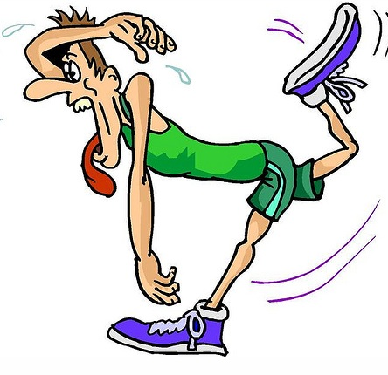
As fatigue progresses
We can observe the effects of these fatigue processes, albeit indirectly, by examining the amplitude of the EMG signal during a muscle contraction.
As fatigue progresses,
1) the firing rate of motor neurons drops, which in turn drops the number of action potentials the muscles themselves then fire, leading to a reduction in strength
2) muscles can often also continue generating action potentials due to neural drive, but the muscle is unable to contract due to molecular fatigue events in the muscle fibers, which in turn leads to a reduction in strength.
This Photo by Unknown Author is licensed under CC BY-NC-ND

Slide 20
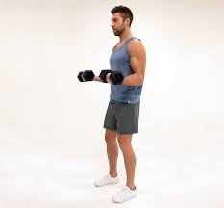
Experiment
Isometric biceps hold
Select a heavy object such as a large textbook to use as a dumbbell. Your object should be around ~10-25 lbs (~5-12 kg).
With your back to a wall to control your posture and arm position, hold the weight in your hand for as long as you can, with your elbow at a 90 degree angle.
This is called an "isometric" contraction since your muscles are working, but your joints are not moving.
Observe how your muscles feel.

Slide 21
Experiment
Repeat the experiment using your other arm.
As you know, you have a dominant arm/hand (left-handed vs right-handed). Is your dominant arm/hand stronger or more fatigue resistant than the other?

Slide 22
Experiment
Isometric biceps hold
Watch the short video located here https://youtu.be/R-SSrJMSmlk
This video shows this same task you just did, but this student is hooked up to an EMG.

Slide 23
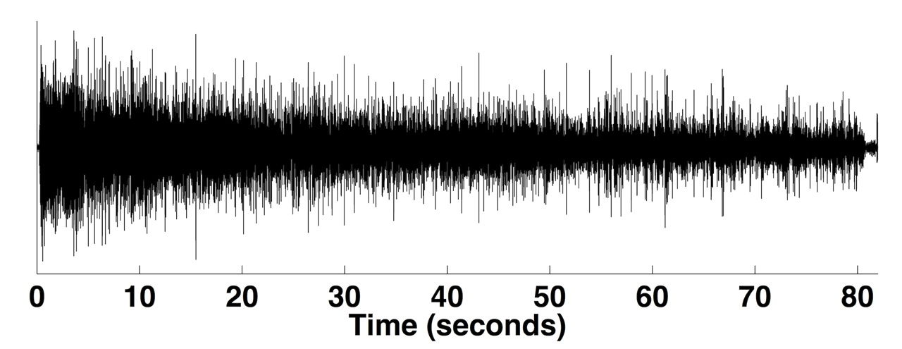
Observe the amplitude (height) and firing rate (number of impulses) in the EMG. What do you see over time?

Slide 24
Log in to CANVAS, click on LAB 7 Write Up Questions and Answer the 10 Questions on the Following Slides.

Slide 25
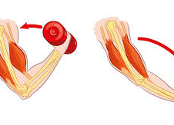
Question 1
What 2 substances have to be present in order for muscle contraction to continue?

Slide 26
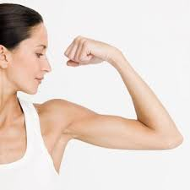
Question 2
How long were you able to hold your weight before you experienced fatigue? Was one arm quicker to fatigue than the other? Why do you think there was a difference in the time of fatigue between your right arm and left arm?

Slide 27
Question 3
What happened to the amplitude of the firing rate over time in the EMG results? Why does the amplitude decrease?

Slide 28
Question 4
What 2 things can cause muscles to become fatigued during high intensity exercise?

Slide 29
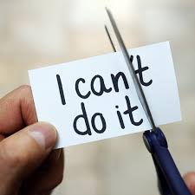
Question 5
What can the body do to continue muscle contraction If glucose isn't available?

Slide 30
Question 6
Summarize the “sliding filament model”.

Slide 31
Question 7
Explain how the signal to contract a muscle travels from an upper motor neuron to the muscle fiber and causes muscle contraction.

Slide 32
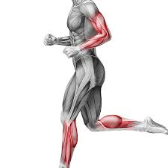
Question 8
Explain what happens as fatigue progresses.

Slide 33
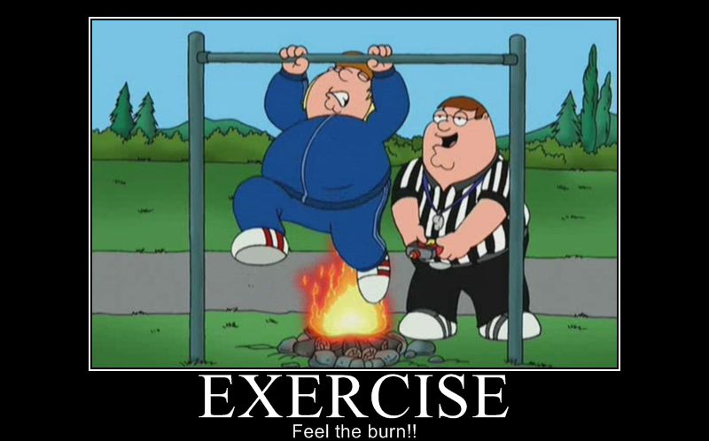
Question 9
Why do you feel a stinging or burning sensation after an intense bout of exercise?

Slide 34
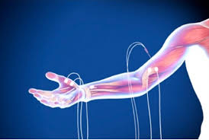
Question 10
Briefly explain what an EMG is and how it is used.

