Slide 1
The Eye

Slide 6
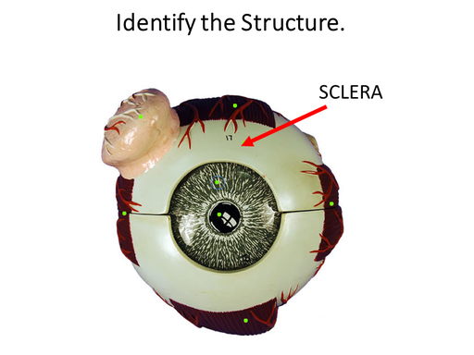
​ The sclera
​ The sclera is the white protective outer layer of connective tissue that surrounds most of the eye (or globe).
It functions to provide structure and protection to the eye and to act as an attachment for muscles of the eye.

Slide 7
​ The sclera
The sclera forms the posterior part of the globe and it continuous with the dura mater and the cornea.
The sclera functions to provide protection, provides the physical structure that give shape to the globe and acts as a surface for muscle attachment.

Slide 8
The Extrinsic Muscles of the Eye

Slide 9
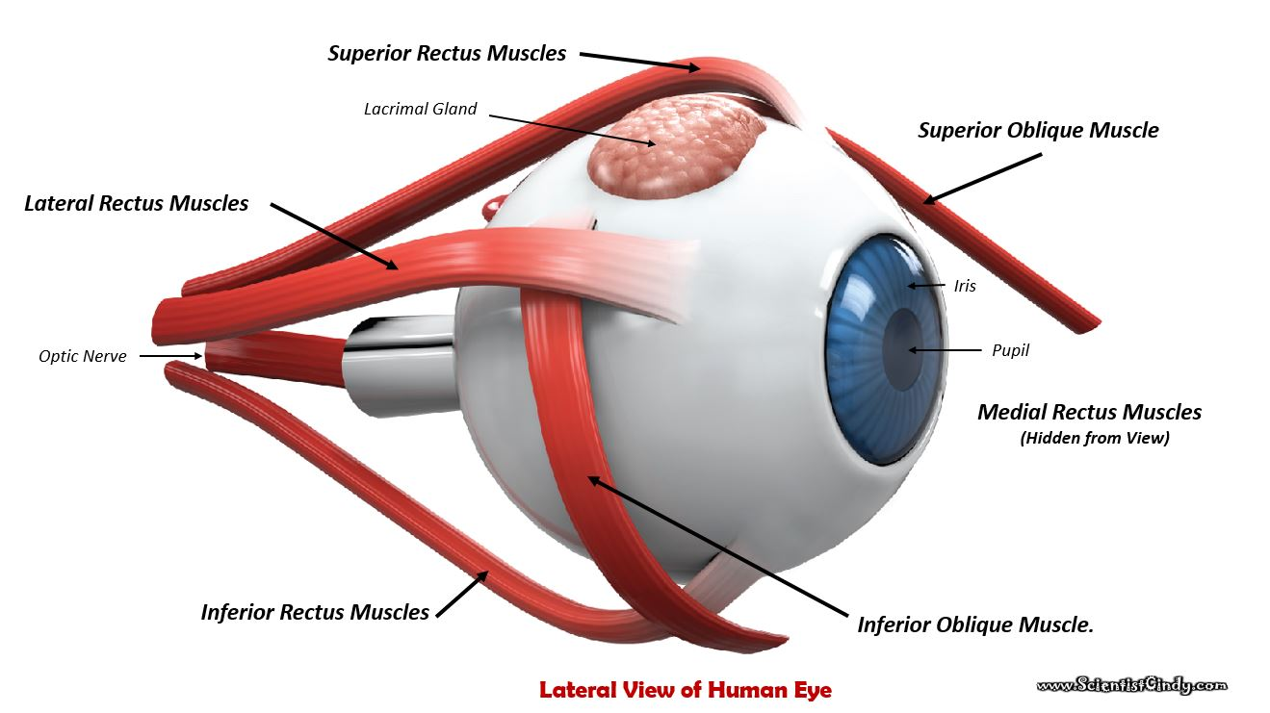
Extrinsic Eye Muscles
There are six extrinsic muscles of the eye (or globe).
These muscles control the movement of the eyes.
These muscles are called extrinsic eye muscles because their origin lies in the orbit and their insertion points are on the outside of the sclera.

Slide 10
The six extrinsic eye muscles are as follows:
Superior and Inferior Rectus Muscles.
Lateral and Medial Rectus Muscles.
Superior and Inferior Oblique Muscle.

Slide 11
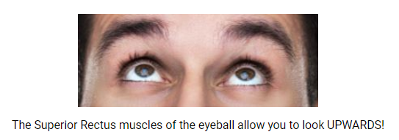
the superior rectus muscles
The function of the superior rectus muscles of the eye allow the eye to look up..

Slide 12
The inferior rectus muscles
The function of the inferior rectus muscles of the eye allow the eye to look down..

Slide 13
The lateral and medial rectus muscles
The function of the lateral and medial rectus muscles of the eye allow the eye to move RIGHT AND LEFT..
The Lateral and Medial Rectus Muscles of the eyeball work in opposite ways to allow to you to look outward with one eye, while you look inward with the other eye.

Slide 14
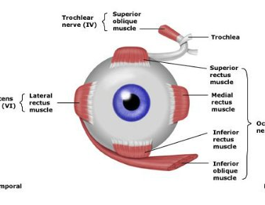
The superior and inferior oblique muscles
The superior and inferior oblique muscles function to rotate the eyeball clock-wise and counter clock-wise to keep the eye from rotating when the rectus muscles are engaged.

Slide 17
The pupil
The pupil is the dark circular part of the eye that functions to allow light to come into the eye.
The pupil is actually not black at all. In fact, it is a hole in your eye. When your doctor looks into your eye either an ophthalmoscope, they are looking through your pupil and examining your retina at the back of your eye.

Slide 18
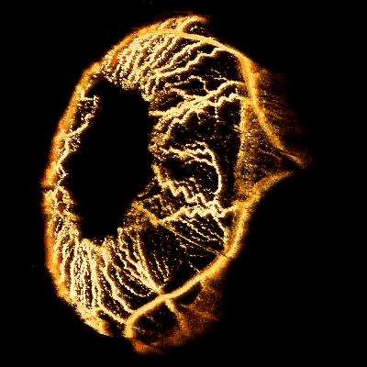
The iris
The iris is the colored portion of your eye. The iris acts as a diaphragm which becomes larger or smaller in order to adjust the amount of light going through the pupil. ​

Slide 19
The Lacrimal Gland
The lacrimal glands function to secrete the watery part of your tears.
The lowermost portion of the lacrimal gland can be seen if you lift up the lateral portion of your upper eyelid

Slide 20
The Lacrimal Gland
The word 'lacrimal' comes from the Latin word 'lacrima' which means "tear".
Our tears function to clean and lubricate the eyes. Tears also form in response to irritation, strong emotion and yawning.

Slide 21
The Lacrimal Gland
The lacrimal glands are located at the upper lateral region of each orbit.
The lacrimal gland produces tears which then flow into canals that connect to the tear duct and drain into the nose.

Slide 22
THE CORNEA
​The cornea is the clear anterior portion of the eye that is continuous with the sclera.
It covers the lens and the pupil. The cornea and lens function to refracts light, to focus the image on the retina at the back of the eye.

Slide 23
The Cornea
While the cornea contributes most of the eye's focusing power, it does not have the ability to change shape, so its focusing power is 'fixed’.
This means that only images that are at a certain distance will be in focus.
For this reason, the cornea functions along with the lens to accommodate images at different distances.

Slide 24
Retina

Slide 25
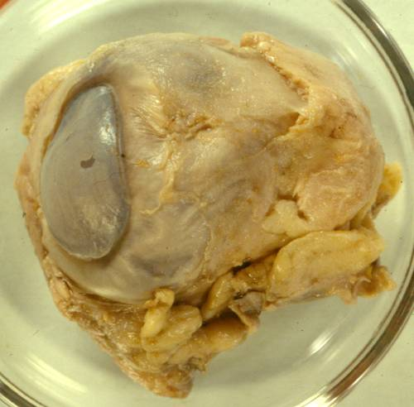
External Tissue of Eye
Cow Eye

Slide 26
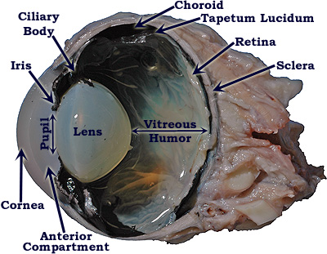
Cow Eye

Slide 27
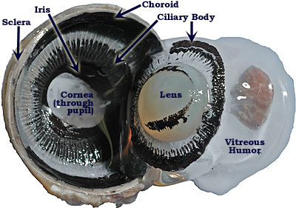
Cow Eye

Slide 28
THE CORNEA ​The cornea is the clear anterior portion of the eye that is continuous with the sclera. It covers the lens and the pupil.

Slide 29
THE CORNEA The cornea and lens function to refracts light, to focus the image on the retina at the back of the eye. While the cornea contributes most of the eye's focusing power, it does not have the ability to change shape, so its focusing power is 'fixed’. This means that only images that are at a certain distance will be in focus. For this reason, the cornea functions along with the lens to accommodate images at different distances.

Slide 30
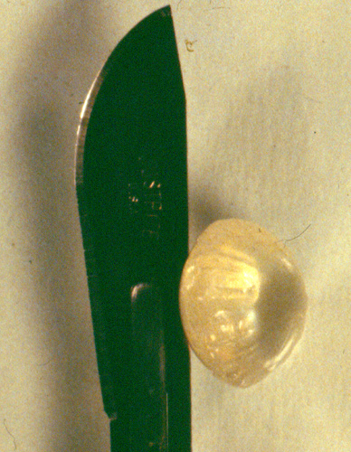
Lens

Slide 31
Lens

Slide 32
Lens
The lens is connected to the ciliary body, which has muscles that change the shape of your lens, causing it to be either more or less convex.
This shape change allows the eye to accommodate viewing images that are at different distances.
For this reason, the adjustment of the lens is referred to as accommodation. ​

Slide 33
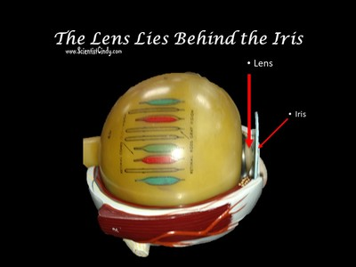
The Lens and the Cornea
The lens and the cornea function together to refract light onto the retina, thereby focusing the image on the retina.

Slide 34
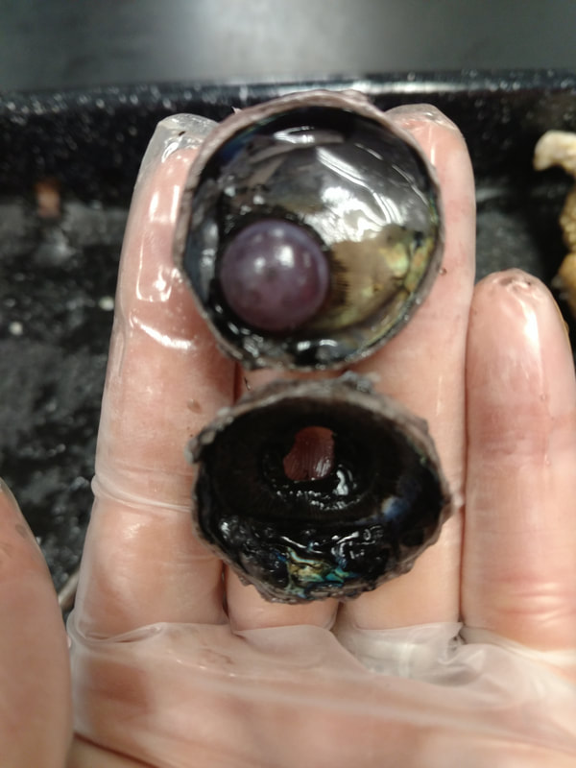
Lens
Lens

Slide 36
LENS – Focusses the image at different distances onto the retina (Accommodation)

Slide 38
Accommodation
Far Away Objects – The zonule fibers provide tension to the lens giving it an elongated shape.
Close Objects – Ciliary muscles contract - Relaxes the tension of the lens leading to a rounder shape changing the focal length of the eye. This brings objects that are closer to the eye into focus.

Slide 39
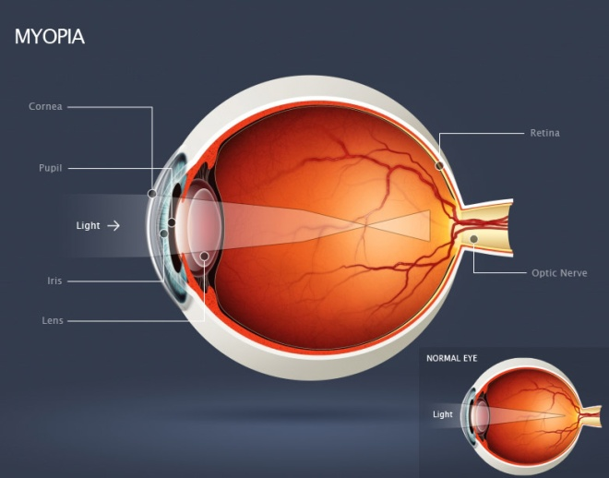
Myopia – Nearsightedness
Myopia
Can see far, but not close
Focal point lies BEFORE the retina
concave lens will correct the problem by focusing the light farther onto the surface of the retina.

Slide 40
Hyperopia - Farsightedness
Hyperopia
Can see close, but not far
Focal point lies BEHIND the retina
a convex lens will refract light rays allowing them to focus directly onto the retina.

Slide 41
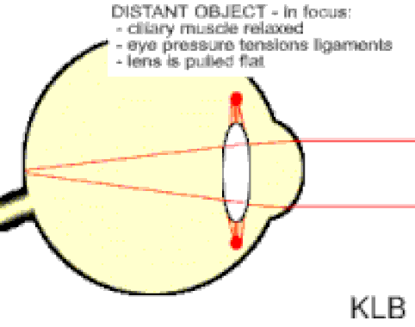

Slide 43
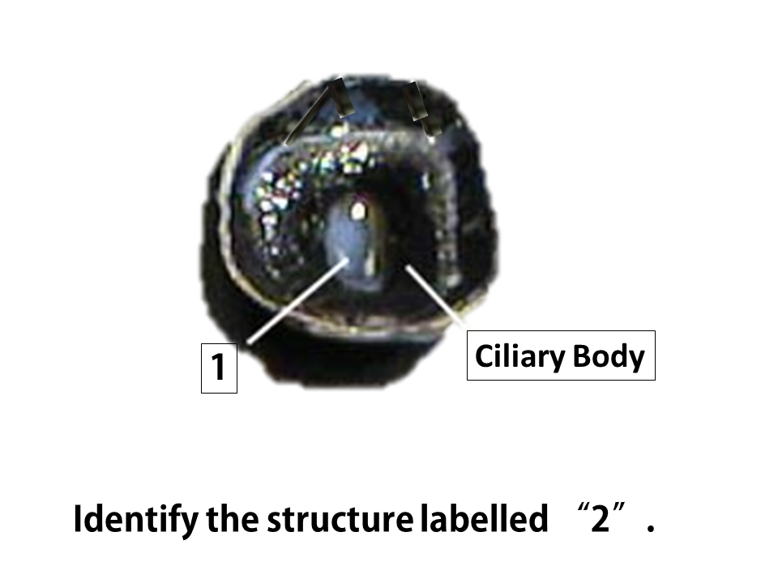
​The ciliary body has ciliary muscles that control the shape of the lens. The ciliary body is connected to the lens by suspensory ligaments.
Changing the shape of the lens is necessary to focus images at different distances onto the retina.
THE CILIARY BODY AND ​SUSPENSORY LIGAMENTS

Slide 44
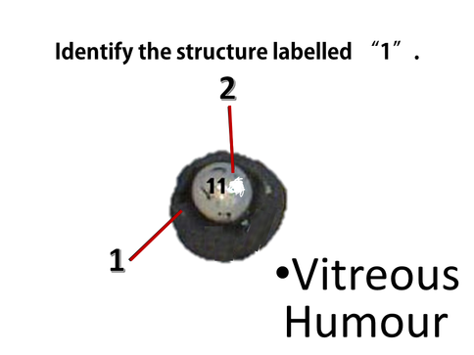
The vitreous humor
The vitreous humor (sometimes referred to as the vitreous body) is the gelatinous liquid that fills the eye.
This liquid functions to maintain the pressure of the eye.

Slide 45
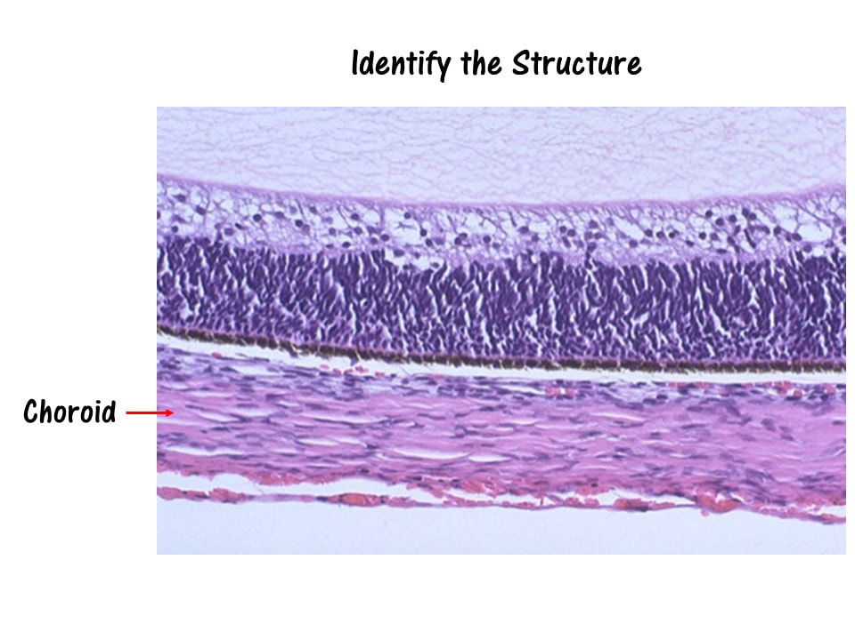
The choroid coat
The choroid coat is a highly-vascularized layer of connective tissue that surrounds the eye.
The choroid coat lies between the retina and the sclera.
The function of the choroid coat is to provide oxygen and nourishment to the retina.

Slide 46
Retina

Slide 47
Color Vision – red, green and blue cones

Slide 48
Cones are photoreceptors in the retina that give us color vision

Slide 49
Rods are photoreceptors in the retina that give us black and white vision

Slide 50
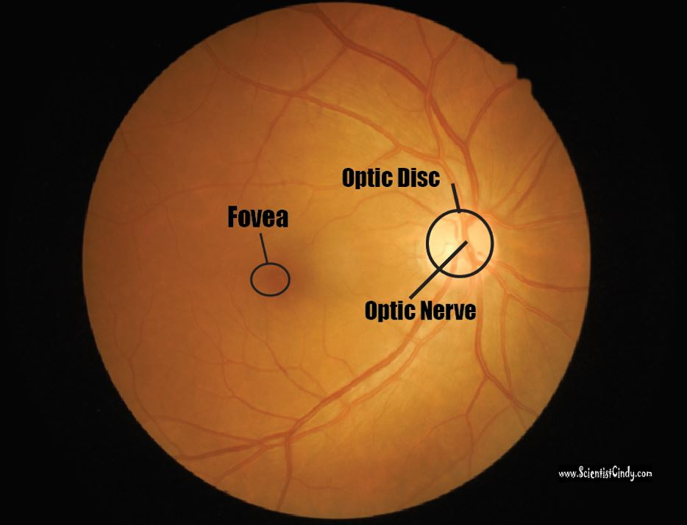
The Retina
The word 'retina' comes from the Latin word for 'net’.
The retina is the innermost layer located at the back of the eye.
The function of the retina is to convert visual information into action potentials (nerve impulses) that will travel to the brain via the optic nerve.

Slide 51
Optic Nerve and Optic Disc
The optic nerve is made up of axons of the ganglion cells that make up the outer layer of the retina.
The optic nerve exits the globe (eyeball) at the optic disc which forms a blind spot.

Slide 53
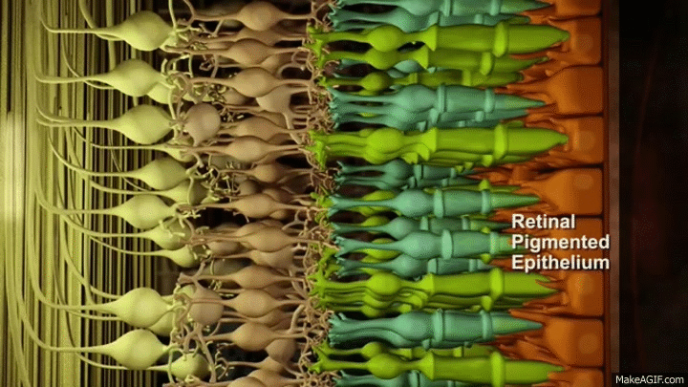
The retina contains light-sensitive (photo-sensitive) cells (called photoreceptors) that fire action potentials in response to changes in visual information (in the form of electromagnetic waves of the visible spectrum). There are two types of photoreceptors; rods and cones.

Slide 54
Rods
Rods are photo receptors that respond to levels of light (shades of black and white) and do not process any color information. The rods make up the major portion of your peripheral vision and are very useful in low-light situations, such as driving at night.

Slide 55
Your cones, however are able to process color information. Cones dominate the central portion of your vision which focuses on the fovea.
You have 3 types of cones, each specializing in either the RED, GREEN or BLUE, electromagnetic waves of the visible spectrum.
The combination of stimulation of these 3 cone types are able to give you all of the colors you see!

Slide 56
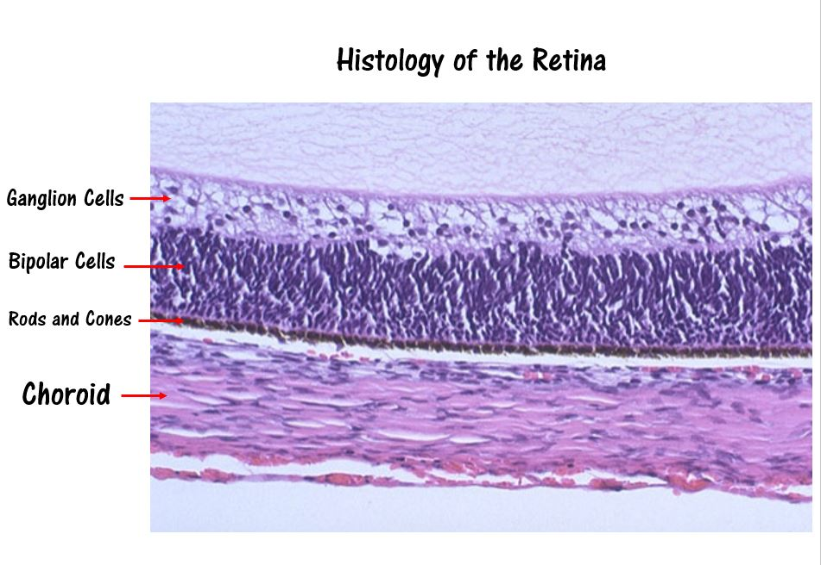

Slide 57
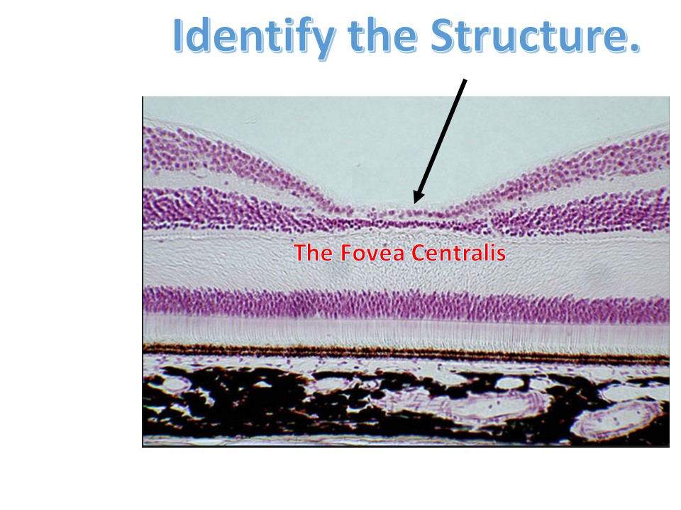
The Fovea Centralis
The center of your field of vision is the most clear.
This is due to a part of the retina called the Fovea Centralis (which lies within a slightly larger region called the Macula Lutea)
The Fovea Centralis has the highest concentration of cones (cells that code for colored vision) than anywhere else in the retina.

Slide 58
The Fovea Centralis
The center of your field of vision is the most clear.
This is due to a part of the retina called the Fovea Centralis (which lies within a slightly larger region called the Macula Lutea)
The Fovea Centralis has the highest concentration of cones (cells that code for colored vision) than anywhere else in the retina.

Slide 59
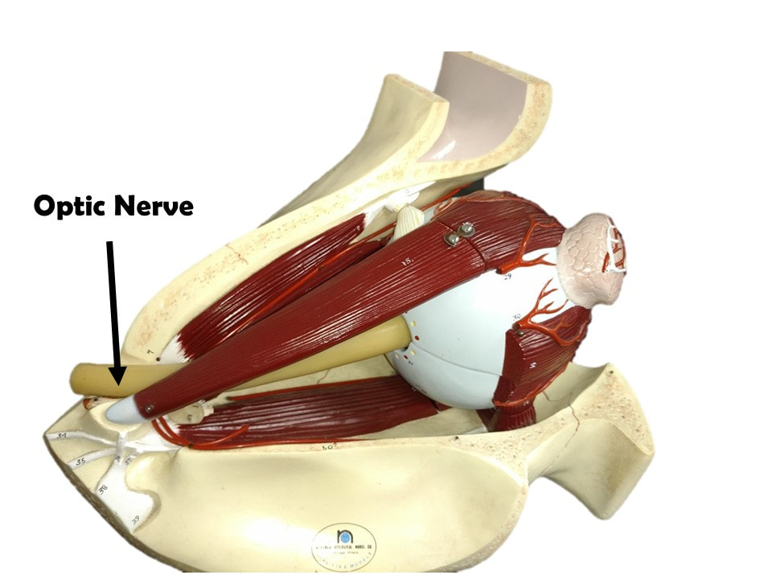
The Optic Nerve
The visual information is gathered by the photoreceptors (the sensory cells of the retina), and processed and sent through the layers of the retina.

Slide 60
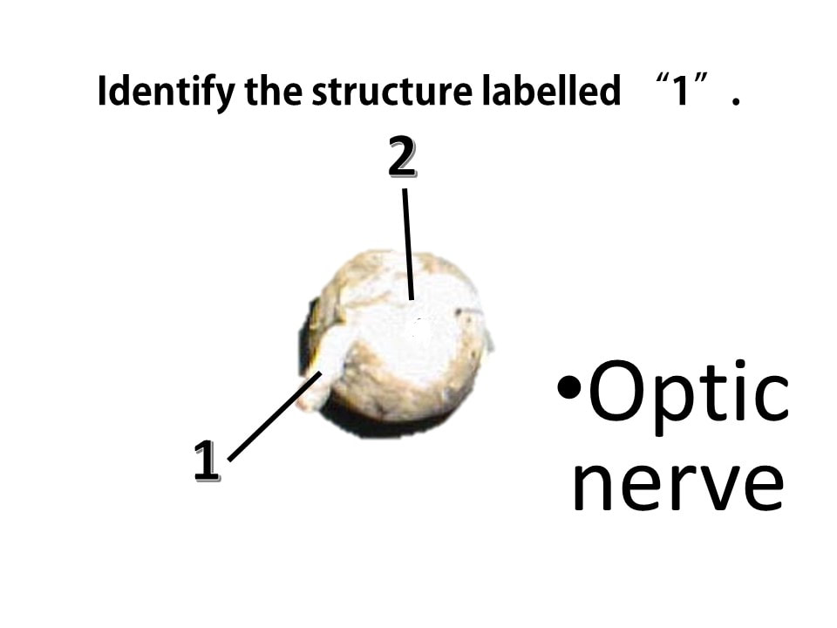
The outermost part of the retina is made up of ganglion cells.
The axons of the ganglion cells make up the optic nerve.

Slide 61
The optic nerve functions to send the visual sensory information from the retina to the brain.

Slide 62
The visual information is gathered by the photoreceptors (the sensory cells of the retina), and processed and sent through the layers of the retina.

Slide 63
The outermost part of the retina is made up of ganglion cells.
The axons of the ganglion cells make up the optic nerve.
The optic nerve functions to send the visual sensory information from the retina to the brain.

Slide 64
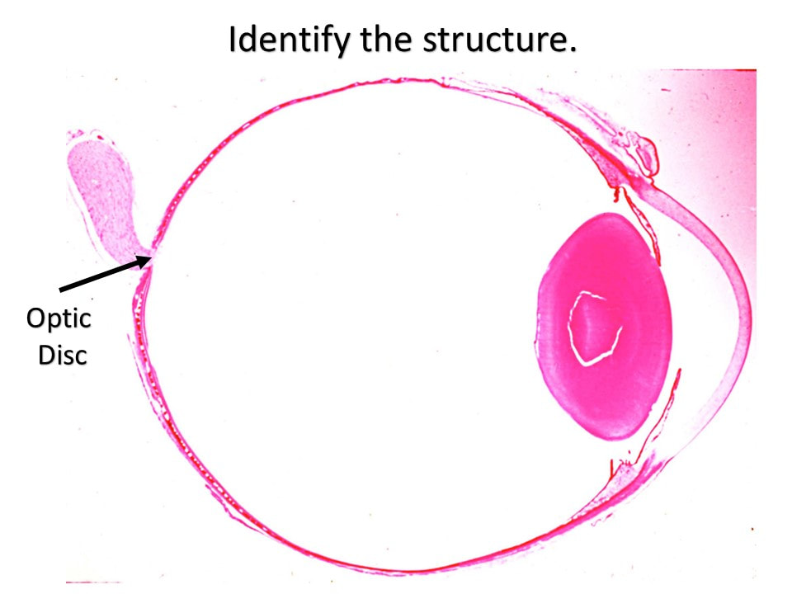
The Optic Disk
The point at which the axons of the ganglion cells leave the eye to form the optic nerve, is called the Optic Disc.
The Optic Disc is essentially a pathway from the eye to the brain.
This pathway is devoid of photoreceptors and creates a small "blind spot" in our visual field that we are normally completely unaware of!

Slide 65
#1 is the Cornea #2 is the SCLERA

Slide 66
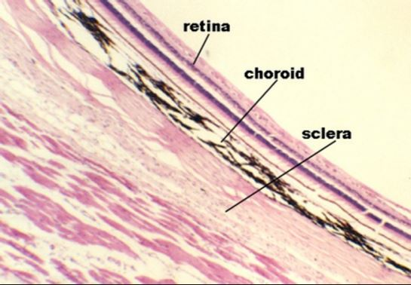
Histology of the Retina

Slide 71
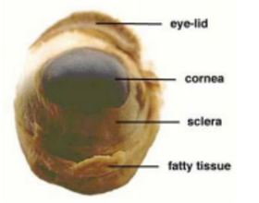
Anterior External ​View of Sheep Eye

Slide 72
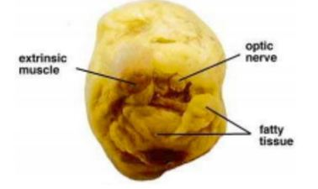
Posterior External ​View of Sheep Eye

Slide 75
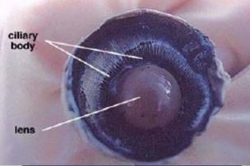

Slide 77
The choroid coat lies between the retina and the sclera and appears dark. It can be seen by peeling back part of the retina, ​as shown here.

Slide 79
