Slide 1
The Integumentary System

Slide 3
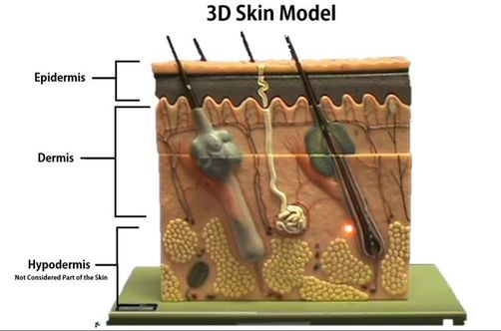
Layers of the Skin
The skin is composed of 2 primary layers: 1) the epidermis and
2) the dermis
The apical (outer most) layer is called the epidermis. The prefix "epi-" means "above". Lying underneath the epidermis is the dermis.
Each of these primary layers is broken down into subsequent layers.

Slide 4
Layers of the Skin
​The outermost surface of your skin (the superficial region) is made of a thick epithelial tissue called epidermis.
The word "derm" means "skin".
The prefix "epi-" means "above".

Slide 5
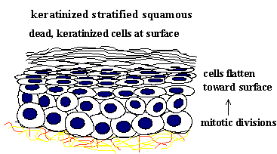
keratinized stratified squamous epithelial tissue
Epidermal tissues that lie toward the outer part of the body or that line tracts, have a layer of dead skin cells for added protection.
This type of epithelial tissue is referred to as keratinized stratified squamous epithelial tissue.

Slide 6
The epidermis consists of 4 cell types
Keratinocytes - The most abundant cell type in the epidermis.
They are created in the stratum basale and pushed upward toward the skin's surface.
These cells make keratin and act to protect deeper layers of soft tissue.
These cells die as they approach the surface of the skin.
Once they are dead and shriveled up, they are called corneocytes.

Slide 7
The epidermis consists of 4 cell types
Melanocytes - Pigmented cells of the stratum basale region that produce melanin which protects from UV radiation.

Slide 8
The epidermis consists of 4 cell types
Merkel Cells - function as touch receptors in association with sensory nerve endings (Merkel disc); located at epidermal-dermal junction

Slide 9
The epidermis consists of 4 cell types
Langerhans’ Cells - epidermal macrophage-like cells that help activate the immune system via receptor-mediated endocytosis

Slide 10
DERMIS
Beneath the epidermis, (deep to the epidermis) is the layer of the dermis.
The dermis is composed of connective tissue.

Slide 11
hypodermis
Below the skin (deep to the skin) there is another layer called the hypodermis.
"Hypo-" means "below".
This layer is composed of areolar connective tissue and adipose tissue.
The hypodermis is NOT considered to be part of the skin itself.

Slide 12
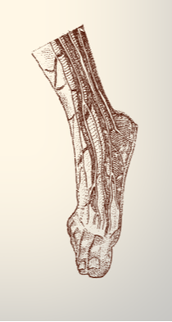
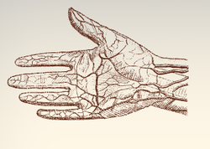
Thick Skin and Thin Skin
​ thick skin… is located in regions of your body that has a lot of physical contact with the outside world. fingertips, palms and soles of feet. These extra layers help to protect the soft tissues from abrasions. ​ ​

Slide 13
Thick Skin and Thin Skin
While the epidermis is thicker in thick skin than in thin skin. But the layer of the dermis is THINNER in thick skin than in thin skin . Thick skin does not contain hairs, sebaceous glands, or sweat glands. ​

Slide 14
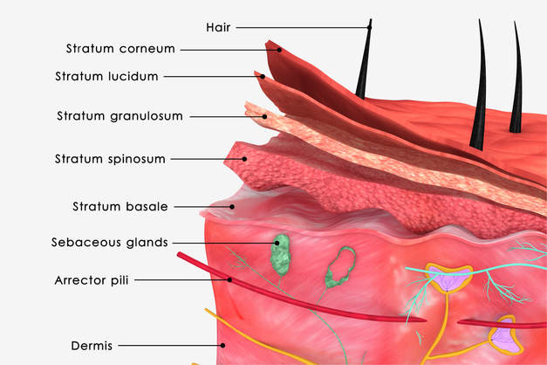
epidermal layers
 | The epithelium of thick skin contains 5 epidermal layers, whereas thin skin contains only 4 layers.​ The epidermal layers of thick skin starting from the most superficial layer are the 1) stratum corneum 2) the stratum lucidum 3) the stratum granulosum 4) the stratum spinosum ​5) the stratum basale. ​ You can easily remember the layers of the epidermis using the acronym: Come, Let's Get Sun-Burned! Thin skin contains the same layers, except for the stratum lucidum, which is missing.

Slide 18
1. The Stratum Corneum (Horny Layer)
The stratum corneum is a keratinized stratified squamous epithelium that contains four types of cells.
The four cells types cells that make up the stratum corneum are
1) keratinocytes
2) melanocytes
3) tactile epithelial cells
4) dendritic cells

Slide 19
1. The Stratum Corneum (Horny Layer)
The stratum corneum is Latin for 'horny layer’.
Its odd name comes from the dead squamous cells called corneocytes that make up the apical surface of the tissue.
The corneocytes form several layers of flattened (squamous) cells with no nuclei and no organelles.
This is the layer that includes the final keratin product, which is a combination of cytokeratin and keratohyaline.

Slide 20
2. *The Stratum Lucidum
The stratum lucidum is Latin for "clear layer".
This epidermal layer gets its name from translucent appearance of the dead skin cells that make it up.
*This layer only exists in the thick skin of the soles of your feet, your palms and your fingertips.

Slide 21
Stratum Granulosum (Granular Layer)
The stratum granulosum is Latin for granular layer.
In this layer, the keratinocytes have become squamous cells that contain granules of keratohyaline, a precursor to the extracellular keratin that protects the skin tissue from abrasion.

Slide 22
Stratum Spinosum (Prickle Cell Layer)
The stratum spinosum is Latin for "spiny". After forming in the basal cell layer, keratinocytes migrate upwards to form the stratum spinosum.
In this layer, they develop short projections that attach via desmosomes to adjacent cells.
The stratum spinosum is also known as the "prickly layer" because of these characteristic spines.
The cells in this layer produce cytokeratin, an intermediate filament precursor to keratin.
The cells in this layer experiences shrinking of its microfilaments during the slide staining process.

Slide 23
Stratum Basale (Basal Layer)
The stratum basale is the deepest of the 5 epidermal layers.
The primary cell of the epidermis is the keratinocyte stem cells which give a continuous supply of new cells to replace old dead ones.
The stratum basale also contain sensory nerves called Meissner's (Tactile) Corpuscles that are sensitive to light tactile sensations (light touch).
This layer also contains melaocytes which produce the pigment melanin which acts to filter out harmful UV radiation.

Slide 24
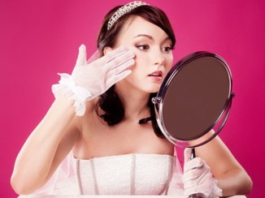
Functions of the Integumentary System ​
 | Protection Body Temperature Regulation Excretion Production of vitamin D Sensory Reception

Slide 25
Functions of the Integumentary System ​: Protection
The primary function of your skin is to provide a physical protective barrier against harmful environmental elements, dehydration and physical forces.
The epithelium allows your internal organs and soft tissues to be somewhat shielded from the outside world.
It provides a barrier that is able to withstand some wear and tear. It can get bumped, bruised or scraped and it is able to heal relatively quickly.

Slide 26
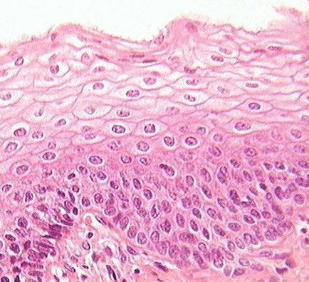
Functions of the Integumentary System ​: Protection
Epidermis –
composed of keratinized stratified squamous epithelial tissue which provides layers of small, squamous cells which are rapidly and easily replaced.

Slide 27
Functions of the Integumentary System ​: Protection
protects you from harmful elements
Bacteria
Viruses
Chemicals
Disease-causing Microbes
Reactive Substances
Irritants
Ultraviolet Radiation (UV Radiation) From The Sun
The UV protection of the epidermis comes from the presence of melanin produced in specialized cells called melanocytes.

Slide 28
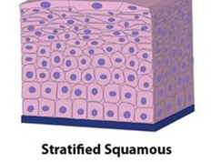
YOU SHALL NOT PASS!
Epithelial tissue is selectively permeable, allowing only certain substances to enter the body at any time.
The skin is our first line of defense against harmful elements in our environment, such as. Your skin functions to prevent excess water loss from the body.

Slide 29
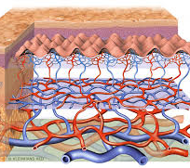
Body Temperature Regulation
MAINTAINING HOMEOSTASIS
The dermis of the skin contains a vast network of blood vessels that are under the control of the nervous system.

Slide 30
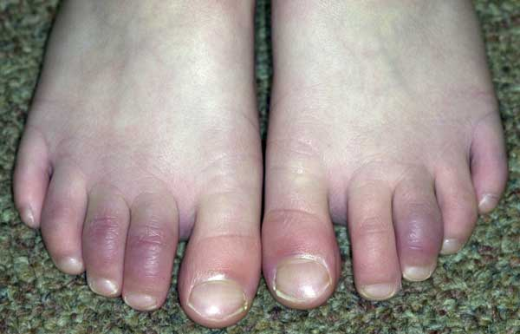
Body Temperature Regulation
When your body gets cold, your nervous system will constrict these blood vessels, thereby restricting the blood flow to your extremities, as well as to the outer surfaces of your body, in an effort to keep the blood warm.

Slide 31
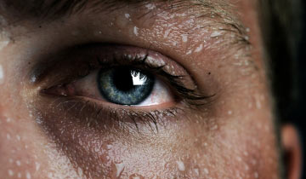
Body Temperature Regulation
The sweat glands are also activated by the nervous system and secrete sweat in response to heat.
When the sweat reaches the surface of the skin, the skin is cooled as the sweat droplet evaporates.

Slide 32
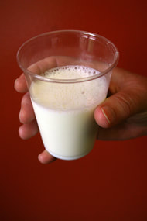
Metabolic Functions
Skin cells also play a role in some chemical conversions. Vitamin D is a steroid that gets converted into calcitriol in the body, Calcitriol is a hormone that assists in the metabolism of calcium.
This is why you will sometimes see "with vitamin D" marked on products containing calcium.
Vitamin D is made using a substance called "a precursor" that is synthesized from cholesterol by epidermal cells.

Slide 33
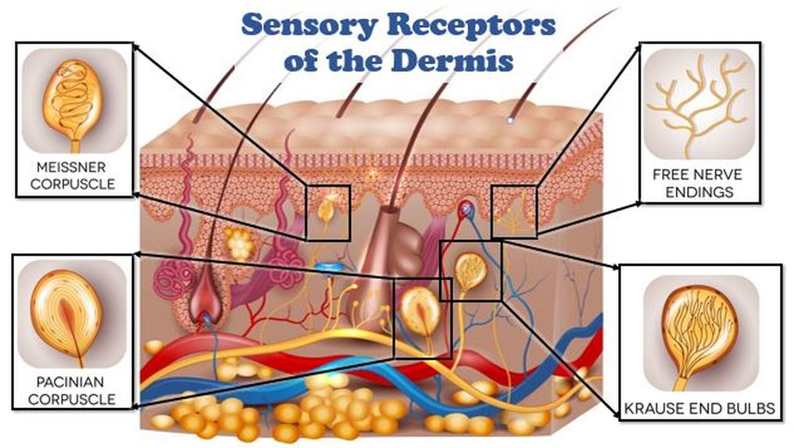
Cutaneous Sensations
Our epithelium is our interface will the outside world.
Our physical sensation of touch, pressure, pain and temperature all come from specialized sensory receptor cells in our epithelium.
Our skin gathers sensory information about the outside world that gets relayed to the brain.
Your skin has sensory receptors for temperature, touch and pain. ​

Slide 35
Epidermal tissue is categorized as a keratinized stratified squamous epithelial tissue. The most abundant type of cell found in the epidermis are keratinocytes. Keratinocytes produce keratin which is a fibrous protein that gives strength to epidermis.

Slide 36
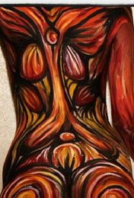
Keratinocytes form in the deepest portion of the epithelium (the stratum basale) and then are continuously pushed outward until they die and eventually get sloughed off of the body.
We loose millions of these dead skin cells every day! your epidermis is completely replaced every 35-45 days.

Slide 37
Melanocytes are specialized cells that lie within the skin. They produce a brown pigment (melanin) that functions to provide protection from damaging UV radiation from the sun.
The pigment filters out the UV light.
When your skin is exposed to more sunlight, your melanocyte darken the skin by increasing the production of melanin.
Melanocytes - make melanin - makes skin dark.
Protects from UV Light. UV light is carcinogenic. This is why getting too much sun can cause skin cancer.

Slide 38
keratin
The keratin protects the deeper tissue layers not only by providing a physical barrier to the outside world, but they provide antibiotics and enzymes that act to detoxify the harmful chemicals to which our skin is exposed.

Slide 39
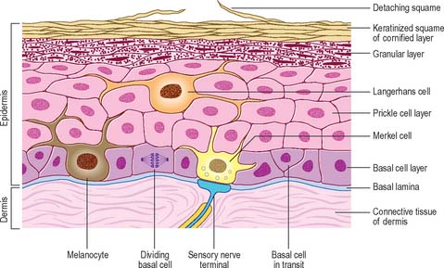
KERATINOCYTES
The keratinocytes undergo physical changes as they mature and move closer to the surface of your skin.
The keratinocytes are created from stem cells that exist in the stratum basale.
As these cells are pushed up by the production of new cells beneath them, they make their way to higher (more apical) epithelial layers.

Slide 40
KERATINOCYTES
When the keratinocytes reach the stratum spinosum (the layer superficial to the stratum basale) they begin to produce keratin.
Once they reach the stratum granulosum, these cells are busy making lots of keratin which fills their cytoplasm.

Slide 41
KERATINOCYTES
The keratinocytes begin to die as they become part of the stratum lucidum, becoming smaller and clear.
They begin to loose their organelles as they die.

Slide 42
CORNEOCYTES
By the time these dead keratinized squamous epithelial cells reach the skin's surface, they are completely dead and are characterized as "corneocytes".
The corneocytes are basically dead, flat sacs completely filled with fibrous keratin.

Slide 43
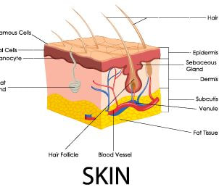
Glandular Epithelium
Epithelial cells that produce secretions are called gland cells or glandular epithelial cells.
The gland cells will come together to form glandular epithelial tissues. ​

Slide 44
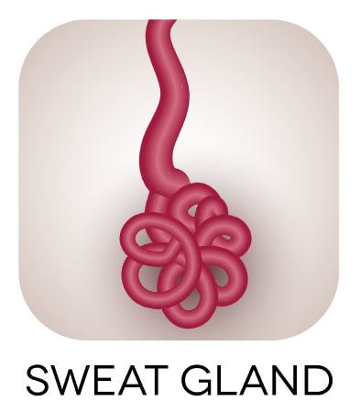
Glandular Epithelium
Epithelial cells that produce secretions are called gland cells or glandular epithelial cells.
The gland cells will come together to form glandular epithelial tissues. ​

Slide 45
Glandular Epithelium
Sweat glands function in thermoregulation to secrete sweat onto the surface of the skin to us cool.

Slide 46
Glandular Epithelium
Sebaceous glands secrete an oily substance called sebum directly into hair follicles.
It lubricates the skin and hair, prevents water loss, from the skin, and acts as a bactericidal agent.

