Slide 1
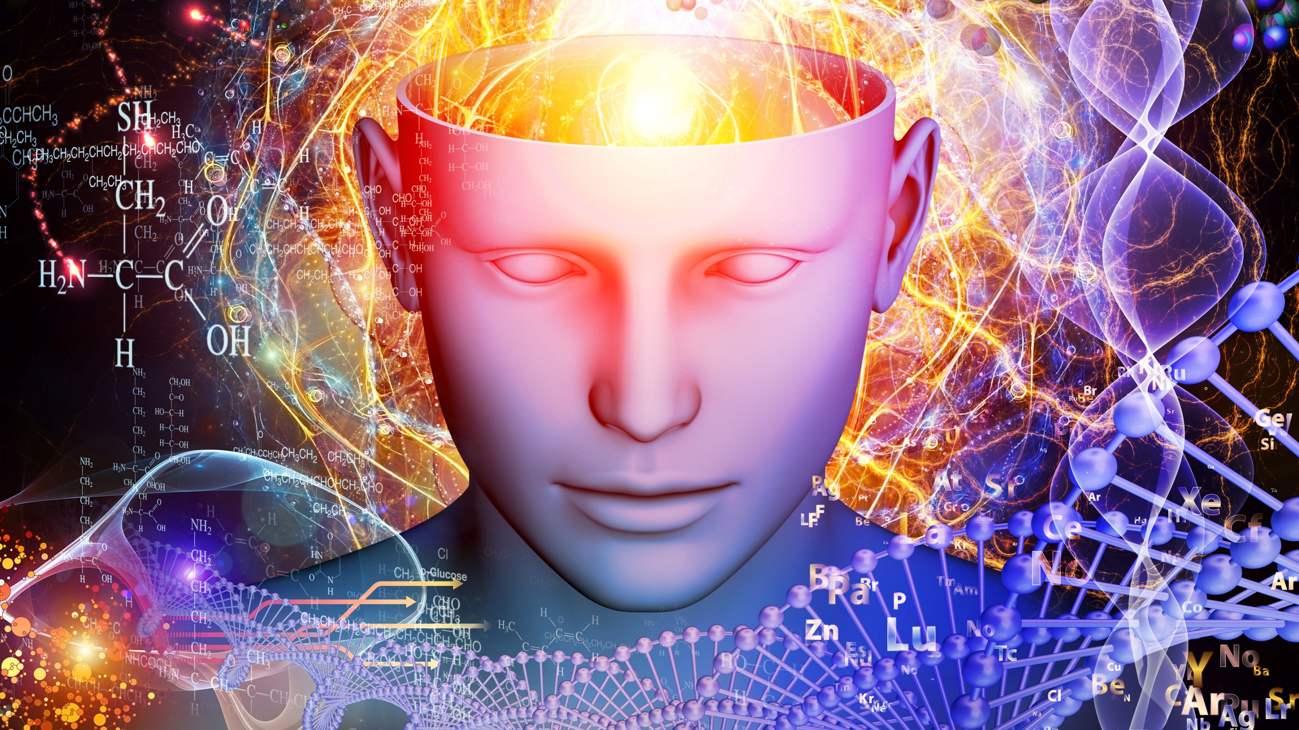
Microbial Genetics
MICROBIOLOGY

Slide 2
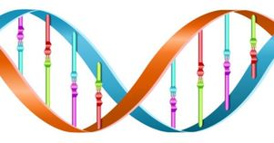
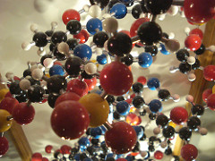
The 2 Functions of DNA
Autocatalytic Function
It Directs its Own Synthesis
Heterocatalytic Function
It Directs the Synthesis of RNA and Proteins

Slide 3
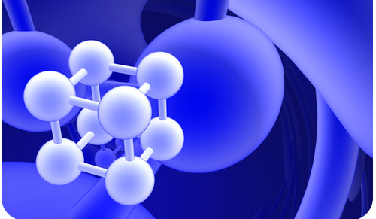
4 Organic Molecules
There are 4 types of organic molecules necessary to support life. All four of these molecules must be present in living organisms.
The 4 Organic Molecules Required for Life Are...
Proteins
Lipids
Carbohydrates (Sugars)
Nucleic Acids
This Photo by Unknown Author is licensed under CC BY-NC-SA

Slide 4
STRUCTURE OF DNA

Slide 5
DNA and RNA
Nucleic acids are the building blocks for DNA and RNA in living organisms. An individual nucleic acid is composed of the following:
A Phosphate Group
A Ribose Sugar
In DNA the Sugar will Be a Deoxyribose Sugar Molecule
In RNA the Sugar will Be a Ribose Sugar Molecule
A Nitrogenous Base
Adenine (A)
Cytosine (C)
Guanine (G)
Thymine (T) in DNA or Uracil (U) in RNA

Slide 6
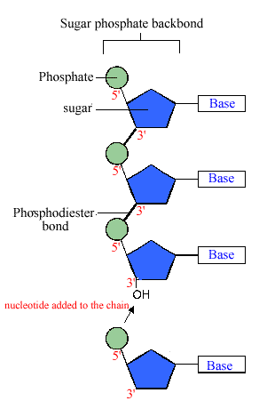
Structure of DNA
NUCLEIC ACID
DNA is Composed of a String of Nucleic Acids
An individual nucleic acid is composed of the following:
A Phosphate Group
A Ribose Sugar
A Nitrogenous Base

Slide 7
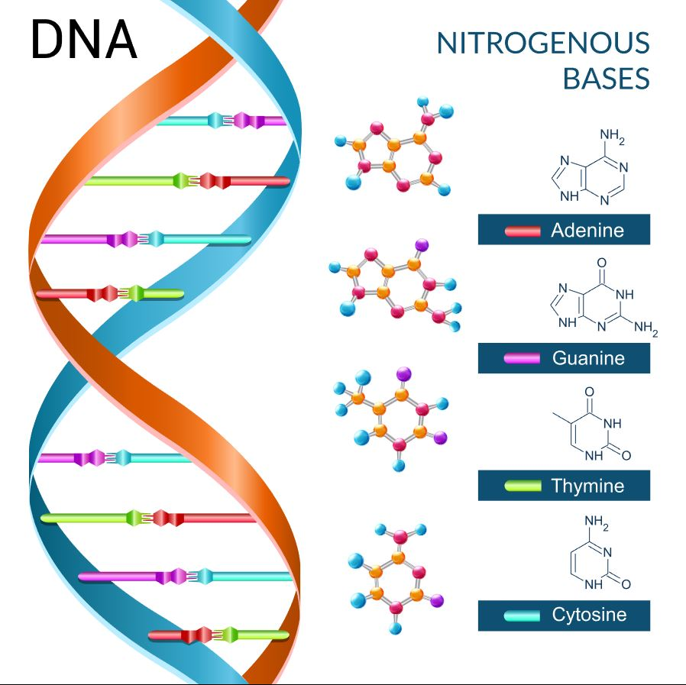
​There are only 4 nitrogenous bases found in DNA
Adenine (A)
Guanine (G)
Cytosine (C)
Thymine (T)

Slide 8
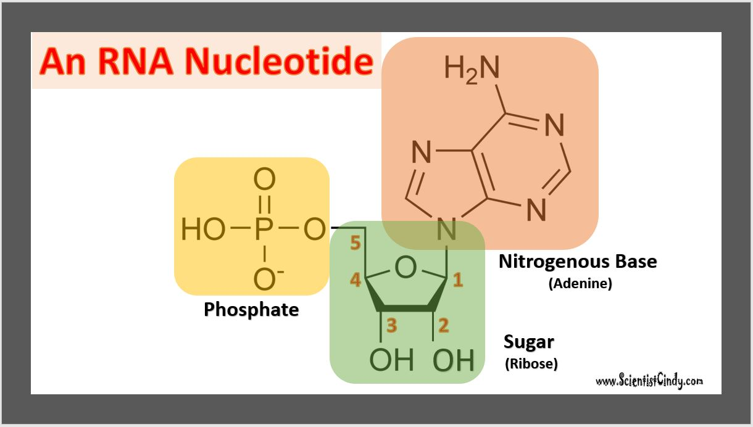
DNA Nucleotide vs RNA Nucleotide
Nucleic acids are the building blocks for both DNA and RNA in living organisms.
RNA and DNA Nucleotides Both Contain a Phosphate Group

Slide 9
DNA Nucleotide vs RNA Nucleotide
Nucleic acids are the building blocks for both DNA and RNA in living organisms.
RNA and DNA Nucleotides Both Contain A Sugar Molecule
DNA Nucleotide have a Deoxy-Ribose Sugar Molecule
RNA Nucleotide have a Ribose Sugar Molecule
This is why DNA stands for Deoxyribonucleic Acid
And RNA stands for Ribonucleic Acid

Slide 10
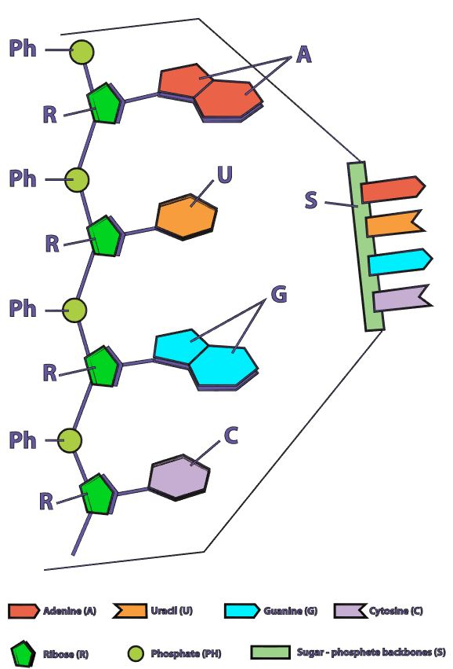
DNA Nucleotide vs RNA Nucleotide
Nucleic acids are the building blocks for both
DNA and RNA in living organisms.
The 4 Nitrogenous Bases in DNA are
Adenine (A)
Cytosine (C)
Guanine (G)
Thymine (T) in DNA ONLY
The 4 Nitrogenous Bases in RNA are
Adenine (A)
Cytosine (C)
Guanine (G)
Uracil (U) in RNA ONLY

Slide 11
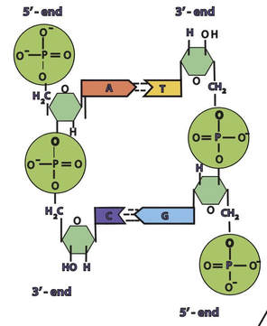
The Sugar-Phosphate Backbone of DNA
Phosphate
Sugar
Sugar
Phosphate
In a molecule of DNA or RNA, individual nucleotides are linked together to make a sugar-phosphate backbone.
Phosphate
Sugar
Sugar
Phosphate

Slide 12
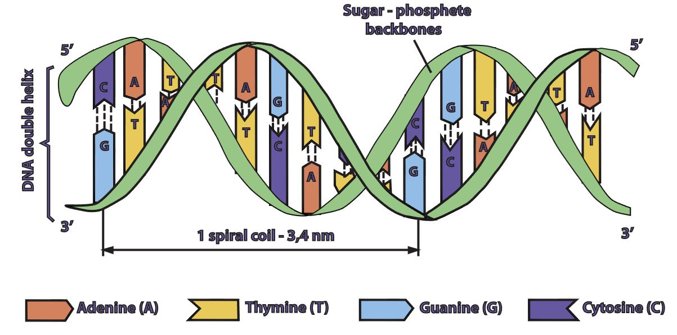
Base Pairing in DNA
DNA is double stranded.
Each strand of DNA is connected to the other DNA strand though hydrogen bonding.
This hydrogen bonding occurs between the nitrogenous bases on opposing DNA strands.
​A can only pair with T
Creates 2 hydrogen bonds
C can only pair with G
Creates 3 hydrogen bonds

Slide 13
DNA Strands are Antiparallel
The DNA strands are oriented antiparallel to one another. The ends of the DNA molecule are different. One end of the DNA molecule is designated 3' (stated as 3 prime) and the other as 5' (stated as 5 prime). They are names according to the carbons in the ribose sugar molecule of the DNA backbone. In a molecule of DNA, one strand will be oriented from 3' to 5', and the other from 5' to 3'.

Slide 14
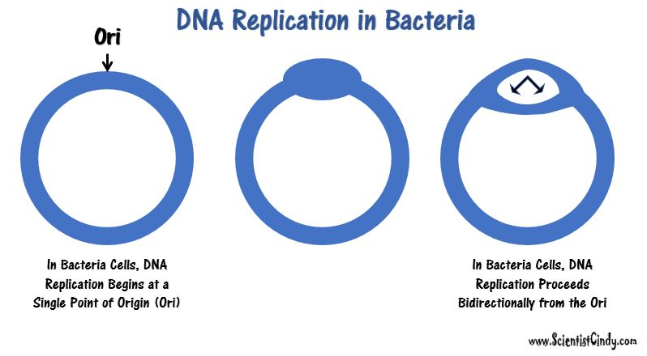

Slide 15
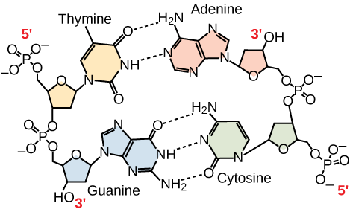
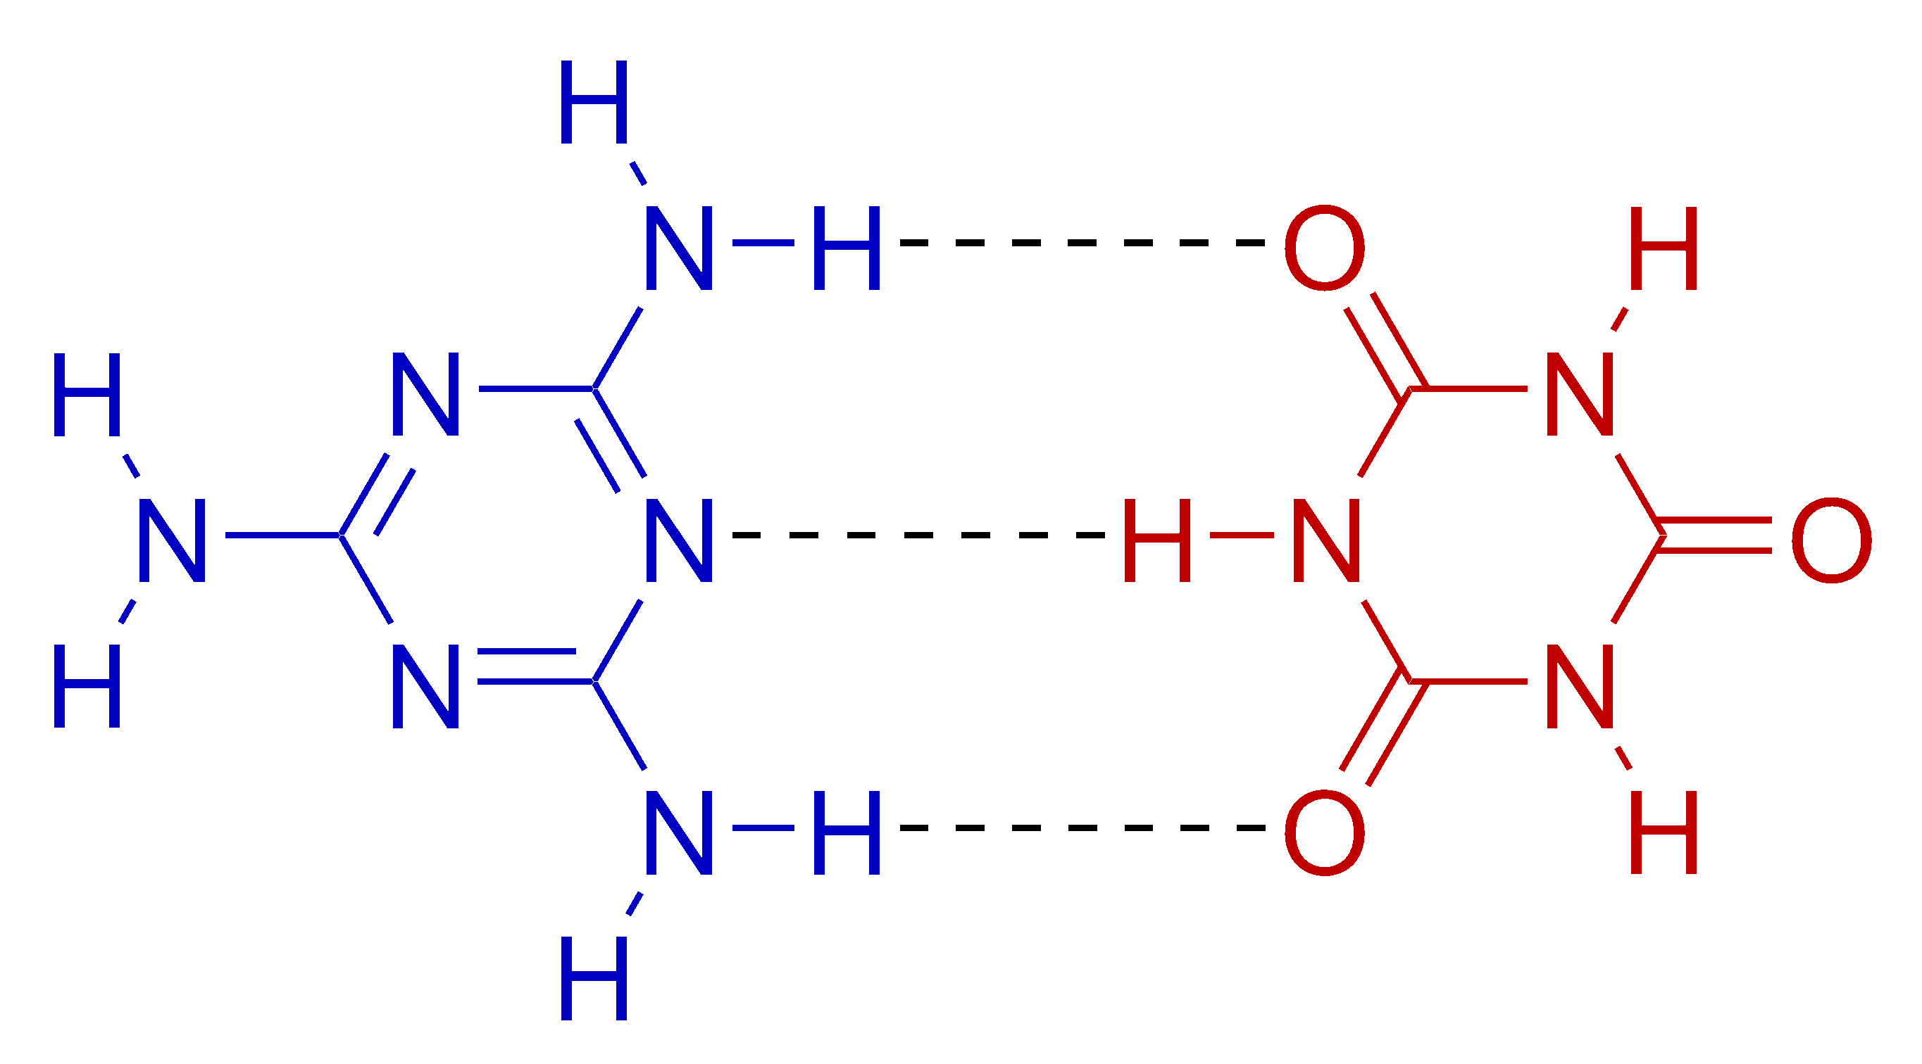
Hydrogen Bonding in DNA
Hydrogen bonds are relatively weak.
It is important for the hydrogen bonds to be able to be broken when the cell needs access to the individual DNA strands.
For example, the two DNA strands need to be separated for DNA replication during reproduction and to make the mRNA template during transcription.

Slide 16
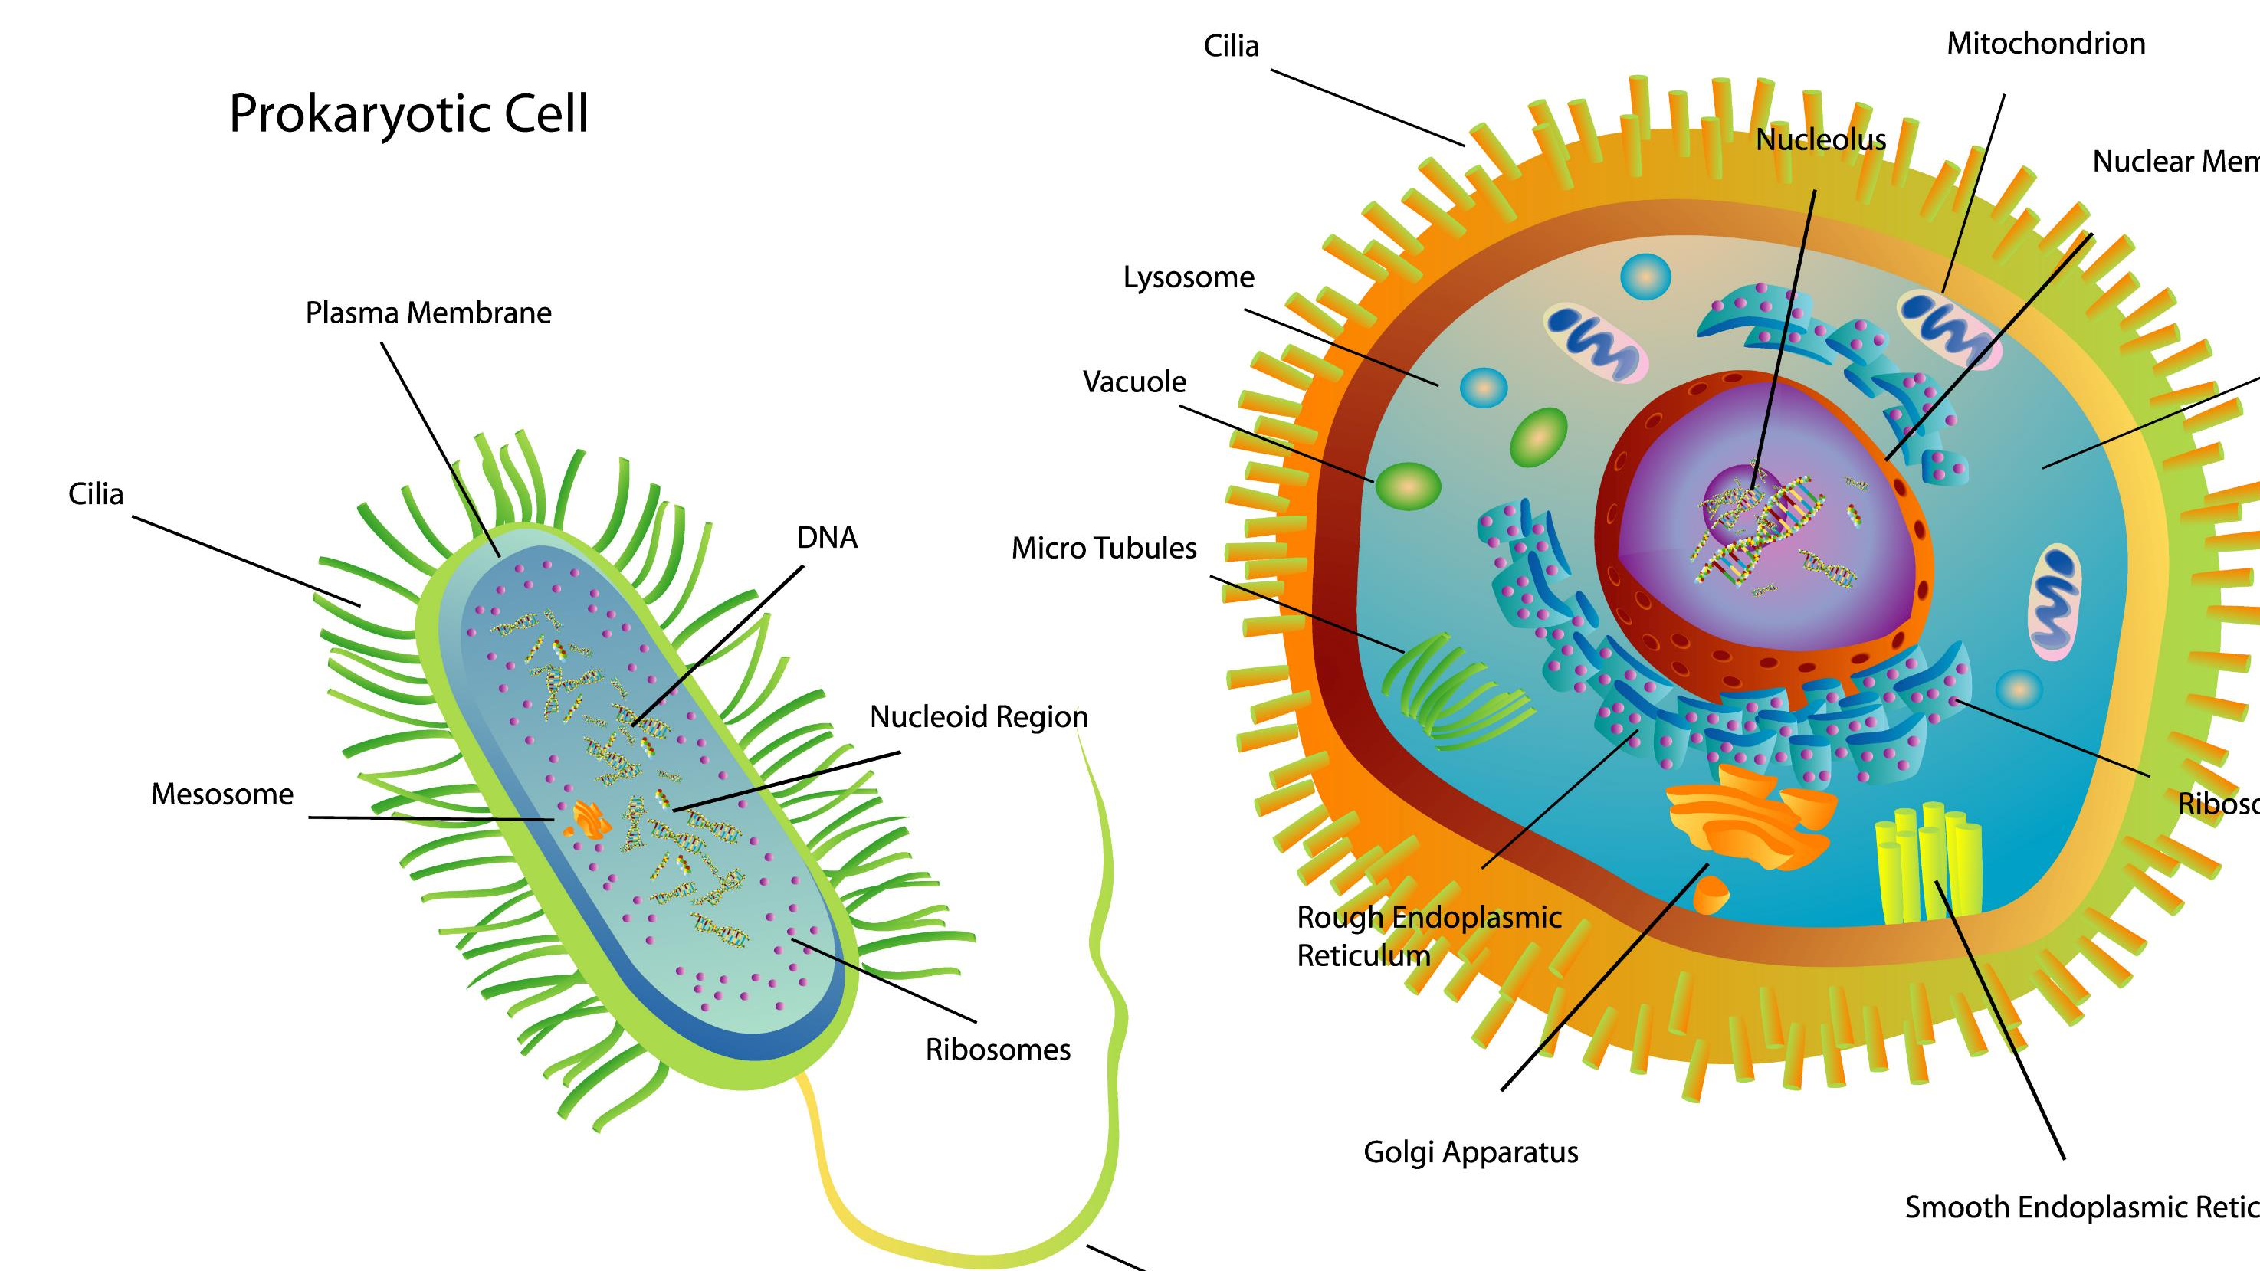
DNA in Eukaryotes
In eukaryotic cells, the genetic material (DNA) is in the nucleus of the cell.
DNA holds the instructions for all of the proteins the cell may required.
These instruction are encoded as the sequence of base pairs on the individual nucleic acids that make up the cell. ​

Slide 17
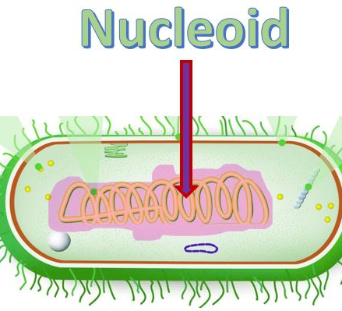
DNA in Prokaryotes
Bacteria cells are prokaryotic
They are much smaller than the eukaryotic cell.
They do not have any membrane-bound organelles.
They do not have a nucleus.
The DNA in prokaryotic cells is found in a region called the nucleoid.

Slide 18
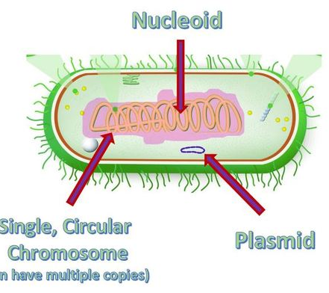
Nucleoid
The DNA in bacteria exist in a region called the nucleoid.
The nucleoid is simply a "cytoplasmic location" and not a membrane-bound organelle, like our nucleus.
However, the nucleoid does succeed in packaging the DNA into a small space within the cytoplasm.
​Proteins assist in anchoring the genetic material to the nucleoid.
Bacteria are small, and the nucleoid takes up almost 1/3 of the space in the cel!.

Slide 19
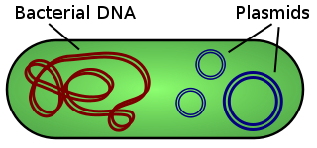
Plasmids
Some species of bacteria have additional small extra-chromosomal circular DNA loops in their cytoplasm, called plasmids.

Slide 20
Plasmids
What is a PLASMID?
Interestingly, these plasmids do not carry any of the genes essential for normal life processes.
Plasmid do alter the sensitivities or abilities of the bacteria that possess them.

Slide 21
Plasmids
What is a PLASMID?
These non-essential genes are classified as accessory genes.
For example, some plasmids carry genes that allow for
antibiotic resistance
habitat tolerance
bacterial conjugation which allows the exchange of genetic material between bacterial cells

Slide 22
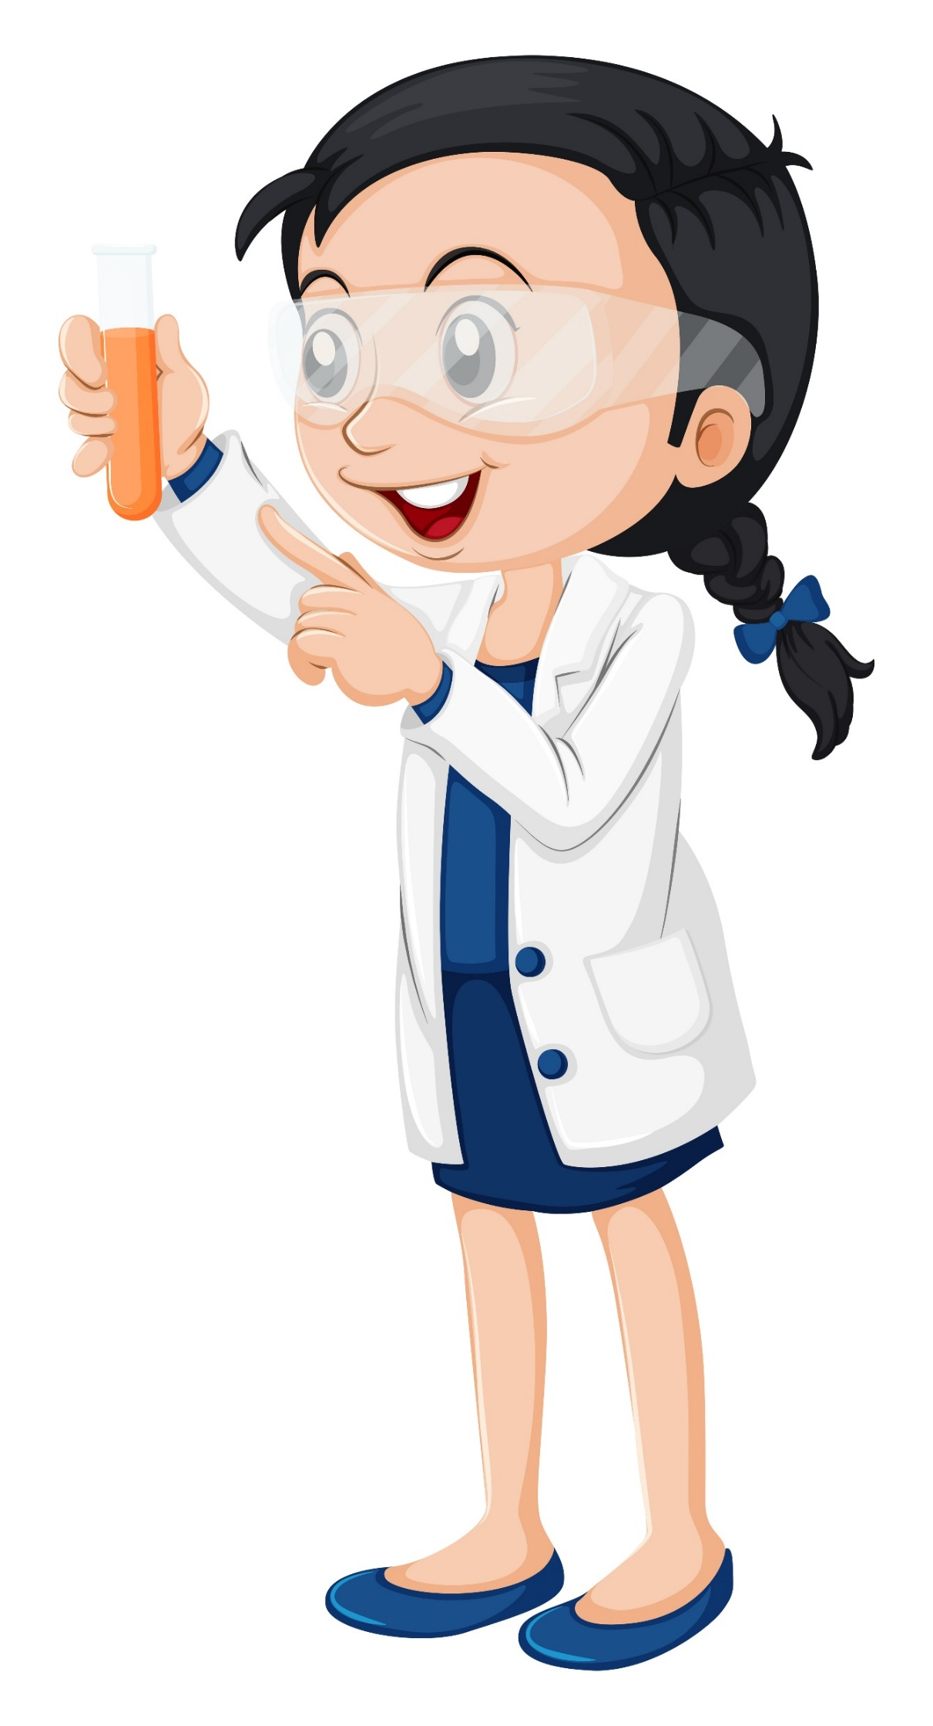
DNA Replication

Slide 23
DNA Replication in Required for cellular division (Binary Fission)
Prokaryotes are Asexual
They have only 1 set of genes so they are Haploid
1 Daughter cell is generated as the genetic clone of 1 parent or 1 progenitor cell

Slide 24
DNA Replication in Required for cellular division (Binary Fission)
Prokaryotes are Asexual
They have only 1 set of genes so they are Haploid
1 Daughter cell is generated as the genetic clone of 1 parent or 1 progenitor cell

Slide 25
A Diploid Eukaryotic Organism is formed from the fusion of a Haploid Egg and a Haploid Sperm that were formed through the process of meiosis.
DNA Replication in Required for Mitosis and Meiosis is Eukaryotic Cells

Slide 26
A Diploid Eukaryotic Organism is formed from the fusion of a Haploid Egg and a Haploid Sperm that were formed through the process of meiosis.
DNA Replication in Required for Mitosis and Meiosis is Eukaryotic Cells

Slide 27
Comparing DNA and DNA Replication Prokaryotes vs Eukaryotes

Slide 28
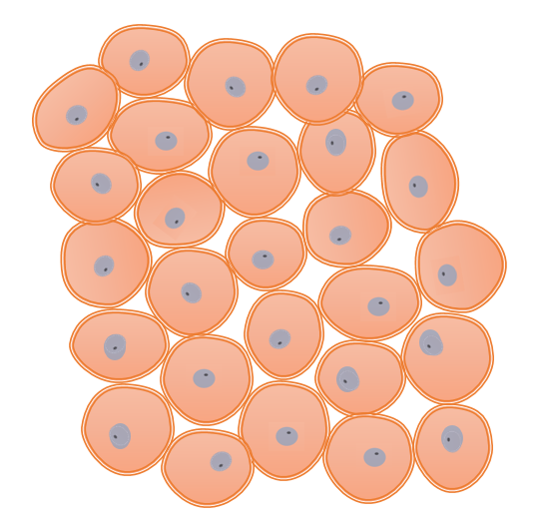
Bacteria VS Animal Cells
The bacterial genome consists of a small single circular chromosome.
DNA is Replicated Quickly rate of ~ 1000 nucleotides per second.
Bacteria are HAPLOID.
Asexual Reproduction via Binary Fission – no genetic recombination.
Large linear chromosomes
Multiple chromosomes
Replication of DNA is slower
Reproduction is sexual – genetic recombination occurs
Animal Cells are DIPLOID.
One full set of chromosomes from each parent. (2 sets total).

Slide 29
DNA Replication
In order for reproduction to occur, the DNA must be replicated. This process is simply called DNA Replication.

Slide 30
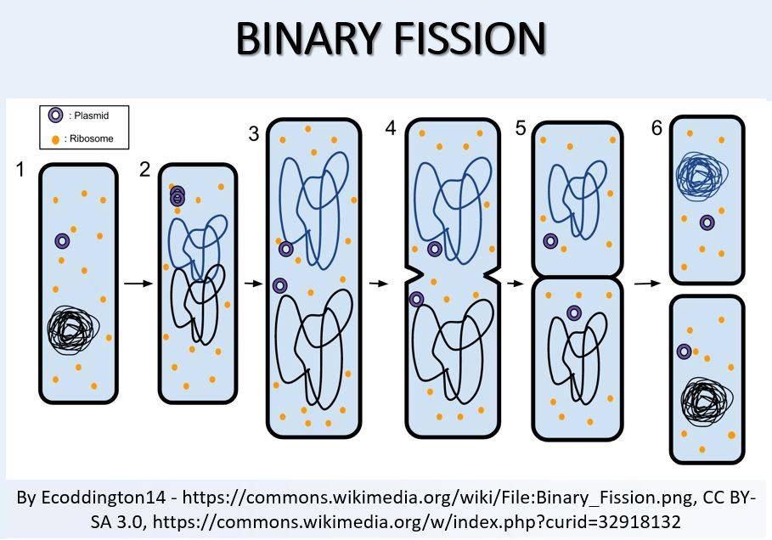
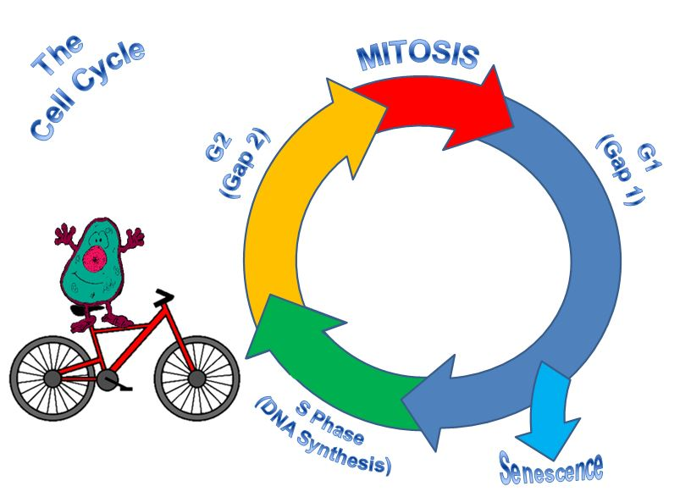
DNA Replication

Slide 31
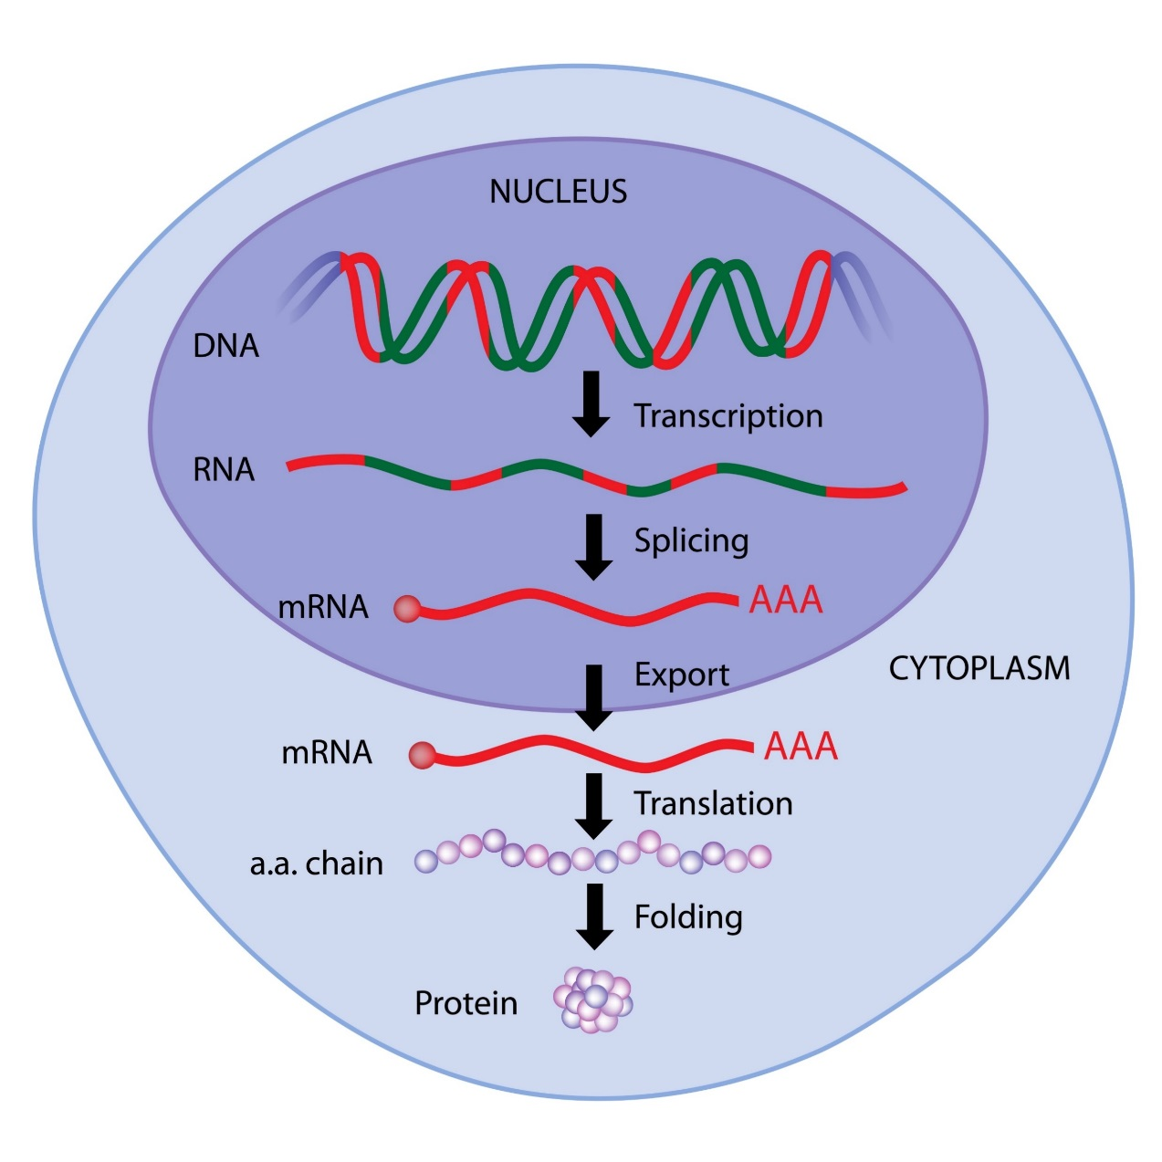
Protein synthesis in bacteria cells
Protein synthesis in eukaryotic cells
Protein synthesis in bacteria cells is much simpler than it is in eukaryotic cells.
Bacterial DNA does not contain introns (regions of DNA that do not code for protein). [ARCHAEA DO HAVE INTRONS].

Slide 32
Protein synthesis in bacteria cells
Protein synthesis in eukaryotic cells
Also, the bacterial has no nucleus for transcription to take place in when the DNA gets transcribed into messenger RNA.
The process in bacteria cells, does not involve any processing of the messenger RNA.
The messenger RNA will simply travel directly to a ribosome, where it will then be translated into a protein.

Slide 33
DNA REPLICAION in Bacteria is a 3-Step Process
INITIATION
Elongation
Termination

Slide 34
Initiation begins at a specific nucleotide sequence called the origin of replication (Ori).

Slide 35
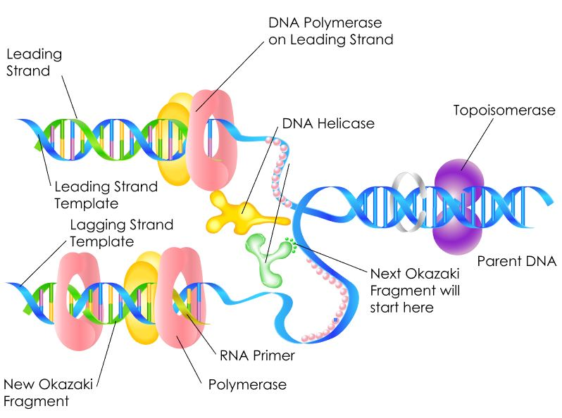
Initiation step of DNA Replication
Topoisomerase II (a.k.a. gyrase) uncoils the DNA.
Helicase then separates the DNA strands by breaking the hydrogen bonds between the nitrogenous base pairs.

Slide 36
Initiation step of DNA Replication
Two replication forks are formed at the origin of replication creating a replication bubble.
replication forks

Slide 37
Binding Proteins
replication fork
The DNA near each replication fork is coated with single-stranded binding proteins to prevent the single-stranded DNA from rewinding into a double helix.
Binding Proteins

Slide 38
INITIATION STEP (in Bacterial DNA Replication)
Initiation begins at a specific nucleotide sequence called the origin of replication (Ori).
Topoisomerase II (a.k.a. gyrase) uncoils the DNA.
Helicase then separates the DNA strands by breaking the hydrogen bonds between the nitrogenous base pairs.
Two replication forks are formed at the origin of replication creating a replication bubble.
The DNA near each replication fork is coated with single-stranded binding proteins to prevent the single-stranded DNA from rewinding into a double helix.

Slide 39
ELONGATION STEP (in DNA Replication)
DNA Polymerase III can only synthesize DNA in the 5’ to 3’ direction.
DNA is double stranded with one strand oriented in the 5’ to 3’ direction and the other stand oriented in the 3’ to 5’ direction.
The consequence of this antiparallel configuration, coupled with the factor that DNA Pol III can only synthesize DNA in the 5' to 3' direction, is that one of the DNA strands will be replicated continuously, but the other will not!

Slide 40
ELONGATION (of DNA Replication)
Leading strand
Leading Strand - The parent strand of DNA which runs in the 3' to 5' direction toward the replication fork. It has the ability to be replicated continuously by DNA polymerase. Lagging Strand - This is the parent strand of DNA which runs in the 5' to 3' direction toward the fork, and it's replicated discontinuously. ​
Lagging strand

Slide 41
Steps of Elongation (in DNA Replication)
DNA Helicase opens up the replication fork
On the Leading Strand, DNA Polymerase III follows helicase and adds on nucleotides according to complementary bases in the 3' to 5' direction. This is considered continuous replication.
DNA Helicase
DNA Polymerase III

Slide 42
Steps of Elongation (in DNA Replication)
On the Lagging Strand, DNA Polymerase III will replicate short portions of DNA at a time, called Okazaki Fragments. This is considered discontinuous replication.
DNA Ligase is the enzyme that functions to connect the Okazaki Fragments together for the copy of the lagging strand. The word "ligate" in Latin means "to tie together."
Okazaki Fragments
DNA Ligase

Slide 43
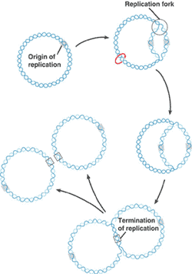
Termination of DNA Replication
Since the bacterial genome consists of a single circular chromosome, at the end of the elongation step of DNA replication, you end up with 2 interlocking circles of DNA that must be separated.

Slide 44
Termination of DNA Replication
Steps of TERMINATION
Bacterial Topoisomerase IV induces a double-strand break into each of the DNA molecules, allowing them to separate from each other (becoming un-concatenated).
Bacterial Topoisomerase IV then reseals each DNA molecule back together again creating 2 separate, un-linked chromosomes.
FREEDOM AT LAST!

Slide 45
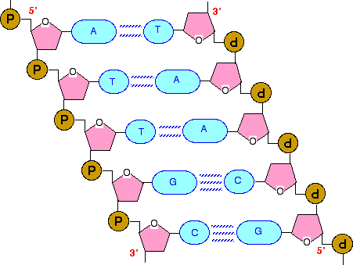
DNA Polymerase III (DNA Pol III)
DNA Pol III is the enzyme required for DNA synthesis (a.k.a. DNA Replication) in bacteria.
DNA pol III adds the individual nucleotides according to their complementary base.
Adenine (A) is the complementary base of Thymine (T)
Cytosine (C) is the complementary base of Guanine (G)

Slide 46
The Central Dogma of Molecular Biology

Slide 47
Central Dogma Of Molecular Biology
The central dogma of molecular biology explains how the information encoded in DNA sequences (genes) is expressed as proteins in a two-step process:
Step One) Transcription
Transcription involves making mRNA using DNA as a template.
Step Two) Translation.
Translation then translates the mRNA sequence into an amino acid sequence to form a protein.

Slide 48
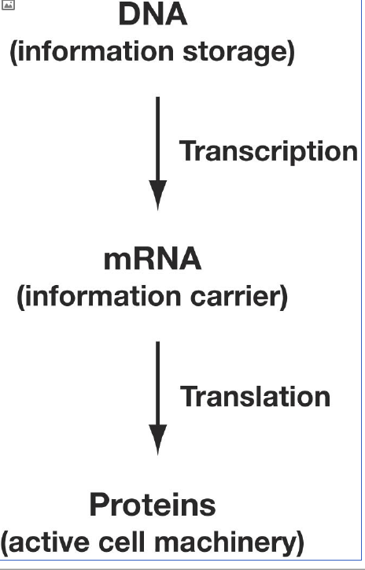
The Central Dogma
• Transcription is a process in which:
– The sequence of bases in a particular stretch of DNA (a gene) specifies the sequence of bases in an mRNA molecule.
• Translation is a process in which:
– A particular mRNA molecule then specifies the exact sequence of amino acids in a protein.
• Thus, genes ultimately code for proteins.
DNA codes for RNA, which codes for protein.

Slide 49
Bacteria vs Prokaryotes – Transcription / RNA Processing

Slide 50
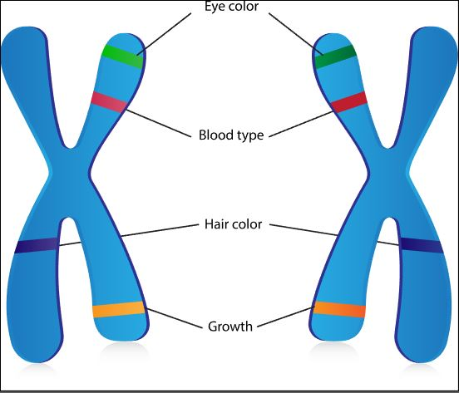
Gene Expression
Genes are segments of nucleic acid sequences that will code for proteins that exhibit a specific genetic trait.
The process by which the genetic sequence gets expressed into protein is a two-step process, transcription followed by translation.

Slide 51
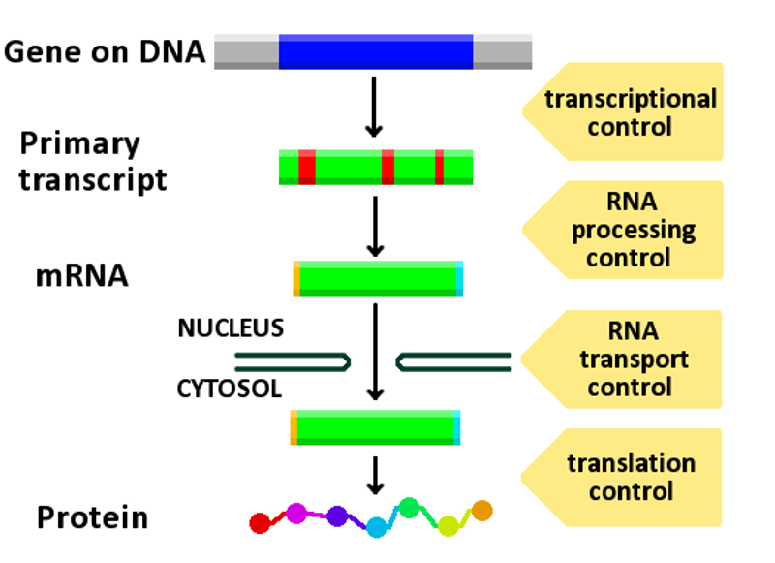
Gene Expression
The first step is transcription. In short, transcription involves using the DNA molecules as a template to form messenger RNA (mRNA).

Slide 52
Gene Expression
The second and final step of this process is called translation. Translation is the process by which the mRNA sequence will be translated into an amino acid sequence which makes up a protein.

Slide 53
Same Names… Different Processes!
CAUTION AHEAD
!
The Process of DNA Replication Proceeds in 3 Steps:
Initiation
Elongation
Termination
The Process of Transcription (DNA → mRNA) Proceeds in 3 Steps:
Initiation
Elongation
Termination
The Process of Translation (mRNA → protein) Proceeds in 3 Steps:
Initiation
Elongation
Termination

Slide 54
TRANSCRIPTION

Slide 55
Transcription in Bacteria is a 3-Step Process
INITIATION
Elongation
Termination

Slide 56
Bacterial Transcription: Summary
Initiation:
Sigma brings RNA polymerase holoenzyme to promoter region of DNA.
DNA helix is opened and transcription begins.
Sigma releases and transcription continues.
•Elongation:
Complementary ribonucleotides are added to the growing mRNA transcript as specified by the DNA template strand.
•Termination:
RNA polymerase reaches a termination signal in the DNA template.
mRNA forms a hairpin loop.
mRNA dissociates from RNA polymerase.

Slide 57
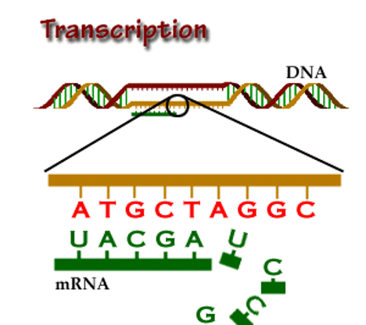
RNA Transcription
RNA transcription in bacteria is done in the cytoplasm, not in the nucleus like in eukaryotic cells.
Transcription in bacteria is done using an enzyme called RNA polymerase.
RNA Polymerase adds nucleotides according to their complementary bases using a free 3’-OH group of the growing nucleotide chain. ​

Slide 58
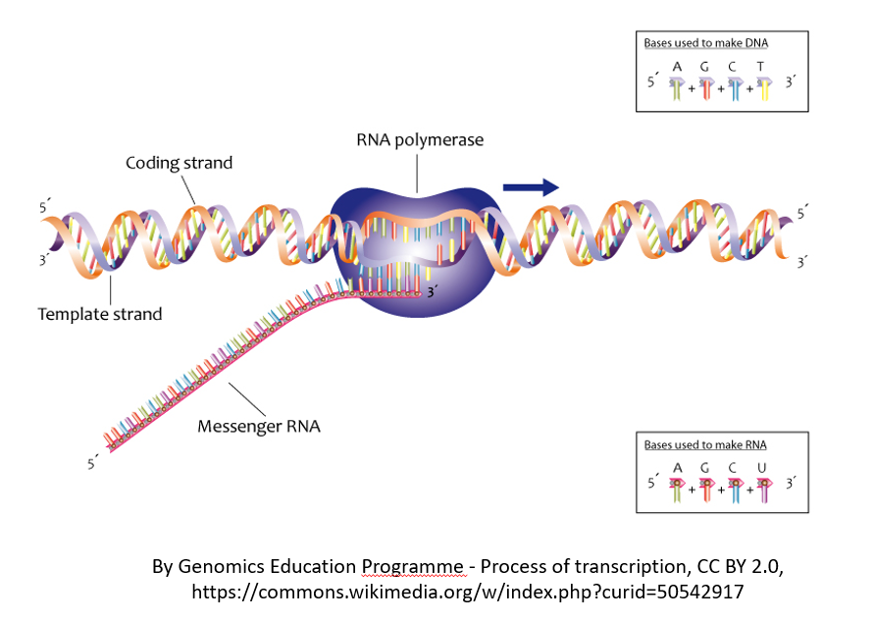
INITIATION (of RNA Transcription)
RNA transcription requires a promoter.
A promoter is a DNA sequence that transcription factors bind to.
Promoters are located “upstream” from the sequences that code for proteins.
The nucleotides that code for proteins would be considered to be located “downstream” from the initiation site (which is where transcription begins).

Slide 59
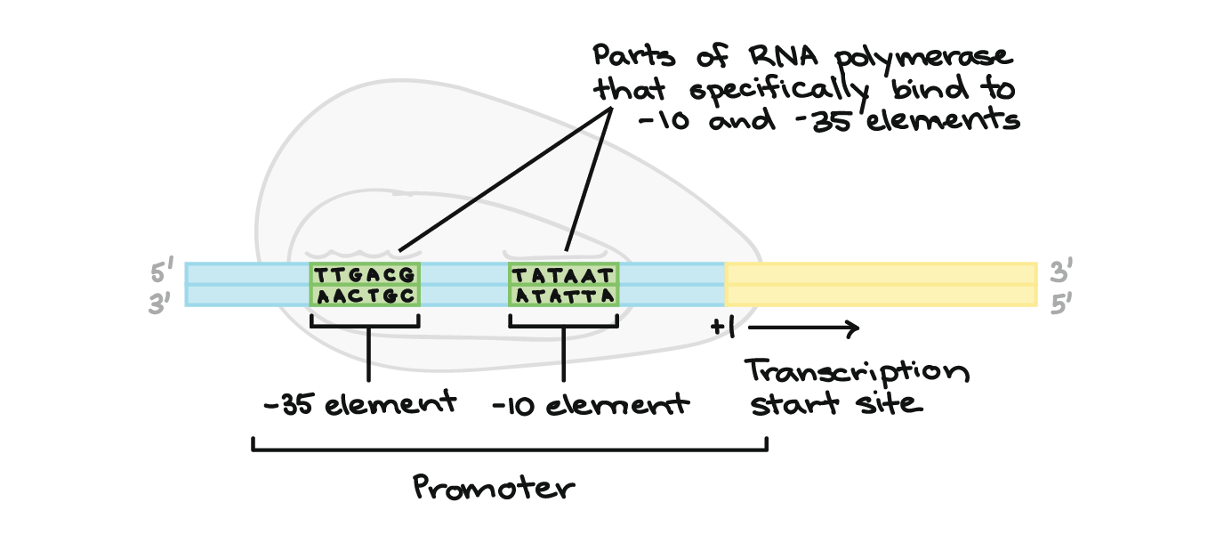
Promoters in Bacteria
Promoters are usually located between –10 and –35 bases upstream from the initiation site (designated +1).
All species of bacteria have two nucleotide sequences that have been conserved, known as "consensus sequences".
https://www.khanacademy.org/science/biology/gene-expression-central-dogma/transcription-of-dna-into-rna/a/stages-of-transcription

Slide 60
Promoters in Bacteria
The 2 consensus sequences are as follows:
The –10 consensus sequence, called the TATA box, is TATAAT.
The –35 sequence is recognized and bound by Sigma.
https://www.khanacademy.org/science/biology/gene-expression-central-dogma/transcription-of-dna-into-rna/a/stages-of-transcription

Slide 61
ELONGATION (of RNA Transcription)
Once all of the relevant transcription factors have bound to the promoter, the elongation in transcription phase begins.
In this part of RNA transcription, the sigma subunit of the RNA polymerase falls off which allows RNA transcription to begin.

Slide 62
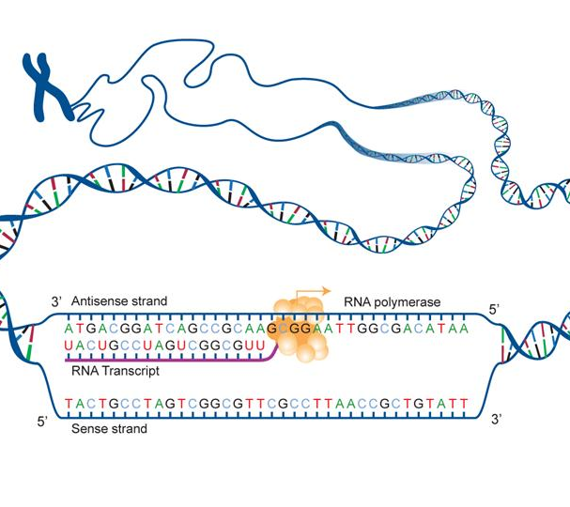
ELONGATION (of RNA Transcription)
The RNA nucleotides are added in a complementary fashion to the DNA template in a 5’ to 3’ direction at a rate of approximately 40 nucleotides per second.
RNA does not have thymine (T), so when the DNA template contains a nucleotide with an adenine (A) base, it will add a nucleotide with Uracil (U) instead.

Slide 63
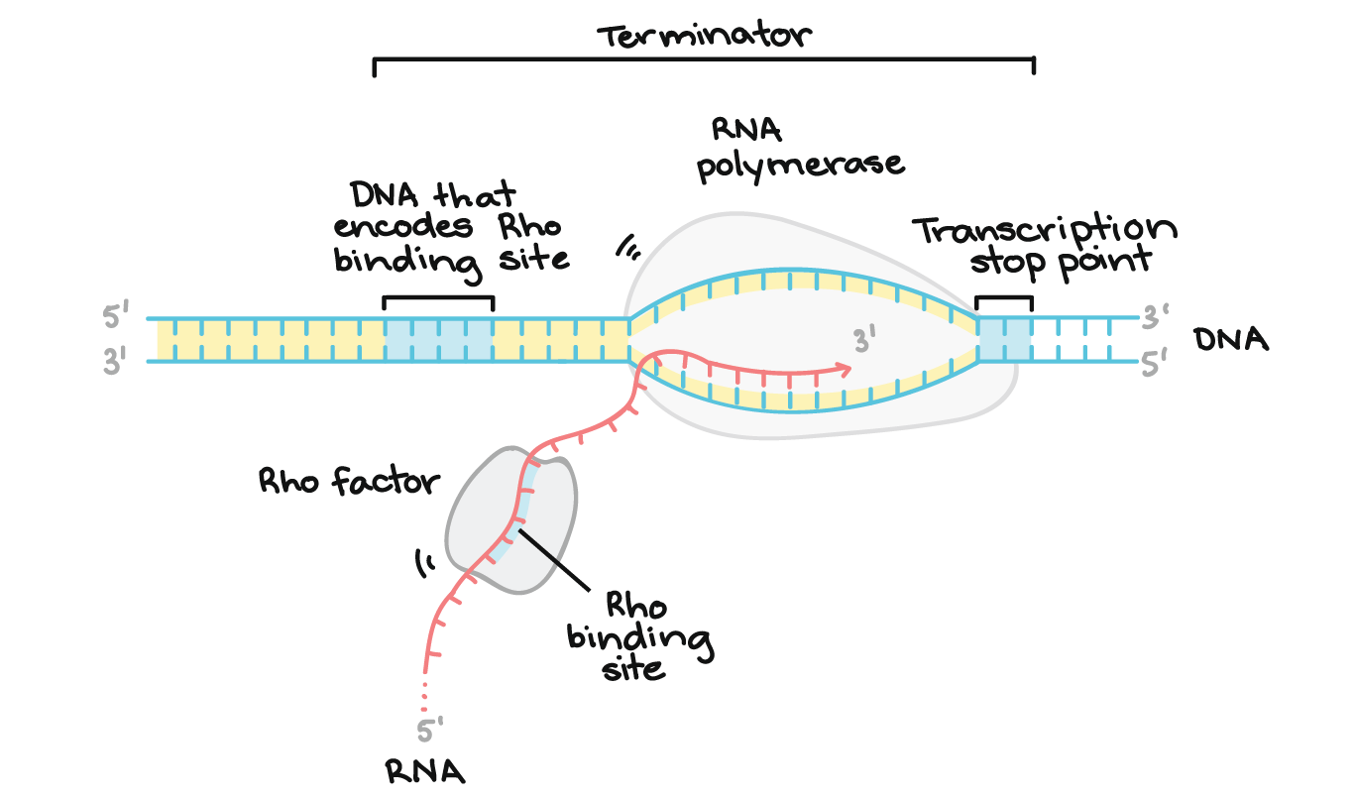
Transcription of RNA is terminated when the bacterial RNA polymerase dissociates from the DNA template and releases the newly made RNA.
This is accomplished through a terminating sequence (a repeated nucleotide sequence) that signals the RNA polymerase to terminate the process.
TERMINATION (of RNA Transcription)

Slide 64
Eukaryotic mRNA Processing
After transcription but before translation, specific regions of the primary RNA transcript are spliced out (cut out) and degraded during RNA processing
Bacterial MRNA does not get processed. Archaea mRNA does.

Slide 65
Transcription: Summary

Slide 66
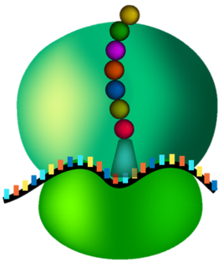
Translation

Slide 67
Translation in Bacteria is a 3-Step Process
INITIATION
Elongation
Termination

Slide 68
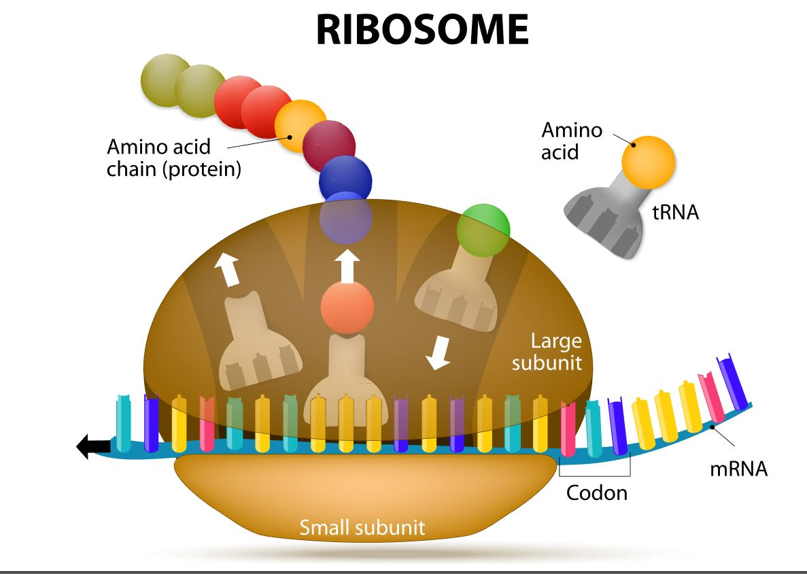
In translation:
The sequence of bases in mRNA is converted (“translated”) to an amino acid sequence of a protein.
Ribosomes catalyze the translation of mRNA sequence into protein. They are the SITE or protein synthesis but they DO NOT actually MAKE the proteins!!!

Slide 69
INITIATION (of Translation)
In bacteria, translation of mRNA into an amino acid sequence begins with the formation of an initiation complex.
The initiation complex is formed when the mRNA, the tRNA, and the first amino acid all come together within the ribosome.

Slide 70
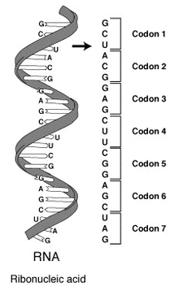
ELONGATION (of Translation)
The nucleotide sequence of mRNA is read in triplets called codons.
All translation begins with what is called "the start codon" which is AUG.
This means that the first 3 bases on the mRNA are Adenine (A), Uracil (U) and Guanine (G) = AUG.
The AUG codon codes for the amino acid methionine.

Slide 71
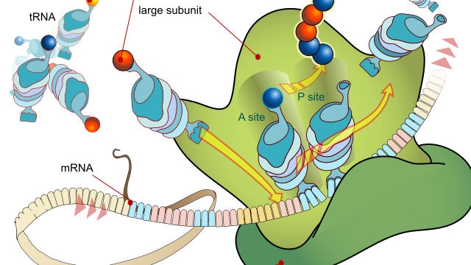
TERMINATION (of Translation)
Termination of protein synthesis occurs at the stop codon. There are three different codons which are considered stop codons (UAA, UAG and UGA).
When one of these stop codons reaches the ribosome, the last amino acid will break free from the ribosome and from the tRNA. The protein is now complete.

Slide 72
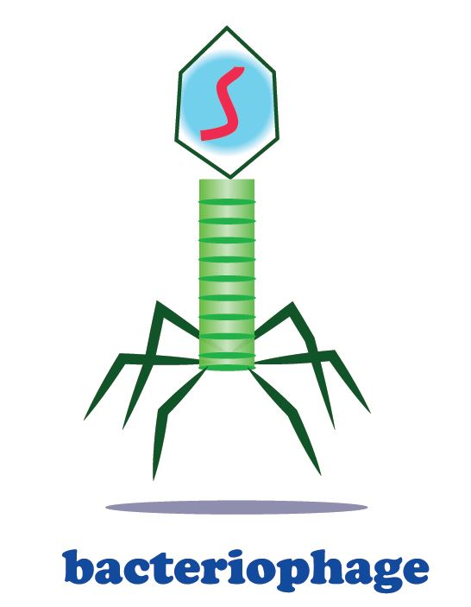
Genetics of Viruses
Bacteriophages are viruses that infect bacteria cells.
Viruses are not made of cells.
They can have DNA or RNA.
Not Considered Alive.
Cannot Reproduce without a Host.

Slide 73
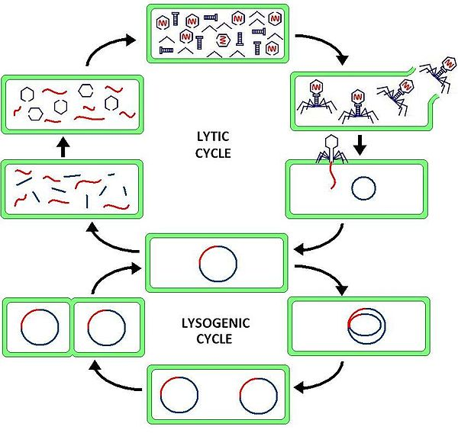
Genetics of Viruses
There are two types of reproductive cycles that a bacteriophage can enter;
1) the lytic cycle and
2) the lysogenic cycle.. The lytic cycle results in lysis of the host cell, which ends in death. In the lysogenic cycle, the viral genome enters the nucleus and inserts itself into the host genome, keeping the host cell alive.

Slide 74
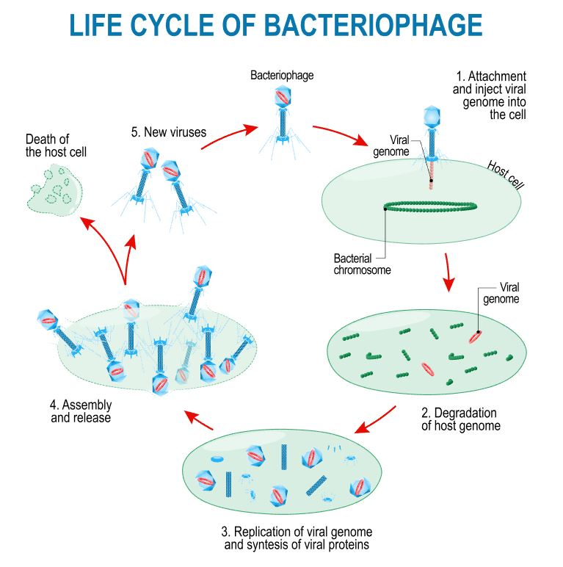
The Lytic Cycle
The lytic cycle results in lysis (bursting open) of the host cell, which ends in death.
The virus attaches to the host and inserts its genetic material (RNA or DNA).
The viral genome hijack’s the host cell’s machinery to produce itself (proteins and genome).
Viral copies are self-assembled and leave the host resulting in lysis of the host cell.

Slide 75
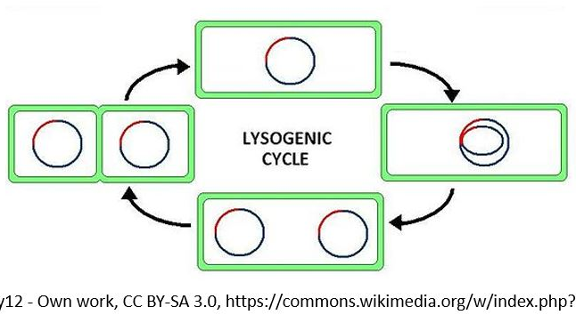
The Lysogenic Cycle
In the lysogenic cycle, the viral genome enters the nucleus of the bacterial host and inserts itself into the host genome.
The host cell will be kept alive for some time.
The genome of the virus will get inserted into the genome of the host cell.
Each time the infected bacteria cell reproduces itself, it will also reproduce the viral DNA as well.
After some time has past, the prophage will exit the host cell's genome and the virus will begin to undergo the deadly lytic cycle.

Slide 76
A Methods of Genetic Recombination in Bacteria

Slide 77
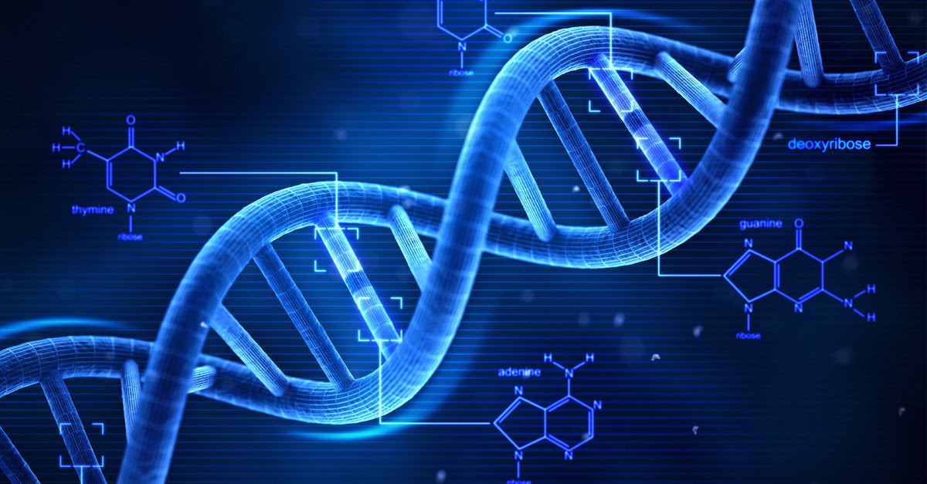
GENETIC RECOMBINATION IN BACTERIA
THE THREE METHODS BY WHICH BACTERIA CAN UNDERGO GENETIC RECOMBINATION ARE AS FOLLOWS:
TRANSFORMATION
TRANSDUCTION
CONJUGATION
This Photo by Unknown Author is licensed under CC BY-NC-ND

Slide 78
Transformation: A Method of Genetic Recombination in Bacteria
Transformation is when a bacteria takes in plasmids from their environment.
In order to take in a plasmid from the environment, microbiologists must "induce competency".
There are several methods used in laboratories to induce competency.
One of the most popular and easiest ways to induce competency in bacteria, is the "heat shock" method.

Slide 79
Transformation: A Method of Genetic Recombination in Bacteria
Heat shocking involves exposing the bacteria to a moderately high temperature for a brief amount of time.
Immediately following the heat exposure, the culture is then put on ice.
This extreme temperature change causes specialized surface proteins on the cell membrane to allow the plasmids to pass through.
The bacteria are able to internalize the plasmids and they can express the genes on those plasmids in the form of proteins. ​

Slide 80
Transduction: A Method of Genetic Recombination in Bacteria
Phages can "accidentally" transfer genetic material from one bacterium to another.
There are two forms of transduction.
Generalized Transduction
the phage uses the lytic cycle
Specialized Transduction
The phage uses the lysogenic cycle

Slide 81
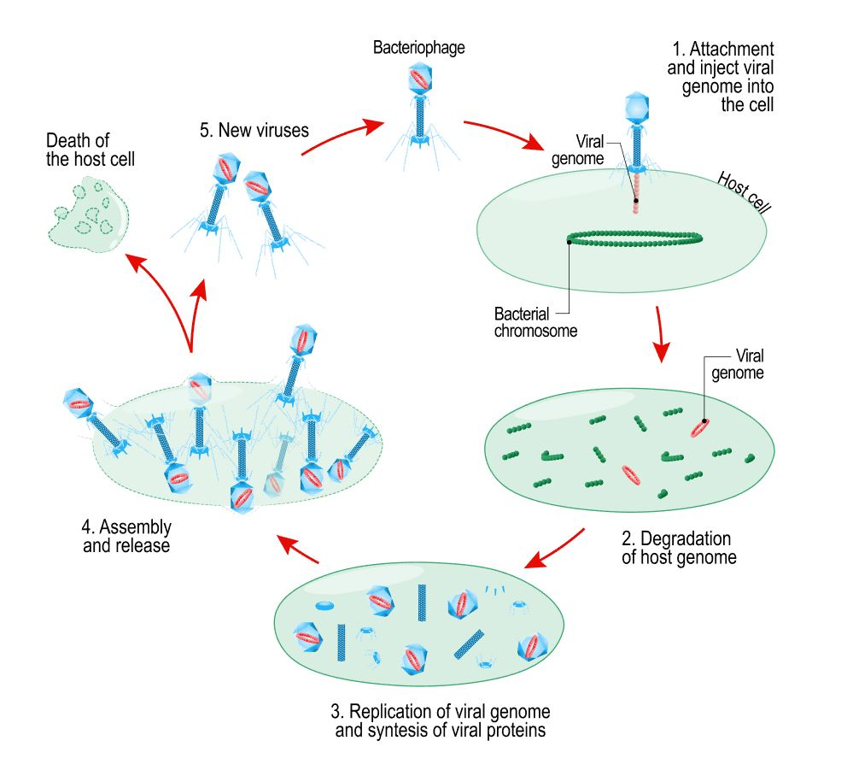
GENERALIZED Transduction: A Method of Genetic Recombination in Bacteria
Steps of Generalized Transduction CONTINUED
The phage is going to land on a bacteria cell (or bacterium).
The phage inserts its genetic information.
The bacteria's machinery is used to form new phages.
The new phages leave the host cell.

Slide 82
Transduction: A Method of Genetic Recombination in Bacteria
Steps of Generalized Transduction CONTINUED
Occasionally, some phages may have some of the bacteria's DNA inside of it when the exit the host cell.
These phages will bring the bacterial DNA with it when it infects the next host cell.
This time, when the phage goes to inject its DNA into the host cell, the bacterial DNA will be transferred to the host cell instead!

Slide 83
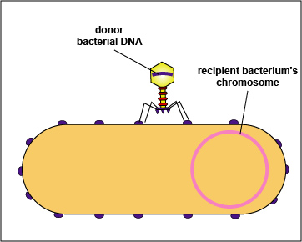
Specialized Transduction: A Method of Genetic Recombination in Bacteria
Steps of Specialized Transduction The process is the same as generalized except that the phage is going to utilize the lysogenic cycle.
The prophage is going to leave the bacteria cell.
The prophage will contain a small piece of bacterial DNA
This bacterial DNA will get transferred to any new host cell the virus infects next.

Slide 84
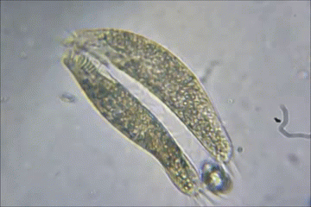
Bacterial Conjugation: A Method of Genetic Recombination in Bacteria
In bacterial conjugation, bacterial cells are able to exchange their genetic material!
This is NOT done as a part of their reproductive process.

Slide 85
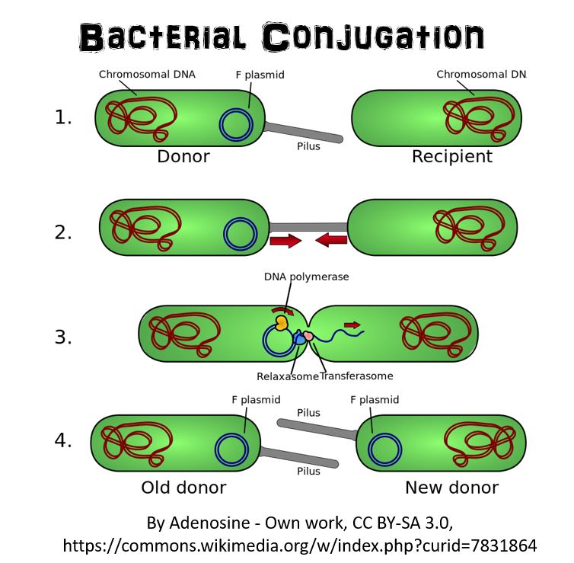
Bacterial Conjugation: A Method of Genetic Recombination in Bacteria
Conjugation is made possible by the "F plasmid".
The F plasmid is the "fertility plasmid".
The F plasmid contains genes that allow bacteria to form a sex pilus (pili is plural) which is a protrusion that can penetrate the cell wall and membrane of another bacterium.
The sex pilus allows the bacteria to form a cytoplasmic bridge with another bacteria.

Slide 86
Bacterial Conjugation: A Method of Genetic Recombination in Bacteria
Once that cytoplasmic bridge forms, the F plasmid is then replicated and the copy of the plasmid will be transferred to the other bacterium.
When the bacteria receives its copy of the F plasmid, it then has the ability to now create its own sex pili and can go give copies of its F plasmid to other bacteria. ​

