Slide 1
Mitosis Models

Slide 2
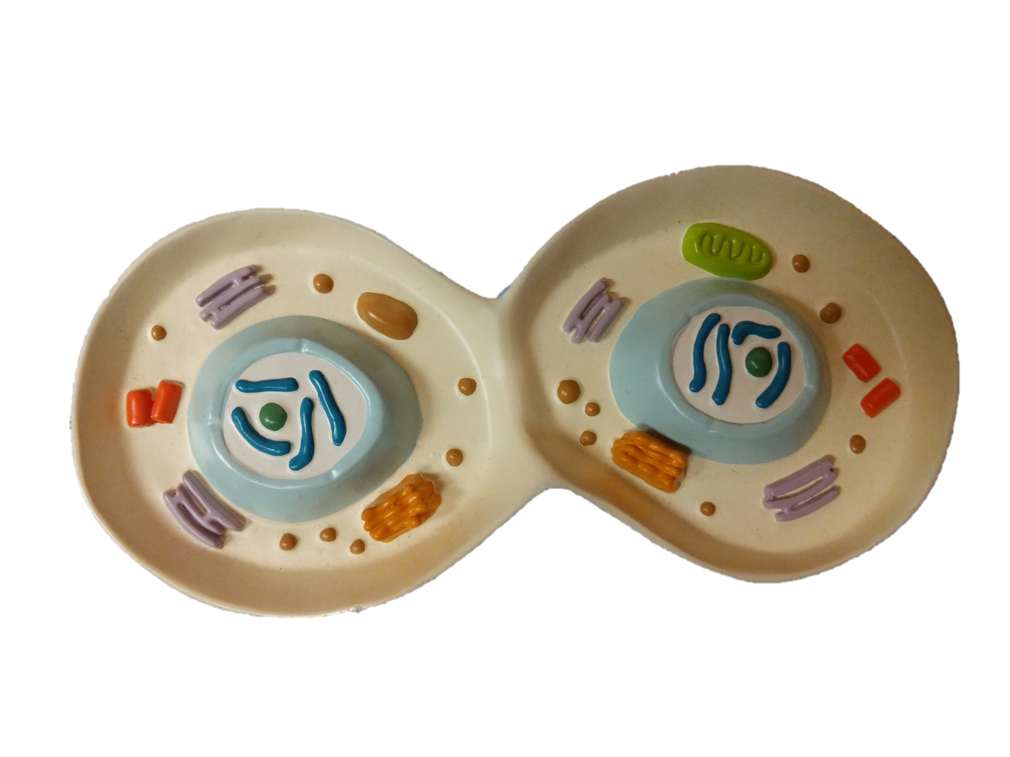
Late Telophase
Endoplasmic
Reticulum
Mitochondria
Centrioles
Centrioles
Nucleolus
Nucleolus
Chromosomes
Golgi Body
Vesicles
Chromosomes

Slide 3
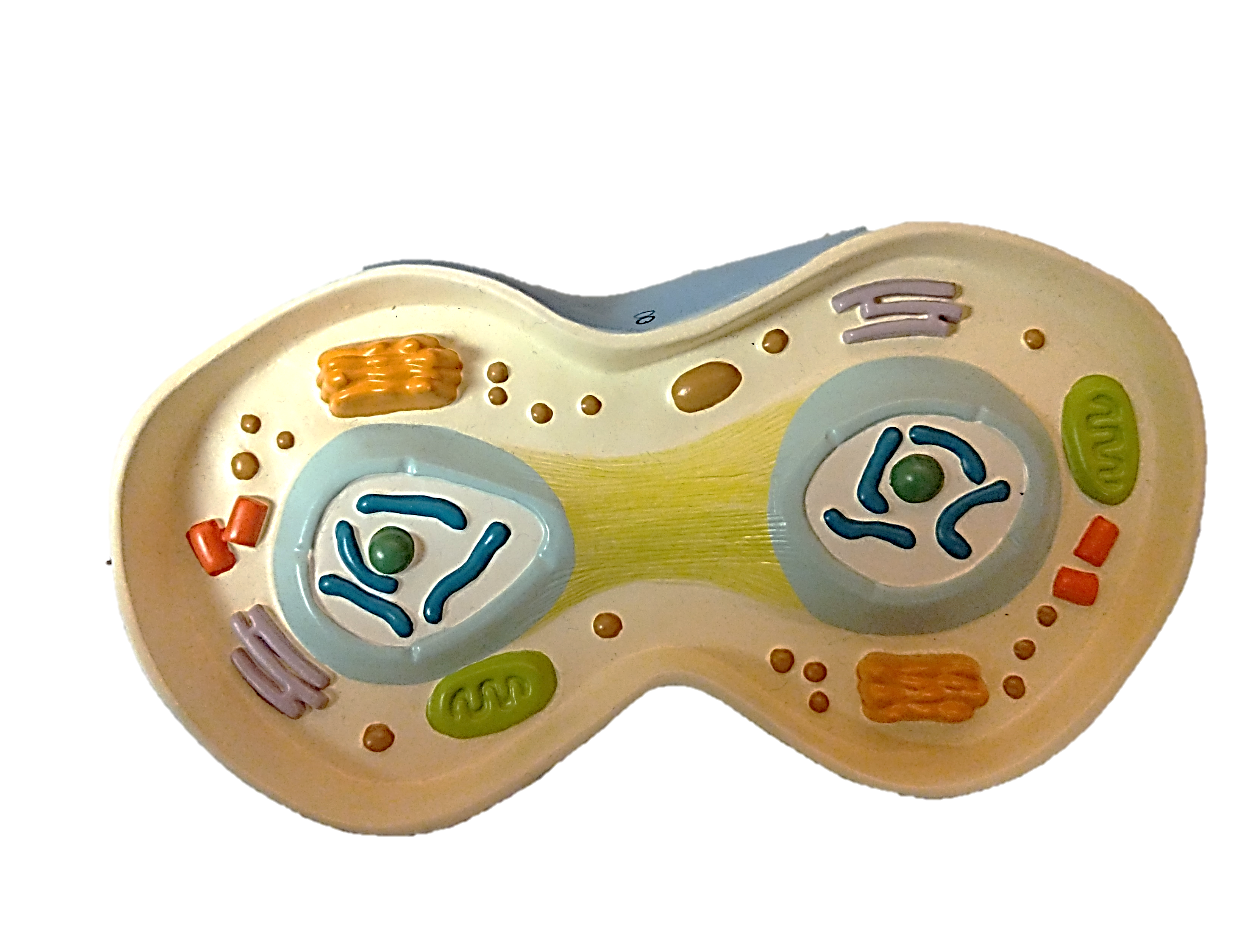
Early Telophase
Golgi Body
Mitochondria
Centrioles
Nucleolus
Nucleolus
Centrioles
Chromosomes
Vesicle
Endoplasmic
Reticulum
Spindle
Apparatus
Chromosomes

Slide 4
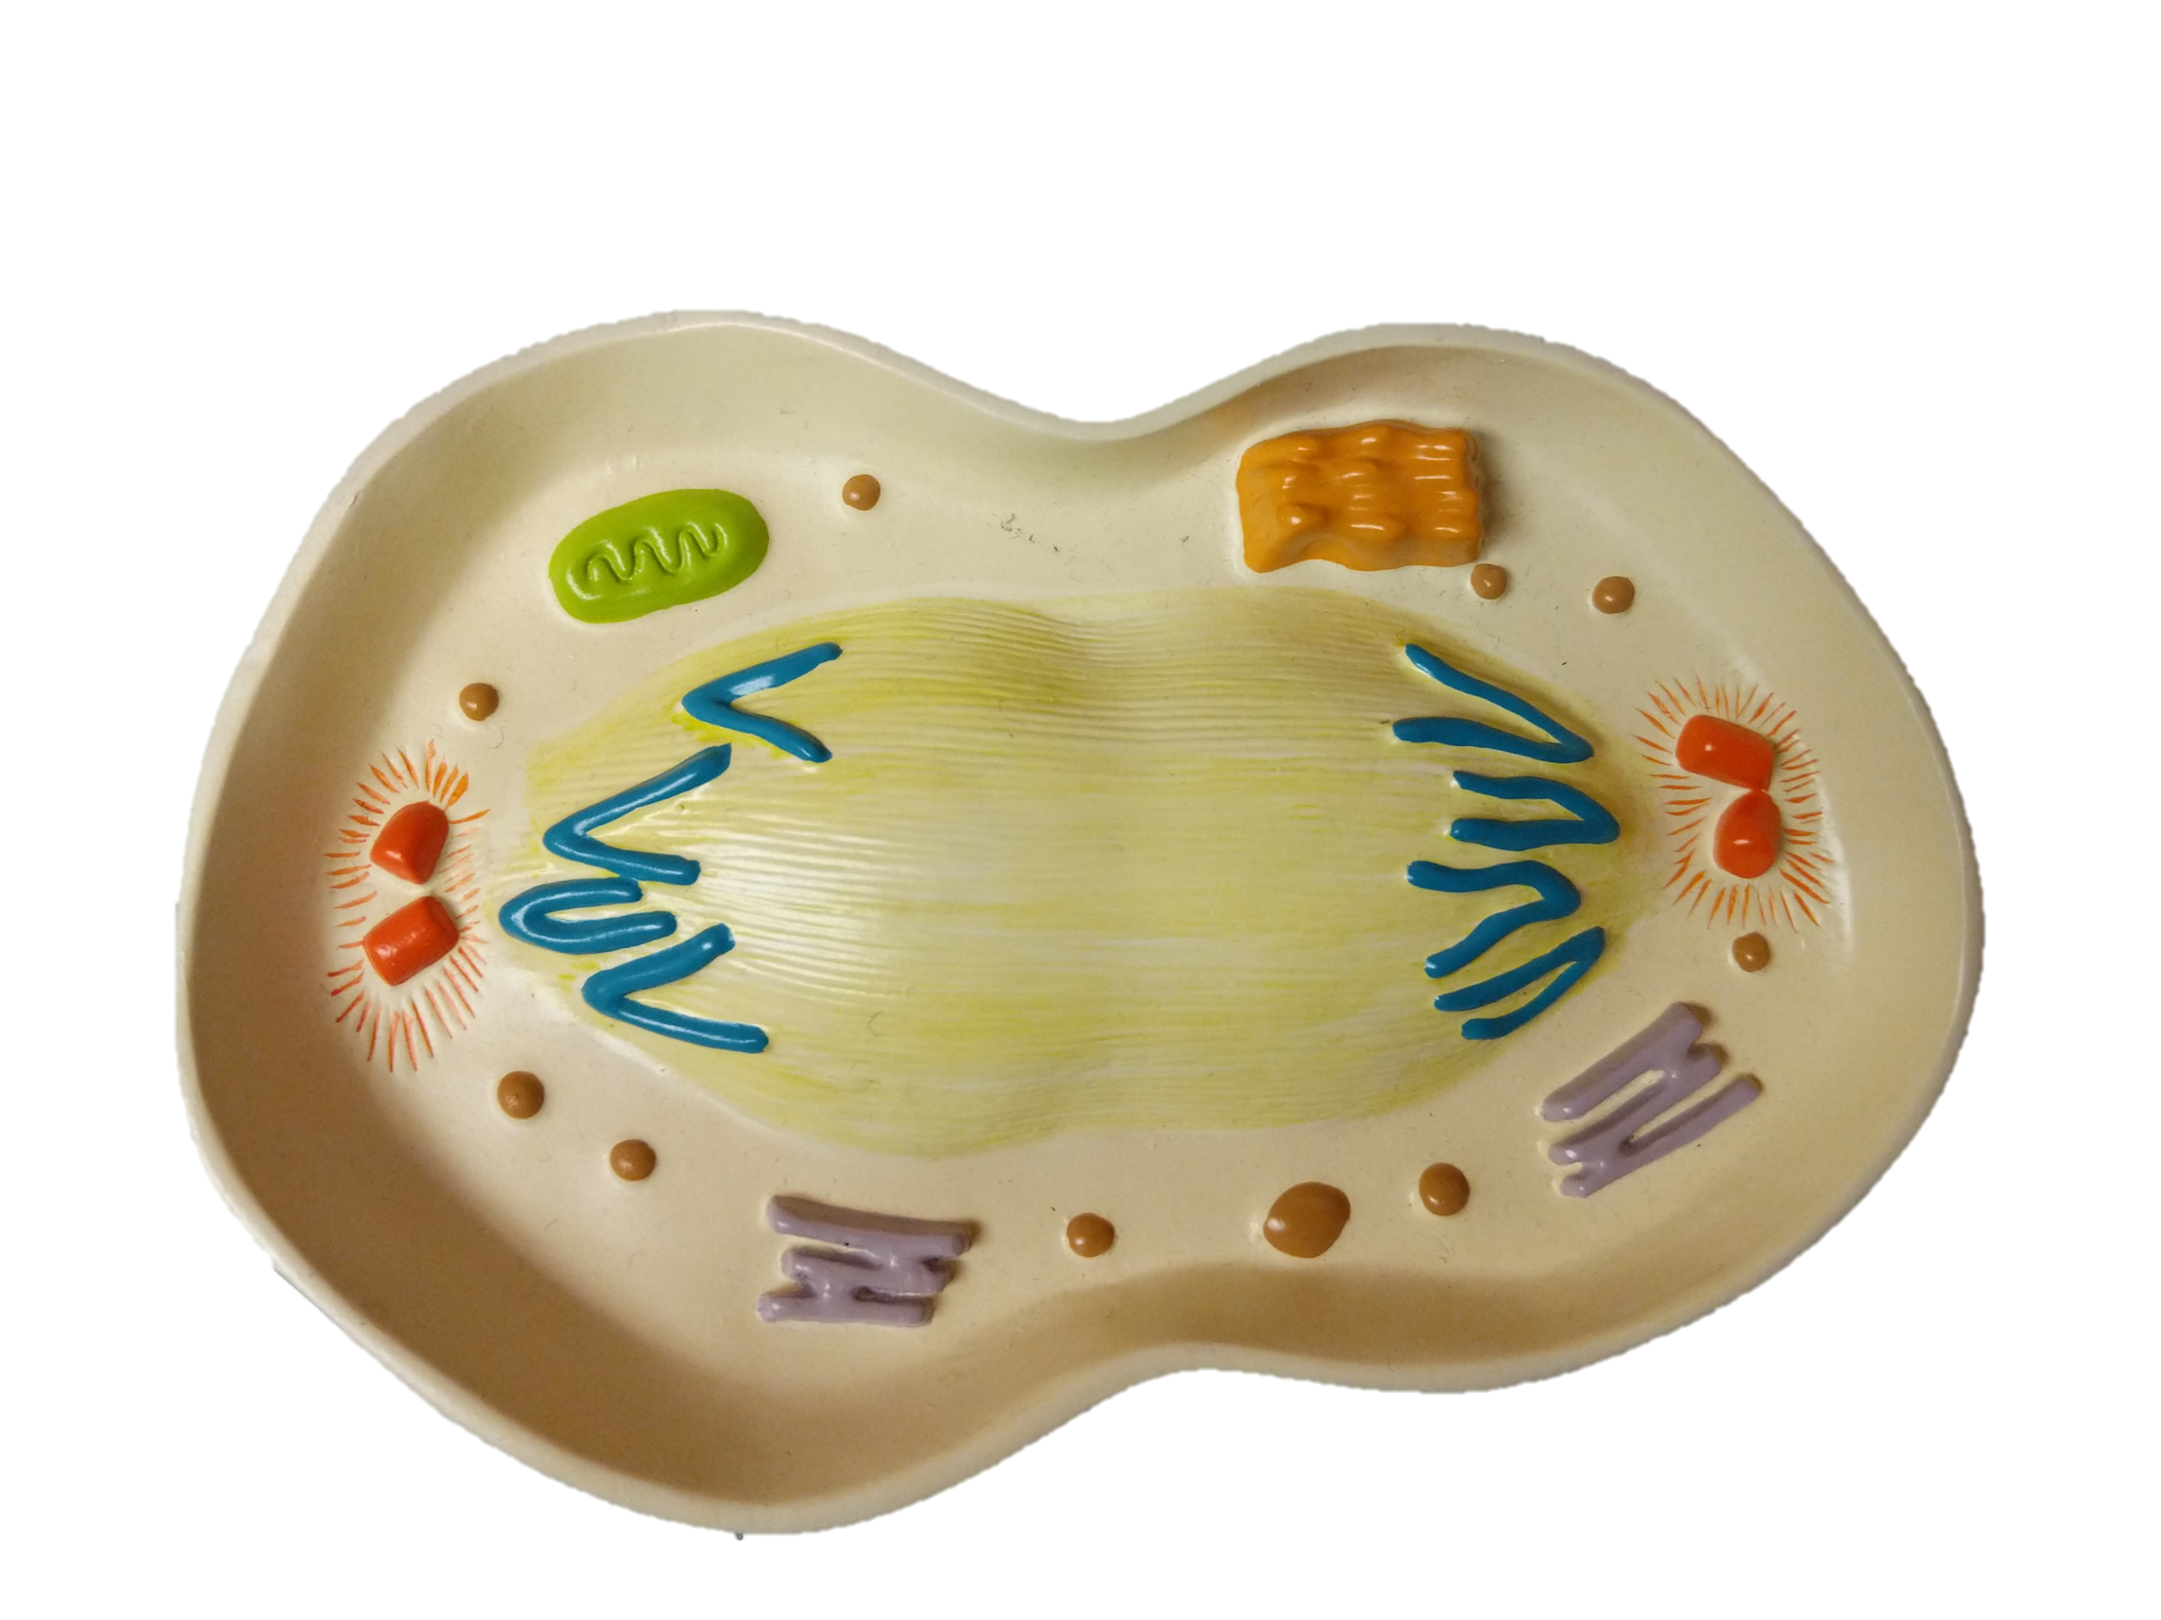
Late Anaphase
Golgi Body
Vesicle
Mitochondria
Aster
Aster
Spindle
Apparatus
Centrioles
Centrioles
Chromosomes (Sister Chromatids)
Endoplasmic
Reticulum
Chromosomes (Sister Chromatids)

Slide 5
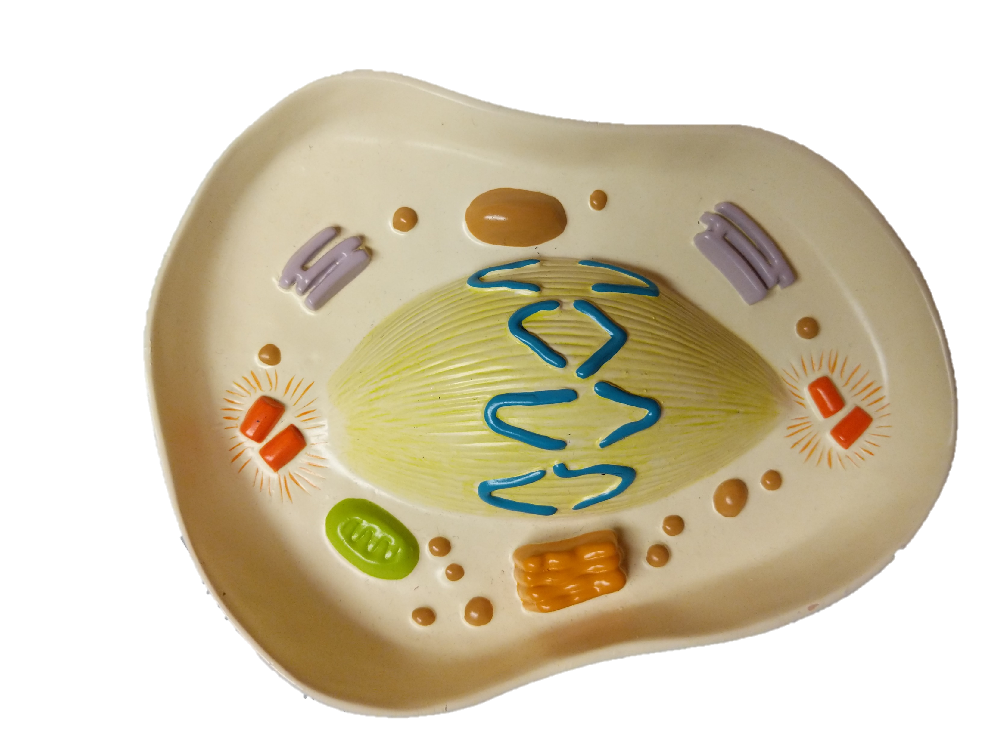
Chromosomes (Sister Chromatids)
Early Anaphase
Spindle
Apparatus
Endoplasmic
Reticulum
Aster
Aster
Centrioles
Centrioles
Vesicles
Mitochondria
Golgi Body

Slide 6
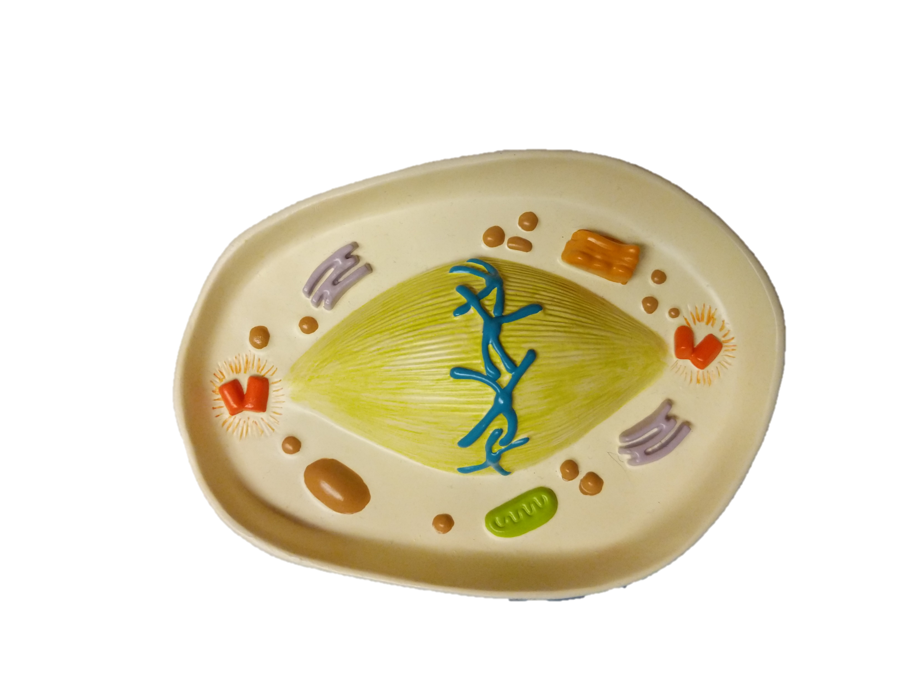
Late Metaphase
Vesicles
Golgi Body
Endoplasmic
Reticulum
Aster
Aster
Centrioles
Centrioles
Chromosome
Spindle
Apparatus
Mitochondria

Slide 7
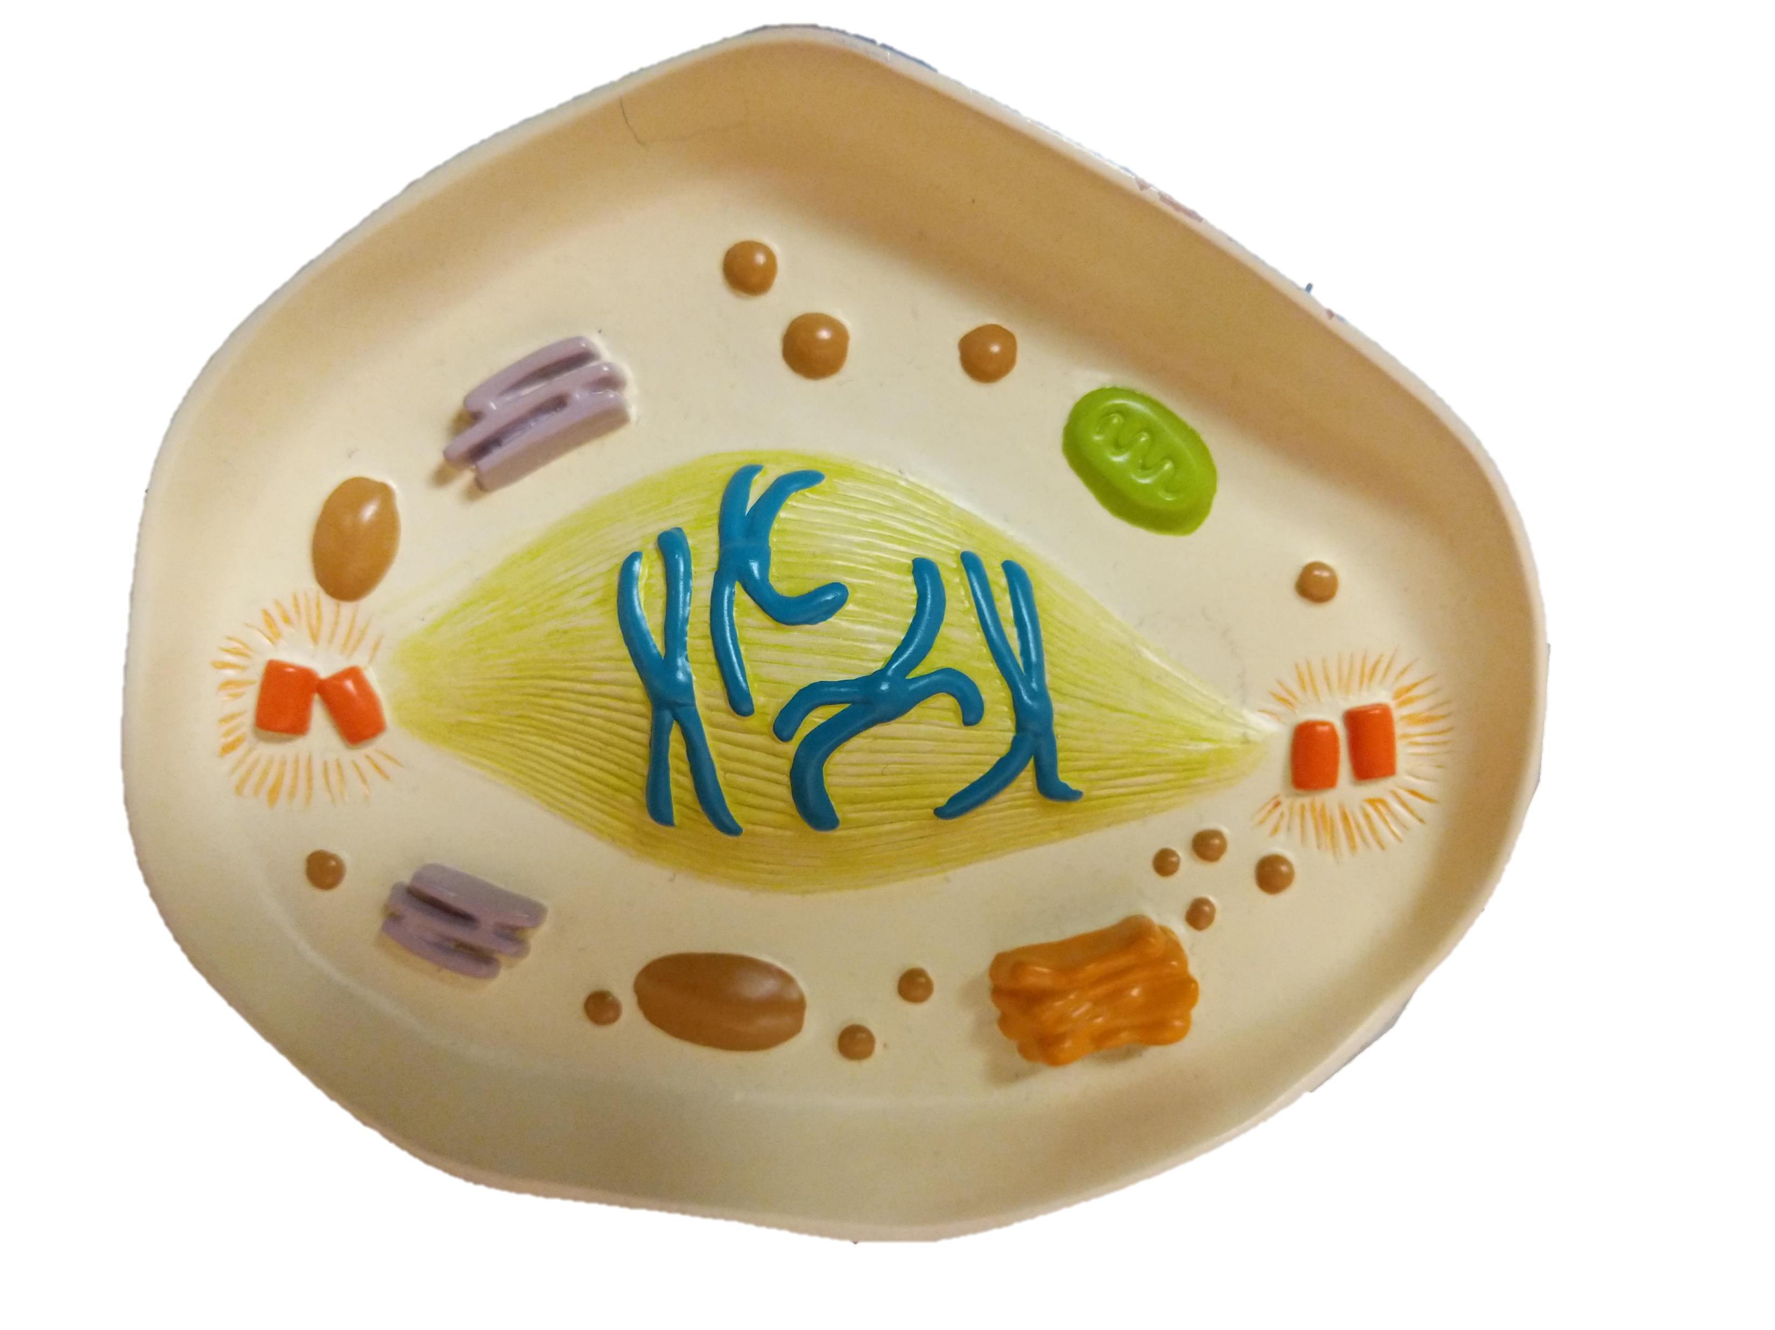
Early Metaphase
Vesicles
Mitochondria
Endoplasmic
Reticulum
Aster
Aster
Centrioles
Centrioles
Chromosome
Spindle
Apparatus
Golgi Body

Slide 8
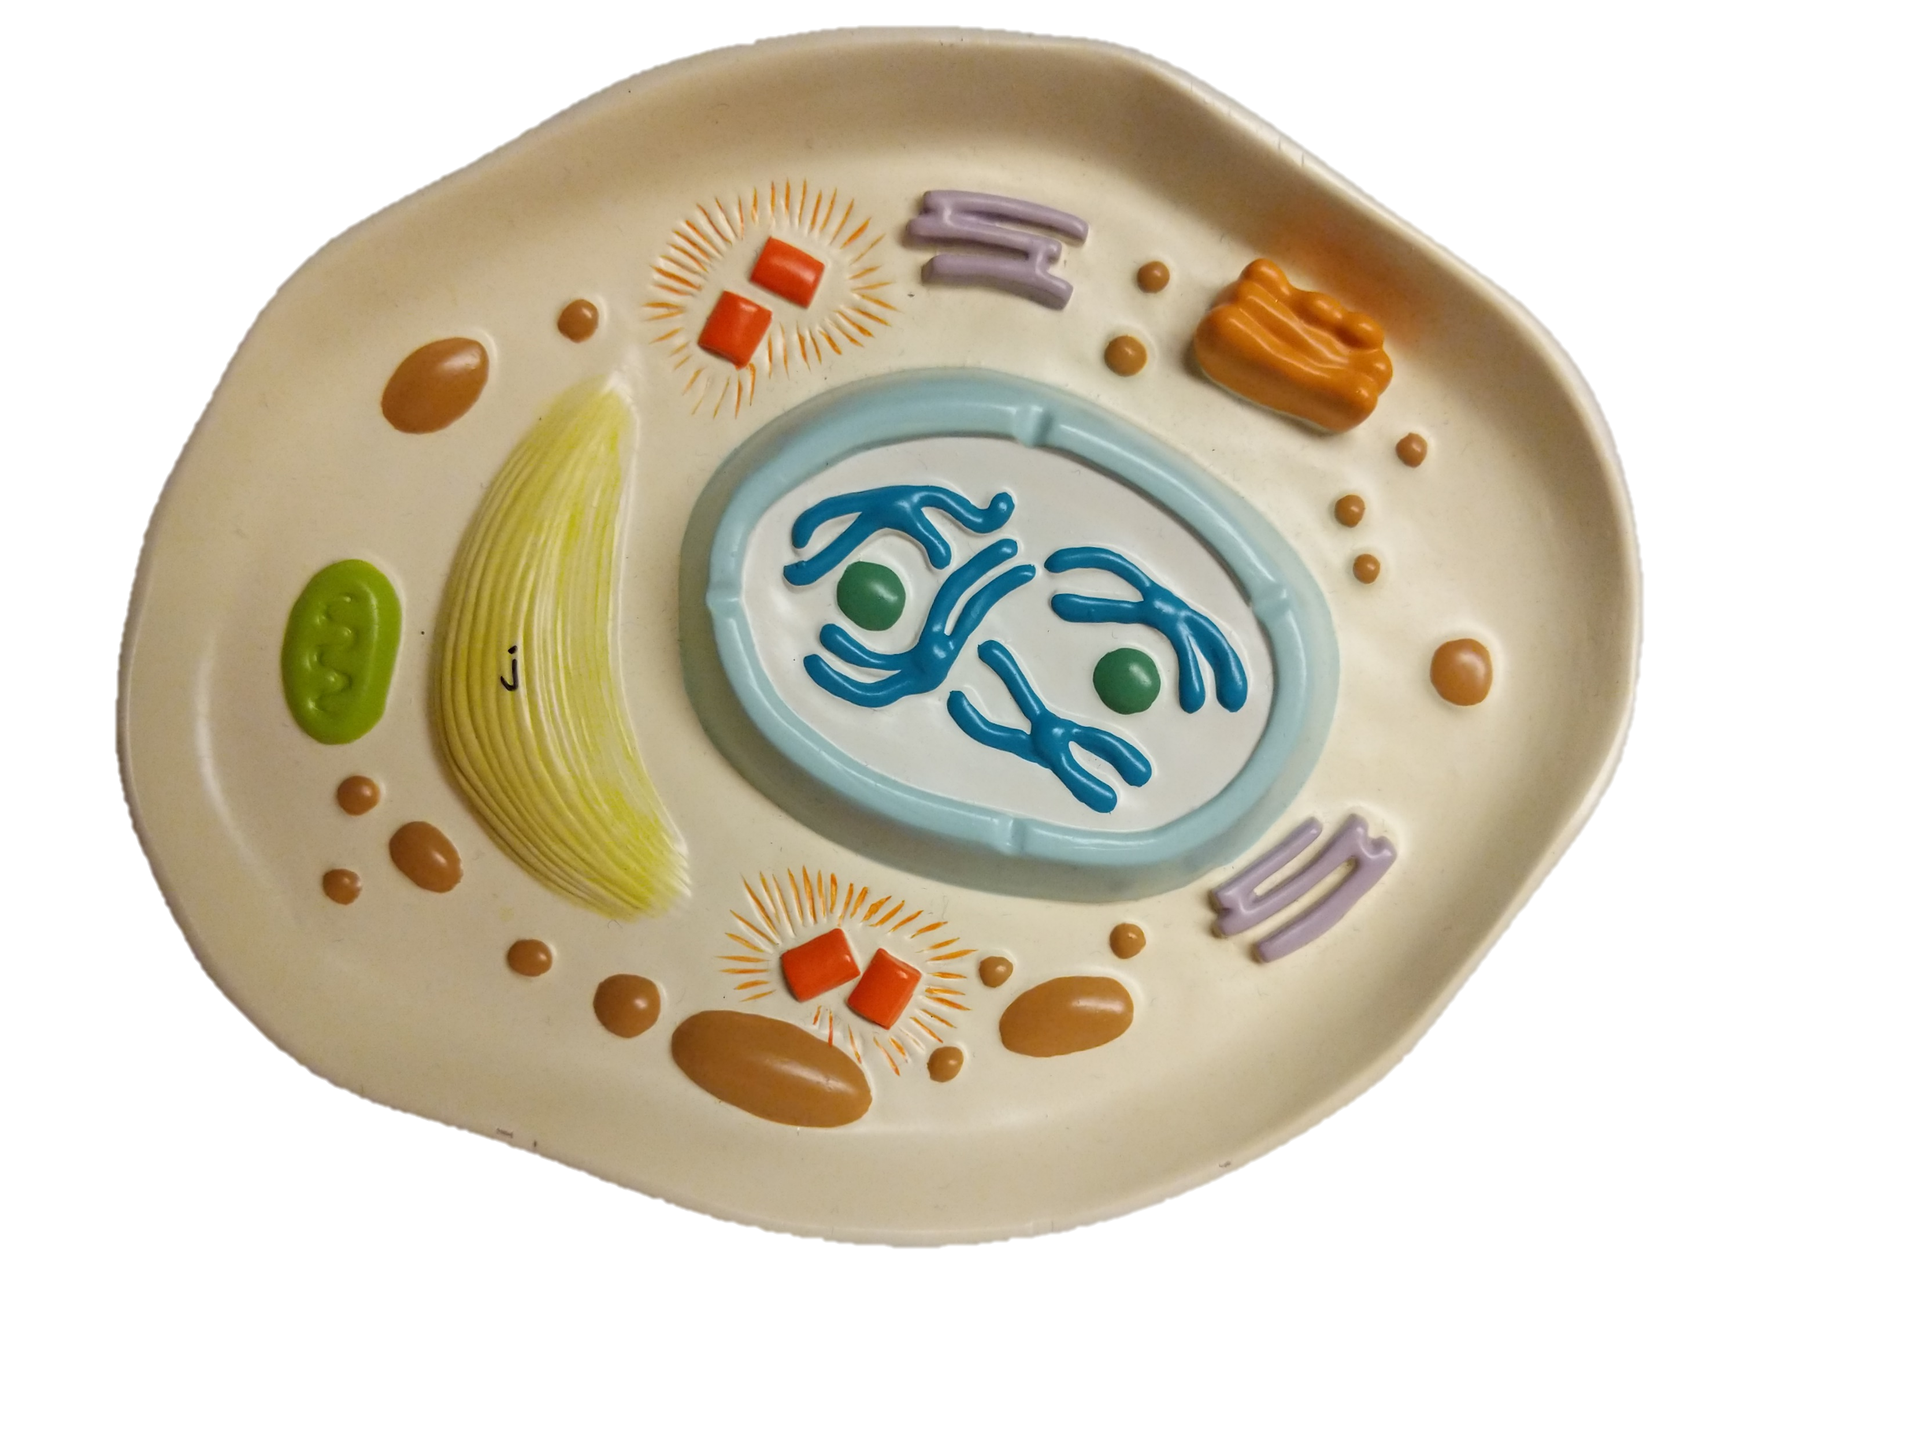
Late Prophase
Aster
Endoplasmic
Reticulum
Centrioles
Vesicle
Golgi Body
Spindle
Apparatus
Chromosome
Nuclear
Membrane
Mitochondria
Aster
Nucleolus
Centrioles

Slide 9
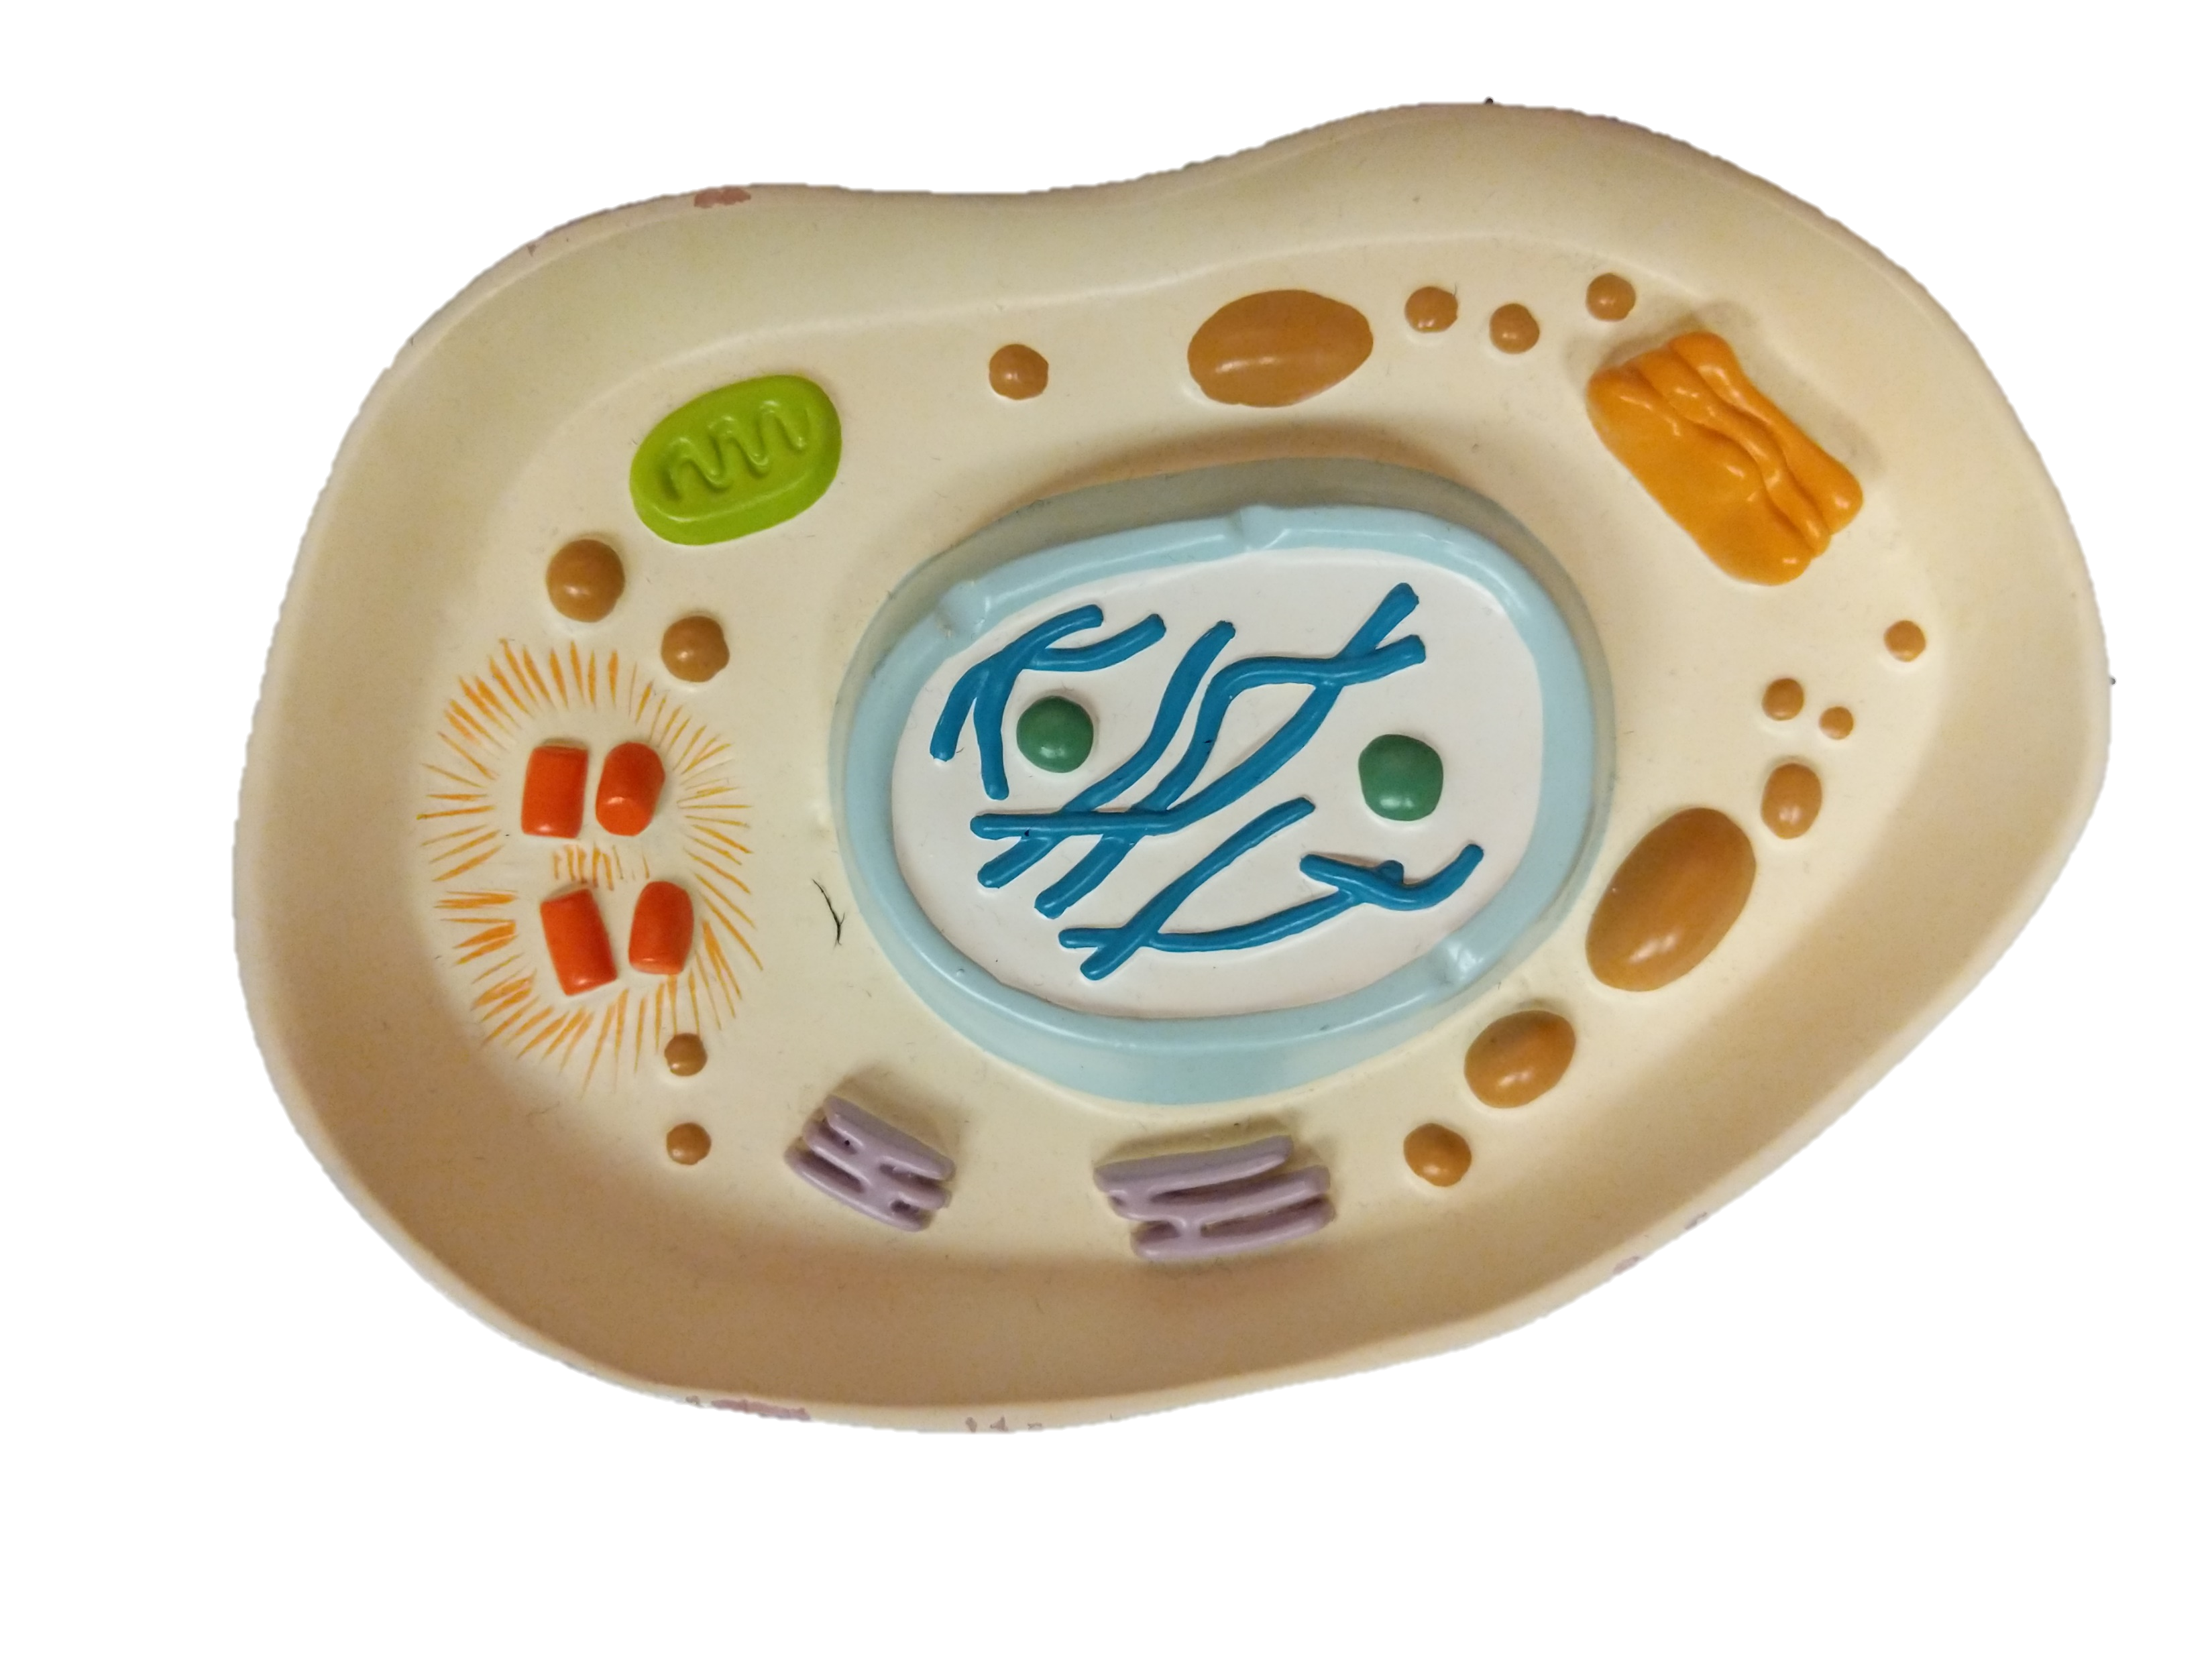
Early Prophase
Nucleolus
Chromosome
Mitochondria
Golgi Body
Centrioles
Centrioles
Vesicles
Aster
Nuclear
Membrane
Endoplasmic
Reticulum

Slide 10
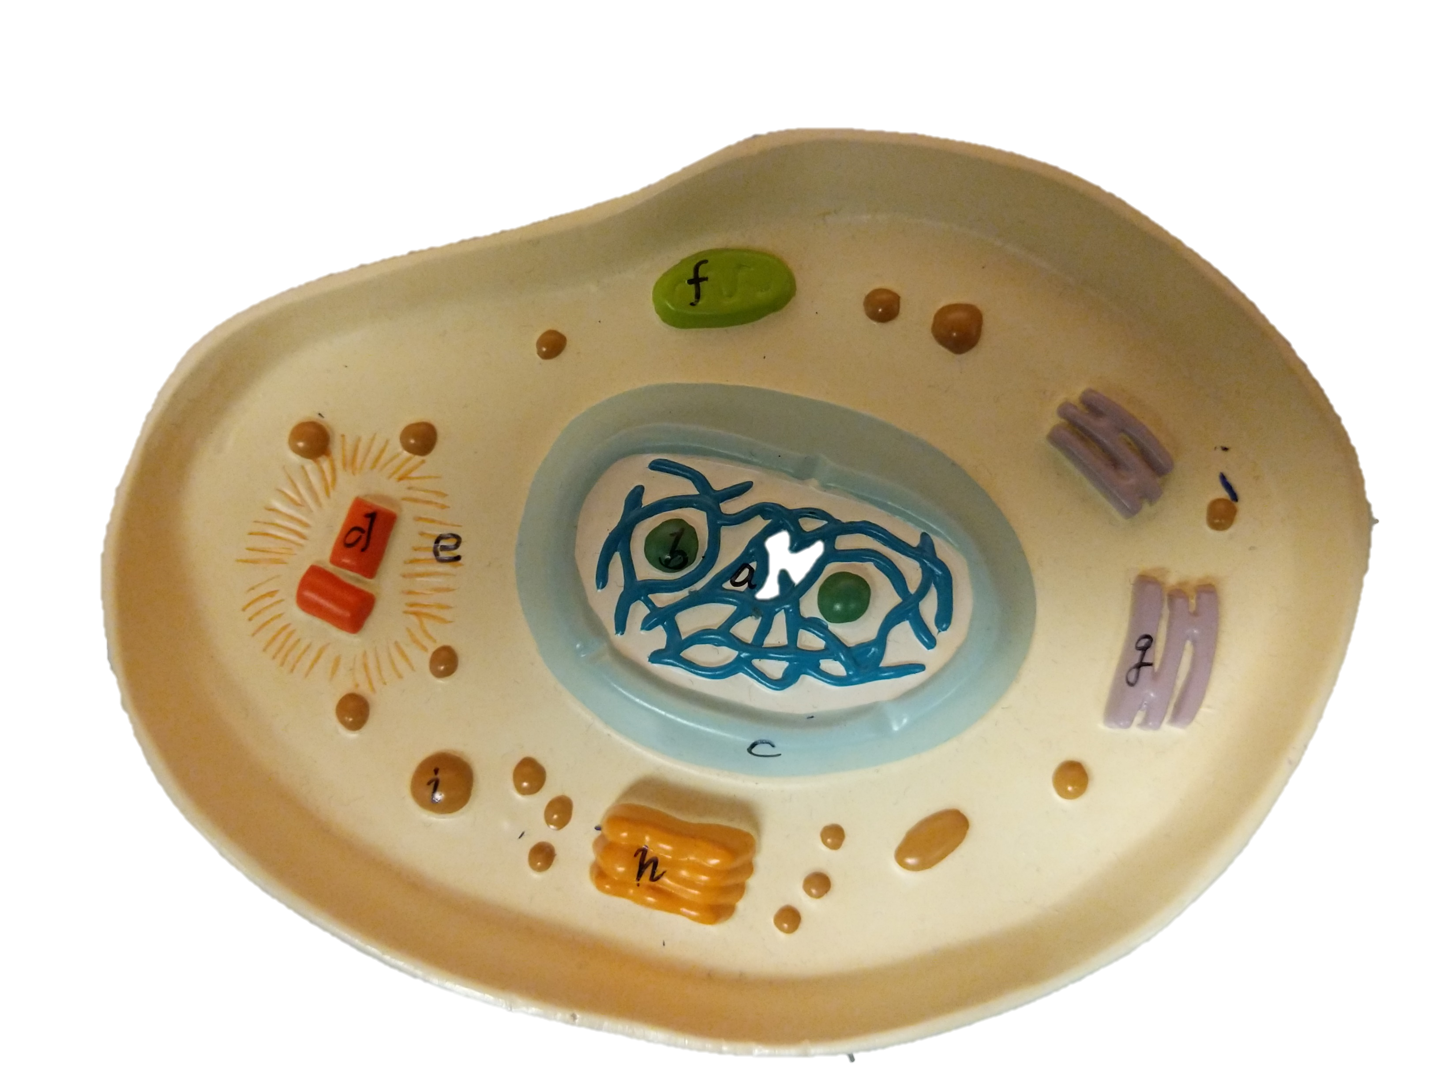
Interphase
Mitochondria
Chromosome
Aster
Endoplasmic
Reticulum
Centrioles
Nucleolus
Vesicle
Nuclear
Membrane
Golgi Body

