Slide 1
Muscle Actions

Slide 2
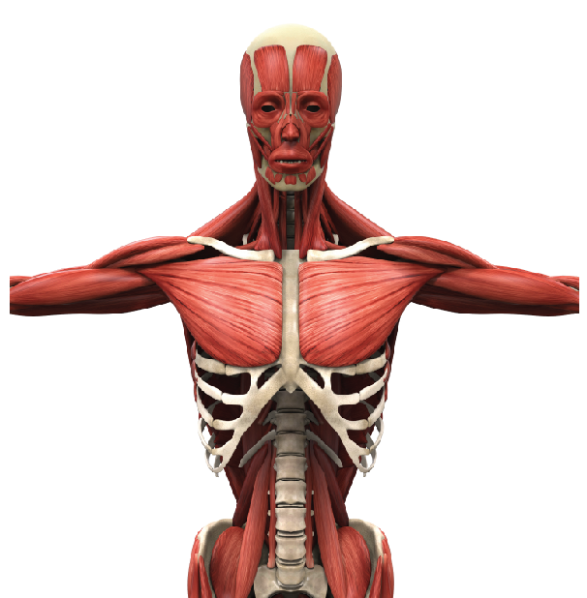
Muscle Movements
​Muscles (skeletal muscles) usually connect to at least 2 bones and span 1 movable joint.
In this way, skeletal muscle moves the bones to allow for movement of the body.
Without skeletal muscles, there would NO conscious, purposeful movement!

Slide 3
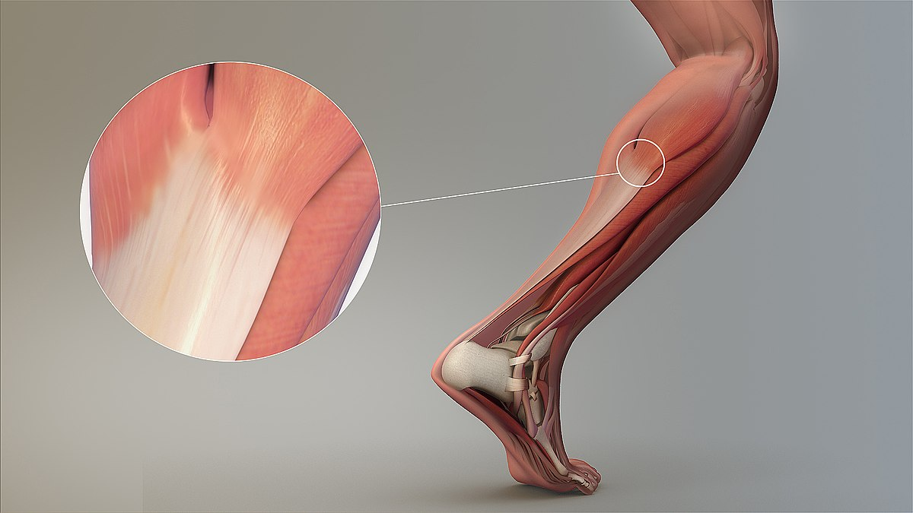
TENDONS
Skeletal muscles attach to at least 2 bones, and span one movable joint.
The way that these muscles attach to the bones of your body, is through TENDONS.

Slide 4
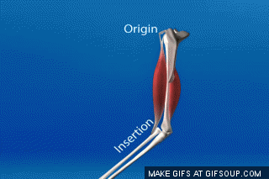
Origins and Insertions
The origin is the attachment site that remains relatively "fixed in space" during muscle contraction
The insertion is the attachment site that moves quite a bit during muscle contraction.
The insertion moves toward the origin during muscle contraction.​

Slide 5
Origins and Insertions
When a muscle contracts, it pulls the bones it connects to closer to one another, by decreasing the angle of the movable joint that is spans. ​
Knowing the insertion and origin helps us identify the action of the muscle.
The way in which these bones are able to move closer to each other is dictated by the type of joint that the muscle spans.

Slide 6
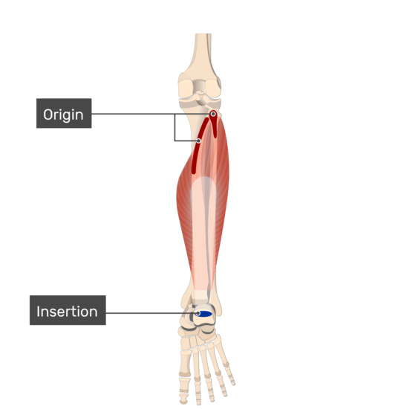
Origins and Insertions
Typically, when we contract a muscle, one of the bones the muscle attaches to moves a lot, while the other bone(s) the muscle attaches to remains relatively "fixed" in space.
​The origin is the attachment site that remains relatively "fixed in space" during muscle contraction
The insertion is the attachment site that moves quite a bit during muscle contraction.

Slide 7
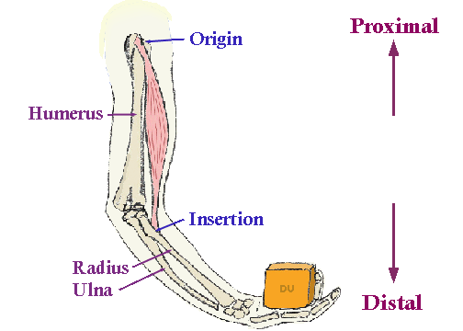
Origins and Insertions
The insertion is usually at the distal end, or the end that is further away from the body's center of mass (or the heart), of the muscle.
The origin is usually at the more proximal, or closer to the body's center of mass, relative to the insertion.

Slide 8
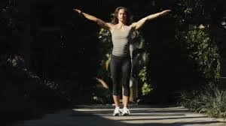
Circumduction
Circumduction can be defined as a conical movement of a limb extending from the joint at which the movement is controlled.

Slide 9
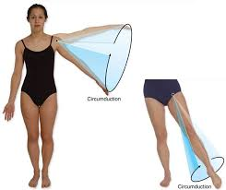
Circumduction
Circumduction can be defined as a conical movement of a limb extending from the joint at which the movement is controlled.

Slide 10
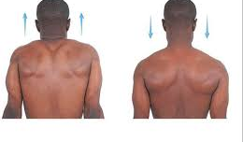
Elevation and Depression
Elevation refers to movement in a superior direction
Depression refers to movement in an inferior direction

Slide 11
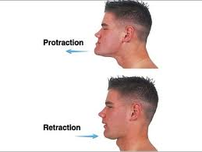
Protraction and Retraction
Protraction describes an anterior movement occurring in the transverse plane (anterolateral movements).
Retraction describes a posterior movement occurring in the transverse plane (anteroposterior movements).

Slide 12
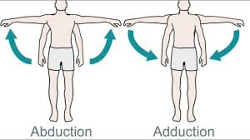
Abduction and Adduction
Abduction and adduction are two terms that are used to describe movements towards or away from the midline of the body.
Abduction is a movement away from the midline
Adduction is a movement towards the midline.

Slide 13
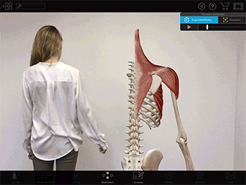
Abduction and Adduction
Abduction and adduction are two terms that are used to describe movements towards or away from the midline of the body.
Abduction is a movement away from the midline
Adduction is a movement towards the midline.

Slide 14
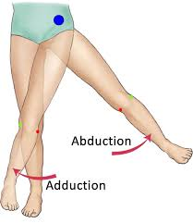
Abduction and Adduction
Adduction of the hip squeezes the legs together.
Abduction of the legs brings the legs apart.

Slide 15
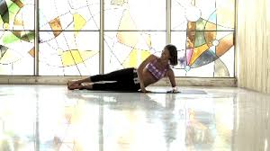
Abduction and Adduction
Adduction of the hip squeezes the legs together.
Abduction of the legs brings the legs apart.

Slide 16
Shoulder Adduction

Slide 17
Abduction and Adduction of the digits
In fingers and toes, the midline used is not the midline of the body, but of the hand and foot respectively.
Therefore, abducting the fingers spreads them out, while adducting brings them together.

Slide 18
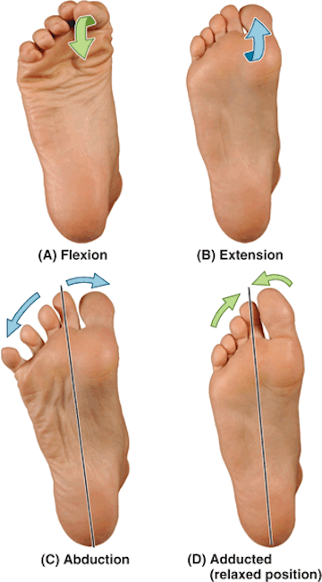
Abduction and Adduction of the digits
In fingers and toes, the midline used is not the midline of the body, but of the hand and foot respectively.
Therefore, abducting the fingers spreads them out, while adducting brings them together.

Slide 19
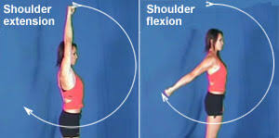
Flexion and Extension
Flexion and extension are movements that occur in the sagittal plane. They refer to increasing and decreasing the angle between two body parts:
Flexion refers to a movement that decreases the angle between two body parts.
Flexion at the elbow is decreasing the angle between the ulna and the humerus. When the knee flexes, the ankle moves closer to the buttock, and the angle between the femur and tibia gets smaller.

Slide 20
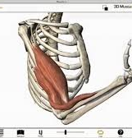
Flexion and Extension
Flexion at the elbow is decreasing the angle between the ulna and the humerus.

Slide 21
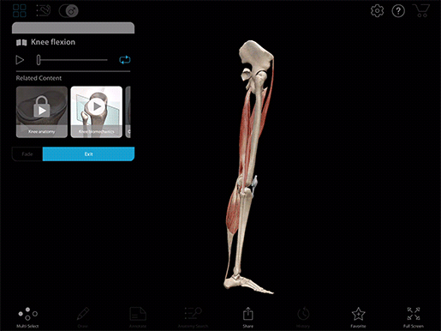
Knee Flexion
When the knee flexes, the ankle moves closer to the buttock, and the angle between the femur and tibia gets smaller.

Slide 22
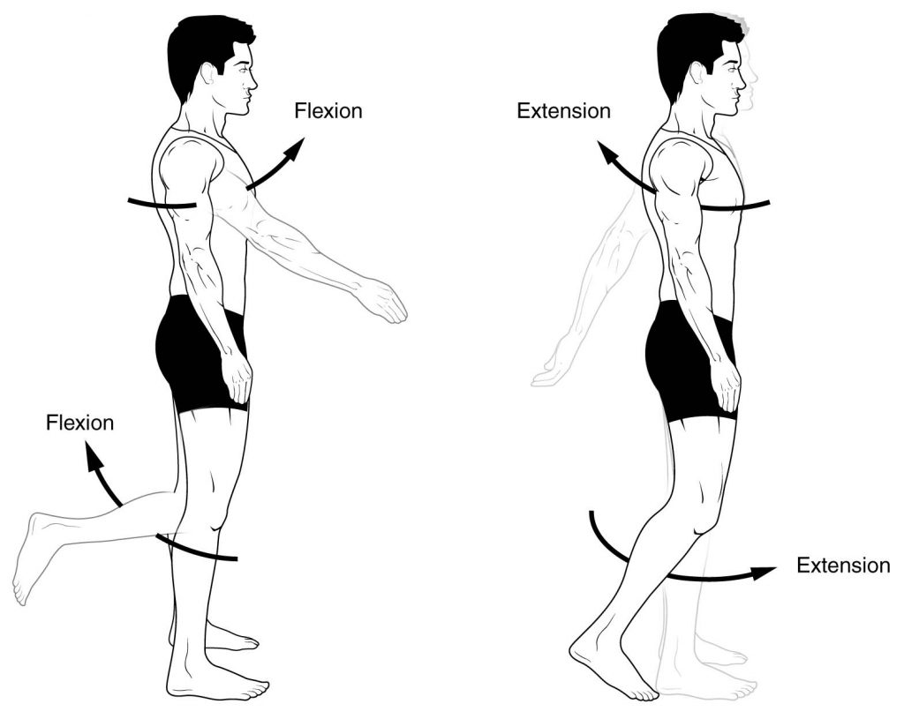
Flexion and Extension
Extension refers to a movement that increases the angle between two body parts.
Extension at the elbow is increasing the angle between the ulna and the humerus.
Extension of the knee straightens the lower limb.

Slide 23
Flexion and Extension of the Head
Head Flexion – the movement of the neck that moves the head posteriorly in anatomical position.
Wrist Extension – the movement of the neck that moves the head anteriorly in anatomical position.

Slide 24
Shoulder Flexion and Extension

Slide 25
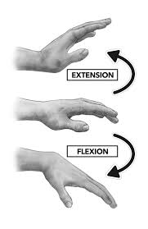
Flexion and Extension of the Wrist
Wrist Flexion – the movement of the wrist that moves the hand posteriorly in anatomical position.
Wrist Extension – the movement of the wrist that moves the hand anteriorly in anatomical position.

Slide 26
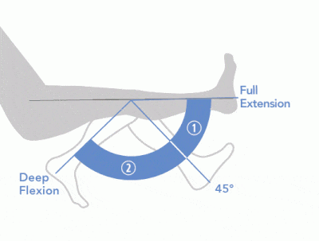
Flexion and Extension
Flexion is the action of decreasing the angle of a joint
Extension is the action of increasing the angle of the joint

Slide 27
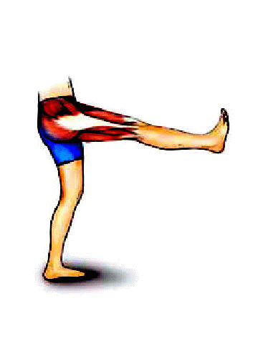
Flexion and Extension
Hip extension is when the leg is moved posteriorly. This motion increases the angle of the joint relative to the anterior surface of the body in anatomical position.

Slide 28
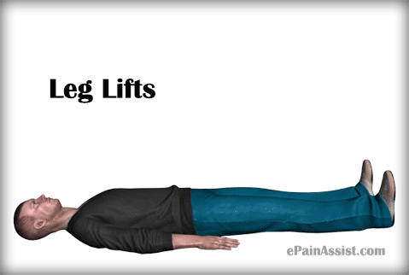
Flexion and Extension
HIP FLEXION - when the leg is moved anterior to the body, this action decreases the angle of the hip joint relative to the anterior surface of the body in anatomical position. This action flexes the hip joint.

Slide 29
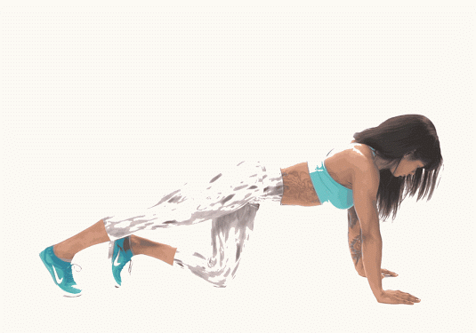
Flexion and Extension
HIP EXTENSION - Hip extension is when the leg is moved posteriorly. This motion increases the angle of the joint relative to the anterior surface of the body in anatomical position.

Slide 30
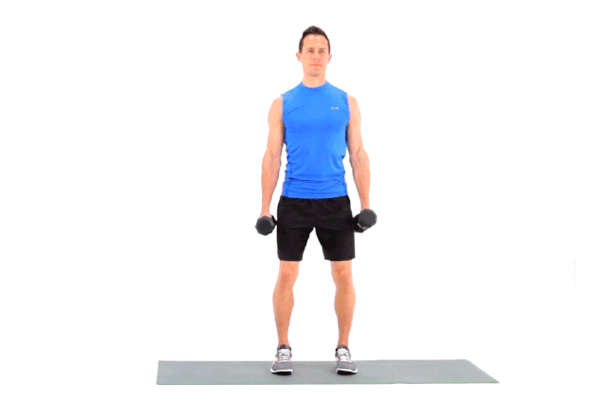
Flexion and Extension
Shoulder Flexion - FLEXION - when the arm is moved anterior to the body, this action decreases the angle of the shoulder joint relative to the anterior surface of the body in anatomical position. This action flexes the shoulder joint.

Slide 31
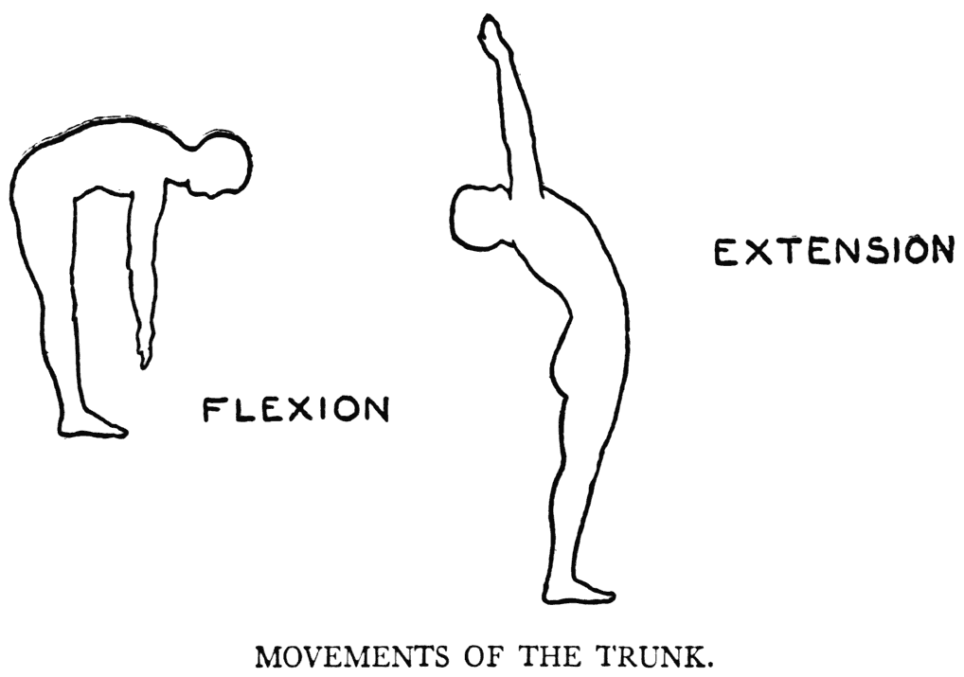
Flexion and Extension of the Trunk
Leaning forward to touch the toes, is considered flexion of the torso or trunk. Leaning backward is considered extension of the torso or trunk.

Slide 32
Flexion and Extension of the Toes
Toe Flexion – curling of the toes
Toe Extension – pulling the toes back toward the tibia

Slide 33
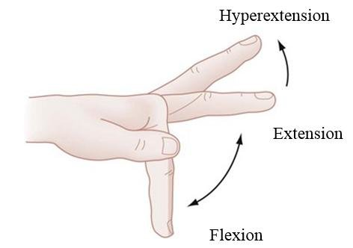
Flexion and Extension of the Fingers
Finger Flexion – movement of the fingers that moves the finger in the ANTERIOR direction from anatomical position.
Finger Extension – movement of the fingers that moves the finger in the POSTERIOR direction from anatomical position.

Slide 34
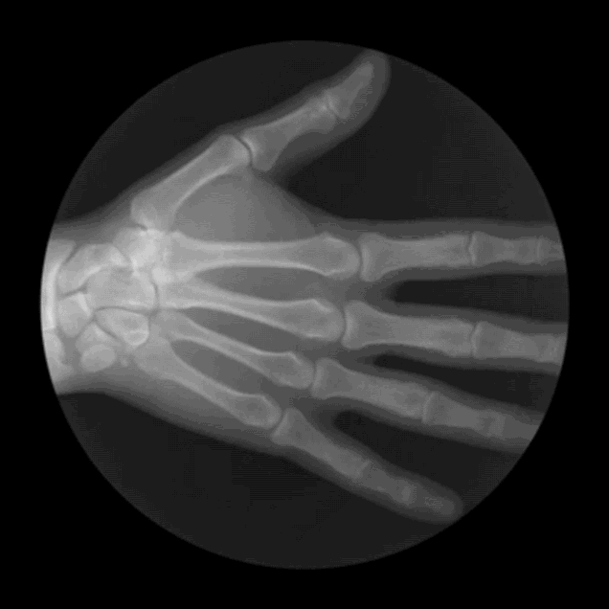
Flexion and Extension of the Fingers
Forming a fist, or bending the fingers is considered flexion of the digits.

Slide 35
Rotation
Rotational motion may occur at a number of different types of joints.

Slide 36
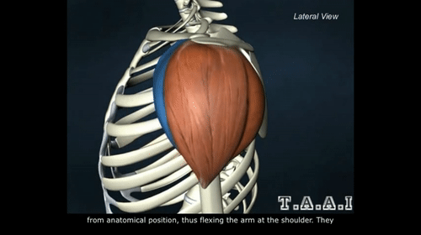
Rotation
When rotational motion occurs at a ball-and-socket joint, such as the hip or shoulder joint, the rotational movement can be described as internal rotation or external rotation.
Internal rotation would be the rotational motion of a limb that is directed TOWARD the midline of the body
External rotation would be the rotational motion of a limb that is directed AWAY FROM the midline of the body.

Slide 37
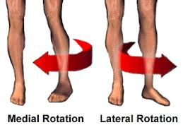
Medial and Lateral Rotation
Medial and lateral rotation describe movement of the limbs around their long axis:
Medial rotation is a rotational movement towards the midline. It is sometimes referred to as internal rotation.
Lateral rotation is a rotating movement away from the midline. This is in the opposite direction to the movements described above.

Slide 38
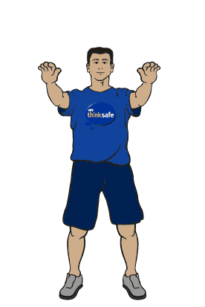
Rotation
Rotational motion may occur at a number of different types of joints.

Slide 39
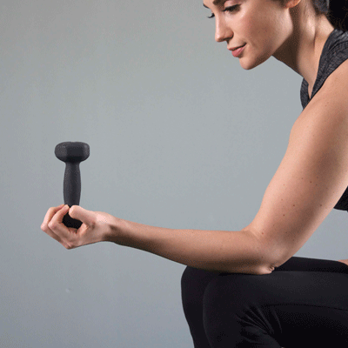
Rotation
Rotational motion may occur at a number of different types of joints.

Slide 40
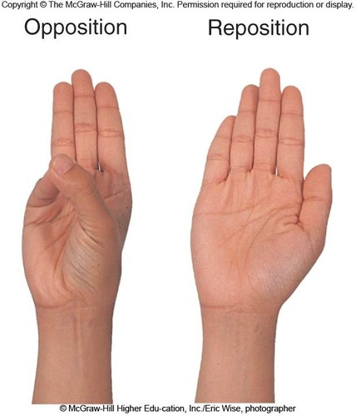
Opposition and Reposition
Opposition brings the thumb and little finger together.
Reposition is a movement that moves the thumb and the little finger away from each other, effectively reversing opposition.

Slide 41
Rotation
Rotation of the head and neck or torso, is not considered to be either medial or lateral rotation.

Slide 42
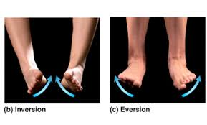
Inversion and Eversion
Inversion and eversion are movements which occur at the ankle joint, referring to the rotation of the foot around its long axis.
Inversion involves the movement of the sole towards the median plane – so that the sole faces in a medial direction.
Eversion involves the movement of the sole away from the median plane – so that the sole faces in a lateral direction.

Slide 43
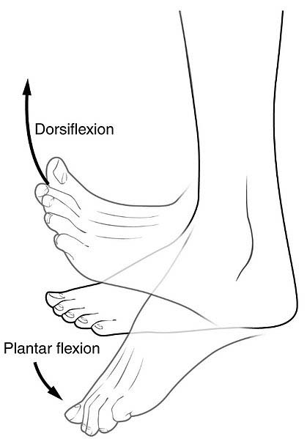
Dorsiflexion and Plantarflexion
Dorsiflexion and plantarflexion are terms used to describe movements at the ankle.
Dorsiflexion refers to flexion at the ankle, so that the foot points more superiorly.
Plantarflexion refers extension at the ankle, so that the foot points inferiorly. Similarly there is a term for the hand, which is palmar flexion.

Slide 44
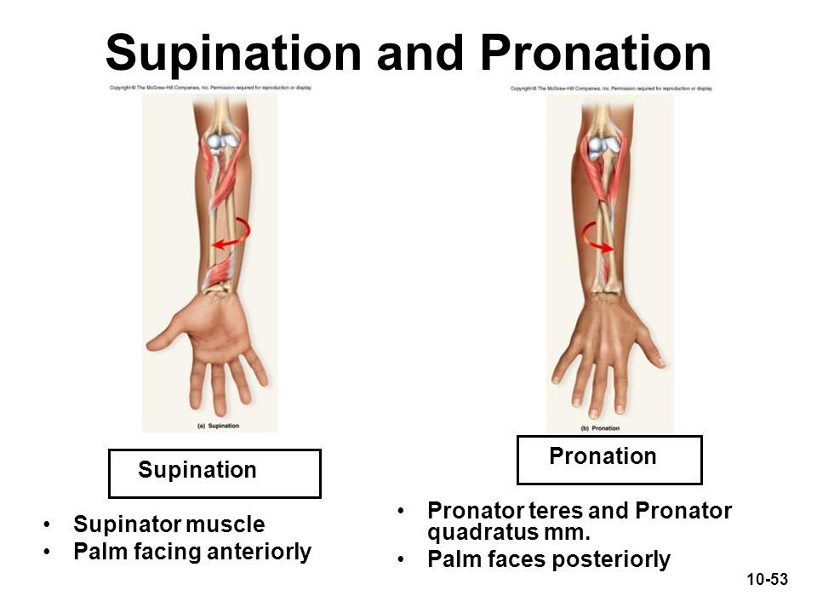
Pronation and Supination
Pronation and supination are a pair of unique movements possible only in the forearms and hands, allowing the human body to flip the palm either face up or face down.

Slide 45
Pronation and Supination
Pronation and supination are a pair of unique movements possible only in the forearms and hands, allowing the human body to flip the palm either face up or face down.

Slide 46
functional groups
Muscles can be classified into three functional groups:
Prime Mover or Agonist - A muscle that has the major responsibility for producing a specific movement is a prime mover, or agonist, of that movement.
Antagonist - Muscles that oppose, or reverse, a particular movement are antagonists
Synergist - Synergists help prime movers or agonists by
adding additional force to the same movement or
Inhibiting oppositional movements

Slide 47
Muscle action
Sometimes muscles are named for the movement they produce.
For example, you may see action words such as
Flexor
Extensor
Adductor

Slide 48
The action of a muscle
The action of a muscle can be inferred by the position of the muscle relative to the joint it crosses.
A muscle that crosses on the anterior side of a joint produces flexion.
Marieb Human Anatomy & Physiology: Tenth Edition
These generalities do not apply to the knee and ankle

Slide 49
The action of a muscle
The action of a muscle can be inferred by the position of the muscle relative to the joint it crosses.
A muscle that crosses on the posterior side of a joint produces extension.
Marieb Human Anatomy & Physiology: Tenth Edition
These generalities do not apply to the knee and ankle

Slide 50
The action of a muscle
The action of a muscle can be inferred by the position of the muscle relative to the joint it crosses.
A muscle that crosses on the lateral side of a joint produces abduction.
These generalities do not apply to the knee and ankle
Marieb Human Anatomy & Physiology: Tenth Edition

Slide 51
The action of a muscle
The action of a muscle can be inferred by the position of the muscle relative to the joint it crosses.
A muscle that crosses on the medial side of a joint produces adduction.
These generalities do not apply to the knee and ankle
Marieb Human Anatomy & Physiology: Tenth Edition

Slide 52
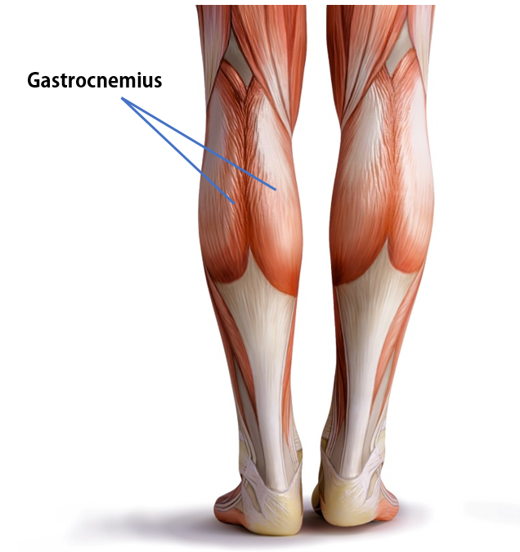
These generalities do not apply to the knee and ankle because the lower limb is rotated during development.
The muscles that cross these joints posteriorly produce flexion, and those that cross anteriorly produce extension.

Slide 54
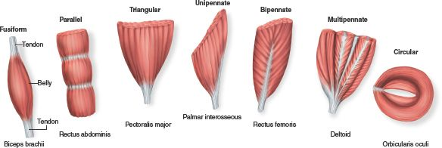
Fascicle arrangements help determine muscle shape and force.
Fascicle arrangements vary, resulting in muscles with different morphologies and functions.
The most common patterns of fascicle arrangement are
Circular
Convergent
Parallel
Pennate

Slide 55
Fascicle Arrangements
Circular
found at external body openings
When muscle contracts, it closes.
Known as sphincters which means (“squeezers”).
Examples are the orbicularis muscles surrounding the eyes and the mouth.

Slide 56
Convergent
Fascicle Arrangements
A convergent muscle has a broad origin, and its fascicles converge toward a single tendon of insertion.
Such a muscle is triangular or fan shaped like the pectoralis major muscle of the anterior thorax.

Slide 57
Parallel
Fascicle Arrangements
May be “straplike”
Example = sartorius muscle

Slide 58
Pennate
Fascicle Arrangements
Penna means “feather”
the fascicles are short and they attach obliquely to a central tendon that runs the length of the muscle.

Slide 59
Pennate
Fascicle Arrangements
Pennate muscles come in three forms:
Unipennate, in which the fascicles insert into only one side of the tendon, as in the extensor digitorum longus muscle of the leg.

Slide 60
Pennate
Fascicle Arrangements
Pennate muscles come in three forms:
Bipennate, in which the fascicles insert into the tendon from opposite sides so the muscle looks like a feather.
The rectus femoris of the thigh is bipennate.

Slide 61
Pennate
Fascicle Arrangements
Pennate muscles come in three forms:
Multipennate, which looks like many feathers side by side, with all their quills inserted into one large tendon.
The deltoid muscle, which forms the roundness of the shoulder, is multipennate.

Slide 62
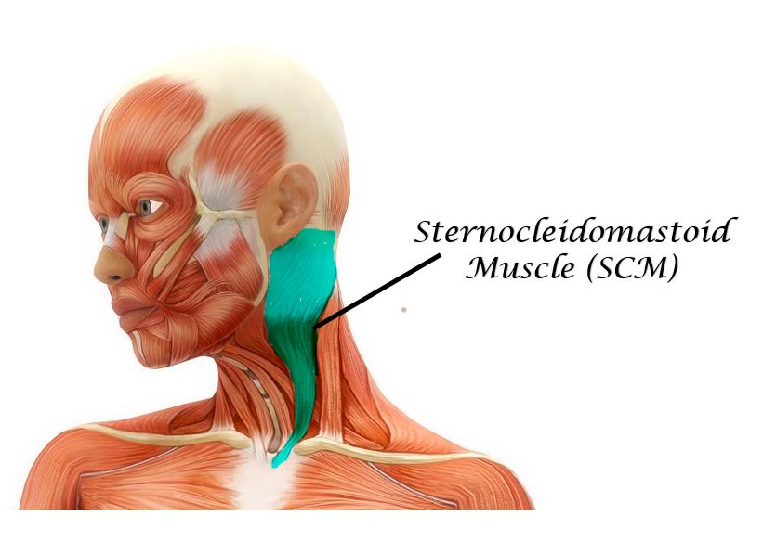
Action of the SCM
Flexes and laterally rotates the head

Slide 63
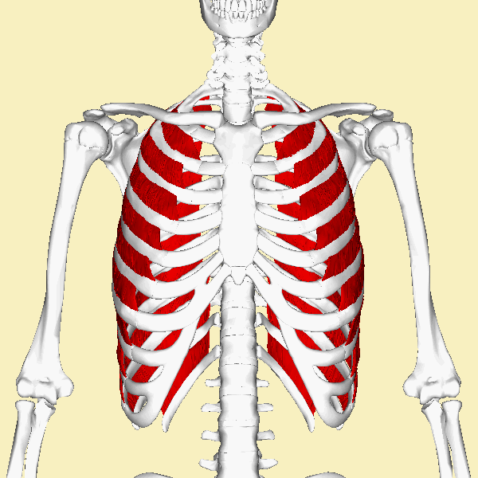
Action of the External intercostals
pull ribs toward one another to elevate rib cage; aid in inspiration; synergists of diaphragm

Slide 64
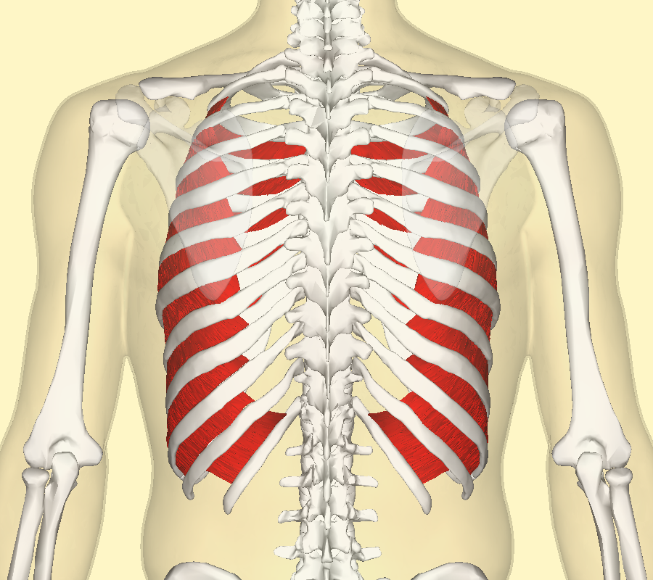
Internal intercostals
draw ribs together and depress rib cage; aid forced expiration; antagonistic to external intercostals

Slide 65
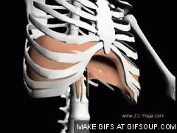
Diaphragm
Prime mover of inspiration; flattens on contraction,

Slide 66
