Slide 1
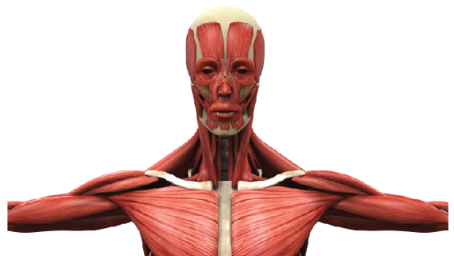
MUSCLES OF THE HEAD, NECK AND TORSO

Slide 4
https://youtu.be/INFJxYx9N8A

Slide 5
MUSCLES OF THE HEAD AND FACE

Slide 8
Orbicularis Oculi Muscles
Function: Closes the Eyes ​The orbicularis oculi muscle is in charge of your "blinking" motion and being able to squint or close your eye tightly.

Slide 9
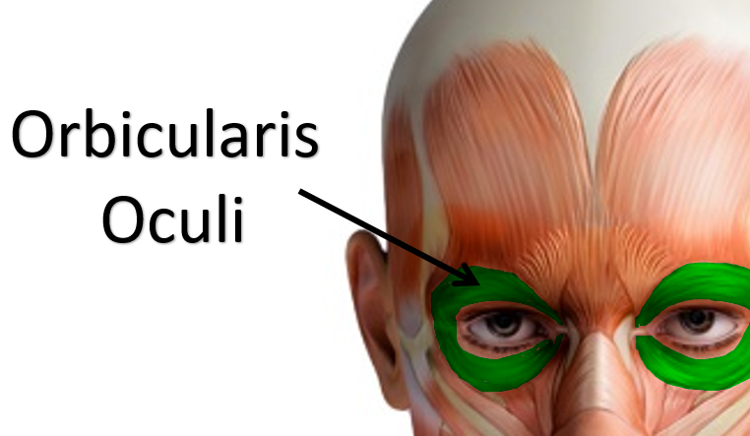
Orbicularis Oculi Muscles
Function: Closes the Eyes ​The orbicularis oculi muscle is in charge of your "blinking" motion and being able to squint or close your eye tightly. It appears as a ring-like band of muscle, called a sphincter muscle, that surrounds the eye. Sphincter muscles are arranged in a circular pattern.

Slide 10
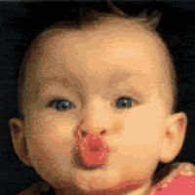
Orbicularis Oris Muscles
Function: Puckers (purses) Lips ​It is sometimes called the kissing muscle because it causes the lips to close and pucker.

Slide 11
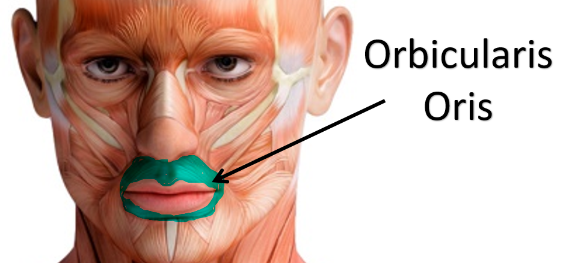
Orbicularis Oris Muscles
​The orbicularis oris muscle is a sphincter muscle that encircles the mouth.

Slide 12
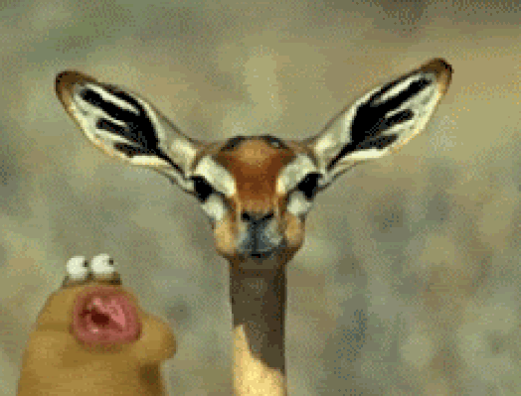
Muscles of Mastication (Temporalis and Masseter)
Mastication is the act of CHEWING

Slide 13
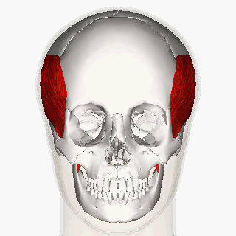
Temporalis Muscles
Function: Elevates Mandible
The temporalis muscle (or temporal muscle) is one of the muscles you use for chewing (mastication).
When you clinch your jaw, you see a couple of muscles contract at the jaw joint.

Slide 14
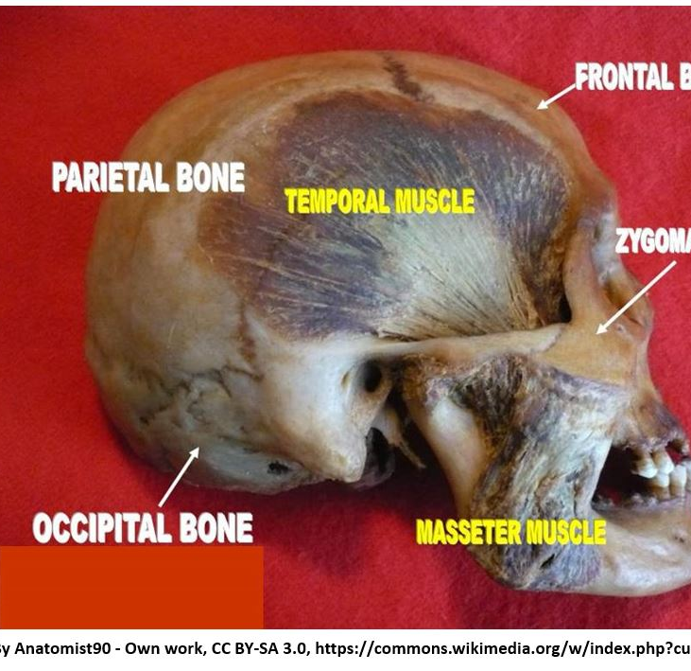
Temporalis Muscles
If you clench your jaw, you can see and feel it contracting at the temples on both sides of your head. It's attached to the mandible (jaw) and to the skull's temporal bone, or temporal fossa.
When the jaw is clinched, the muscles of mastication are visible. The upper muscle is the temporalis and the lower, more noticeable muscle is the masseter.

Slide 15
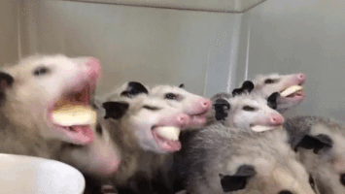
Masseter Muscles
The name "masseter" comes from a Greek meaning "one who chews". ​

Slide 16
Masseter Muscles
The masseter is the major muscle of the jaw. It's principle action is to close the jaw, but it also acts in the side-to-side and forward and back (i.e. protraction and retraction) movement of the jaw.

Slide 17
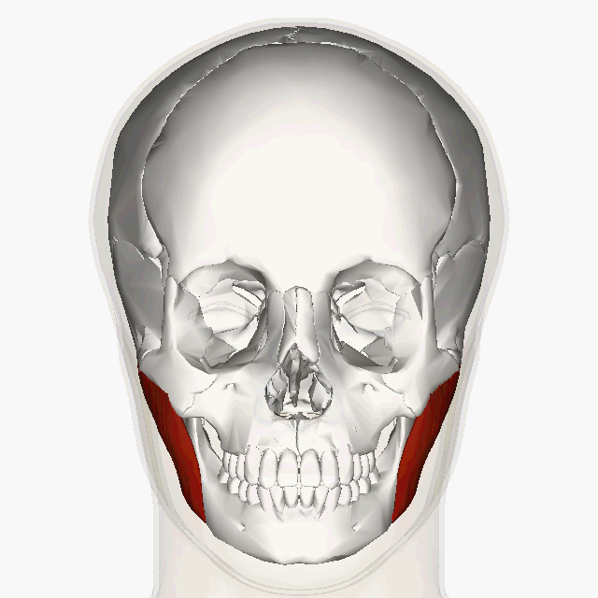
Masseter Muscles
Function: Closes Jaw
The most visible muscle of mastication is the masseter muscle. It is a strong, superficial muscle that function to close the jaw.

Slide 18
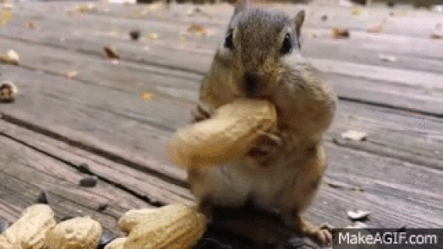
Buccinator Muscles
Function: Holds Food in Mouth (Keeps Food Between Grinding Teeth)

Slide 19
The buccinator functions to flatten the cheek area and help hold food in the right place so it can get chomped by your teeth, instead of falling into the pockets of your cheeks between the cheek and gums.
Buccinator Muscles

Slide 20
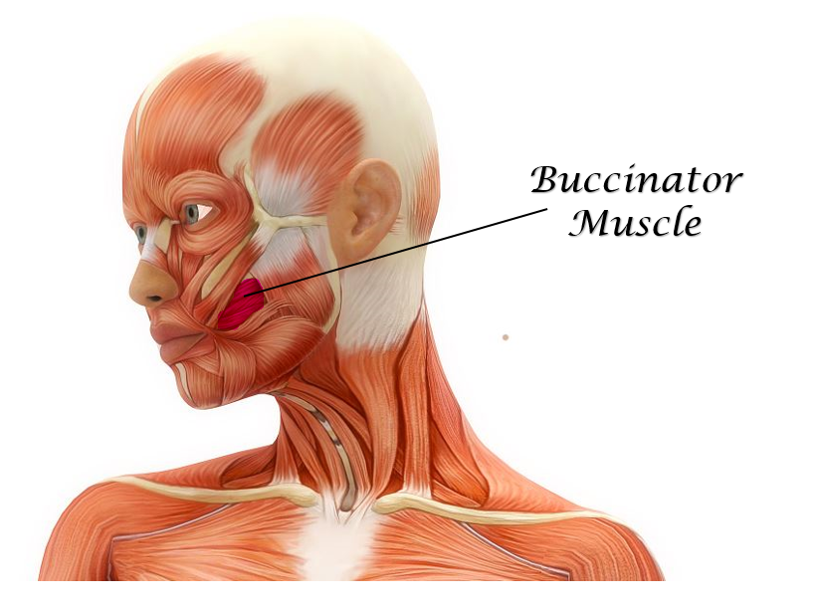
Buccinator Muscles
Your buccinators are the muscles of your cheeks. You may recall that the cheek is considered the "buccal" region. These anatomical terms come from the Greek word, "bucca".

Slide 21
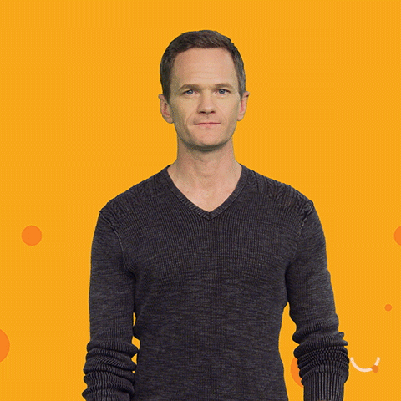
Zygomaticus Muscles
Function: Smiling
The zygomaticus muscles are the muscles of your face that help you show emotion by smiling.

Slide 22
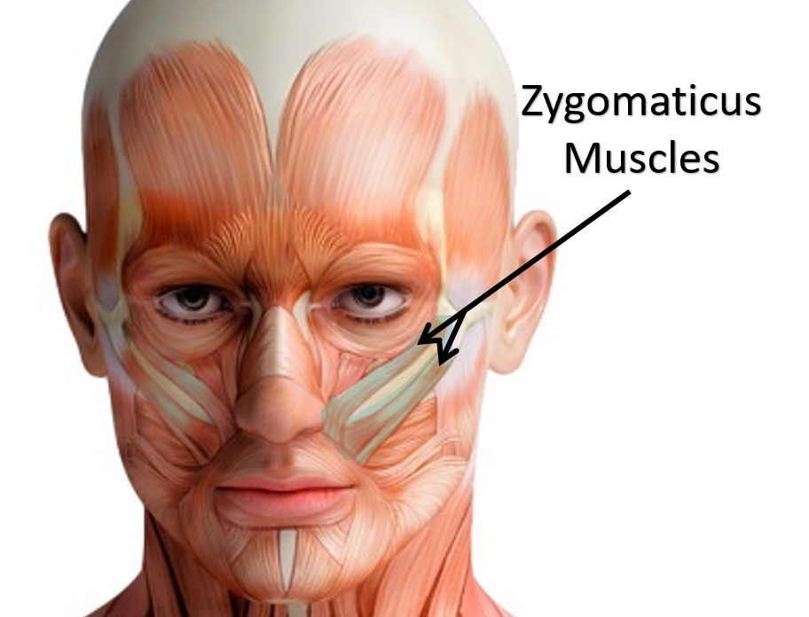
Zygomaticus Muscles
You have a zygomaticus major and a zygomaticus minor.
These muscles act together to form the smile on your face by pulling up the corners of your mouth.
This also allows the poofing out your 'happy' cheeks.

Slide 23
Zygomaticus Major Muscles of the face.
The zygomaticus major is larger than the minor and sits lower on the face, extending down to the mouth

Slide 24
Zygomaticus Minor Muscles of the face.
The zygomaticus minor is higher and closer to the nose and upper cheek. ​Both of the zygomaticus muscles also function to keep food in the mouth when chewing.

Slide 25
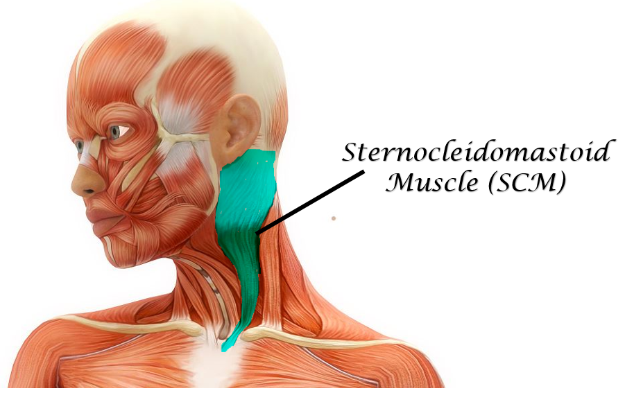
Sternocleidomastoid Muscles
Function: Flexes the Head
The sternocleidomastoid muscles (sternomastoid or SCM) are the muscles of your neck responsible for rotation of your head and flexion (tilting head on one shoulder).

Slide 26
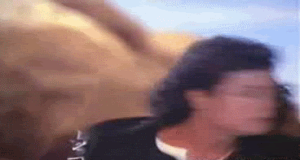
Sternocleidomastoid Muscles
It is one of the largest cervical muscles and is easy visible when a person turns their head from side to side.

Slide 27
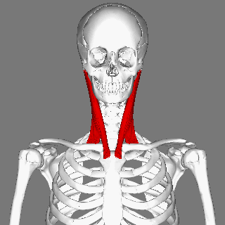
Sternocleidomastoid Muscles
The 'sterno-' portion of its name comes from that fact that one of its origination points is at the sternum (more specifically at the manubrium which is the upper portion of the sternum).

Slide 28
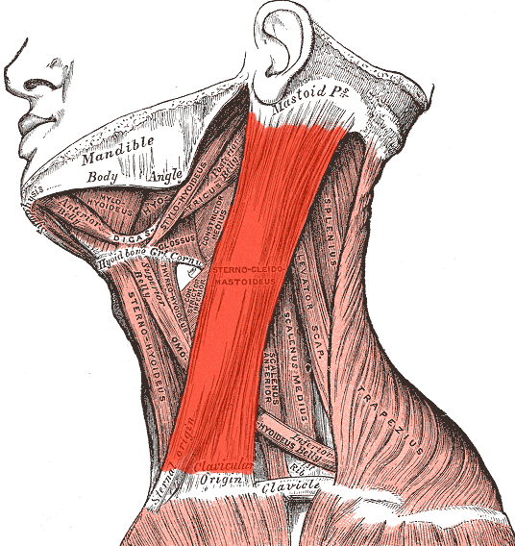
Sternocleidomastoid Muscles
It also originates at the clavicle (collar bone), which is where the 'cleido-' portion of its name comes from.

Slide 29
Sternocleidomastoid Muscles
The name ends with "mastoid", because the sternocleidomastoid muscle ends with an attachment at the mastoid process of the temporal bone The name. sternocleidomastoid, describes the muscles' points of connectivity within the body.

Slide 30
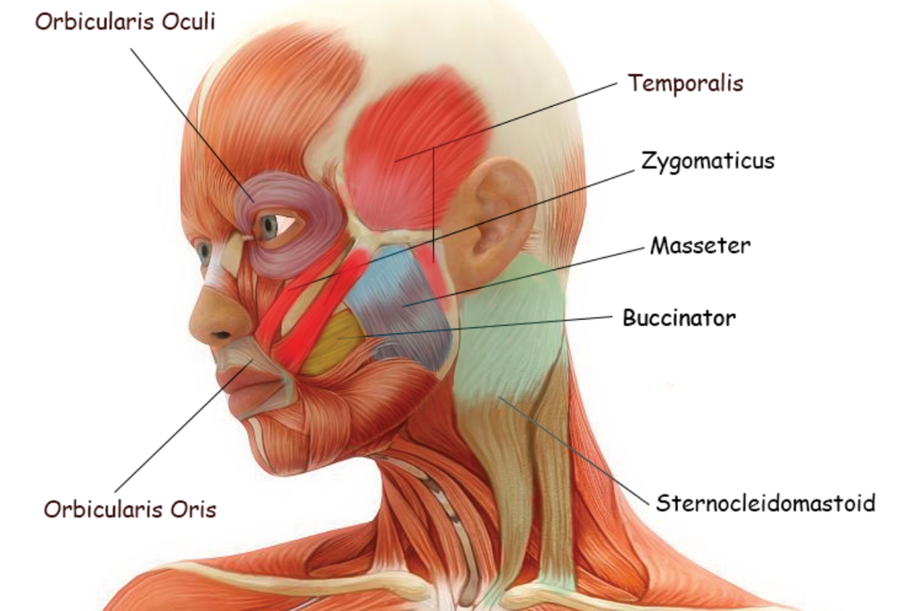
Summary of the Muscles of Head and Neck

Slide 31
MUSCLES OF THE TORSO (trunk)
The Superficial Muscles of the Thorax Include the Trapezius, the Pectoralis (Major and Minor), the Deltoid and the Latissimus Dorsi

Slide 32
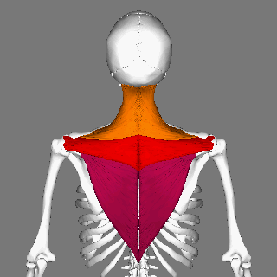
Trapezius Muscles
Function: Shrugs Shoulders

Slide 33
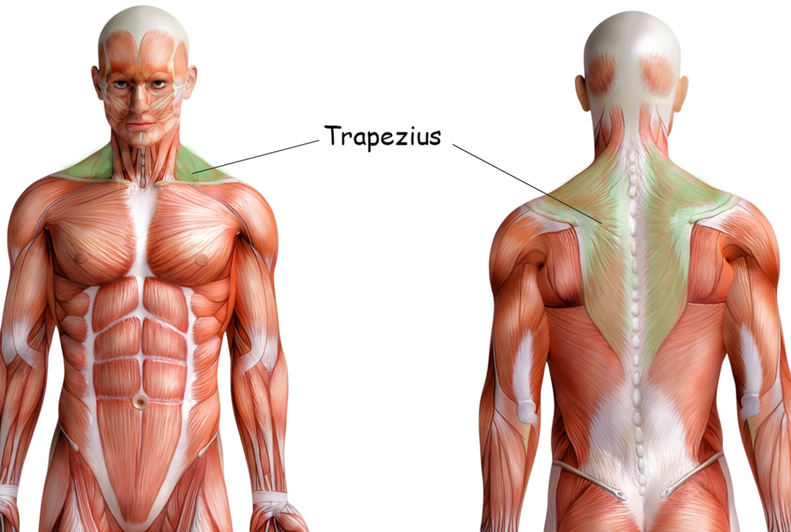
Trapezius Muscles
The trapezius muscles are the large major muscles of the upper back. The trapezius muscles function to move, rotate and stabilize the scapula (shoulder blade).

Slide 35
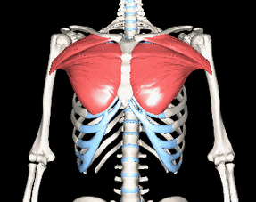
Pectoralis Major and Minor Muscles
Function: Flexion, rotation and adduction of the arm.

Slide 36
Pectoralis Major Muscles
The pectoralis major is a large muscle of the upper chest region (thoracic region). It connects the bones of the chest to the shoulders and upper arms.
The pectoralis major muscle allows you to move your arm across the body.

Slide 37
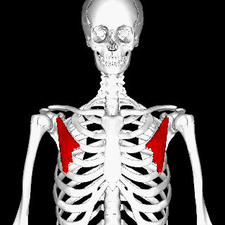
Pectoralis Minor Muscles
The pectoralis minor muscles lie underneath the pectoralis major muscles closer to the axillary region (region of the armpit).
The pectoralis minor and are considerably smaller.
It is smaller of the two sets of muscles that connect the bones of the chest to the shoulder and upper arm.

Slide 38
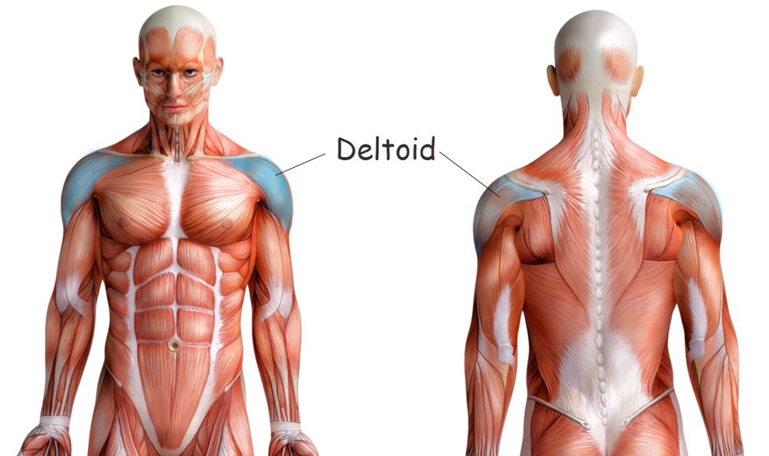
Deltoid Muscles
The deltoid muscle is the rounded muscle of the shoulder and upper arm. The deltoid muscle is named after the Greek letter "delta", because it has a similar triangular shape. The deltoid is attaches to clavicle (collarbone), the scapula (shoulder blade), and the humerus (upper arm bone). Contraction of the deltoid muscle results in a wide range of movement of the arm at the shoulder due to its location and the wide separation of its muscle fibers.

Slide 39
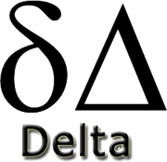
Deltoid Muscles
The deltoid muscle is the rounded muscle of the shoulder and upper arm. The deltoid is attaches to clavicle (collarbone), the scapula (shoulder blade), and the humerus (upper arm bone). Contraction of the deltoid muscle results in a wide range of movement of the arm at the shoulder due to its location and the wide separation of its muscle fibers.

Slide 40
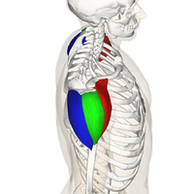
Deltoid Muscles
The deltoid muscle is named after the Greek letter "delta", because it has a similar triangular shape.

Slide 42
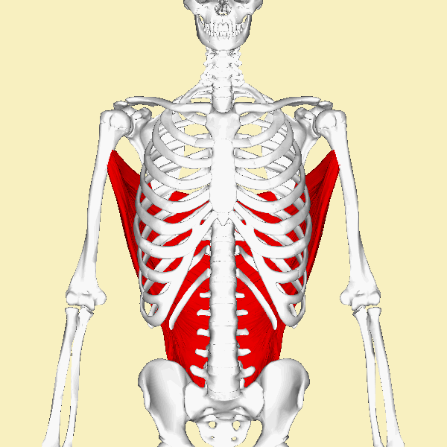
Latissimus Dorsi
 | FUNCTION : Major muscle for arm extension, adduction and medial rotation of arm. Other functions – Bringing the arm down forcefully (hammering) Swimming Reaching overhead Chin-ups

Slide 43
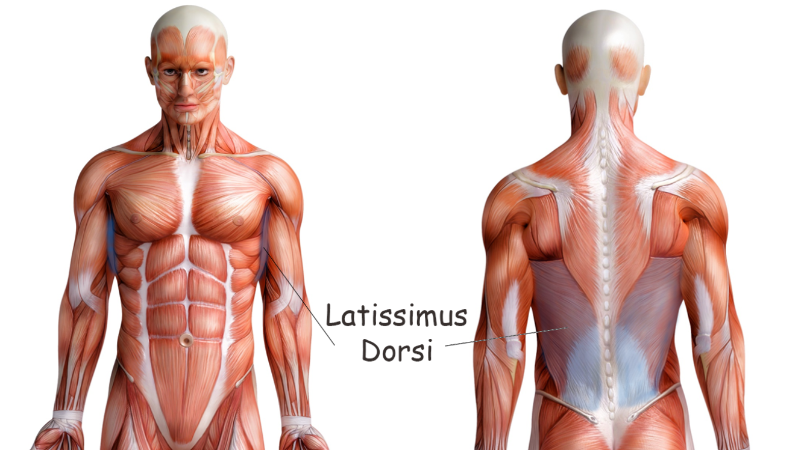
Latissimus dorsi comes from the words ‘latissimus’ = widest and ‘dorsi’ = back

Slide 44
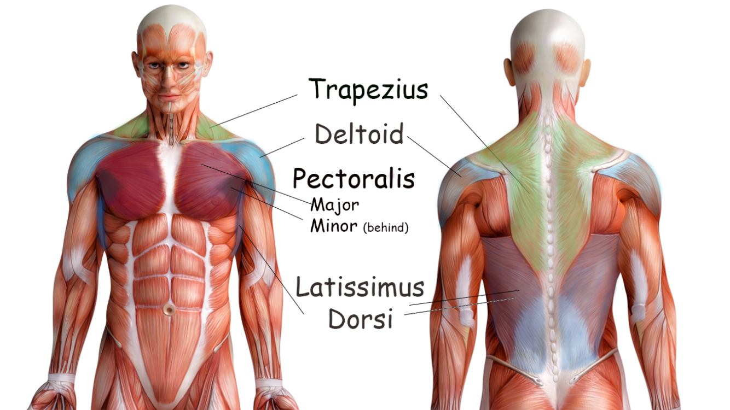

Slide 45
Deep Muscles of the Torso
The Deep Muscles of the Torso Include the Internal and External Intercostal Muscles and the Muscles of the Rotator Cuff (the supraspinatus muscle, the infraspinatus muscle, the teres minor muscle and the subscapularis muscle)

Slide 46
Internal and External Intercostal Muscles

Slide 47
Internal and External Intercostal Muscles
The function of the deep muscles of the thorax is to assist in respiration (breathing).
The medical term for inhalation (or breathing inwardly) is inspiration and the medical term for exhalation (or breathing outwardly) is expiration.

Slide 48
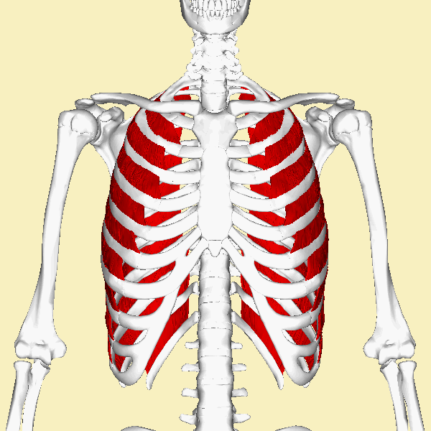
External Intercostals
The external intercostal muscles make up the most superficial of the 3 layers of intercostals.

Slide 49
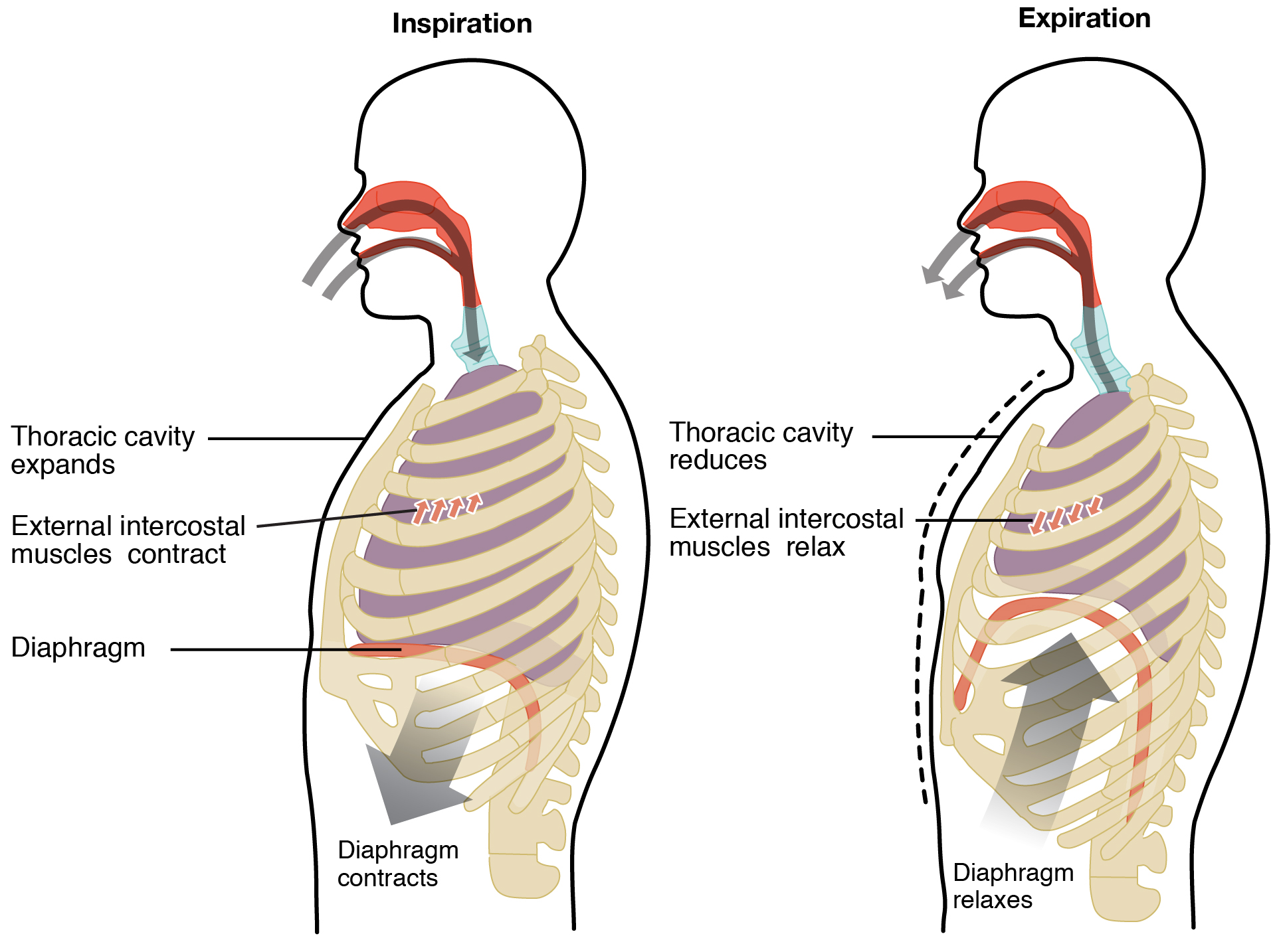
The external intercostal muscles
In order for inspiration to occur, the thoracic cavity (which includes the pleural cavities) must expand (or increase in volume).
The external intercostal muscles function to expand the thoracic cavity upon inspiration (inhalation) by acting to lift the rib cage.

Slide 50
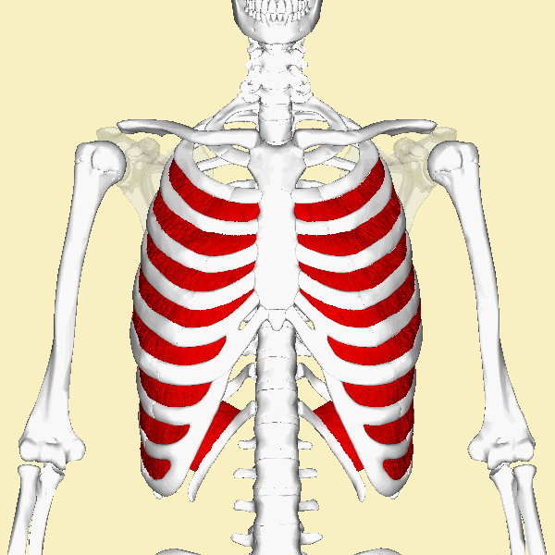
Internal Intercostals
The internal intercostals form the intermediate intercostal muscle layer.

Slide 51
The internal intercostal muscles
In order for expiration (exhalation) to occur, the thoracic cavity must collapse (or decrease in volume).
The internal intercostal muscles pull the rib cage down to allow for expiration (or exhalation).

Slide 52
Just FYI - The deepest muscle layer of the thoracic wall attaches to the internal surfaces of the ribs.
The function of the deepest layer is unknown.

Slide 53
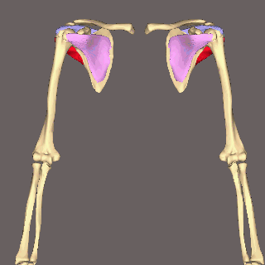
The Rotator Cuff Muscles
Four muscles make up the rotator cuff that encircles the shoulder joint.
The rotator cuff muscles include the following: 1) The Subscapularis (Pink) 2) The Supraspinatus (Violet) 3) The Infraspinatus (Blue) 4) The Teres Minor (Red)

Slide 54
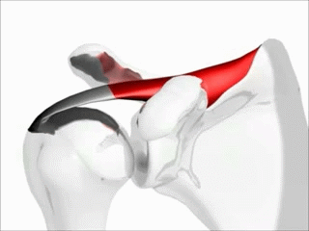
Supraspinatus
Function = initiates abduction of arm
The supraspinatus muscles originate at the supraspinatus fossa (which lies just above the spinous process of the scapulae and inserts at the greater tubercle of the humerus.
The supraspinatus muscles function to abduct the arm and to stabilize the shoulder.
It is located superiorly at the posterior aspect of the scapulae.

Slide 55
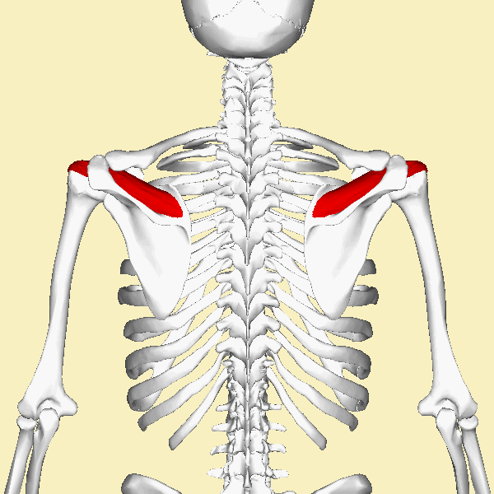
Supraspinatus
Function = initiates abduction of arm
The supraspinatus muscles originate at the supraspinatus fossa (which lies just above the spinous process of the scapulae and inserts at the greater tubercle of the humerus.

Slide 56
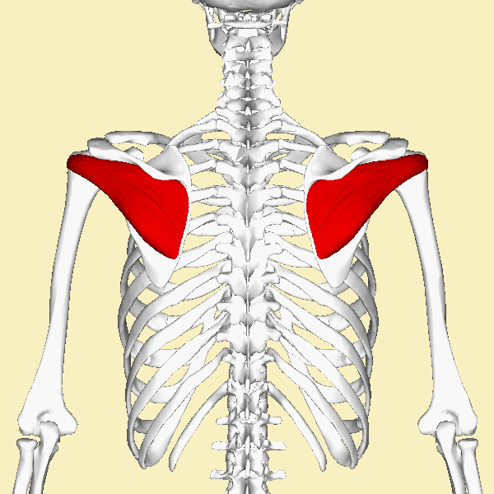
Infraspinatus
Function = laterally rotates the arm; helps stabilize the shoulder
The infraspinatus muscles connect the scapulae and the humerus as one of the rotator cuff muscles.
It lies at the posterior aspect of the scapulae and is below (inferior to) the supraspinatus.

Slide 57
Infraspinatus
The literal translation for infraspinatus in "below spine" which refers to its origin beneath the spine of the scapulae.
The infraspinatus functions to laterally rotate the arm and it helps stabilize the shoulder by drawing the humerus toward the glenoid fossa of the scapula.

Slide 60
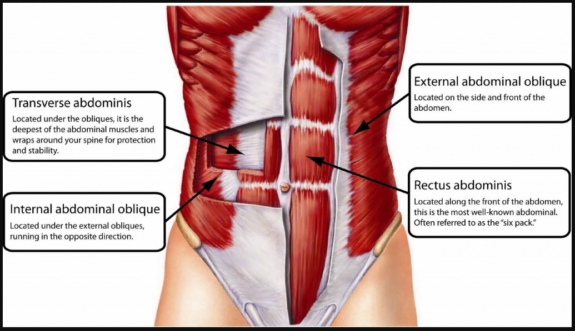
Muscles of the Abdomen
The abdominal muscles include the following:
External oblique
Internal oblique
Transversus abdominus
Rectus abdominis

Slide 61
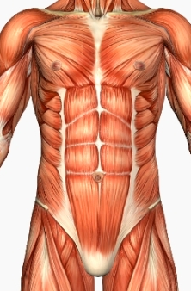
Muscles of the Abdomen
The walls of the abdomen do not have bones protecting it.
This allows for the abdomen to be more flexible, but it leaves the area more vulnerable to injury.
For this reason, your abdominal wall contains strong, broad, sheet-like muscles.
This Photo by Unknown Author is licensed under CC BY-SA-NC

Slide 62
Muscles of the Abdomen
The anterior and lateral portions of the abdominal wall are composed of three broad, flat sheets of muscle.
These are the external obliques, the internal obliques, and the transverse abdominis.

Slide 63
STRIATIONS OF THE ABDOMINAL MUSCLES
How the striations of the muscle you are looking at, will an important clue that tells you what abdominal muscle it is.
RECTUS ABDOMINIS - striations are oriented VERTICALLY (up and down)
TRANSVERSE ABDOMINIS - striations are oriented HORIZONTALLY (on the transverse plane)
EXTERNAL OBLIQUES - striations are oriented DIAGONALLY DOWNWARD
INTERNAL OBLIQUES - striations are oriented DIAGONALLY UPWARD

Slide 65
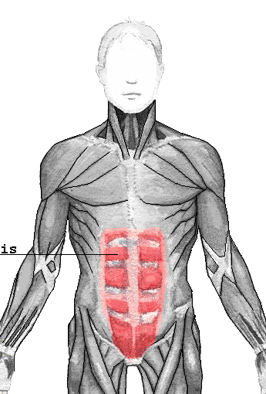
The rectus abdominis muscles
The rectus abdominis muscles are what is commonly referred to as your "abs" or your "six-pack".
These are the muscles that run vertically on each side of the anterior wall of the abdomen.
The "six pack" appearance of the rectus abdominis muscles is due to bands of connective tissue, called the tendinous intersections.

Slide 66
The rectus abdominis muscles
There two parallel muscles are separated by the linea alba, which is a vertical band of connective tissue that runs down the midline.
The rectus abdominis runs from the pevis to the anterior portions of the lower ribs and the xiphoid process of the sternum. ​

Slide 67
The rectus abdominis muscles
​ The rectus abdominis connects the lower ribs to the pubic bone which is located at the front of the pelvis.
The main function of the rectus abdominis is to move the body between the ribcage and the pelvis

Slide 68
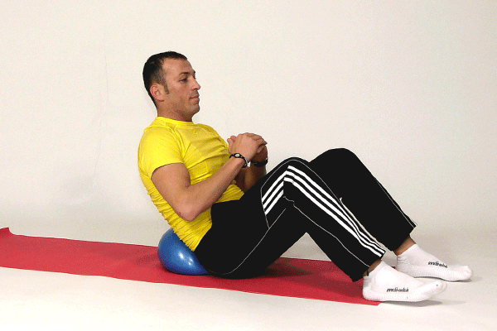
External Obliques
Function = Assists is trunk rotation and flexion of the vertebral column.

Slide 69
External Obliques
The external oblique muscles are named according to their location.
The word 'oblique' means 'to run at an angle’.
The external obliques originate by the lower ribs and insert at a few locations within the pelvis. ​
The external obliques function to flex the vertebral column and to compress the abdominal wall.

Slide 70
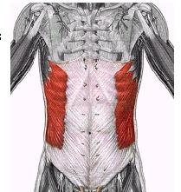
External Obliques
The external obliques lie on either side of the rectus abdominis muscles.
The function of the external oblique muscles is to allow the trunk to twist to the opposite side of whichever external oblique is contracting.
For example, the right external oblique contracts to turn the body to the left.
They also function in trunk rotation and lateral flexion.

Slide 71
Internal Obliques
Function = Assists is trunk rotation and flexion of the vertebral column.
The internal oblique muscles lie underneath (deep) to the external obliques. These muscles attach to the area of the rectus abdominis muscles that is located just inside of the hip (coxal) bones

Slide 72
The Eternal and Internal Obliques
The internal oblique muscles operate in the opposite direction to the external oblique muscles.
For example, twisting the trunk to the left requires the left side internal oblique and the right side external oblique to contract together.

Slide 73
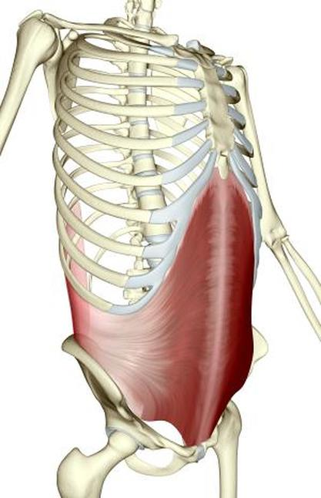
Transverse Abdominis
Function = Compresses abdomen inwards
The word 'transverse' means 'horizontal' and 'abdominis' means 'of the abdomen’.
Therefore the 'transverse abdominis' translates literally to mean 'horizontal muscles of the abdomen’.

Slide 74
Transverse Abdominis
The traverse abdominis muscles are the deepest (innermost) muscles of the abdominal wall.
The fibers of this muscle run horizontally.
It functions to compress the abdomen and assists in child delivery in females.

Slide 75
