Slide 1
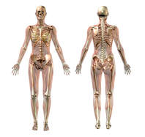
The Muscles of the Limbs

Slide 2
The muscles of the brachial region
The muscles of the brachial region span the elbow joint.
The muscle of the brachial region have their origin in the brachial region (upper arm area) and attach to the antebrachial region (lower arm area) on the forearm bones (radius and ulna).

Slide 3
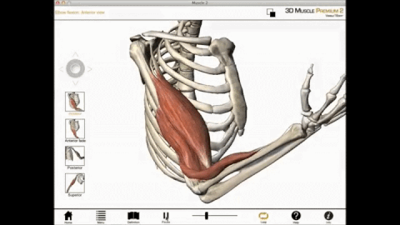
The Biceps Brachii Function = Flexion of forearm
The biceps brachii is a "two-headed" fusiform muscle. The biceps brachii functions to flex the forearm and to supinates it.
This muscle cannot flex the forearm without also supinating it, so it is ineffective when one lifts a heavy object with a pronated hand that must stay pronated.
(This is why doing chin-ups with palms facing anteriorly is harder than with palms facing posteriorly.)

Slide 4
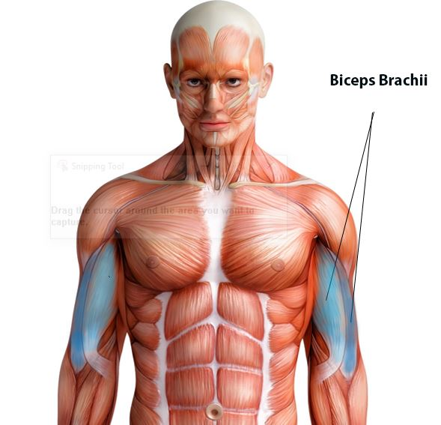

Slide 6
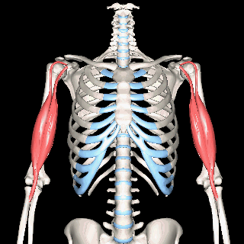
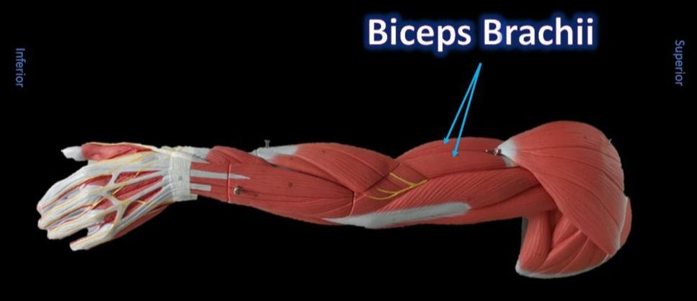

Slide 7
The Brachioradialis Function = Flexes forearm at the elbow
​ The brachioradialis is a weak flexor muscle of the forearm that functions to flex the forearm at the elbow.
It is the superficial muscle that lies mostly in the forearm.

Slide 8
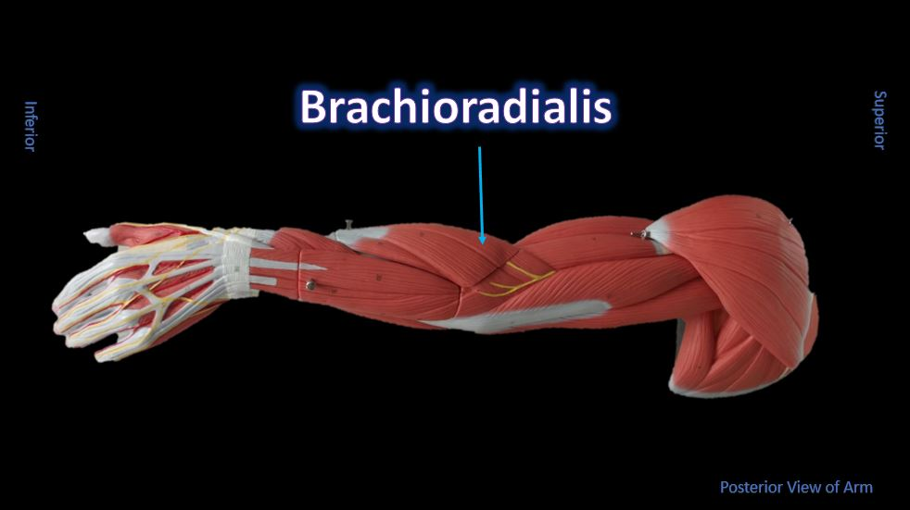
The Brachioradialis Function = Flexes forearm at the elbow
​ The brachioradialis is a weak flexor muscle of the forearm that functions to flex the forearm at the elbow.
It is the superficial muscle that lies mostly in the forearm.

Slide 9
The Brachioradialis Function = Flexes forearm at the elbow
The brachioradialis lies at the radial side of the proximal antebrachial region.
On the anatomical model, this muscle is found by following the lateral most nerve (yellow) at the elbow region.

Slide 10
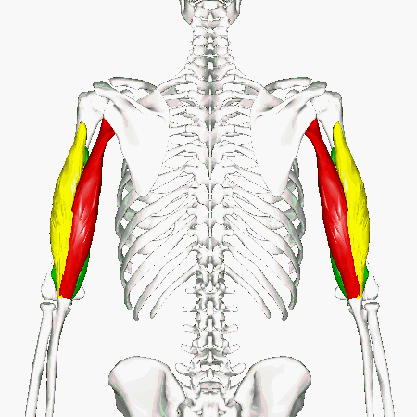
Triceps Brachii Function = Main extensor of forearm
The Triceps gets its name from the fact that it has three "heads"; KEY - Long head (RED) Lateral head (YELLOW) Medial head (GREEN)

Slide 11
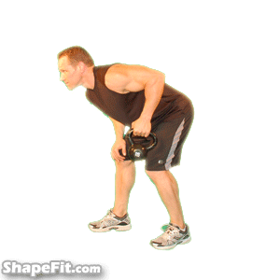
Triceps Brachii
The main extensor (prime mover) of the forearm is the triceps brachii.
The triceps brachii function to extend the arm, which increases the angle between the upper and lower arm.

Slide 12
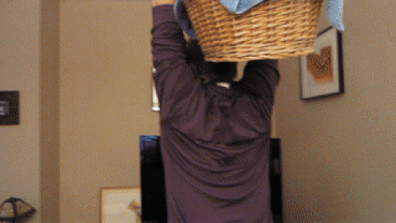
Triceps Brachii
As the arm extends, the elbow straightens.
The triceps brachii is the antagonist of the flexors of the forearm.

Slide 13
Triceps Brachii

Slide 15
Pronator Teres Function = Pronation of forearms and hands

Slide 16
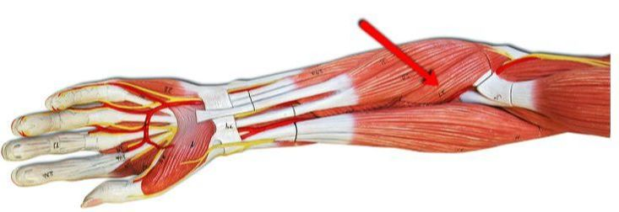
Pronator Teres Function = Pronation of forearms and hands
The pronator teres is a muscle of the human body (located mainly in the forearm) that assists in the pronation of the forearm.

Slide 17
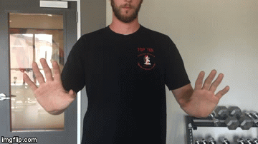
Pronator Teres Function = Pronation of forearms and hands

Slide 18
Pronator Teres Function = Pronation of forearms and hands

Slide 19
Pronator Teres Function = Pronation of forearms and hands
The pronator teres muscle is located on the anterior portion of the forearm just below the antecubital region (inner elbow area).

Slide 20
Extensor Carpi Ulnaris Function = Flexes and adducts wrist/hand

Slide 21
All flexors of the wrist will be located at the inner forearm.

Slide 22
Extensor Carpi Ulnaris
The extensor carpi ulnaris is a skeletal muscle located on the "ulnar side" of the forearm (this is the portion of the arm that is "under" the radius when you do a "thumb up").

Slide 23
Extensor Carpi Ulnaris
It is visible on the posterior aspect of the forearm. It acts to extend and adduct at the carpus/wrist from anatomical position.
Being an extensor muscle, extensor carpi ulnaris is on the posterior side of the forearm.

Slide 24
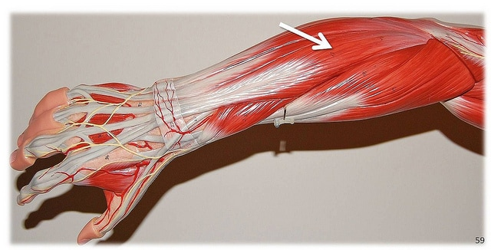
Extensor Digitorum Function = Extends wrist and medial digits (phalanges)

Slide 25
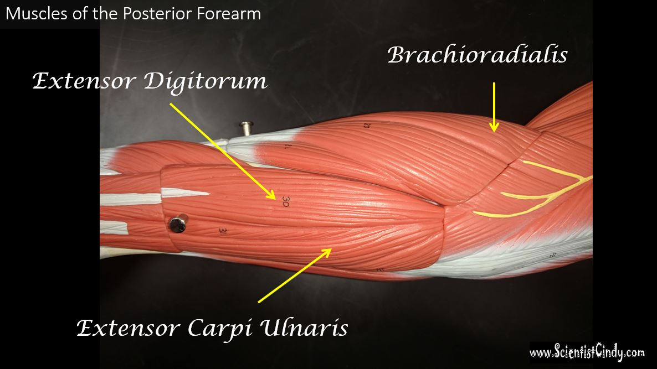
Extensor Digitorum Function = Extends wrist and medial digits (phalanges)
All wrist extensors are located on the back of the forearm. ​

Slide 26
Extensor Digitorum Function = Extends wrist and medial digits (phalanges)
The extensor digitorum muscle is located at the posterior forearm.
It extends the medial four digits of the hand, the wrist, and the elbow. It tends to separate the fingers as it extends them. ​

Slide 27
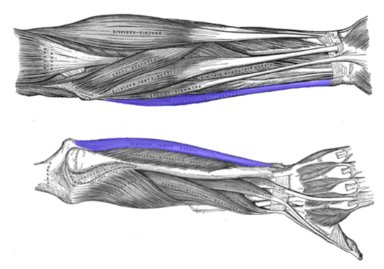
Flexor Carpi Ulnaris Function = flexion and adduction the hand

Slide 28
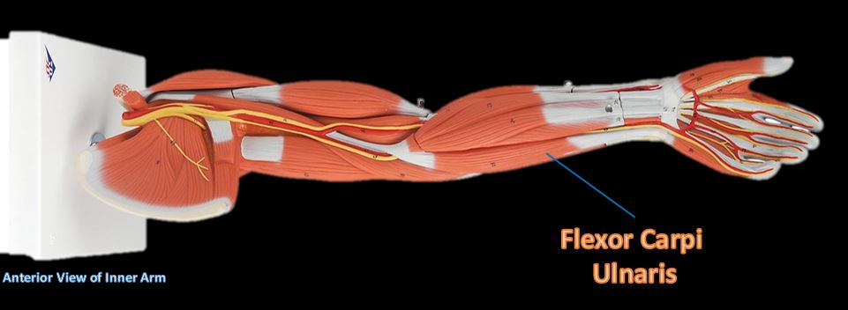
Flexor Carpi Ulnaris
The flexor carpi ulnaris muscle is a muscle located on the posterior aspect of the forearm that functions to flex and adduct the hand.

Slide 29
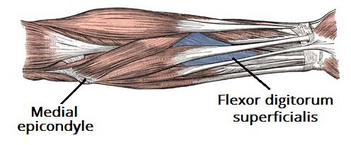
Extensor Digitorium Superficialis Function = Flexes hand and middle phalanges.

Slide 30
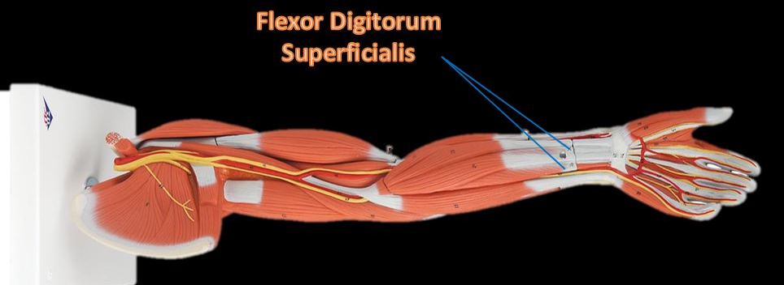
Extensor Digitorium Superficialis Function = Flexes hand and middle phalanges.
Flexes hand and middle phalanges.
This flexor muscle is the important for speed and flexion against resistance.

Slide 31
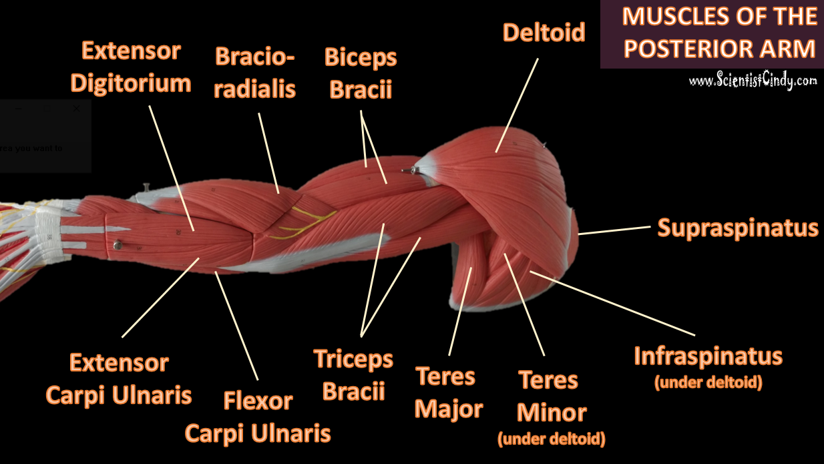

Slide 33
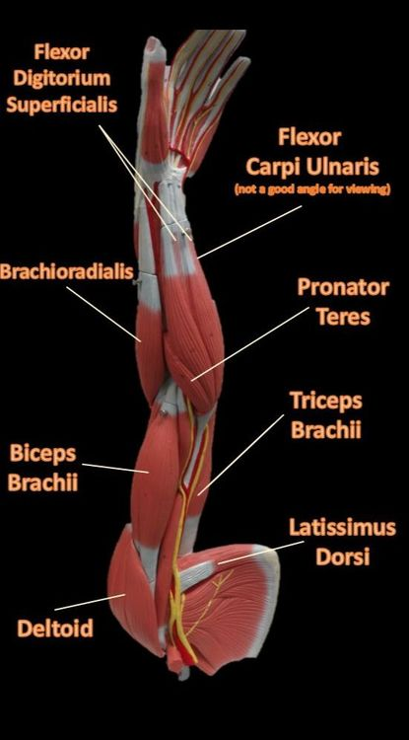
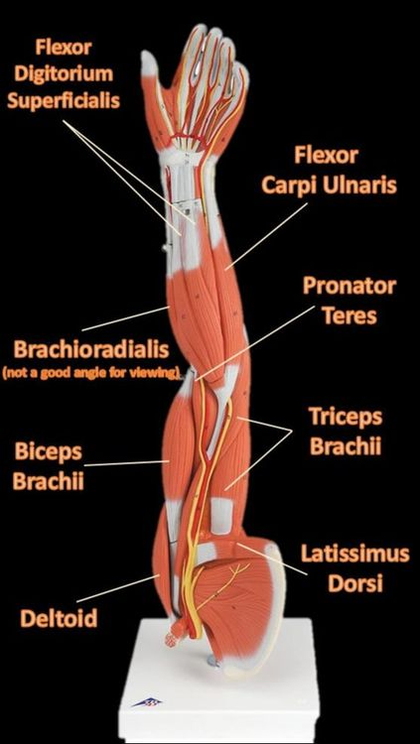
​Muscles of anterior arm showing the flexor carpi ulnaris in the orientation of the body and in the orientation of the counter top display.

Slide 34
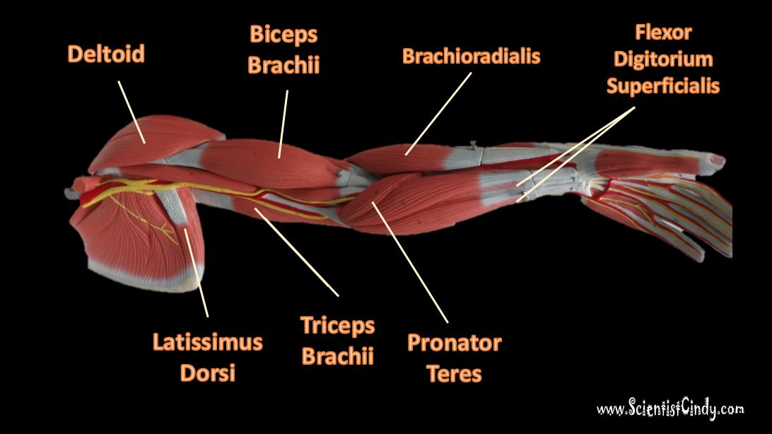
Muscles of anterior arm showing the brachioradialis in the orientation of the body (below) and orientation on counter top.

Slide 35
Muscles of anterior arm showing the brachioradialis in the orientation of the body (below) and orientation on counter top.

Slide 36
Muscles of the Legs
Supporting, balancing, and propelling the body is the work of the muscular system of the legs and feet.
From the large, strong muscles of the buttocks and legs to the tiny, fine muscles of the feet and toes, these muscles can exert tremendous power while constantly making small adjustments for balance – whether the body is at rest or in motion.

Slide 37
Anterior View of Leg Muscles

Slide 38
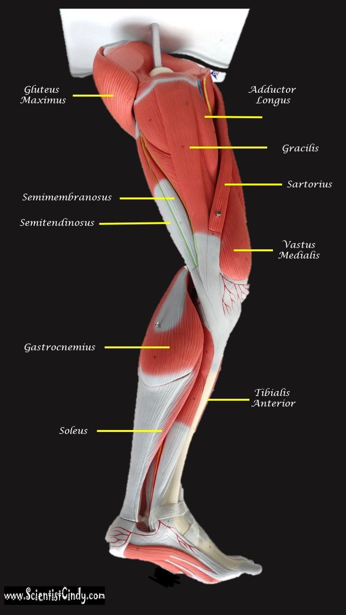
Medial View of Leg Muscles

Slide 39
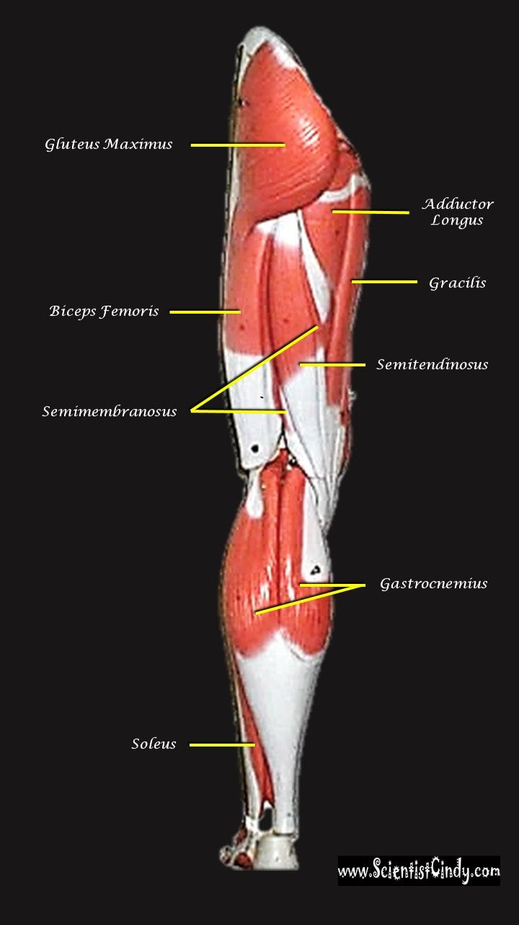
Posterior View of Leg Muscles

Slide 40
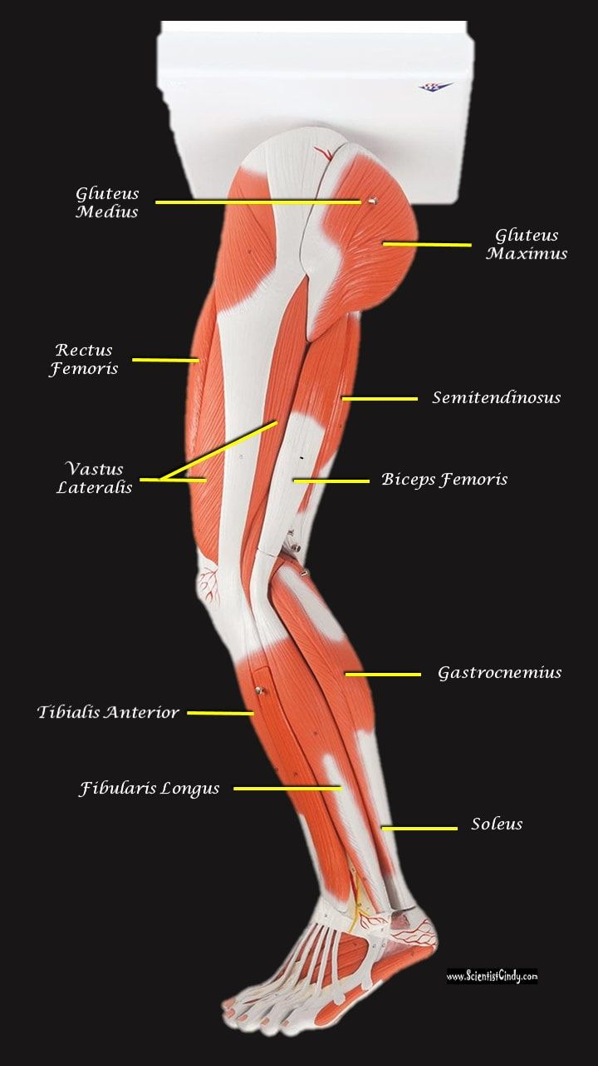
Lateral View of Leg Muscles

Slide 41
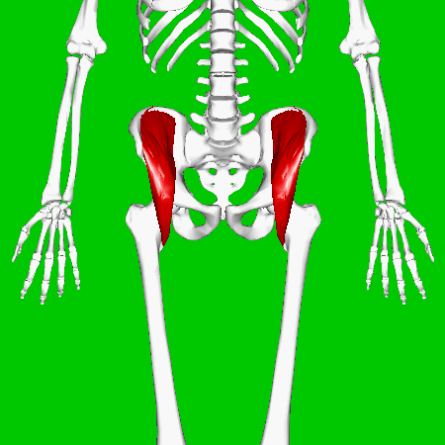
Iliacus Muscles Function = flexes the thigh (femur) at the hip, adducts thigh, medially rotates thigh.

Slide 42
Iliacus Muscles
The iliacus muscle originates at the illium, which is located on the inside of the hip (coxal) bones (at the anterior aspect).

Slide 43
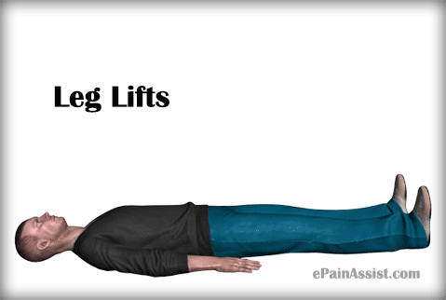
Iliacus Muscles
The function of the iliacus muscles are to lifting (flex) the femur forward.
The iliacus muscle is part of the Iliopsoas which is the prime mover in thigh flexion and in flexing trunk (as when bowing).

Slide 44
Iliacus Muscles
The hip is a ball-and-socket joint that permits flexion, extention, adduction, abduction, and rotation of the thigh.

Slide 45
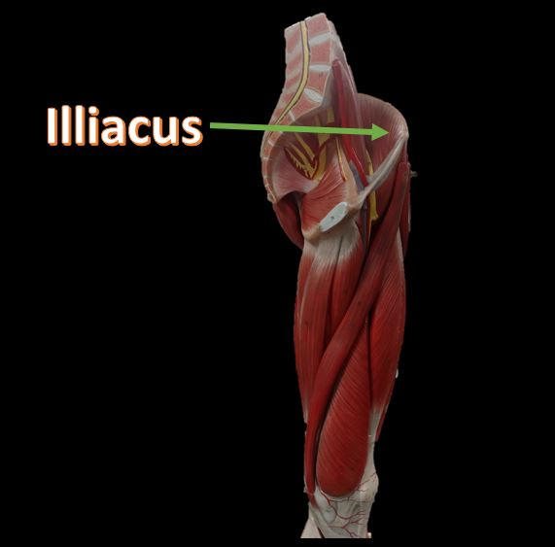
Iliacus Muscles
The muscles that flex the thigh at the hip originate from the vertebral column and pelvis and pass anterior to (in front of ) the hip joint.
These muscles include the illiacus muscles and the rectus femoris.

Slide 46
Iliacus Muscles
The muscles that flex the thigh at the hip originate from the vertebral column and pelvis and pass anterior to (in front of ) the hip joint.
These muscles include the illiacus muscles and the rectus femoris.

Slide 47
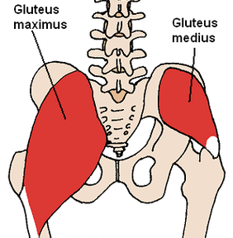
GLUTEAL MUSCLES
The muscles of the buttocks (gluteal muscles) include. ​
gluteus maximus
gluteus medius
gluteus minimus

Slide 48
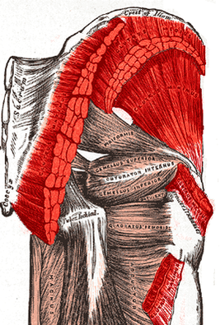
GLUTEAL MUSCLES
The muscles of the buttocks (gluteal muscles) include. ​
gluteus maximus
gluteus medius
gluteus minimus

Slide 49
GLUTEAL MUSCLES
Each of these muscles originate at the ilium and the sacrum and insert at the femur.

Slide 50
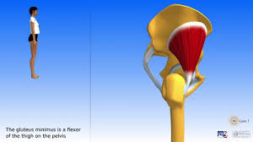
GLUTEAL MUSCLES
The gluteal muscles allow for the extension of the thigh (femur) and abduction of the thigh (femur), as well as the external rotation and internal rotation of the hip joint.

Slide 51
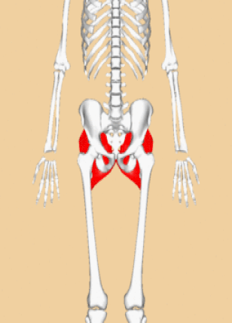
Gluteus Maximus
The thigh extensors arise posterior to the hip joint and include the gluteus maximus and hamstrings.
It is the largest and most superficial of gluteus muscles.
This muscle forms most of the mass of the buttocks.
The gluteus maximus is the main extensor of thigh.
It functions to assist in stair climbing and is able to laterally rotate and adduct the thigh.

Slide 53
Gluteus Medius
A portion of the gluteus medius lies superior to gluteus maximus. The inferior portion of the gluteus medius lies underneath (deep to) the gluteus maximus. The gluteus medius is one of the three gluteal muscles which lie on the outer portion of the pelvis at the posterior aspect.

Slide 54
Gluteus Medius

Slide 55
The gluteus minimus is not shown on the muscular model of the leg.
The gluteus minimus muscle lies directly beneath the gluteus medius muscle.

Slide 56
Gluteus Minimus

Slide 57
Gluteus Minimus

Slide 58
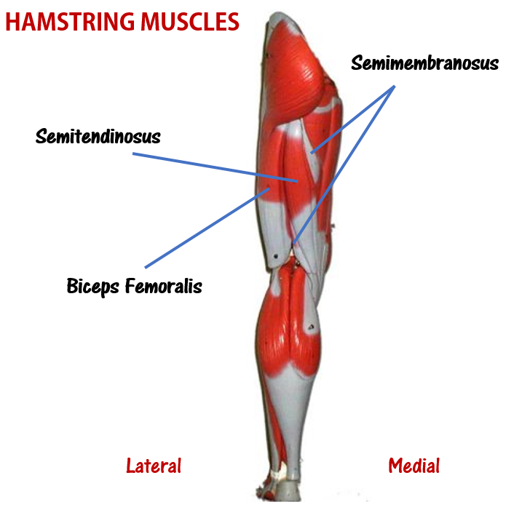
Hamstring Muscles
The hamstring refers to a group of muscles that lie at the posterior aspect of the thigh.
The hamstring muscles cross (and therefore act upon) both the hip joint and the knee joint.
The hamstring is the single large tendon found behind the knee or comparable area.

Slide 59
Hamstring Muscles
The hamstrings include the following muscles from medial to lateral:
The semimembranosus
The semitendinosus
The biceps femoris

Slide 60
Hamstring Muscles
Theses hamstring muscles have similar structure and function.
They each originate at the ischial tuberosity of the hip bone and travel over the posterior of the knee joint and inserts in either the tibia or the fibula of the lower leg.

Slide 61
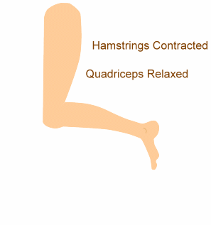
Hamstring Muscles
The hamstring muscle function in the flexion of the knee joint and extension of the hip joint.

Slide 62
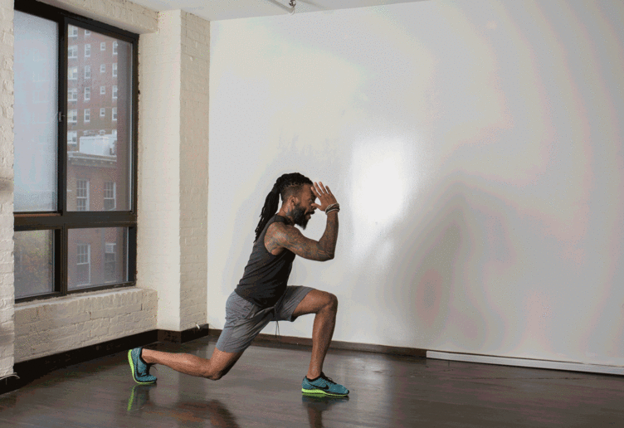
Hamstring Muscles
The hamstrings play a crucial role in many daily activities such as walking, running, jumping, and controlling some movement in the trunk.
In walking, they are most important as an antagonist to the quadriceps in the deceleration of knee extension.

Slide 63
Hamstring Muscles
The hamstrings play a crucial role in many daily activities such as walking, running, jumping, and controlling some movement in the trunk.
In walking, they are most important as an antagonist to the quadriceps in the deceleration of knee extension.

Slide 64
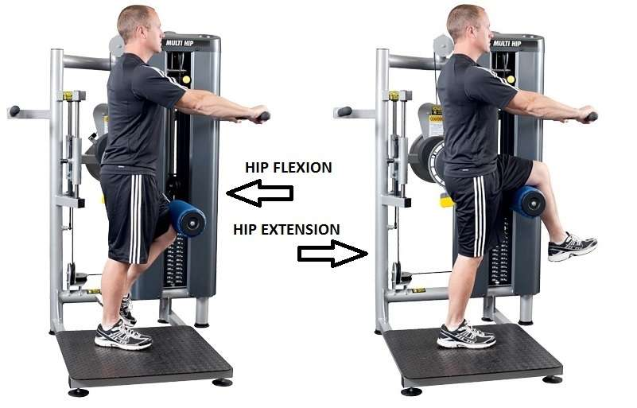
The Hamstring Muscles: The Semimembranosus Muscle
Function = Extends thigh; flexes leg; medially rotates leg.
The semimembranosus muscle is medial hamstring muscle, lying toward the posterior portion of the inner thigh, underneath (deep) to the semitendinous muscle.

Slide 65
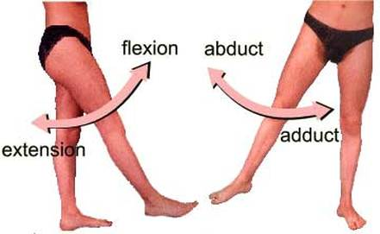
The Hamstring Muscles: The Semitendinosus Muscle
Function = Extends thigh; flexes leg; medially rotates leg.
The semitendinosus muscle lies medial to biceps femoris. It is superficial, and has a long, slender tendon at the posterior aspect of the thigh.

Slide 66
The Hamstring Muscles: The Biceps Femoris
Function = Extends thigh; flexes leg; medially rotates leg.
​ The biceps femoris gets its name because it has "two heads"; a long head and a short head.
The long head of the biceps femoris extends the hip, as when beginning to walk; both short and long heads flex the knee and laterally (outwardly) rotate the lower leg when the knee is bent.

Slide 68
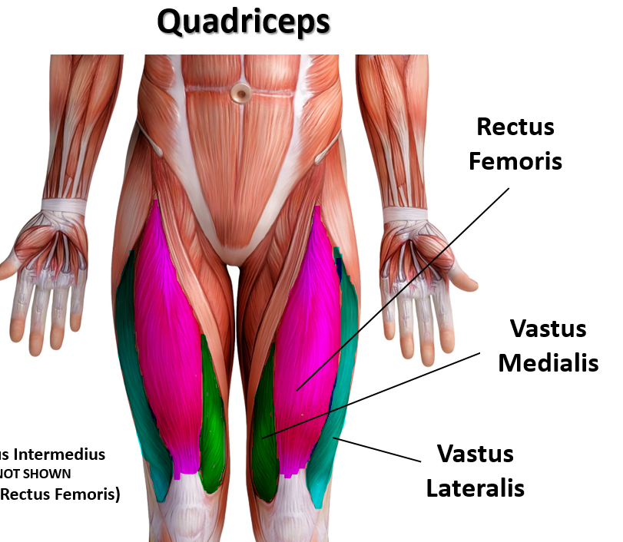
Muscles of the Quadriceps
extensors of the knee.

Slide 69
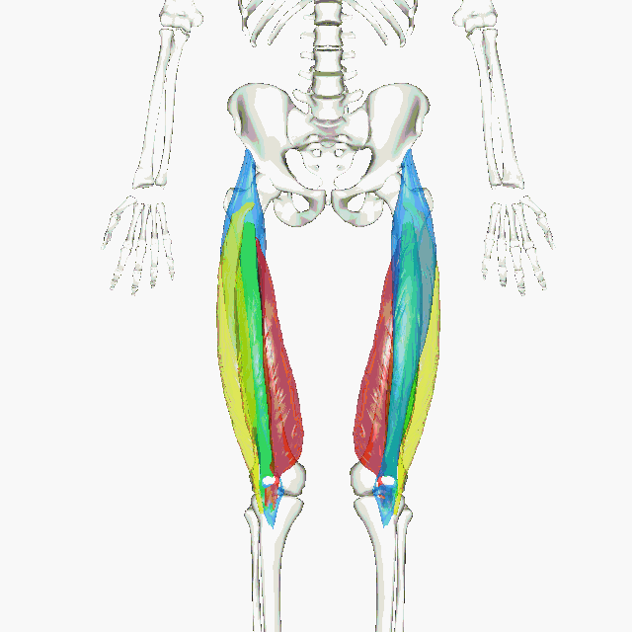
Muscles of the Quadriceps
The animated GIF shows the 4 muscles of the quadriceps as the following colors: rectus femoris - blue vastus lateralis - yellow vastus intermedius - green vastus medialis - red

Slide 70
Muscles of the Quadriceps
The hip is a ball-and-socket joint that permits flexion, extension, adduction, abduction, and rotation of the thigh.
The muscles that flex the thigh at the hip originate from the vertebral column and pelvis and pass anterior to (in front of ) the hip joint.

Slide 71
Muscles of the Quadriceps
The quadriceps femoris gets its name from the Latin words that mean "four-headed muscle of the femur".
The quadraceps femoris refers to a muscle group that consists of 4 muscles of the anterior (front) thigh area (or the femoral area.
The muscles are extensors of the knee.

Slide 72
Muscles of the Quadriceps: Rectus femoris
​Rectus femoris occupies the middle of the thigh, covering most of the other three quadriceps muscles. It originates on the ilium.
It is named from its “straight course”.

Slide 73
Muscles of the Quadriceps
The other three lie deep to rectus femoris and originate from the body of the femur, which they cover from the trochanters to the condyles.

Slide 74
Muscles of the Quadriceps: Vastus lateralis
Vastus lateralis is on the lateral side of the femur (i.e. on the outer side of the thigh).

Slide 75
Muscles of the Quadriceps: Vastus medialis
Vastus medialis is on the medial side of the femur (i.e. on the inner part thigh).

Slide 76
Muscles of the Quadriceps: Vastus medialis
Vastus intermedius lies between vastus lateralis and vastus medialis on the front of the femur (i.e. on the top or front of the thigh), but underneath (deep) to the rectus femoris.
Typically, it cannot be seen without dissection of the rectus femoris.

Slide 77
Rectus Femoris
Function = Extends leg and flexes thigh (brings thigh up)
The rectus femoris is the quadriceps muscle that lies at the middle of the front part of the thigh.
It lies (wholly or partially) on top of the other three quadriceps muscles. It originates on the ilium.
It is named from its straight-appearing orientation at the front of the thigh.

Slide 79
Vastus Medialis Function = Extends leg; stabilize knee (patella)

Slide 80
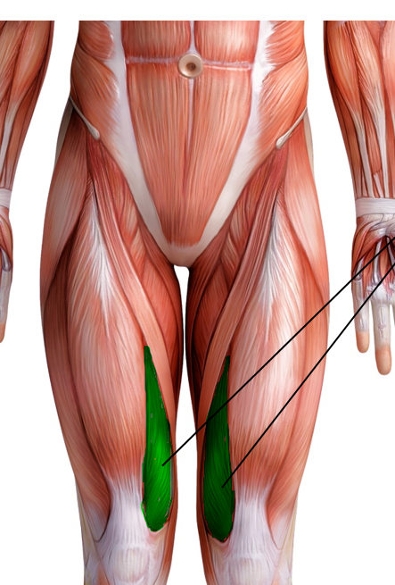
The vastus medialis
The vastus medialis is located on the front medial portion of the thigh. It is one of the quadraceps muscles. The vastus medialis originates medially along the entire length of the femur. It is connected to the other quadriceps muscle.

Slide 82
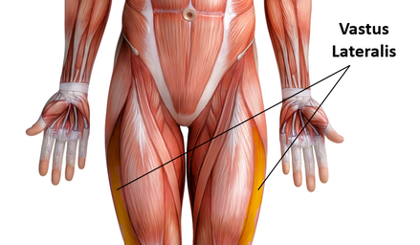
Vastus Lateralis Function = Extends leg (brings leg straight) and stabilizes knee
The vastus lateralis muscle is the largest head of the quadriceps group. It forms the lateral aspect of the thigh.

Slide 84
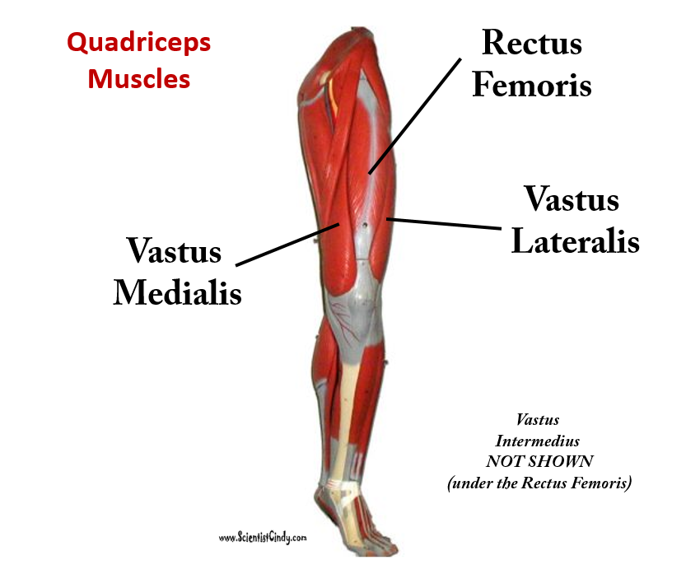
Vastus Intermedius Function = Extends leg
Vastus Intermedius Cannot be Viewed in the Muscular Leg Model Without Removing the Rectus Femoris. ​Vastus intermedius lies between vastus lateralis and vastus medialis on the front of the femur (i.e. on the top or front of the thigh), but underneath (deep) to the rectus femoris. Typically, it cannot be seen without dissection of the rectus femoris.
In the 3D model, you will have to remove the rectus femoris in order to view the vastus intermedius.

Slide 85
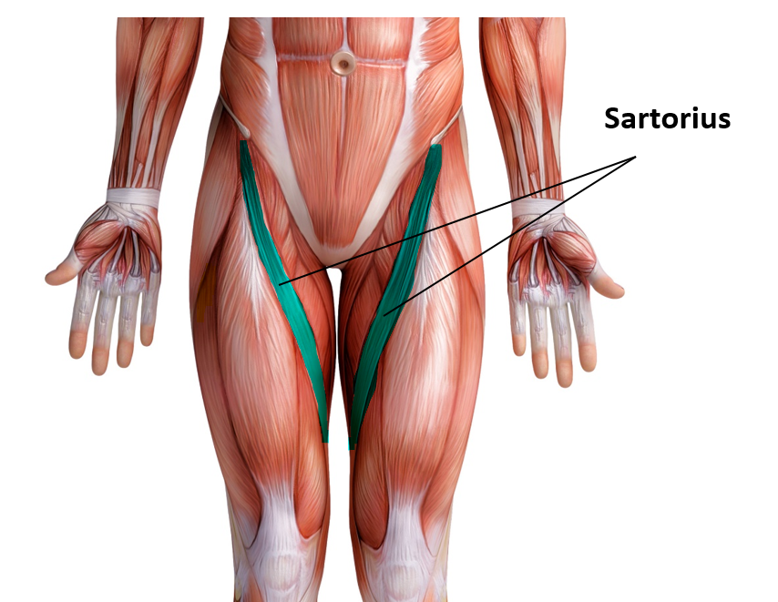
Sartorius Muscles
​Function = Flexes, abducts, and laterally rotates thigh; flexes leg (weak) as in a soccer kick; helps produce the cross-legged position.

Slide 86
Sartorius Muscles
The sartorius muscle is able to flex, adduct and laterally rotate the thigh. It also is able to flex the knee and medially rotates the leg.
Turning the foot to look at the sole or sitting cross-legged demonstrates all four actions of the sartorius.

Slide 87
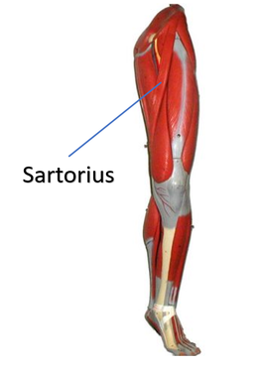
The sartorius muscle
The sartorius muscle is the longest muscle in the human body. It is easily recognized because it is superficial, long and thin. It is a strap-like superficial muscle that runs obliquely across the front (anterior surface) of the thigh and inserts at the knee. The sartorius muscle is weak, but it assists other muscles in moving the hip joint and the knee joint.

Slide 89
Gracilis Muscle Function = Adducts thigh, flexes and medially rotates leg

Slide 90
The gracilis muscle is the most superficial muscle on the inner thigh.
The muscle fibers originate at the pubis and run vertically downward, spans the knee joint, then inserts into the tibia.
The gracilis muscle functions to adduct the lower limb.
The muscle adducts, medially rotates, and flexes the hip as above, and also aids in flexion of the knee.

Slide 91
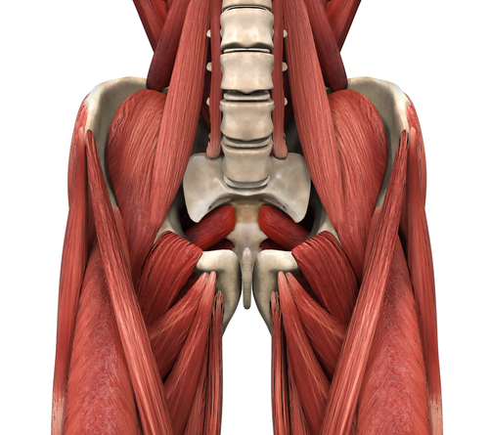
Groin Muscles
There are five groin (adductor) muscles;
three of them are called the 'short adductors' (pectineus, adductor brevis and adductor longus)
and the other two are called the 'long adductors' and consist of gracilis and adductor magnus.

Slide 92
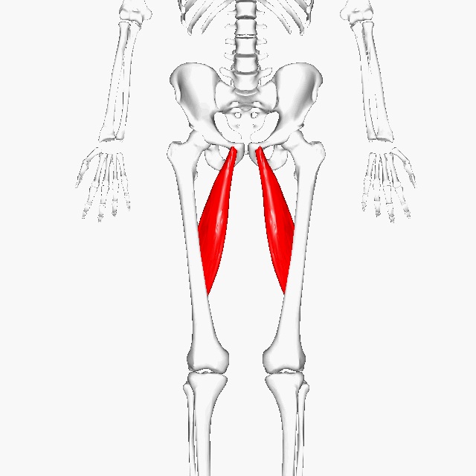
Adductor Longus Function = adducts the thigh
The adductor longus is a muscle located in the inner thigh area.

Slide 93
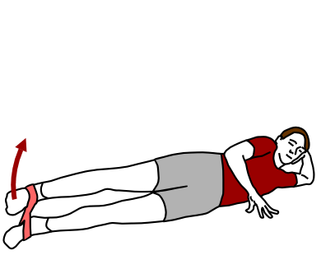
Adductor Longus Function = adducts the thigh
It is one of the adductor muscles of the hip; its main function is to adduct the thigh.

Slide 95
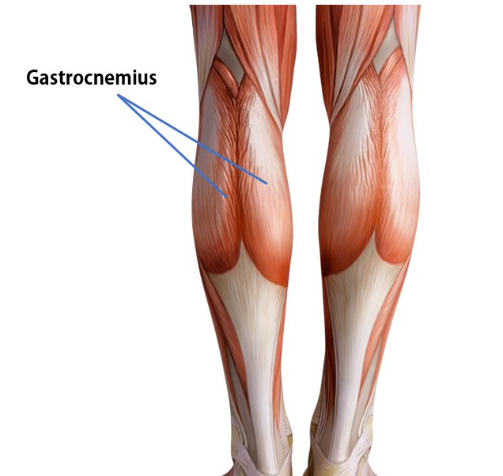
Gastrocnemius Muscle
The anatomical name for your calf muscle is the gastrocnemius.
The gastrocnemius muscle is named from the Latin words for "stomach" and "leg", because is kind of looks like a stomach (bulging region) of your leg.

Slide 96
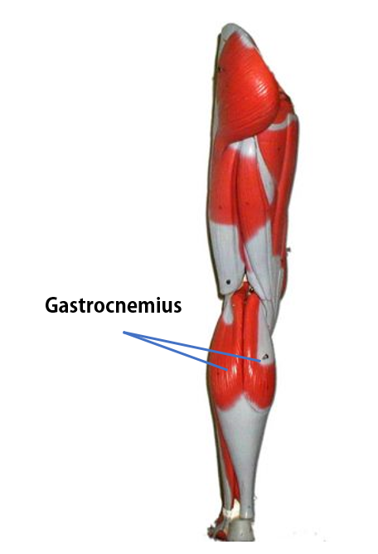
Gastrocnemius Muscle
It is a powerful muscle of the lower posterior leg that has two heads.
The gastrocnemius muscles originate just above the knee and insert at the heel.

Slide 97
The tibialis anterior is a muscle in humans that originates in the upper two-thirds of the lateral (outside) surface of the tibia and inserts into the medial cuneiform and first metatarsal bones of the foot. It acts to dorsiflex and invert the foot.

Slide 99
The soleus
The soleus is the plantar flexor muscle of the ankle.
It is capable of exerting powerful forces onto the ankle joint.
It is located on the back of the lower leg and originates at the posterior (rear) aspect of the fibular head and the medial border of the tibial shaft.

Slide 101
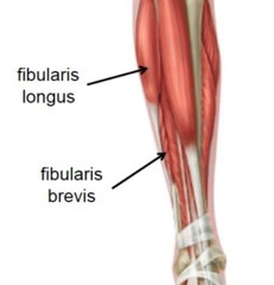
Fibularis (Peroneus) Longus
The peroneus longus (also known as fibularis longus) is a superficial muscle in the lateral compartment of the leg, and acts to evert and plantarflex the ankle.

