Slide 1
Pathogenicity
With ScientistCindy

Slide 2
What Causes Disease?
By Scientist Cindy

Slide 3
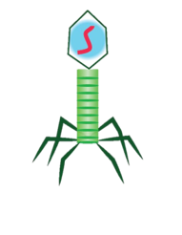
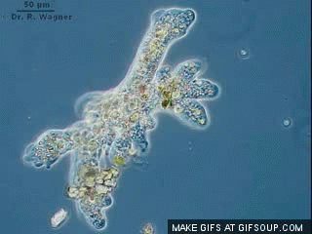
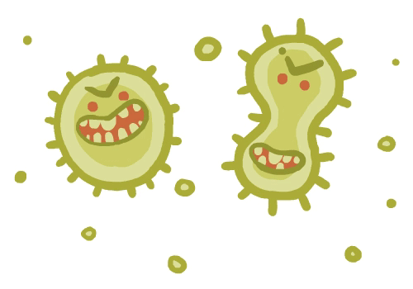
Microorganisms that Cause Disease
In microbiology, we focus our attention on the microorganisms that cause disease.
Microorganisms that cause disease can include
Bacteria
Viruses
Protozoa
Fungi

Slide 4
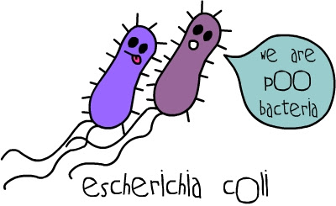
A Bad Rap?
Not all bacteria are bad!
Not all viruses are harmful!
Not all protozoa are parasites!
Not all fungi are infectious!

Slide 5
Symbiotic Bacteria

Slide 6
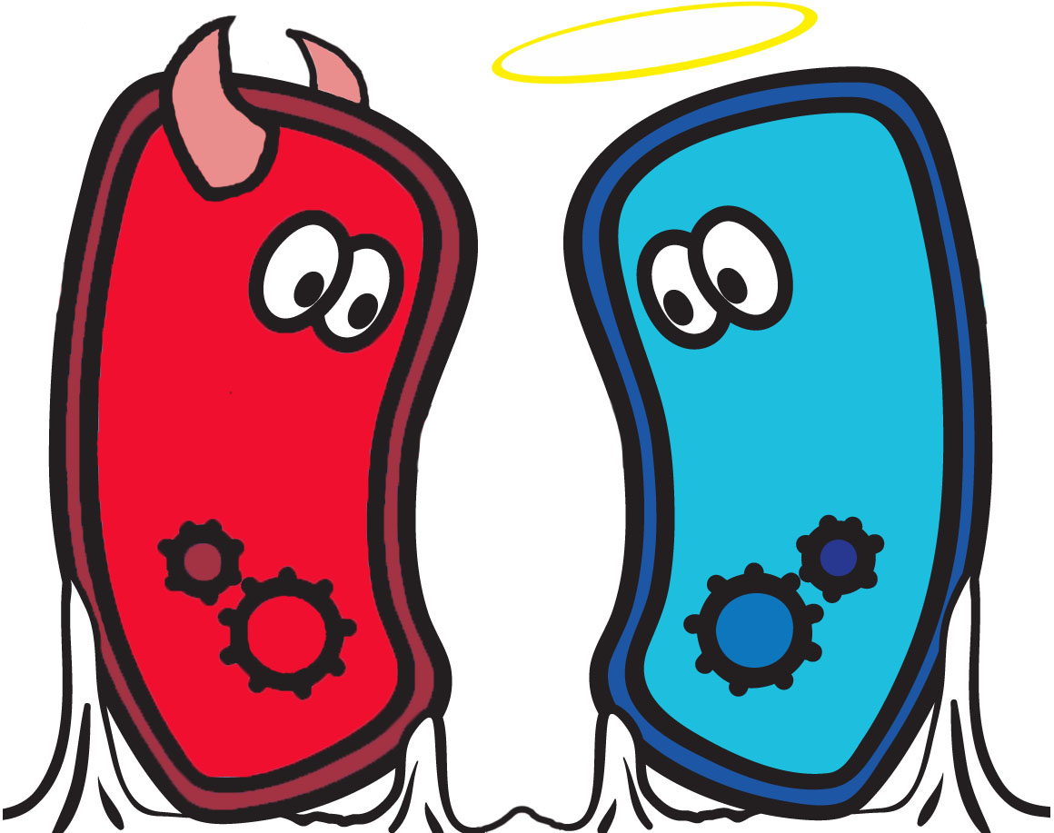
Harmful vs Harmless Bacteria
When attempting to understand and diagnose disease, the first order of business is to be able to identify…
The types of bacteria that are considered the “normal flora” of the human body”
…and…
The locations in which these “normal flora” of the body are typically found.

Slide 7
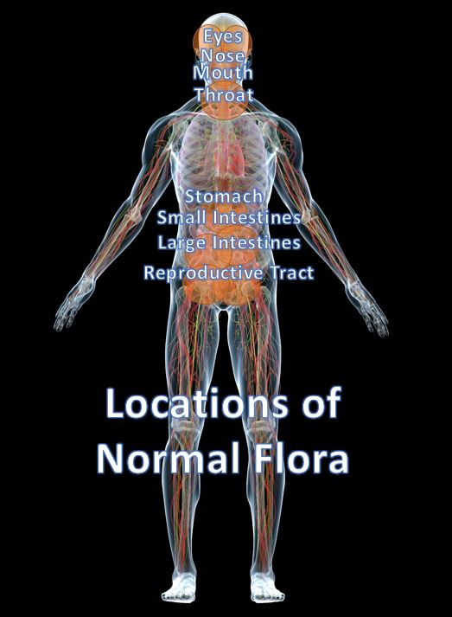
Normal Flora
Our normal flora consists of all of the many different kinds of microbes that inhabit our body!
Normal Flora Inhabit Our…
Skin
Nose
Eyes
Mouth
Throat
GI Tract (stomach, intestines, etc.)
Respiratory Tract
Urinary Tract
Reproductive Tract

Slide 8
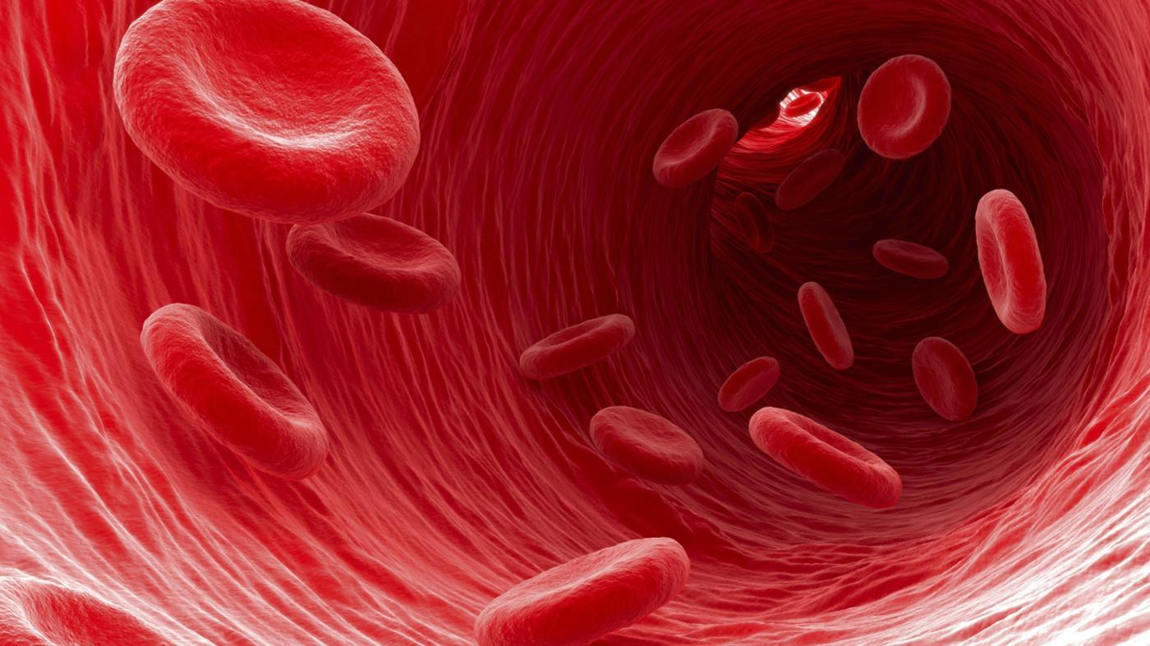
Other Areas of the Body Should NOT Contain Flora.
Anatomical sites in the body including
Organs
Blood
Urine
Lymphatic Fluid
Cerebral Spinal Fluid
This Photo by Unknown Author is licensed under CC BY-SA

Slide 9
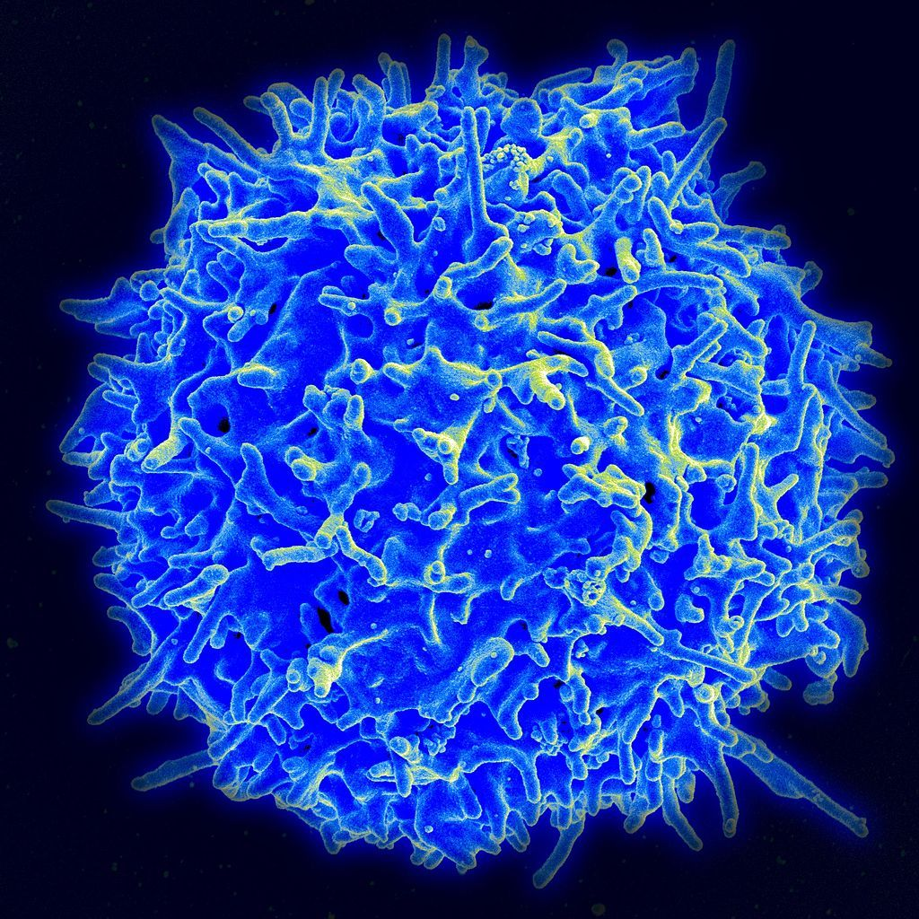
INFECTIONS
The colonization of our body by normal flora (in the “usual areas” they inhabit) is NOT considered an "infection".
However, if bacteria that are considered normal flora in one area of the body colonize an area of the body they should NOT be in, THIS IS AN INFECTION!
This Photo by Unknown Author is licensed under CC BY-NC-SA

Slide 10
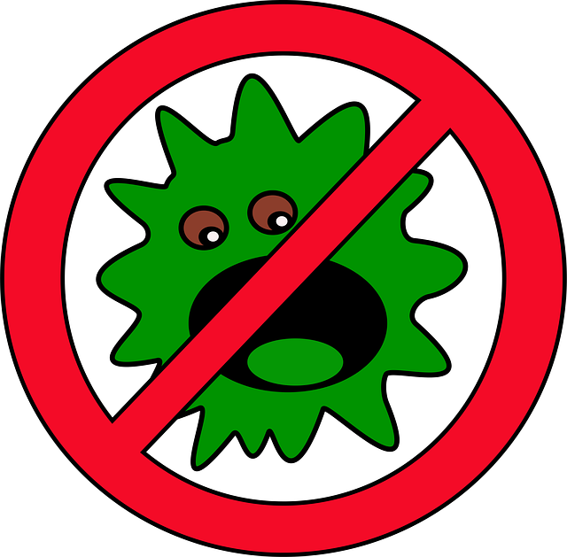
Infections
Infections also occur when exogenous bacteria (bacteria residing outside our bodies) infect us and cause disease.

Slide 11
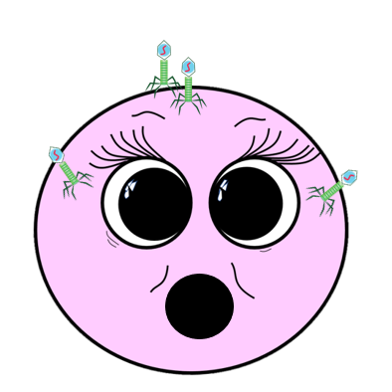
TERMINOLOGY
Disease = Illness
A pathogen = a microorganism that causes disease
Pathogenicity = ability to cause disease
Virulence = the degree to which the pathogen makes an organism ill

Slide 12
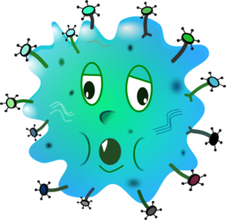
ETIOLOGY
ETIOLOGY - The etiology of a disease is defined as the cause of the disease.
ETIOLOGICAL AGENT - An etiological agent is the microorganism that is responsible for causing the disease.

Slide 13
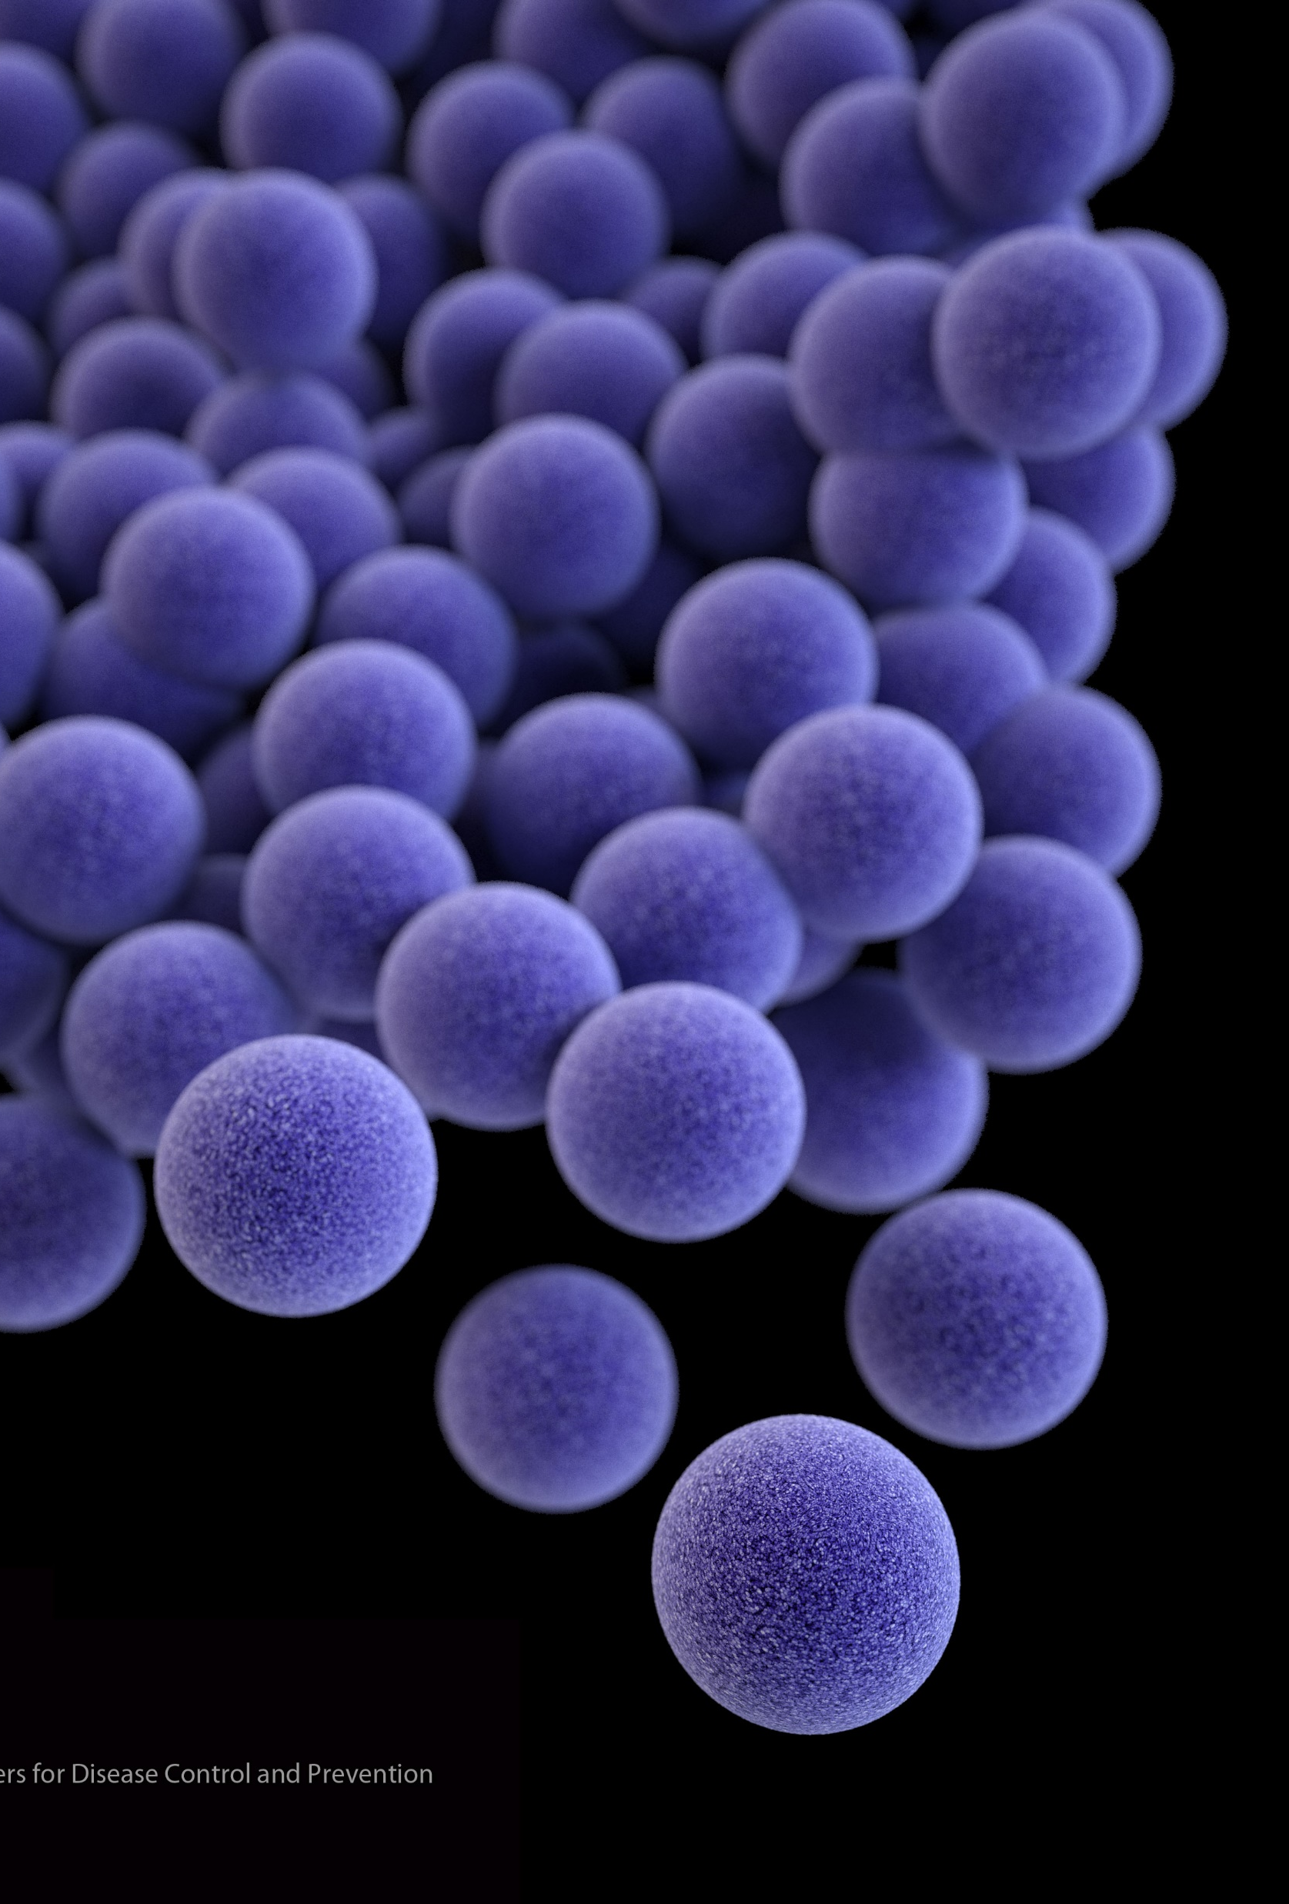
Staphylococcus aureus
All human skin is colonized by a bacteria called Staphylococcus aureus (sometimes abbreviated as Staph. aureus) about 40% of the time.
This bacteria lives on the surface of the skin and is considered part of the "normal flora" of humans.

Slide 14
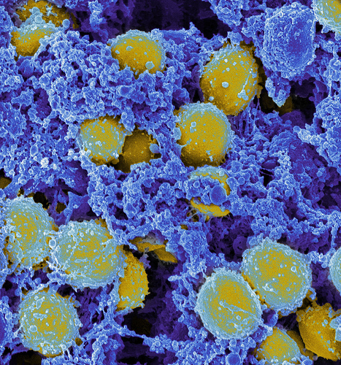
Staphylococcus aureus
Another way to say this is to say that human skin is "colonized" with Staphylococcus aureus.
It is not considered an infection and does not cause harm... as long as it stays on the surface of the skin. ​
This Photo by Unknown Author is licensed under CC BY

Slide 15
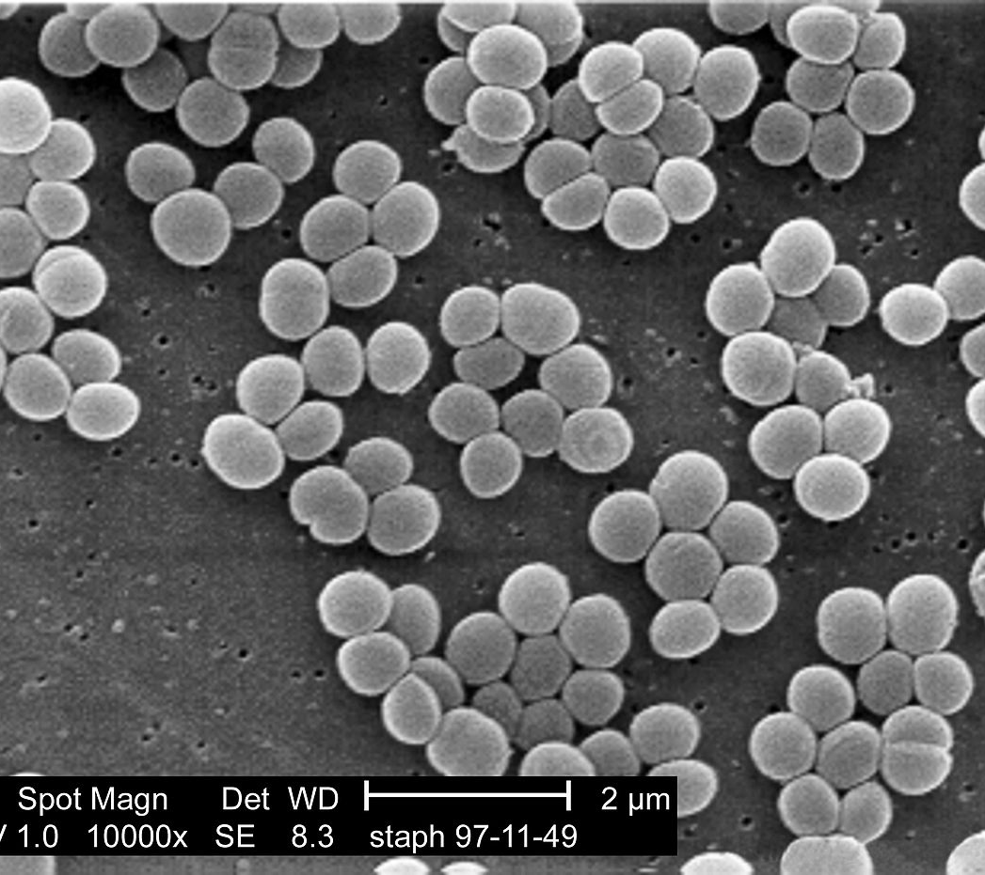
STAPH INFECTIONS
However, if a person were to cut themselves or get some kind of open wound on their skin, the Staphylococcus aureas has a chance of penetrating through the outer layers of skin and entering the blood stream.
At this point, the person is said to have a Staphylococcus aureus infection.
This Photo by Unknown Author is licensed under CC BY-SA

Slide 16
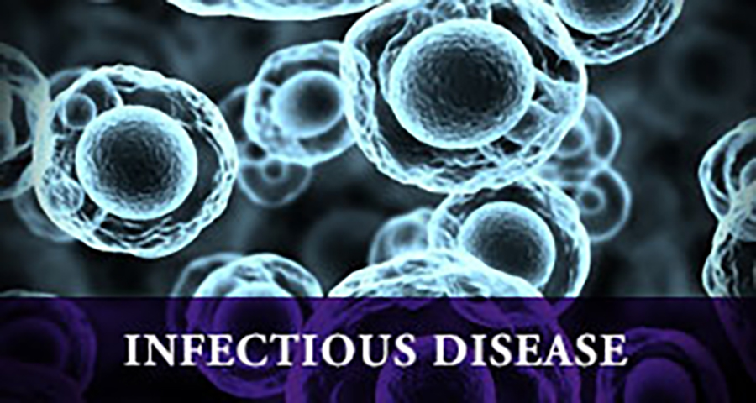
INFECTION AND INFECTIOUS DISEASE
An infection is defined as the presence of a microorganism in a part of the body where it is normally not found.
An infectious disease is defined as an infection that causes harm to the host.

Slide 17
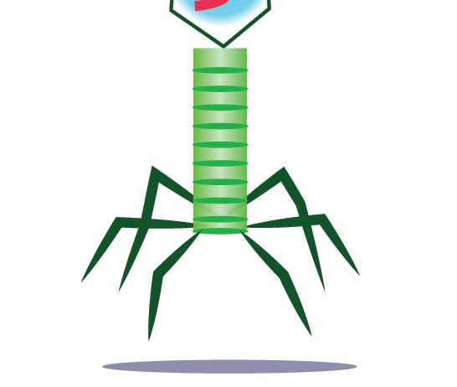
Chronic vs. Acute Diseases
Long-lasting (typically years) or constantly reoccurring.
Sudden onset
Rapid Progression
In Need of Urgent Care
Short Duration
Chronic
Acute
Disease-Causing Virus
Disease-Causing Virus

Slide 18
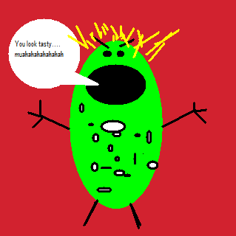
PATHOGENICITY
Pathogenicity varies with a microbe’s ability to invade or harm host tissues and with the condition of host defenses.
Highly pathogenic = spreads easily!

Slide 19
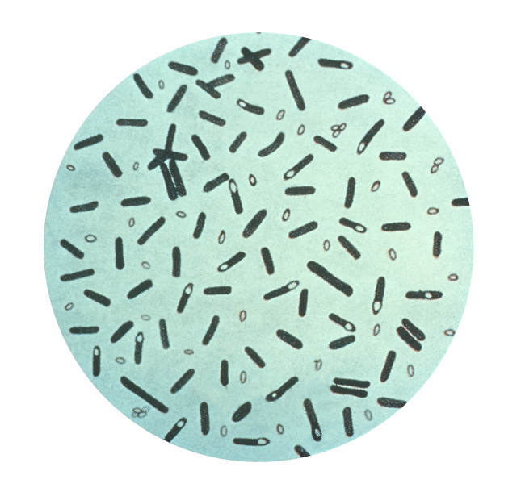
Virulence
Virulence refers to the precise mechanisms used by the pathogen invade and damage host tissues.
Virulence is the degree of pathogenicity.
HOW ill does it make its host?
Is it deadly?
This Photo by Unknown Author is licensed under CC BY-NC-SA

Slide 20
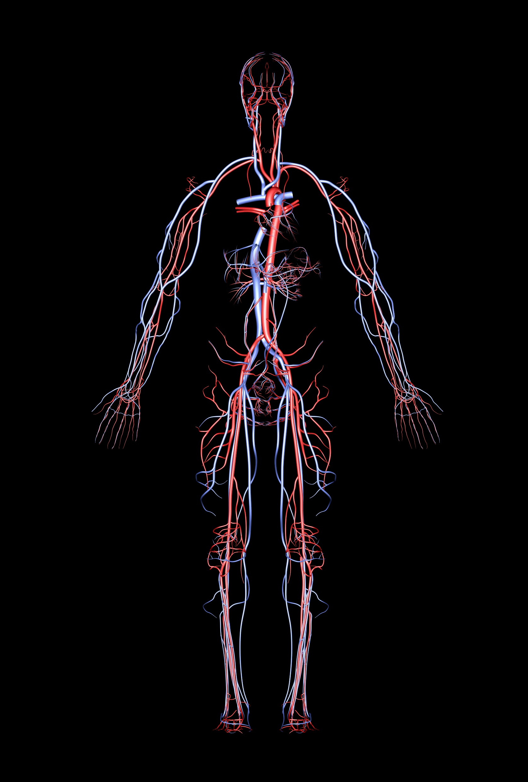
Types of Infection Based on Location
Systemic infection - microbe is spread through the tissues by circulation (the circulatory system).
Localized infection - microbe remains in isolated site (such as the site of a wound).
Primary infection - initial infection in a series.
Secondary infection - infection that presents itself after the primary infection.
For example, the primary infection may weaken the immune system, allowing a secondary infection to arise as the result.

Slide 21
Carriers
CARRIER - An individual capable of transmitting a pathogen without displaying symptoms is referred to as a carrier.
PASSIVE CARRIER - A passive carrier is contaminated with the pathogen and can mechanically transmit it to another host; however, a passive carrier is not infected.
ACTIVE CARRIER - An active carrier is an infected individual who can transmit the disease to others. An active carrier may or may not exhibit signs or symptoms of infection.

Slide 22
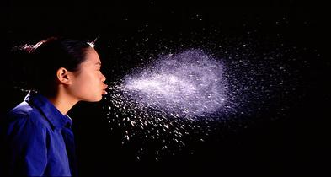
Infectious Vs Non-infectious Diseases
Infectious diseases are diseases that CAN BE SPREAD, from one person to another (direct or indirect contact).
MODE OF TRANSMISSION

Slide 23
What is considered “direct contact”?
There are two types of contact transmission: direct and indirect.
Direct contact transmission occurs when there is physical contact between an infected person and a susceptible person.
Indirect contact transmission occurs when there is no direct human-to-human contact.

Slide 24
What is considered “direct contact”?
Direct contact can be PHYSICAL (person to person) …

Slide 25
What is considered “direct contact”?
Direct contact can be SEXUAL (contact with body fluids)…

Slide 26
What is considered “direct contact”?
Direct contact can be PHYSICAL contact directly with the pathogen…

Slide 27
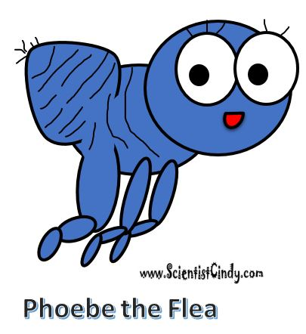
Types of Indirect Transmission
Indirect contact:
Vectors – Vectors are usually blood-sucking insects that carry pathogens from one human to the next or one animal to a human.
Fomites – Fomites are objects or materials that are likely to carry infection, such as clothes, towels, utensils, and furniture.
Vehicles – Vehicles (soil, water, and food)

Slide 28
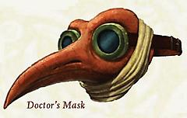
COMMUNICABLE INFECTIOUS DISEASE - occurs when pathogen is transmitted from host to host directly or indirectly
CONTAGIOUS DISEASES - readily transmissible through direct contact only.

Slide 29
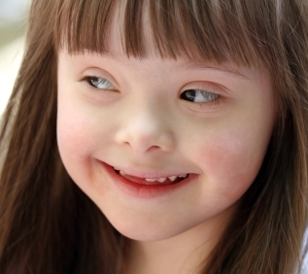
Non-infectious Diseases
A noninfectious disease is not contagious
These diseases are not caused by pathogens.
Instead, they are likely to have causes such as
Cancer
Diabetes
Genetic Diseases
Autoimmune Disease
This lovely young lady has a chromosomal abnormality known as trisomy 21 or Downs Syndrome. This is a genetic disease and is not contagious.

Slide 30
ZOONOTIC DISEASES
Zoonotic diseases are infectious diseases of animals that can cause disease when transmitted to humans.
Rabies
Anthrax
Lime Disease
Trichinosis
This Photo by Unknown Author is licensed under CC BY-NC-SA

Slide 31
INVASION

Slide 32
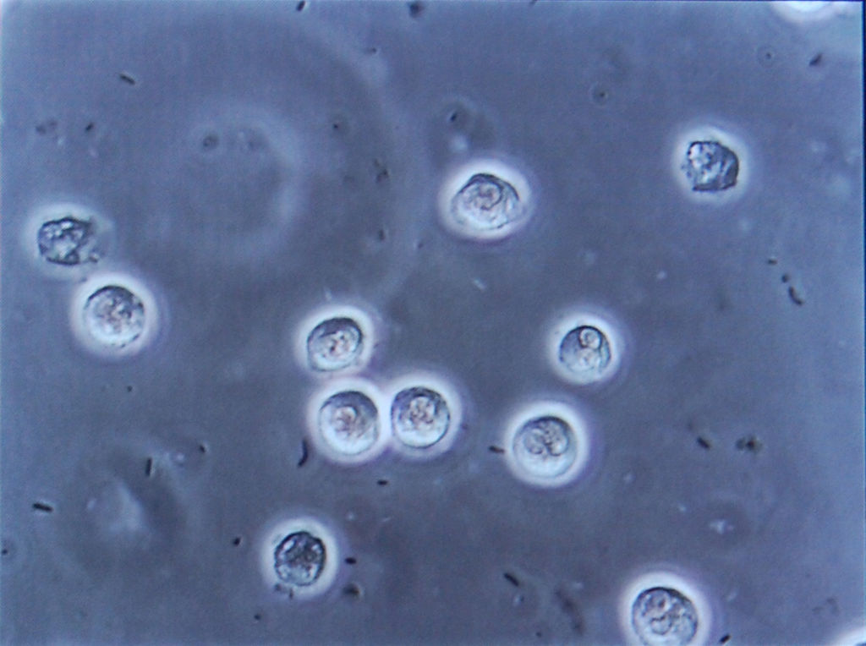
Mechanisms of Pathogenicity
To cause disease a pathogen must:
1. Gain access to the host
2. Adhere to host tissues
3. Penetrate or evade host defenses
4. Damage the host
Damage may be done directly
Damage may be done by the accumulation of microbial waste products

Slide 33
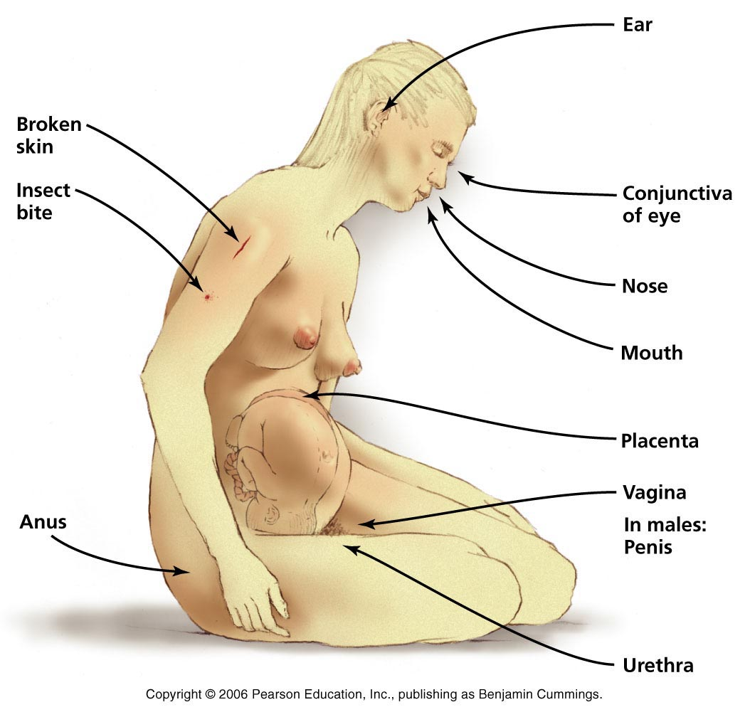
Entry Into Host: PORTALS OF ENTRY
1. Gain access to the host
The mucous membranes are the most common way pathogens enter the body.
respiratory tract (most common)
gastrointestinal tract
urinary/genital tracts
conjunctiva

Slide 34
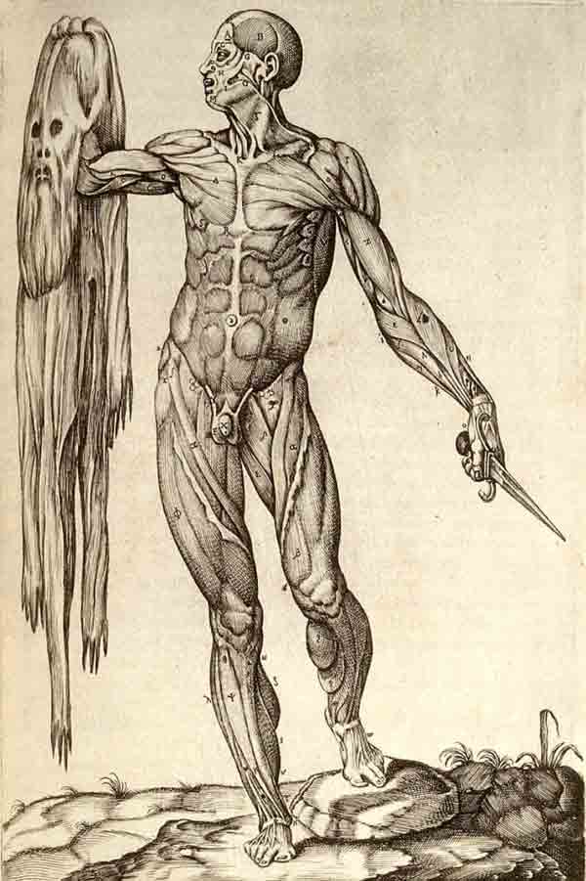
Entry Into Host: PORTALS OF ENTRY
1. Gain access to the host
Skin (keratinized cutaneous membrane)
Open wounds
Hair follicles
Sweat glands
*Very few microbes are able to colonize the surface of the skin.
*Skin is usually an impermeable barrier for microorganisms.

Slide 35
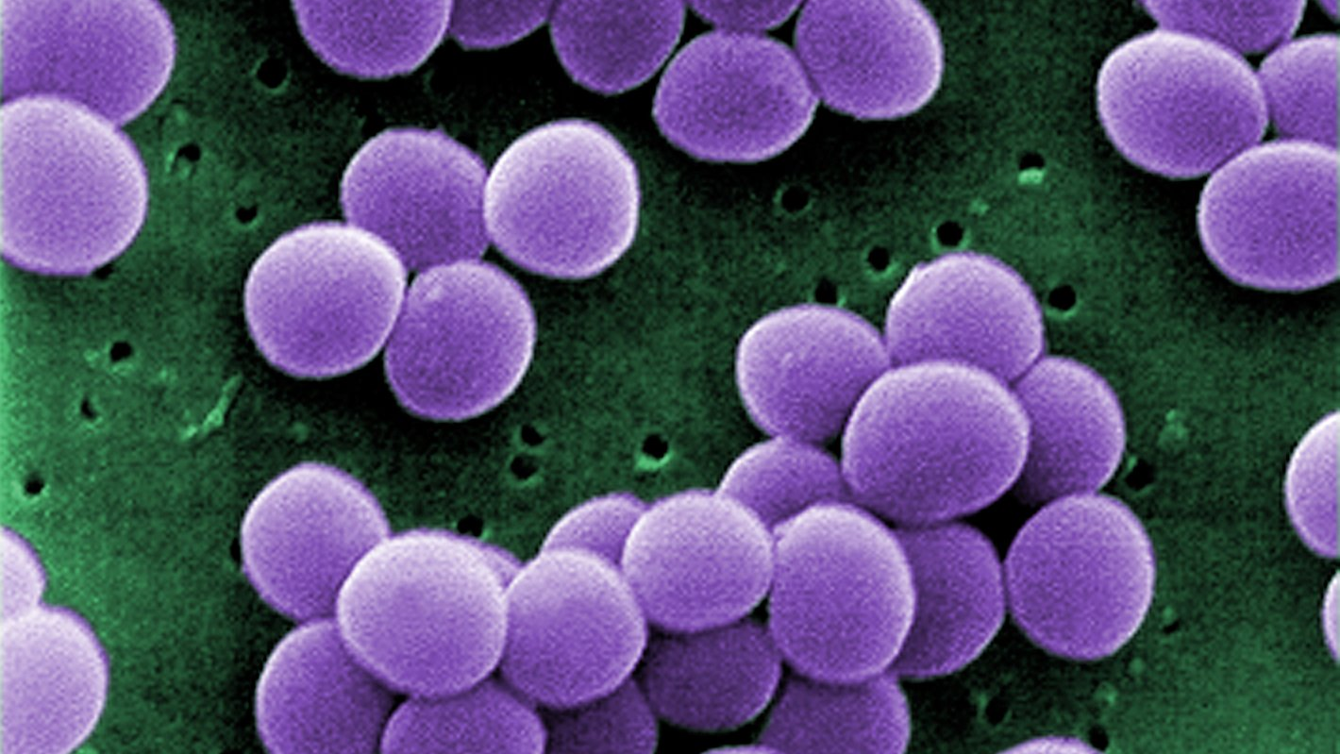
Entry Into Host: PORTALS OF ENTRY
1. Gain access to the host
Parenteral route –penetration of the skin:
Punctures
Injections
Bites
Cuts
Surgery
Etc.
When a pathogen enters a host through a parenteral route, it is inserted directly into deeper tissues.
Parenteral transmission is defined as that which occurs outside of the alimentary tract (gastrointestinal tract).

Slide 36
Mechanisms of Pathogenicity
To cause disease a pathogen must:
1. Gain access to the host
2. Adhere to host tissues
3. Penetrate or evade host defenses
4. Damage the host
Damage may be done directly
Damage may be done by the accumulation of microbial waste products

Slide 37
Adherence
Adherence is the attachment of the microbe to the host at the portal of entry.
Mechanisms of Adhesion
Pathogens can have surface adhesion molecules that are ligands which bind in a lock-and-key manner with receptors on the surface of a host cell.

Slide 38
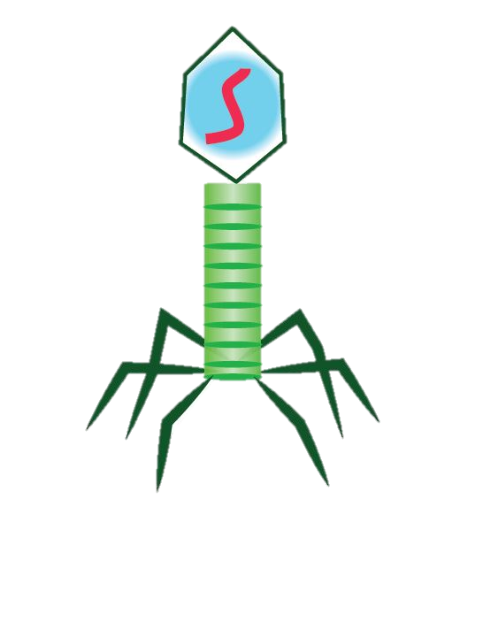
This binding allows the pathogenic microbe entrance to the host cell.
Host Cell

Slide 40
Mechanisms of Pathogenicity
To cause disease a pathogen must:
1. Gain access to the host
2. Adhere to host tissues
3. Penetrate or evade host defenses
4. Damage the host
Damage may be done directly
Damage may be done by the accumulation of microbial waste products

Slide 41
Mechanisms of Pathogenicity
To cause disease a pathogen must:
1. Gain access to the host
2. Adhere to host tissues
3. Penetrate or evade host defenses
4. Damage the host
Damage may be done directly
Damage may be done by the accumulation of microbial waste products
Three examples
of mechanisms that pathogens use to evade or penetrate host defenses are:
Capsules
Antigen Variation
M Proteins

Slide 42
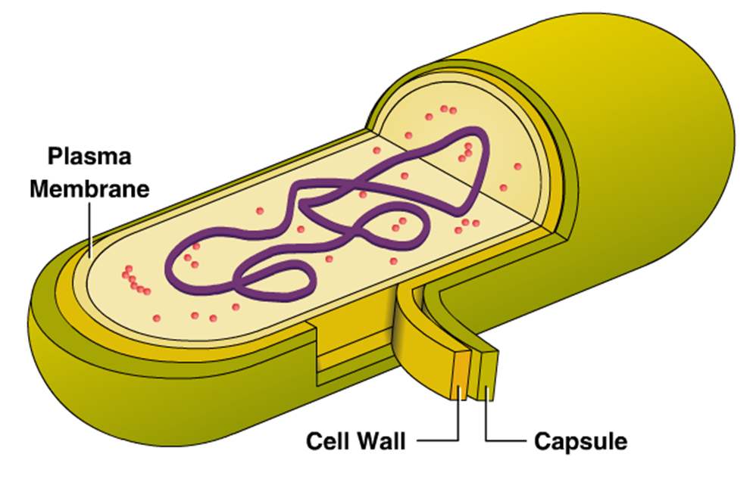
Evasion of Host Defenses - CAPSULES
The cell capsule is a very large structure of some prokaryotic cells, such as bacterial cells.
It is a polysaccharide layer that lies outside the cell envelope of bacteria, and is thus deemed part of the outer envelope of a bacterial cell.
By This vector image is completely made by Ali Zifan - Own work; used information from Biology 10e Textbook (chapter 4, Pg: 63) by: Peter Raven, Kenneth Mason, Jonathan Losos, Susan Singer · McGraw-Hill Education., CC BY-SA 4.0, https://commons.wikimedia.org/w/index.php?curid=44194140

Slide 43
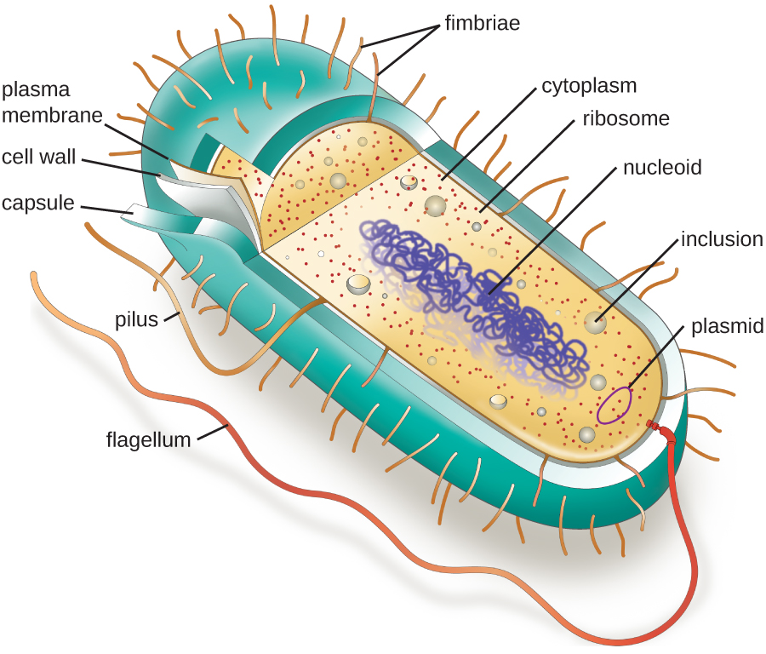
Capsules
Evades the Host Immune Defenses by…
impairs phagocytosis: prevents engulfment and destruction by leukocytes

Slide 44
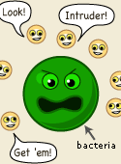
Antigenic Variation
Evading the Host Immune Defenses
Antigenic Variation - pathogens alter their surface antigens to escape the host immune defenses.

Slide 45
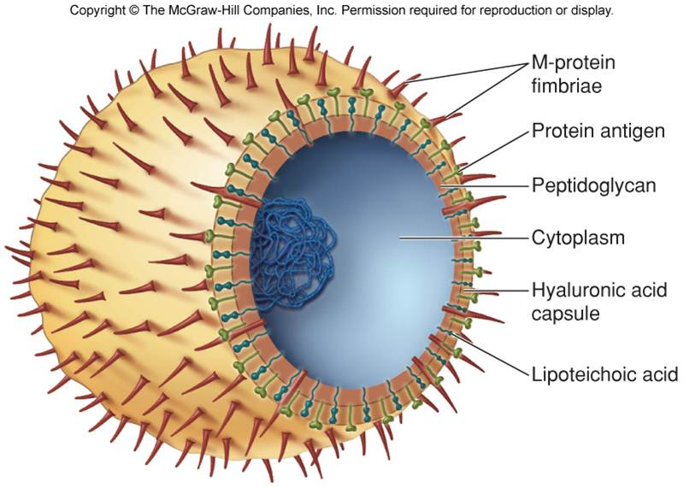
Cell Wall Components such as the M Protein
Evading the Host Immune Defenses
M protein of Streptococcus pyogenes:
-heat and acid resistant
-mediates attachment of bacterium to epithelial cells
-resists phagocytosis by leukocytes

Slide 46
Mechanisms of Pathogenicity
To cause disease a pathogen must:
1. Gain access to the host
2. Adhere to host tissues
3. Penetrate or evade host defenses
4. Damage the host
Damage may be done directly
Damage may be done by the accumulation of microbial waste products
Then THE DAMAGE STARTS~!

Slide 47
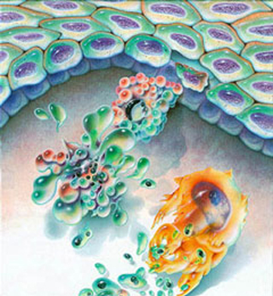
Direct Damage to Host Cells
Damage to the host
When a pathogen grows inside of host cells, the host cells undergo lysis.
When the pathogens are penetrating through the host’s tissue, the cells of that tissue are damaged and die.

Slide 48
Once the microbe has invaded the tissue, the result is damage to the tissues through a variety of different mechanisms. Some of these way are due to chemicals secreted by the pathogens called virulence factors.
Damage to the host

Slide 50
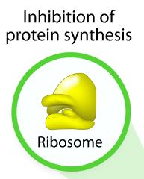
Antibiotics like tetracycline and erythromycin function by inhibiting protein synthesis.

Slide 51
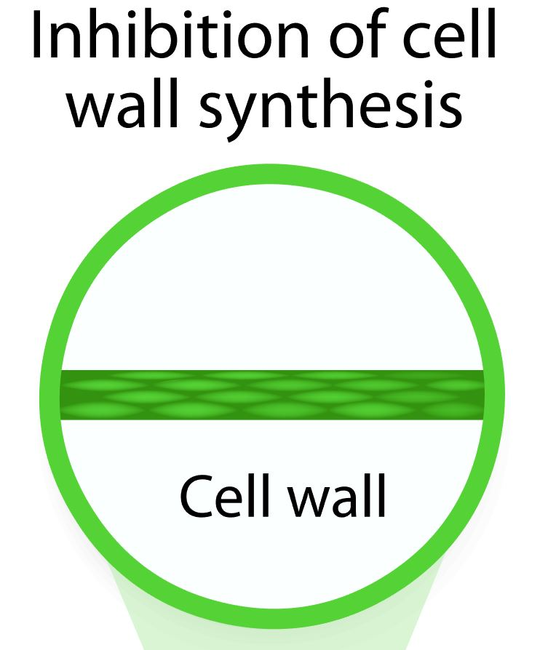
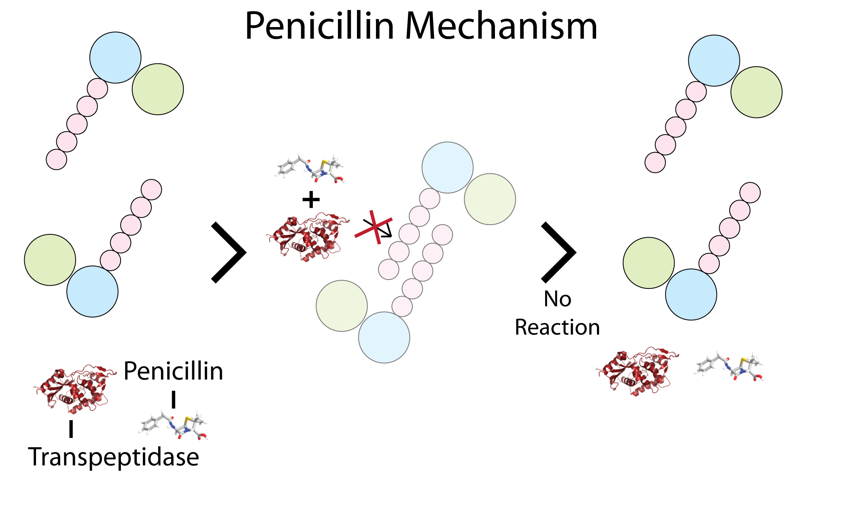
Antibiotics Like Penicillin, Block the Formation of the Cell Wall

Slide 52
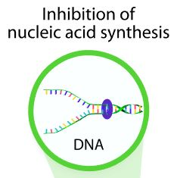
Antibiotics like Ciprofloxacin (Cipro), inhibit nucleic acid synthesis.

Slide 53
Antibiotics like Bactrim (Cipro), inhibit nucleic acid synthesis

Slide 54
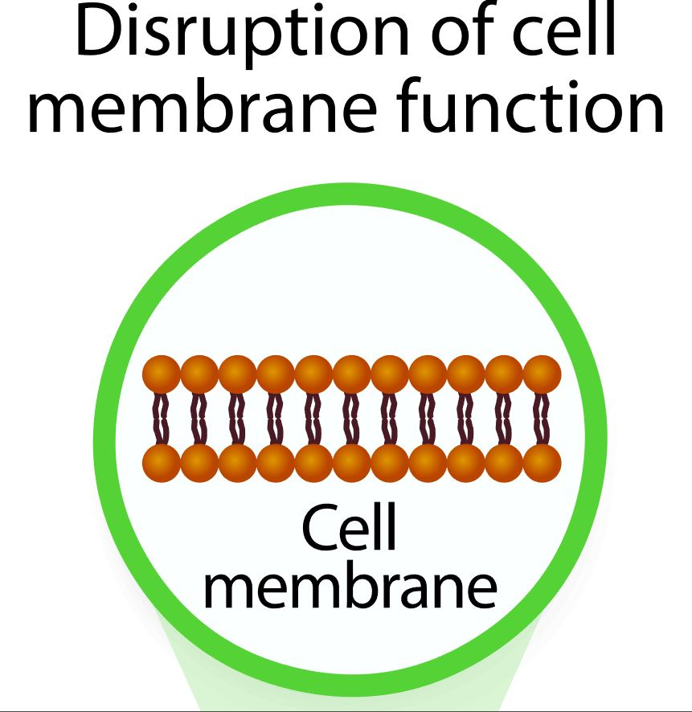
Antibiotics like polymyxins and antifungals, disrupt the cell membrane leading to lysis.

Slide 56
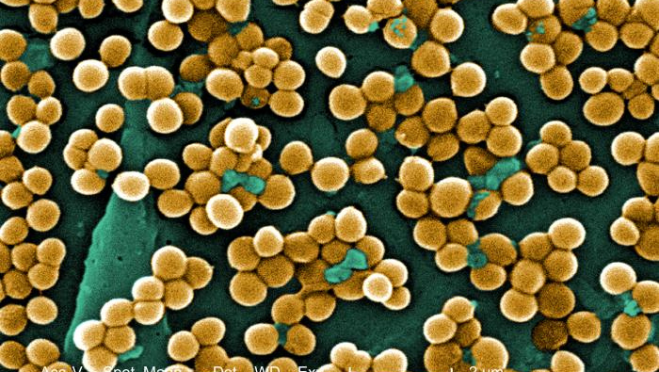
Virulence Factors
Virulence Factors – are chemicals secreted by the pathogen that function to
Evade the host’s immune system
Cause harm to host tissues
Virulence factors fall into 2 main categories
Exoenzymes
Toxins

Slide 57
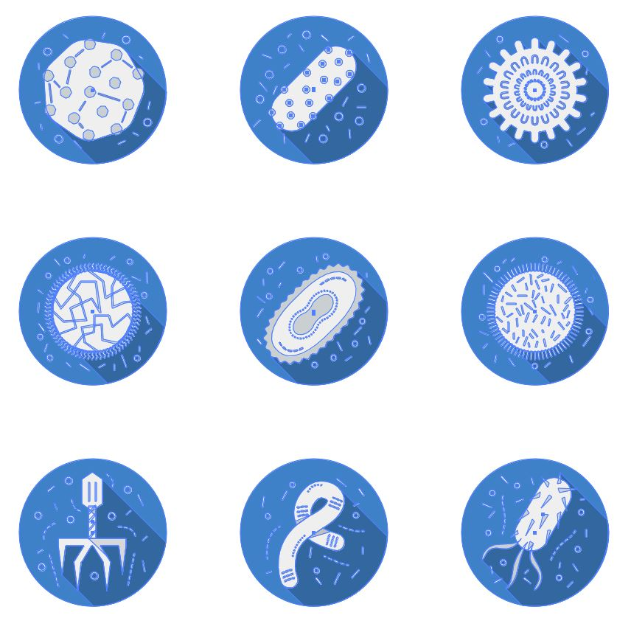
Virulence Factors - Exoenzymes
An exoenzyme, also known as an extracellular enzyme, is an enzyme that is secreted by a cell that functions outside of that cell.
Exoenzymes of Pathogens Function to
Digest Epithelial Tissues
Disrupt Tissues
Allow Pathogen Invasion

Slide 58
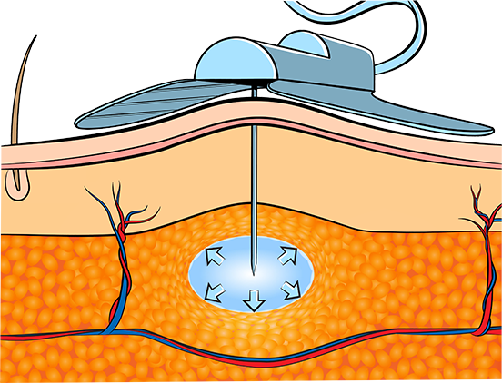
Enzymes (exoenzymes) a virulence factor
4. Damage the host
Pathogen
Example - Hyaluronidase
Hyaluronidase is an exoenzyme that hydrolyzes breaks down connective and epithelial tissues to allow the pathogen to invade into deeper tissues.
Hyaluronidase

Slide 59
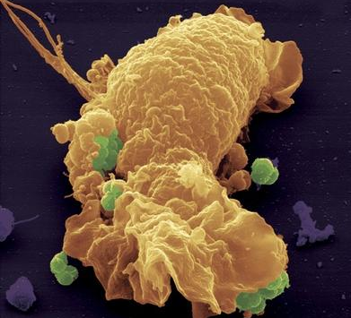
Exotoxins
Membrane disrupting toxins cause lysis of the host cell by disrupting the plasma membrane
leukocidins: pokes hole in membranes of phagocytic leukocytes
hemolysins: pokes hole in membranes of red blood cells (RBCs)

Slide 60
Exotoxins
Superantigens
Superantigens are proteins released from pathogenic bacteria that cause a NONSPECIFIC immune response in the host.
This causes release of cytokines which can cause fever, nausea, vomiting, diarrhea, shock and death (septic shock)
e.g. toxic shock syndrome (Staphylococcus) e.g. enterotoxins: Staphylococcal food poisoning

