Slide 1
Hierarchical Levels of Anatomy
Prof. Sanchez

Slide 2
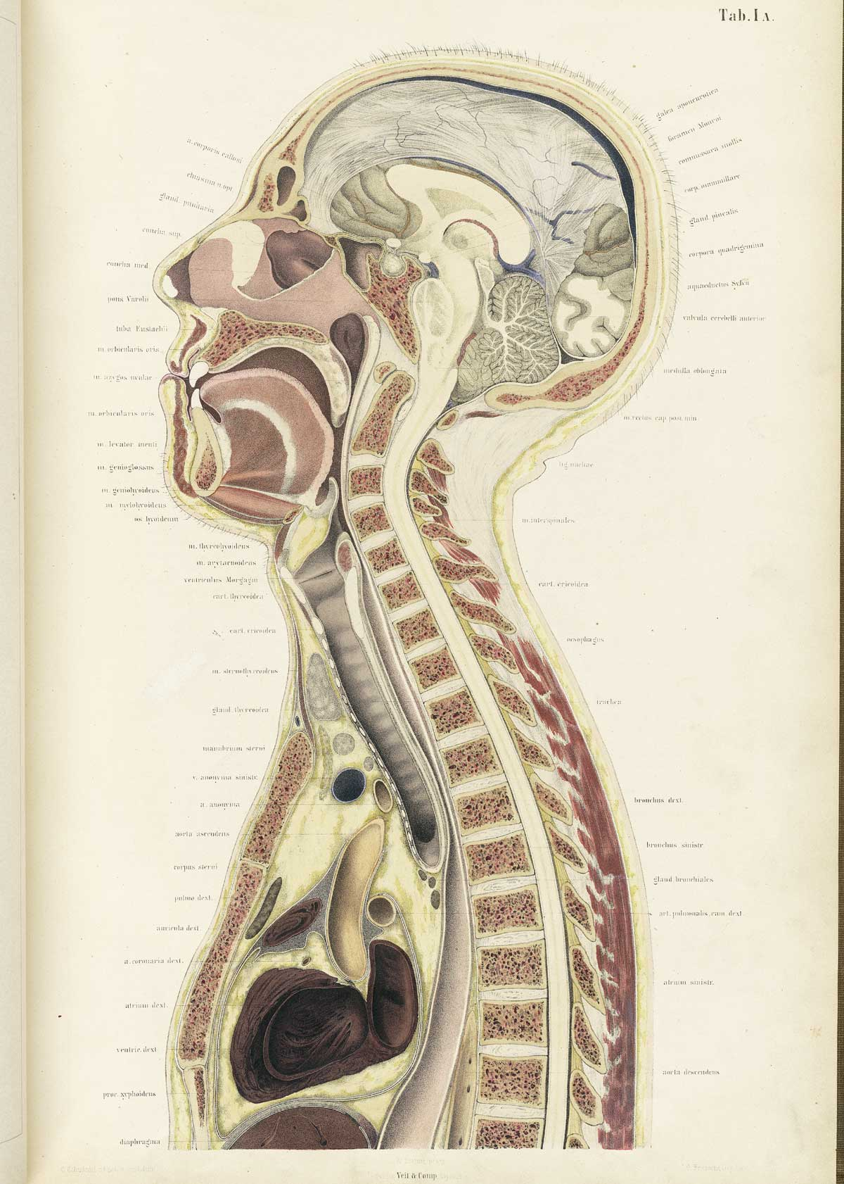
Hierarchical Levels of Anatomy
There are six hierarchical levels of anatomy and physiology. (1) Chemical level (2) Cellular level (3) Tissue level (4) Organ level (5) Organ system level (6) Organism level

Slide 3
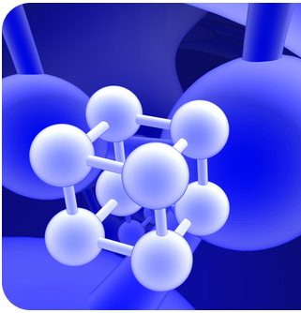
The Chemical Level (Atomic and Molecular Level)
The story of biology begins in chemistry.
We must have a basic understanding of chemistry to understand biology. This is because, everything that is made up of matter (from rocks to human beings) is made up of atoms.
The Chemical Level Includes the Atomic Level and Molecular Level of our Bodies
This Photo by Unknown Author is licensed under CC BY-SA-NC

Slide 4
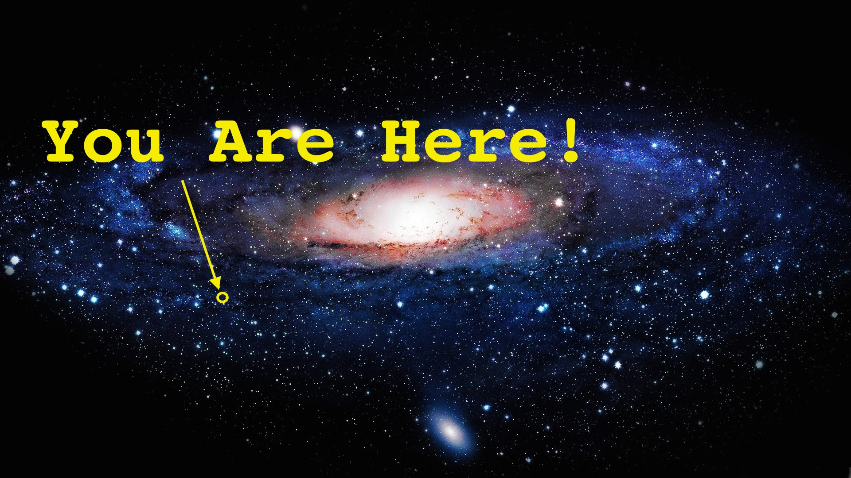
The story of YOU
The story of YOU is more beautiful and complex than you can ever image! ​ Many scientists believe that our universe started with a "BIG BANG" or a "BIG BANG-LIKE" event.
The universe we live in was created by some type of BANG that contained all of the subatomic particles needed to make matter.
In the beginning, the early universe was too hot for atoms to form, but as the universe cooled the first atoms were able to form.
This Photo by Unknown Author is licensed under CC BY-NC-ND

Slide 5
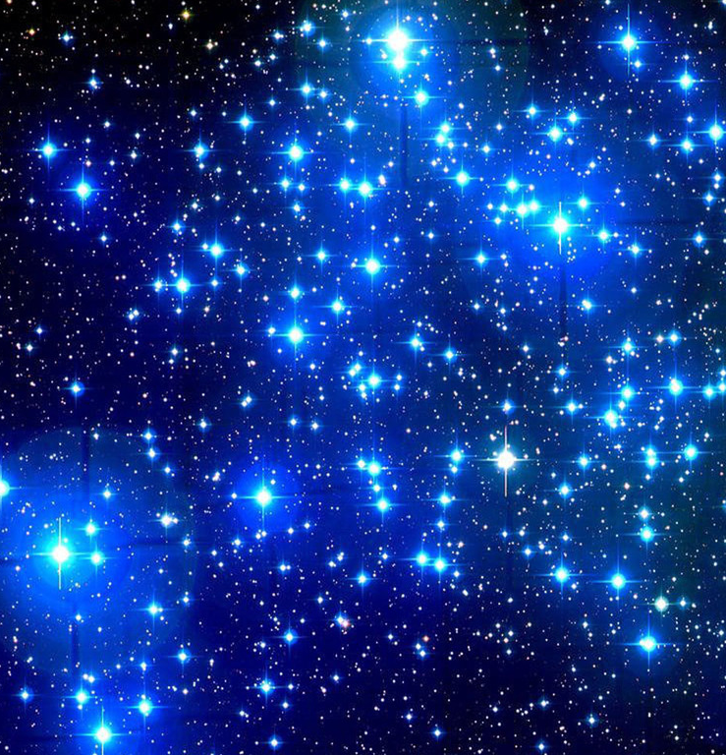
We are all made of stars!
The first atoms to form were hydrogen and helium.
Hydrogen is made up of only 1 electron and 1 proton.
Helium is made up of 2 electrons and 2 protons.
Stars are made up almost entirely of hydrogen and helium.
All of the heavier elements are made when a star dies and explodes as a super nova.
This Photo by Unknown Author is licensed under CC BY-NC-ND

Slide 6
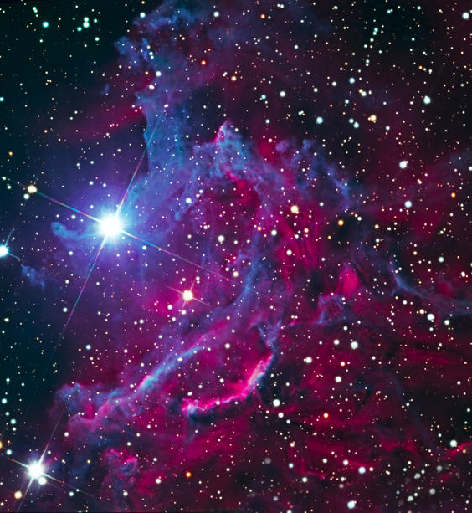
We are all made of stars!
The matter that you are made of has been around since the beginning of the universe 13 billion years ago.
All of the heavier elements required for life like you and I to exist, were form in the cauldron of an exploding star.
This Photo by Unknown Author is licensed under CC BY-NC

Slide 7
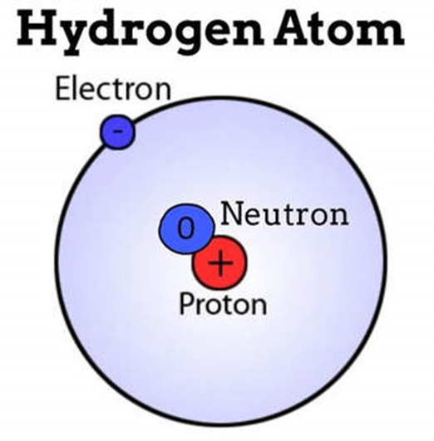
ATOMS - What's the MATTER?
All matter in the universe as we know it, is made up of atoms.
It is for this reason that we define the atom as the fundamental unit of matter.

Slide 8
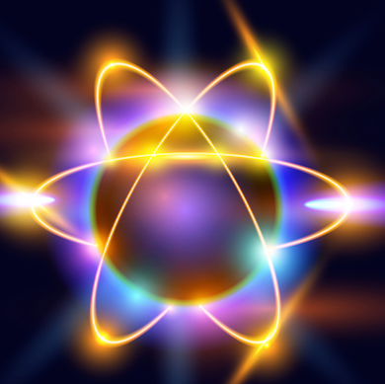
The Atom
Atoms are made up of a combination of subatomic particles, which are protons, electrons and neutrons.
This Photo by Unknown Author is licensed under CC BY-NC

Slide 9
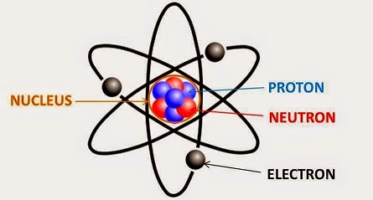
The Atom
PROTONS are positively charged and are found at the nucleus (center) of the atom. ELECTRONS are negatively charged and are found on the outer portions of the atom. NEUTRONS have no charge and are found in the nucleus of the atom.

Slide 10
96% of all living matter is composed of only 4 atoms (elements)!

Slide 11
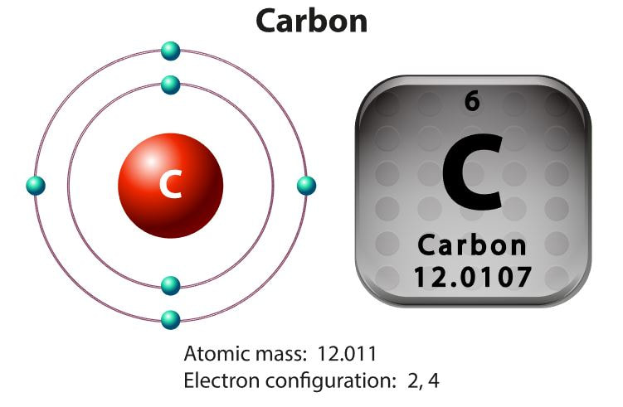
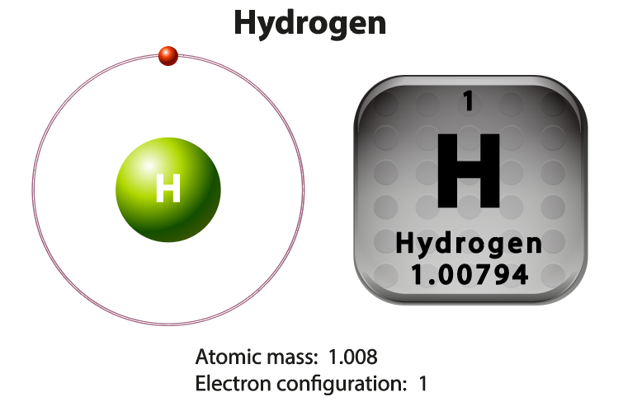
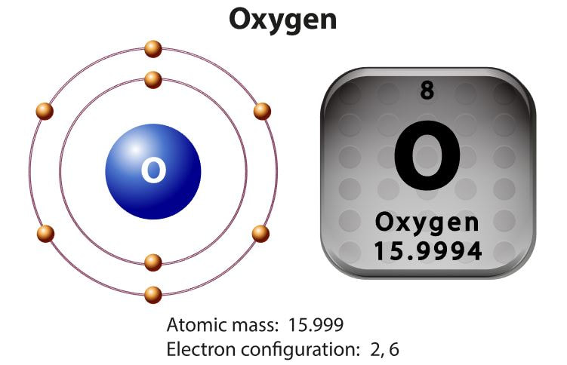
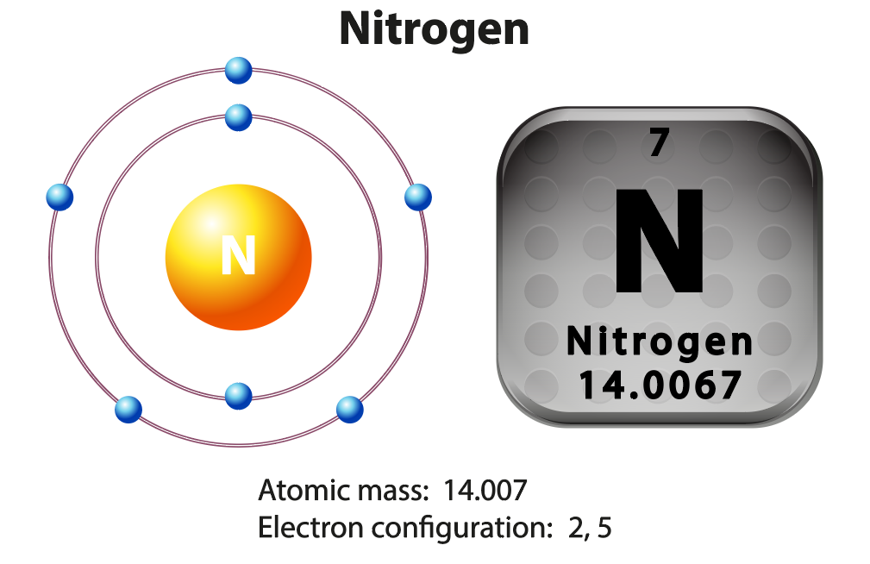
Carbon Hydrogen | Oxygen Nitrogen

Slide 12
Hydrogen
The simplest and most abundant atom is the hydrogen atom. The hydrogen atom contains only one electron and one proton. An atom, by definition, is neutral (uncharged). That means in an atom, the number of protons will equal the number of electrons.

Slide 13
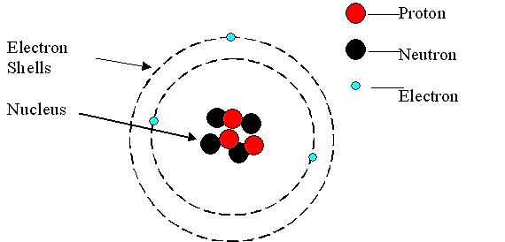
An atom is made up of subatomic particles.
The nucleus (or center) of the atom is made up of one or more positively charged subatomic particles called protons and uncharged subatomic particles called neutrons.

Slide 14
Atoms
Almost all of the mass of the atom is located in the nucleus.
Electrons "orbit" the nucleus of the atom.
The electron(s) that are located on the outermost portion of the atom can participate in chemical reactions and can create bonds with other atoms.

Slide 15
Atoms are Essentially EMPTY SPACE!

Slide 16
Molecules
WHAT IS A MOLECULE?

Slide 17
Molecules
When an atom forms a bond with one or more other atoms, it is called a molecule.
A molecule is made up of one or more atoms.

Slide 18
Diversity of Molecules
Sometimes these molecules are small and simple.
We can take oxygen as an example.
Oxygen is a gas that is made up of simply 2 oxygen molecules that are bound together (02).

Slide 19
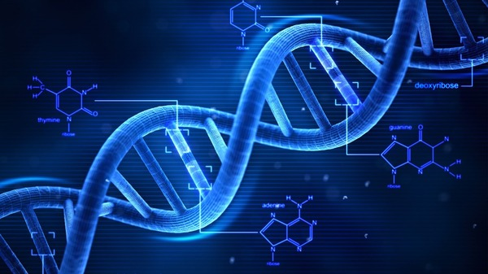
Diversity of Molecules
Some molecules consist of thousands of atoms (macromolecules) like DNA and proteins.

Slide 20
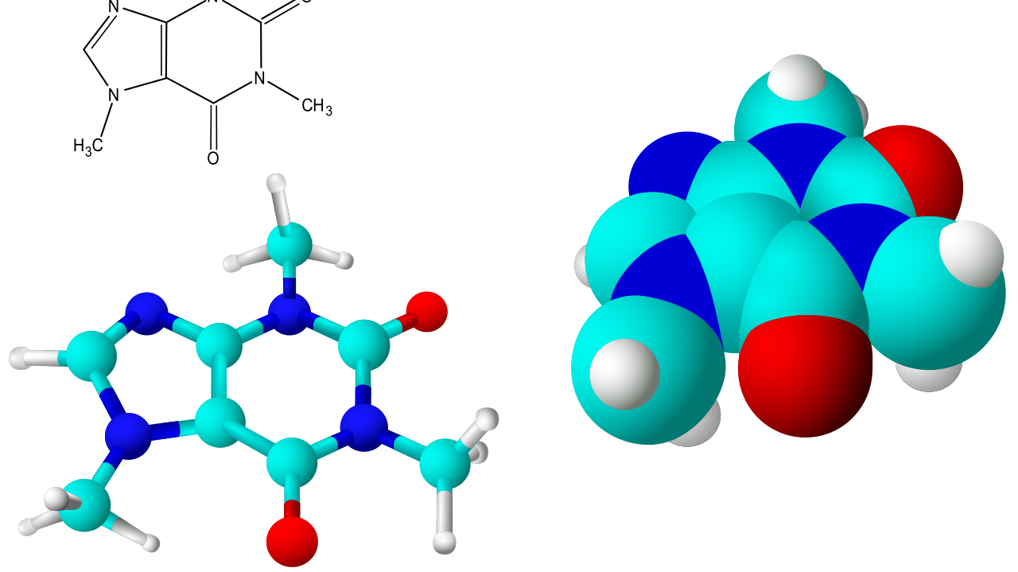
4 most important molecules for LIFE!
Proteins, lipids, carbohydrates and nucleic acids are the 4 most important molecules for the cell, and for life in general.
This Photo by Unknown Author is licensed under CC BY-SA

Slide 21
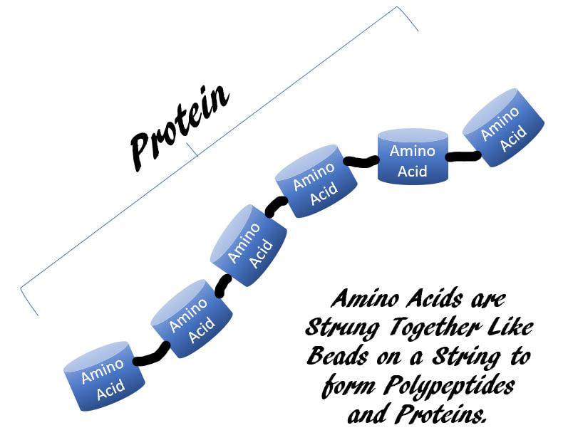
Proteins
Amino Acids Bond Together Forming Proteins

Slide 22
Nucleic Acids
Nucleic Acids includes DNA and RNA.
Nucleic Acids are polymers that are formed from a long string composed of a single monomers, called nucleotides. Nucleic acids includes our DNA and RNA. DNA stands for Deoxyribonucleic acid and RNA stands for Ribonucleic Acid.

Slide 23
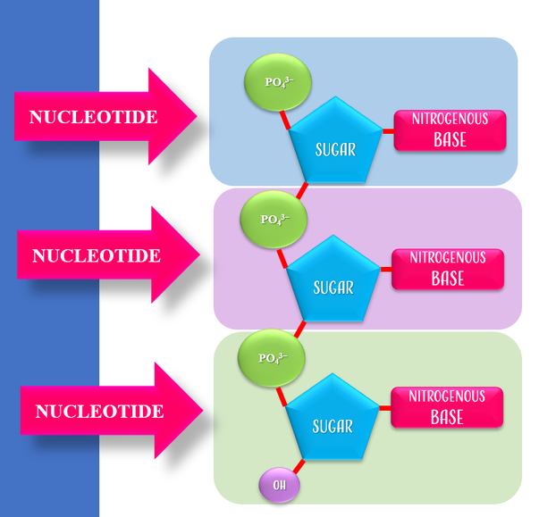
Function of Nucleic Acids
DNA and RNA function in coding and transferring genetic information.
DNA functions as the master "instruction manual" that has all of the information on how that cell should develop and hold the instructions for making proteins which act out the various functions of the cell.

Slide 24
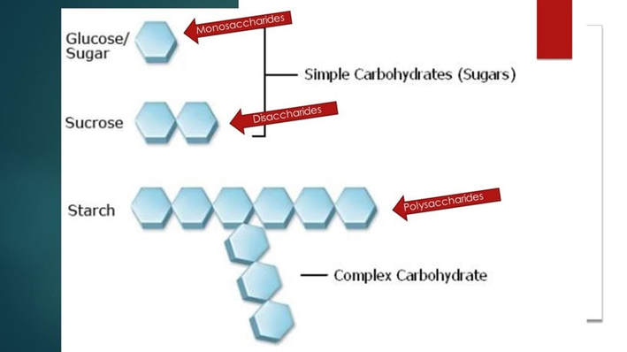
Single Sugar Units (monosaccharides) Bond Together Forming Large Carbohydrate Molecules (polysaccharides)

Slide 25
Carbohydrates
Carbohydrates get converted into energy in the body through our metabolism.
Our metabolism breaks down the glucose molecule and creates ATP.
ATP is the principle energy source for the cell.
ATP is often called "the energy currency of the cell".
This Photo by Unknown Author is licensed under CC BY-SA

Slide 26
Carbohydrates
Monosaccharides are simple sugars composed of one sugar molecule. Glucose is an example of a monosaccharide.

Slide 27
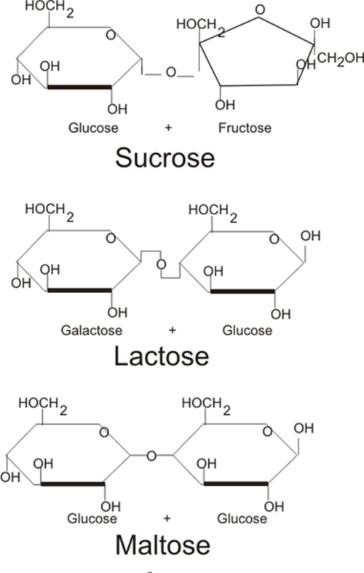
Carbohydrates
Disaccharides are composed of 2 sugar molecules bound to each other. Sucrose (table sugar) is an example of a disaccharide.
This Photo by Unknown Author is licensed under CC BY-SA

Slide 28
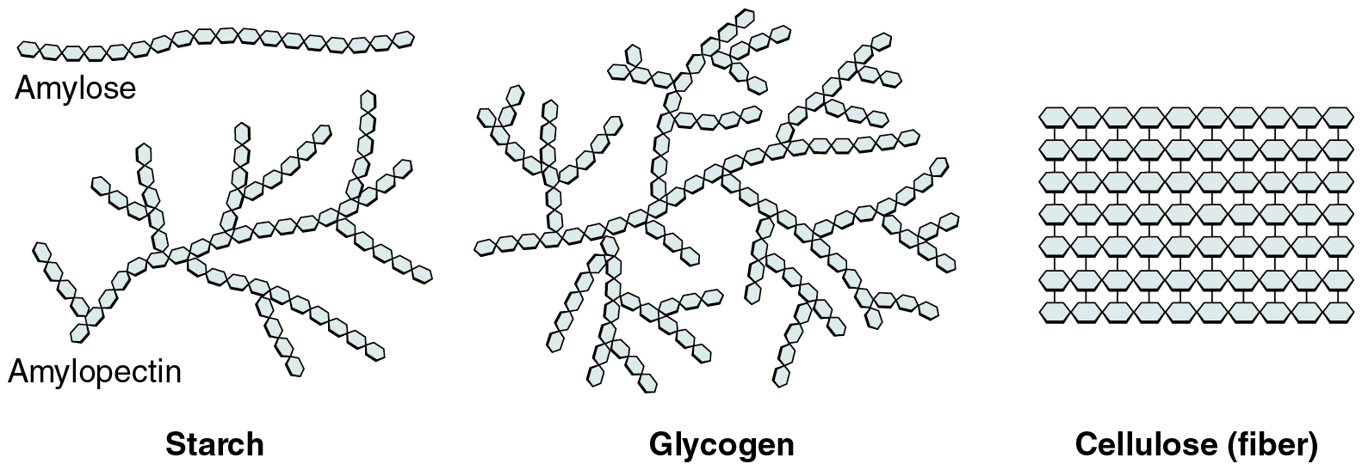
Carbohydrates
Polysaccharide are sugar (or carbohydrates) that are formed from long chain of monosaccharides bound together, Starch is an example of a polysaccharide.

Slide 29
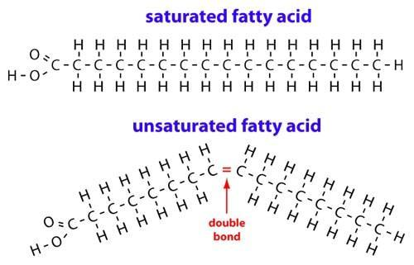
Fatty Acids ​
Fatty Acids are Important Components of Lipids.

Slide 30
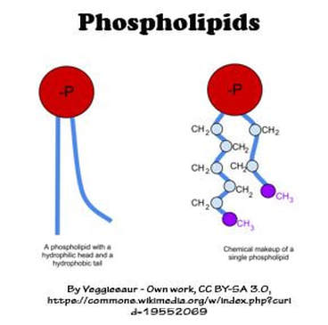
Components of Lipids.
PHOSPHOLIPIDS CONTAIN 2 FATTY ACID TAILS AND MAKE UP THE PLASMA MEMBRANE OR CELL MEMBRANES FOR EACH OF OUR 100 TRILLION CELLS

Slide 31
The Cellular Level
This Photo by Unknown Author is licensed under CC BY
The cell is the fundamental unit of life.
All living things are made up of one or more cells.

Slide 32
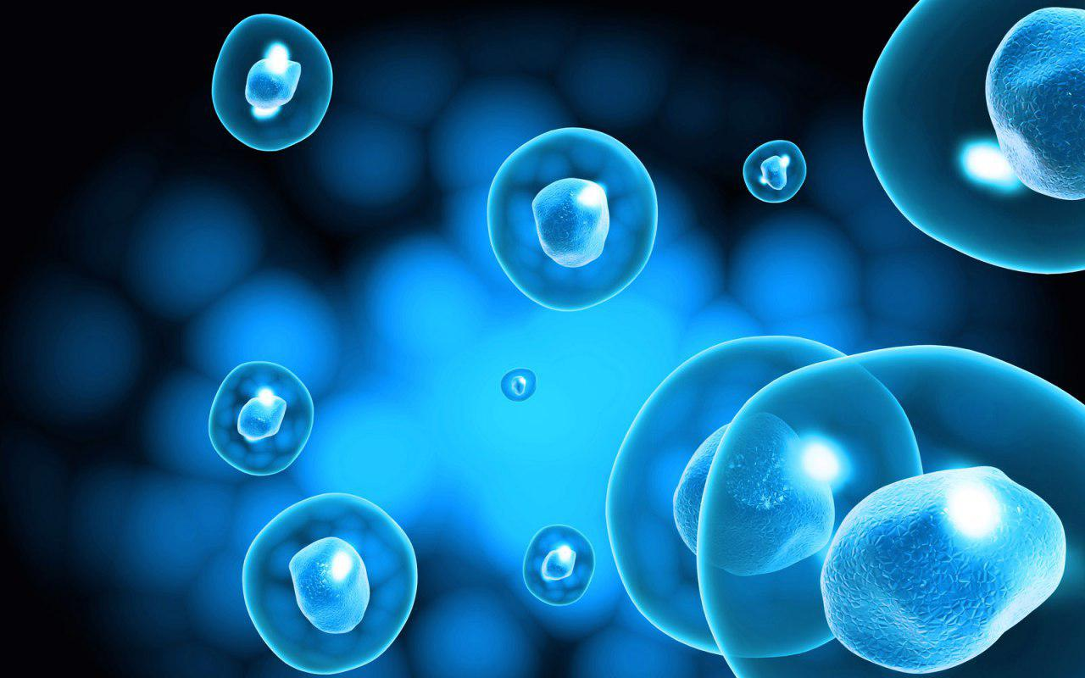
Cells
Cells and their surroundings are made up of molecules.
It takes about 100 trillion atoms to make a typical cell.
This Photo by Unknown Author is licensed under CC BY

Slide 33
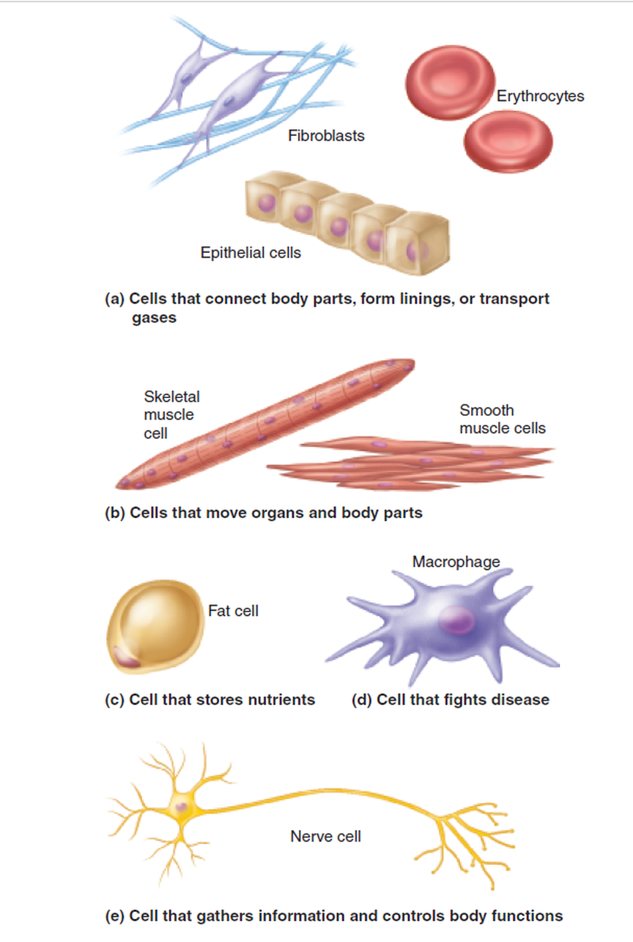
Wide Diversity of Cell Types
There Are More Than 200 Types of Cells in the Human Body

Slide 34
The Tissue Level
Cells of similar types come together to form tissues.
A TISSUE is a group of two or more cells (of similar function or origin) that come together to perform a common function.

Slide 35
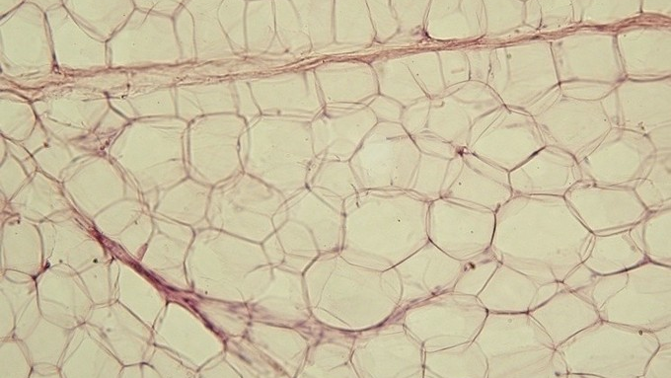
There are 4 types of tissues
Epithelial (skin) Tissue
Connective Tissue
Nervous Tissue
Muscle Tissue
This Photo by Unknown Author is licensed under CC BY-SA

Slide 36
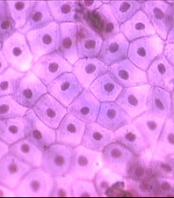
epithelial tissue
Epithelial cells come together to form epithelial tissue.
This Photo by Unknown Author is licensed under CC BY-SA

Slide 37
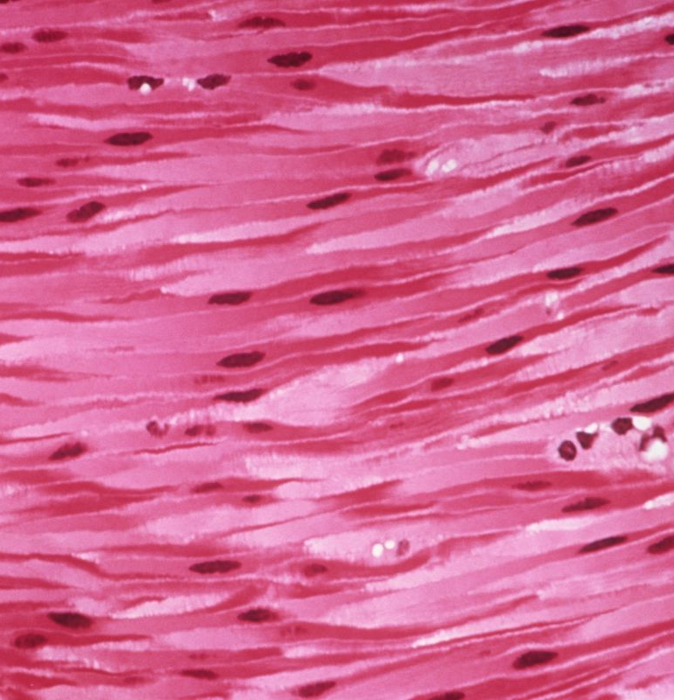
Muscle Tissue
Muscle Cells (Muscle Fibers) come together to form muscle tissue.
The body contains three types of muscle tissue:
(a) skeletal muscle,
(b) smooth muscle, and
(c) cardiac muscle.
This Photo by Unknown Author is licensed under CC BY-NC

Slide 38
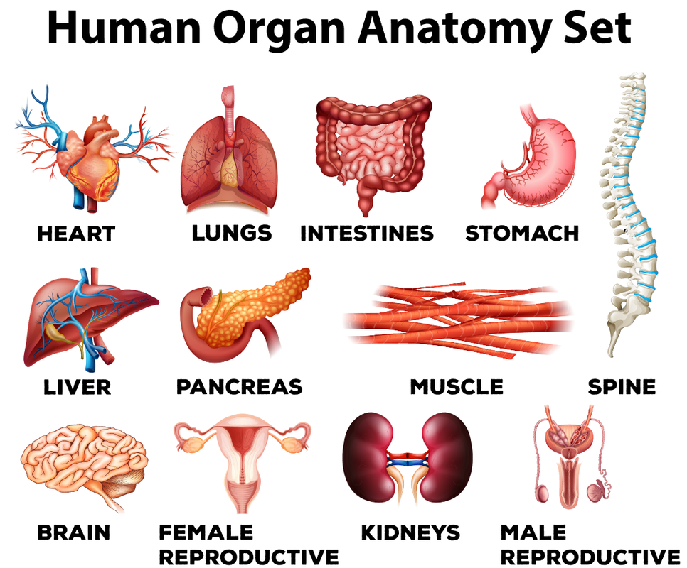
The Organ Level
Different tissue types come together to form organs.
An organ is a discrete structure made up of more than 2 different tissue types that work together as a functional unit for the body.

Slide 39
An organ system is a group of organs and associated structures that perform a specific function in the body.
The Organ System Level
There are 11 Organ Systems of the Human Body.

Slide 40
The Integumentary System
The integumentary system includes the skin, the hair and the nails of the body. It is also considered an organ. In fact, the integumentary system is the body's largest organ. This system provides protection and helps regulate body temperature.

Slide 41
The Circulatory System
The circulatory system (or cardiovascular system) includes the heart, the blood and the blood vessels. The function of the circulatory system is to move blood, nutrients, oxygen, carbon dioxide, and hormones, around the body.​

Slide 42
The Muscular System
The muscular system is an organ system consisting of skeletal, smooth and cardiac muscles. It permits movement of the body, maintains posture and circulates blood throughout the body. The muscular systems in vertebrates are controlled through the nervous system although some muscles can be completely autonomous.

Slide 43
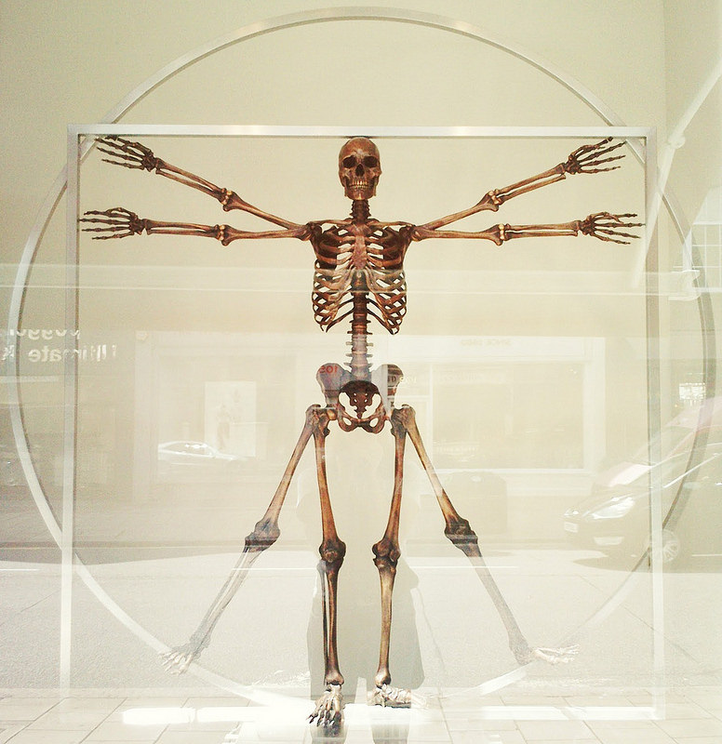
The skeletal system
The skeletal system includes the 206 named bones of the body, as well as the tendons, ligaments and cartilage that actively support it. The function of the skeletal system is to allow for movement, provide structure, produce blood cells and to store calcium.

Slide 44
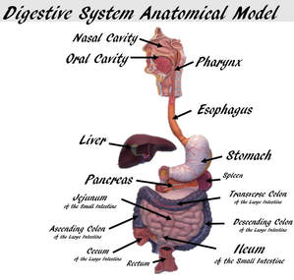
The digestive system
The digestive system includes the mouth, esophagus, stomach, small intestine, large intestine, rectum, and anus.
There are also accessory digestive organs like the liver and pancreas that assist the digestive system.
The function of the digestive system is to break down food, absorb nutrients, and eliminate waste as feces. ​

Slide 45
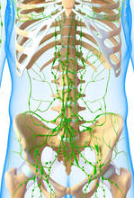
The immune system
The immune system is the body's defense against disease. The immune system includes the includes, the thymus and the leukocytes (white blood cells) of the body.

Slide 46
The immune system
The lymphatic system includes lymph nodes, lymph ducts and lymph vessels, and also plays a role in the body's defenses.
Its main job is to make is to make and move lymph, a clear fluid that contains white blood cells, which help the body fight infection.
The lymphatic system also removes excess lymph fluid from bodily tissues, and returns it to the blood.

Slide 47
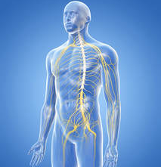
The nervous system
The nervous system includes the brain, the spinal cord, peripheral nerves and sensory receptors.
The nervous system senses the conditions of our internal and our external environments.
Responses and commands are sent from the brain and spinal cord to muscles of the body.
Much of the function of the nervous system is not under conscious control.

Slide 48
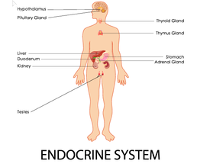
The endocrine system
The endocrine system includes the eight major glands of the body that secrete hormones.
Hormones function to regulate many of the body's functions including growth, metabolism, and sexual reproduction.

Slide 49
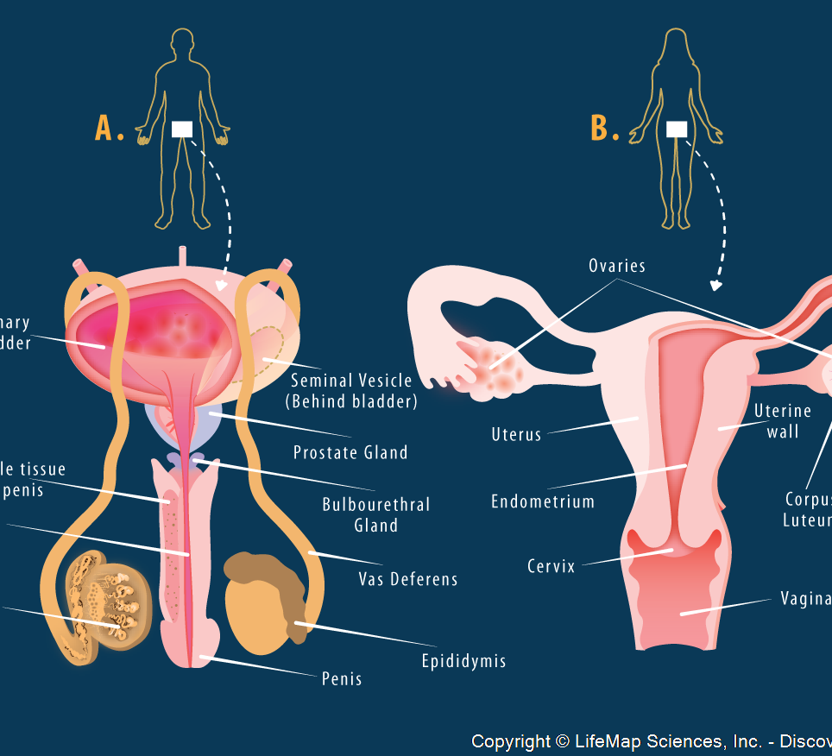
The reproductive system
The reproductive system allows humans to reproduce.
The male reproductive system includes the penis and the testes, which produce sperm.
The female reproductive system consists of the vagina, the uterus and the ovaries, which produce eggs.
During conception, a sperm cell fuses with an egg cell, which creates a fertilized egg that implants and grows in the uterus. ​

Slide 50
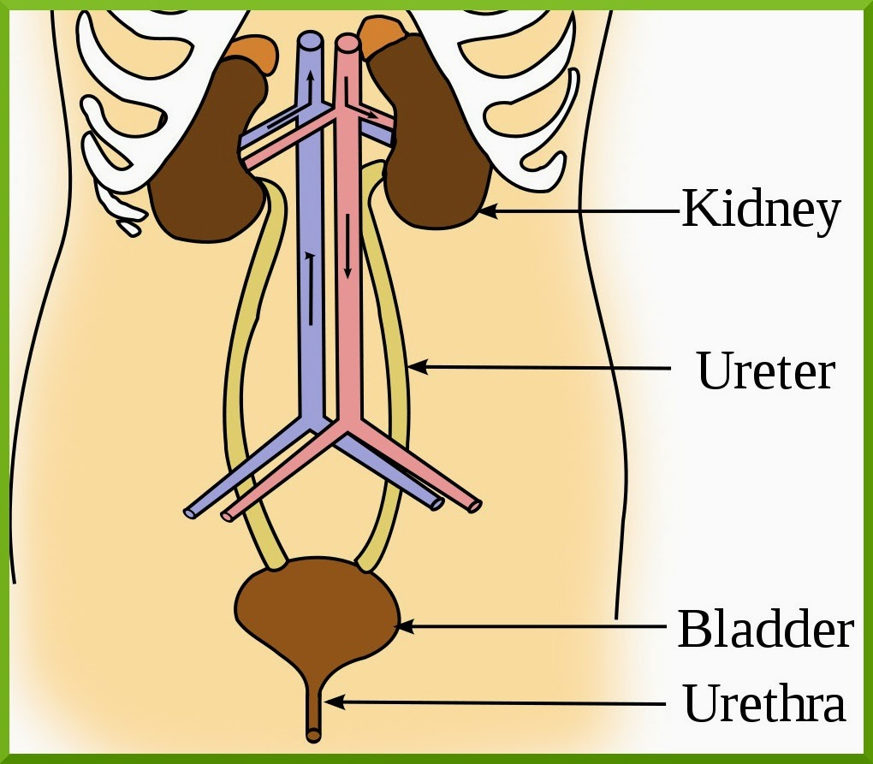
The urinary system
The urinary system helps eliminate a waste product called urea from the body, which is produced when certain foods are broken down.
The whole system includes two kidneys, two ureters, the bladder, two sphincter muscles and the urethra.
Urine produced by the kidneys travels down the ureters to the bladder, and exits the body through the urethra.
This Photo by Unknown Author is licensed under CC BY-SA-NC

Slide 51
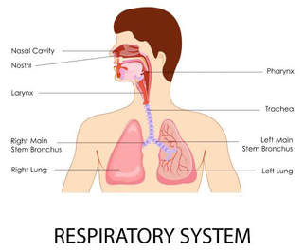
The respiratory system
The respiratory system allows us to take in vital oxygen and expel carbon dioxide in a process we call breathing. It consists mainly of the trachea, the diaphragm and the lungs.

Slide 52
The Organism Level
The level of the organism looks at how all of the anatomical structure of body work together to provide all of the necessary function for life.

