Slide 1
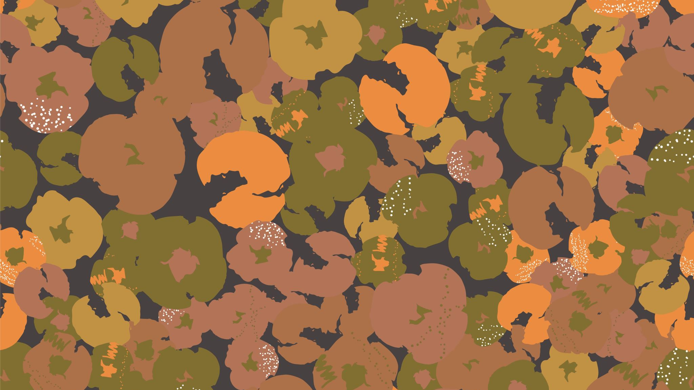
Practical Exam #2 REDEMPTION EXAM
Bones Practical Exam

Slide 2
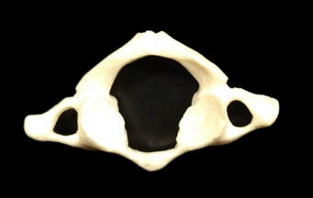
What is the LEVEL of the VERTEBRAE?
Thoracic
Axis
Atlas
Cervical
Lumbar
Question 1

Slide 3
What is the LEVEL of the VERTEBRAE?
Thoracic
Axis
Atlas
Cervical
Lumbar
Question 2

Slide 4
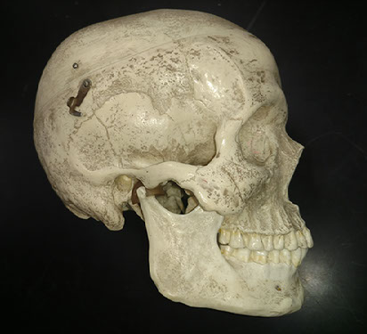
Question 3
What is STRUCTURE?
Zygoma
Zygomatic process
Temporal process
External auditory canal
Mandibular fossa

Slide 5
Question 4
What is STRUCTURE?
Zygoma
Zygomatic process
Temporal process
External auditory canal
Mandibular fossa

Slide 6
Question 5
What is STRUCTURE?
Zygoma
Zygomatic process
Temporal process
External auditory canal
Mandibular fossa

Slide 7
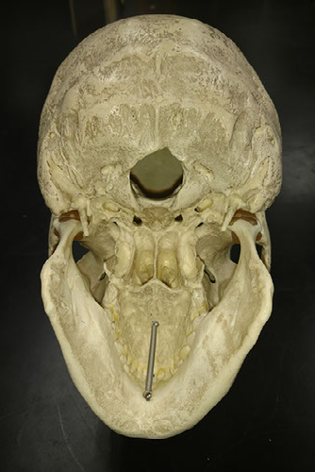
Question 6
What is the BONE?
Zygoma
Maxilla
Vomer
Palatine Bone
Ethmoid

Slide 8
Question 7
Identify the STRUCTURES?
Foramen Magnum
Optic Foramina
Occipital Foramina
Occipital Condyles
Palatine Condyles

Slide 9
What is the HOLE?
Foramen Magnum
Intervertebral Foramen
Occipital Foramen
Occipital Condyle
Transverse Foramen
Question 8

Slide 10
Identify the STRUCTURE.
Vomer
Nasal Bone
Nasal Conchae
Ethmoid Sinuses
Perpendicular Plate
Question 9

Slide 11
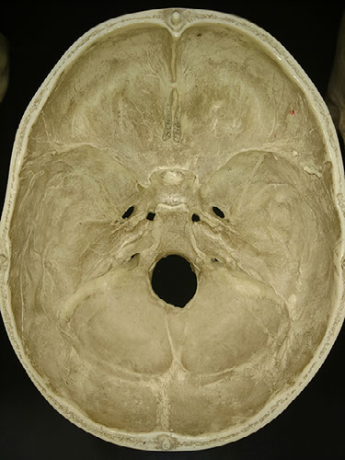
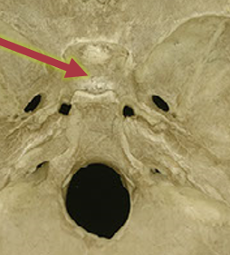
Question 10
Identify the STRUCTURE.
Crista Galli
Sella Turcica
Optic Foramina
Cribriform Plate
Perpendicular Plate

Slide 12
Identify the STRUCTURE.
Crista Galli
Sphenoid
Optic Foramina
Cribriform Plate
Perpendicular Plate
Question 11

Slide 13
Identify the STRUCTURE.
Crista Galli
Sphenoid
Optic Foramina
Cribriform Plate
Perpendicular Plate
Question 12

Slide 14
Identify the STRUCTURE.
Mandibular fossa
Mandibular condyle
Mandibular fossa
Optic Foramina
Cribriform Plate
Question 13

Slide 15
Identify the SUTURE.
Coronal Suture
Squamosal Suture
Lambdoidal Suture
Sagittal Suture
Transverse Suture
Question 14

Slide 16
Identify the SUTURE.
Coronal Suture
Squamosal Suture
Lambdoidal Suture
Sagittal Suture
Transverse Suture
Question 15

Slide 17
What is the BONE?
Zygoma
Maxilla
Vomer
Palatine Bone
Ethmoid
Question 16

Slide 18
What is the BONE?
Temporal Bone
Occipital Bone
Sphenoid
Palatine Bone
Ethmoid
Question 17

Slide 19
Identify the SUTURE.
Coronal Suture
Squamosal Suture
Lambdoidal Suture
Sagittal Suture
Transverse Suture
Question 18

Slide 20
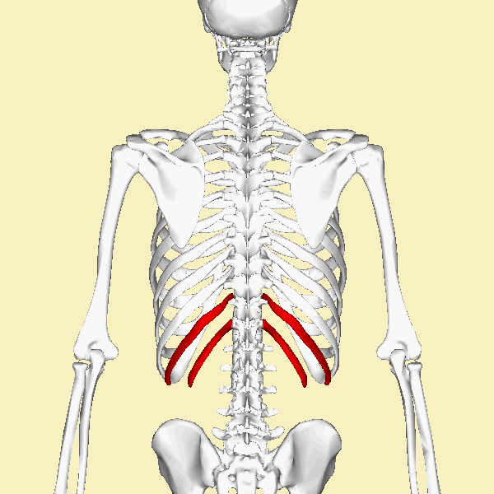
Identify the type of rib.
False Ribs
Pseudo-ribs
Floating Ribs
True Ribs
Fake Ribs
Question 19

Slide 21
Identify the structure.
Femoral Head
Head of the Humorous
Glenoid Fossa
Capitulum
Lesser Tubercle
Question 20

Slide 22
Identify the structure.
Spine of the Scapula
Coracoid Process
Coronoid Process
Acromion Process
Glenoid Fossa
Question 21

Slide 23
Identify the structure.
Spine of the Scapula
Coracoid Process
Coronoid Process
Acromion Process
Glenoid Fossa
Question 22

Slide 24
Identify the structure.
Spine of the Scapula
Coracoid Process
Coronoid Process
Acromion Process
Glenoid Fossa
Question 23

Slide 25
Identify the structure.
Capitulum
Olecranon Process
Coronoid Process
Trochlea
Olecranon Fossa
Question 24

Slide 26
Identify the structure.
Capitulum
Olecranon Process
Coronoid Process
Trochlea
Olecranon Fossa
Question 25

Slide 27
Identify the structure.
Capitulum
Olecranon Process
Coronoid Process
Trochlea
Olecranon Fossa
Question 26

Slide 28
Identify the BONE.
Ulna
Humerus
Radius
Fibula
Clavicle
Question 27

Slide 29
Identify the BONE.
Ulna
Humerus
Radius
Fibula
Clavicle
Question 28

Slide 30
Identify the STRUCTURE.
Medial condyle
Medial malleolus
Lateral condyle
Fibular condyle
Greater Trochanter
Question 29

Slide 31
Identify the LEVEL.
Cervical
Lumbar
Thoracic
Axis
Atlas
Question 30

Slide 32
Identify the STRUCTURE.
Dens
Transverse process
Spinous process
Body
Transverse foramen
Question 31

Slide 33
Identify the STRUCTURE.
Dens
Transverse process
Spinous process
Body
Transverse foramen
Question 32

Slide 34
Identify the STRUCTURE.
Dens
Transverse process
Spinous process
Body
Transverse foramen
Question 33

Slide 35
Identify the STRUCTURE.
Dens
Transverse process
Spinous process
Body
Transverse process
Question 34

Slide 36
Identify the BONE.
Ulna
Humerus
Radius
Fibula
Clavicle
Question 35

Slide 37
Identify the STRUCTURE.
Foramen magnum
Transverse foramen
Obturator Foramen
Os Coxae
Acetabulum
Question 36

Slide 38
Question 37
Identify the STRUCTURE.
Foramen magnum
Transverse foramen
Obturator Foramen
Os Coxae
Acetabulum

Slide 39
Identify the STRUCTURE.
Iliac crest
Spinous process
Ischial spine
Coxa Fossa
Acetabulum
Question 38

Slide 40
Identify the STRUCTURE.
Femoral Head
Humeral Head
Head of the Radius
Head of the Tibia
Head of the fibula
Question 39

Slide 41
Identify the STRUCTURE.
Lesser trochanter
Greater tubercle
Greater trochanter
Lesser tubercle
Trochlea
Question 40

Slide 42
Identify the STRUCTURE.
Medial condyle
Lateral fossa
Lateral condyle
Medial malleolus
Radial tuberosity
Question 41

Slide 43
Identify the STRUCTURE.
Medial condyle
Lateral fossa
Lateral condyle
Medial malleolus
Radial tuberosity
Question 42

Slide 44
Identify the STRUCTURE.
Medial condyle
Lateral fossa
Lateral condyle
Medial malleolus
Radial tuberosity
Question 43

Slide 45
Identify the STRUCTURE.
Femoral Head
Humeral Head
Head of the Radius
Head of the Tibia
Head of the fibula
Question 44

Slide 46
Identify the STRUCTURE.
Medial condyle
Lateral fossa
Lateral condyle
Medial malleolus
Radial tuberosity
Question 45

Slide 47
Identify the STRUCTURE.
Olecranon process
Coracoid process
Coronoid process
Trochlear notch
Radial tuberosity
Question 46

Slide 48
Identify the STRUCTURE.
Olecranon process
Coracoid process
Coronoid process
Trochlear notch
Radial tuberosity
Question 47

Slide 49
Identify the STRUCTURE.
Olecranon process
Coracoid process
Coronoid process
Trochlear notch
Radial tuberosity
Question 48

Slide 50
What is the BONE?
Temporal Bone
Occipital Bone
Sphenoid
Palatine Bone
Parietal Bone
Question 49

Slide 51
What is the BONE?
Temporal Bone
Occipital Bone
Frontal Bone
Palatine Bone
Ethmoid
Question 50

