Slide 1
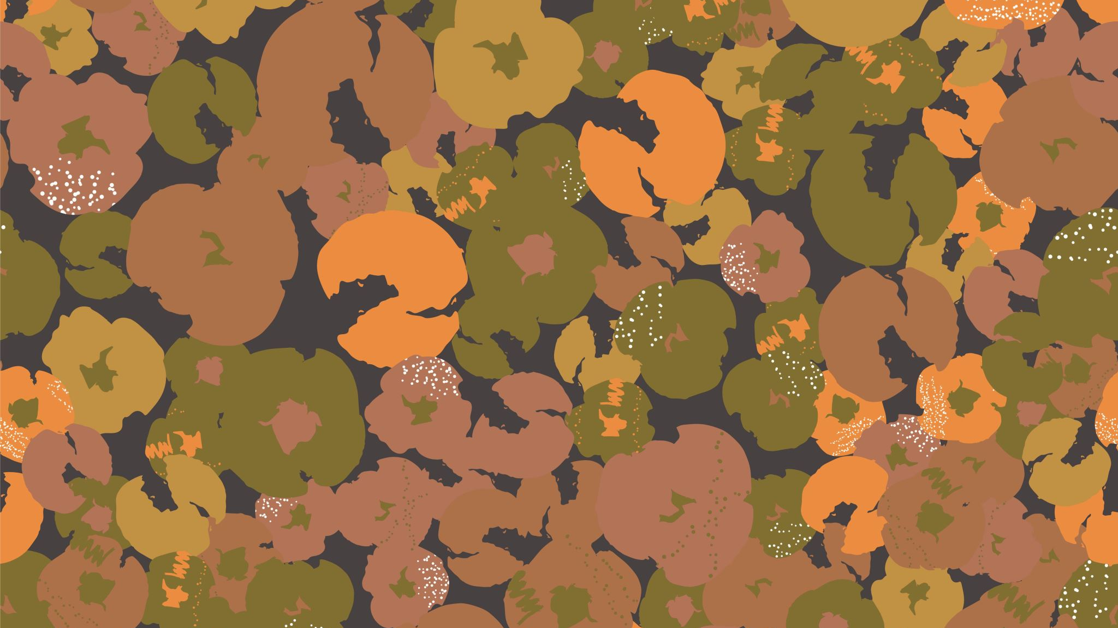
Practical Exam #3 The Muscles
GOOD LUCK!

Slide 2
Identify the muscle.
Semitendinosus
Tibialis Anterior
Vastus Medialis
Soleus
Semimembranosus
Fibularis longus
Biceps femoris
Question 1

Slide 3
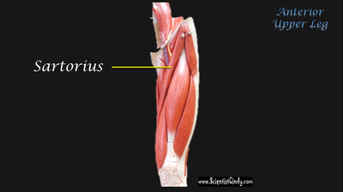
What is the muscle?
Semitendinosus
Gracilis
Vastus Medialis
Soleus
Semimembranosus
Sartorius
Biceps femoris
Question 2
Question 2

Slide 4
What is this muscle?
Pronator teres
Brachioradialis
Subscapularis
Triceps brachii
Biceps brachii
Deltoid
Trapezius
Question 3

Slide 5
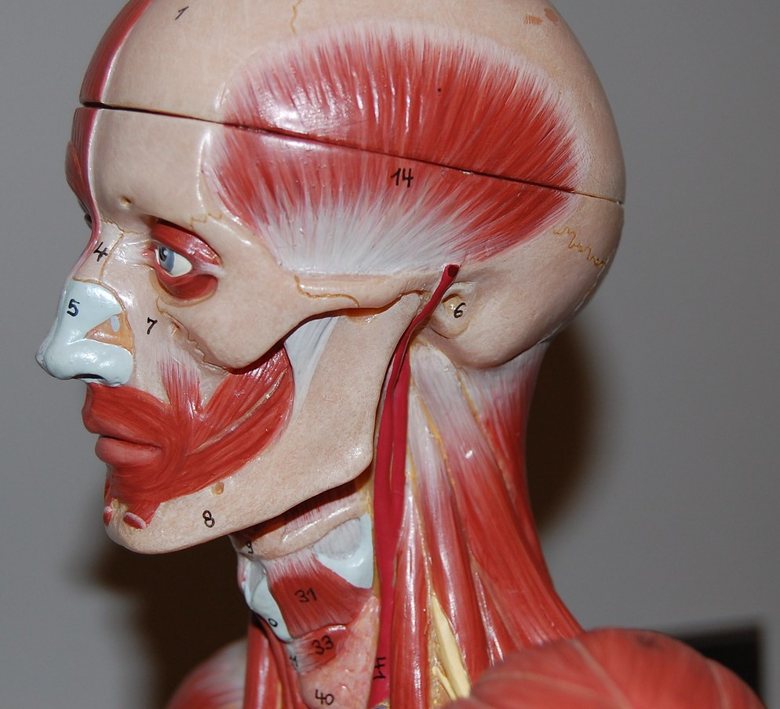
Question 4
What is muscle?
Buccinator
Zygomaticus
Temporalis
Masseter
Orbicularis oris
Orbicularis oculi
This Photo by Unknown Author is licensed under CC BY-NC

Slide 6
Question 5
What is muscle?
Buccinator
Zygomaticus
Temporalis
Masseter
Orbicularis oris
Orbicularis oculi
This Photo by Unknown Author is licensed under CC BY-NC

Slide 7
Question 6
What is the muscle?
Sartorius
Fibularis longus
Soleus
Gastrocnemius
Tibialis anterior
Vastus medialis
Semitendinosus

Slide 8
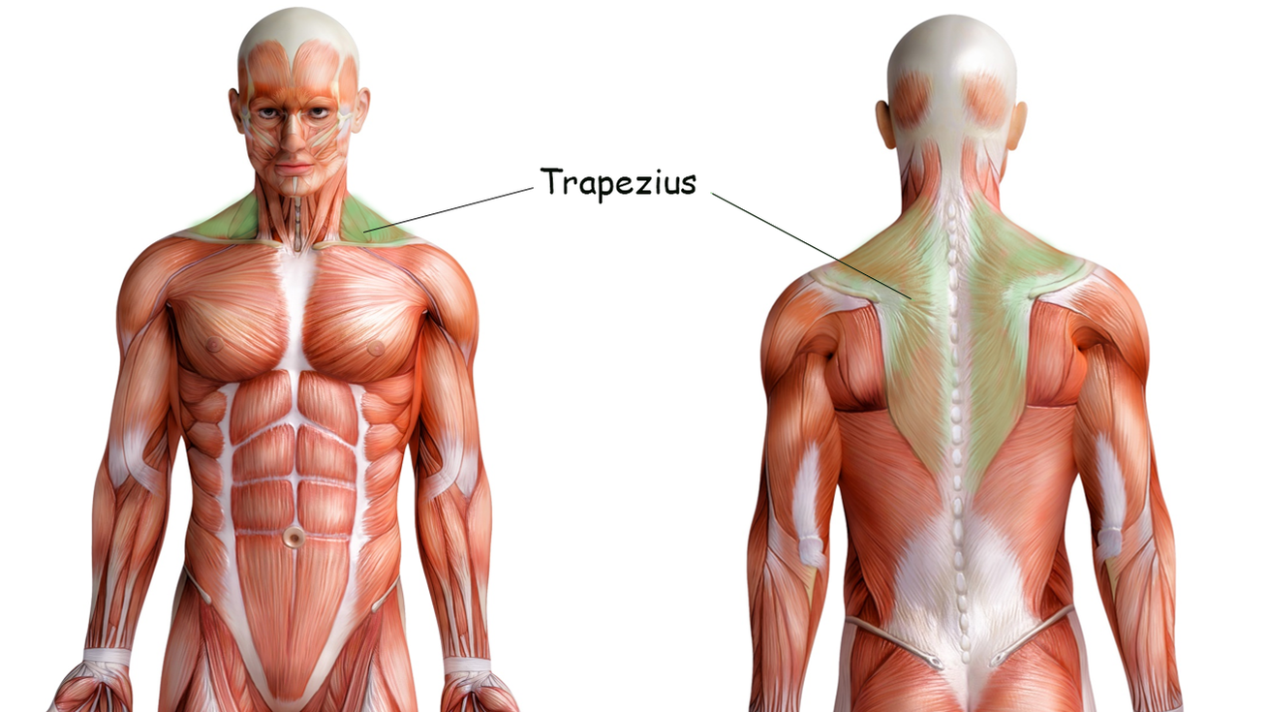
Identify the muscle?
Latissimus dorsi
Deltoid
Trapezius
Sternocleidomastoid
Temporalis
Buccinator
Biceps brachii
Question 7

Slide 9
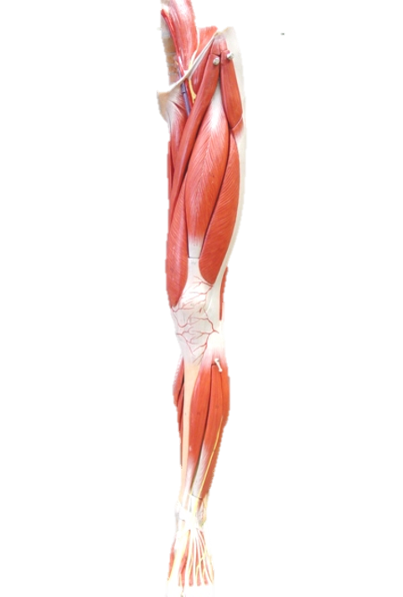
What is the muscle?
Anterior tibialis
Fibularis longus
Biceps femoris
Sartorius
Vastus lateralis
Rectus femoris
Semimembranosus
Question 8

Slide 10
Question 9
Identify the muscle.
Deltoid
Trapezius
Latissimus dorsi
Sternocleidomastoid
Abdominus rectus
Pectoralis major
Pectoralis minor
Intercostal muscles
This Photo by Unknown Author is licensed under CC BY-NC

Slide 11
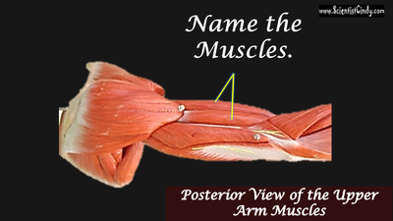
Question 10
Identify the muscle.
Triceps brachii
Biceps brachii
Brachialis
Brachioradialis
Deltoid
Pronator teres
Teres major

Slide 12
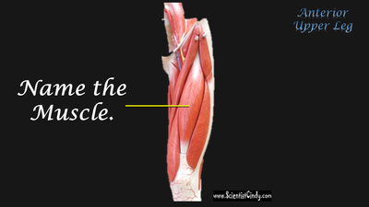
Identify the muscle.
Sartorius
Gracilis
Soleus
Biceps femoris
Rectus femoris
Vastus medialis
Vastus lateralis
Question 11

Slide 13
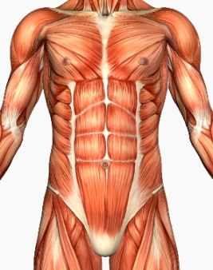
Identify the muscle.
Transverse Abdominus
Trapezius
Latissimus dorsi
External abdominal obliques
Abdominus rectus
Internal abdominal obliques
Question 12

Slide 14
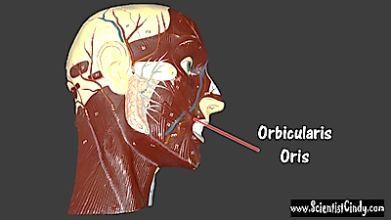
Question 13
Identify the
muscle.
Temporalis
Buccinator
Orbicularis oris
Zygomaticus
Orbicularis oculi
Masseter

Slide 15
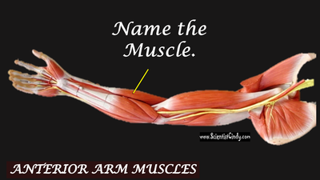
Identify the muscle.
Triceps brachii
Biceps brachii
Brachialis
Brachioradialis
Deltoid
Pronator teres
Teres major
Question 14

Slide 16
Identify the MUSCLE.
Teres major
Teres minor
Infraspinatus
Supraspinatus
Deltoid
Trapezius
Subscapularis
Question 15

Slide 17
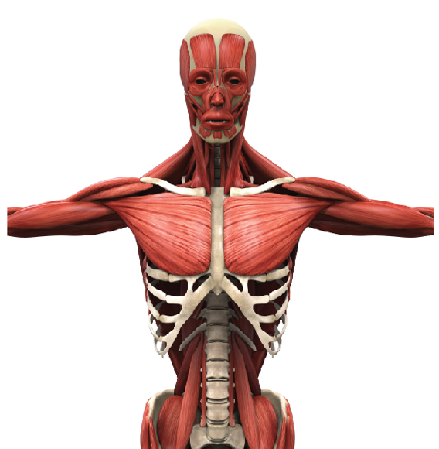
What is the muscle?
Deltoid
Trapezius
Latissimus dorsi
Sternocleidomastoid
Abdominus rectus
Pectoralis major
Pectoralis minor
Intercostal muscles
Question 16

Slide 18
What is the muscle?
Infraspinatus
Subscapularis
Supraspinatus
Teres major
Teres minor
Pronator teres
Question 17

Slide 19
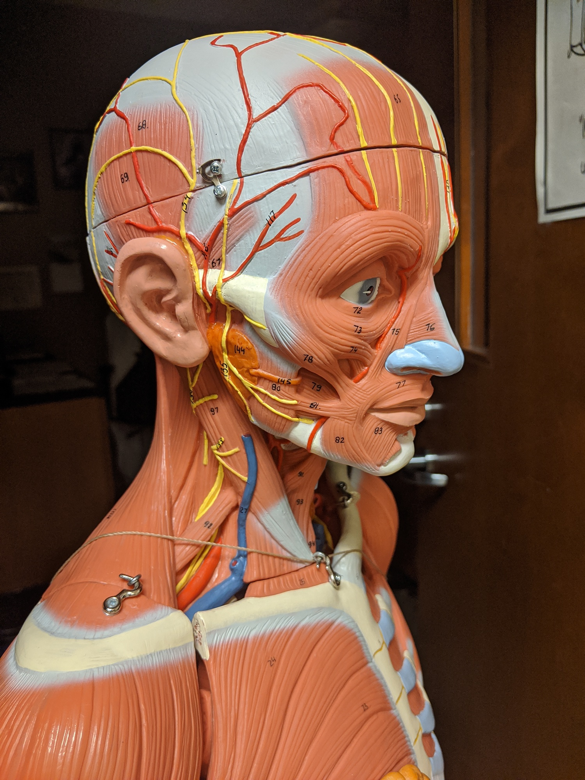
Identify the muscle.
Orbicularis oculi
Masseter
Orbicularis oris
Zygomaticus
Temporalis
Buccinator
Sternocleidomastoid
Question 18

Slide 20
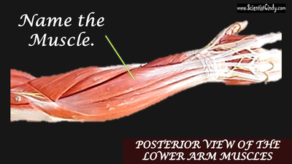
Identify the muscle.
Extensor digitorum
Flexor digitorum superficialis
Pronator teres
Extensor carpi ulnaris
Flexor carpi ulnaris
Question 19

Slide 21
Question 20
Identify the muscle.
Fibularis longus
Biceps femoris
Gastrocnemius
Gracilis
Sartorius
Semitendinosus
Vastus medialis

Slide 22
What is this muscle?
Pronator teres
Brachioradialis
Subscapularis
Triceps brachii
Biceps brachii
Deltoid
Question 21

Slide 23
Question 22
Identify the muscle.
Fibularis longus
Biceps femoris
Gastrocnemius
Gracilis
Sartorius
Semitendinosus
Vastus medialis

Slide 24
Identify the muscle.
Gluteus medius
Biceps femoris
Rectus femoris
Gracilis
Sartorius
Semitendinosus
Vastus medialis
Question 23

Slide 25
Question 24
Identify the muscle.
Gluteus medius
Biceps femoris
Rectus femoris
Gracilis
Sartorius
Semitendinosus
Vastus medialis

Slide 26
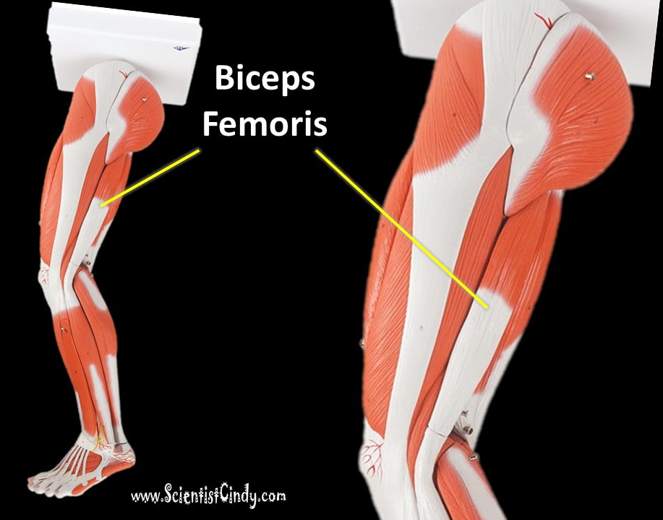
Identify the muscle.
Gluteus medius
Biceps femoris
Rectus femoris
Gracilis
Sartorius
Semitendinosus
Vastus medialis
Question 25

Slide 27
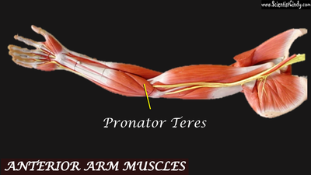
Identify the muscle.
Extensor digitorum
Flexor digitorum superficialis
Pronator teres
Extensor carpi ulnaris
Flexor carpi ulnaris
Question 26

Slide 28
Identify the muscle.
Extensor digitorum
Flexor digitorum superficialis
Pronator teres
Extensor carpi ulnaris
Flexor carpi ulnaris
Question 27

Slide 30
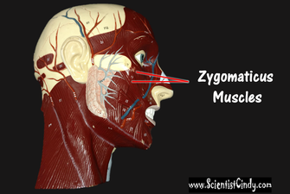
Identify the muscle.
Temporalis
Zygomaticus
Buccinator
Orbicularis oculi
Orbicularis oris
Masseter
Question 29

Slide 31
Identify the muscle.
Extensor digitorum
Flexor digitorum superficialis
Pronator teres
Extensor carpi ulnaris
Flexor carpi ulnaris
Question 30

Slide 32
Identify the muscle.
Pronator teres
Brachioradialis
Subscapularis
Triceps brachii
Deltoid
Trapezius
Question 31

Slide 33
Identify the muscle.
Semitendinosus
Biceps femoris
Rectus femoris
Vastus intermedius
Vastus lateralis
Vastus medialis
Question 32

Slide 34
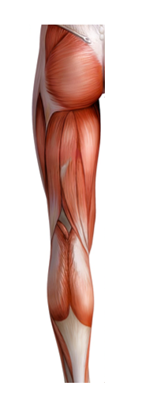
Identify the muscle.
Vastus Lateralis
Gluteus maximus
Gluteus medius
Semitendinosus
Semimembranosus
Rectus femoris
Biceps femoris
Question 33

Slide 35
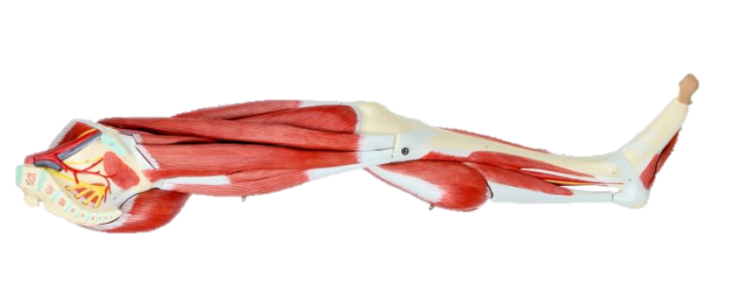
Identify the muscle.
Sartorius
Gracilis
Soleus
Fibularis longus
Vastus Lateralis
Vastus Medialis
Semitendinosus
Question 34

Slide 36
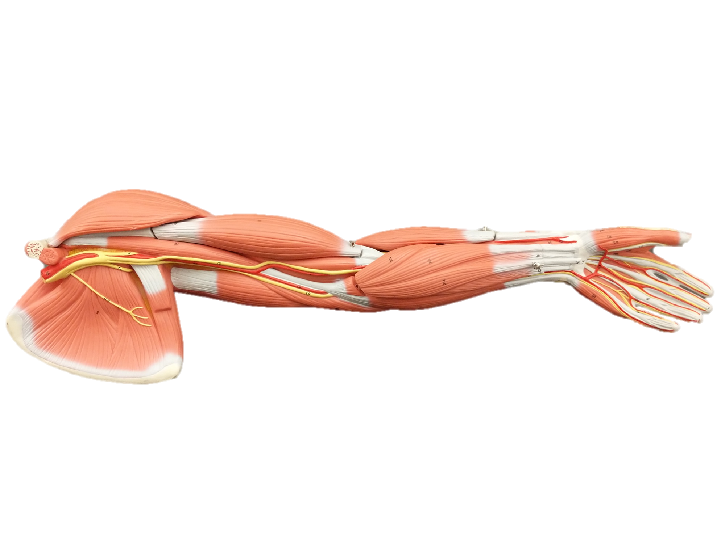
Identify the muscle.
Extensor digitorum
Flexor digitorum superficialis
Pronator teres
Extensor carpi ulnaris
Flexor carpi ulnaris
Question 35

Slide 37
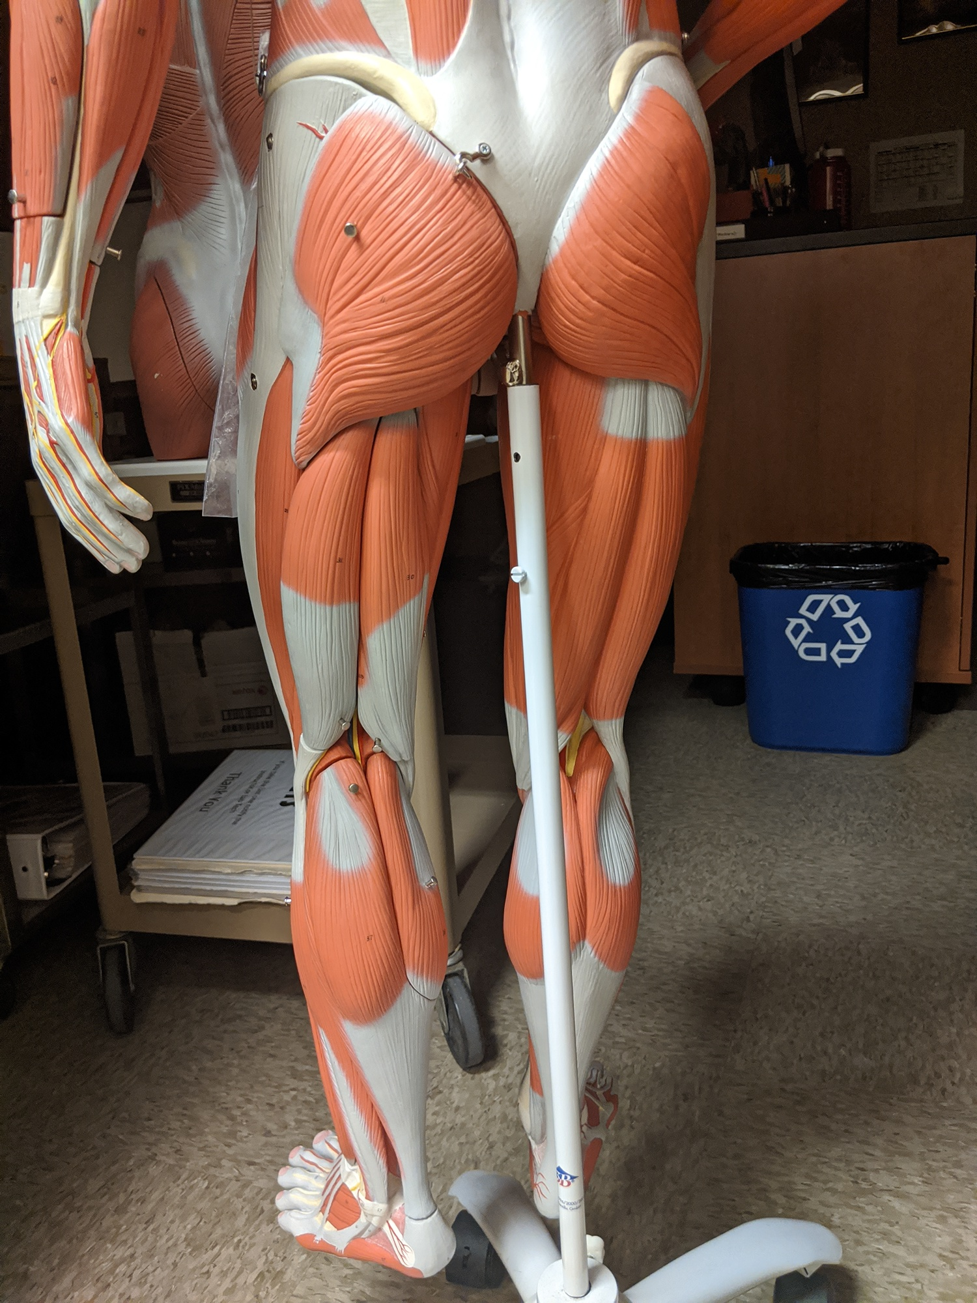
Identify the muscle.
Vastus Lateralis
Vastus intermedius
Vastus Medialis
Semitendinosus
Semimembranosus
Rectus femoris
Biceps femoris
Question 36

Slide 38
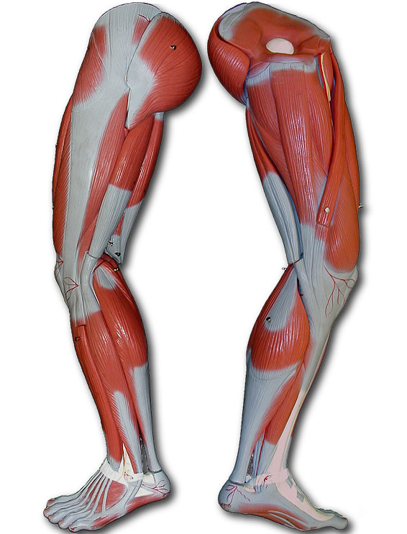
Question 37
Identify the muscle.
Vastus Lateralis
Vastus intermedius
Vastus Medialis
Semitendinosus
Semimembranosus
Rectus femoris
Biceps femoris

Slide 39
Identify the muscle.
Vastus Lateralis
Vastus intermedius
Vastus Medialis
Semitendinosus
Semimembranosus
Rectus femoris
Biceps femoris
Question 38

Slide 40
Identify the muscle.
Pronator teres
Infraspinatus
Subscapularis
Supraspinatus
Trapezius
Deltoid
Trapezius
Question 39

Slide 41
Identify the muscle.
Vastus Lateralis
Vastus intermedius
Vastus Medialis
Semitendinosus
Semimembranosus
Gastrocnemius
Biceps femoris
Question 40

Slide 42
Identify the muscle.
Pronator teres
Brachioradialis
Subscapularis
Triceps brachii
Biceps brachii
Deltoid
Trapezius
Question 41

Slide 43
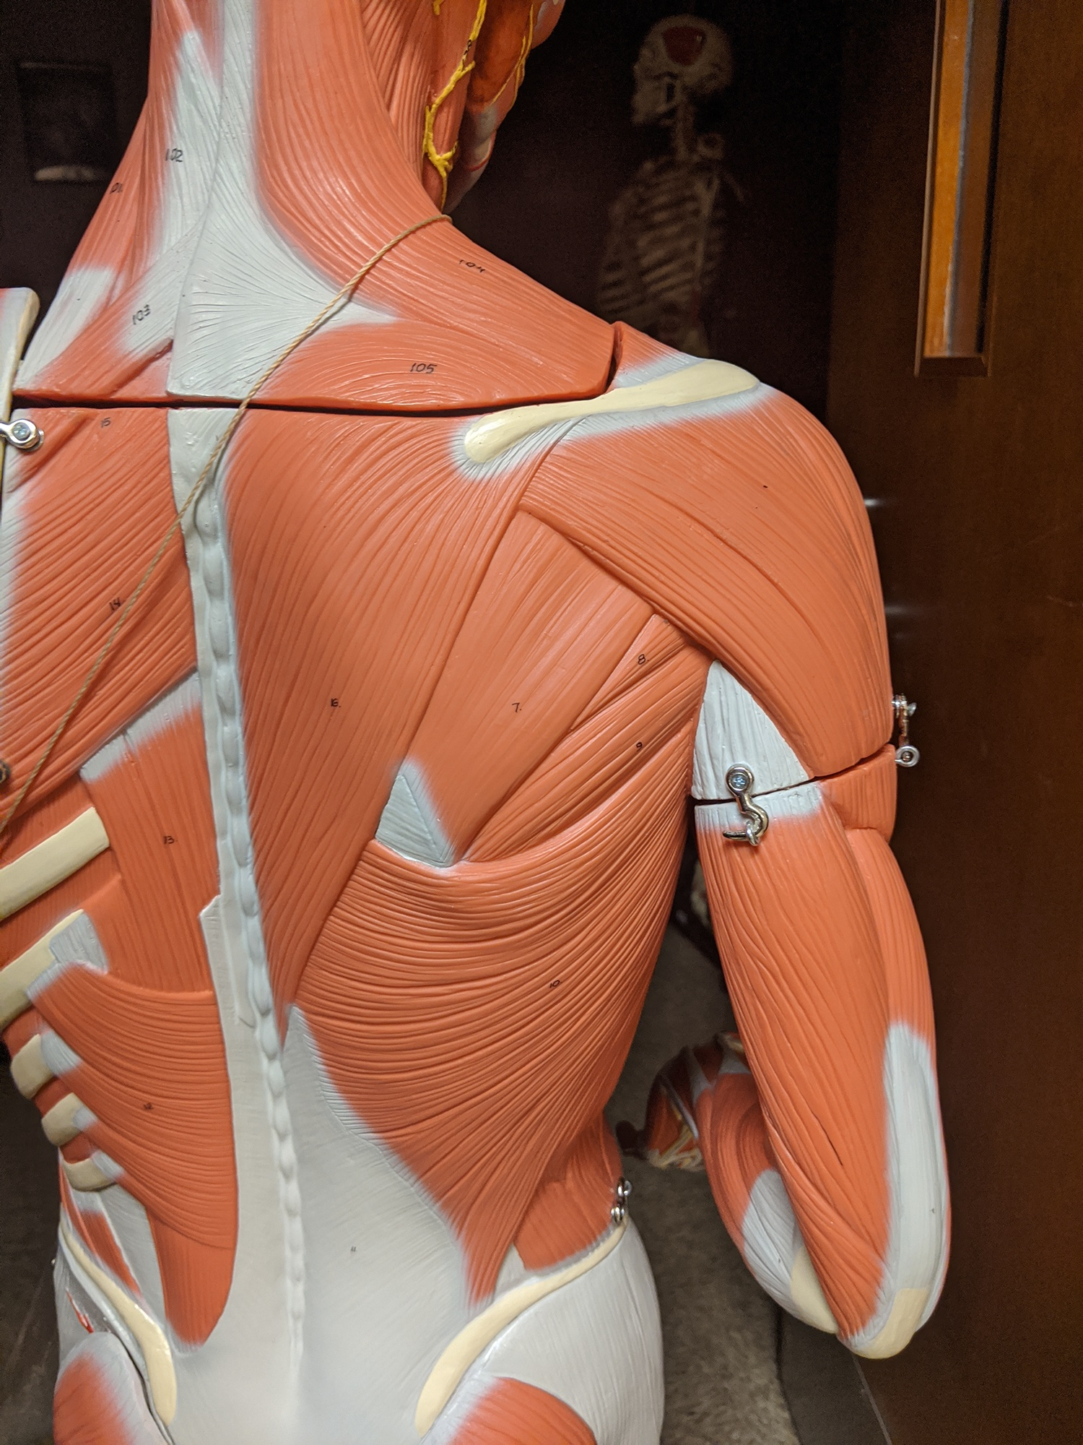
Identify the muscle.
Trapezius
Latissimus dorsi
External obliques
Intercostal muscles
Sternocleidomastoid
Brachialis
Supraspinatus
Question 42

Slide 44
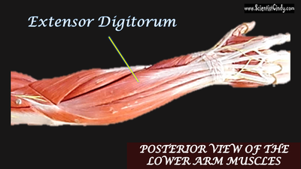
Identify the muscle.
Extensor digitorum
Flexor digitorum superficialis
Pronator teres
Extensor carpi ulnaris
Flexor carpi ulnaris
Question 43

Slide 45
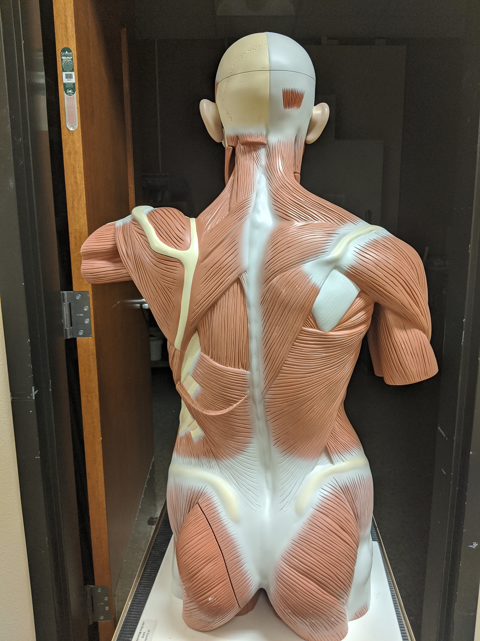
Identify the muscle.
Teres major
Teres minor
Pronator teres
Trapezius
Intercostal muscles
Infraspinatus
Subscapularis
Question 44

Slide 46
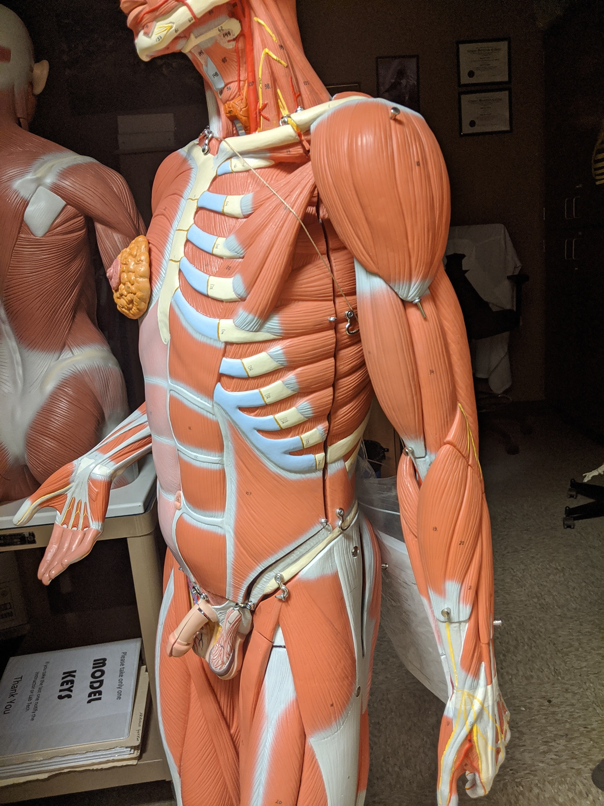
Identify the muscle.
Deltoid
Trapezius
Latissimus dorsi
Sternocleidomastoid
Rectus Abdominus
Pectoralis major
Pectoralis minor
Intercostal muscles
Question 45

Slide 47
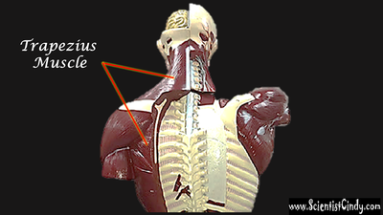
Identify the muscle.
Deltoid
Trapezius
Latissimus dorsi
Sternocleidomastoid
Abdominus rectus
Pectoralis major
Pectoralis minor
Intercostal muscles
Question 46

Slide 48
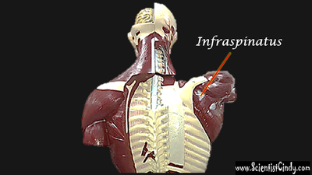
Identify the muscle.
Infraspinatus
Deltoid
Sternocleidomastoid
Trapezius
Question 47

Slide 49
Identify the muscle.
Trapezius
Latissimus dorsi
External obliques
Intercostal muscles
Sternocleidomastoid
Brachialis
Supraspinatus
Question 48

Slide 50
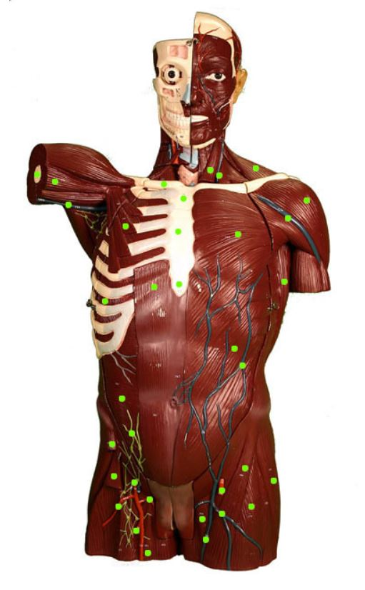
What is the muscle?
Deltoid
Trapezius
Latissimus dorsi
Sternocleidomastoid
Rectus Abdominus
Pectoralis major
Pectoralis minor
Intercostal muscles
Question 49

Slide 51
What is the muscle?
Deltoid
Trapezius
Latissimus dorsi
Sternocleidomastoid
Rectus Abdominus
Pectoralis major
Pectoralis minor
Intercostal muscles
Question 50

