Slide 1
Photo Album
by Cynthia Anderson

Slide 4
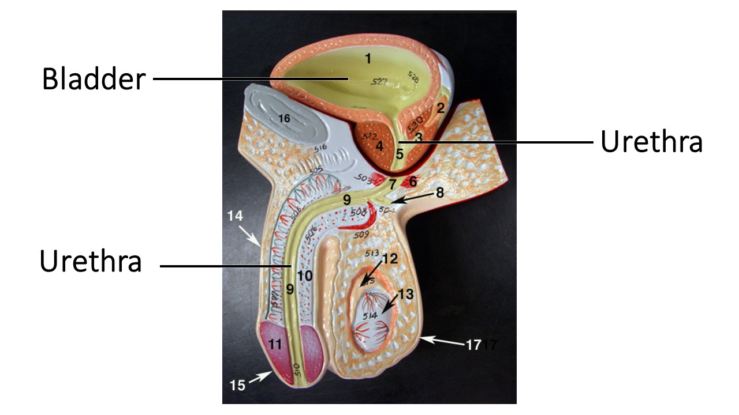

Slide 7
