Slide 1
Reproductive System
Physiology

Slide 2
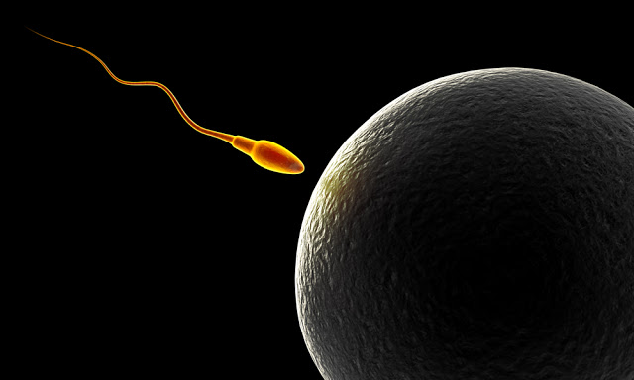
Reproduction
Reproduction can be defined as the process by which an organism continues its species.
In the human reproductive process, two kinds of sex cells (gametes), are involved:
the male gamete (sperm)
the female gamete (egg or ovum)
This Photo by Unknown Author is licensed under CC BY

Slide 3
Differences between male and female reproductive systems
A male who is healthy, and sexually mature, continuously produces sperm.
____________________________________________
The woman is born with a predetermined immature number of oocytes and cannot produce new ones.
After puberty, during each menstrual cycle, one oocyte matures during ovulation.
The ovaries of a newborn baby girl contain about one million oocytes.
This number declines to 400,000 to 500,000 by the time puberty is reached.
On average, 500-1000 oocytes are ovulated during a woman's reproductive lifetime.
When a young woman reaches puberty, a primary oocyte is discharged from one of the ovaries every 28 days.
This continues until the woman reaches menopause, usually around the age of 50 years.
Occytes are present at birth, and age as a woman ages.

Slide 5
Functions of the Female Reproductive System
Produces eggs (ova)
Receives the male spermatozoa during intercourse
Protects and nourishes the fertilized egg until it is fully developed
Delivers fetus through birth canal

Slide 6
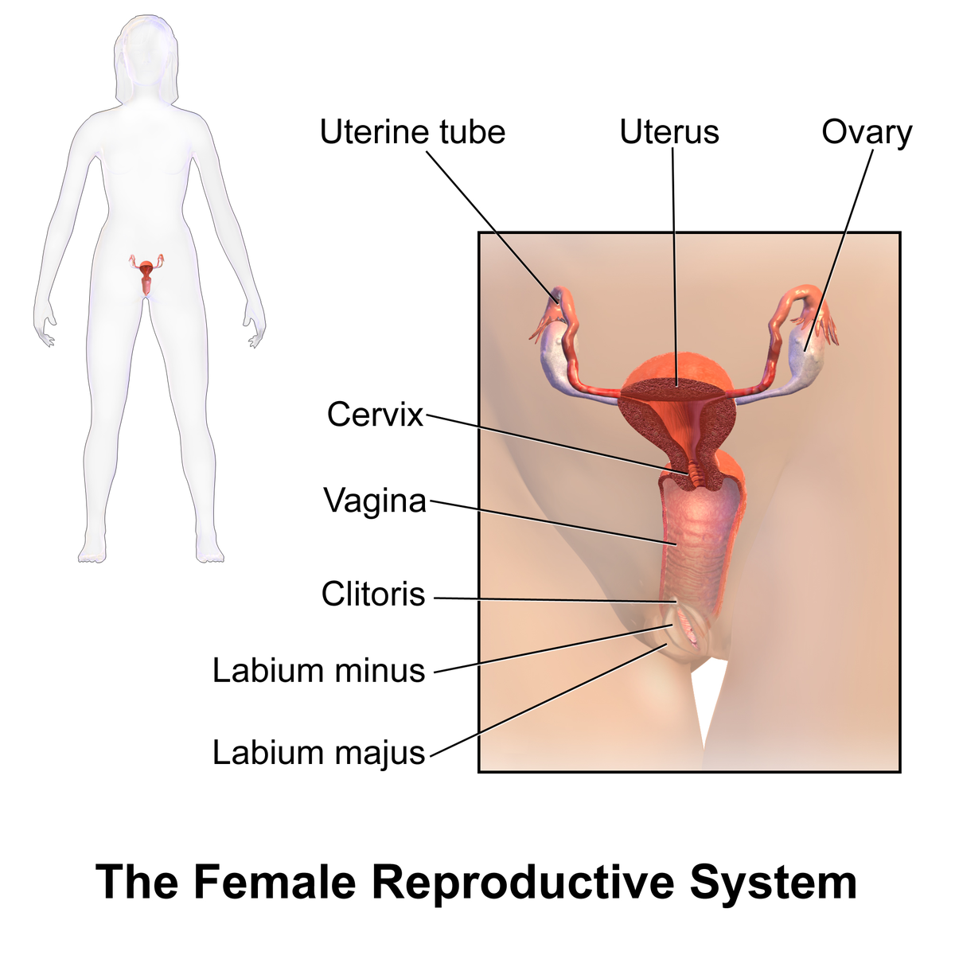
Labia Majora
The labia majora are the outer "lips" of the vulva.
The labia majora wrap around the vulva from the mons pubis to the perineum.

Slide 7
Labia Minora
Medial to the labia majora are the labia minora. The labia minora are the inner lips of the vulva. They are thin stretches of tissue within the labia majora that fold and protect the vagina, urethra, and clitoris.
There is no pubic hair on the labia minora, but there are sebaceous glands.
The labia minora protect the vaginal and urethral openings.

Slide 8
Clitoris
The clitoris is a small oval structure located at the top of the labia minora.
It is believed that it functions solely for sexual pleasure.
During sexual excitement, the clitoris erects and extends, the hood retracts, making the clitoral glans more accessible.
The size of the clitoris is variable between women.

Slide 9
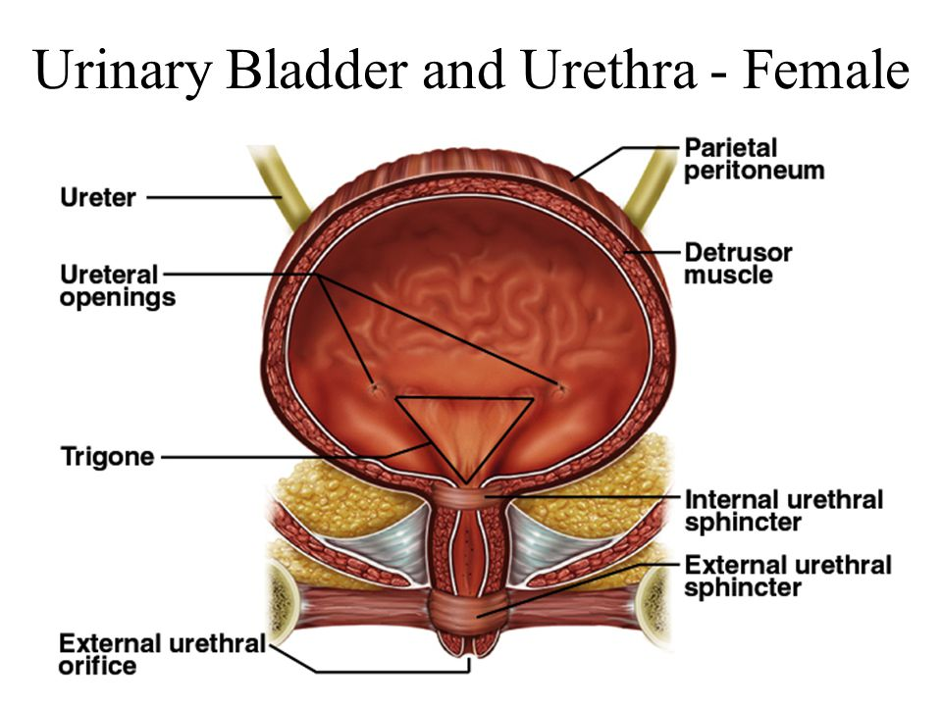
Urethra
The opening to the urethra is just below the clitoris.
The urethra is used for the passage of urine.
The urethra is connected to the bladder.

Slide 10
Urethra
In females the urethra is 1.5 inches long, compared to males whose urethra is 8 inches long.
Because the urethra is so close to the anus, women should always wipe themselves from front to back to avoid infecting the vagina and urethra with bacteria.
This location issue is the reason for bladder infections being more common among females.

Slide 11
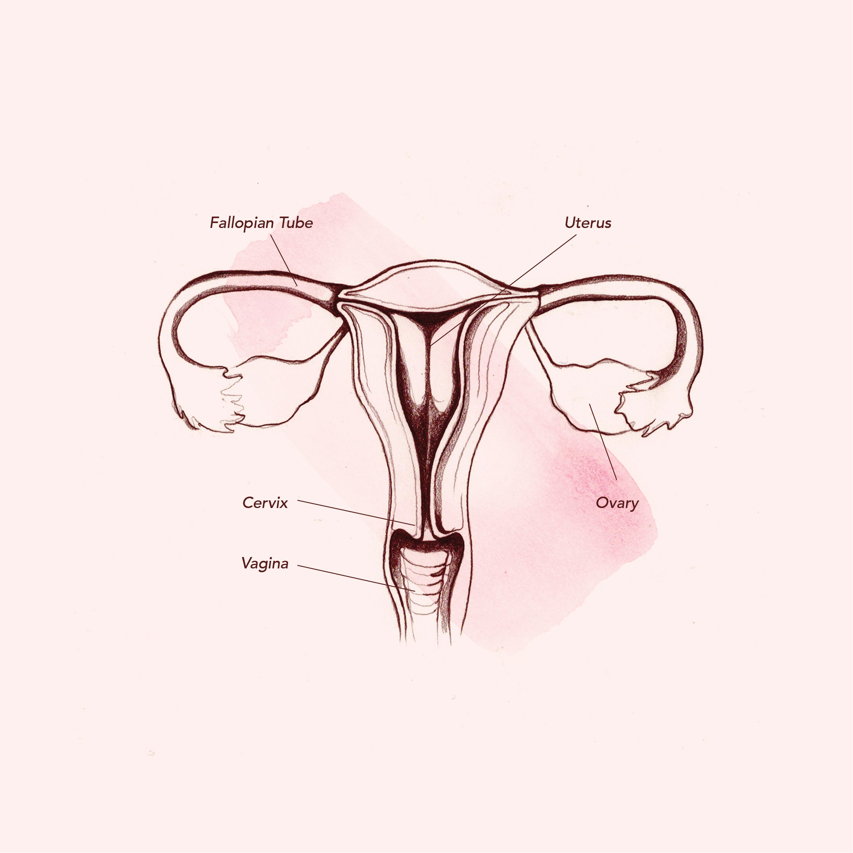
Vagina
The vagina is a muscular, hollow tube that extends from the vaginal opening to the cervix of the uterus.
The vagina functions as a passageway for sperm to gain access to the fallopian tubes where fertilization may occur.

Slide 12
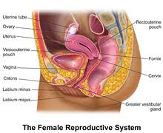
Cervix
The cervix (from Latin "neck") is the lower, narrow portion of the uterus where it joins with the top end of the vagina.
During menstruation, the cervix stretches open slightly to allow the endometrium to be shed.
During childbirth, contractions of the uterus will dilate the cervix up to 10 cm in diameter to allow the child to pass through.

Slide 13
Uterus
The uterus is shaped like an upside-down pear, with a thick lining and muscular walls. Located near the floor of the pelvic cavity, it is hollow to allow a blastocyte, or fertilized egg, to implant and grow.
It also allows for the inner lining of the uterus to build up until a fertilized egg is implanted, or it is sloughed off during menses.
The uterus contains some of the strongest muscles in the female body.
These muscles are able to expand and contract to accommodate a growing fetus and then help push the baby out during labor.

Slide 14
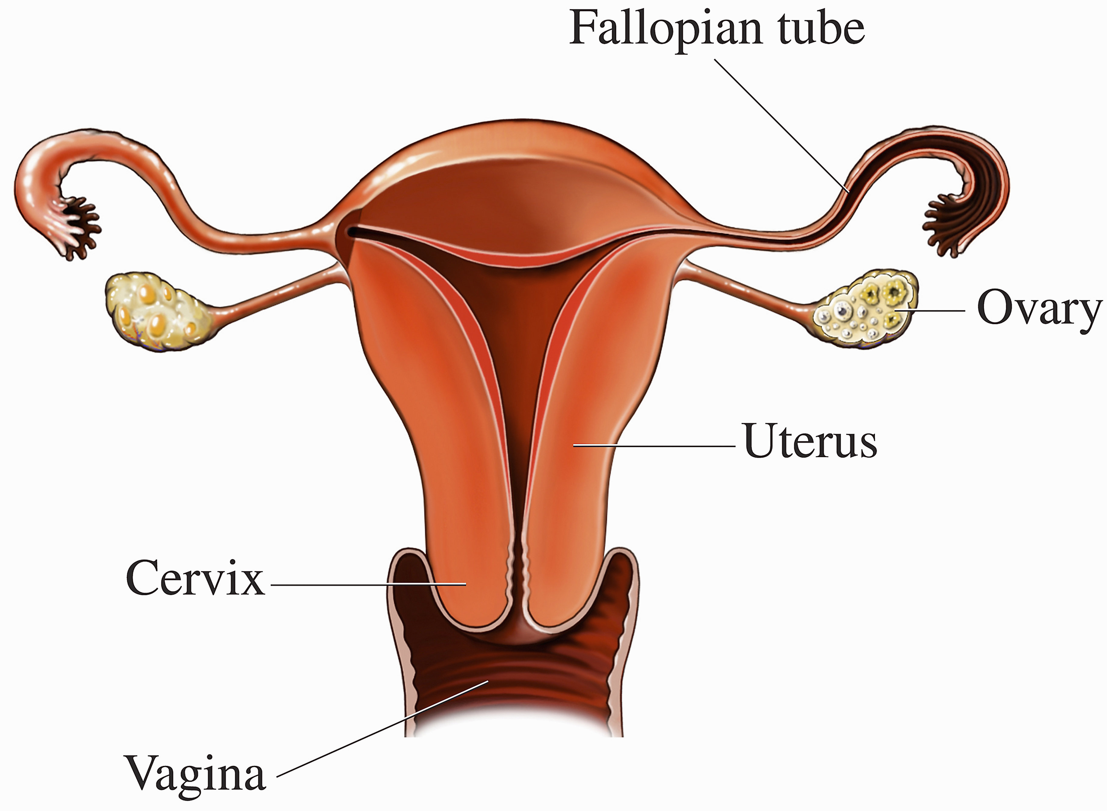
The Female Gonads
The female gonads are the ovaries.
The ovaries house the immature oocytes that mature to become ova (eggs).
During ovulation, one mature egg is released from the ovary into the fallopian tube, where fertilization can occur.

Slide 15
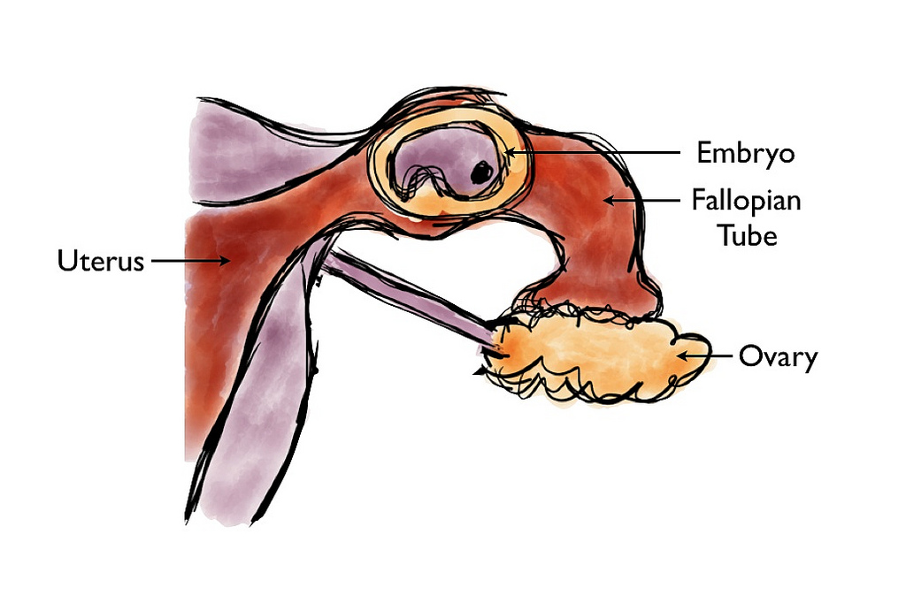
The Fallopian Tube (Uterine Tube)
During ovulation, a mature egg (oocyte or ovum) is released from the ovary into the fallopian tube.
Fertilization of the egg occurs in the fallopian tube.

Slide 16
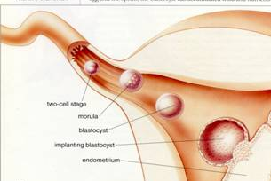
Sperm cells remain viable within the female reproductive tract for about 72 hours. Only a single sperm cell is needed to fertilize the ovum. During fertilization, the sperm donates its genetic material to the ovum at which time the egg becomes fertilized (becoming a ZYGOTE). The zygote will remain in the fallopian tube for approximately three days before it travels to the uterus where it will remain for approximately four to five days before implantation into the uterine lining.

Slide 17
The Male Reproductive System

Slide 20
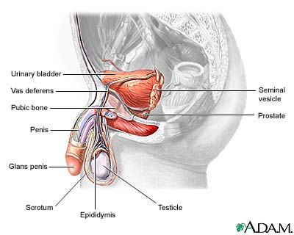
The Penis
The male external structures are the penis and the scrotum (a pouch which protects the testes).
The penis consists of the glans (the head), and the shaft(the body).
The glans is covered by a fold of skin called the foreskin(circumcision removes the foreskin).

Slide 21
Scrotum
The scrotum surrounds and protects the two testes, internal structures also referred to as testicles.
The scrotum functions to regulate the temperature of the testes, because sperm prefer to be a few degrees BELOW body temperature.

Slide 22
The Male Gonads – The Testes
The testes are the male where sperm cells are produced.

Slide 23
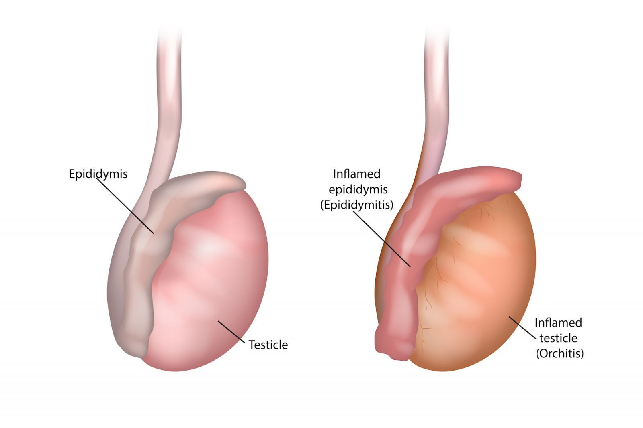
The epididymis
The epididymis is a small oblong body which rests on the surface of the testes where sperm mature and are stored.
The epididymis leads into the vas deferens (narrow tubes which carry sperm away from the testes).

Slide 24
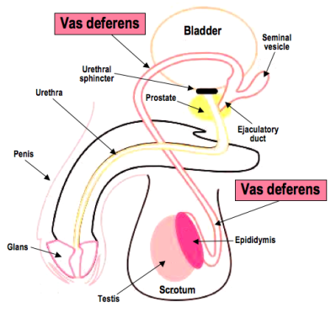
The vas deferens
The vas deferens extends to join with the ducts of the two seminal vesicles (located on side of the prostate gland) to form the ejaculatory ducts which extend through the body of the prostate gland and empty into the urethra.

Slide 25
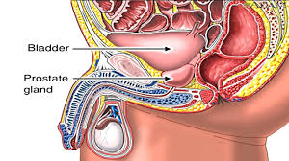
The prostate gland
The prostate gland surrounds the neck of the bladder (the structure that stores urine) and the urethra, (a thin tube which extends through the penis and carries semen and urine outside of the body, although not simultaneously).

Slide 26
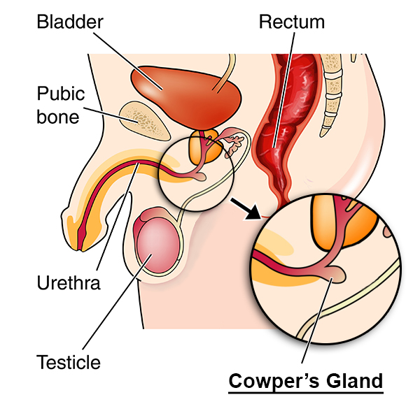
Cowper's glands
The Cowper's glands (also called the bulbourethral glands) are found on each side of the urethra, just below the prostate gland.

Slide 31
