Slide 1

The Urinary System
By Scientist Cindy

Slide 2
What is the Urinary System?
The Urinary System is a group of organs in the body concerned with filtering out excess fluid and other substances from the bloodstream.
  The substances are filtered out from the body in the form of urine.
  Urine is a liquid produced by the kidneys, collected in the bladder and excreted through the urethra.
  Urine is used to extract excess minerals or vitamins from the body.

Slide 3
Functions of the Urinary System
Excretion – the process of eliminating waste products
Maintains an appropriate fluid volume – regulating the amount of water that is excreted in the urine.
Regulates the concentrations of various electrolytes in the body fluids
Maintaining normal pH of the blood.

Slide 4
The Urinary organs
  The Urinary organs include
    the kidneys
    The ureters
    The bladder
    The urethra

Slide 5
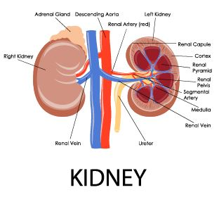
The kidneys
The kidneys are the most important excretory organ.
The primary function of the kidneys is to maintain a stable internal environment (homeostasis) for optimal cell and tissue metabolism.
  The kidneys removes unwanted urea, mineral salts, toxins, and other waste products from the blood.
  The kidneys conserve water, salt, and electrolyte concentration.
  At least one kidney must function properly for life to be maintained.

Slide 6
Six important roles of the kidneys are:
Regulation of plasma ionic composition
Regulation of plasma osmolarity
Regulation of plasma volume
Regulation of plasma hydrogen ion concentration (pH)
Removal of metabolic waste products and foreign substances from the plasma
Secretion of Hormones

Slide 7
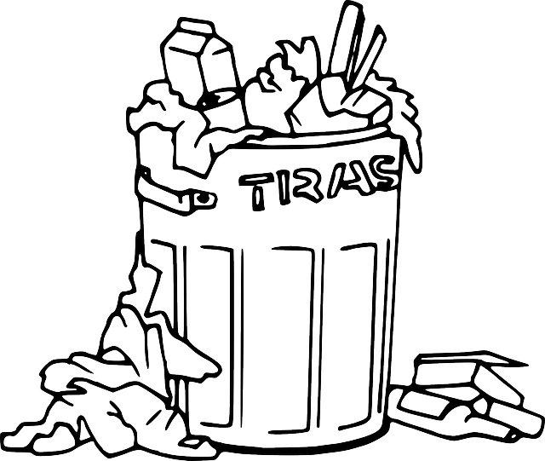
ROLES OF THE KIDNEYS
- Removal of waste
The kidneys get rid of
  Urea - metabolic waste from the liver
  Ammonia - metabolic waste from the liver
  Creatinine - metabolic waste from the muscles
  Uric acid - metabolic waste from the break down of nucleotides.
    Uric acid is insoluble and too much uric acid in the blood will build up and form crystals that can collect in the joints and cause gout.

Slide 8
Kidneys And Their Structure
Renal pyramid
Renal artery
Renal vein
Renal pyramid
Interlobar artery
Renal artery
Renal vein
Renal hilum
Renal pelvis
Ureter
Minor calyx
Renal capsule
Inferior renal capsule
Superior renal capsule
Interlobar vein
Nephron
Minor calyx
Major calyx
Renal papilla
Renal column
Renal hilum
Renal pelvis
Ureter

Slide 9
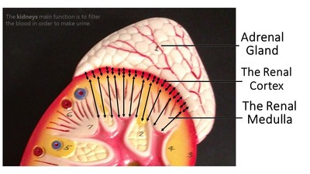
Kidneys And Their Regions
The Renal Cortex
The Renal Medulla

Slide 10
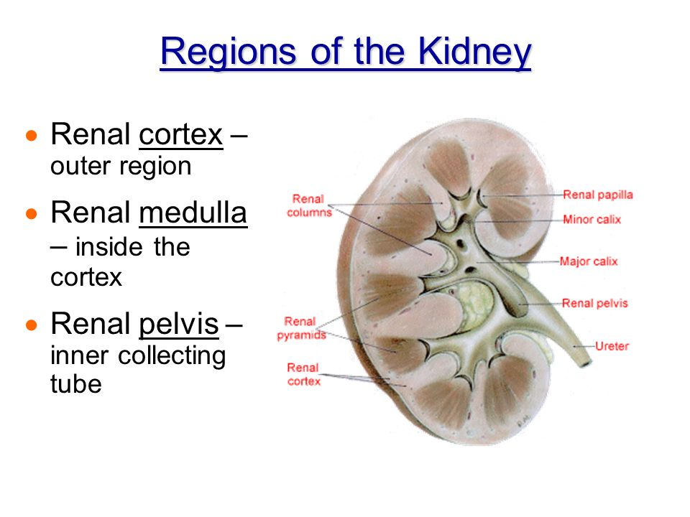
regions of the kidney
There are three major regions of the kidney:
  renal cortex
  renal medulla
  renal pelvis
The outer, granulated layer is the renal cortex
The inner radially striated layer is the renal medulla
The renal medulla contains the renal pyramids
The renal pelvis are continuous with the ureters

Slide 11
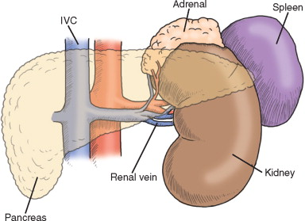
Renal Vein
inferior vena cava
The renal veins are veins that drain the kidney.
They connect the kidney to the inferior vena cava.
Renal vein

Slide 12
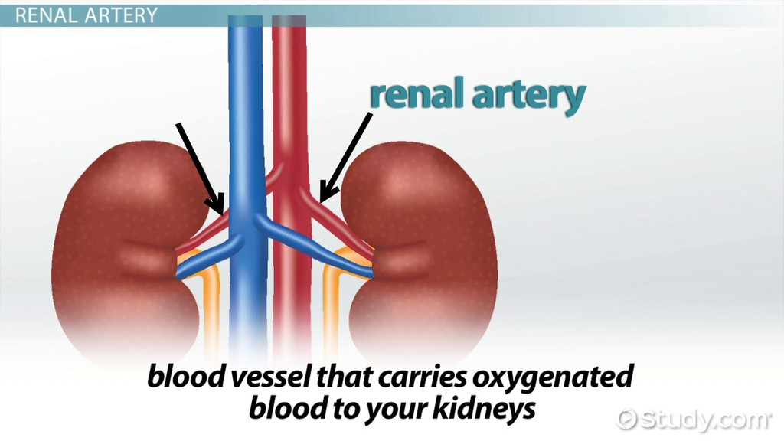
Renal Artery
The renal arteries arise off the abdominal aorta and supply the kidneys with blood.
The renal arteries carry a large portion of the total blood flow to the kidneys.
Up to a third of the total cardiac output can pass through the renal arteries to be filtered by the kidneys.

Slide 13
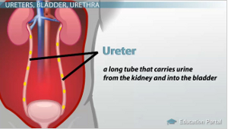
Ureters
The ureters are two tubes that drain urine from the kidneys to the bladder.
Muscles in the walls of the ureters send the urine in small spurts into the bladder
After the urine enters the bladder from the ureters, small folds in the bladder mucosa act like valves preventing backward flow of the urine.

Slide 14
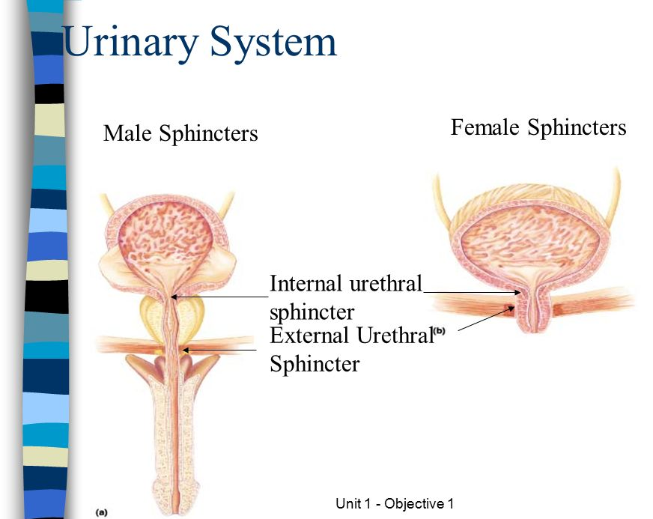
Urinary Sphincters
The outlet of the bladder is controlled by a sphincter muscle.
  A full bladder stimulates sensory nerves in the bladder wall that relax the sphincter and allow release of the urine. However, relaxation of the sphincter is also in part a learned response under voluntary control.
  The released urine enters the urethra.

Slide 15
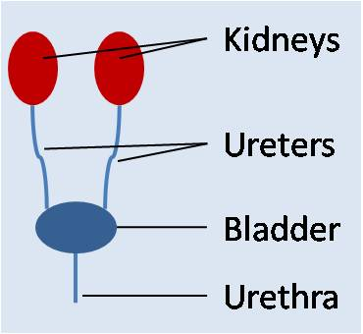
The urethra
The urethra is a muscular tube that connects the bladder with the outside of the body.
The function of the urethra is to remove urine from the body.

Slide 16
The female urethra is much shorter than the male urethra.

Slide 17
The Female Urethra
The female urethra is much shorter than the male urethra.
Women tend to be more susceptible to infections of the bladder (cystitis) and the urinary tract (UTI).

Slide 18
Male urethra
In the human male, the urethra is a common pathway for semen as well as urine.
The urethral sphincter is much stronger in males
  meaning that they can retain a large amount of urine for twice as long as females

Slide 19
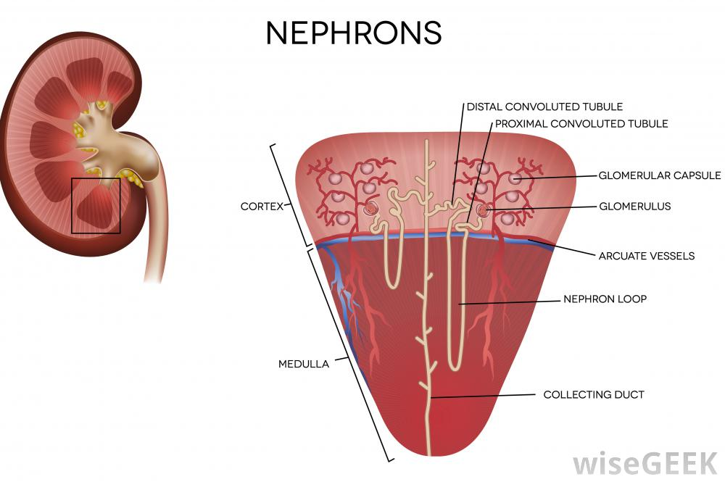
Nephrons
A nephron is the basic structural and functional unit of the kidney.
Its chief function is to
  regulate water and soluble substances by filtering the blood
  reabsorbing what is needed and excreting the rest as urine.

Slide 20
Nephrons
Nephrons
  Eliminate wastes from the body
  Regulate blood volume
  Regulate blood pressure
  Control levels of electrolytes and metabolites
  Regulate blood ph

Slide 21
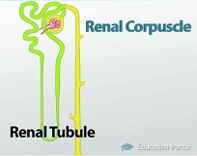
Nephrons
Each nephron is composed of
  an initial filtering component (the renal corpuscle)
  a tubule specialized for reabsorption and secretion (the renal tubule).

Slide 22
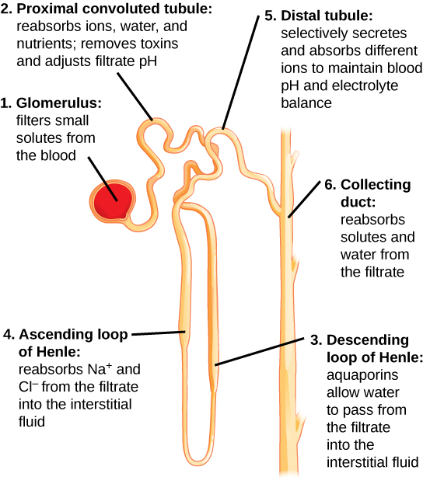
Renal Tubules

Slide 23
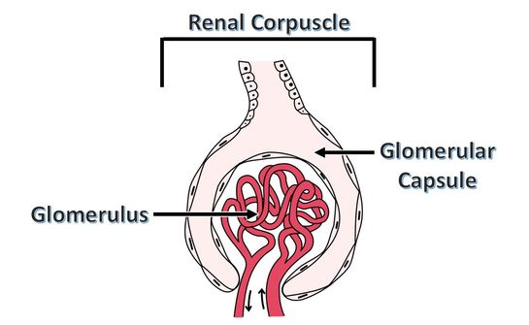
Renal Corpuscle
Together, the Glomerulus and Glomerular Capsule or Bowman's Capsule are called the Renal Corpuscle.
Between the visceral and parietal layers of the Renal Corpuscle is the Bowman's space.

Slide 24
The renal corpuscle
The renal corpuscle
  Filters out large solutes from the blood
  Allows water and small solutes to move on to the renal tubule

Slide 25
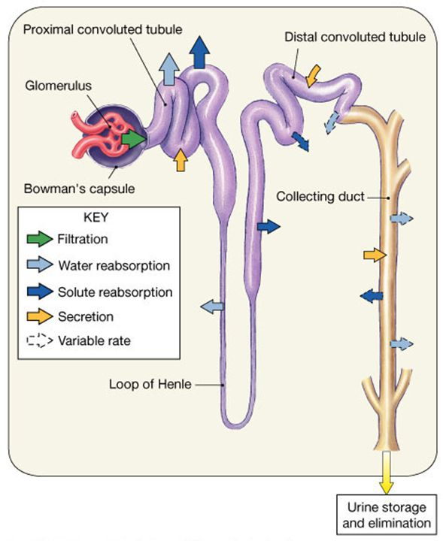
Collecting ducts
Each distal convoluted tubule delivers its filtrate to a system of collecting ducts.
As the urine travels down the collecting duct, as much as three-fourths of the water from urine can be reabsorbed as it leaves the collecting duct by osmosis.

Slide 26

Tubular Secretion
Urine is a collection of substances that have not been reabsorbed during glomerular filtration or tubular reabsorbtion.

