Slide 1

Muscles
By Scientist Cindy
See More at www.scientistcindy.com

Slide 2
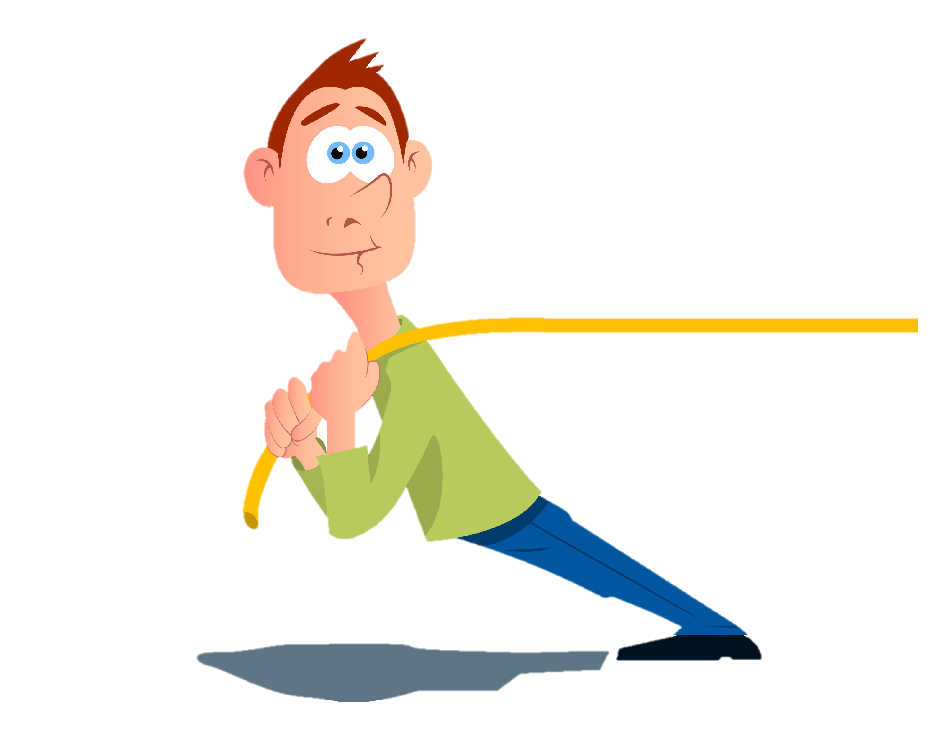
Muscles CONTRACT (SHRINK)
Muscles always PULL they never PUSH.
When a muscle contracts, it pulls the bones it connects to closer to one another, by decreasing the angle of the movable joint that is spans.

Slide 3
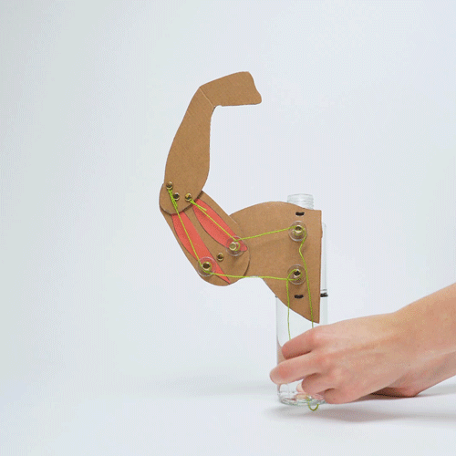
Muscles always PULL they never PUSH.
Here’s Proof!
In this “muscle machine”, it is the “pulling action” of the biceps muscles that exerts the force that pulls the arm upwards.
AND…it is the “pulling action” of the triceps muscles that exerts the force that pulls the arm Downwards.

Slide 4
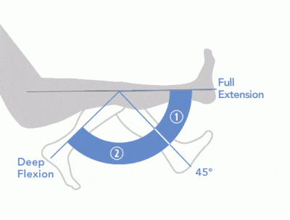
Flexion and Extension
Flexion is the action of decreasing the angle of a joint
Extension is the action of increasing the angle of the joint

Slide 5
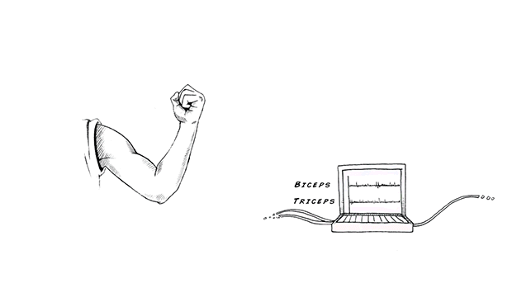
Agonist / Antagonist
When you flex your arm at the elbow joint,
  The biceps muscle are contracting; exerting the force needed to decrease the angle of the elbow joint for flexion.
  At the same time, the triceps muscle that function to exert force in the opposite direction, must relax, in order to allow for this movement!

Slide 6
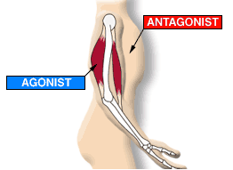
Agonist / Antagonist
We call these opposites agonist and antagonist
Agonist muscles - muscles that produce movement through contraction
Antagonist muscles – muscles which(if contracted) function to exert force in the opposite direction to the agonist muscle.

Slide 7
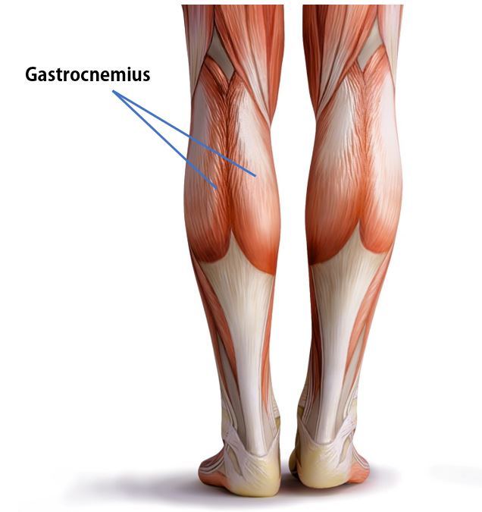
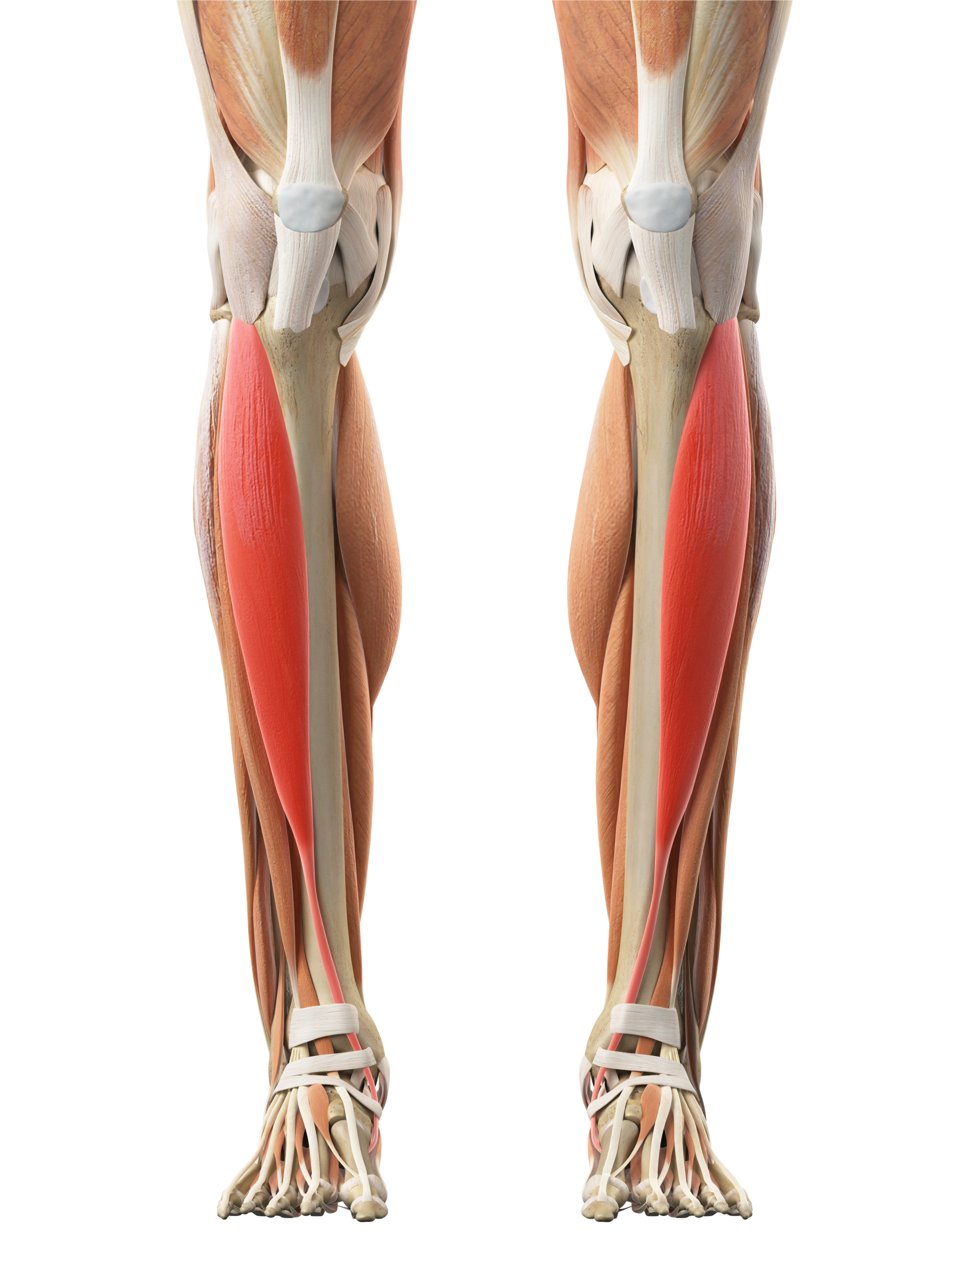
Agonist / Antagonist
Another example of an agonist/antagonist pair is the gastrocnemius muscle (calf muscle) and the tibialis anterior.
Tibialis Anterior

Slide 8
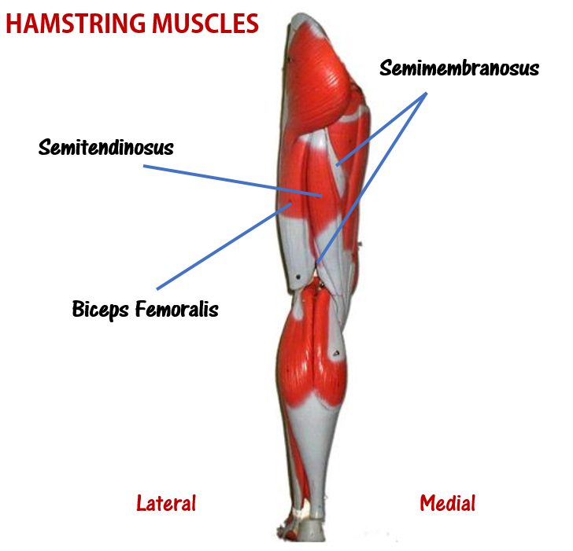
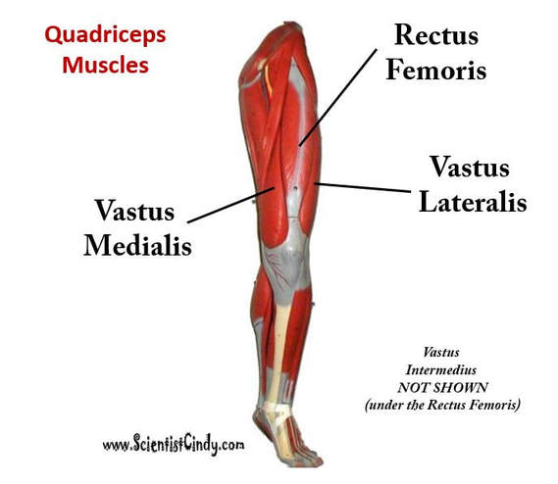
Agonist / Antagonist
Another example of an agonist/antagonist pair is the quadriceps muscles and the hamstring muscles.

Slide 9
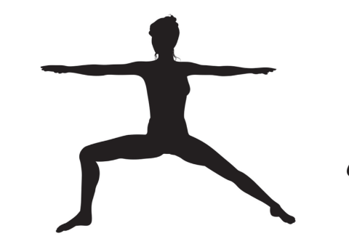
Agonist / Antagonist
Another example of an agonist/antagonist pair is the quadriceps muscles and the hamstring muscles.
The quadriceps act as antagonists when you lift your leg up high (hip flexion), because their direction of exerted force (if contracted) would be in a direction that was opposite from the direction of motion.

Slide 10
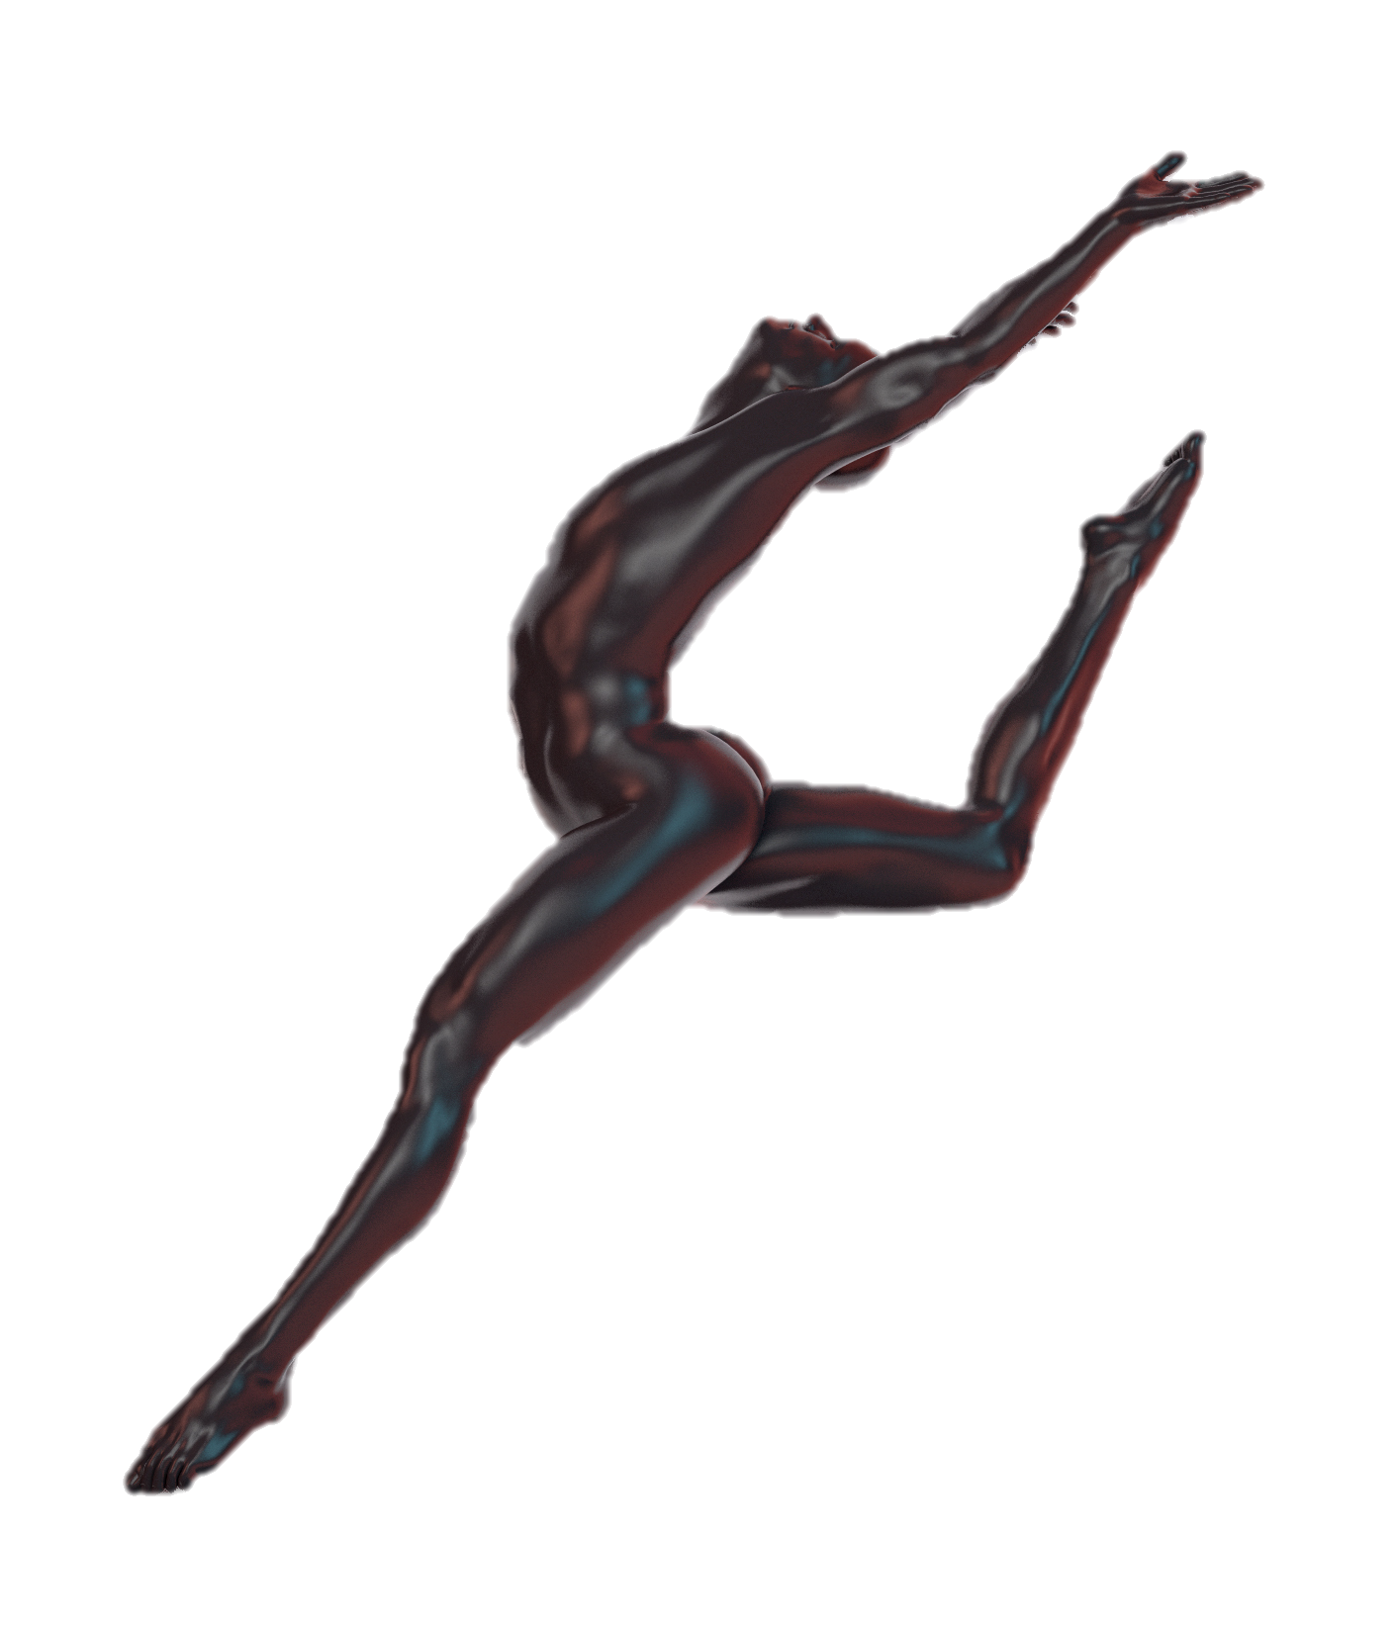
Agonist/Antagonist
Sometimes antagonist muscles slow down and control the movement of the agonist partner.

Slide 11
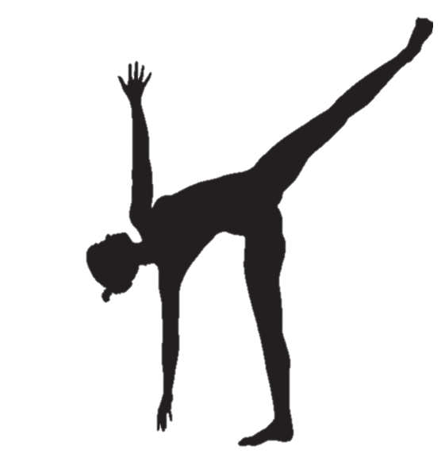
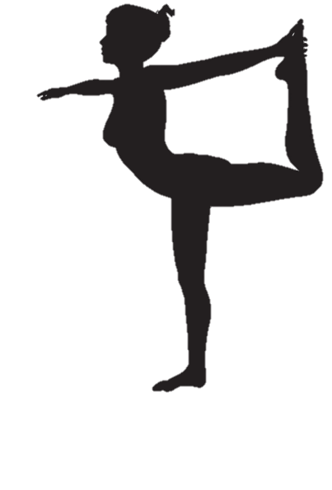
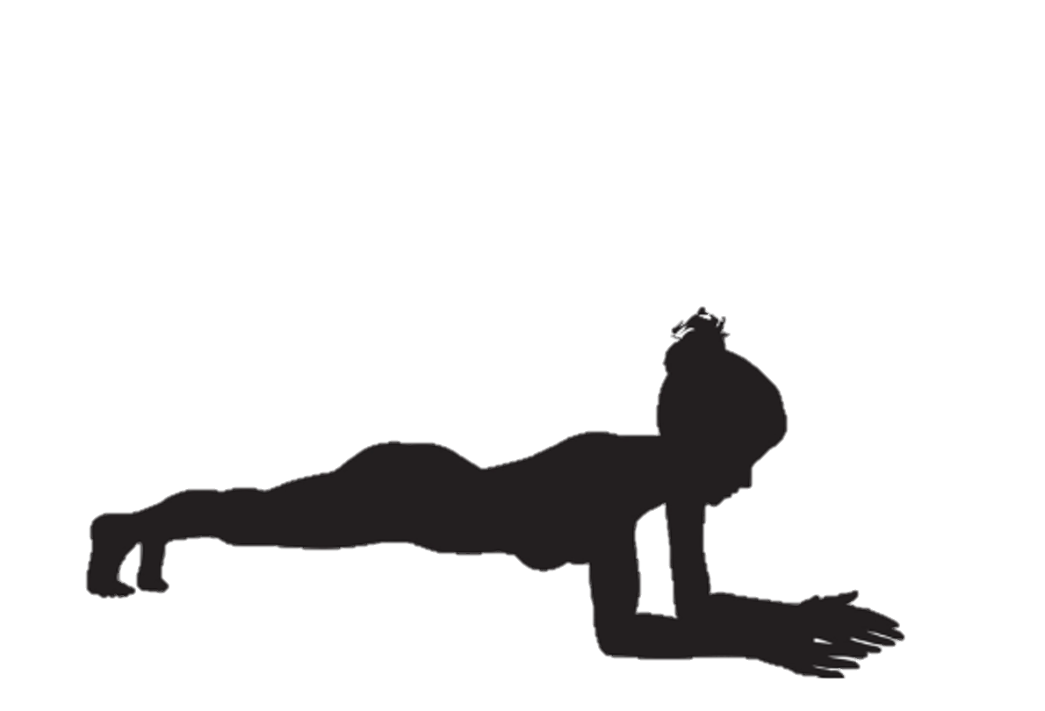
Agonist/
Antagonist
If you were to flex an agonist and antagonist at the same time, there would be no movement.

Slide 12
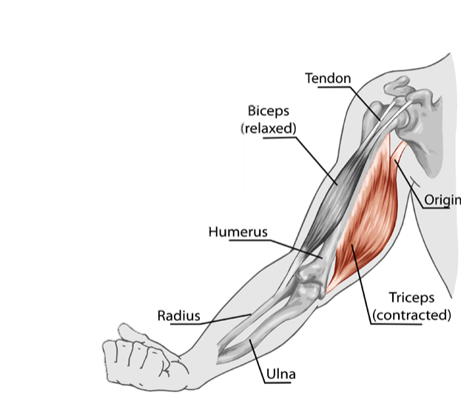
Origin and Insertion
Skeletal muscles…
  attach to at least 2 bones,
  and span one movable joint.
The way that these muscles attach to the bones of your body, is through TENDONS.

Slide 13
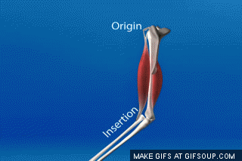
Origin and Insertion
It is Important to be Able to Distinguish Between the Origin and the Insertion Point of a Muscle.
This information will tell us the function of the muscle.
Remember that structure equals function!

Slide 14
Origin and Insertion
Typically, when we contract a muscle, one of the bones that the muscle attaches to moves a lot, while the other bone(s) that the muscle attaches to remains relatively still or "fixed" in space.
The origin is the attachment site that remains relatively "fixed in space" during muscle contraction
The insertion is the attachment site that moves quite a bit during muscle contraction.

Slide 15
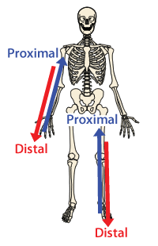
Origin and Insertion
The insertion will usually be the more distal (distant from the torso) point of muscle attachment to bone (via the tendon).
The origin will usually be the more proximal (closer to the torso) point of muscle attachment to bone (via the tendon).

Slide 16
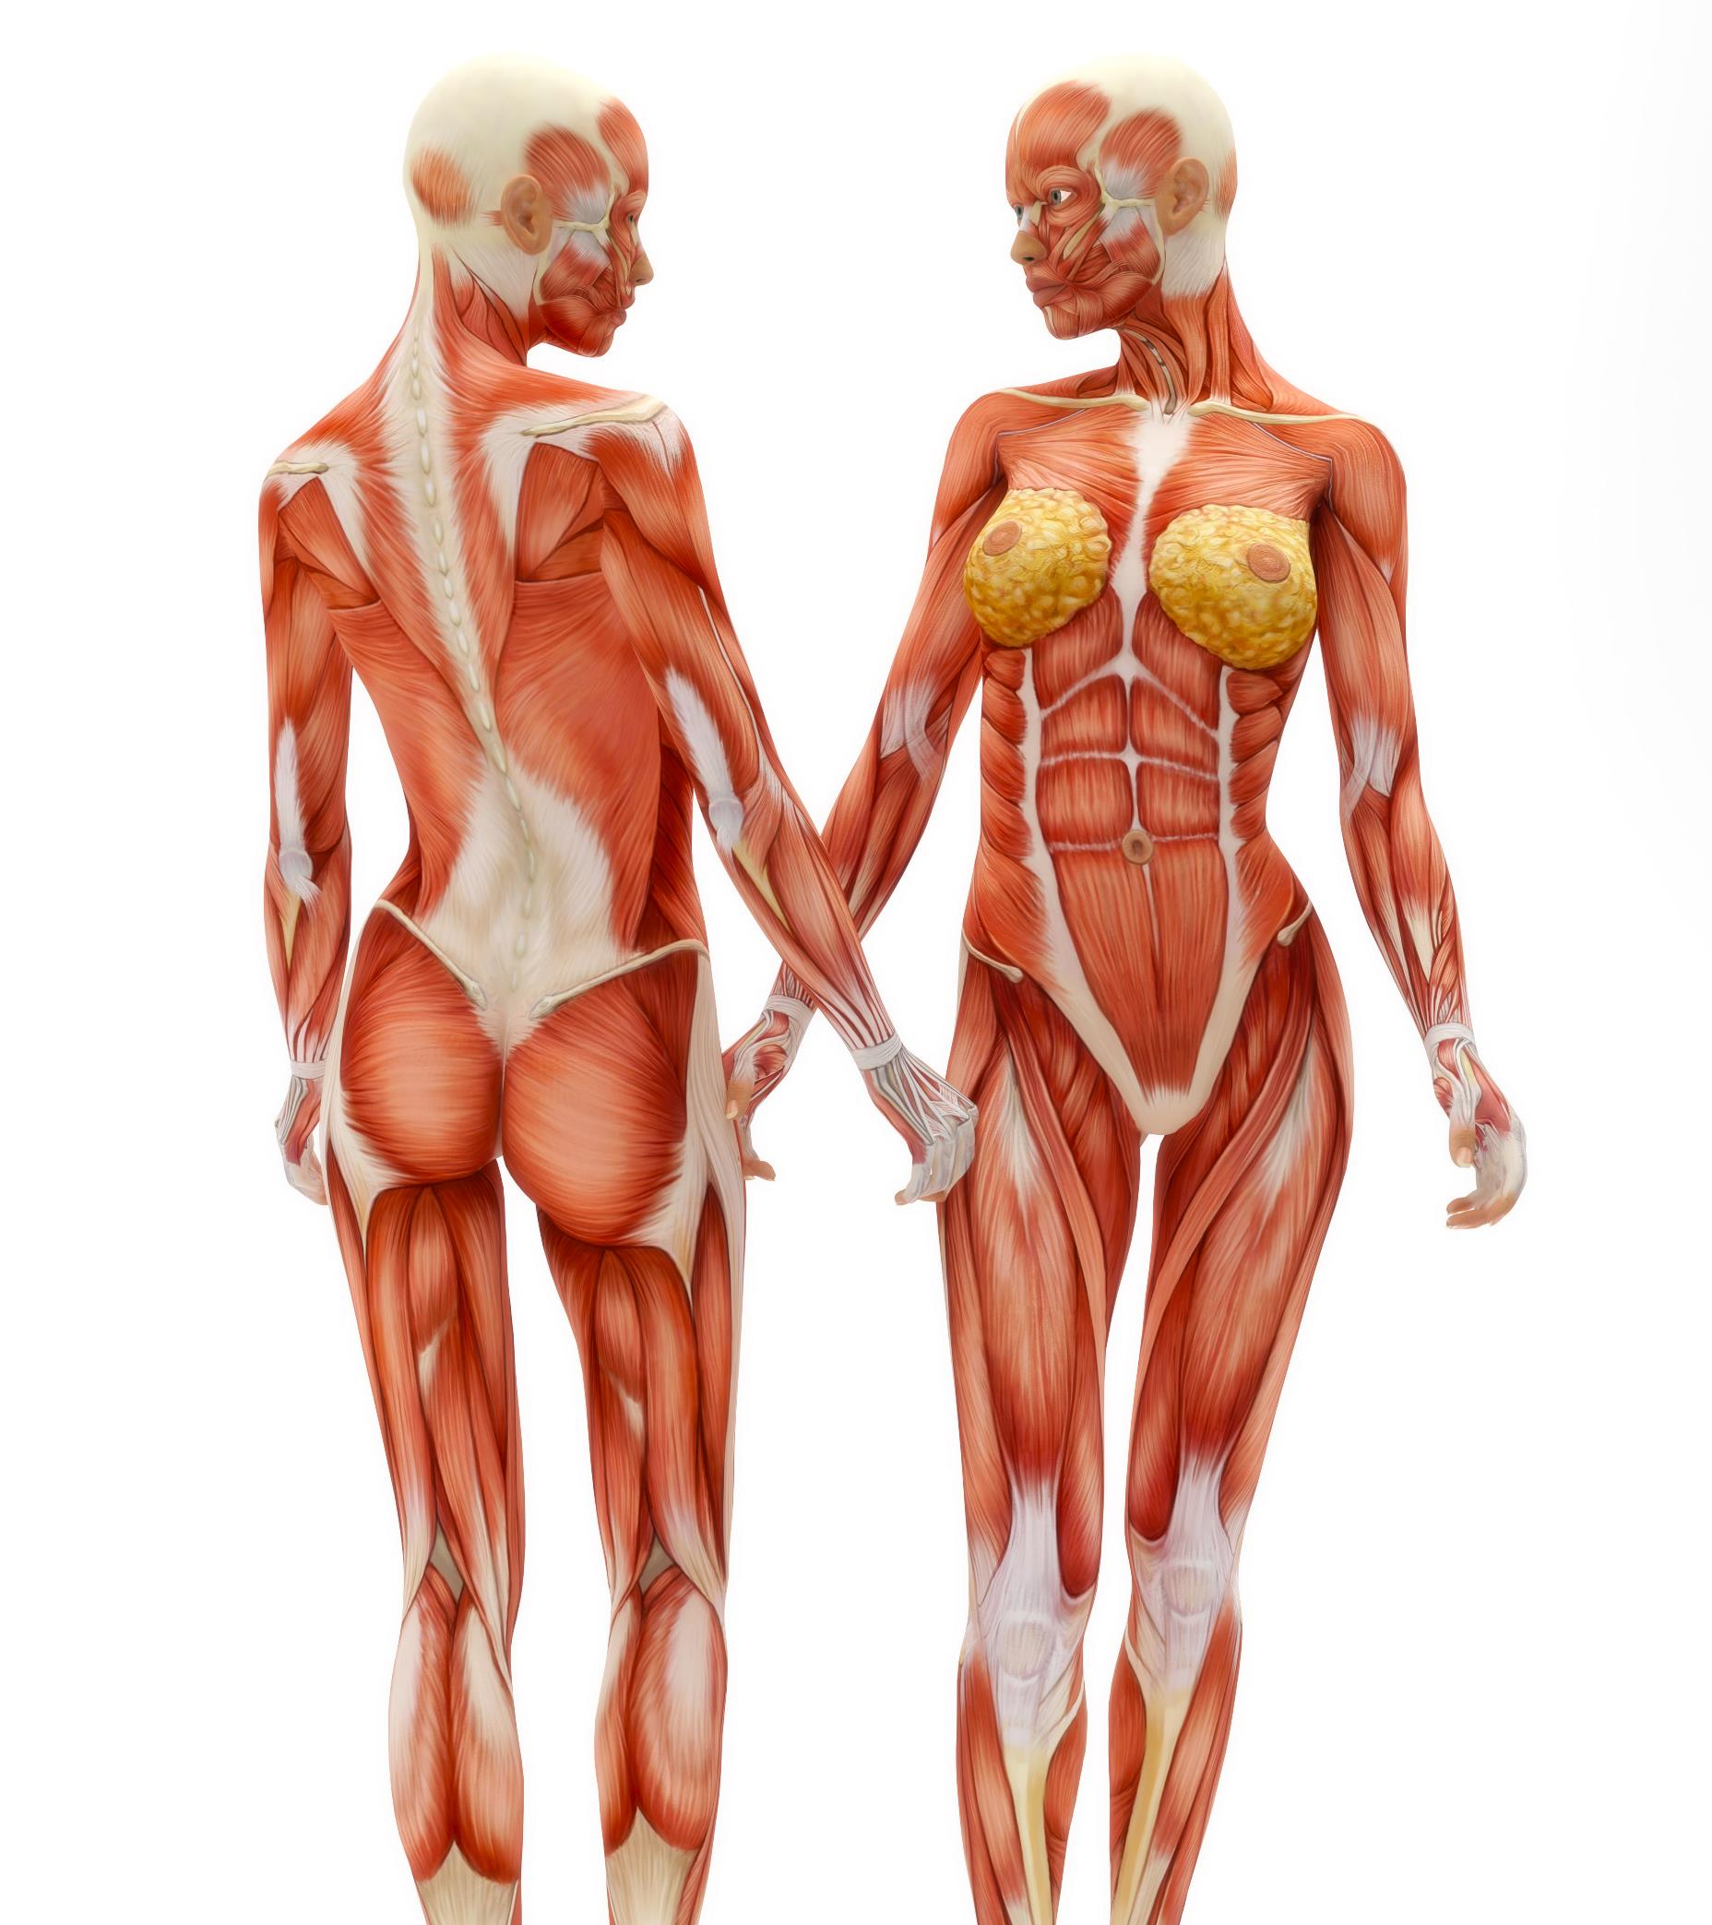
Muscle Action
Muscular contraction results in the movement or action of the bones attached.
The action of a muscle is the direct result of the muscle attachments. So, knowing the origin and insertion points, gives us information on the “action” that muscle performs.

Slide 17
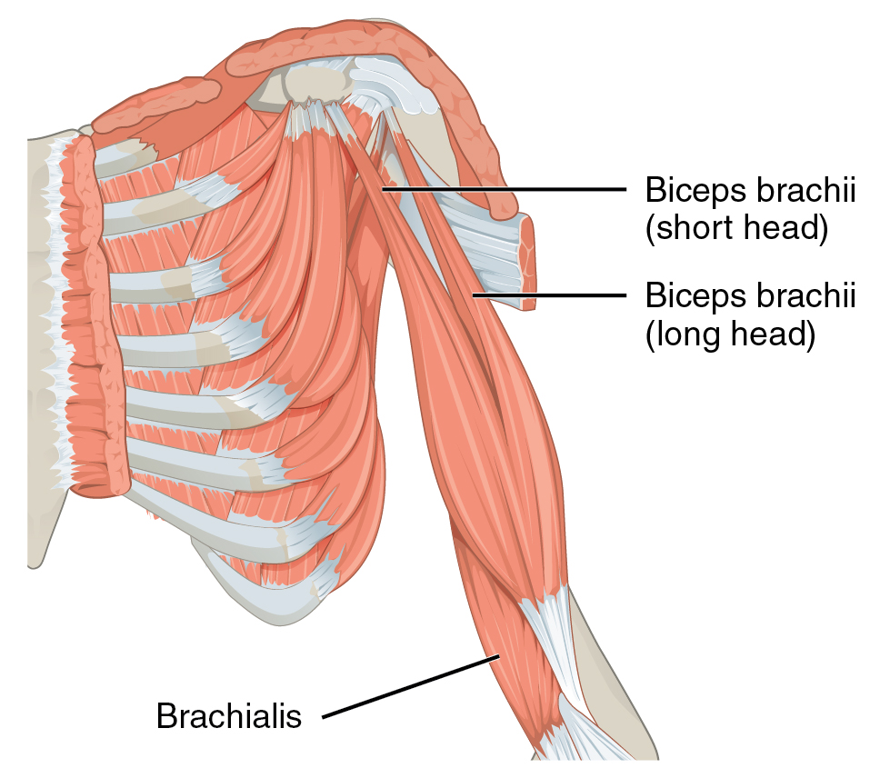
Muscle Action
Muscle actions can be described in one of two ways.
  in terms of the bone or the appendage moved.
    For example, the biceps brachii performs flexion of the forearm as the forearm is moved.
  Or in terms of the joint, or the articulation.
    For example, that same muscle, the biceps brachii, performs flexion at the elbow, in which the elbow is the joint.

Slide 18
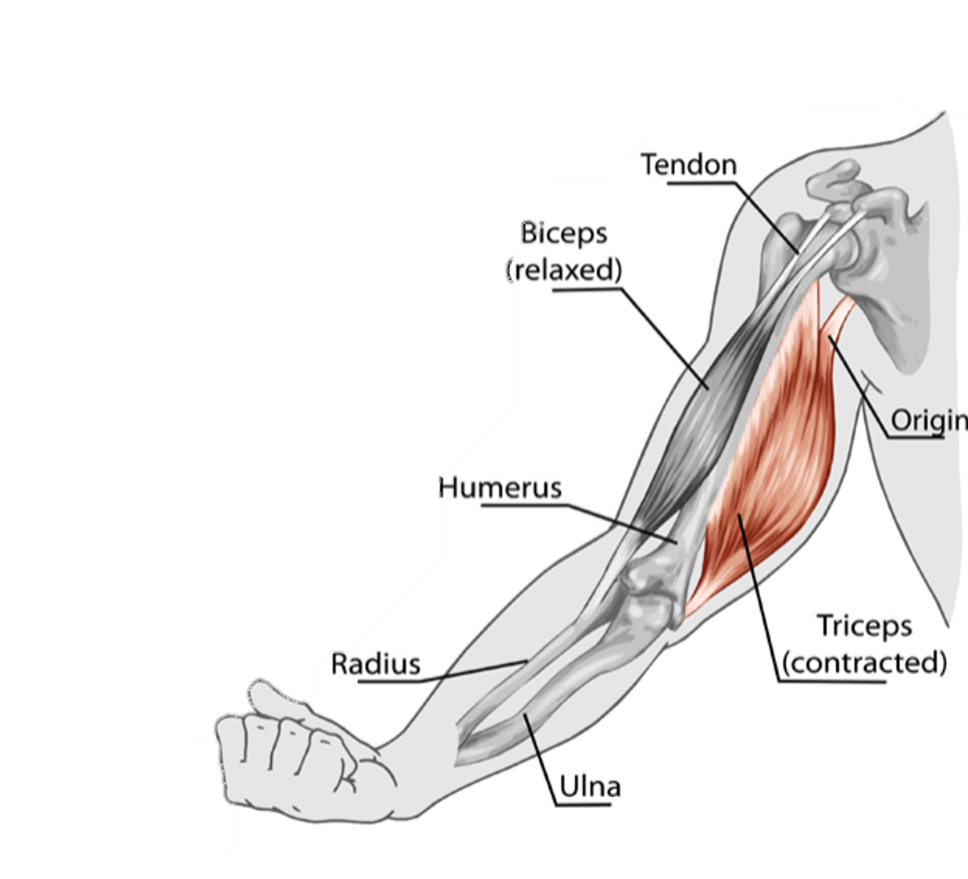
Muscle Action
The biceps brachii is the agonist of forearm flexion.
We can also say that the biceps brachii is the “prime mover” of the forearm.

Slide 19
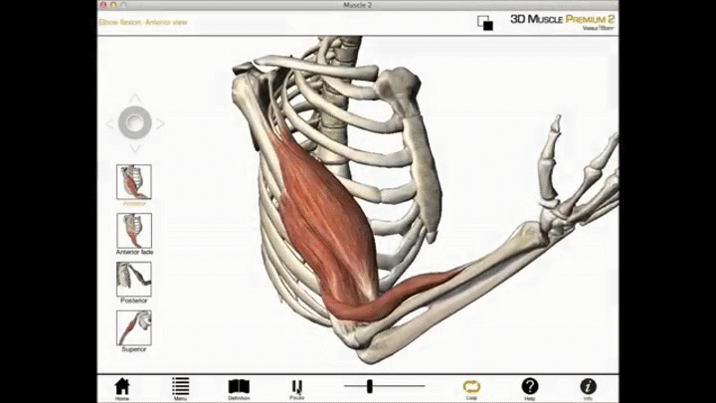
Muscle Action
For example: The biceps brachii originates on the front of the scapula of the shoulder and inserts on the front of the radius in the forearm.
Due to these attachments, contraction and muscle shortening of the biceps flexes the forearm.

Slide 20
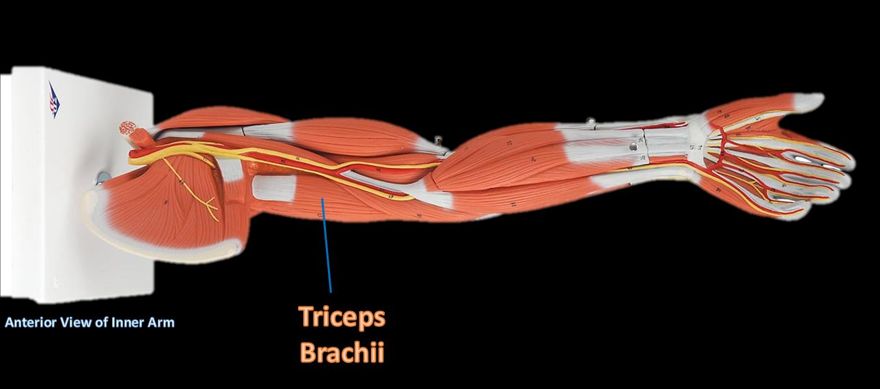
Muscle Action
The triceps is the antagonist, and its action opposes that of the agonist.
The triceps brachii originates on the back of the scapula and humerus, and inserts on the back of the ulna in the forearm.

Slide 21
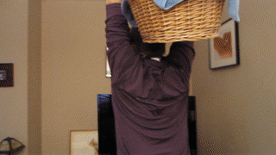
Muscle Action
Due to these attachments, the triceps is stretched during forearm flexing.
Stretching the muscle causes the triceps muscle to contract and, thus, slow flexion.
Antagonist muscles slows and controls the movement.

Slide 22
functional groups
Muscles can be classified into three functional groups:
Prime Mover or Agonist - A muscle that has the major responsibility for producing a specific movement is a prime mover, or agonist, of that movement.
Antagonist - Muscles that oppose, or reverse, a particular movement are antagonists
Synergist - Synergists help prime movers or agonists by
adding additional force to the same movement or
Inhibiting oppositional movements

Slide 23
Muscle action
Sometimes muscles are named for the movement they produce.
For example, you may see action words such as
  Flexor
  Extensor
  Adductor

Slide 24
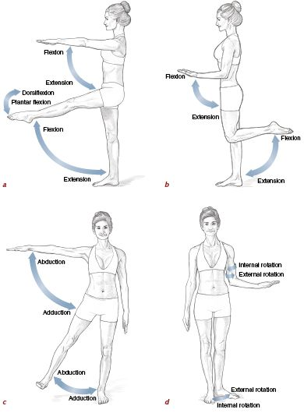
Muscle Actions

Slide 25
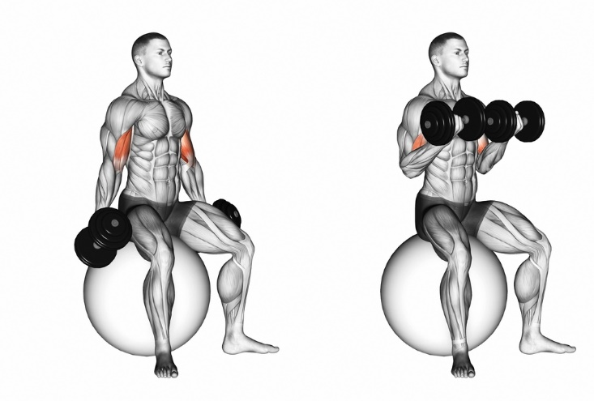
The action of a muscle
The action of a muscle can be inferred by the position of the muscle relative to the joint it crosses.
A muscle that crosses on the anterior side of a joint produces flexion.
http://ushcgshots.com/media/wysiwyg/image1.jpeg

Slide 26
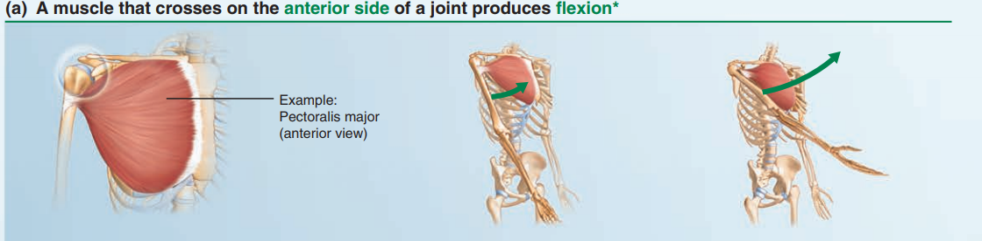
The action of a muscle
The action of a muscle can be inferred by the position of the muscle relative to the joint it crosses.
A muscle that crosses on the anterior side of a joint produces flexion.
Marieb Human Anatomy & Physiology: Tenth Edition
These generalities do not apply to the knee and ankle

Slide 27
The action of a muscle
The action of a muscle can be inferred by the position of the muscle relative to the joint it crosses.
A muscle that crosses on the posterior side of a joint produces extension.
Marieb Human Anatomy & Physiology: Tenth Edition
These generalities do not apply to the knee and ankle

Slide 28
The action of a muscle
The action of a muscle can be inferred by the position of the muscle relative to the joint it crosses.
A muscle that crosses on the lateral side of a joint produces abduction.
These generalities do not apply to the knee and ankle
Marieb Human Anatomy & Physiology: Tenth Edition

Slide 29
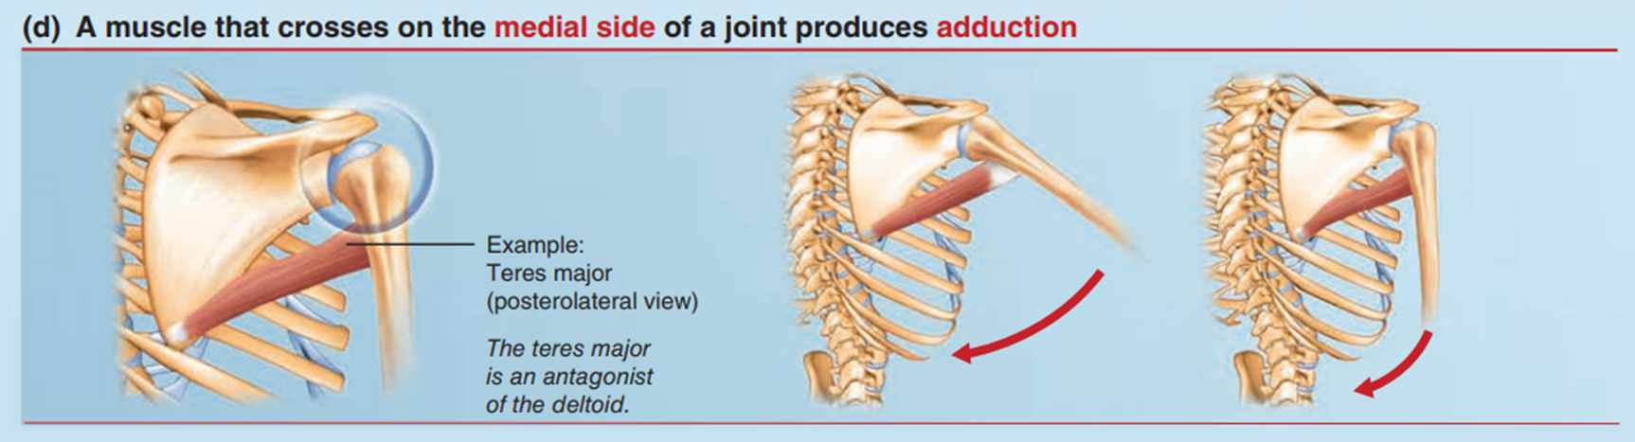
The action of a muscle
The action of a muscle can be inferred by the position of the muscle relative to the joint it crosses.
A muscle that crosses on the medial side of a joint produces adduction.
These generalities do not apply to the knee and ankle
Marieb Human Anatomy & Physiology: Tenth Edition

Slide 30

These generalities do not apply to the knee and ankle because the lower limb is rotated during development.
The muscles that cross the knee joint posteriorly produce flexion, and those that cross anteriorly produce extension.

Slide 31
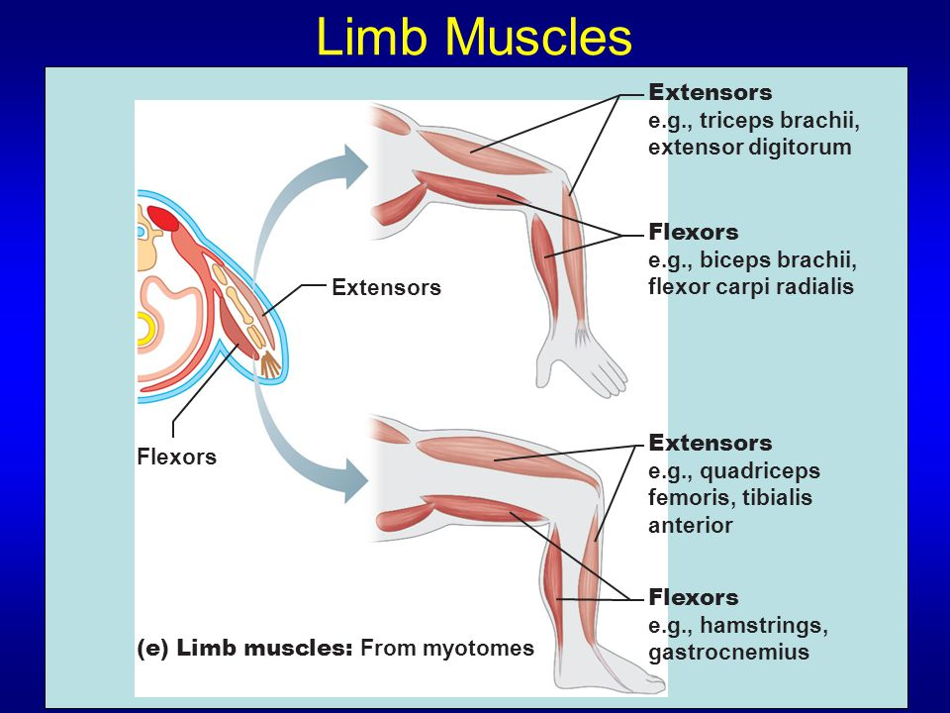
The extensors of the lower leg (or knee) are opposite from the rest of the body!

Slide 32
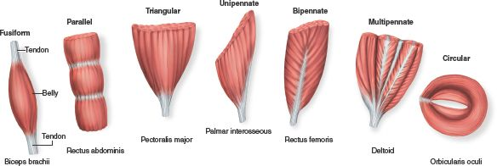
Fascicle arrangements help determine muscle shape and force.
Fascicle arrangements vary, resulting in muscles with different morphologies and functions.
The most common patterns of fascicle arrangement are
  Circular
  Convergent
  Parallel
  Pennate

Slide 33
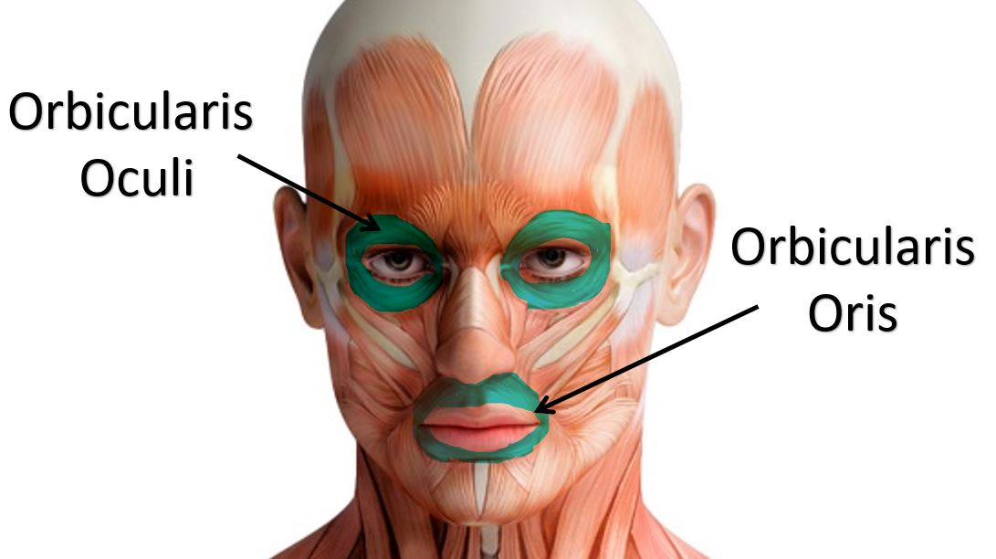
Fascicle Arrangements
Circular
Found At External Body Openings
When Muscle Contracts, It Closes.
Known As Sphincters Which Means (“Squeezers”).
Examples Are The Orbicularis Muscles Surrounding The Eyes And The Mouth.

Slide 34
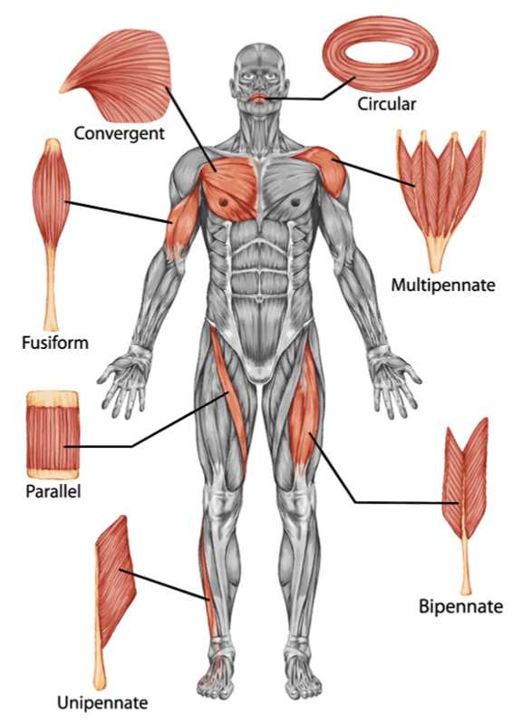
Convergent
Fascicle Arrangements
A convergent muscle has a broad origin, and its fascicles converge toward a single tendon of insertion.
Such a muscle is triangular or fan-shaped like the pectoralis major muscle of the anterior thorax.

Slide 35
Parallel
Fascicle Arrangements
May be “strap-like”
Example = sartorius muscle

Slide 36
Pennate
Fascicle Arrangements
Penna means “feather”
the fascicles are short and they attach obliquely to a central tendon that runs the length of the muscle.

Slide 37
Pennate
Fascicle Arrangements
Pennate muscles come in three forms:
Unipennate, in which the fascicles insert into only one side of the tendon, as in the extensor digitorum longus muscle of the leg.

Slide 38
Pennate
Fascicle Arrangements
Pennate muscles come in three forms:
Bipennate, in which the fascicles insert into the tendon from opposite sides so the muscle looks like a feather.
  The rectus femoris of the thigh is bipennate.

Slide 39
Pennate
Fascicle Arrangements
Pennate muscles come in three forms:
Multipennate, which looks like many feathers side by side, with all their quills inserted into one large tendon.
  The deltoid muscle, which forms the roundness of the shoulder, is multipennate.

Slide 40
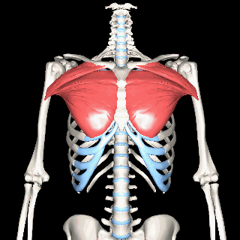
Pectoralis Major
Adducts and medially rotates arm

Slide 41
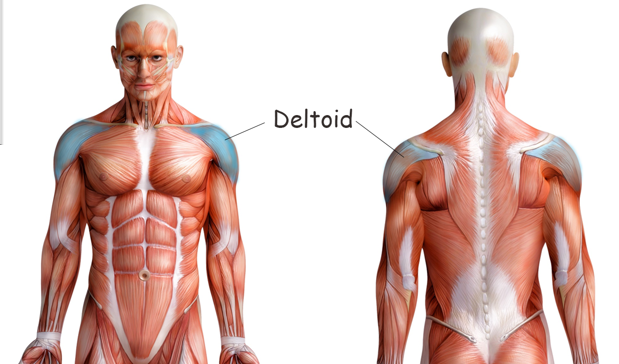
DELTOID
- Prime mover of arm abduction - Antagonist of arm adduction

Slide 42
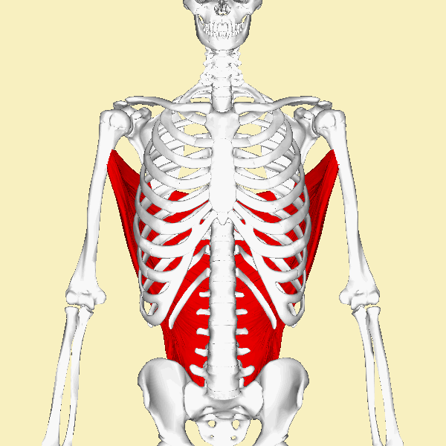
Latissimus Dorsi
Prime mover of arm extension
Antagonist of arm flexion

Slide 43
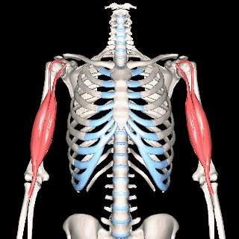
Biceps brachii
Prime Mover of Forearm Flexion
Antagonist of Forearm Extension

Slide 44
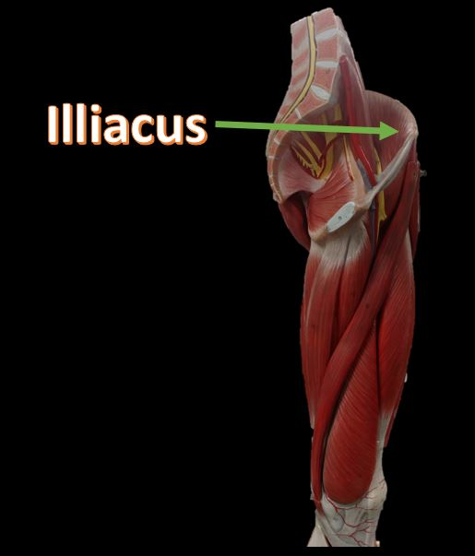
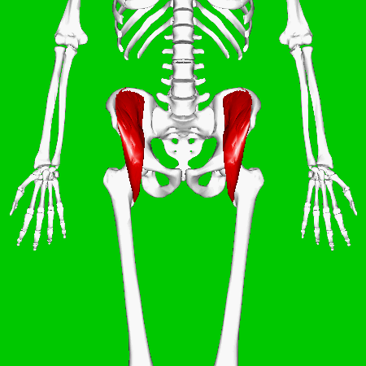

Iliacus
Prime Mover for Thigh or Hip Flexion
Antagonist of Hip Extension

Slide 45
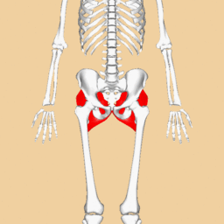
Gluteus maximus
Prime Mover of Thigh Extension
Antagonist of Thigh or Hip Flexions

Slide 46
Hamstrings - Extends thigh
Hamstrings include the…
Biceps femoris
Semitendinosus
Semimembranosus

Slide 47
Quadriceps - Flexes thigh
Hamstrings include the…
Biceps femoris
Semitendinosus
Semimembranosus

Slide 48
Action | Prime Mover | Antagonist
Shoulder/arm flexion | pectoralis major | latissimus dorsi
Shoulder/arm extension | latissimus dorsi | pectoralis major
Elbow/ forearm flexion | brachialis | triceps brachii
Elbow/forearm extension | triceps brachii | biceps brachii
shoulder adduction | latissimus dorsi & pectoralis major | deltoid
shoulder abduction | deltoid | pectoralis major & latissimus dorsi
Hip or thigh flexion | Iliac / iliacus | gluteus maximus
hip or thigh extension | gluteus maximus | Iliac / iliacus
knee flexion | hamstrings | quadriceps
knee extension | quadriceps | hamstrings

Slide 49
NOW LET’S ZOOM
IN!

Slide 50
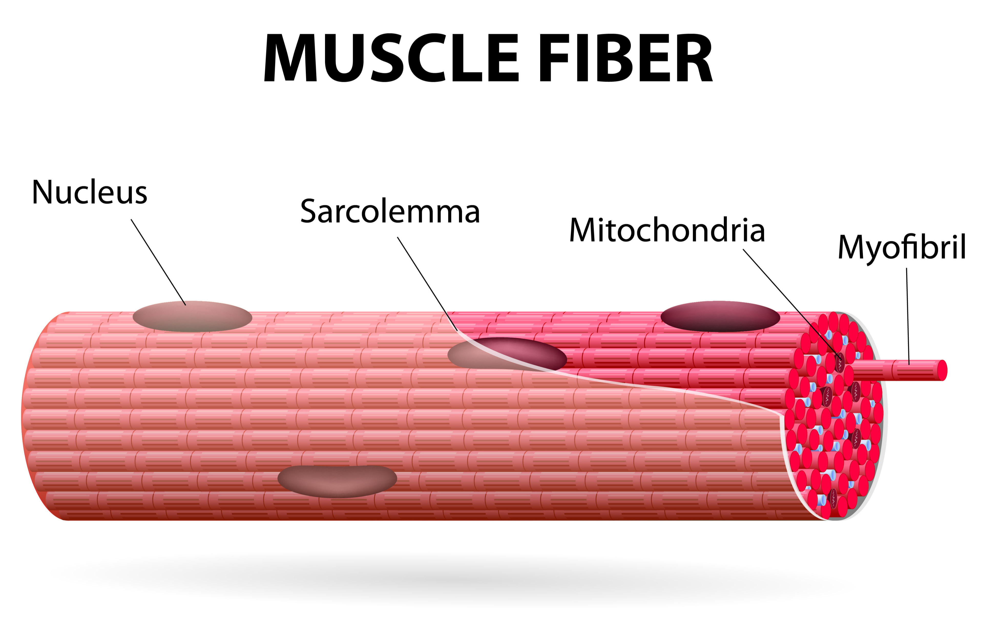
Properties of Muscle Cells
Skeletal muscle fibers form through the fusion of many embryonic muscle cells, which helps to explain their rather odd structure.
Skeletal muscle cells are multinucleated
They contain numerous mitochondria.

Slide 51
Properties of Muscle Cells
Thus, the fluid that fills the lumen of the t-tubule is the extracellular fluid. Within the cytoplasm of the skeletal muscle fiber (myoplasm or sarcoplasm), there are numerous specialized structures, which we need to understand.

Slide 52
Properties of Muscle Cells
A highly specialized endoplasmic reticulum referred to as the sarcoplasmic reticulum is tightly wrapped around individual myofibrils and functions to store a high concentration of Ca2+. Release of Ca2+ from the sarcoplasmic reticulum is responsible for triggering muscular

Slide 53
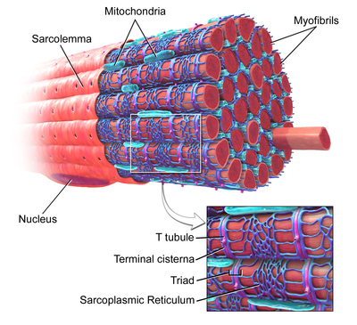
Properties of Muscle Cells
The plasma membrane of skeletal muscle cells has a special name; the sarcolemma.
The sarcolemma is unique, because it continues deep into the muscle cell to form the “T-tubules” or “transverse tubules”.
The t-tubule is continuous with the sarcolemma.
IMAGE courtesy of: Blausen.com staff (2014). "Medical gallery of Blausen Medical 2014". WikiJournal of Medicine 1 (2). DOI:10.15347/wjm/2014.010.
ISSN 2002-4436. - Own work

Slide 54
Properties of Muscle Cells
The function of the t-tubules is to allow the muscle action potentials to reach deep into the muscle cell.
Also the lumen (fluid) of the t-tubule is continuous with the extracellular space.
The t-tubule is continuous with the sarcolemma.
IMAGE courtesy of: Blausen.com staff (2014). "Medical gallery of Blausen Medical 2014". WikiJournal of Medicine 1 (2). DOI:10.15347/wjm/2014.010.
ISSN 2002-4436. - Own work

Slide 55
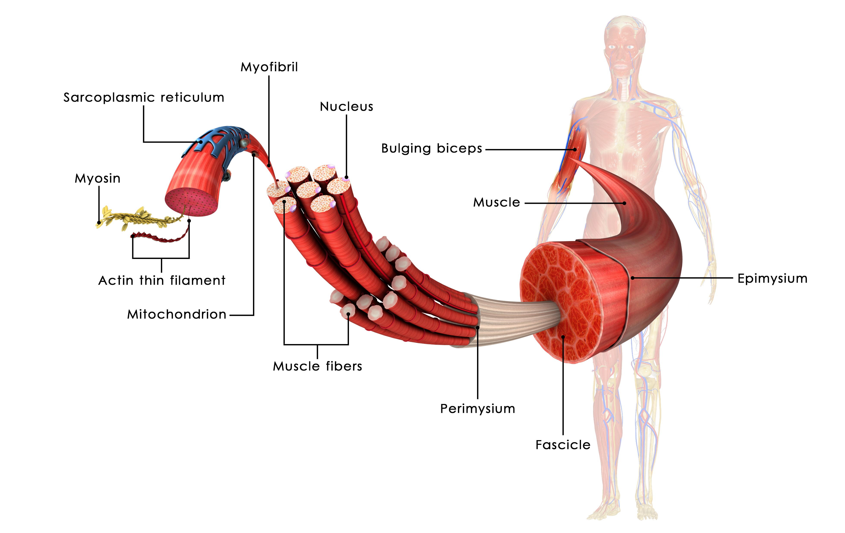
The Muscle Cell / Myocyte / Muscle Fiber
A myocyte (also known as a muscle cell or a muscle fiber) is the type of cell found in muscle tissue.
Myocytes are long, tubular cells that develop from myoblasts to form muscles in a process known as myogenesis.

Slide 56
Structure of Muscle Cells (Fibers)
Fascicles
Myofibers = muscle fibers = muscle cells
Myofibrils
Myofilaments (myosin and actin)

Slide 57

Myofibril
II. Structural Hierarchy of Skeletal Muscle
Understanding muscle function depends critically on an understanding of muscle structure; from the gross anatomical level all the way down to the level of the molecules making up the contractile machinery of muscle cells. The structural hierarchy of skeletal muscle is summarized below.
Gross anatomical muscle Fascicles
Myofibers = muscle fibers = muscle cells
Myofibrils
Myofilaments (myosin and actin)
Myosin
Actin Thin Filament
Muscle Fiber

Slide 58
Structure of Muscle Cells (Fibers)
A skeletal muscle (like the biceps shown in the illustration) is a collection of muscle bundles or fascicles.
Each fascicle is made up of a number of muscle cells (or myofibers or muscle fibers).
Each muscle cell is composed of hundreds to thousands of myofibrils.
Each myofibril is composed of many myosin filaments and actin thin filaments.

Slide 59
Structure of Muscle Cells (Fibers)
● Epimysium. The epimysium is an “overcoating” that surrounds the whole muscle.

Slide 60
Structure of Muscle Cells (Fibers)
Within each skeletal muscle, the muscle fibers are grouped into fascicles that resemble bundles of sticks.
Surrounding each fascicle is a layer of connective tissue called perimysium.

Slide 61
Structure of Muscle Cells (Fibers)
Endomysium. The endomysium is a wispy sheath of connective tissue that surrounds each individual muscle fiber.
It consists of fine areolar connective tissue.
Endomysium

Slide 62
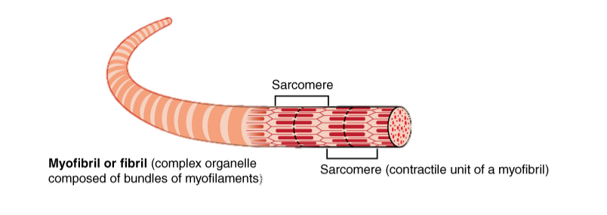
Myofibrils are composed of sarcomeres
The sarcomere is the functional unit of skeletal muscle
Muscle fibers are made up of myofibrils.
Those myofibrils are composed of contractile units called SARCOMERES.

Slide 63
PROTEINS of MUSCLE SARCOMERE
A. Contractile proteins
  1. Myosin (gives rise to the thick filaments)
  2. Actin (gives rise to the thin filaments)
B. Regulatory proteins
  1. Tropomyosin (in the absence of Ca2+, it covers the myosin-binding site of actin)
  2.Troponin (Ca2+ sensor)

Slide 64
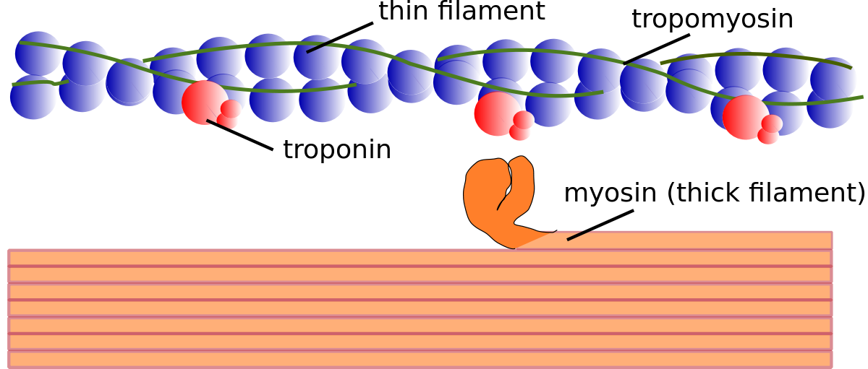
A. Contractile proteins
Myosin is the protein that makes up the thick filaments of the sarcomere.
Myosin has a head region and a tail region of the thick filaments

Slide 65
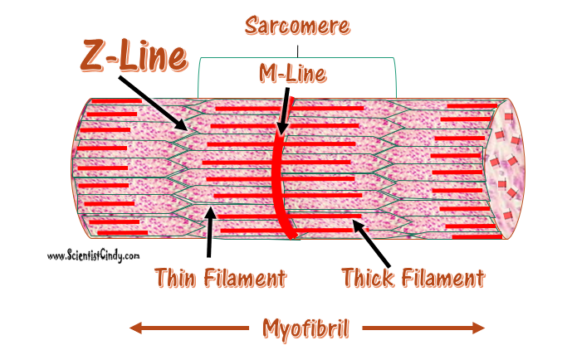
A. Contractile proteins
The myosin head has an actin-binding site that is used to interact with the actin thin filament.
The myosin head also has an ATP-binding site.

Slide 66
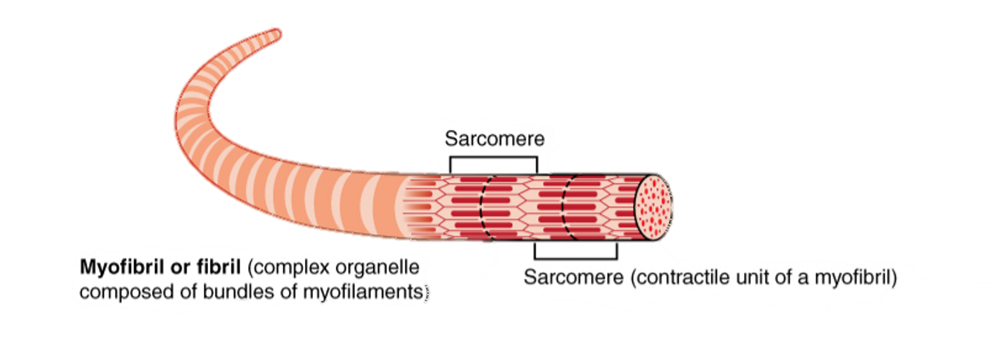
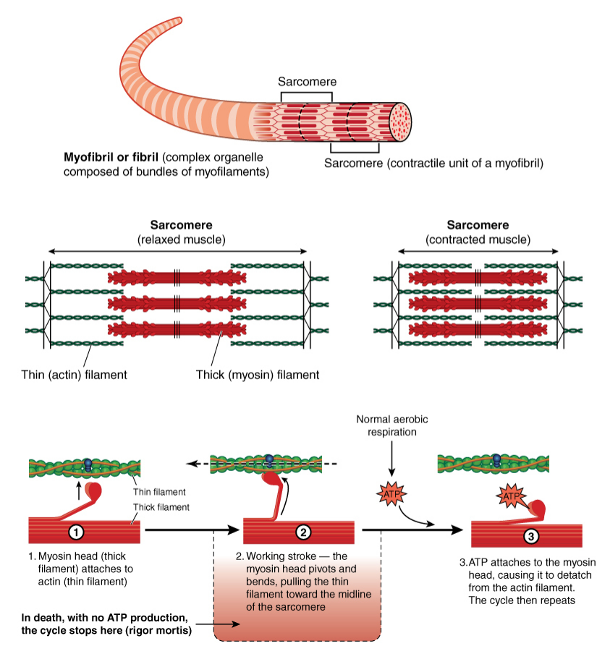
The sarcomere is the functional unit of skeletal muscle
The sarcomere is the functional unit of skeletal and cardiac muscle.
The sarcomere contains the myofilaments.
The Myofilaments Are
  the ACTIN (THIN) FILAMENTS
  the MYOSIN (THICK) FILAMENTS

Slide 67
The sarcomere is the functional unit of skeletal muscle
During muscle relaxation…
During muscle contraction…
the actin and myosin filaments DO NOT overlap. The sarcomere is lengthened, becoming longer.
the actin and myosin filaments DO overlap. The sarcomere is contracted, becoming shorter.
The Myofilaments Are
  the ACTIN (THIN) FILAMENTS
  the MYOSIN (THICK) FILAMENTS
The SAROMERES perform the contractile behavior of the muscle fibers.

Slide 68
The sarcomere is the functional unit of skeletal muscle
The sarcomere contains contractile proteins
• Myosin (gives rise to the thick filaments)
• Actin (gives rise to the thin filaments)

Slide 69
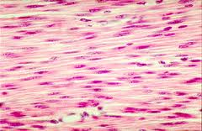
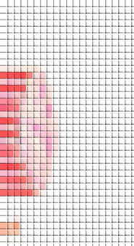
Cross-Bridge Cycle/ Muscle Contraction
Sarcomere
Z-Line
M-Line
The Actin thin filaments are attached to the Z lines.
Myosin thick filaments overlap with the thin filaments in the middle of a sarcomere.
Myosin pulls the thin filaments towards the M-Line on each side, shortening the sarcomere and causing contraction.
Thin Filament
Thick Filament
Myofibril

Slide 70
Sliding Filament Model of Contraction
Muscle contraction is an energy-requiring event (requires ATP) that involves the movement of the thin filaments over the thick filaments.

Slide 71
In a relaxed muscle fiber, the thin and thick filaments overlap only at the ends of the A band.
The sliding filament model of contraction states that during contraction, the thin filaments slide past the thick ones so that the actin and myosin filaments overlap to a greater degree.
H Zone
I Band
I Band
M Line
Z Line
Z Line

Slide 72
The following Occurs in the Sarcomere when the muscle Shortens:
H Zone
I Band
I Band
● The I bands shorten.
● The distance between successive Z discs shortens.
● The H zones disappear.
● The contiguous A bands move closer together, but their length does not change.
M Line
Z Line
Z Line

Slide 73
IV. Sliding Filament Model of Contraction
This shortening brings the Z disks of a sarcomere closer together. During muscle contraction, the size of the A band remains the same, but the I band and the H zone become shorter as the thin filaments slide past the thick filaments.

Slide 74
IV. Sliding Filament Model of Contraction
A very important point to consider is that the tension generated in a muscle is directly proportional to the overlap between the thick and thin filaments.
This extent of the overlap, of course, is a function of the number of myosin head groups that interact with actin molecules.
Thus, the greater the overlap, the larger the tension that is developed by the muscle.

Slide 75
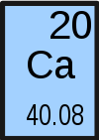
Tropomyosin
As long as calcium is available, the cross-bridge can form, and the muscle contracts.
This Photo by Unknown Author is licensed under CC BY-SA

Slide 76
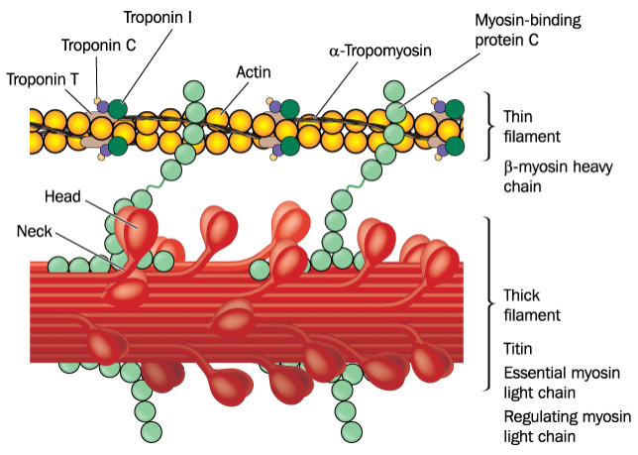
The sarcomere is the functional unit of skeletal muscle
The sarcomere also contains
Regulatory proteins
  Tropomyosin (in the absence of Ca2+, it covers the myosin-binding site of actin)
  Troponin (Ca2+ sensor)

Slide 77
Regulatory proteins
Two regulatory proteins closely interact with actin.
A regulatory protein called tropomyosin normally lies over the binding sites and prevents the interaction of the myosin head group with actin.

Slide 78
Regulatory proteins
When the myoplasmic Ca2+ concentration is low at its resting level, tropomyosin covers the myosin binding site of ctin.
Tropomyosin also closely interacts with troponin, which is a Ca2+ sensor.

Slide 79
Regulatory proteins
Binding of Ca2+ to troponin moves the troponin-
tropomyosin complex out of the way exposing the myosin binding site. This allows the myosin head to interact with G-actin

Slide 80
Cross-Bridge Cycling
Actin is the protein that makes up the thin filaments of the sarcomere.
The actin units have myosin binding sites.
Thus, myosin is able to bind to the myosin binding site of on actin.
It can do this because the myosin head has an actin binding site on it!

Slide 81
Tropomyosin
Tropomyosin covers the myosin binding sites and prevents cross-bridge formation when a muscle is relaxed.

Slide 82
Tropomyosin
When the muscle receives enough stimulation from the nervous system to initiate contraction, calcium is released from the sarcoplasmic reticulum.
Calcium binds to tropomyosin and moves it away from the myosin binding sites, allowing cross-bridge formation and muscular contraction.

Slide 83

Overall, as a muscle cell shortens, all of the following occur:
The I bands shorten.
The distance between successive Z discs shortens.
The H zones disappear.
The contiguous A bands move closer together, but their length does not change.
By OpenStax - https://cnx.org/contents/FPtK1zmh@8.25:fEI3C8Ot@10/Preface, CC BY 4.0, https://commons.wikimedia.org/w/index.php?curid=30015051

Slide 84

Sliding Filament Model of Contraction
As the thin filaments are connected to the Z disks, and as muscle contraction brings about movement of the thin filaments over the thick filaments and towards the center of the sarcomere (the M line), a shortening of the sarcomere takes place.

Slide 85
Cross-Bridge Cycle/ Muscle Contraction
Sarcomere Shortening
The sarcomere is the functional unit of striated muscle. Let's look at the cross-bridge within the context of a single sarcomere to understand how contraction occurs.

Slide 86
Cross-Bridge Cycling
In order for the muscle to contract…
the actin and the myosin molecules of the thin and thick filaments have to interact with one another.
When the actin and myosin interact, they are said to be connected by cross-bridges.
The cross-bridges refer to the myosin head groups that interact with a myosin-binding site on actin.

Slide 87
Z disks or Z line
Two adjacent Z disks along the myofibril mark the boundaries of a single sarcomere.
The Z disks are the attachment sites for the thin filaments.
Therefore, from each Z disk, thin filaments extend to two neighboring sarcomeres.

Slide 88
Z disks or Z line
When a muscle fiber contracts, the Z disks of a sarcomere move closer together. Thus, the sarcomere shortens as the muscle contracts.

Slide 89
M line
The M line is the attachment site for the thick filaments.
The M line is in the middle of the A band and, thus, it is in the middle of the sarcomere.

Slide 90
Events That lead to muscle fiber contraction
Muscle fiber contraction requires the following steps:
Membrane Depolarization / Fiber Activation: The fiber must be activated or stimulated by a nerve (motor neuron)so that the membrane/sarcolemma becomes depolarized (the membrane potential becomes less negative due to an influx of positively charged sodium ions).
Action Potential Generation: The change in membrane potential must be strong enough to generate an action potential in the sarcolemma.
Action Potential Propagation: Once the action potential is initiated, it will be propagated along the sarcolemma.
Calcium Release: Calcium is released from the sarcoplasmic reticulum.

Slide 91


Excitation-Contraction Coupling
How do muscles contract?
The whole process really begins with the command from the central nervous system.
The decision to make a conscious movement is made in the brain.
The command to move is sent from the brain’s motor cortex and travels down the spinal cord, to the motor nerve (directly or indirectly).
The signal initiating movement of the muscle travels from the central nervous system to the motor nerve (motor neuron).

Slide 92


Excitation-Contraction Coupling
The signal reaches the terminal end (called the axon terminal) of the motor neuron causing the release of the neurotransmitter, acetylcholine.
Motor Neuron
(neurotransmitters)

Slide 93
Excitation-Contraction Coupling
The signal reaches the terminal end (called the axon terminal) causing calcium channels to open.
The influx of calcium in the axon terminal causes the release of the neurotransmitter, acetylcholine.
Motor Neuron
Ca2⁺
Ca2⁺
Ca2⁺
Ca2⁺
Ca2⁺
Ca2⁺
(neurotransmitters)

Slide 94
Excitation-Contraction Coupling
The signal reaches the terminal end (called the axon terminal) causing calcium channels to open.
The influx of calcium in the axon terminal causes the release of the neurotransmitter, acetylcholine.
Motor Neuron
Ca2⁺
Ca2⁺
Ca2⁺
Ca2⁺
Ca2⁺
Ca2⁺
(neurotransmitters)

Slide 95
Excitation-Contraction Coupling
Acetylcholine diffuses passively across the synaptic cleft and transiently binds to post- synaptic (nicotinic) receptors.
This binding causes the receptors to open, allowing an influx of sodium ions into the muscle fiber.
Motor Neuron
Ca2⁺
Ca2⁺
Ca2⁺
Ca2⁺
Ca2⁺
Ca2⁺
Na⁺
Na⁺
Na⁺
(neurotransmitters)
Na⁺
Na⁺
Na⁺
Na⁺
Na⁺

Slide 96

Acetylcholine diffuses passively across the synaptic cleft and transiently binds to post- synaptic (nicotinic) receptors.
This binding causes the receptors to open, allowing an influx of sodium ions into the muscle fiber.
Neuromuscular Junction
Motor Neuron
Action Potential
(Carries positive charge ion the form of Na+)
Voltage-Gated Ca²⁺ Channel
Synaptic Vesicles filled with Acetylcholine
Nicotinic Receptors
MUSCLE
CELL

Slide 97

Events That lead to muscle fiber contraction
Action potential arrives at axon terminal of the motor neuron at neuromuscular junction
Acetylcholine (Ach) is released
Ach binds to receptors on the sarcolemma

Slide 98
Events That lead to muscle fiber contraction
Ion permeability of sarcolemma changes
Local change in membrane voltage (depolarization) occurs
Local depolarization (end plate potential) ignites AP in sarcolemma

Slide 99

Events That lead to muscle fiber contraction
AP travels across the entire sarcolemma
AP travels along T tubules
SR releases Ca2+

Slide 100

Events That lead to muscle fiber contraction
Ca2+ binds to troponin which exposes the myosin-binding sites on actin
Troponin changes conformation when it binds calcium, and that moves the tropomyosin away from the myosin binding sites, allowing cross-bridge formation and muscular contraction.
Myosin heads bind to actin; contraction begins
IMAGE COURTESY OF: By Arcadian (Troponino.jpg) [https://commons.wikimedia.org/wiki/File%3ATroponino.svg], via Wikimedia Commons

Slide 101
Events That lead to muscle fiber contraction
Binding of myosin cross-bridges to the binding sites on G-actin molecules.
Power stroke of the cross-bridges and movement of the thin filaments over the thick filaments.
Continued cross-bridge cycling for as long as ATP is present and Ca2+ concentrations remain high in the myoplasm.
Muscle shortening and/or tension development.

Slide 102

Twitch
A single muscle twitch, which is a single contraction in response to a brief threshold stimulation.
Threshold stimulation: the smallest amount of stimulation that result in sarcomere shortening.

Slide 103

Twitch response
A threshold stimulation is the smallest amount of stimulation that will actually result in a contraction.
If we administer a single threshold stimulus in a lab, we get a single muscle twitch in response.
We can measure this with a Myogram.

Slide 104
The Muscle Twitch
A muscle twitch is the minimum muscle response to a single action potential generated by a motor neuron.
Excitatory input from the motor neuron must reach a minimum threshold (minimum level) to trigger the flood of calcium from the sarcoplasmic reticulum, in order for any muscular repose to occur.

Slide 105

The Muscle Twitch
Every twitch has three distinct phases
Latent period. This is the lag time due to the time needed for the action potential to spread through the sarcolemma and T-tubules and trigger calcium release from the sarcoplasmic reticulum. No tension in muscle, no force is generated yet.

Slide 106

The Muscle Twitch
Period of Contraction
Period of contraction.
Cross bridges are forming.
The muscle tenses.
  If the tension becomes great enough to overcome the resistance of the load, the muscle shortens.

Slide 107

The Muscle Twitch
Period of relaxation.
Ca2+ reenters the SR.
The number of active cross bridges is declining.
Contractile force is declining.
Muscle tension decreases to zero.
Myogram tracing returns to the baseline.
IMAGE COURTESY OF OpenStax - https://cnx.org/contents/FPtK1zmh@8.25:fEI3C8Ot@10/Preface, CC BY 4.0, https://commons.wikimedia.org/w/index.php?curid=30015047

Slide 108
tetanus
High Frequency Stimulation / Fused (Complete) Tetanus.
At higher stimulus frequencies, the twitch responses summate producing constant tension.
When there is repeated stimulation, the twitch responses can stack up on top of each other (they are additive) creating prolonged muscle tension, called tetanus or tetanic contractions.
tension
stimulation
time

Slide 109

Length-Tension Relationship
The amount of tension developed by a muscle is directly proportional to the overlap between the thick and thin filaments. The greater the number of myosin head groups that

Slide 110

Muscle Fatigue
Muscle fatigue is a state of physiological inability to contract even though the muscle still may be receiving stimuli.

Slide 111

CROSS-BRIDGE CYCLING

Slide 112
cross-bridges
Muscles relax when neural stimulation stops, and calcium is pumped back into the sarcoplasmic reticulum using ATP.
Additionally, ATP stimulates cross-bridge detachment.
Muscles contract after death, causing what we call rigor mortis.
As dead cells can't make ATP, calcium continues to bind troponin, and cross-bridges remain attached.

Slide 113
Cross-Bridge Cycling

Slide 114
Cross-Bridge Cycle
The cross-bridge cycle may be arbitrarily divided into six steps:

Slide 115
Cross-Bridge Cycle
Step 1. In this step, the myosin head interacts tightly with a G-actin of the thin filament.
The part of the myosin head group that interacts with actin is referred to as the actin- binding site, and the part of the G-actin molecule that interacts with myosin is referred to as the myosin-binding site.

Slide 116
Cross-Bridge Cycle
Step 1. In this step, the myosin head makes a 45-degree angle with the thick filament. This is referred to as the rigor state because if there is no ATP present (such as after death), the thin and thick filaments maintain this tight interaction rendering the muscle very stiff.
Rigormortis

Slide 117
Cross-Bridge Cycle
Step 2. In addition to the actin-binding site, the myosin head also has a nucleotide- binding site.
This is a site where ATP and ADP interact with myosine.
The cytoplasmic ATP concentration in skeletal muscle cells is 3–5 mM.
In this step, an ATP molecule binds to the nucleotide-binding site of the myosin head. Binding of ATP causes the release of the myosin head from the G-actin molecule.

Slide 118
Cross-Bridge Cycle
Step 3. Myosin is an ATPase (myosin ATPase) in that it has the ability to hydrolyze ATP to ADP and inorganic phosphate (Pi). In this step, the myosin head converts the bound ATP to ADP and Pi. Both ADP and Pi remain bound to the myosin head.

Slide 119
Cross-Bridge Cycle
Step 4. The energy released from the hydrolysis of ATP is used to change the conformation of the myosin head, so that now it makes a 90-degree angle with the thick filament.
This change in conformation “energizes” the myosin head (i.e., it places it in a high-energy state). At this point, if sufficient Ca2+ is present in the cytoplasm (see Excitation-Contraction Coupling below), the myosin head attaches to a G-actin one or two positions away from the one bound in Step 1.

Slide 120
Cross-Bridge Cycle
Step 4. If there is not enough Ca2+ present in the cytoplasm, the myosin head remains in this energized 90-degree angle.
A rise in cytoplasmic Ca2+ concentration is essential and evokes a series of events that facilitates the binding of myosing head to G-actin again.
Please note that the relaxed state refers to the muscle cell and not to the conformation of the myosin molecule. At rest, most skeletal muscle fibers are in this “relaxed state”.

Slide 121
Cross-Bridge Cycle
Step 5. This is the power stroke step. Now Pi is released from the myosin head. As Pi is released, the energized 90-degree angle myosin head begins to assume its original 45- degree angle.
However, as it is bound to a G-actin of the thin filament, the change back to the 45-degree angle moves the actin thin filament toward the center of the sarcomere (M line).

Slide 122
Cross-Bridge Cycle
Step 6. At this point, ADP is released from the myosin head, and the myosin head remains tightly bound to the G-actin. This brings us back to the beginning of the cycle at Step 1. If there is ATP around (and if the cytoplasmic Ca2+ concentration is high; see below), the cycle will repeat itself again and again. The repeated action of the cross- bridge cycle results in the sliding of the thin filaments over the thick filaments, which will lead to muscle shortening.

Slide 123
It is important to emphasize that the cross-bridge cycle can take place only if the cytoplasmic Ca2+ concentration is high.
Thus, when skeletal muscles are at rest and the cytoplasmic Ca2+ concentration is low, the cross-bridge cycle does not take place.
Instead, the myosin head groups remain in an “energized” state.

Slide 124
Cross Bridge Cycle

Slide 125


Cross Bridge Cycle

