Slide 1
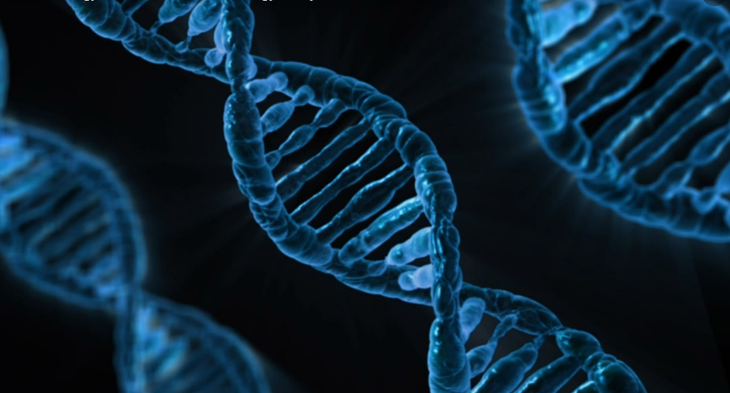
Microbial Genetics

Slide 2
Microbial Genetics
All Living Organisms Have DNA. This DNA has many of the same basic features in all organisms.

Slide 3
Microbial Genetics
Let’s first look at some similarities, then we will look at how DNA can have different features in organisms in different domains.

Slide 4
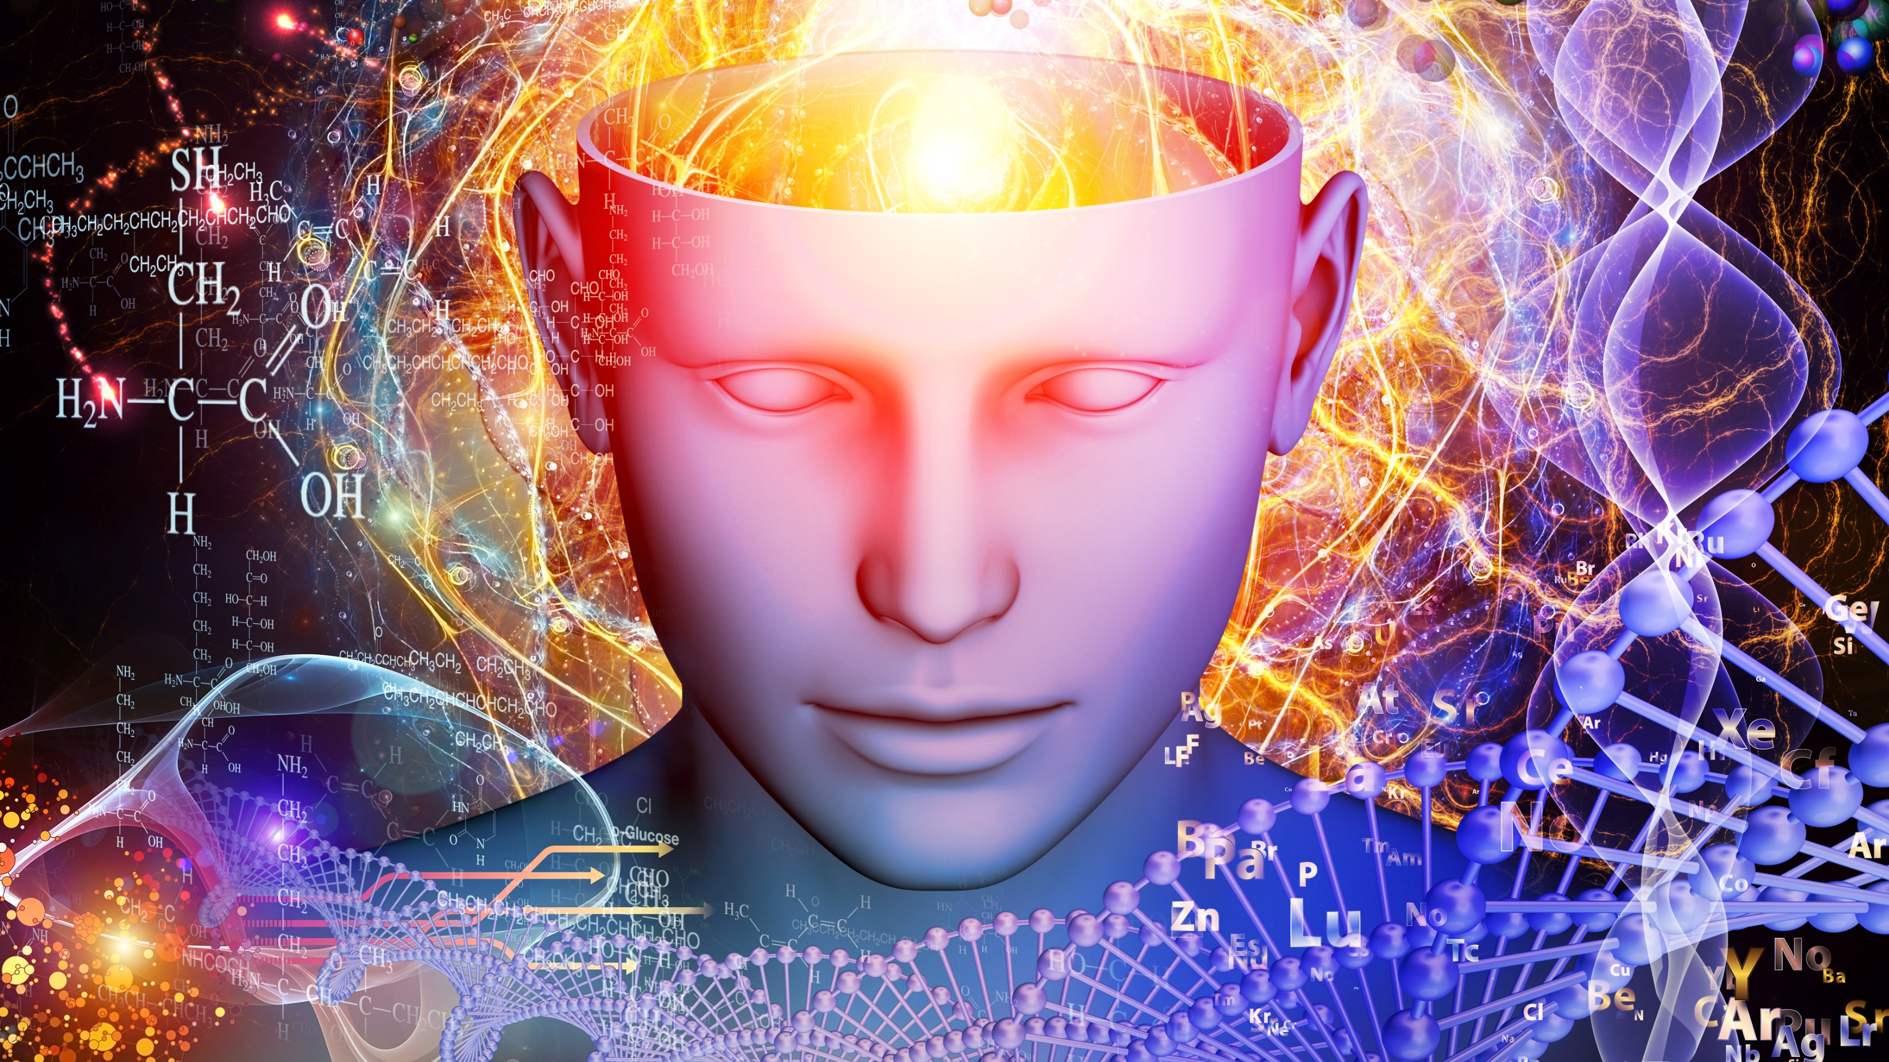
The 2 Functions of DNA
All Living Organisms Use DNA as Their Genetic Material
All Living Organisms Must Replicate (Make a Copy of) Their DNA to Undergo Cell Division
Autocatalytic Function
It Directs its Own Synthesis
DNA Replication
Needed to Cell Division
Cell Division Occurs to Make New Organisms or to Replace Old, Worn-Out Cells.

Slide 5
The 2 Functions of DNA
All Living Organisms EXPRESS their Genes using transcription and translation.
All Living Organisms make mRNA from DNA in Transciption
Heterocatalytic Function
It Directs the Synthesis of RNA and Proteins
Gene Expressed as Protein
Needed to Carry Out the Functions of the cell.
mRNA is then Used to Make Proteins in all Living organisms.

Slide 6
Central Dogma Of Molecular Biology
The central dogma of molecular biology explains how the information encoded in DNA sequences (genes) is expressed as proteins in a two-step process:
Step One) Transcription
Transcription involves making mRNA using DNA as a template.
Step Two) Translation.
Translation then translates the mRNA sequence into an amino acid sequence to form a protein.

Slide 7
The 4 Macromolecules of Life
Macromolecule (or Polymer) | Examples | Subunit (or Monomer) | More Information
Polypeptides | Proteins | Amino Acids | Numerous types that carry out almost all of the cell’s functions
Nucleic Acids | DNA and RNA | Nucleotides | Deoxyribonucleic Acid (DNA) is formed from Deoxyribonucleotides Ribonucleic Acid (RNA) is formed from Ribonucleotides
Polysaccharides | Sugars, Starch | Monosaccharides | Energy
Lipids | Fats, cholesterols and steroids | Fatty Acids often Combined with Other Molecules | Phospholipids that form cell membranes

Slide 8
STRUCTURE OF Nucleic Acids

Slide 9
Nucleic Acids include DNA and RNA
DNA
RNA

Slide 10
DNA is Double-Stranded
DNA
RNA is Single-Stranded
RNA

Slide 11
Structure of Nucleic Acids
PO₄³⁻
NUCLEOTIDE
Sugar
Nitrogenous
BASE
DNA and RNA are Nucleic Acids
Nucleic Acids are composed of a String of Nucleotides
Each nucleotide has the same general structure:
A Phosphate Group
A Type of Ribose Sugar
A Nitrogenous Base
PO₄³⁻
NUCLEOTIDE
Sugar
Nitrogenous
BASE
PO₄³⁻
NUCLEOTIDE
Sugar
Nitrogenous
BASE
OH

Slide 12
The Differences Between DNA Nucleotides and RNA Nucleotides

Slide 13
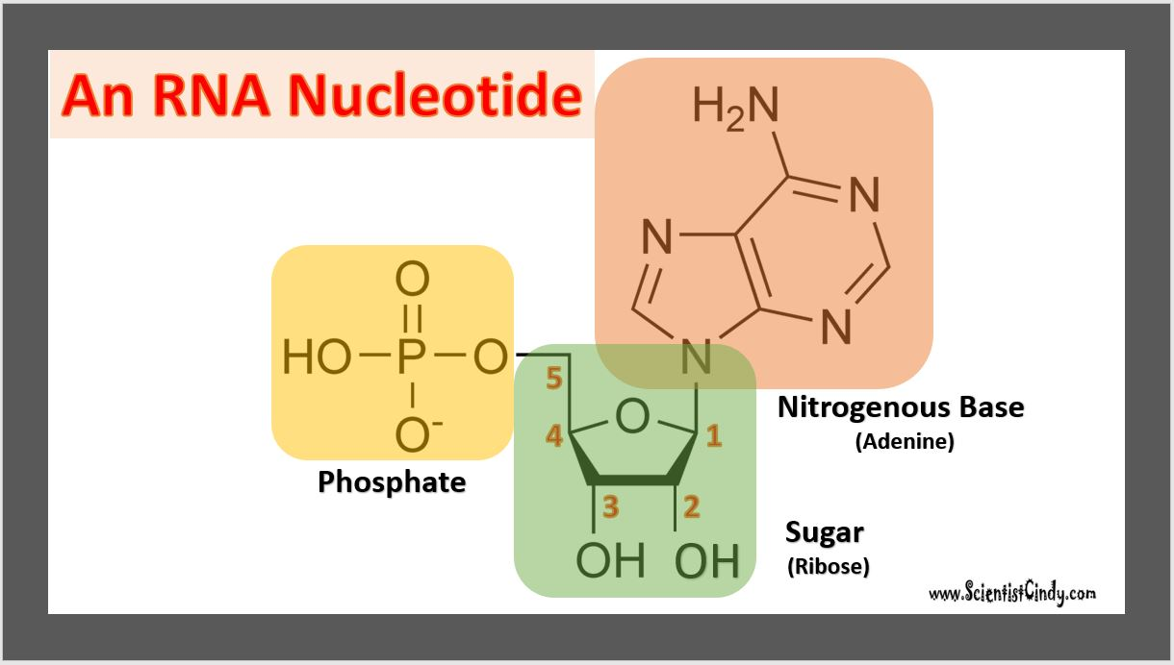
DNA Nucleotides
vs
RNA Nucleotides
RNA and DNA Nucleotides Both Contain a Phosphate Group

Slide 14
DNA Nucleotides
vs
RNA Nucleotides
RNA and DNA Nucleotides Both Contain A Sugar Molecule
DNA Nucleotide have a Deoxy-Ribose Sugar Molecule
RNA Nucleotide have a Ribose Sugar Molecule
This is why DNA stands for Deoxyribonucleic Acid
And RNA stands for Ribonucleic Acid

Slide 15
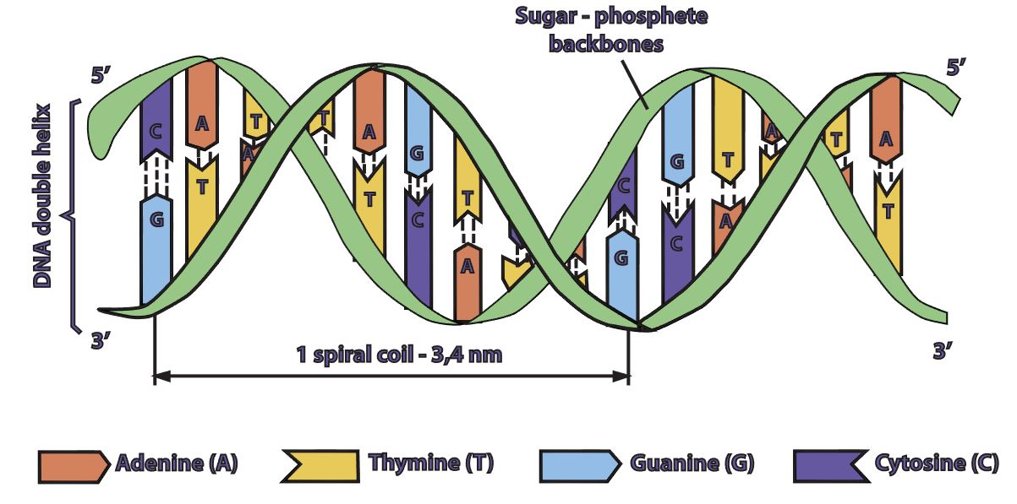
The 4 Nitrogenous Bases in DNA are
Adenine (A)
Cytosine (C)
Guanine (G)
Thymine (T) in DNA ONLY
DNA Nucleotides vs RNA Nucleotides
DNA

Slide 16
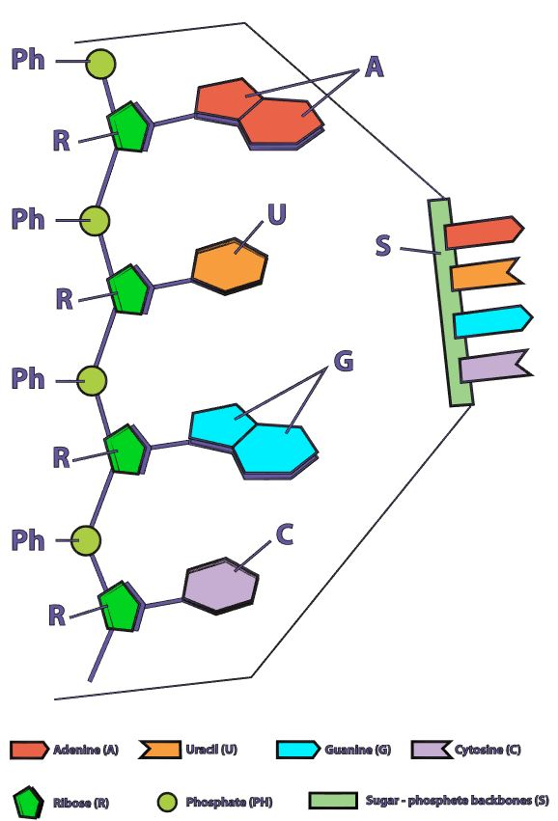
DNA Nucleotides
vs
RNA Nucleotides
RNA
The 4 Nitrogenous Bases in DNA are
Adenine (A)
Cytosine (C)
Guanine (G)
Thymine (T) in DNA ONLY
The 4 Nitrogenous Bases in RNA are
Adenine (A)
Cytosine (C)
Guanine (G)
Uracil (U) in RNA ONLY

Slide 17
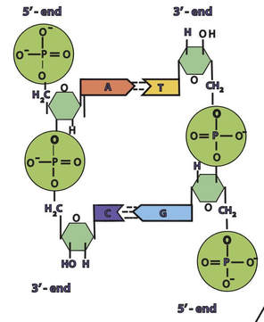
DNA is Double Stranded
DNA Strand #2
DNA Strand #1
The DNA in all living organisms is DOUBLE STRANDED.

Slide 18
DNA Strands are Anti-Parallel
3’ to 5’ direction
5’ to 3’ direction
The DNA in all living organisms is oriented with one DNA strand positioned in the 5’ to 3’ direction and the other strand positioned in the 3’ to 5’ direction.

Slide 19
The Sugar-Phosphate Backbone of DNA
Phosphate
Sugar
Sugar
In a molecule of DNA (or RNA), individual nucleotides are linked together to make a sugar-phosphate backbone.
The bond used in the sugar-phosphate backbone are phospho-diester bonds.
These are very strong bonds.
Phosphate
Phosphate
Sugar
Sugar
Phosphate

Slide 20
Base-Pairing and Hydrogen Bonding in DNA
Base
Base
DNA Strand #2
DNA Strand #1
In a molecule of DNA, the 2 DNA strands are connected to each through hydrogen bonds.
These hydrogen bonds occur between nitrogenous bases that exist on opposing strands.
Base
Base

Slide 21
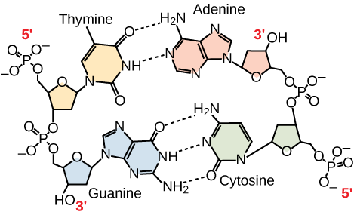
The Bases CANNOT Just “pair up” with Anyone…. THERE ARE RULES!
Adenine (A) can only pair with Thymine (T)
Adenine (A) and Thymine (T) bond using 2 hydrogen bonds
Guanine (G) can only pair with Cytosine (C)
Guanine (G) and Cytosine (C) bond using 3 hydrogen bonds

Slide 22
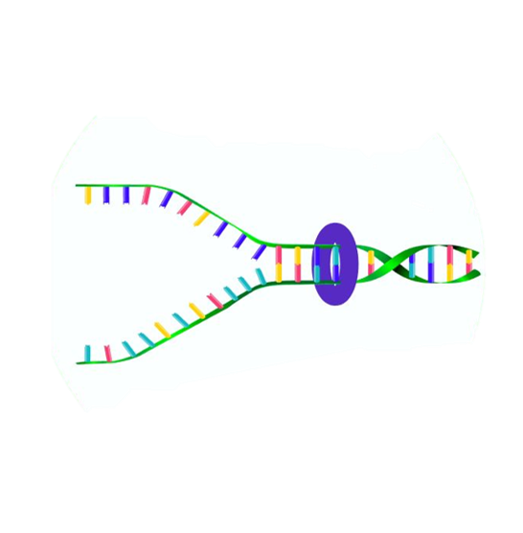
Hydrogen Bonding in DNA
Hydrogen bonds are relatively weak.
It is important for the hydrogen bonds to be able to be broken when the cell needs access to the individual DNA strands.
For example, the two DNA strands need to be separated for DNA replication for cellular division and to make the mRNA template during transcription.

Slide 23
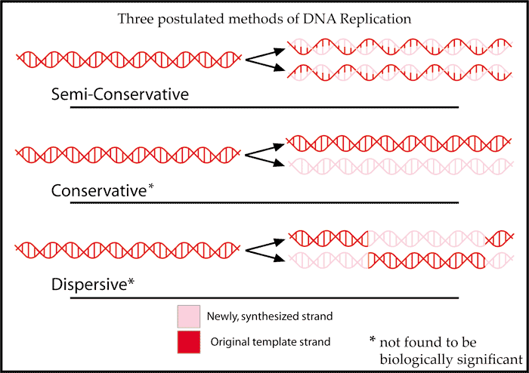
DNA replication is done in a semi-conservative manner.

Slide 24
Semi-conservative means that one parent strand is conserved in each new DNA molecule

Slide 25
Differences in DNA SHAPE
Prokaryotes =
One Single Circular Chromosome
Eukaryotes = Multiple Linear Chromosomes

Slide 26
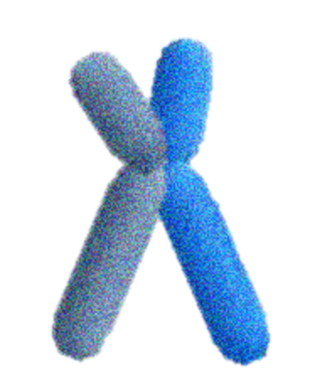
Eukaryotic Cells have Multiple Linear Chromosomes

Slide 27
Prokaryotic Cells have One Single Circular Chromosome

Slide 28
Differences in Extra-chromosomal DNA

Slide 29
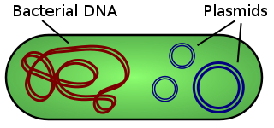
Plasmids
Some species of bacteria have additional small extra-chromosomal circular DNA loops in their cytoplasm, called plasmids.

Slide 30
Plasmids
A plasmid is a small DNA molecule within a cell that is physically separated from a chromosomal DNA and can replicate independently.

Slide 31
Plasmids
They are most commonly found as small circular, double-stranded DNA molecules in bacteria; however, plasmids are sometimes present in archaea and eukaryotic organisms.

Slide 32
Plasmids
What is a PLASMID?
Interestingly, these plasmids do not carry any of the genes essential for normal life processes.
Plasmid do alter the sensitivities or abilities of the bacteria that possess them.

Slide 33
Plasmids
What is a PLASMID?
These non-essential genes are classified as accessory genes.
For example, some plasmids carry genes that allow for
antibiotic resistance
habitat tolerance
bacterial conjugation which allows the exchange of genetic material between bacterial cells

Slide 34
PLASMIDS
What is a PLASMID?
Interestingly, these plasmids do not carry any of the genes essential for normal life processes.
Plasmid do alter the sensitivities or abilities of the bacteria that possess them.
These non-essential genes are classified as accessory genes.
For example, some plasmids carry genes that allow for
antibiotic resistance
habitat tolerance
bacterial conjugation which allows the exchange of genetic material between bacterial cells
Some species of bacteria have additional small extra-chromosomal circular DNA loops in their cytoplasm, called plasmids.
ARE MORE COMMON IN BACTERIA

Slide 35
Differences in DNA LOCATION

Slide 36
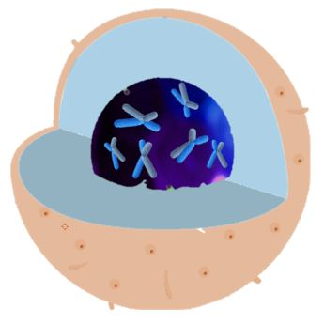
DNA in Eukaryotes
In eukaryotic cells, the genetic material (DNA) is in the nucleus of the cell.

Slide 37
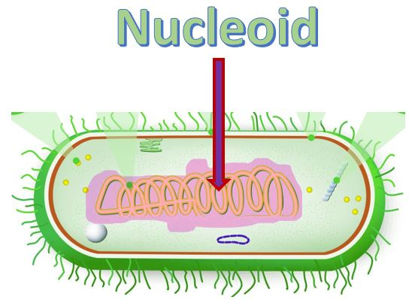
DNA in Prokaryotes
The DNA in prokaryotic cells is found in a region called the nucleoid.

Slide 38
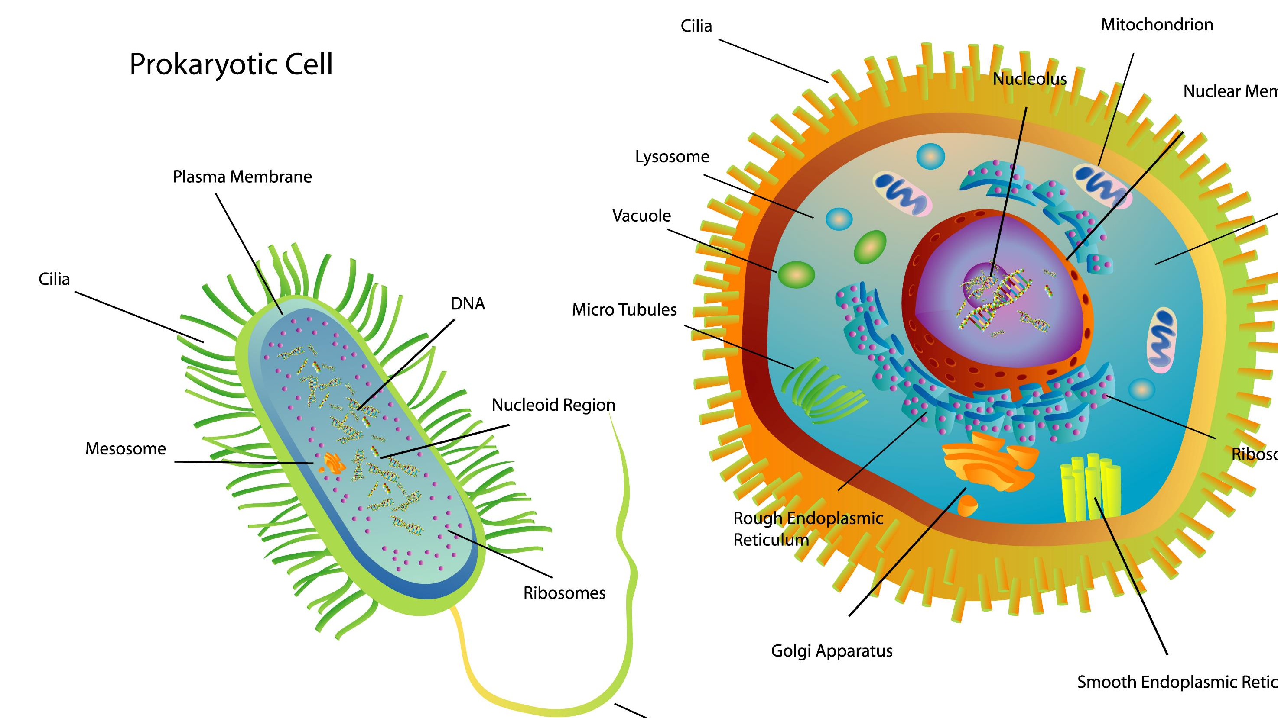
DNA in Eukaryotes
In eukaryotic cells, the genetic material (DNA) is in the nucleus of the cell.
DNA holds the instructions for all of the proteins the cell may required.
These instruction are encoded as the sequence of base pairs on the individual nucleic acids that make up the cell. ​

Slide 39
DNA in Prokaryotes
Bacteria cells are prokaryotic
They are much smaller than the eukaryotic cell.
They do not have any membrane-bound organelles.
They do not have a nucleus.
The DNA in prokaryotic cells is found in a region called the nucleoid.

Slide 40
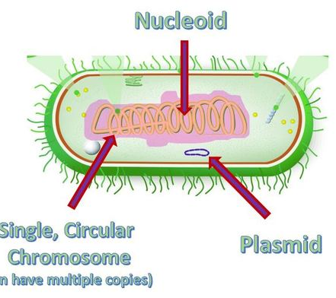
Nucleoid
The DNA in bacteria exist in a region called the nucleoid.
The nucleoid is simply a "cytoplasmic location" and not a membrane-bound organelle, like our nucleus.
However, the nucleoid does succeed in packaging the DNA into a small space within the cytoplasm.
​Proteins assist in anchoring the genetic material to the nucleoid.
Bacteria are small, and the nucleoid takes up almost 1/3 of the space in the cel!.

Slide 41
Differences in DNA SIZE

Slide 42
The DNA in Bacteria Cells DO NOT HAVE HISTONES

Slide 43
Archaeal Cells and Eukaryotic Cells have their DNA packaged by
HISTONE PROTEINS

Slide 44
Bacterial Cells
DO NOT
Have
HISTONE PROTEINS

Slide 45
Bacterial DNA does not have Introns

Slide 46
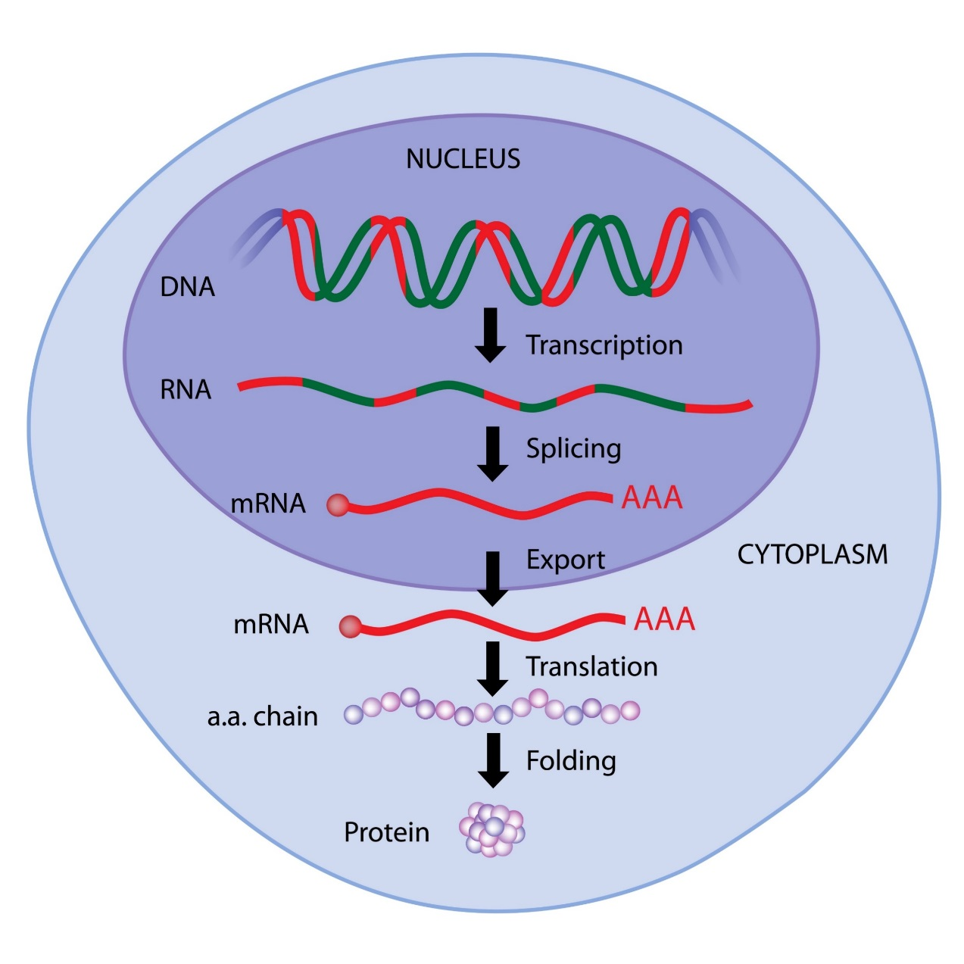
INTRONS
Introns are regions of DNA or RNA that do not code for protein.
Archaeal cells and eukaryotic cells have introns!

Slide 47
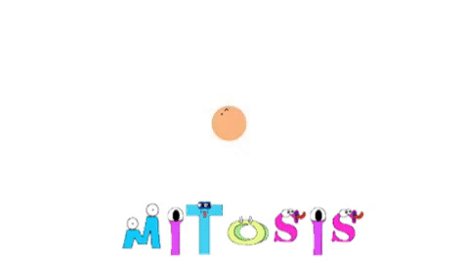
Different Reproduction Strategies
Prokaryotic and Eukaryotic Organisms
Have Different Reproduction Strategies

Slide 48
Prokaryotic and Eukaryotic Cells can Reproduce Asexually

Slide 49
Asexual Reproduction in Prokaryotes is Called Binary Fission
Asexual Reproduction in Eukaryotes is Called Mitosis

Slide 50
DNA Replication in Required for cellular division (Binary Fission)
Prokaryotes are Asexual
They have only 1 set of genes so they are Haploid
2 daughter cells are generated as the genetic clone of 1 parent or 1 progenitor cell

Slide 51
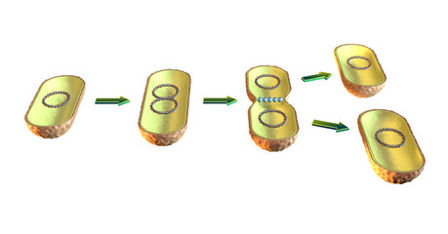
BINARY FISSION
The process of binary fission is less complex than mitosis.
First, the prokaryotic DNA replicates.
The duplicated strand then moves to another location within the cell, stretching it out.
The plasma membrane then begins to pinch inward until the cell is completely split into two identical cells.
DNA Replication
Cell Elongation
Septum Formation
Separation

Slide 52
Prokaryotic Cell Division is Done by Binary Fission
Prokaryotes are Asexual
Prokaryotes have only 1 set of genes so they are Haploid
One single parent cells gives rise to 2 genetically identical daughter cells
Binary Fission is an asexual process
No genetic variation introduced

Slide 53
Eukaryotic Cells Undergo Mitosis
Large linear chromosomes
Multiple chromosomes
Replication of DNA is slower
Reproduction by mitosis is asexual
Eukaryotic Cells are DIPLOID.
One full set of chromosomes from each parent. (2 sets total).

Slide 54
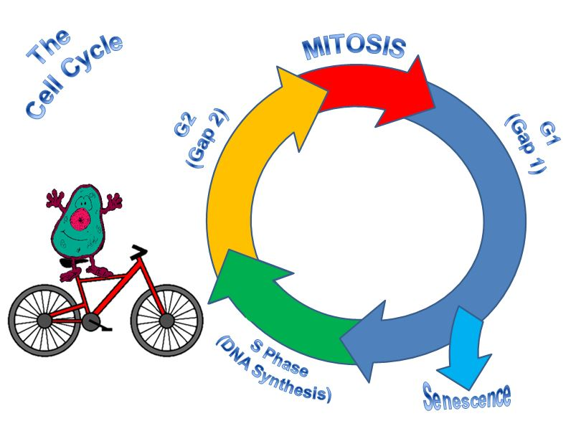
PROKARYOTES
No mitotic spindle forms in bacteria.
DNA replication happens during binary fission
EUKARYOTES
The mitotic spindle forms.
DNA replication happens during S phase, long before mitosis begins.

Slide 55
A Diploid Eukaryotic Organism is formed from the fusion of a Haploid Egg and a Haploid Sperm that were formed through the process of meiosis.
DNA Replication in Required for Mitosis and Meiosis is Eukaryotic Cells

Slide 56
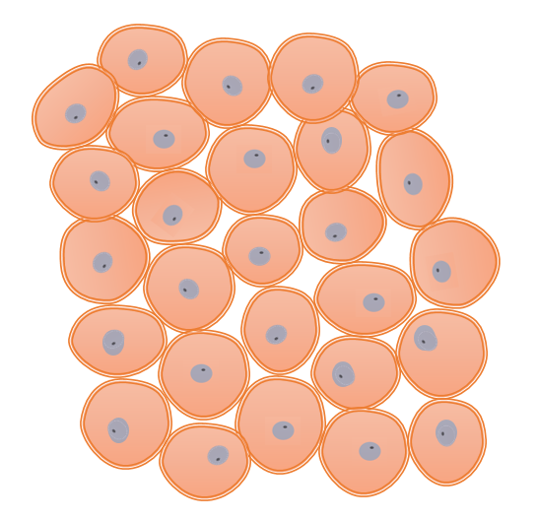
Bacteria VS Animal Cells
The bacterial genome consists of a small single circular chromosome.
DNA is Replicated Quickly rate of ~ 1000 nucleotides per second.
Bacteria are HAPLOID.
Asexual Reproduction via Binary Fission – no genetic recombination.
Large linear chromosomes
Multiple chromosomes
Replication of DNA is slower
Reproduction is sexual – genetic recombination occurs
Animal Cells are DIPLOID.
One full set of chromosomes from each parent. (2 sets total).

Slide 58
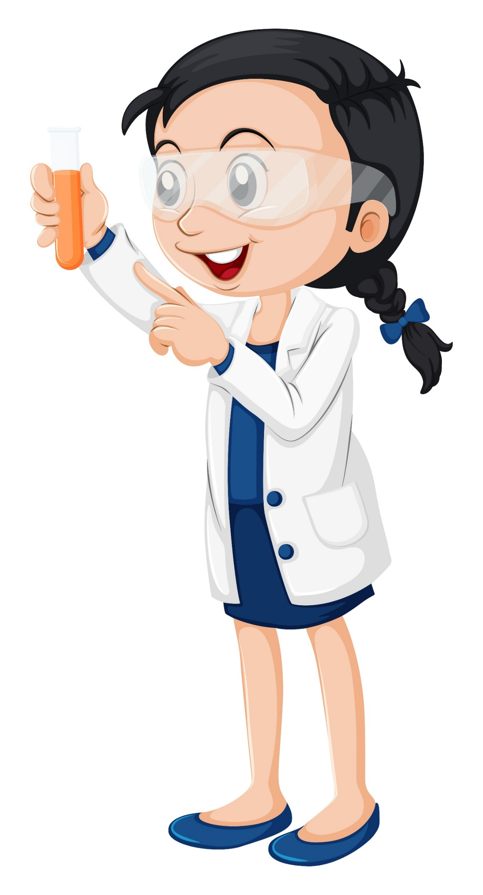
DNA Replication
DNA Replication in Required for Cellular Division

Slide 59
DNA REPLICAION in Bacteria is a 3-Step Process
INITIATION
Elongation
Termination

Slide 60
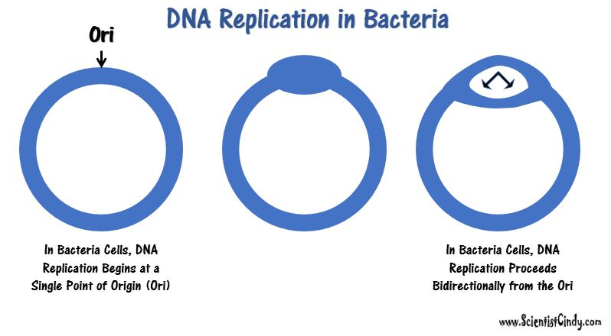

Slide 61
Eukaryotic DNA can be about 50 times larger than the prokaryotic genome. Since so much DNA must be copied in the eukaryotic cell, we have thousands of origins of replication (Ori) all working at the same time.

Slide 62
Initiation begins at a specific nucleotide sequence called the origin of replication (Ori).
There are specific nucleotide sequences called origins of replication (Ori) located on the bacterial chromosome.
The Ori is the point at which DNA replication begins.
Prokaryotic organisms will have a single origin of replication.

Slide 63
Initiation begins at a specific nucleotide sequence called the origin of replication (Ori).
A Replication Bubble will form at the Ori.

Slide 64
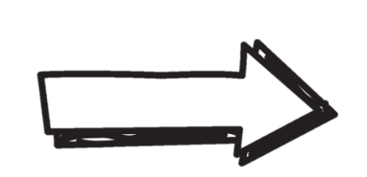
Initiation step of DNA Replication
Two replication forks are formed at the origin of replication creating a replication bubble.
DNA replication will proceed in both directions from the Ori, creating 2 replication forks.
replication forks

Slide 65
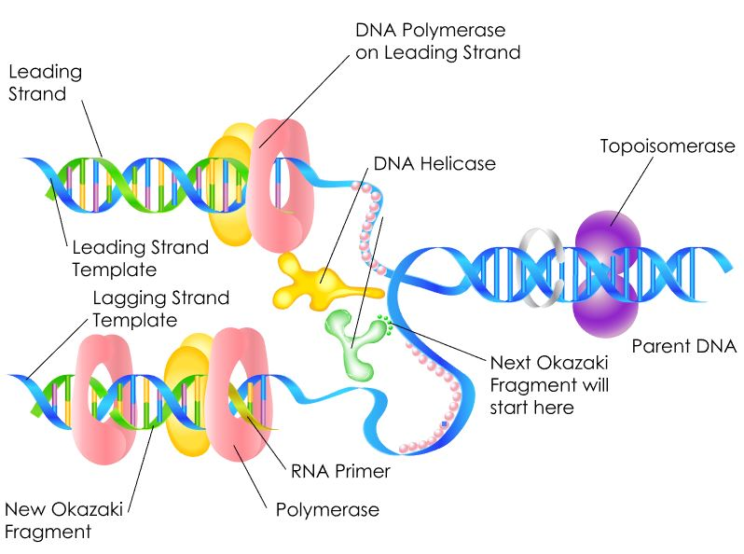
Initiation of DNA Replication in Prokaryotic Cells
Helicase and topoisomerase I (DNA Gyrase) function to uncoil and unwind the DNA.
Helicase then acts to break the hydrogen bonds between the nitrogenous base pairs.

Slide 66
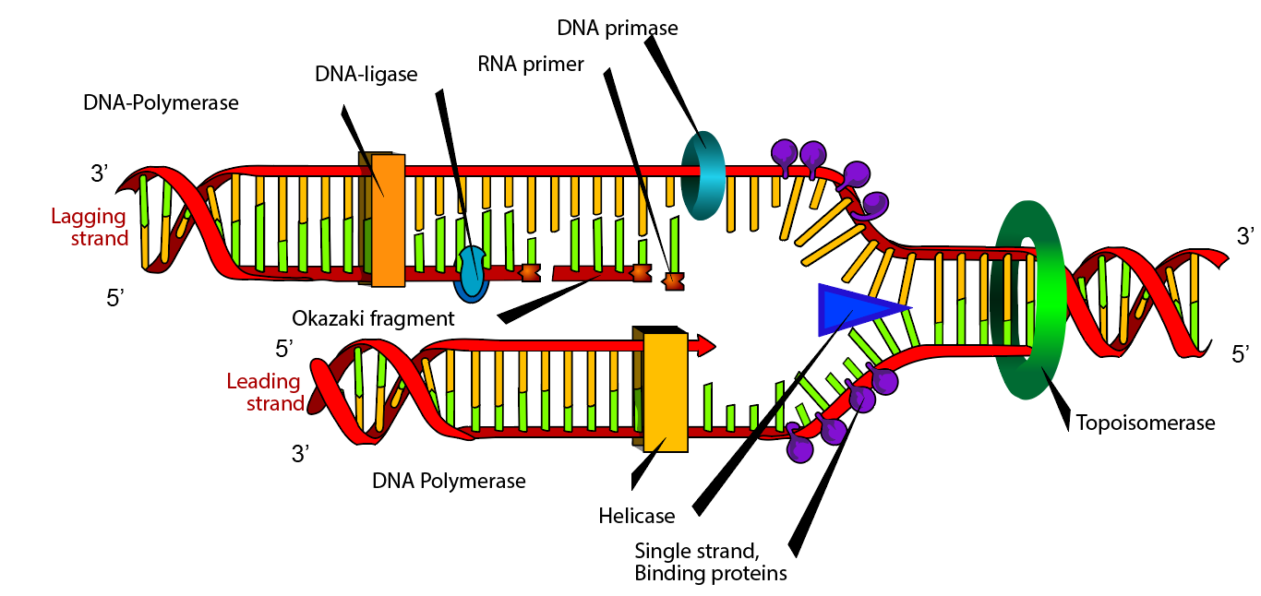
A replication fork is formed when helicase separates the DNA strands at the origin of replication.

Slide 67
The DNA becomes more highly coiled ahead of the replication fork.
Topoisomerase (DNA Gyrase) breaks and reforms DNA’s sugar-phosphate backbone ahead of the replication fork, thereby relieving the pressure that results from this supercoiling.

Slide 68
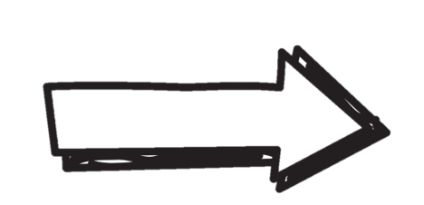
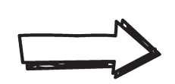
Binding Proteins
replication fork
Single-strand DNA binding proteins then will bind to the single-stranded DNA to prevent the helix from re-forming.
Binding Proteins

Slide 69
ELONGATION STEP in DNA Replication

Slide 70
ELONGATION STEP (in DNA Replication)
DNA Polymerase can only synthesize DNA in the 5’ to 3’ direction.
DNA is double stranded with one strand oriented in the 5’ to 3’ direction and the other stand oriented in the 3’ to 5’ direction.
The consequence of this antiparallel configuration, coupled with the factor that DNA Pol can only synthesize DNA in the 5' to 3' direction, is that one of the DNA strands will be replicated continuously, but the other will not!

Slide 71
The lagging strand of DNA is that strand of the DNA double helix that is orientated in a 5′ to 3′ manner.

Slide 72
The lagging strand of DNA is that strand of the DNA double helix that is orientated in a 5′ to 3′ manner.
Therefore, its complement must be synthesized in a 3′→5′ manner.

Slide 73
Because DNA polymerase III cannot synthesize in the 5′→3′ direction,

Slide 74
…the lagging strand is synthesized in short segments known as Okazaki fragments.

Slide 75
Primase builds RNA primers. DNA polymerase then uses the RNA primers to synthesize DNA in the 5′→3′ direction.

Slide 76
ELONGATION (of DNA Replication)
Leading strand
Leading Strand –
the strand that is replicated continuously by DNA polymerase. Lagging Strand -
the strand that is replicated discontinuously by DNA polymerase. ​
Lagging strand

Slide 77
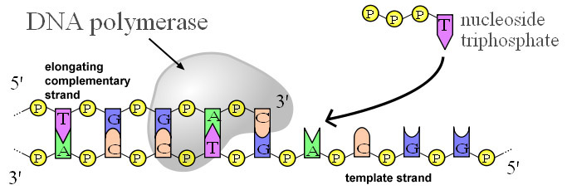
DNA Polymerases are used for DNA Replication/synthesis
DNA Polymerases are enzymes required for DNA synthesis (a.k.a. DNA Replication) in living organisms.
In bacteria, DNA polymerase III (DNA pol III) adds the individual nucleotides according to their complementary base.
Adenine (A) is the complementary base of Thymine (T)
Cytosine (C) is the complementary base of Guanine (G)

Slide 78
DNA ligase then joins the deoxyribonucleotides together, completing the synthesis of the lagging strand.

Slide 79
Steps of Elongation (in DNA Replication)
DNA Ligase is the enzyme that functions to connect the Okazaki Fragments together for the copy of the lagging strand. The word "ligate" in Latin means "to tie together."
LIGASE

Slide 80
Steps of Elongation (in DNA Replication)
Okazaki Fragment
DNA Ligase
LIGASE
Okazaki Fragment

Slide 81
Steps of Elongation (in DNA Replication)
Okazaki Fragment
DNA Ligase
LIGASE
Okazaki Fragment

Slide 82
Steps of Elongation (in DNA Replication)
Okazaki Fragment
LIGASE
DNA Ligase
Okazaki Fragment

Slide 83
TERMINATION of DNA Replication

Slide 84
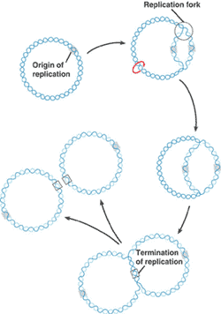
Termination of DNA Replication
Since the bacterial genome consists of a single circular chromosome, at the end of the elongation step of DNA replication, you end up with 2 interlocking circles of DNA that must be separated.

Slide 85
Termination of DNA Replication
FREEDOM AT LAST!
Steps of TERMINATION
Bacterial Topoisomerase IV induces a double-strand break into each of the DNA molecules, allowing them to separate from each other (becoming un-concatenated).
Bacterial Topoisomerase IV then reseals each DNA molecule back together again creating 2 separate, un-linked chromosomes.

Slide 86
The 2 Functions of DNA
All Living Organisms EXPRESS their Genes using transcription and translation.
All Living Organisms make mRNA from DNA in Transciption
Heterocatalytic Function
It Directs the Synthesis of RNA and Proteins
Gene Expressed as Protein
Needed to Carry Out the Functions of the cell.
mRNA is then Used to Make Proteins in all Living organisms.

Slide 87
The Central Dogma of Molecular Biology

Slide 88
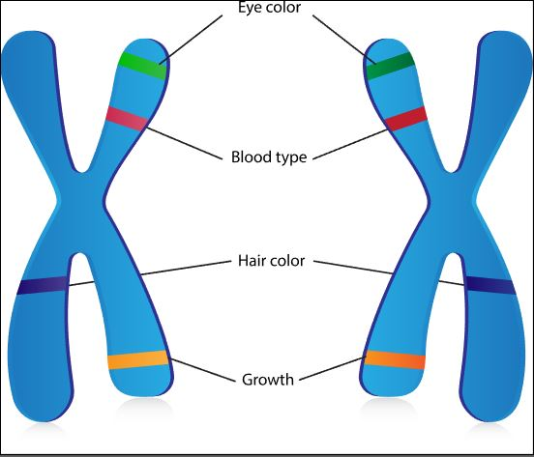
Gene Expression
Genes are segments of nucleic acid sequences that will code for proteins that exhibit a specific genetic trait.

Slide 89
Gene Expression
Genes are expressed as protein through a 2-step process.
_________
Transcription
Translation

Slide 90
Central Dogma Of Molecular Biology
The central dogma of molecular biology explains how the information encoded in DNA sequences (genes) is expressed as proteins in a two-step process:
Step One) Transcription
Transcription involves making mRNA using DNA as a template.
Step Two) Translation.
Translation then translates the mRNA sequence into an amino acid sequence to form a protein.

Slide 91
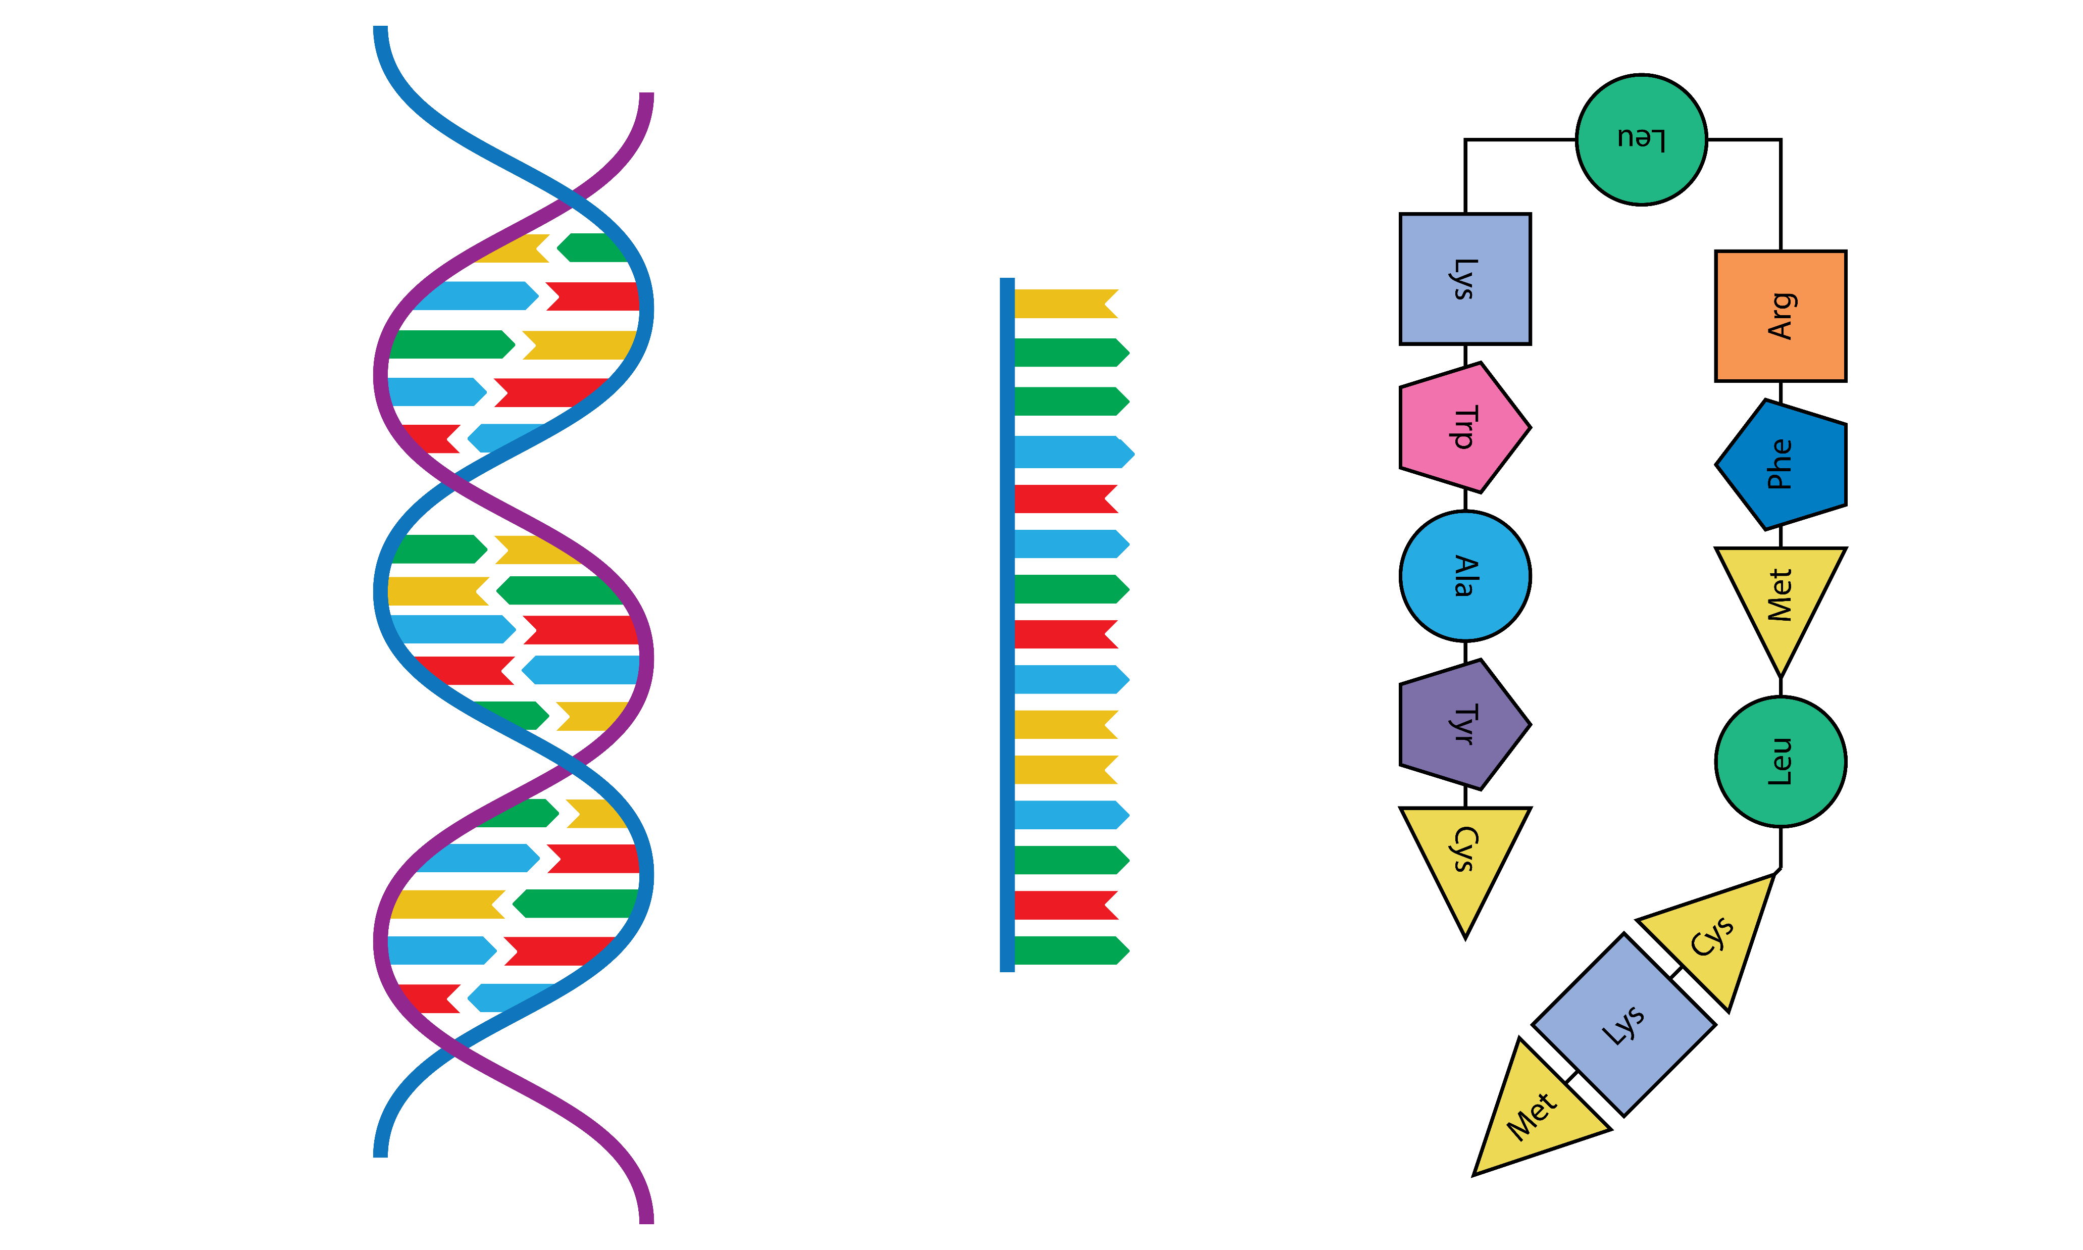
Gene Expression
The first step is transcription.
In short, transcription involves using the DNA molecules as a template to form messenger RNA (mRNA).
DNA
TRANSCRIPTION
mRNA

Slide 92
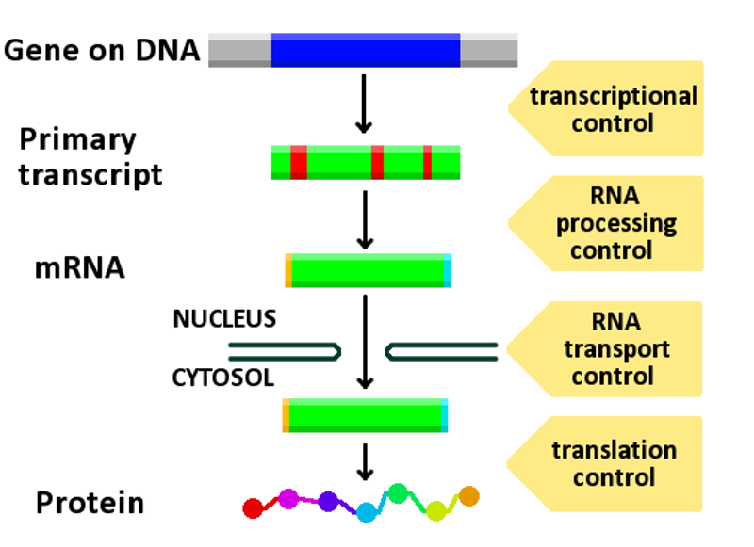
Gene Expression
Eukaryotic cells and Archaeal cells contains non-coding regions of DNA and RNA called INTRONS.
Introns are removed from the mRNA through RNA Processing.

Slide 93
Gene Expression
Eukaryotic cells and Archaeal cells contains non-coding regions of DNA and RNA called INTRONS.
Introns are removed from the mRNA through RNA Processing.

Slide 94
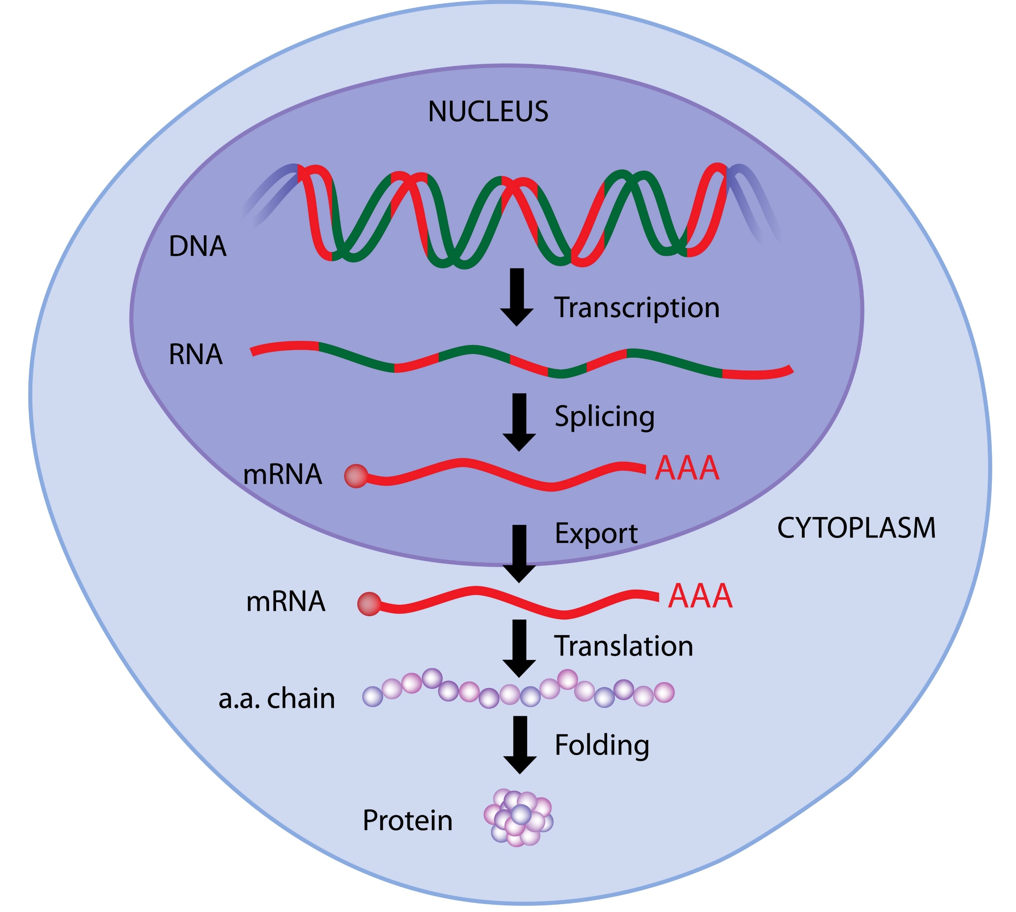
Gene Expression - Eukaryotes
Eukaryotic cells have a nucleus.
The process of transcription takes place in the nucleus of eukaryotic cells.

Slide 95
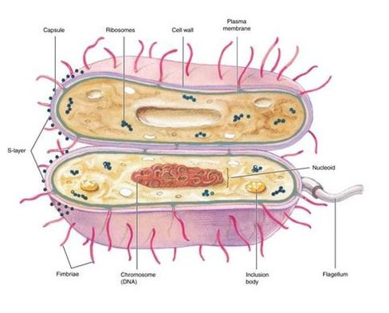
Prokaryotic cells
DO NOT have a nucleus.
_________
The process of transcription takes place in the cytoplasm (or nucleoid region of the cytoplasm) of prokaryotic cells.

Slide 96
Gene Expression
The second and final step of this process is called translation.
_____
Translation is the process by which the mRNA sequence will be translated into an amino acid sequence which makes up a protein.
DNA
Protein
TRANSCRIPTION
TRANSLATION
mRNA

Slide 97
Same Names… Different Processes!
CAUTION AHEAD
!
The Process of DNA Replication Proceeds in 3 Steps:
Initiation
Elongation
Termination
The Process of Transcription (DNA → mRNA) Proceeds in 3 Steps:
Initiation
Elongation
Termination
The Process of Translation (mRNA → protein) Proceeds in 3 Steps:
Initiation
Elongation
Termination

Slide 98
TRANSCRIPTION

Slide 99
Transcription is a 3-Step Process
INITIATION
Elongation
Termination

Slide 100
Bacterial Transcription: Summary
Initiation:
Sigma brings RNA polymerase holoenzyme to promoter region of DNA.
DNA helix is opened and transcription begins.
Sigma releases and transcription continues.
•Elongation:
Complementary ribonucleotides are added to the growing mRNA transcript as specified by the DNA template strand.
•Termination:
RNA polymerase reaches a termination signal in the DNA template.
mRNA forms a hairpin loop.
mRNA dissociates from RNA polymerase.

Slide 101
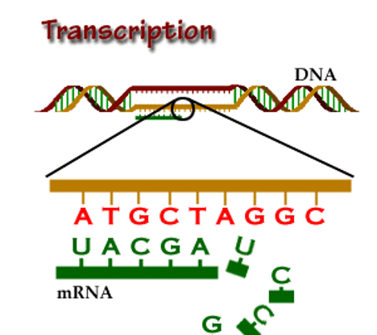
RNA Transcription
RNA transcription in bacteria is done in the cytoplasm, not in the nucleus like in eukaryotic cells.
Transcription in bacteria is done using an enzyme called RNA polymerase.
RNA Polymerase adds nucleotides according to their complementary bases using a free 3’-OH group of the growing nucleotide chain. ​

Slide 102
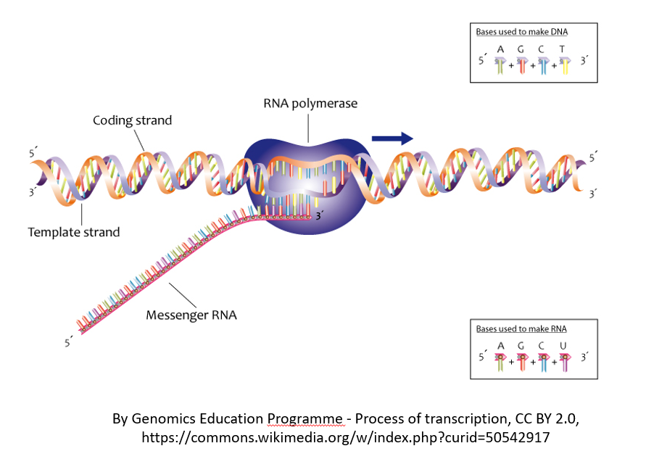
INITIATION (of RNA Transcription)
RNA transcription requires a promoter.
A promoter is a DNA sequence that transcription factors bind to.
Promoters are located “upstream” from the sequences that code for proteins.
The nucleotides that code for proteins would be considered to be located “downstream” from the initiation site (which is where transcription begins).

Slide 103
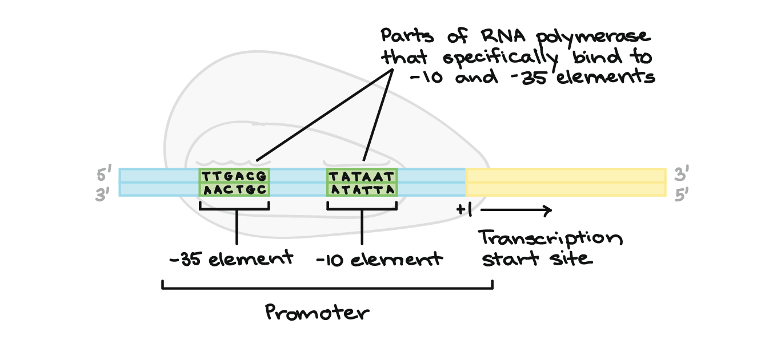
Promoters in Bacteria
Promoters are usually located between –10 and –35 bases upstream from the initiation site (designated +1).
All species of bacteria have two nucleotide sequences that have been conserved, known as "consensus sequences".
https://www.khanacademy.org/science/biology/gene-expression-central-dogma/transcription-of-dna-into-rna/a/stages-of-transcription

Slide 104
Promoters in Bacteria
The 2 consensus sequences are as follows:
The –10 consensus sequence, called the TATA box, is TATAAT.
The –35 sequence is recognized and bound by Sigma.
https://www.khanacademy.org/science/biology/gene-expression-central-dogma/transcription-of-dna-into-rna/a/stages-of-transcription

Slide 105
ELONGATION (of RNA Transcription)
Once all of the relevant transcription factors have bound to the promoter, the elongation in transcription phase begins.
In this part of RNA transcription, the sigma subunit of the RNA polymerase falls off which allows RNA transcription to begin.

Slide 106
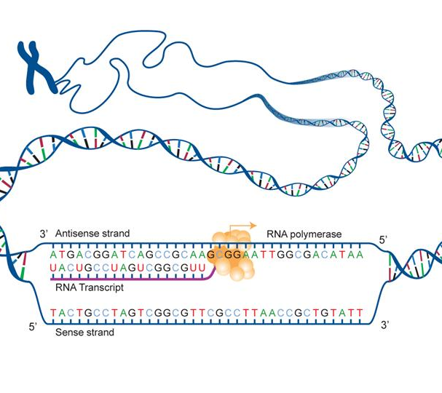
ELONGATION (of RNA Transcription)
The RNA nucleotides are added in a complementary fashion to the DNA template in a 5’ to 3’ direction at a rate of approximately 40 nucleotides per second.
RNA does not have thymine (T), so when the DNA template contains a nucleotide with an adenine (A) base, it will add a nucleotide with Uracil (U) instead.

Slide 107
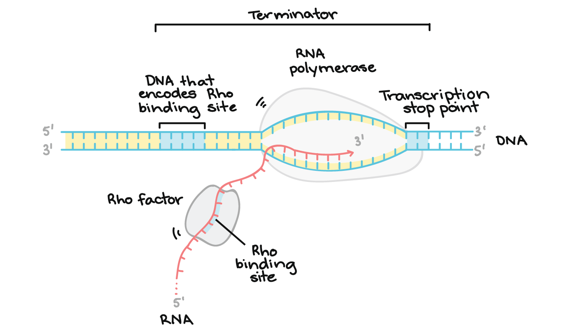
Transcription of RNA is terminated when the bacterial RNA polymerase dissociates from the DNA template and releases the newly made RNA.
This is accomplished through a terminating sequence (a repeated nucleotide sequence) that signals the RNA polymerase to terminate the process.
TERMINATION (of RNA Transcription)

Slide 108
Eukaryotic mRNA Processing
After transcription but before translation, specific regions of the primary RNA transcript are spliced out (cut out) and degraded during RNA processing
Bacterial MRNA does not get processed. Archaea mRNA does.

Slide 109
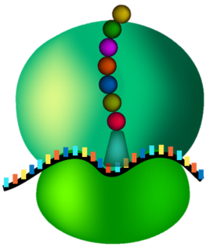
Translation

Slide 110
Translation in Bacteria is a 3-Step Process
INITIATION
Elongation
Termination

Slide 111
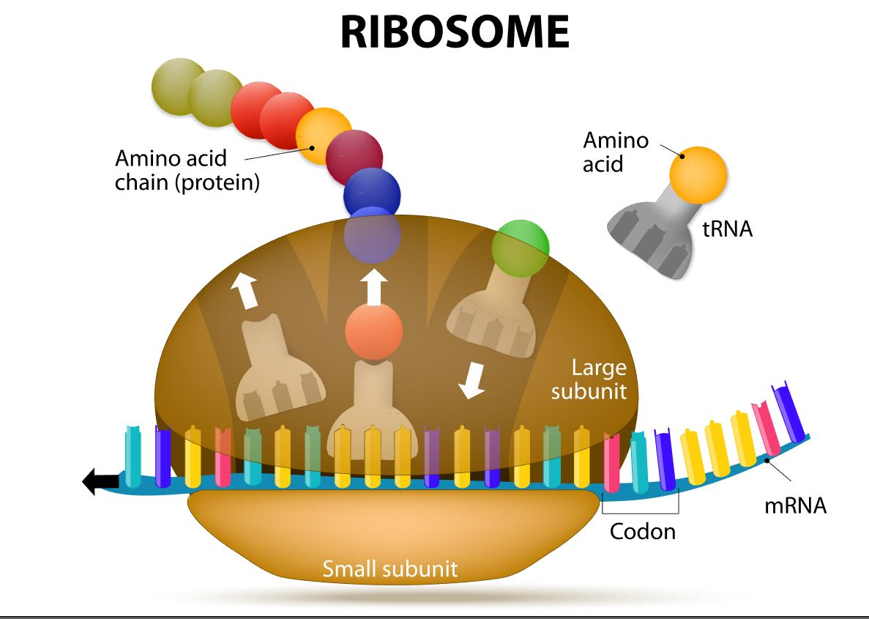
In translation:
The sequence of bases in mRNA is converted (“translated”) to an amino acid sequence of a protein.
Ribosomes catalyze the translation of mRNA sequence into protein.
They are the SITE or protein synthesis but they DO NOT actually MAKE the proteins!!!

Slide 112
INITIATION (of Translation)
In bacteria, translation of mRNA into an amino acid sequence begins with the formation of an initiation complex.
The initiation complex is formed when the mRNA, the tRNA, and the first amino acid all come together within the ribosome.

Slide 113
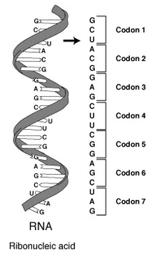
ELONGATION (of Translation)
The nucleotide sequence of mRNA is read in triplets called codons.
All translation begins with what is called "the start codon" which is AUG.
This means that the first 3 bases on the mRNA are Adenine (A), Uracil (U) and Guanine (G) = AUG.
The AUG codon codes for the amino acid methionine.

Slide 114
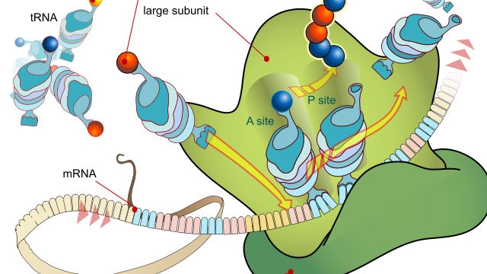
TERMINATION (of Translation)
Termination of protein synthesis occurs at the stop codon. There are three different codons which are considered stop codons (UAA, UAG and UGA).
When one of these stop codons reaches the ribosome, the last amino acid will break free from the ribosome and from the tRNA. The protein is now complete.

Slide 115
Viruses
And Friends

Slide 116
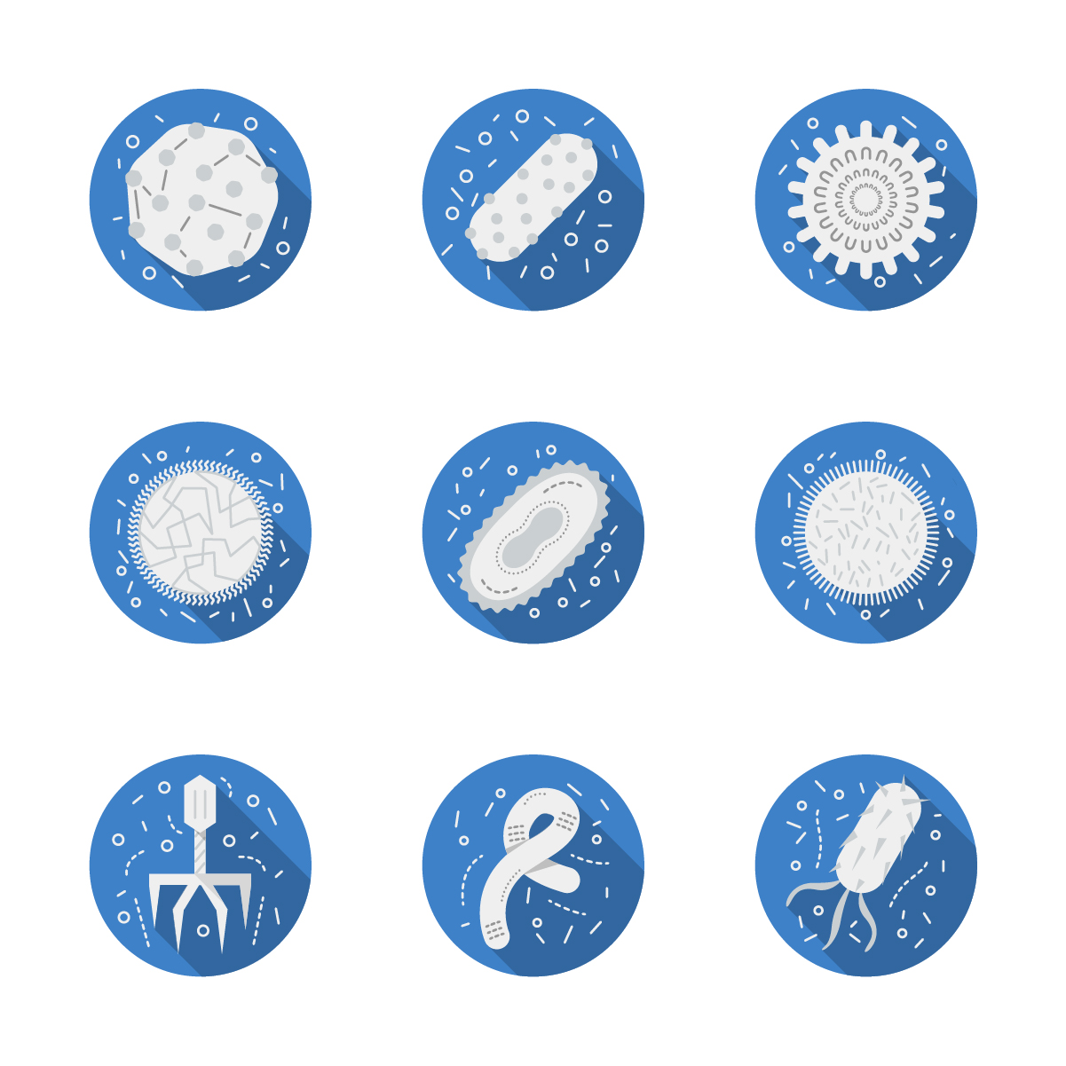
Are Viruses Alive?
Prokaryotes, like bacteria, and eukaryotes are considered to be living organisms.
The current criteria for life includes that all lifeforms must consist of one or more cells.

Slide 117
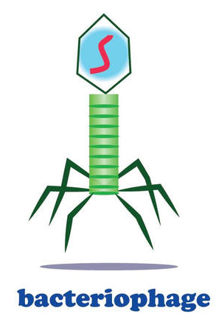
Alive or Not?
Viruses are not made up of cells, so they are not considered "alive" by the current convention.
However, viruses are extremely sophisticated and have been successfully reproducing, adapting and evolving for billions of years.
Viruses are not considered organisms. Instead, they are considered "acellular particles" or virions.

Slide 118
Are Viruses Alive?
Another ONE OF THE criteria FOR WHAT WE CONSIDER TO BE ’LIVING’ IS THE ABILITY TO REPRODUCE.
Viruses do have the ability to reproduce, but only with the assistance of a host cell.

Slide 119
Viruses are Small (~ 10 - 100 nm)
Bacteria cells are about 10X smaller than eukaryotic cells, and viruses are about 10 X smaller than even bacteria cells!

Slide 120
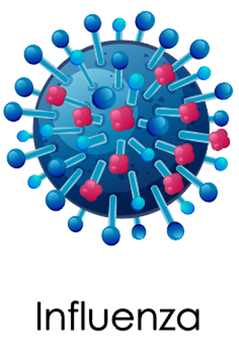
Viruses are Small (~ 10 - 100 nm)
With so little space, it is no wonder that they must rely on invading a host cell in order to reproduce.
Viruses invade a host cell and then hijack the cell's reproductive machinery in order to make copies of itself.

Slide 121
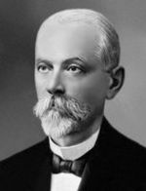
THE DISCOVERY OF THE FIRST VIRUS
Dmitry Ivanovsky
Two scientists contributed to the discovery of the first virus, Tobacco mosaic virus. Dmitry Ivanovsky and Martinus Beijerinck.
In 1892, Dmitry Ivanovsky filtered the sap from a diseased tobacco plant and discovered that the filtrate was able to infect a healthy tobacco plant with the disease.

Slide 122
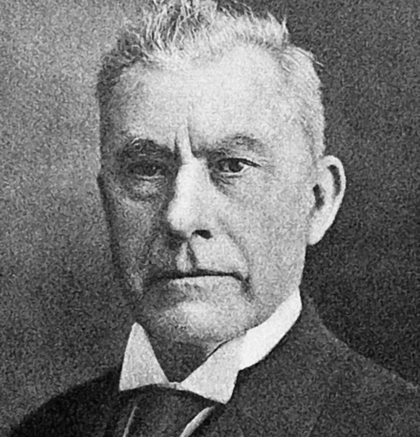
THE DISCOVERY OF THE FIRST VIRUS
Independently, Martinus Beijerinck, discovered the same virus while conducting similar experiments in 1899.
Beijerinck described the filtrate as a “contagious, living liquid” that acted like a poison or virus (virus = “poison”). This is how viruses got their name and the filed of virology was born.
Martinus Beijerinck

Slide 123
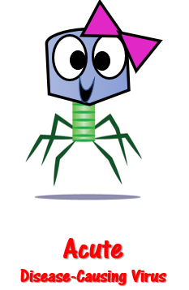
THE DISCOVERY OF THE FIRST VIRUS
Before this time, viruses had not yet been discovered or classified.
At this point in time, many of the illnesses caused by viral infections were thought to be caused by bacterial agents. ​

Slide 124
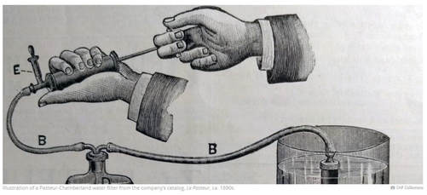
THE DISCOVERY OF THE FIRST VIRUS
The isolation of bacteria involved a process called filtering.
Because viruses are about ten times smaller than bacteria cells, the filters of the day were unable to isolate the individual virus particles.

Slide 125
THE PASTEUR-CHAMBERLAND FILTER
​ Pasteur and Chamberland created a new filter, called the Pasteur-Chamberland filter, which was able to trap viruses.

Slide 126
The Birth of Virology
The invention of the Pasteur-Chamberland Filter made isolating the Tobacco Mosaic Virus Possible, which lead to an entirely new scientific field of study – VIROLOGY!

Slide 127
No One is Safe!
Viruses attack organisms in all 3 domains of life. Viruses can be classified by according to the type of organism that they invade.

Slide 128
For example, there are…
animal viruses
plant viruses
bacterial viruses called bacteriophages.

Slide 129
The Viral Genome
The viral genome is small, usually measuring under 200 kilobases (kb).
Viruses usually contain only one molecule of genetic material.

Slide 130
The Viral Genome
The genome of a virus can be in various forms.
Most viruses tend to carry single-stranded RNA as their genetic material

Slide 131
The Viral Genome
It can also be
Single-stranded Circular DNA

Slide 132
The Viral Genome
or can also be
Double-stranded Circular DNA or RNA

Slide 133
The Viral Genome
or
Double-stranded Linear DNA or RNA

Slide 134
The Viral Genome
Or even
Single-stranded Linear DNA or RNA

Slide 135
STRUCTURE OF A VIRUS
The basic structure of a virus is made up of genetic information in the form of a single molecule of DNA or RNA, surrounded by a protein coat called a capsid.

Slide 136
Structure of a Virus
The genetic material is surrounded by a protein coat that is called the
capsid. ​

Slide 137
CAPSOMERES
The capsid is made up of proteins called capsomeres.
The capsomere is a subunit of the capsid, an outer covering of protein that protects the genetic material of a virus.
Capsomeres self-assemble to form the capsid.

Slide 138
VIRIONS
When a single virus is in its complete INFECTIOUS FORM, outside of a host cell, it is known as a VIRION.

Slide 139
Capsids
All viruses have capsids
Capsids are protein coats that enclose and protect their nucleic acid.
Each capsid is constructed from identical subunits called capsomeres made of protein.
The capsid together with the nucleic acid are nucleocapsid.

Slide 140
Capsids
Capsids are composed of a protein shell built from capsomere proteins.
Capsid- Protein coat that encapsulates the viral genome.
Nucleocapsid-Capsid with genome inside (plus anything else that may be inside like enzymes and other viral proteins for some viruses).

Slide 141
​Capsid Functions
Protects genetic material from environmental hazards such as damaging UV-radiation, physical abrasion and degrading enzymes (nucleases).

Slide 142
​Capsid Functions
Holds the virus-attachment protein that binds with host cell's membrane receptors.
This interaction allows viral infection to occur.
Delivers the viral genome to the host cell.

Slide 143
Shapes of Viruses
Capsids give viruses their shape.
Viruses are seen in a wide variety of shapes, but most often the shape will have a high degree of symmetry.

Slide 144
Shapes of Viruses
The types of symmetry displayed most often by viral capsids are helical and icosahedral.

Slide 145
Icosahedral capsid symmetry is the most economical way to assemble a symmetric capsid using nonsymmetrical protein molecules.

Slide 146
Icosahedral Shaped Viruses
In viruses with icosahedral shapes, the capsid takes on a 20-sided rounded shape containing 20 identical triangular-shaped faces.
Each of the 20 faces shaped like a triangle is composed of the same number of capsomeres.

Slide 147
Viral Envelopes
Many animal viruses have an additional layer of protection in the form of viral envelopes.
These viral envelopes surround and protect the capsid.
Viruses usually obtain the viral envelopes by stealing portions of the cell membranes of cells they have infected in the past.
Viral Envelopes are composed of a phospholipid bilayer with protein stolen from the host’s membrane.

Slide 148
Viral Envelopes
These pieces of membranes contain markers (proteins) that disguise the virus.
When the cells of the immune system inspect the envelope of the virus, they then find the same membrane proteins as the host cell.
The immune system is often tricked into thinking the virus belongs in the host, and leaves it alone!

Slide 149
Viral Envelopes
The viral envelope can contain regions of membrane that allows the virus to enter the host cell via endocytosis and to leave the host cell via exocytosis.

Slide 150
Viral Replication Strategies ​
Attachment
Infection
Degradation of Host Genome
Viral Genome Replication and Viral Protein Synthesis
Viral assembly and release
Free Viruses Go On To Repeat The Cycle

Slide 151
ATTACHMENT
There are many strategies viruses use to attach to the host cell, but usually this process is done by a lock-and-key mechanism that will occur between the proteins of the capsid on the virus and the receptors of the host cell.

Slide 152
ATTACHMENT
- The virus must recognize the host cell and bind to its receptor using viral attachment protein.
Different types of viruses will only be able to recognize and bind to specific receptors.
Viruses are host-specific. The specific type of viral attachment protein must fit (like a key) with the host receptor (like a lock).

Slide 153
Bacteriophages are viruses that infect bacteria cells.

Slide 154
There are two types of reproductive cycles that a bacteriophage can enter;
1) The lytic cycle
and
2) The lysogenic cycle

Slide 155
The lytic cycle results in lysis of the host cell, which ends in death.
___________________
In the lysogenic cycle, the viral genome enters the nucleus and inserts itself into the host genome, keeping the host cell alive.

Slide 156
The Lytic Cycle
The virus docks onto the host cell and attaches to the host.
Most often, then is done through a lock-and-key mechanism which involves a viral protein binding to a specific receptor on the surface of the host cell.
Once attached, the virus injects its genome into the cell.

Slide 157
Attachment and Infection
Infection is when the virus inserts its viral DNA (or RNA) into the host cell. ​​ ​
Once the viral DNA/RNA enters the host cell, the viral DNA/RNA will use the host cell's nucleotides and enzymes to replicate itself making more copies of the viral genome..

Slide 158
The Lytic Cycle
The viral DNA (or RNA) takes over the host cell's nucleotides, and enzymes, along with its machinery, and makes copies of itself.
The viral DNA is transcribed into messenger RNA (mRNA) which is then translated into protein.

Slide 159
The Lytic Cycle
Once all of the viral building blocks have been made, the viral components will self-assemble to form new copies of the virus.
This process continues (more and more viral copies are made until the host cell can no longer sustain life).
The new viral copies will produce a substance called lysin, which is an enzyme that functions to weaken the structural integrity of the cell wall.

Slide 160
The Lytic Cycle
The viral copies create osmotic pressure that drives the extracellular fluid into the cell.
The build up of pressure results in lysis of the cell. This is when the host cell bursts open, and the newly created viruses are released into the extracellular environment.
These new viruses are now free to infect other host cells, and repeat the lytic cycle.

Slide 161
The Lysogenic Cycle
Unlike the lytic cycle, the lysogenic cycle is not going to kill the host cell.
The viruses that reproduce using this method are considered "temperate" viruses.

Slide 162
The Lysogenic Cycle
First, the phage infects the host bacteria.
Then, the viral DNA (or RNA) will be inserted into the bacteria host.
The Viral DNA is then going to incorporate itself into the host cells genome.

Slide 163
The Lysogenic Cycle
Once the virus's DNA has been incorporated into the host cells DNA, it is now considered a prophage.
Each time the infected bacteria cell reproduces itself, it will also reproduce the viral DNA

Slide 164
The Lysogenic Cycle
After some time has past, the prophage will exit the host cell's genome and the virus will begin to undergo the deadly lytic cycle.

Slide 165
Retroviruses

Slide 166
Retroviruses
Retroviruses contain reverse transcriptase (RNA-dependent DNA polymerase).
Retroviruses contain RNA as their genetic material.

Slide 167
Reverse Transcription
Retroviruses convert RNA to DNA.
This is basically the reverse of normal transcription process, which would make RNA by using DNA as a template.

Slide 168
Retrovirus Life Cycle (HIV)
Upon the infection of a host cell, the viral RNA is used as a template to form DNA through the use of reverse transcriptase.

Slide 169
Retrovirus Life Cycle (HIV)
The resulting viral DNA will then integrate itself into the genome of the host cell.
Now, every time the host cell replicates, it will also replicate the viral DNA, which is used to assemble viral progeny.
The viral progeny can then exit the host cell via budding and go on to infect a new cell, thereby repeating the retrovirus life cycle.

Slide 170
Viroids
Viroids are the smallest infectious pathogens known.
Viroids are small particles that are even smaller than viruses and they are composed simply of only an extremely small single-stranded RNA molecule measuring less than 400 nucleotides.

Slide 171
Viroids
Viroids do not contain any type of protective coat or capsid or envelope. Virions twist into bent, coiled conformations which allow them to evade destruction by RNases (ribonucleases).
This infectious particle is pathogenic to plants and interferes with the plants normal growth process.

Slide 173
Prions
Many of you may remember the "mad cow epidemic" that reached its peak in 1993.
Hundreds of thousands of cattle became ill, putting a halt on meat production in Europe.

Slide 174
Prions
ANGRY COW
"Mad cow" disease is a progressive neurological disease caused by a prion.
The most common form of prion disease that affects humans is Creutzfeldt-Jakob disease (CJD), or more commonly known as "mad cow" disease.

Slide 175
Prions
Prion diseases can affect both humans and animals.
Prions can be passed from animals to humans by consuming the meat of infected animals.

Slide 176
Prions
Prions are proteins that interfere with the normal protein folding.
When prions are present in the brain, the proteins of the brain to fold abnormally.
The abnormal folding completely alters the protein's function.

Slide 177
Viruses
And Friends

Slide 178
Are Viruses Alive?
Prokaryotes, like bacteria, and eukaryotes are considered to be living organisms.
The current criteria for life includes that all lifeforms must consist of one or more cells.

Slide 179
Alive or Not?
Viruses are not made up of cells, so they are not considered "alive" by the current convention.
However, viruses are extremely sophisticated and have been successfully reproducing, adapting and evolving for billions of years.
Viruses are not considered organisms. Instead, they are considered "acellular particles" or virions.

Slide 180
Are Viruses Alive?
Another ONE OF THE criteria FOR WHAT WE CONSIDER TO BE ’LIVING’ IS THE ABILITY TO REPRODUCE.
Viruses do have the ability to reproduce, but only with the assistance of a host cell.

Slide 181
Viruses are Small (~ 10 - 100 nm)
Bacteria cells are about 10X smaller than eukaryotic cells, and viruses are about 10 X smaller than even bacteria cells!

Slide 182
Viruses are Small (~ 10 - 100 nm)
With so little space, it is no wonder that they must rely on invading a host cell in order to reproduce.
Viruses invade a host cell and then hijack the cell's reproductive machinery in order to make copies of itself.

Slide 183
THE DISCOVERY OF THE FIRST VIRUS
Dmitry Ivanovsky
Two scientists contributed to the discovery of the first virus, Tobacco mosaic virus. Dmitry Ivanovsky and Martinus Beijerinck.
In 1892, Dmitry Ivanovsky filtered the sap from a diseased tobacco plant and discovered that the filtrate was able to infect a healthy tobacco plant with the disease.

Slide 184
THE DISCOVERY OF THE FIRST VIRUS
Independently, Martinus Beijerinck, discovered the same virus while conducting similar experiments in 1899.
Beijerinck described the filtrate as a “contagious, living liquid” that acted like a poison or virus (virus = “poison”). This is how viruses got their name and the filed of virology was born.
Martinus Beijerinck

Slide 185
THE DISCOVERY OF THE FIRST VIRUS
Before this time, viruses had not yet been discovered or classified.
At this point in time, many of the illnesses caused by viral infections were thought to be caused by bacterial agents. ​

Slide 186
THE DISCOVERY OF THE FIRST VIRUS
The isolation of bacteria involved a process called filtering.
Because viruses are about ten times smaller than bacteria cells, the filters of the day were unable to isolate the individual virus particles.

Slide 187
THE PASTEUR-CHAMBERLAND FILTER
​ Pasteur and Chamberland created a new filter, called the Pasteur-Chamberland filter, which was able to trap viruses.

Slide 188
The Birth of Virology
The invention of the Pasteur-Chamberland Filter made isolating the Tobacco Mosaic Virus Possible, which lead to an entirely new scientific field of study – VIROLOGY!

Slide 189
No One is Safe!
Viruses attack organisms in all 3 domains of life. Viruses can be classified by according to the type of organism that they invade.

Slide 190
For example, there are…
animal viruses
plant viruses
bacterial viruses called bacteriophages.

Slide 191
The Viral Genome
The viral genome is small, usually measuring under 200 kilobases (kb).
Viruses usually contain only one molecule of genetic material.

Slide 192
The Viral Genome
The genome of a virus can be in various forms.
Most viruses tend to carry single-stranded RNA as their genetic material

Slide 193
The Viral Genome
It can also be
Single-stranded Circular DNA

Slide 194
The Viral Genome
or can also be
Double-stranded Circular DNA or RNA

Slide 195
The Viral Genome
or
Double-stranded Linear DNA or RNA

Slide 196
The Viral Genome
Or even
Single-stranded Linear DNA or RNA

Slide 197
STRUCTURE OF A VIRUS
The basic structure of a virus is made up of genetic information in the form of a single molecule of DNA or RNA, surrounded by a protein coat called a capsid.

Slide 198
Structure of a Virus
The genetic material is surrounded by a protein coat that is called the
capsid. ​

Slide 199
CAPSOMERES
The capsid is made up of proteins called capsomeres.
The capsomere is a subunit of the capsid, an outer covering of protein that protects the genetic material of a virus.
Capsomeres self-assemble to form the capsid.

Slide 200
VIRIONS
When a single virus is in its complete INFECTIOUS FORM, outside of a host cell, it is known as a VIRION.

Slide 201
Capsids
All viruses have capsids
Capsids are protein coats that enclose and protect their nucleic acid.
Each capsid is constructed from identical subunits called capsomeres made of protein.
The capsid together with the nucleic acid are nucleocapsid.

Slide 202
Capsids
Capsids are composed of a protein shell built from capsomere proteins.
Capsid- Protein coat that encapsulates the viral genome.
Nucleocapsid-Capsid with genome inside (plus anything else that may be inside like enzymes and other viral proteins for some viruses).

Slide 203
​Capsid Functions
Protects genetic material from environmental hazards such as damaging UV-radiation, physical abrasion and degrading enzymes (nucleases).

Slide 204
​Capsid Functions
Holds the virus-attachment protein that binds with host cell's membrane receptors.
This interaction allows viral infection to occur.
Delivers the viral genome to the host cell.

Slide 205
Shapes of Viruses
Capsids give viruses their shape.
Viruses are seen in a wide variety of shapes, but most often the shape will have a high degree of symmetry.

Slide 206
Shapes of Viruses
The types of symmetry displayed most often by viral capsids are helical and icosahedral.

Slide 207
Icosahedral capsid symmetry is the most economical way to assemble a symmetric capsid using nonsymmetrical protein molecules.

Slide 208
Icosahedral Shaped Viruses
In viruses with icosahedral shapes, the capsid takes on a 20-sided rounded shape containing 20 identical triangular-shaped faces.
Each of the 20 faces shaped like a triangle is composed of the same number of capsomeres.

Slide 209
Viral Envelopes
Many animal viruses have an additional layer of protection in the form of viral envelopes.
These viral envelopes surround and protect the capsid.
Viruses usually obtain the viral envelopes by stealing portions of the cell membranes of cells they have infected in the past.
Viral Envelopes are composed of a phospholipid bilayer with protein stolen from the host’s membrane.

Slide 210
Viral Envelopes
These pieces of membranes contain markers (proteins) that disguise the virus.
When the cells of the immune system inspect the envelope of the virus, they then find the same membrane proteins as the host cell.
The immune system is often tricked into thinking the virus belongs in the host, and leaves it alone!

Slide 211
Viral Envelopes
The viral envelope can contain regions of membrane that allows the virus to enter the host cell via endocytosis and to leave the host cell via exocytosis.

Slide 212
Viral Replication Strategies ​
Attachment
Infection
Degradation of Host Genome
Viral Genome Replication and Viral Protein Synthesis
Viral assembly and release
Free Viruses Go On To Repeat The Cycle

Slide 213
ATTACHMENT
There are many strategies viruses use to attach to the host cell, but usually this process is done by a lock-and-key mechanism that will occur between the proteins of the capsid on the virus and the receptors of the host cell.

Slide 214
ATTACHMENT
- The virus must recognize the host cell and bind to its receptor using viral attachment protein.
Different types of viruses will only be able to recognize and bind to specific receptors.
Viruses are host-specific. The specific type of viral attachment protein must fit (like a key) with the host receptor (like a lock).

Slide 215
Bacteriophages are viruses that infect bacteria cells.

Slide 216
There are two types of reproductive cycles that a bacteriophage can enter;
1) The lytic cycle
and
2) The lysogenic cycle

Slide 217
The lytic cycle results in lysis of the host cell, which ends in death.
___________________
In the lysogenic cycle, the viral genome enters the nucleus and inserts itself into the host genome, keeping the host cell alive.

Slide 218
The Lytic Cycle
The virus docks onto the host cell and attaches to the host.
Most often, then is done through a lock-and-key mechanism which involves a viral protein binding to a specific receptor on the surface of the host cell.
Once attached, the virus injects its genome into the cell.

Slide 219
Attachment and Infection
Infection is when the virus inserts its viral DNA (or RNA) into the host cell. ​​ ​
Once the viral DNA/RNA enters the host cell, the viral DNA/RNA will use the host cell's nucleotides and enzymes to replicate itself making more copies of the viral genome..

Slide 220
The Lytic Cycle
The viral DNA (or RNA) takes over the host cell's nucleotides, and enzymes, along with its machinery, and makes copies of itself.
The viral DNA is transcribed into messenger RNA (mRNA) which is then translated into protein.

Slide 221
The Lytic Cycle
Once all of the viral building blocks have been made, the viral components will self-assemble to form new copies of the virus.
This process continues (more and more viral copies are made until the host cell can no longer sustain life).
The new viral copies will produce a substance called lysin, which is an enzyme that functions to weaken the structural integrity of the cell wall.

Slide 222
The Lytic Cycle
The viral copies create osmotic pressure that drives the extracellular fluid into the cell.
The build up of pressure results in lysis of the cell. This is when the host cell bursts open, and the newly created viruses are released into the extracellular environment.
These new viruses are now free to infect other host cells, and repeat the lytic cycle.

Slide 223
The Lysogenic Cycle
Unlike the lytic cycle, the lysogenic cycle is not going to kill the host cell.
The viruses that reproduce using this method are considered "temperate" viruses.

Slide 224
The Lysogenic Cycle
First, the phage infects the host bacteria.
Then, the viral DNA (or RNA) will be inserted into the bacteria host.
The Viral DNA is then going to incorporate itself into the host cells genome.

Slide 225
The Lysogenic Cycle
Once the virus's DNA has been incorporated into the host cells DNA, it is now considered a prophage.
Each time the infected bacteria cell reproduces itself, it will also reproduce the viral DNA

Slide 226
The Lysogenic Cycle
After some time has past, the prophage will exit the host cell's genome and the virus will begin to undergo the deadly lytic cycle.

Slide 227
Retroviruses

Slide 228
Retroviruses
Retroviruses contain reverse transcriptase (RNA-dependent DNA polymerase).
Retroviruses contain RNA as their genetic material.

Slide 229
Reverse Transcription
Retroviruses convert RNA to DNA.
This is basically the reverse of normal transcription process, which would make RNA by using DNA as a template.

Slide 230
Retrovirus Life Cycle (HIV)
Upon the infection of a host cell, the viral RNA is used as a template to form DNA through the use of reverse transcriptase.

Slide 231
Retrovirus Life Cycle (HIV)
The resulting viral DNA will then integrate itself into the genome of the host cell.
Now, every time the host cell replicates, it will also replicate the viral DNA, which is used to assemble viral progeny.
The viral progeny can then exit the host cell via budding and go on to infect a new cell, thereby repeating the retrovirus life cycle.

Slide 232
Viroids
Viroids are the smallest infectious pathogens known.
Viroids are small particles that are even smaller than viruses and they are composed simply of only an extremely small single-stranded RNA molecule measuring less than 400 nucleotides.

Slide 233
Viroids
Viroids do not contain any type of protective coat or capsid or envelope. Virions twist into bent, coiled conformations which allow them to evade destruction by RNases (ribonucleases).
This infectious particle is pathogenic to plants and interferes with the plants normal growth process.

Slide 235
Prions
Many of you may remember the "mad cow epidemic" that reached its peak in 1993.
Hundreds of thousands of cattle became ill, putting a halt on meat production in Europe.

Slide 236
Prions
ANGRY COW
"Mad cow" disease is a progressive neurological disease caused by a prion.
The most common form of prion disease that affects humans is Creutzfeldt-Jakob disease (CJD), or more commonly known as "mad cow" disease.

Slide 237
Prions
Prion diseases can affect both humans and animals.
Prions can be passed from animals to humans by consuming the meat of infected animals.

Slide 238
Prions
Prions are proteins that interfere with the normal protein folding.
When prions are present in the brain, the proteins of the brain to fold abnormally.
The abnormal folding completely alters the protein's function.

Slide 239
A Methods of Genetic Recombination in Bacteria

Slide 240
GENETIC RECOMBINATION IN BACTERIA
THE THREE METHODS BY WHICH BACTERIA CAN UNDERGO GENETIC RECOMBINATION ARE AS FOLLOWS:
TRANSFORMATION
TRANSDUCTION
CONJUGATION
This Photo by Unknown Author is licensed under CC BY-NC-ND

Slide 241
Transformation
Transformation occurs naturally in some species of bacteria, but it can also be induced in the lab.

Slide 242
Transformation – Inducing COMPETENCE
For transformation to happen, bacteria must be in a state of competence, which might occur as a time-limited response to environmental conditions such as
electrical charge
temperature
starvation
Cell density

Slide 243
NATURAL TRANSFORMATION
Some bacteria are able to take up plasmids or other fragments of genetic material from its surroundings Naturally under certain conditions.

Slide 244
NATURAL TRANSFORMATION
free-floating DNA can then be picked up by competent cells. The exogenous DNA is incorporated into the host cell’s chromosome via recombination.

Slide 245
Transformation: A Method of Genetic Recombination in Bacteria
Transformation is when a bacteria takes in plasmids from their environment.
In order to take in a plasmid from the environment, microbiologists must "induce competency".
There are several methods used in laboratories to induce competency.
One of the most popular and easiest ways to induce competency in bacteria, is the "heat shock" method.

Slide 246
Transformation: A Method of Genetic Recombination in Bacteria
Heat shocking involves exposing the bacteria to a moderately high temperature for a brief amount of time.
Immediately following the heat exposure, the culture is then put on ice.
This extreme temperature change causes specialized surface proteins on the cell membrane to allow the plasmids to pass through.
The bacteria are able to internalize the plasmids and they can express the genes on those plasmids in the form of proteins. ​

Slide 247
Transduction is the injection of foreign DNA by a bacteriophage virus into the host bacterium.
Transduction

Slide 248
Bacterio-phages can "accidentally" transfer genetic material from one bacterium to another.

Slide 249
TRANSDUCTION
In transduction, DNA is transferred from one bacterium to another by a virus or viral vector.
Transduction can also be used in the lab to introduce a foreign gene into a bacterial host cell’s genome.

Slide 250
Transduction: A Method of Genetic Recombination in Bacteria
Transduction happens through either the
lytic cycle
or the
lysogenic cycle.
The Lytic Cycle
The Lysogenic Cycle

Slide 251
Transduction: A Method of Genetic Recombination in Bacteria
When bacteriophages normally infect a bacterial cell, the virus’s genetic material harnesses the host cell’s replicational, transcriptional, and translation machinery to reproduce itself.

Slide 252
Transduction
When the new bacteria are formed, the new bacteriophages must package their DNA into their capsids.
This process is not perfect. We find that sometimes small pieces of bacterial DNA will get packaged along with the bacteriophage’s genome.
Bacteriophages
Bacteriophages Having Some Bacterial DNA with Their Own Viral DNA

Slide 253
When the new bacteriophages infect a new host cell, the bacterial DNA is injected along with the viral genome.

Slide 254
CONJUGATION
Conjugation is the transfer of genetic material between two bacterial cells in direct contact with each other through a cytoplasmic bridge.

Slide 255
Bacterial Conjugation:
A Method of Genetic Recombination or Horizontal Gene Transfer in Bacteria
In bacterial conjugation, bacterial cells are able to exchange their genetic material!
This is NOT done as a part of their reproductive process.

Slide 256
Bacterial Conjugation: A Method of Genetic Recombination in Bacteria
Conjugation is made possible by the "F plasmid".
The F plasmid is the "fertility plasmid".

Slide 257
The F plasmid contains genes that allow bacteria to form a sex pilus.
The sex pilus can penetrate the cell wall and membranes of other bacterium.
The sex pilus forms a cytoplasmic bridge with another bacteria.
Bacterial Conjugation:
A Method of Genetic Recombination in Bacteria

Slide 258
Once that cytoplasmic bridge forms, the F plasmid is then replicated and the copy of the plasmid will be transferred to the other bacterium.
When the bacteria receives its copy of the F plasmid, it then has the ability to now create its own sex pilus and can go give copies of its F plasmid to other bacterium. ​

