Slide 1
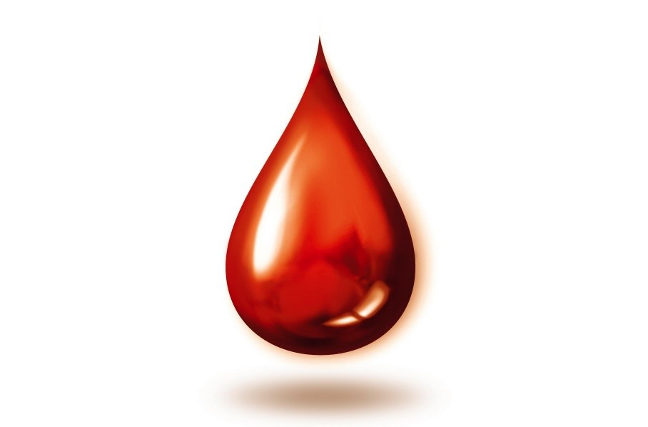
Blood Physiology

Slide 2
The functions of blood
The functions of blood are
  Transport
  Regulation
  Protection

Slide 3

The functions of blood - Transport
Transport functions of blood include:
Delivering oxygen from the lungs and nutrients from the digestive tract to all body cells.
Transporting metabolic waste products from cells to elimination sites
  to the lungs to eliminate carbon dioxide
  To the kidneys to dispose of nitrogenous wastes in urine
Transporting hormones from the endocrine organs to their target organs.

Slide 4

The functions of blood - Regulation
Regulatory functions of blood include:
Maintaining appropriate body temperature by absorbing and distributing heat throughout the body and to the skin surface to encourage heat loss.
Maintaining normal pH in body tissues.
  Contains buffers in the form of proteins, solutes and the body’s “alkaline reserve” of bicarbonate ions.
Maintaining adequate fluid volume in the circulatory system.
  Blood proteins prevent excessive fluid loss
  Keeps the fluid volume in the blood vessels steady

Slide 5

The functions of blood - Protection
Protective functions of blood include:
Preventing blood loss.
  When a blood vessel is damaged, platelets and plasma proteins initiate clot formation, halting blood loss.
Preventing infection.
  Contains antibodies, complement proteins, and white blood cells, all of which help defend the body against foreign invaders such as bacteria and viruses.

Slide 6
Components of Blood
If you take a sample of blood, place it in a centrifuge tube and spin it in a centrifuge…
  heavier formed elements migrate to the bottom
  less dense plasma remains at the top

Slide 7
Components of Blood
Plasma
• 55% of whole blood
• Least dense component
Buffy coat
• Leukocytes and platelets
• <1% of whole blood
Erythrocytes
• 45% of whole blood
(hematocrit)
• Most dense component

Slide 8
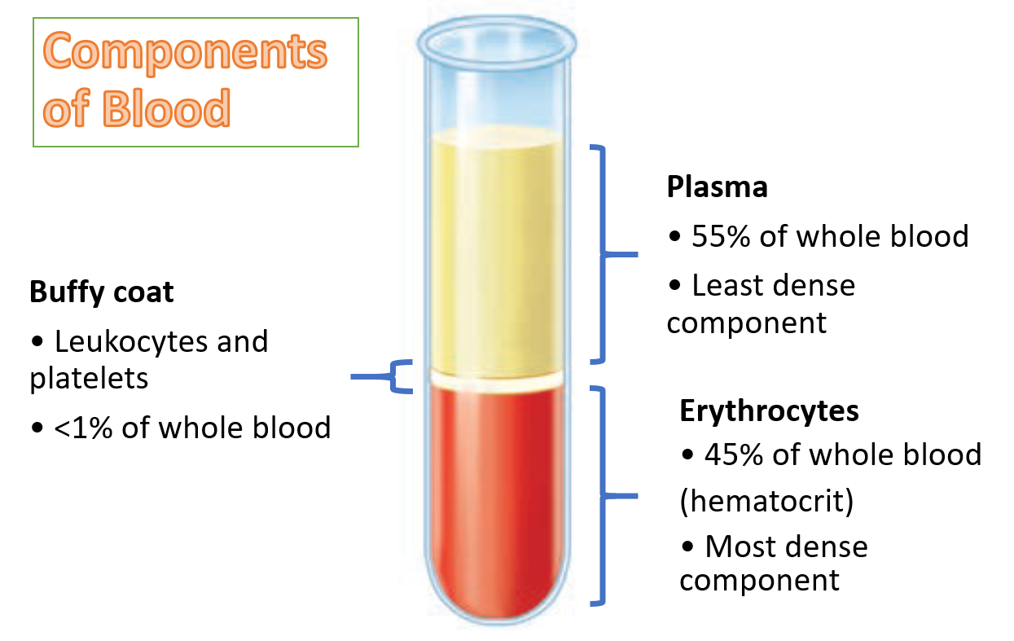
Components of Blood - hematocrit
Most of the reddish mass at the bottom of the tube is erythrocytes, the red blood cells that transport oxygen.
Erythrocytes normally constitute about 45% of the total volume of a blood sample, a percentage known as the hematocrit
Normal hematocrit values vary.
  In males ~ 47%
  In females ~ 42%

Slide 9
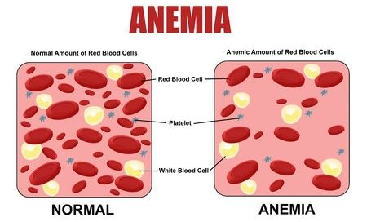
low red blood count
A low red blood count or anemia can cause feelings of fatigue and weakness. When people have a lower red blood count than normal, their body has to work overtime to get enough oxygen to the cells.

Slide 10

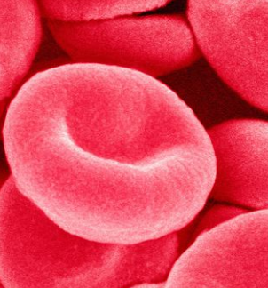
high red blood count
Polycythemia vera (a blood disorder in which the bone marrow produces too many red blood cells)
The main problem caused by polycythaemia vera is that the high number of red cells increases the blood's 'thickness' (viscosity).
Blood flow to organs is reduced and, rarely, blood clots can form.

Slide 11
buffy coat
A thin, whitish layer called the buffy coat is present at the erythrocyteplasma junction.
This layer contains white blood cells (leukocytes) and platelets
  The White Blood cells that act in various ways to protect the body
  Platelets are cell fragments that help stop bleeding.

Slide 12
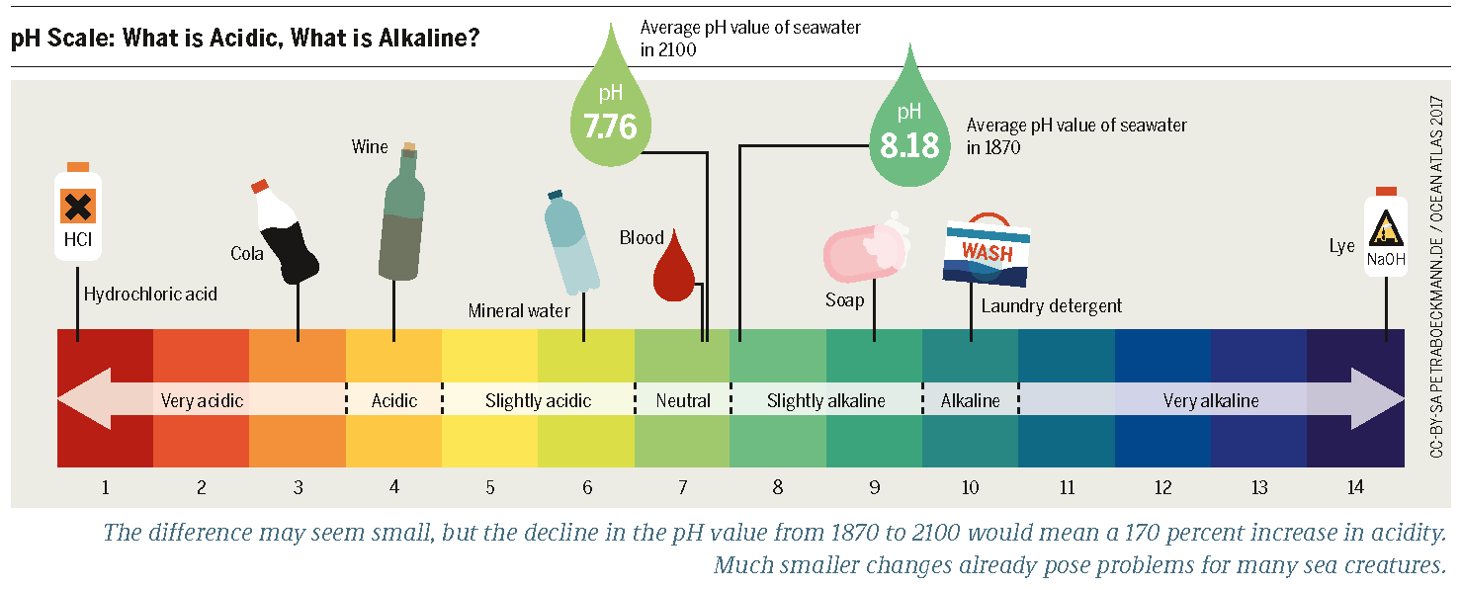
Physical Characteristics and Volume
Blood is slightly alkaline, with a pH between 7.35 and 7.45.

Slide 13
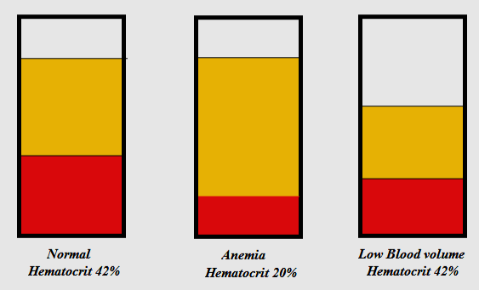
Blood Volume
When the number of red blood cells increases above normal, blood becomes more viscous and flows more slowly.
When the number of red blood cells drops below normal, the blood thins and flows more rapidly.

Slide 14
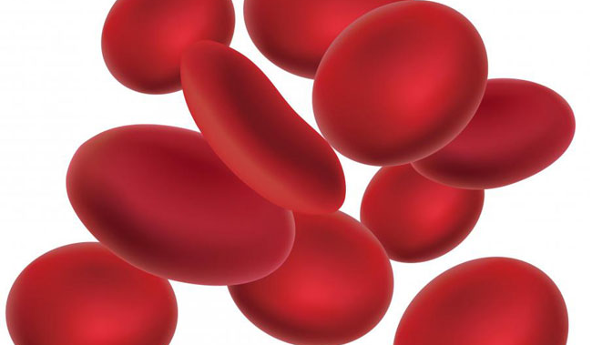
Blood Volume
Blood accounts for approximately 8% of body weight.
Blood volume in healthy adult males = 5–6 L.
Blood volume in healthy adult females = 4–5 L.

Slide 15
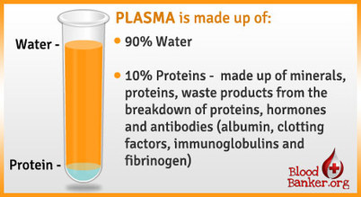
Composition of Plasma
– Water
Water = 90% of plasma volume
  Functions in dissolving and suspending medium for solutes of blood
  Functions to absorb heat

Slide 16
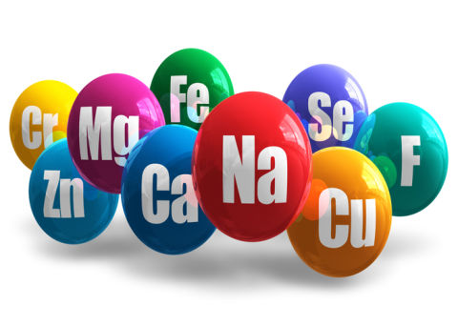
Composition of Plasma
– Solutes
Solutes
Electrolytes
  Most abundant solutes by number;
    cations include sodium, potassium, calcium, magnesium
    anions include chloride, phosphate, sulfate, and bicarbonate
  Functions to maintain osmotic pressure
  Functions to maintain normal blood pH

Slide 17
Composition of Plasma
– Solutes
Solutes
Plasma proteins 8% (by weight) of plasma;
  contribute to osmotic pressure
  maintain water balance in blood
  Other specialized function

Slide 18
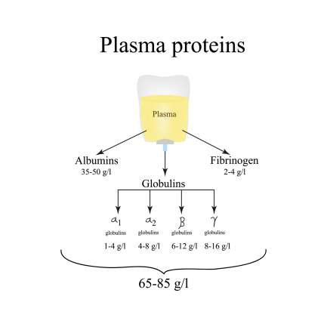
Composition of Plasma
– Plasma Proteins
Plasma proteins
  8% (by weight) of plasma;
  contributes to osmotic pressure
  maintains water balance in blood
  Other specialized function

Slide 19
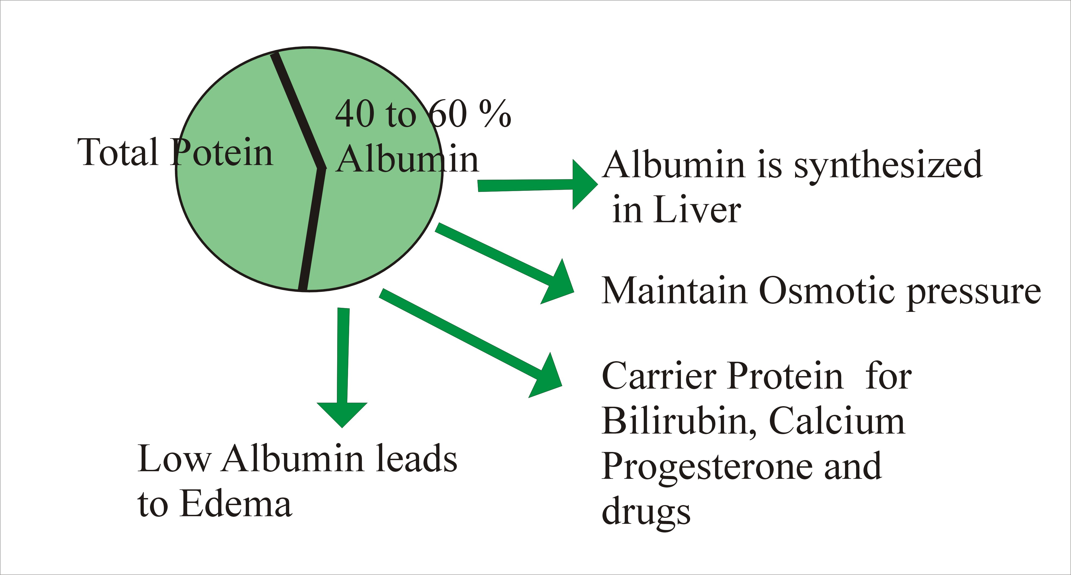
Composition of Plasma
– Plasma Proteins
Albumin
60% of plasma proteins
Produced by liver
It acts as a carrier to shuttle certain molecules through the circulation
It is an important blood buffer
It is the major blood protein contributing to the plasma osmotic pressure (the pressure that helps to keep water in the bloodstream).

Slide 20
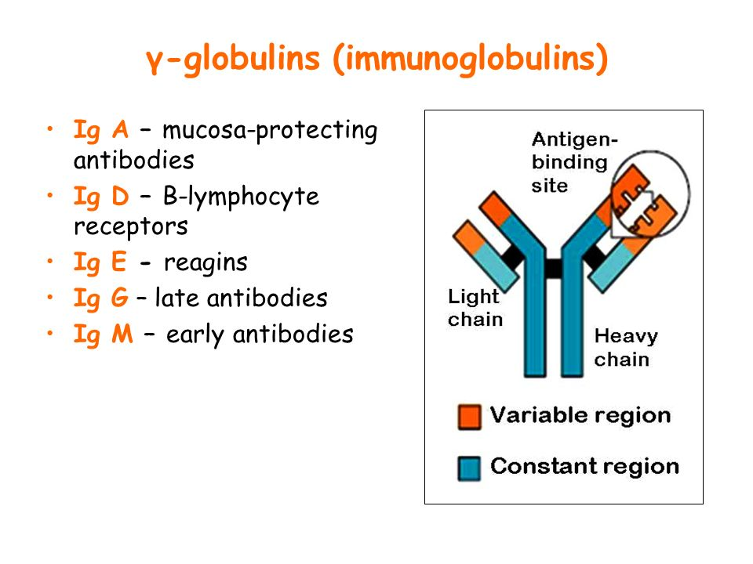
Composition of Plasma
– Plasma Proteins
Globulins = 36% of plasma proteins
Globulin is categorized into three main groups:
  alpha globulins
  beta globulins
  gamma globulins

Slide 21
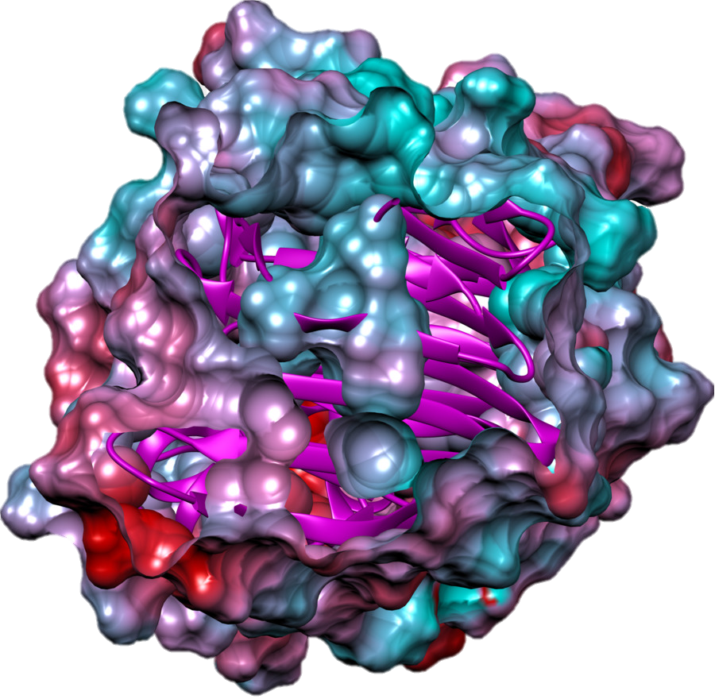
Composition of Plasma
– Plasma Proteins
GLOBULINS
alpha globulins and beta globulins are primarily transport proteins
  Produced by liver; most are transport proteins that bind to lipids, metal ions, and fat-soluble vitamins

Slide 22
Composition of Plasma
– Plasma Proteins
GLOBULINS
gamma
  gamma globulins are mainly comprised of immunoglobulins (Igs), also known as antibodies
  Antibodies released by plasma cells during immune response

Slide 23

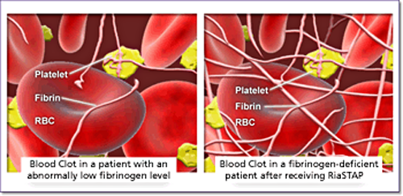
Composition of Plasma
– Plasma Proteins
Fibrinogen
4% of plasma proteins
produced by liver
forms fibrin threads of blood clot

Slide 24
Composition of Plasma
– Nonprotein nitrogenous substances
By-products of cellular metabolism
  Urea
  Uric Acid
  Creatinine
  Ammonium Salts

Slide 25
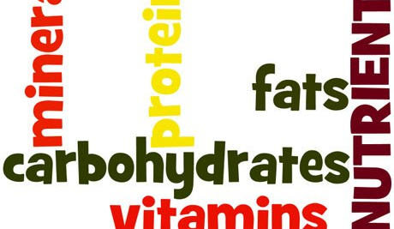
Composition of Plasma
– Nutrients
Nutrients
Materials absorbed from digestive tract and transported for use throughout body
  Glucose and other simple carbohydrates
  Amino acids (protein building blocks)
  Fatty acids - glycerol and triglycerides (fat digestion products)
  Cholesterol
  Vitamins

Slide 26
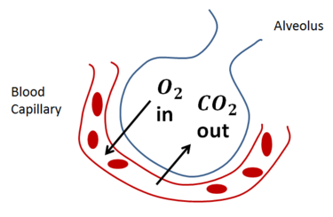
Composition of Plasma
– Respiratory gases
Respiratory gases (Oxygen and carbon dioxide)
Oxygen-
  mostly bound to hemoglobin inside RBCs
Carbon Dioxide
  Some bound to hemoglobin in RBCs
  Some dissolved as bicarbonate ion

Slide 27
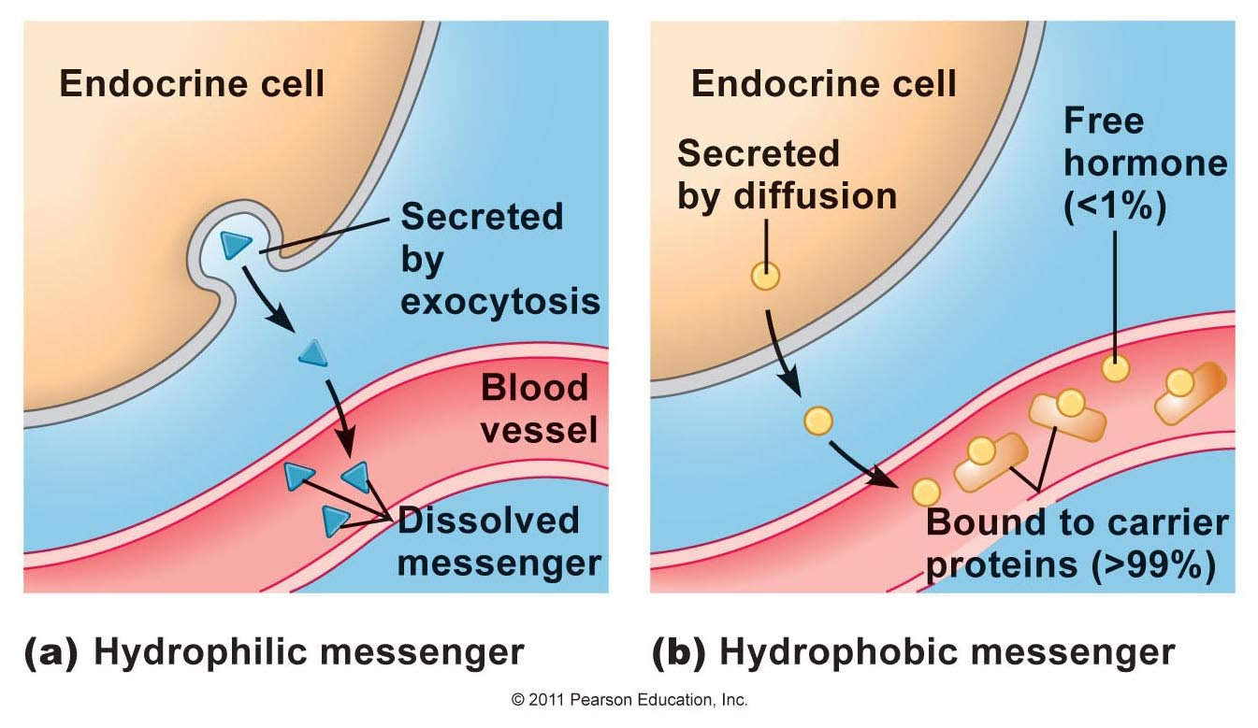
Composition of Plasma
– Hormones
Hormones
  Steroid and thyroid hormones

Slide 28
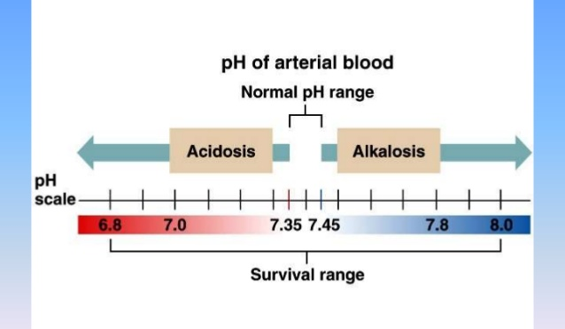
pH of Blood
When the blood starts to become too acidic (acidosis), both the lungs and the kidneys are called into action to restore plasma’s normal, slightly alkaline pH (7.4).
Body organs make dozens of adjustments, day in and day out, to maintain the many plasma solutes at life-sustaining levels.

Slide 29
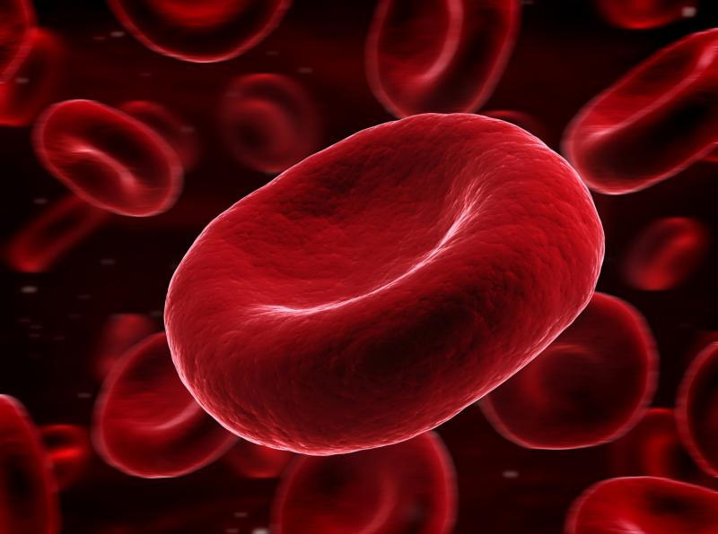
The formed elements of blood
The formed elements of blood—
  Erythrocytes
  Leukocytes
  Platelets

Slide 30
The formed elements of blood
Cells or not?
Erythrocytes have no nuclei or organelles.
Platelets are cell fragments.
Only leukocytes are complete cells.
Short life-span
Most types of formed elements survive in the bloodstream for only a few days.
Reproduction
Most blood cells do not divide.
Instead, stem cells divide continuously in red bone marrow to replace them.

Slide 31
Erythrocytes or red blood cells (RBCs)
Erythrocytes or red blood cells (RBCs)
  Very small cells, about 7.5 μm in diameter.
  Erythrocytes vastly outnumber the other types of formed elements.
  Shape is biconcave disc
    flattened discs with depressed centers (Figure 17.3).
Mature erythrocytes
  Lack a nucleus
  Lack organelles

Slide 32
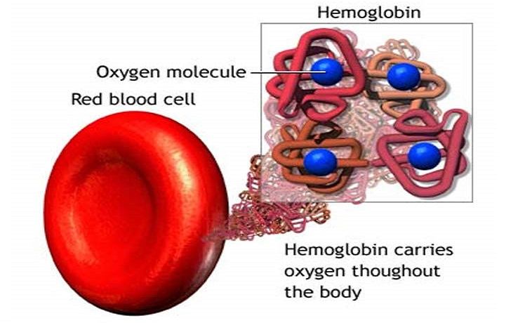
Erythrocytes or red blood cells (RBCs)
Contains hemoglobin (Hb)
  – a protein that functions in gas transport.

Slide 33
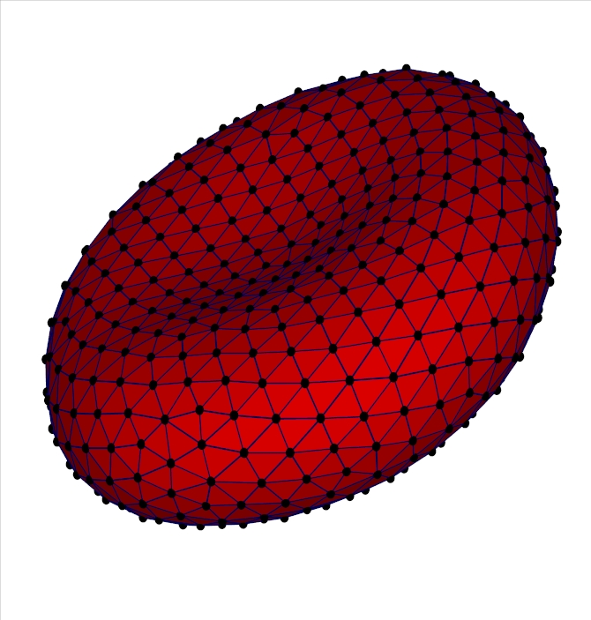
Erythrocytes or red blood cells (RBCs)
spectrin
  attaches to the cytoplasmic face of RBC plasma membranes to maintain the biconcave shape of an erythrocyte.
  the spectrin net is deformable, allowing erythrocytes to change shape as necessary

Slide 34
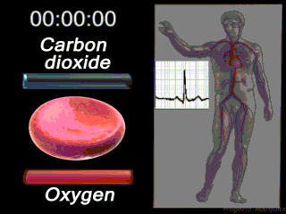
Erythrocytes or red blood cells (RBCs)
picks up oxygen in the capillaries of the lungs and releases it to tissue cells across other capillaries throughout the body.
transports ~ 20% of the carbon dioxide released by tissue cells back to the lungs.

Slide 35


Erythrocytes or red blood cells (RBCs)
Characteristics that contribute to erythrocyte gas transport functions:
Shape – Biconcave Disc
  High surface area-to-volume ratio –
    Its small size and shape provide a huge surface area relative to volume (about 30% more surface area than comparable spherical cells).
  Large Surface Area –
    The disc shape maximizes the surface area to allow for maximal diffusion of gas.
Hemoglobin – Ability to bind O₂ and CO₂
  This molecule binds to and transports respiratory gases (oxygen and carbon dioxide).
Energy Efficient - Don’t need to use any of the oxygen they carry
  Lack mitochondria
  Generate ATP anaerobically
  Don’t reproduce

Slide 36
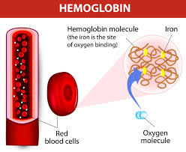
Hemoglobin
Hemoglobin
makes red blood cells red
  Hemoglobin is made up of the red heme pigment bound to the protein globin.
binds easily and reversibly with oxygen
consists of four polypeptide chains—
  two alpha (α) and two beta (β)—each binding a ring-like heme group
  Each heme group contains one atom of iron in its center

Slide 37
Hemoglobin
Hemoglobin
Each molecule can transport four molecules of oxygen because each iron atom can combine reversibly with one molecule of oxygen.
A single red blood cell contains about 250 million hemoglobin molecules, so each of these tiny cells can scoop up about 1 billion molecules of oxygen!

Slide 38
Oxygen loading from the lungs and oxygen transport to tissue cells
Oxygen-deficient blood moves to the lungs
Oxygen diffuses from the alveoli (air sacs) of the lungs into the blood stream
Oxygen diffuses into the erythrocytes and binds to the iron atom in the center of hemoglobin.
When oxygen binds to iron, the hemoglobin, now called oxyhemoglobin, assumes a new three dimensional shape and becomes ruby red.

Slide 39
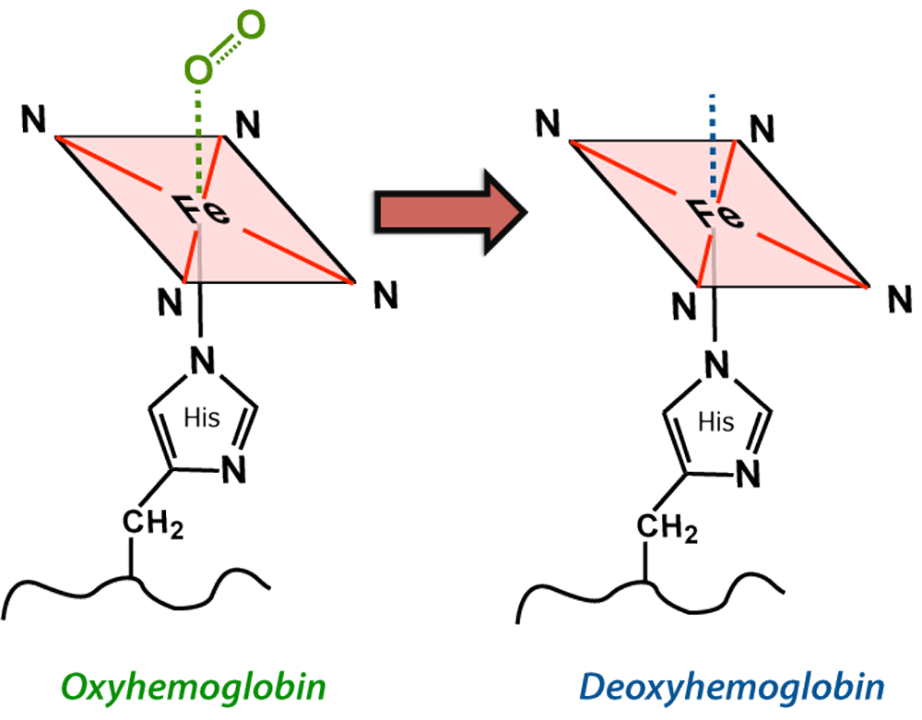
oxygen transport to the lings from tissue cells
CO₂
CO₂
Oxygen-rich blood travels to tissues of the body.
Oxygen detaches from iron
Hemoglobin resumes its former shape, and the resulting deoxyhemoglobin, or reduced hemoglobin, becomes dark red (NOT BLUE).
The released oxygen diffuses from the blood into the extracellular fluid and then into the cells.

Slide 40
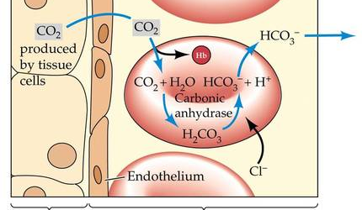
Carbon Dioxide transport from tissue cells to the blood
Carbon dioxide loading occurs in the tissues.
About 20% of the carbon dioxide transported in the blood combines with hemoglobin.
CO₂ binds to hemaglobin’s amino acids (not the heme group) to form carbaminohemoglobin
CO₂ is transported from tissues to lungs.
Carbon dioxide is eliminated from the body through the lungs during expiration (exhalation).

Slide 41
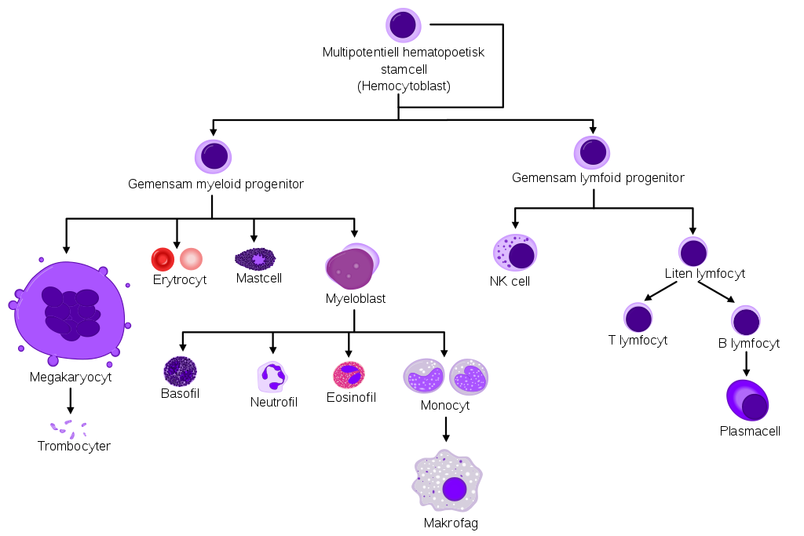
Production of Erythrocytes - Hematopoiesis
Blood cell formation is referred to as hematopoiesis
Hematopoiesis occurs in the red bone marrow
As blood cells mature, they migrate into the bloodstream.
Red bone marrow turns out ~100 billion new cells every day.
All blood cells arise from the hematopoietic stem cell, sometimes called a hemocytoblast.

Slide 42
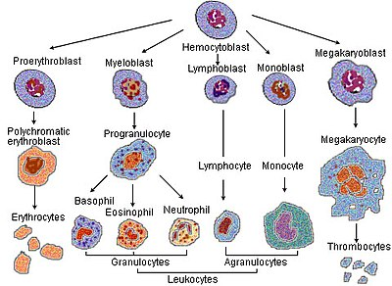
Red blood cells (erythrocytes)
Red blood cell (erythrocyte) also known as "RBC's".
RBC’s are formed in red bone marrow.
The formation of RBC’s is called erythropoiesis.

Slide 43
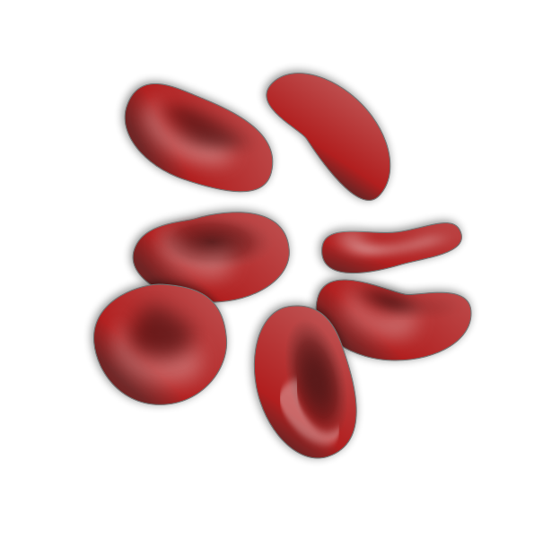
Red blood cells (erythrocytes) - Characteristics
Anucleate - Red blood cells lose nuclei upon maturation
Lack Essentially All Organelles
Do not reproduce themsleves
Shape - take on a biconcave, dimpled, disc shape.
Small - They are about 7-8 micrometers in diameter.

Slide 44
Red blood cells (erythrocytes) - Characteristics
Simple - RBC's lack a nucleus (no DNA) and no organelles
Numerous - There are about 1000x more red blood cells than white blood cells.
Short-lived - RBC's live about 120 days and do not self repair.
Easily replaced - Myeloid tissue will produce about 200 billion RBCs a day!
Carry hemoglobin - RBC's contain hemoglobin which transports oxygen from the lungs to the rest of the body, such as to the muscles, where it releases the oxygen load.
Red in Color - The hemoglobin gets it’s red color from their respiratory pigments.

Slide 45
Shape of RBCs
RBC'S have a shape of a disk that appears to be “caved in” or almost flattened in the middle; this is called bi-concave.
Purpose of the biconcave shape –
  allows the RBC to carry oxygen and pass through even the smallest capillaries in the lungs.
  This shape also allows RBCs to stack like dinner plates and bend as they flow smoothly through the narrow blood vessels in the body.

Slide 46
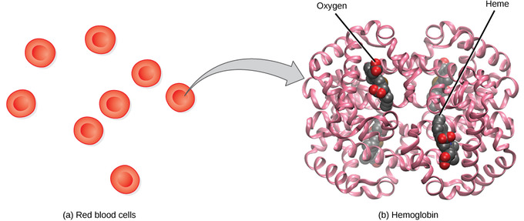
hemoglobin
The main component of the RBC is hemoglobin
  RBCs have about 250 million per cell.
  The word hemoglobin comes from hemo meaning blood and globin meaning protein.
  Hemoglobin also is responsible for the cell’s ability to transport oxygen and carbon dioxide.
  Oxyhemoglobin (hemoglobin + iron + oxygen) gives the RBC's bright red color.

Slide 47
viscosity
The thickness of blood is called viscosity.
The greater the viscosity of blood, the more friction there is and more pressure is needed to force blood through.

Slide 48

Functions of RBCs – gas transport
The main function is the transportation of oxygen throughout the body (oxyhemoglobin) and the ability of the blood to carry out carbon dioxide which is called (carbaminohemoglobin).

Slide 49
Functions of RBCs
Normal pH of blood ranges between 7.35-7.45; blood is slightly Alkaline.
A drop in pH below 7.35 is a condition is also called Acidosis.
A jump in pH higher then 7.45 is a condition called "Alkalosis".
To maintain the homeostasis (or balance,) the blood has tiny molecules within the RBC that help prevent drops or increases from happening.

Slide 50
Destruction of RBCs
Red blood cells are broken down and hemoglobin is released.
The globin part of the hemoglobin is broken down into amino acid components, which in turn are recycled by the body.
The iron is recovered and returned to the bone marrow to be reused.
The heme portion of the molecule experiences a chemical change and then gets excreted as bile pigment (bilirubin) by the liver.
Heme portion after being broken down contributes to the color of feces and your skin color changing after being bruised.

Slide 51
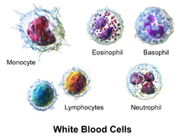
White blood cells (leukocytes)
These special cells help our bodies defend themselves against pathogens.
Not only do they help our immune system but they remove toxins, wastes, and abnormal or damaged cells.

Slide 52
White blood cells (leukocytes)
- Physical Characteristics
White blood cells are different from red cells
  larger in size (10-14 micrometers in diameter)
  do not contain hemoglobin
  Are not red, but are translucent.
  Have nucleii
This Photo by Unknown Author is licensed under CC BY-SA

Slide 53
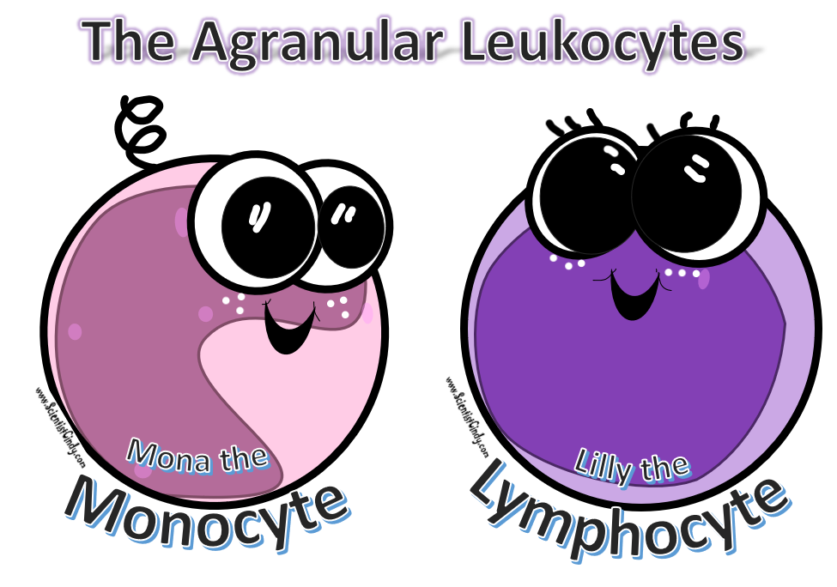
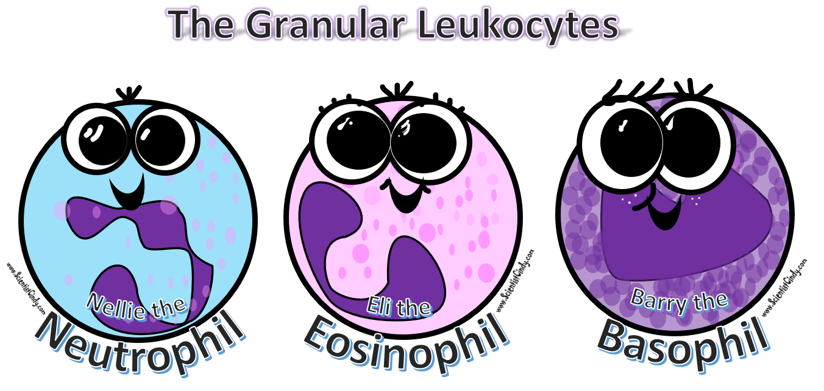
White Blood Cells
- Granular vs Agranular
The Granular phenotype are able to stain blue.
The Agranular phenotype are able to stain red.
Granular Cells -
  Neutrophils make up 50-70% of Granular cells
  Eosinophils make up 2-4%,
  Basophils 0-1%.
Agranular Cells -
  Monocytes make up 2-8% of Agranular cells.
  B and T Lymphocytes make up 20-30%.

Slide 54
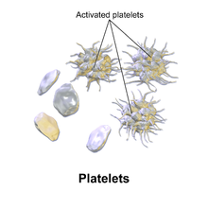
Platelets (thrombocytes)
Platelets, also called thrombocytes
  membrane-bound cell fragments.
  Have no nucleus
  Very Small - between one to two micrometers in diameter
  Few in Number – Less than 1% of whole blood consists of platelets.

Slide 55
Platelets (thrombocytes)
Result from fragmentation of large cells called Megakaryocytes - which are cells derived from stem cells in the bone marrow.
Rapidly Replaced - produced at a rate of 200 billion per day.
Regulation of production - regulated by the hormone called Thrombopoietin.
Short life-span - 8–10 days.
This Photo by Unknown Author is licensed under CC BY-SA

Slide 56
Platelets (thrombocytes)
FUNCTION TO CLOT BLOOD
The sticky surface of the platelets allow them to accumulate at the site of broken blood vessels to form a clot.
This aids in the process of hemostasis ("blood stopping").
Platelets secrete factors that…
Increase local platelet aggregation - thromboxane A
Enhance vasoconstriction - serotonin
Promote blood coagulation - thromboplastin

Slide 57
Hemostasis (Coagulation or Clotting) – 3 stages
(1) vascular spasm, vasoconstriction, or intense contraction of blood vessels
(2) formation of a platelet plug
(3) blood clotting or coagulation.

Slide 58
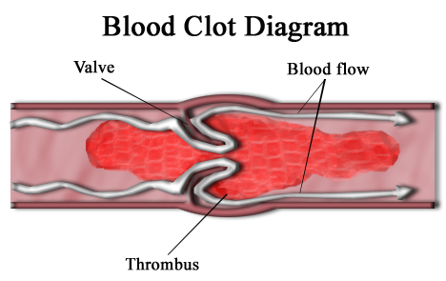
A Blood Clot Forms:
First, blood changes from a liquid to a gel.
  clotting factors take part in a series of chemical reactions that eventually create a mesh of protein fibers within the blood.

Slide 59
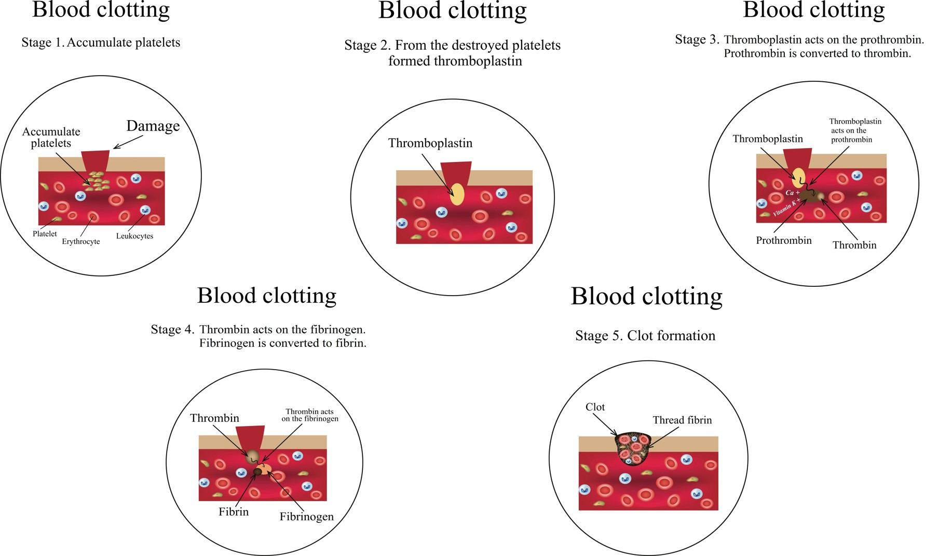
Prothrombin
When blood vessels are damaged, vessels and nearby platelets are stimulated to release a substance called prothrombin activator
Prothrombin activator activates the conversion of prothrombin into an enzyme called thrombin.
This reaction requires calcium ions.

Slide 60
Thrombin:
Thrombin facilitates the conversion of a soluble plasma protein called fibrinogen into long insoluble fibers or threads of the protein fibrin.

Slide 61
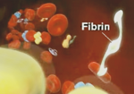
Fibrin:
Fibrinogen is cleaved by thrombin to form its active form, "fibrin."
Fibrin threads wind around the platelet plug at the damaged area of the blood vessel, forming an interlocking network of fibers and a framework for the clot.
This net of fibers traps and helps hold platelets, blood cells and other molecules tight to the site of injury, functioning as the initial clot.
This temporary fibrin clot can form in less than a minute, and usually does a good job of reducing the blood flow.
Next, platelets in the clot begin to shrink, tightening the clot and drawing together the vessel walls.
This Photo by Unknown Author is licensed under CC BY-NC-ND

Slide 62
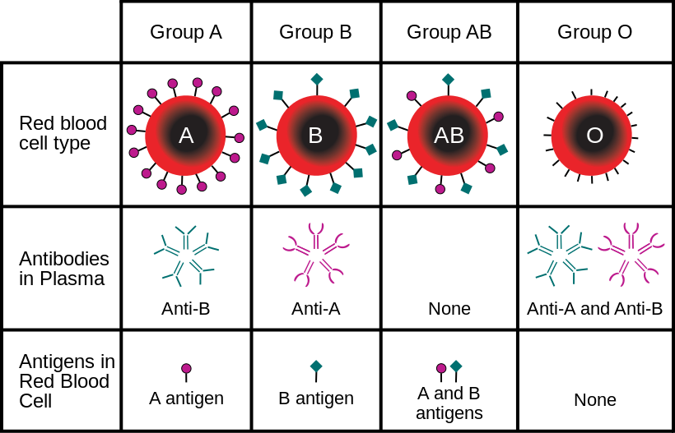

Slide 63
Compatibility of blood types.
Blood Group AB individuals have both A and B antigens on the surface of their RBCs, and their blood serum does not contain any antibodies against either A or B antigen.
Therefore, a individual with type AB blood can receive blood from any group (with AB being preferable), but can only donate blood to another group AB individual.
AB blood is also known as "Universal receiver."

Slide 64
Compatibility of blood types.
Blood Group A individuals have the A antigen on the surface of their RBCs, and blood serum containing antibodies against the B antigen.
A group A individual can only receive blood from individuals of groups A or O and can donate blood to individuals of groups A or AB.

Slide 65
Compatibility of blood types.
Blood Group B individuals have the B antigen on their surface of their RBCs, and blood serum containing antibodies against the A antigen.
A group B individual can only receive blood from individuals of groups B or O, and can donate blood to individuals of groups B or AB.

Slide 66
Compatibility of blood types.
Blood group O individuals do not have either A or B antigens on the surface of their RBCs, but their blood serum contains antibodies against both A and B antigens.
A group O individual can only receive blood from a group O individual, but they can donate blood to individuals of any ABO blood group (ie A, B, O or AB).
O blood is also know as "Universal donor."

Slide 67
Inheritance
Blood types are inherited and represent contributions from both parents.
The ABO blood type is controlled by a single gene with three alleles:
  i, IA, and IB.
IA gives type A, IB gives type B, i give types O

Slide 68
Compatibility in Blood/Plasma Transfusions
An O donor you can't give type O plasma to a type A, B or AB, because a person with type O blood has A and B antibodies and the recipient would have an immune response.
An AB donor could give plasma to anyone, since they have no antibodies.

Slide 69
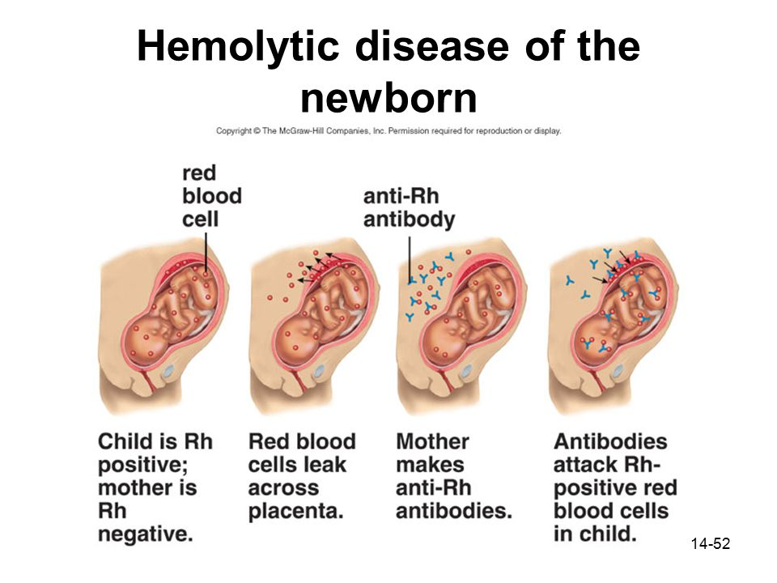
Hemolytic Disease of the Newborn
Hemolytic disease of the newborn, (also known as HDN) is a condition that develops when the mother produces antibodies against the red blood cells in the fetal circulation.
RESULT:
  The red cells are broken down
  Fetal anemia
  Fetal death from heart failure - hydrops fetalis

Slide 70
Hemolytic Disease of the Newborn
Rh negative mothers of Rh positive fetus are given Rh immune globulin (RhIG) to prevent the mother from creating antibodies that attack the fetus.
Rh immune globulin (RhIG) works by binding any fetal red cells with the D antigen before the mother is able to produce an immune response and form anti-D antibodies.

Slide 71
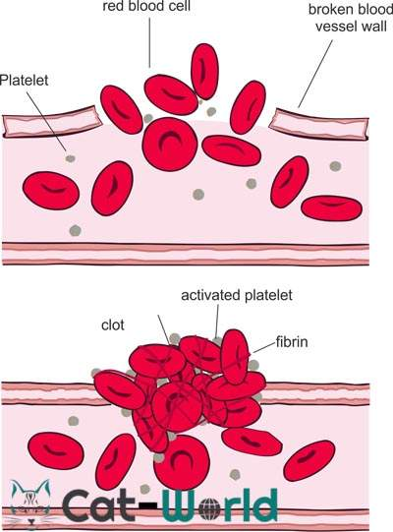
Diseases of the Blood
- Von Willebrand Disease
The most common inherited bleeding disorder
Similar to hemophilia in that it involves a deficiency in the ability of blood to clot properly.
Those affect by von Willebrand disease will have one or more of the following
  - low levels of von Willebrand factor (a protein that helps the blood to clot)
  - their von Willebrand factor doesn't work properly.

Slide 72
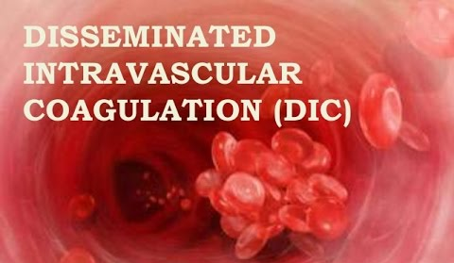
Diseases of the Blood
- Disseminated Intravascular Coagulation
Disseminated intravascular coagulation (DIC), also called consumptive coagulopathy, is a pathological process in the body where the blood starts to coagulate throughout the whole body.
This depletes the body of its platelets and coagulation factors, and there is a paradoxically increased risk of hemorrhage.
It occurs in critically ill patients, especially those with Gram-negative sepsis (particularly meningococcal sepsis) and acute promyelocytic leukemia.

Slide 73
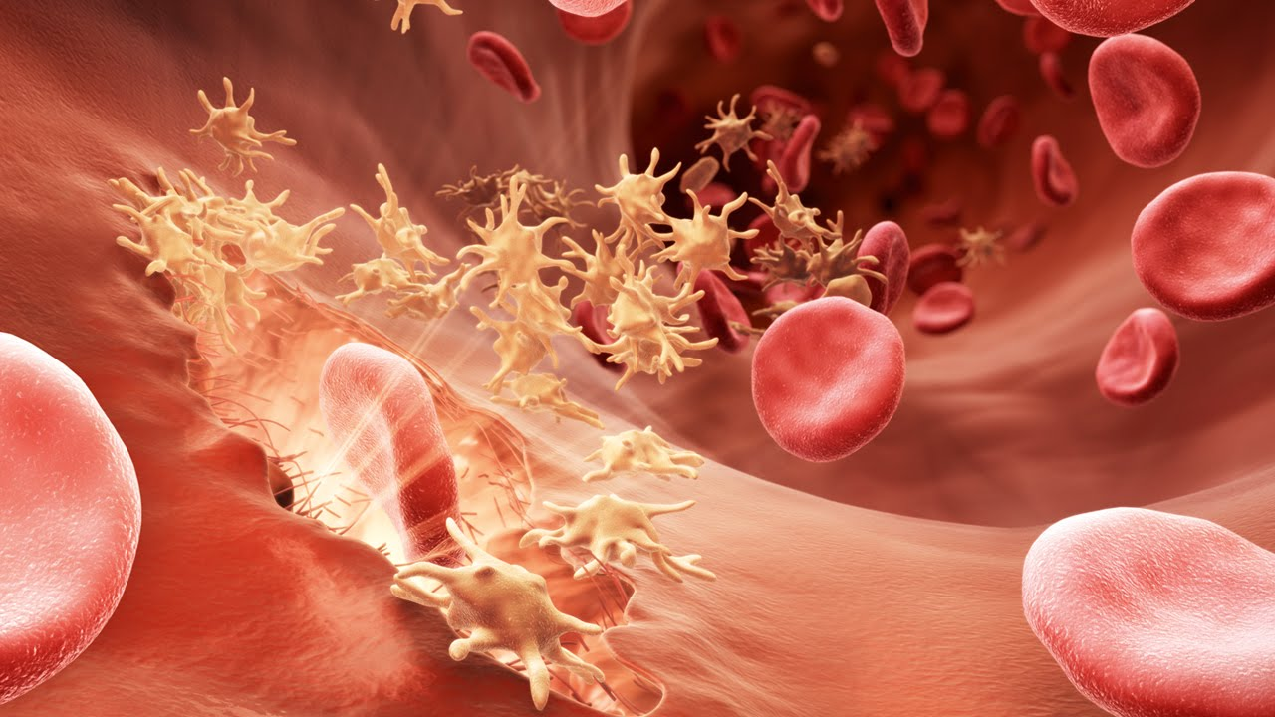
Diseases of the Blood
- Hemophilia
low or no blood protein
inability to produce blood clots
There are two types of Hemophilia:
  Type A, which is a deficiency in factor VIII
  Type B, (Christmas disease) a deficiency on factor IX.
Because people with hemophilia do not have the ability to make blood clots, even a little cut may kill them, or the smallest bump or jar to the body could cause severe bruising that doesn't get better for months.

Slide 74
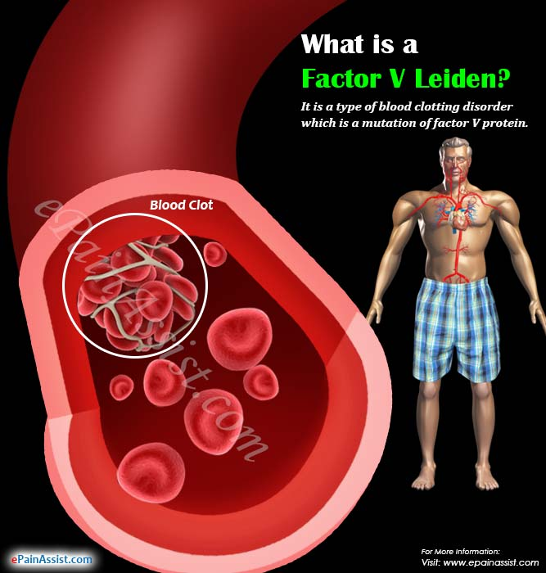
Diseases of the Blood
- Factor V Leiden
The opposite of Hemophilia
a variant of human factor V causes a hypercoagulability
the most common hereditary hypercoagulability disorder
Causes a slightly higher risk of developing blood clots
Those that test positive for factor V should avoid (oral contraceptives, obesity, smoking, and high blood pressure.)

Slide 75
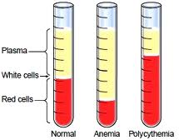
Diseases of the Blood
- Anemia
Anemia comes from the Greek word meaning "without blood“
deficiency of red blood cells (RBCs) and/or hemoglobin.
results in a reduced ability of blood to transfer oxygen to the tissues, causing hypoxia (lack of oxygen).

Slide 76
Diseases of the Blood
- Anemia
The three main classes of anemia include
excessive blood loss (acutely such as a hemorrhage or chronically through low-volume loss)
excessive blood cell destruction (hemolysis)
deficient red blood cell production (ineffective hematopoiesis).
In menstruating women, dietary iron deficiency is a common cause of deficient red blood cell production.

Slide 77
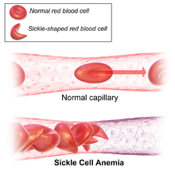
Diseases of the Blood
- Sickle Cell Anemia
The red blood cells change shape upon deoxygenation because of polymerization of the abnormal sickle hemoglobin.
This process damages the red blood cell membrane, and can cause the cells to become stuck in blood vessels.
This deprives the downstream tissues of oxygen.
Causes pain, damage of internal organs, and/or stroke.
Lifespan is often shortened with sufferers living to an average of 40 years.

Slide 78
Diseases of the Blood
- Polycythemia
There is an abnormally large number of red blood cell.
Hematocrit may be as high as 70 to 80% (~45% is normal).
Total blood volume can increase to as much as twice as normal.
Circulation becomes sluggish.
Vessels become engorged.

Slide 79
Diseases of the Blood
- Polycythemia
Increased blood viscosity
  Capillaries can become plugged by the very viscous blood
  The flow of blood through the vessels tends to be extremely sluggish.
People with untreated polycythemia are at a risk of various thrombotic events
  Thrombosis - the formation of a blood clot inside a blood vessel, obstructing the flow of blood through the circulatory system.

