Slide 1
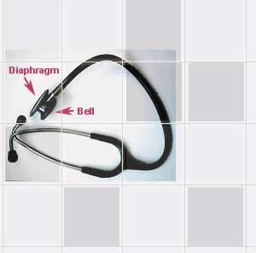
Lab 9: BLOOD PRESSURE LAB
The McGill Physiology Virtual Lab

Slide 2
The Cardiovascular Lab
The Cardiovascular Lab consists of two main exercises, involving measurement of
A. The Arterial Blood Pressure
B. The Electrocardiogram
To derive the most benefit from this exercise, students should review appropriate chapters in the textbook dealing with the heart, and the sequence of events in the cardiac cycle.

Slide 3
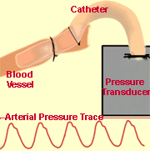
Blood pressure can be measured by several techniques.
The direct method (refer to the diagram below) involves directly inserting a tube or catheter into a blood vessel.
The catheter is connected to a blood pressure transducer, which generates an electrical signal.

Slide 4
Blood pressure can be measured by several techniques.
In this experiment, we measure the arterial blood pressure using two different methods.
Both of these methods are indirect, in that they do not involve inserting a catheter directly into the artery and connecting that catheter to a blood pressure transducer.
The first method uses the sense of touch: it is thus called the palpatory method.
The second method uses the sense of hearing: it is thus called the auscultatory method

Slide 5
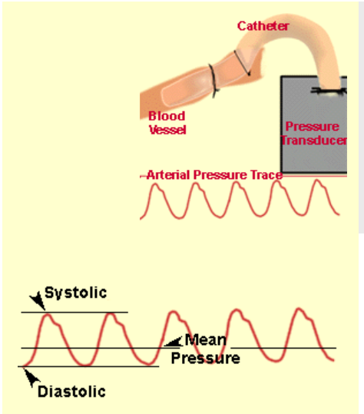
Blood Pressure Tracing: Using The Direct Method
The figure to the left shows a typical tracing of the blood pressure recorded from an artery using the direct method.
The maximum pressure is called the systolic pressure; the minimum pressure is called the diastolic pressure.
The pulse pressure is the difference between the systolic and diastolic pressures.
The mean pressure is given approximately by the sum of the diastolic pressure and one third of the pulse pressure.

Slide 6
The Sphygmomanometer
A sphygmomanometer, an instrument that measures pressure, is needed in both methods.
Each sphygmomanometer consists of a cuff (containing a "bladder") which is connected by lengths of tubing to an inflating bulb with a needle valve and to an aneroid pressure gauge.

Slide 7
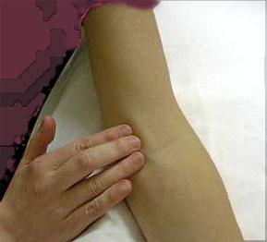
Correct positioning of the cuff
The centre of the sphygmomanometer bladder should be placed over the brachial artery.
Many cuffs have some sort of marking scheme so that placement over the brachial artery - under, or just medial to, the biceps tendon - is facilitated.

Slide 8
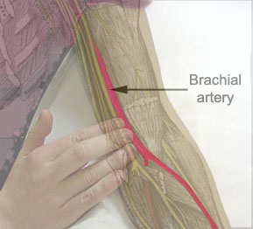
Correct positioning of the cuff
The lower border of the cuff should be ~2cm proximal to the antecubital fossa and the cuff should be firmly wrapped around the arm.

Slide 9
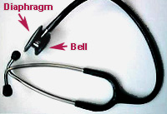
The Stethoscope
In addition, a stethoscope is needed for the auscultatory method.
Note that the chest-piece of the stethoscope has both a bell and a diaphragm.

Slide 10
Blood Pressure> Palpatory Method
The relaxed subject sits on a chair.
The cuff of the sphygmomanometer is wrapped firmly around the right arm above the elbow.
The lower arm should be resting on a table-top or bench.

Slide 11
Blood Pressure> Palpatory Method
The radial pulse (the pulse at the radial artery in the wrist) is palpated with the fingers of the left hand.
The number of beats in 30 seconds is counted, and the heart rate in beats per minute is recorded.

Slide 12
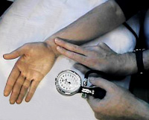
Blood Pressure> Palpatory Method
The valve on the inflating bulb of the sphygmomanometer is turned fully clockwise so that it is closed.
The cuff is inflated slowly (10 mm Hg/sec) by pumping the inflating bulb until the radial pulse is no longer felt.
The cuff is inflated further until the pressure is about 30 mm Hg higher.

Slide 13
Blood Pressure> Palpatory Method
The valve on the inflating bulb is opened slightly by turning it in the counterclockwise direction, allowing the pressure to drop slowly by about 5 mm Hg/sec.
At some point, one will be able to feel the radial pulse once again.
The pressure indicated on the gauge when the pulse reappears is noted.
This is the systolic pressure.

Slide 14
Blood Pressure> Palpatory Method
Now the pressure in the cuff is quickly released, so as not to cause undue discomfort to the subject.
The determination of blood pressure is repeated two more times for the right arm, and then repeated again using the left arm instead of the right arm.

Slide 15
Explanatory Notes
The cuff pressure's constriction of the artery is opposed by the blood pressure.
Therefore, in order to completely constrict the artery, the cuff pressure must be greater than the highest blood pressure, the systolic pressure.

Slide 16
Explanatory Notes
The cuff pressure is gradually decreased.
At the point where the cuff pressure drops below the systolic pressure of the blood, blood can pass through the constricted opening of the artery and the pulse will be felt.
In other words, the systolic pressure, the highest blood pressure, will be the point at which the cuff pressure is first overcome.

Slide 17
Explanatory Notes
The pulse will continue to be felt as the pressure in the cuff falls from systolic all the way down to zero.

Slide 18
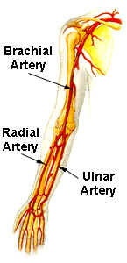
Explanatory Notes
Note that the although the radial pulse is palpated, the systolic blood pressure actually recorded is that in the brachial artery, where the actual cuff constriction occurs.

Slide 19
Blood Pressure> Auscultatory Method
The relaxed subject sits on a chair with the lower arm supported as before.
The blood pressure cuff is placed on the subject's right arm, allowing 1 inch between the bottom of the cuff and the crease of the elbow.

Slide 20
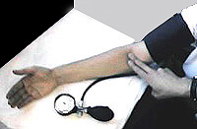
Blood Pressure> Auscultatory Method
The brachial pulse is palpated just above the angle of the elbow (the "antecubital fossa").

Slide 21
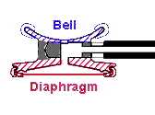
Blood Pressure> Auscultatory Method
One group member puts on a stethoscope, with the earpieces on the headpiece angled forward.
The recording end of the stethoscope is twisted, so that the diaphragm and not the bell is activated.
This can be tested by tapping lightly on the diaphragm.

Slide 22
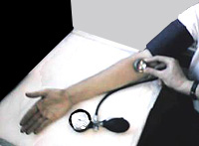
Blood Pressure> Auscultatory Method
The diaphragm is placed over the brachial artery in the space between the bottom of the cuff and the crease of the elbow.
At this point no sounds should be heard.

Slide 23
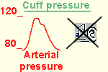
Blood Pressure> Auscultatory Method
The cuff pressure is inflated quickly to a pressure about 30 mm Hg higher than the systolic pressure determined by the method of palpation.
Then the air is let out of the cuff at a rate such that cuff pressure falls at a rate of about 5 mm Hg/sec.

Slide 24
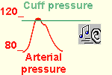
Blood Pressure> Auscultatory Method
At some point the person listening with the stethoscope will begin to hear sounds with each heartbeat.
This point marks the systolic pressure.
The sounds are called Korotkoff sounds.

Slide 25
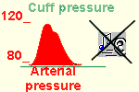
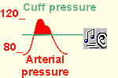
Blood Pressure> Auscultatory Method
As the pressure is lowered further, the character of the Korotkoff sounds should change. At some point, the sounds will disappear. The pressure reading at this point gives the diastolic pressure.

Slide 26
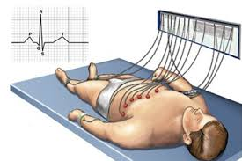
Blood Pressure> Auscultatory Method
The subject should now lie on his or her back for five minutes.
The systolic pressure and diastolic pressure are recorded.
Then the subject stands up, and the pressures are immediately recorded once more.

Slide 27
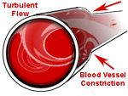
Explanatory Notes
The laminar flow that normally occurs in arteries produces little vibration of the arterial wall and therefore no sounds.
However, when an artery is partially constricted, blood flow becomes turbulent, causing the artery to vibrate and produce sounds.

Slide 28
Explanatory Notes
When measuring blood pressure using the auscultation method, turbulent blood flow will occur when the cuff pressure is greater than the diastolic pressure and less than the systolic pressure.
The "tapping" sounds associated with the turbulent flow are known as Korotkoff sounds.
Remember that these sounds are not to be confused with the heart sounds produced by the opening and closing of the heart valves.

Slide 29
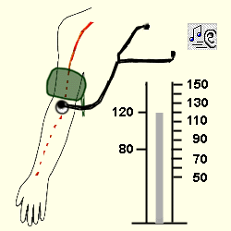
Summary of the auscultatory method:
Initially the cuff is inflated to a level higher than the systolic pressure.
Thus the artery is completely compressed, there is no blood flow, and no sounds are heard.
The cuff pressure is slowly decreased.
At the point where the systolic pressure exceeds the cuff pressure, the Korotkoff sounds are first heard and blood passes in turbulent flow through the partially constricted artery.
Korotkoff sounds will continue to be heard as the cuff pressure is further lowered.
However, when the cuff pressure reaches diastolic pressure, the sounds disappear.
Now at all points in time during the cardiac cycle, the blood pressure is greater than the cuff pressure, and the artery remains open.

Slide 30
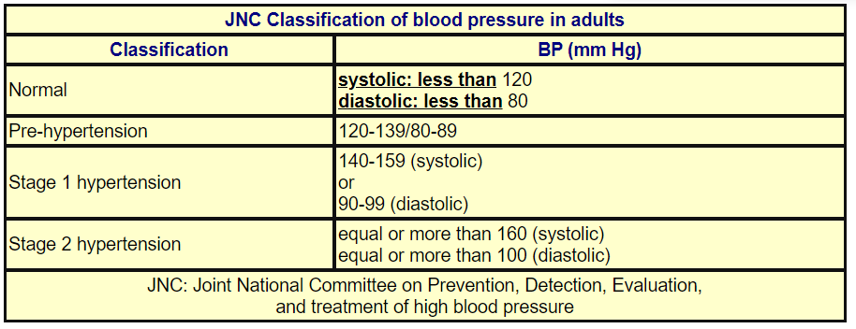
Blood Pressure Chart

Slide 31
Errors in blood pressure readings:
The cuff is not of the proper size: if the cuff is too small the blood pressure readings may be artefactually high.
If the cuff is too big, the readings may be artefactually low.

Slide 32
Errors in blood pressure readings:
The cuff is positioned too loosely: the blood pressure may be artefactually high.

Slide 33
Errors in blood pressure readings:
The center of the cuff bladder is not positioned over the brachial artery.

Slide 34
Errors in blood pressure readings:
The cuff is inflated too slowly: a slow inflation causes venous congestion, which in turn causes the Korotkoff sounds to be faint; this results in false readings with the systolic value being too low and the diastolic reading too high.

