Slide 1
Metabolism

Slide 2
Properties of Living Organisms
1. Have a complex structure whose basic unit of organization is the cell
2. Acquire, transform, store, and use energy
3. Sense and respond to internal and external environments
4. Maintain homeostasis through internal control systems with feedback
5. Store, use, and transmit information
6. Reproduce, develop, grow, and die
7. Have emergent properties that cannot be predicted from the simple sum of the parts
8. Individuals adapt and species evolve

Slide 4
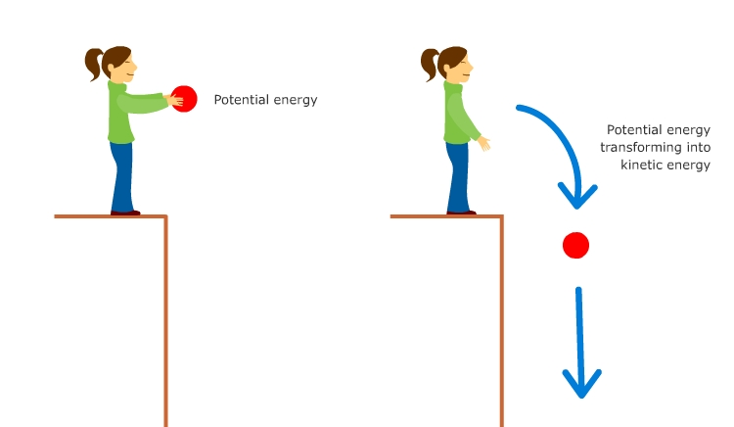
Kinetic energy
Kinetic energy is the energy of motion.
A ball rolling down a hill, perfume molecules spreading through the air, electric charge flowing through power lines, heat warming a frying pan, and molecules moving across biological membranes are all examples of bodies that have kinetic energy.

Slide 5
Potential energy
Potential energy is stored energy. A ball poised at the top of a hill has potential energy because it has the potential to start moving down the hill.
A molecule positioned on the high-concentration side of a concentration gradient stores potential energy because it has the potential energy to move down the gradient.
In chemical bonds, potential energy is stored in the position of the electrons that form the bond

Slide 7
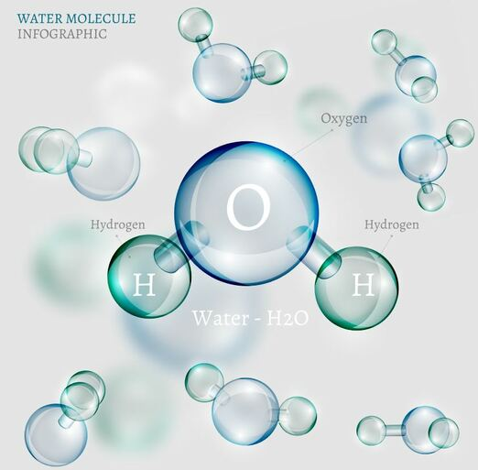
Water
Your cells are 75% water. All life needs water.
Water is resistant to temperature change.
Water is considered a POLAR molecule. Since it is slightly negative on one end, and slightly positive on the other end!
The Polarity of water allows it to have the ability to dissolving a variety of different substances!
This is why water is called the UNIVERSAL SOLVENT.
Water can dissolve more substances than any other molecule!

Slide 8
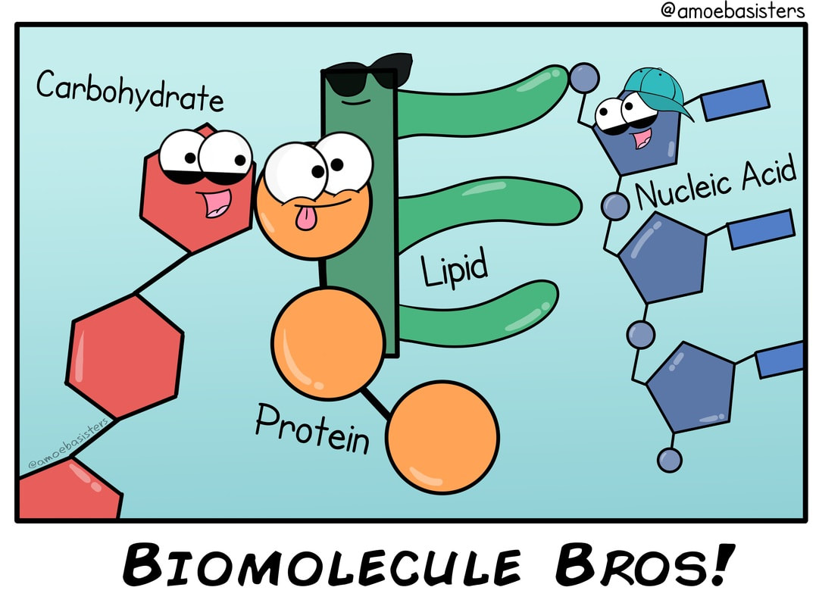
What Types of Substances are Metabolized?
Living organisms typically need a steady supply of at least the following four important classes of organic molecules:
Carbohydrates (sugars)
​monosacharrides (simple sugars)
disacharrides (simple sugars)
polysaccharides
​(complex carbohydrates)
Lipids (fats)
​saturated fats
unsaturated fats
polyunsaturated fats
​trans-fats
Proteins
​amino acids
dipeptides, tripeptides, polypeptides
Nucleic Acids ( RNA and DNA )

Slide 9
The chemical processing that takes place involves a series of chemical reactions (called a metabolic pathway) that will function to trap some of their chemical energy in the form of ATP …and to break down the larger molecules into smaller molecules that can be used as building blocks for the synthesis of new cellular components. ​
Metabolism is the sum of all of the chemical reactions that occur in the living organism.

Slide 10
What is Metabolism?
Metabolism: Metabolism is a general term for all of the biochemical reactions taking place within an organism.
The biochemical reactions of metabolism fall into 2 broad categories;
1) anabolism, and 2) catabolism.

Slide 11
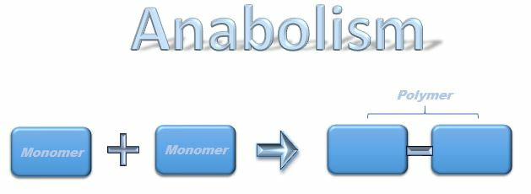
Anabolic reactions require energy to build, so they are considered endergonic reactions. These endergonic, anabolic reaction create chemical bonds that store potential energy, like a new battery that has not yet been used. When that potential energy is needed, the bond will be broken to release that potential energy so that it can be used.

Slide 12
Anabolism
Anabolism is the set of metabolic reactions that create or synthesize larger, more complex molecules from smaller ones.
Anabolic reactions are synthesis reactions.
Anabolism involves the process of creating or building chemical bonds, which requires energy in the form of ATP.
Reactions that require energy are called endergonic.
Examples of anabolism
amino acids come together to form proteins
monosacharrides come together to form carbohydrates
fatty acids can be combined into lipids

Slide 13
Anabolic reactions
Anabolic reactions of metabolism are used to polymerize amino acids into proteins that can function as structural proteins within the cell, or they can function as enzymes which assist the chemical reactions taking place in the cell. ​

Slide 14
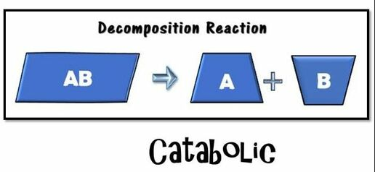
catabolic reactions
Living organisms must synthesize polymers of these important molecules in order to sustain life.
Similarly, these molecules can be broken down to release energy or to use as building blocks for other molecules that the organism may need at the time.
These would be the catabolic reactions of metabolism. ​

Slide 15
catabolic reactions
For example, cells must maintain their structural integrity by constantly replacing its damaged components.
This maintenance process involves the synthesis of new molecules and polymers.

Slide 16
catabolism
​Examples of catabolism =
proteins are broken down to form amino acids
carbohydrates and polysaccharides are broken down to form monosaccharides
lipids could be broken down into their fatty acid components

Slide 17
Catabolism:
Catabolism: Larger molecules are broken apart into smaller molecules by breaking chemical bonds.
This process releases energy in the form of ATP​
Reactions that release energy are called exergonic.

Slide 18
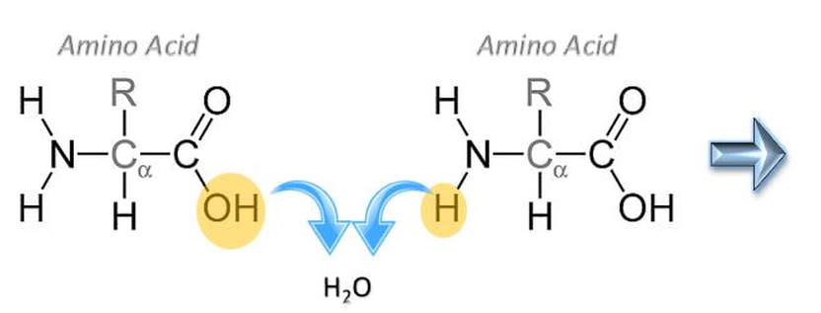
Formation of a Peptide Bond
Formation of a Peptide Bond
This a condensation reaction in which water is removed from 2 amino acids that become joined.
The products of this reaction is a dipeptide and a water molecule.

Slide 19
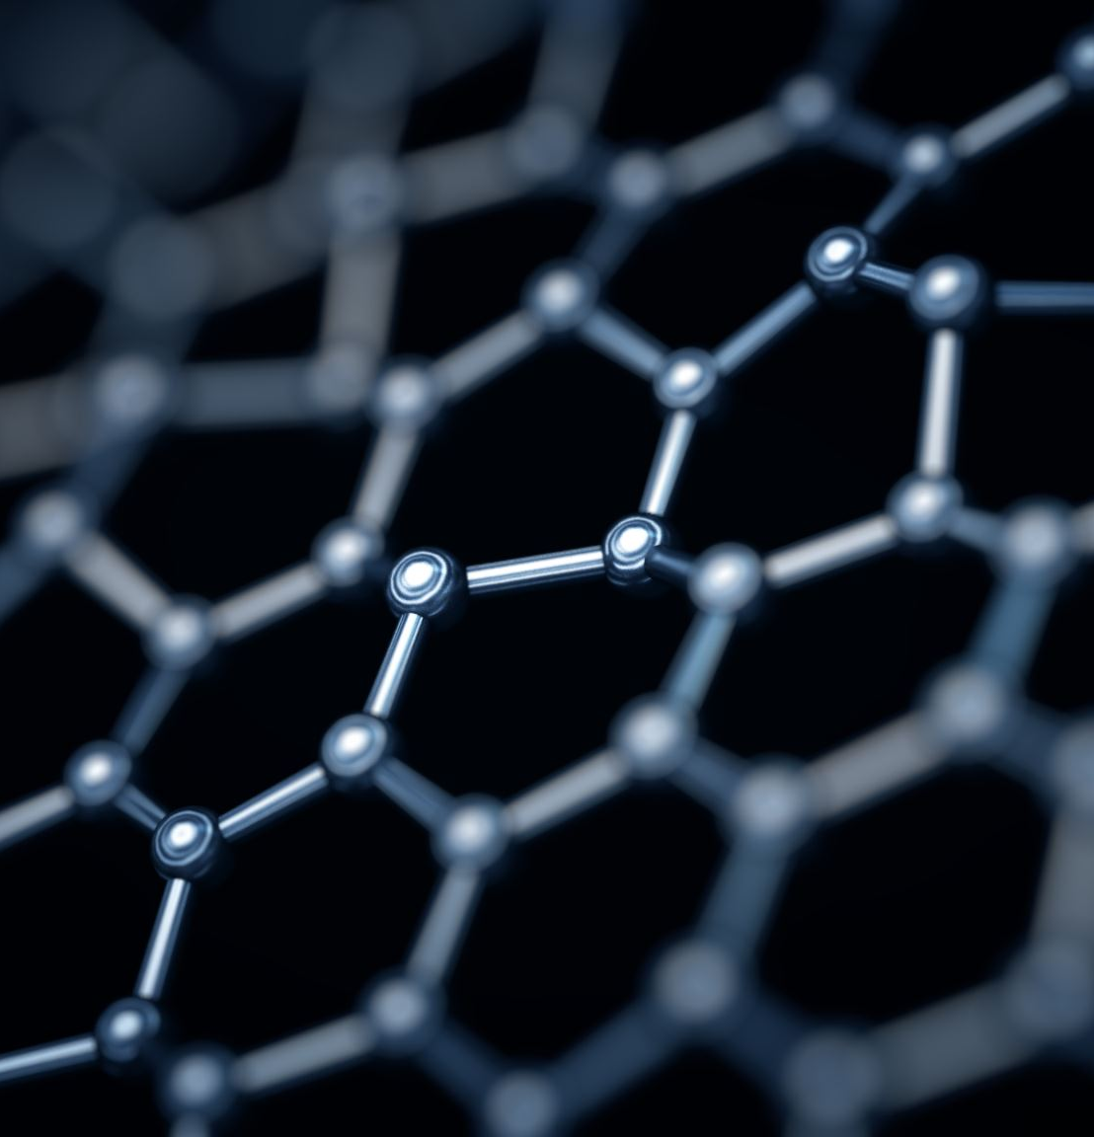
Bonds Important for Life
What bonds are formed in the creation of the 4 major classes of biomolecules?
Monosaccharides are joined via glycosidic linkages to form disaccharides and polysaccharides
Amino acids are joined via peptide bonds to make polypeptide chains
Glycerol and fatty acids are joined via an ester linkage to create triglycerides (ether linkage in archaea)
Nucleotides are joined by phosphodiester bonds to form polynucleotide chains

Slide 20
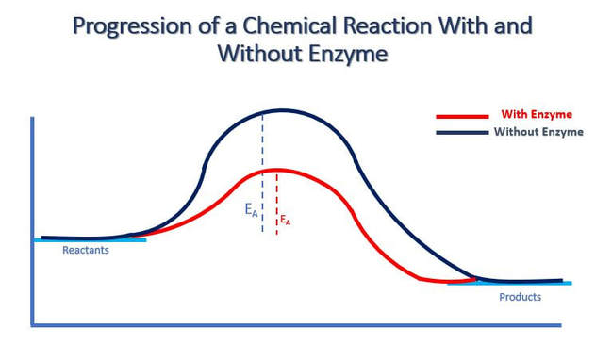
Enzymes
An enzyme is usually a protein.
Enzymes are catalysts which function to reduce the activation energy of a chemical reaction, so that the reaction occurs much more quickly than it would in the absence of the enzyme.
The speed difference is usually several orders of magnitude faster with the addition of the enzyme.
For example, a single lunch would take thousands of years for our bodies to metabolize in the absence of enzymes.

Slide 21
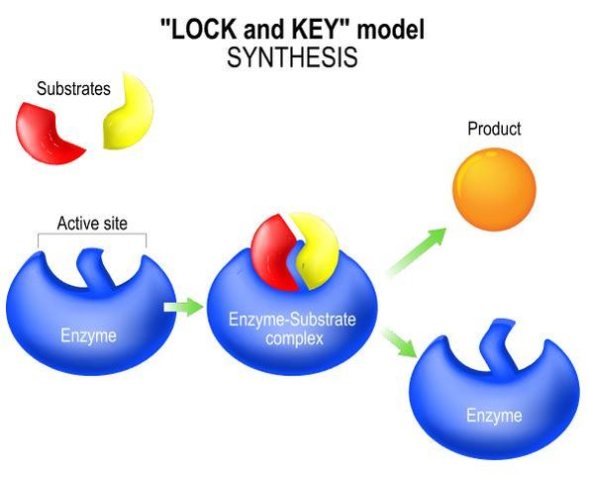
Lock and Key Model
​ An enzyme is specific to the reaction it catalyzes.
In the lock and key synthesis model, the enzyme interacts with the substrate specifically in a lock and key fashion.
The shape of the substrates fit perfectly and specifically into the active site of the enzyme like a key in a lock.
In biology, when we see this pattern of shapes fitting together perfectly with each other, we say that the shapes are complimentary.

Slide 22
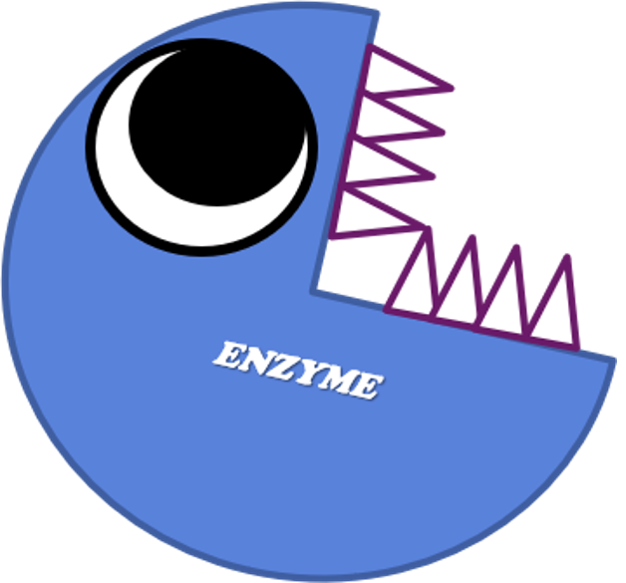
Enzymes
When the substrates are bound to the enzyme, an enzyme–substrate complex is formed briefly, followed by the synthesis the product.
The product is released from the enzyme and the enzyme become available for new substrates.

Slide 23
Enzymes
The enzyme itself is not consumed in the reaction and is technically not considered a reactant or a product in the reaction in which it catalyzes.
This is because, the enzyme itself does not undergo a chemical change, but at the end of the reaction, the enzyme is at the same state that it was in at the beginning of the reaction. ​

Slide 24
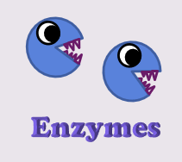
Properties of Enzymes
Enzymes are reusable.
Enzymes are highly specific.
Enzymes have an active site.
Enzymes are usually proteins
Enzymes will have names that end in "-ase"

Slide 25
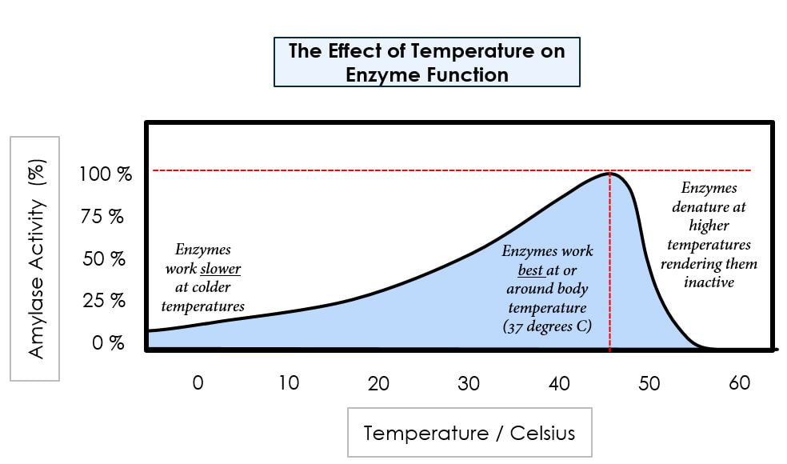
Factors that Affect Enzyme Activity
The rate at which an enzyme converts its substrate into product is affected by many factors.
Temperature - The rate chemical reactions increases with increasing temperature, because the heat is adding kinetic energy to the molecules which makes them move faster.

Slide 26
Factors that Affect Enzyme Activity
Enzymes function more quickly as the temperature increases, until the temperature gets so hot that the structural integrity of the enzyme is affected.
Heat breaks bonds within the protein that lead to the disruption of its tertiary (three-dimensional) structure.
This structural disruption is called denaturation and is the death of the protein.

Slide 27
Factors that Affect Enzyme Activity
Each enzyme has an optimal temperature.
Enzymes in the human body have an optimal temperature of around 37 degrees Celsius.
Above the optimum, there is a rapid decline in enzyme function with increasing temperature due to denaturation of the enzyme’s tertiary structure. ​

Slide 28
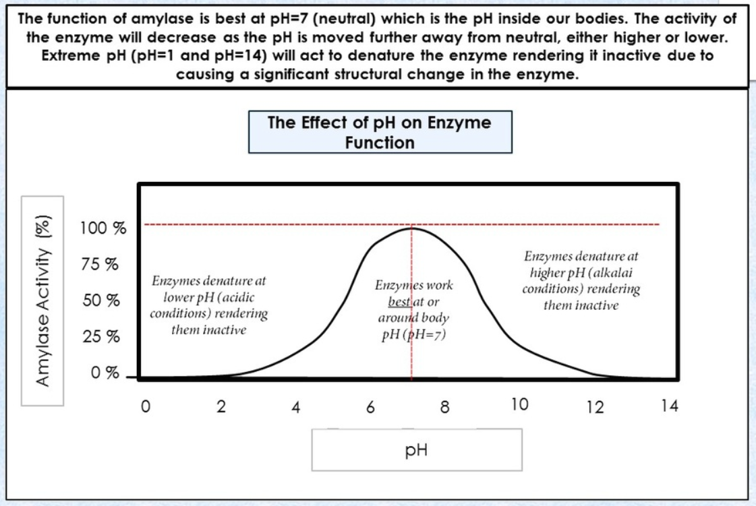
Factors that Affect Enzyme Activity - pH
pH also affects enzyme activity.
Enzymes have a pH level that it functions best at.
Enzymes in the human body function best at a pH of 7.4 (slightly Alkaline).
As the pH level gets further away (in either direction) from this optimal zone, the side chains of the amino acids become ionized which leads to a loss of tertiary structure, followed by denaturation. ​

Slide 29
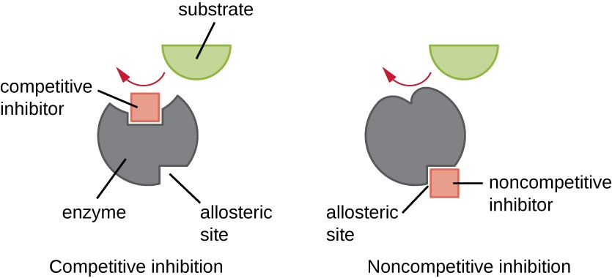
competitive and noncompetitive inhibitors
The difference between competitive and noncompetitive inhibitors
competitive inhibitors: binds to the same site as a substrate (-competition for binding)
noncompetitive inhibitors: bind to a different site from the one the substrate uses. This binding can result in allosteric inhibition by altering the shape of the substrate binding site.

Slide 30
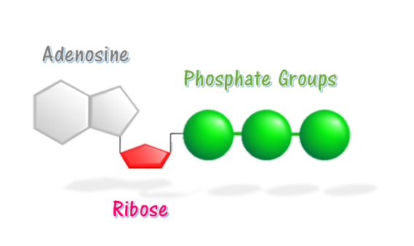
ATP
Energy taken up by the cell, be it in the form of nutrients or sunlight, must be converted into a usable form.
The usable form is ATP. ​
ATP is a high-energy transfer compound, that has the ability to store potential energy in its chemical bonds.
The potential energy found in ATP comes from the breakdown of nutrients or by the trapping of sunlight energy (in photosynthesis).
For example. the catabolic reactions that break down glucose, generate ATP.

Slide 31
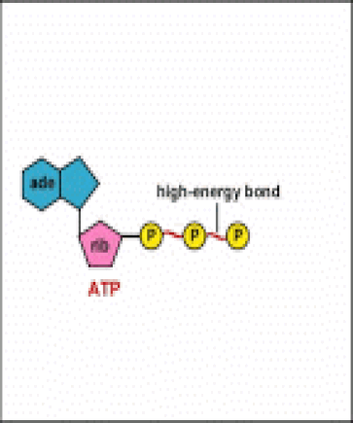
ATP
ATP is Adenosine triphosphate.
The bond that we are most interest in is the bond that links the third phosphate group.
This bond hold a lot of potential energy and is considered a ‘high-energy’ phosphate bond.
When energy is needed, this bond can be broken and energy is released.
When the bond is broken, ATP is broken down to form ADP and inorganic phosphate (Pi).

Slide 32
How Cells Make ATP
Cellular Respiration - process in which cells break down glucose and make ATP for energy​
Most of the ATP generated in the electron transport chain, also known as oxidative phosphorylation, which is the final step in cellular respiration.

Slide 33
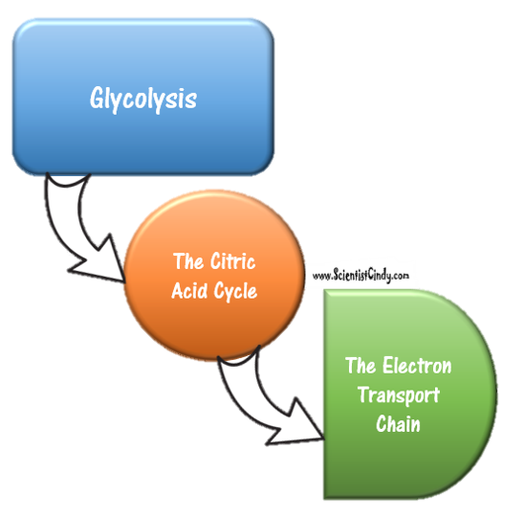
Cellular respiration
Cellular respiration has 3 parts.
1) Glycolysis
2) The Kreb's Cycle / The Citric Acid Cycle
​3) The Electron Transport Chain / Oxidative Phosphorylation

Slide 34
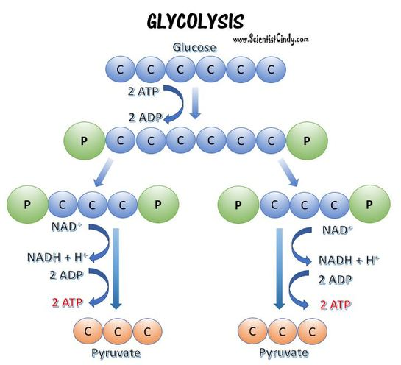
cellular respiration - Glycolysis
Glycolysis- a glucose molecule is are broken down to form 2 pyruvate molecules

Slide 35
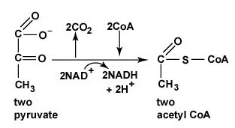
cellular respiration - Glycolysis
The Transition Reaction (not a stage, but an important step
​- pyruvate from glycolysis is transformed into Acetyl CoA before continuing on to the Krebs Cycle

Slide 36
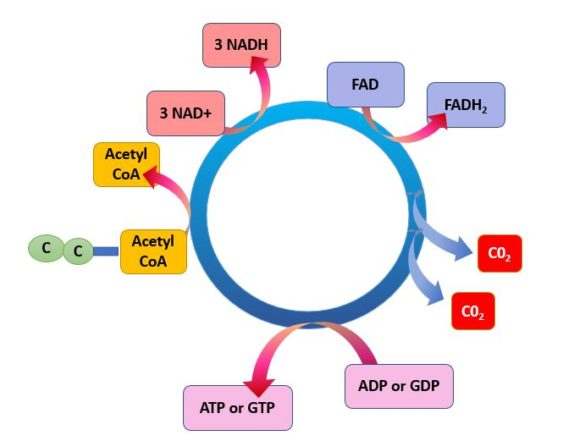
cellular respiration - Glycolysis
Krebs Cycle
- pyruvate is further broken down
- NADH is created
- NADH transports electrons from cellular respiration to the electron transport chain.

Slide 37
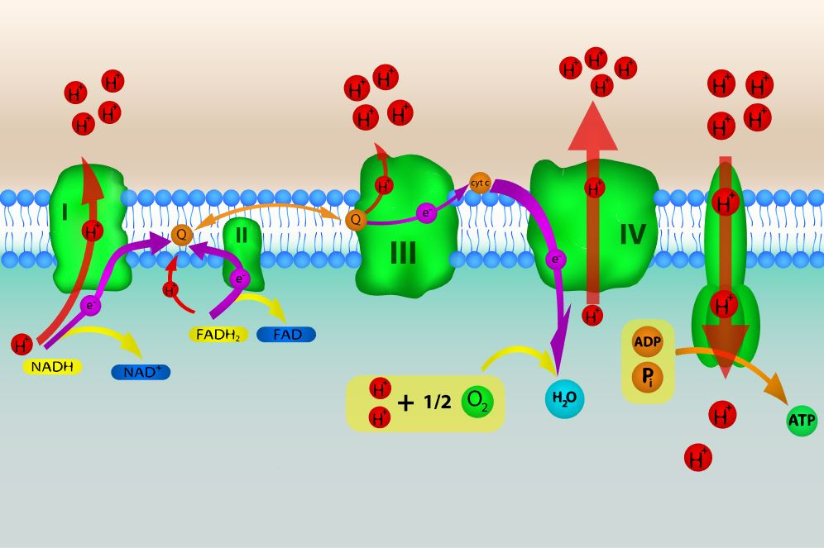
cellular respiration - The Electron Transport Chain
The Electron Transport Chain -
electrons are transported along a series of coenzymes and cytochromes
energy is released as the electrons move along the transport chain.
chemiosmosis occurs - the energy given off by electrons is used to pump protons across a membrane via a proton pump.
The energy generated from the electrochemical gradient of protons provides the energy for ATP synthesis.

Slide 38
The energy is generally not needed immediately, so it is used to combine ADP with phosphate ions to form ATP molecules.
During the process of cellular respiration, carbon dioxide is given off as a waste product.
This carbon dioxide can be used by photosynthesizing cells to form new carbohydrates.
Also in the process of cellular respiration, oxygen gas is required to serve as an acceptor of electrons.
This oxygen gas is identical to the oxygen gas given off in photosynthesis.​

Slide 39
Other Catabolic Pathways
In addition to sugars, humans also have the ability to metabolize lipids and proteins.
The catabolic pathways for metabolizing lipids and proteins join with the processes of glycolysis and the Krebs cycle.

