Slide 1
INTRODUCTION TO ​THE ENDOCRINE SYSTEM

Slide 2
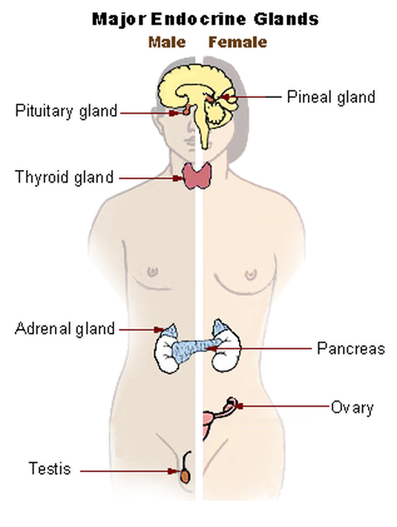
Endocrine glands
Endocrine glands are glands of the endocrine system that secrete hormones directly into interstitial fluid and the bloodstream.
The major glands of the endocrine system include:
pineal gland
pituitary gland
pancreas
ovaries/testes
thyroid gland
parathyroid gland
hypothalamus
adrenal glands

Slide 3
The endocrine system
The endocrine system consists of cells, tissues, and organs that secrete hormones as a primary or secondary function.
Endocrine glands are ductless glands that secrete their hormones directly into the surrounding fluid.
The interstitial fluid and the blood vessels then transport the hormones throughout the body.

Slide 4
Communication in the Body
The body uses two systems to communicate with the body: the endocrine system and the nervous system.

Slide 5
The Endocrine System - Communication
The endocrine system is a communication system that utilizes signaling molecules called hormones and neurohormones to send information from one part of the body to another.

Slide 6
The Endocrine System - Communication
Hormones are chemical signals that are synthesized and secreted by endocrine cells/glands.
Neurohormones are chemical signals that are synthesized and secreted by neurons. Hormones/neurohormones travel via diffusion or via the blood stream to their target cells.

Slide 7
The Endocrine System - Communication
In endocrine signaling, hormones secreted into the extracellular fluid diffuse into the blood or lymph, and can then travel great distances throughout the body.

Slide 8
Endocrine Signaling vs. Autocrine signaling
In contrast, autocrine signaling takes place within the same cell. An autocrine (auto- = “self”) is a chemical that elicits a response in the same cell that secreted it.

Slide 9
Endocrine Signaling vs. paracrine signaling
Unlike endocrine signaling, paracrine signaling is local intercellular communication. The signaling molecule in paracrine signaling is a chemical that induces a response in neighboring cells.
Although paracrines may enter the bloodstream, their concentration is generally too low to elicit a response from distant tissues.

Slide 10
Target Cells and Receptors
Target cells contain specific receptors for the hormone/neurohormone.
Receptors may be located on the
Cell surface
Cytoplasm
Nucleus

Slide 11
Target Cells and Receptors
Receptors on the cell surface will use second messenger systems to cause a rapid, non-genomic effect.
Receptors in the cytoplasm and nucleus will influence transcription/translation causing a slower genomic effect.
If a cell does not contain the receptor that is specific for that hormone/neurohormone, then it will not respond to the hormone/neurohormone.

Slide 12
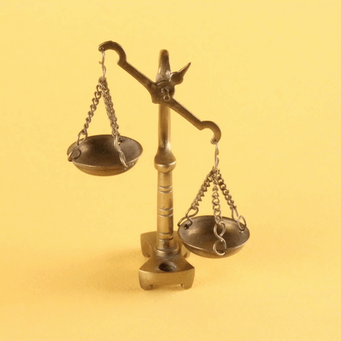
The Endocrine System Functions in HOMEOSTASIS
Our bodies can only function within a relatively very narrow range of values for all of its physiological functions.
The ability of the body to maintain these physiological parameters within the necessary ranges needed to sustain life is called HOMEOSTASIS.

Slide 13
What is Homeostasis?
Homeostasis is the ability of the body's systems to maintain a stable, relatively constant internal environment.
Homeostasis is the tendency to resist change in order to maintain a stable, relatively constant internal environment.​
Homeostasis refers to the maintenance of relatively constant internal conditions.
For example, your body shivers to maintain a relatively constant body temperature when the external environment gets colder.

Slide 14
How is Homeostasis Maintained?
The function of maintaining homeostasis is provided by the endocrine system.
The endocrine system exerts its control through various feedback loops.
Maintaining homeostasis requires that the body continuously monitors its internal conditions.

Slide 15
Body Balance
Each of the body's physiological parameters has a SET POINT.
The human body must maintain homeostasis within just a few points of the body's set point value.
Without this, the body can quickly become out of balance and death can occur.

Slide 17
Types of Glands
Exocrine Glands are those which release their cellular secretions through a duct which empties to the outside or into the lumen (empty internal space) of an organ. These include certain sweat glands, salivary and pancreatic glands, and mammary glands. They are not considered a part of the endocrine system.
Endocrine Glands are those glands which have no duct and release their secretions directly into the intracellular fluid or into the blood. The collection of endocrine glands makes up the endocrine system.

Slide 19
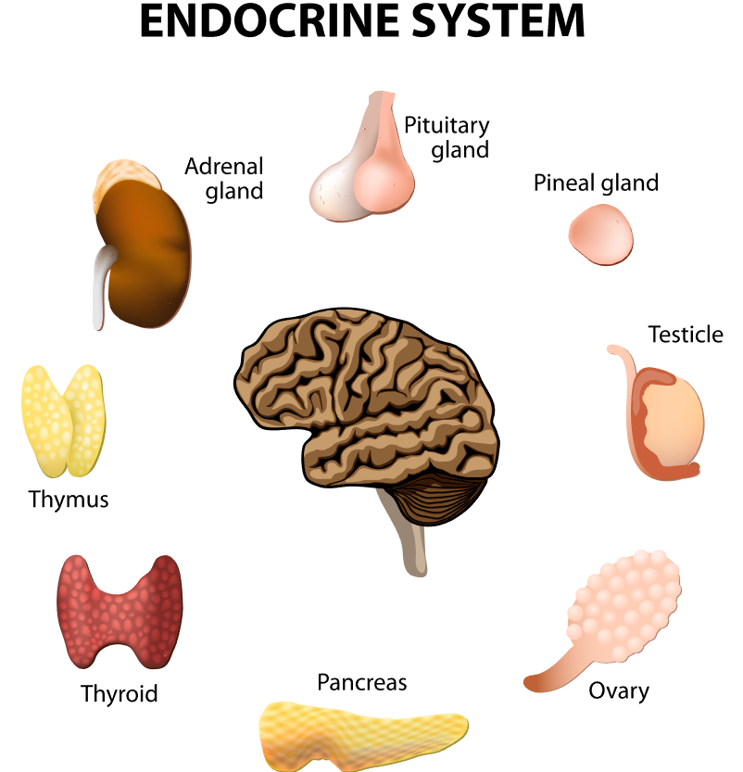
HORMONE CLASSIFICATIONS
​The classification of a hormone can help us understand how they affect the target cell.
Hormones can be classified into different classes:
Steroid Hormones
Non-Steroidal Hormones
Peptide Hormones
Amino Acid-Derived Hormones

Slide 20
Non-steroidal hormones
Non-steroidal hormones include 1) peptide hormones 2) amino acid-derived hormones

Slide 21
Non-steroidal hormones
PROPERTIES OF NON-STEROIDAL HORMONES
Non-Steroidal hormones are hydrophillic so they are soluble in bodily fluids
Non-Steroidal hormone receptors are located on the cell's surface so they cause a rapid non-genomic effect
Non-Steroidal hormones have a short half-life (have short-term effects).

Slide 22
Peptide hormones
​Peptide hormones are synthesized through transcription and translation.
1
They are stored by the cell in storage vesicles until the cell receives a signal to secrete the hormone.
2
Most hormones are considered peptide hormones. ​
3

Slide 23
Amino acid-derived hormones
Amino acid-derived hormones are formed from amino acid precursors.
For example, the amino acid tryptopohan is used by the body to make a dopamine, norepinephrine, epinephrine, melatonin and serotonin.
The amino acid tyrosine is used to make the thyroid hormones triiodothyronine (T3) and thyroxine (T4). T3 and T4 regulate the metabolism and energy levels of the body.
The amino acid glutamic acid is used to make histamines which function as part of the body's immune system.

Slide 24
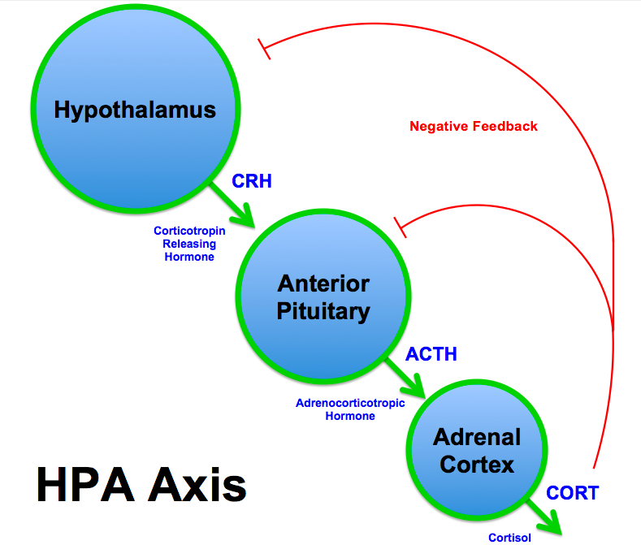
Feedback Loops
Homeostasis is maintained through feedback loops.
There are 2 types of feedback loops; Negative and Positive.
NEGATIVE FEEDBACK SYSTEMS - Homeostasis typically involves negative feedback loops that counteract changes of various properties from their target values, known as set points.
POSITIVE FEEDBACK SYSTEMS - In contrast to negative feedback loops, positive feedback loops amplify their initiating stimuli.

Slide 25
Feedback loops
Control centers in the brain play roles in regulating physiological parameters and keeping them within the normal range.
As the body works to maintain homeostasis, any significant deviation from the normal range will be resisted and homeostasis restored through a process called a feedback loop.

Slide 26
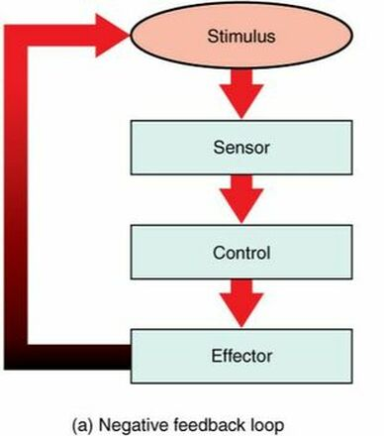
feedback loops
A feedback loop has three basic components:
Sensors / Receptors - Monitors the internal physiological parameter and reports changes to the Control Center
The Control Center - Receives sensory input and compares the reported physiological parameter's value to the set point.
Effectors - If the Control Center finds that the value of the physiological parameter is too far away from the set point, the control center will send a command to effectors.
The effector will function to bring the physiological parameter closer to the set point. is the component in a feedback system that causes a change to reverse the situation and return the value to the normal range.
Effectors are muscles and glands.

Slide 27
Negative Feedback Loop Schematic
Negative feedback loops are the body’s most common mechanisms used to maintain homeostasis.
A negative feedback system is one that tries to keep the body constant. ​
Negative feedback is a mechanism in which the effect of the response to the stimulus is to shut off the original stimulus or reduce its intensity.
In a negative feedback loop, when a mismatch is sensed by the control center, this deviation from the set point is resisted (counter-acted) through a physiological process that returns the body to homeostasis.

Slide 28
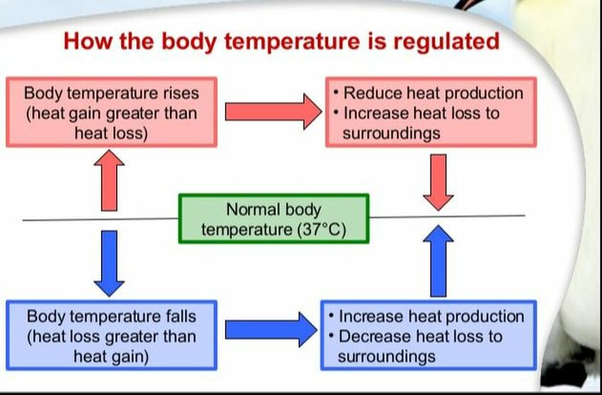
TEMPERATURE REGULATION (Thermoregulation)
The body regulates its temperature through a process called thermoregulation.
Thermoregulation is the ability of the body to maintain its temperature between ~36.5–37.5 °C (or 97.7–99.5 °F).
Thermoregulation is an example of negative feedback. ​
The negative feedback loop that regulates temperature can function to ultimately turn the internal temperature up or down (as needed) to get closer to the body's necessary set point.

Slide 29
TEMPERATURE REGULATION (Thermoregulation)
Humans and other mammals must maintain an internal body temperature close to 98.6 degrees Fahrenheit or 37.0 degrees Celsius, despite how cold our external environment is.
Our body's internal temperature must stay within a very narrow range of temperatures (between ~F95∘F/ C35∘C and F107∘F/ C41.7∘C) to avoid illness or even death.

Slide 30
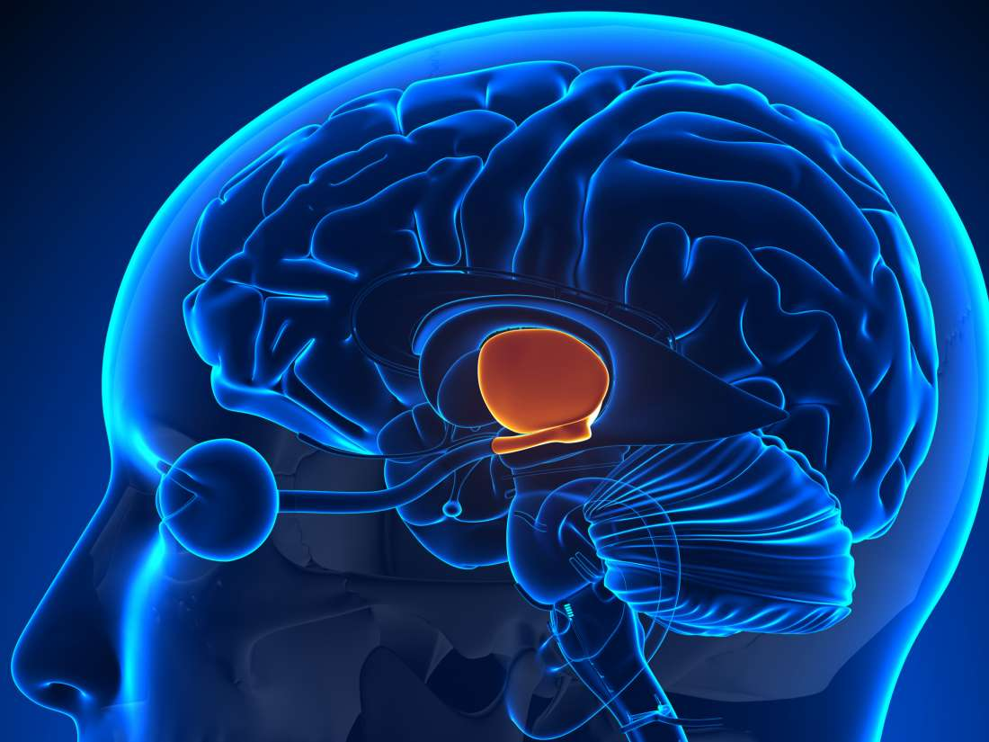
THERMOREGULATION
The hypothalamus in the brain is the master switch that works as a thermostat to regulate the body’s core temperature.

Slide 31
If the temperature goes above the set core temperature:
The hypothalamus can initiate several processes to lower the body temperature.
The following 3 effects occur in efforts to decrease the internal body temperature:
Blood Flow Redirection
Sweating
Breathing Changes

Slide 32
If the temperature goes above the set core temperature:
Blood Flow Redirection -
Blood vessels in the skin begin to dilate allowing more blood from the body core to flow to the extremities and the surface of the skin.
This allows for heat loos through the skin which cools the internal temperature.

Slide 33
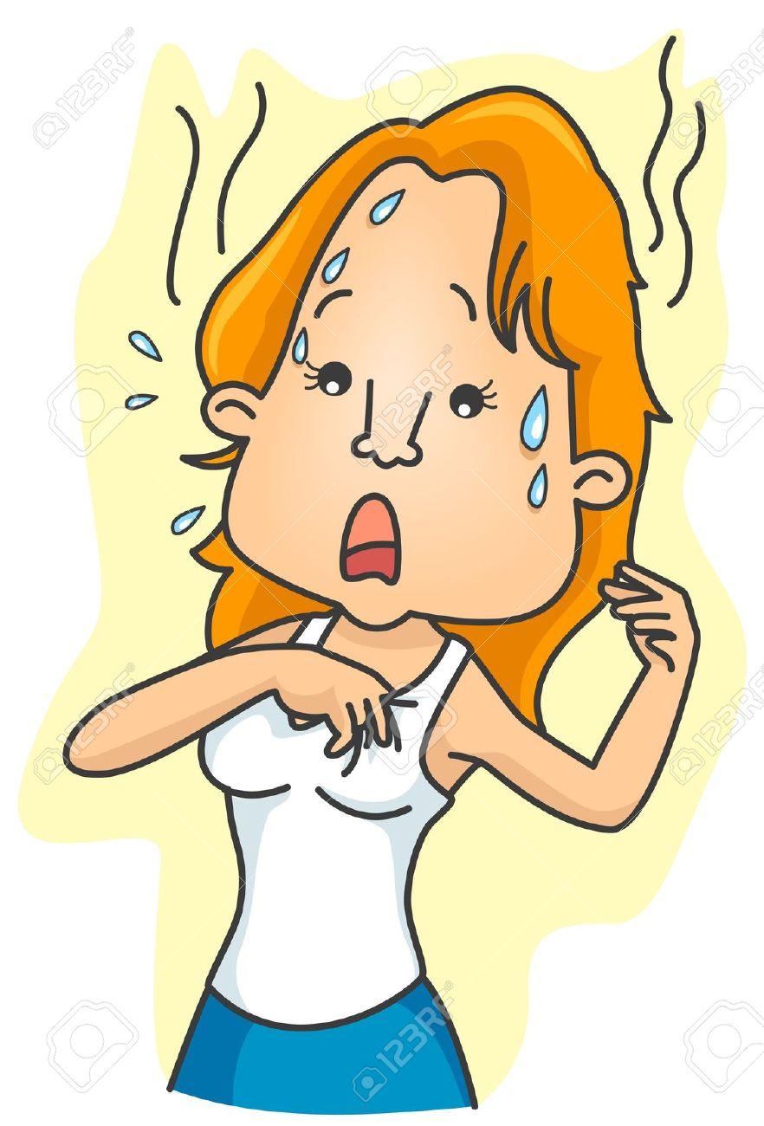
If the temperature goes above the set core temperature:
Sweating -
Sweat glands are activated to increase their secretion of sweat.
Sweat pools at the skin's surface and is evaporated as it touches the air.
As the sweat evaporates from the skin surface into the surrounding air, it dissipates heat and cools the skin.

Slide 34
If the temperature goes above the set core temperature:
Breathing Changes -
Heat is lost as the depth of respiration increases.
Breathing through an open mouth instead of through the nasal passageways helps to release heat from the body.

Slide 35
If the temperature falls below the set core temperature:
The hypothalamus can initiate several processes to raise the body temperature. The following 3 effects occur in efforts to increase the internal body temperature: Blood Flow Redirection - Shivering - Metabolism Increase -

Slide 36
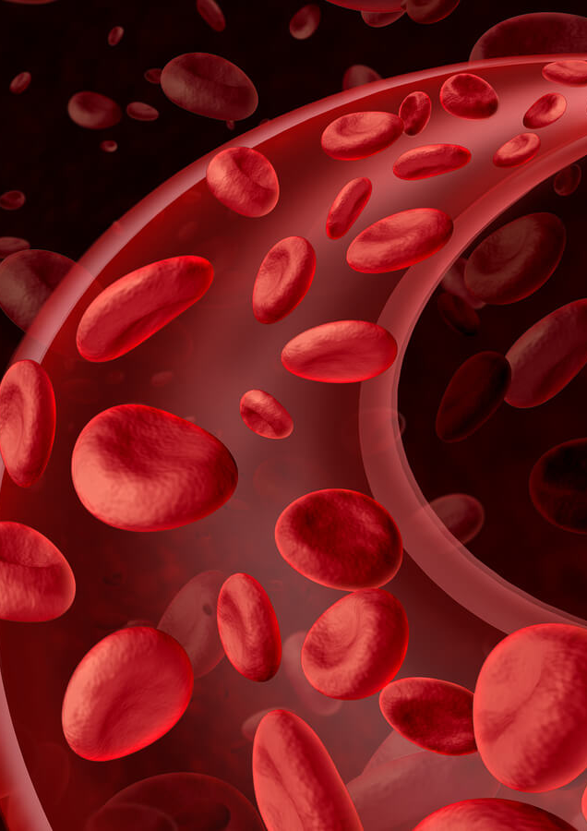
If the temperature falls below the set core temperature:
Blood Flow Redirection -
Blood vessels in the skin begin to restrict the blood flow away from the body's extremities and away from the skin's surface, thereby conserving heat.
The blood flow is diverted to the body's core to ensure that the vital organ continue normal function.

Slide 37
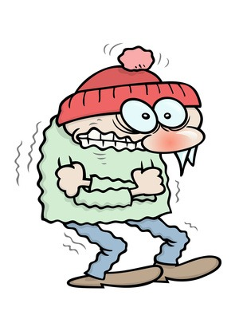
If the temperature falls below the set core temperature:
Shivering -
If heat loss is severe, the brain triggers muscle contraction known as shivering.
The act of shivering releases heat while using up ATP.
This Photo by Unknown Author is licensed under CC BY-NC-ND

Slide 38
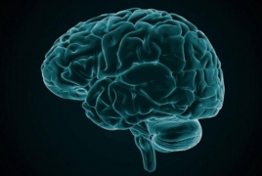
If the temperature falls below the set core temperature:
Metabolism Increase -
Thyroid Hormone Release -
The brain triggers the thyroid gland to release thyroid hormone, which increases metabolic activity and heat production in cells throughout the body.
Epinephrine (Adrenaline) Release -
The brain signals the adrenal glands to release epinephrine (adrenaline).
Epinephrine is a hormone that causes the breakdown of glycogen into glucose, which can be used as an energy source.
The breakdown of glycogen into glucose also results in increased metabolism and heat production.
This Photo by Unknown Author is licensed under CC BY

Slide 39
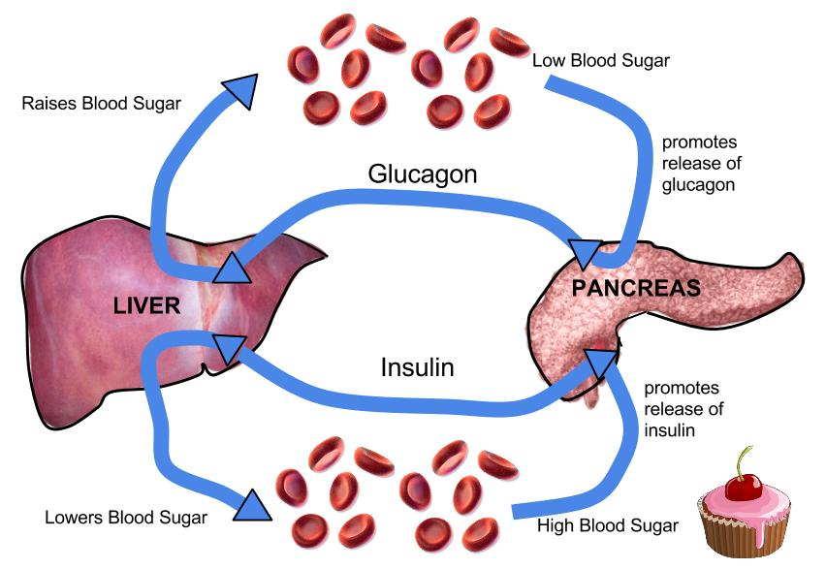
Blood Glucose Levels
Glucose: Insulin and Glucagon - The receptors of the pancreas are responsible for monitoring glucose levels in the blood.
Pancreatic Hormones regulate blood sugar level before and after meals. - Islets; clusters of cells in pancreas
GLUCAGON – increases sugar
INSULIN – decreases sugar

Slide 40
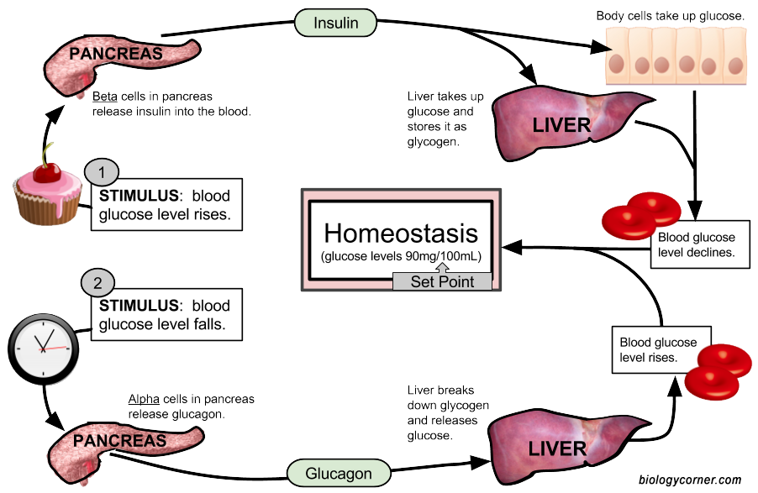
DROP in Blood Glucose Levels
Between meals, blood glucose levels drop.
This drop is glucose triggers the release of glucagon from the pancreas.
Glucagon stimulates the liver to breakdown glycogen into glucose.
This increases the blood glucose levels.

Slide 41
RISE in Blood Glucose Levels
After a meal, blood glucose levels increase.
The increase blood glucose triggers the release of insulin from the pancreas.
Insulin activates the conversion of glucose to glycogen in the liver.
This functions to decrease the blood glucose levels.

Slide 42
Positive Feedback Loops
Positive feedback intensifies a change in the body’s physiological condition rather than reversing it.
A deviation from the normal range results in more change, and the system moves farther away from the normal range.
Positive feedback in the body is normal only when there is a definite end point.

Slide 43
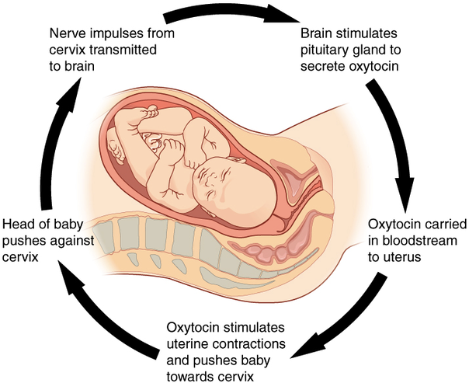
Positive Feedback Loops
Positive feedback intensifies a change in the body’s physiological condition rather than reversing it.
A deviation from the normal range results in more change, and the system moves farther away from the normal range.
Positive feedback in the body is normal only when there is a definite end point.
Childbirth and the body’s response to blood loss are two examples of positive feedback loops that are normal but are activated only when needed.

Slide 44
Positive Feedback Loops
Childbirth at full term is an example of a situation in which the maintenance of the existing body state is not desired.
Enormous changes in the mother’s body are required to expel the baby at the end of pregnancy.
And the events of childbirth, once begun, must progress rapidly to a conclusion or the life of the mother and the baby are at risk.
The extreme muscular work of labor and delivery are the result of a positive feedback system

Slide 45
Positive Feedback Loops
Normal childbirth is driven by a positive feedback loop.
A positive feedback loop results in a change in the body’s status, rather than a return to homeostasis.
The first contractions of labor (the stimulus) push the baby toward the cervix (the lowest part of the uterus).
The cervix contains stretch-sensitive nerve cells that monitor the degree of stretching (the sensors).
These nerve cells send messages to the brain, which in turn causes the pituitary gland at the base of the brain to release the hormone oxytocin into the bloodstream.
Oxytocin causes stronger contractions of the smooth muscles in of the uterus (the effectors), pushing the baby further down the birth canal.
This causes even greater stretching of the cervix.
The cycle of stretching, oxytocin release, and increasingly more forceful contractions stops only when the baby is born.
At this point, the stretching of the cervix halts, stopping the release of oxytocin.

Slide 46
types of hormones
There are two types of hormones secreted in the endocrine system:
Steroidal (or lipid based)
non-steroidal hormones
​peptide hormones
Amino-Acid Derived Hormones

Slide 47
HORMONE CLASSIFICATIONS
Hormones can be classified in three different classes:
Peptide hormones
Steroids
Amino acid derived hormones

Slide 48
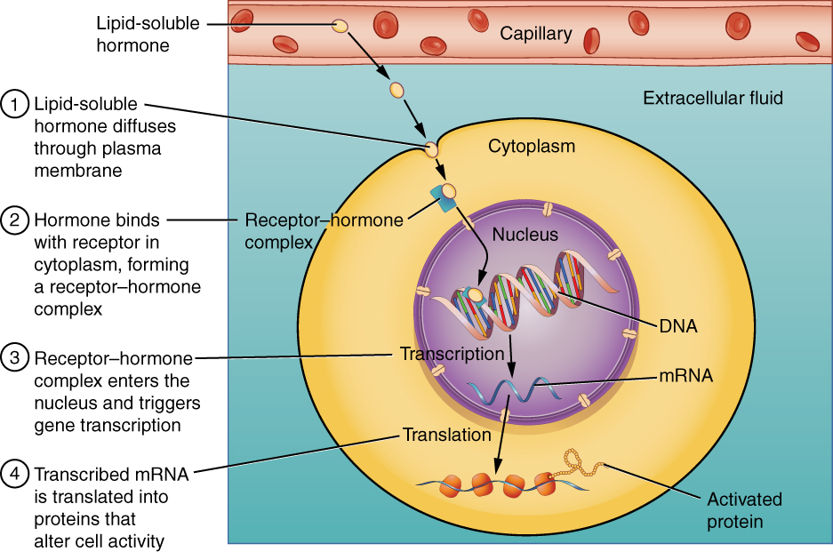
Peptide hormones
​Peptide hormones are synthesized through transcription and translation and are stored by the cell in storage vesicles until the cell receives a signal to secrete the hormone.
Most hormones are considered peptide hormones. ​

Slide 49
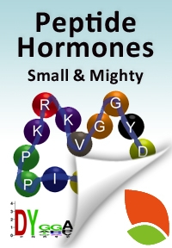
Peptide hormones
PROPERTIES OF PEPTIDE HORMONES
1) Peptide hormones are hydrophilic and are soluble in bodily fluids
2) Peptide hormones have receptors that are located on the cell's surface causing a rapid non-genomic effect
3) Peptide hormones have a short half-life

Slide 50
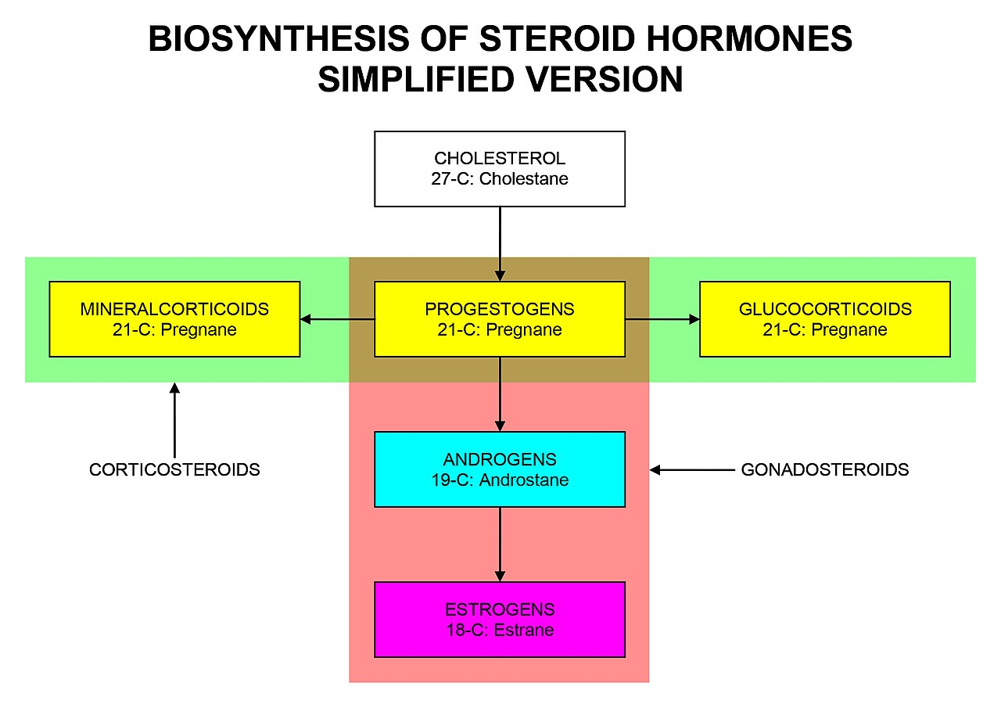
Steroid hormones
Steroid hormones include corticosteroids and sex hormones.
Steroid hormones are derived from cholesterol.

Slide 51
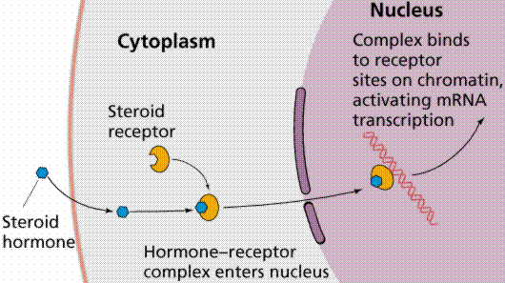
Steroid hormones
PROPERTIES OF STEROID HORMONES 1) Steroid hormones are hydrophobic so they are able to cross the cell membrane 2) Steroid hormones require a carrier protein to travel through the blood stream 3) Steroid hormones have receptors that are located in the cell's cytoplasm or nucleas causing SLOW ACTIONS. 4) Steroid hormones have a long half-life.

Slide 52
Amino acid-derived hormones
Amino acid-derived hormones are formed from amino acid precursors.
For example, the amino acid tryptopohan is used by the body to make a dopamine, norepinephrine, epinephrine, melatonin and serotonin.
The amino acid tyrosine is used to make the thyroid hormones triiodothyronine (T3) and thyroxine (T4) which regulate the metabolism and energy levels of the body.
The amino acid glutamic acid is used to make histamines which function as part of the body's immune system.

Slide 53
Amino acid-derived hormones
PROPERTIES OF AMINO ACID-DERIVED HORMONES 1)Amino acid-derived hormones are hydrophilic so they are soluble in bodily fluids 2) Amino acid-derived hormone receptors are located on the cell's surface so they cause a rapid non-genomic effect 3) Amino acid-derived hormones have a short half-life.

Slide 54
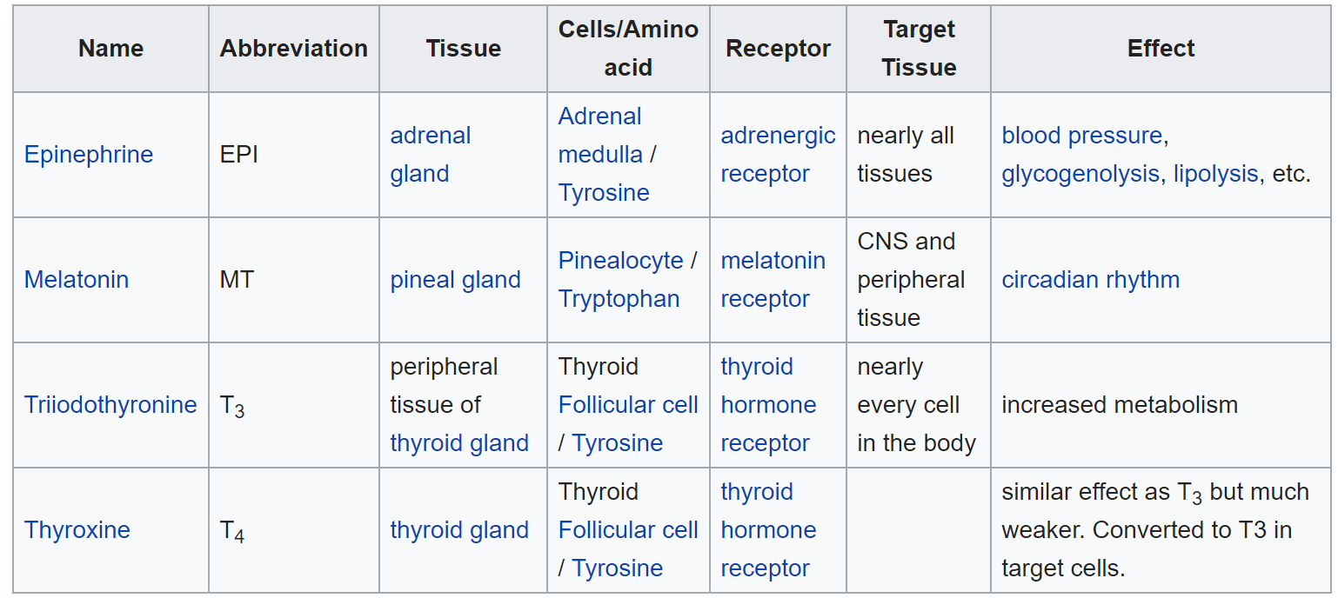

Slide 55
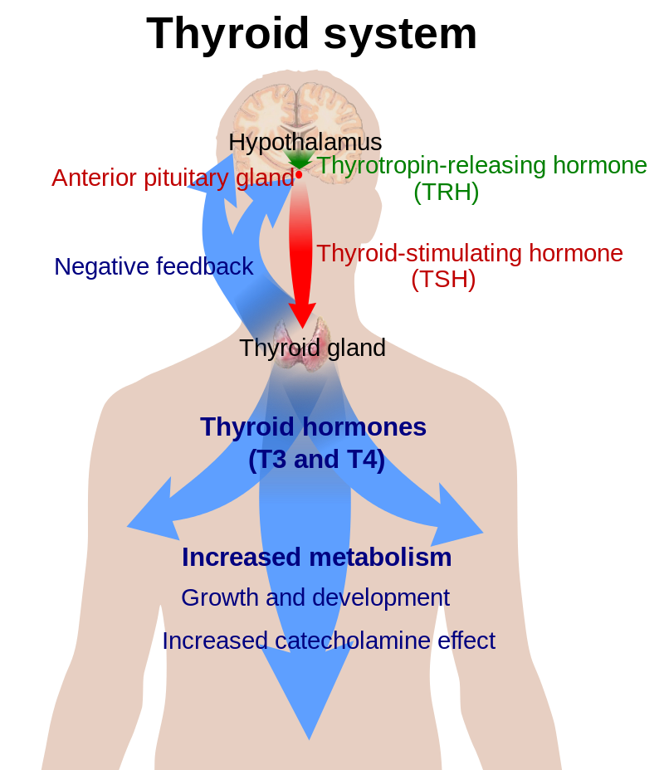
The hypothalamic–pituitary–thyroid axis (HPT axis)
The hypothalamic–pituitary–thyroid axis (HPT axis) is part of the neuroendocrine system responsible for the regulation of metabolism.
Thyroid hormone exerts negative feedback control over the hypothalamus as well as anterior pituitary, thus controlling the release of both TRH from hypothalamus and TSH from anterior pituitary gland.

Slide 56
The hypothalamic–pituitary–thyroid axis (HPT axis)
The hypothalamus senses low circulating levels of thyroid hormones T3 (Triiodothyronine) and T4 (Thyroxine).
The hypothalamus responds to low levels of T3 and T4 by releasing TRH (thyrotropin-releasing hormone)
TRH stimulates the anterior pituitary to produce TSH (thyroid-stimulating hormone)
TSH stimulates the thyroid to produce thyroid hormone s (T3 and T4) until levels in the blood return to normal.
The ultimate effect of the release of thyroid hormones (T3 and T4) is to increase metabolic function and thereby return metabolic function back to the set-point or back to 'normal' levels.

Slide 57
