Slide 1
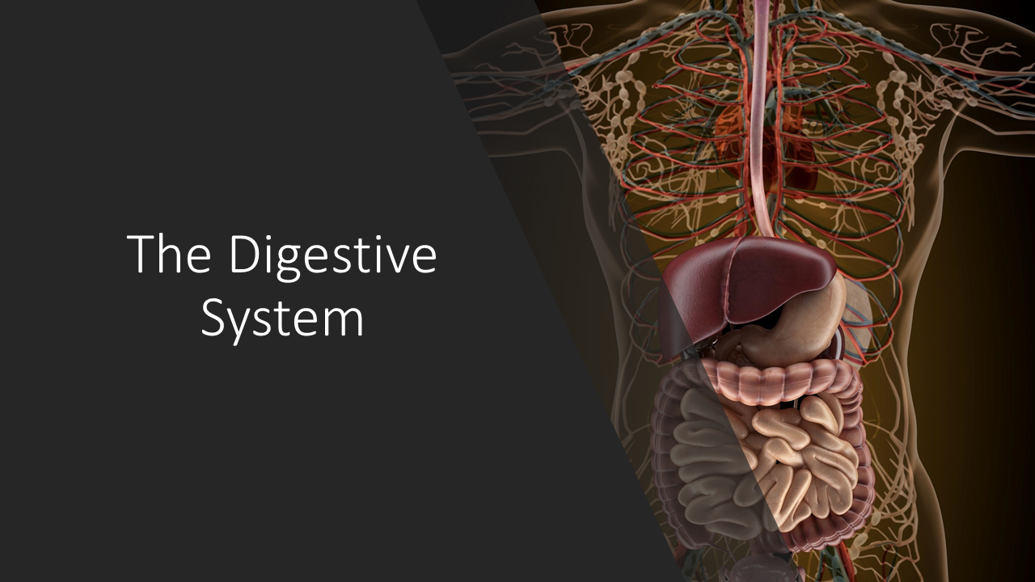
With Scientist Cindy

Slide 2
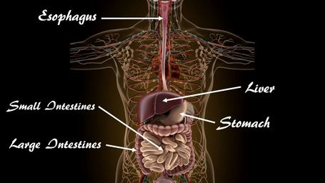
Gross Anatomy

Slide 3
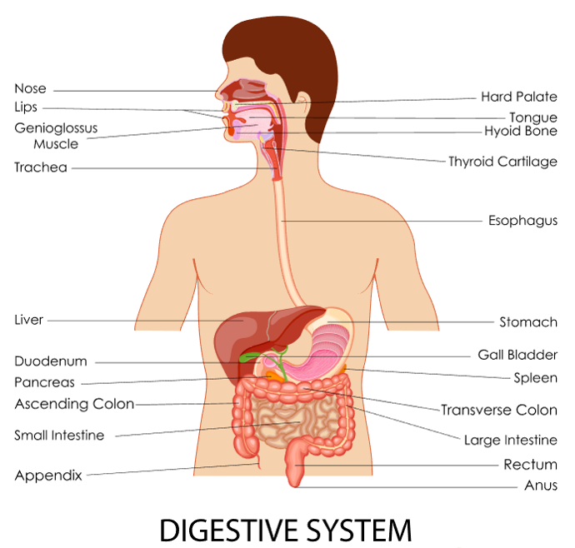
The digestive system works to convert the food we eat into smaller units our body can absorb and use.

Slide 4
Your body is organized as a tube.
The inside of the alimentary canal is considered to be OUTSIDE of the body! This is because both ends of the canal are exposed to the external environment. If you were to stretch out your alimentary canal, it would reach up to about 30 feet in length!

Slide 5
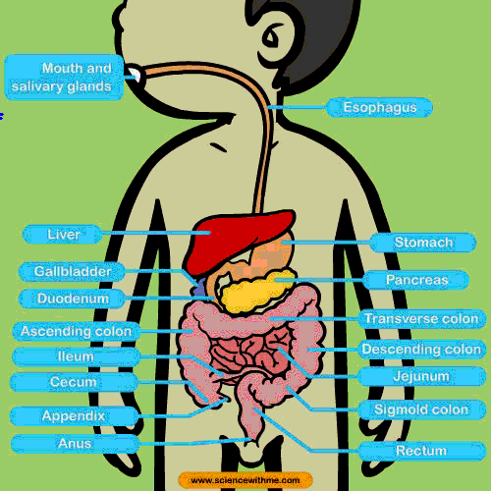
Functions of the Digestive System
Take in food
Break food up into nutrient molecules
Absorbing nutrient molecules into the circulatory system
Eliminating the indigestible waste

Slide 6
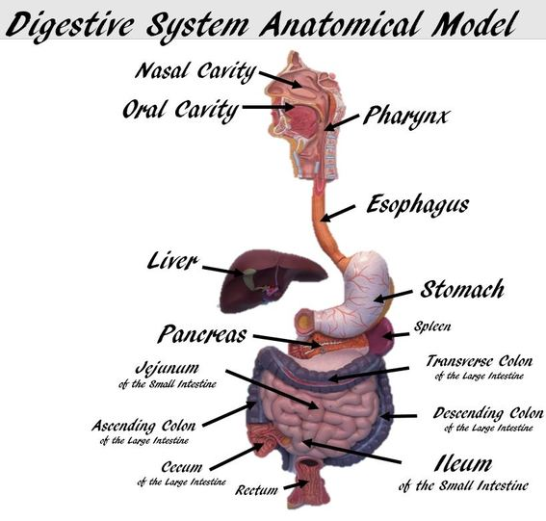
Anatomy of the Digestive System
The alimentary canal gets its names from a word meaning "nourishment". The alimentary canal is better known as the gastrointestinal (or G.I.) tract. The alimentary canal is a continuous tube lined with smooth muscle that extends from the mouth to the anus.

Slide 7
The organs that make up the alimentary canal are as follows:
Mouth
Pharynx
Esophagus
Stomach
Small Intestine (small bowel)
Large Intestine (large bowel)

Slide 8
The organs of the digestive system perform the following six activities:
Ingestion - taking of food into the mouth.
Propulsion - movement of food through the alimentary canal
Swallowing (voluntary)
Peristalsis - moves food through the alimentary canal by waves of involuntary contraction and relaxation of smooth muscle
Mechanical - the physical processes that break up larger pieces of food into smaller pieces.
Chewing
Churning - processes of the stomach
Peristalsis - Rhythmic contraction and relaxation (peristalsis) of smooth muscle of the small intestine.

Slide 9
The organs of the digestive system perform the following six activities:
Digestion - the chemical decomposition of carbohydrates, proteins, and lipids into their simpler building blocks (simple sugars, amino acids, and fatty acids or glycerol, respectively).
Digestion is carried out by digestive enzymes and other substances secreted by the accessory organs.
The processes of digestion take place in the lumen of the alimentary canal.
Absorption - the transportation of digested food from the lumen of the alimentary canal into the blood and lymphatic capillaries located in the wall of the canal.
Defecation - the elimination of indigestible substances (wastes) from the body as feces.

Slide 10
The digestive system is divided into two main groups: the alimentary canal and the accessory digestive organs.

Slide 11
ACCESSORY DIGESTIVE ORGANS
The digestive system includes the accessory digestive organs which are as follows:
Teeth
Tongue
Gallbladder
The Large Digestive Glands
The Salivary Glands
The Liver
The Pancreas
The accessory digestive organs function to secrete saliva, bile, and digestive enzymes, that assist to breakdown food. ​

Slide 12
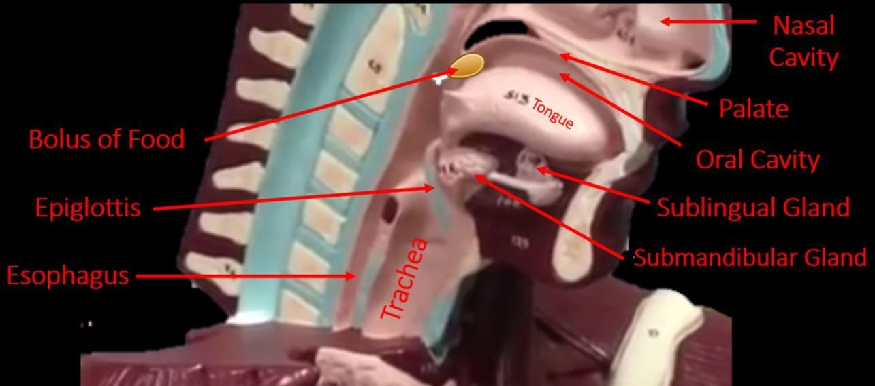
Anatomy of the Head Region

Slide 13
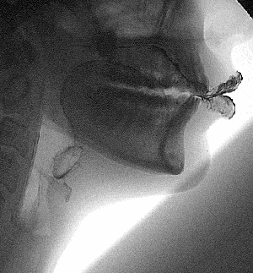
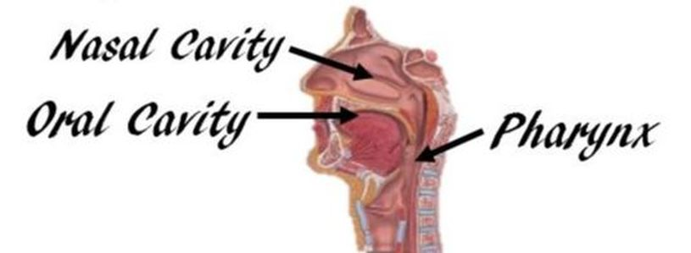
Food Enters the Body Through the Oral Cavity

Slide 14
Food Enters the Body Through the Oral Cavity
​The oral cavity (or mouth) contains
The teeth, the cheek, the palate and the anterior portion of the tongue.
The opening of the mouth is referred to as the oral orifice.
The mouth functions to take in food and to contain structures needed for mastication.
It also houses the tongue to sense, taste and it assists in the formation of words and sounds for speech.

Slide 15
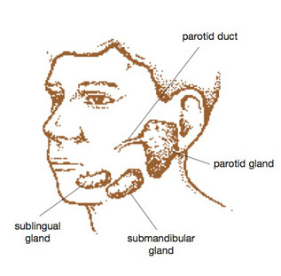
THE SALIVARY GLANDS
The salivary glands produce saliva. Saliva is necessary to moisten food to create a bolus (moist ball of food that can be swallowed). ​ The parotid gland is found outside of the cheek, the sublingual gland lies under the tongue and the submandibular gland lies under the mandible (jaw).

Slide 16
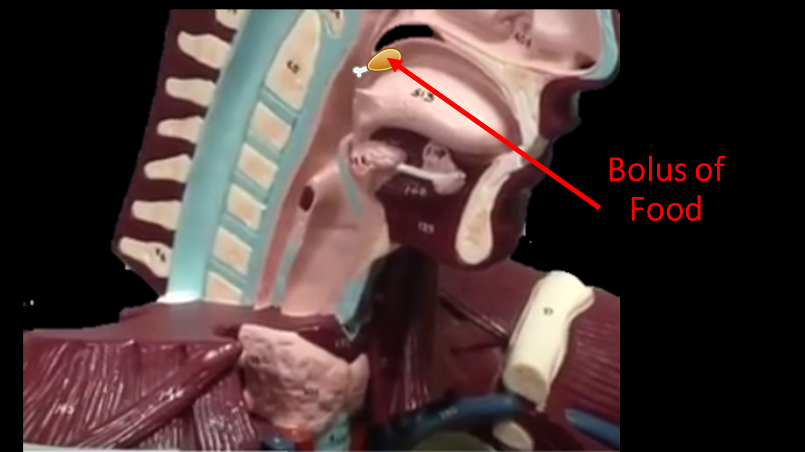
Bolus
Saliva is necessary to moisten food to create a bolus (moist ball of food that can be swallowed).

Slide 17
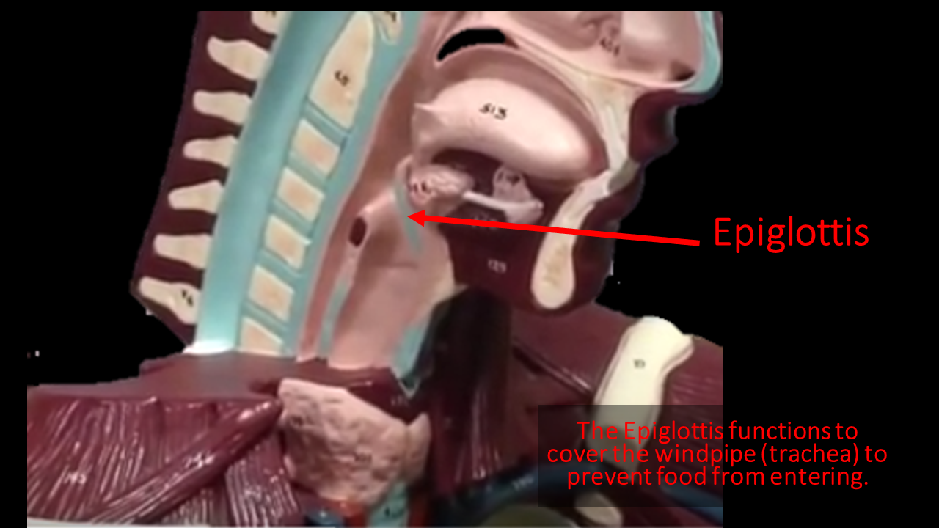
EPIGLOTTIS
. The epiglottis is a small flap of tissue that covers the trachea when you swallow to prevent food from entering the airways!

Slide 18
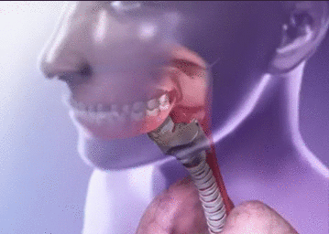
EPIGLOTTIS

Slide 19
​ The pharynx is better known as the throat. The throat leads from the nose cavity and the mouth cavity to the esophagus and the trachea. Pharynx is subdivided into the following three sections; 1) the nasopharynx 2) the oropharynx 3) the laryngopharynx

Slide 20
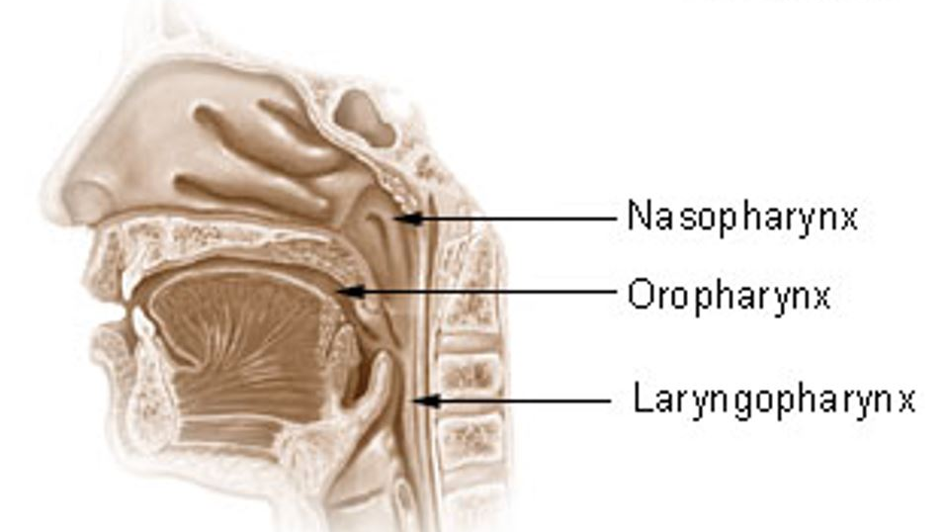
The 3 Regions of the Pharynx

Slide 21
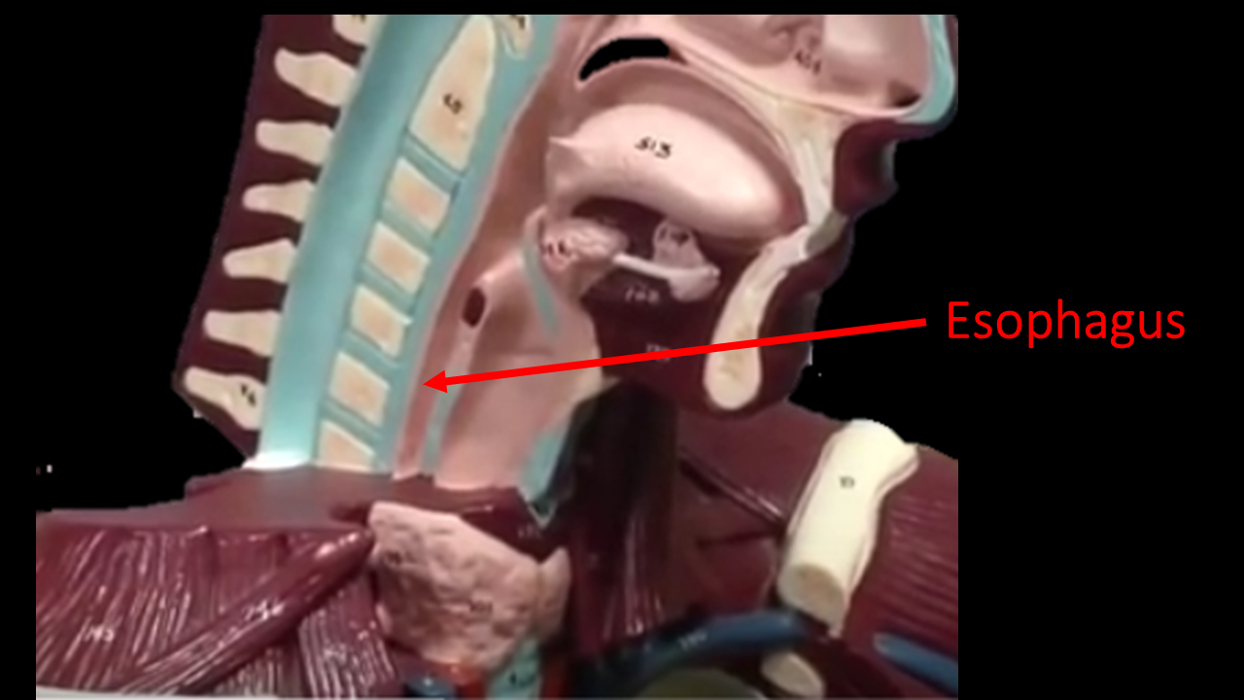
Esophagus
The esophagus is lined with smooth muscle that propels swallowed food to the stomach.
The function of the esophagus is deliver food from the pharynx to the stomach.

Slide 23
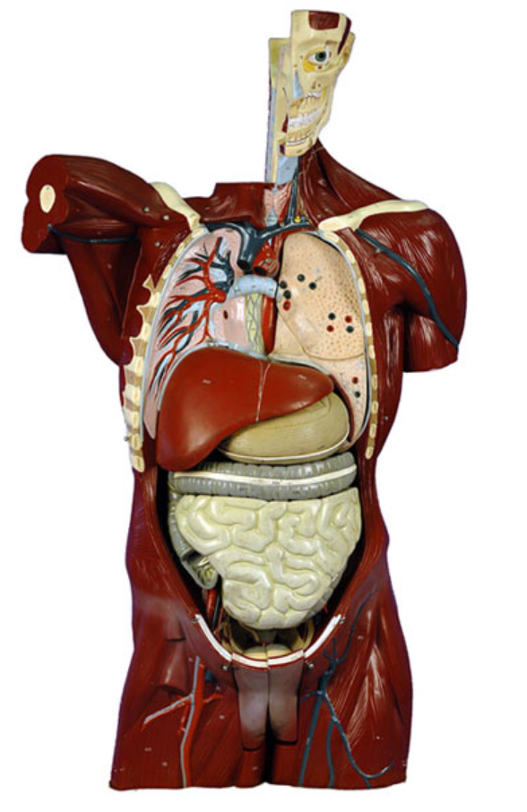
Trachea
Thyroid Cartilage
Secondary Bronchi
Primary Bronchi
Diaphragm
Liver
Stomach
Large Intestines
Small Intestines

Slide 24
Thyroid Cartilage
Trachea
Primary Bronchi
Secondary Bronchi
Diaphragm

Slide 25
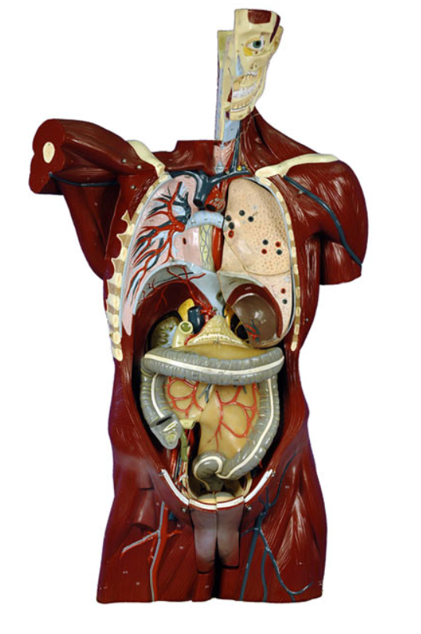
Trachea
Thyroid Cartilage
Primary Bronchi
Secondary Bronchi
Diaphragm
Kidney
Duodenum
Pancreas
Pancreatic Duct
Transverse Colon
Ascending Colon
Mesentery
Ileocecal Valve
Descending Colon
Cecum
Sigmoid Colon

Slide 26
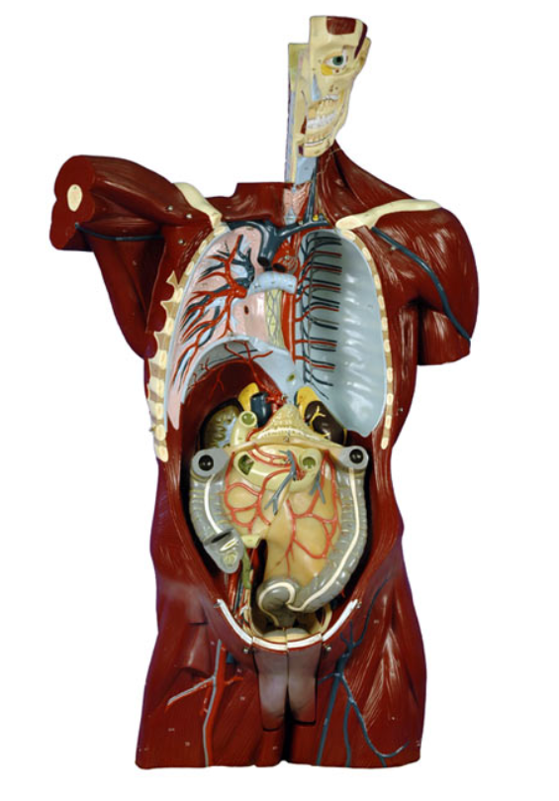
Trachea
Thyroid Cartilage
Primary Bronchi
Secondary Bronchi
Diaphragm
Pleural Cavity
Duodenum
Pancreas
Pancreatic Duct
Ascending Colon
Mesentery
Ileocecal Valve
Descending Colon
Cecum
Sigmoid Colon

Slide 27
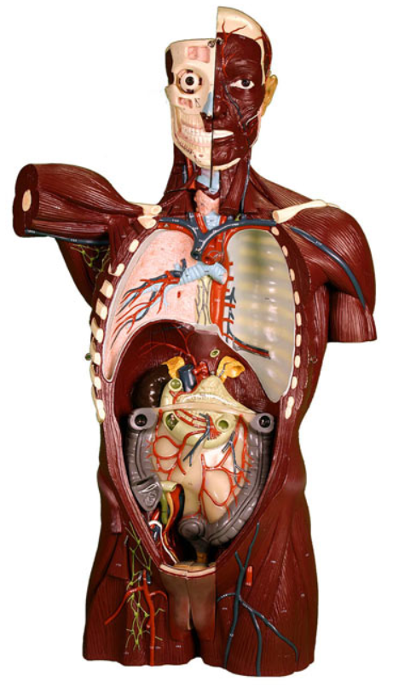

Slide 28
Pleural Cavity
Diaphragm
Kidney
Pancreas
Duodenum
Pancreatic Duct
Mesentery
Ascending Colon
Descending Colon
Ileocecal Valve
Cecum
Sigmoid Colon

Slide 29
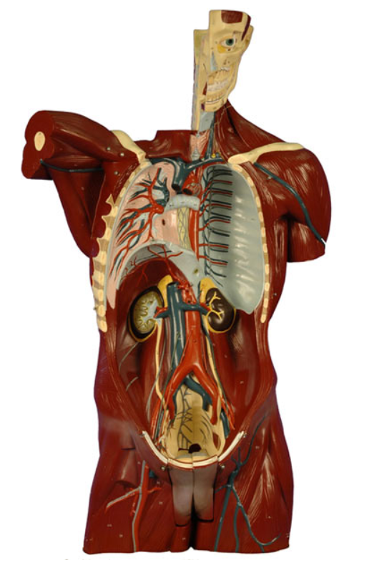
Trachea
Thyroid Cartilage
Primary Bronchi
Secondary Bronchi
Diaphragm
Pleural Cavity
Kidney
Kidney
Ureter
Ureter

Slide 32
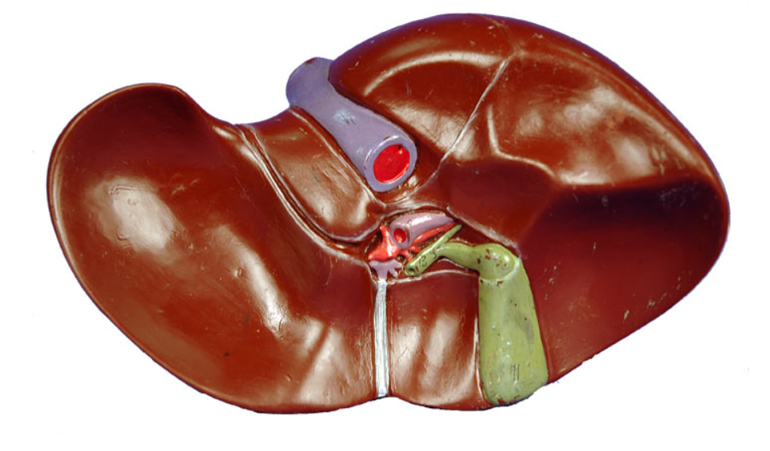
The liver functions to detoxify chemicals, metabolize drugs, secrete the digestive enzymes in the form of bile, and produces blood clotting factors.
In the digestive system, the liver functions to secrete the digestive enzymes in the form of bile which helps to break down fats (lipids).

Slide 34
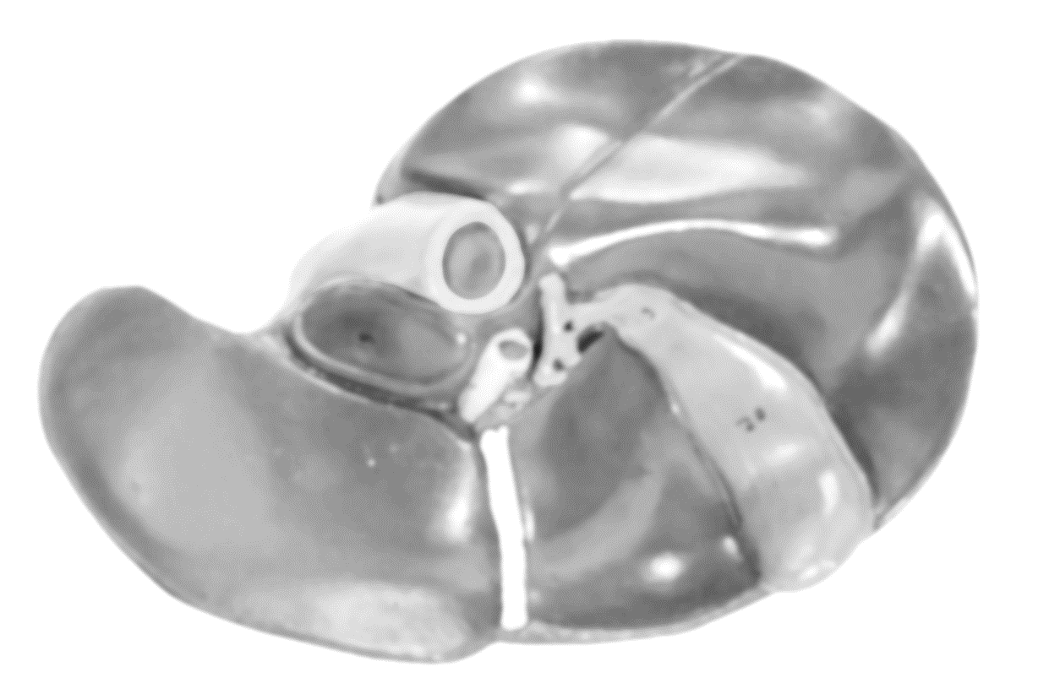
The ultimate destination of the bile is the duodenum of the small intestine.
The bile produced in the liver can be stored in the gallbladder which lies directly underneath the liver.
The gallbladder's function is to store and concentrate the bile that was made in the liver.
Bile from the liver can also bypass the gallbladder altogether and get secreted by a different pathway.

Slide 36
The Stomach

Slide 37
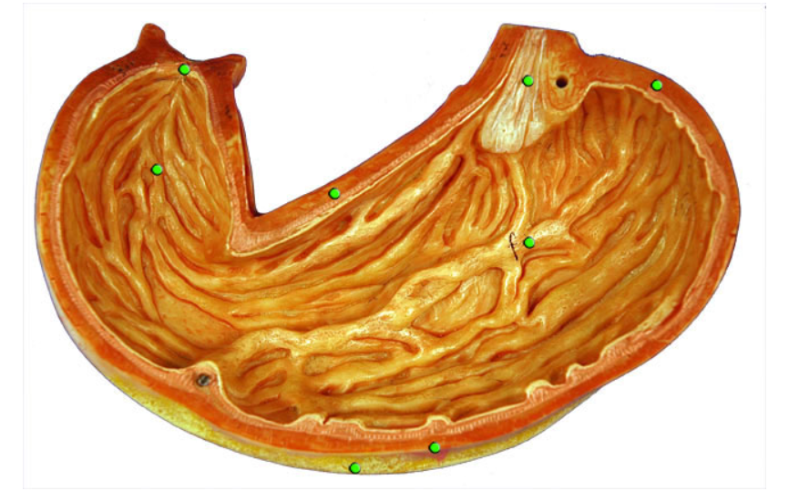

Slide 39
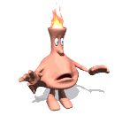

Slide 40
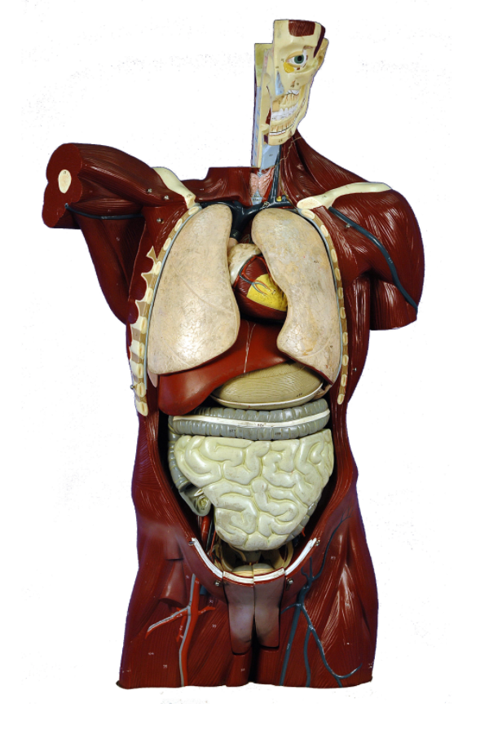
Lungs
Heart
Liver
Stomach
Large Intestines
Small Intestines

Slide 42
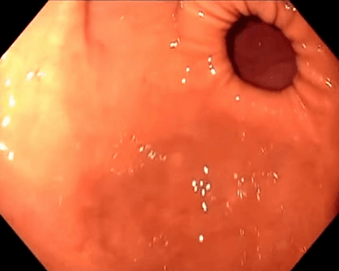
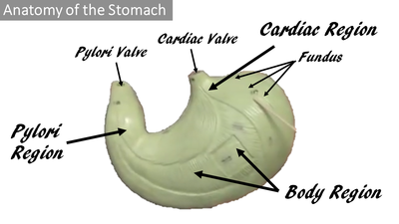
Sphincter Muscles of the Stomach

Slide 44
From the esophagus, the bolus of food will pass through the cardiac sphincter of the stomach.

Slide 45
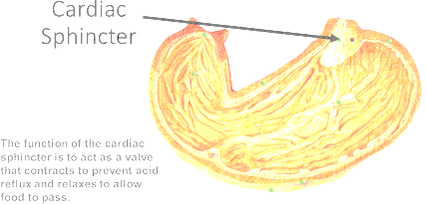
THE CARDIAC SPHINCTER/VALVE
The function of the cardiac sphincter is to act as a valve that relaxes to allow food to enter the stomach from the esophagus.
The cardiac sphincter also functions to prevent stomach acid from traveling upward from the stomach into the esophagus.
When the cardiac sphincter fails to prevent this from happening, the result is acid reflux or heart burn.

Slide 46
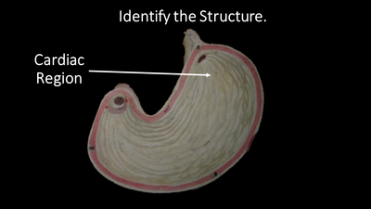
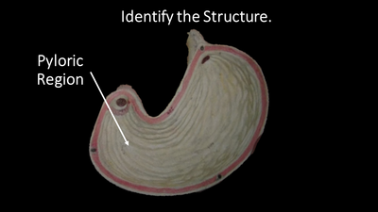
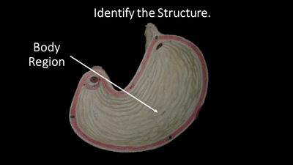

Slide 47
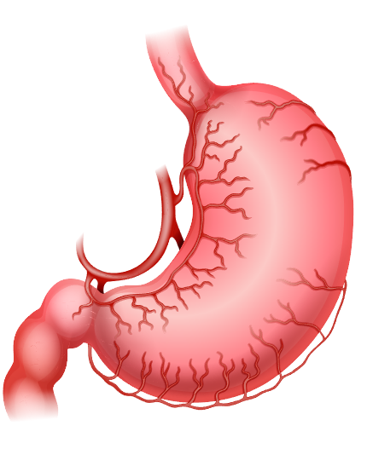
Anatomy of the Stomach
The stomach begins at the cardial sphincter that connects the esophagus to the stomach.
Food enters the first portion of the stomach, called the cardial region.
The fundus of the stomach is the superior "dome-shaped" region of the stomach that lies just inferior of the diaphragm.
The large midportion of the stomach is called the body.
As you travel through the stomach, the body becomes the pyloric region (which includes the pyloric antrum and pyloric canal) which looks like a funnel. The terminal end of the stomach contains the pyloric sphincter.
The word pylorus means “gatekeeper”. Living up to its name, the pyloric sphincter controls the entry of partially digested food into the small intestine.

Slide 50
THE PYLORIC SPHINCTER/VALVE
The function of the pyloric sphincter is to act as a valve that prevents larger chunks of food to pass onto the duodenum from the stomach.
The pyloric valve only allows food that has been broken down into relatively small parts to pass onto the duodenum.
The duodenum is considered the first part of the small intestine.

Slide 51
The stomach transforms your food into a paste-like, partially digested substance called chyme. The chyme leaves the stomach via the pyloric valve, and enters the duodenum which is the first part of the small intestine.

Slide 52
Subdivisions of the Small Intestine
The small intestine begins at the pyloric sphincter of the stomach and is divided into three sections:
The duodenum
The jejunum
The ileum.

Slide 53
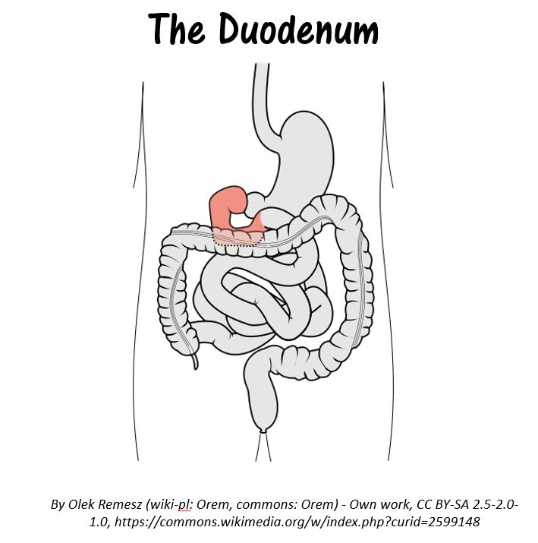
The duodenum is the1st part of the small intestine.
It is smallest portion of the small intestine.
Most of digestion occurs in the duodenum, due to enzymes and juices from the liver and pancreas.

Slide 54
The jejunum is the segment of the small intestine that comes after the duodenum.
Most of the nutrients present in food are absorbed by the jejunum before being passed on to the ileum for further absorption.

Slide 55
The ileum is the last part of the three part tube that makes up the small intestine.
It is where the remaining nutrients are absorbed before moving into the large intestine.

Slide 59
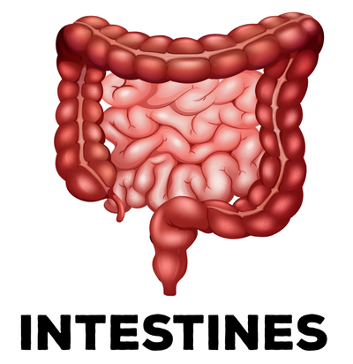
As the food makes its journey, some water will be absorbed, leaving behind waste products to be eliminated from the body in the form of feces.
The main function of the large intestine (also called the colon) is to concentrate and produce waste in the form of feces.

Slide 60
The ileum is the last part of the three part tube that makes up the small intestine. It is where the remaining nutrients are absorbed before moving into the large intestine.

Slide 61
Chyme (paste of food with gastric juices) leaves the ileum of the small intestine and enter into the cecum of the large intestine through the ileocecal valve.
The ileocecal valve is a sphincter muscle valve that separates the small intestine and the large intestine. It functions to prevent substances flowing back into the ileum once they have reached the cecum.

Slide 62
Once food has been further broken down in the cecum, it will travel up the ascending colon, across the transverse colon, down the descending colon, then through the sigmoid colon, rectum and finally, out the anus.

Slide 63
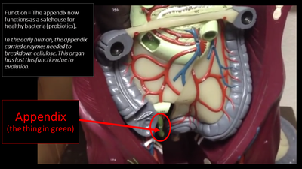
The Appendix
Extending from the inferior end of the large intestine’s cecum, the human appendix is a narrow outcropping of tissue. whose resemblance to a worm inspired its alternate name, vermiform (worm-like) appendix.
The appendix now functions to store immune cells and healthy bacteria (probiotics) that aid digestion.
The appendix is sometimes referred to as a vestigial organ, because early humans, the appendix carried enzymes needed to breakdown cellulose.
This organ has since lost this function due to evolution.

Slide 64
The large intestine is the terminal portion of the alimentary canal (commonly known as the gastrointestinal tract). The large intestine function to absorb water and vitamins while converting undigested food into feces. The large intestine borders the small intestine and can be up to 5 feet long.

Slide 65
The large intestine is separated into the following areas:
Cecum
Ascending Colon
Transverse Colon
Descending Colon
Sigmoid Colon
Rectum
Anal Canal

Slide 66
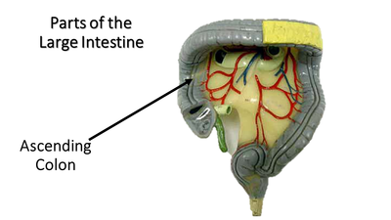
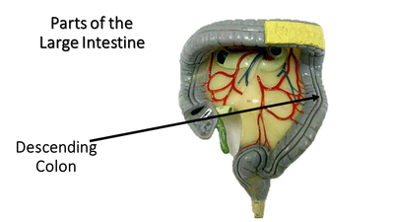

Slide 68
The End

