Slide 1
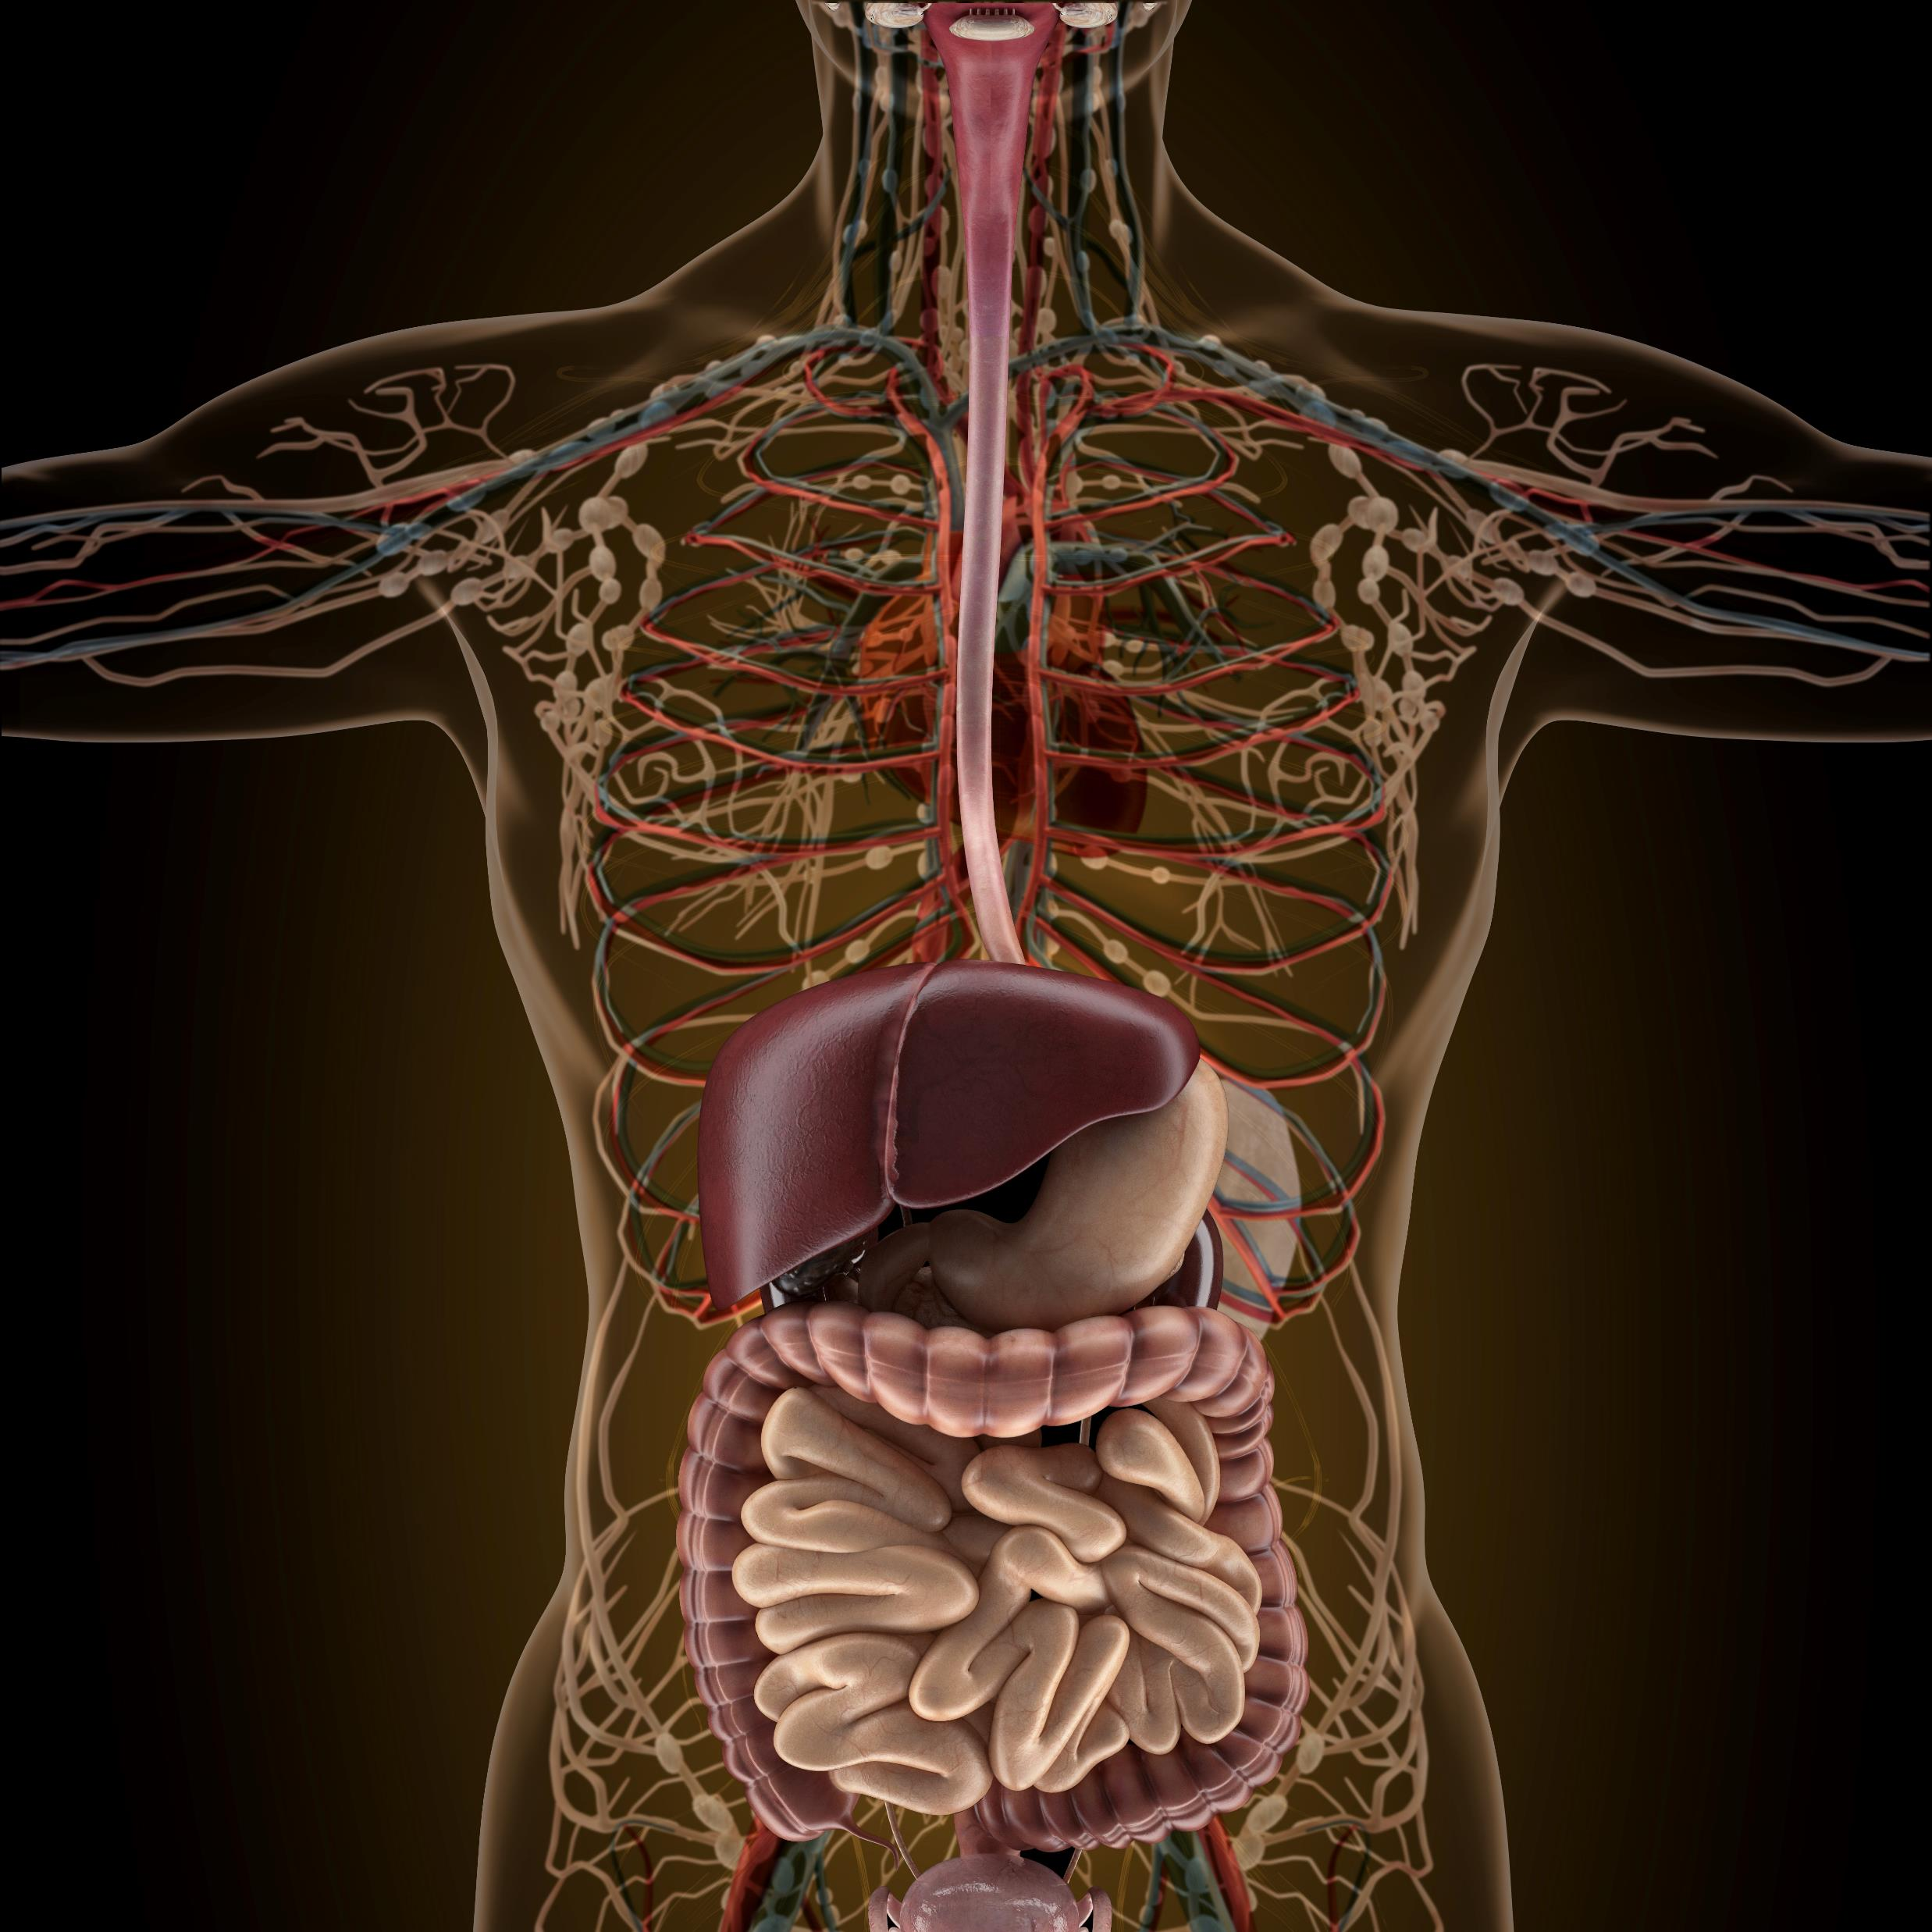
The Digestive System
By Scientist Cindy

Slide 2
FUNCTIONS OF THE DIGESTIVE SYSTEM
2 functions of the digestive system :
Digestion
Absorption
The Gastrointestinal System is responsible for
the breakdown and absorption of various foods and liquids needed to sustain life.

Slide 3
FUNCTIONS OF THE DIGESTIVE SYSTEM
During digestion, two main processes occur at the same time;
Mechanical Digestion
Chemical Digestion

Slide 4
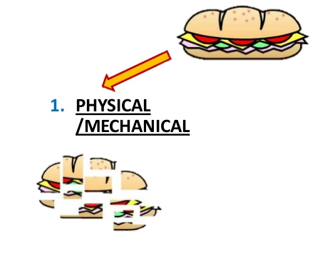
Mechanical Digestion:
Mechanical Digestion: larger pieces of food get broken down into smaller pieces while being prepared for chemical digestion.
Mechanical digestion starts in the mouth and continues into the stomach.

Slide 5
Chemical Digestion:
Chemical Digestion: starts in the mouth and continues into the intestines.
Several different enzymes break down macromolecules into smaller molecules that can be absorbed.

Slide 6
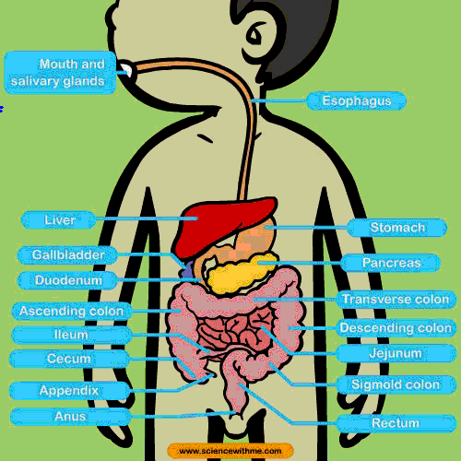
The GI Tract
The GI tract includes
The Mouth
The Esophagus
The Stomach
The Small Intestine (Duodenum, Jejunum, Ileum)
The Large Intestine (Colon)
Rectum
Anus

Slide 7
Accessory Organs
1. Salivary glands
2. Tongue
3. Teeth
4. Liver
5. Gallbladder
6. Pancreas
7. Vermiform appendix

Slide 8
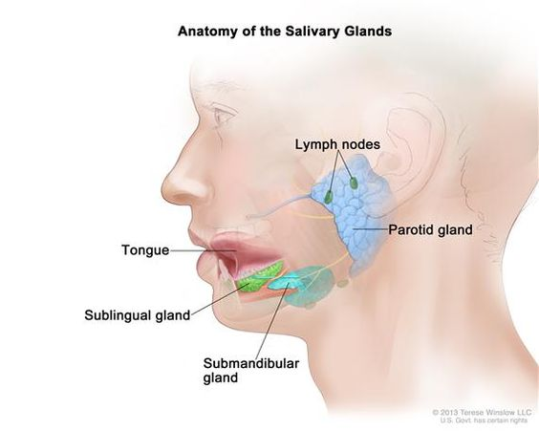
Salivary glands
The 3 salivary glands –
Parotid Gland
Submandibular Gland
Sublingual Gland
The Salivary Glands are exocrine glands that produce saliva which begins the process of digestion with amylase, and moistens the food creating a bolus.

Slide 9
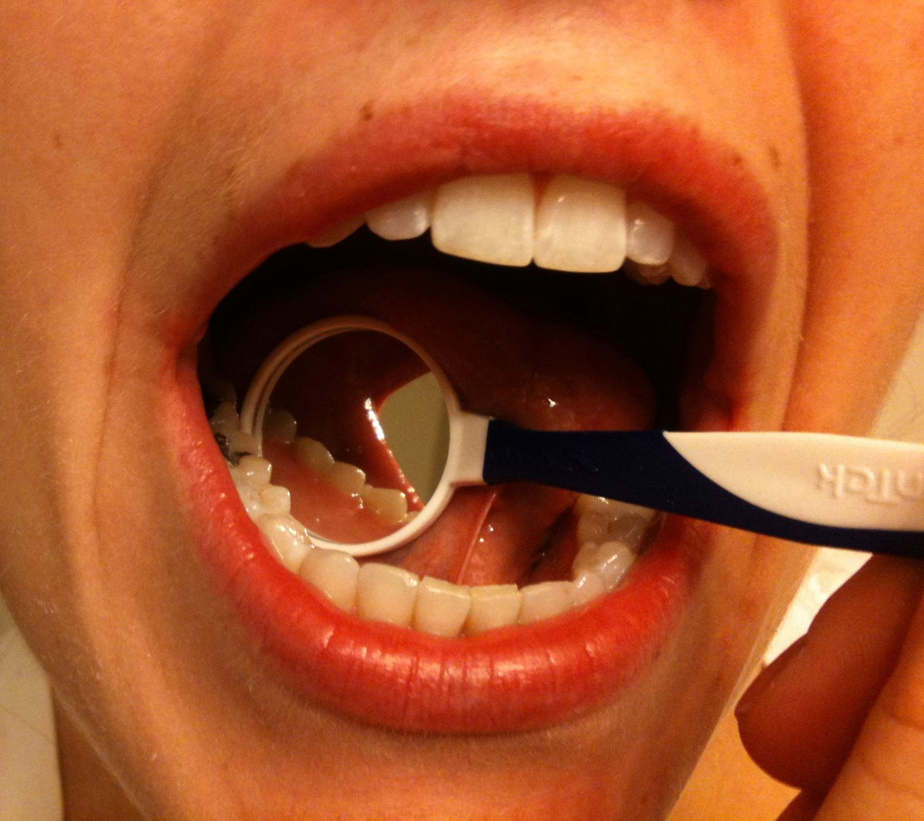
Tongue and Teeth
Tongue
Manipulates food for chewing/swallowing
Main taste organ, covered in taste buds
Teeth
For chewing food up
This Photo by Unknown Author is licensed under CC BY-SA-NC

Slide 10
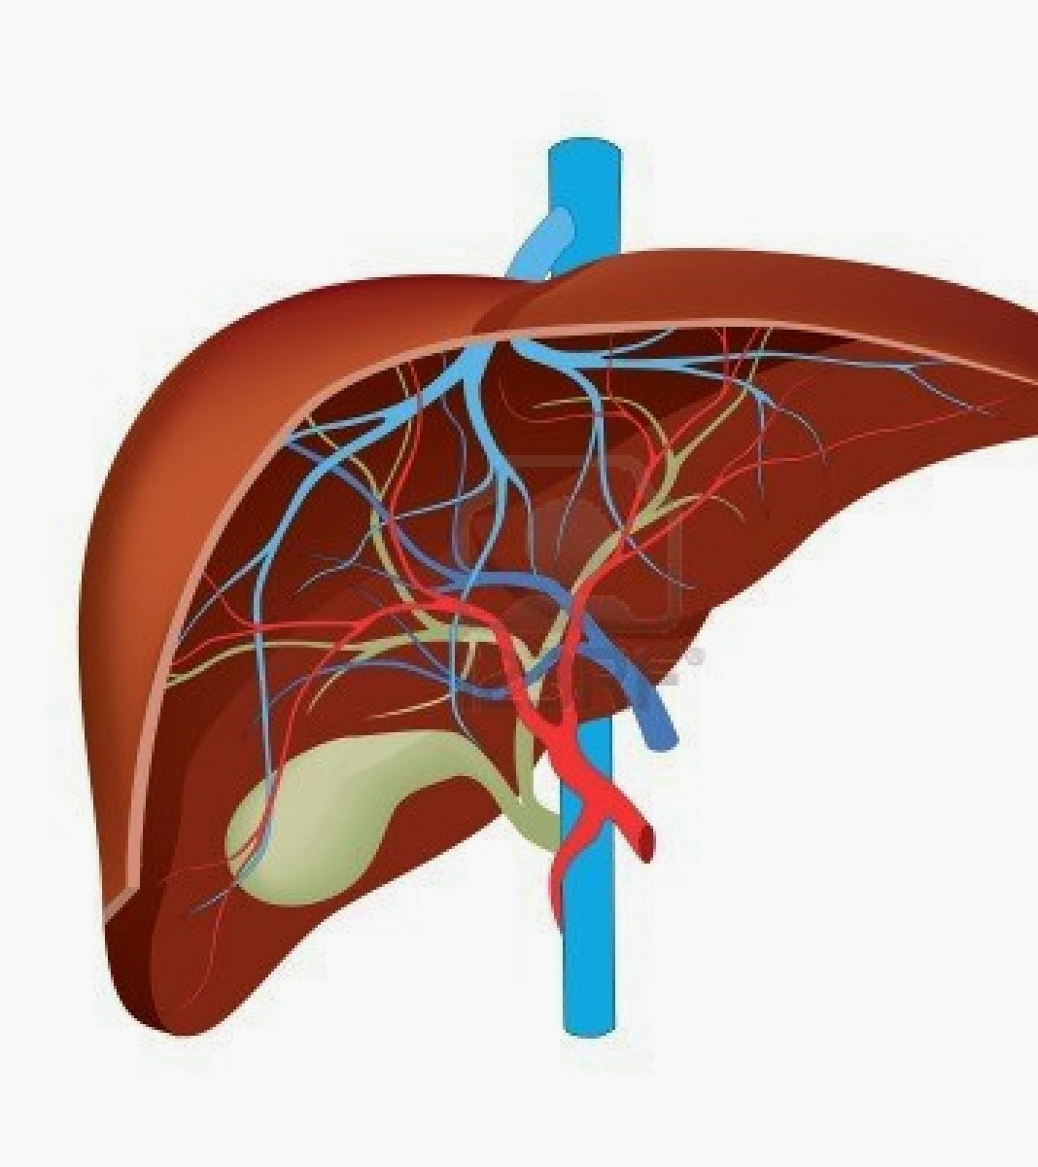
Liver
Produces and excretes bile required for emulsifying fats.
Some of the bile drains directly into the duodenum and some is stored in the gall bladder.
Helps metabolize proteins, lipids, and carbohydrates.
Urea is formed in liver from amino acids and compounds of ammonia.
Breaks down insulin and other hormones.
Produces coagulation factors.

Slide 11
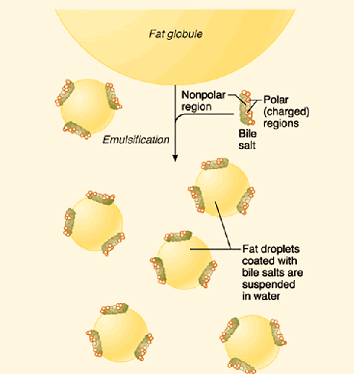
Liver
The liver produces and excretes bile required for emulsifying fats.
Some of the bile drains directly into the duodenum and some is stored in the gall bladder.

Slide 12
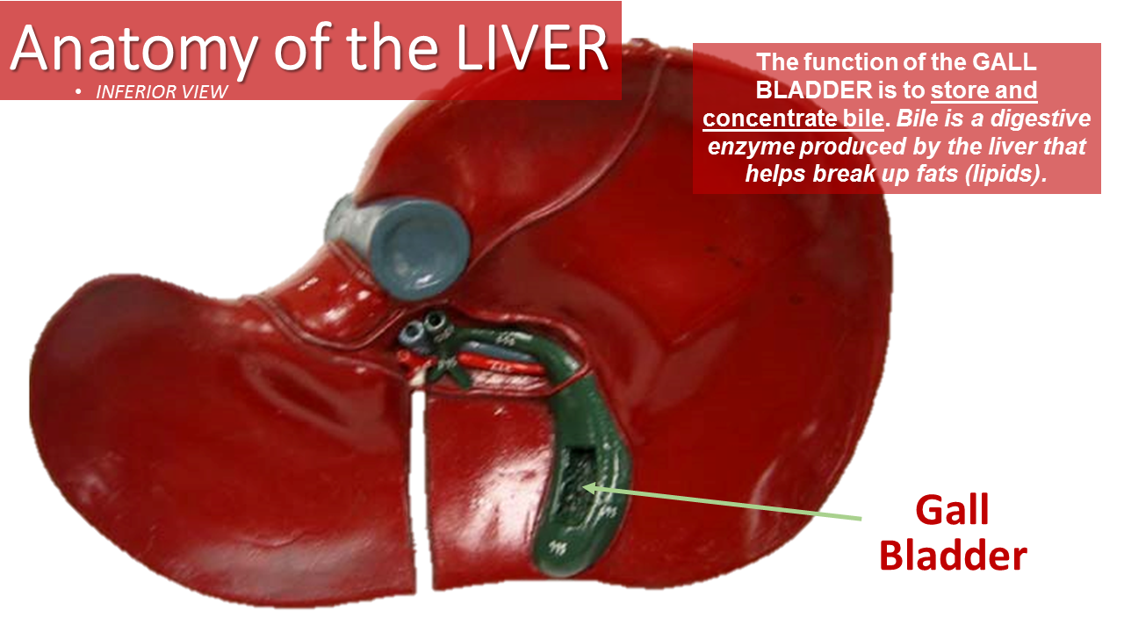
Gallbladder
FUNCTION:
Bile storage – Stores and Concentrated Biles from the Liver

Slide 13
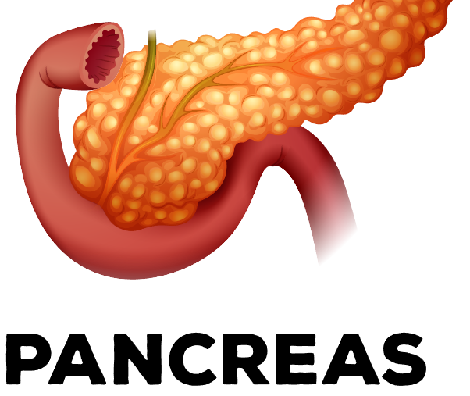
Pancreas
Releases pancreatic juice into the duodenum.
Pancreatic juice has many digestive enzymes.

Slide 14
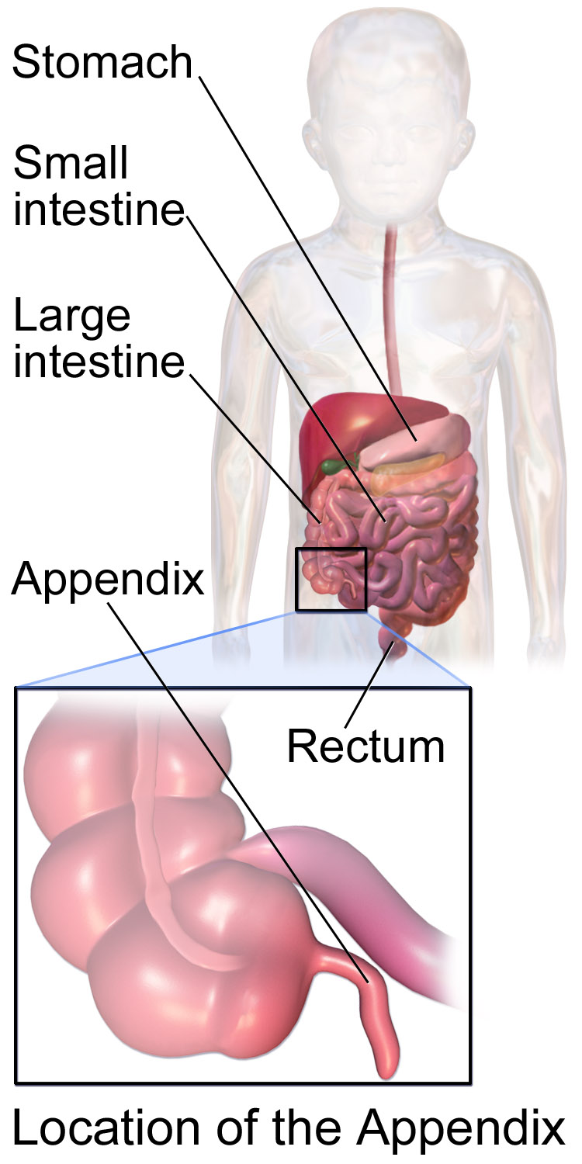
Vermiform Appendix
There are a few theories on what the appendix does.
Vestigal organ
Immune function
Helps maintain gut flora

Slide 15
The gastrointestinal tract
The gastrointestinal tract, is also called the digestive tract, alimentary canal, or gut
It is the system of organs that
takes in food
digests it
expels waste

Slide 16
The alimentary canal
The alimentary canal is the long tube of organs that runs from the mouth (where the food enters) to the anus (where indigestible waste leaves).

Slide 17
2 Processes of Digestion
During digestion two main processes occur at the same time:
Mechanical Digestion:
larger pieces of food get broken down into smaller pieces while being prepared for chemical digestion.
Mechanical digestion starts in the mouth and continues in to the stomach.
Chemical Digestion:
several different enzymes break down macromolecules into smaller molecules that can be more efficiently absorbed.
Chemical digestion starts with saliva and continues into the intestines.

Slide 18
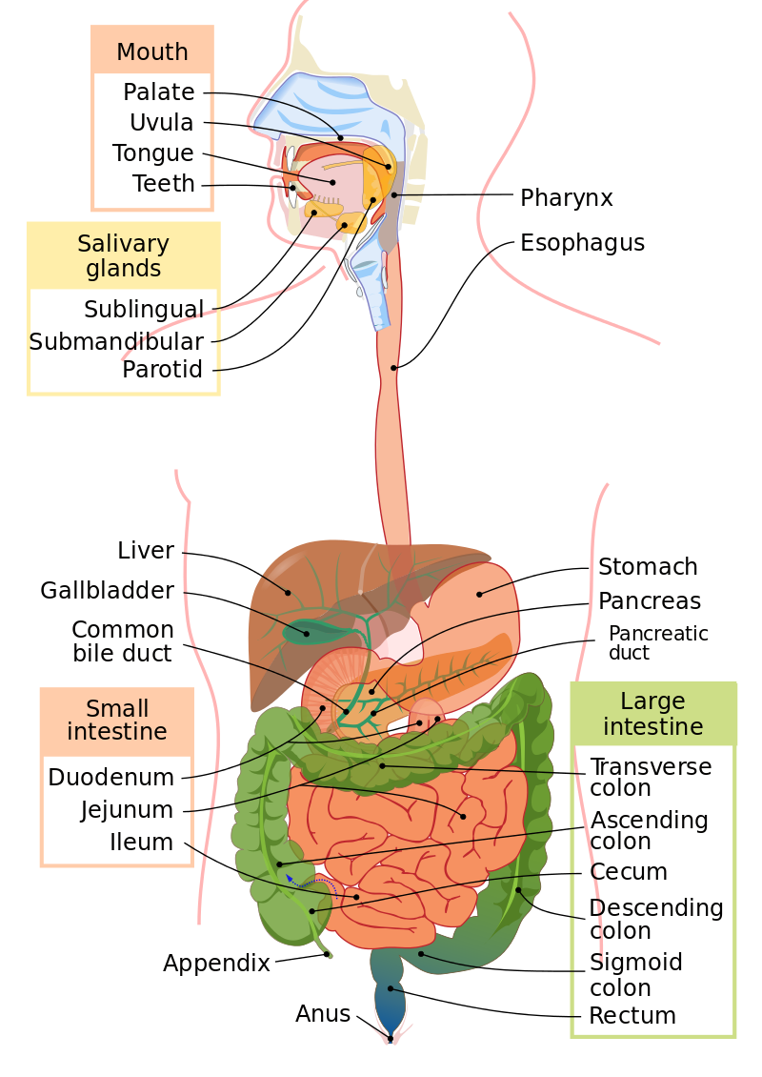
Digestive System Basics
The average adult digestive tract is about thirty feet (30') long.
While in the digestive tract the food is really passing through the body rather than being in the body.
The smooth muscles of the tubular digestive organs move the food efficiently along as it is broken down into absorb-able atoms and molecules.
During absorption, the nutrients that come from food (such as proteins, fats, carbohydrates, vitamins, and minerals) pass through the wall of the small intestine and into the bloodstream and lymph.
In this way nutrients can be distributed throughout the rest of the body.
In the large intestine there is re absorption of water and absorption of some minerals as feces are formed.
The parts of the food that the body passes out through the anus is known as feces.

Slide 19
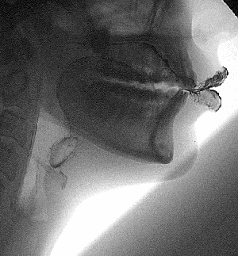
Mastication
Digestion begins in the mouth.
Saliva moistens the food while
Teeth chew it up and make it easier to swallow.
Amylase, which is the digestive enzyme found in saliva, starts to break down starch into simpler sugars before the food even leaves the mouth.

Slide 20
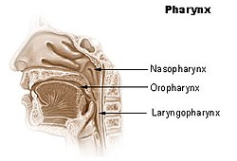
The Pharynx (Throat) (Nasopharynx, Oropharynx, Laryngopharynx)
Swallowing your food happens when the muscles in your tongue and mouth move the food into your oropharynx, then on to the laryngopharynx.
The pharynx is a common passageway for air (in the respiratory system) and for food (in the digestive system).

Slide 21
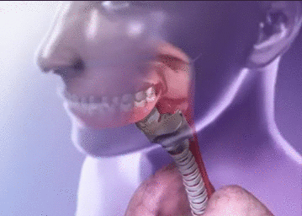
THE EPIGLOTTIS
A small flap of skin called the epiglottis closes over the pharynx to prevent food from entering the trachea and thus choking.
For swallowing to happen correctly a combination of 25 muscles must all work together at the same time.

Slide 22
ENZYME SUMMARY
Carbohydrate Digestion: | Enzymes are Secreted From…. | Where Does it Occur?
 | Salivary glands | Mouth
 | Pancreas | Small intestine
Protein Digestion:
 | Gastric glands | Stomach
 | Pancreas | Small intestine
Nucleic Acid Digestion:
 | Pancreas | Small intestine
 | Pancreas | Small intestine
Fat Digestion:
 | Pancreas | Small intestine

Slide 23
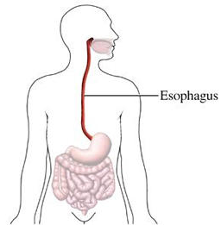
ESOPHAGUS
The esophagus is the muscular tube through which food passes from the pharynx (throat) to the stomach.
This is where the second stage of digestion is initiated (the first stage is in the mouth with teeth and tongue masticating food and mixing it with saliva).

Slide 24
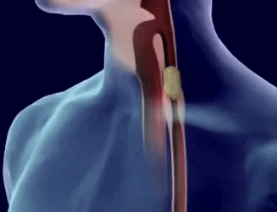
peristalsis
After passing through the throat, the food moves into the esophagus and is pushed down into the stomach by the process of peristalsis.
peristalsis is the involuntary wavelike muscle contractions that occur along the G.I. tract.
peristalsis is how food is pushed through the G.I. tract
The esophagus is lined with mucus membranes, and uses peristaltic action to move swallowed food down to the stomach.

Slide 25
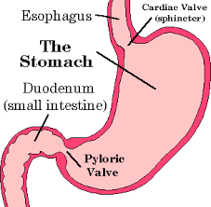
CARDIAC SPHINCTER
This part of the esophagus is called the lower esophageal sphincter a.k.a. the cardiac sphincter.
This aids in keeping food down and not being regurgitated.

Slide 27
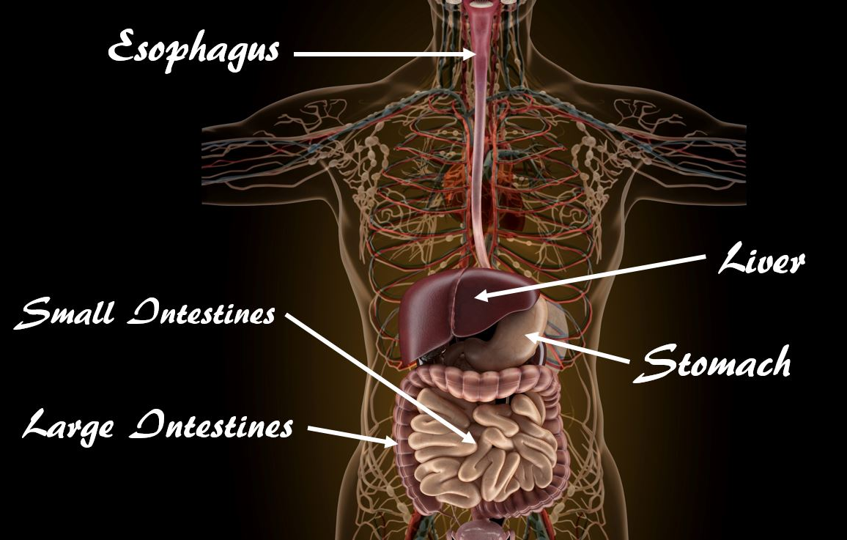
The stomach
The stomach is a thick walled organ that lies between the esophagus and the first part of the small intestine (the duodenum).
It is on the left side of the abdominal cavity.
The fundus of the stomach lying against the diaphragm.

Slide 28
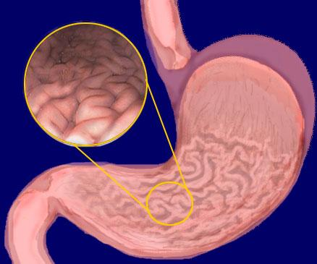
The stomach
On the inside of the stomach there are folds of skin call the gastric rugae.
Gastric rugae make the stomach very extendable, especially after a very big meal.

Slide 29
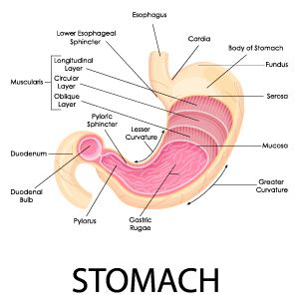
The stomach
The stomach is divided into four sections, each of which has different cells and functions.
1) Cardiac region, where the contents of the esophagus empty into the stomach,
2) Fundus, formed by the upper curvature of the organ,
3) Body, the main central region, and
4) Pylorus or atrium, the lower section of the organ that facilitates emptying the contents into the small intestine.

Slide 30
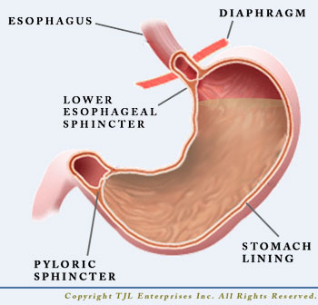
Stomach Sphincters
Two smooth muscle valves, or sphincters, keep the contents of the stomach contained.
1) Cardiac or esophageal sphincter
2) Pyloric sphincter

Slide 31
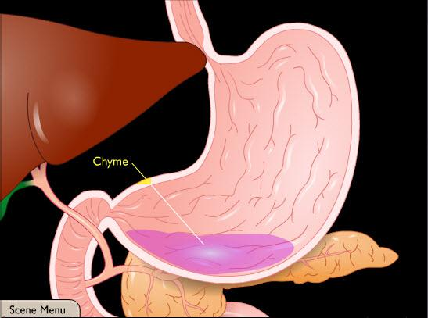
Chyme
After receiving the bolus (chewed food) the stomach undergoes smooth muscular contractions (peristalsis) mixed and churned with gastric juices the bolus is transformed into a semi-liquid substance called chyme.

Slide 32
Digestion in the stomach
Stomach muscles mix up the food with enzymes and acids to make smaller digestible pieces.
The pyloric sphincter, a walnut shaped muscular tube at the stomach outlet, keeps chyme in the stomach until it reaches the right consistency to pass into the small intestine.
The food leaves the stomach in small squirts rather than all at once.

Slide 33
Digestion in the stomach
Water, alcohol, salt, and simple sugars can be absorbed directly through the stomach wall.
However, most substances in our food need a little more digestion and must travel into the intestines before they can be absorbed.

Slide 34
Small Intestines
The small intestine is the site where most of the chemical and mechanical digestion is carried out.
Tiny projections called villi line the small intestine which absorbs digested food into the capillaries.
Most of the food absorption takes place in the jejunum and the ileum.

Slide 35
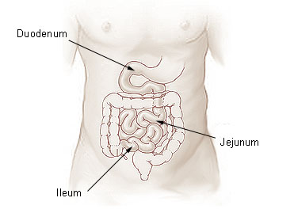
The three main sections of the small intestine
The three main sections of the small intestine are
the duodenum
the jejunum
the ileum

Slide 36
The duodenum
The duodenum
It is the first and shortest part of the small intestine.
The duodenum is also where the bile and pancreatic juices enter the intestine.
Most digestion occurs HERE!

Slide 37
The jejunum
The jejunum is a part of the small intestines that lies after the duodenum and before the ileum.
The inner surface of the jejunum, its mucous membrane, is covered in projections called villi, which increase the surface area of tissue available to absorb nutrients from the gut contents.

Slide 38
The ileum
The cells that line the ileum contain the protease and carbohydrate enzymes responsible for the final stages of protein and carbohydrate digestion.

Slide 39
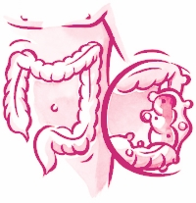
The large intestine (colon)
The large intestine (colon) extends from the end of the ileum to the anus. It is about 5 feet long, being one-fifth of the whole extent of the intestinal canal.
It's caliber is largest at the commencement at the cecum, and gradually diminishes as far as the rectum, where there is a dilatation of considerable size just above the anal canal.
This Photo by Unknown Author is licensed under CC BY-SA

Slide 40
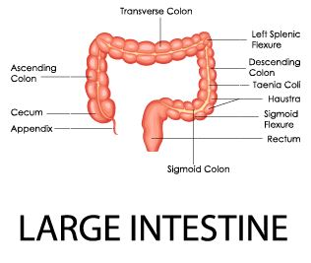
The large intestine
The large intestine is divided into the cecum, ascending colon, transverse colon, the descending, sigmoid colon (flexure) rectum, and anal canal.

Slide 41
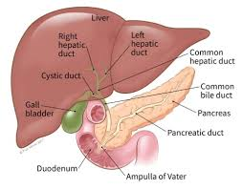
Ductal System
The bile produced in the liver is collected in bile canaliculi, which merge from bile ducts.
These eventually drain into the right and left hepatic ducts.
The right and left hepatic ducts merge to form the common hepatic duct.

Slide 42
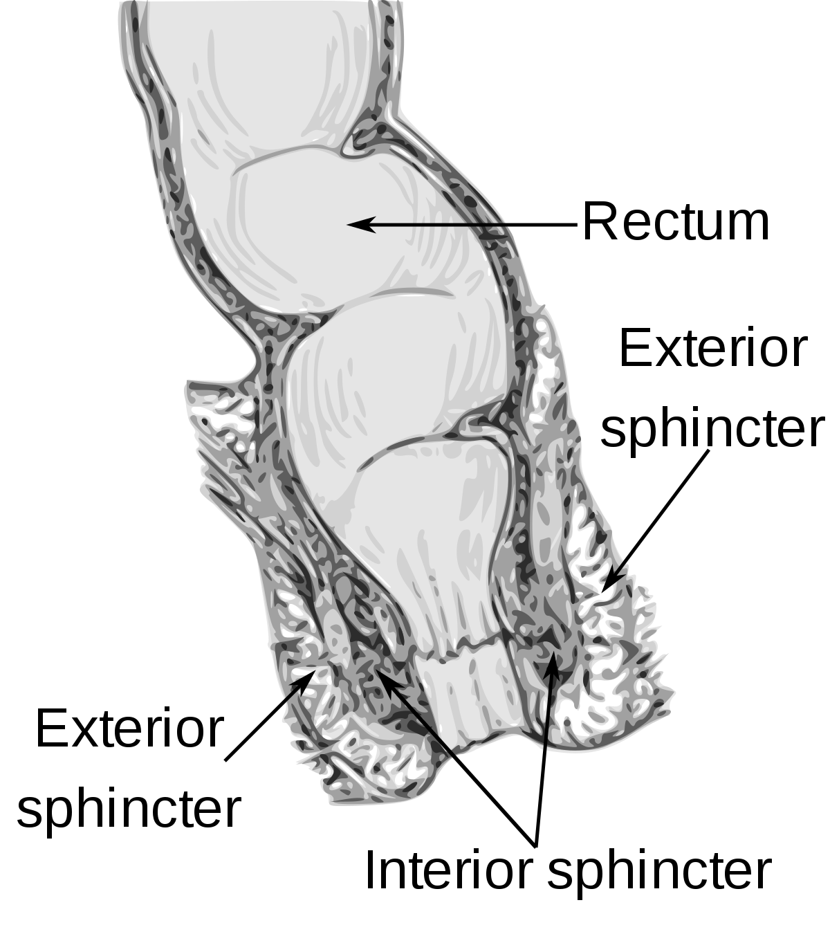
Anus
The Anus has two anal sphincters
Internal Anal Sphincter
External Anal Sphincter
These hold the anus closed until defecation occurs.
The internal sphincter - consists of smooth muscle and its action is involuntary
The external sphincter The other consists of striated muscle and its action is voluntary.

