Slide 1
ECOSYSTEMS
With Scientist Cindy
www.scientistcindy.com

Slide 2
What should you learn?
You should be able to…
define ecology.
distinguish among the following ecological levels: population, community, ecosystem, landscape, and biosphere.

Slide 3
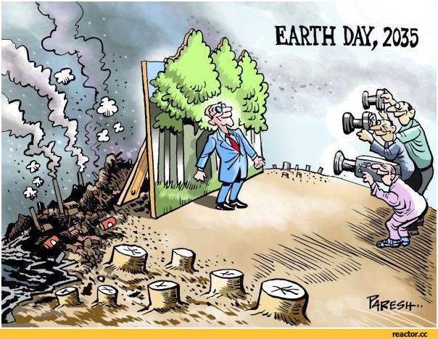
ECOLOGY
The study of systems that include interactions among organisms and between organisms and their abiotic environment.

Slide 4
ECOLOGY - “the study of one’s house.”
Ernst Haeckel, a 19th-century scientist, developed the concept of ecology and named it—eco from the Greek word for
“house” and logy from the Greek word for “study.”
Thus, ecology literally means “the study of one’s house.”

Slide 5
The environment consists of two parts
The environment consists of two parts
the biotic (living) environment
a. which includes all organisms
abiotic (nonliving, or physical) surroundings
Space / territory
temperature
sunlight
soil
wind
precipitation

Slide 6
What Do Ecologists Do?
Ecologists study the vast complex web of relationships among living organisms and their physical environment.
Ecologists look for answers to the questions:
why organisms are distributed the way they are
why some species are more abundant than others
how the ecological roles of different organisms in their environment vary
how the interactions between organisms and their environment help to maintain the overall health of our living world.

Slide 7
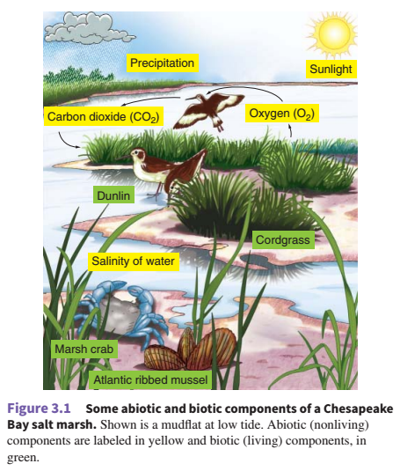
Can You…
Identify the biotic factors?
Identify the abiotic factors?
Predict how the ecosystem would be different at high tide?
Predict how the ecosystem would be affected after a severe flood?

Slide 8
Ecology
Ecology is the broadest field within the biological sciences, because it is linked to every other biological discipline.
The universality of ecology links subjects that are not traditionally part of biology.
Geology and earth science - takes into consideration the physical environment of planet Earth.
Chemistry - knowledge of chemistry is necessary to understand chemical reactions in the atmosphere, the soil, and living organisms (example – photosynthesis)
Physics - the principles of physics reveals the laws of thermodynamics.
Sociology - Humans are biological organisms, and our activities have a bearing on ecology.
Economics – economic dependence on industries that harm the environment such as farming, deforestation, power plants, fossil fuels etc.
Politics have profound ecological implications – control over resources

Slide 9
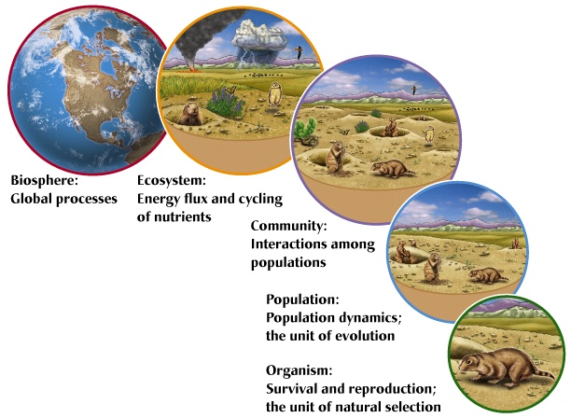
Levels of Organization
Biosphere = All ecosystems on planet Earth
Ecosystem = All biotic and abiotic (living and non-living) factors in a given location
Ecologists study the levels of biological organization from individual organisms to the biosphere.
Community = Many populations of the different species that live together in a given area
Population = Many individuals of the same species that live together in a given area
Organism = A single individual of one species
Raven, Peter H.; Hassenzahl, David M.; Hager, Mary Catherine; Gift, Nancy Y.. Environment, 9th Edition (Page 42). Wiley. Kindle Edition.

Slide 10
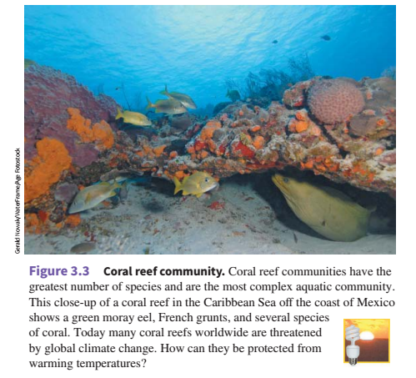
The coral reef community.
This is a great example of a community.
Raven, Peter H.; Hassenzahl, David M.; Hager, Mary Catherine; Gift, Nancy Y.. Environment, 9th Edition (Page 42). Wiley. Kindle Edition.

Slide 11
What is the source of energy for all (essentially) ecosystems?
The Sun supports most of Earth's ecosystems.
Plants create chemical energy from abiotic factors that include solar energy.
The food energy created by producers is passed on to consumers through the food chain.

Slide 12
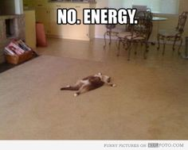
How Energy Flows Through Ecosystems
All living things need energy to power the processes of life.
For example, it takes energy to grow.
It also takes energy to produce offspring.
In fact, it takes energy just to stay alive.
Remember that energy can’t be created or destroyed.
It can only change form.
Energy changes form as it moves through ecosystems.
CAT

Slide 15
The Flow of Energy
Most ecosystems get their energy from the Sun.
Only producers can use sunlight to make usable energy.
Producers convert the sunlight into chemical energy or food.

Slide 18
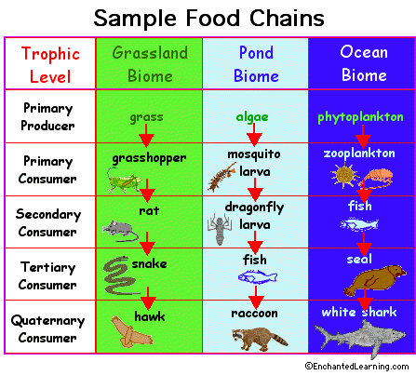
The Flow of Energy – Food Chain
Producers – Make their own energy (food)
Consumers – Must consume other organisms to gain energy
In this way, energy flows from one living thing to another.

Slide 26
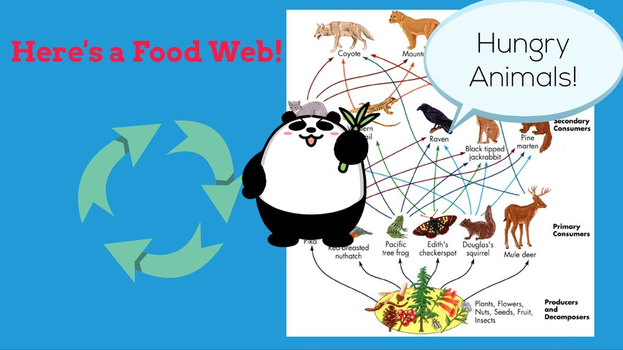

Slide 28
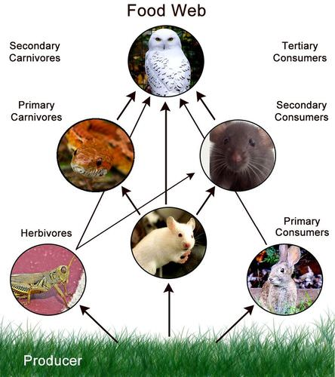
Food Webs

Slide 29
An Ecosystem Consists of Biotic and Abiotic Factors

Slide 30
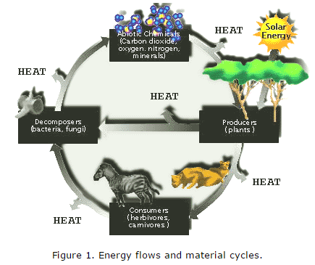
Processes of an Ecosystem
Ecosystem processes include…
The water cycle
The carbon cycle
The nitrogen cycle
The phosphorus cycle
The sulfur cycle
ENERGY FLOW
These are necessary processes that must occur
In order for life to exist and persist.

Slide 31
Processes of an Ecosystem
Ecosystems have…
Energy flows
Material cycles

Slide 32
Ecosystems affect other ecosystem nearby
LANDSCAPE = A region that includes several interacting ecosystems.
Examples of interactions between different ecosystems in a landscape:
1) An organism may feed in one ecosystem and build a habitat in a nearby ecosystem.

Slide 33
Energy Flow
Energy enters the biological system as light energy, or photons.
Light energy is transformed into chemical energy by organisms through cellular processes including photosynthesis and respiration.
Some of this energy is converted to heat energy and can no longer be recycled in the system
Without the continued input of solar energy, biological systems would quickly shut down. Thus the earth is an open system with respect to energy.

Slide 34
Energy Flow
Photons → Producers → Primary Consumers → Secondary Consumers → Tertiary Consumers → and so on.
Only 10% of the energy is transferred to the next level.

Slide 35
BIOSPHERE
The Biosphere includes all organisms, populations, communities, ecosystems, and landscapes on Earth, as well as the Earth’s physical environment: the atmosphere, hydrosphere, and lithosphere
Raven, Peter H.; Hassenzahl, David M.; Hager, Mary Catherine; Gift, Nancy Y.. Environment, 9th Edition (Page 42). Wiley. Kindle Edition.

Slide 36
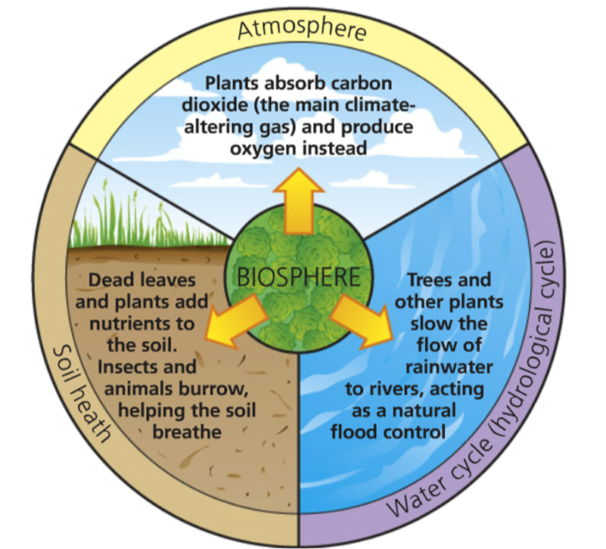
The Biosphere includes …
The atmosphere = gaseous envelope surrounding Earth
The hydrosphere = Earth’s supply of water (liquid and frozen, fresh and salty, groundwater and surface water.)
The lithosphere = the soil and rock of Earth’s crust.

Slide 37
Energy
Energy is the capacity or ability to do work.
In organisms, biological processes that require energy include
growing
moving
reproducing
maintaining life processes
repairing damaged tissues

Slide 38
Energy exists in several forms:
Chemical - Chemical energy is energy stored in the bonds of molecules; energy is released when chemical bonds are broken.
Radiant – All forms of electromagnetic waves – solar (ultraviolet radiation, visible light, and infrared radiation), radio waves, gamma waves, microwaves, and X-rays
Thermal - Thermal energy is heat that flows from an object with a higher temperature (the heat source) to an object with a lower temperature (the heat sink). Heat refers to the kinetic energy of the subatomic particles within the matter itself.
Mechanical - Mechanical energy is energy involved in the movement of matter.
Nuclear - Some of the matter contained in atomic nuclei can be converted into nuclear energy. Subatomic particles that make up the nucleus of an atom
Electrical - Electrical energy is energy that flows as charged particles. Electrons are transferred from one metal ion to the next in a copper wire, for example.
Kinetic – In physics, the kinetic energy of an object is the energy that it possesses due to its motion.
Potential – energy “stored” or the ability to do work.

Slide 39
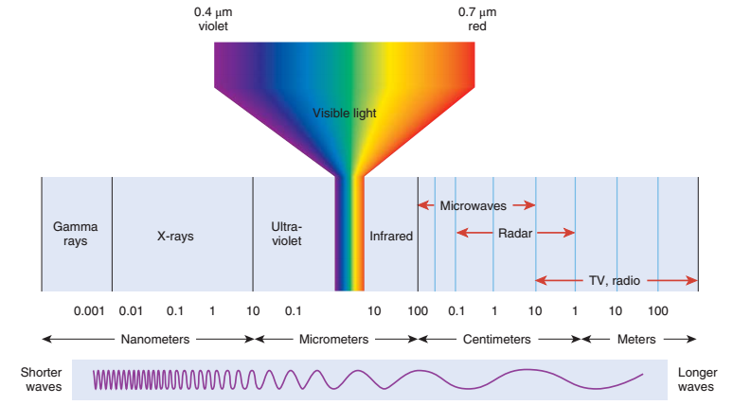
The Electromagnetic Spectrum

Slide 40
(a) Closed system. Energy is not exchanged between a closed system and its surroundings. A thermos bottle is an approximation of a closed system. Closed systems are rare in nature.
Raven, Peter H.; Hassenzahl, David M.; Hager, Mary Catherine; Gift, Nancy Y.. Environment, 9th Edition (Page 44). Wiley. Kindle Edition.

Slide 41
(a) Closed system. Energy is not exchanged between a closed system and its surroundings. A thermos bottle is an approximation of a closed system. Closed systems are rare in nature.
(b) Open system. Energy is exchanged between an open system and its surroundings. Earth is an open system because it receives energy from the sun, and this energy eventually escapes Earth as it dissipates into space.

Slide 42
Thermodynamics
Thermodynamics is the branch of science concerned with heat and temperature and their relation to energy and work.

Slide 43
Thermodynamics
THE FIRST LAW OF THERMODYNAMICS
According to the first law of thermodynamics, an organism may absorb energy from its surroundings, or it may give up some energy into its surroundings, but the total energy content of the organism and its surroundings is always the same. As far as we know, the energy present in the universe at its formation, approximately 15–20 billion years ago, equals the amount of energy present in the universe today.
Raven, Peter H.; Hassenzahl, David M.; Hager, Mary Catherine; Gift, Nancy Y.. Environment, 9th Edition (Page 45). Wiley. Kindle Edition. and work.

Slide 44
Thermodynamics
THE SECOND LAW OF THERMODYNAMICS
As each energy transformation occurs, some energy is changed to heat that is released into the cooler surroundings. No other organism can ever reuse this energy for biological work; it is “lost” from the biological point of view.
Raven, Peter H.; Hassenzahl, David M.; Hager, Mary Catherine; Gift, Nancy Y.. Environment, 9th Edition (Page 45). Wiley. Kindle Edition. and work.

Slide 45
Thermodynamics
THE SECOND LAW OF THERMODYNAMICS
Entropy – systems go from order → disorder
As each energy transformation occurs, some energy is changed to heat that is released into the cooler surroundings. No other organism can ever reuse this energy for biological work; it is “lost” from the biological point of view.
Raven, Peter H.; Hassenzahl, David M.; Hager, Mary Catherine; Gift, Nancy Y.. Environment, 9th Edition (Page 45). Wiley. Kindle Edition. and work.

Slide 46
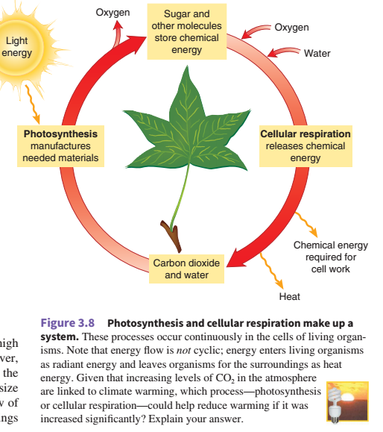
Photosynthesis and Cellular Respiration
Figure 3.8 from text: Raven, Peter H.; Hassenzahl, David M.; Hager, Mary Catherine; Gift, Nancy Y.. Environment, 9th Edition (Page 45). Wiley. Kindle Edition.

Slide 47
Photosynthesis
6 CO₂ + 12 H₂O + radiant energy → C₆ H₁₂ O₆ + 6 H₂O + 6 O₂
English translation =
6 Carbon-Dioxide molecules + 12 Water molecules
are used (react) in photosynthesis to produce
1 Glucose molecule, 6 Water molecules and 6 Oxygen molecules

Slide 48
Aerobic Cellular Respiration
C₆ H₁₂ O₆ + 6 H₂O + 6 O₂ → 6 CO₂ + 12H₂O + energy
English translation =
1 Glucose molecule, 6 Water molecules and 6 Oxygen molecules are used (react) in aerobic cellular respiration to produce 6 Carbon-Dioxide molecules + 12 Water molecules + energy

Slide 49
Photosynthesis VS. Aerobic Cellular Respiration
PHOTOSYNTHESIS REACTION:
6 CO₂ + 12 H₂O + radiant energy → C₆ H₁₂ O₆ + 6 H₂O + 6 O₂
AEROBIC CELLULAR RESPIRATION REACTION:
C₆ H₁₂ O₆ + 6 H₂O + 6 O₂ → 6 CO₂ + 12H₂O + energy
Do you see any similarities?

Slide 50
What are CALORIES?
A calorie is the amount of energy (joules) required to raise the temperature of 1 mL of water by 1 degree Celsius.
What we call calories is actually kilocalories.
Biologists generally express energy in units of work ( kilojoules, kJ) or units of heat (kilocalories, kcal).
1 mL of water = 1 GRAM in weight

Slide 51
What are CALORIES?
A calorie is the amount of energy (joules) required to raise the temperature of 1 mL of water by 1 degree Celsius.
What we call calories is actually kilocalories.
Biologists generally express energy in units of work ( kilojoules, kJ) or units of heat (kilocalories, kcal).
1 mL of water = 1 GRAM in weight

Slide 52
OPEN SYSTEM
Energy enters the biological system as light energy, or photons, is transformed into chemical energy in organic molecules by cellular processes including photosynthesis and respiration, and ultimately is converted to heat energy.

Slide 53
OPEN SYSTEM
This energy is dissipated, meaning it is lost to the system as heat; once it is lost it cannot be recycled.
Without the continued input of solar energy, biological systems would quickly shut down.
Thus the earth is an open system with respect to energy.

Slide 54
CLOSED SYSTEM
Elements such as carbon, nitrogen, or phosphorus enter living organisms in a variety of ways.
Plants obtain elements from the surrounding atmosphere, water, or soils.
Animals may also obtain elements directly from the physical environment, but usually they obtain these mainly as a consequence of consuming other organisms.
These materials are transformed biochemically within the bodies of organisms, but sooner or later, due to excretion or decomposition, they are returned to an inorganic state.
Often bacteria complete this process, through the process called decomposition or mineralization.

Slide 55
CLOSED SYSTEM
During decomposition these materials are not destroyed or lost, so the earth is a closed system with respect to elements (with the exception of a meteorite entering the system now and then). The elements are cycled endlessly between their biotic and abiotic states within ecosystems. Those elements whose supply tends to limit biological activity are callednutrients.

Slide 56
Transformation of Energy in an Ecosystem
The transformations of energy in an ecosystem begin first with the input of energy from the sun.
Energy from the sun is captured by the process of photosynthesis.
Carbon dioxide is combined with hydrogen (derived from the splitting of water molecules) to produce carbohydrates (CHO).
Energy is stored in the high energy bonds of adenosine triphosphate, or ATP.

Slide 57
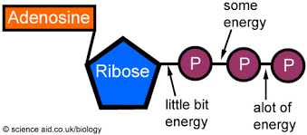
Transformation of Energy in an Ecosystem
ATP = Adenosine Triphosphate

Slide 58
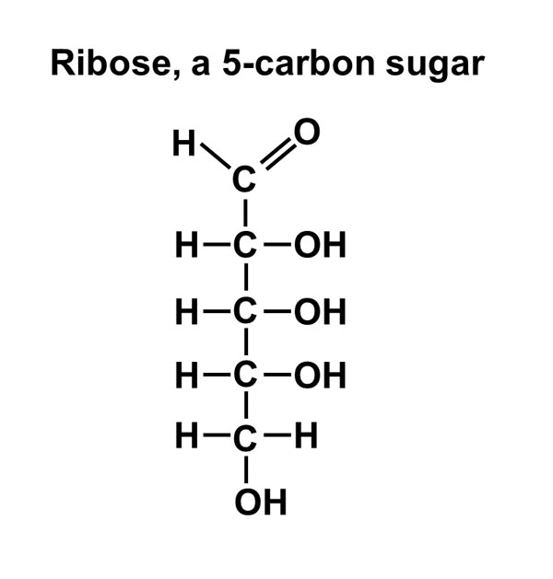
Carbohydrates (sugars)
Carbohydrates store energy in their H-C (hydrocarbon) bonds.
Breaking thee bonds releases energy.

Slide 59
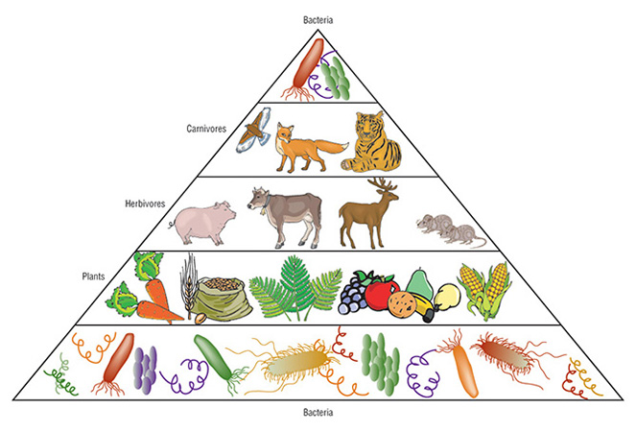
ECOLOGICAL PYRAMID
- A graphical representation designed to show the biomass or bio productivity at each trophic level in a given ecosystem. Biomass is the amount of living or organic matter present in an organism.

Slide 60
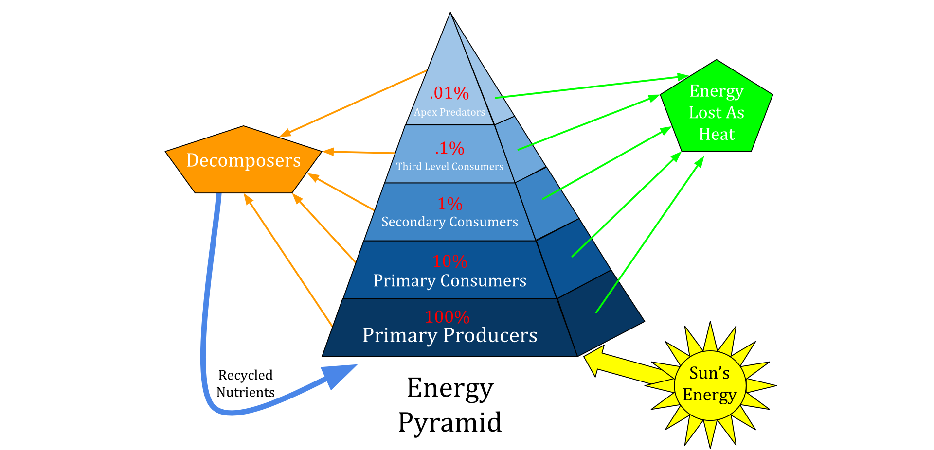
Ecological Pyramid – Energy Pyramid
An energy pyramid is a presentation of the trophic levels in an ecosystem. Energy from the sun is transferred through the ecosystem by passing through various trophic levels. Roughly 10% of the energy is transferred from one trophic level to the next, thus preventing a large number of trophic levels. There must be higher amounts of biomass at the bottom of the pyramid to support the energy and biomass requirements of the higher trophic levels.
An energy pyramid is a presentation of the trophic levels in an ecosystem. Energy from the sun is transferred through the ecosystem by passing through various trophic levels. Roughly 10% of the energy is transferred from one trophic level to the next, thus preventing a large number of trophic levels. There must be higher amounts of biomass at the bottom of the pyramid to support the energy and biomass requirements of the higher trophic levels.
An energy pyramid is a presentation of the trophic levels in an ecosystem. Energy from the sun is transferred through the ecosystem by passing through various trophic levels. Roughly 10% of the energy is transferred from one trophic level to the next, thus preventing a large number of trophic levels. There must be higher amounts of biomass at the bottom of the pyramid to support the energy and biomass requirements of the higher trophic levels.
An energy pyramid is a presentation of the trophic levels in an ecosystem. Energy from the sun is transferred through the ecosystem by passing through various trophic levels. Roughly 10% of the energy is transferred from one trophic level to the next, thus preventing a large number of trophic levels. There must be higher amounts of biomass at the bottom of the pyramid to support the energy and biomass requirements of the higher trophic levels.

Slide 61
Ecological Pyramid – Energy Pyramid
Energy from the sun is transferred through the ecosystem by passing through various trophic levels. Roughly 10% of the energy is transferred from one trophic level to the next, thus preventing a large number of trophic levels. There must be higher amounts of biomass at the bottom of the pyramid to support the energy and biomass requirements of the higher trophic levels.
An energy pyramid is a presentation of the trophic levels in an ecosystem.

Slide 62
What is a TROPHIC LEVEL?
A TROPHIC LEVEL is “each of several hierarchical levels in an ecosystem, comprising organisms that share the same function in the food chain and the same nutritional relationship to the primary sources of energy.”
https://www.google.com/?ion=1&espv=2#q=trophic%20level

Slide 63
Extreme cheapskates https://www.youtube.com/watch?v=11c4LRomkSo
The girl who silence the world for 5 minutes https://www.youtube.com/watch?v=xXiWi8LnZ7I

Slide 64
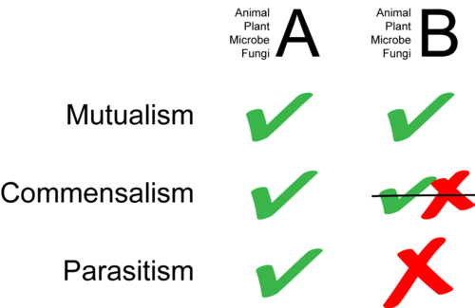

Slide 65
Symbiosis (from Greek συμβίωσις "living together", from σύν "together" and βίωσις "living")^{[2]} is a close and often long-term interaction between two different biological species. In 1877 Albert Bernhard Frank used the word symbiosis (which previously had been used to depict people living together in community) to describe the mutualistic relationship in lichens.^{[3]} In 1879, the German mycologist Heinrich Anton de Bary defined it as "the living together of unlike organisms."^{[4][5]}

Slide 66
ENDO SYMBIOSIS
symbiosis in which one of the symbiotic organisms lives inside the other.

Slide 67
Symbiogenesis, or endosymbiotic theory
is an evolutionary theory that explains the origin of eukaryotic cells from prokaryotes.
Mitochondria in animal cells and chloroplasts in plant cells are thought to have originated from a primitive prokaryotic cell engulfing another prokaryotic to form the first eukaryotic cell.

Slide 68
Symbiogenesis, or endosymbiotic theory
possibly other organelles representing formerly free-living bacteria (prokaryotes) were taken inside another cell as an endosymbiont around 1.5 billion years ago.

Slide 69
Ectosymbiosis
Ectosymbiosis is symbiosis in which the symbiont lives on the body surface of the host, including internal surfaces such as the lining of the digestive tube and the ducts of glands.

