Slide 1
Energy Flow Through the ecosystem
– with ScientistCindy @ WWW.ScientistCindy.Com

Slide 2
What is the source of energy for almost all ecosystems?
The Sun supports most of Earth's ecosystems.
Plants create chemical energy from abiotic factors that include solar energy.
The food energy created by producers is passed through the food chain.

Slide 3
How Energy Flows Through Ecosystems
All living things need energy to power the processes of life.
For example, it takes energy to grow.
It also takes energy to produce offspring.
In fact, it takes energy just to stay alive.
Remember that energy can’t be created or destroyed.
It can only change form.
Energy changes form as it moves through ecosystems.

Slide 4
The Flow of Energy
Most ecosystems get their energy from the Sun.
Only producers can use sunlight to make usable energy.
Producers convert the sunlight into chemical energy or food.

Slide 5
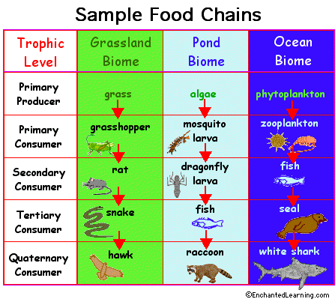
The Flow of Energy
Producers – Make their own energy (food)
Consumers – Must consume other organisms to gain energy
In this way, energy flows from one living thing to another.

Slide 6
Food Chains
A food chain is a simple diagram that shows one way energy flows through an ecosystem.
Producers form the base of all food chains.
The consumers that eat producers are called primary consumers.
The consumers that eat primary consumers are secondary consumers.
This chain can continue to multiple levels.

Slide 7
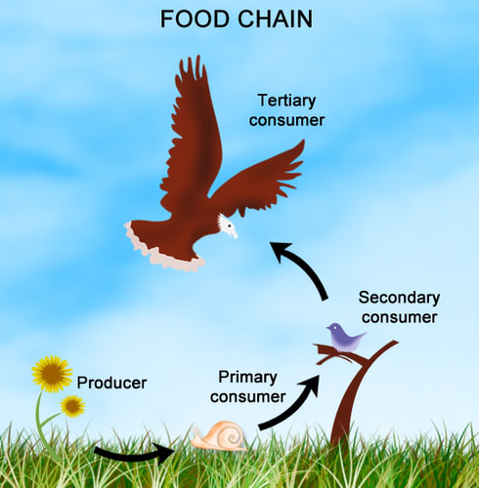
Producers form the base of all food chains.
The consumers that eat producers are called primary consumers.
The consumers that eat primary consumers are secondary consumers.
The consumers that eat secondary consumers are tertiary consumers.

Slide 8
The Flow of Energy
At each level of a food chain, a lot of energy is lost.
Only about ten percent of the energy passes to the next level.
Where does that energy go?
Some energy is given off as heat.
Some energy goes into animal wastes.
Energy also goes into growing things that another consumer can't eat, like fur.
It's because so much energy is lost that most food chains have just a few levels. There’s not enough energy left for higher levels.

Slide 9
Food Webs
Food chains are too simple to represent the real world.
They don’t show all the ways that energy flows through an ecosystem.
A more complex diagram is called a food web.
A food web consists of many overlapping food chains.

Slide 10
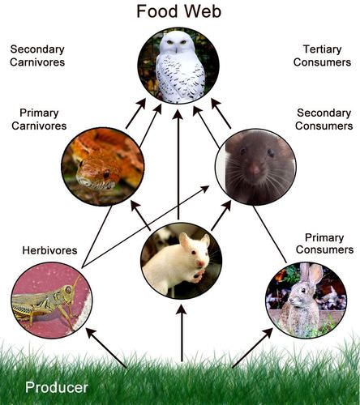
Food Webs

