Slide 1
ENZYMES
MICROBIOLOGY

Slide 2
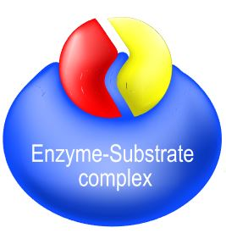
Enzymes
An enzyme is usually a protein.
Enzymes are catalysts which function to reduce the activation energy of a chemical reaction, so that the reaction occurs much more quickly than it would in the absence of the enzyme.
The speed difference is usually several orders of magnitude faster with the addition of the enzyme.
For example, a single lunch would take thousands of years for our bodies to metabolize in the absence of enzymes.

Slide 3
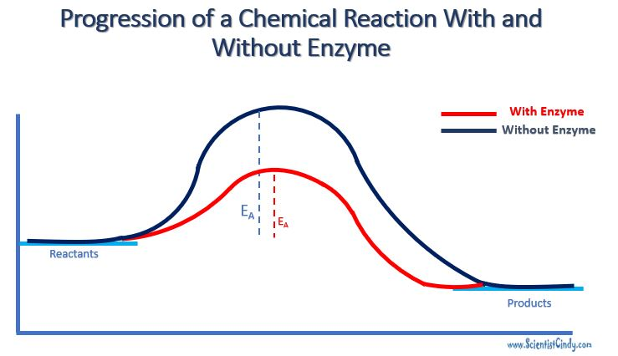
Enzymes are generally large protein complexes.
Enzymes function to increase the probability of chemical reactions occurring by lowering the energy of activation.

Slide 4
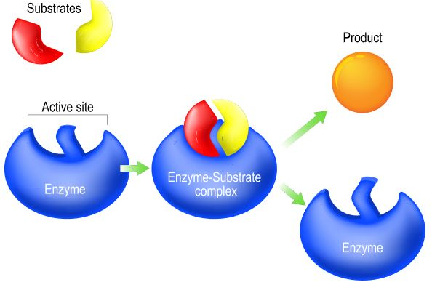
Enzymes
Enzymes are reusable; as soon as reaction is finished, the enzyme is released to work again.
Enzymes are needed in very small amounts because they can catalyze the same reaction thousands of times.

Slide 5
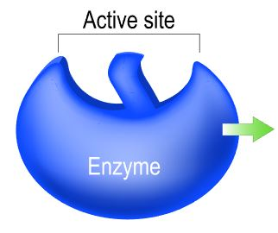
Enzymes
Enzymes have an active site that positions the substrate so the reaction can occur.
Enzyme activity is highly specific and functions in only one type of reaction.

Slide 6
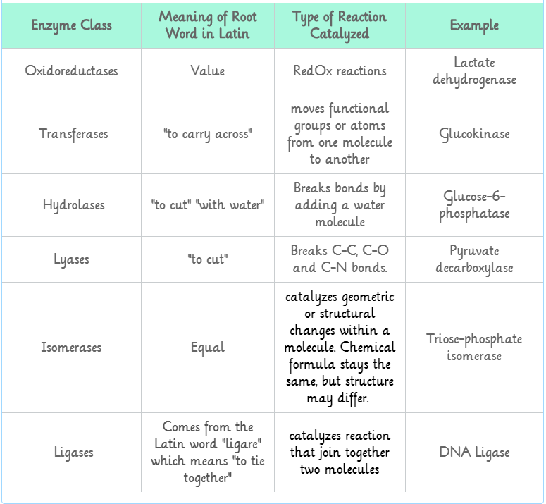
ENZYME NAMES
Enzyme names typically end in -ase.
Enzyme names start with the type of reaction they act upon.

Slide 7
Sometimes Enzymes Require helpers
Enzymes may require metal ions in order to work:
Cofactors are commonly Mg⁺², Fe⁺², or Zn⁺².
Enzymes may require vitamins or cofactors in order to work:
Coenzymes often carry electrons.

Slide 9
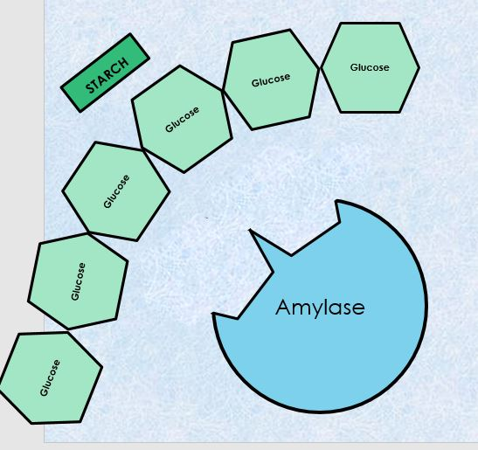
Enzymes
Starch is a polysaccharide (complex carbohydrate.
It is a polymer, that is made up of monomers of glucose. Glucose is a monosaccharide.
Amylase is an enzyme that functions to break down starch into disaccharides.

Slide 10
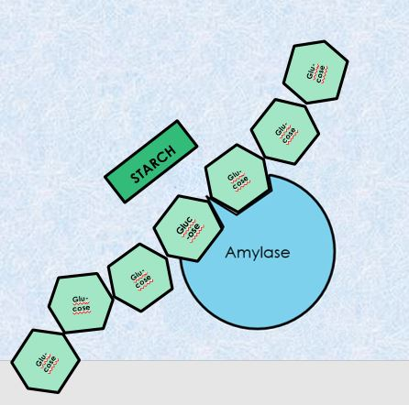
Enzymes
Starch is a polysaccharide (complex carbohydrate.
It is a polymer, that is made up of monomers of glucose. Glucose is a monosaccharide.
Amylase is an enzyme that functions to break down starch into disaccharides.

Slide 11
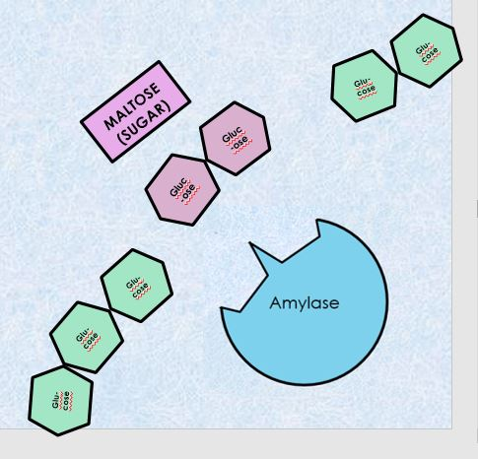
Enzymes
Starch is a polysaccharide (complex carbohydrate.
It is a polymer, that is made up of monomers of glucose. Glucose is a monosaccharide.
Amylase is an enzyme that functions to break down starch into disaccharides.

Slide 12
Enzyme Inhibition via Metabolic Pathway Modulation
Feedback inhibition hinders metabolic pathways:
It inhibits an enzyme in the pathway so no product is available to feed the next reaction.
One of the most common patterns of inhibition.

Slide 13
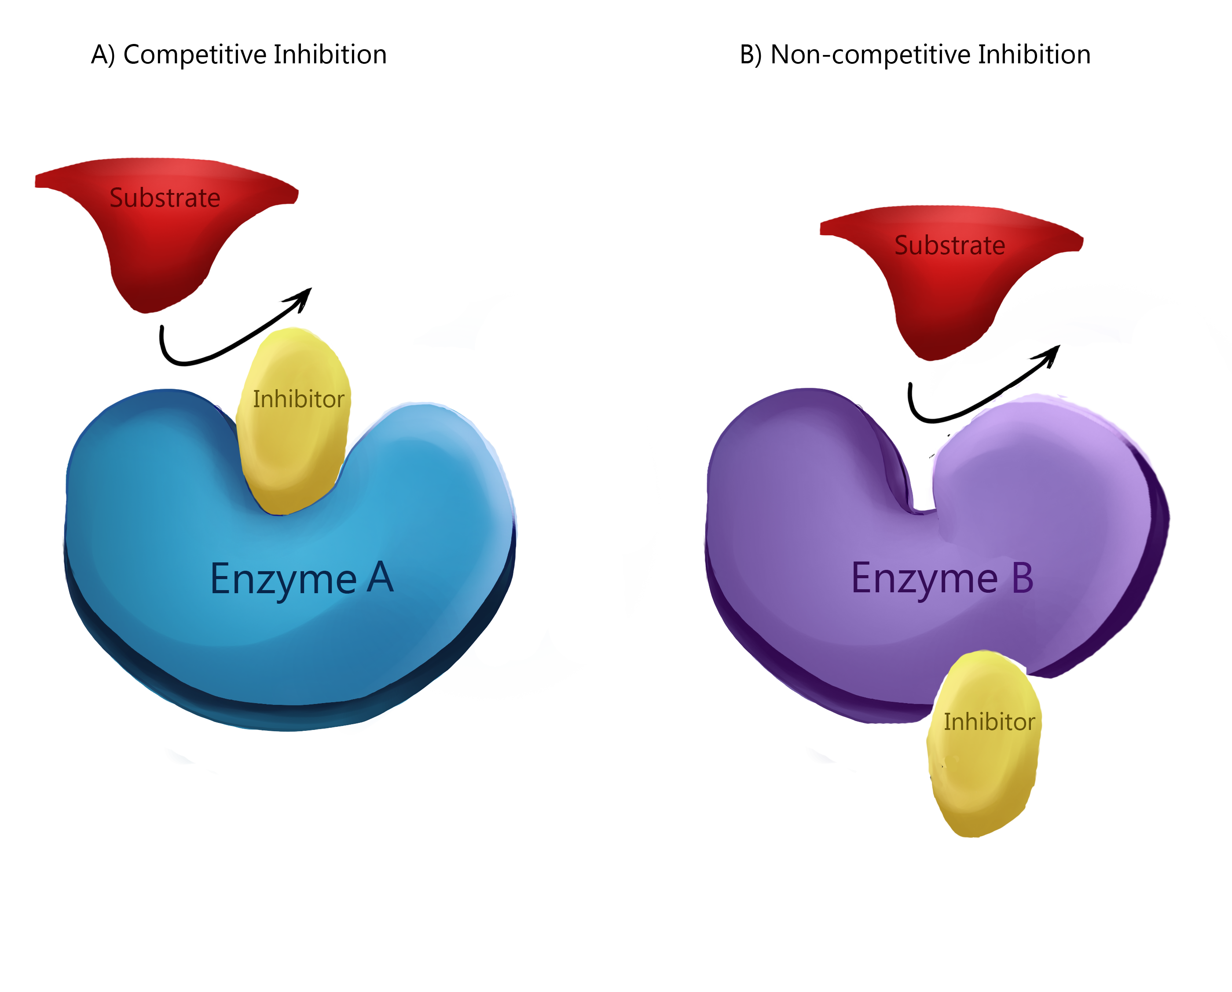
Enzyme Inhibition via Metabolic Pathway Modulation
Types of inhibition include:
Noncompetitive inhibition: Changing the shape of an active site so the substrate no longer fits.
Competitive inhibition: Blocking an active site with the attachment of a similar-shaped molecule so the substrate cannot bind.

Slide 14
The difference between competitive and noncompetitive inhibitors
competitive inhibitors: binds to the same site as a substrate (-competition for binding)
noncompetitive inhibitors: bind ALLOSTERICALLY (to a different site) from the one the substrate uses. This binding can result in allosteric inhibition by altering the shape of the substrate binding site.

Slide 15
enzymes
Enzymes are specific to the reaction it catalyzes.
In the lock and key synthesis model, the enzyme interacts with the substrate specifically in a lock and key fashion.
The shape of the substrates fit perfectly and specifically into the active site of the enzyme like a key in a lock.
In biology, when we see this pattern of shapes fitting together perfectly with each other, we say that the shapes are complimentary.

Slide 16
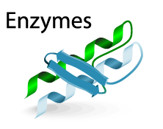
Properties of Enzymes
Enzymes are reusable.
Enzymes are highly specific.
Enzymes have an active site.
Enzymes are usually proteins
Enzymes will have names that end in "-ase"

Slide 18
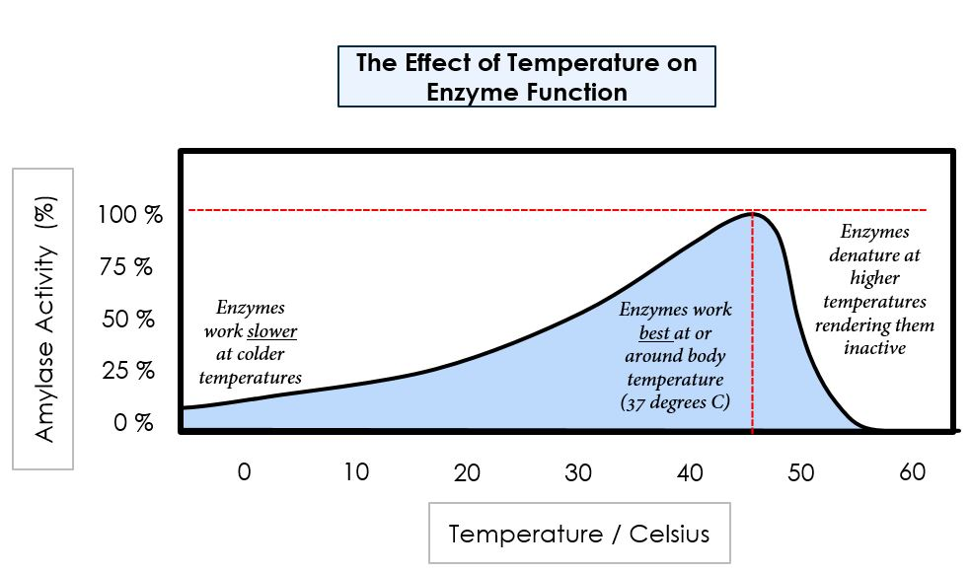
Temperature
The rate at which an enzyme converts its substrate into product is affected by many factors.
Temperature - The rate chemical reactions increases with increasing temperature, because the heat is adding kinetic energy to the molecules which makes them move faster.

Slide 20
pH also affects enzyme activity. Enzymes have a pH level that it functions best at. As the pH level gets further away (in either direction) from this optimal zone, the side chains of the amino acids become ionized which leads to a loss of tertiary structure, followed by denaturation. ​

