Slide 1
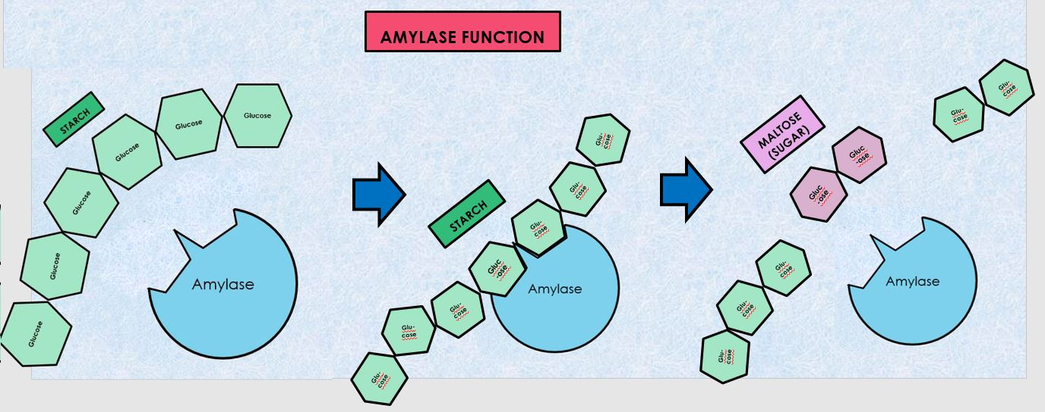
ENZYME LAB
Effect of temperature and pH on amylase’s ability to transform starch into maltose (sugar)

Slide 2
Amylase
AMYLASE is an enzyme that is found in our bodies that functions to help the body in the digestion food. Amylase is found in saliva and in the pancreas.
Amylase catalyzes the hydrolysis (breaking down) of starch, glycogen and related polysaccharides into more simple and readily usable forms of sugar.

Slide 3
AMYLASE has an OPTIMAL RANGE of pH and Temperature which is pH = 7 (neutral) and 37 degrees C. These are the same conditions that exist in our bodies. When an enzyme is within its Optimal Range or conditions, it will be able to catalyze reactions at its fastest rate.
Enzymes are not products or reactants in the chemical reaction, they just assist (catalyze) the reaction by making it proceed much more quickly than it would in the absence of the enzyme. For this reason, amylase can be used again and again!

Slide 4
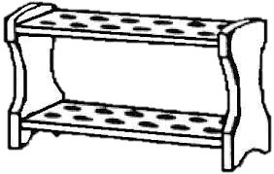
Gather your materials: 1 TEST TUBE RACK AND 15 TEST TUBES

Slide 5
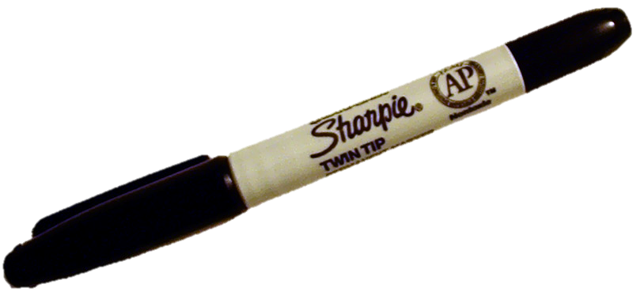
Label 9 of the tubes 1 through 9 then add an identifying mark so you will be able to identify your team’s tubes.
2
6
7
8
9
1
3
4
5
*
*
*
*
*
*
*
*
*

Slide 6
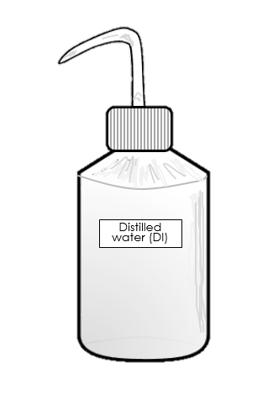
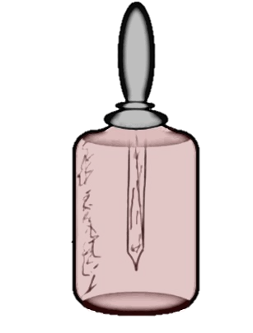
Gather the following
A bottle of Distilled Water (DI Water)
1 ice bucket
3. AMYLOSE (STARCH)
4. AMYLASE (ENZYME)
5. NaOH (Sodium Hydroxide)
6. HCl (Hydrochloric Acid)
AMYLOSE
NaOH
AMYLASE
HCl

Slide 7
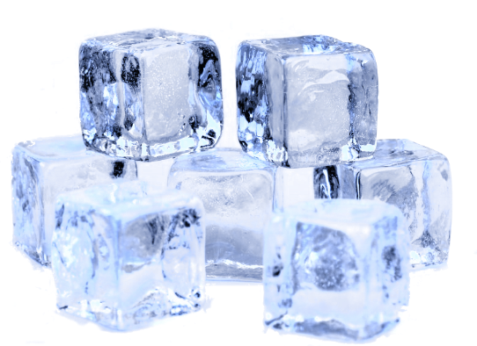
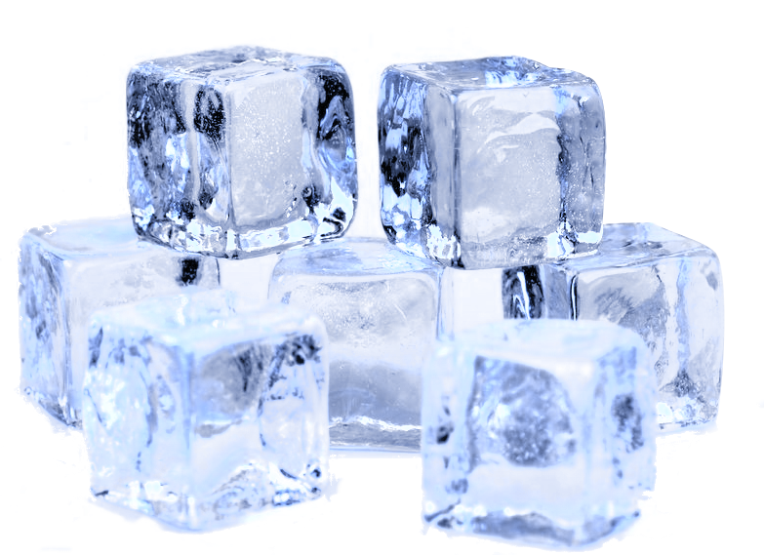
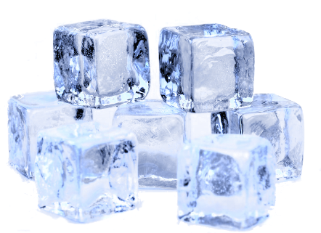
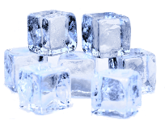
Place the starch, amylase and water in ice. Keep these chilled throughout the experiment.
Amylose (Starch)
Amylase
NaOH
HCl
NaOH

Slide 8
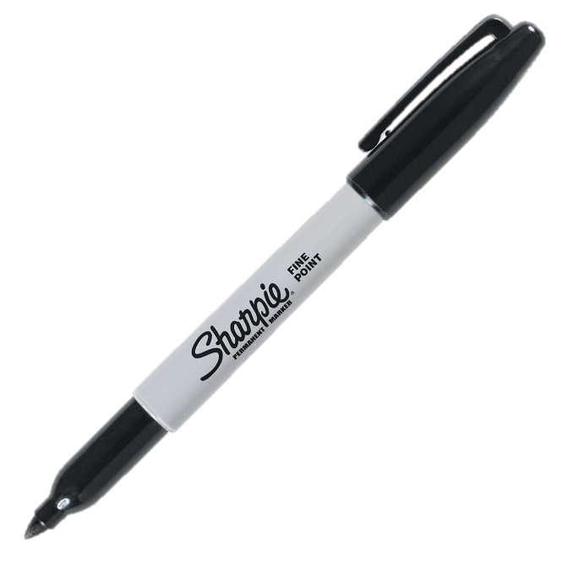
Get 9 eye droppers or pipettes and label them 1 though 9
7
1
2
3
4
5
8
9
1
6

Slide 9
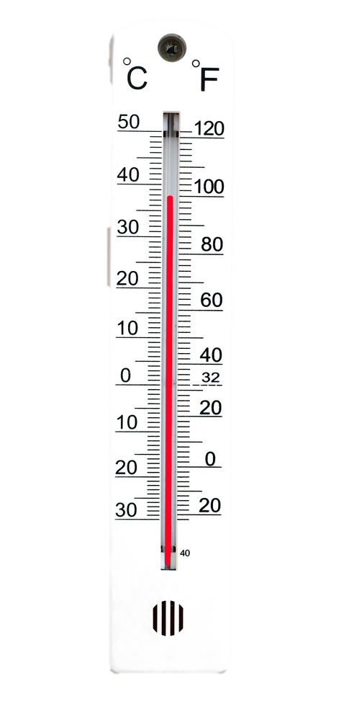
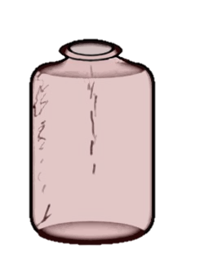
Tube 1 1) Add 10 drops of amylase to tube one. 2) Set on ice ( 0 degrees Celsius) for at least 10 minutes. 3) Record the time.
Amylase
Amylase
1
1
1

Slide 10
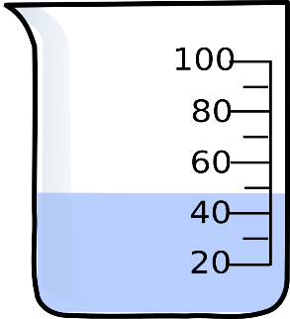
1) Add 10 drops of amylase to tube 2. 2) Set in beaker of hot water on the hot plate (100 degrees Celsius) for at least10 minutes. 3) Record the time.
TUBE 2
Test tube #2
2
100 degrees C
Amylase
2
2
2

Slide 11
Tube 3 1) Add 20 drops of distilled water to tube 3. 2) Set this aside in rack.
3
Distilled Water
3
*

Slide 12
Tube 4 1) Add 1 drop amylase and 10 drops of distilled water to tube 4. 2) Set this aside in rack.
2
3
4
Amylase
*

Slide 13
Tube 5 1) Add 20 drops of amylase and 1 drop of distilled water to tube 5. 2) Set this aside.
3
4
3
5
Amylase
*

Slide 14
Tube 6 1) Add 10 drops of amylase only to tube 6. 2) Note that this is pH=7. 3) Set this aside.
3
4
5
3
6
Amylase
*

Slide 15
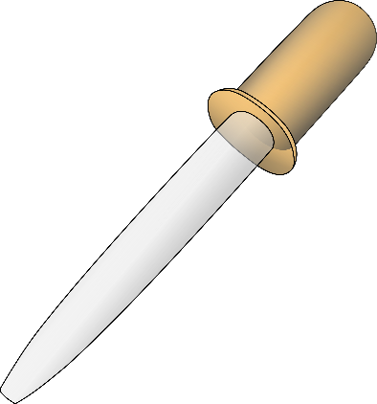
Tube 7 1) ADD 10 drops of amylase and 1 drop of sodium hydroxide (NaOH) to tube 7. 2) Note that this is pH=14. 3) Set this aside.
Amylase
3
4
5
3
6
7
NaOH
*

Slide 16
Tube 8 1) ADD 10 drops amylase and 1 drop hydrochloric acid (HCl) to test tube 8. 2) Note that this is pH=1 3) Set this aside.
3
4
5
Amylase
3
6
7
8
HCl
*

Slide 17
Tube 9 1) Add 10 drops of amylase alone to test tube #9. 3) Set this aside in test tube rack -this tube will remain at room temperature which is about 22 degrees C.
Amylase
3
4
5
3
6
8
7
9
*

Slide 18
TUBES 3, 4, 5, 6, 7, and 8 ONLY 1) Add 20 drops of amylose (starch) to tubes 3, 4, 5, 6, 7, and 8 ONLY (do not add to tube #9)
20 drops in EACH tube!.
Amylose (starch)
3
3
4
5
7
8
6

Slide 19
1) Place test tubes 3, 4, 5, 6, 7, and 8 into a test tube rack and immerse in the 37 degree C water bath. 2) Incubate for 20 minutes. 3) Note the time.
Our body’s temperature is 37degrees C!
37 degrees C
min
power
sec
3
4
5
6
7
8

Slide 20
Grab tube 9 again. 1) Add 20 drops of amylose (starch) to test tube 9 3) Allow to incubate for 20 minutes at room temperature (22 degrees C). 3) Note the time.
Amylose (starch)
3
9
min
power
sec
*

Slide 21
1) Add 10 drops of cold amylose (starch) from the ice bath to test tube 1 (test tube 1 should have been incubated on ice for at least 10 minutes prior to this step!). 2) Keep incubating on ice for 20 minutes. 3) Record the time.
Tube 1
Amylase
Make sure the test tube 1 has been on ice for at least 10 minutes before adding cold starch!
1
1
1
Amylose (starch)

Slide 22
TUBE 2 1) Add 20 drops of amylose (starch) to test tube 1 incubating on the hot plate at 100 degrees Celsius (test tube 1 should have been incubated on ice for at least 10 minutes prior to this step!). 2) Keep incubating on hot plate for another 20 minutes. 3) Record the time.
Make sure the test tube 1 has been incubating for at least 10 minutes before adding starch!1
Test tube #2
100 degrees C
Amylose (starch)

Slide 23
Let tubes 1 through 9 incubate for 20 minutes from the time starch was added
While you are
waiting,
set up your
SPOT
PLATE!
See next slide.
min
power
sec

Slide 24
1) While you wait, set up your SPOT PLATE!
Reference spot 3 drops starch + 3 drops KI
Tube #1 starch + amylase 0 degrees C
Tube #9 starch + amylase 22 degrees C
Tube #2 starch + amylase 100 degrees C
Tube #8 starch + amylase 37 degrees C, pH=1
Place your welled plate on top of a paper towel.
Label the paper towel to correspond to the wells as shown here →
empty
Tube #3 water + starch 37 degrees C
Tube #7 starch + amylase 37 degrees C, pH=14
empty
Tube #4 water + dilute amylase 37 degrees C
Tube #6 starch + amylase 37 degrees C, pH=7
Make sure to use the correct dropper for each sample! Ex. Use dropper #1 to get the sample from test tube #1!
Tube #5 water + concentrated amylase 37 degrees C

Slide 25
1) Add 3 drops of iodine potassium iodide, aka Lugol’s solution (IKI) to each well.
Reference spot 3 drops starch + 3 drops KI
Tube #1 starch + amylase 0 degrees C
Tube #9 starch + amylase 22 degrees C
Tube #2 starch + amylase 100 degrees C
Tube #8 starch + amylase 37 degrees C, pH=1
empty
Tube #3 water + starch 37 degrees C
Tube #7 starch + amylase 37 degrees C, pH=14
empty
Tube #4 water + dilute amylase 37 degrees C
Tube #6 starch + amylase 37 degrees C, pH=7
IKI
( Lugol’s )
Tube #5 water + concentrated amylase 37 degrees C

Slide 26
Make note of the color of Lugol’s Soln (IKI) before anything else is added to it.
Lugol’s Solution is elemental Iodine dissolved in a potassium iodide solution. In the presence of starch, Lugol’s solution turns blue-black. This is due to the formation of polyiodide chains from the reaction of starch and iodine.
If starch is broken down into smaller units, there will be no color change in the Lugol’s Solution.
Amylase functions to speed up the reaction of amylase breaking down starch into its smaller components such as maltose which is a disaccharide.
Lugol’s
Lugol’s soln by itself should be a yellowish – brownish color.

Slide 27
Once the 20 minutes has ended, gather test tubes 1 through 9 and pair each of them with the appropriate dropper as shown here!
For example, dropper #1 goes with test tube #1… and so on.
3
1
2
3
4
5
6
7
9
5
8
min
power
sec

Slide 28
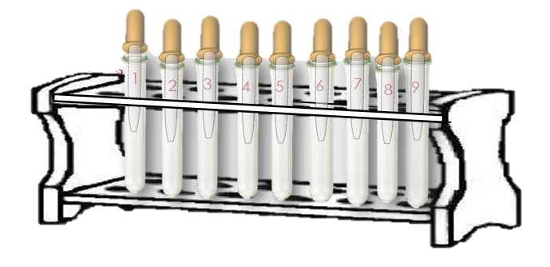
- Add 3 drops of sample 1 from test tube 1 using dropper #1 into the well labelled Tube #1. - Continue likewise for each of the remaining samples. Be sure to use the correct sample and the appropriate dropper to the correct spot as indicated here →
Be sure to put any remaining sample in your dropper back into the correct tube. You will be using it to test for the presence of sugar in the next step.
Reference spot 3 drops starch + 3 drops KI
Tube #1 starch + amylase 0 degrees C
Tube #1 goes here
Tube #9 goes here
Tube #9 starch + amylase 22 degrees C
Tube #2 starch + amylase 100 degrees C
Tube #2 goes here
Tube #8 goes here
Tube #8 starch + amylase 37 degrees C, pH=1
empty
Tube #3 water + starch 37 degrees C
Tube #3 goes here
Tube #7 goes here
Tube #7 starch + amylase 37 degrees C, pH=14
empty
Tube #4 water + dilute amylase 37 degrees C
Tube #4 goes here
Tube #5 goes here
Tube #6 goes here
Tube #6 starch + amylase 37 degrees C, pH=7
Tube #5 water + concentrated amylase 37 degrees C

Slide 29
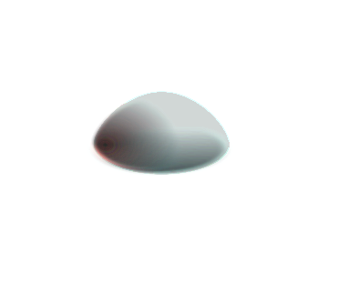
Write down observations (color changes) immediately after adding your sample to the IKI on the welled plate.
Reference spot 3 drops starch + 3 drops KI
Results may vary, but you should get similar results. Some colors may change over time. Use the colors that immediately appeared after adding the sample as your data.
Tube #1 starch + amylase 0 degrees C
Tube #9 starch + amylase 22 degrees C
Tube #2 starch + amylase 100 degrees C
Tube #8 starch + amylase 37 degrees C, pH=1
empty
Tube #3 water + starch 37 degrees C
Tube #7 starch + amylase 37 degrees C, pH=14
empty
Tube #4 water + dilute amylase 37 degrees C
Tube #6 starch + amylase 37 degrees C, pH=7
Tube #5 water + concentrated amylase 37 degrees C

Slide 30
COLOR KEY
NO DIGESTION = Blue-Black
Reference spot 3 drops starch + 3 drops KI
ANALYZE YOUR RESULTS!
PARTIAL DIGESTION = Brown
COMPLETE DIGESTION = Yellow
Tube #1 starch + amylase 0 degrees C
Tube #9 starch + amylase 22 degrees C
Identify the activity of the amylase (based on the level of digestion) in each sample based on the results.
Give an explanation for each of the results!
Partial digestion
NO digestion
Partial digestion
Tube #2 starch + amylase 100 degrees C
Tube #8 starch + amylase 37 degrees C, pH=1
empty
NO digestion
NO digestion
Tube #3 water + starch 37 degrees C
Tube #7 starch + amylase 37 degrees C, pH=14
empty
NO digestion
NO digestion
Tube #4 water + dilute amylase 37 degrees C
Tube #6 starch + amylase 37 degrees C, pH=7
Partial digestion
Complete digestion
Complete digestion
Tube #5 water + concentrated amylase 37 degrees C

Slide 31
The samples that reacted strongly with the Lugol’s Solution appear black or blue-black. In these samples, amylase was unable to convert starch into maltose (sugar).
There was no digestion (amylase was inactive or absent) in samples
2, 3, 7, and 8.
Let’s look at WHY?
Reference spot 3 drops starch + 3 drops IKI
ANALYZE YOUR RESULTS!
Tube #1 starch + amylase 0 degrees C
Tube #9 starch + amylase 22 degrees C
Partial digestion
NO digestion
Partial digestion
Tube #2 starch + amylase 100 degrees C
Tube #8 starch + amylase 37 degrees C, pH=1
empty
Partial digestion
NO digestion
Tube #3 water + starch 37 degrees C
Tube #7 starch + amylase 37 degrees C, pH=14
empty
NO digestion
NO digestion
Tube #4 water + dilute amylase 37 degrees C
Tube #6 starch + amylase 37 degrees C, pH=7
Partial digestion
Complete digestion
Complete digestion
Tube #5 water + concentrated amylase 37 degrees C

Slide 32
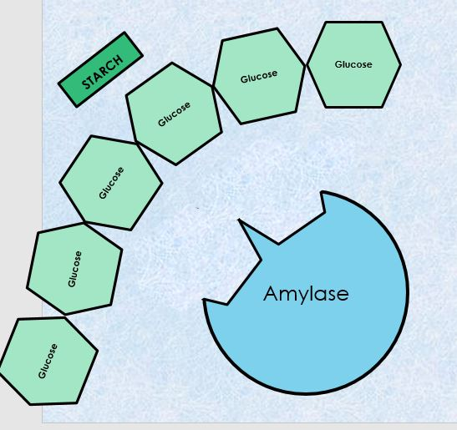
NEGATIVE CONTROL
Starch is a polysaccharide that is made up of glucose monomers. Lugol’s solution (IKI) turns dark blue-black in the presence of starch.
Reference spot 3 drops starch + 3 drops IKI
AMYLASE FUNCTION
Glu-cose
Glu-cose
Glu-cose
MALTOSE (SUGAR)
Gluc-ose
Glu-cose
Gluc-ose
Glucose
STARCH
Glu-cose
Gluc-ose
Glu-cose
Glucose
Glu-cose
Glu-cose
Glu-cose
Glu-cose
Glu-cose

Slide 33
Tube #2 starch + amylase 100 degrees C
Enzymes are sensitive to their environment. Amylase works best at around 37 degrees C, which is the same as our internal body temperature. When enzymes (or any protein for that matter) are heated too much (anything over about 80 degrees C for amylase) it will denature.
The Effect of Temperature on Enzyme Function
100 %
-----------------------------------------------------------------------------------------
75 %
Enzymes denature at higher temperatures rendering them inactive
50 %
Amylase Activity (%)
Enzymes work slower at colder temperatures
---------------------------
Enzymes work best at or around body temperature (37 degrees C)
25 %
0 %
0
10
20
30
40
50
60
Temperature / Celsius

Slide 34
Amylase Function vs. Temperature
Tube #1 starch + amylase 0 degrees C
In Test Tube #1 = Amylase was able to digest some of the starch in the sample, but at a much slower rate than observed at 37 degrees Celsius.
Partial digestion
Tube #9 starch + amylase 22 degrees C
In Test Tube #9 = Amylase was able to digest some of the starch in the sample, but at a slower rate than observed at 37 degrees Celsius.
Partial digestion
Tube #6 starch + amylase 37 degrees C, pH=7
In Test Tube #6 = Amylase was able to completely digest the starch in the sample, because it was at its optimal temperature of 37 degrees Celsius, which is the same as our body’s internal temperature.
Complete digestion
Tube #2 starch + amylase 100 degrees C
In Test Tube #2 = Amylase was not to digest the starch in the sample, because the heat caused the enzyme to denature, rendering it inactive.
No digestion

Slide 35
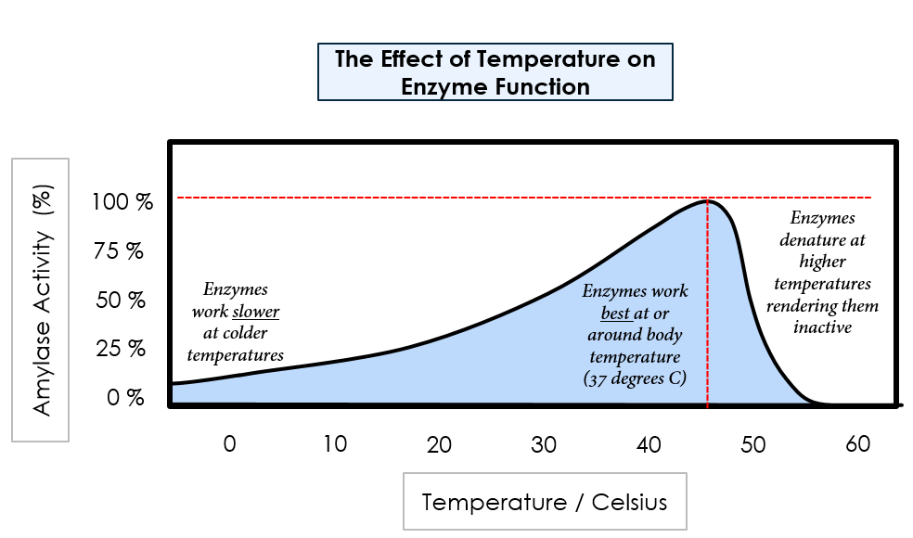
Amylase Function vs. Temperature
Amylase works at a slower rate when it is cold, but cold temperatures do not act to denature it. However, at high temperatures (~100°C) amylase does become denatured causing irreversible damage to its molecular structure. This is due to the additional kinetic energy within the atoms that make up the enzyme.

Slide 36
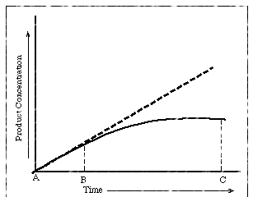
Amylase Function vs. Amylase Concentration
Tube #3 water + starch 37 degrees C
In Test Tube #3 = Amylase was not present, therefore there was no means by which starch could have been digested into sugar. Therefore, no digestion was observed.
No digestion
Tube #4 water + dilute amylase 37 degrees C
In Test Tube #4 = Amylase was able to digest some of the starch in the sample, but at a slower rate because it was significantly diluted.
Partial digestion
Tube #5 water + concentrated amylase 37 degrees C
In Test Tube #6 = Amylase was able to completely digest the starch in the sample, because it was present in the sample at a high concentration.
Complete digestion
The function of amylase will increase with increased concentration, until the substrate become the limiting factor.

Slide 37
Amylase Function vs. pH
Tube #8 starch + amylase 37 degrees C, pH=1
In Test Tube #8 = Amylase was not present, therefore there was no means by which starch could have been digested into sugar. Therefore, no digestion was observed.
No digestion
Tube #7 starch + amylase 37 degrees C, pH=14
In Test Tube #7 = Amylase was able to digest some of the starch in the sample, but at a slower rate because it was significantly diluted.
Partial digestion
Tube #6 starch + amylase 37 degrees C, pH=7
In Test Tube #6 = Amylase was able to completely digest the starch in the sample, because it was present in the sample at a high concentration.
Complete digestion
The function of amylase is best at pH=7 (neutral) which is the pH inside our bodies. The activity of the enzyme will decrease as the pH is moved further away from neutral, either higher or lower. Extreme pH (pH=1 and pH=14) will act to denature the enzyme rendering it inactive due to causing a significant structural change in the enzyme.

Slide 38
The function of amylase is best at pH=7 (neutral) which is the pH inside our bodies. The activity of the enzyme will decrease as the pH is moved further away from neutral, either higher or lower. Extreme pH (pH=1 and pH=14) will act to denature the enzyme rendering it inactive due to causing a significant structural change in the enzyme.
The Effect of pH on Enzyme Function
100 %
-----------------------------------------------------------------------------------------
75 %
Enzymes denature at higher pH (alkalai conditions) rendering them inactive
50 %
Enzymes denature at lower pH (acidic conditions) rendering them inactive
Enzymes work best at or around body pH (pH=7)
Amylase Activity (%)
---------------------------
25 %
0 %
0
2
4
6
8
10
12
14
pH

Slide 39
NEXT STEP GET NEW CLEAN TUBES THAT WERE LABELLED 10,11,12, 13, 14 AND 15!
We will now confirm the digestion of starch to sugar by performing the sugar test on tubes 1,2,4,5,6 and 9. We will test 1 through 6, because they showed either partial or complete digestion. We will test 9 to see if heat had an effect on the sample.
11
13
1
2
3
5
4
6
9
12
15
10
14

Slide 40
Transfer 10 drops of liquid from test tube 1 into test tube 10.
1
11
13
1
2
3
5
4
6
9
12
15
10
14

Slide 41
Transfer 10 drops of liquid from test tube 2 into test tube 11.
2
11
13
1
2
3
5
4
6
9
12
15
10
14

Slide 42
Transfer 10 drops of liquid from test tube 4 into test tube 12.
4
11
13
1
2
4
5
6
9
12
15
10
14

Slide 43
Transfer 10 drops of liquid from test tube 5 into test tube 13.
5
11
13
1
2
4
5
6
9
12
15
10
14

Slide 44
Transfer 10 drops of liquid from test tube 6 into test tube 14.
6
11
13
1
2
4
5
6
9
12
15
10
14

Slide 45
Transfer 10 drops of liquid from test tube 9 into test tube 15.
9
11
13
1
2
4
5
6
9
12
15
10
14

Slide 46
ADD 10 drops of Benedict’s Solution to each tube.
11
13
12
15
BENEDICT’S SOLJTION
10
14

Slide 47
A red (could also be orange or yellow) color indicates the presence of sugar.
The Benedict's test indicates the presence of ‘reducing sugars’ when those sugars are heated in the presence of an alkali solution. These ‘reducing sugars’ get converted to reducing enediols. The enediols reduce the cupric compounds (Cu²⁺) present in the Benedict's reagent to cuprous compounds (Cu⁺) which forms a precipitate of copper(I) oxide (Cu₂O) which appears RED or Orange or Yellow.
11
13
12
15
10
14

Slide 48
Incubate the tubes at 100 degrees C on the hot plate for 15 minutes.

Slide 49
A greenish precipitate indicates a 0.5 g% concentration;
A yellow precipitate indicates a 1 g% concentration;
An orange precipitate indicates a 1.5 g%
A red precipitate indicates a 2 g% or higher concentration.
The color of the obtained precipitate gives an idea about the quantity of sugar present in the solution, hence the test is semi-quantitative.
11
13
12
15
10
14

