Slide 1
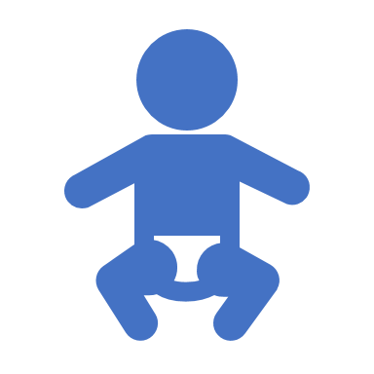
Fetal Development

Slide 2
When does pregnancy begin?
The start of pregnancy is actually the first day of your last menstrual period.
This is called the 'menstrual age' and is about two weeks ahead of when conception actually occurs.

Slide 3
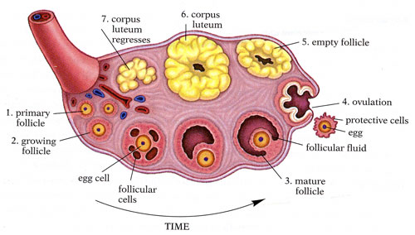
LEADING UP TO PREGNANCY
Each month a group of eggs (called oocytes) is recruited from the ovary for ovulation (release of the egg).
The eggs develop in small fluid-filled cysts called follicles.

Slide 4
Ovarian Follicles
Normally, one follicle in the group is selected to complete maturation. This dominant follicle suppresses all the other follicles in the group, which stop growing and degenerate.

Slide 5
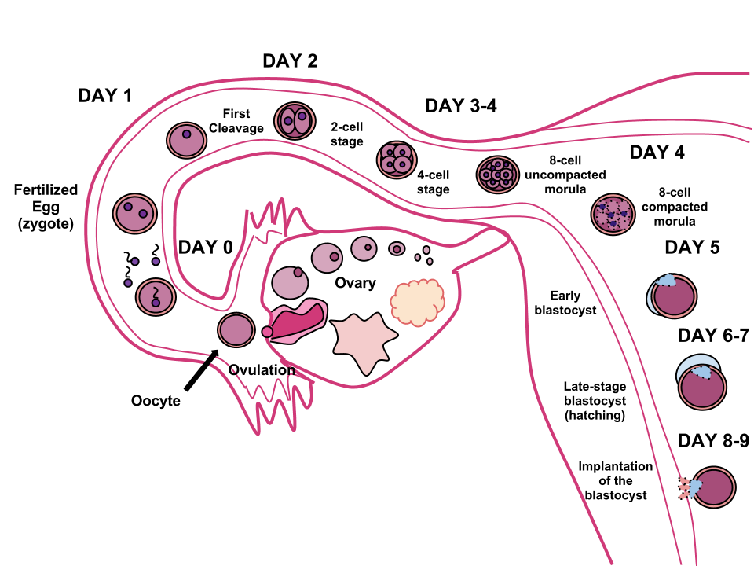
Ovulation
The mature follicle opens and releases the egg from the ovary (ovulation).
Ovulation generally occurs about two weeks before a woman's next menstrual period begins.

Slide 6
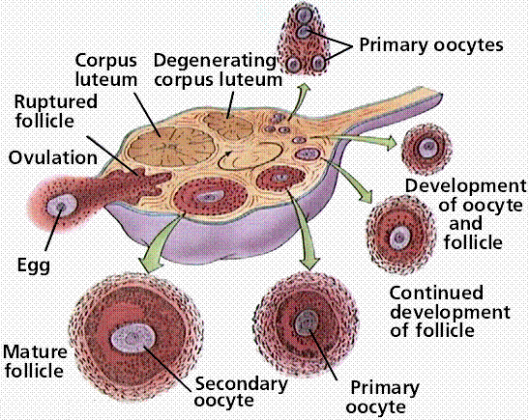
corpus luteum
After ovulation, the ruptured follicle develops into a structure called the corpus luteum.
The corpus luteum secretes progesterone and estrogen.

Slide 7
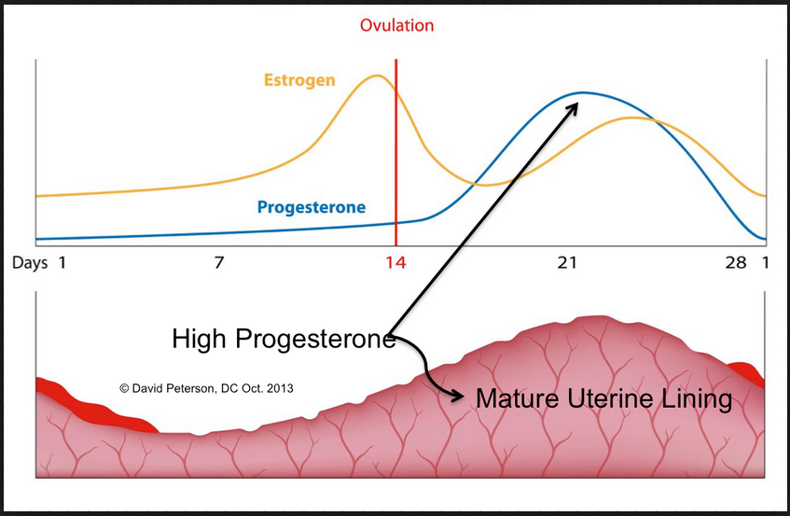
Endometrium thickening
The progesterone helps prepare the endometrium (lining of the uterus) for the embryo to implant.

Slide 8
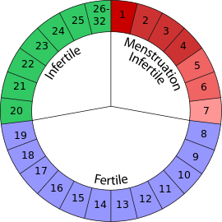
Fertilization Window
On average, fertilization occurs about two weeks after your last menstrual period.
This Photo by Unknown Author is licensed under CC BY-SA

Slide 9
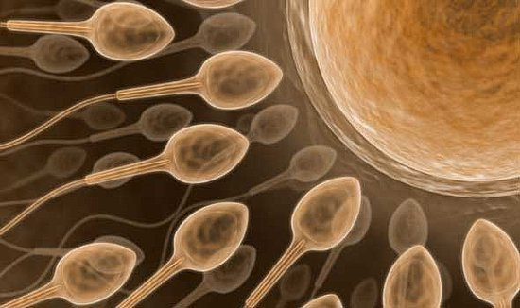
Egg Meets Sperm
When the sperm penetrates the egg, changes occur in the protein coating around it to prevent other sperm from entering. At the moment of fertilization, your baby's genetic make-up is complete, including its sex.
This Photo by Unknown Author is licensed under CC BY-SA-NC

Slide 10
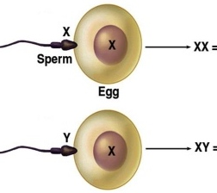
23rd Chromosome – The Sex-Determining Chromosome
If a Y sperm fertilizes the egg, your baby will be a boy; if an X sperm fertilizes the egg, your baby will be a girl.
This Photo by Unknown Author is licensed under CC BY-SA

Slide 11
Human chorionic gonadotrophin (hCG)
Human chorionic gonadotrophin (hCG) is a hormone present in your blood from the time of conception.
It is produced by cells that form the placenta and is the hormone detected in a pregnancy test.
However, it usually takes three to four weeks from the first day of your last period for the hCG to increase enough to be detected by pregnancy tests.

Slide 12
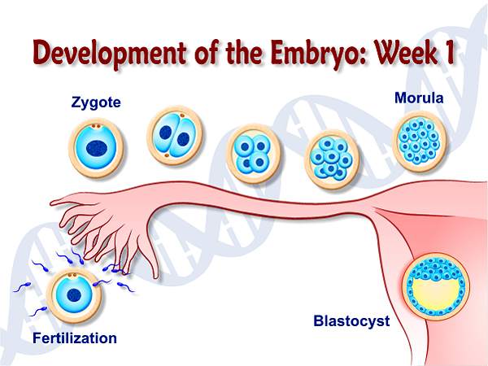
Week One
Within 24 hours after fertilization, the egg begins dividing rapidly into many cells.
It remains in the fallopian tube for about three days.

Slide 14
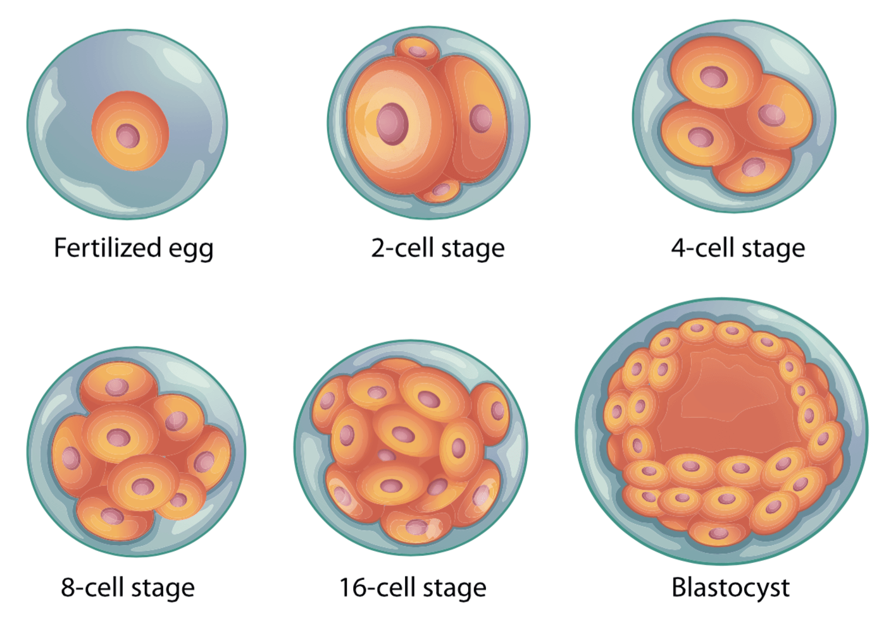
IMPLANTATION
The fertilized egg (called zygote) continues to divide as it passes slowly through the fallopian tube to the uterus.
When the blastocyst reaches the uterus, where its next job is to attach to the endometrium (a process called implantation).

Slide 15
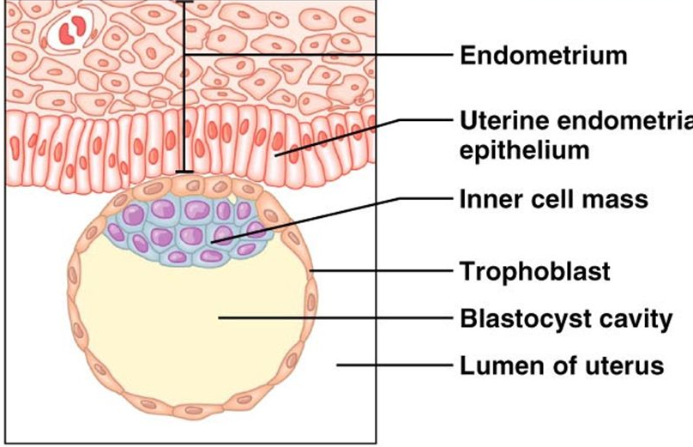
IMPLANTATION
When the blastocyte establishes contact with the endometrium, an exchange of hormones helps the blastocyte attach.
Some women notice spotting (or slight bleeding) for one or two days around the time of implantation.
The endometrium becomes thicker and the cervix is sealed by a plug of mucus.

Slide 16
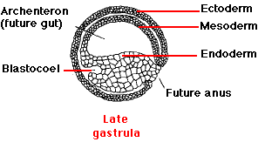
Within three weeks, the blastocyte cells ultimately form a little ball, or an embryo, and the baby's first nerve cells have already formed.
This Photo by Unknown Author is licensed under CC BY-SA-NC

Slide 17
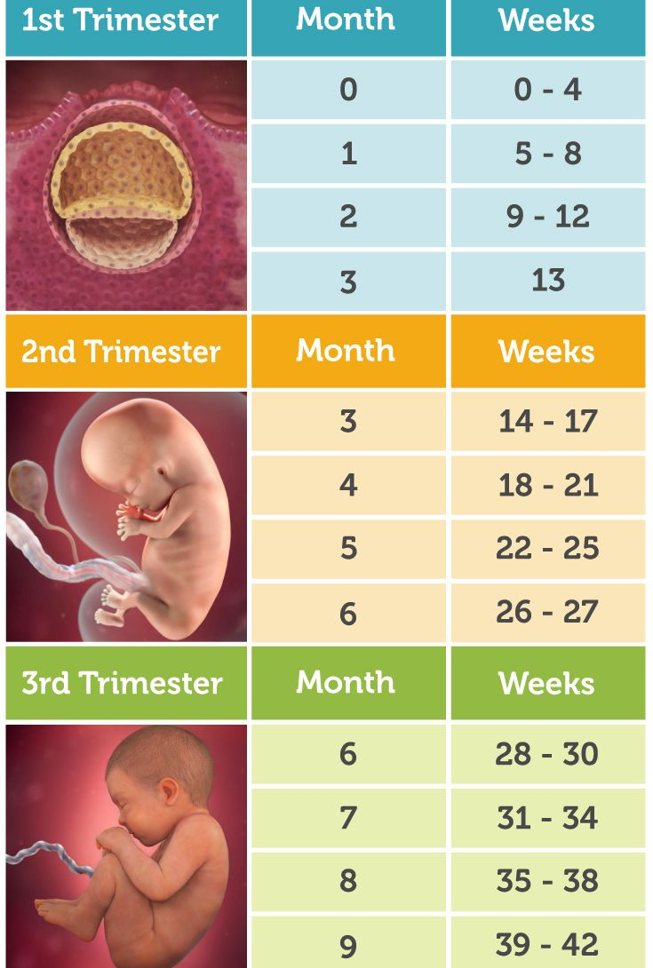
Trimesters
The development stages of pregnancy are called trimesters, or three-month periods, because of the distinct changes that occur in each stage.

Slide 18
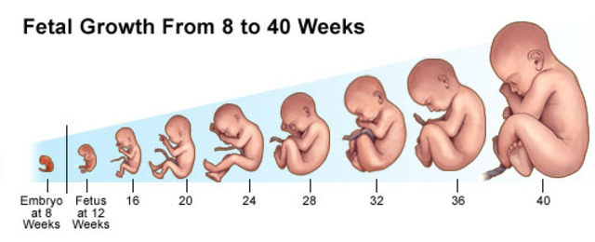
Stages of Growth: Month by Month

Slide 19
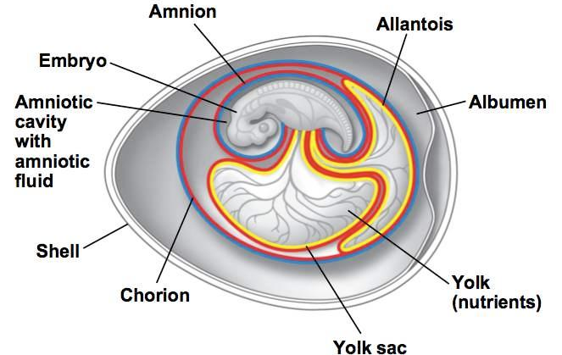
Month 1
As the fertilized egg grows, a water-tight sac forms around it, gradually filling with fluid.
This is called the amniotic sac, and it helps cushion the growing embryo.

Slide 20
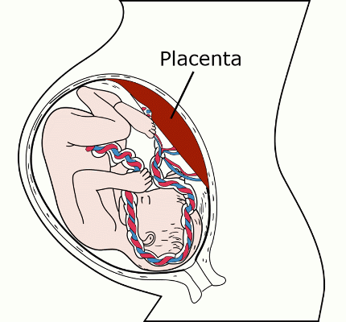
Month 1
The placenta also develops.
The placenta is a round, flat organ that transfers nutrients from the mother to the baby, and transfers wastes from the baby.
This Photo by Unknown Author is licensed under CC BY-SA-NC

Slide 22
Month 1
A primitive face will take form with large dark circles for eyes.
The mouth, lower jaw, and throat are developing.
Blood cells are taking shape, and circulation will begin.

Slide 23
Month 1
The tiny "heart" tube will beat 65 times a minute by the end of the fourth week.
By the end of the first month, your baby is about 1/4 inch long – smaller than a grain of rice!

Slide 24
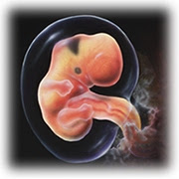
Month 2
Your baby's facial features continue to develop.
Each ear begins as a little fold of skin at the side of the head.
Tiny buds that eventually grow into arms and legs are forming.
Fingers, toes and eyes are also forming.

Slide 25
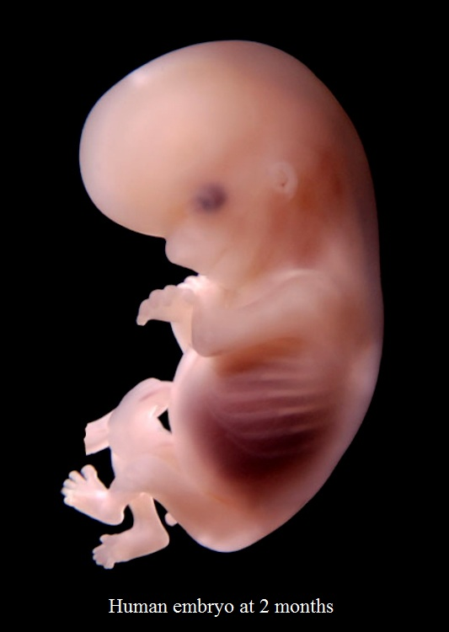
Month 2
The neural tube (brain, spinal cord and other neural tissue of the central nervous system) is well formed. The digestive tract and sensory organs begin to develop. Bone starts to replace cartilage.
The head is large in proportion to the rest of the baby's body.

Slide 26
Month 2
By the end of the second month, your baby is about 1 inch long and weighs about 1/30 of an ounce.
At about 6 weeks, your baby's heart beat can usually be detected.
After the 8th week, your baby is called a fetus instead of an embryo.

Slide 27
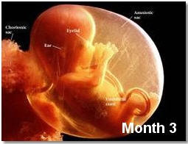
Month 3
Your baby's arms, hands, fingers, feet, and toes are fully formed.
Your baby can open and close its fists and mouth.
Fingernails and toenails are beginning to develop and the external ears are formed.
The beginnings of teeth are forming.

Slide 28
Month 3
By the end of the third month, your baby is fully formed.
All the organs and extremities are present and will continue to mature in order to become functional.
The circulatory and urinary systems are working and the liver produces bile.

Slide 29
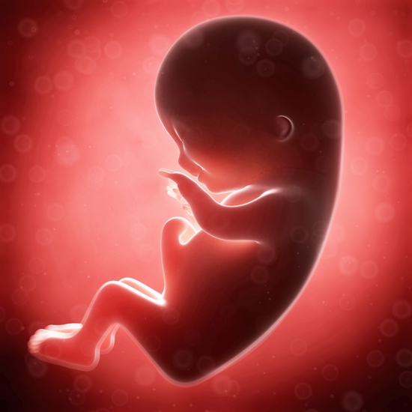
Month 3
At the end of the third month, your baby is about 4 inches long and weighs about 1 ounce.
Since your baby's most critical development has taken place, your chance of miscarriage drops considerably after three months.

Slide 30
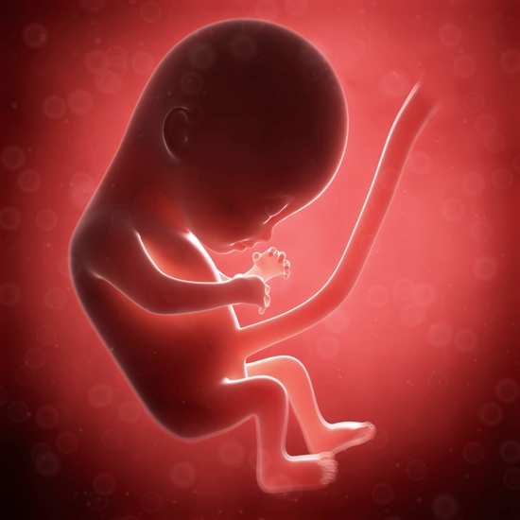
Month 4
Your baby's heartbeat may now be audible through an instrument called a doppler.
The fingers and toes are well-defined.
Eyelids, eyebrows, eyelashes, nails, and hair are formed.
Teeth and bones become denser.
Your baby can even suck his or her thumb, yawn, stretch, and make faces.

Slide 31
Month 4
The nervous system is starting to function.
The reproductive organs and genitalia are now fully developed, and your doctor can see on ultrasound if you are having a boy or a girl.
By the end of the fourth month, your baby is about 6 inches long and weighs about 4 ounces.

Slide 32
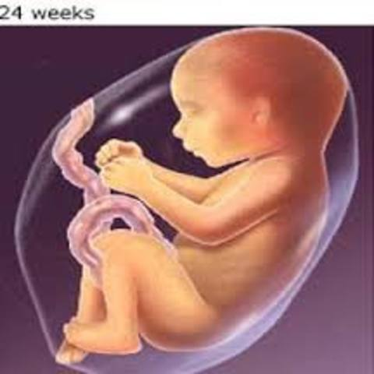
Month 5
You may begin to feel your baby move, since he or she is developing muscles and exercising them. This first movement is called quickening.
Hair begins to grow on baby's head. Your baby's shoulders, back, and temples are covered by a soft fine hair called lanugo. This hair protects your baby and is usually shed at the end of the baby's first week of life.

Slide 33
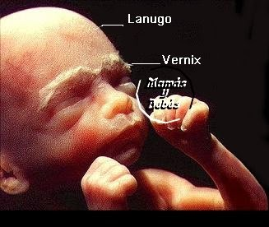
Month 5
The baby's skin is covered with a whitish coating called vernix caseosa.
This "cheesy" substance is thought to protect baby's skin from the long exposure to the amniotic fluid.
This coating is shed just before birth.
By the end of the fifth month, your baby is about 10 inches long and weighs from 1/2 to 1 pound.

Slide 34
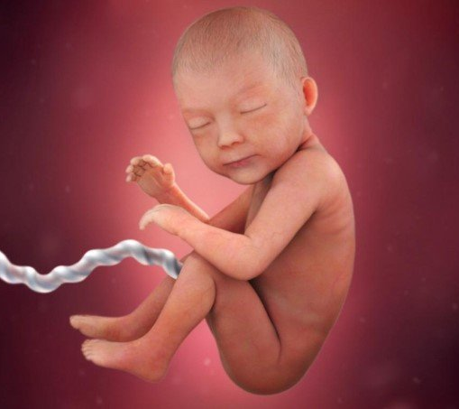
Month 6
Your baby's skin is reddish in color, wrinkled, and veins are visible through the baby's translucent skin. Baby's finger and toe prints are visible. The eyelids begin to part and the eyes open.

Slide 35
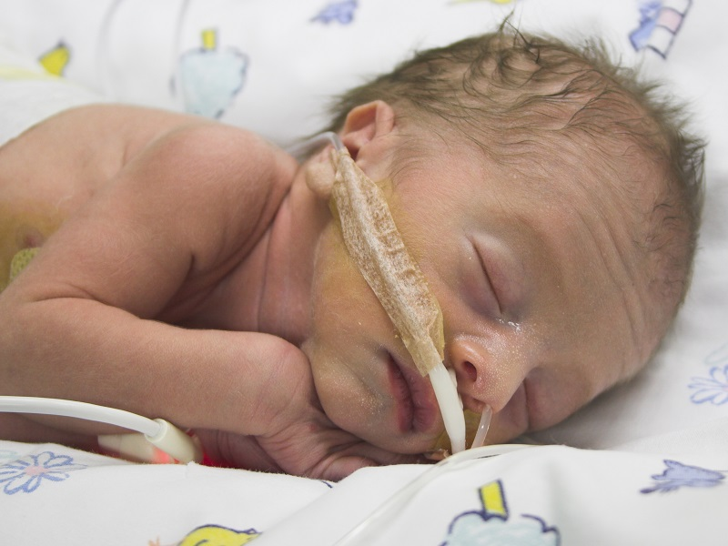
Month 6
Baby responds to sounds by moving or increasing the pulse. You may notice jerking motions if baby hiccups.
If born prematurely, your baby may survive after the 23rd week with intensive care.
By the end of the sixth month, your baby is about 12 inches long and weighs about 2 pounds.

Slide 36
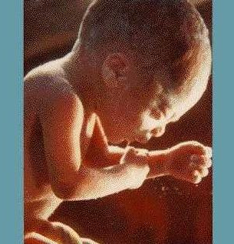
Month 7
Your baby will continue to mature and develop reserves of body fat.
Your baby's hearing is fully developed.
He or she changes position frequently and responds to stimuli, including sound, pain, and light.
The amniotic fluid begins to diminish.

Slide 37
Month 7
At the end of the seventh month, your baby is about 14 inches long and weighs from 2 to 4 pounds.
If born prematurely, your baby would be likely to survive after the seventh month.

Slide 38
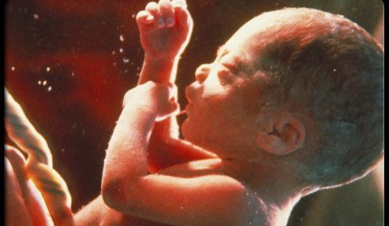
Month 8
Your baby will continue to mature and develop reserves of body fat.
You may notice that your baby is kicking more.
Baby's brain is developing rapidly at this time, and your baby can see and hear.
Most internal systems are well developed, but the lungs may still be immature.
Your baby is about 18 inches long and weighs as much as 5 pounds.

Slide 39
Month 9
Your baby continues to grow and mature: the lungs are nearly fully developed.
Your baby's reflexes are coordinated so he or she can blink, close the eyes, turn the head, grasp firmly, and respond to sounds, light, and touch.
Baby is definitely ready to enter the world!

Slide 40
Month 9
You may notice that your baby moves less due to tight space.
Your baby's position changes to prepare itself for labor and delivery.
The baby drops down in your pelvis.
Usually, the baby's head is down toward the birth canal.
Your baby is about 18 to 20 inches long and weighs about 7 pounds.

