Slide 1
Lab Quiz #5

Slide 2
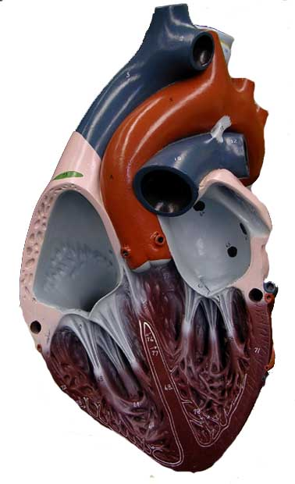
Question 1
Identify the Structure

Slide 3
Question 2
Identify the Vessel

Slide 4
Question 3
Identify the Structure

Slide 5
Question 4
Identify the Structure

Slide 6
Question 5
Identify the Structure

Slide 7
Question 6
Identify the Structure

Slide 8
Question 7
Identify the Structure

Slide 9
Question 8
Identify the Artery

Slide 10
Question 9
Identify the Artery

Slide 11
Question 10
Identify the Vein

