Slide 1
Lecture Exam 4
STUDY GUIDE
TOPICS COVERED:
The Renal/Urinary System
The Respiratory System

Slide 2
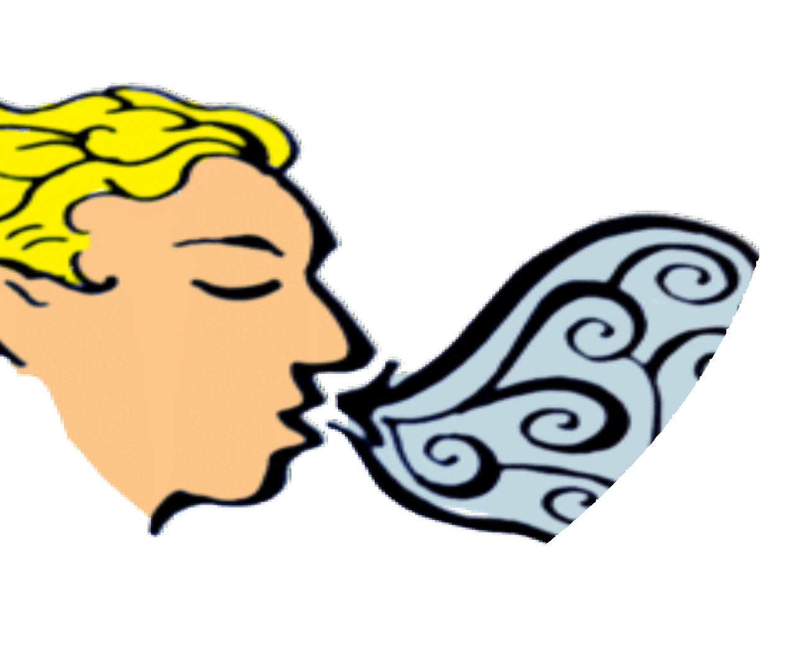
The Respiratory System
BY SCIENTIST CINDY

Slide 3
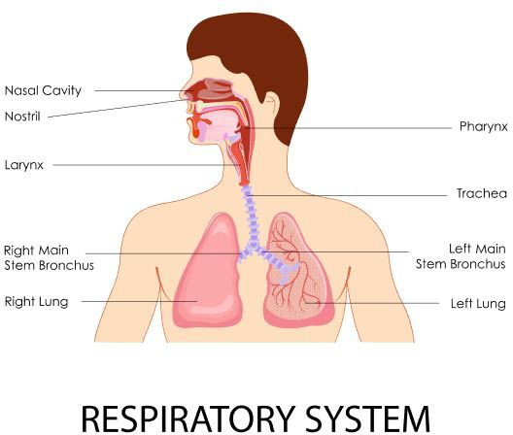
Divisions of the Respiratory Tract
The respiratory tract is the path of air from the nose to the lungs. It is divided into two sections: Upper Respiratory Tract and the Lower Respiratory Tract.
  The upper respiratory tract consists of the Nostrils, Nasal Cavities, Pharynx, Epiglottis, and the Larynx.
  The lower respiratory tract consists of the Trachea, Bronchi, Bronchioles, and the Lungs.

Slide 4

BREATHING or ventilation
The four primary processes of respiration are:
EXTERNAL RESPIRATION, which is the exchange of gases (oxygen and carbon dioxide) between inhaled air and the blood.
INTERNAL RESPIRATION, which is the exchange of gases between the blood and tissue fluids.
CELLULAR RESPIRATION

Slide 5
REGULATION OF BLOOD pH, which occurs in coordination with the kidneys
The secondary processes of respiration include:
DEFENSE AGAINST MICROBES
CONTROL OF BODY
TEMPERATURE due to loss of evaporate during expiration

Slide 6

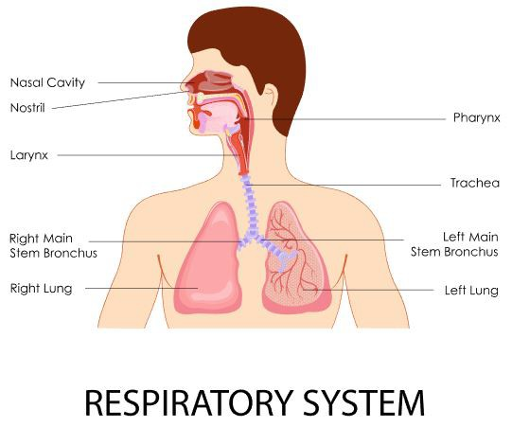
The Pathway of Air
nasal cavities
pharynx (nasopharynx, oropharynx, and laryngopharynx)
larynx
trachea
bronchi (right bronchus and left bronchus)

Slide 7
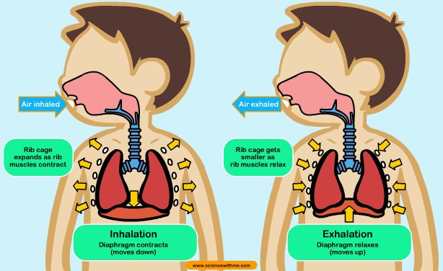
Breathing and Lung Mechanics
Ventilation
There are two phases of ventilation;
  Inspiration
  Expiration

Slide 8
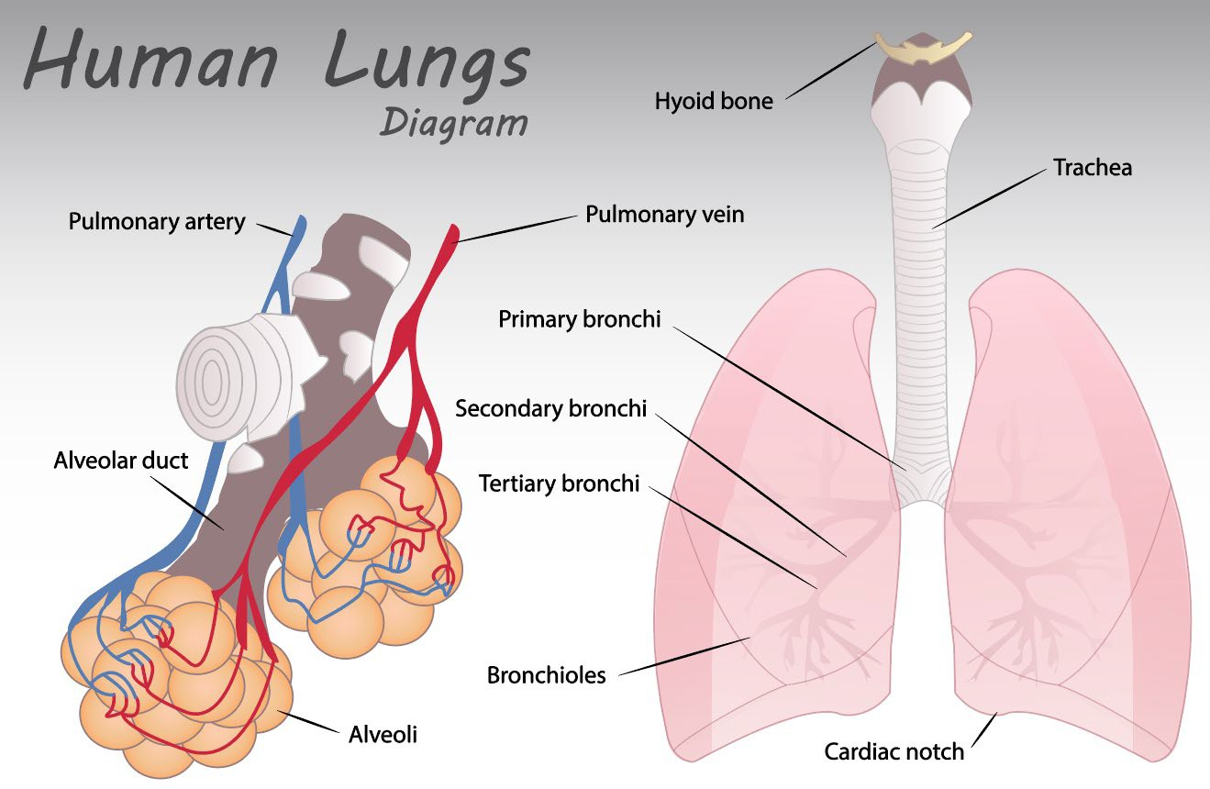
Breathing and Lung Mechanics – Ventilation
Ventilation is the exchange of air between the external environment and the alveoli.

Slide 9
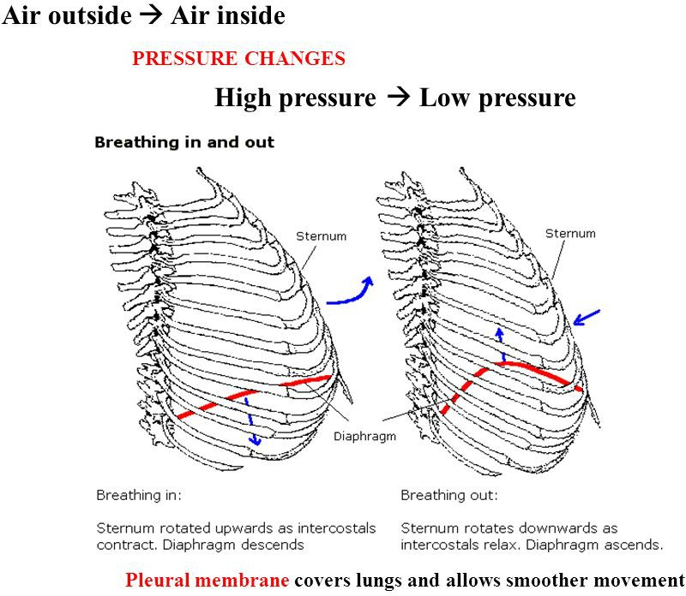
Breathing and Lung Mechanics – Ventilation
Air moves by bulk flow from an area of high pressure to low pressure.

Slide 10
Breathing and Lung Mechanics – Ventilation
Air will move in or out of the lungs depending on the pressure in the alveoli.
The body changes the pressure in the alveoli by changing the volume of the lungs.
As volume increases pressure decreases and as volume decreases pressure increases.

Slide 11
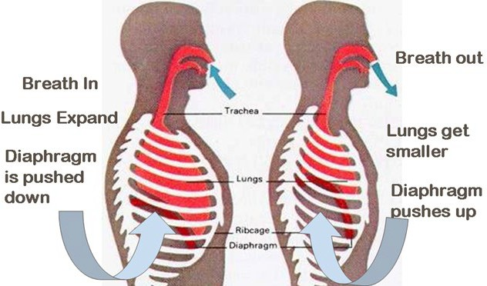
Changes in pressure are driven by changing the volume of the lungs.
Gas pressure DECREASES when lung volume INCREASES
Gas pressure INCREASES when lung volume DECREASES
Changes in Intrapulmonary
Pressure

Slide 13
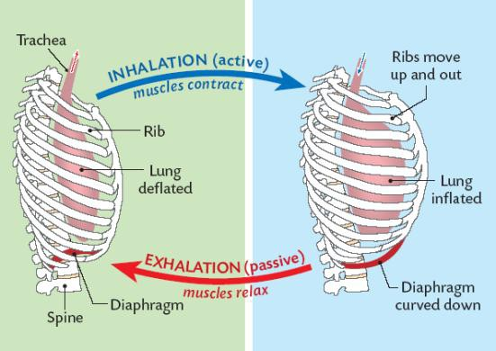

Slide 14
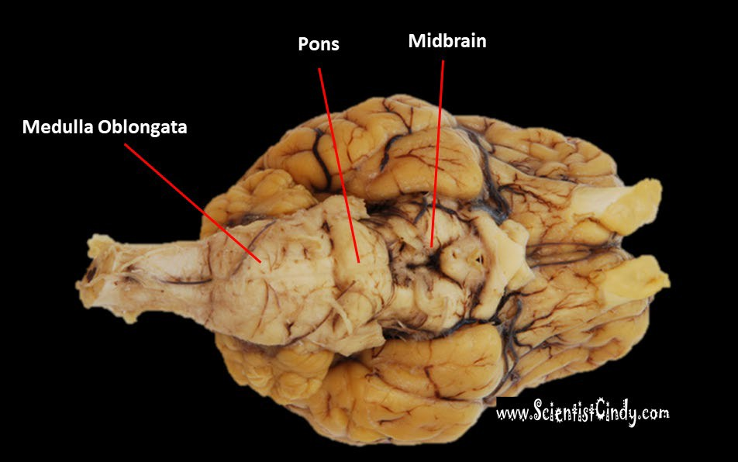
Control of Ventilation
The rhythm of ventilation is also controlled by the "Respiratory Center" which is located largely in the medulla oblongata of the brain stem.
This is part of the autonomic nervous system and is involuntarily.

Slide 15

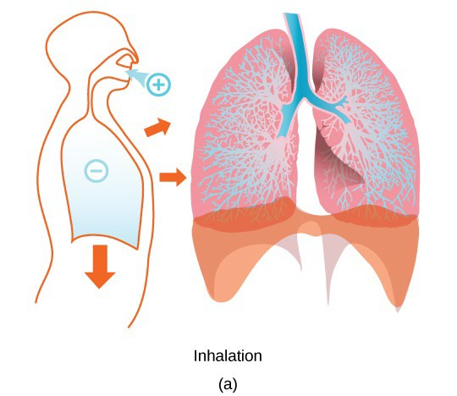
Inspiration (Inhalation)
During normal quiet breathing,
Inspiration is initiated by contraction of the diaphragm -
  When the diaphragm contracts it moves downward toward the abdomen.
  This downward movement of the diaphragm
    Enlarges lung volume
    Decreases lung pressure
    Air moves from low pressure to high pressure, so air flows INTO the lungs.

Slide 16
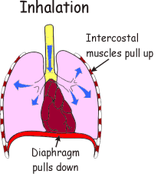
Inspiration (Inhalation)
During forceful breathing,
Inspiration is assisted by the intercostal muscles
initiated by contraction of the intercostal muscles -
  When the intercostal muscles contract, the rib cage moves…
    Upward and Outward
  This upward and outward movement of the rib cage
    Enlarges lung volume
    Decreases lung pressure
    Air moves from low pressure to high pressure, so air flows INTO the lu

Slide 17
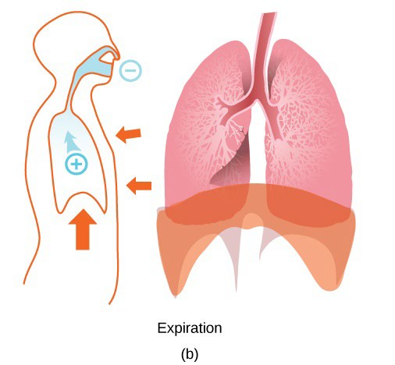

Expiration (Exhalation)
During normal quiet breathing,
Expiration is initiated by RELAXATION of the diaphragm -
  When the diaphragm RELAXES it moves UPWARD toward the thorax (chest).
  This upward movement of the diaphragm
    Decreases lung volume
    Increases lung pressure
    Air moves from low pressure to high pressure, so air flows OUT OF the lungs.
During quiet breathing, expiration is normally a passive process and does not require muscles to work (rather it is the result of the muscles relaxing).

Slide 18
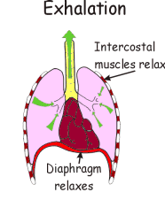
Expiration (Exhalation)
During forceful breathing,
Expiration is initiated by the RELAXATION of the intercostal muscles
RELAXATION of the intercostal muscles causes the rib cage to move downward and Inward
  This Downward and Inward
movement of the rib cage
    Decreases lung volume
    Increases lung pressure
    Air moves from low pressure to high pressure, so air flows OUT OF the lungs.

Slide 19
gas exchange
regulation of blood pH
Homeostasis is maintained by the respiratory system in two ways:

Slide 20


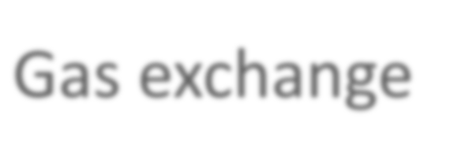


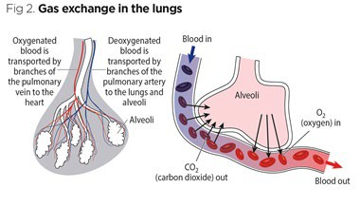
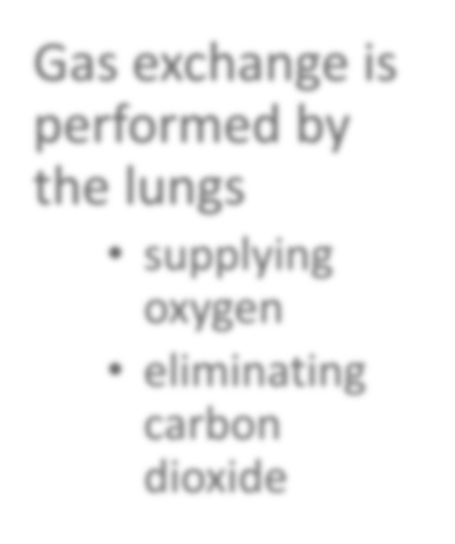
Gas exchange
Gas exchange is performed by the lungs
supplying oxygen
eliminating carbon dioxide

Slide 21
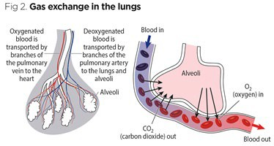
Gas exchange takes place between the air in the alveoli of the lungs, and the blood in the pulmonary capillaries.
  Gas exchange is the result of a pressure gradient or concentration gradient that exists between the alveoli and the blood.
  This process of gas exchange is done through diffusion.
Gas exchange

Slide 22
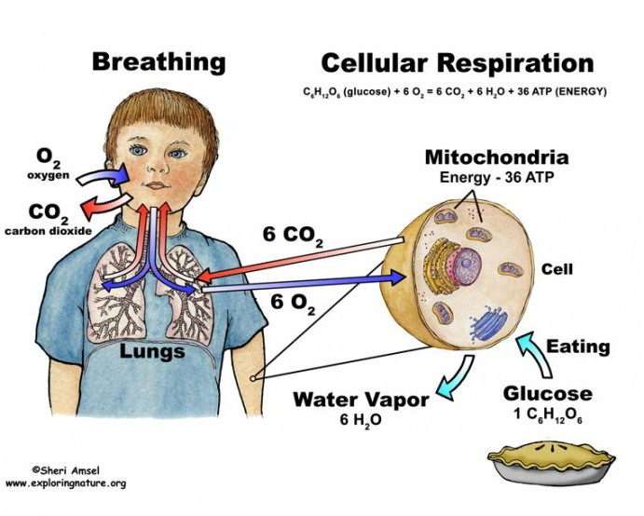
Gas exchange
Carbon dioxide is a waste product given off by cellular respiration.
As carbon dioxide exits the body, oxygen needed for cellular respiration enters the body through the lungs.
ATP, produced by cellular respiration, provides the energy for the cells of the body.

Slide 23
carbon dioxide (CO2)
Most of the carbon dioxide is carried to the lungs in plasma as bicarbonate ions (HCO3-).
  When blood enters the pulmonary capillaries, the bicarbonate ions and hydrogen ions are converted first into carbonic acid (H2CO3) and then converted into carbon dioxide (CO2) and water.
This chemical reaction removes hydrogen ions.
This neutralizes acidity (low pH).

Slide 24
De-oxygenated blood
Deoxygenated blood coming from the pulmonary arteries has…
  An O₂ partial pressure (pp) of ~40 mmHg
  A CO₂ partial pressure (pp) of ~45 mmHg
Oxygenated blood leaving the lungs through the pulmonary veins
has…
  An O₂ partial pressure (pp) of ~100 mmHg
  A CO₂ partial pressure (pp) of ~40 mmHg
The partial pressure (pp) of O₂ in the alveoli is ~105 mmHg

Slide 25
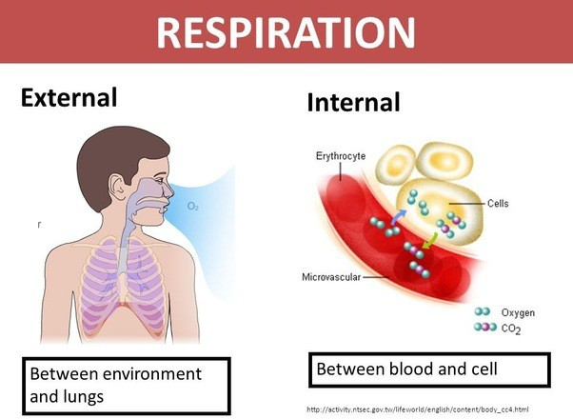
Internal Respiration
Internal respiration is the exchanging of gases at the cellular level.
The Passage Way From the Trachea to the Bronchioles
The inferior portion of the trachea to form the right primary bronchus and left primary bronchus.
  The point at which the trachea branches to form these bronchi is called the Carina.
The Bronchial Tree is a series of respiratory tubes that branch off into smaller and smaller tubes as they run throughout the lungs.

Slide 26
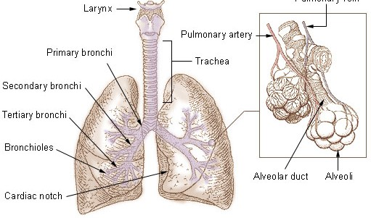
The lungs are attached to the heart and trachea through structures that are called the roots of the lungs.
  The roots of the lungs are the bronchi, pulmonary vessels, bronchial vessels, lymphatic vessels, and nerves.
  These structures enter and leave at the hilus of the lung
There are a number of terminal bronchioles connected to respiratory bronchioles which then advance into the alveolar ducts that then become alveolar sacs.
Each bronchiole terminates in an elongated space enclosed by many air sacs called alveoli which are surrounded by blood capillaries.
Bronchial Tree

Slide 27
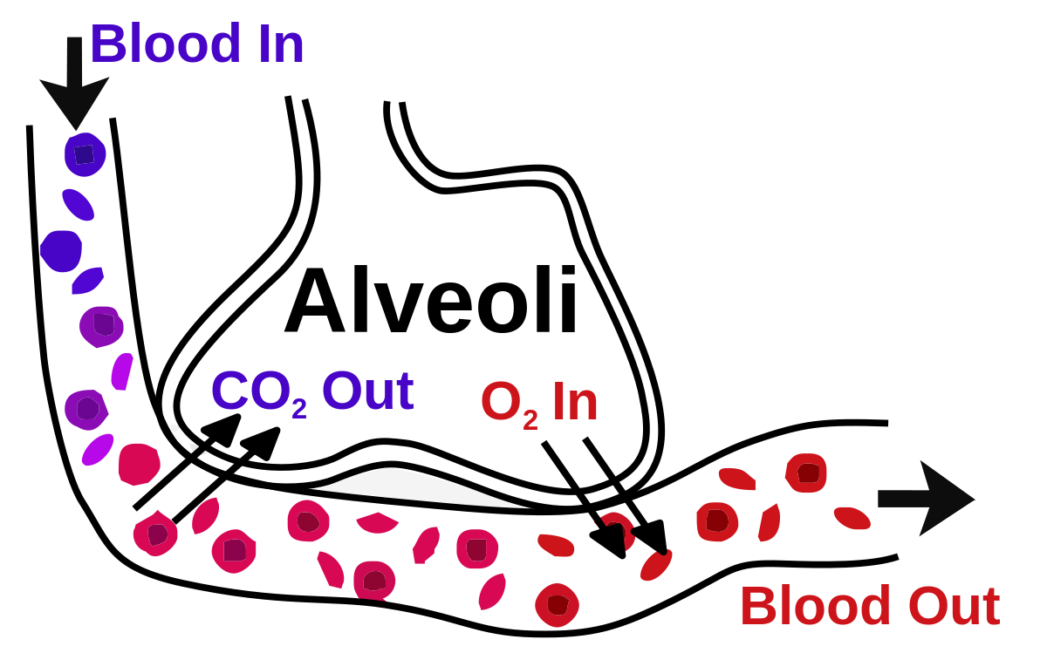
Alveoli
The Pulmonary Alveoli are membranous air sacs within the lungs.
Alveoli are units of respiration and the site of gas exchange between the respiratory and circulatory systems.

Slide 28
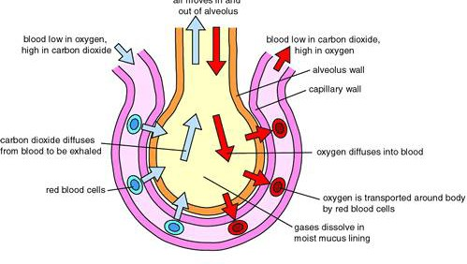
Oxygen diffuses alveolus into the capillaries
  Capillaries are permeable to oxygen.
  Once in the capillary
    ~ 5% of the oxygen will be dissolved in the blood plasma.
    ~ 95% of the oxygen will bind to hemoglobin in red blood cells.
Oxygen Diffusion

Slide 29
It is in the mitochondria of the cells where oxygen is actually consumed and carbon dioxide produced.
Cellular Respiration
Oxygen is produced as it combines with hydrogen ions to form water at the end of the electron transport chain.
As cells take apart the carbon molecules from glucose, these get released as carbon dioxide.

Slide 30
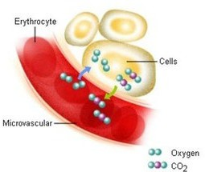
Each body cell releases carbon dioxide into nearby capillaries by diffusion.
The concentration of carbon dioxide is higher in the body cells than in the blood.
In the capillaries…
  some of the carbon dioxide is dissolved in plasma
  some of the carbon dioxide is taken up by red blood cells and bound to hemoglobin
  most carbon dioxide enters the red blood cells where it binds with water to form carbonic acid.
  carbon dioxide then travels to the capillaries surrounding the lung
water molecule leaves, causing it to turn back into carbon dioxide.
It then enters the lungs where it is exhaled into the atmosphere.

Slide 31
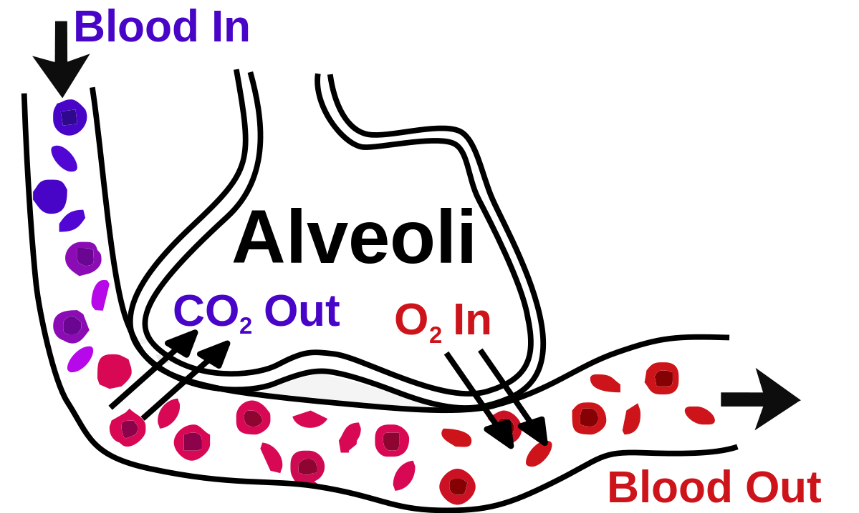
1. Carbon Dioxide enters the red blood cells at capillary beds.
Carbon Dioxide binds with water to form carbonic acid.
Carbonic Acid then travels to the capillaries surrounding the lung.
Carbonic Acid is transformed into water and carbon dioxide.
Carbon Dioxide diffuses from the red blood cells in the capillaries to the alveoli of the lungs.
The Carbon Dioxide is exhaled out of the body through the lungs.
Carbon Dioxide

Slide 32
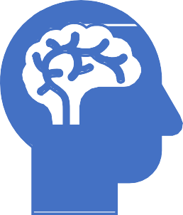
Stimulation of Breathing
There are two pathways of motor neuron stimulation of the respiratory muscles.
  The first is the control of voluntary breathing by the cerebral cortex.
  The second is involuntary breathing controlled by the medulla oblongata.

Slide 33
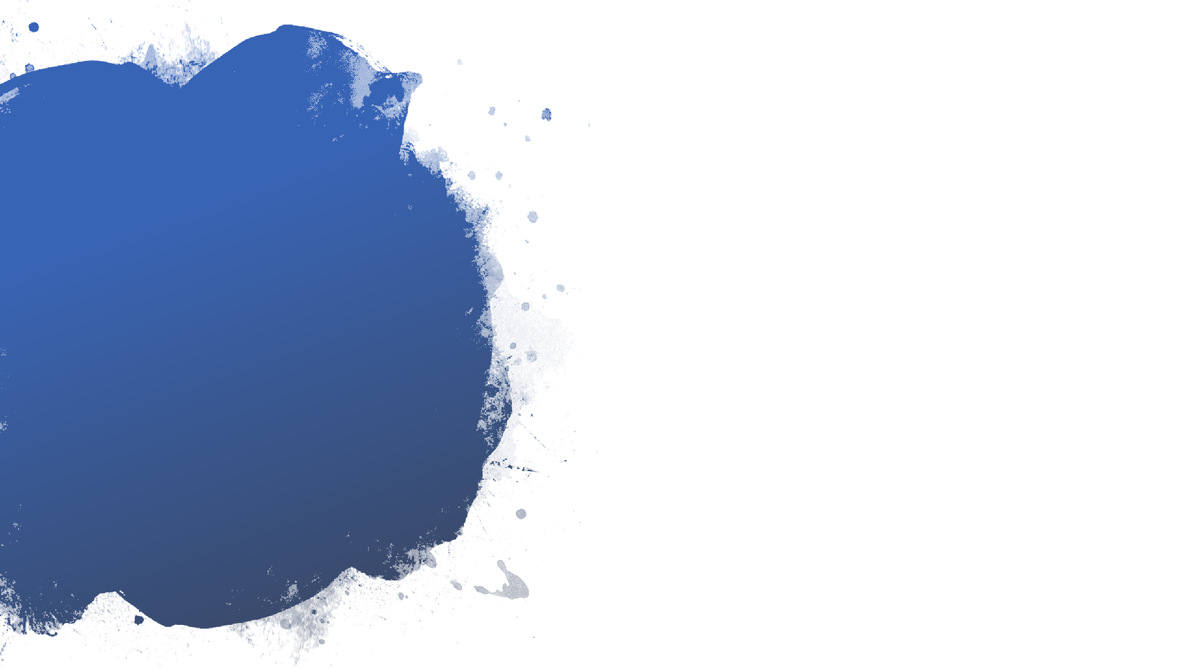
chemoreceptors that since pH levels are located in the…
Stimulation of Breathing
The aorta
The carotid arteries
The medulla oblongata

Slide 34


As carbon dioxide levels increase, there is a buildup of carbonic acid, which releases hydrogen ions and lowers pH, making the blood more ACIDIC.
Chemoreceptors do not respond to changes in oxygen levels
Stimulation of Breathing
Chemoreceptors do respond to changes pH
pH levels are dependent upon plasma carbon dioxide levels.
In other words, the level of CO₂ is the driving force for breathing.

Slide 35
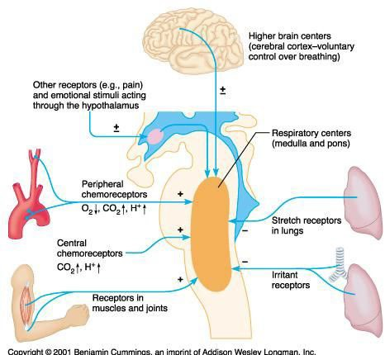
Regulation of Breathing
The receptors in the aorta and the carotid sinus initiate a reflex that immediately stimulates breathing rate.
Receptors in the medulla stimulate a sustained increase in breathing until blood pH returns to normal.
Example
During exercise, muscle cells metabolize ATP at a much faster rate than usual.
This increase in ATP production produces much higher quantities of CO2.
When CO2 levels increase, blood pH drops.
The body responds (compensates) by involuntarily increasing breathing rate.
The increased breathing rate expels more carbon dioxide
The increased breathing rate continues until pH has returned to normal.
Metabolic acidosis therefore can be corrected by respiratory compensation (hyperventilation).

Slide 36
pH is the concentration of hydrogen ions (H+).
Buffers are molecules which take in or release ions in order to maintain the H+ ion concentration at a certain level.

Slide 37

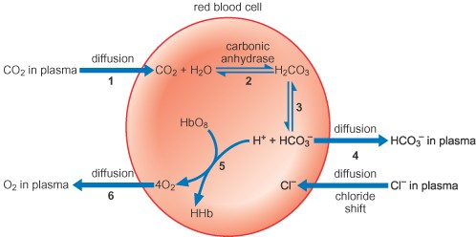
Buffers
When blood pH is too low and the blood becomes too acidic (acidosis), there are too many H+ ions is to blame.
Buffers help to soak up those extra H+ ions.
The lack of H+ ions causes the blood to be too basic (alkalosis).
In this situation, buffers release H+ ions.
Buffers function to maintain the pH of our blood by either donating or grabbing H+ ions as necessary to keep the number of H+ ions floating around the blood at just the right amount.

Slide 38
The most important buffer we have in our bodies is a mixture of carbon dioxide (CO2) and bicarbonate ion (HCO3).
Bicarbonate Buffer System
CO2 forms carbonic acid (H2CO3) when it dissolves in water and acts as an acid giving up hydrogen ions (H+) when needed.
HCO3 is a base and soaks up hydrogen ions (H+) when there are too many of them. In a nutshell, blood pH is determined by a balance between bicarbonate and carbon dioxide.

Slide 39
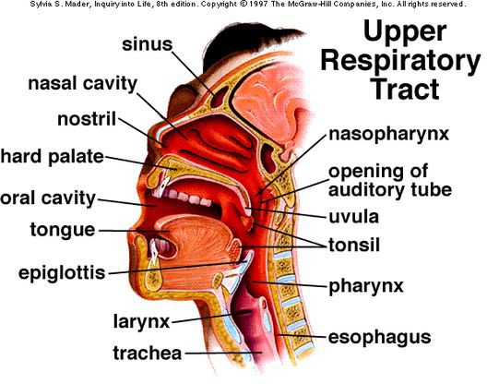
the nose and the pharynx
The upper respiratory tract consists of the nose and the pharynx.
Primary functions
  receive the air from the external environment
  filter, warm, and humidify air before it reaches the delicate lungs where gas exchange will occur.

Slide 40
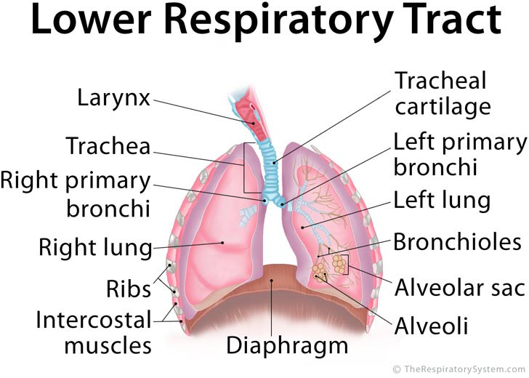
the larynx, the trachea, and the bronchi
The lower respiratory tract includes
  the larynx
  the trachea
  the bronchi

Slide 41
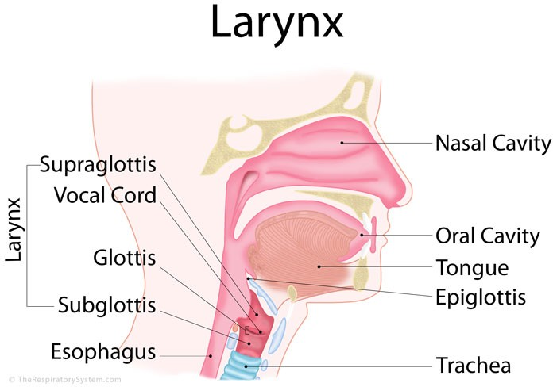
Larynx
The larynx contains two important structures:
  the epiglottis
  the vocal cords

Slide 42
Larynx
The larynx (the voice box) functions:
  Protection of the trachea
  Produce sounds (vocalization) via the vocal cords

Slide 43
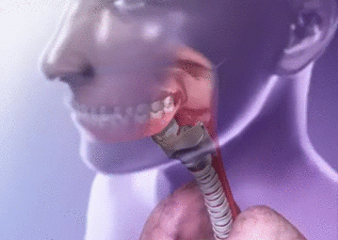
The epiglottis
The epiglottis is a flap of cartilage located at the opening to the larynx.
During swallowing, the epiglottis moves downward closing of the airways, to prevent chocking.

Slide 44
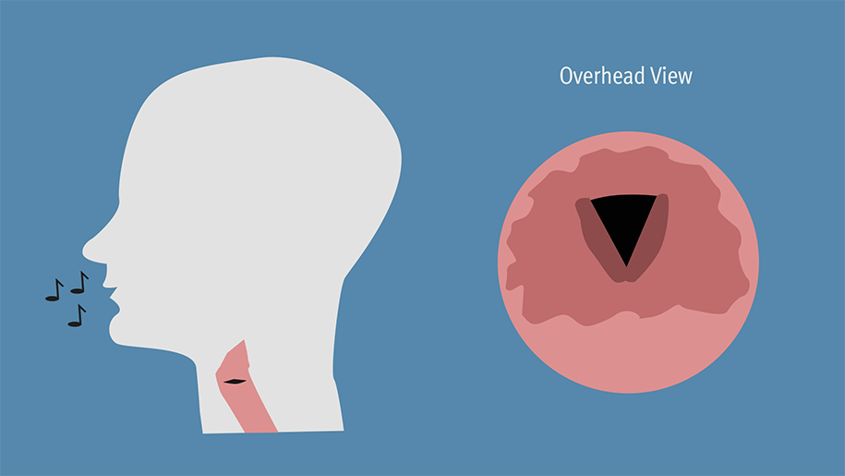
The vocal cords
The vocal cords consist of two folds of connective tissue that stretch and vibrate when air passes through them,
causing vocalization.

Slide 45

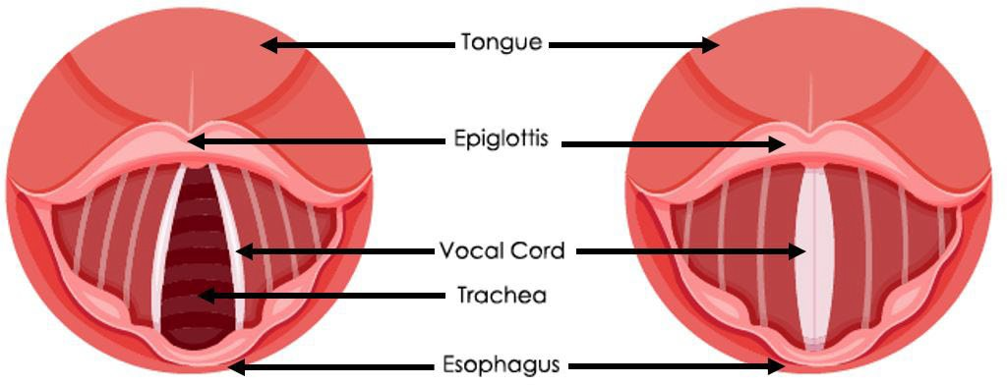
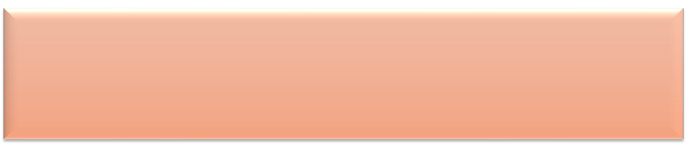
The vocal
cords
The length the vocal cords are stretched determines what PITCH
the sound will have.
The strength of expiration from the lungs also contributes to the
VOLUME of the sound.

Slide 46
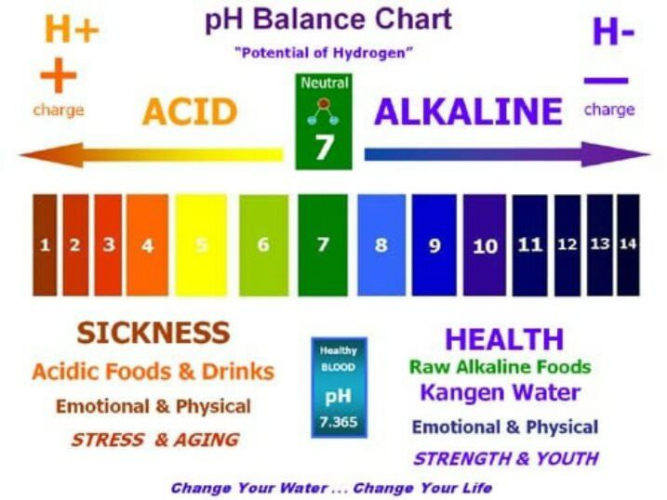
Acid-base Balance
Blood is normally slightly basic, with a
normal pH range of 7.35 to 7.45.
Usually the body maintains the pH of blood close to 7.40.

Slide 47
Breathing plays a major role in acid-base balance in the body.
Acid-base Balance
Changes in pulmonary ventilation (breathing rate, depth of respiration) can help adjust pH when disturbances in pH occur.

Slide 48
The two main organs that help balance the pH of blood are the:
Acid-base Balance
Lungs - removes carbon dioxide (an acid) through breathing (respiration).
Kidneys - removes acids through urine (excretion).

Slide 49
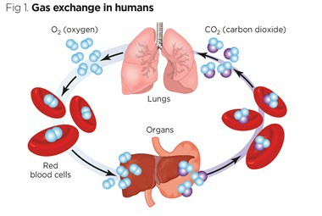

Slide 50
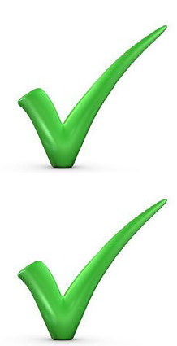
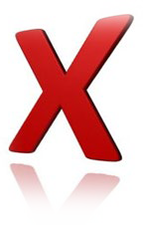
CO₂ is transport
CO₂ is transported in the blood stream by three different means:
as dissolved CO₂ gas in the plasma
in the form of bicarbonate in the blood plasma
by binding to hemoglobin in the erythrocytes
Both methods of transporting CO₂ in the plasma can influence the pH of the plasma.

Slide 51

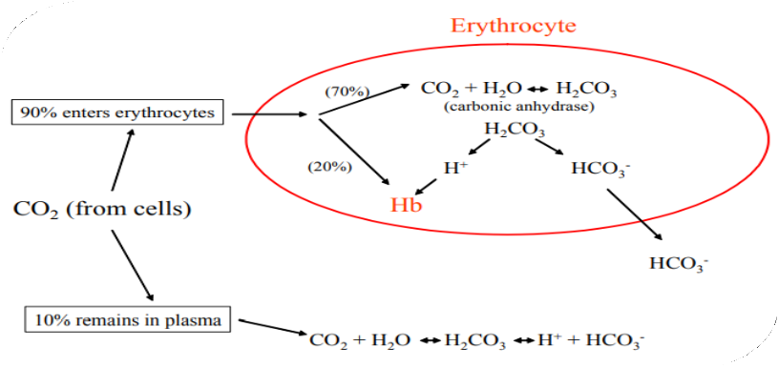
What happens to CO₂
~ 90% of the CO₂ is absorbed by the erythrocytes.
~ 20% binds to hemoglobin
~ 70% reacts with water to form carbonic acid
  The carbonic acid formed subsequently dissociates into H+ and bicarbonate.
  H+ binds to specific amino acid side chains on the hemoglobin
  The bicarbonate is transported out to the blood plasma.
  The bicarbonate formed acts as a buffer against pH changes.
    In other words, if the concentration of hydrogen ions increases, bicarbonate will bind to the free hydrogen ions to form carbonic acid.

Slide 52
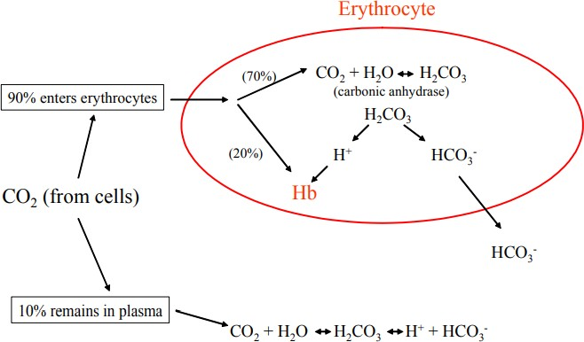
CO₂ is transport
Some of the CO2 dissolved in the plasma can react spontaneously with water to form carbonic acid.
Thus increased CO2 in the plasma tend to decrease plasma pH through increased carbonic acid formation.

Slide 53

Carbon Dioxide (CO₂) reversibly reacts with water to form Carbonic Acid (H₂CO₃).
Carbonic acid dissociates into bicarbonate and hydrogen ions.
Carbon Dioxide Exchange and pH Balance.
CO₂+ H₂O ↔ H₂CO₃ ↔ H⁺ + HCO₃⁻
Carbon Dioxide Water Carbonic Acid Hydrogen Ion Carbonate Ion

Slide 54
When you hold you breath OR if you are not getting enough oxygen…
  CO₂ levels increase
  Carbonic Acid (H₂CO₃) levels increase
  Hydrogen Ion (H⁺) levels increase
  pH levels decrease
  Becomes more acidic
Carbon Dioxide Exchange and pH Balance.
CO₂+ H₂O ↔ H₂CO₃ ↔ H⁺ + HCO₃⁻
Carbon Dioxide Water Carbonic Acid Hydrogen Ion Carbonate Ion

Slide 55
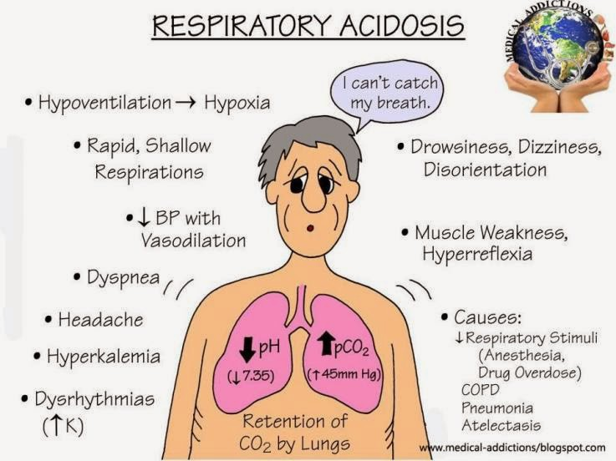
RESULT OF HOLDING YOUR BREATH or NOT GETTING ENOUGH OXYGEN
carbon dioxide accumulates in the blood.
the pH of the blood decreases, becoming more acidic!
Blood pH balance
Acidosis is when your blood pH drops below 7.35 and becomes too acidic.
Alkalosis is when your blood pH is higher than 7.45 and becomes too alkaline.

Slide 56
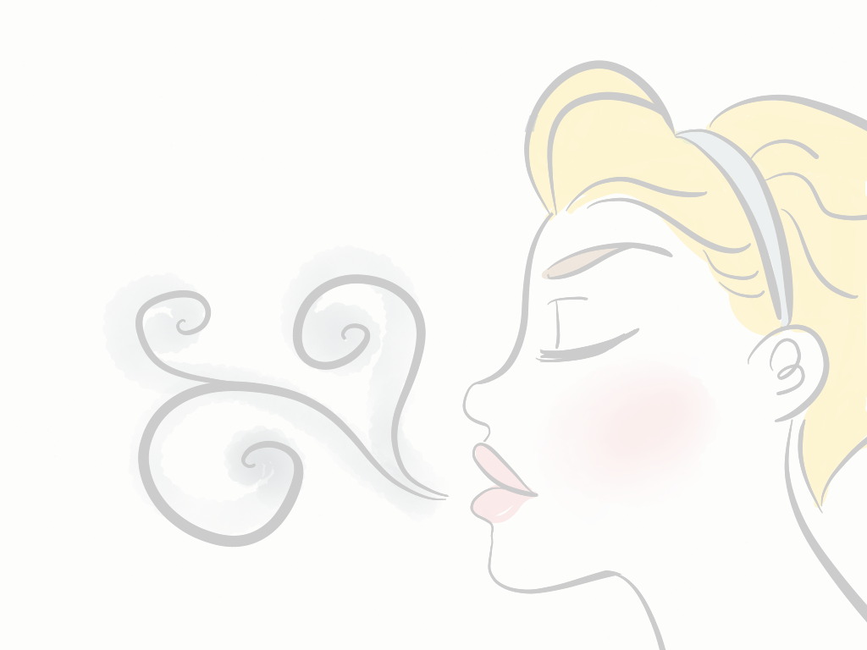


Low pH is called acidosis.
Low blood pH is a more common medical problem than high blood pH.
Acidosis can be a warning sign that a health condition isn’t properly controlled.
Some health conditions cause natural acids to build up in your blood.
  Acids that can lower blood pH include:
    lactic acid
    keto acids
    sulphuric acid
    phosphoric acid
    hydrochloric acid
    carbonic acid
    Diet - In a healthy person, diet does not affect blood pH.

Slide 57
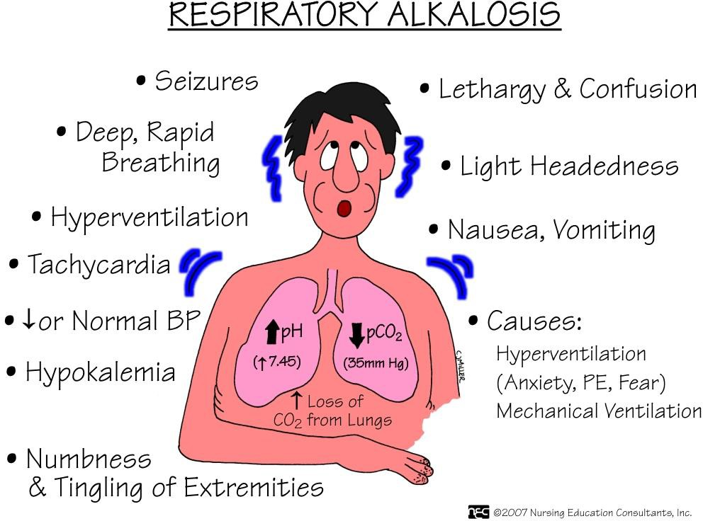
RESULT OF RAPID BREATHING or HYPERVENTALATION
Alkalosis is caused by an overabundance of bicarbonate or a low level of carbon dioxide.
People may have irritability, muscle twitching, muscle cramps, or even muscle spasms.

Slide 58


Alkalosis happens when your blood pH is higher than the normal range.
There are several causes of high blood pH.
  Dehydration (Fluid loss)
    Losing too much water from your body can increase blood pH.
    This happens because you also lose some blood electrolytes (salts and minerals) with water loss.
    These include sodium and potassium.
Causes of fluid loss are excess:
  sweating
  vomiting
  diarrhea
  Diuretic drugs may cause you to urinate too much
  Kidney problems
    - kidneys may not remove enough alkaline substances (such as bicarbonate) through the urine

Slide 59
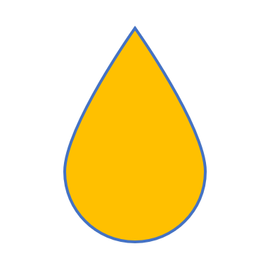
The Urinary System
By Scientist Cindy

Slide 60
What is the Urinary System?
The Urinary System is a group of organs in the body concerned with filtering out excess fluid and other substances from the bloodstream.
  The substances are filtered out from the body in the form of urine.
  Urine is a liquid produced by the kidneys, collected in the bladder and excreted through the urethra.
  Urine is used to extract excess minerals or vitamins from the body.

Slide 61
Functions of the Urinary System
Excretion – the process of eliminating waste products
Maintains an appropriate fluid volume – regulating the amount of water that is excreted in the urine.
Regulates the concentrations of various electrolytes in the body fluids
Maintaining normal pH of the blood.

Slide 62
The Urinary organs
  The Urinary organs include
    the kidneys
    The ureters
    The bladder
    The urethra

Slide 63
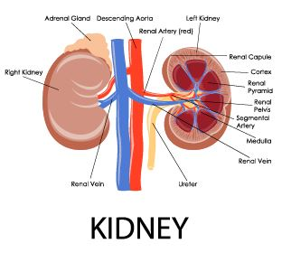
The kidneys
The kidneys are the most important excretory organ.
The primary function of the kidneys is to maintain a stable internal environment (homeostasis) for optimal cell and tissue metabolism.
  The kidneys removes unwanted urea, mineral salts, toxins, and other waste products from the blood.
  The kidneys conserve water, salt, and electrolyte concentration.
  At least one kidney must function properly for life to be maintained.

Slide 64
Six important roles of the kidneys are:
Regulation of plasma ionic composition
Regulation of plasma osmolarity
Regulation of plasma volume
Regulation of plasma hydrogen ion concentration (pH)
Removal of metabolic waste products and foreign substances from the plasma
Secretion of Hormones

Slide 65
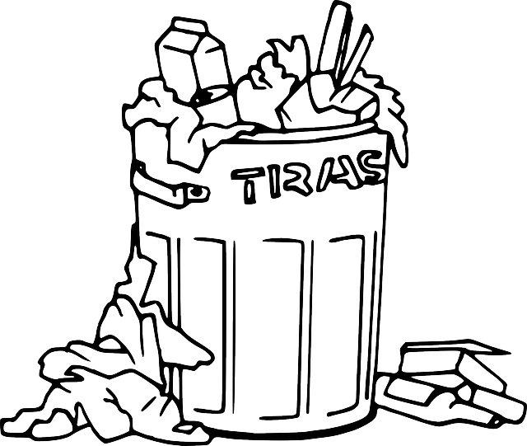
ROLES OF THE KIDNEYS
- Removal of waste
The kidneys get rid of
  Urea - metabolic waste from the liver
  Ammonia - metabolic waste from the liver
  Creatinine - metabolic waste from the muscles
  Uric acid - metabolic waste from the break down of nucleotides.
    Uric acid is insoluble and too much uric acid in the blood will build up and form crystals that can collect in the joints and cause gout.

Slide 66
Kidneys And Their Structure
Renal pyramid
Renal artery
Renal vein
Renal pyramid
Interlobar artery
Renal artery
Renal vein
Renal hilum
Renal pelvis
Ureter
Minor calyx
Renal capsule
Inferior renal capsule
Superior renal capsule
Interlobar vein
Nephron
Minor calyx
Major calyx
Renal papilla
Renal column
Renal hilum
Renal pelvis
Ureter

Slide 67
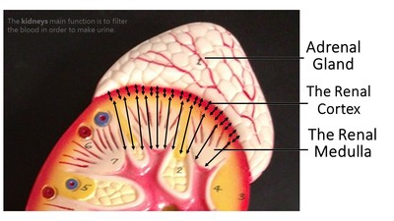
Kidneys And Their Regions
The Renal Cortex
The Renal Medulla

Slide 68
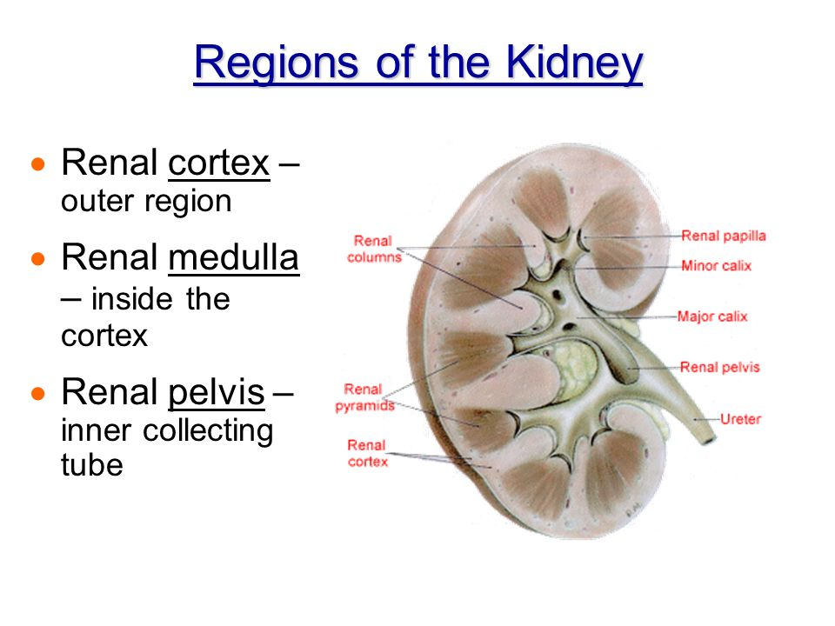
regions of the kidney
There are three major regions of the kidney:
  renal cortex
  renal medulla
  renal pelvis
The outer, granulated layer is the renal cortex
The inner radially striated layer is the renal medulla
The renal medulla contains the renal pyramids
The renal pelvis are continuous with the ureters

Slide 69
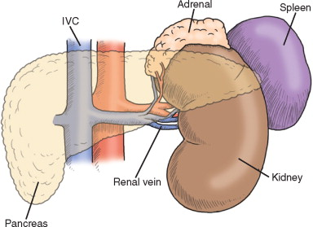
Renal Vein
inferior vena cava
The renal veins are veins that drain the kidney.
They connect the kidney to the inferior vena cava.
Renal vein

Slide 70

Renal Artery
The renal arteries arise off the abdominal aorta and supply the kidneys with blood.
The renal arteries carry a large portion of the total blood flow to the kidneys.
Up to a third of the total cardiac output can pass through the renal arteries to be filtered by the kidneys.

Slide 71

Ureters
The ureters are two tubes that drain urine from the kidneys to the bladder.
Muscles in the walls of the ureters send the urine in small spurts into the bladder
After the urine enters the bladder from the ureters, small folds in the bladder mucosa act like valves preventing backward flow of the urine.

Slide 72

Urinary Sphincters
The outlet of the bladder is controlled by a sphincter muscle.
  A full bladder stimulates sensory nerves in the bladder wall that relax the sphincter and allow release of the urine. However, relaxation of the sphincter is also in part a learned response under voluntary control.
  The released urine enters the urethra.

Slide 73

The urethra
The urethra is a muscular tube that connects the bladder with the outside of the body.
The function of the urethra is to remove urine from the body.

Slide 74
The female urethra is much shorter than the male urethra.

Slide 75
The Female Urethra
The female urethra is much shorter than the male urethra.
Women tend to be more susceptible to infections of the bladder (cystitis) and the urinary tract (UTI).

Slide 76
Male urethra
In the human male, the urethra is a common pathway for semen as well as urine.
The urethral sphincter is much stronger in males
  meaning that they can retain a large amount of urine for twice as long as females

Slide 77

Nephrons
A nephron is the basic structural and functional unit of the kidney.
Its chief function is to
  regulate water and soluble substances by filtering the blood
  reabsorbing what is needed and excreting the rest as urine.

Slide 78
Nephrons
Nephrons
  Eliminate wastes from the body
  Regulate blood volume
  Regulate blood pressure
  Control levels of electrolytes and metabolites
  Regulate blood ph

Slide 79

Nephrons
Each nephron is composed of
  an initial filtering component (the renal corpuscle)
  a tubule specialized for reabsorption and secretion (the renal tubule).

Slide 80

Renal Tubules

Slide 81

Renal Corpuscle
Together, the Glomerulus and Glomerular Capsule or Bowman's Capsule are called the Renal Corpuscle.
Between the visceral and parietal layers of the Renal Corpuscle is the Bowman's space.

Slide 82
The renal corpuscle
The renal corpuscle
  Filters out large solutes from the blood
  Allows water and small solutes to move on to the renal tubule

Slide 83

Collecting ducts
Each distal convoluted tubule delivers its filtrate to a system of collecting ducts.
As the urine travels down the collecting duct, as much as three-fourths of the water from urine can be reabsorbed as it leaves the collecting duct by osmosis.

Slide 84

Tubular Secretion
Urine is a collection of substances that have not been reabsorbed during glomerular filtration or tubular reabsorbtion.

Slide 85

The Digestive System
By Scientist Cindy

Slide 86
FUNCTIONS OF THE DIGESTIVE SYSTEM
2 functions of the digestive system :
  Digestion
  Absorption
The Gastrointestinal System is responsible for
  the breakdown and absorption of various foods and liquids needed to sustain life.

Slide 87

FUNCTIONS OF THE DIGESTIVE SYSTEM
  During digestion, two main processes occur at the same time;
    Mechanical Digestion
    Chemical Digestion

Slide 88

Mechanical Digestion:
Mechanical Digestion: larger pieces of food get broken down into smaller pieces while being prepared for chemical digestion.
Mechanical digestion starts in the mouth and continues into the stomach.

Slide 89

Chemical Digestion:
Chemical Digestion: starts in the mouth and continues into the intestines.
Several different enzymes break down macromolecules into smaller molecules that can be absorbed.

Slide 90

The GI Tract
The GI tract includes
  The Mouth
  The Esophagus
  The Stomach
  The Small Intestine (Duodenum, Jejunum, Ileum)
  The Large Intestine (Colon)
  Rectum
  Anus

Slide 91
Accessory Organs
1. Salivary glands
2. Tongue
3. Teeth
4. Liver
5. Gallbladder
6. Pancreas
7. Vermiform appendix

Slide 92

Salivary glands
  The 3 salivary glands –
    Parotid Gland
    Submandibular Gland
    Sublingual Gland
  The Salivary Glands are exocrine glands that produce saliva which begins the process of digestion with amylase, and moistens the food creating a bolus.

Slide 93

Tongue and Teeth
Tongue
Manipulates food for chewing/swallowing
Main taste organ, covered in taste buds
Teeth
For chewing food up
This Photo by Unknown Author is licensed under CC BY-SA-NC

Slide 94

Liver
Produces and excretes bile required for emulsifying fats.
  Some of the bile drains directly into the duodenum and some is stored in the gall bladder.
Helps metabolize proteins, lipids, and carbohydrates.
Urea is formed in liver from amino acids and compounds of ammonia.
Breaks down insulin and other hormones.
Produces coagulation factors.

Slide 95

Liver
The liver produces and excretes bile required for emulsifying fats.
  Some of the bile drains directly into the duodenum and some is stored in the gall bladder.

Slide 96

Gallbladder
FUNCTION:
Bile storage – Stores and Concentrated Biles from the Liver

Slide 97

Pancreas
Releases pancreatic juice into the duodenum.
Pancreatic juice has many digestive enzymes.

Slide 98

Vermiform Appendix
There are a few theories on what the appendix does.
Vestigal organ
Immune function
Helps maintain gut flora

Slide 99

The gastrointestinal tract
The gastrointestinal tract, is also called the digestive tract, alimentary canal, or gut
It is the system of organs that
  takes in food
  digests it
  expels waste

Slide 100

The alimentary canal
The alimentary canal is the long tube of organs that runs from the mouth (where the food enters) to the anus (where indigestible waste leaves).

Slide 101
2 Processes of Digestion
During digestion two main processes occur at the same time:
Mechanical Digestion:
  larger pieces of food get broken down into smaller pieces while being prepared for chemical digestion.
  Mechanical digestion starts in the mouth and continues in to the stomach.
Chemical Digestion:
  several different enzymes break down macromolecules into smaller molecules that can be more efficiently absorbed.
  Chemical digestion starts with saliva and continues into the intestines.

Slide 102
Digestive System Basics
The average adult digestive tract is about thirty feet (30') long.
While in the digestive tract the food is really passing through the body rather than being in the body.
The smooth muscles of the tubular digestive organs move the food efficiently along as it is broken down into absorb-able atoms and molecules.
During absorption, the nutrients that come from food (such as proteins, fats, carbohydrates, vitamins, and minerals) pass through the wall of the small intestine and into the bloodstream and lymph.
In this way nutrients can be distributed throughout the rest of the body.
In the large intestine there is re absorption of water and absorption of some minerals as feces are formed.
The parts of the food that the body passes out through the anus is known as feces.

Slide 103

Mastication
Digestion begins in the mouth.
Saliva moistens the food while
Teeth chew it up and make it easier to swallow.
Amylase, which is the digestive enzyme found in saliva, starts to break down starch into simpler sugars before the food even leaves the mouth.

Slide 104

The Pharynx (Throat)
(Nasopharynx, Oropharynx, Laryngopharynx)
Swallowing your food happens when the muscles in your tongue and mouth move the food into your oropharynx, then on to the laryngopharynx.
The pharynx is a common passageway for air (in the respiratory system) and for food (in the digestive system).

Slide 105

THE EPIGLOTTIS
A small flap of skin called the epiglottis closes over the pharynx to prevent food from entering the trachea and thus choking.
For swallowing to happen correctly a combination of 25 muscles must all work together at the same time.

Slide 106
ENZYME
SUMMARY
Carbohydrate Digestion: | Enzymes are Secreted From…. | Where Does it Occur?
 | Salivary glands | Mouth
 | Pancreas | Small intestine
Protein Digestion:
 | Gastric glands | Stomach
 | Pancreas | Small intestine
Nucleic Acid Digestion:
 | Pancreas | Small intestine
 | Pancreas | Small intestine
Fat Digestion:
 | Pancreas | Small intestine

Slide 107

ESOPHAGUS
The esophagus is the muscular tube through which food passes from the pharynx (throat) to the stomach.
This is where the second stage of digestion is initiated (the first stage is in the mouth with teeth and tongue masticating food and mixing it with saliva).

Slide 108

peristalsis
After passing through the throat, the food moves into the esophagus and is pushed down into the stomach by the process of peristalsis.
peristalsis is the involuntary wavelike muscle contractions that occur along the G.I. tract.
peristalsis is how food is pushed through the G.I. tract
The esophagus is lined with mucus membranes, and uses peristaltic action to move swallowed food down to the stomach.

Slide 109

CARDIAC SPHINCTER
This part of the esophagus is called the lower esophageal sphincter a.k.a. the cardiac sphincter.
This aids in keeping food down and not being regurgitated.

Slide 110


Slide 111

The stomach
The stomach is a thick walled organ that lies between the esophagus and the first part of the small intestine (the duodenum).
It is on the left side of the abdominal cavity.
The fundus of the stomach lying against the diaphragm.

Slide 112

The stomach
On the inside of the stomach there are folds of skin call the gastric rugae.
Gastric rugae make the stomach very extendable, especially after a very big meal.

Slide 113

The stomach
The stomach is divided into four sections, each of which has different cells and functions.
1) Cardiac region, where the contents of the esophagus empty into the stomach,
2) Fundus, formed by the upper curvature of the organ,
3) Body, the main central region, and
4) Pylorus or atrium, the lower section of the organ that facilitates emptying the contents into the small intestine.

Slide 114

Stomach Sphincters
Two smooth muscle valves, or sphincters, keep the contents of the stomach contained.
1) Cardiac or esophageal sphincter
2) Pyloric sphincter

Slide 115

Chyme
After receiving the bolus (chewed food) the stomach undergoes smooth muscular contractions (peristalsis) mixed and churned with gastric juices the bolus is transformed into a semi-liquid substance called chyme.

Slide 116
Digestion in the stomach
Stomach muscles mix up the food with enzymes and acids to make smaller digestible pieces.
The pyloric sphincter, a walnut shaped muscular tube at the stomach outlet, keeps chyme in the stomach until it reaches the right consistency to pass into the small intestine.
The food leaves the stomach in small squirts rather than all at once.

Slide 117
Digestion in the stomach
Water, alcohol, salt, and simple sugars can be absorbed directly through the stomach wall.
However, most substances in our food need a little more digestion and must travel into the intestines before they can be absorbed.

Slide 118
Small Intestines
The small intestine is the site where most of the chemical and mechanical digestion is carried out.
Tiny projections called villi line the small intestine which absorbs digested food into the capillaries.
Most of the food absorption takes place in the jejunum and the ileum.

Slide 119

The three main sections of the small intestine
The three main sections of the small intestine are
the duodenum
the jejunum
the ileum

Slide 120
The duodenum
The duodenum
It is the first and shortest part of the small intestine.
The duodenum is also where the bile and pancreatic juices enter the intestine.
Most digestion occurs HERE!

Slide 121
The jejunum
The jejunum is a part of the small intestines that lies after the duodenum and before the ileum.
The inner surface of the jejunum, its mucous membrane, is covered in projections called villi, which increase the surface area of tissue available to absorb nutrients from the gut contents.

Slide 122
The ileum
The cells that line the ileum contain the protease and carbohydrate enzymes responsible for the final stages of protein and carbohydrate digestion.

Slide 123

The large intestine (colon)
The large intestine (colon) extends from the end of the ileum to the anus. It is about 5 feet long, being one-fifth of the whole extent of the intestinal canal.
It's caliber is largest at the commencement at the cecum, and gradually diminishes as far as the rectum, where there is a dilatation of considerable size just above the anal canal.
This Photo by Unknown Author is licensed under CC BY-SA

Slide 124

The large intestine
The large intestine is divided into the cecum, ascending colon, transverse colon, the descending, sigmoid colon (flexure) rectum, and anal canal.

Slide 125

Ductal System
  The bile produced in the liver is collected in bile canaliculi, which merge from bile ducts.
  These eventually drain into the right and left hepatic ducts.
  The right and left hepatic ducts merge to form the common hepatic duct.

Slide 126

Anus
The Anus has two anal sphincters
  Internal Anal Sphincter
  External Anal Sphincter
These hold the anus closed until defecation occurs.
  The internal sphincter - consists of smooth muscle and its action is involuntary
  The external sphincter The other consists of striated muscle and its action is voluntary.

