Slide 1
LUNG LAB
BY SCIENTIST CINDY

Slide 2
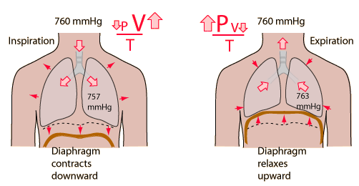
Breathing
Air flow into and out of the lungs is driven by pressure differences between the atmospheric air and air in the lungs.
When atmospheric pressure exceeds intrapulmonary pressure, air flows into the lungs.
When intrapulmonary pressure exceeds atmospheric pressure, air flows out of the lungs.

Slide 3
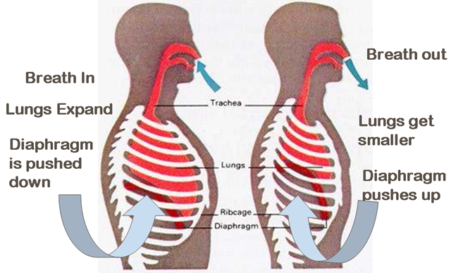
Changes in intrapulmonary pressure
Changes in intrapulmonary pressure are driven by changing the volume of the lungs.
According to Boyle’s Law, the pressure exerted by a given amount of gas at a constant temperature is inversely proportional to the volume of that gas.
Thus increasing the volume of the lungs will decrease intrapulmonary pressure, whereas decreasing lung volume will increase intrapulmonary pressure.

Slide 4
Spirometry
Spirometry is a test that measures lung function.
A spirometer measures the amount of air (volume) traveling out of the lungs during exhalation (expiration).

Slide 5
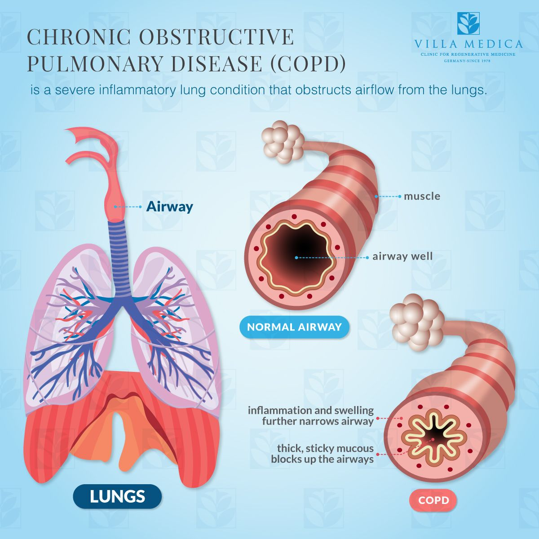
Spirometry Uses
Spirometry can be useful in identifying conditions that affect the lungs such as…
Asthma
Pulmonary Fibrosis
Cystic Fibrosis
Chronic Obstructive Pulmonary Disease (COPD)

Slide 6
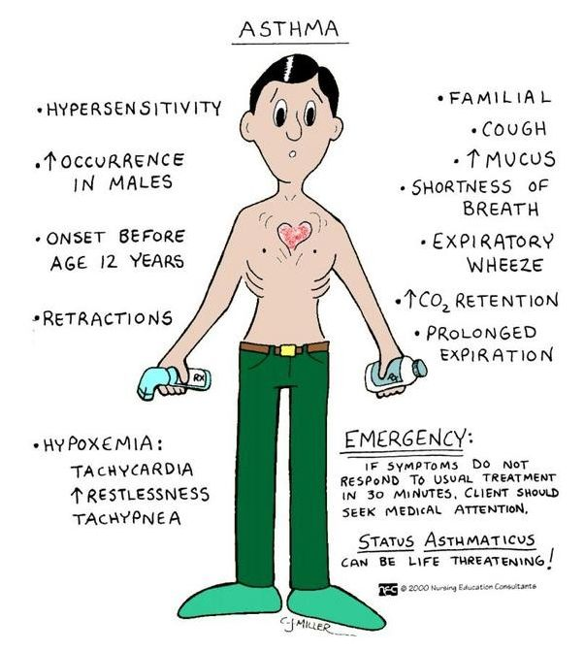
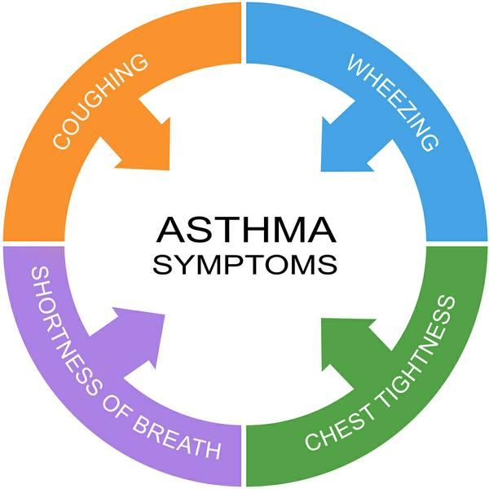
Asthma

Slide 7
Pulmonary Fibrosis

Slide 8
Cystic Fibrosis

Slide 9
Chronic Obstructive Pulmonary Disease (COPD)

Slide 10
Acid-base Balance
Breathing plays a major role in acid-base balance in the body.
Changes in pulmonary ventilation (breathing rate, depth of respiration) can help adjust pH when disturbances in pH occur.

Slide 11
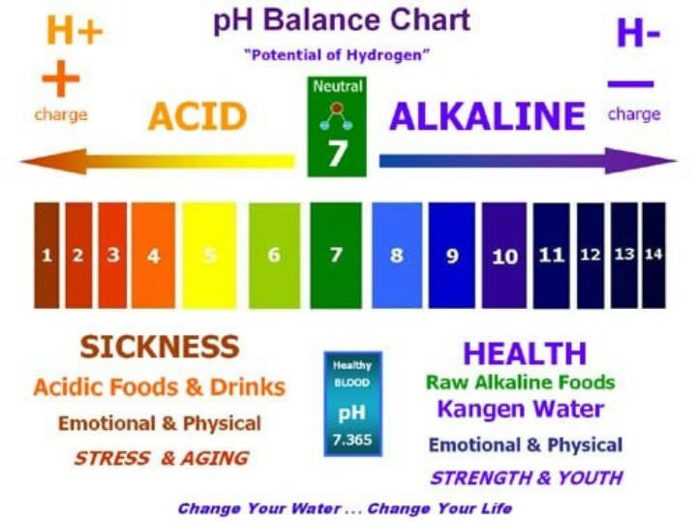
Acid-base Balance
Blood is normally slightly basic, with a normal pH range of 7.35 to 7.45.
Usually the body maintains the pH of blood close to 7.40.

Slide 12
Acid-base Balance
Carbon Dioxide is acidic (an acid)
Bicarbonate is basic (a base)

Slide 13
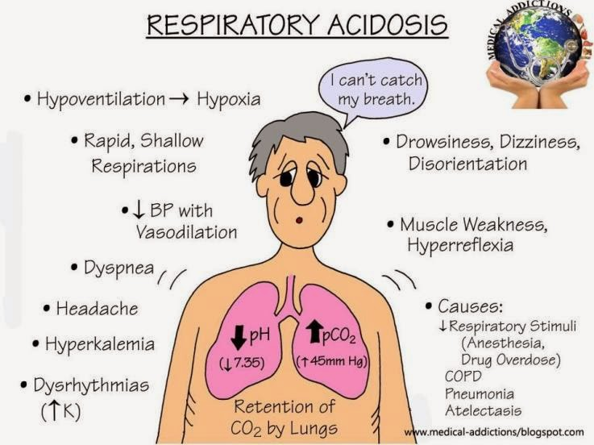
RESULT OF HOLDING YOUR BREATH or NOT GETTING ENOUGH OXYGEN
carbon dioxide accumulates in the blood.
the pH of the blood decreases, becoming more acidic!
Blood pH balance
Acidosis is when your blood pH drops below 7.35 and becomes too acidic.
Alkalosis is when your blood pH is higher than 7.45 and becomes too alkaline.

Slide 14
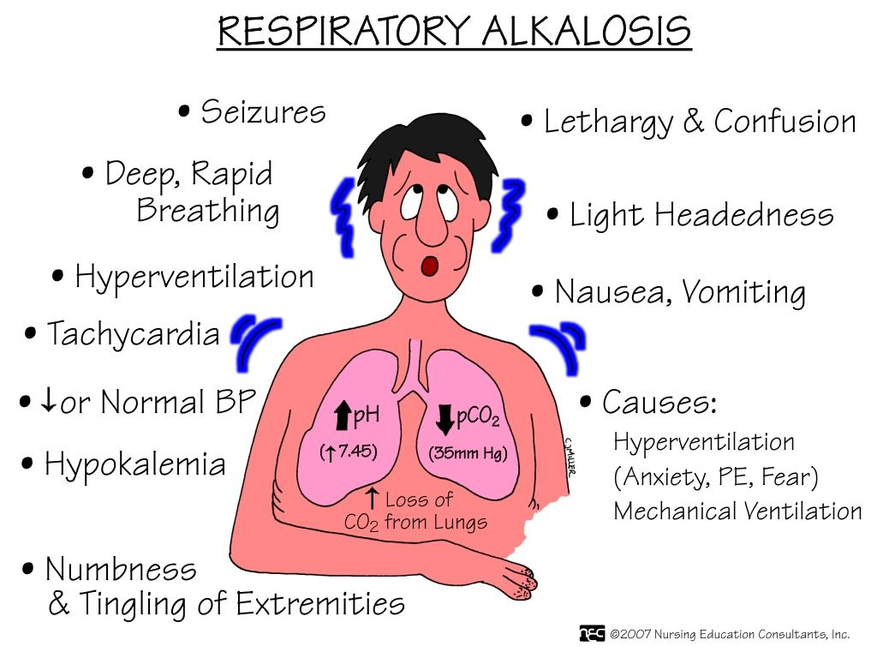
RESULT OF RAPID BREATHING or HYPERVENTALATION
Alkalosis is caused by an overabundance of bicarbonate or a low level of carbon dioxide.
People may have irritability, muscle twitching, muscle cramps, or even muscle spasms.

Slide 15
Acid-base Balance
The two main organs that help balance the pH of blood are the:
Lungs - removes carbon dioxide (an acid) through breathing (respiration).
Kidneys - removes acids through urine (excretion).

Slide 16
Causes of pH changes - High pH
Alkalosis happens when your blood pH is higher than the normal range.
There are several causes of high blood pH.
Dehydration (Fluid loss)
Losing too much water from your body can increase blood pH.
This happens because you also lose some blood electrolytes (salts and minerals) with water loss.
These include sodium and potassium.
Causes of fluid loss are excess:
sweating
vomiting
diarrhea
Diuretic drugs may cause you to urinate too much
Kidney problems
- kidneys may not remove enough alkaline substances (such as bicarbonate) through the urine

Slide 17
Causes of pH changes - Low pH
Low pH is called acidosis.
Low blood pH is a more common medical problem than high blood pH.
Acidosis can be a warning sign that a health condition isn’t properly controlled.
Some health conditions cause natural acids to build up in your blood.
Acids that can lower blood pH include:
lactic acid
keto acids
sulphuric acid
phosphoric acid
hydrochloric acid
carbonic acid
Diet - In a healthy person, diet does not affect blood pH.

Slide 18
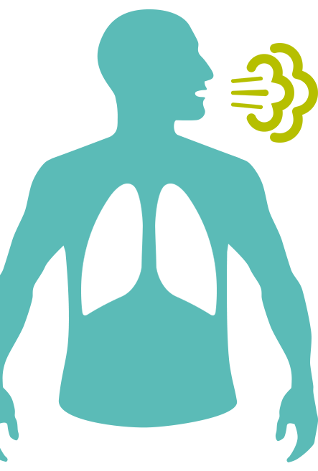
Respiratory Rate
Respiratory rate: A person's respiratory rate is the number of breaths you take per minute.
The normal respiration rate for an adult at rest is 12 to 20 breaths per minute.
A respiration rate under 12 or over 25 breaths per minute while resting is considered abnormal.

Slide 21
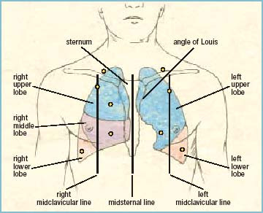
Auscultation and Lung Sounds
Lung sounds, also called breath sounds, can be auscultated across the anterior and posterior chest walls with a stethoscope.
Adventitious lung sounds are
Crackles
Wheezes
SOUND REFERRENCE GUIDE -
https://www.easyauscultation.com/lung-sounds-reference-guide

Slide 22
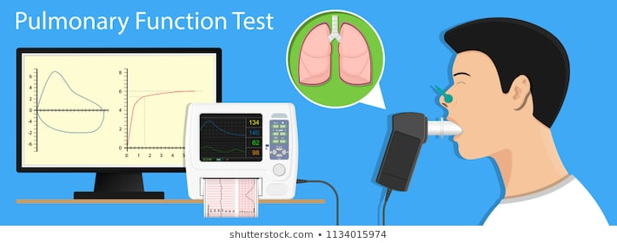
SPIROMETRY
https://www.youtube.com/watch?v=bdkyrngFhho

Slide 23
LUNG CAPACITY
TV

Slide 24
Definitions
TLC | Total lung capacity: the volume in the lungs at maximal inflation, the sum of VC and RV.
TV | Tidal volume: that volume of air moved into or out of the lungs during quiet breathing (TV indicates a subdivision of the lung; when tidal volume is precisely measured, as in gas exchange calculation, the symbol TV or V_{T}is used.)
RV | Residual volume: the volume of air remaining in the lungs after a maximal exhalation
ERV | Expiratory reserve volume: the maximal volume of air that can be exhaled from the end-expiratory position
IRV | Inspiratory reserve volume: the maximal volume that can be inhaled from the end-inspiratory level
IC | Inspiratory capacity: the sum of IRV and TV
IVC | Inspiratory vital capacity: the maximum volume of air inhaled from the point of maximum expiration
VC | Vital capacity: the volume of air breathed out after the deepest inhalation.
V_{T} | Tidal volume: that volume of air moved into or out of the lungs during quiet breathing (VT indicates a subdivision of the lung; when tidal volume is precisely measured, as in gas exchange calculation, the symbol TV or V_{T}is used.)
FRC | Functional residual capacity: the volume in the lungs at the end-expiratory position

Slide 25
AVERAGE VALUES - LUNG CAPACITIES
Lung capacities in healthy adults[10]
Volume | Average value (litres) |  | Derivation
 | In men | In women
Vital capacity | 4.6 | 3.1 | IRV + TV + ERV
Inspiratory capacity | 3.5 | 2.4 | IRV + TV
Functional residual capacity | 2.3 | 1.8 | ERV + RV
Total lung capacity | 5.8 | 4.2 | IRV + TV + ERV + RV

Slide 26
AVERAGE VALUES - LUNG VOLUMES
Average lung volumes in healthy adults[10]
Volume | Value (litres)
 | In men | In women
Inspiratory reserve volume (IRV) | 3.0 | 1.9
Tidal volume (TV) | 0.5 | 0.5
Expiratory reserve volume (ERV) | 1.1 | 0.7
Residual volume (RV) | 1.2 | 1.1

Slide 27
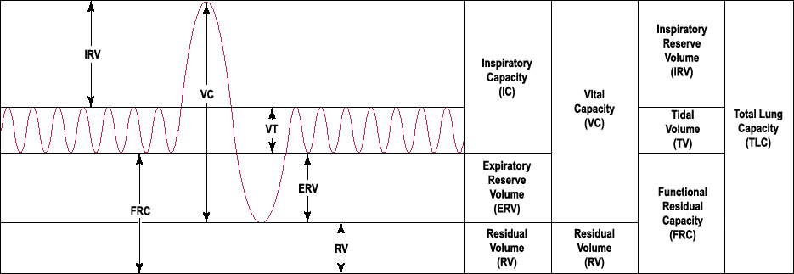
TIDAL VOLUME (TV):
TV
TIDAL VOLUME IS MEASURED AS FOLLOWS:
Inhale normally and then exhale normally into the spirometer.
Tidal volume (symbol VT or TV) is the lung volume representing the normal volume of air displaced between normal inhalation and exhalation when extra effort is not applied.
In a healthy, young human adult, tidal volume is approximately 500 mL or 0.5L

Slide 28
EXPIRATORY RESERVE VOLUME (ERV):
TV
The expiratory reserve volume is the maximum volume of air that can forcibly expired beyond a normal tidal expiration.
Average ERV at rest is approximately 1100 ml (1.1 L) for men and 700 ml (0.7 L) for women at rest.
EXPIRATORY RESERVE VOLUME is measured as follows:
Inhale normally, exhale normally, and then take a deep exhalation until you cannot exhale any longer into the spirometer.

Slide 29
VITAL CAPACITY (TC):
TV
VITAL CAPACITY is measured as follows :
Take a deep inhalation and then take a deep exhalation until you cannot exhale any longer into the spirometer.
A normal adult has a vital capacity between 3 and 5 litres.

Slide 30
RESIDUAL VOLUME (RV):
TV
The residual volume (RV) is the amount of air that remains in the lungs following a maximal expiration, and can only be forced out of the lungs by collapsing the lungs.
The RV for men is approximately 1200 ml (1.2 L) and approximately 1100 ml (1.1 L) in women.

Slide 31
RESIDUAL VOLUME (RV):
TV
Residual Volume cannot be directly measured, because this is the volume (amount of space) in your lungs that remains AFTER you have forcefully breathed out as much as possible.
However, we CAN get an estimate of this value by calculating the the residual volume from other values that can be directly measured!
$RESIDUAL VOLUME \left(RV\right)=VITAL CAPACITY \left(VC\right)×RV FACTOR \left(a\right)$, *where (a) is the RV Factor given in the lines below.
RV factors (a) based on age:
16-34 years old = 0.250
35-49 years old = 0.305
50-69 years old = 0.445
The RV for men is approximately 1200 ml (1.2 L) and approximately 1100 ml (1.1 L) in women.

Slide 32
INSPIRATORY RESERVE VOLUME (IRV):
TV
IRV can be calculated as follows:
$INSPIRATORY RESERVE VOLUME \left(IRV\right)=VITAL CAPACITY \left(VC\right)−TIDAL VOLUME \left(TV\right)$
Average Inspiratory reserve volume (IRV) | 3000 mL (3.0 L) in males | 1900 mL(1.9 L) in females

Slide 33
INSPIRATORY CAPACITY (IC):
Lung capacities in healthy adults[10]
Volume | Average value (litres) |  | Derivation
 | In men | In women
Inspiratory capacity | 3.5 | 2.4 | IRV + TV
I
TV
INSPIRATORY CAPACITY (IC) can be calculated as follows:
$$INSPIRATORYCAPACITY \left(IC\right)=$$
$INSPIRATORY RESERVE VOLUME \left(IRV\right)+ TIDAL VOLUME \left(TV\right)$

Slide 34
FUNCTIONAL RESIDUAL CAPACITY (FRC):
Lung capacities in healthy adults[10]
Volume | Average value (litres) |  | Derivation
 | In men | In women
Functional residual capacity | 2.3 | 1.8 | ERV + RV
TV
FUNCTIONAL RESIDUAL CAPACITY (FRC) can be calculated as follows:
$$FUNCTIONAL RESIDUAL CAPACITY \left(FRC\right)=$$
$EXPIRATORY RESERVE VOLUME \left(ERV\right)+RESIDUAL VOLUME \left(RV\right)$

Slide 35
INSPIRATORY CAPACITY (IC):
Lung capacities in healthy adults[10]
Volume | Average value (litres) |  | Derivation
 | In men | In women
Inspiratory capacity | 3.5 | 2.4 | IRV + TV
TV
INSPIRATORY CAPACITY (IC): can be calculated as follows:
$INSPIRATORY RESERVE VOLUME \left(IRV\right)=VITAL CAPACITY \left(VC\right)−TIDAL VOLUME \left(TV\right)$

Slide 36
TOTAL LUNG CAPACITY (TLC):
Lung capacities in healthy adults[10]
Volume | Average value (litres) |  | Derivation
 | In men | In women
Total lung capacity | 5.8 | 4.2 | IRV + TV + ERV + RV
TV
TOTAL LUNG CAPACITY (TLC) can be calculated as follows:
$$TOTAL LUNG CAPACITY \left(TLC\right)=$$
$VITAL CAPACITY \left(VC\right) +RESIDUAL VOLUEME \left(RV\right)$

Slide 37
Measure Your Actual Vital Capacity
Inhale normally, exhale normally, and then take a deep exhalation into the spirometer.
Repeat 3 times and take the average.
$\frac{\left(Measured VC Value \#1+ Measured VC Value \#2+ Measured VC Value \#3\right)}{3}=AVERAGE VC Value$

Slide 38
Find Your Predicted Vital Capacity
Predicted VC (in L):
Male = 0.052(H) – 0.022(A) – 3.6
Female = 0.041(H) – 0.018(A) – 3.6
c. (H) = height in cm
d. (A) = Age in years
e. (VC) = predicted vital capacity in L
$$PREDICTED VITAL CAPACITY for Females=$$
$$\left[0.041 ×\left(your height in cm\right)\right]−\left[0.018×\left(your age in yrs\right)\right]−3.6$$
$$PREDICTED VITAL CAPACITY for Males=$$
$$\left[0.052 ×\left(your height in cm\right)\right]−\left[0.022×\left(your age in yrs\right)\right]−3.6$$

Slide 39
Find Your Percent Predicted Vital Capacity
Calculate Percent Predicted Vital Capacity.
$$\% PREDICTED CAPACITY \left(\% VC\right)=$$
$$\left(directly measured VC Value in ml\right)÷\left(predicted VC Value in ml\right)×100$$

Slide 40
Carbon Dioxide Exchange and pH Balance.
Carbon Dioxide (CO₂) is an important factor in the regulation of pH in the human body, because Carbon Dioxide (CO₂) in solution can reversibly react with water to form Carbonic Acid (H₂CO₃).
CO₂+ H₂O ↔ H₂CO₃
Carbon Dioxide
Water
Carbonic Acid

Slide 41
Carbon Dioxide Exchange and pH Balance.
Carbonic acid, in turn, may dissociate into bicarbonate and hydrogen ions.
This results in raising the H⁺ concentration which lowers the pH, making it more ACIDIC.
H₂CO₃ ↔ H⁺ + HCO₃⁻
Carbonic Acid
Hydrogen Ion
Carbonate

Slide 42
CO₂ is transport
CO₂ is transported in the blood stream by three different means:
as dissolved CO₂ gas in the plasma
in the form of bicarbonate in the blood plasma
by binding to hemoglobin in the erythrocytes
Both methods of transporting CO₂ in the plasma can influence the pH of the plasma.

Slide 43
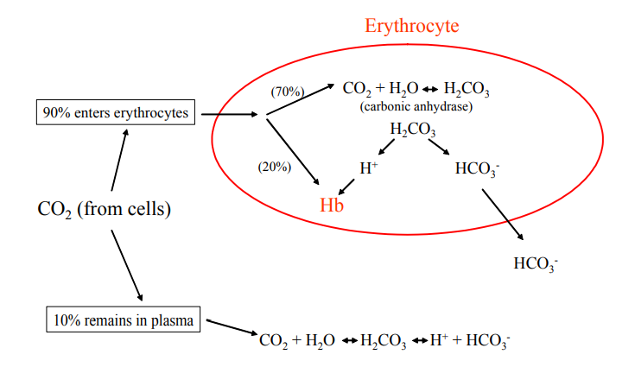
CO₂ is transport
Some of the CO2 dissolved in the plasma can react spontaneously with water to form carbonic acid.
Thus increased CO2 in the plasma tend to decrease plasma pH through increased carbonic acid formation.

Slide 44
What happens to CO₂
~ 90% of the CO₂ is absorbed by the erythrocytes.
~ 20% binds to hemoglobin
~ 70% reacts with water to form carbonic acid
The carbonic acid formed subsequently dissociates into H+ and bicarbonate.
H+ binds to specific amino acid side chains on the hemoglobin
The bicarbonate is transported out to the blood plasma.
The bicarbonate formed acts as a buffer against pH changes.
In other words, if the concentration of hydrogen ions increases, bicarbonate will bind to the free hydrogen ions to form carbonic acid.

Slide 45
Measuring pH - Phenolphthalein
Phenolphthalein is an acid/base indicator.
It is colorless when acidic (pH < 7.0)
It is pink when basic (pH > 7.0)

Slide 46
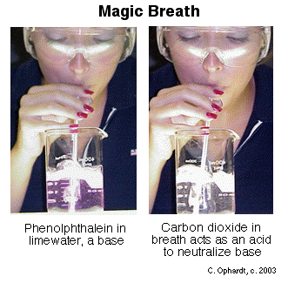
pH Balance
Saturated phenolphthalein solution
(pH indicator;
clear=acid, pink=basic)
Insert the straw into the beaker and blow OUTWARD.
The color will start to change from pink to colorless.

Slide 47
pH Balance
When you exhale into the solution, the carbon dioxide in a person's breath reacted with the water to form Carbonic Acid.

