Slide 1
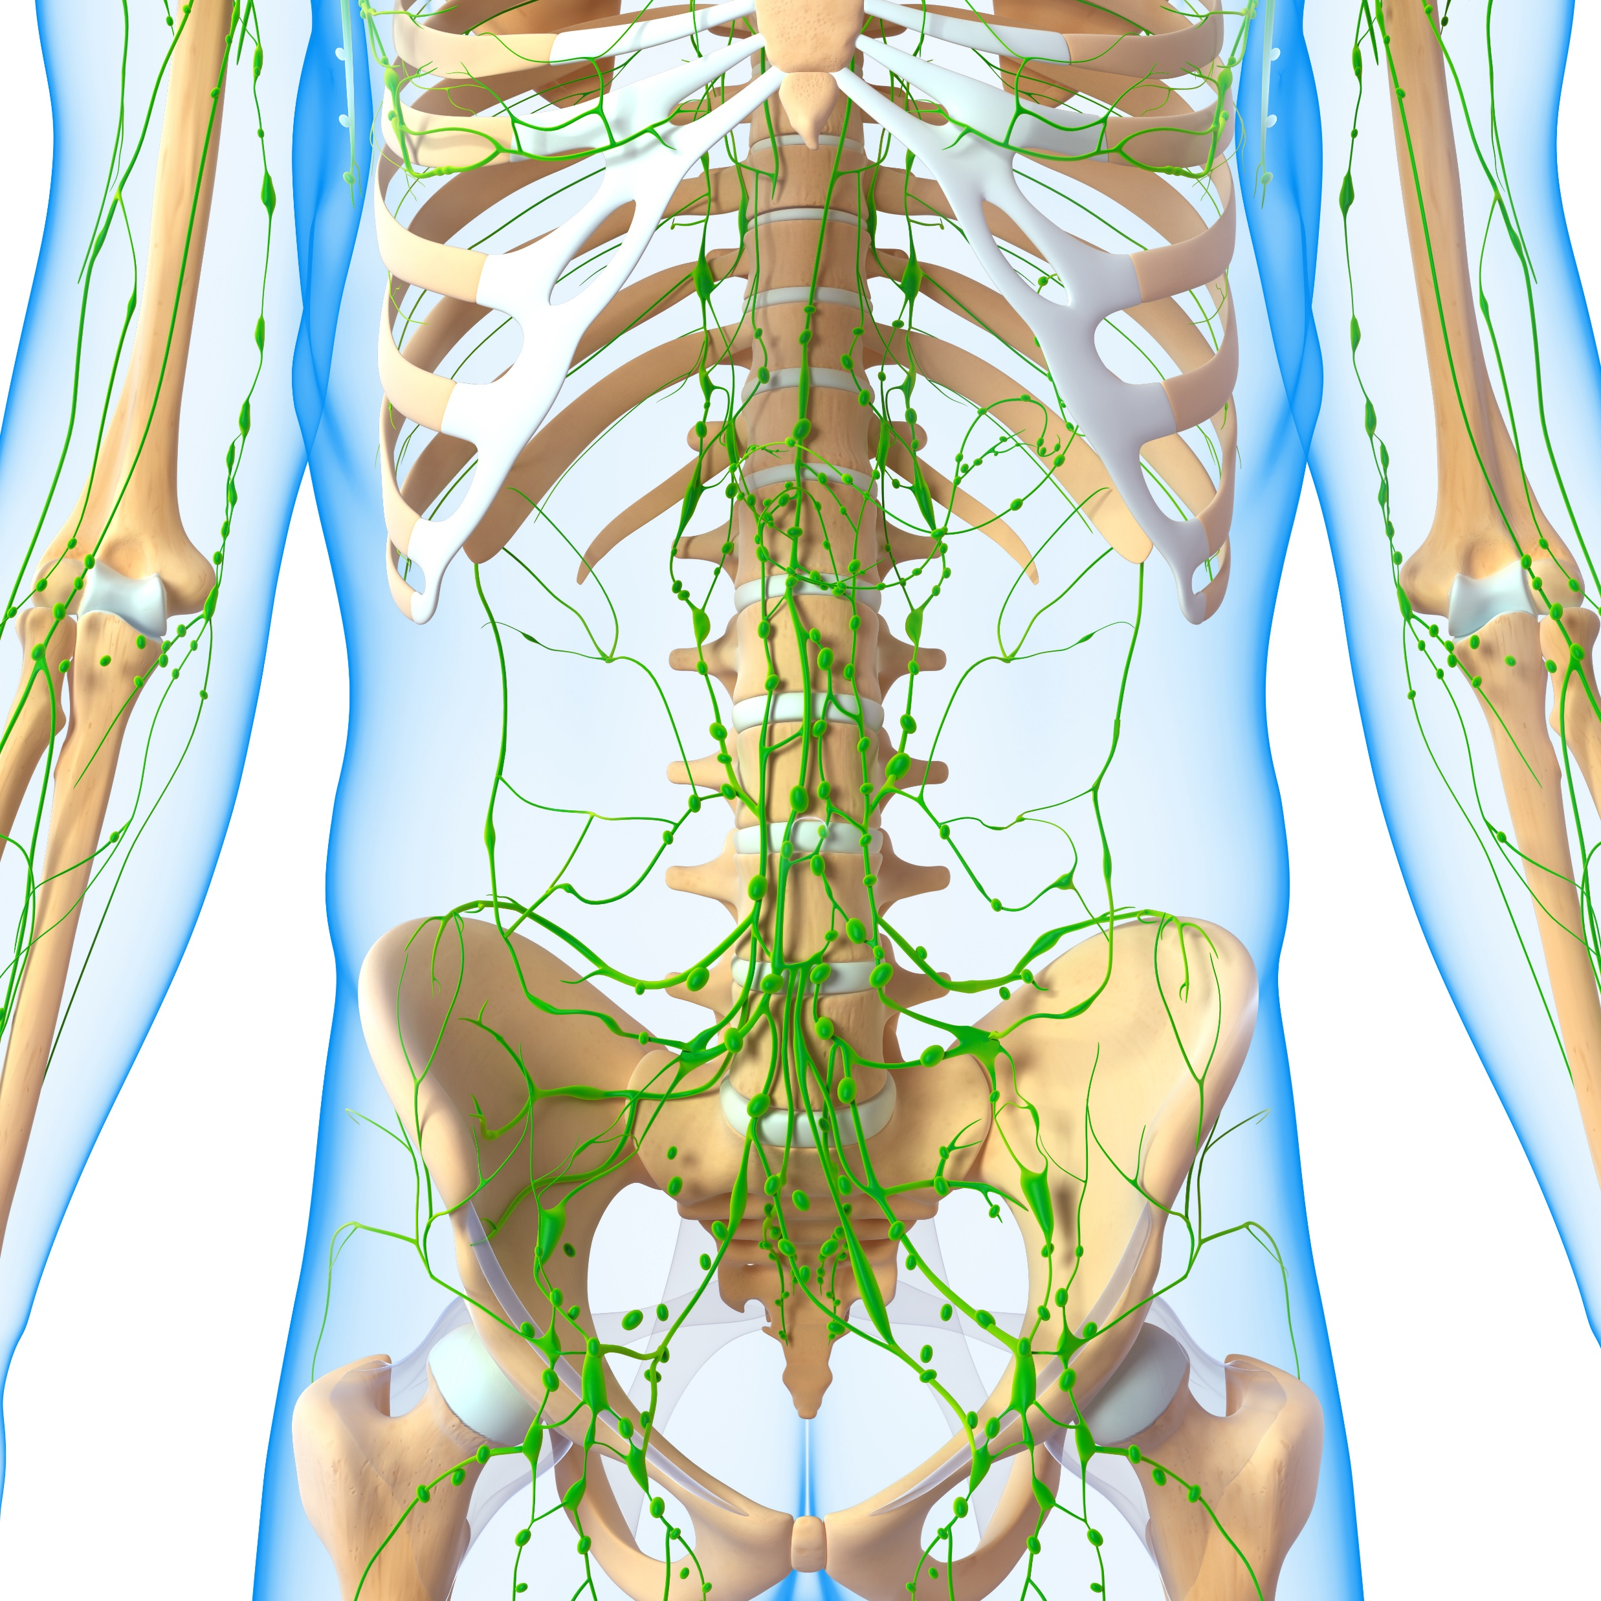
THE LYMPHATIC SYSTEM

Slide 2
OBJECTIVES
Describe the structure and function of the lymphatic tissue (lymph fluid, vessels, ducts, and organs)
Describe the structure and function of the primary and secondary lymphatic organs
Discuss the cells of the immune system, how they function, and their relationship with the lymphatic system

Slide 3
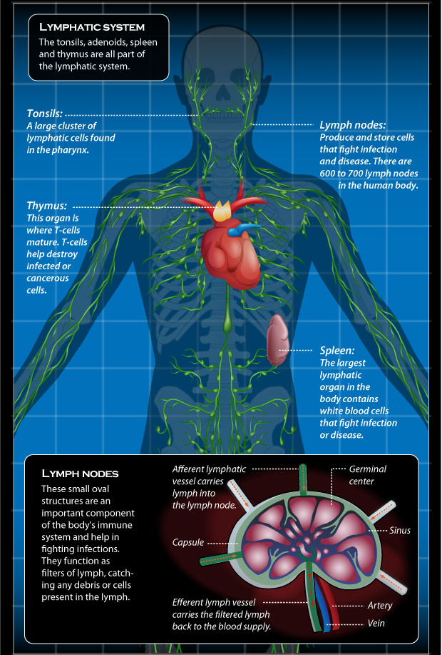
What is the Lymphatic System?
The lymphatic system is a series of vessels, ducts, and trunks that remove interstitial fluid from the tissues and return it the blood.

Slide 4
Functions of the lymphatic system
Carries excess fluids to the bloodstream
Filters pathogens from the blood
Lymph nodes swell during an infection
Transports immune cells (white blood cells or lymphocytes)

Slide 6
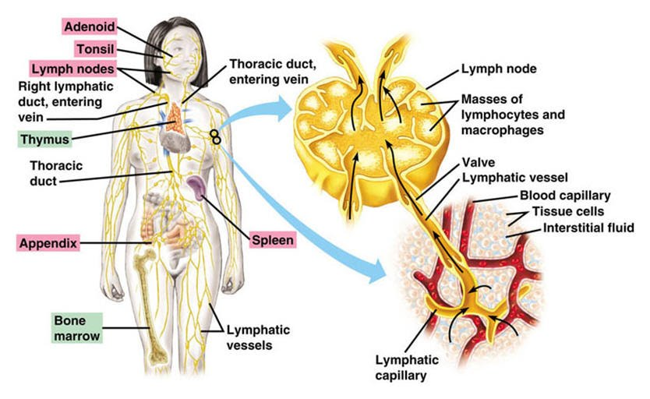
Lymphatic System – Fluid Transport
A major function of the lymphatic system is to drain body fluids and return them to the bloodstream.
Blood pressure causes leakage of fluid from the capillaries, resulting in the accumulation of fluid in the interstitial space.
Once this filtrate is out of the bloodstream and in the tissue spaces, it is referred to as interstitial fluid.

Slide 7
Functions of the Lymphatic System
~20 liters of fluid (plasma) diffuses out of the blood vessels at the level of the capillaries
~17 liters of this interstitial fluid is reabsorbed directly by the blood vessels.
~3 liters is brought back to the blood vessels through lymphatic vessels - via a series of vessels, trunks, and ducts.

Slide 8
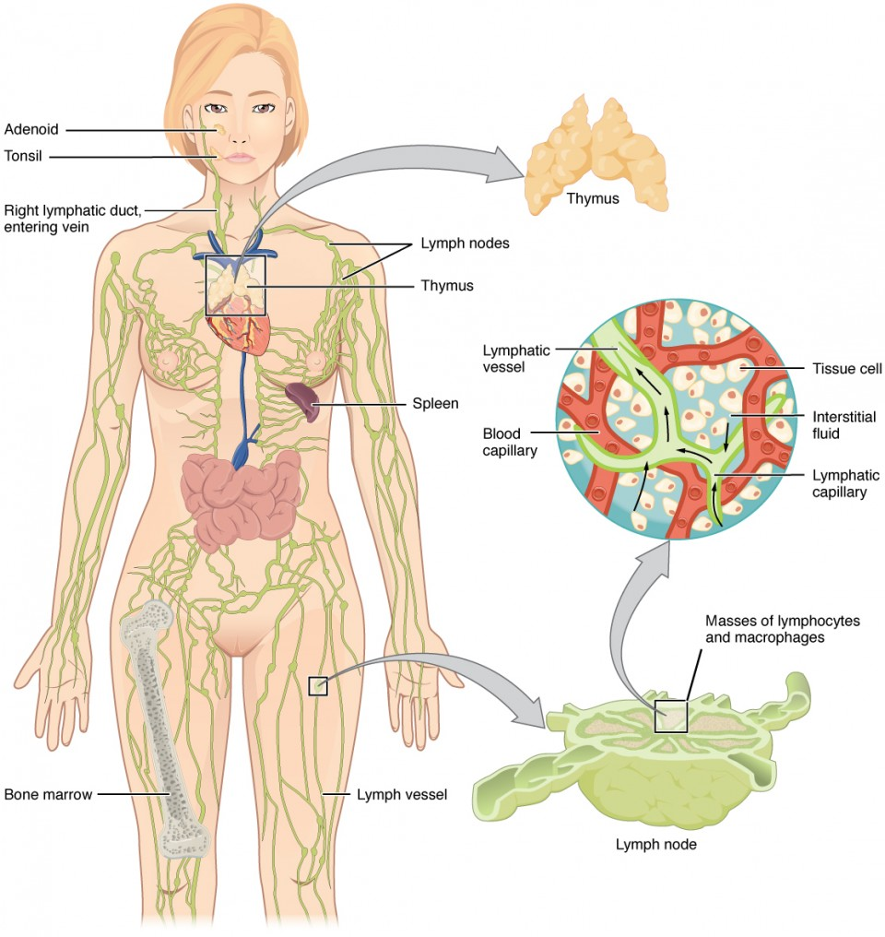
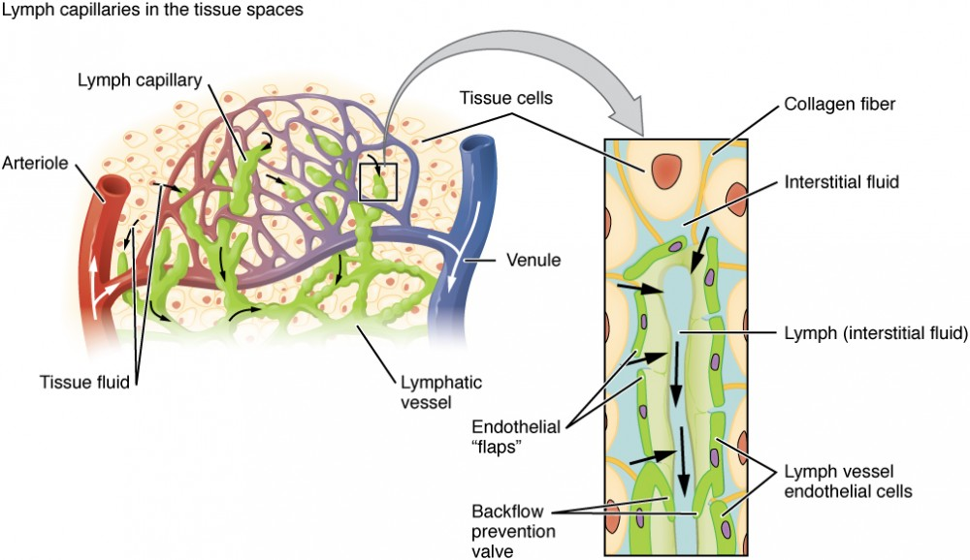
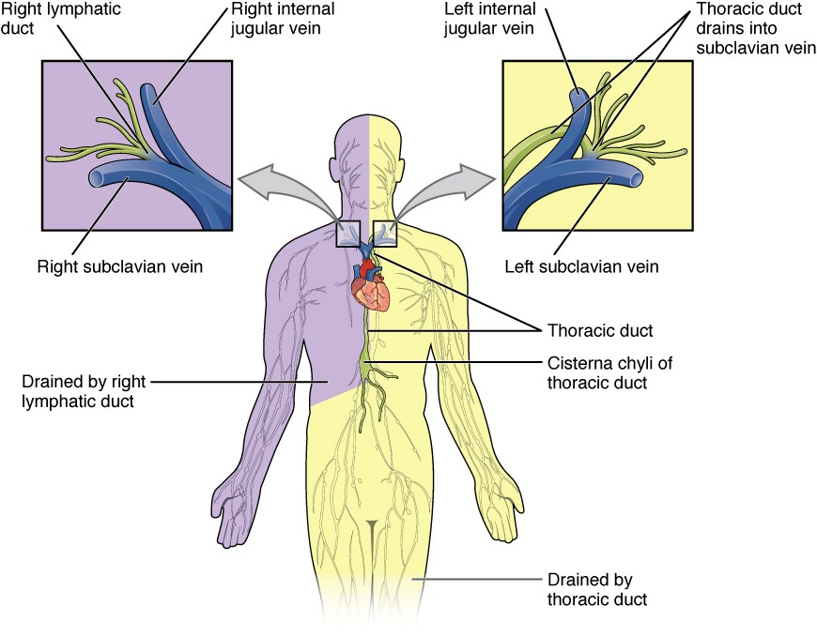
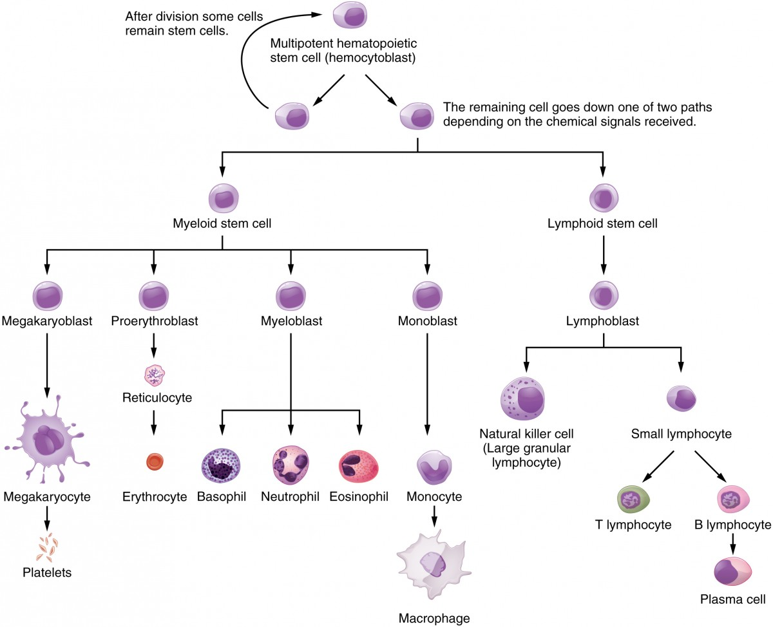
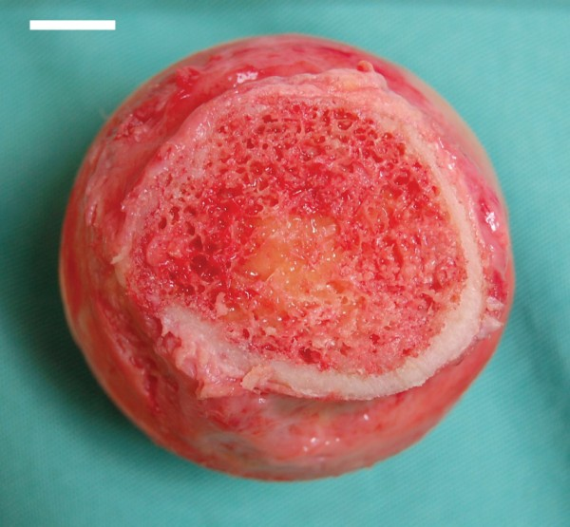
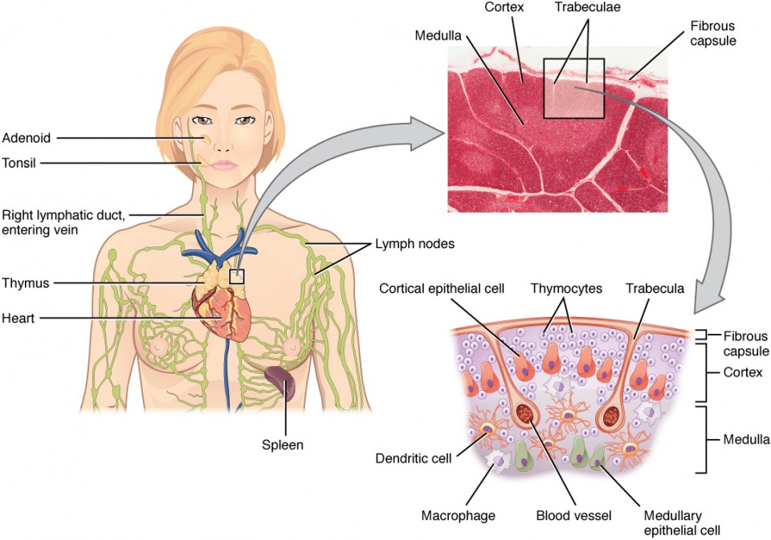
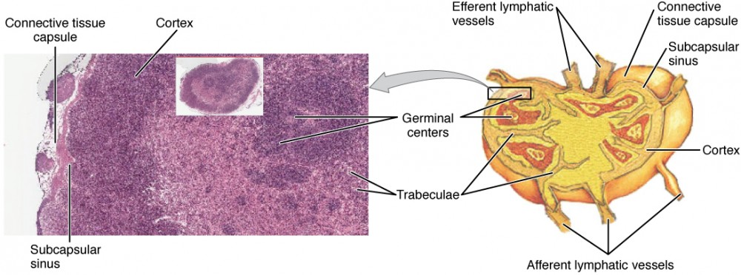
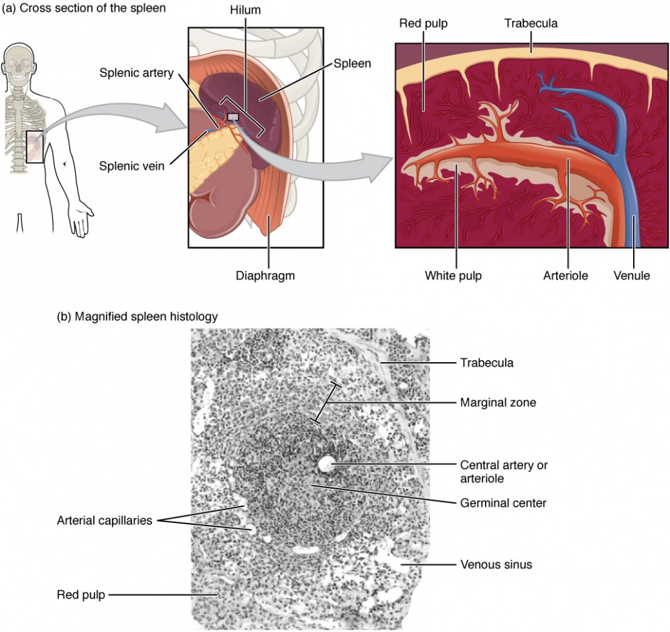
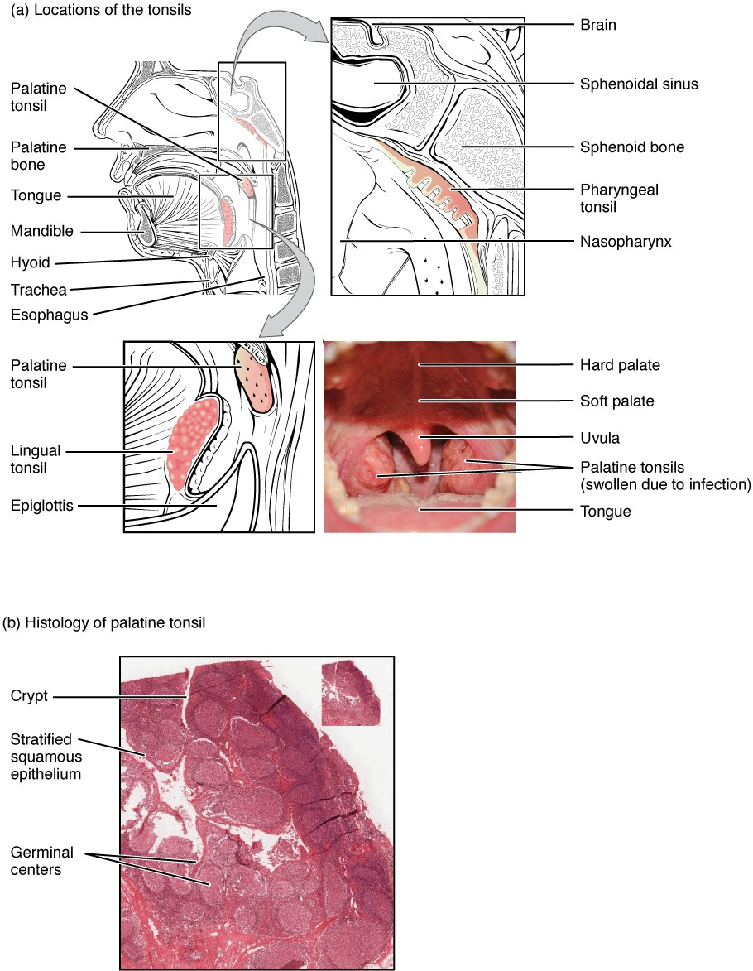
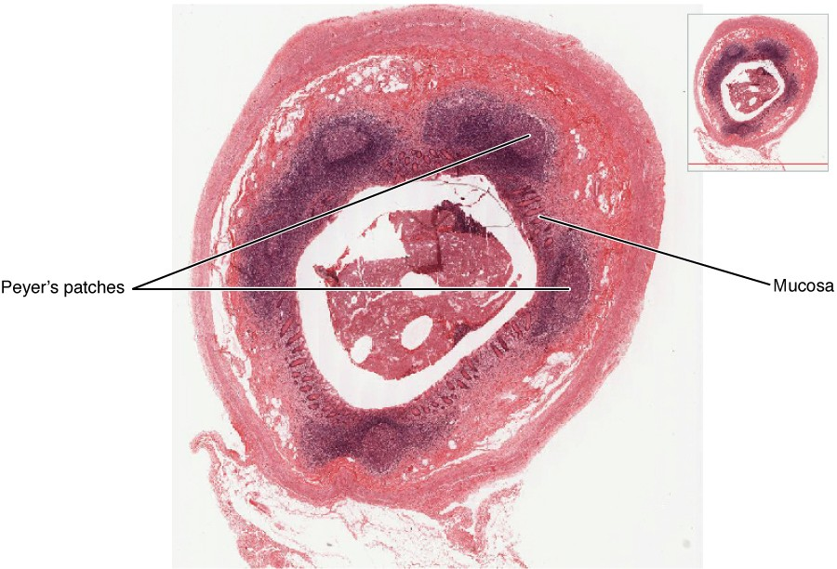
TABLE 1. LYMPHOCYTES
Type of lymphocyte | Primary function
B lymphocyte | Generates diverse antibodies
T lymphocyte | Secretes chemical messengers
Plasma cell | Secretes antibodies
NK cell | Destroys virally infected cells

Slide 9
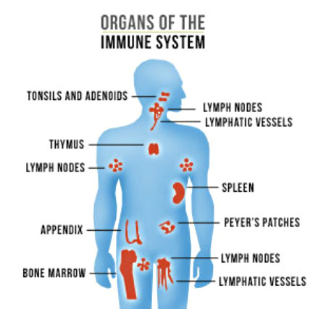
Primary lymphoid organs
Primary lymphoid organs include:
the bone marrow
The thymus gland
The bone marrow and thymus are the locations where lymphocytes of the adaptive immune system proliferate and mature.

Slide 10
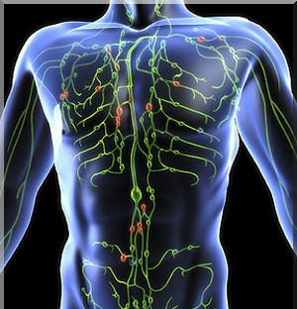
lymphatic fluid
Lymph or lymphatic fluid is the term used to describe interstitial fluid once it has entered the lymphatic system.

Slide 11
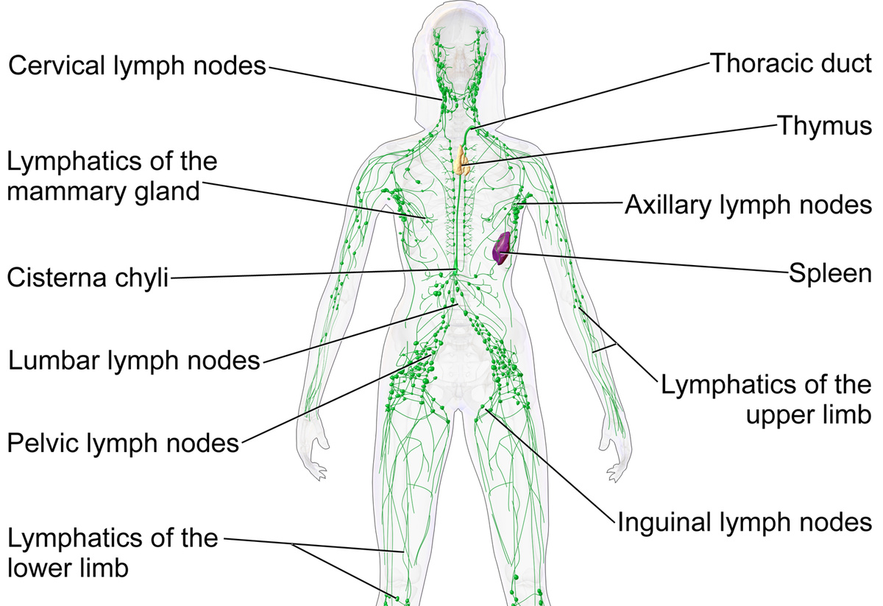
lymph nodes
Cells of the immune system also use lymph nodes as major staging areas for the development of critical immune responses.
A lymph node is one of the small, bean-shaped organs located throughout the lymphatic system.
the lymph nodes, which are commonly found near the groin, armpits, neck, chest, and abdomen.

Slide 12
Lymphatic Capillaries
lymph is not actively pumped by the heart
lymph is forced through the vessels by…
the movements of the body- the contraction of skeletal muscles during body movements, and breathing.
One-way valves (semi-lunar valves) in lymphatic vessels keep the lymph moving toward the heart.

Slide 13
Lymphatic Capillaries
Lymphatic capillaries, also called the terminal lymphatics, are vessels where interstitial fluid enters the lymphatic system to become lymph fluid.
Lymphatic capillaries are interlaced among the arterioles and venules of the circulatory system in the soft connective tissues of the body.

Slide 14
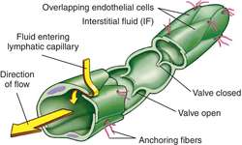
Lymphatic capillaries
Lymphatic capillaries are formed by a one cell-thick layer of endothelial cells.
interstitial fluid flows into lymphatic capillaries via overlapping cells.
When interstitial pressure is low, the endothelial flaps close to prevent “backflow.”

Slide 15
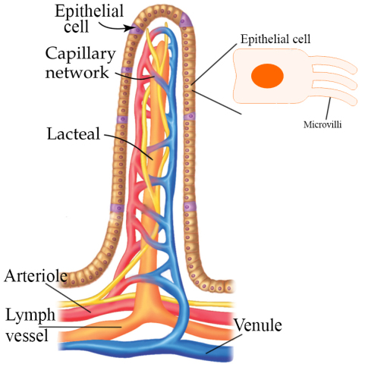
lacteals
In the small intestine, lymphatic capillaries called lacteals are critical for the transport of dietary lipids and lipid-soluble vitamins to the bloodstream.
In the small intestine, dietary triglycerides combine with other lipids and proteins, and enter the lacteals to form a milky fluid called chyle.
The chyle then travels through the lymphatic system, eventually entering the liver and then the bloodstream.

Slide 17
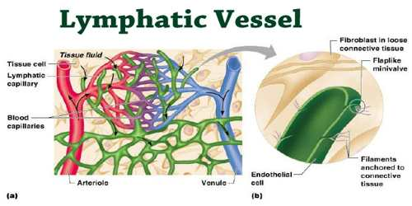
lymphatic vessels - Transport
the network of lymphatic vessels transports…
cells of the immune system
lipids
fat-soluble vitamins

Slide 18
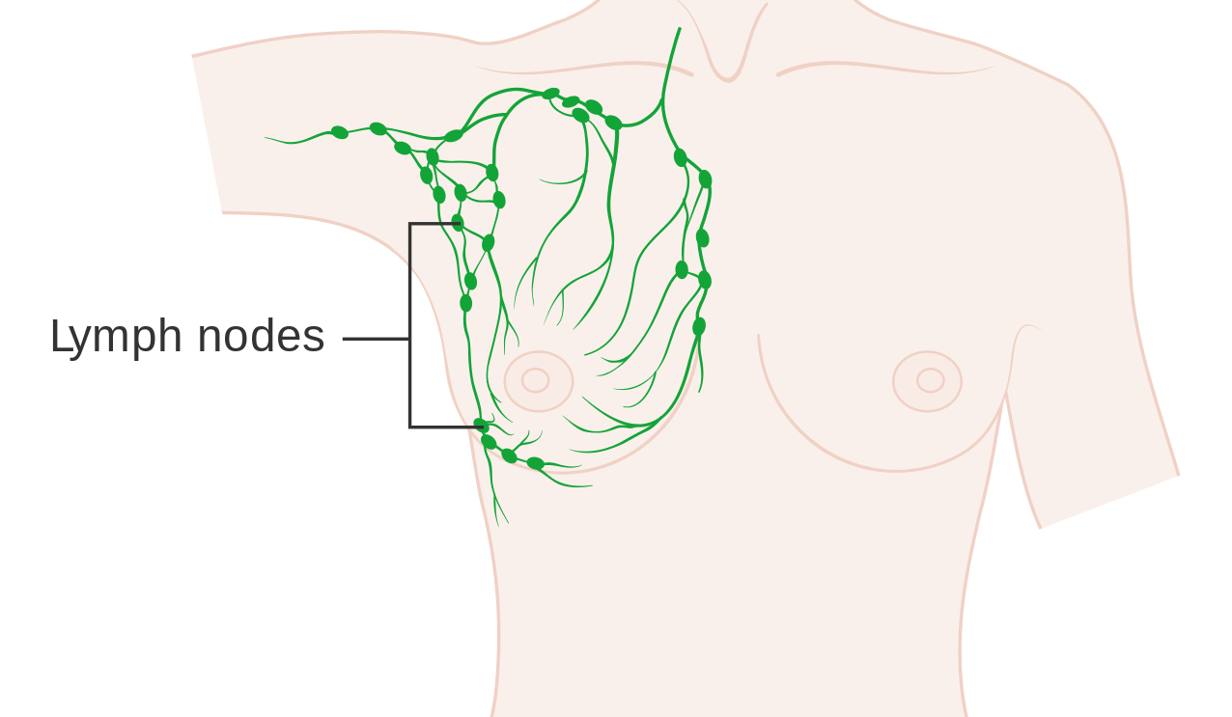
lymph nodes
Cells of the immune system also use lymph nodes as major staging areas for the development of critical immune responses.
A lymph node is one of the small, bean-shaped organs located throughout the lymphatic system.

Slide 19
Lymphatic Vessels
The lymphatic vessels begin as capillaries, which feed into larger and larger lymphatic vessels, and eventually empty into the bloodstream by a series of ducts.

Slide 20
Lymphatic Capillaries
lymph is not actively pumped by the heart
lymph is forced through the vessels by…
the movements of the body- the contraction of skeletal muscles during body movements, and breathing.
One-way valves (semi-lunar valves) in lymphatic vessels keep the lymph moving toward the heart.
Lymph flows from the lymphatic capillaries, through lymphatic vessels, and then is dumped into the circulatory system via the lymphatic ducts located at the junction of the jugular and subclavian veins in the neck.

Slide 21
Lymphatic Capillaries
Lymphatic capillaries, also called the terminal lymphatics, are vessels where interstitial fluid enters the lymphatic system to become lymph fluid.
vessels are interlaced among the arterioles and venules of the circulatory system in the soft connective tissues of the body.

Slide 22
Lymphatic capillaries
Lymphatic capillaries are formed by a one cell-thick layer of endothelial cells.
interstitial fluid flows into lymphatic capillaries via overlapping cells.
When interstitial pressure is low, the endothelial flaps close to prevent “backflow.”

Slide 23
lacteals
In the small intestine, lymphatic capillaries called lacteals are critical for the transport of dietary lipids and lipid-soluble vitamins to the bloodstream.
In the small intestine, dietary triglycerides combine with other lipids and proteins, and enter the lacteals to form a milky fluid called chyle.
The chyle then travels through the lymphatic system, eventually entering the liver and then the bloodstream.

Slide 24
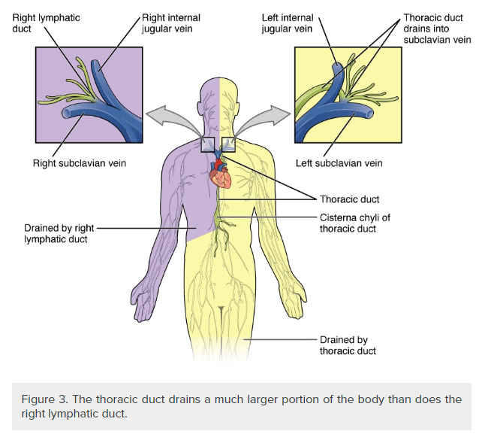
Larger Lymphatic Vessels, Trunks, and Ducts
The lymphatic capillaries empty into larger lymphatic vessels, which are similar to veins in terms of their structure and the presence of valves.

Slide 25
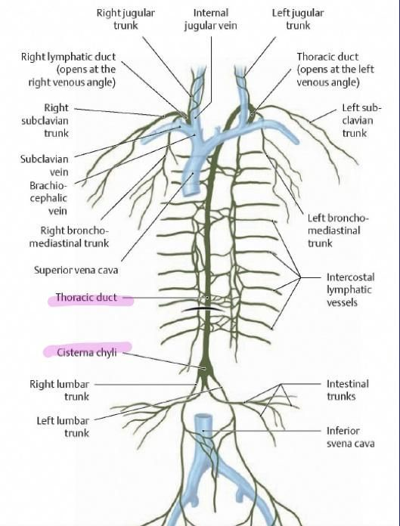
Larger Lymphatic Vessels, Trunks, and Ducts
The superficial and deep lymphatics eventually merge to form larger lymphatic vessels known as lymphatic trunks.

Slide 26
Larger Lymphatic Vessels, Trunks, and Ducts
RIGHT SUBCLAVIAN VEIN
On the right side of the body, the right sides of the head, thorax, and right upper limb drain lymph fluid into the right subclavian vein via the right lymphatic duct.
THORACIC DUCT

Slide 27
Larger Lymphatic Vessels, Trunks, and Ducts
LEFT SUBCLAVIAN VEIN
On the left side of the body, the remaining portions of the body drain into the larger thoracic duct, which drains into the left subclavian vein.
THORACIC DUCT

Slide 28
Larger Lymphatic Vessels, Trunks, and Ducts
The thoracic duct begins beneath the diaphragm
receives lymph from the lower abdomen, pelvis, and lower limbs by way of the left and right lumbar trunks and the intestinal trunk.
THORACIC DUCT
RIGHT LUMBAR TRUNK
RIGHT LUMBAR TRUNK
INTERSTITIAL TRUNK

Slide 29
Asymmetrical Lymphatic Drainage
RIGHT LYMPHATIC DUCT
LEFT LYMPHATIC DUCT
The overall drainage system of the body is asymmetrical.
The right lymphatic duct receives lymph from only the upper right side of the body.
The lymph from the rest of the body enters the bloodstream through the thoracic duct via all the remaining lymphatic trunks.
In general, lymphatic vessels of the subcutaneous tissues of the skin, that is, the superficial lymphatics, follow the same routes as veins, whereas the deep lymphatic vessels of the viscera generally follow the paths of arteries.

Slide 30
The Organization of Immune Function
The immune system has 3 levels of defense against illness and disease.
1st line of defense - Barrier defenses: skin and mucous membranes
2nd line of defense - Nonspecific innate immune response
Fast-acting
Generalized non-specific attack
3rd line of defense - Adaptive immune response
Slow-acting
Very specific

Slide 31
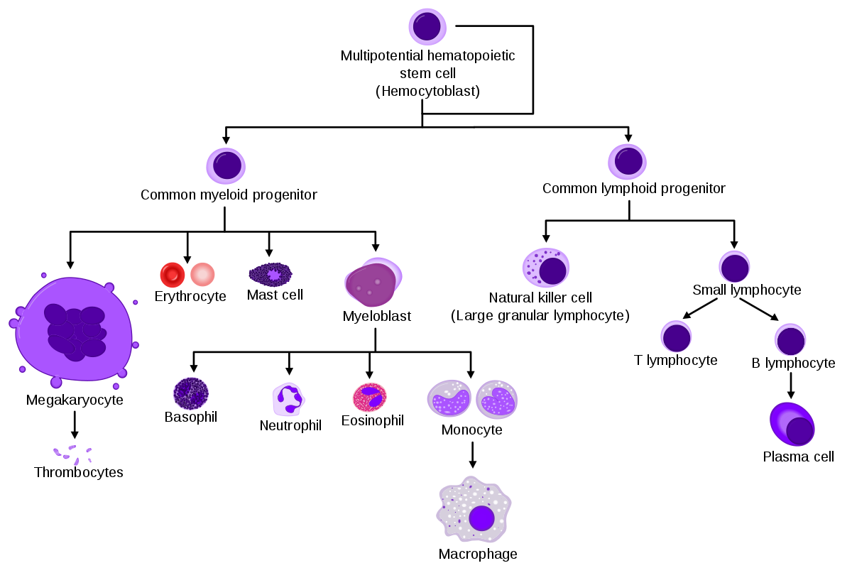
White Blood Cells (Leukocytes)
Cells of the immune
and lymphatic system
all come from the hematopoietic
stem cells of the
bone marrow.

Slide 32
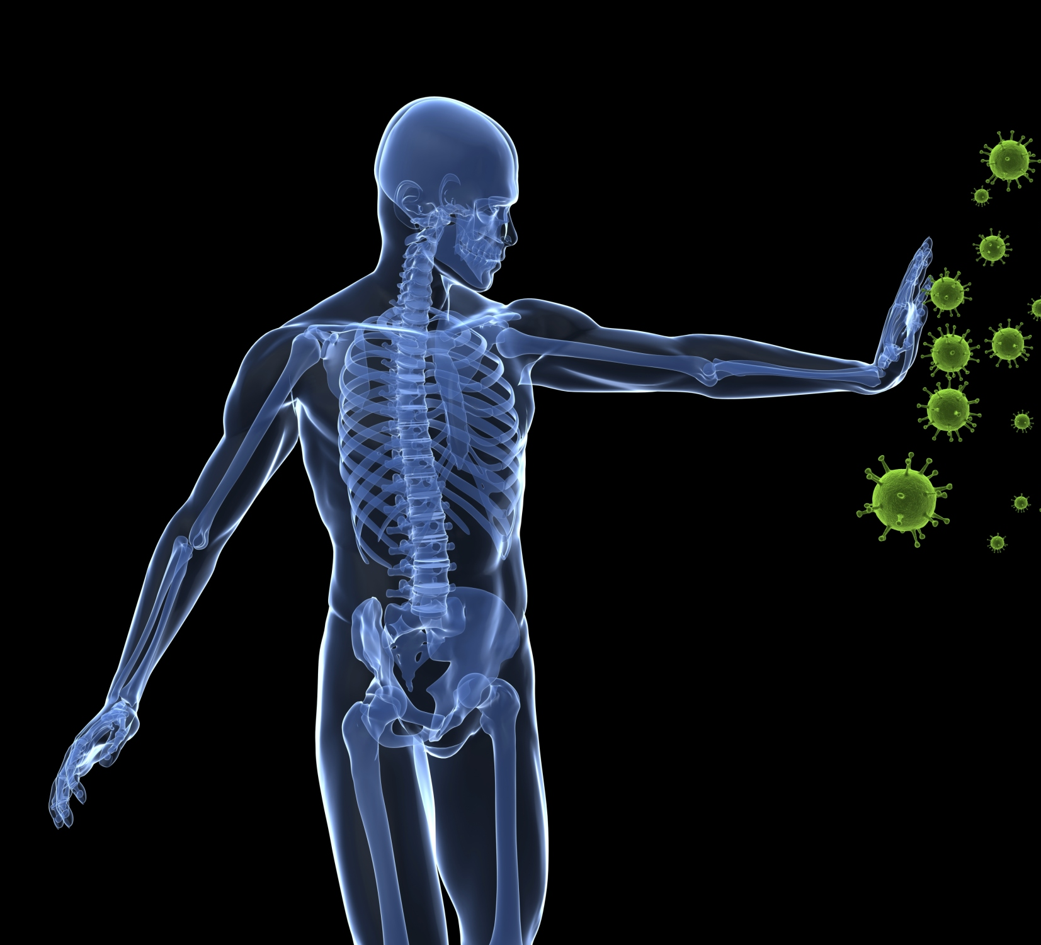
The Functions of the Immune System
Scavenge dead, dying body cells
Destroy abnormal (cancerous)
Protect from pathogens & foreign molecules: parasites, bacteria, viruses
This Photo by Unknown Author is licensed under CC BY-SA

Slide 33
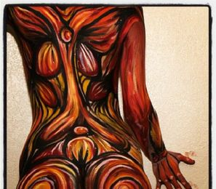
THE FIRST LINE OF DEFENSE - Prevention
The Physical and Chemical Barriers are the First Lines of Defense.

Slide 34
THE FIRST LINE OF DEFENSE - Prevention
Physical Barriers of the Body
Skin
Mucous Membranes
Chemical Defenses
Sweat
Acidic Environments
Lysozyme

Slide 35
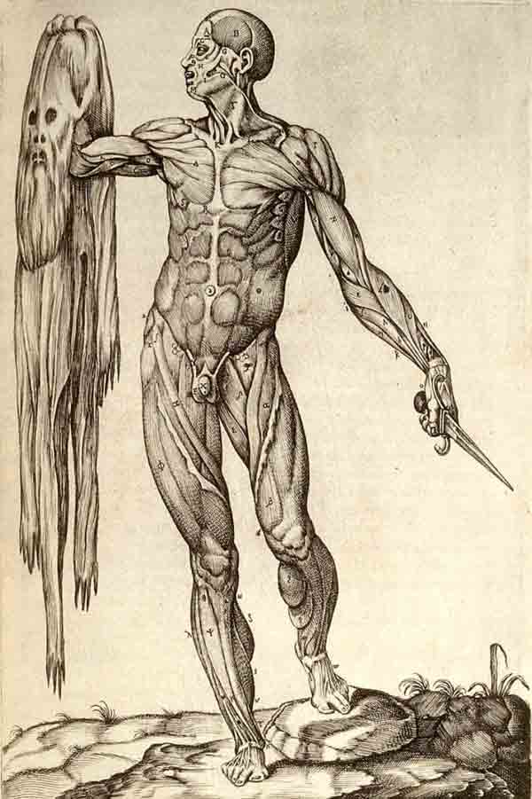
THE SKIN
Skin provides a physical barrier as a first line of defense against infection.
bacteria and viruses cannot penetrate the tightly knit cells of the skin.

Slide 36
Tight Junctions, Desmosomes and Gap Junctions Hold Epithelial Cells Tightly Together Creating a Preventative Barrier.

Slide 37
THE FIRST LINE OF DEFENSE - Prevention
2 Types of Defenses
Physical Barriers of the Body
Skin
Mucous Membranes
Chemical Defenses
Sweat
Acidic Environments
Lysozyme

Slide 38
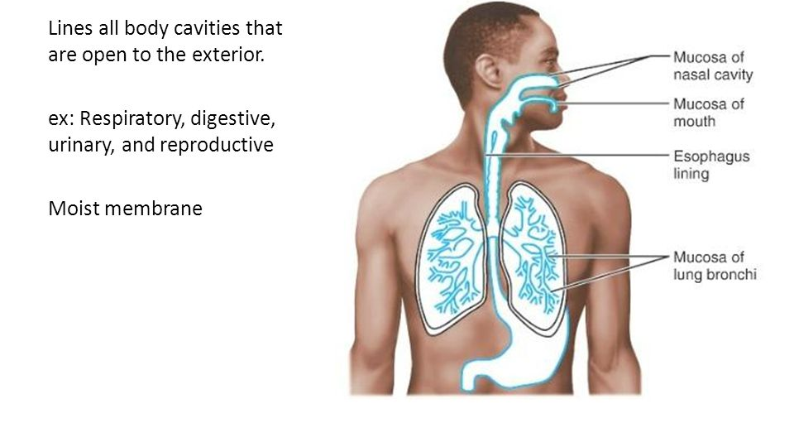
Mucous membranes:
Linings of the Respiratory System
Linings of the Digestive System
Urogenital Tracts
Especially the mouth, nose, eyelids, trachea, lungs, stomach, intestines, ureters, urethra, and urinary bladder.

Slide 39
Mucous membranes are made up of goblet cells and ciliated epithelial cells.
THE GOBLET CELLS SECRETE MUCUS.
MUCUS FUNCTION TO…
Cover And Protect Cells
Combat Pathogens With Antimicrobial Peptides
Trap Pathogens

Slide 40
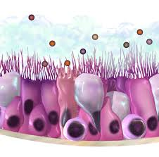
Mucous membranes are lined with ciliated epithelial cells.
Cilia function to sweep away pathogens caught in the mucus.
The mucus is then expelled from the body through coughing up or swallowing the pathogen and the mucus it is trapped in.
http://www.epithelium3d.com/images/cilia-movement-2%20(2).gif?crc=125337232

Slide 41
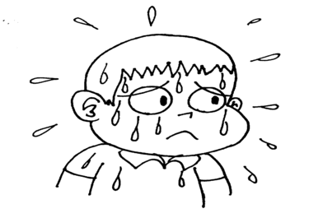
THE FIRST LINE OF DEFENSE - Prevention
2 Types of Defenses
Physical Barriers of the Body
Skin
Mucous Membranes
Chemical Defenses
Sweat
Acidic Environments
Lysozyme

Slide 42
The Great Assalt of 2012…
SWEAT
The skin has sweat glands that secrete sweat which has high concentrations of sodium.
During perspiration, high levels of sodium can kill certain types of bacteria.
SALT
MICROBE

Slide 43
THE FIRST LINE OF DEFENSE - Prevention
2 Types of Defenses
Physical Barriers of the Body
Skin
Mucous Membranes
Chemical Defenses
Sweat
Acidic Environments
Lysozyme

Slide 44
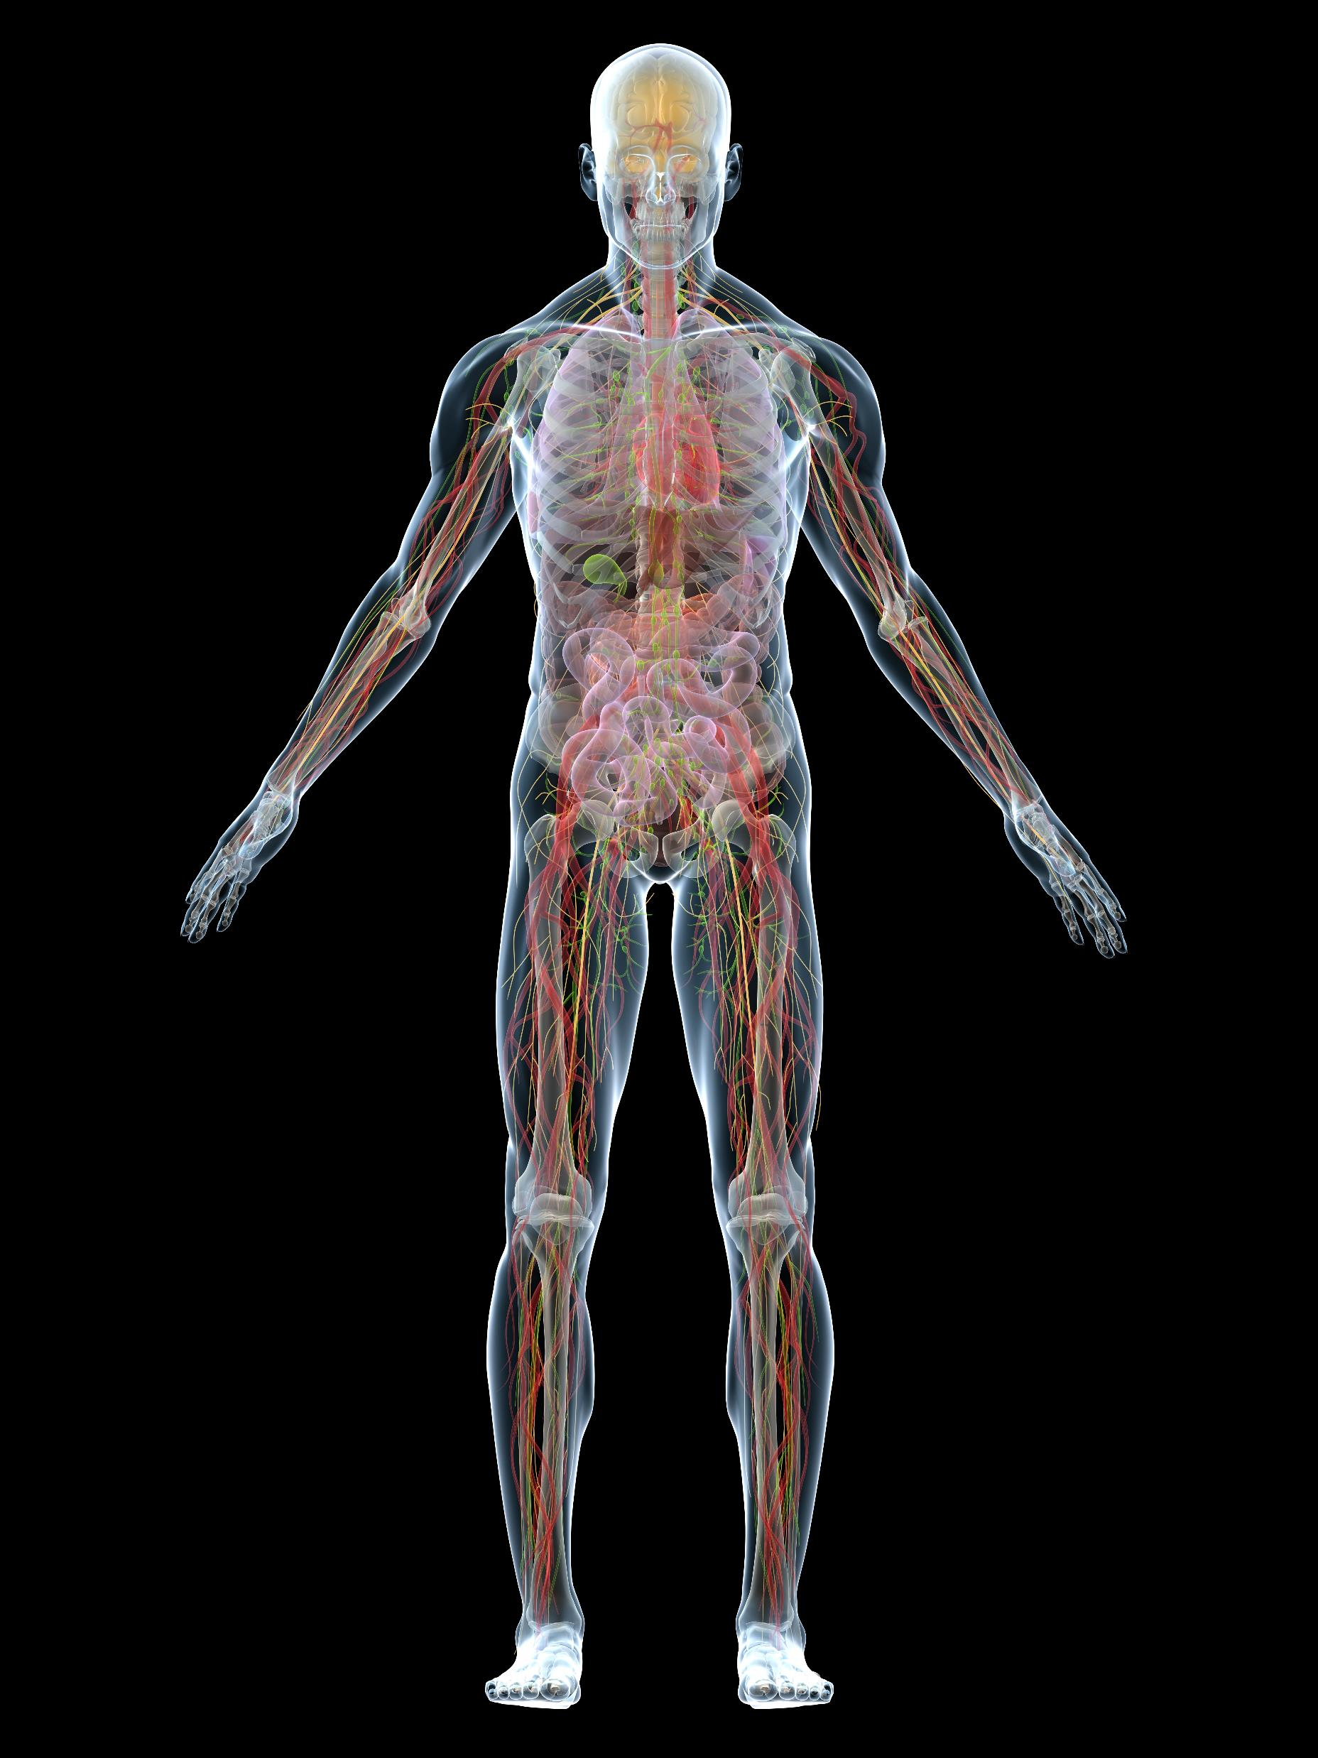
ACIDIC ENVIRONMENTS
The acidic environments of urinary tract, stomach and vagina discourages microbial growth.

Slide 45
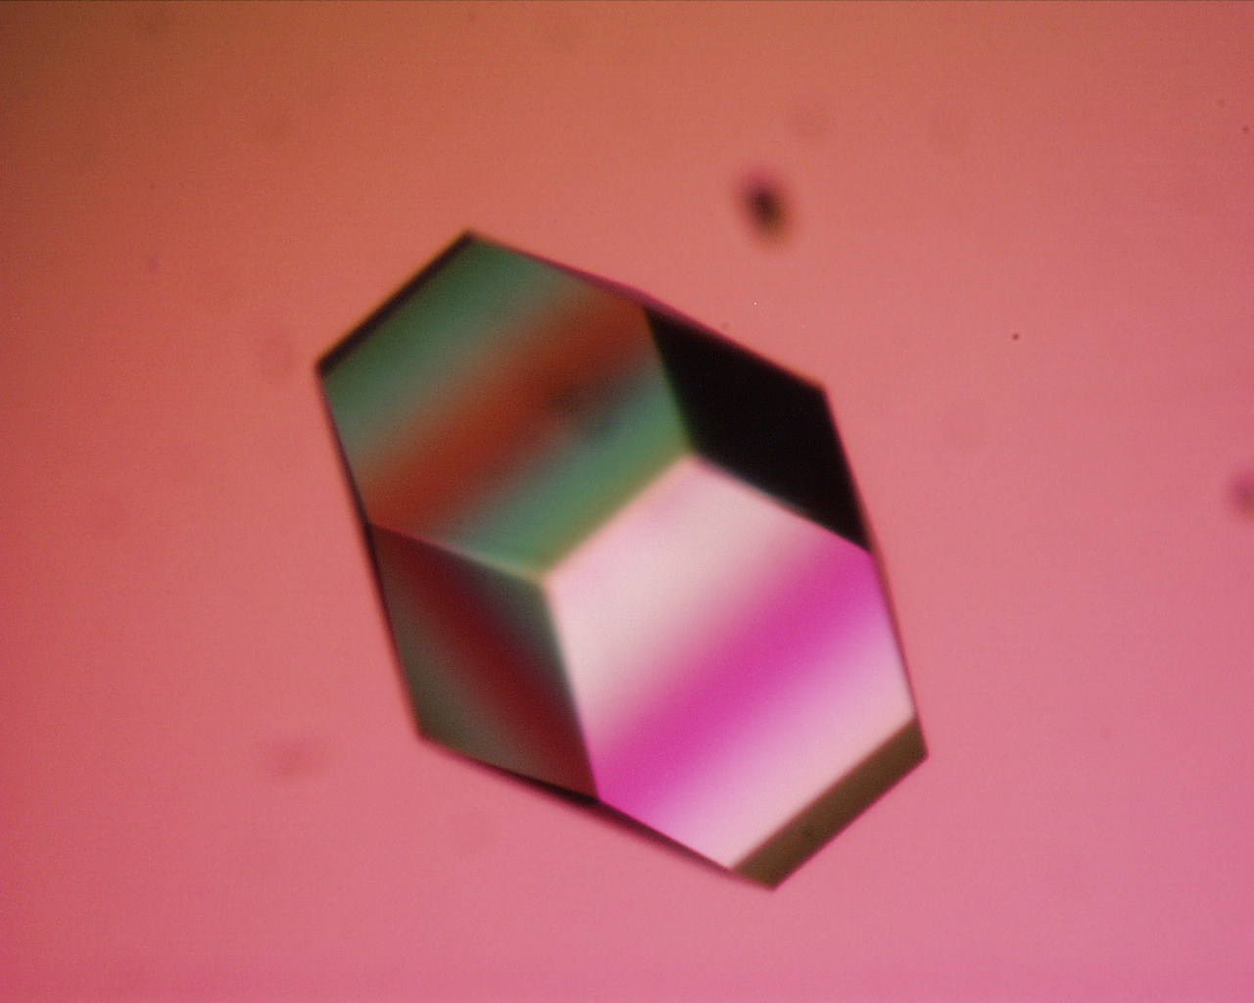
THE FIRST LINE OF DEFENSE - Prevention
2 Types of Defenses
Physical Barriers of the Body
Skin
Mucous Membranes
Chemical Defenses
Sweat
Acidic Environments
Lysozyme

Slide 46
Lysozyme
Saliva and tears contains an enzyme called lysozyme that functions to block the synthesis of the bacterial cell wall.
When the bacterial cell wall cannot be synthesized or repaired, the bacteria dies soon after.
This Photo by Unknown Author is licensed under CC BY-NC-ND

Slide 47
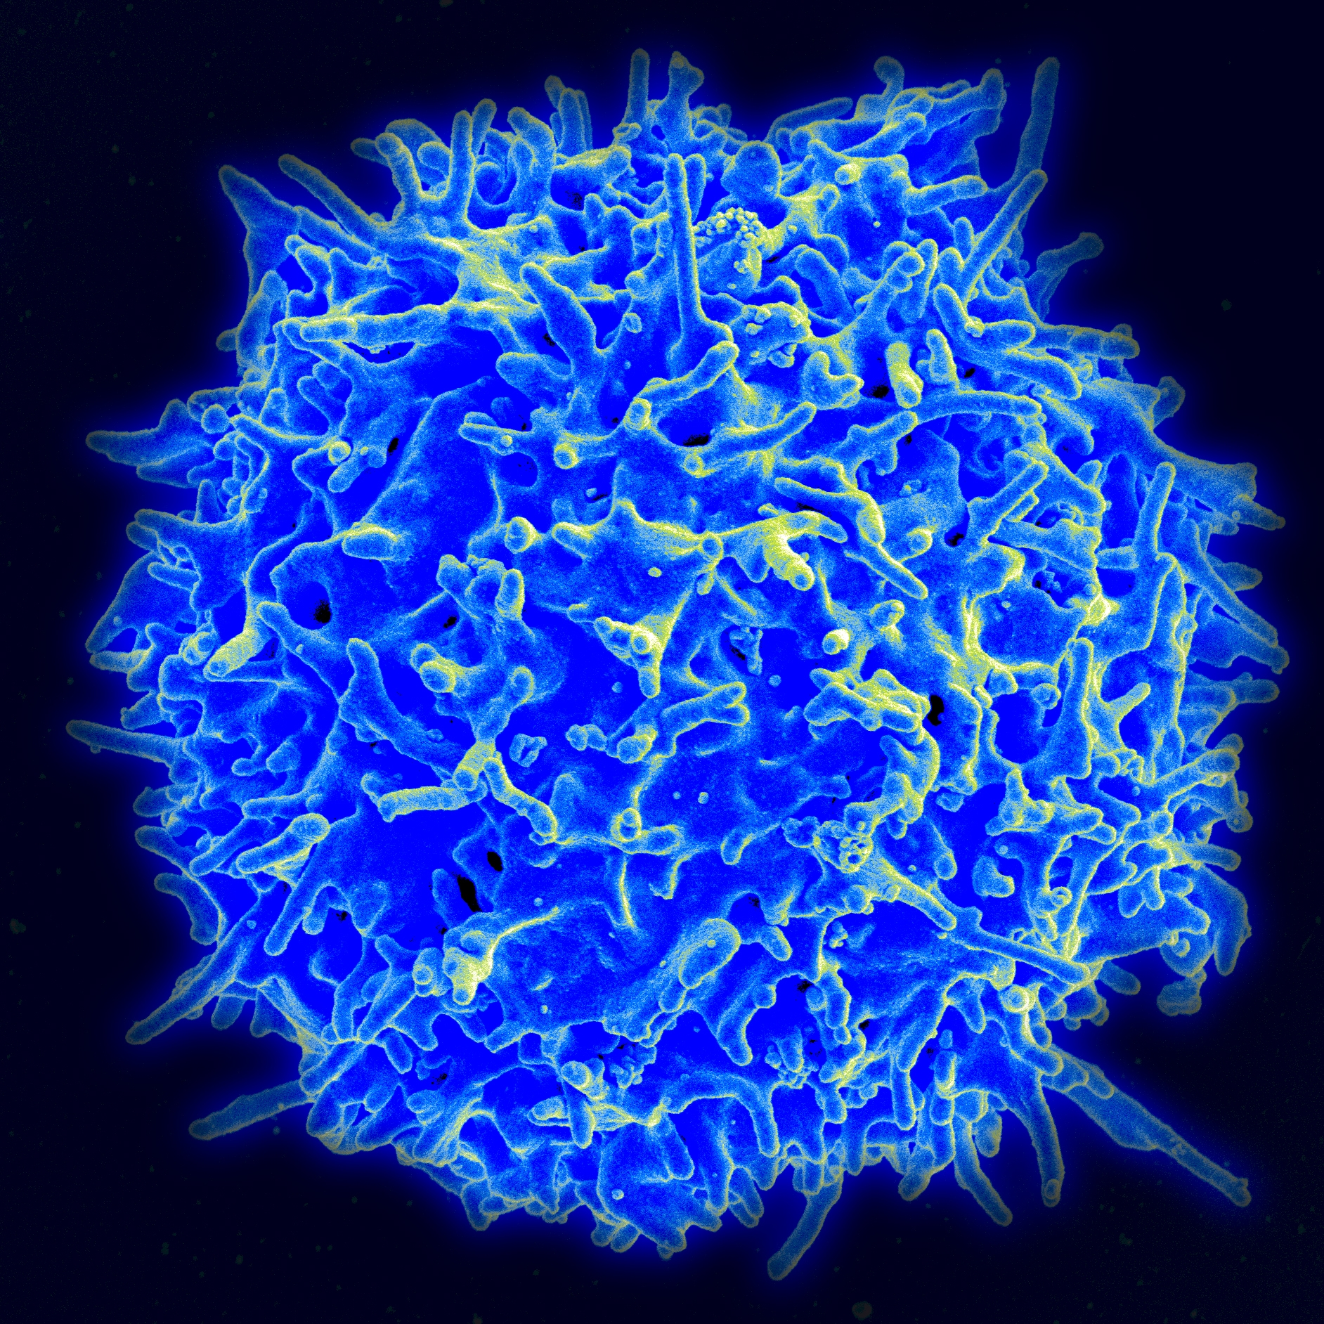
Nonspecific Resistance (Innate Immunity) - The Second Line of Defense

Slide 48
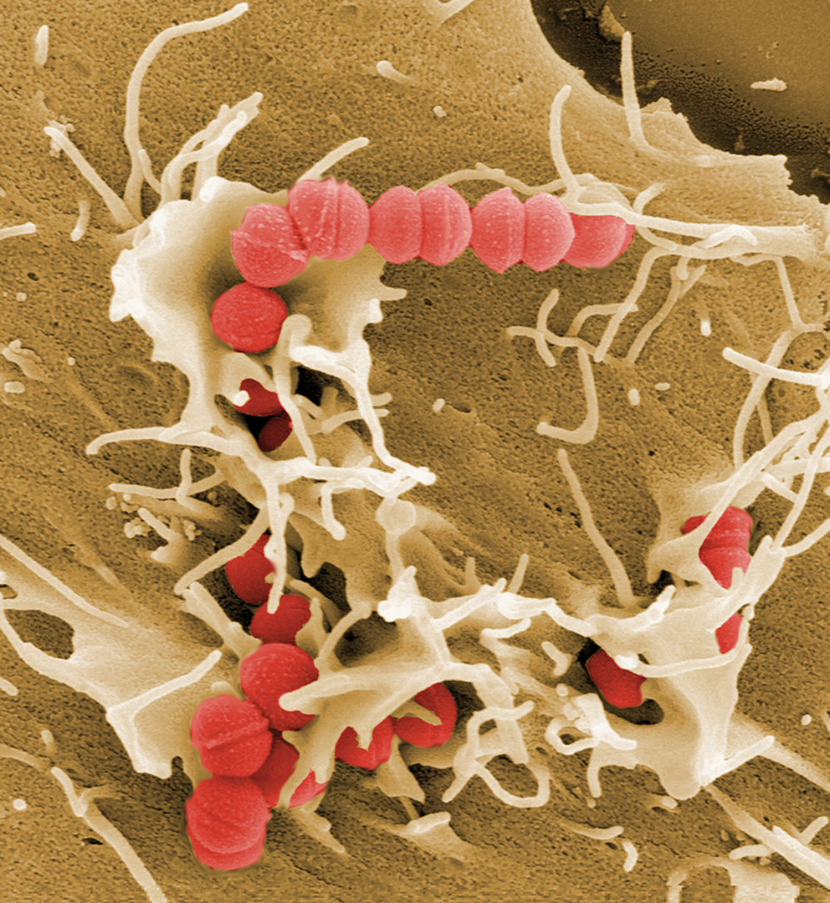
INVASION!
Sometimes the body’s physical and chemical barriers are not enough to keep pathogen out of the body.
When a pathogen or other suspicious substance is found inside our body, the second line of defense goes into action!
This Photo by Unknown Author is licensed under CC BY-ND

Slide 49
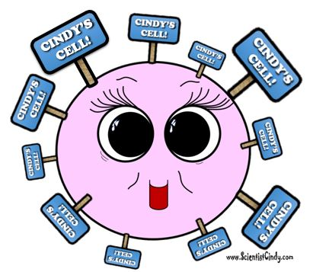
How Are Intruders Identified?
Step One: Identifying "Self" from "Non-self“
The cells of each person's body has a unique molecular marker that tells the cells of their immune system that it belongs there and should not be destroyed.

Slide 50
Major Histocompatibility Complexes (MHC)
CINDY’S CELL!
These molecular markers are called Major Histocompatibility Complexes (MHC or MHC-I)
Only identical twins have identical MHCs.

Slide 51
In fact, when a tissue or organ donor is being tested as a possible “match”,
it is the similarity of the MHCs that determines a compatible match!

Slide 52
Recognizing Invaders
The immune system is constantly screening the cells of the body and checking these MHC molecules for signs of danger.
Immune cells can use the MHCs to know if a cell is one of the following potential threats
A Foreign Invader
A Damaged Cell
An Infected Cells
A Mutated or Cancerous Cell
NOT CINDY’S CELL!
The
PO PO

Slide 53
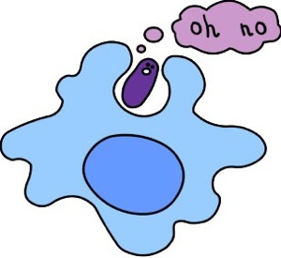
THE SECOND LINE OF DEFENSE
THE SECOND LINE OF DEFENSE
These defenses are the
internal cellular and
chemical defenses
of the body that kick into action if the pathogen enters the body.

Slide 56
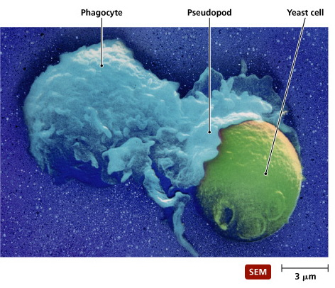
PHAGOCYTES
Defensive cells are white blood cells called phagocytes that "eat" unwanted invaders of the body, as well as dead or damaged cells.
The term phagocytes comes from the words for "phage" which means "to eat", and "cyte" which means "cell".
So phagocytes will "eat" unwanted entities.

Slide 57
PHAGOCYTOSIS
So phagocytes will "eat" unwanted entities found in the body by engulfing them and chemically breaking them down in a process called phagocytosis.
Phagocytes are nonspecific and will get rid of pathogenic organisms, as well as dead or damaged cells or unwanted debris found in the body.
In a sense, they are the body's janitorial service. ​

Slide 58
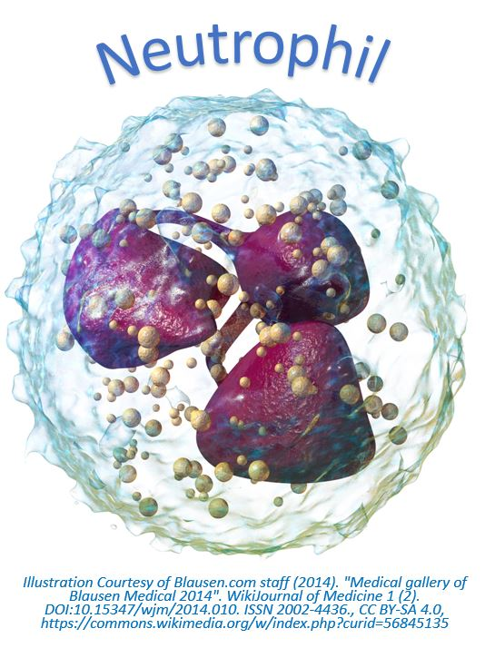
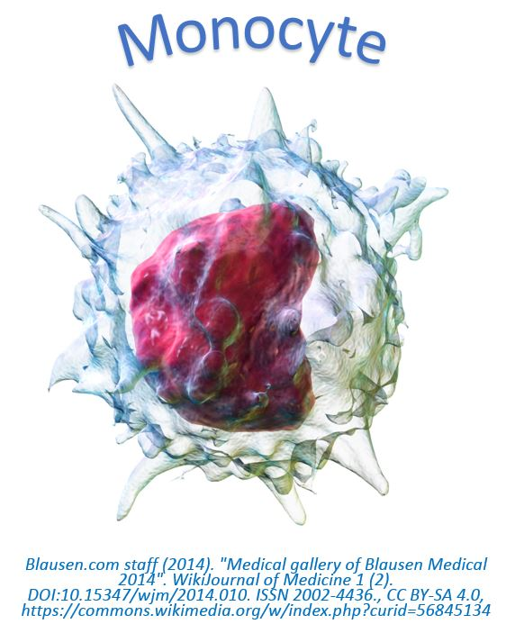
THE TWO TYPES OF PHAGOCYTES
The human body has two types of phagocytes;
Neutrophils
Monocytes (Macrophages).
Both of these are types of white blood cells, but they have unique morphology, physiology and different mechanisms of action.

Slide 60
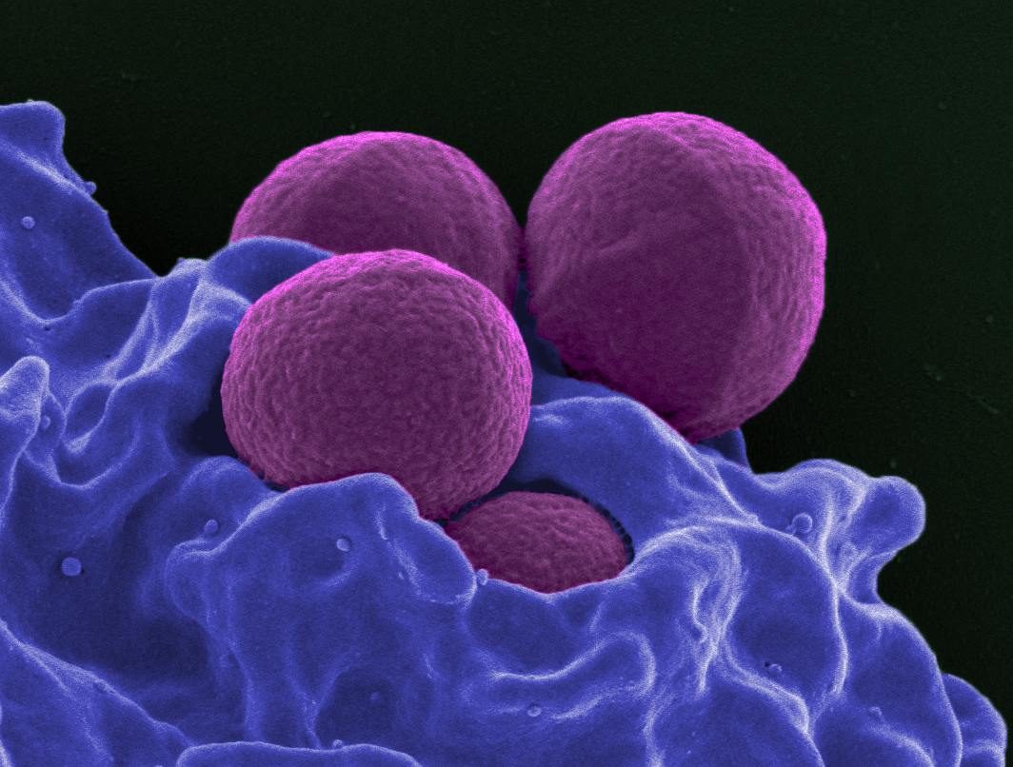
THE NEUTROPHILS
​ The neutrophils are one of the two types of white blood cells categorized as phagocytes..
They are the first responders.
This Photo by Unknown Author is licensed under CC BY-SA

Slide 62
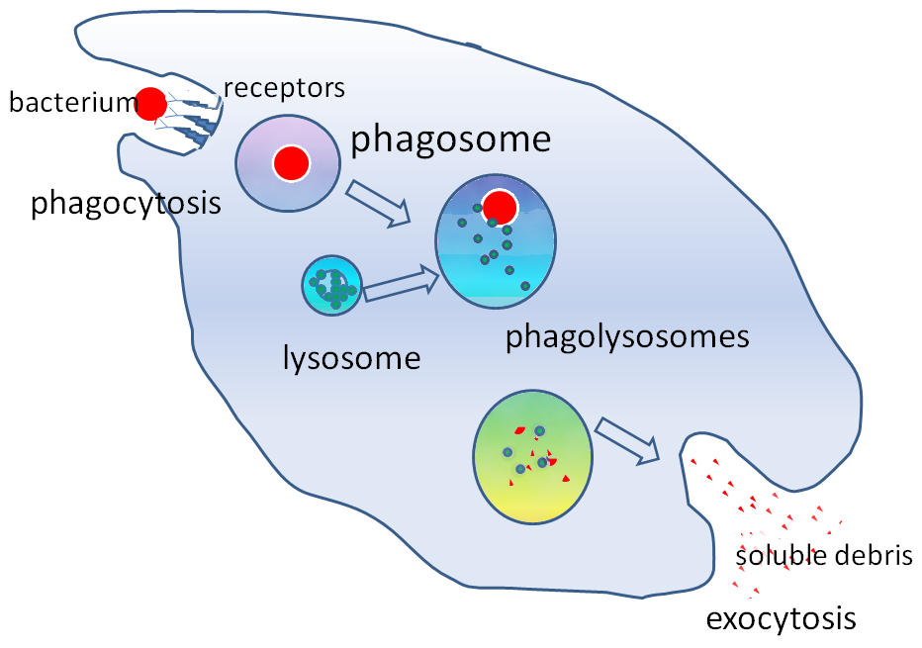
Monocytes (macrophages)
Monocytes (macrophages) are the other types of white blood cells that are categorized as phagocytes.
Live in lymphatic fluids
They are able to consume large particles of debris
Can consume large amounts.
Eats a larger variety of things than neutrophils.

Slide 63
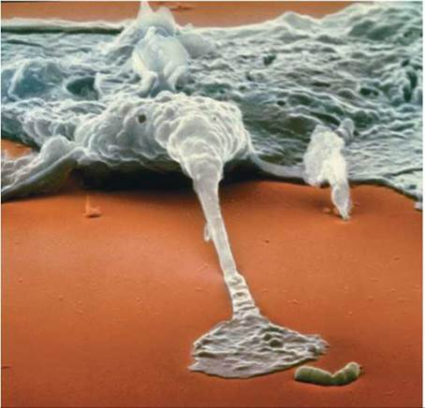
Monocytes (macrophages)
A macrophage ingesting a bacterium (the rod-shaped structure).
The bacterium will be pulled inside the cell within a membrane-bound vesicle and quickly killed. –
http://schoolbag.info/biology/humans/17.html

Slide 65
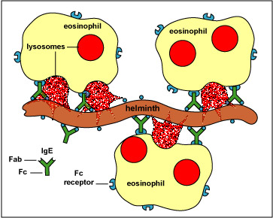
EOSINOPHILS
The eosinophils specialize in attacking pathogens that are too large for the macrophages to engulf, such as parasitic worms.
This Photo by Unknown Author is licensed under CC BY-NC-SA

Slide 66
EOSINOPHILS
Eosinophils function by positioning themselves close to the pathogen and releasing enzymes that kill the organism and break it down into smaller pieces.
At this point, the macrophages can remove the smaller pieces using phagocytosis. ​

Slide 68
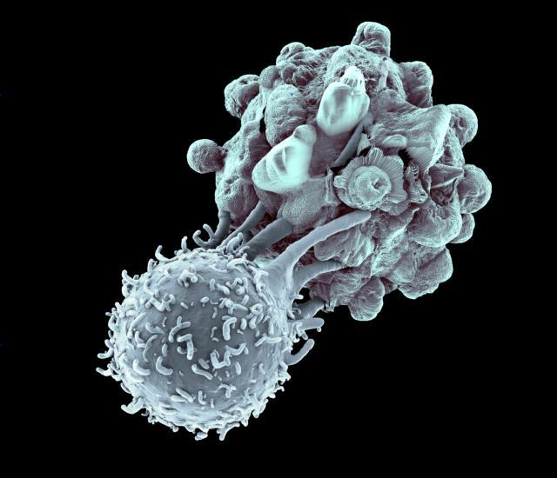
Natural Killer Cells
NATURAL KILLER CELLS induce APOPTOSIS or KILL virus-infected or tumor cells.
Natural killer cells function in cell-mediated, cytotoxic innate immunity

Slide 69
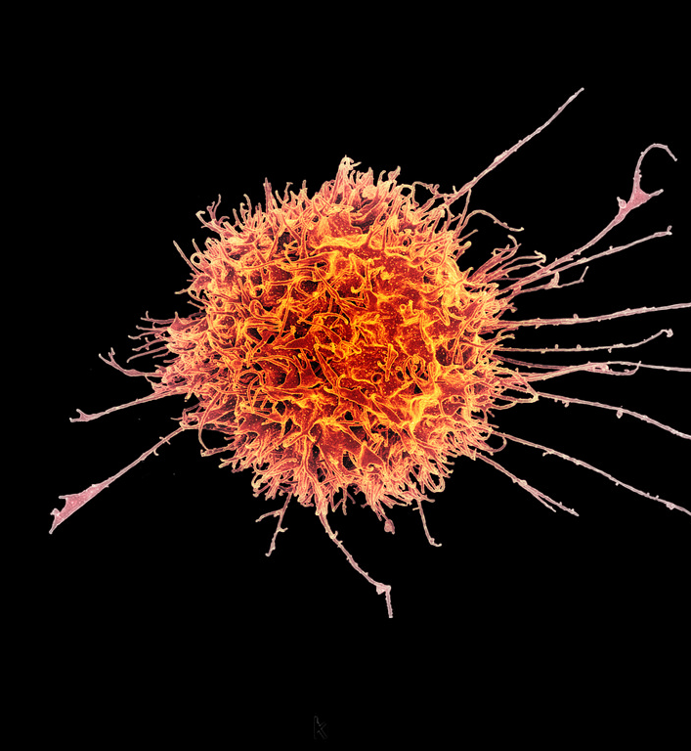
Natural killer cells
Natural killer cells are constantly on patrol seeking out any suspicious characters it finds in the body.
Natural killer cells (NK cells) will indiscriminately kill anything that it perceives as "abnormal".
This means that the NK cells will not only destroy foreign invaders, but will also destroy the body's own cells that may show signs of mutation, or infection or disease.

Slide 70
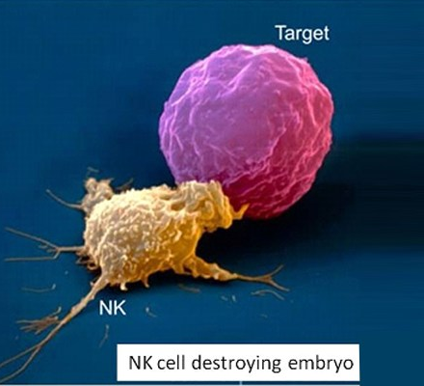
Natural Killer Cells are Indiscriminate Killers
OH NO!
For example, host cells that have become cancerous or that have become infected with a virus are likely targets for the NK cells.
The natural killer cells destroy their target by coming into direct contact with the suspicious cell and secreting proteins that degrade the structural integrity of its membrane until the cell dies.
invader

Slide 71
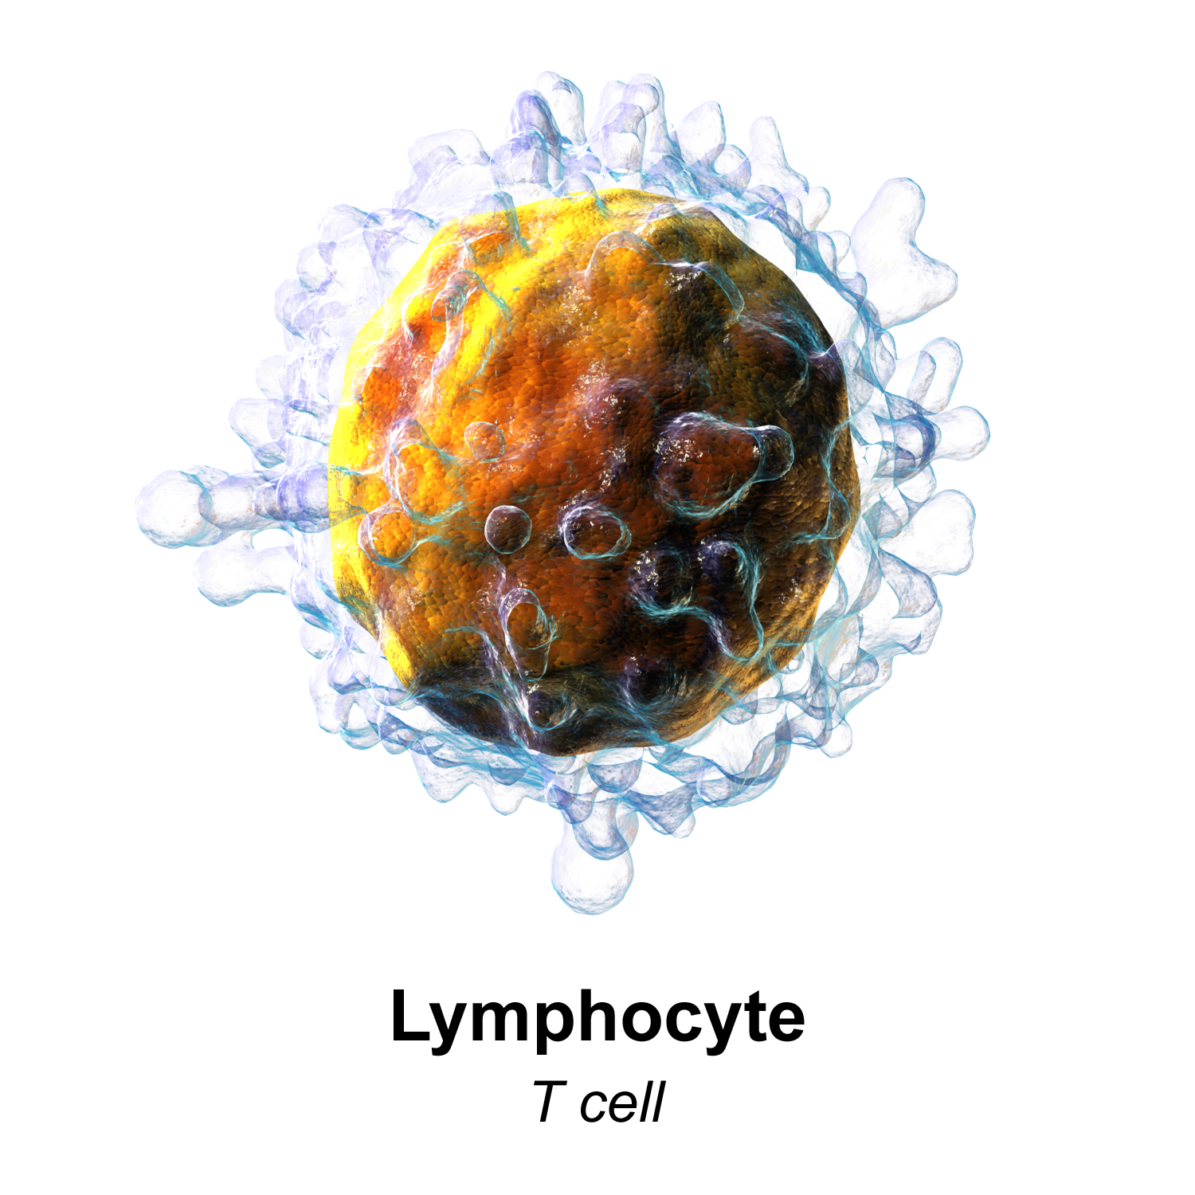
THE THIRD OF DEFENSE = the adaptive immune response
THE THIRD LINE OF DEFENSE - Destroy - Destroy the invading pathogen.
This is the third line of defense and it is accomplished as the adaptive immune response.

Slide 72
Adaptive (Specific) Immune System
Innate (Nonspecific) Immune System
vs.
Includes the First and Second lines of defense
Also called non-specific immune responses - Attacks only based on the identification of general threats
Innate (born with it)
Responds more quickly to infection and injury
Ready to fight at all times
Includes the Third line of defense only
Uses specific antigens to strategically launch an immune response.
Acquired after birth (from exposure to pathogens)
Much slower to respond to threats and infections
Is NOT ready to fight at all times. Becomes activated only after there has been an exposure to pathogens
Uses an immunological memory to learn about the threat and enhance the immune response accordingly.

Slide 73
Innate Immunity in a Nutshell

Slide 74
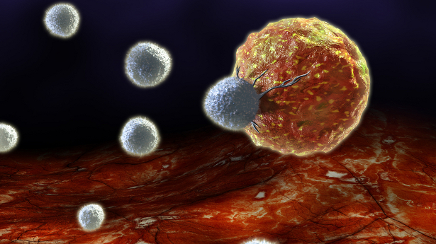
The adaptive immune response involves…
B cells and T cells
Recognizing Antigens and Producing Antibodies
This Photo by Unknown Author is licensed under CC BY-NC-ND

Slide 75
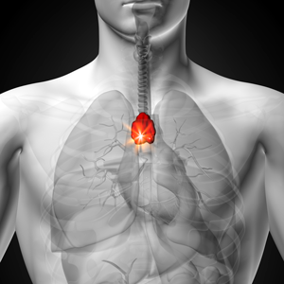
The cells of the adaptive immune system
THYMUS GLAND
Both B cells and T cells are lymphocytes.
B-cells and T-cells are derived from hematopoietic stem cells, in red bone marrow.
B-CELLS MATURE IN THE BONE MARROW
T-CELLS MATURE IN THE THYMUS GLAND
hematopoietic stem cell
Lymphocytes
B-Cell
T-Cell

Slide 76
B-Cells Moving Out!
B-cells mature in the bone marrow.
Once mature, they move out and into the lymphatic system to reside in the secondary lymphatic organs.

Slide 77
Secondary Lymphatic Organs _____ The B-Cells Stay in the Secondary Lymphatic Organs and Wait to be Activated by the presence of an ANTIGEN
Tonsils
Adenoids
Lymph Nodes
Thymus
Spleen

Slide 78
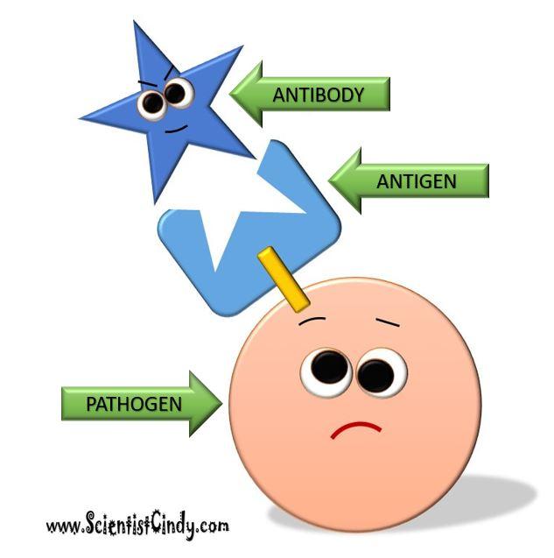
ANTIGENS and ANTIBODIES
ANTIGENS are defined as anything that has the ability to provoke an immune response
Antigens can be viruses, bacteria, or other molecules.
ANTIBODIES (immunoglobulins) are the proteins produced by the immune system to specifically bind to specific antigens.

Slide 79
B-Cells PURPOSE IN LIFE!
The whole purpose in a B-cell’s life is to…
IDENTIFY ANTIGENS
ALERT THE IMMUNE SYSTEM THAT AN ANTIGEN HAS BEEN FOUND
SECRETE ANTIBODIES
B-Cell

Slide 80
B-Cells Have Antibodies
B-Cells produce antibodies (or immunoglobulins) that they place on their cell’s surface.
The membrane-bound antibodies act like KEYS and are able to bind to an antigen, because they fit with it, kind of like as if it were a LOCK.
B-Cell

Slide 81
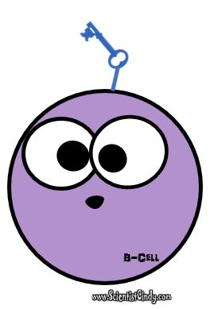
B-CELL CARRYING ANTIBODIES meets a PATHOGEN with ANTIGENS
Each B-Cells contains antibodies (like a key) that are specific to only one antigen.
A pathogen can have many antigens, but the B-Cell has only key to one antigen.

Slide 82
THE INVASION!
When an antigen invades the body, it will encounter many B-Cells.
Since, each B-Cell is specific to only one antigen, the antigen may come across a multitude of B-Cells that it does not bind with… before it comes across a B-Cell that DOES!
Oh! Umm.. I was.. Umm.. just passing through officer.

Slide 83
B-CELL CARRYING ANTIBODIES
The B cell will keep trying different keys (antibodies) until it finds a MATCH!

Slide 84
Once the B-Cell Finds a Match, it takes the antigen
“B” Stands for “BULLY” !!!
B-Cell
Into itself Using Endocytosis

Slide 85
The Antigen is Fragmented
Once the antigen is inside of the B-Cell, the B-Cell will break down the antigen molecule into smaller fragments.
Umm… That Doesn’t Sound Good!

Slide 86
MHC-II Molecules
The B-Cell then uses these fragments to create MHC-II molecules that are displayed on the B-Cells Surface.
At this stage, the B-Cell can also be called an “antigen-presenting cell”.
MHC-II

Slide 87
The T-Cells
The T cell will then bind to the MHC-II complex and become activated.
The activated T cell releases cytokines that causes the B cells to undergo rapid cell division.
cytokines

Slide 88
B-Cell Activation → Proliferation
Activated B Cell
CYTOKINES
The B-Cell begins to proliferate
The B cell proliferates to form specialized
memory B cells
effector B cells
Effector B Cell
Memory B Cell

Slide 89
MEMORY CELLS
Memory cells are involved in the secondary immune response.
This means that if this same antigen invades the body again in the future, thousands of memory B-Cells will be all ready to go and will quickly jump into action to destroy the invader!

Slide 90
Effector B-cells (Plasma Cells)
The effector B-Cells (plasma cells) secrete millions of antibodies.
These antibodies are able to bind to the antigen that caused the immune response.

Slide 91
The Originally Activated B-cell
The originally activated B-Cell Leaves the Secondary Lymphatic Organ that it has been residing in.
The activated B-Cell then will circulate throughout the body’s humors in search of more of these same antigens that it can bind to.
When the B-Cell encounters an antigen, the B-Cell will lock onto it and act in a variety of ways that ultimately leads to the death of the invader.

Slide 92
Lymphocytes
Lymphocytes are the primary cells of adaptive immune responses.
The two basic types of lymphocytes are B cells and T cells
B cells develop and mature in red bone marrow
T cells mature in the thymus after being developed in the red bone marrow.

Slide 93
Table 1. Lymphocytes
Type of lymphocyte | Primary function
B lymphocyte | Generates diverse antibodies
T lymphocyte | Secretes chemical messengers
Plasma cell | Secretes antibodies
NK cell | Destroys virally infected cells

Slide 94
Primary Lymphoid Organs
The lymphoid organs are where lymphocytes mature, proliferate, and are selected, which enables them to attack pathogens without harming the cells of the body.
This Photo by Unknown Author is licensed under CC BY

Slide 95
Bone Marrow
Initial development of the white blood cells (including B cells and T cells) occurs in the red bone marrow.
The B cells undergo maturation in the red bone marrow.
The T cells undergo maturation in the thymus gland.

Slide 96
Thymus
The thymus gland is a bi-lobed organ found in the space between the sternum and the aorta of the heart.
Connective tissue holds the lobes closely together but also separates them and forms a capsule.

Slide 97
THYMIC INVOLUTION
One major cause of age-related immune deficiencies is thymic involution.
The shrinking of the thymus gland that begins at birth, at a rate of about three percent tissue loss per year, and continues until 35–45 years of age, when the rate declines to about one percent loss per year for the rest of one’s life.
At that pace, the total loss of thymic epithelial tissue and thymocytes would occur at about 120 years of age.

Slide 98
Secondary Lymphoid Organs and their Roles in Active Immune Responses
Lymphocytes circulate in the blood and lymph, and are concentrated in secondary lymphoid organs
The secondary lymphatic organs include the…
Lymph nodes
Spleen
Lymphoid nodules.

Slide 99
LYMPH NODES
Lymph nodes are the “filters of the lymph”.
Lymph Nodes
Remove debris
Fights pathogens
Bacteria that infect the interstitial fluid are taken up by the lymphatic capillaries and transported to a regional lymph node.
Dendritic cells and macrophages kill many of the pathogens

Slide 100
LYMPH NODES
The lymph nodes act as sites of the adaptive immune responses mediated by T cells, B cells, and accessory cells of the adaptive immune system.

Slide 101
The Spleen
The spleen is a major secondary lymphoid organ.
It attached to the left lateral border of the stomach.
The spleen is a fragile organ without a strong capsule, and is dark red due to its extensive vascularization.

Slide 102
The Spleen
The spleen is sometimes called the “filter of the blood”.
Extensive vascularization
Has macrophages and dendritic cells
Act to remove microbes and other materials from the blood, including dying red blood cells.
The spleen also functions as the location of immune responses to blood-borne pathogens.

Slide 103
Lymphoid Nodules
The lymphoid nodules consist of a dense cluster of lymphocytes.
Lymphoid nodules are located in the respiratory and digestive tracts.
Tonsils are lymphoid nodules located along the inner surface of the pharynx (throat) and are important in fighting pathogens.
Tonsil swelling is an indication of an active immune response to infection.
This Photo by Unknown Author is licensed under CC BY-SA

