Slide 1
Microbial Metabolism
MICROBIOLOGY

Slide 2
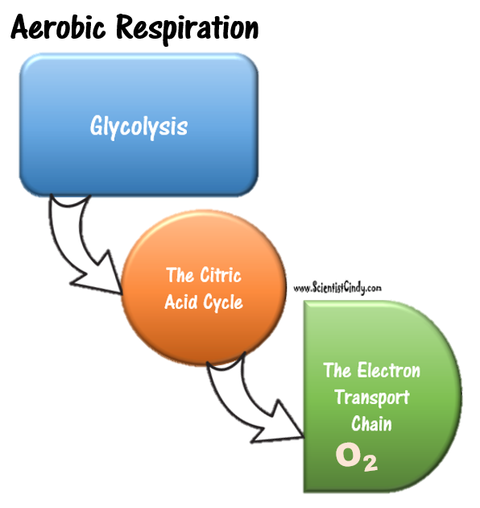
Cellular Respiration
Cellular respiration is a metabolic pathway that breaks down glucose and produces ATP.
The stages of cellular respiration include glycolysis, the citric acid (or Krebs cycle), and the electron transport chain (or oxidative phosphorylation).
Cellular Respiration

Slide 3
Cellular Respiration
The electron transport chain (or oxidative phosphorylation) generates much more ATP than is generated in glycolysis or the Citric Acid Cycle or Krebs Cycle.
is powered by the movement of electrons through the electron transport chain, a series of proteins embedded in the inner membrane of the mitochondrion.
These electrons come originally from glucose and are shuttled to the electron transport chain by electron carriers \text{NAD}^+NAD
Cellular Respiration

Slide 4
CELLULAR RESPIRATION
What is cellular respiration? Respiration takes place when any organic compound (usually carbohydrate) is oxidized completely (usually to CO₂ and H₂O).
Let’s look at the different types of cellular respiration and then show some examples of each type of bacteria.

Slide 5
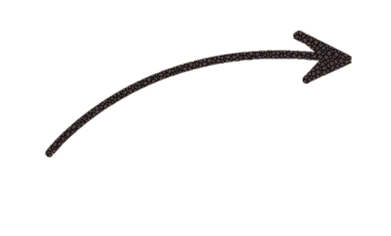
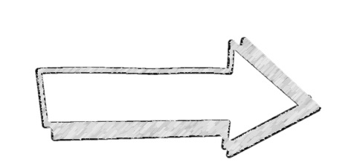
cellular respiration
Glucose
In the process of cellular respiration, one glucose molecule is gradually broken down (or completely oxidized) into carbon dioxide and water.
Cellular respiration produces ATP
ATP
H₂O
C0₂

Slide 6
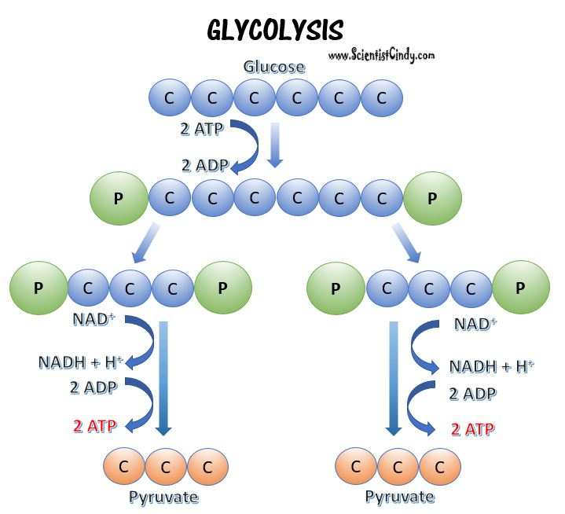
Glycolysis is common to both Aerobic and Anaerobic Pathways
In glycolysis, ATP is generated by substrate-level phosphorylation.
Substrate-level phosphorylation is the production of ATP by transferring high energy phosphate groups from an organic molecule to ADP.

Slide 7
Glycolysis is common to both Aerobic and Anaerobic Pathways
Energy Investment Phase
Glycolysis is an anaerobic process.
2 ATP are used to spilt glucose in the energy investment phase into two molecules of glyceraldehyde-3-phosphate.

Slide 8
Glycolysis is common to both Aerobic and Anaerobic Pathways
Energy Investment Phase
In the Energy Payoff Phase, Redox transformations take place that lead to the generation of 4 ATP.
Net Gain of 2 ATP.
The final result from this stage is ATP, the electron carrier NADH and pyruvate.
Energy Payoff Phase

Slide 9
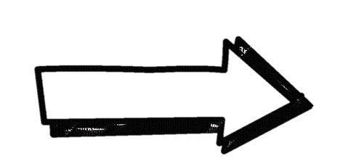
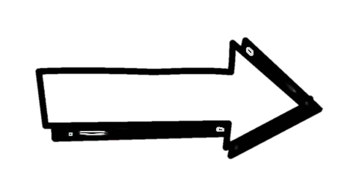
The transition reaction
GLUCOSE
Glycolysis
In the transition reaction, each pyruvate molecule produced in glycolysis undergoes an oxidation reaction.
Each pyruvate molecule is converted into acetyl CoA (or acetyl-coenzyme A)
Carbon dioxide and NADH+ are produced
Pyruvate
Pyruvate
NADH
CO₂
Transition Reaction
Acetyl CoA
Acetyl CoA
Krebs
Cycle
TCA (Krebs)

Slide 10
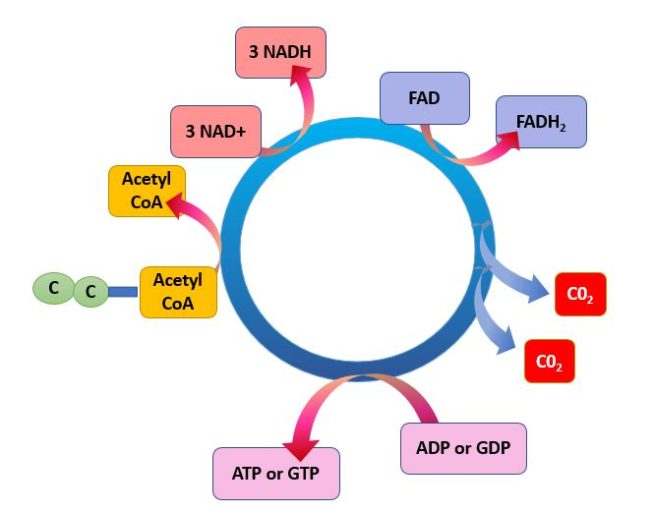
The Citric Acid Cycle (Krebs Cycle)
Simplified Diagram of the
Citric Acid Cycle (Krebs Cycle)
3 NADH and 1 FADH2 along with 2 CO2 molecules are generated from acetyl CoA.
NADH and FADH2 are electron carriers.

Slide 11
The Citric Acid Cycle (Krebs Cycle)
Each Acetyl Co-A molecule then enters the TCA cycle (Krebs Cycle) separately to yield…
Two ATP, two FADH₂, and six NADH are produced.
CO₂ is produced as a waste product

Slide 12
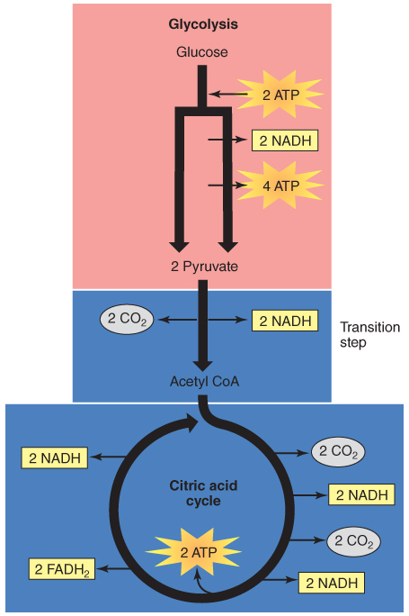
A Summary of Glycolysis and the Citric Acid Cycle
For each glucose molecule that enters glycolysis followed by the citric acid cycle:
Net of 10 NADH.
Net of two FADH₂.
Net of four ATP.
CO₂ waste by-product.
NADH and FADH₂ are important electron carriers in the process of oxidative phosphorylation.

Slide 13
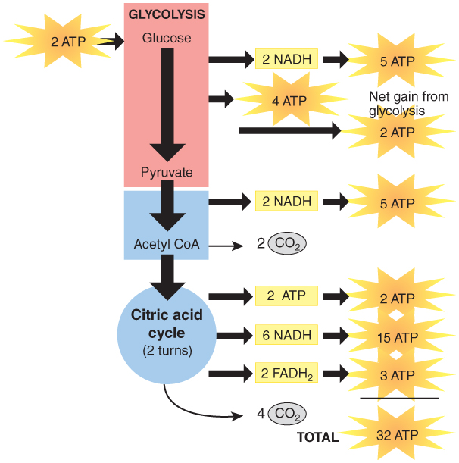
Oxidative Phosphorylation Is the Process by Which Most ATP Molecules Arise
NADH and FADH₂ provide pairs of electrons for oxidative phosphorylation.
Electrons are passed along a series of four protein complexes called cytochromes.
Known as electron transport.
The energy released is used to combine phosphate with ADP to form ATP.
Up to 32 ATP are produced.

Slide 14
Location, Location, Location.
3 Stages of Cellular Respiration in Eukaryotic Cells
Glycolysis - Cytoplasm
The Krebs/Citric Acid Cycle – Between the inner and outer membrane of the mitochondria (peripheral space)
Oxidative Phosphorylation / Electron Transport Chain – Inner Cell Membrane of the Mitochondria

Slide 15
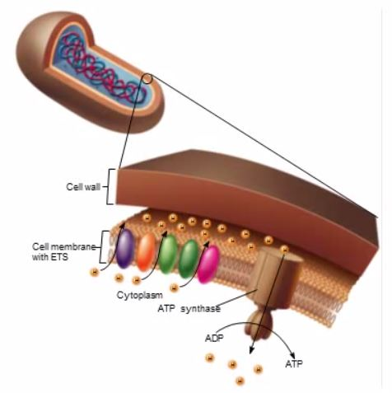
Location, Location, Location.
3 Stages of Cellular Respiration in Prokaryotic Cells
Glycolysis - Cytoplasm
The Krebs/Citric Acid Cycle –(periplasmic space)
Oxidative Phosphorylation / Electron Transport Chain –Cell Membrane

Slide 16
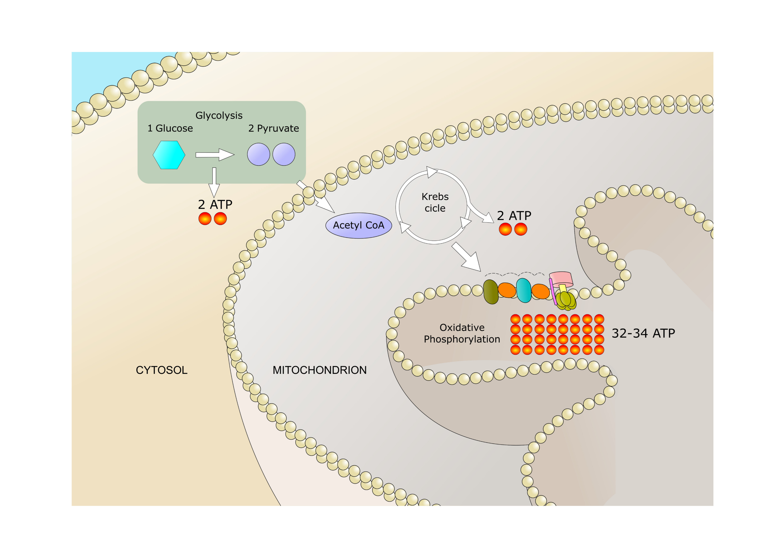
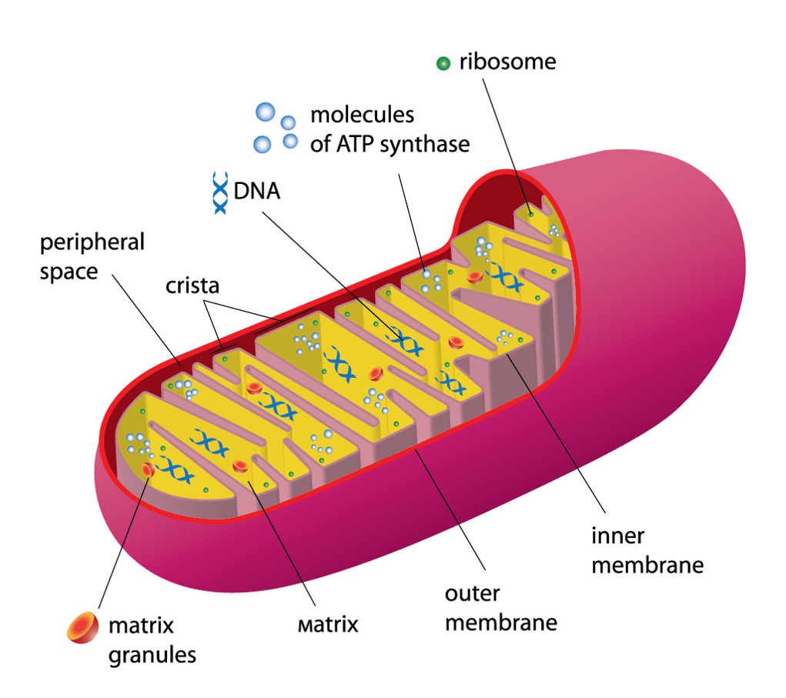
Electron Transport Chain (Oxidative Phosphorylation) in eukaryotes
The electron transport chain is a series of proteins and molecules embedded in the cell membrane of prokaryotes (or in the membrane of the mitochondria in eukaryotes) that pass along electrons.
Eukaryotic electron transport chain exists in the inner membrane of the mitochondria
Eukaryotic cell
Mitochondria

Slide 17
Electron Transport Chain (Oxidative Phosphorylation)
Prokaryotic electron transport chain exists in the cell membrane.
The electron transport chain is a series of proteins and molecules embedded in the cell membrane of prokaryotes that pass along electrons.

Slide 18
Chemiosmosis Follows Electron Transport
As electrons move down the electron transport chain, protons are pumped across the membrane.
This establishes a concentration gradient for the protons.
The protons then flow through ATP synthase via facilitated diffusion.
ATP synthase harnesses the energy from the flowing protons to phosphorylate ADP into ATP.
Oxygen accepts two protons and becomes water.

Slide 19
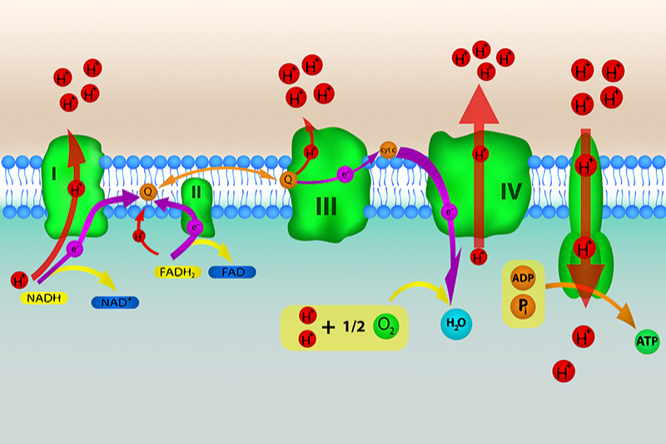
Oxidative phosphorylation in bacterial cells.
The energy created by the electron transport is used to pump protons across the membrane.
This build up of positive charge creates a proton motive force, which is potential energy in the form of a proton gradient.

Slide 20
Oxidative phosphorylation in bacterial cells.
The separation of charges that results is potential energy.
Protons will experience a driving force that pushes them from the area of high proton concentration to the area of low concentration.

Slide 21
Oxidative phosphorylation in bacterial cells.
During respiration, this proton motive force is used by the ATP synthase to make ATP, the vital high-energy molecule that supports growth and synthesis of all the major cellular compounds.

Slide 22
Oxidative phosphorylation in bacterial cells.
The ATP synthase opens a channel through the membrane and, as the protons flow through the channel down the gradient, the energy turns the ATP synthase, resulting in a torque force that is used to add a phosphate group to ADP to generate ATP. This process of using an electron transport chain to generate a proton motive force used for ATP synthesis is referred to as oxidative phosphorylation.

Slide 23
oxidation-reduction reactions
Energy transferred using oxidation-reduction reactions, or redox reactions.
Redox reactions involve the transfer of electrons → 'oxidation’ = the removal of electrons and 'reduction’ = the addition of electrons.

Slide 24
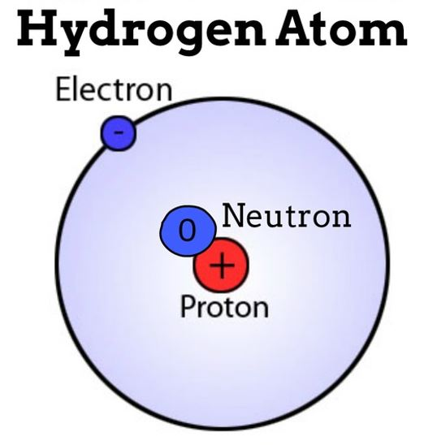
Electron Transport Chain (Oxidative Phosphorylation)
PROTONS
The first enzyme complex is a dehydrogenase that removes hydrogen from NADH. Hydrogen has one proton and one electron. When the hydrogens are removed in the electron transport chain, the hydrogen atom is split into its individual proton and electron.
ELECTRONS

Slide 25
Electron Transport Chain (Oxidative Phosphorylation)
The electrons are passed through the membrane from complex to complex in the electron transport chain.
The protons are pumped into the periplasmic space in prokaryotes (in eukaryotes the protons are pumped into the peripheral space of the mitochondria)
The passing of electrons down the electron transport chain generates energy, like electricity goes through a copper wire.

Slide 26
Electron Transport Chain (Oxidative Phosphorylation)
The terminal oxidase (complex IV) is a proton pump that transfers the electrons to oxygen and H+ to form water.
OXYGEN IS THE FINAL ELECTRON ACCEPTOR. THIS IS WHY IT IS CALLED AEROBIC CELLULAR RESSPIRATION.
The energy created from the electron transport chain is used by complex IV to pump even more protons into the space! (periplasmic space for prokaryotes or peripheral space for eukaryotes.)

Slide 27
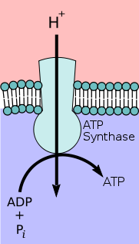
Electron Transport Chain (Oxidative Phosphorylation)
This results in a gradient of protons across the cell membrane, high on the outside and low on the inside. This proton gradient feeds the next block in our metabolic model, the ATP synthase
The protons build up in the space creating a proton gradient (a concentration gradient of protons) which is a source of potential energy, since substances always want to move down their own concentration gradients. This is also called the proton-motive force.
This process of ATP synthesis is referred to as oxidative phosphorylation

Slide 28
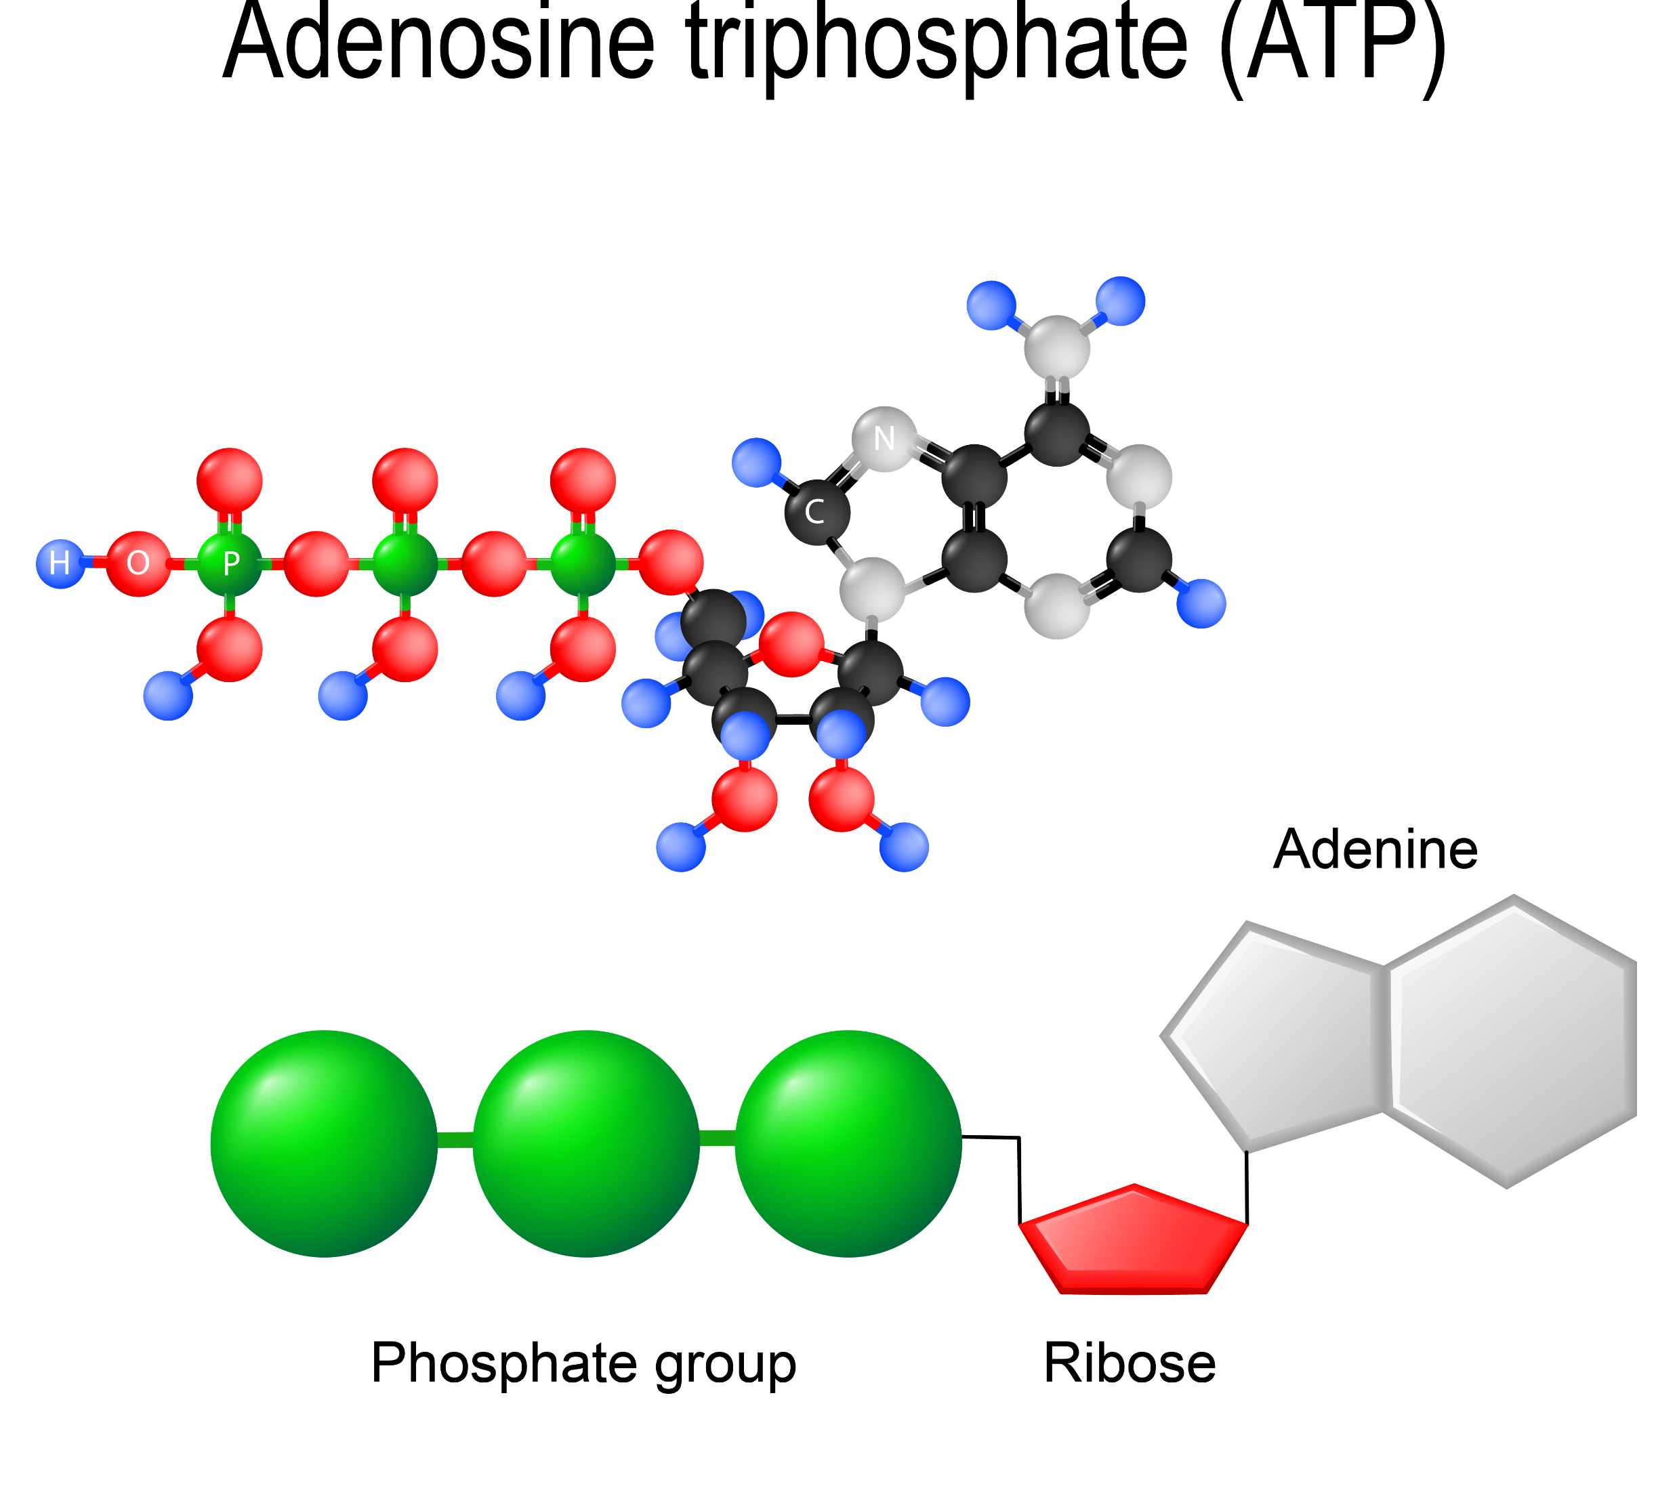
ATP is made by…
Substrate Level phosphorylation
Direct transfer of phosphate
Occurs in Glycolysis
Oxidative Phosphorylation
Occurs in the Electron Transport Chain
Uses energy of Chemiosmosis

Slide 29
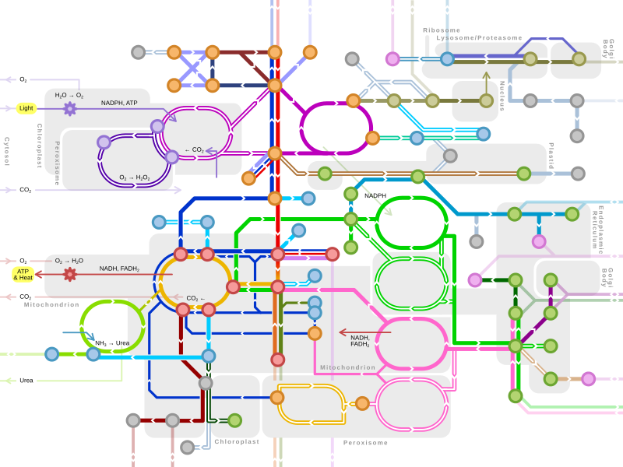
Metabolism
Most microorganisms obtain their energy from the nutrients they take into the cell.
For microorganisms, these nutrients may come from either an organic or an inorganic source.
Once the energy-giving nutrients enter the cell, they must be chemically processed so that they can be used.
They are of no use to the cell in their "raw" form.
The chemical processing that takes place involves a series of chemical reactions (called a metabolic pathway) that will function to trap some of their chemical energy in the form of ATP
…and to break down the larger molecules into smaller molecules that can be used as building blocks for the synthesis of new cellular components.

Slide 30
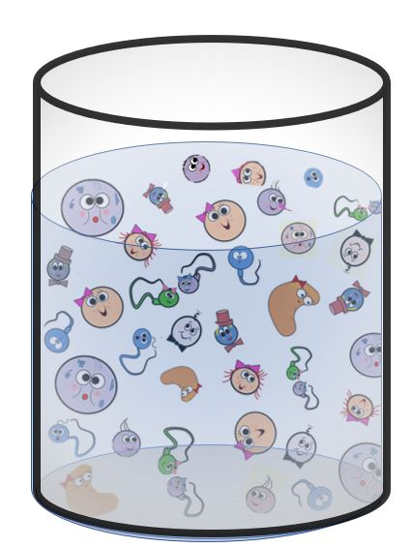
METABOLISM
Living organisms must synthesize polymers of these important molecules in order to sustain life. = ANABOLIC REACTIONS
Similarly, these molecules can be broken down to release energy or to use as building blocks for other molecules that the organism may need at the time. These would be the catabolic reactions of metabolism. ​= CATABOLIC REACTIONS

Slide 31
Catabolic
Anabolic

Slide 32
Metabolism is all the biochemical reactions taking place in an organism.
Anabolic reactions:
Build polymers from smaller building blocks.
Endergonic reactions because energy input is required.
Catabolic reactions:
Break down polymers into simpler molecules.
Exergonic reactions because energy is released.
Macronutrients are the building blocks of what we eat and appear as
carbohydrates,
proteins, and
fats.
We also need nucleic acids, but we don’t get that from our diet, we synthesize it.

Slide 33
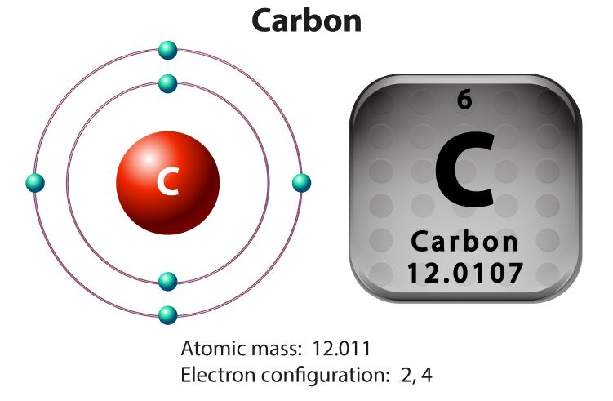
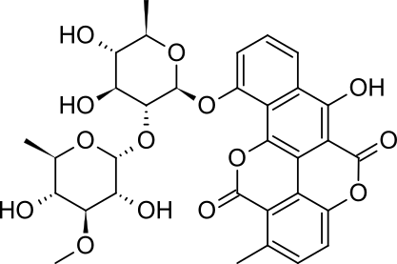
Carbon
All life as we know it is carbon-based. ​
The term "organic molecules" in science, means the molecule is composed of carbons and hydrogens..
A carbon bound to hydrogen can be generically called a "hydrocarbon" and the bond between them can be called a "hydrocarbon bond".
Hydrocarbons are found in fossil fuels like oil, gasoline, and organic matter. These are high energy bonds that we use for energy.

Slide 34
Carbon is able to form up to 4 strong bonds
Carbon is able to form up to 4 strong covalent bonds

Slide 35
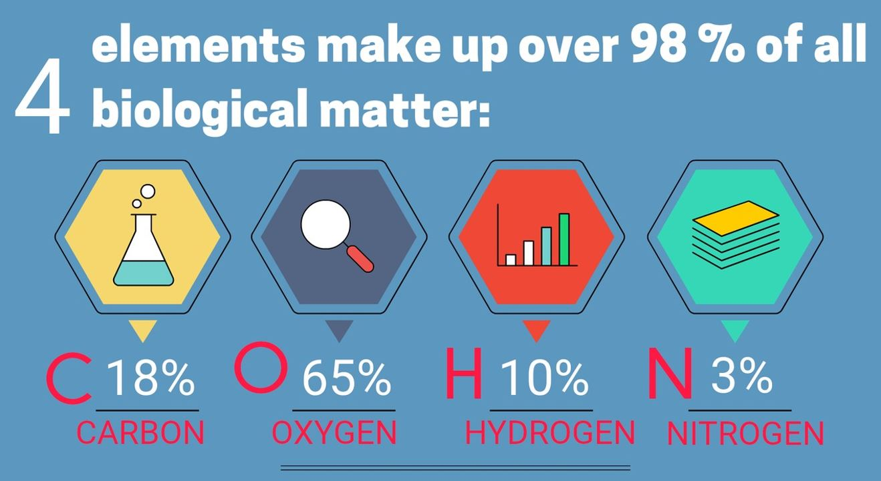
C, H, O and N.
96%
The most important elements for life are carbon, oxygen, hydrogen and nitrogen. Surprisingly, our bodies (as well as all biological entities) is more that 96%
carbon
oxygen
hydrogen
nitrogen
Sulfur and phosphorus are often added to the list as well.

Slide 36
Main Classes of Carbon Compounds
There are four principle groups of organic compounds that contribute to much of the structure and function of a cell.

Slide 37
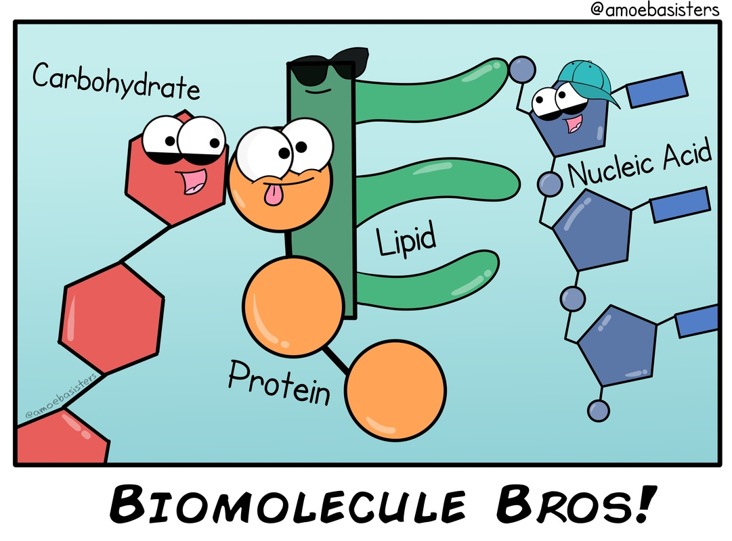
Bonding
Monosaccharides are joined via glyosidic linkages to form disaccharides and polysaccharides
Amino acids are joined via peptide bonds to make polypeptide chains
Glycerol and fatty acids are joined via an ester linkage to create triglycerides (ether linkage in archaea)
Nucleotides are joined by phosphodiester bonds to form polynucleotide chains

Slide 38
oxidation-reduction (redox) reaction
Oxidation – the gaining of an oxygen atom or the loss of a hydrogen atom
Oxidation can also be described as the loss of an electron (e⁻)

Slide 40
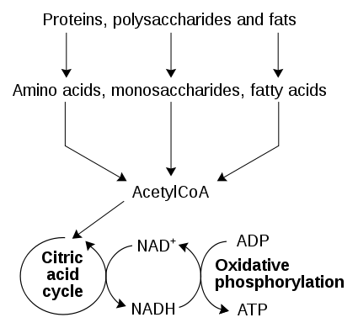
Metabolism = all the biochemical reactions taking place in an organism.
Anabolic reactions:
Build polymers from smaller building blocks.
Endergonic reactions because energy input is required.
Catabolic reactions:
Break down polymers into simpler molecules.
Exergonic reactions because energy is released.

Slide 41
Catabolism

Slide 43
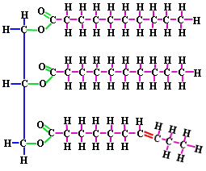
Lipids
Non-polar, hydrophobic molecules which may come in a variety of forms
Lipids serve as a major component of cell membranes (phospholipids and cholesterol)
They may be utilized as a long-term energy storage molecule (fats and oils)
Also may function as a signaling molecule (steroids)

Slide 44
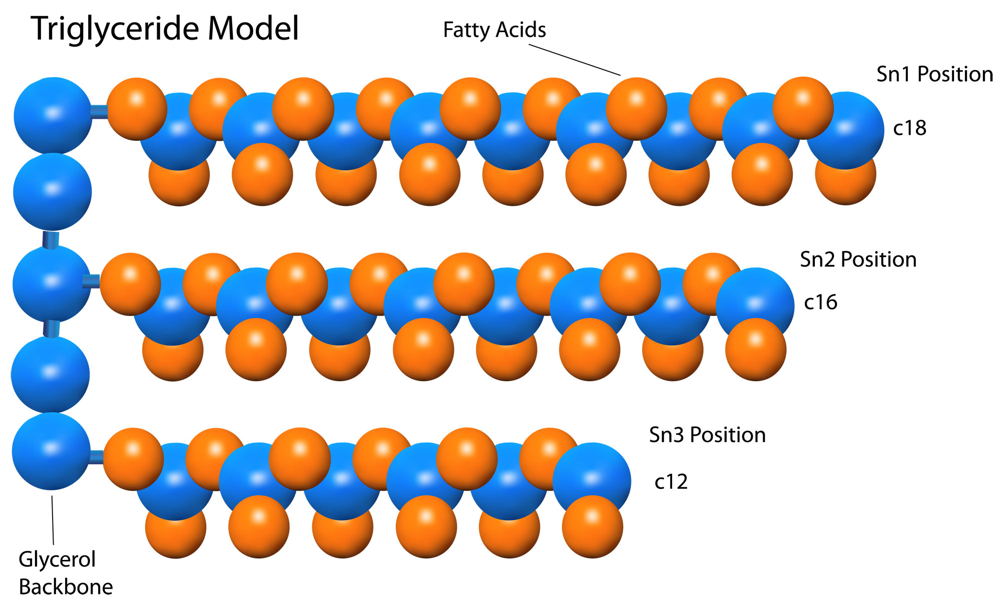
Lipid Catabolism
Triglycerides are a form of long-term energy storage in animals.
They are made of glycerol and three fatty acids.

Slide 45
Phospholipids

Slide 46
Proteins are broken down into amino acids.
Carbohydrates are broken down into monosaccharides .
Lipids (triglycerides specifically) get broken down into individual fatty acids.
Catabolism

Slide 47
BUILDING MACROMOLECULES
ANABOLIC REACTIONS

Slide 48
Anabolism

Slide 49
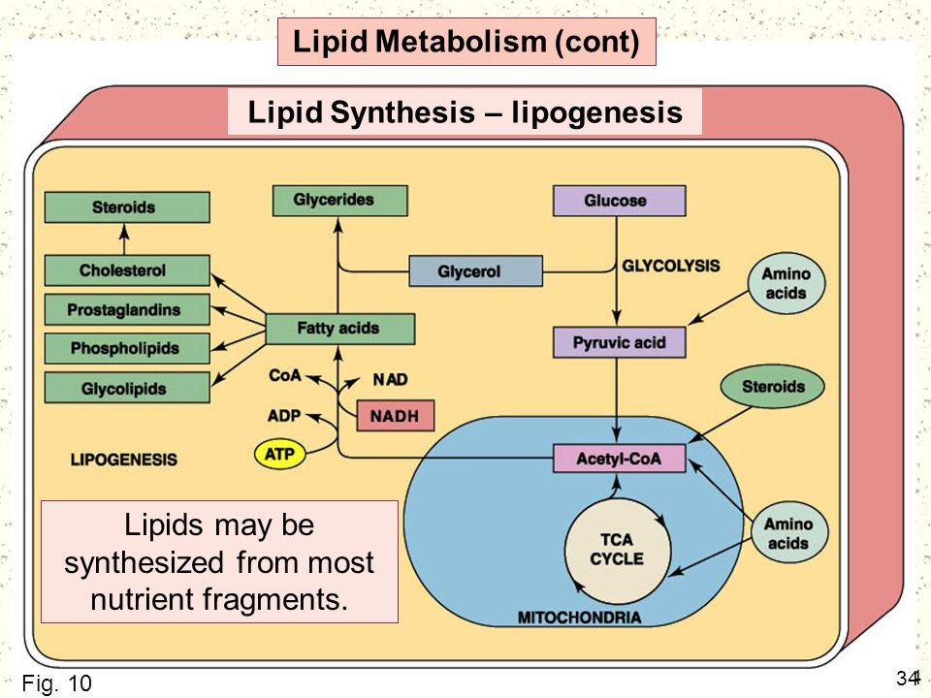
The ATP stores Energy Only Short- Term
ATP cannot be stored because it is relatively unstable.
Long-term energy storage occurs by producing more stable organic compounds like glycogen or lipids.

Slide 51
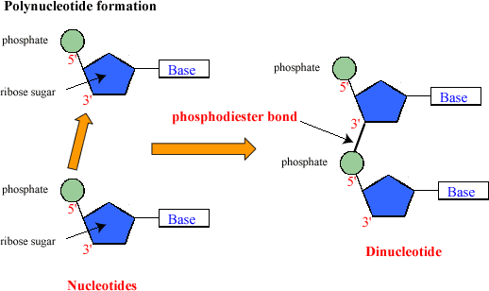
Nucleic Acids
DNA and RNA are polymers made up of monomers that are nucleic acids.
The polymerization of RNA and DNA is made possible by the formation of phosphodiester bonds that form between the nucleic acids.

Slide 52
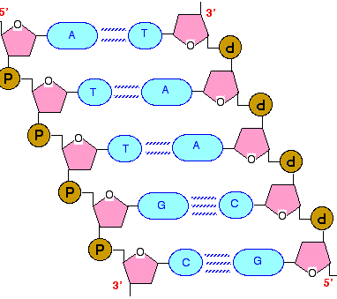
Nucleic Acids
Genetic material of all cells and determines the inherited features of an organism
DNA functions as a master code for protein assembly, while RNA plays an active role in the manufacturing of proteins
DNA and RNA are polymers made up of monomers that are nucleic acids.

Slide 53
Formation of a Peptide Bond
This a condensation reaction in which water is removed from 2 amino acids that become joined.

Slide 54
Formation of a Peptide Bond
The products of this reaction is a dipeptide and a water molecule.

Slide 55
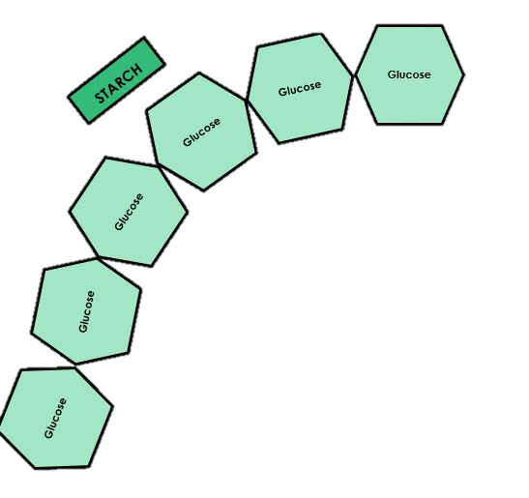
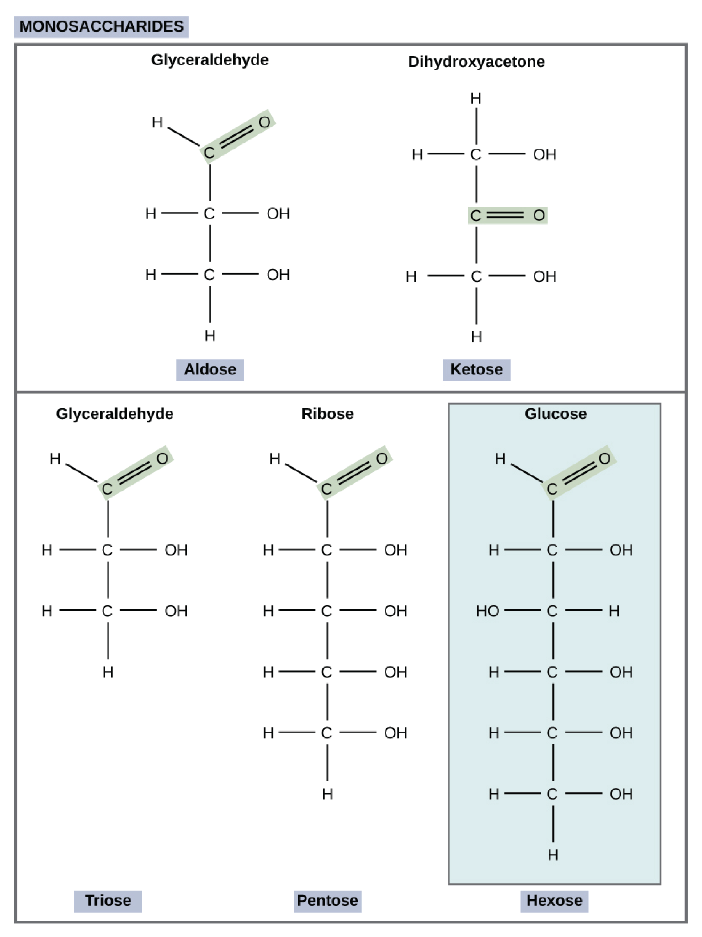
Carbohydrates
Composed of C,H and O atoms in a common ratio – (CH₂O)_{n}
Principally function as a source of energy (short-term energy)
monosaccharides ( mono = one, saccharide = sugar ) – also known as simple sugars
disaccharides ( di = two, saccharide = sugar )- also known as simple sugars
polysaccharides ( poly = many, saccharide = sugar ) – these include complex carbohydrates.
Polysaccharides are polymers that are composed of monomers of monosaccharides.

Slide 56
Carbohydrates
Glyosidic bonds form using condensation or dehydration or synthesis reactions.
Glyosidic bonds are broken using hydrolysis or decomposition reactions.

Slide 58
Glycogenesis

Slide 59
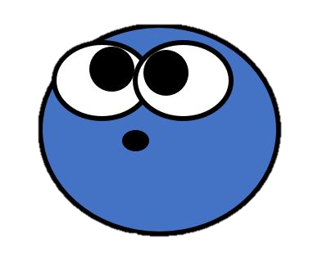
Non-Carbohydrate Energy Sources
The Other Catabolic Pathways!

Slide 60
Types of catabolism
Bacteria can capture energy and store it in ATP using aerobic respiration, anaerobic respiration or fermentation.
Fermentation is the anaerobic catabolism of a single chemical compound using a series of redox transformations with the goal of generating ATP by substrate-level phosphorylation.

Slide 61
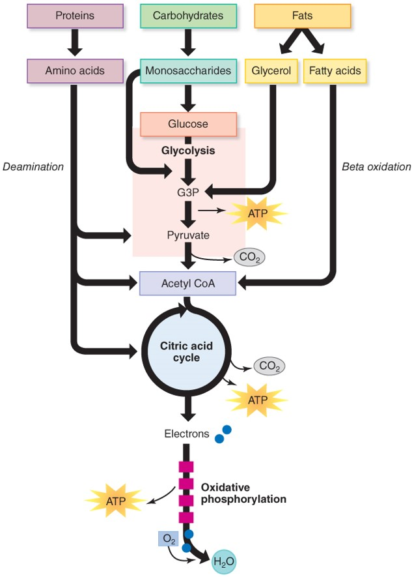
Overview of Catabolism
Pathways for the catabolism of proteins and fats end up merging with the pathway of cellular respiration!

Slide 62
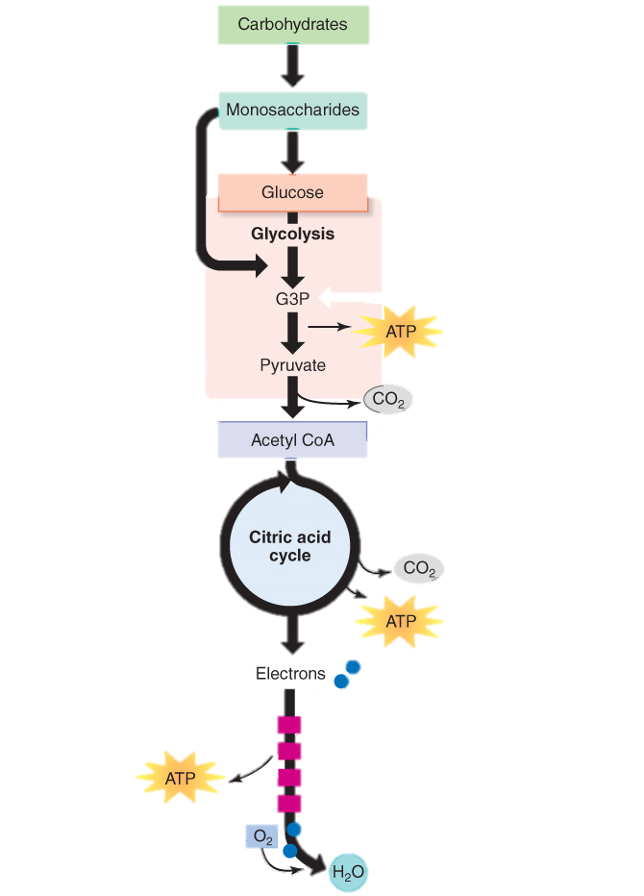
Carbohydrate catabolism
Carbohydrates:
Polysaccharides and disaccharides are catabolized to monosaccharides.
Monosaccharides are either converted to glucose or enter the metabolic pathways as intermediate molecules.

Slide 63
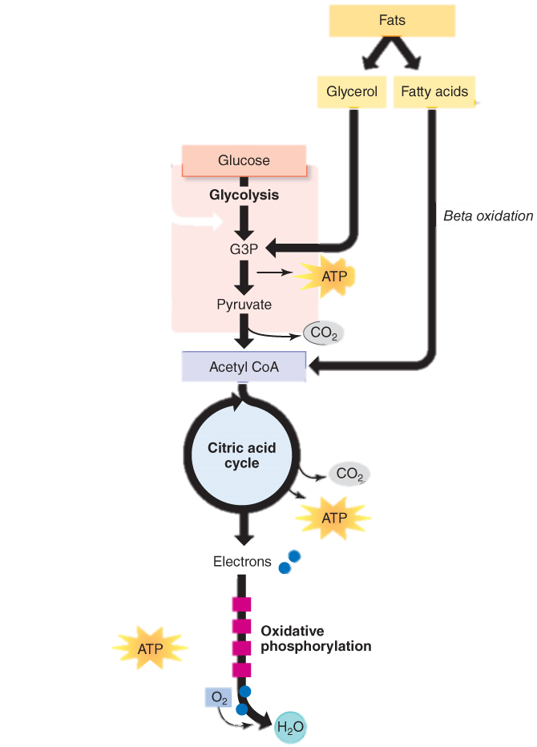
Lipid Catabolism
Fats:
Fats are good energy sources because the bonds store enormous amounts of chemical energy.
Fatty acids and glycerol are separated.
Glycerol is converted to acetyl CoA.
Fatty acids are broken down through beta oxidation.
Proteins:
Used for energy when fats and carbs are lacking.
Deamination is the replacement of the amino group in a protein with a carboxyl group in protein breakdown.

Slide 64
Lipid Catabolism
The resulting products of lipid catabolism, glycerol and fatty acids, can be further degraded.
Glycerol easily converted to a form that continues through glycolysis.
The released fatty acids are catabolized in a process called β-oxidation.

Slide 65
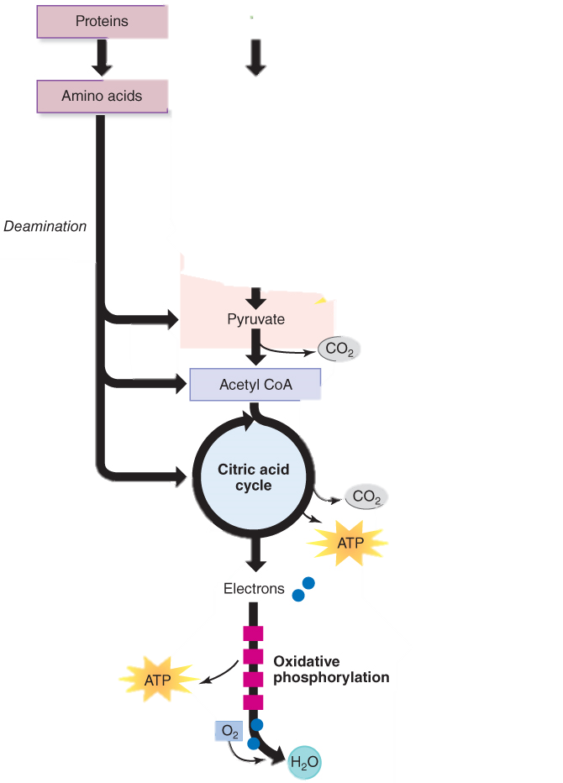
Protein catabolism
Proteins:
Used for energy when fats and carbs are lacking.
Proteins are degraded through the concerted action of a variety of microbial protease enzymes.
Extracellular proteases cut proteins at specific amino acid sequences, breaking them down into smaller peptides that can then be taken up by cells.

Slide 66
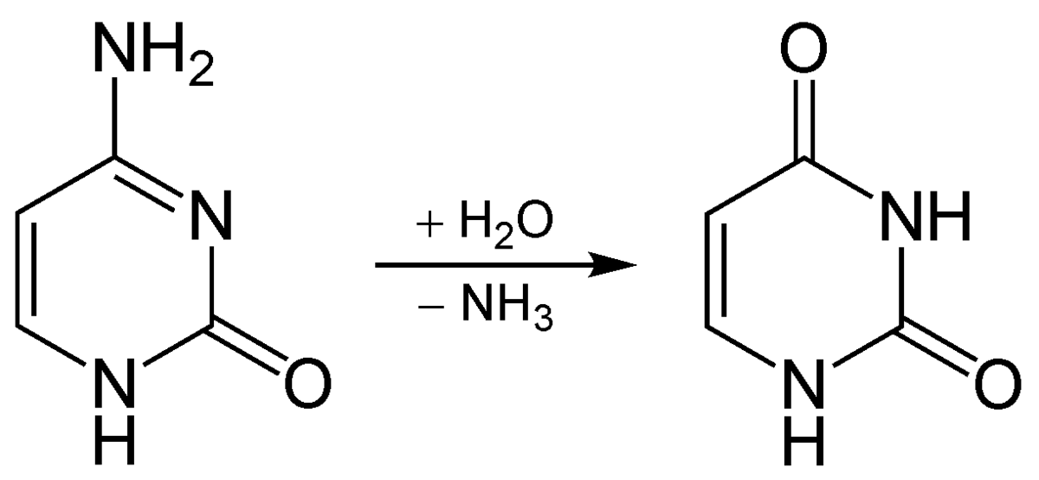
Protein Catabolism
Deamination
The polypeptides can then be broken down further into individual amino acids by additional intracellular proteases.
Each amino acid can be enzymatically deaminated to remove the amino group.
The remaining molecules can then enter the transition reaction or the Krebs cycle.

Slide 67
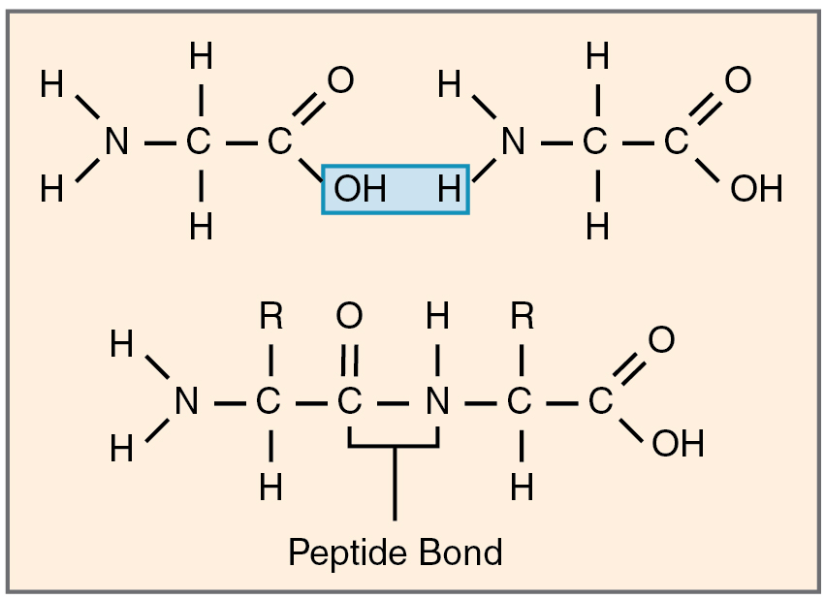
Proteins
Proteins are polymers that are composed of amino acid monomers.
Amino acids are joined by peptide bonds.
Short chains of amino acids can be called di-peptides, tri-peptides, or polypeptides.
When the string of amino acids get relatively long, it is considered a protein.
https://commons.wikimedia.org/wiki/File:224_Peptide_Bond-01.jpg

Slide 68
ATP

Slide 69
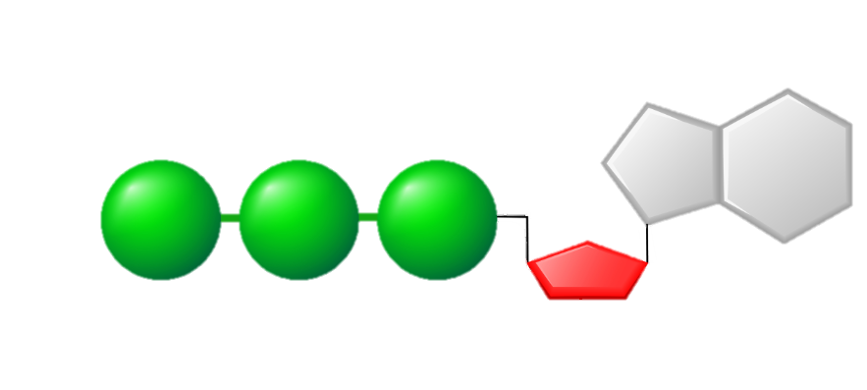
Energy in the Form of ATP Is Required for Metabolism
ATP (adenosine triphosphate) is the cellular energy currency of all cells.
Allows for the coupling of energy-requiring anabolic reactions and energy-releasing catabolic reactions in cells.
Made in cell membrane of prokaryotic cells and mitochondria of eukaryotic cells.
Adenosine
Phosphate Groups
Ribose

Slide 70
ATP
Energy taken up by the cell, in the form of nutrients or sunlight, must be converted (metabolized) into a usable form.
The usable form is ATP. ​
ATP is a high-energy transfer compound, that has the ability to store potential energy in its chemical bonds.
The potential energy found in ATP comes from the breakdown of nutrients or by the trapping of sunlight energy (in photosynthesis).
For example. the catabolic reactions that break down glucose, generate ATP.

Slide 71
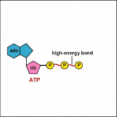
ATP
ATP is adenine triphosphate.
The bond that we are most interest in is the bond that links the second and third phosphate groups together.
This bond holds a lot of potential energy (it is a ‘high-energy’ bond).
When energy is needed, this bond can be broken and energy is released.
When the bond is broken, ATP is broken down to form ADP and inorganic phosphate (Pi).

Slide 72
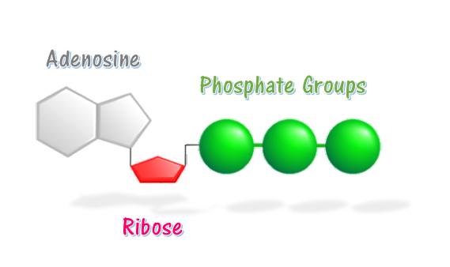
The ATP/ADP Cycle
Energy is released from ATP when the high-energy bond between the last 2 phosphate groups of ATP is broken.
ATP → ADP + P_{(i)}
HIGH-ENERGY BOND

Slide 73
ATP
ADP + P_{(i)}
ENERGY GOES IN
Energy is Released

Slide 74
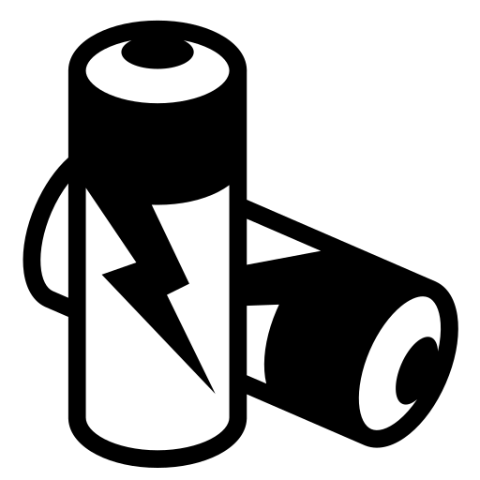
The ATP/ADP Cycle
Adding a phosphate group to a molecule is called phosphorylation.
ADP waits around until it gets phosphorylated, and becomes ATP again.
ADP is like a uncharged battery
ATP is like a charged battery
ADP + P_{(i)} → ATP

Slide 75
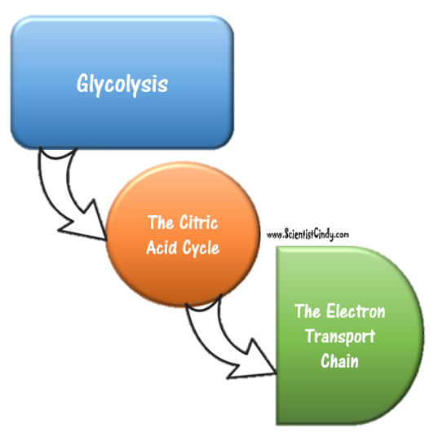
CELLULAR RESPIRATION
ALL organisms make energy through cellular respiration, but they do this differently depending on if they are anaerobic or aerobic.
Cellular respiration is divided into 3 steps
Glycolysis
The TCA or Krebs Cycle
The Electron Transport Chain

Slide 76
Aerobic respiration
Aerobic Respiration
Aerobic respiration occurs in three steps:
Glycolysis breaks down glucose into two smaller molecules called pyruvate
The Krebs cycle, or the citric acid cycle, where the pyruvate molecules go through a series of reactions to release electrons
The electron transport chain in which electrons are used to create most of the 36 ATP
In aerobic respiration, molecular O₂ serves as the terminal acceptor of electrons. This is why this process is called “aerobic” respiration.
Aerobic meaning WITH OXYGEN.
O₂

Slide 77
Anaerobic Respiration
Aerobic Respiration
Anaerobic respiration is a mode of metabolism in which an inorganic molecule other than O₂ serves as a the terminal electron acceptor at the end of the electron transport chain
Such acceptor compounds include NO₃–, SO₄^{2–}, fumarate, and CO₂ for methane-producing bacteria.
These bacteria that will not grow anaerobically unless a specific chemical component, which serves as a terminal electron acceptor, is added to the medium.
Bacteria requiring one of these compounds for anaerobic growth are said to be anaerobic respirers.
Bacteria that participate in the nitrogen cycle are usually anaerobic respirers.
NO₃–, SO₄^{2–}, fumarate, and CO₂

Slide 78
Aerobic Cellular Respiration
Aerobic Cellular Respiration is the process in which a compound is oxidized, using oxygen as the terminal electron acceptor. Used by Humans! Some prokaryotes too!

Slide 79
Aerobic respiration
In organisms that have the ability to undergo both aerobic and anaerobic respiration, if oxygen is present, the organism will always use aerobic respiration, because it is more efficient, yielding up to 38 ATP.
The chemical formula for aerobic respiration shows that glucose and water react to form the products: carbon dioxide, water, and ATP. This type of respiration produces 36 ATP molecules from one glucose molecule.
C ₆ H ₁₂ O ₆ (glucose) + 6O ₂ (oxygen) → 6CO ₂ (carbon dioxide) + 6H ₂ O (water) + 36ATP

Slide 80
Glycolysis
Many bacteria lack the enzymes needed to undergo the type of glycolysis that humans undergo.
They use alternative forms of glycolysis.
There are 3 main types of glycolysis
Embden-meyerhof-parnas
Entner-doudoroff Pathway
Pentose Phosphate Pathway

Slide 81
The Emden-Meyerhof-Parnas (EMB) Pathway
You probably didn’t know it, but you already know the Emden-Meyerhof-Parnas
glycolytic pathway.
This is the glycolysis that you learn in high school. This is the one that our bodies and mammals use. Here is my VERY simplified version
Of the EMP glycolytic pathway.

Slide 82
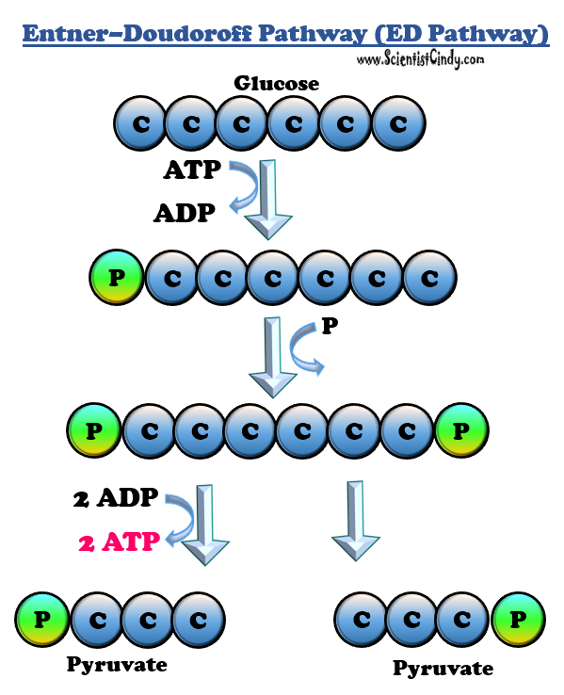
Entner-Doudoroff (ED) pathway
Other Glycolytic Pathways
When we refer to glycolysis, unless otherwise indicated, we are referring to the EMP pathway used by animals and many bacteria.
Only in some prokaryotes
Pseudomonas aeruginosa, only have the ED pathway for glycolysis, other bacteria, like
E. coli, have the ability to use either the ED pathway or the EMP pathway.

Slide 83
The ED glycolysis creates 2 pyruvate molecules from glucose. It Has a net yield of 1 ATP for every one glucose molecule It also generates 1 NADH and 1 NADPH.

Slide 84
Entner–Doudoroff Pathway (ED Pathway)
The Emden-Meyerhof-Parnas (EMB) Pathway
Glucose
C
C
C
C
C
C
ATP
ADP
P
C
C
C
C
C
C
P
P
C
C
C
C
C
C
P
2 ADP
2 ATP
P
C
C
C
C
C
C
P
Pyruvate
Pyruvate
EMB Glycolysis has a net yield of 2 ATP molecules and 2 NADH molecules for every one glucose molecule metabolized.
Has a net yield of 1 ATP for ever one glucose
molecule processed, as well as 1 NADH and 1 NADPH.

Slide 85
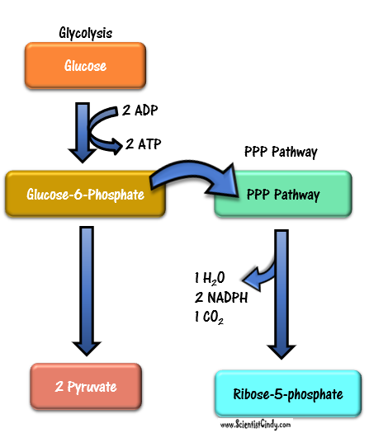
Pentose Phosphate Pathway (PPP) of Glycolysis
This pathway can operate in the presence or absence of oxygen.
This glycolytic pathway can occur in all cells when building materials are needed.

Slide 86
Pentose Phosphate Pathway (PPP) of Glycolysis
​ The PPP creates building blocks for amino acids and nucleotides.
This form of glycolysis will take place in the cell when amino acids and nucleotides are needed to form proteins and nucleic acids, respectively (RNA or DNA).

Slide 87
Pentose Phosphate Pathway (PPP) of Glycolysis
Glycolysis
Glucose
2 ADP
2 ATP
PPP Pathway
The pentose phosphate pathway takes place in the cytosol of the cell, the same location as glycolysis.
The two most important products from this process are the ribose-5-phosphate sugar used to make DNA and RNA, and the NADPH molecules which help with building other molecules.
Produces
1 H₂O
2 NADPH
1 CO₂
Ribose-5-phosphate
Glucose-6-Phosphate
PPP Pathway
1 H₂O
2 NADPH
1 CO₂
2 Pyruvate
Ribose-5-phosphate

Slide 88
Anaerobic Respiration
Now fermentation is a type of anaerobic respiration, but that is not what we are referring to here.
True anaerobic respiration, will go through all of the steps of glycolysis, the TCA cycle or a similar cycle, and an electron transport chain. The enzymes and substrates may look a bit different, though.
The thing that defines anaerobic respiration, is that the final electron acceptor will be something besides oxygen.

Slide 89
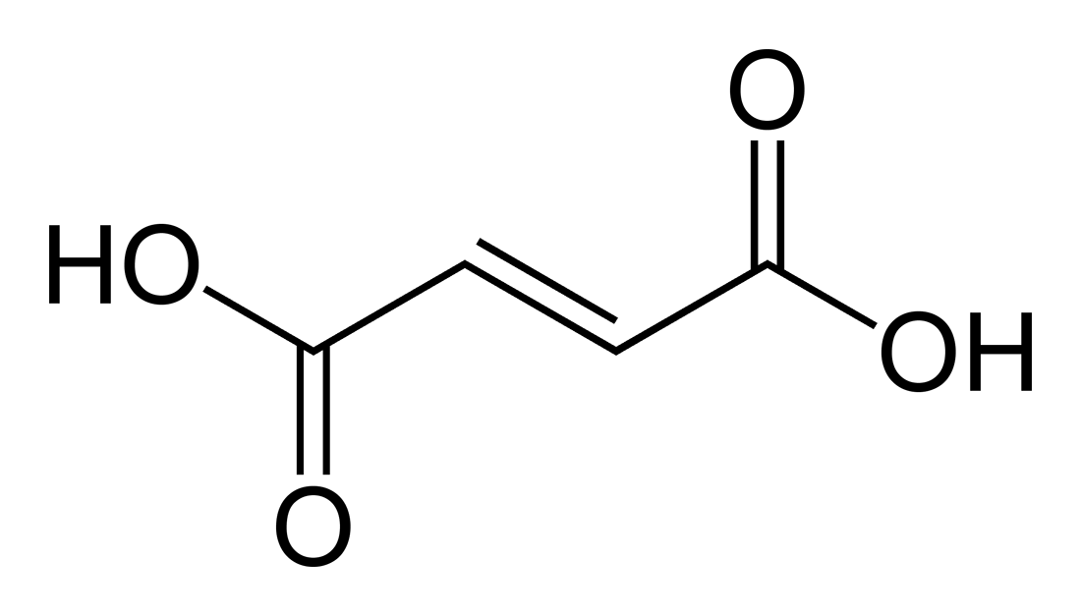
Methanogens - Anaerobic Respiration
Methanogens
Anaerobic Respiration
FUMARATE
Anaerobic respiration is another mode of metabolism in which a specific compound other than O₂ serves as a terminal electron acceptor.
Such acceptor compounds include NO₃–, SO₄^{2–}, fumarate, and CO₂ for methane-producing bacteria.
These bacteria that will not grow anaerobically unless a specific chemical component, which serves as a terminal electron acceptor, is added to the medium.
Bacteria requiring one of these compounds for anaerobic growth are said to be anaerobic respirers.
Bacteria that participate in the nitrogen cycle are usually anaerobic respirers.
NO₃–, SO₄^{2–}, fumarate, or CO₂
Electron acceptors =
NO₃–, SO₄^{2–}, fumarate, or CO₂

Slide 90
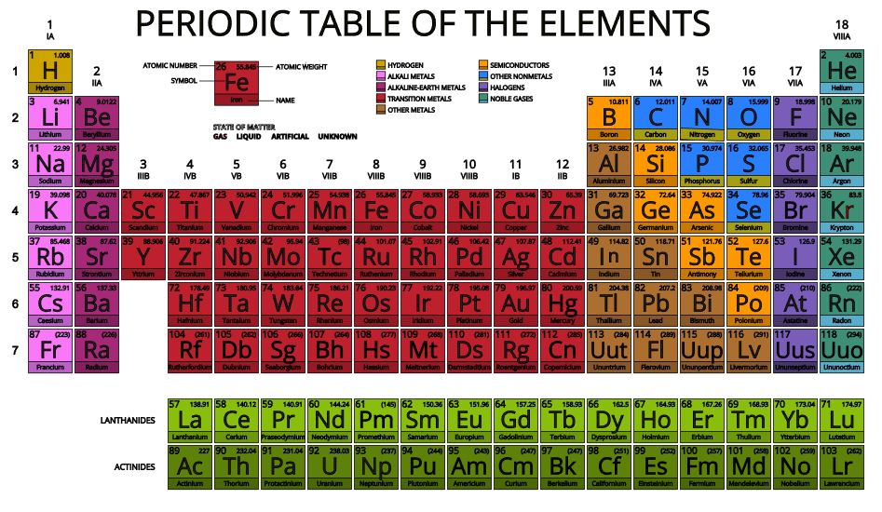
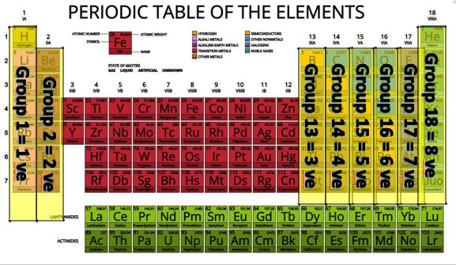
However, when you look at the periodic table, you will see why these alternatives kind of make since.
NO₃–, SO₄^{2–}, fumarate, or CO₂
NO₃–, SO₄^{2–}, fumarate, or CO₂

Slide 91
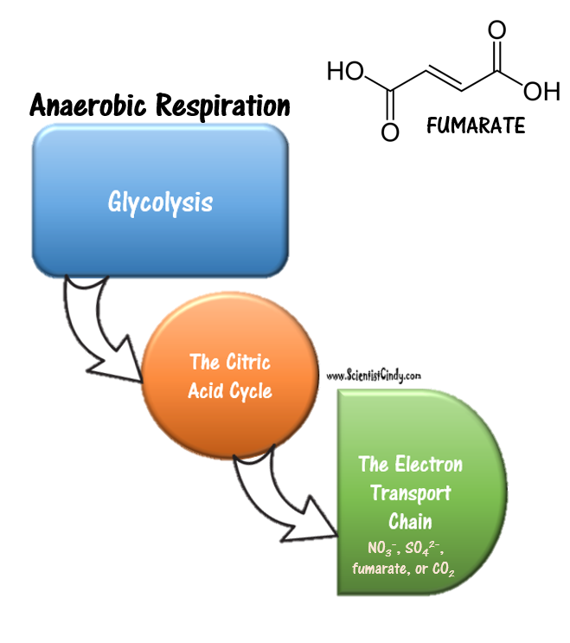
Anaerobic Respiration
In both aerobic and anaerobic respiration, the end goal is the same..
MAKE ATP by oxidative phosphorylation
- produces ATP by generating a proton motive force that can be used by ATP synthase to make ATP.
In anaerobic respiration, we use something BESIDES OXYGEN as the final electron acceptor.

Slide 92
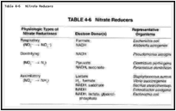
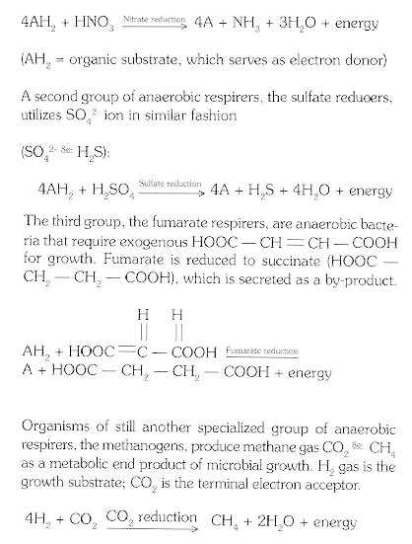
nitrate reducers Anaerobic Respiration / Nitrate Respiration
Anaerobic Respiration / Nitrate Respiration
A large group of anaerobic respirers are the nitrate reducers.
The nitrate reducers use NO₃– ion as the final electron acceptor.
.
Nitrate Reducers.
NO₃⁻

Slide 93
https://www.ncbi.nlm.nih.gov/books/NBK7919/#mmed_ch4
NO₃–, is used as the final electron acceptor for the anaerobic bacteria E. coli.

Slide 94
Anaerobic Bacterial Metabolism – Nitrate Respiration
This electron transport chain has different enzymes too.
Different species can process the nitrate into different end products. Generation of the proton motive force that can be used by the ATP synthase, is still the same.

Slide 95
Sulfate reducers Anaerobic Respiration / Sulfate Respiration
Anaerobic Respiration / Sulfate Respiration
Sulfur and sulfurous compound can be used in replacement of oxygen in the electron transport chain to generation of the proton motive force that can be used by the ATP synthase, is still the same.
SO²⁻₄

Slide 96
Anaerobic Bacterial Metabolism – Sulfate Respiration
Most of the cells use pyruvate, lactate, or hydrogen as their electron donor.
In contract NADH and FADH2 is used in aerobic respiration.

Slide 97
Methanogenesis
Methanogenesis is the biological production of methane.
It is carried out by methanogens
An example, is the strictly anaerobic Archaea, the Methanococcus,
Methanogens reduce carbon dioxide (CO₂) to methane (CH₄) using electrons from hydrogen gas (H₂)
CO₂ ₊ H₂ → CH₄

Slide 98
Denitrification
Denitrification is the utilization of nitrate (NO⁻₃) as a terminal electron acceptor.
It is a widespread process that is used by many members of the Proteobacteria.
Important for nitrogen cycle.
Used in treatment of wastewater.

Slide 99
The Nitrogen Cycle
The nitrogen cycle consists of a recycling process by which organic and inorganic nitrogen compounds are used metabolically and recycled among bacteria, plants, and animals.
Important processes, including ammonification, mineralization, nitrification, denitrification, and nitrogen fixation, are carried out primarily by bacteria.

Slide 100
Sulfate reduction – sulfate as electron acceptor
Sulfate-reducing bacteria
Sulfate reduction is used by many Gram-negative bacteria found within the deltaproteobacteria, such as Desulfotomaculum or the archaeon Archaeoglobus.
Hydrogen sulfide (H₂S) is produced as a metabolic end product.
For sulfate reduction electron donors and energy is needed.

Slide 101
enzymes
Enzymes are specific to the reaction it catalyzes.
In the lock and key synthesis model, the enzyme interacts with the substrate specifically in a lock and key fashion.
The shape of the substrates fit perfectly and specifically into the active site of the enzyme like a key in a lock.
In biology, when we see this pattern of shapes fitting together perfectly with each other, we say that the shapes are complimentary.

Slide 102
Properties of Enzymes
Enzymes are reusable.
Enzymes are highly specific.
Enzymes have an active site.
Enzymes are usually proteins
Enzymes will have names that end in "-ase"

Slide 104
Temperature
The rate at which an enzyme converts its substrate into product is affected by many factors.
Temperature - The rate chemical reactions increases with increasing temperature, because the heat is adding kinetic energy to the molecules which makes them move faster.

Slide 105
Fermentation
Fermentation is essentially the same process as glycolysis EXCEPT that . instead of making 2 pyruvate molecules from glucose, the final product is NOT PYRUVATE.
Then WHAT IS IT??
It depend in what TYPE of fermentation is going on.

Slide 106
fermentation
FERMENTATION
Some living systems use an organic molecule (commonly pyruvate) as a final electron acceptor through a process called fermentation.
Fermentation starts with glycolysis.
Fermentation does not involve the TCA Cycle
Fermentation does not involve an electron transport system
Fermentation does not directly produce any additional ATP beyond that produced during glycolysis by substrate-level phosphorylation = 2ATP.

Slide 107
Fermentation
Fermentation, requires an organic compound as a terminal electron acceptor.
In fermentations, simple organic end products are formed from the anaerobic dissimilation of glucose (or some other compound).
On reduction, these organic end products are secreted into the medium as waste metabolites (usually alcohols or acid).

Slide 108
Differences Between Anaerobic Cellular Respiration and Fermentation
Anaerobic Cellular Respiration
Fermentation
Fermentation uses the same molecule as the electron donor and acceptor.
All the redox transformations act on the atoms found in the initial substrate.
Fermentation uses substrate-level phosphorylation to synthesize ATP.
Cellular Respiration uses two different molecules for the electron donor and the electron acceptor.
In cellular respiration, most of the ATP is generated using oxidative phosphorylation.

Slide 109
36-38 vs only 2 ATP
Some prokaryotes are facultative anaerobes, meaning that do have the necessary genes and enzymes to carry out aerobic cellular respiration, as long as oxygen is present to be the final electron acceptor in the process.
Facultative anaerobes will use aerobic cellular respiration whenever possible because it yields so much more ATP.

Slide 111
Lactic Acid Fermentation
During lactic acid fermentation, cells use a molecule called NADH to take electrons from glucose.
The NADH use the energy stored in the electrons to make ATP, and convert glucose to pyruvate.
This process is called glycolysis and is the first step in all forms of cellular respiration.
In lactic acid fermentation, the next step is to pyruvate to lactic acid. Lactic acid, although a waste product for bacteria, can be used to make human foods, like yogurt.
Glycolysis
Lactic Acid Fermentation
NADH + H⁺
NADH + H⁺
NAD⁺
NAD⁺
C
C
C
C
C
C
Lactate
Lactate

Slide 112
Lactic Acid Fermentation
Fermentation is most often triggered by a lack of sufficient amounts of oxygen to continue running the aerobic respiration chain.
Humans undergo lactic acid fermentation.
Instead of finishing with pyruvate, lactic acid is created instead. Long distance runners are familiar with lactic acid. It can build up in the muscles and cause cramping.
NADH + H⁺
NADH + H⁺
NAD⁺
NAD⁺
C
C
C
C
C
C
Lactate
Lactate

Slide 113
lactic acid bacteria
Bacteria of several gram-positive genera, including Lactobacillus, Leuconostoc, and Streptococcus, are collectively known as the lactic acid bacteria (LAB), and various strains are important in food production.
During yogurt and cheese production, the highly acidic environment generated by lactic acid fermentation denatures proteins contained in milk, causing it to solidify.
This Photo by Unknown Author is licensed under CC BY-ND

Slide 114
Alcoholic Fermentation
C
C
C
C
C
C
glucose
ADP
NAD⁺
ATP
NADH
In ethanol fermentation, NADH takes electrons from glucose and turns it into pyruvate during glycolysis.
From here, the pyruvate is converted to ethanol instead of lactic acid.
This is the same ethanol that we find in beverages like wine and beer.
Alcoholic fermentation also makes carbon dioxide, which gives beer the carbonation.
2
C
C
C
pyruvate
2 CO²
2
C
C
acetaldehyde
NADH
NAD⁺
2
C
C
ethanol

Slide 115
Fermentation recycles NAD+
Fermentation recycles NAD⁺ for glycolysis.
Without these pathways, glycolysis would not occur and no ATP would be harvested from the breakdown of glucose.

Slide 116
alcohol fermentation
In the first reaction, the enzyme pyruvate decarboxylase removes a carboxyl group from pyruvate, releasing CO2 gas while producing the two-carbon molecule acetaldehyde.
The second reaction, transfers an electron from NADH to acetaldehyde, producing ethanol and NAD+.
The ethanol fermentation of pyruvate by the yeast Saccharomyces cerevisiae is used in the production of alcoholic beverages.
The yeast Saccharomyces cerevisiae also makes bread products rise due to CO2 production.
Ethanol fermentation can also be used in biofuel production.

Slide 117
heterolactic fermentation
Some bacteria perform heterolactic fermentation, which producing a mixture of lactic acid, ethanol and/or acetic acid, and CO2 as a result.
The reason that these organisms are able to to do this, is because they use the pentose phosphate pathway instead of the EMP pathway for glycolysis.

Slide 118
Pyruvate
Lactobacillus Streptococcus
Saccharomyces
Escherichia
Enterobacter
Propionibacterium
Clostridium
Butyric Acid, Butanol, Acetone, CO₂
Propanoic Acid and Acetic Acid, CO₂
Neutral End Products, CO₂
Acidic End Products, CO₂
Ethanol, CO₂
Lactic Acid
GLUCOSE
Glycolysis
2 ATP
Bacterial Fermentation

Slide 120
fermentation
Organisms carrying out fermentation, called fermenters, produce a maximum of two ATP molecules per glucose during glycolysis.
The table compares the final electron acceptors and methods of ATP synthesis in aerobic respiration, anaerobic respiration, and fermentation.

Slide 121
propionic acid fermentation
The propionic acid produced during propionic acid fermentation contributes to the distinctive flavor of Swiss cheese, for example.
This Photo by Unknown Author is licensed under CC BY-SA

Slide 122
Fermentation - chemical solvents
Several fermentation products are important commercially outside of the food industry.
For example, chemical solvents such as acetone and butanol are produced during acetone-butanol-ethanol fermentation.
Complex organic pharmaceutical compounds used in antibiotics (e.g., penicillin), vaccines, and vitamins are produced through mixed acid fermentation.
This Photo by Unknown Author is licensed under CC BY-NC-SA

Slide 123
Fermentation – Lab/Diagnostic Use
Fermentation products are used in the laboratory to differentiate various bacteria for diagnostic purposes.
For example, E. coli can ferment lactose, forming gas, whereas some of its close gram-negative relatives cannot.
The ability to ferment the sugar alcohol sorbitol is used to identify the pathogenic enterohemorrhagic O157:H7 strain of E. coli because, unlike other E. coli strains, it is unable to ferment sorbitol.
Last, mannitol fermentation differentiates the mannitol-fermenting Staphylococcus aureus from other non–mannitol-fermenting staphylococci.

Slide 126
Nutritional Categories
MICROBIOLOGY

Slide 127
Bacterial Requirements for Growth
The process of metabolism requires 3 things:
A Source of Carbon
A Source of Energy
A Source of Electrons (or Hydrogen Atoms)

Slide 128
The six most common elements associated with organic molecules
The six most common elements associated with organic molecules—
carbon
hydrogen
nitrogen
oxygen
phosphorus
sulfur

Slide 129
ALL ORGANISMS NEED A SOURCE OF CARBON
​- We can categorize organisms based on how they obtain CARBON from the environment.
Organisms are categorized as either autotrophic or heterotrophic based upon how they get their carbon.

Slide 130
Microbial Metabolic Diversity
Categorizations based on
CARBON SOURCE
Auto vs Hetero

Slide 131
Microbial Metabolic Diversity
Categorizations based on
ENERGY SOURCE
PHOTO vs CHEMO

Slide 132
There are 4 classes of organisms based on what they use as a source of carbon and what they can metabolize for energy.
Photoautotrophs -
Carbon Source - carbon dioxide
Energy Source - sunlight energy
Chemoautotrophs -
Carbon Source - carbon dioxide
Energy Source - organic molecules (lipids, carbohydrates and proteins)
Photoheterotrophs -
Carbon Source - organic molecules (lipids, carbohydrates and proteins)
Energy Source - sunlight energy
​Chemoheterotrophs -
Carbon Source - organic molecules (lipids, carbohydrates and proteins)
Energy Source - organic molecules (lipids, carbohydrates and proteins)
This Photo by Unknown Author is licensed under CC BY

Slide 133
There are 4 classes of organisms based on what they use as a source of carbon and what they can metabolize for energy.
Photoautotrophs -
Carbon Source - Carbon Dioxide
Energy Source - Sunlight Energy
Chemoautotrophs -
Carbon Source - Carbon Dioxide
Energy Source - Organic Molecules
Photoheterotrophs -
Carbon Source - Organic Molecules
Energy Source - Sunlight Energy
Chemoheterotrophs -
Carbon Source - Organic Molecules
Energy Source - Organic Molecules
The best way to understand the classifications of organisms (based on energy and carbon sources) is to break down the word.
For example, each of these terms begins with either “photo-” or “chemo”.
So here’s the rule. The first word is going to define the ENERGY source for that class or organisms.
The word “photo-” means “light”.
This means that organisms classified as PHOTOautotrophs or PHOTOheterotrophs will use sunlight or photons (packets of light energy) as their ENERGY source!

Slide 134
There are 4 classes of organisms based on what they use as a source of carbon and what they can metabolize for energy.
Photoautotrophs -
Carbon Source - Carbon Dioxide
Energy Source - Sunlight Energy
Chemoautotrophs -
Carbon Source - Carbon Dioxide
Energy Source - Organic Molecules
Photoheterotrophs -
Carbon Source - Organic Molecules
Energy Source - Sunlight Energy
Chemoheterotrophs -
Carbon Source - Organic Molecules
Energy Source - Organic Molecules
The word “chemo-” means “chemical”, but for our purposes I want to think of chemo- more specifically as “organic chemical compounds”.
This means that organisms classified as CHEMOautotrophs or CHEMOheterotrophs will use organic chemical compounds as their ENERGY source!
Organic Chemical Compounds include: Proteins, Lipids and Carbohydrates.

Slide 135
There are 4 classes of organisms based on what they use as a source of carbon and what they can metabolize for energy.
Photoautotrophs -
Carbon Source - Carbon Dioxide
Energy Source - Sunlight Energy
Chemoautotrophs -
Carbon Source - Carbon Dioxide
Energy Source - Organic Molecules
Photoheterotrophs -
Carbon Source - Organic Molecules
Energy Source - Sunlight Energy
Chemoheterotrophs -
Carbon Source - Organic Molecules
Energy Source - Organic Molecules
$$CO2$$
$$CO2$$
Next, let’s look at the second word, which is the word that sits somewhat in the middle of these classifications.
Each of these terms has either “auto-” or “hetero-” in it.
So here’s the rule. The first word is going to define the ENERGY source for that class of organisms. The second is going to define the CARBON source for that class of organisms.
The word “auto-” means “self”. These are “autotrophs” that we know make their own food. They do not need to consume organic matter like heterotrophs do.
This means that organisms classified as photoAUTOtrophs and chemoAUTOtrophs will use the inorganic chemical compound, carbon dioxide as their CARBON source!

Slide 136
There are 4 classes of organisms based on what they use as a source of carbon and what they can metabolize for energy.
Photoautotrophs -
Carbon Source - Carbon Dioxide
Energy Source - Sunlight Energy
Chemoautotrophs -
Carbon Source - Carbon Dioxide
Energy Source - Organic Molecules
Photoheterotrophs -
Carbon Source - Organic Molecules
Energy Source - Sunlight Energy
Chemoheterotrophs -
Carbon Source - Organic Molecules
Energy Source - Organic Molecules
$$CO2$$
$$CO2$$
The word “hetero-” means “other”. These are “heterotrophs” which means “eat other”. These organisms must consume organic matter to live.
This means that organisms classified as photoHETEROtrophs and chemoHETEROtrophs must consume organic molecules to use as their CARBON source!
Organic molecules include proteins, lipids and carbohydrates.

Slide 137
THANK YOU!

