Slide 1
OSMOTIC RESPONSE of cells
laboratory

Slide 2
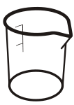
Label 4 beakers as follows

Slide 3
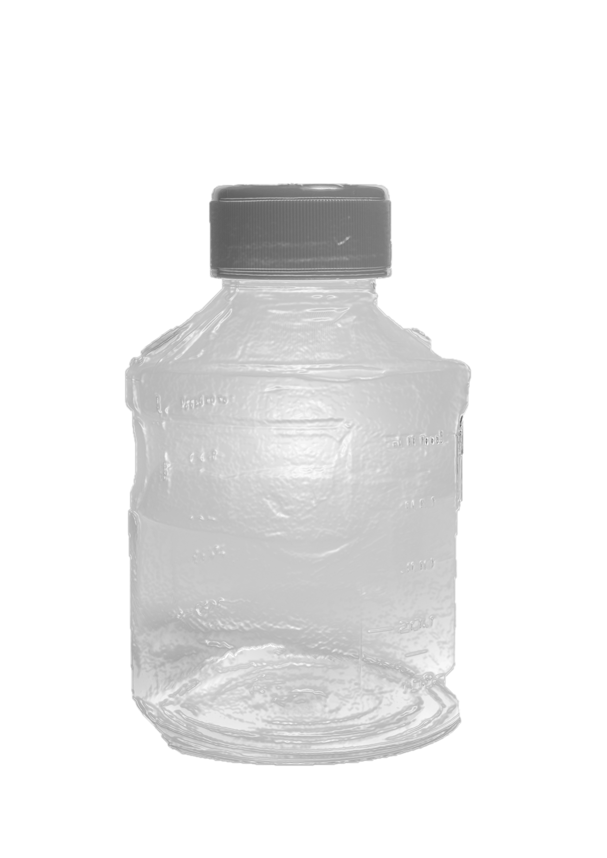
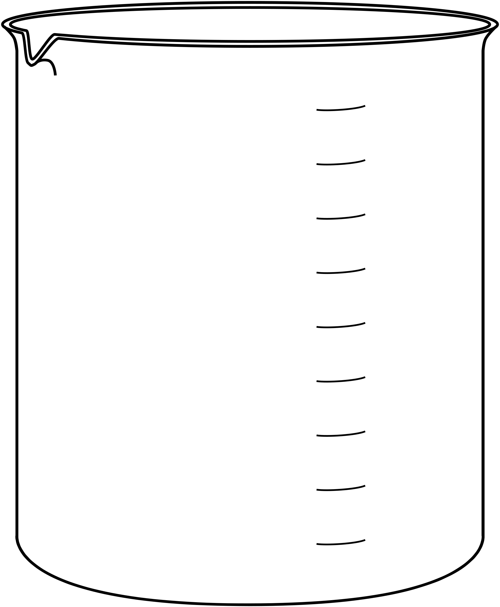
Add 40mL 0% salt solution to beaker a
0% Sodium
(salt) Solution
40 mL
30 mL
20 mL
10 mL

Slide 4
Add 10mL of 1% salt solution to beaker B
1% Sodium
(salt) Solution
WEE!
40 mL
30 mL
20 mL
10 mL

Slide 5
Add 20mL of 2% salt solution to beaker C
2% Sodium
(salt) Solution
40 mL
30 mL
20 mL
10 mL

Slide 6
Add 40mL of 4% salt solution to beaker D
4% Sodium
(salt) Solution
40 mL
30 mL
20 mL
10 mL

Slide 7
Cut the skin off top and bottom of potato

Slide 8
Use a Cork borer to take 4 core samples of the potato.

Slide 9
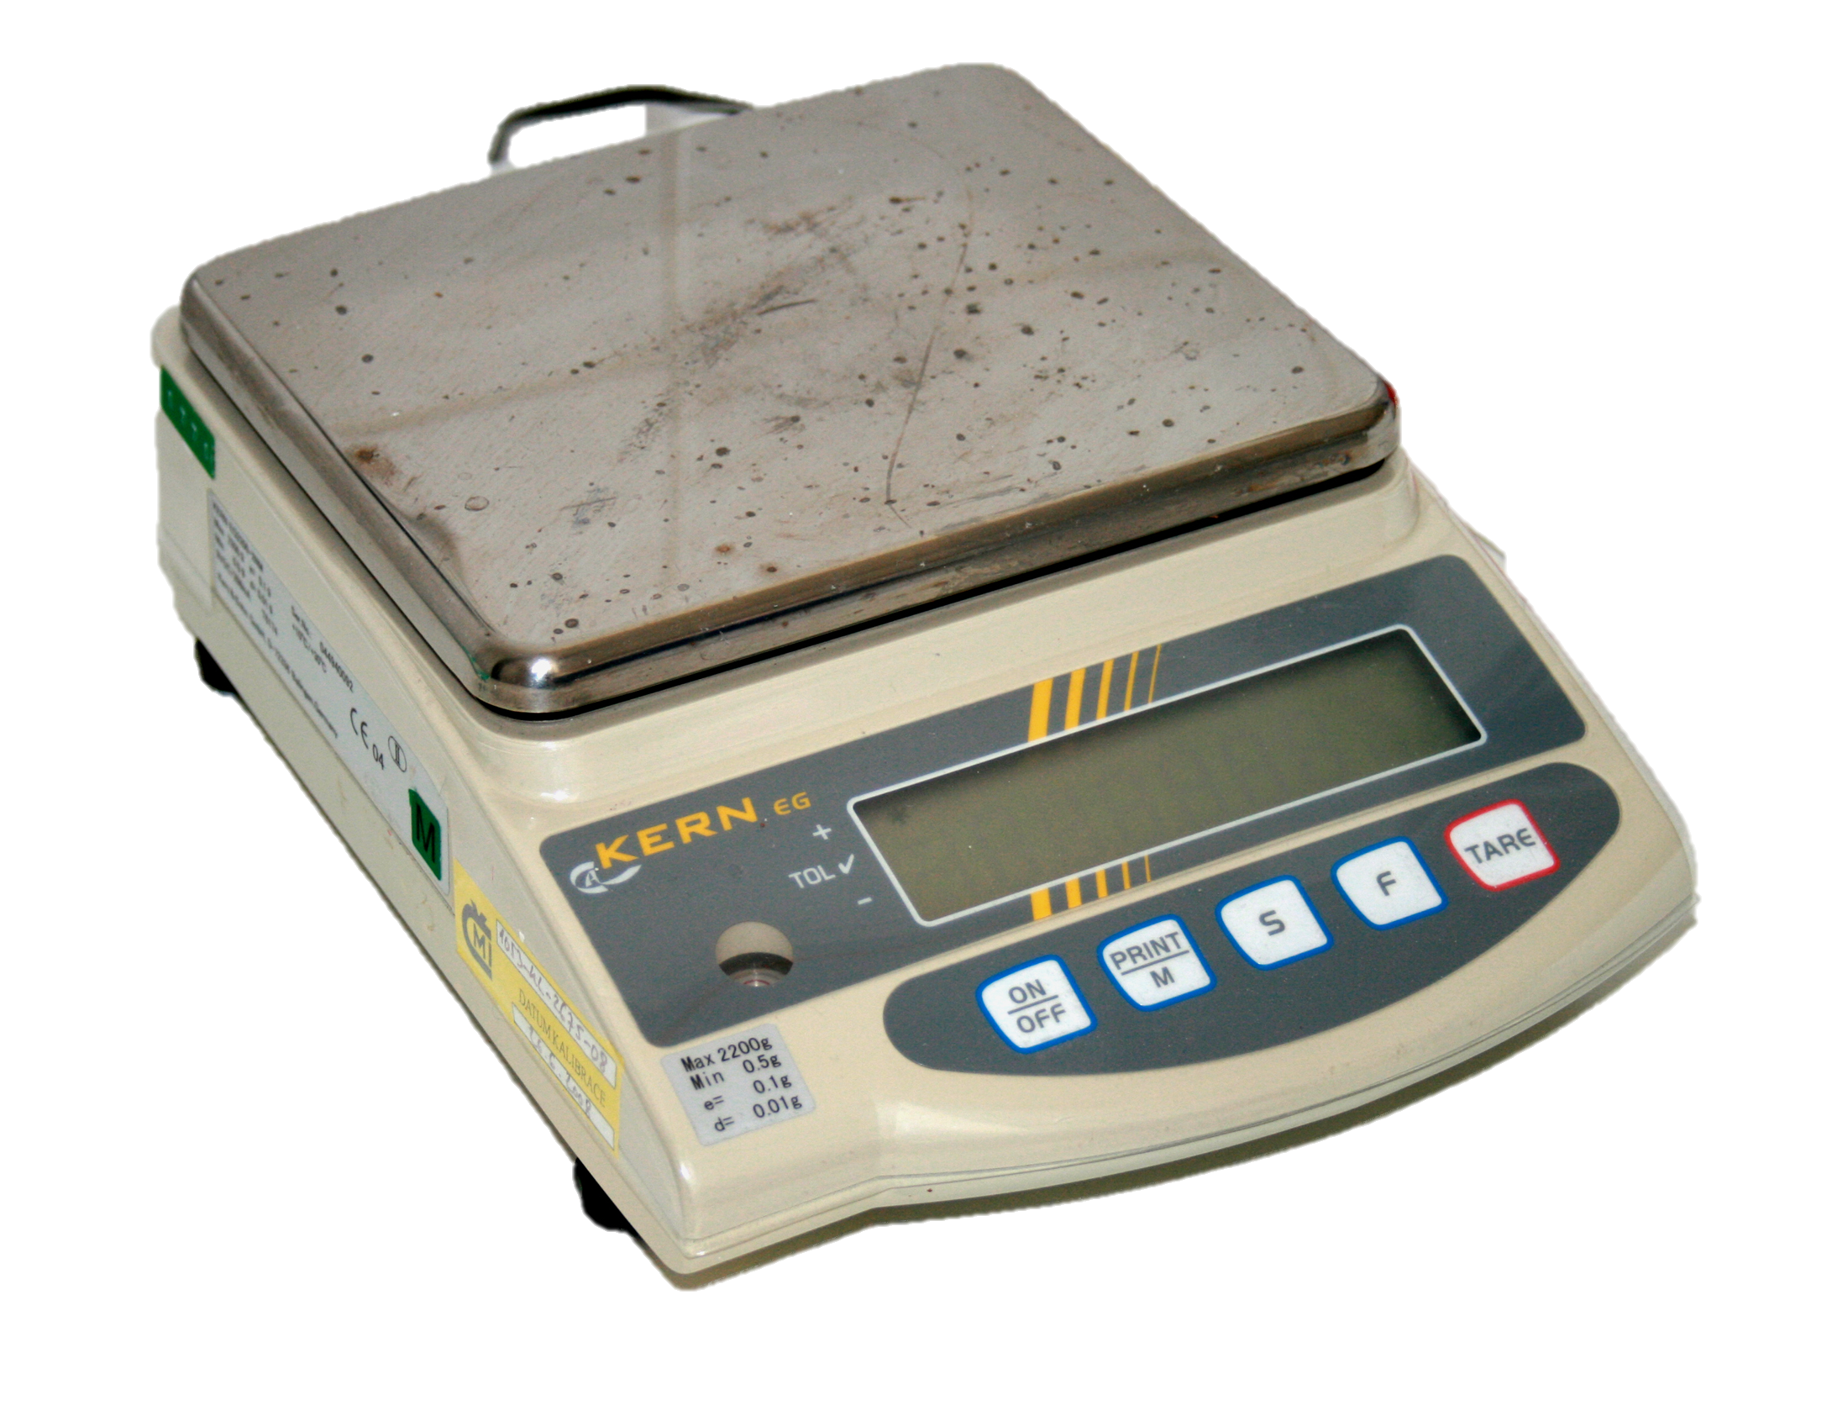
Place an empty weigh boat on the scale and hit “TARE” to ‘zero out’ the scale.
0.00g

Slide 10
Weigh each potato core separately and record the weight.
0.521g

Slide 11
Immerse the potato cores in the salt solutions for 30 minutes.

Slide 12
After 30 minutes, remove the cores and dry using a paper towel.

Slide 13
Place an empty weigh boat on the scale and hit “TARE” to ‘zero out’ the scale.
0.00

Slide 14
RECORD THE FINAL Weight OF each potato core separately.
0.635g

Slide 15
RESULTS – 2% and 4% salt solution caused water loss
You should find that the potato cores placed in the 4% solution (this is a hypertonic solution) have lost weight! They will also appear shrunken under the microscope. The membrane of the plant cell has pulled away from the cell wall, due to water loss by osmosis.
You should notice a similar effect in the 2% solution, but probably not as much of a water loss as was observed in the higher salt solution.

Slide 16
RESULTS – 1% solution had no effect.
You should find that the potato cores placed in the 1% solution (this is an isotonic solution) have NOT changed their weight. They should Appear ‘normal’ under the microscope.

Slide 17
RESULTS – 0% solution had no effect.
You should find that the potato cores placed in the 0% solution have gained weight by taking on water through osmosis.

Slide 18
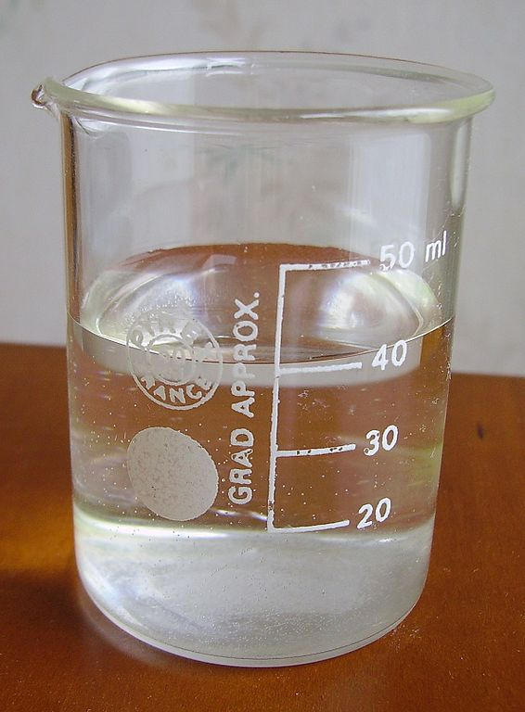
Osmosis in an isotonic solution in an animal cell
ISOTONIC
In an isotonic solution, the salt concentration is the same out side the cell as it is inside of the cell.
Since the concentrations are the same, there will be no NET flow of water flowing into or out of the cell. The cell is said to be “osmotically balanced”.
There is no change to the shape of the cell and the cell is happy.
WATER FLOW IN
WATER FLOW OUT

Slide 19
Osmosis in an isotonic solution in an plant cell
ISOTONIC
In an isotonic solution, the salt concentration is the same out side the cell as it is inside of the cell.
Since the concentrations are the same, there will be no NET flow of water flowing into or out of the cell. The cell is said to be “osmotically balanced”.
There is no change to the shape of the cell and the cell is happy.
WATER FLOW IN
WATER FLOW OUT

Slide 20
Osmosis in an hypotonic solution in an animal cell
HYPOTONIC
WATER FLOWS INTO CELL
In a hypotonic solution, the salt concentration is lower on the outside of the cell than it is inside of the cell.
water will then flow INTO the cell.
The cell will swell an bloat and can even burst!
I don’t fell so well!

Slide 21
Osmosis in an hypotonic solution in an plant cell
ISOTONIC
WATER FLOWS INTO CELL
In a hypotonic solution, the salt concentration is lower on the outside of the cell than it is inside of the cell.
A great example of a hypotonic solution would be water since it has 0% salt.
water will then flow INTO the cell.
This cell will become inflated, because the water outside the cell is at a higher concentration than the water inside the cell. As water moves in by osmosis the cell membrane presses out against the cell wall.

Slide 22
Osmosis in an hypertonic solution in an animal cell
HYPERTONIC
WATER FLOWS OUT OF CELL
In a hypertonic solution, the salt concentration is HIGHER on the outside of the cell than it is inside of the cell.
water will then flow out of the cell.
The cell will shrivel up and shrink. The process is also known as “crenation”
I don’t fell so well!

Slide 23
Osmosis in an hypotonic solution in an plant cell
ISOTONIC
WATER FLOWS OUT OF CELL
In a hypertonic solution, the salt concentration is HIGHER on the outside of the cell than it is inside of the cell.
water will then flow out of the cell.
The cell will shrivel up and shrink. The process is also known as “crenation”.

Slide 24
RESULTS

