Slide 1
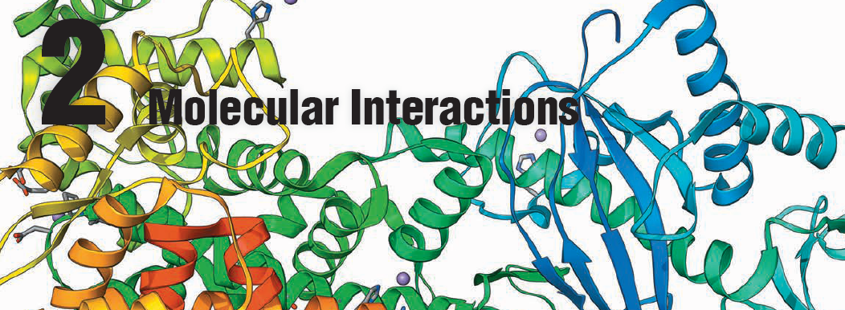
Physiology Chapter 2

Slide 2
2.1 Molecules and Bonds
Only three—oxygen, carbon, and hydrogen—make up more than 90% of the body’s mass.
These three plus eight additional elements are considered major essential elements.
Some additional minor essential elements (trace elements) are required in minute amounts, but there is no universal agreement on which trace elements are essential for cell function in humans

Slide 5
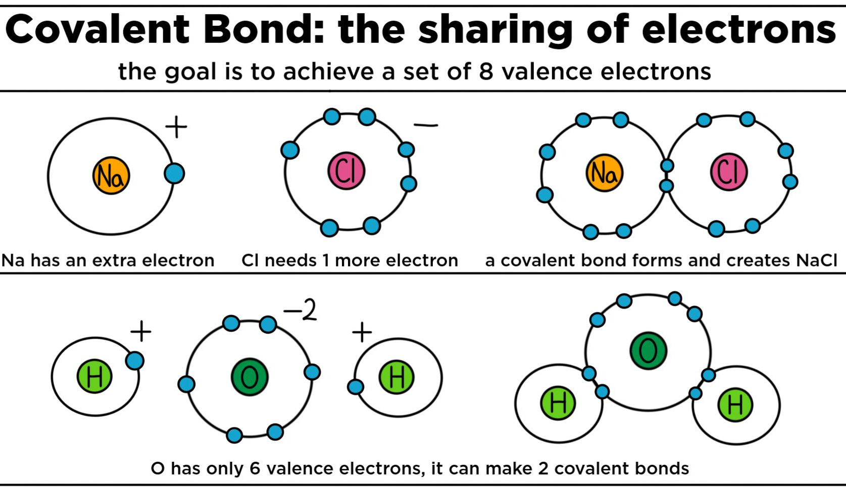
Covalent bonds
In a covalent bond, electrons are SHARED between the atoms.
The outer shells actual overlap in this type of bond.
Covalent bonds a very strong, which makes them important for building the macromolecules that organisms need like DNA and complex proteins.
The backbone of these macromolecules are held together by covalent bonds.

Slide 6
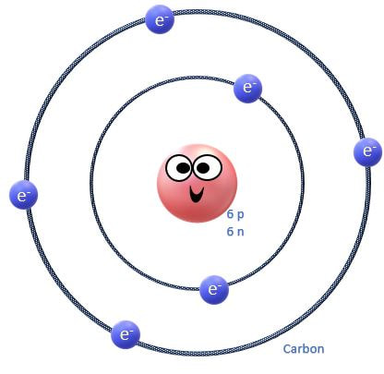
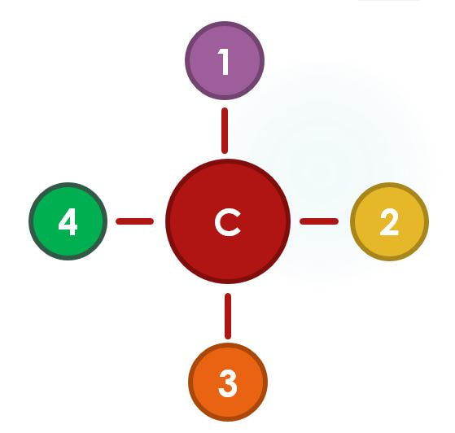
Carbon is the only atom capable of forming 4 STRONG COVALENT BONDS!
Carbon is great at covalently bonding to other atoms and it is the only element that has the ability to do so with as many as 4 different atoms at a time!

Slide 7
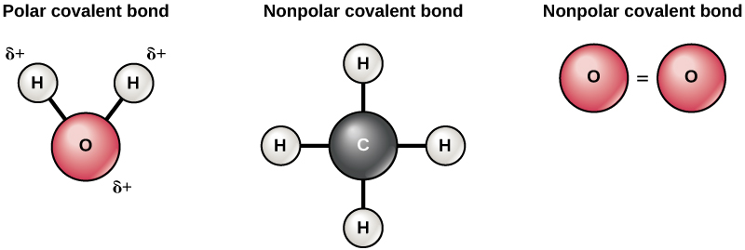
Types of Covalent Bonds
Not all covalent bonds are created equally. Because the electron(s) are SHARED between atoms, the electrons may be
1) equally shared, as in the case of non-polar covalent bonds or
2) unequally shared, as in the case of polar covalent bonds. ​
Non-polar covalent bonds - electrons are equally shared
Polar covalent bonds - electrons are unequally shared

Slide 8
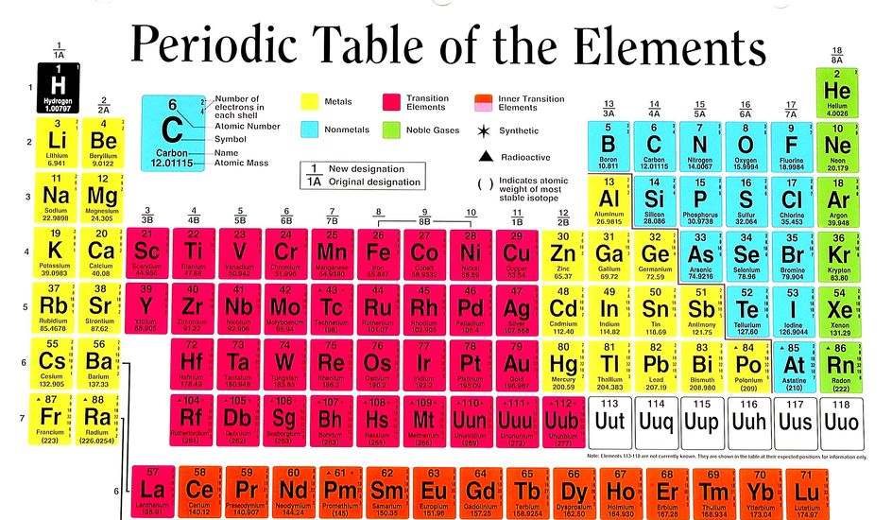
Chemical Bonding
It is possible to predict how many covalent bonds an atom can form by knowing how many electrons are available for bonding!
How do we know which electrons are available for bonding?
If the electron is unpaired AND is in the outer shell – IT IS AVAILABLE FOR BINDING!

Slide 9
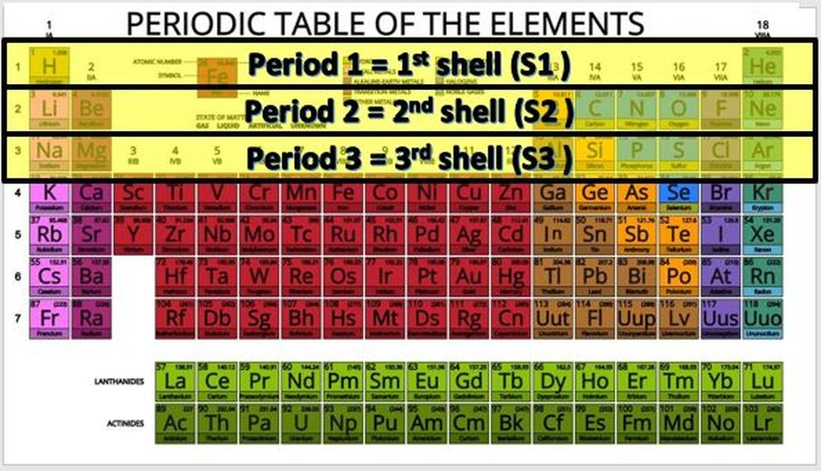
How do atoms bond?
They bond according to the how many protons and electrons they have, and where those electrons are located. The electrons orbit the nucleus of the atom in invisible territories called shells. These shells have a limited amount of space and can only hold a certain number of electrons, kind of like cages in an imaginary electron zoo! The shell that is closest to the nucleus, is called S1. It is the shell that is at the lowest energy level.

Slide 10
Whenever electrons are added to an atom, they will be added to the lowest possible energy level (or shell) first, until that shell is filled, before moving on to higher energy levels.

Slide 11
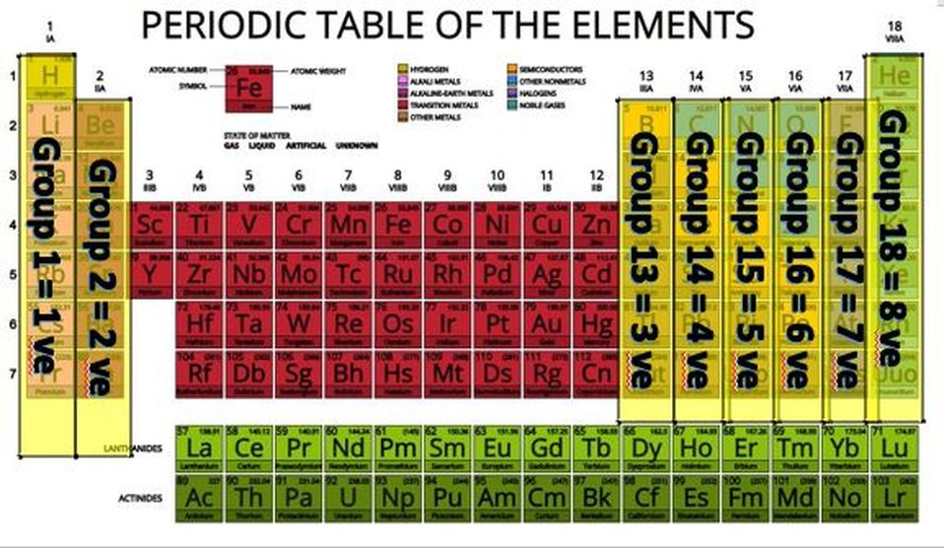
We get a great deal of valuable information from the periodic table.
The periodic table is set up numerical order (from left to right) according to the number of protons (a.k.a. the atomic number) in the nucleus.
Since atoms are neutral, we know that the number of electrons will be equal to the number of protons.

Slide 12
The columns of the periodic table are called "groups". If we skip over the transition metals and drop the "1" on the double-digit groups, we get the number of valence electrons. For example, group 1 elements have 1 valence electron group 2 has 2 valence electrons, group 13 has 3 valence electrons...and so on, 'til group 18 when we get 8 valence electrons. Group 8 elements are called "noble gases" and have no room to gain electrons. They also are very stable and do not want to loose any electrons. Nobel gases are "inert" or non-reactive. Atoms tend to react in such a way as to become like the nearest noble gas, because they want to be stable too!

Slide 13
Atoms are NEUTRAL. If an atom loses or gains an electron, it becomes CHARGED and is now called an ION!

Slide 14
Organic Molecules
Most Biomolecules Contain Carbon, Hydrogen, and Oxygen
Molecules that contain large amounts of carbon are known as organic molecules, because it was once thought that they all existed in or were derived from plants and animals. Organic molecules essential for life are often called BIOMOLECULES.

Slide 15
​There are four major groups of biomolecules: Carbohydrates Lipids Proteins Nucleotides

Slide 16
Organic Molecules
The body uses carbohydrates, lipids, and proteins for energy and as the building blocks of cellular components.

Slide 17
Organic Molecules
The fourth group, the nucleotides, includes DNA, RNA, ATP, and cyclic AMP.
DNA and RNA are the structural components of genetic material
ATP (adenosine triphosphate) and related molecules carry energy
Cyclic AMP (adenosine monophosphate; cAMP) and related compounds regulate metabolism

Slide 19
Organic Molecules
Each group of biomolecules has a characteristic composition and molecular structure.
Lipids are mostly carbon and hydrogen
Carbohydrates are primarily carbon, hydrogen, and oxygen, in the ratio CH₂O
Proteins and nucleotides contain nitrogen in addition to carbon, hydrogen, and oxygen
Two amino acids, the building blocks of proteins, also contain sulfur.

Slide 20
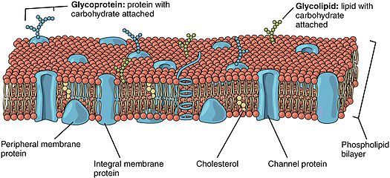
Conjugated proteins
Conjugated proteins are protein molecules combined with another kind of biomolecule.
Lipoproteins – protein combined with lipid(s)
Glycoprotein – protein combined with carbohydrate(s)

Slide 21
Conjugated Lipids
Lipids bound to carbohydrates become glycolipids.
Glycoproteins, glycolipids and lipoproteins, are important components of cell membranes.

Slide 22
Many biomolecules are polymers, large molecules made up of repeating units of monomers.

Slide 23
Lipids
Lipids are biomolecules made mostly of carbon and hydrogen.
Most lipids have a backbone of glycerol and 1–3 fatty acids.
An important characteristic of lipids is that they are nonpolar (hydrophobic) and therefore not very soluble in water.

Slide 24
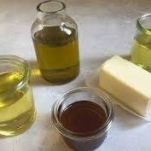
Lipids can be divided into two broad categories.
• Fats are solid at room temperature. Most fats are derived from animal sources.
• Oils are liquid at room temperature. Most plant lipids are oils.

Slide 25
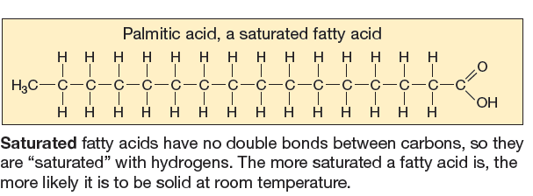
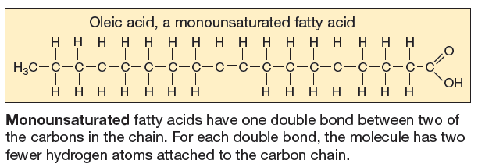
Saturated Fats

Slide 26
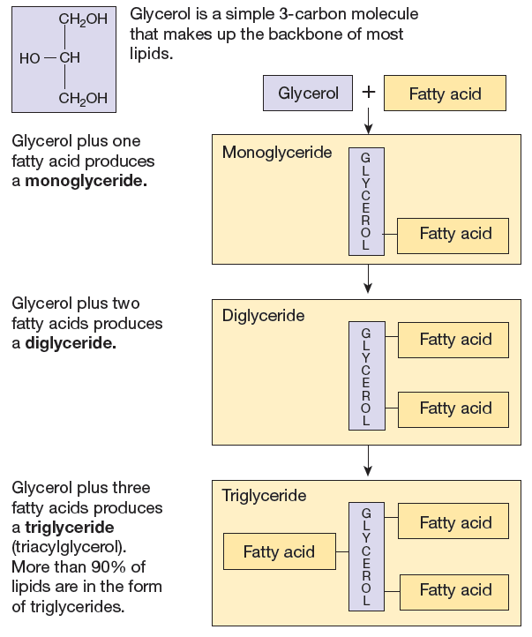
Fatty Acids

Slide 27
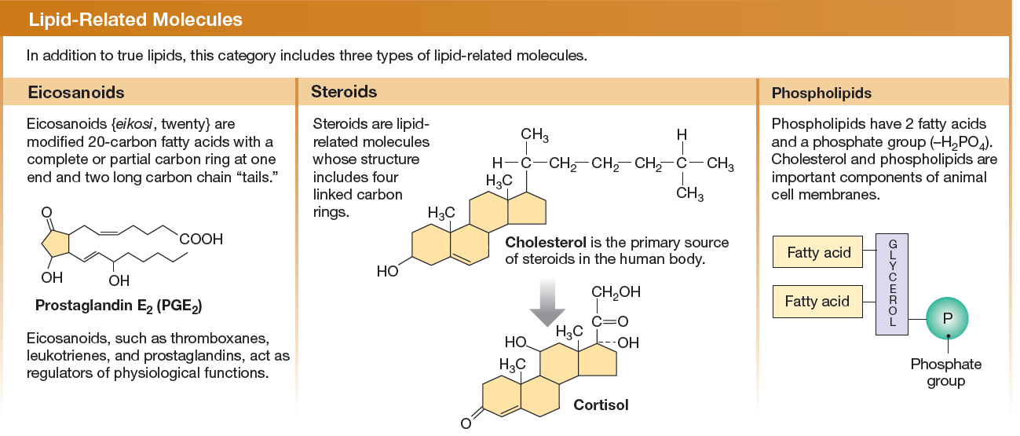

Slide 28
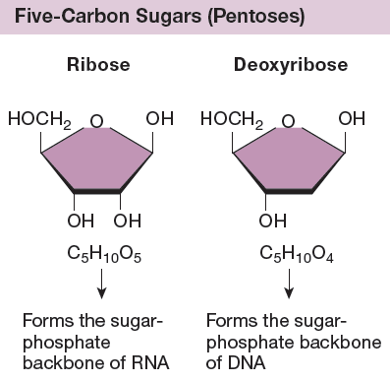
Monosaccharides

Slide 29
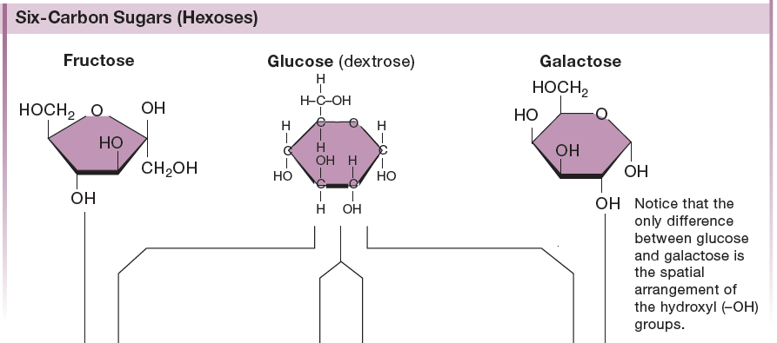
Monosaccharides

Slide 30
Disaccharides

Slide 31
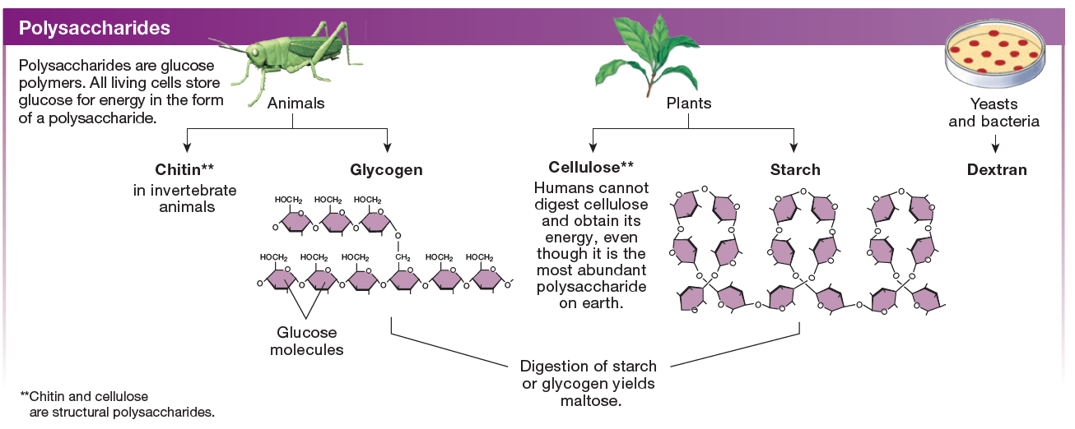
Polysaccharides

Slide 32
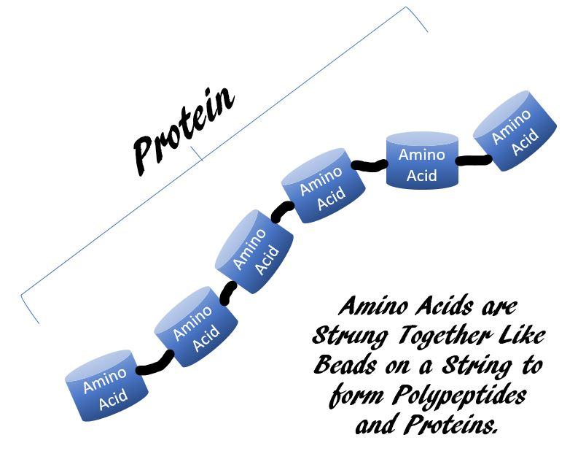
Amino Acids and Proteins
Proteins are polymers of smaller building-block molecules called amino acids.

Slide 33
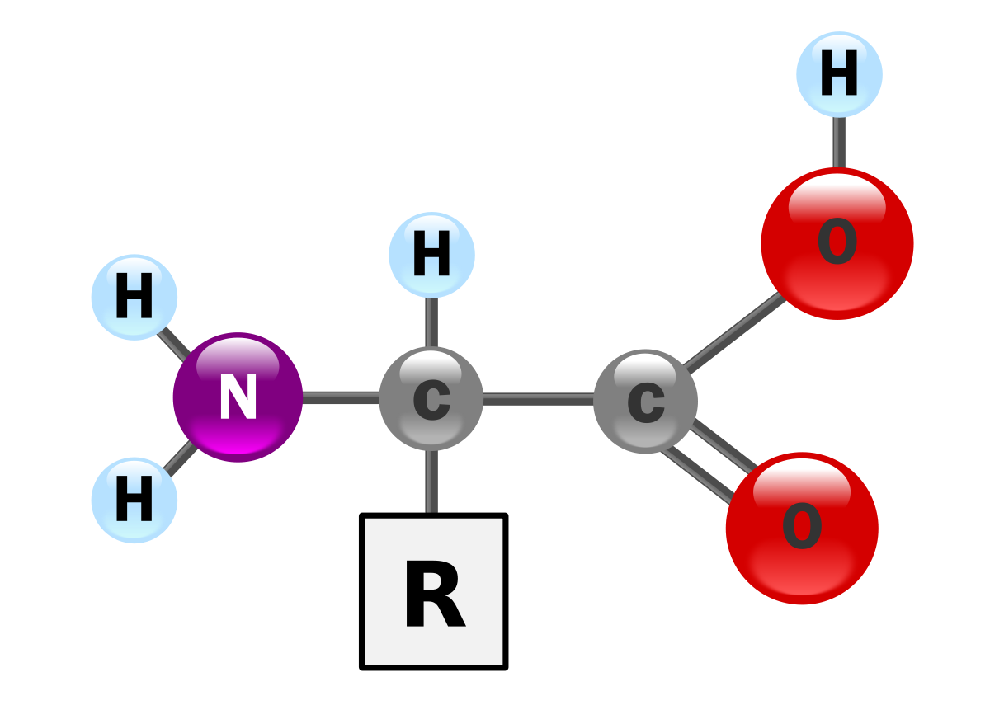
Amino Acids
carboxyl group (–COOH)
All amino acids have a carboxyl group, an amino group, and a hydrogen attached to the same carbon.
The fourth bond of the carbon attaches to a variable “R” group.
amino group (–NH2)

Slide 34
Amino Acids
carboxyl group (–COOH)
The “R” groups are called “functional groups”
The functional groups dictate an amino acids ability to undergo chemical reactions
amino group (–NH2)
Functional group (–R)

Slide 35
Amino Acids link together through peptide bonds

Slide 36
Protein Structure
PRIMARY STRUCTURE - The sequence of amino acids in a peptide chain is called the primary structure.

Slide 37
Protein Structure
Secondary structure can be created by hydrogen bonds between adjacent chains or loops or covalent bonds between different amino acids.

Slide 38
Protein Structure
Tertiary structure is the protein’s three-dimensional shape.
Tertiary structures can be a mix of secondary structures. Beta-sheets are shown as flat ribbon arrows and alpha helices are shown as ribbon coils.

Slide 39
Protein Structure
Multiple subunits combine with noncovalent bonds.
Hemoglobin molecules, for Example, are made from four separate globular protein subunits that are bound together!

Slide 40
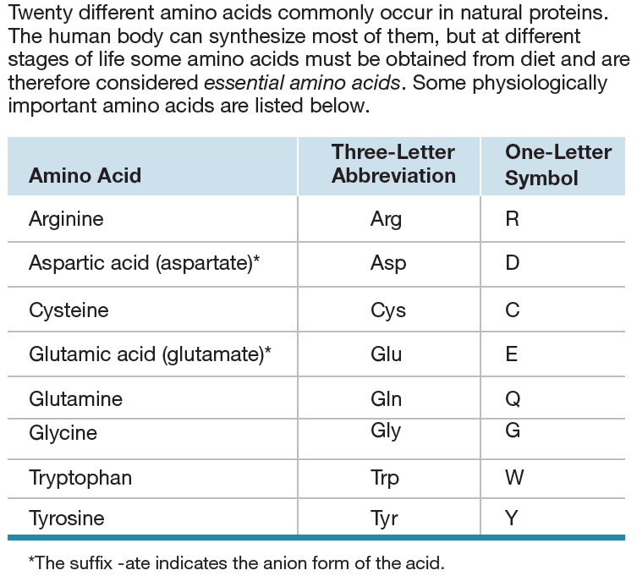
There are 20 Amino Acids found in nature.

Slide 41
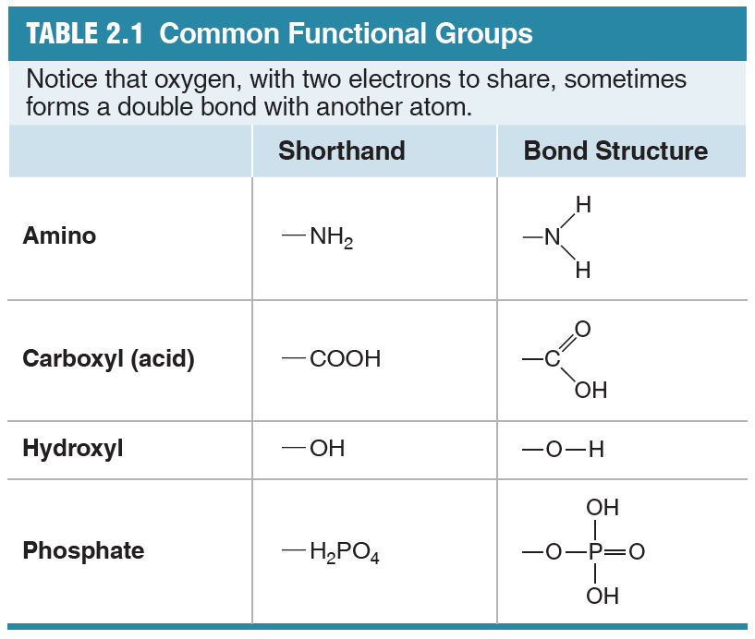
Functional Groups
atoms in a functional group tend to move from molecule to molecule as a single unit.
Hydroxyl groups,-OH, common in many biological molecules
Amino groups, -NH2, are the signature of amino acids.
Phosphate groups, -H2PO4, play important roles in different cell processes, such as energy transfer and protein regulation.
Addition of a phosphate group is called phosphorylation
Removal of a phosphate group is dephosphorylation

Slide 42
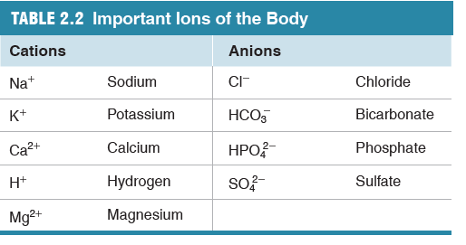
Ions
Atoms, by definition, are NEUTRAL (have NO charge).
When an atom or molecule gains or loses one or more electrons, it becomes charged and becomes an ion.

Slide 43
The 4 Macromolecules of Life
Macromolecule (or Polymer) | Examples | Subunit (or Monomer) | More Information
Polypeptides | Proteins | Amino Acids | Numerous types that carry out almost all of the cell’s functions
Nucleic Acids | DNA and RNA | Nucleotides | Deoxyribonucleic Acid (DNA) is formed from Deoxyribonucleotides Ribonucleic Acid (RNA) is formed from Ribonucleotides
Polysaccharides | Sugars, Starch | Monosaccharides | Energy
Lipids | Fats, cholesterols and steroids | Fatty Acids often Combined with Other Molecules | Phospholipids that form cell membranes

Slide 44
STRUCTURE OF Nucleic Acids

Slide 45
Nucleic Acids include DNA and RNA
DNA
RNA

Slide 46
DNA is Double-Stranded
DNA
RNA is Single-Stranded
RNA

Slide 47
Structure of Nucleic Acids
PO₄³⁻
NUCLEOTIDE
Sugar
Nitrogenous
BASE
DNA and RNA are Nucleic Acids
Nucleic Acids are composed of a String of Nucleotides
Each nucleotide has the same general structure:
A Phosphate Group
A Type of Ribose Sugar
A Nitrogenous Base
PO₄³⁻
NUCLEOTIDE
Sugar
Nitrogenous
BASE
PO₄³⁻
NUCLEOTIDE
Sugar
Nitrogenous
BASE
OH

Slide 48
The Differences Between DNA Nucleotides and RNA Nucleotides

Slide 49
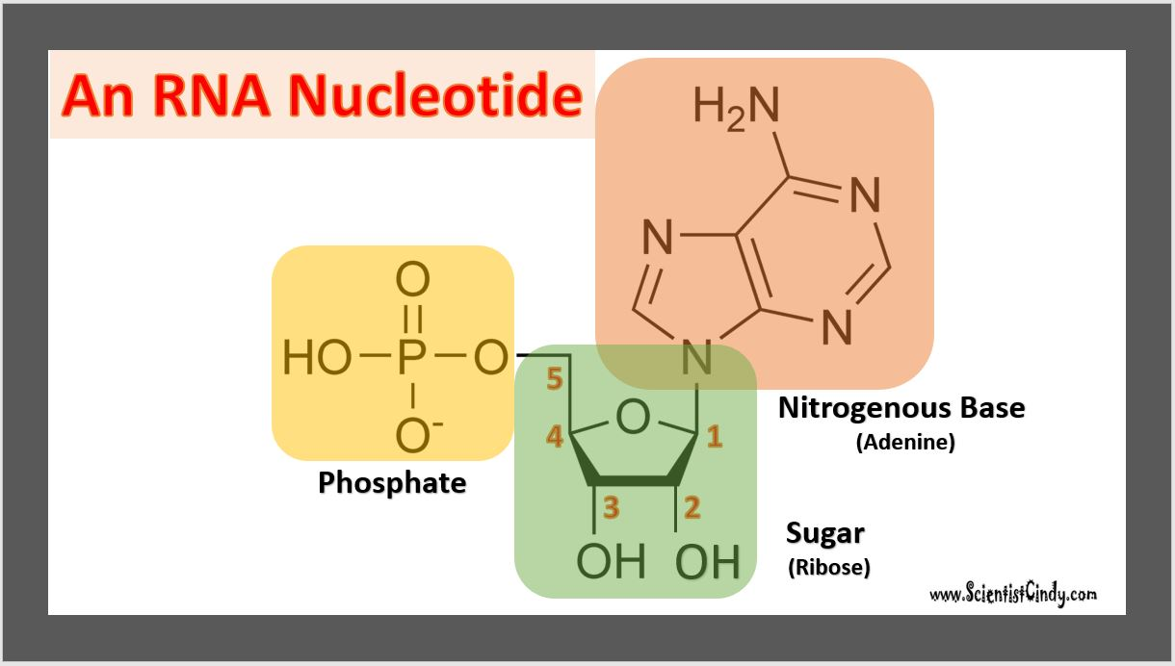
DNA Nucleotides
vs
RNA Nucleotides
RNA and DNA Nucleotides Both Contain a Phosphate Group

Slide 50
DNA Nucleotides
vs
RNA Nucleotides
RNA and DNA Nucleotides Both Contain A Sugar Molecule
DNA Nucleotide have a Deoxy-Ribose Sugar Molecule
RNA Nucleotide have a Ribose Sugar Molecule
This is why DNA stands for Deoxyribonucleic Acid
And RNA stands for Ribonucleic Acid

Slide 51
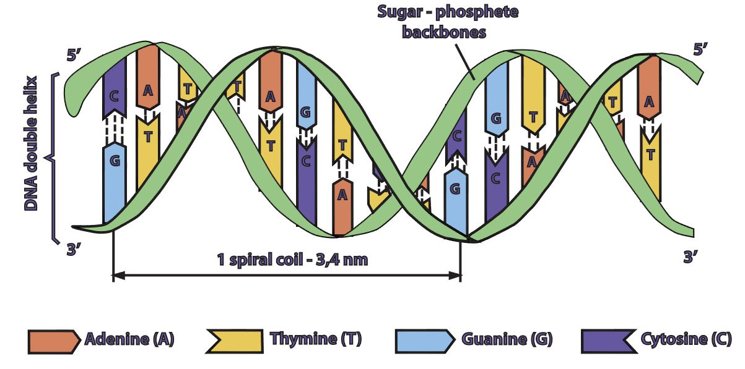
The 4 Nitrogenous Bases in DNA are
Adenine (A)
Cytosine (C)
Guanine (G)
Thymine (T) in DNA ONLY
DNA Nucleotides vs RNA Nucleotides
DNA

Slide 52
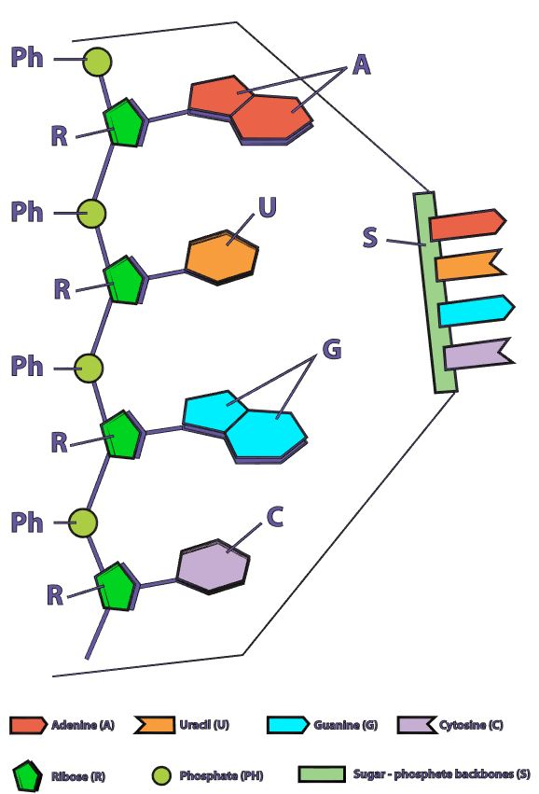
DNA Nucleotides
vs
RNA Nucleotides
RNA
The 4 Nitrogenous Bases in DNA are
Adenine (A)
Cytosine (C)
Guanine (G)
Thymine (T) in DNA ONLY
The 4 Nitrogenous Bases in RNA are
Adenine (A)
Cytosine (C)
Guanine (G)
Uracil (U) in RNA ONLY

Slide 53
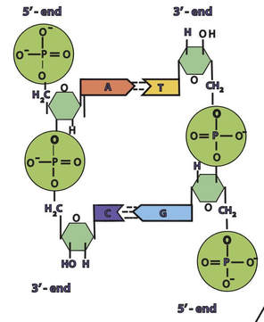
DNA is Double Stranded
DNA Strand #2
DNA Strand #1
The DNA in all living organisms is DOUBLE STRANDED.

Slide 54
DNA Strands are Anti-Parallel
3’ to 5’ direction
5’ to 3’ direction
The DNA in all living organisms is oriented with one DNA strand positioned in the 5’ to 3’ direction and the other strand positioned in the 3’ to 5’ direction.

Slide 55
The Sugar-Phosphate Backbone of DNA
Phosphate
Sugar
Sugar
In a molecule of DNA (or RNA), individual nucleotides are linked together to make a sugar-phosphate backbone.
The bond used in the sugar-phosphate backbone are phospho-diester bonds.
These are very strong bonds.
Phosphate
Phosphate
Sugar
Sugar
Phosphate

Slide 56
Base-Pairing and Hydrogen Bonding in DNA
Base
Base
DNA Strand #2
DNA Strand #1
In a molecule of DNA, the 2 DNA strands are connected to each through hydrogen bonds.
These hydrogen bonds occur between nitrogenous bases that exist on opposing strands.
Base
Base

Slide 57
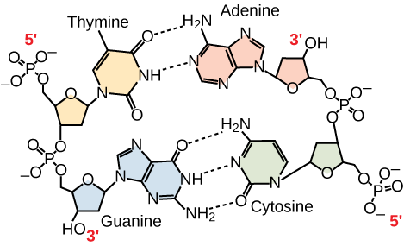
The Bases CANNOT Just “pair up” with Anyone…. THERE ARE RULES!
Adenine (A) can only pair with Thymine (T)
Adenine (A) and Thymine (T) bond using 2 hydrogen bonds
Guanine (G) can only pair with Cytosine (C)
Guanine (G) and Cytosine (C) bond using 3 hydrogen bonds

Slide 58
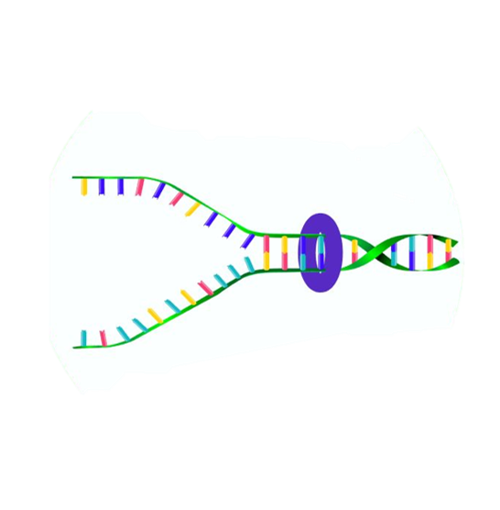
Hydrogen Bonding in DNA
Hydrogen bonds are relatively weak.
It is important for the hydrogen bonds to be able to be broken when the cell needs access to the individual DNA strands.
For example, the two DNA strands need to be separated for DNA replication for cellular division and to make the mRNA template during transcription.

Slide 59
Central Dogma Of Molecular Biology
The central dogma of molecular biology explains how the information encoded in DNA sequences (genes) is expressed as proteins in a two-step process:
Step One) Transcription
Transcription involves making mRNA using DNA as a template.
Step Two) Translation.
Translation then translates the mRNA sequence into an amino acid sequence to form a protein.

Slide 60
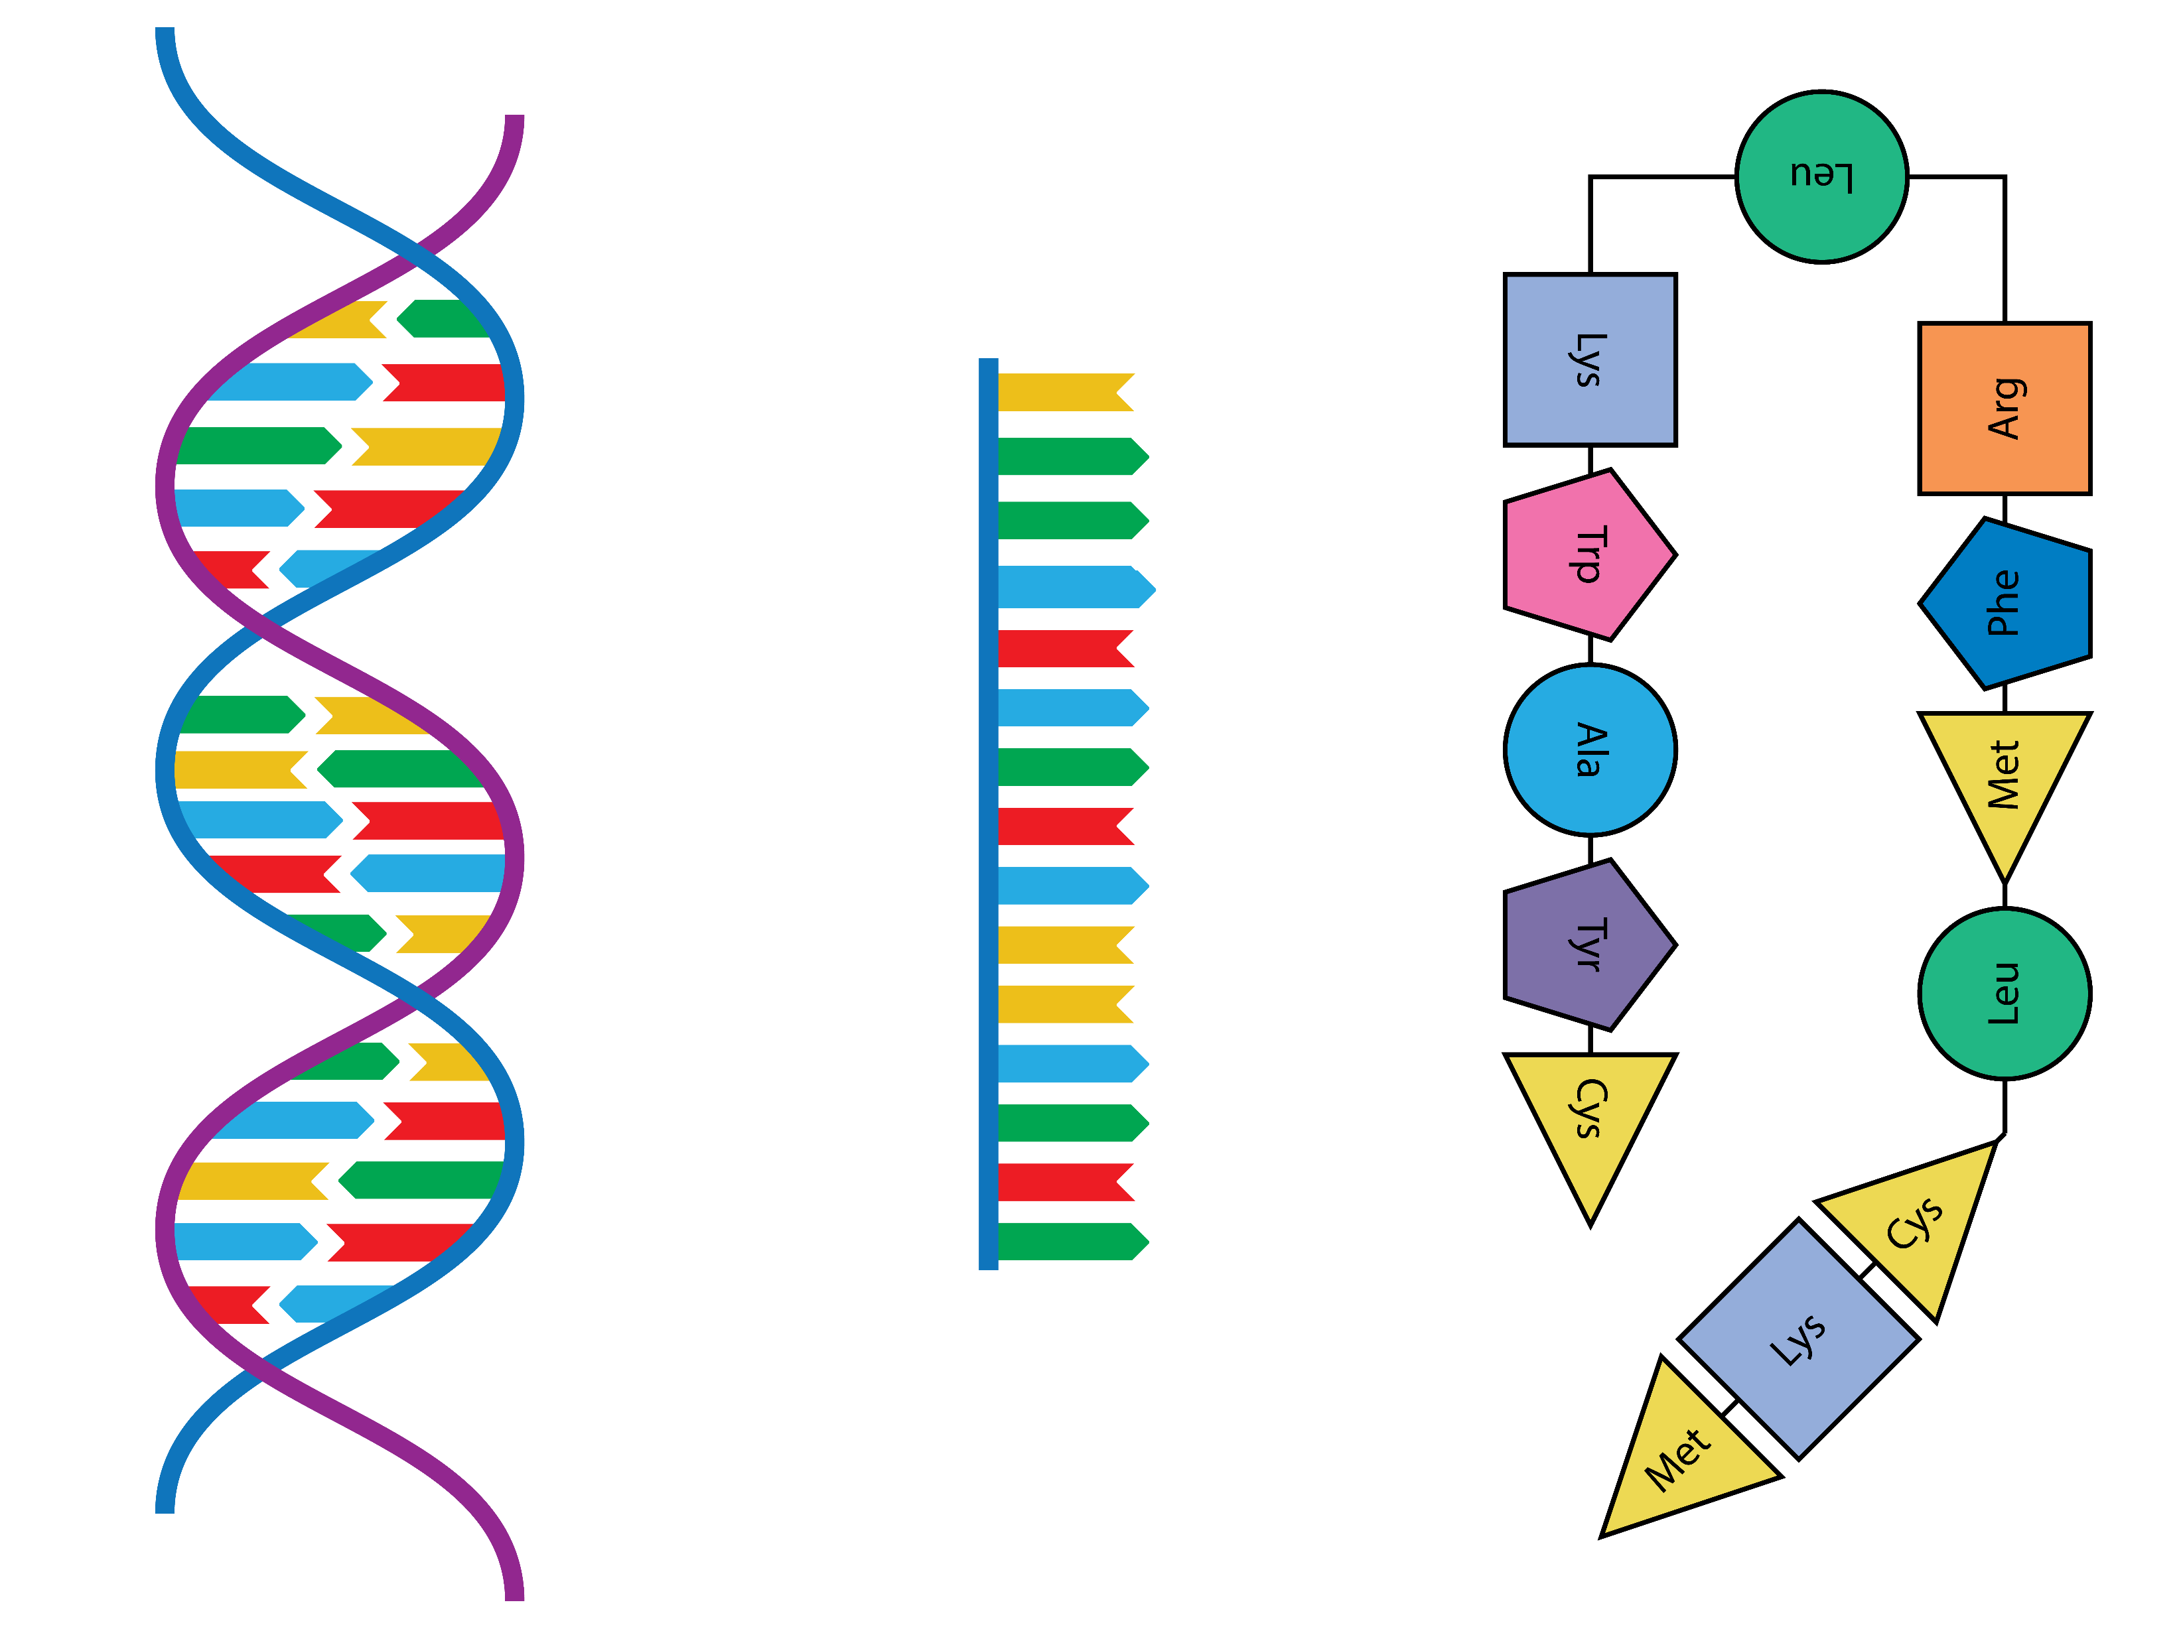
Gene Expression
DNA
Protein
TRANSCRIPTION
TRANSLATION
mRNA

Slide 61
RNA (ribonucleic acid)
RNA (ribonucleic acid) is a single–strand nucleic acid with ribose as the sugar in the backbone, and four bases—adenine, guanine, cytosine, and uracil.

Slide 62
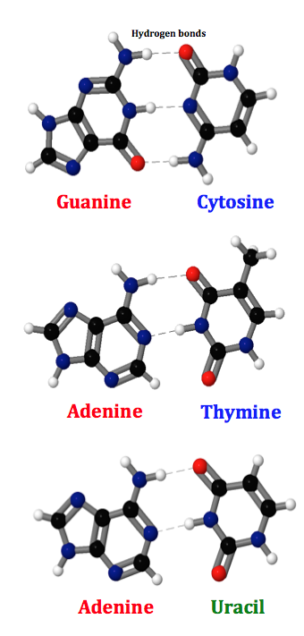
Base-Pairing in RNA and DNA
Occurs in both
RNA and DNA
This bonding follows very specific rules: • Because purines are larger than pyrimidines, space limitations always pair a purine with a pyrimidine.
• Guanine (G) forms three hydrogen bonds with cytosine (C).
• Adenine (A) forms two hydrogen bonds with thymine (T) or uracil (U).
Occurs in DNA only
Occurs in RNA only

Slide 63
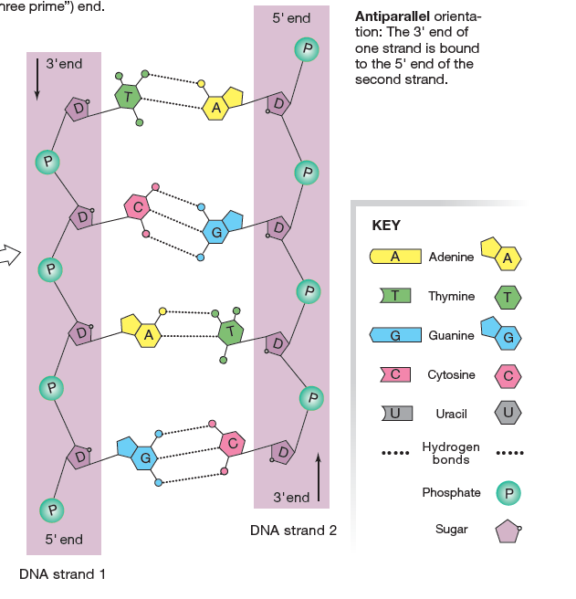
DNA
The strands of DNA are ANTI-PARALLEL to one another!

Slide 64
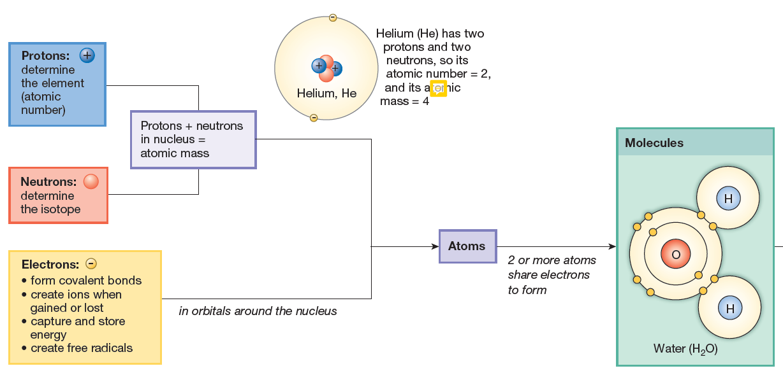

Slide 67
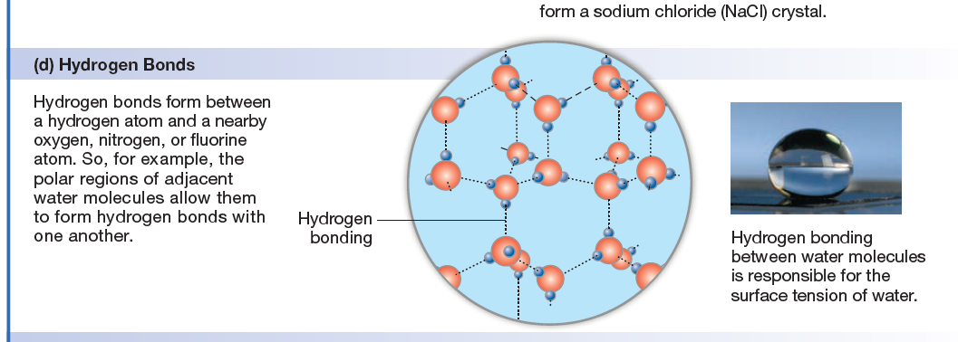
Noncovalent Bonds Hydrogen Bonds

Slide 68
Solubility
The degree to which a molecule is able to dissolve in a solvent is the molecule’s solubility: the more easily a molecule dissolves, the higher its solubility.
Water, the biological solvent, is polar, so molecules that dissolve readily in water are polar or ionic molecules whose positive and negative regions readily interact with water.

Slide 69
Solubility
Molecules that dissolve easily in water are said to be hydrophilic {-philic, loving}.
Molecules such as oils that do not dissolve well in water are said to be hydrophobic {-phobic, hating}.
Hydrophobic substances are usually nonpolar molecules that cannot form hydrogen bonds with water molecules.
The lipids (fats and oils) are the most hydrophobic group of biological molecules.

Slide 71
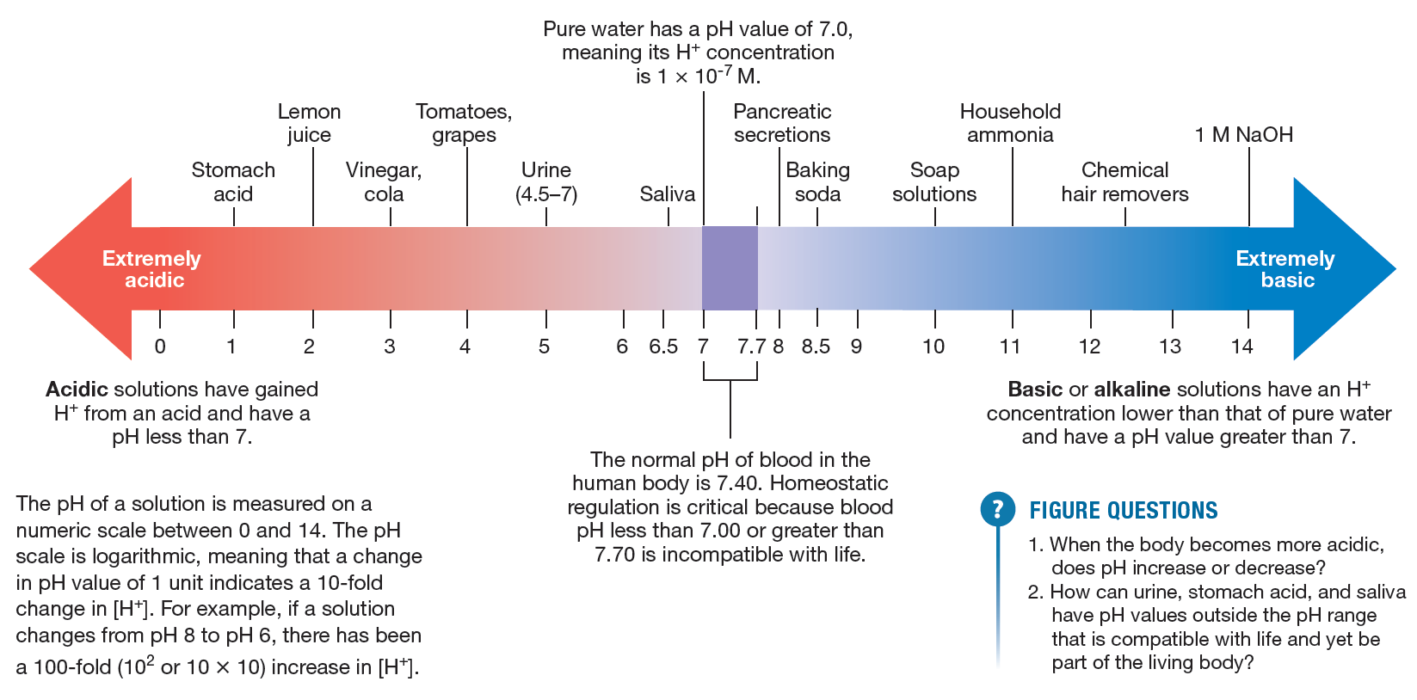
pH Scale

Slide 72
Proteins – the workers of the cell!
Proteins play important roles in so many cell functions that we can consider them the “workhorses” of the body.
Most soluble proteins fall into seven broad categories.

Slide 73
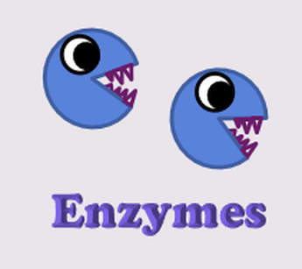
1. Enzymes.
Some proteins act as enzymes, biological catalysts that speed up chemical reactions.
Enzymes play an important role in metabolism.

Slide 74
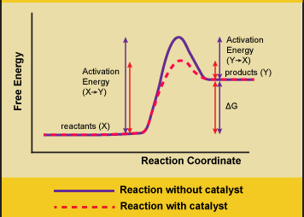
What are ENZYMES?
All molecular bonds have energy barriers that must be overcome in order for the chemical reaction to occur.
Enzymes cause these chemical reactions to go much faster (by several orders of magnitude) by lowering the “activation energy” of the reaction.
Without enzymes, it could take decades to digest one hamburger!

Slide 75
Properties of Enzymes
Enzymes are...proteins
catalysts that lower the activation energy of a reaction
highly specific
increase the rate of a chemical reaction
re-usable / not consumed in the reaction

Slide 76
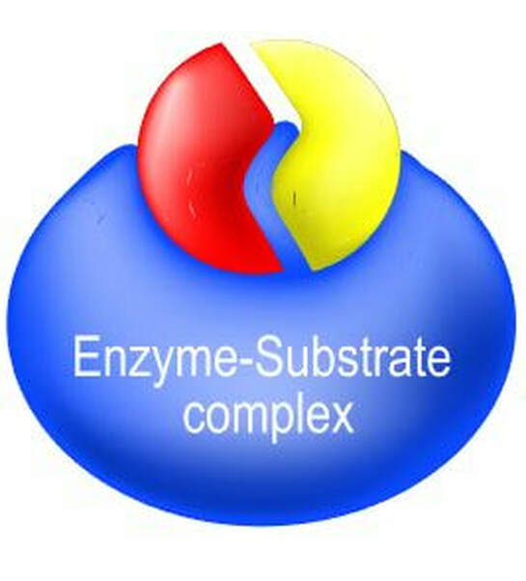
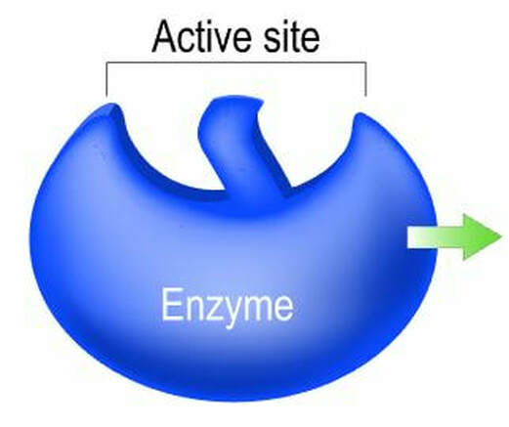

Slide 79
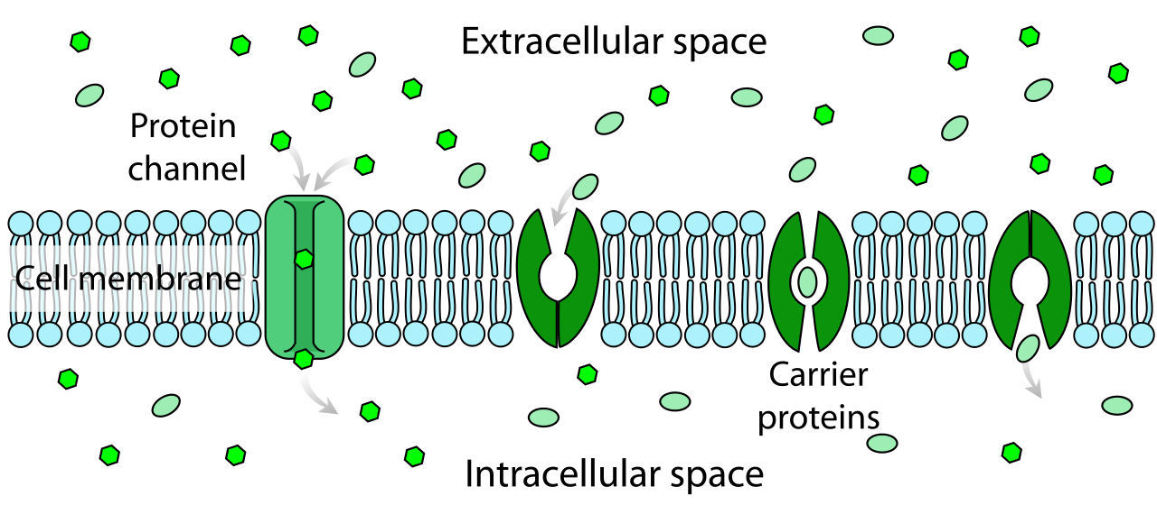
2. Membrane transporters.
Proteins in cell membranes help move substances back and forth between the intracellular and extracellular compartments.
These proteins may form channels in the cell membrane, or they may bind to molecules and carry them through the membrane.

Slide 80
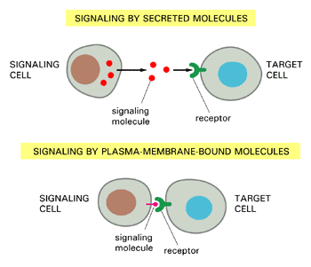
3. Signal molecules.
Some proteins and smaller peptides act as hormones and other signal molecules.

Slide 81
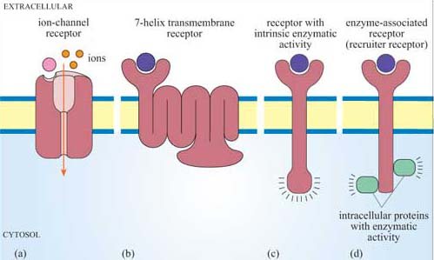
4. Receptors.
Proteins that bind signal molecules and initiate cellular responses are called receptors.

Slide 82
5. Binding proteins.
These proteins, found mostly in the extracellular fluid, bind and transport molecules throughout the body.
the oxygen-transporting protein hemoglobin
the cholesterol binding proteins, such as LDL, low-density lipoprotein.

Slide 83
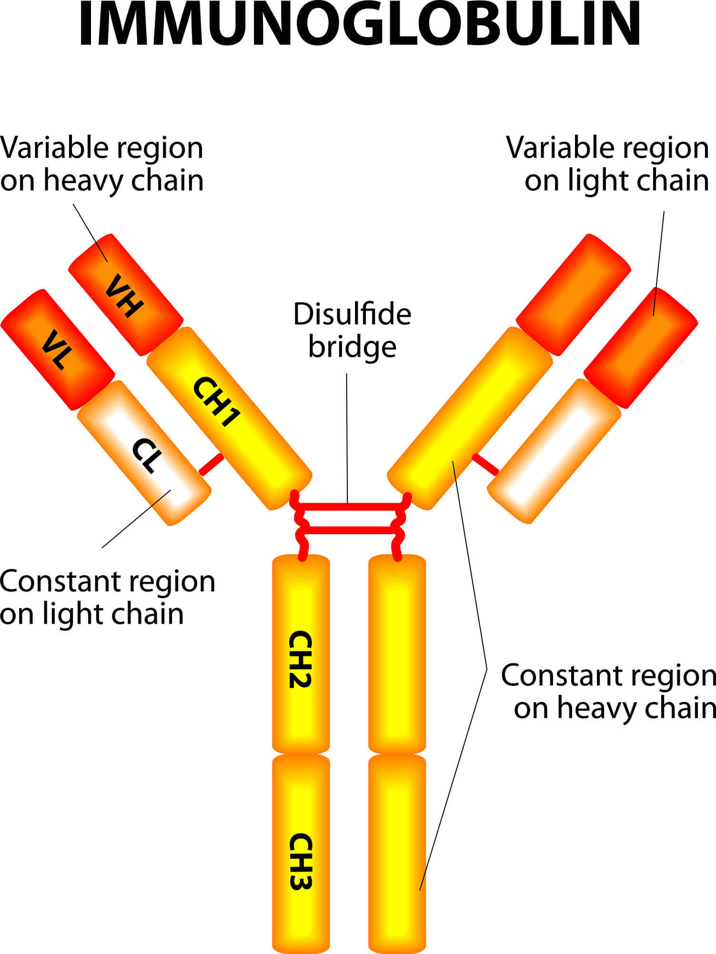
6. Immunoglobulins.
These extracellular immune proteins, also called antibodies, help protect the body from foreign invaders and substances.

Slide 84
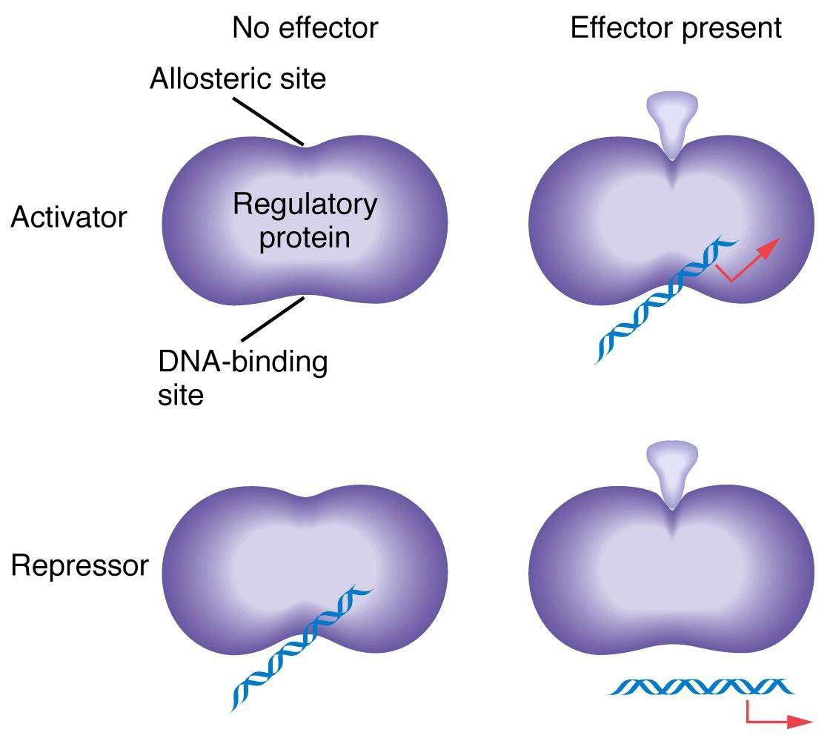
7. Regulatory proteins.
Regulatory proteins turn cell processes on and off or up and down.
For example, the regulatory proteins known as transcription factors bind to DNA and alter gene expression and protein synthesis.

Slide 85
Proteins are specific for certain ligands to bind.

Slide 86
A competitive inhibitor COMPETES for the SAME binding site as the ligand (the molecule that is supposed to bind there).

Slide 87
A noncompetitive inhibitor binds to a DIFFERENT binding site than the ligand and alters the shape of the ligand-binding site.

Slide 88
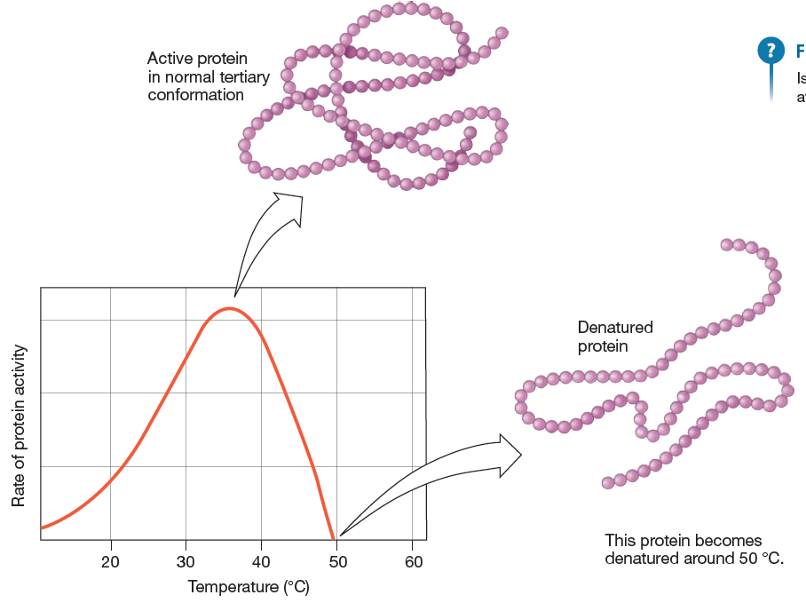
Extreme changes Temperature can slow down (cold temp.)or speed up(hot temp.) or denature (extremely hot temp.)

Slide 89
If we increase the amount of the enzyme present, we can speed up the rate of the reaction --- UNTIL we run out of substrates.

Slide 90
If we increase the amount of the ligand, we can speed up the rate of the reaction --- UNTIL we run out of available ENZYMES.

