Slide 1
Renal Feedback Loops and Mechanisms Focusing on the Regulation of Blood Volume, Blood Osmolarity, Blood pH, and Blood Glucose. The Effects of Diuretics.

Slide 2
Summary
Urine tests are laboratory analyses performed on urine samples.
Urine analysis can provide useful information about a persons’ health.

Slide 3
Urinalysis
They are routinely used are regular doctor appointments and hospital settings to determine if patients have
Infections
Diabetes
Renal issues
Liver issues
Metabolic issues
Other conditions

Slide 4
Measuring Urine pH
According to the American Association for Clinical Chemistry, the average value for urine pH is 6.0.
Safe pH range is from 4.5 to 8.0.
Urine under 5.0 is acidic
Urine higher than 8.0 is alkaline, or basic.

Slide 5
High Urine pH – Alkaline
Urine higher than 8.0 is alkaline, or basic.
If a person has a high urine pH, meaning that it is more alkaline, it might signal a medical condition such as:
kidney stones
urinary tract infections (UTIs)
kidney-related disorders
prolonged vomiting
kidney stone formation

Slide 6
Low Urine pH – Acidic
Urine under 5.0 is acidic
If a person has low urine pH, meaning that it is more acidic, it might indicate a medical condition such as:
diabetic ketoacidosis
diarrhea
starvation

Slide 7
Urine glucose concentration
The normal amount of glucose in urine is 0 to 0.8 mmol/L (millimoles per liter).
A higher measurement could be a sign of a health problem.
Diabetes is the most common cause of elevated glucose levels.
Renal glycosuria can cause urine glucose levels to be high even if blood glucose levels are normal.

Slide 8
Urine glucose concentration

Slide 9
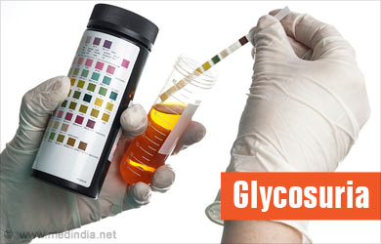
Urine glucose concentration - renal glycosuria
in those with renal glycosuria, glucose is abnormally elevated in the urine due to improper functioning of the renal tubules, which are primary components of nephrons, the filtering units of the kidneys.

Slide 10
Urine specific gravity

Slide 11
Urine specific gravity
Ideally, urine specific gravity results will fall between 1.002 and 1.030 if your kidneys are functioning normally.
Specific gravity results above 1.010 can indicate mild dehydration.
The higher the number, the more dehydrated you may be.

Slide 12
Urine Protein Concentration
Normal values are 0 to 20 mg/dL.
For a 24-hour urine collection, the normal value is less than 80 mg per 24 hours.
The protein urine dipstick test measures the presence of proteins, such as albumin, in a urine sample.

Slide 13
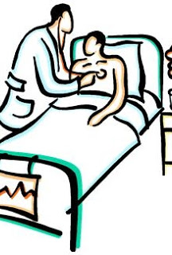
Urine Protein Concentration
Larger amounts of protein in the urine may be due to:
Heart failure
Kidney problems, such as
kidney damage
diabetic kidney disease
Kidney cysts
Loss of body fluids (dehydration)
Problems during pregnancy, such as
seizures due to eclampsia
high blood pressure caused by preeclampsia
Urinary tract problems, such as a bladder tumor or infection
Multiple myeloma
This Photo by Unknown Author is licensed under CC BY-NC-ND

Slide 15
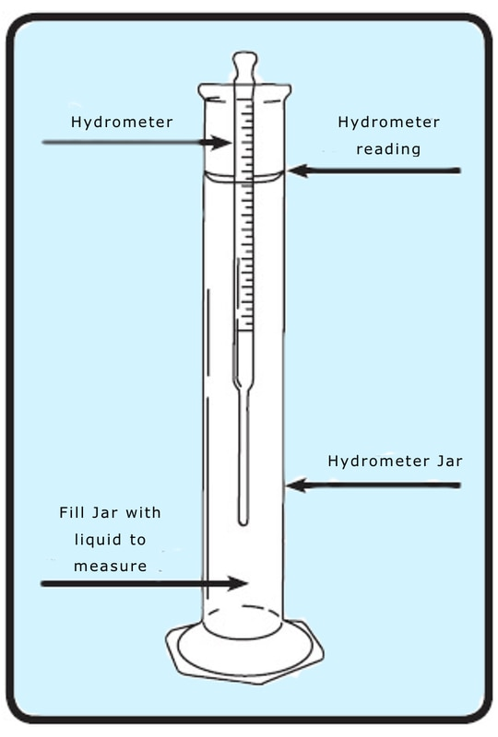
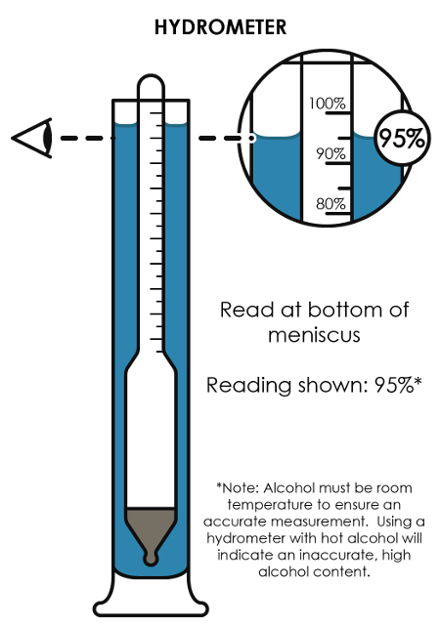
hydrometer

Slide 16
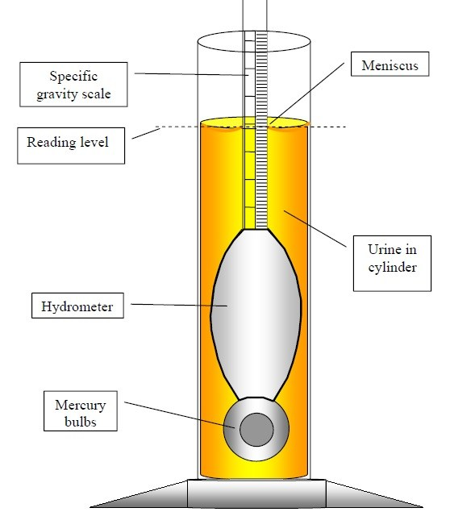
Urinometer
A Urinometer is a simple piece of equipment for determining urine specific gravity.
A typical urinometer is composed of a float, a weight, and a stem.
The float is an air-filled glass tube, ending in the weight on the left and the stem on the right.

Slide 17
Know Your equipment

Slide 18
Urine Chloride Concentration
Increased levels of Urinary Chloride (hyperchloremia) may be produced by conditions, such as:
Consumption of increased amounts of salt
Addison disease
Salt loss in urine due to inflamed kidneys; a condition known as salt-wasting nephropathy
Passing increased amounts of urine (polyuria)

Slide 19
Urine Chloride Concentration
Decreased levels of Urinary Chloride (hypochloremia) may be caused by conditions, such as:
Consumption of decreased amounts of salt
Cushing syndrome
Conn syndrome
Vomiting, diarrhea, excess sweating, leading to loss of fluids from the body

Slide 20
A. Personal Urinalysis Test - INSTRUCTIONS
Use the urinometer to measure the specific gravity.
Use a transfer pipet to fill the glass graduated cylinder about 75% full.
Gently add the hydrometer and make sure it is floating freely in the middle of the graduated cylinder.
Take your reading at the meniscus.

Slide 21
A. Personal Urinalysis Test - INSTRUCTIONS
Use the chloride testing station to determine the chloride ion concentration.
Add 10 drops of urine into a test tube.
Add one drop of 20% potassium chromate and mix.
Add 3% silver nitrate and mix.
COUNT the drops as you add them one drop at a time of 3% silver nitrate at a time until the solution turns brown.
Calculate the chloride ion concentration using the following formula
$\frac{\left(\# drops\right)×(0.061 g Cl−)}{0.1 L}$ = X grams per liter (this is MOLARITY)

Slide 22
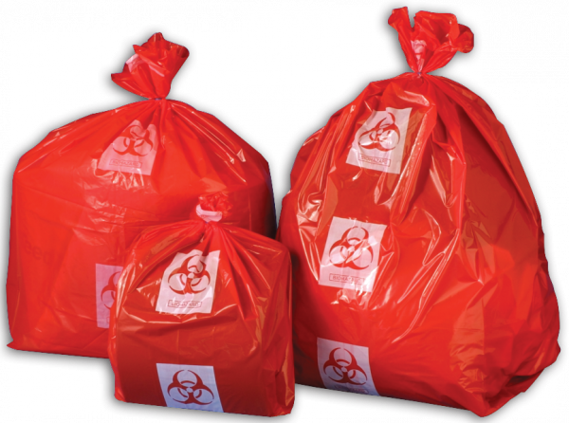
CLEAN-UP
Return your urine to your urine cup.
Dispose of the urine by flushing it down the toilet.
All items that have or may have urine on them must go in the biohazard softs.
Chloride testing liquids should go in the chemical waste container
Test tubes should go in the test tube collecting bucket.

Slide 23
B. Group Project:
Control Drink (Day 1) &. Experimental Drink (Day 2)
Tests • Same as section A
Choose one student per group to be the participant.
On Day 1 they will drink the control.
On Day 2 they will drink the experimental.
DAY ONE • Control drink: 500mL of drinking water
DAY TWO • Experimental drink: 500mL of an assigned experimental drink
A lot of water (NOTE: 1000mL)
½ teaspoon Baking Soda
Orange juice
0.9% NaCl
1.5% NaCl
5% glucose
Gatorade
Caffeine/Black coffee

Slide 24
Protocol:
Time = 0min: Have the students empty their bladder as soon as the lab begins. They should measure their urine volume and bring back a sample. When they return, have them “chug” their assigned drink and begin the timer (20min interval). STUDENTS CANNOT EAT NOR DRINK ANYTHING FROM THIS POINT ON. Run a complete urine analysis on their time 0min urine.
Time = 20min: When the timer rings, have the student empty their bladder. They should measure their urine volume and bring back a sample. When they return begin the timer (20min interval). Run a complete urine analysis on their time 20min urine.
Time = 40min: When the timer rings, have the student empty their bladder. They should measure their urine volume and bring back a sample. When they return begin the timer (20min interval). Run a complete urine analysis on their time 40min urine.
Time = 60min: When the timer rings, have the student empty their bladder. They should measure their urine volume and bring back a sample. When they return begin the timer (20min interval). Run a complete urine analysis on their time 60min urine.
Time = 80min: When the timer rings, have the student empty their bladder. They should measure their urine volume and bring back a sample. When they return begin the timer (20min interval). Run a complete urine analysis on their time 80min urine.
Time =100min: When the timer rings, have the student empty their bladder. They should measure their urine volume and bring back a sample. When they return begin the timer (20min interval). Run a complete urine analysis on their time 100min urine.
OPTIONAL Time =120min: When the timer rings, have the student empty their bladder. They should measure their urine volume and bring back a sample. When they return begin the timer (20min interval). Run a complete urine analysis on their time 120min urine.
8. STUDENTS MAY NOW EAT & DRINK WHATEVER THEY WISH OUTSIDE OF THE LAB.
9. CLEAN-UP: dispose of urine and waste appropriately. Points will be lost if waste is mismanaged.

