Slide 1
Male Reproductive
Anatomy and Physiology
Human Sexuality
BIO 301
With Cynthia Anderson Sanchez

Slide 2
DO YOU KNOW??
Your Body is Busy!
Whether you are male or female, your body is working hard every day, preparing itself for sexual reproduction!
Male and female bodies do different things to prepare for making offspring!
Notes:
While most parents blush at the thought of explaining the mechanics of human reproduction to their curious 5-yr old child asking where babies come from, there is a lot more to human reproduction than the act of intercourse itself.

Slide 3
I want to know!
Knowing what your body is going through, helps you to “make sense” of physical symptoms you may experience.
Also, knowing when fertilization is most likely to happen, is very helpful for planning for that “bundle of joy”. Knowing helps prevent unplanned pregnancies, too!
I am in control.
I am informed.
I can make informed decisions.
Notes:
While most parents blush at the thought of explaining the mechanics of human reproduction to their curious 5-yr old child asking where babies come from, there is a lot more to human reproduction than the act of intercourse itself.

Slide 4
Male Reproductive Strategies a short introduction from CRASHCOURSE via YOUTUBE see more at https://www.youtube.com/watch?v=-XQcnO4iX_U

Slide 5
The Mighty Sperm
Men can produce 1,500 Sperm a Second.
They can 400,000 spermatozoa in a single ejaculate.
They can make millions of sperm cells over their lifetime.

Slide 6
What’s the Point of Sex (biologically-speaking) ?
The purpose of the male reproductive system is to
Ensure the continuation of the human species
To produce, store and transport spermatozoa.

Slide 7
The Gonads
The term ‘gonads’ is a generic term that applies to the anatomical location of where the gametes are produced.
The male gonads are the testis.
Sperm cells (spermatozoa) are produced in the testis.
http://www.innerbody.com/image/repmov.html

Slide 8
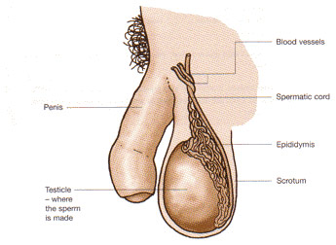
The Male External Genitalia
The male external genitalia consists of…
1) The Scrotum
The scrotum is a sac-like organ made of skin and muscles that houses the testes below the penis in the pubic region.
2) The Penis
The penis is the male external excretory and sex organ.
http://medicalterms.info/img/uploads/anatomy/scrotum.jpg
http://www.innerbody.com/image/repmov.html

Slide 9
The Scrotum
The Scrotum
The function of the scrotum is to to regulate the temperature of the sperm.
It does this by contracting and relaxing muscles to move the testis either closer to or further from the warm body.
http://medicalterms.info/img/uploads/anatomy/scrotum.jpg
http://www.innerbody.com/image/repmov.html

Slide 10
The Scrotum
Umm… Snowballs??
Overheated testis can cause infertility among males.
Several products and procedures are available to help the keep your sperm cool.
The “Snowballs” underwear is at the top of my list, just for the name alone!
https://www.snowballsunderwear.com/

Slide 11
The penile opening (the urethra) is shared by the urinary tract as well as the reproductive tract. In other words, the urethra is used for urination as well as to deliver semen.

Slide 12
The Penis
The penis functions as both a reproductive organ and an excretory organ.
As a reproductive organ, the penis becomes erect during sexual intercourse in order to deliver semen more effectively into the vagina.
Semen travels through the urethra to the tip of the penis where it is ejaculated out of the body.

Slide 13
Sperm Facts – NBC News http://www.cbsnews.com/pictures/sperm-15-crazy-things-you-should-know/
Everything you ever wanted to know about sperm, and a few things you didn’t!

Slide 14
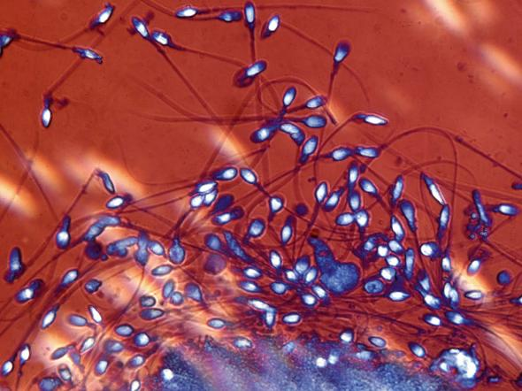
Sperm Production
PHOTOGRAPH BY MANFRED KAGE, PHOTO LIBRARY
I am in control.
I am informed.
I can make informed decisions.
Here is a picture of a of human spermatozoa taken from a 2010 National Geographic News article titled
“How a Man Produces 1,500 Sperm a Second”
Written by Christine Dell'Amore.
http://news.nationalgeographic.com/news/2010/03/100318-men-sperm-1500-stem-cells-second-male-birth-control/
Notes:
While most parents blush at the thought of explaining the mechanics of human reproduction to their curious 5-yr old child asking where babies come from, there is a lot more to human reproduction than the act of intercourse itself.

Slide 15
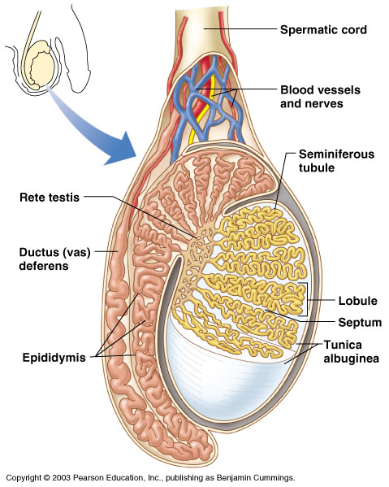
The Adventure of the Sperm
Spermatogenesis (sperm production) begins in the testis and takes 64-72 days
Interstitial cells in testis produce androgens such as testosterone

Slide 16
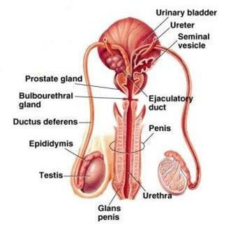
Male Reproductive System
Testis – male gonad
Epididymis
Ductus (vas) deferens
Seminal vesicles
Prostate gland
Bulbourethral (Cowper’s) gland
Urethra

Slide 17
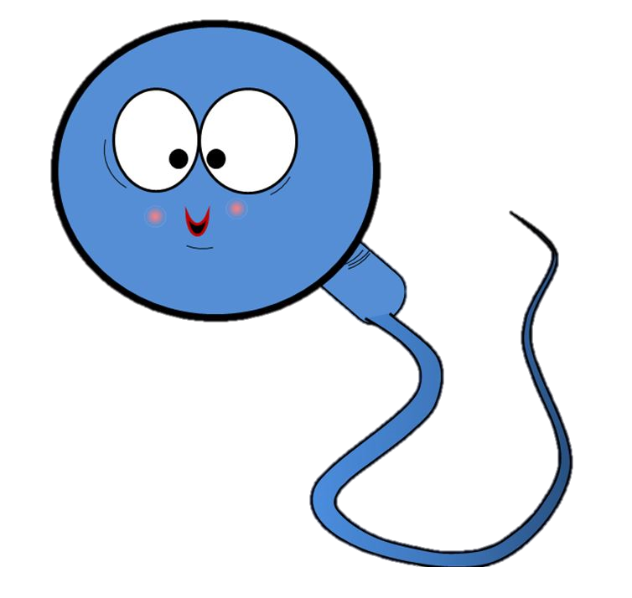
Semen – designed to survive the female reproductive tract
Semen is a mixture of sperm and seminal fluid (accessory gland secretions)
Advantages of additive secretions:
Fructose provides energy for sperm cells
Alkalinity of semen helps neutralize the acidic environment of vagina
Semen inhibits bacterial growth
Enhances sperm motility

Slide 18
Courtesy of “Medical Videos” YouTube..
https://www.youtube.com/watch?v=CH9PJurG8ok
Notes:
Usually, in textbooks, you will see drawing of these huge sperm that are about half the size of the egg. In reality, the egg is several times larger than the sperm, as we can see here in this video from “Medical Videos”. This video is showing in vitro fertilization, which is a technique in which eggs (or ova) are placed in a Petri dish and then exposed to spermatozoa. Notice here that the spermatozoa surround the egg and basically have to fight their way in. The egg has a protective layer that inhibits the sperm from directly being able to fertilize it. Instead, the spermatozoa secretes enzymes that penetrate this protective layer. The sperm must compete with other sperm in a race to see which of the spermatozoa will be able to gain access to the egg for fertilization. Once one of these spermatozoa succeeds at gaining access to the egg, the spermatozoa will fuse to the egg and insert its genetic material. Once this occurs the egg will form a special layer called the “fertilization membrane” which prevents other spermatozoa from gaining access to the egg.
Nature does this because it is important that only the strongest, healthiest spermatozoa get the change to fertilize the egg. This is a process of nature selection. Eggs fertilized with healthy sperm are more likely to survive and thrive.

Slide 19
The Male Reproductive Anatomy

Slide 33
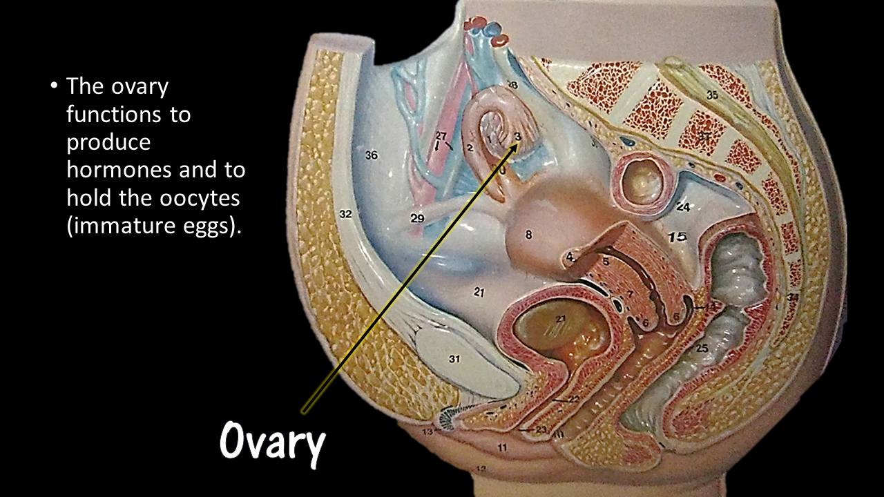

Slide 38
Female Reproductive System
Bio 301 — Human Sexuality
With Professor Cynthia Anderson Sanchez

Slide 39
I want to know!
Knowing what your body is going through, helps you to “make sense” of physical symptoms you may experience.
Also, knowing when fertilization is most likely to happen, is very helpful for planning for that “bundle of joy”. Knowing helps prevent unplanned pregnancies, too!
I am in control.
I am informed.
I can make informed decisions.
Notes:
While most parents blush at the thought of explaining the mechanics of human reproduction to their curious 5-yr old child asking where babies come from, there is a lot more to human reproduction than the act of intercourse itself.

Slide 40
The Ovary
Women are born with as many immature eggs (oocytes) as they will ever have in their lifetime.
The ovaries are full of follicles.
Each follicle has one oocyte that is able to mature into a mature ovum (egg).
Follicles

Slide 41
The Ovary
The ovaries play two central roles in the female reproductive system
The ovaries act as glands by secreting important sex hormones including estrogen and progesterone.
Progesterone
Estrogen

Slide 42
The Ovary
The ovaries play two central roles in the female reproductive system
The ovaries act as glands by secreting important sex hormones including estrogen and progesterone.
The ovaries act as gonads by housing the follicles that develop into mature ova (eggs).
Follicles

Slide 43
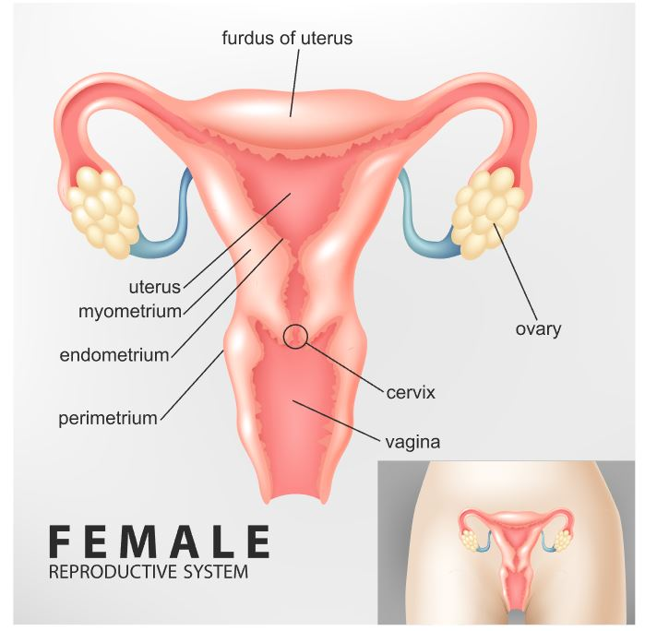
The female has two ovaries; one on the left side and one on the right side.
The ovary that participates in each cycle changes. They basically take turns. For example, one month the right ovary will release the oocyte and the next month the left ovary will release an egg.
This is why women who have damage or loss to one ovary are still fertile and able to have healthy offspring.
Right Ovary
Left Ovary

Slide 44
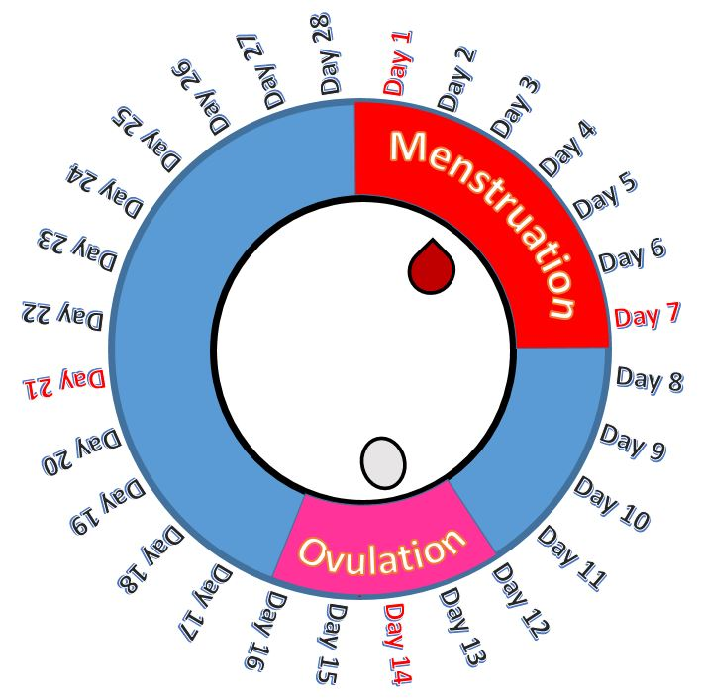
Fertility Window
From puberty to menopause, women are only able to conceive during a 6-day window of time out of their monthly cycle.
Women can only get pregnant on the day of ovulation, or the five days immediately prior.

Slide 45
Fertility Window
Ovulation usually starts about 14 days after the onset of the woman’s last menstruation.
Having intercourse from about day 10 to about day 14 of the cycle, increases the chance of pregnancy.

Slide 46
Females are born with as many follicles as they will ever have in their lifetime.
The female is born with hundreds of thousands of follicles in each ovary.
Each of these follicles houses a single immature egg (ovum).

Slide 47
Females are born with as many follicles as they will ever have in their lifetime.
About once every 28 days, one of the follicles in the ovary will come to maturation and create a single ovum.
The Follicular Phase of the
Ovarian Cycle
Ovum
Secondary
Follicle
Oocyte
Primordial
Follicle
Primary
Follicle

Slide 48
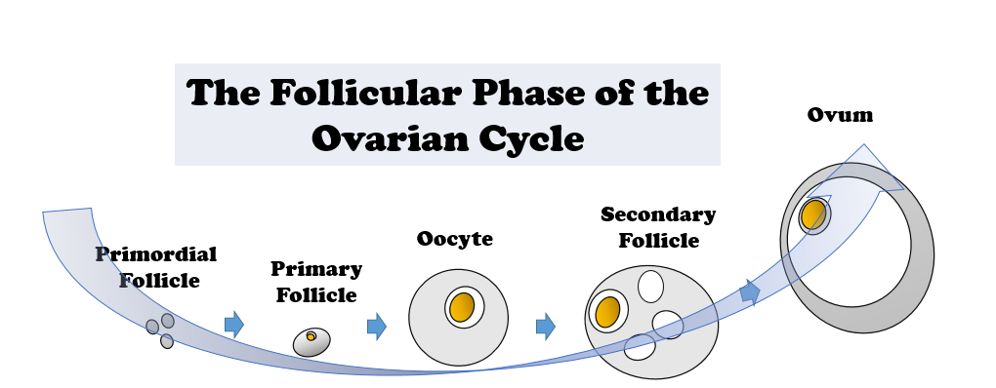
Females are born with as many follicles as they will ever have in their lifetime.
Fallopian Tube
Once the ovum has matured, ovulation occurs.
Ovulation is when the mature egg is released from the ovary and enters the fallopian tube.
Ovum
{
Ovary

Slide 49
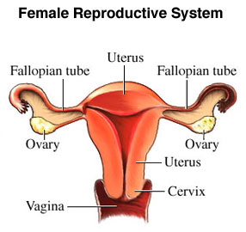
The Fallopian Tubes
Fallopian Tubes
The Fallopian tubes connect the ovaries to the uterus.
Ova (egg cells) are carried to the uterus through the fallopian tubes following ovulation.
https://ccbbiology10.wikispaces.com/file/view/Reproductive-System-Pattonville-High-School-News.jpg/404807362/286x307/Reproductive-System-Pattonville-High-School-News.jpg

Slide 50
The Fallopian Tubes
Fallopian Tubes
Fertilization of the egg occurs in the Fallopian tube!
The ova may also be fertilized while in the Fallopian tubes if sperm is present following sexual intercourse.
https://ccbbiology10.wikispaces.com/file/view/Reproductive-System-Pattonville-High-School-News.jpg/404807362/286x307/Reproductive-System-Pattonville-High-School-News.jpg

Slide 51
The Fallopian Tubes
Fallopian Tubes
If the egg is not fertilized, it will break down and it will be expelled from the uterus, along with the uterine lining, during menstruation.
https://ccbbiology10.wikispaces.com/file/view/Reproductive-System-Pattonville-High-School-News.jpg/404807362/286x307/Reproductive-System-Pattonville-High-School-News.jpg

Slide 52
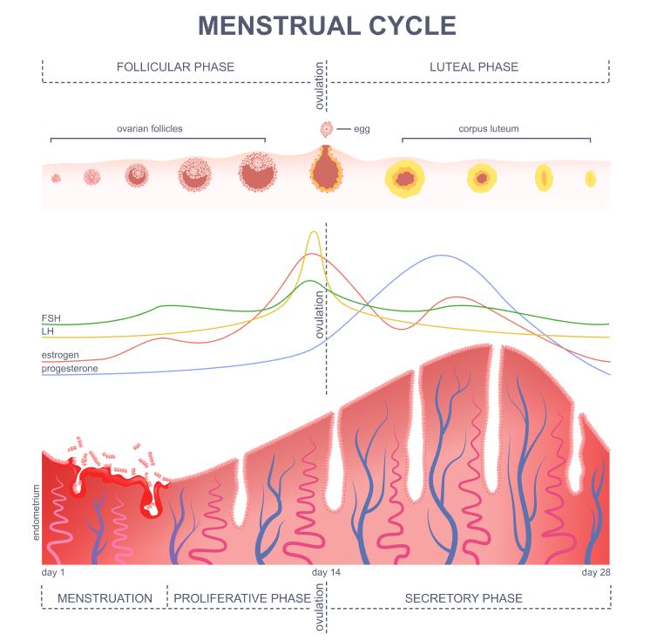
The Menstrual Cycle is pretty complicated!
We are going to cover the menstrual cycle
in detail in the next video!
This will be an overview.

Slide 53
The Follicular Phase
The follicle develops a mature ovum.

Slide 54
The Follicular Phase
The follicle develops a mature ovum.
2. Ovulation
Release of the mature ovum from the ovary into the fallopian tube.

Slide 55
The Follicular Phase
The follicle develops a mature ovum.
2. Ovulation
Release of the mature ovum from the ovary into the fallopian tube.
3. Luteal Phase
Decay of the “leftover” portion of the follicle, called the corpus luteum.

Slide 56
The Menstrual Cycle
Fallopian Tubes
“Day 1” of the menstrual cycle is defined as the first day of “bleeding” or menstruation.
If you are female, you may have noticed your doctor or nurses asking you, “when was the first day of your last period.”
This let’s your medical provider know where you are at in your cycle!
https://ccbbiology10.wikispaces.com/file/view/Reproductive-System-Pattonville-High-School-News.jpg/404807362/286x307/Reproductive-System-Pattonville-High-School-News.jpg

Slide 57
The Menstrual Cycle
Thickening of the Uterine Wall
Why do women bleed?
Every 28 days or so, a woman’s body prepares itself for pregnancy JUST IN CASE, by thickening the walls of the uterus.

Slide 58
The Menstrual Cycle
Breakdown and Release of Uterine Lining During Menstruation
Why do women bleed?
When the egg does not get fertilized, hormones trigger the thickened lining of the uterus to break down and leave the body in the form of a blood-like secretion.

Slide 59
The Uterus
The UTERUS is also known as the WOMB.
If a woman becomes pregnant, this is where the fetus will grow and develop.

Slide 60
The Cervix
NOT TO SCALE!!!
The cervix is the opening from the uterus to the vagina.
When a woman is ready to give birth, a doctor will check to see if the cervix has dilated.
The cervix must dilate (get bigger) to allow the baby to pass through.

Slide 61
The Vagina
The Vagina is the birth canal for the baby.
It is also the receptacle for spermatozoa during sexual intercourse.

Slide 62
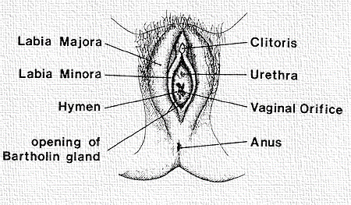
A Tour of the Outer Reproductive Anatomy!
The vulva is the collective name for the external female genitalia in the pubic region.
THE VULVA includes
The labia (majora and minora)
The clitoris
The urethra
The vaginal opening

Slide 63
A Tour of the Outer Reproductive Anatomy!
In women, the vaginal opening is protected by two layers of folded skin called the
Labia majora
Labia minora

Slide 64
A Tour of the Outer Reproductive Anatomy!
The urethra lies just above the vaginal orifice.
The urethra belongs to the urinary tract and is used for urination.

Slide 65
A Tour of the Outer Reproductive Anatomy!
The clitoris is the most sensitive part of the vulva.
It is the equivalent to the head of the penis in males, but in females it has no real function.

