Slide 1
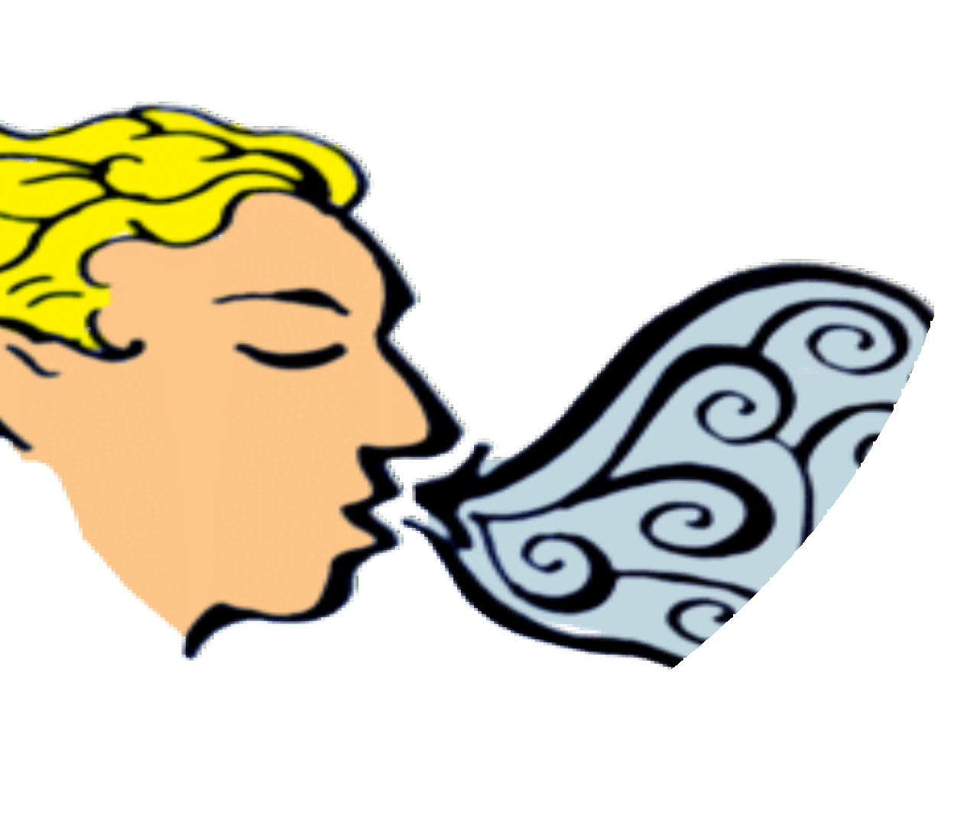
The Respiratory System
BY SCIENTIST CINDY

Slide 2
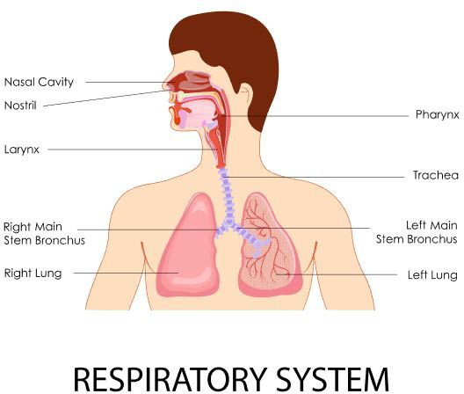
Divisions of the Respiratory Tract
The respiratory tract is the path of air from the nose to the lungs. It is divided into two sections: Upper Respiratory Tract and the Lower Respiratory Tract.
  The upper respiratory tract consists of the Nostrils, Nasal Cavities, Pharynx, Epiglottis, and the Larynx.
  The lower respiratory tract consists of the Trachea, Bronchi, Bronchioles, and the Lungs.

Slide 3

BREATHING or ventilation
The four primary processes of respiration are:
EXTERNAL RESPIRATION, which is the exchange of gases (oxygen and carbon dioxide) between inhaled air and the blood.
INTERNAL RESPIRATION, which is the exchange of gases between the blood and tissue fluids.
CELLULAR RESPIRATION

Slide 4
REGULATION OF BLOOD pH,
which occurs in coordination with the kidneys
The secondary processes of respiration include:
DEFENSE AGAINST MICROBES
CONTROL OF BODY
TEMPERATURE due to loss of evaporate during expiration

Slide 5

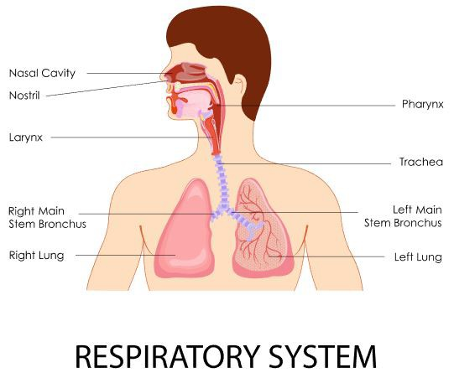
The Pathway of Air
nasal cavities
pharynx (nasopharynx, oropharynx, and laryngopharynx)
larynx
trachea
bronchi (right bronchus and left bronchus)

Slide 6
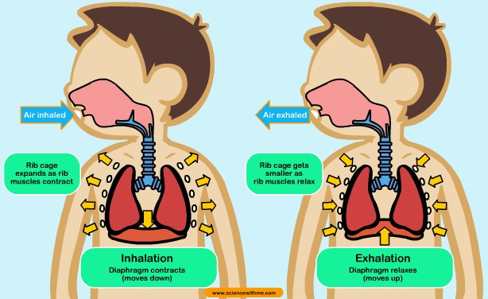
Breathing and Lung Mechanics
Ventilation
There are two phases of ventilation;
  Inspiration
  Expiration

Slide 7
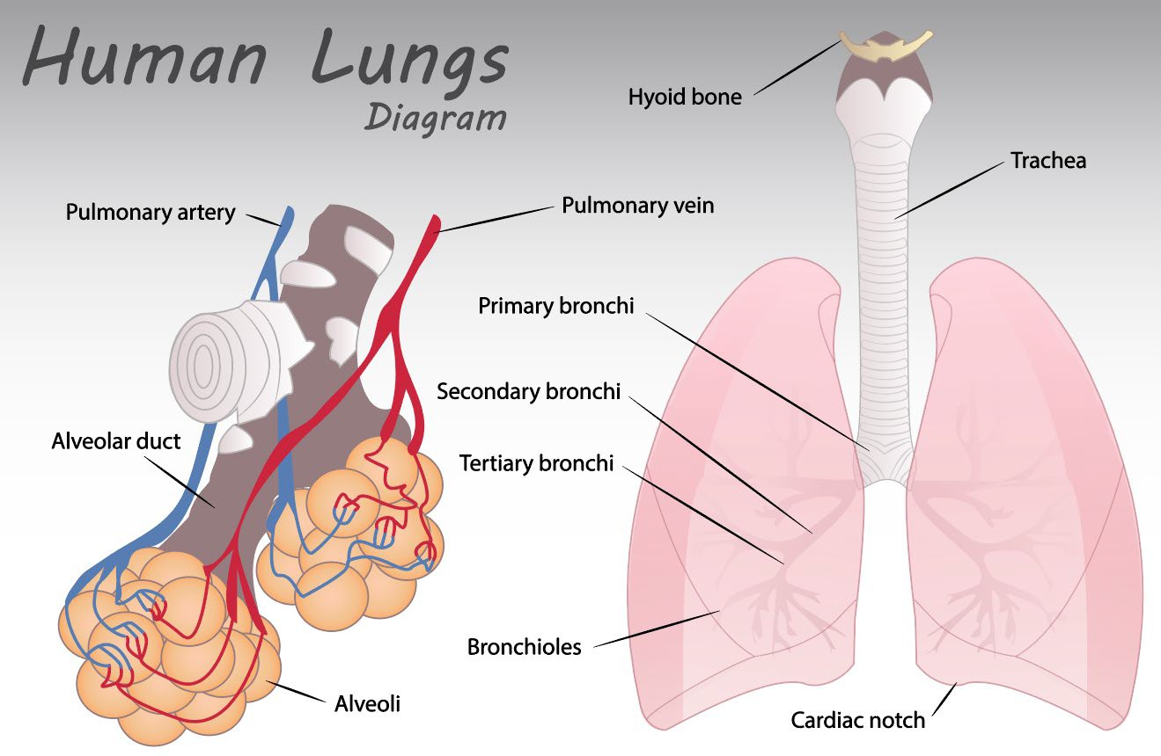
Breathing and Lung Mechanics – Ventilation
Ventilation is the exchange of air between the external environment and the alveoli.

Slide 8


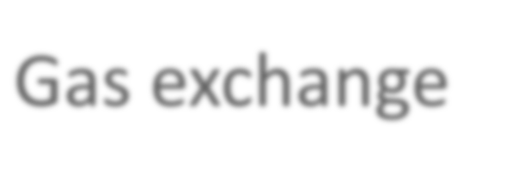


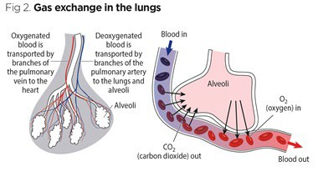
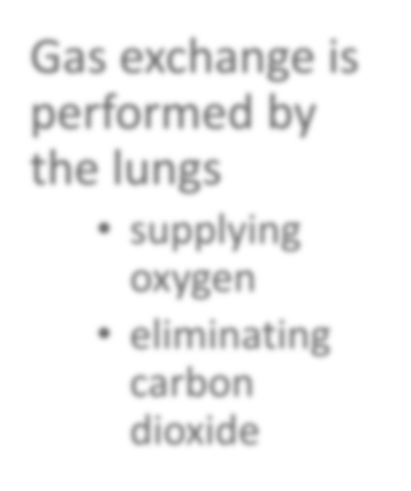
Gas exchange
Gas exchange is performed by the lungs
supplying oxygen
eliminating carbon dioxide

Slide 9
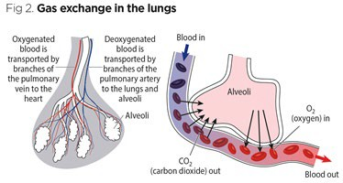
Gas exchange takes place between the air in the alveoli of the lungs, and the blood in the pulmonary capillaries.
Gas exchange is the result of a pressure gradient or concentration gradient that exists between the alveoli and the blood.
This process of gas exchange is done through diffusion.
Gas exchange

Slide 10
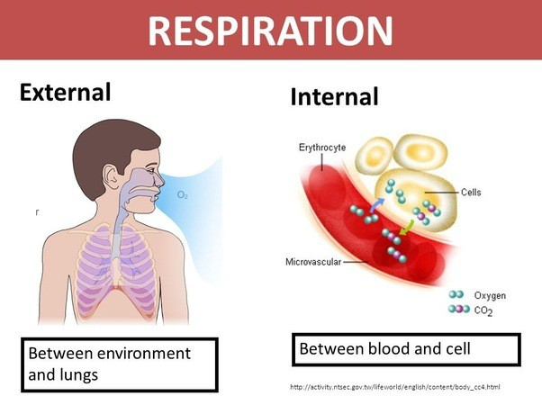
Internal Respiration
Internal respiration is the exchanging of gases at the cellular level.
The Passage Way From the Trachea to the Bronchioles
The inferior portion of the trachea to form the right primary bronchus and left primary bronchus.
  The point at which the trachea branches to form these bronchi is called the Carina.
The Bronchial Tree is a series of respiratory tubes that branch off into smaller and smaller tubes as they run throughout the lungs.

Slide 11
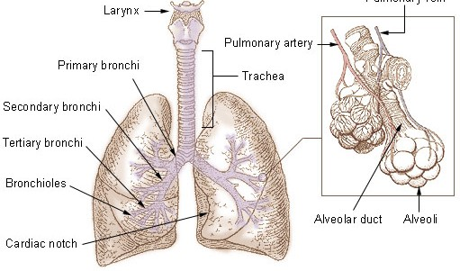
The lungs are attached to the heart and trachea through structures that are called the roots of the lungs.
  The roots of the lungs are the bronchi, pulmonary vessels, bronchial vessels, lymphatic vessels, and nerves.
  These structures enter and leave at the hilus of the lung
There are a number of terminal bronchioles connected to respiratory bronchioles which then advance into the alveolar ducts that then become alveolar sacs.
Each bronchiole terminates in an elongated space enclosed by many air sacs called alveoli which are surrounded by blood capillaries.
Bronchial Tree

Slide 12
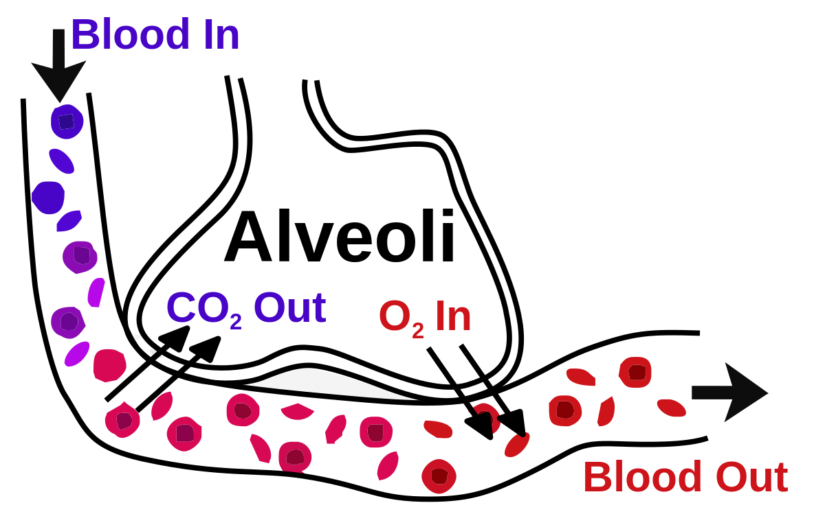
Alveoli
The Pulmonary Alveoli are membranous air sacs within the lungs.
Alveoli are units of respiration and the site of gas exchange between the respiratory and circulatory systems.

Slide 13
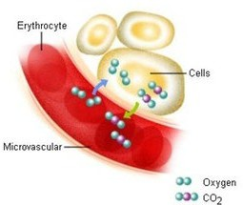
Each body cell releases carbon dioxide into nearby capillaries by diffusion.
The concentration of carbon dioxide is higher in the body cells than in the blood.
In the capillaries…
  some of the carbon dioxide is dissolved in plasma
  some of the carbon dioxide is taken up by red blood cells and bound to hemoglobin
  most carbon dioxide enters the red blood cells where it binds with water to form carbonic acid.
  carbon dioxide then travels to the capillaries surrounding the lung
water molecule leaves, causing it to turn back into carbon dioxide.
It then enters the lungs where it is exhaled into the atmosphere.

Slide 14
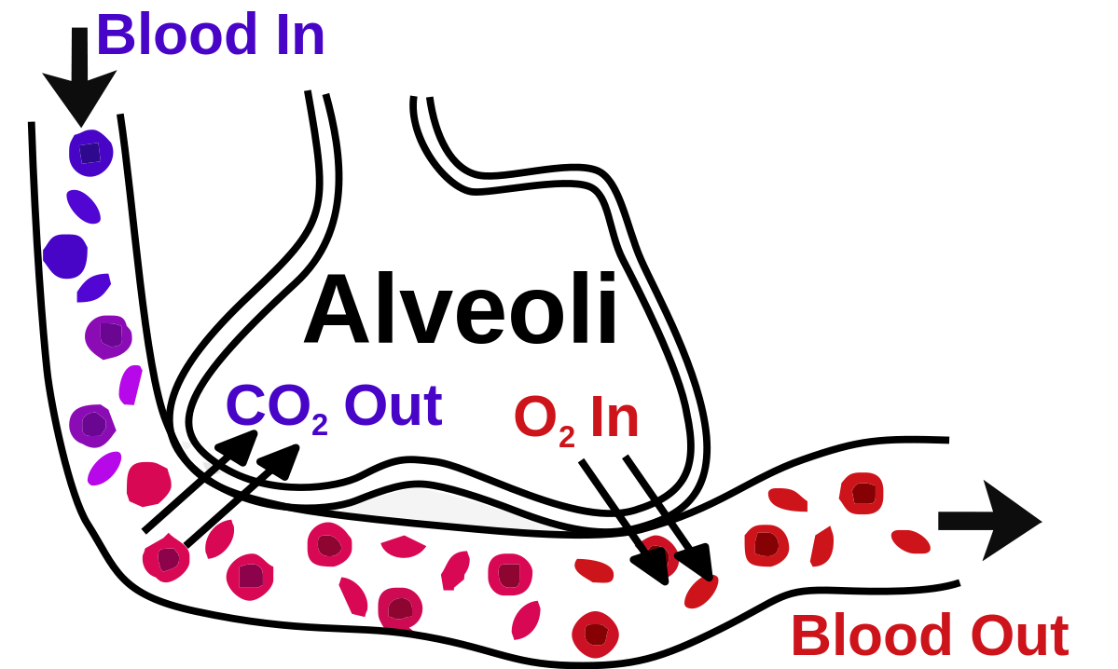
1. Carbon Dioxide enters the red blood cells at capillary beds.
Carbon Dioxide binds with water to form carbonic acid.
Carbonic Acid then travels to the capillaries surrounding the lung.
Carbonic Acid is transformed into water and carbon dioxide.
Carbon Dioxide diffuses from the red blood cells in the capillaries to the alveoli of the lungs.
The Carbon Dioxide is exhaled out of the body through the lungs.
Carbon Dioxide

Slide 15
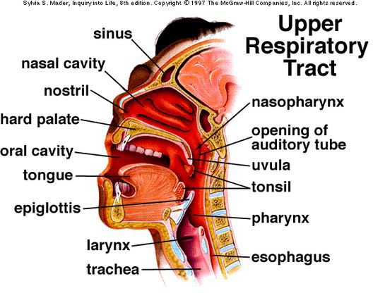
the nose and the pharynx
The upper respiratory tract consists of the nose and the pharynx.
Primary functions
  receive the air from the external environment
  filter, warm, and humidify air before it reaches the delicate lungs where gas exchange will occur.

Slide 16
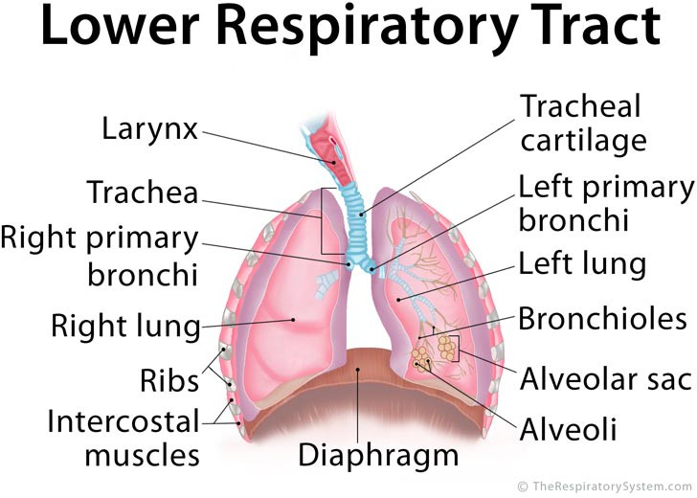
the larynx, the trachea, and the bronchi
The lower respiratory tract includes
  the larynx
  the trachea
  the bronchi

Slide 17
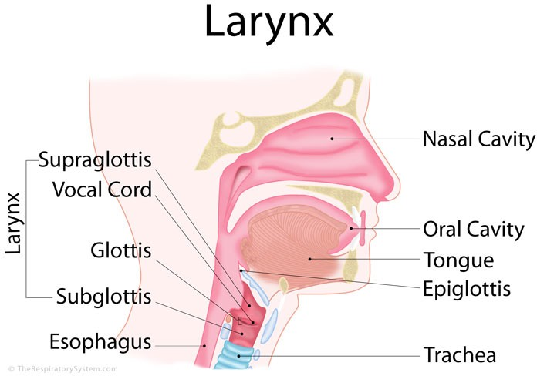
Larynx
The larynx contains two important structures:
  the epiglottis
  the vocal cords

Slide 18
Larynx
The larynx (the voice box) functions:
  Protection of the trachea
  Produce sounds (vocalization) via the vocal cords

Slide 19
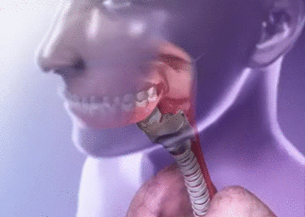
The epiglottis
The epiglottis is a flap of cartilage located at the opening to the larynx.
During swallowing, the epiglottis moves downward closing of the airways, to prevent chocking.

Slide 20
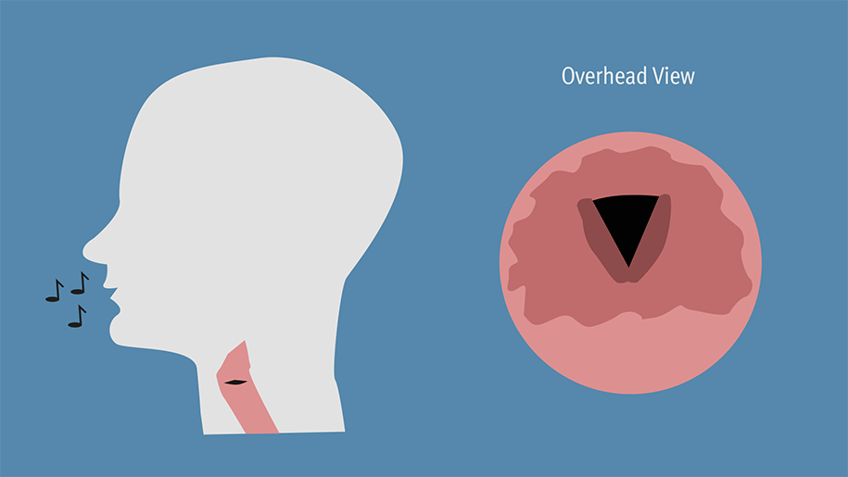
The vocal cords
The vocal cords consist of two folds of connective tissue that stretch and vibrate when air passes through them,
causing vocalization.

Slide 21

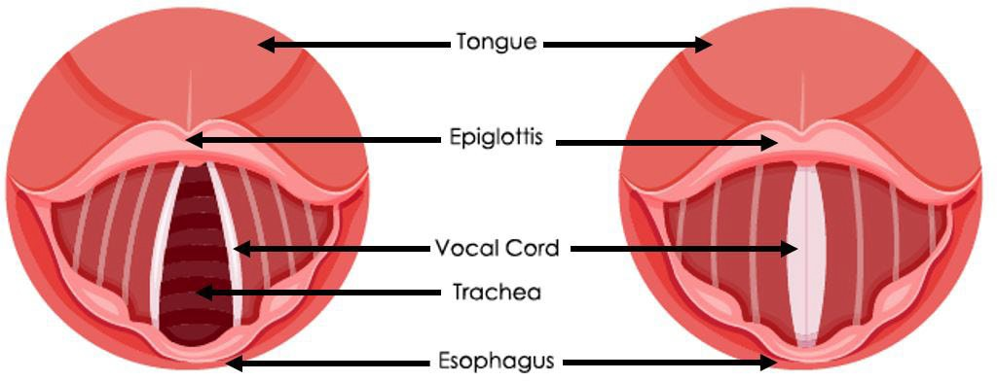
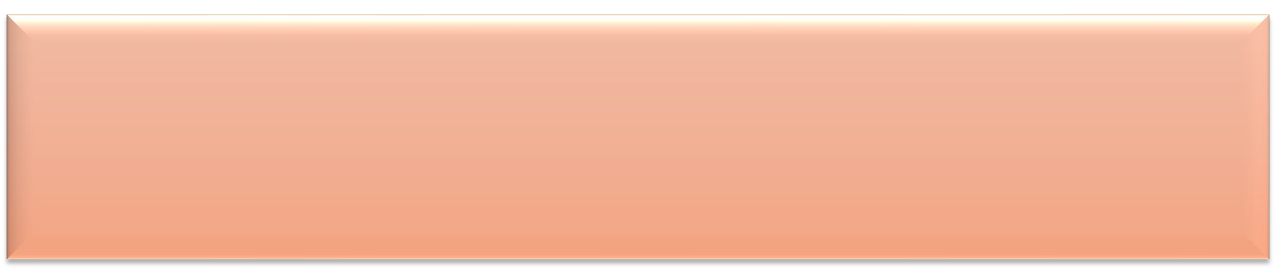
The vocal
cords
The length the vocal cords are stretched determines what PITCH
the sound will have.
The strength of expiration from the lungs also contributes to the
VOLUME of the sound.

Slide 22
