Slide 1
The Eye

Slide 2
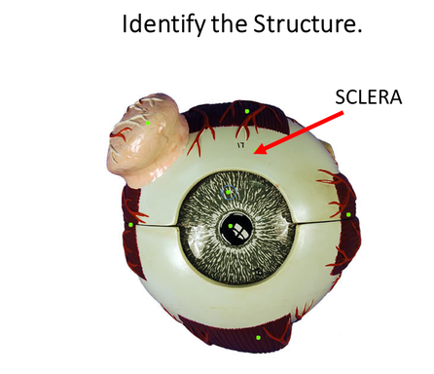
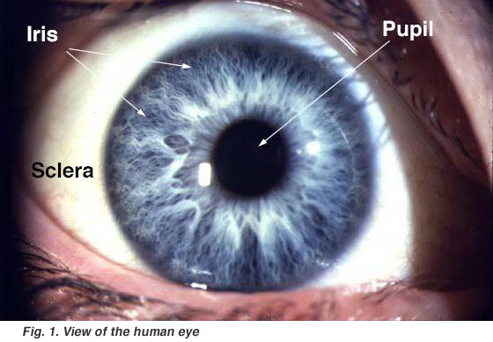
External Anatomy of the Human Eye
The sclera is the white protective outer layer of connective tissue that surrounds most of the eye (or globe).
It functions to
provide structure
protection
attachment for muscles

Slide 3
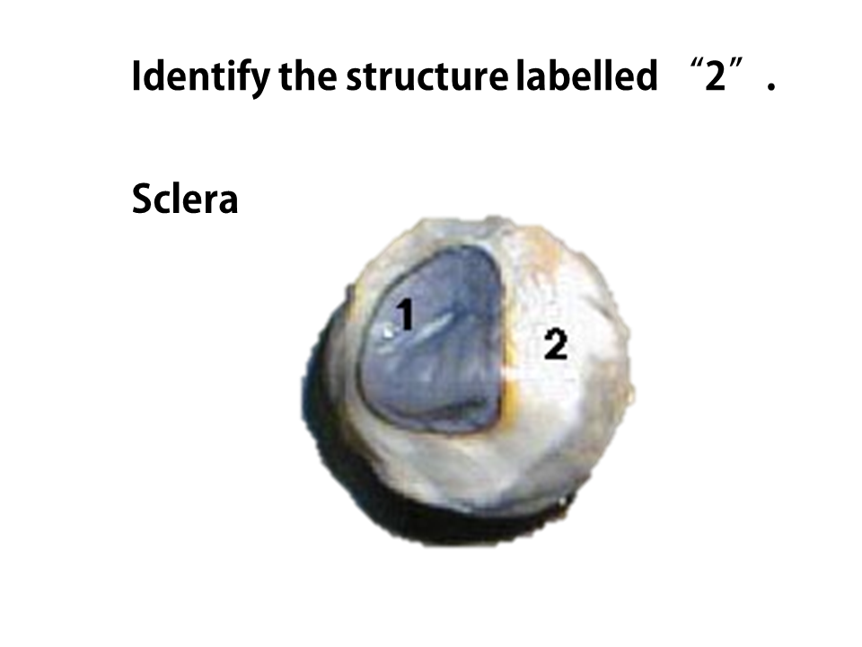
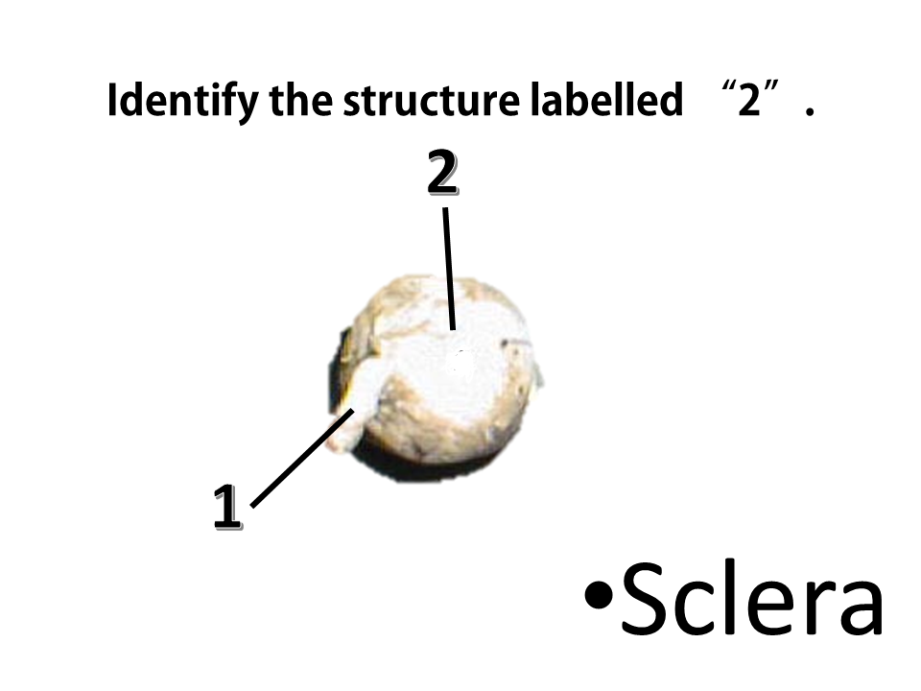

Slide 4
The pupil
The pupil is the dark circular part of the eye that functions to allow light to come into the eye.
The pupil is actually not black at all. In fact, it is a hole in your eye.

Slide 5
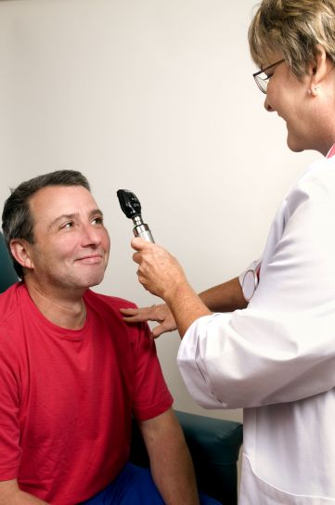
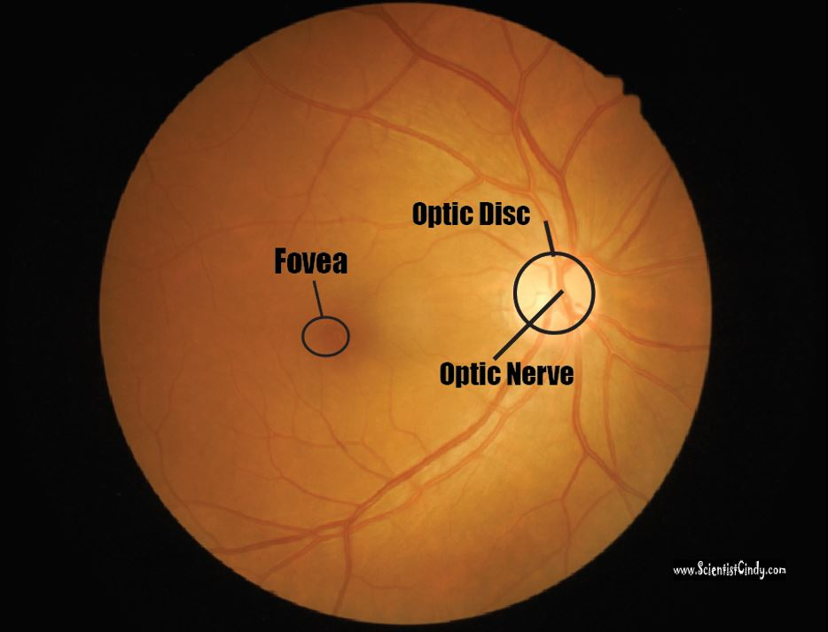
When your doctor looks into your eye either an ophthalmoscope, they are looking through your pupil and examining your retina at the back of your eye.

Slide 6
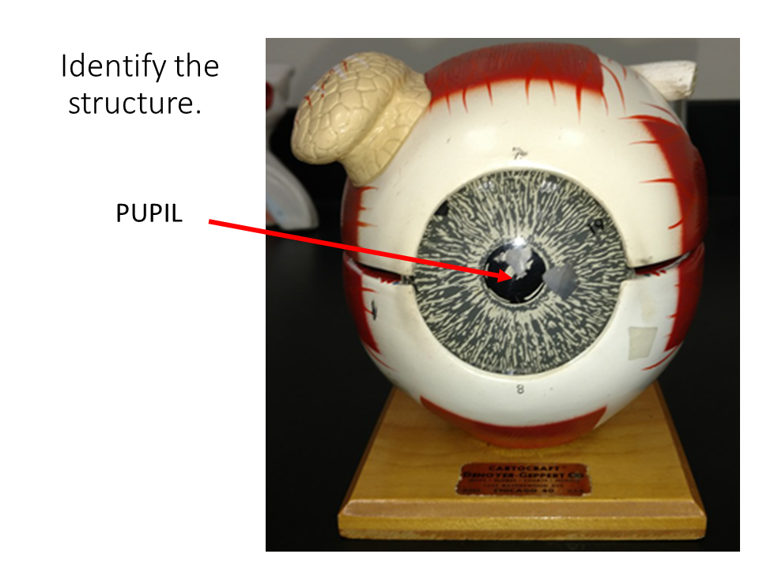
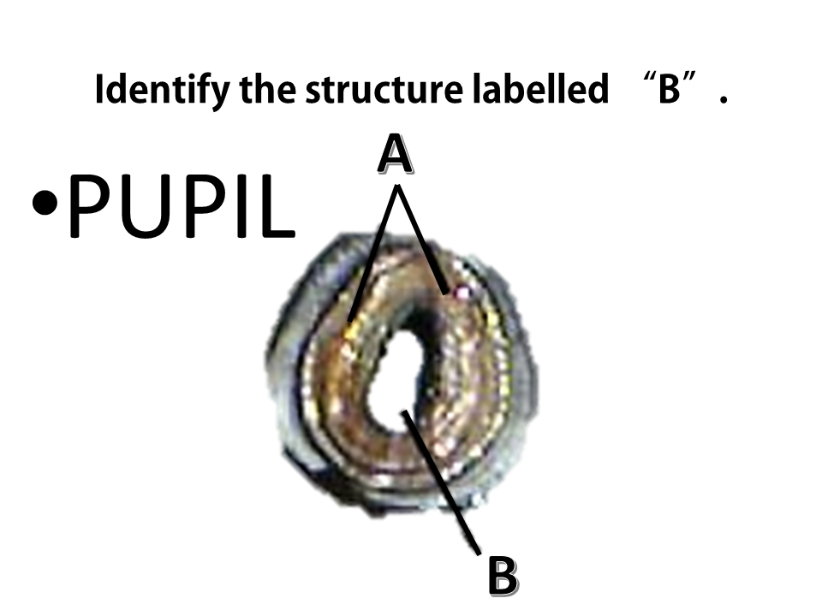
Pupil

Slide 8
The iris is the colored portion of your eye. The iris acts as a diaphragm which becomes larger or smaller in order to adjust the amount of light going through the pupil. ​

Slide 9
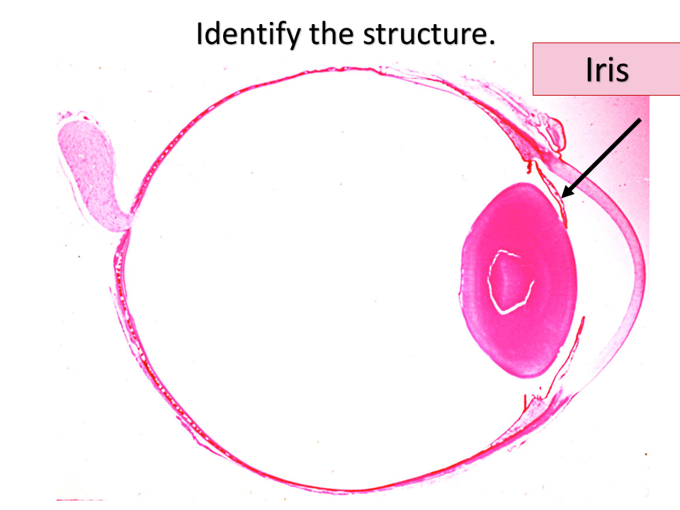
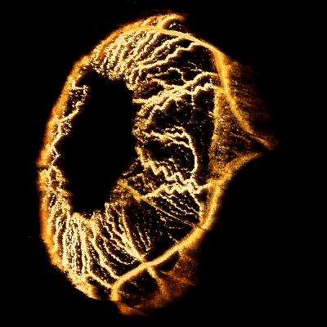
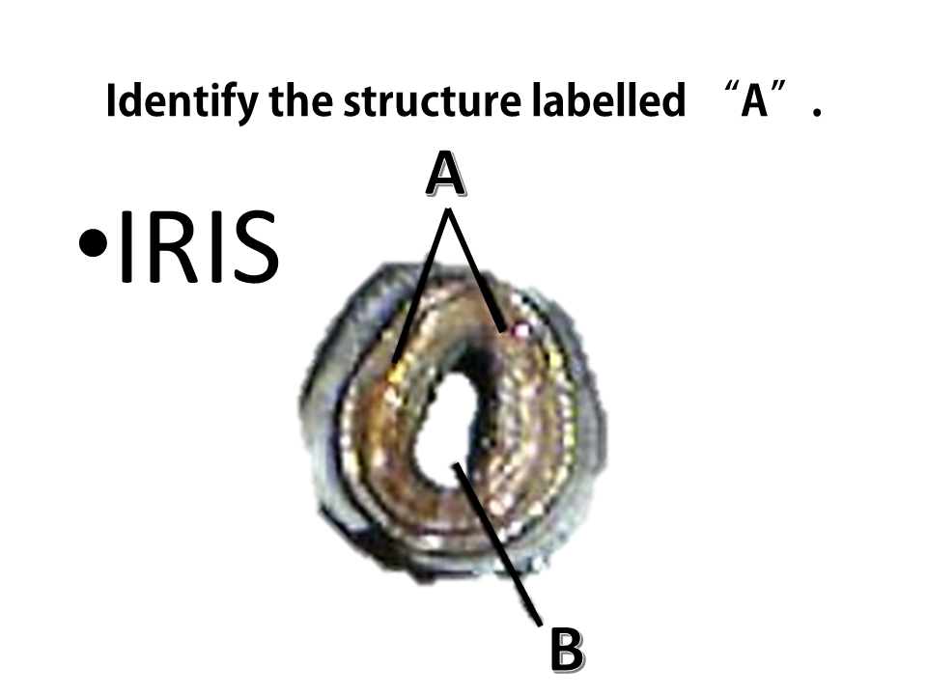

Slide 10
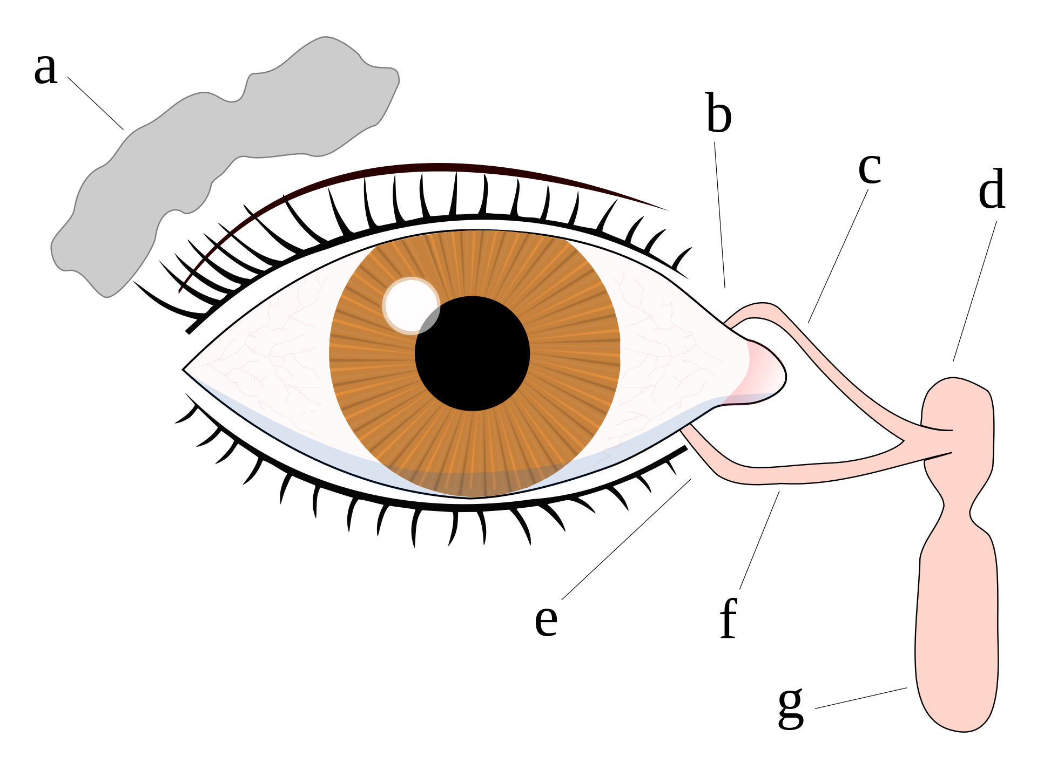
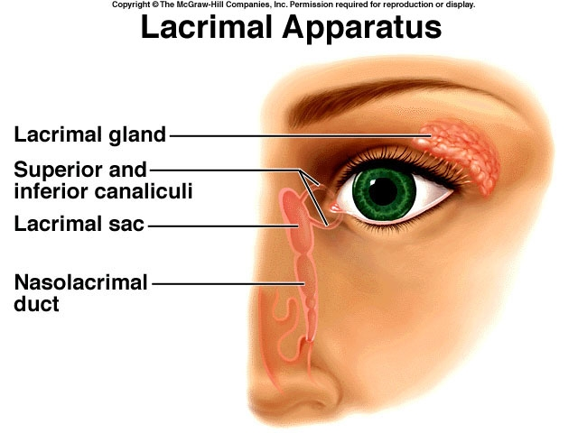
Lacrimal apparatus – functions in forming and draining tears.

Slide 11
The word 'lacrimal' comes from the Latin word 'lacrima' which means "tear". Our tears function to clean and lubricate the eyes.
Tears also form in response to irritation, strong emotion and yawning.

Slide 12
The lacrimal glands are located at the upper lateral region of each orbit.
The lacrimal gland produces tears which then flow into canals that connect to the tear duct and drain into the nose.

Slide 13
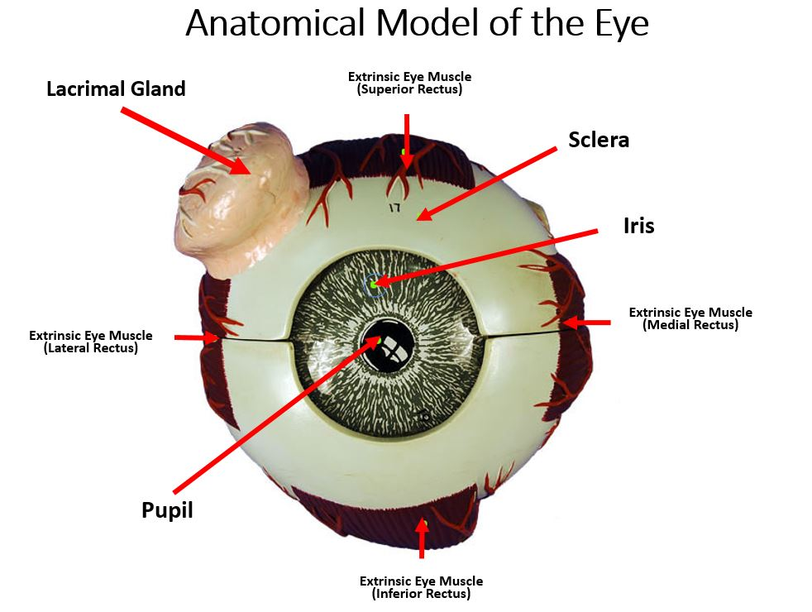

Slide 14
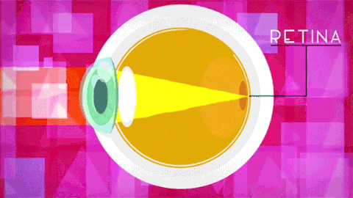
THE CORNEA
​The cornea is the clear anterior portion of the eye that is continuous with the sclera.
It covers the lens and the pupil.

Slide 15
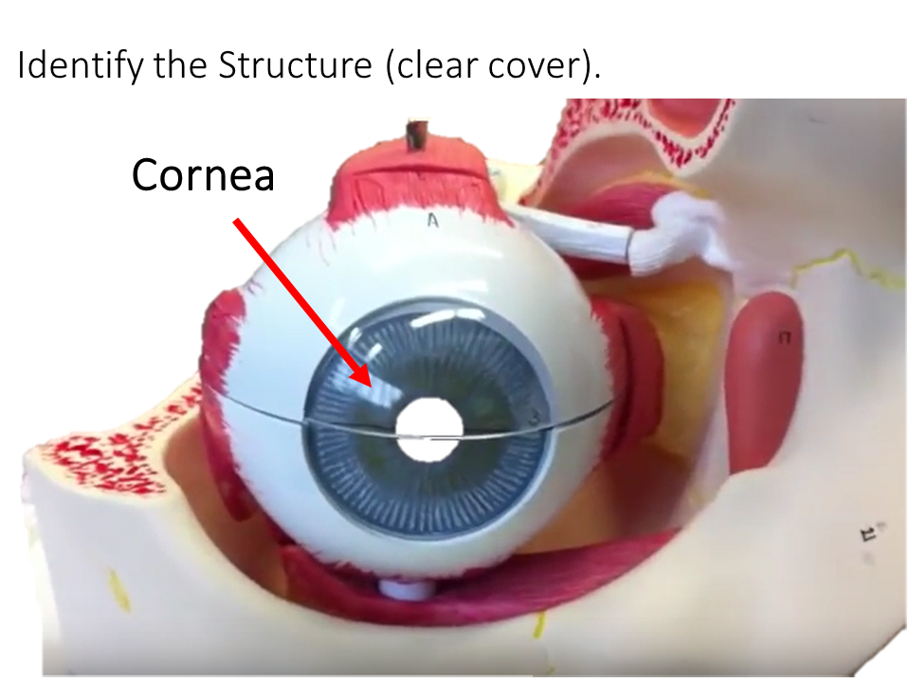

Slide 16
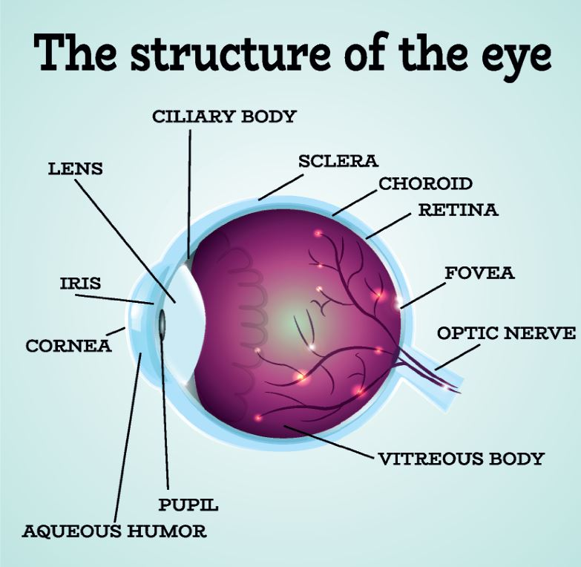

Slide 17
THE CORNEA
​ The cornea and lens function to refract light, to focus the image on the retina at the back of the eye.

Slide 18
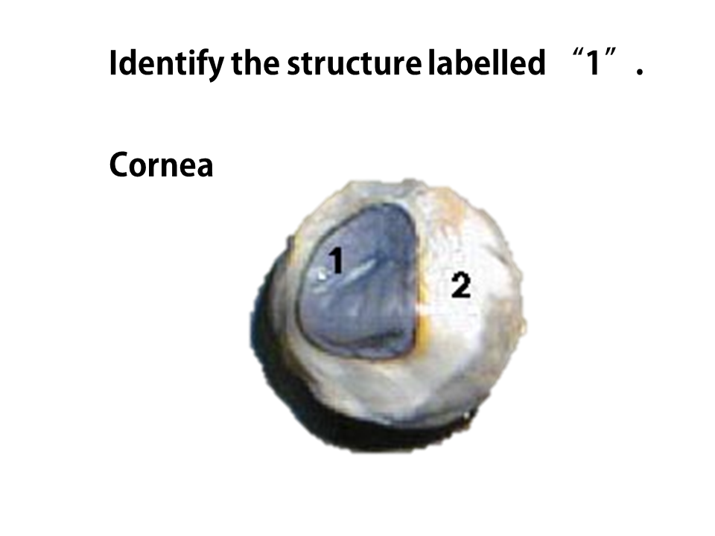
THE CORNEA
​ The cornea and lens function to refract (bend) light, to focus the image on the retina at the back of the eye.
While the cornea contributes most of the eye's focusing power, it does not have the ability to change shape, so its focusing power is 'fixed'. This means that only images that are at a certain distance will be in focus.
For this reason, the cornea functions along with the lens to accommodate images at different distances.

Slide 19
https://www.youtube.com/watch?v=Sqr6LKIR2b8

Slide 20
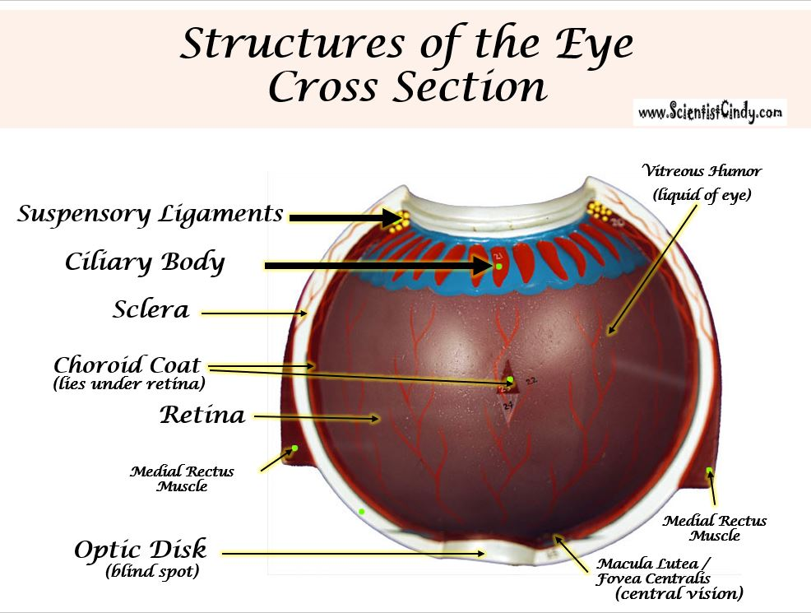

Slide 21
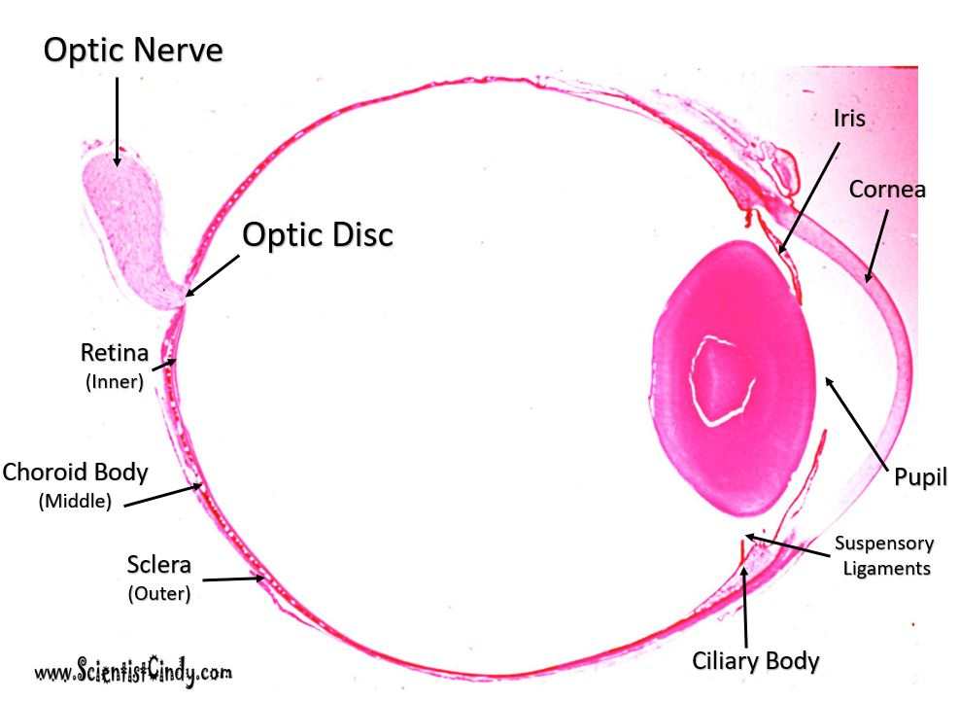

Slide 22
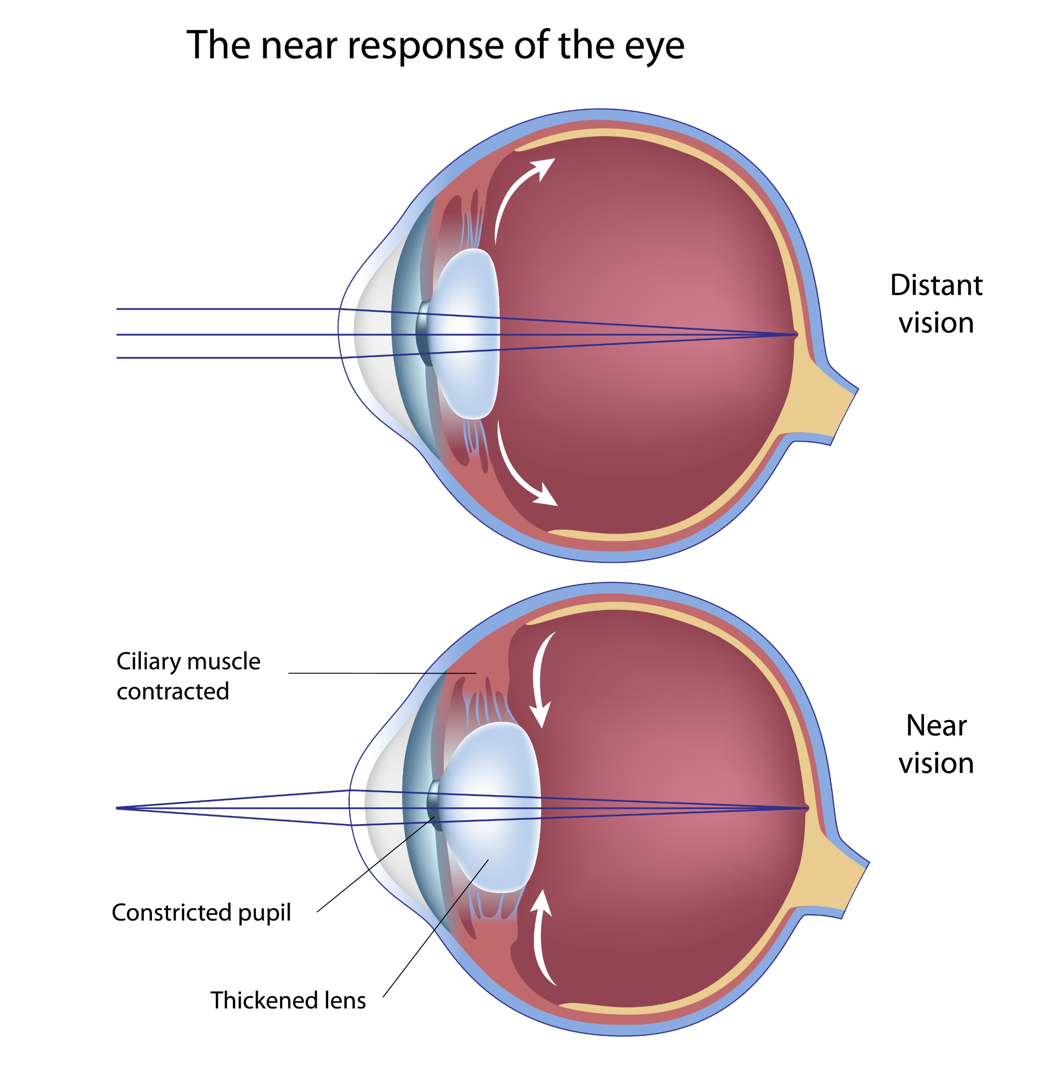
THE LENS
The lens is connected to the ciliary body, which has muscles.
The muscles of the ciliary body squeeze the lens to make it more convex.

Slide 23
Convex?
Curves
INWARD
Curves
OUTWARD
No
Curve
Neither Concave nor Convex
Concave
Convex

Slide 24
THE LENS
Less Convex Lens =
Muscles of the Ciliary Body are RELAXED.
Able to see DISTANT objects.
Light rays are bent LESS by the lens.

Slide 25
THE LENS
More Convex Lens =
Muscles of the Ciliary Body are CONTRACTED.
Able to see CLOSE objects.
Light rays are bent MORE by the lens.

Slide 26
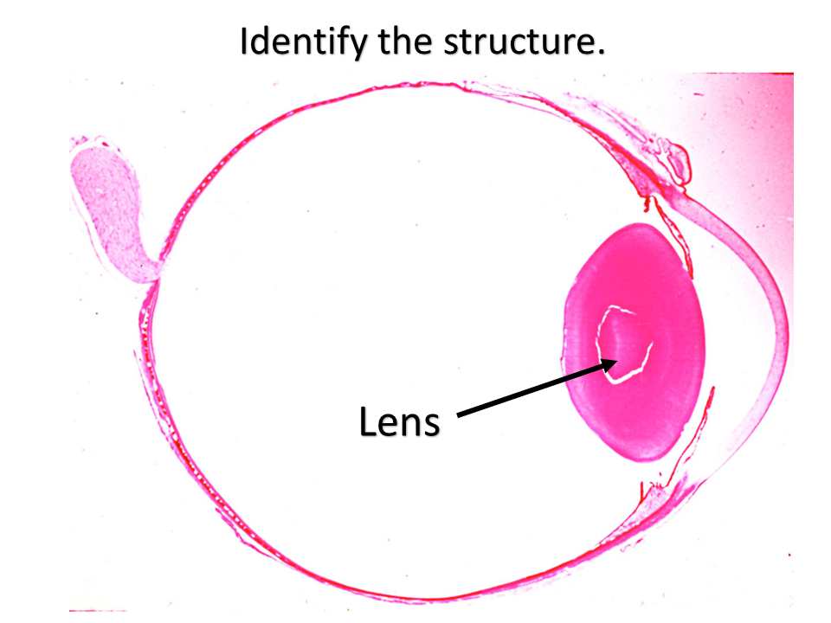
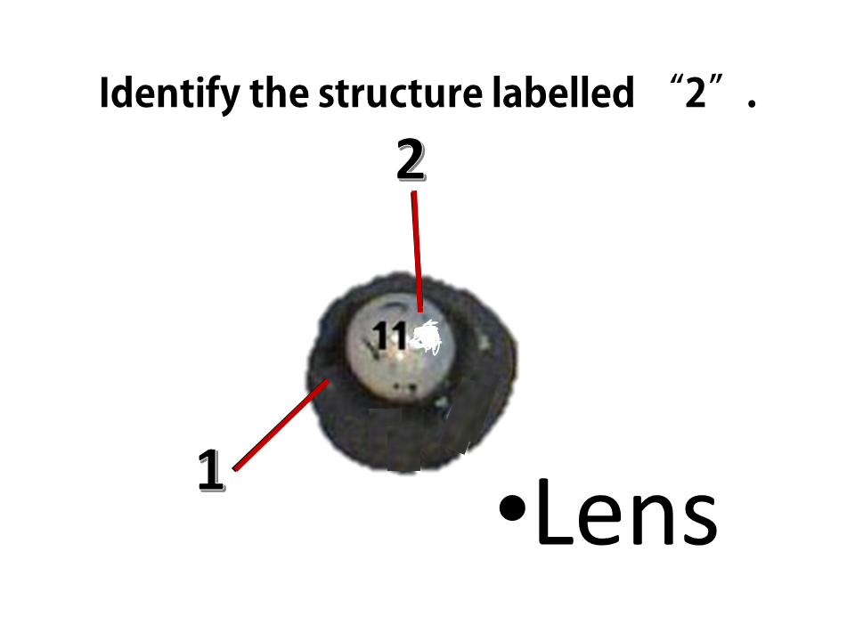
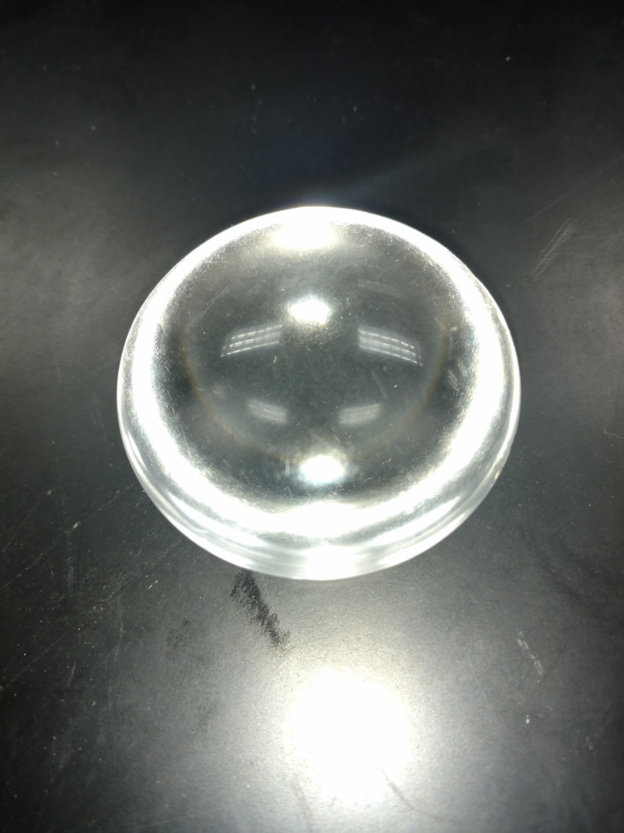
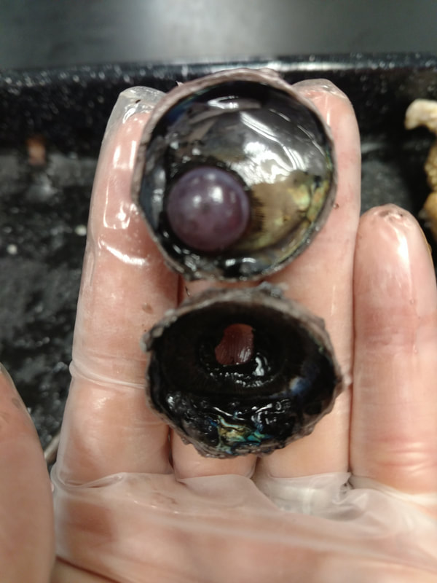

Slide 27
Accommodation
https://www.youtube.com/watch?v=YcedXDN6a88

Slide 28
The Ciliary Body is a Sphincter Muscle (meaning it is ROUND).
When sphincter muscles CONTRACT, the Lens is Squeezed.

Slide 29
More Convex Lens =
Muscles of the Ciliary Body are CONTRACTED.
Able to see CLOSE objects.
Light rays are bent MORE by the lens.
Lens
Focal Point

Slide 30
The cornea a clear structure that covers the iris and pupil.
Images are upside down and reversed onto our retina.
Cornea
Focal Point
Lens

Slide 31
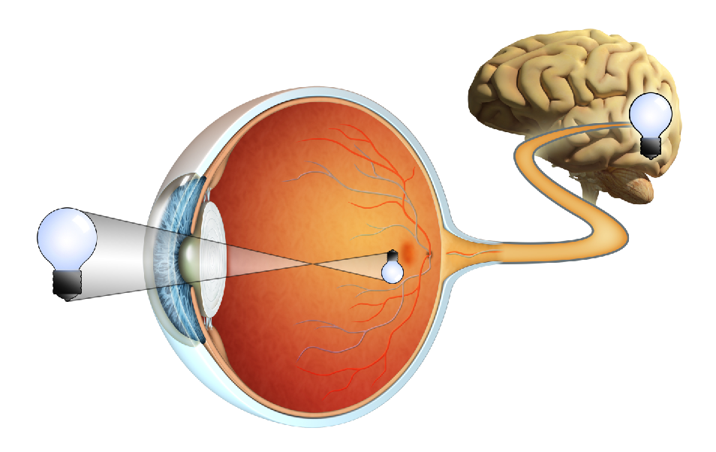

Slide 32
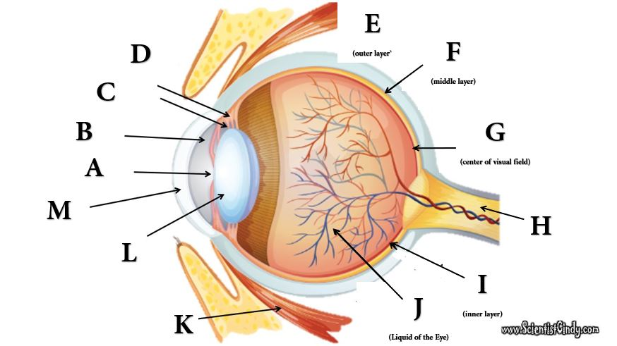
Can You Identify These Structures?

Slide 33
Crash Course
https://www.youtube.com/watch?v=o0DYP-u1rNM&t=506s

Slide 34
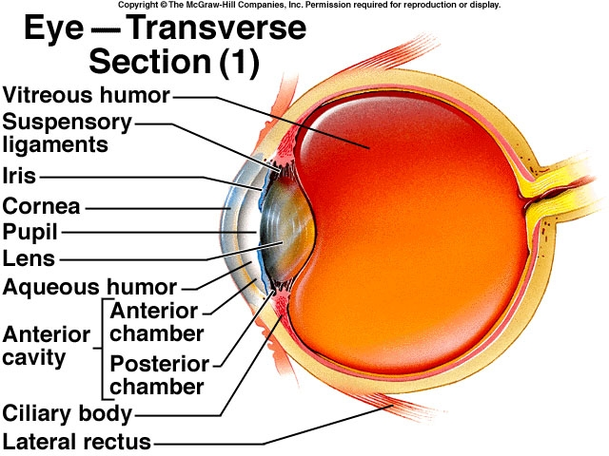
The vitreous humor (sometimes referred to as the vitreous body) is the gelatinous liquid that fills the eye.
This liquid functions to maintain the pressure of the eye.

Slide 35
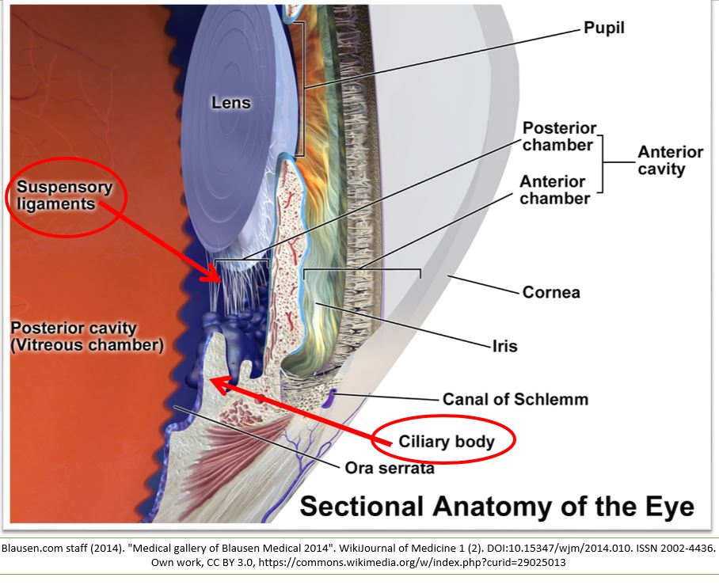
THE CILIARY BODY AND ​SUSPENSORY LIGAMENTS
​The ciliary body has ciliary muscles that control the shape of the lens. The ciliary body is connected to the lens by suspensory ligaments.

Slide 37
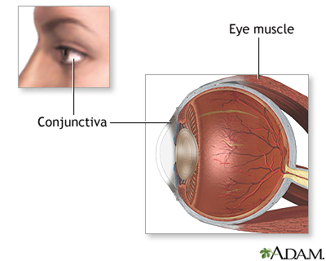
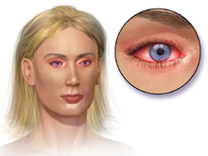
4. Conjunctiva

Slide 38
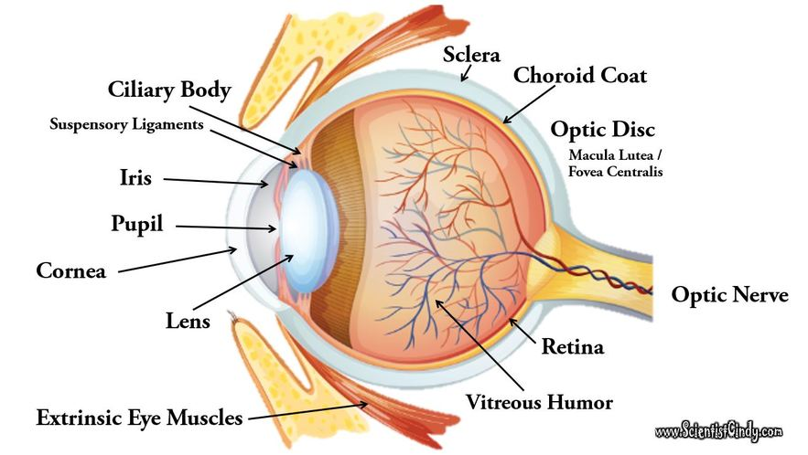

Slide 41
There are six extrinsic muscles of the eye (or globe). These muscles control the movement of the eyes. These muscles are called extrinsic eye muscles because their origin lies in the orbit and their insertion points are on the outside of the sclera.

Slide 42
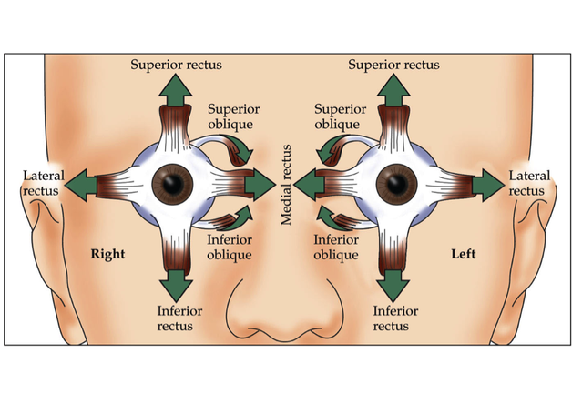
The six extrinsic eye muscles are as follows:
Superior and Inferior Rectus Muscles.
Lateral and Medial Rectus Muscles.
Superior and Inferior Oblique Muscle.

Slide 43
Muscles of the Eye
Muscle | Location | Function
Orbicularis Oris | Outer Rim | Squinting Blinking
Superior Rectus | Attached to Superior Sclera | Looking UP
Inferior Rectus | Attached to Inferior Sclera | Looking DOWN
Medial Rectus | Attached to Medial Sclera | Eye Looks Toward the Nose
Lateral Rectus | Attached to Lateral Sclera | Eye Looks Away From the Nose
Superior Oblique | Attaches to the superior medial Surface of the sclera | rotate the eyeball counter clock-wise to keep the eye from rotating when the rectus muscles are engaged
Inferior Oblique | Attaches to the superior medial Surface of the sclera | rotate the eyeball clock-wise to keep the eye from rotating when the rectus muscles are engaged

Slide 44
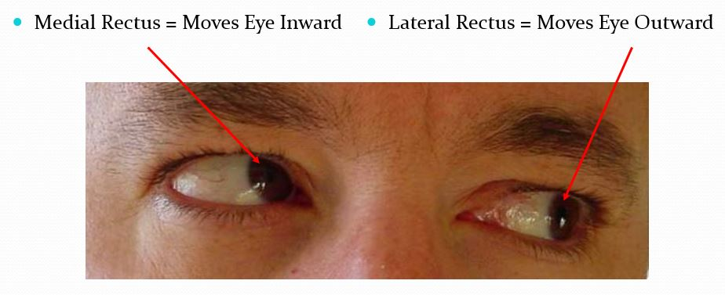
Medial and Lateral Rectus
The function of the rectus muscles of the eye allow the eye to look up, down, left and right.
The Lateral and Medial Rectus Muscles of the eyeball work in opposite ways to allow to you to look outward with one eye, while you look inward with the other eye.

Slide 45
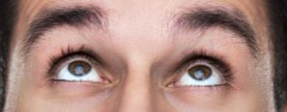
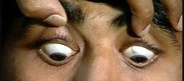
superior and inferior rectus muscles
The Superior Rectus muscles of the eyeball allow you to look UPWARDS! | The Inferior Rectus Muscles of the eyeball allow you to look DOWNWARD!

Slide 46
superior and inferior oblique muscles
The superior and inferior oblique muscles function to rotate the eyeball clock-wise and counter clock-wise to keep the eye from rotating when the rectus muscles are engaged.

Slide 48
Retina
several layers “inside out”
Pigmented epithelium
Rods and Cones (photoreceptors)
Bipolar cells
Ganglion cells
(vitreous humor)

Slide 49
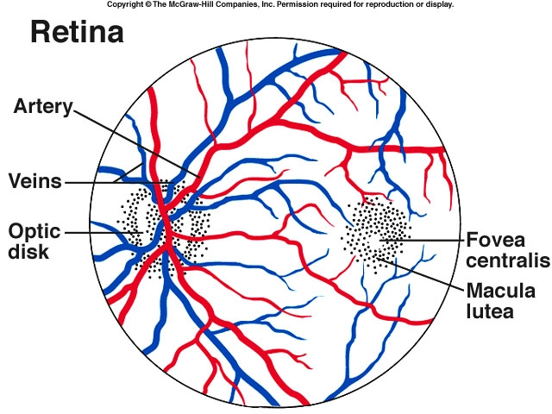
Light is focused by cornea and lens on
the Fovea centralis (“central pit”) which is in the
center of the Macula lutea (“yellow spot”)
The third refractive component is the
length of the eyeball.

Slide 51
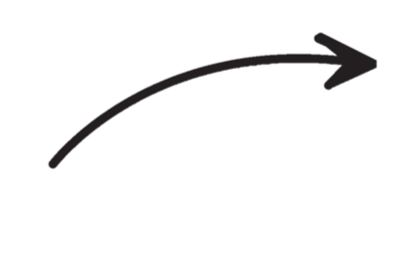
Fovea Centralis and Macula
Optic Disk

Slide 52
Blind Sight
https://www.youtube.com/watch?v=4Xan6UqNCQ8

Slide 53
Refractive Disorders
Emmetropia – good vision 20/20
Myopia – nearsightedness
Hyperopia – farsightedness
Astigmatism – light does not focus to a single point on the retina
Presbyopia – “old sight” – loss of ability to accommodate or see up close

Slide 55
Emmetropia – good vision 20/20

Slide 56
Myopia – nearsightedness

Slide 57
Hyperopia – farsightedness

Slide 58
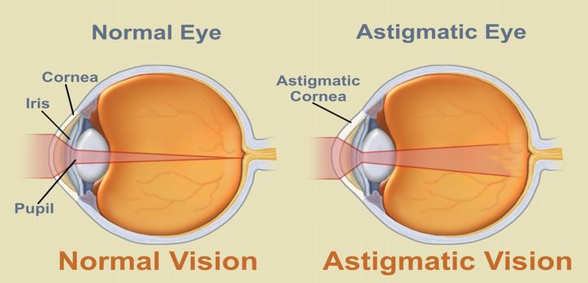
This Photo by Unknown Author is licensed under CC BY-SA
Astigmatism – light does not focus to a single point on the retina
Presbyopia – “old sight” – loss of ability to accommodate or see up close

Slide 67
Color vision
3 kinds of cones: blue, green and red
Wavelength of pigments may be shifted, causing
color blindness
Red – green color blindness most common
Sex-linked trait carried on X chromosome
(Males only have one gene for color vision)

Slide 69
Rods: Cones:
Can see in dim light Require more light
See in black and white See in color
Respond to movement Give best acuity
Found more in periphery More central, esp.
in fovea centralis

Slide 72
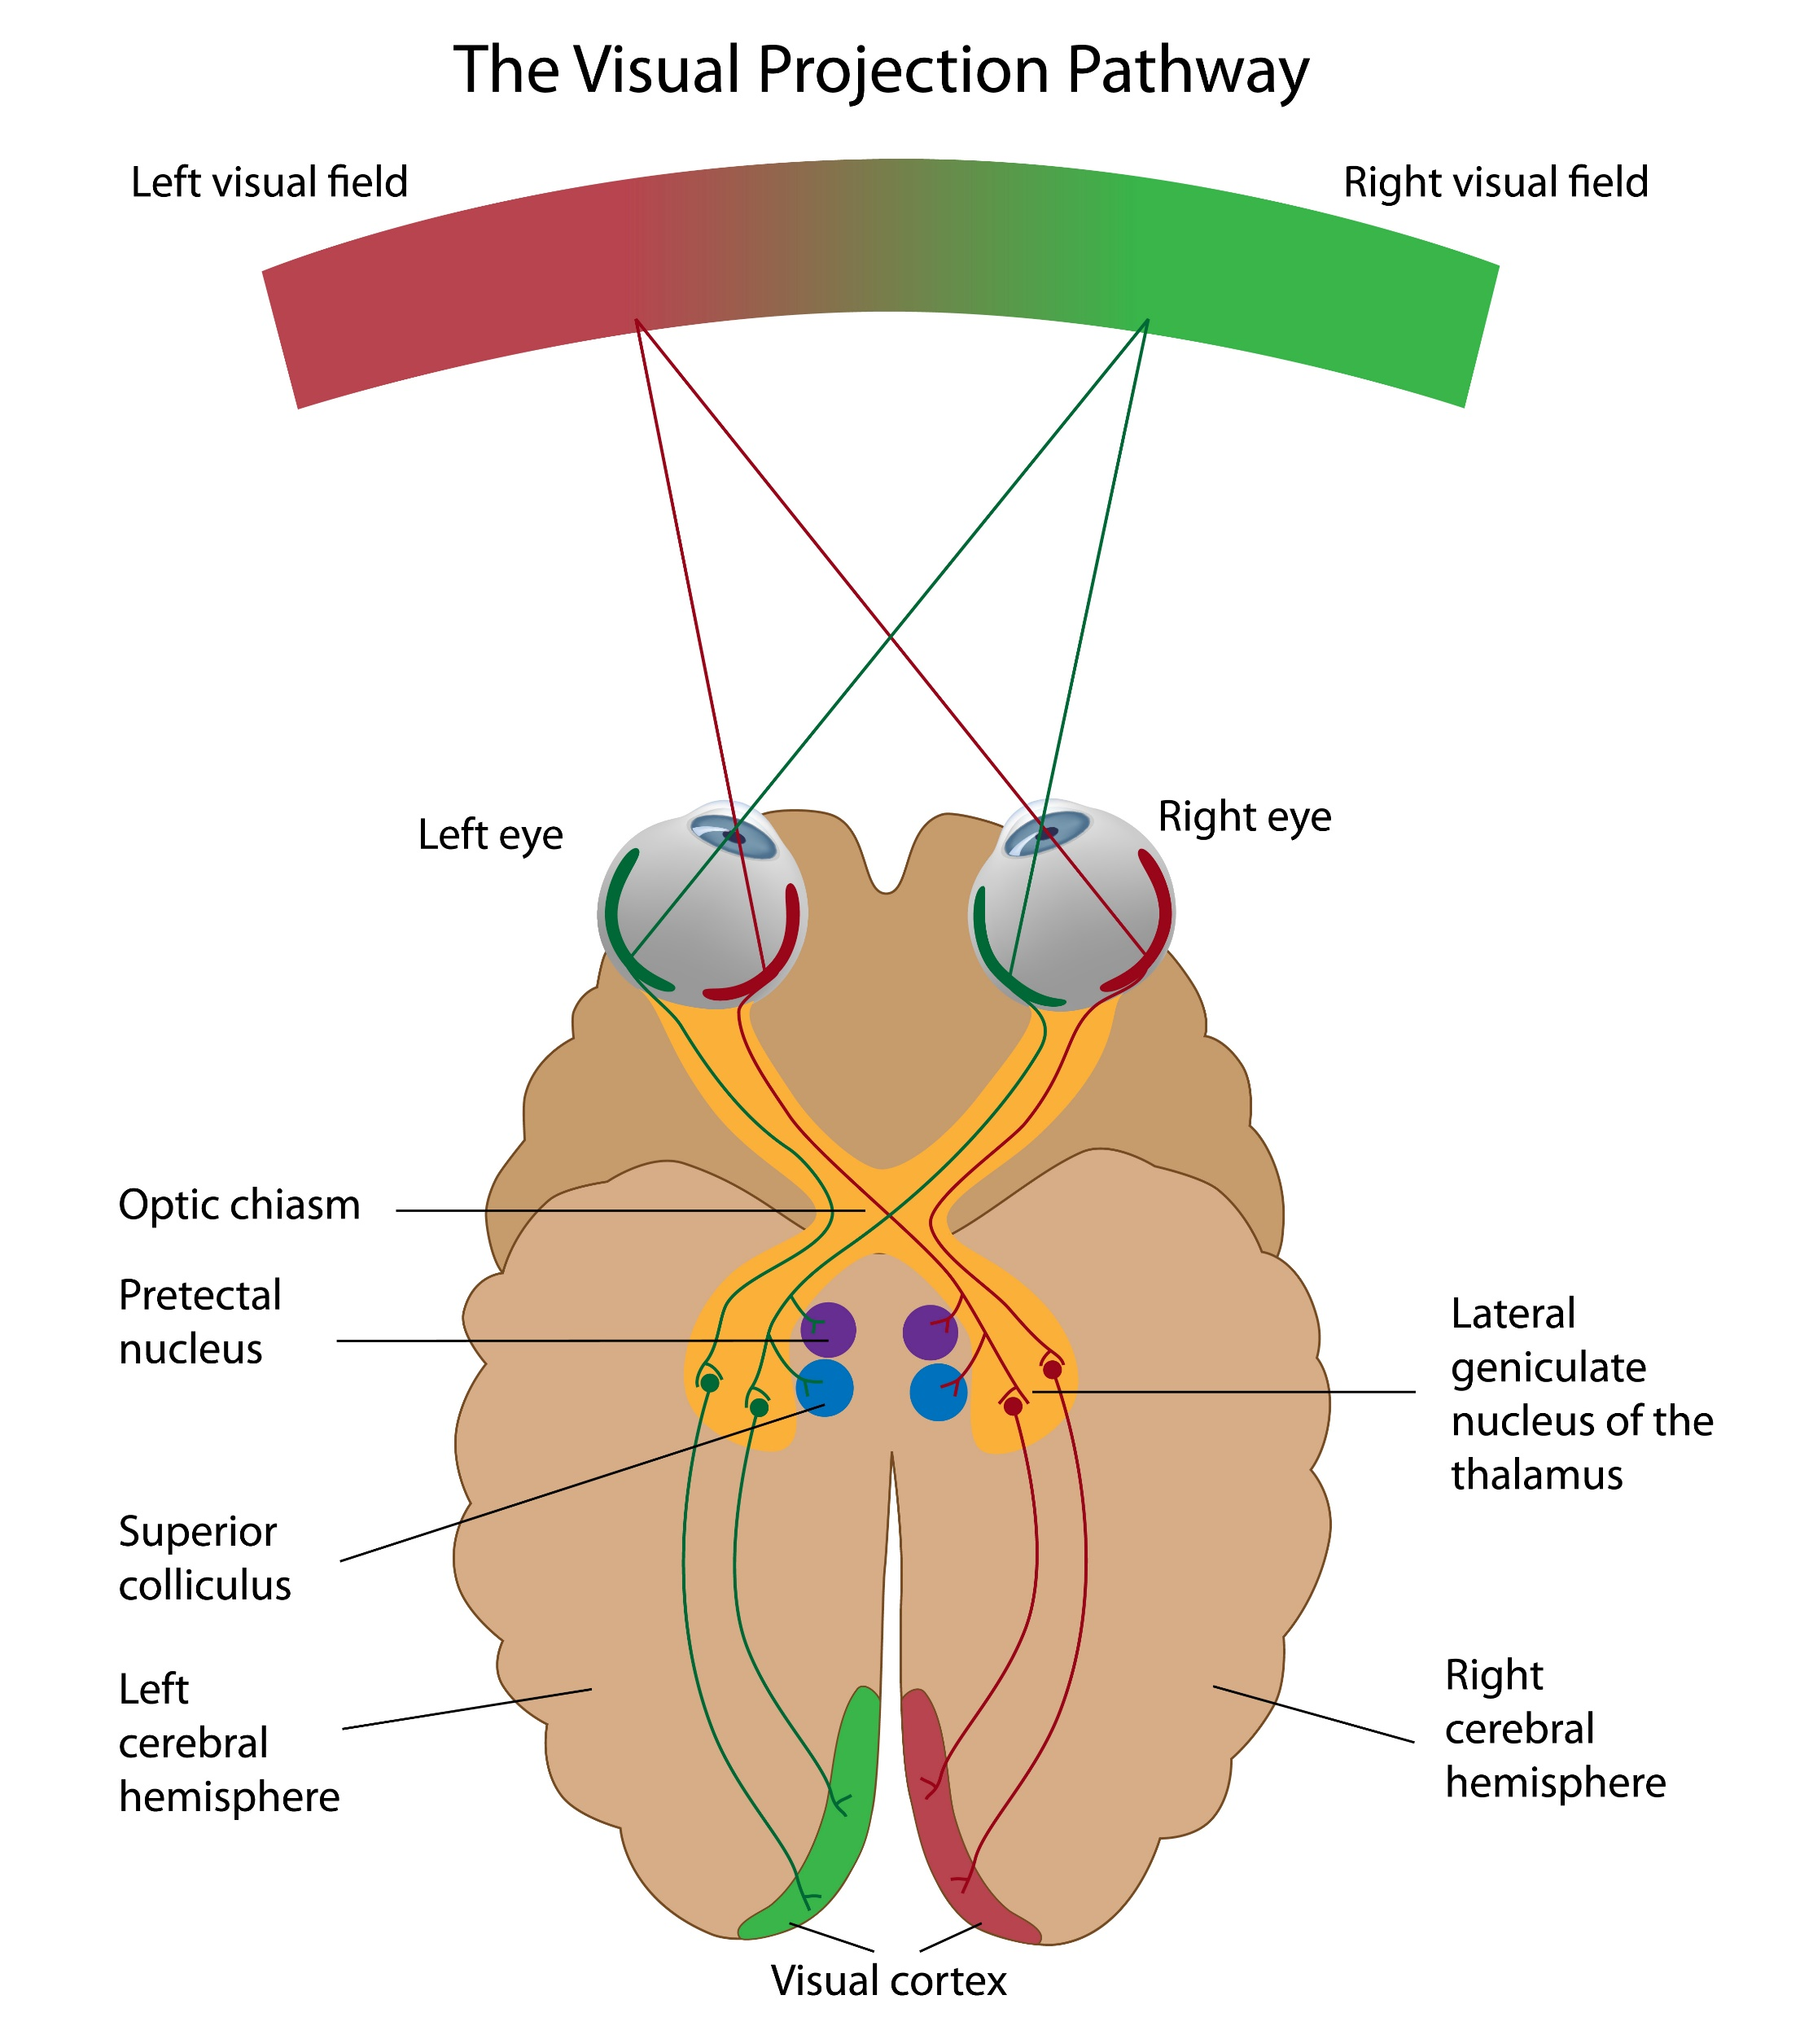
Use both eyes to perceive depth – “depth perception”
Nasal (medial) optic fibers cross at the optic chiasm
Temporal (lateral) fibers do not cross over

Slide 73
Each visual cortex (R &L) receives information from both eyes so it can compare what each eye sees.

Slide 74
https://www.youtube.com/watch?v=R4SYxTecL8E

Slide 75
Retina
https://www.youtube.com/watch?v=-zzRamRKKdc

Slide 76
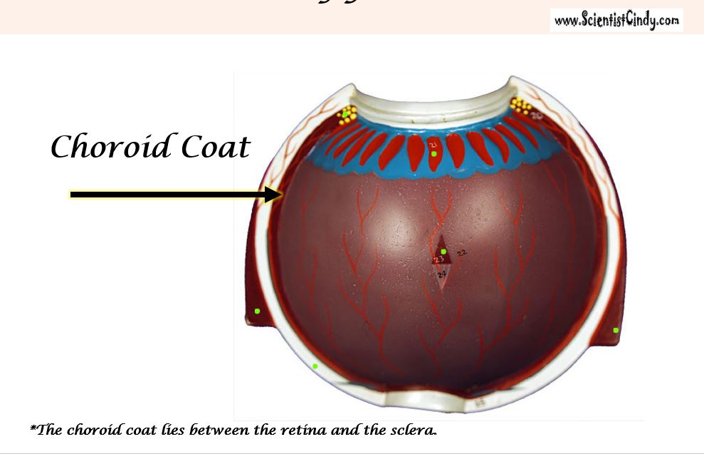
The choroid coat is a highly-vascularized layer of connective tissue that surrounds the eye. The choroid coat lies between the retina and the sclera. The function of the choroid coat is to provide oxygen and nourishment to the retina.

Slide 77
The Retina
The word 'retina' comes from the Latin word for 'net’.
The retina is the innermost layer located at the back of the eye.
The function of the retina is hold the photoreceptors.
The photoreceptors contain pigments that change shape when light hits them.

Slide 78
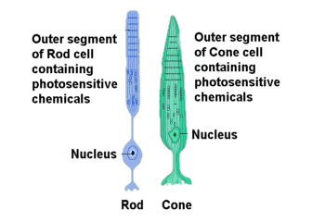
There are two types of photoreceptors; rods and cones.
Photoreceptors convert visual information into action potentials (nerve impulses) that will travel to the brain via the optic nerve.

Slide 79
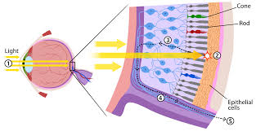
Rods are photo receptors that respond to levels of light (shades of black and white) and do not process any color information.
The rods make up the major portion of your peripheral vision and are very useful in low-light situations, such as driving at night.

Slide 80
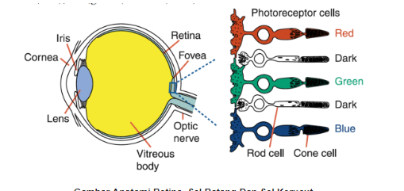
Your cones, however are able to process color information.
Cones dominate the central portion of your vision which focuses on the fovea.

Slide 81
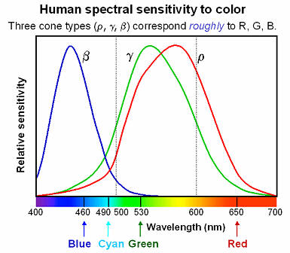
You have 3 types of cones, each specializing in either the RED, GREEN or BLUE, electromagnetic waves of the visible spectrum. -The combination of stimulation of these 3 cone types are able to give you all of the colors you see!

Slide 82
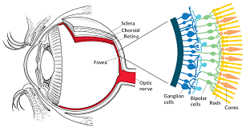
Layers of the Retina photoreceptors, bipolar cells and ganglion cells

Slide 83
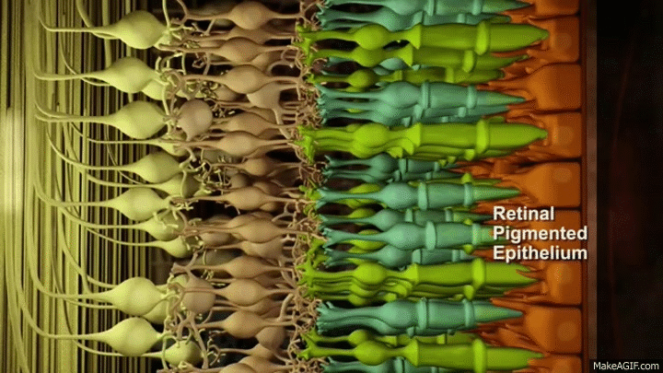
The optic nerve is made up of axons of the ganglion cells that make up the last layer of the retina.

Slide 84
The Optic Nerve
The visual information is gathered by the photoreceptors (the sensory cells of the retina), and processed and sent through the layers of the retina. The outermost part of the retina is made up of ganglion cells.
The axons of the ganglion cells make up the optic nerve.
The optic nerve functions to send the visual sensory information from the retina to the brain.

Slide 85
The point at which the optic nerve leaves the eye (globe) it forms the optic disc.
The optic disc is devoid of photoceptor so it forms our blind spot.

Slide 86
The Optic Disk
The point at which the axons of the ganglion cells leave the eye to form the optic nerve, is called the Optic Disc.
The Optic Disc is essentially a pathway from the eye to the brain.
This pathway is devoid of photoreceptors and creates a small "blind spot" in our visual field that we are normally completely unaware of!

Slide 87
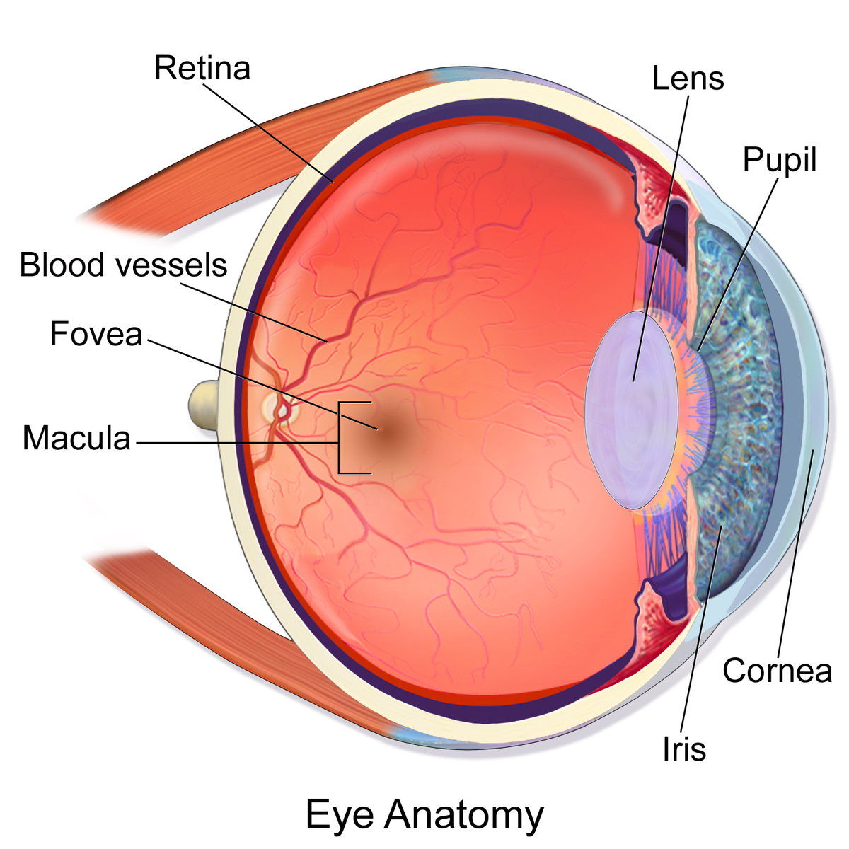
The center of your field of vision is the most clear. This is due to a part of the retina called the Fovea Centralis (which lies within a slightly larger region called the Macula Lutea)

Slide 88
The Fovea Centralis has the highest concentration of cones (cells that code for colored vision) than anywhere else in the retina.

