Slide 1
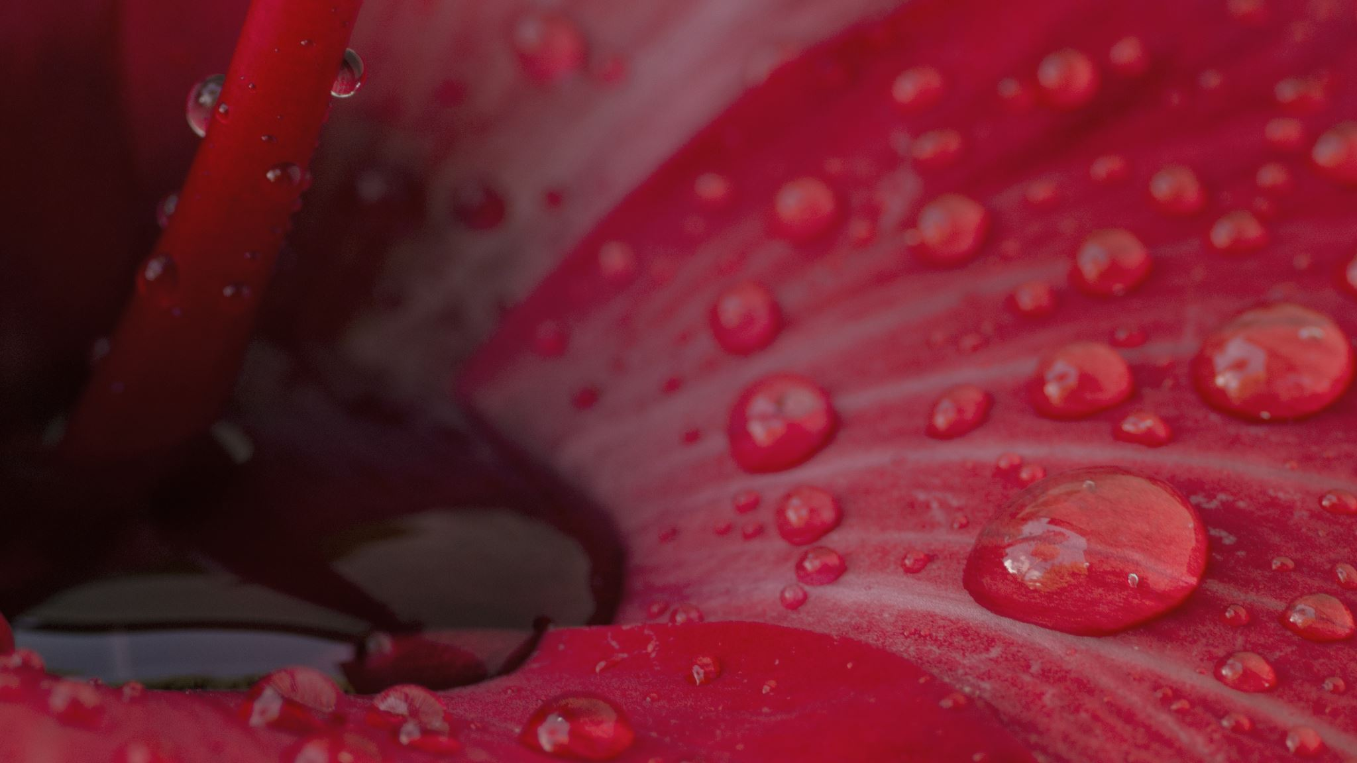
Spectroscopy
Physiology - Chemistry lab

Slide 2
SPECTROSCOPY
A spectrophotometer is an instrument that measures the amount of photons (the intensity of light) absorbed after it passes through sample solution.
With the spectrophotometer, the amount of a known chemical substance (concentrations) can also be determined by measuring the intensity of light detected.

Slide 3
Spectrophotometry
Measures how much a chemical substance absorbs light.
Each compound absorbs light over a certain range of wavelength.
This measurement can also be used to measure the amount of a known chemical substance.

Slide 4
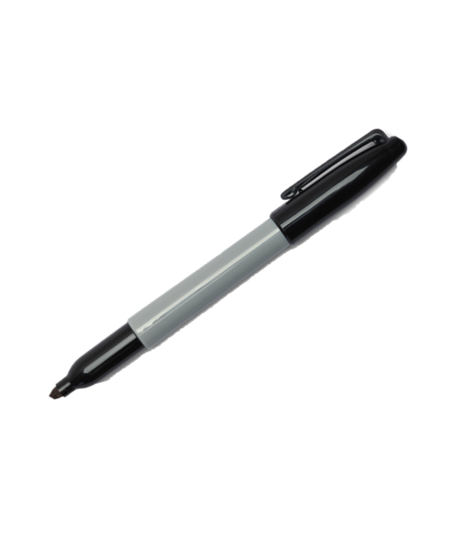
Getting Set Up…
Turn on your spectrophotometer to allow it to warm up.
ii. Obtain 3 test tubes and label them with a wax pen
1. B for blank
2. U for unknown glucose solution
3. S for standard
S
B
U

Slide 5
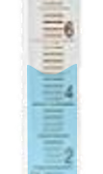
Add Glucose Reagent
Measure using the bottom of the meniscus!
iii. Add 5mL of glucose reagent to each tube using a graduated cylinder.
S
B
meniscus
U

Slide 6
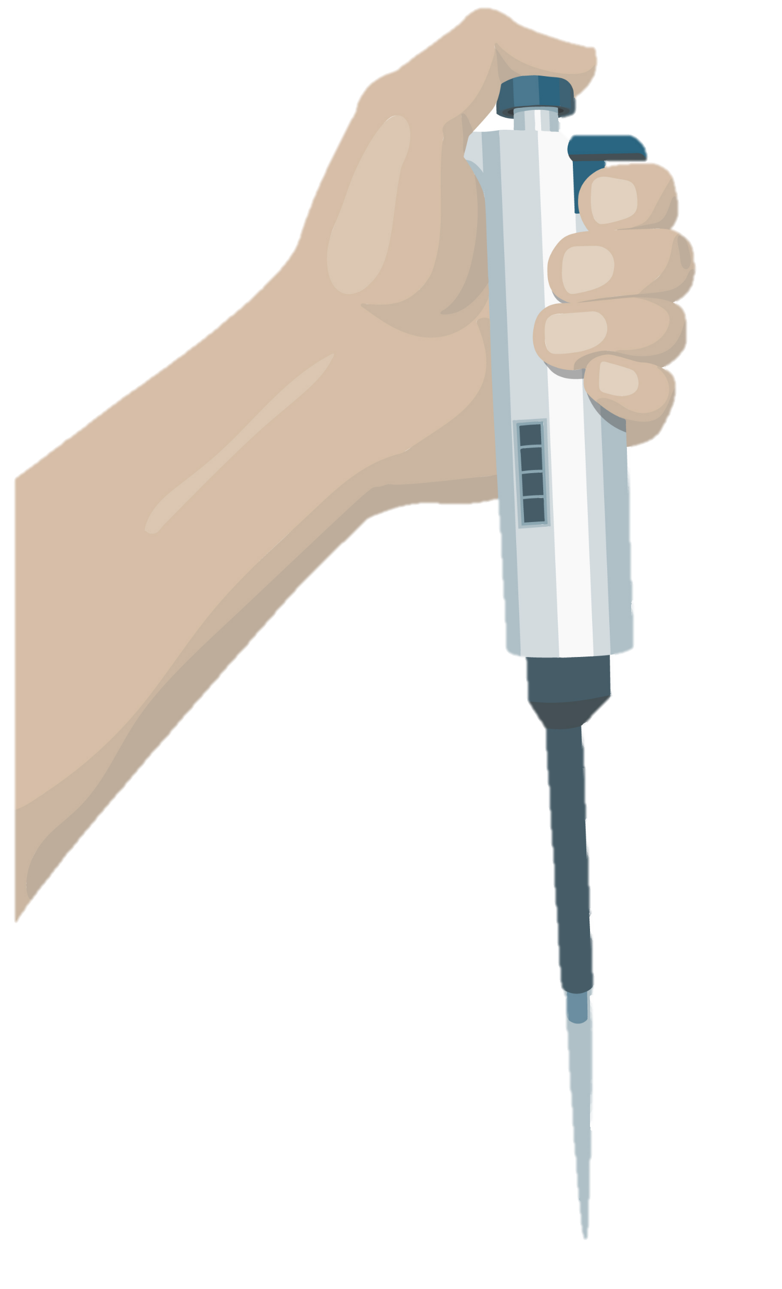
Add DI Water to the BLANNK test tube ONLY!
iv. Add 50μL of DI water to the BLANK test tube using a microliter pipet.
Mix well.
S
B
U

Slide 7
Add the GLUCOSE STANDARD to the STANDARD test tube ONLY!
v. Add 50μL of glucose standard to the STANDARD test tube.
Mix well.
Look at the bottle and record the glucose concentration.
S
B
U

Slide 8
Add the UNKNOWN GLUCOSE SOLUTION to the UNKNOWN test tube ONLY!
vi. Add 50μl of the unknown glucose solution to the UNKNOWN
test tube.
Mix well.
S
B
U

Slide 9
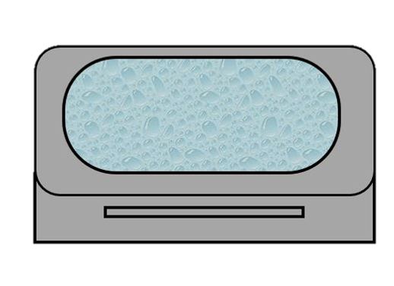
vii. Incubate each test tube for 20min in the water bath .
B
S
U

Slide 10
Label 3 cuvettes (B, U, S) as you are waiting.
S
B
U

Slide 11
NEXT STEPS…
After the incubation period, pour the contents of each test tube into the APPROPRIATE cuvette.
Measure the absorbance of the standards and unknown solutions.
Don’t forget to mix the solutions before measuring the absorbance.

Slide 12
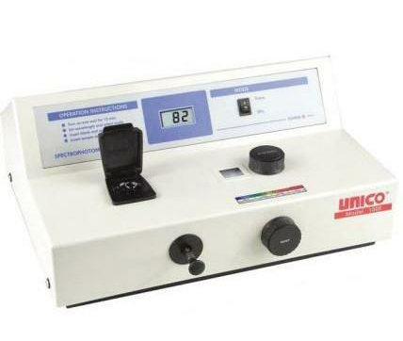
Measure the absorbance
ix. Set the wavelength of the spectrophotometer to 500nm.
x. Blank the spectrophotometer.
Don’t forget to mix the solution
before you measure the absorbance.
xi. Measure the absorbance of the standard and unknown
solutions.
Don’t forget to mix the solutions before measuring the
absorbance.

Slide 14
Albumin Concentration of an Unknown
Obtain 7 fresh test tubes and LABEL:
B for blank (DI water)
U for unknown albumin solution
2 for 2g/dl albumin standard
4 for 4g/dl albumin standard
6 for 6g/dl albumin standard
8 for 8g/dl albumin standard
10 for 10g/dl albumin standard
B
2
8
U
4
6
10

Slide 15
Measure using the bottom of the meniscus!
Add 5mL of Biuret reagent to each tube using a graduated cylinder.
B
2
8
U
4
6
10
meniscus

Slide 16
Add 50ul of the indicated solutions below, using a pipette
B for blank (DI water)
U for unknown albumin solution
2 for 2g/dl albumin standard
4 for 4g/dl albumin standard
6 for 6g/dl albumin standard
8 for 8g/dl albumin standard
10 for 10g/dl albumin standard
2
8
B
U
4
6
10

Slide 17
Incubate
Incubate 10 min and label 7 cuvettes as follows:
B for blank (DI water)
U for unknown albumin solution
2 for 2g/dl albumin standard
4 for 4g/dl albumin standard
6 for 6g/dl albumin standard
8 for 8g/dl albumin standard
10 for 10g/dl albumin standard
2
8
B
U
4
6
10

Slide 18
NEXT STEPS…
Transfer the solutions into the proper cuvettes
Measure the absorbance of the standards and unknown solutions.
Don’t forget to mix the solutions before measuring the absorbance.

Slide 19
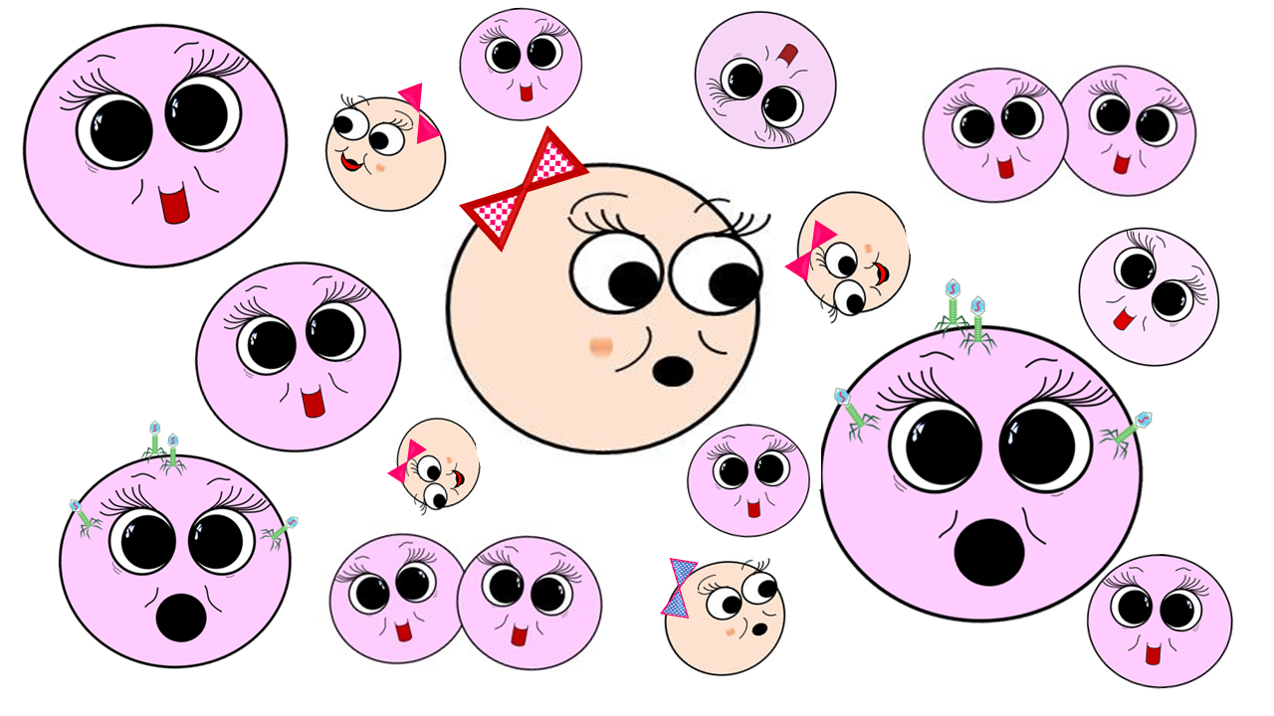
Concentration = Absorbance / Slope
From the slope of the best-fit line together with the absorbance, you can now calculate the concentration for that solution (i.e. Concentration = Absorbance / Slope)
EXAMPLE: To find the concentration for your UNKNOWN solution that has an absorbance of 0.975, you will first need to find the slope of the BEST-FIT line.

Slide 20
11. Create a standard curve and determine the albumin concentration of the unknown.

Slide 21
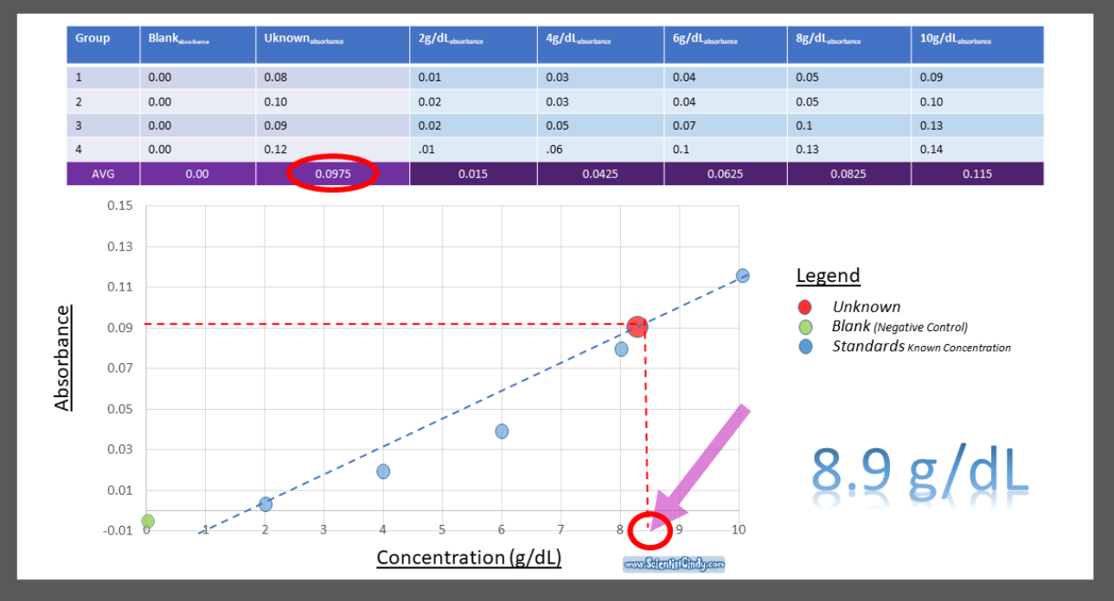

Slide 22
1. Prepare a scatter plot of the data on graph paper.
2. Draw a straight line on the graph so that each of the plotted points are as close to the line as possible.

Slide 23
2. Draw a straight line on the graph so that each of the plotted points are as close to the line as possible

Slide 24
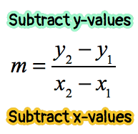
Calculate the Slope
POINT
1
(X_{1,} Y₁) = . (1, 0.08)
POINT
2
(X_{2,} Y₂) = (7, 0.07)
3. Find ANY two points that you think will be on the "best-fit" line to calculate the slope.
Record the X,Y coordinates for these two points on the line.
FOR EXAMPLE: Let’s say these 2 points were located on your best-fit line. (X_{1,} Y₁) = . (1, 0.08) and (X_{2,} Y₂) = (7, 0.07).
Calculate the slope of the line through your two points (rounded to five decimal places).
Y₂ = . 0.07
Y₁ = . 0
X_{1,} = . 1
X_{2,} = . 7
$$m=\frac{0.07 −0.08}{7 −1}$$
$m=\frac{0.01}{6}$ = 0.00167
Slope Formula →

Slide 25
6. Write the equation of the line.
Use the point intercept form of the equation of a line.
EXAMPLE:
We will use the point we used to calculate the slope → (X_{1,} Y₁) = . (1, 0.08)
We will use the slope we calculated as (m) in the equation. → m = 0.00167
Plug in the values for x₁ , y₁ and m.
ISOLATE Y
$y −y1$ $=m(x −x1)$
$$y −0.08=0.0167(x −1)$$
$$y =0.0167 \left(x −1\right)+0.08$$
This is the formula for your line!

Slide 26
Calculate the Concentration!
From the slope of the best-fit line together with the absorbance, you can now calculate the concentration for that solution (i.e. Concentration = Absorbance / Slope)
C$oncentration(unknown)=\frac{Absorbance (unknown)}{Slope}$
C$oncentration(unknown)=\frac{0.975}{0.00167}$
$Absorbance (unknown)$ $=0.975$
$$Slope=0.00167$$
C$oncentration=583.832\frac{g}{dl}$

Slide 27
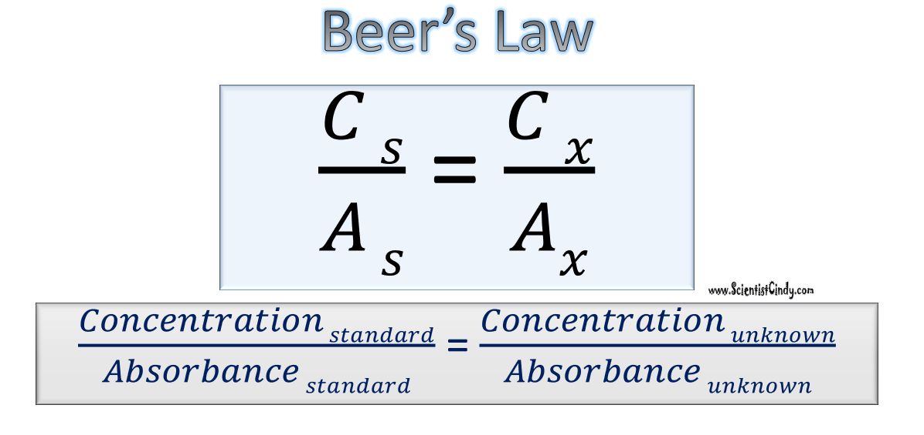
Use Beer’s Law to Confirm Your Answer

Slide 28
Use Beer’s Law to Confirm Your Answer
Pick one of the samples of Albumin with a KNOWN concentration.
The sample having the KNOWN concentration of 2 g/dl had an absorbance measuring 0.015.
The sample with the UNKNOWN concentration of 2 g/dl had an absorbance measuring 0.0975.
Sample
Absorbance
$$\frac{2 }{0.015 }=\frac{Concentration (unknown)}{0.0975}$$

Slide 29
$$\frac{2 }{0.015 }=\frac{Concentration (unknown)}{0.0975}$$
$\frac{\left(0.0975\right)(2) }{0.015 }=$ $Concentration (unknown)$
$$\frac{0.195}{0.015 }=Concentration (unknown)$$
13 g/dl$=Concentration (unknown)$

