Slide 1
The Chemical Components of Cells

Slide 2
In this lab we will
Test for STARCH
Test for SUGARS
Test for PROTEIN

Slide 3
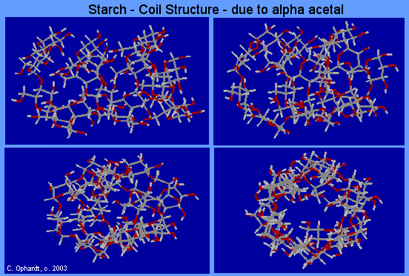
Starch
Plants store glucose as the polysaccharide starch.
The cereal grains (wheat, rice, corn, oats, barley) as well as tubers such as potatoes are rich in starch.
Starch can be separated into two fractions--amylose and amylopectin. Natural starches are mixtures of amylose (10-20%) and amylopectin (80-90%).

Slide 4
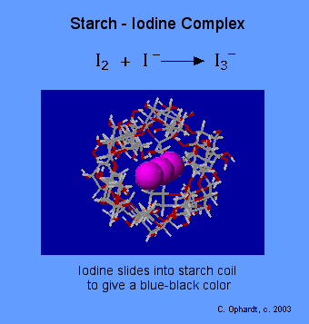
ACTIVITY #1 - Starch
Chemical Test for Starch:
Amylose in starch is responsible for the formation of a deep blue color in the presence of iodine.
The iodine molecule slips inside of the amylose coil.
Iodine - KI Reagent: Iodine is not very soluble in water, therefore the iodine reagent is made by dissolving iodine in water in the presence of potassium iodide. This makes a linear triiodide ion complex with is soluble. The triiodide ion slips into the coil of the starch causing an intense blue-black color.

Slide 5
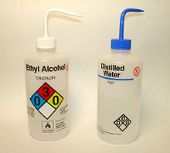
ACTIVITY 1 MATERIALS
Wash Bottle
3 test tubes
Test tube rack
Wash Bottle of Distilled Water labeled “DW”
Dropper Bottle of 1% Glucose (sugar)
Dropper Bottle of 1% Starch (amylose)
Dropper Bottle of Distilled Water (DW)
KI solution (potassium iodide)
Benedict’s reagent
Dropper Bottle

Slide 6
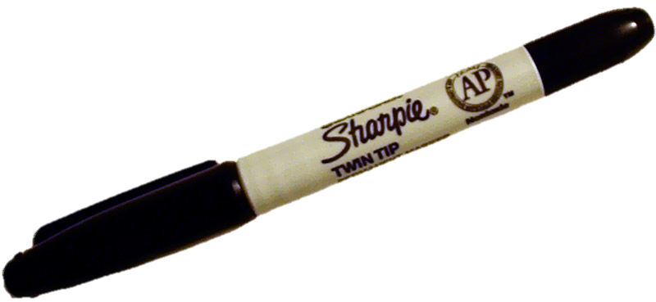
First - Label 3 test tubes with a SHARPIE as shown
Test for PROTEIN
Test for STARCH
Test for SUGARS
DW
SUGAR
STARCH

Slide 7
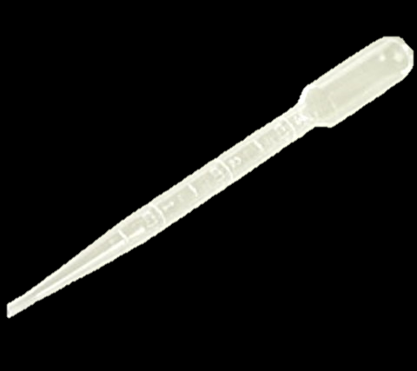
Step 2 – Add 5 DROPS of KI to each tube
KI
KI
KI
KI is Potassium Iodide
Add drops using a
disposable pipette
DW
STARCH
SUGAR

Slide 8
Step 3a – Add 5 DROPS of DW in the DW tube ONLY
Add 5 DROPS of DW in the DW tube ONLY!
DW
DW

Slide 9
Step 3b – Add 5 DROPS of 1% glucose (sugar) in the SUGAR tube ONLY
Add 5 DROPS of 1% glucose (sugar) in the SUGAR tube ONLY.
SUGAR
1%
GLUCOSE
(SUGAR)

Slide 10
Step 3c – Add 5 DROPS of 1% amylose (starch) in the STARCH tube ONLY
Add 5 DROPS of 1% amylose (starch) in the STARCH tube ONLY.
STARCH
1%
AMYLOSE
(STARCH)

Slide 11
Gently shake and see if the color changes!
The color change to
DEEP BLUISH BLACK
Means that tube has
STARCH in it!
DW
STARCH
SUGAR

Slide 12
Starch is indicated by a Color Change to Deep Blue
Amylose in starch is
responsible for the
formation of a deep
blue color in the
presence of iodine.
DW
SUGAR
STARCH

Slide 13
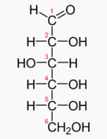
ACTIVITY #2 – TEST FOR SUGAR

Slide 14
NEXT →TEST FOR SUGAR!
GET 3 NEW CLEAN TUBES
Label as shown here →
DW
SUGAR
STARCH

Slide 15
Step 2 – Add 10 DROPS of BENEDICT’S SOLUTION to each tube
KI
KI
KI
KI is Potassium Iodide
Add drops using a
disposable pipette
DW
STARCH
SUGAR

Slide 16
Step 3a – Add 10 DROPS of DW in the DW tube ONLY
Add 10 DROPS of DW in the DW tube ONLY!
DW
DW

Slide 17
Step 3b – Add 10 DROPS of 1% glucose (sugar) in the SUGAR tube ONLY
Add 10 DROPS of 1% glucose (sugar) in the SUGAR tube ONLY.
SUGAR
1%
GLUCOSE
(SUGAR)

Slide 18
Step 3c – Add 10 DROPS of 1% amylose (starch) in the STARCH tube ONLY
Add 10 DROPS of 1% amylose (starch) in the STARCH tube ONLY.
STARCH
1%
AMYLOSE
(STARCH)

Slide 19
Gently shake and place CAREFULLY in boiling water for 10 minutes
DW
STARCH
SUGAR
SUGAR

Slide 20
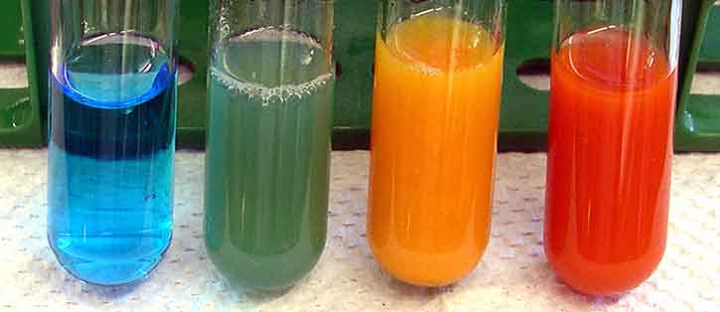
If the solution changes from bluish (the color of the Benedict’s Solution) to GREEN, RED, YELLOW or ORANGE, that sample has SUGAR!
Benedict's test will detect the presence of
aldehydes, and alpha-hydroxy-ketones.
Thus, although the ketose fructose is not strictly a
reducing sugar, it is an alpha-hydroxy-ketone, and
gives a positive test because it is converted to the
aldoses glucose and mannose by the base in the reagent.
DW
STARCH
SUGAR
SUGAR

Slide 21
The Benedict’s Test for Sugar
When reducing sugars are heated in the presence of an alkali, they get reduced the cupric ions (Cu²⁺) present in the Benedict's reagent to cuprous ions (Cu⁺) which get precipitated as insoluble red copper(I) oxide(Cu₂O).
DW
STARCH
SUGAR
SUGAR

Slide 22
If the solution changes that sample has SUGAR!
The color of the obtained precipitate gives an idea about the quantity of sugar present in the solution, hence the test is semi-quantitative.
GREEN = ~ 0.5 g% concentration;
YELLOW = ~ 1 g% concentration;
ORANGE = ~ 1.5 g%
RED = ~ 2 g% or higher concentration.
COLOR CHANGE
GREEN
YELLOW
ORANGE
RED
DW
STARCH
SUGAR
SUGAR

Slide 23
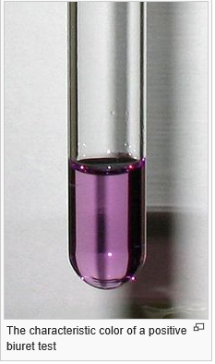
Activity #3 – Test for Protein
The biuret test is a for the presence of peptide bonds.
In the presence of peptides, a copper(II) ion forms violet-colored coordination complexes in an alkaline solution.
Image from https://en.wikipedia.org/wiki/Biuret_test

Slide 24
Activity #3 – Test for Protein
The Biuret reagent is made of sodium hydroxide (NaOH) and hydrated copper(II) sulfate, together with potassium sodium tartrate. Potassium sodium tartrate is added to complex to stabilize the cupric ions.
The reaction of the cupric ions with the nitrogen atoms involved in peptide bonds leads to the displacement of the peptide hydrogen atoms under the alkaline conditions which causes the color change.
Image from https://en.wikipedia.org/wiki/Biuret_test

Slide 25
Step 1 – Gather your Materials
Get 2 NEW CLEAN test tubes
Label one: PROTEIN
Biuret’s Solution
Biuret’s
1%
Gelatin
DW

Slide 26
Then label the 2 test tubes with a SHARPIE as shown
Label one: DW
Label one: PROTEIN
DW
PROTEIN

Slide 27
Step 2 – Add 10 DROPS of BIURET’S SOLUTION to each tube
Add drops using a
disposable pipette
Biuret’s
Biuret’s
DW
PROTEIN
Biuret’s

Slide 28
Step 3a – Add 5 DROPS of DW in the DW tube ONLY
Add 5 DROPS of DW in the DW tube ONLY!
DW
DW

Slide 29
Step 3b – Add 5 DROPS of 1% gelatin in the STARCH tube ONLY
Add 5 DROPS of 1% gelatin in the protein tube ONLY.
PROTEIN
1%
Gelatin

Slide 30
Wait 3 Minutes then Gently shake and see if the color changes!
The color change to
PURPLE
Means that tube has
PROTEIN in it!
DW
PROTEIN

