Slide 1
Tissues Study Guide
ANATOMY

Slide 2
Ciliated Pseudo-stratified Columnar Epithelium

Slide 3
Simple Cuboidal Epithelium

Slide 4
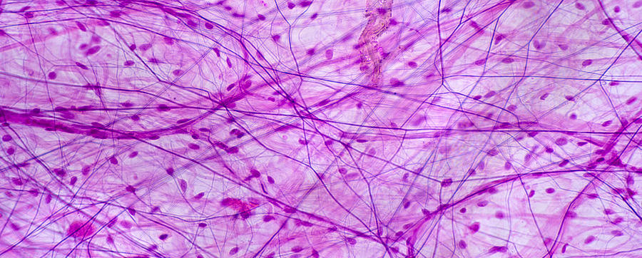
Areolar Connective Tissue

Slide 5
Transitional Epithelium

Slide 6
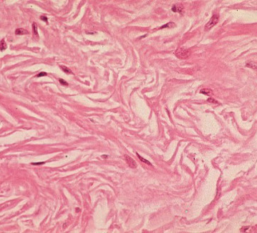
Dense Irregular Connective Tissue

Slide 7
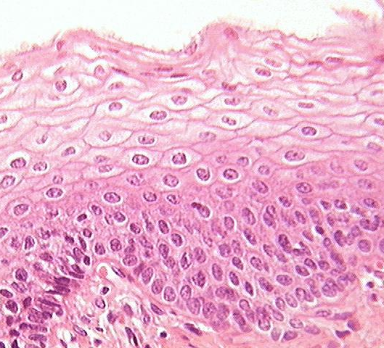
Stratified Squamous Epithelium

Slide 8
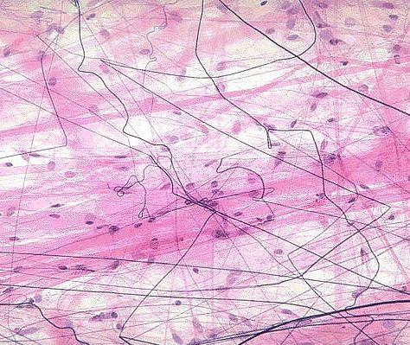
Areolar Connective Tissue

Slide 9
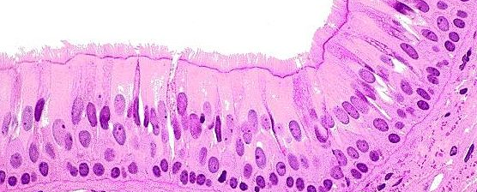
Ciliated Pseudostratified Columnar Epithelium

Slide 10
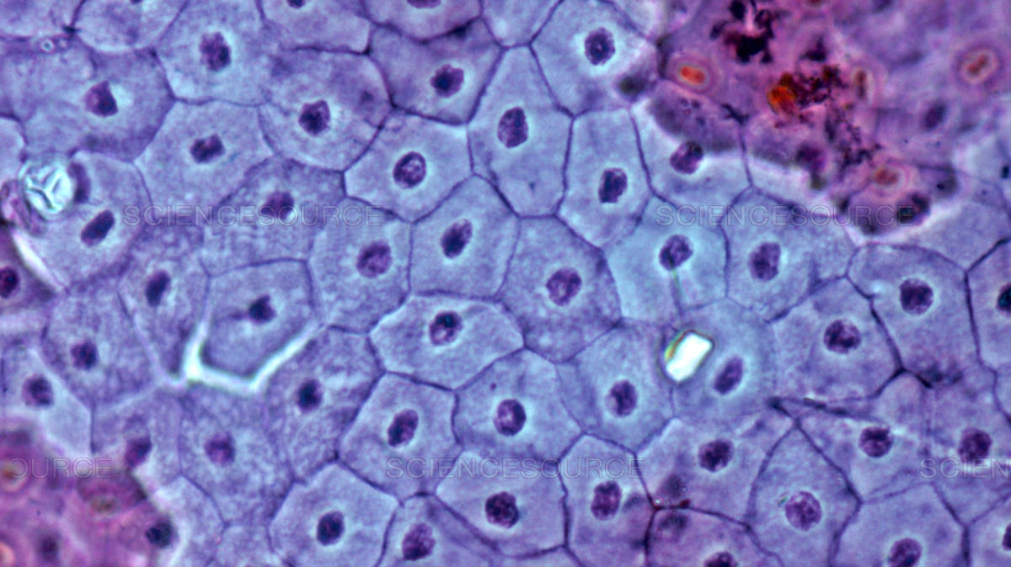
Simple Squamous Epithelial Tissue

Slide 11
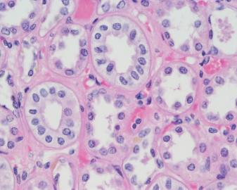
Simple Cuboidal Epithelium

Slide 12
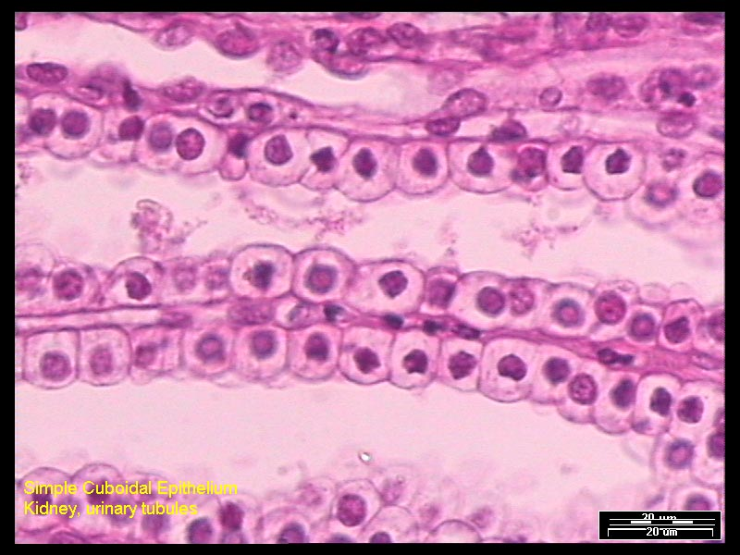
Simple Cuboidal Epithelium

Slide 13
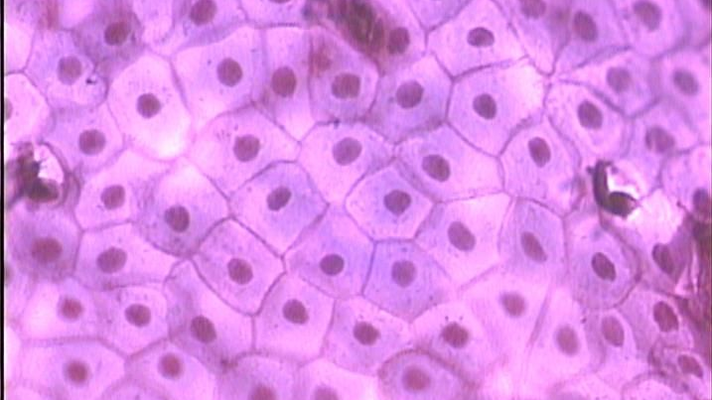
Simple Squamous Epithelial Tissue

Slide 14
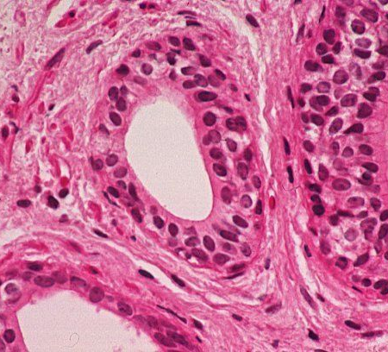
Stratified Cuboidal Epithelium

Slide 15
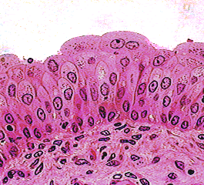
Transitional Epithelium

Slide 16
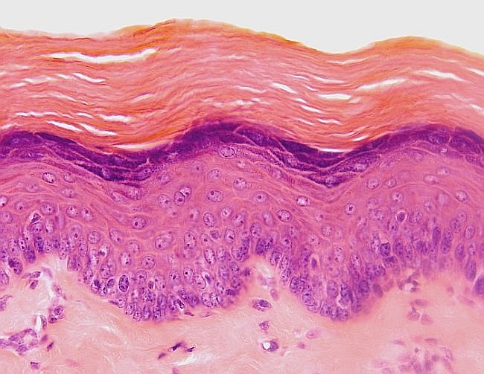
Keratinized Stratified Squamous Epithelium

Slide 17
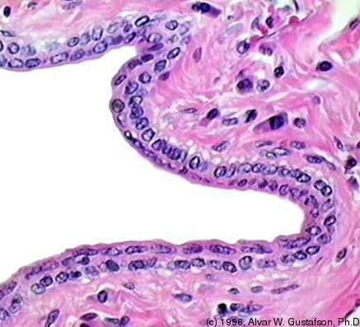
Stratified Cuboidal Epithelium

Slide 18
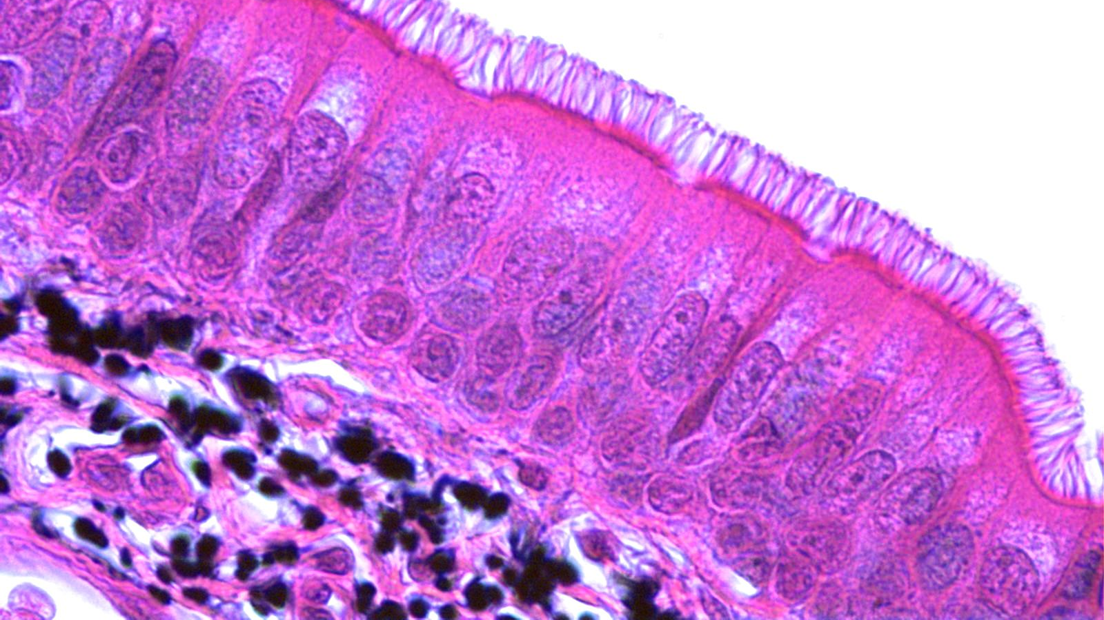
Ciliated Pseudostratified Columnar Epithelium

Slide 19
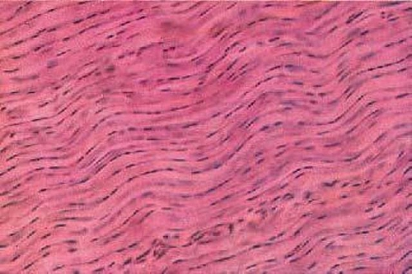
Dense Regular Connective Tissue

Slide 20
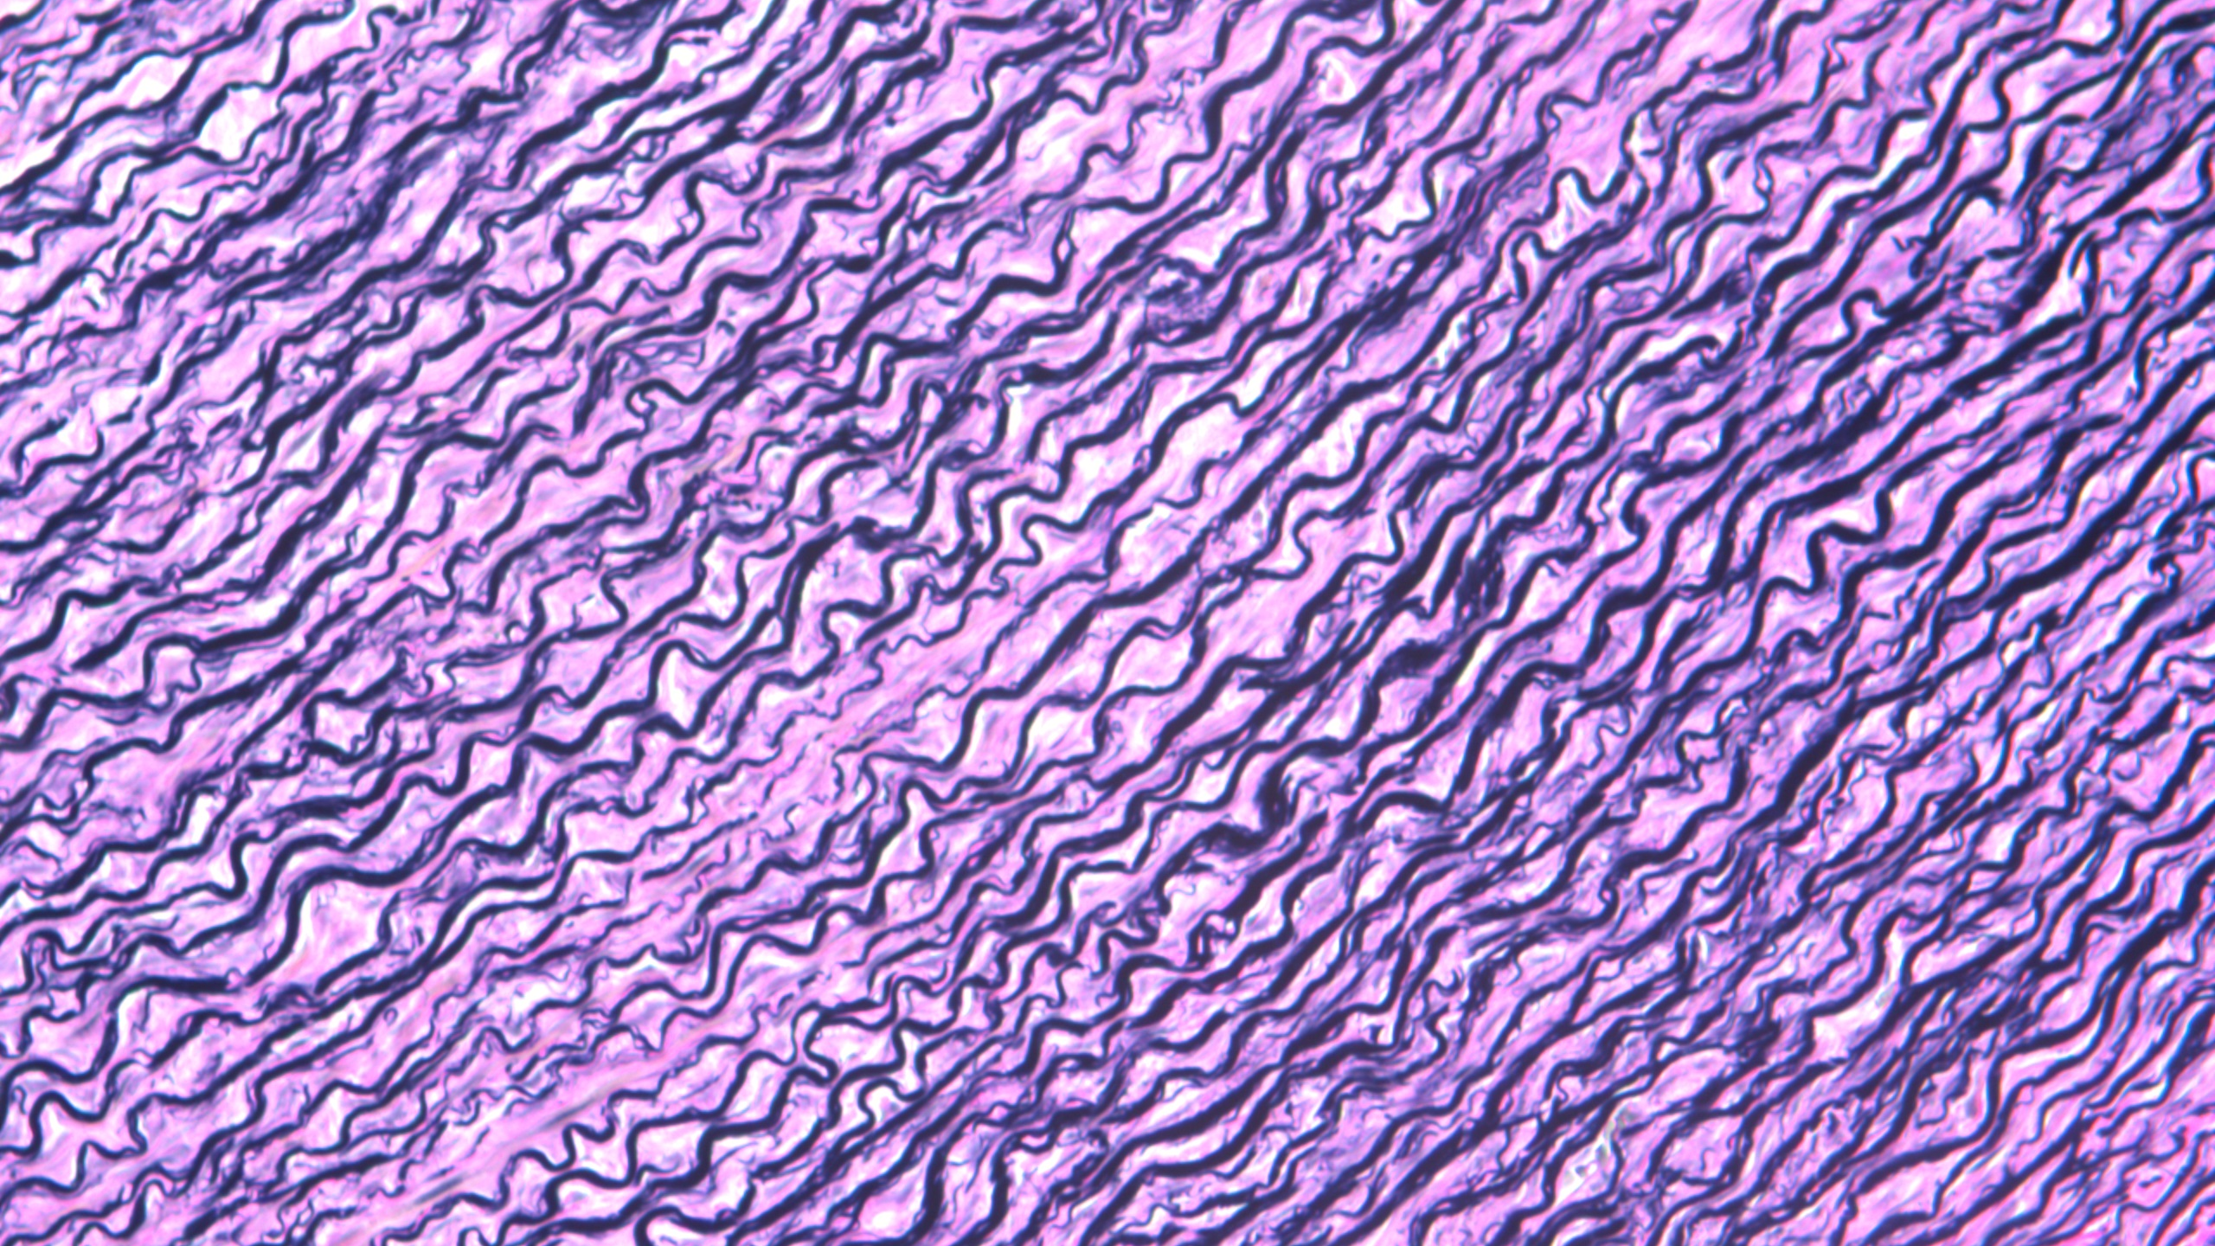
Elastic Connective Tissue

Slide 21
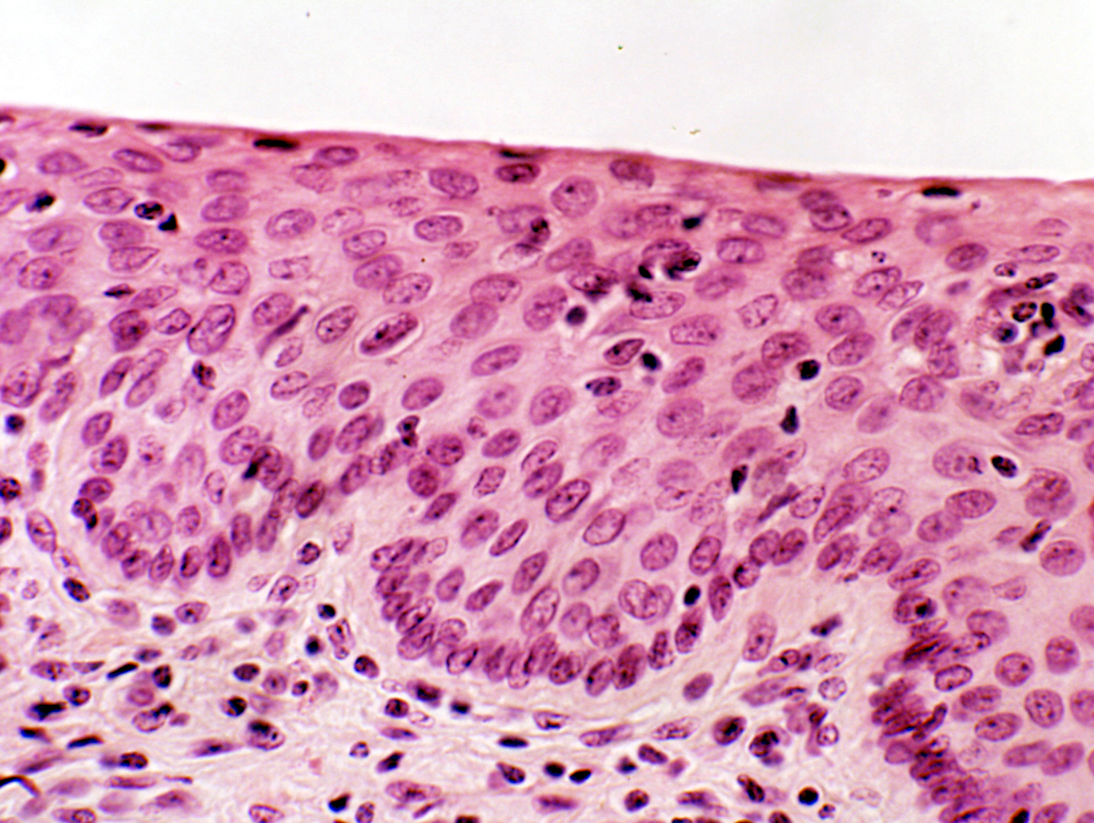
Stratified Squamous Epithelium

Slide 22
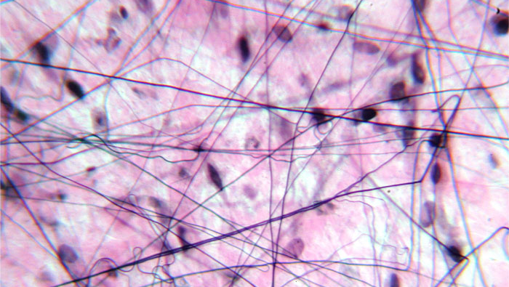
Areolar Connective Tissue

Slide 23
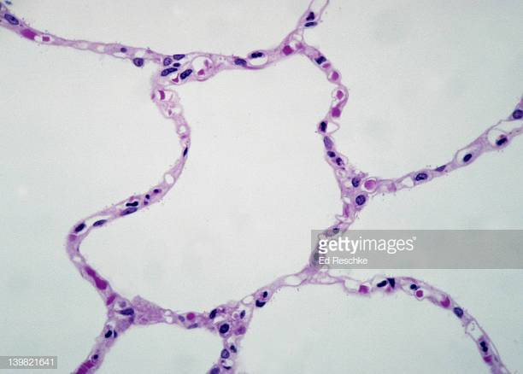
Simple Squamous Epithelial Tissue

Slide 24
Dense regular connective tissue

Slide 25
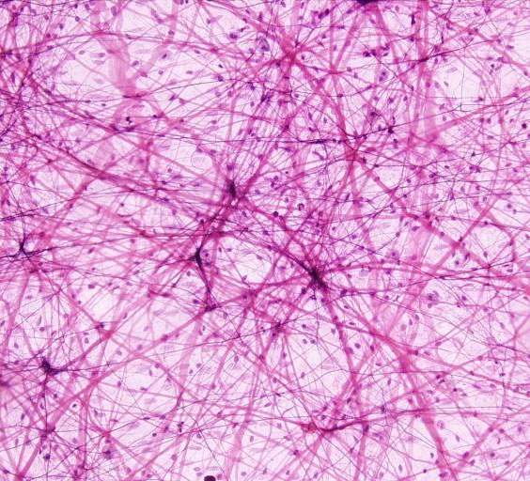
Areolar Connective Tissue

Slide 26
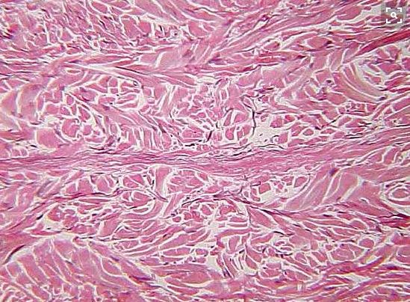
Dense Irregular Connective Tissue

Slide 27
Stratified Columnar Epithelium

Slide 28
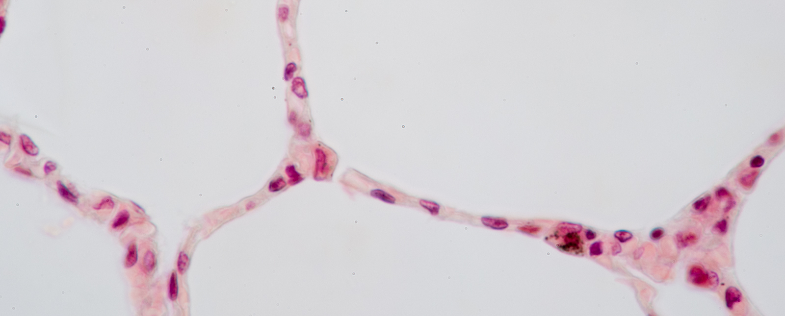
Simple Squamous Epithelial Tissue

Slide 29
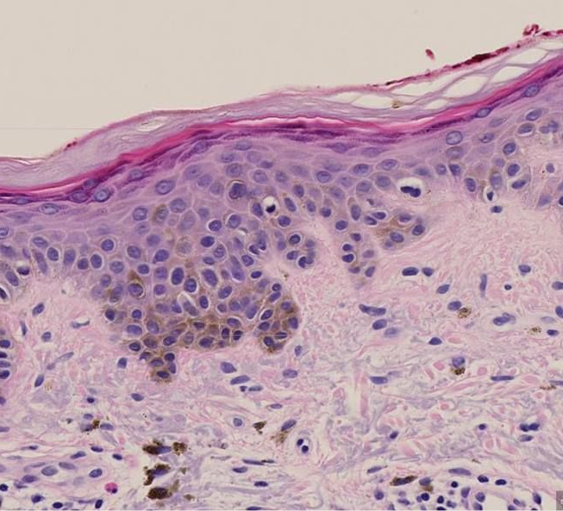
Keratinized Stratified Squamous Epithelium

Slide 30
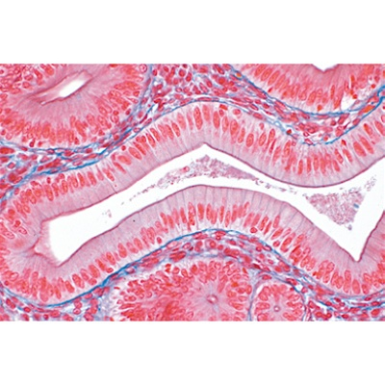
Simple Columnar Epithelium

Slide 31
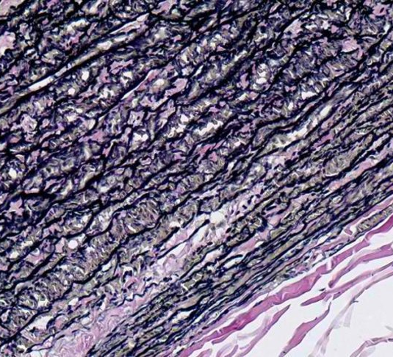
Elastic Connective Tissue

Slide 32
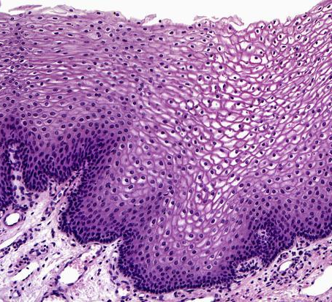
Stratified Squamous Epithelium

Slide 33
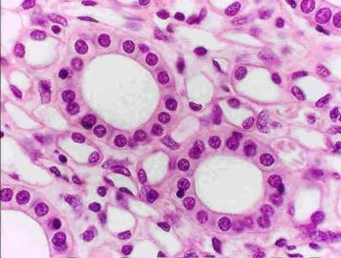
Simple Cuboidal Epithelium

Slide 34
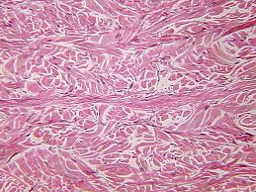
Dense Irregular Connective Tissue

Slide 35
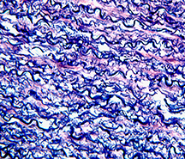
Elastic Connective Tissue

Slide 36
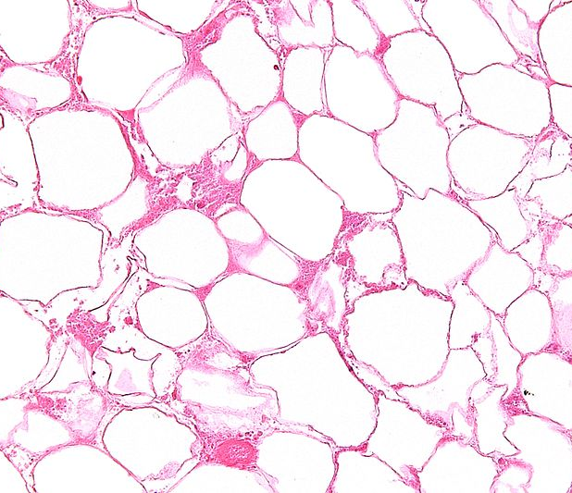
Adipose Tissue

Slide 37
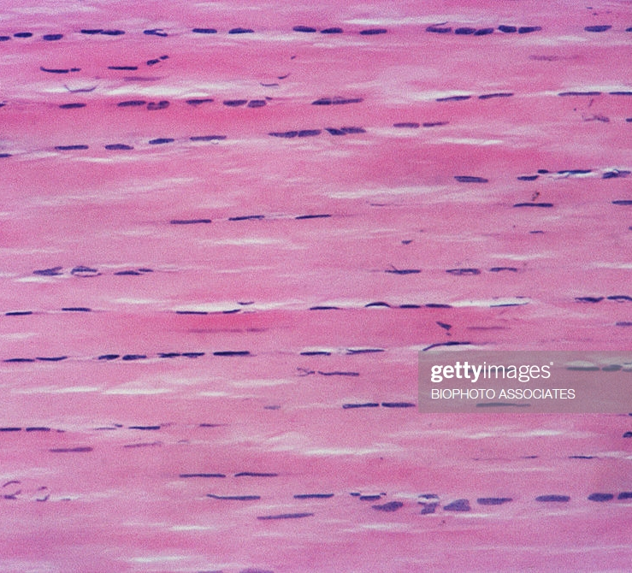
Dense Regular Connective Tissue

Slide 38
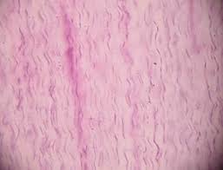
Dense Regular Connective Tissue

Slide 39
Dense Regular Connective Tissue

Slide 40
Ciliated Pseudostratified Columnar Epithelium

Slide 41
Reticular Connective Tissue

Slide 42
Adipose Tissue

Slide 43
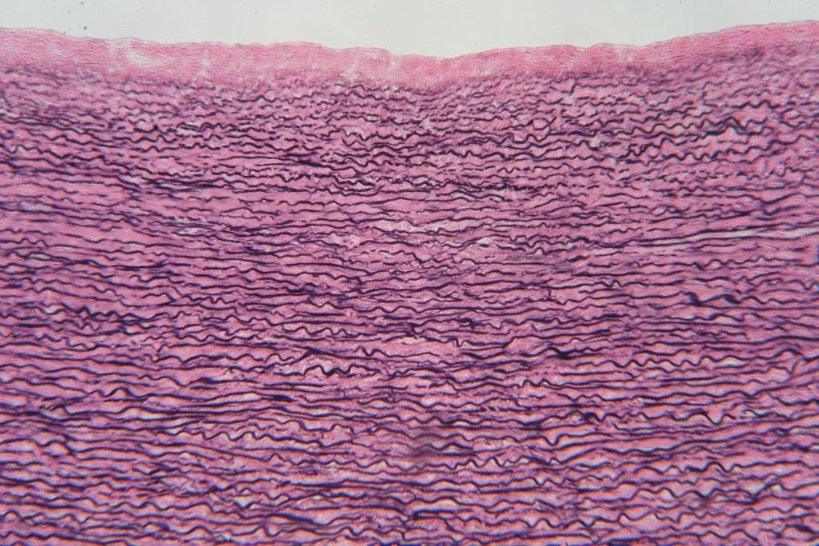
Elastic Connective Tissue

Slide 44
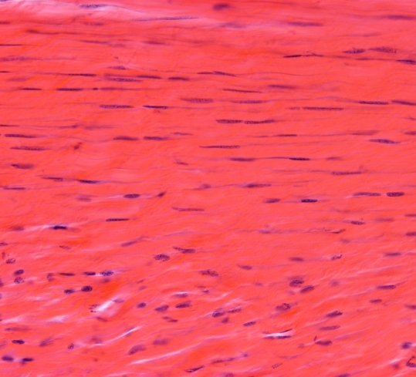
Dense Regular Connective Tissue

Slide 45
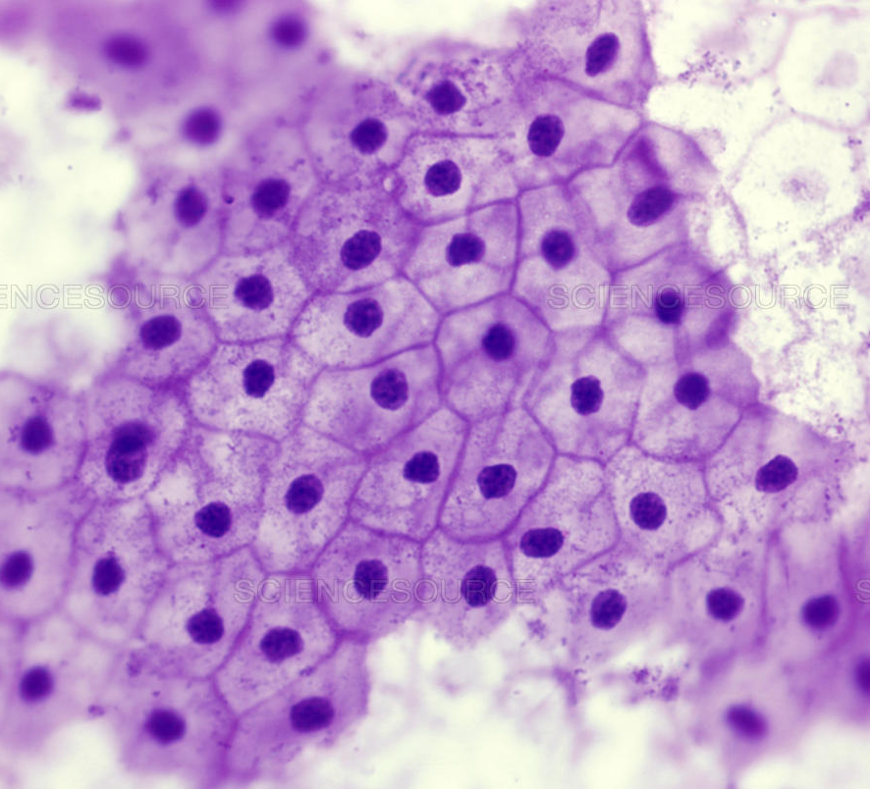
Simple Squamous Epithelial Tissue

Slide 46
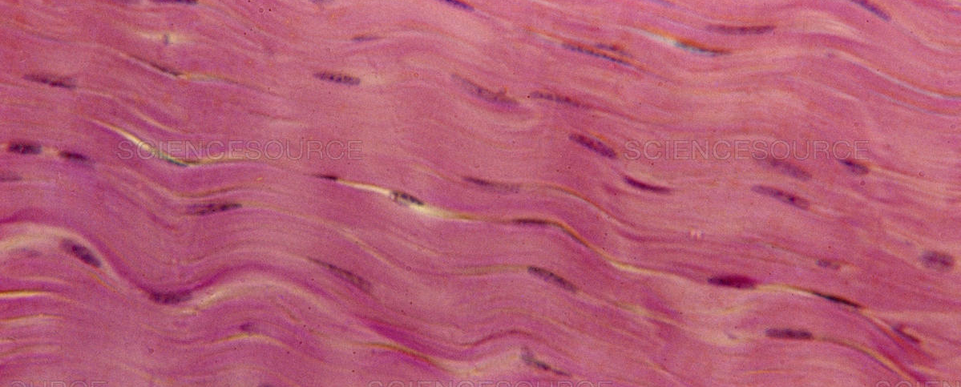
Dense Regular Connective Tissue

Slide 47
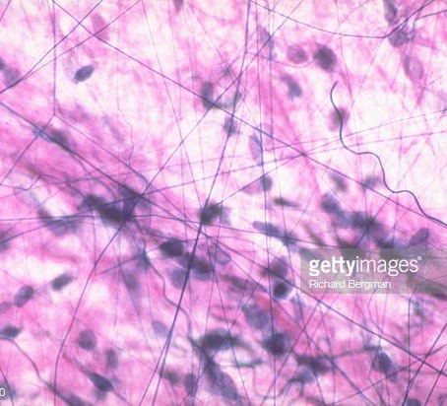
Areolar Connective Tissue

Slide 48
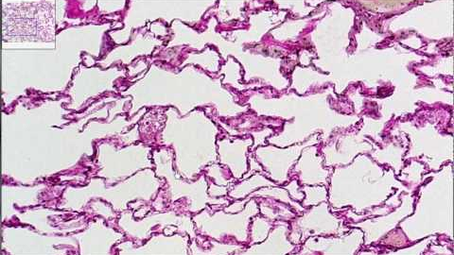
Simple Squamous Epithelial Tissue

Slide 49
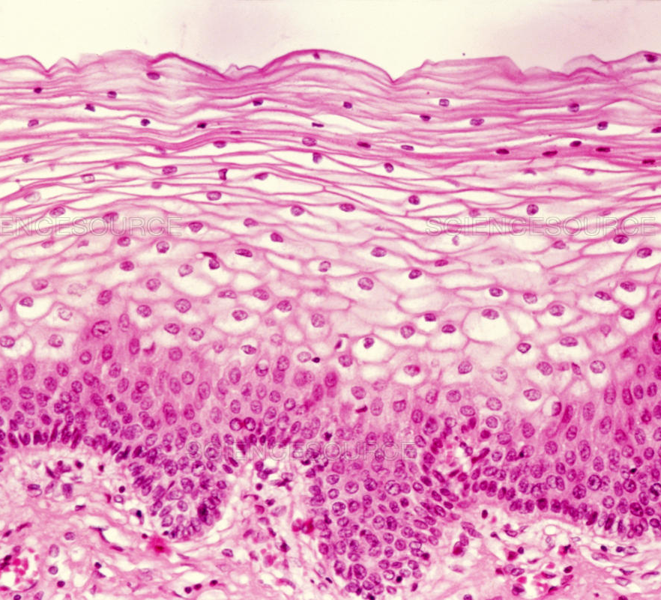
Stratified Squamous Epithelium

Slide 50
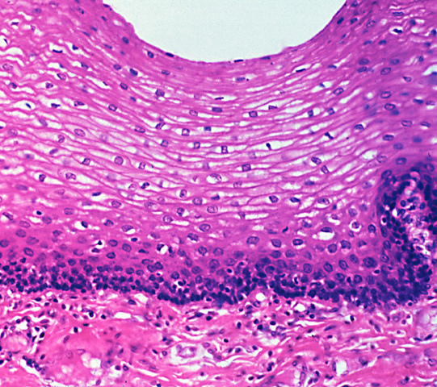
Stratified Squamous Epithelium

Slide 51
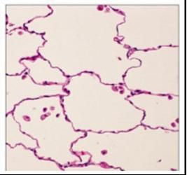
Simple Squamous Epithelial Tissue

Slide 52
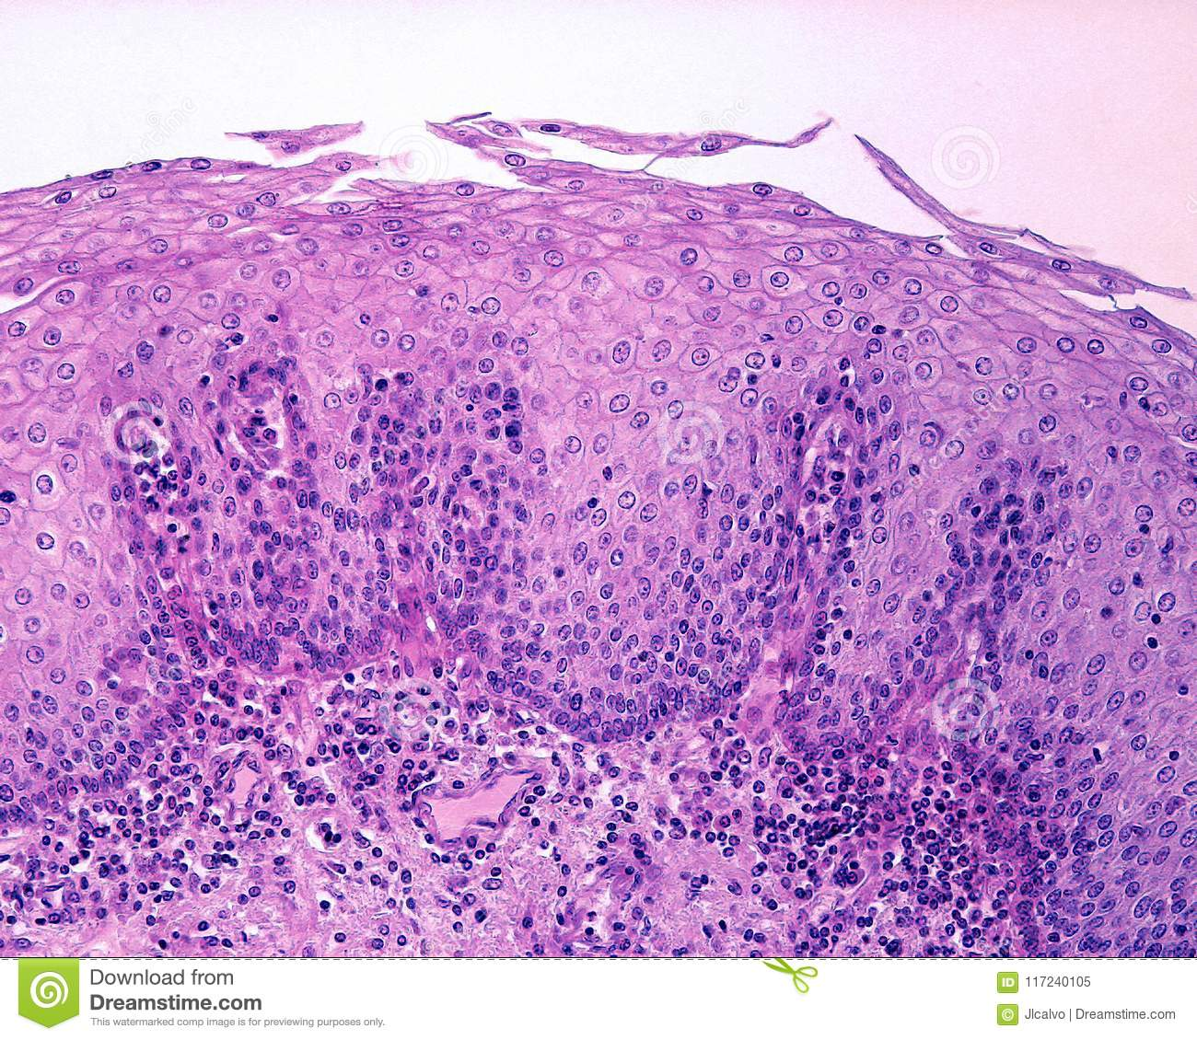
Stratified Squamous Epithelial Tissue

Slide 53
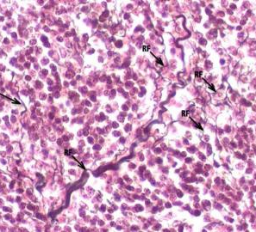
Reticular Connective Tissue

Slide 54
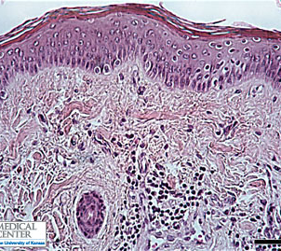
Keratinized Stratified Squamous Epithelium

Slide 55
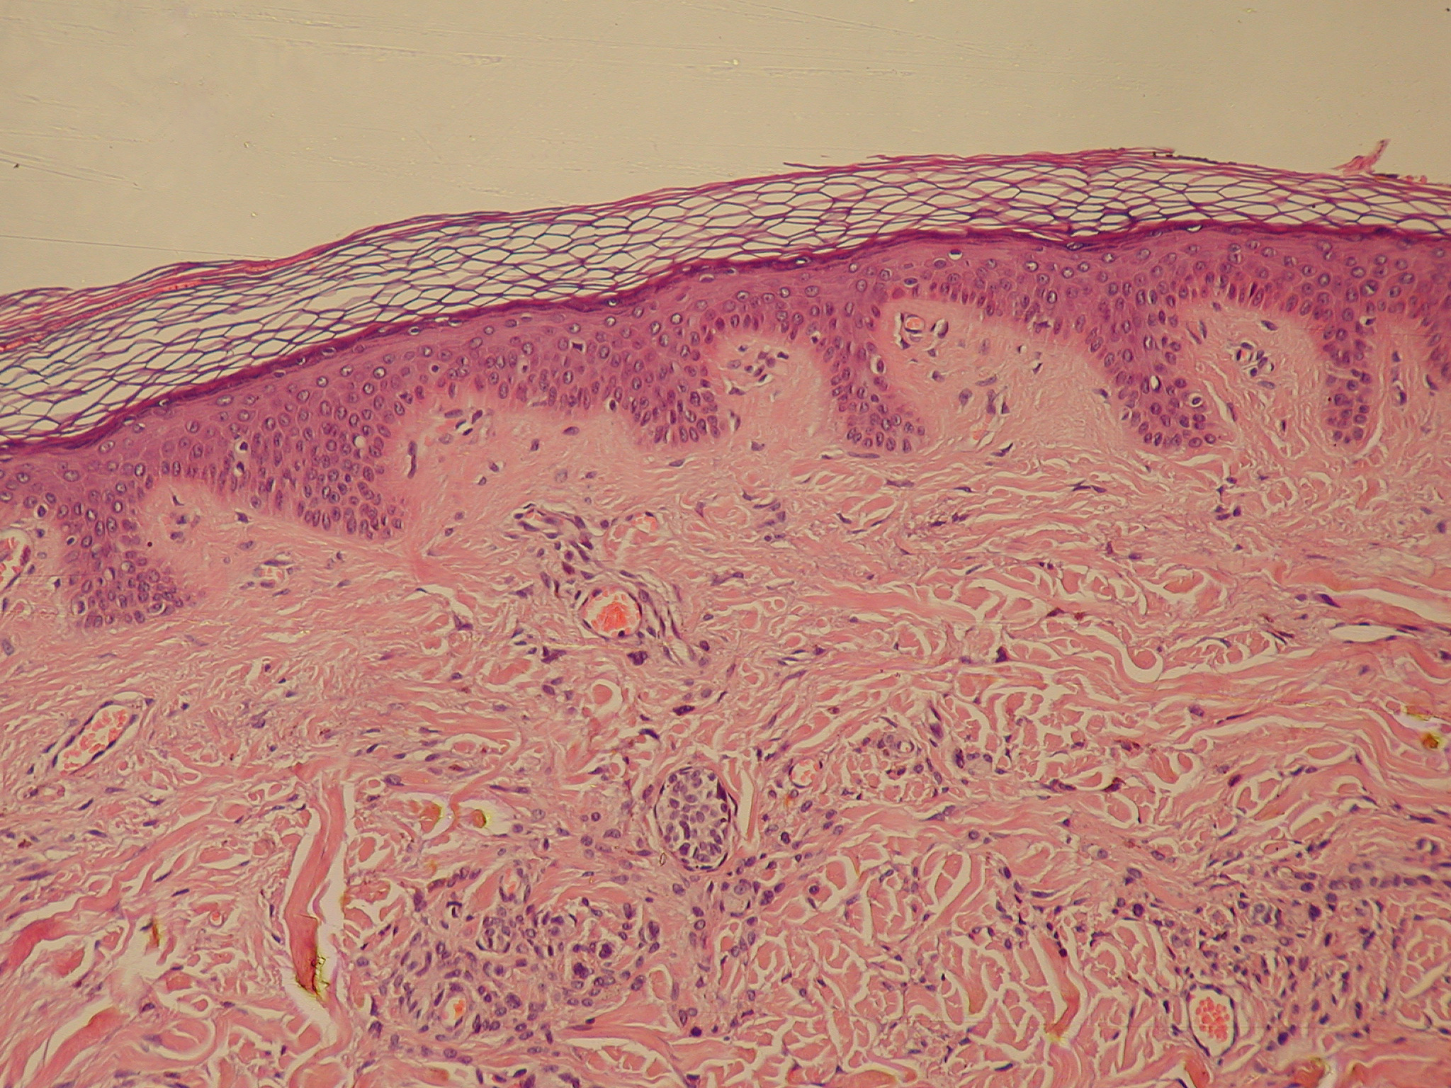
Keratinized Stratified Squamous Epithelium

Slide 56
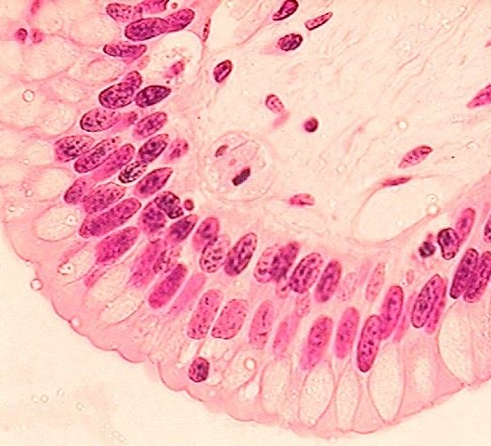
Stratified Columnar Epithelial Tissue

Slide 57
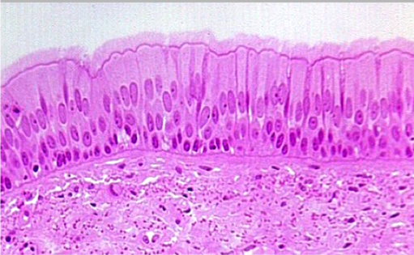
Ciliated Pseudostratified Columnar Epithelium

Slide 58
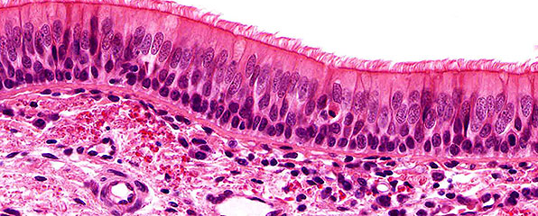
Ciliated Pseudostratified Columnar Epithelium

Slide 59
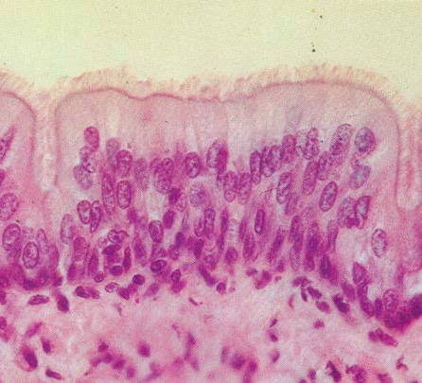
Ciliated Pseudostratified Columnar Epithelium

Slide 60
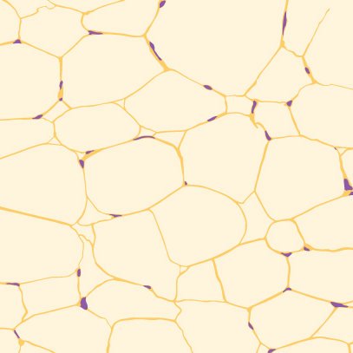
Adipose Tissue

Slide 61
Simple Cuboidal Epithelium

Slide 62
Reticular Connective Tissue

Slide 63
Ciliated Pseudostratified Columnar Epithelium

Slide 64
Dense Regular Connective Tissue

Slide 65
Stratified Columnar Epithelium

Slide 66
Stratified Squamous Epithelium

Slide 67
Stratified Cuboidal Epithelium

Slide 68
Transitional Epithelium

Slide 69
Areolar Connective Tissue

Slide 70
Elastic Connective Tissue

Slide 71
Dense Irregular Connective Tissue

Slide 72
Dense Irregular Connective Tissue

Slide 73
Dense Irregular Connective Tissue

Slide 74
Dense Regular Connective Tissue

Slide 75
Reticular Connective Tissue

Slide 76
Areolar Connective Tissue

Slide 77
Adipose Tissue

Slide 78
Adipose Tissue

Slide 79
Elastic Connective Tissue

Slide 80
Reticular Connective Tissue

